Slide 1

|QET>
Quantum Energetics
Foundations, Applications
Alexia Auffèves, CNRS, MajuLab@CQT, Singapore
Congrès Général de la SFP
Paris, 3-7 juillet 2023

Slide 2
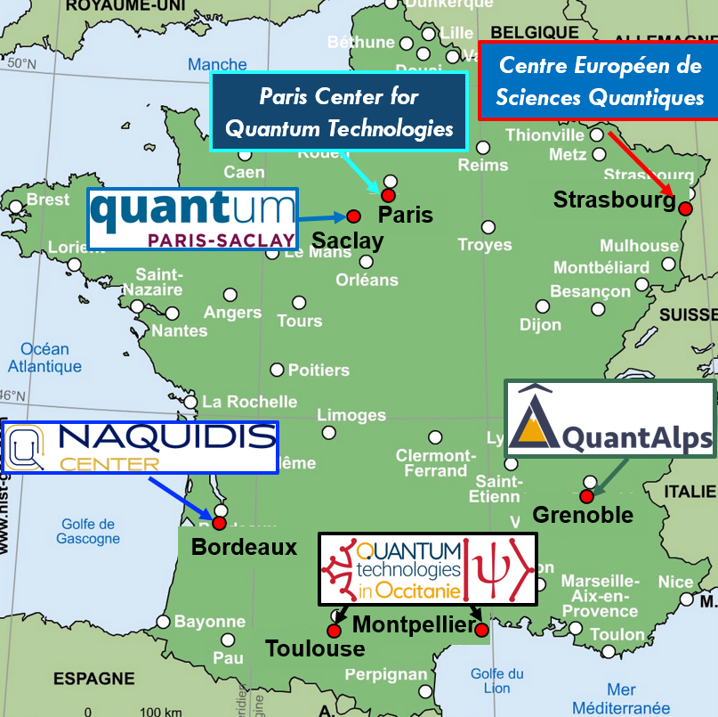



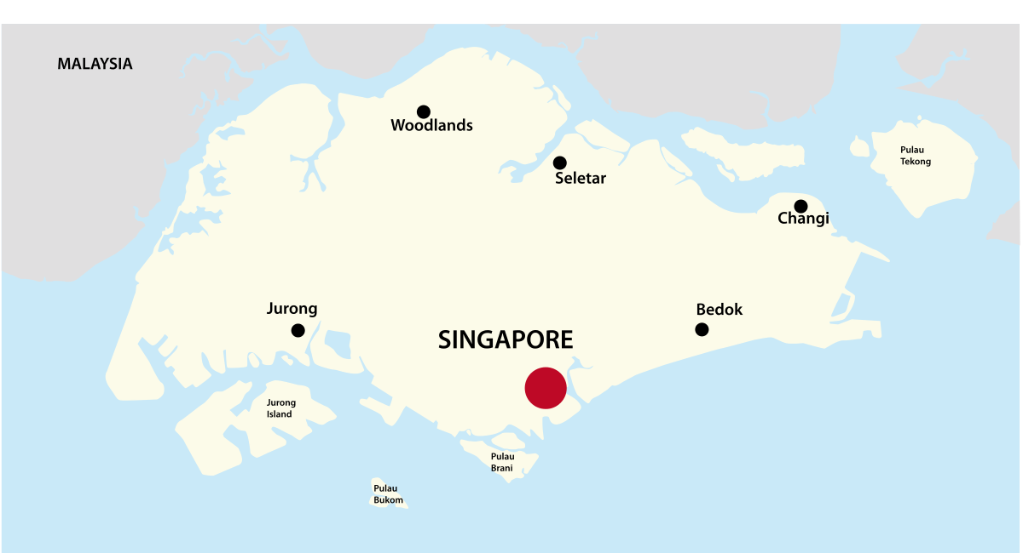
French-Singaporean quantum centre
majulab.cnrs.fr
Singapore
MJ@NTU site
MJ@NUS main site
QuantAzur

Slide 3
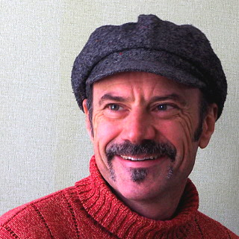


Quantum energy team |QET>
Robert Whitney
AA
quantum-energy-team.cnrs.fr
Singapore
MJ@NTU site
Energetics of:
quantum measurement
quantum optics
quantum transport
quantum technologies
MJ@NUS main site
QuantAzur
Open positions for PhDs and post-docs!

Slide 4
Outline
From classical thermodynamics to quantum energetics
Energetics of quantum measurement
Energy-efficient quantum technologies
|QET>

Slide 5
Outline
From classical thermodynamics to quantum energetics
Energetics of quantum measurement
Energy-efficient quantum technologies
|QET>

Slide 6
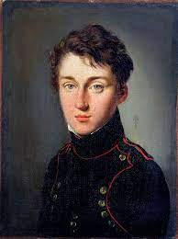

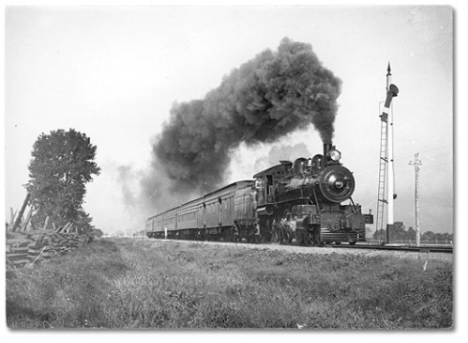


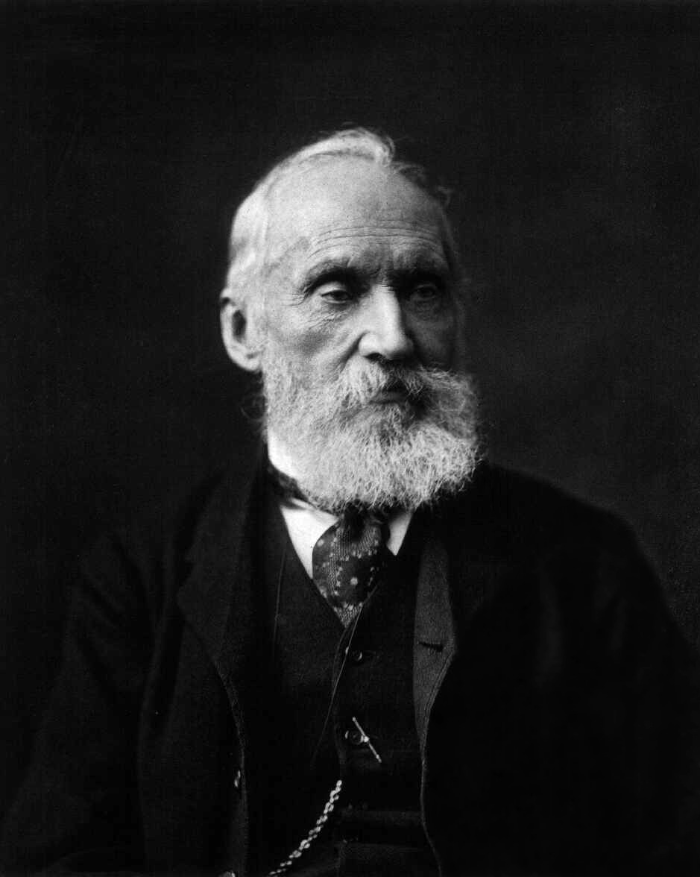
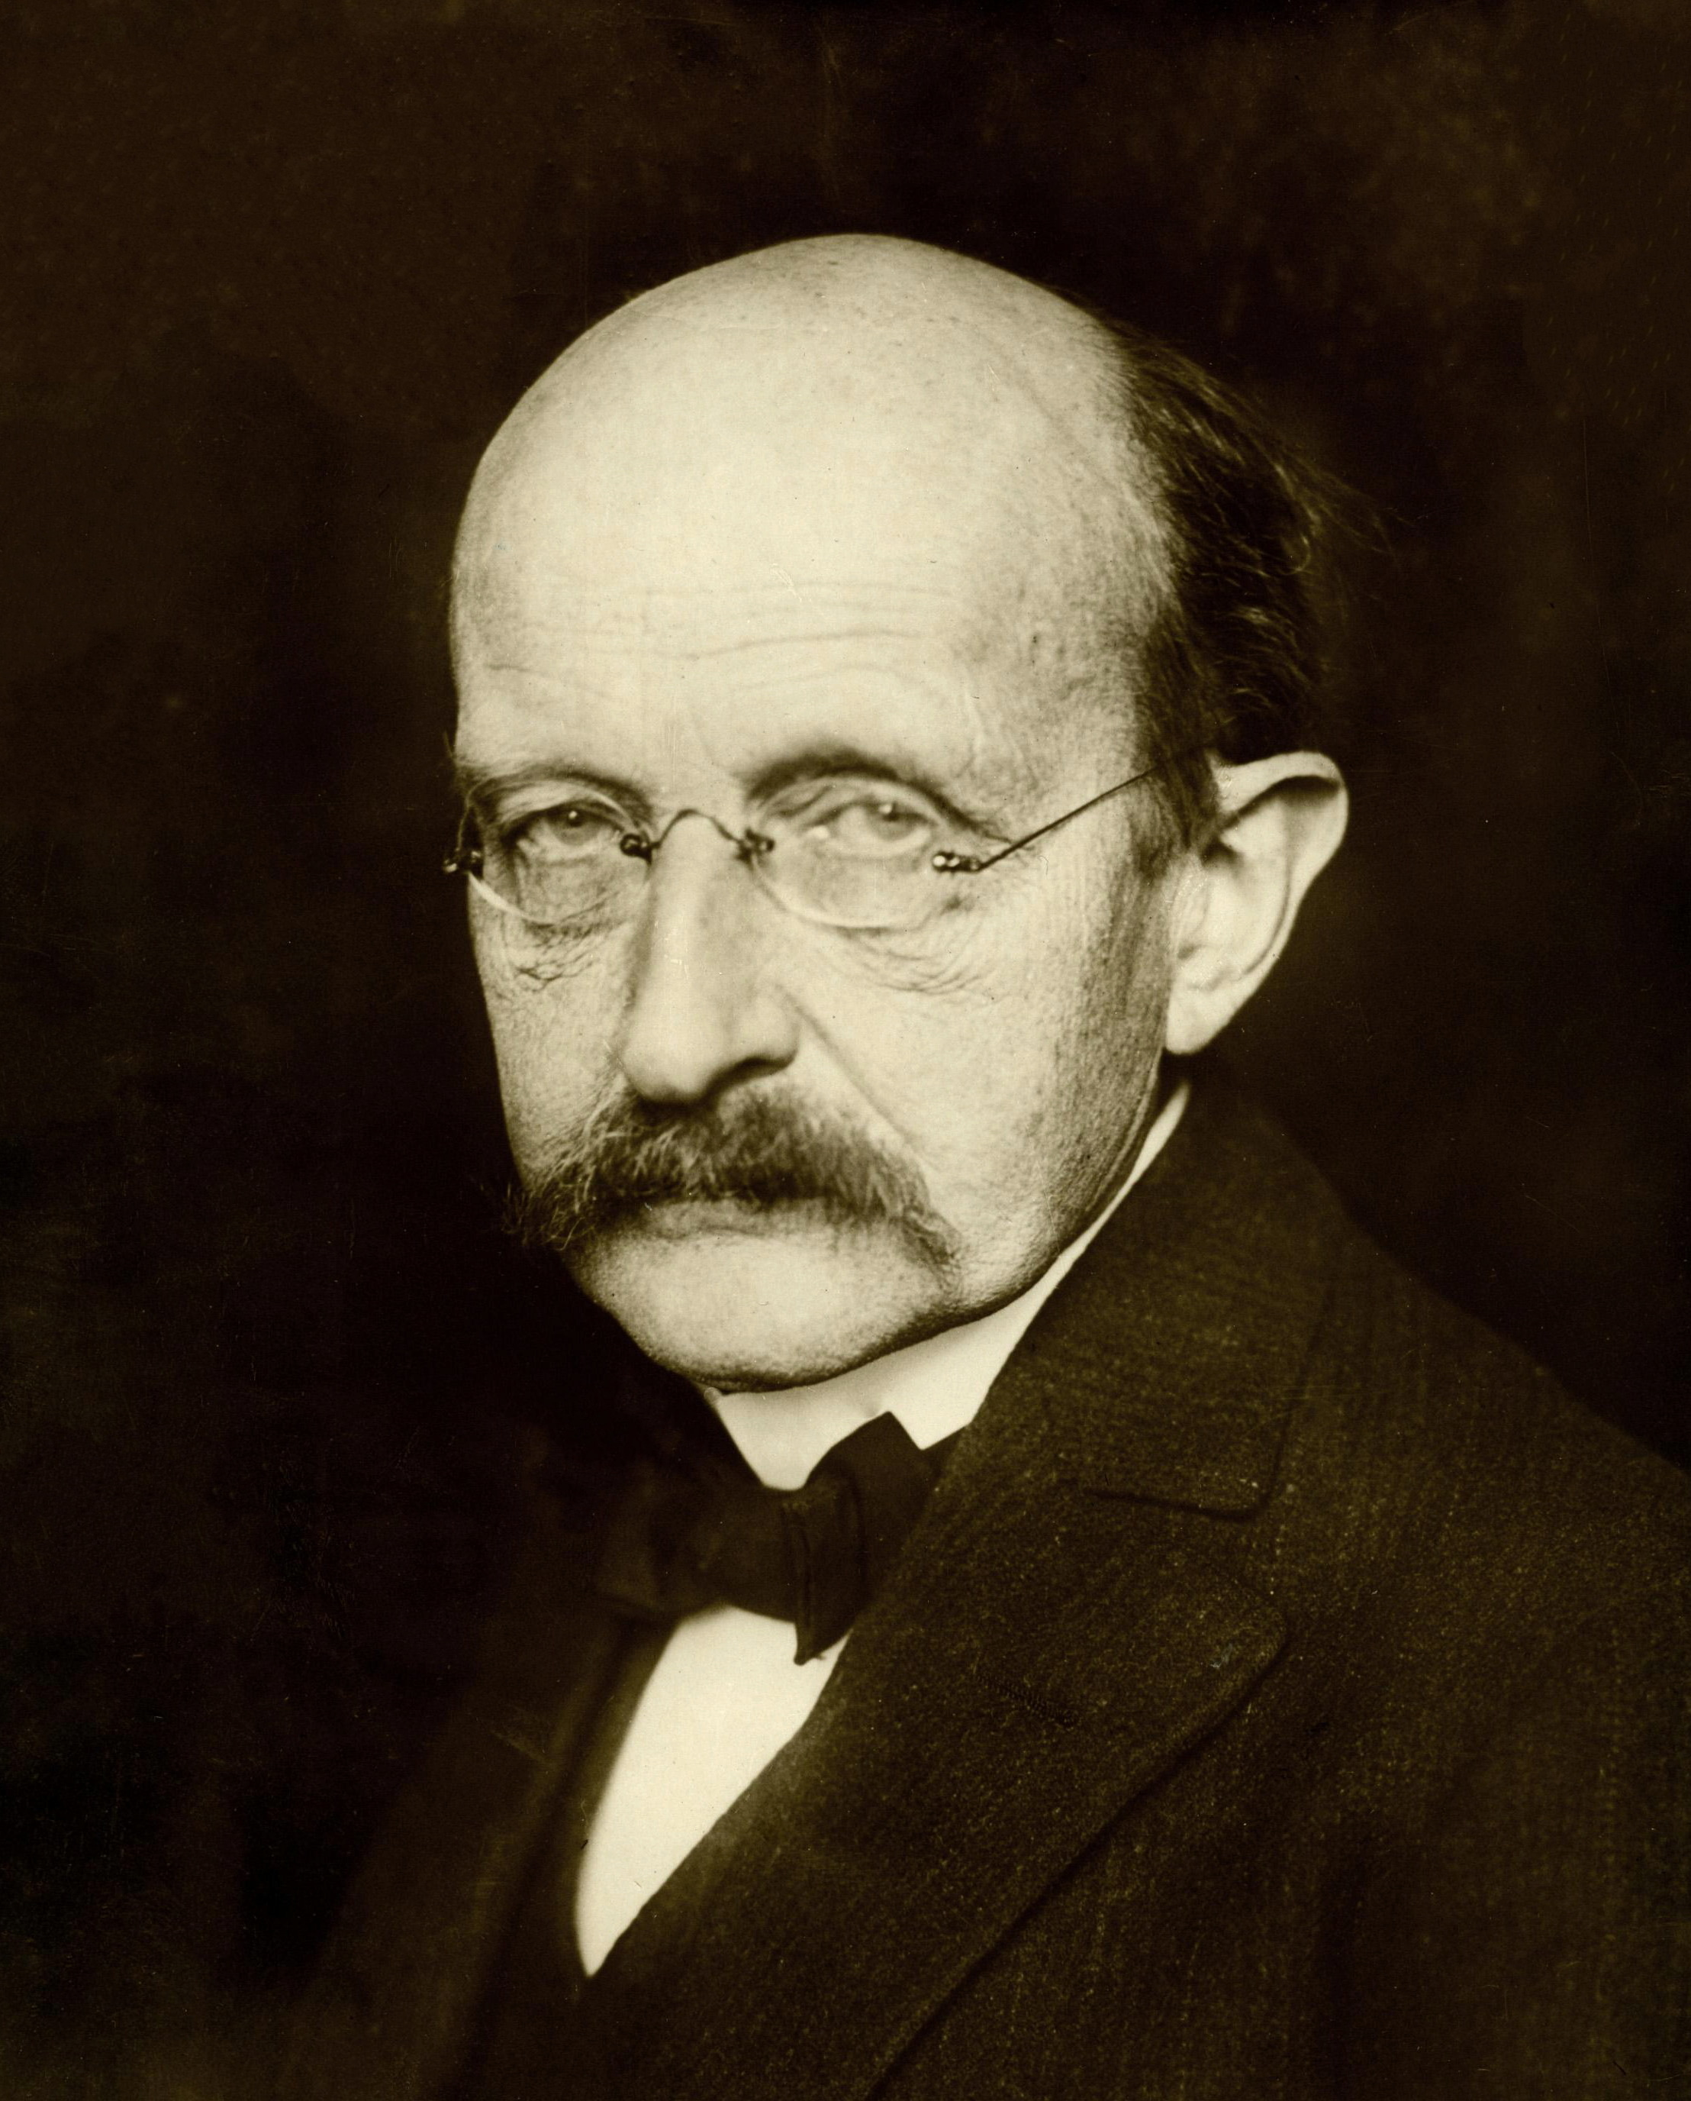
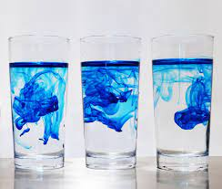

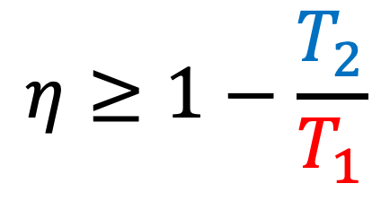
Macroscopic thermodynamics
W
Q
S
S. Carnot
1796-1832
$$η≥1−\frac{T_{2}}{T_{1}}$$
W. Thompson 1824-1907
M. Planck
1858-1947
$∆iS≥0$

Slide 7
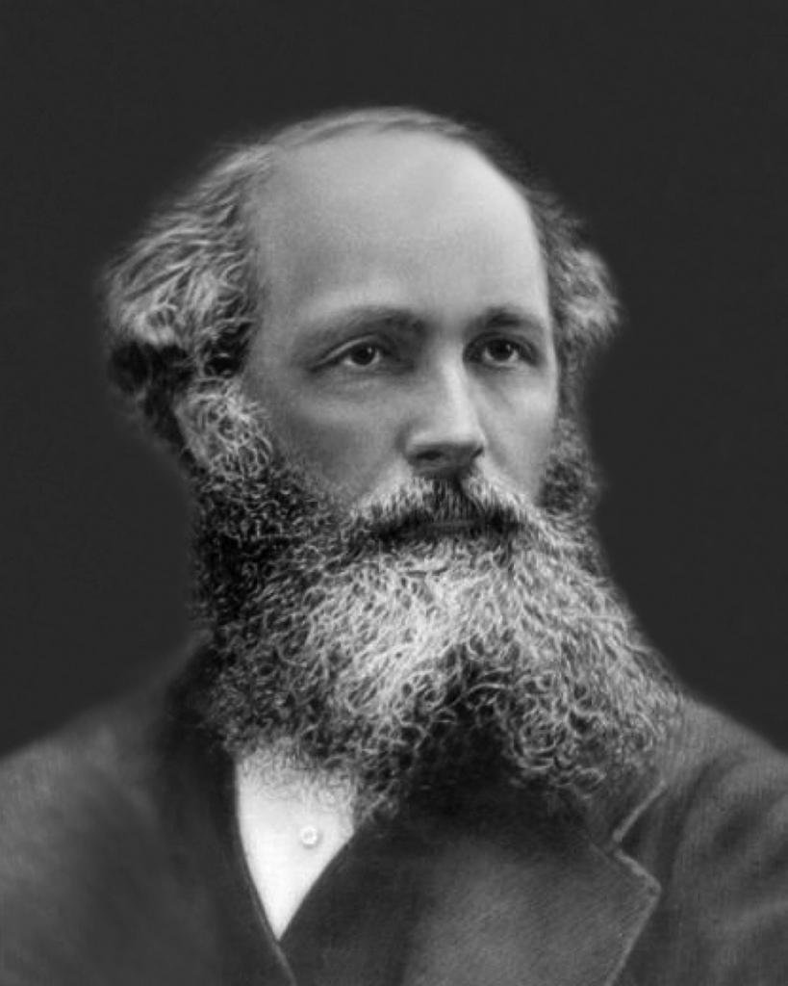

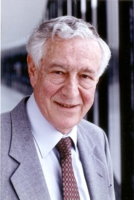
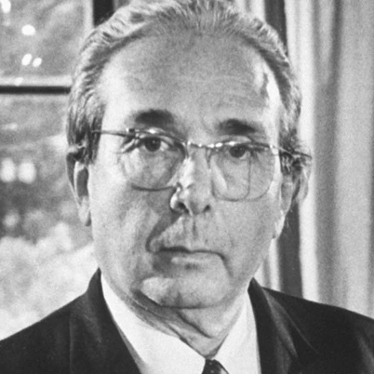

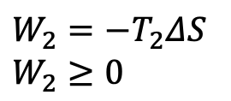
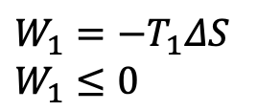

Onset of information thermodynamics
T₁
$$W_{1}=−T_{1}ΔS$$
$$W_{1}≤0$$
T₂
$$W_{2}=−T_{2}ΔS$$
$$W_{2}≥0$$
S. Carnot
1796-1832
J. C. Maxwell
1831-1879
T₁
$$W_{1}=−{k_{B} ln(2)T}_{1}$$
T₂
$$W_{2}={k_{B} ln(2)T}_{2}$$
R. Landauer
1927-1999
L. Szilard
1898-1964

Slide 8
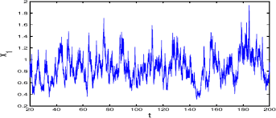
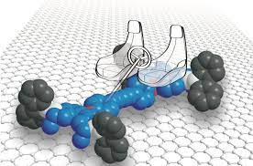
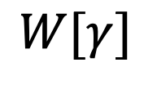

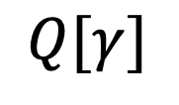
Stochastic thermodynamics
Extends the concepts and laws of thermodynamics at the level of single trajectories
$$γ$$
0
1
New meanings for work, heat, engines, irreversibility
All you need is energy and randomness
$$W[γ]$$
$$Q[γ]$$

Slide 9
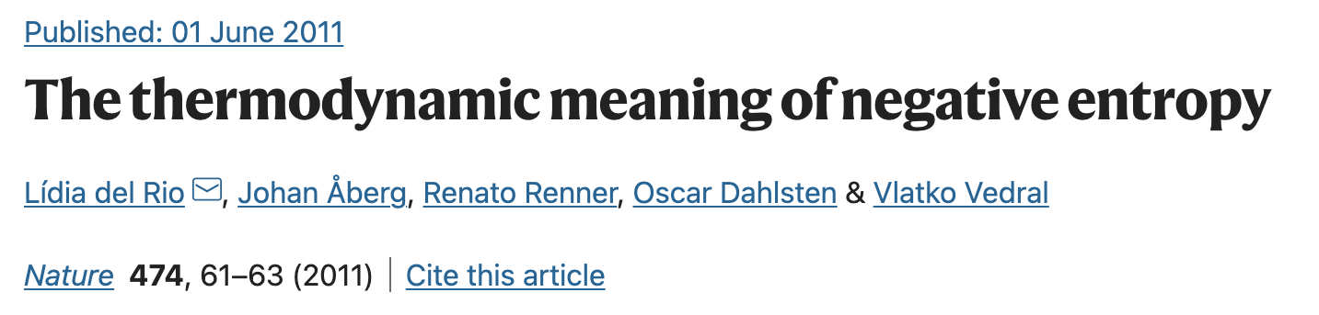
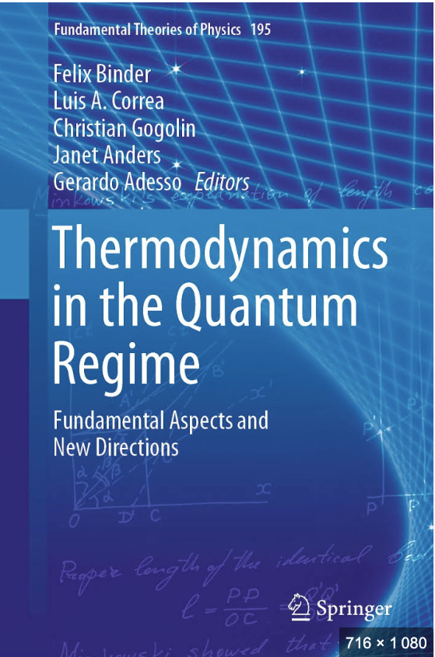
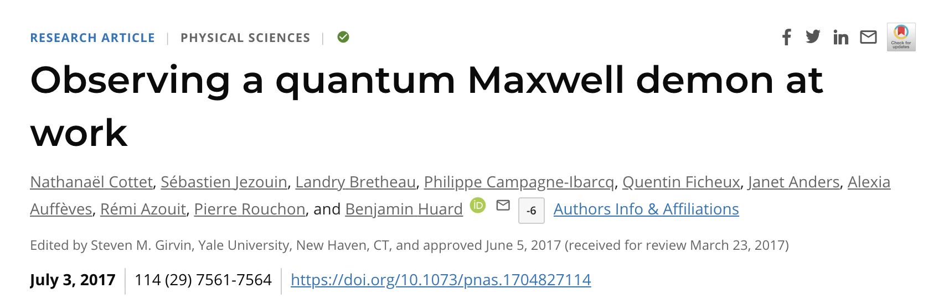
Towards quantum thermodynamics I
Quantum information
|0>
|1>
QTD
W?
Q?
Thermodynamics
Quantum advantages in engines?
Quantum coherence as a resource
Work cost of quantum coherence
Quantum Maxwell’s demons
...

Slide 10
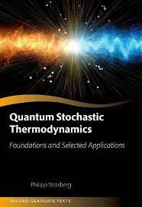

Towards quantum thermodynamics II
|0>
|1>
Stochastic thermodynamics
QTD
W?
Q?
Quantum physics
Quantum irreversibility?
Quantum fundamental bounds
Quantum fluctuation theorems
...

Slide 11
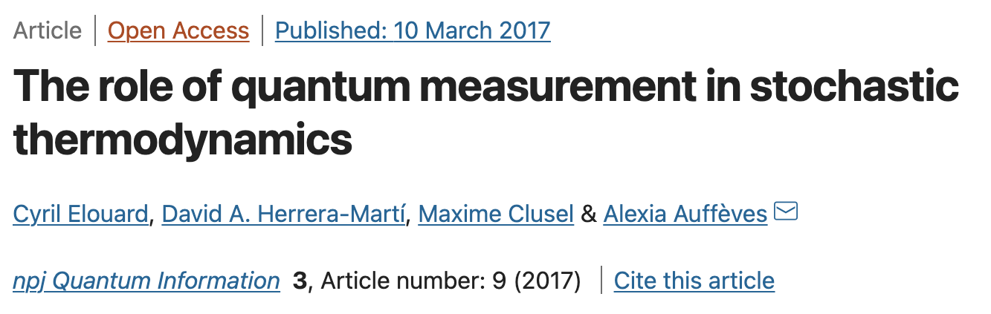
Towards quantum thermodynamics III energetics
|0>
|1>
W?
« Quantum Heat »
Quantum measurement:
A source of randomness, entropy and energy
Propose to « rebuild quantum thermodynamics on quantum measurement »

Slide 12


Emergence of quantum energetics
Study of energy, entropy, information flows and their relations in the quantum world
Cousin of quantum thermodynamics, but not necessary to have a temperature
S
S

Slide 13
Motivations
Quantum noise as a resource (Can we turn heat into work?)
Quantum batteries (Can I store and retrieve work at will?)
Quantum irreversibility
Quantum fluctuation theorems
Minimal work costs, bounds and efficiencies
S
S

Slide 14
Outline
From classical thermodynamics to quantum energetics
Energetics of quantum measurement
Energy-efficient quantum technologies
|QET>

Slide 15
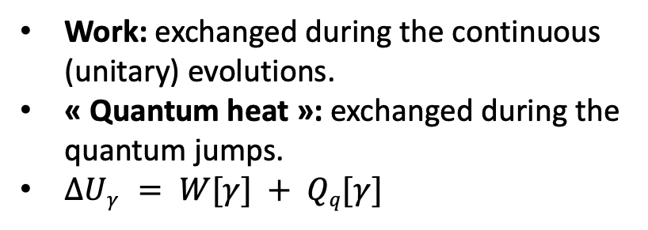

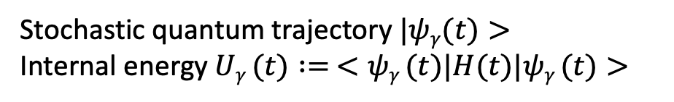
Scenery and definitions
Projective measurements
H(t)
S
$$γ:=\{m(tk)\}$$
Stochastic quantum trajectory $|ψγ(t)>$
Internal energy $Uγ (t) := <ψγ (t)|H(t)|ψγ (t)>$
M
Work: exchanged during the continuous (unitary) evolutions.
« Quantum heat »: exchanged during the quantum jumps.
$ΔUγ = W[γ] + Qq[γ]$
Hamiltonian evolution
t₂
t₃
t₁
Stochastic quantum jumps

Slide 16

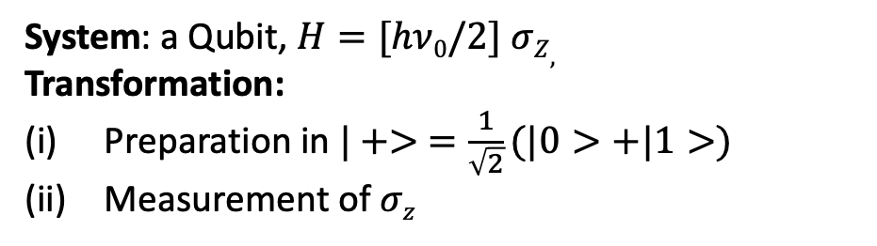



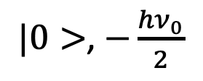
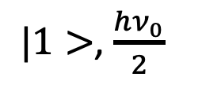

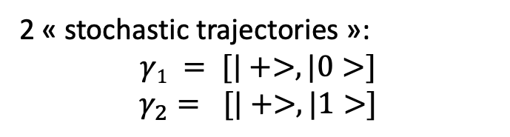

Example 1
System: a Qubit, $H=[hν0/2] σZ,$
Transformation:
Preparation in $|+> =\frac{1}{\sqrt{2}}(|0>+|1>)$
Measurement of $σz$
$|1>$, $\frac{hν_{0}}{2}$
$$P\left(1\right)$$
$$σz$$
2 « stochastic trajectories »:
$$γ1 = [|+>, |0>]$$
$$γ_{2}= [|+>, |1>]$$
$$|+>, 0$$
$0$ or $1$?
Energetic balance
Initial energy $Ui = 0$
Final energy $Uf=± hν0/2$
$$ΔU\left[γ\right]=± hν0/2 = Qq[γ]$$
$|0>$, $−\frac{hν_{0}}{2}$
$$P\left(0\right)$$
Energetic footprint of quantum measurement: « Quantum heat »
A purely quantum term due to measurement back-action

Slide 17

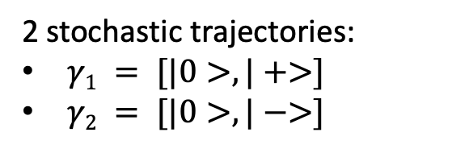


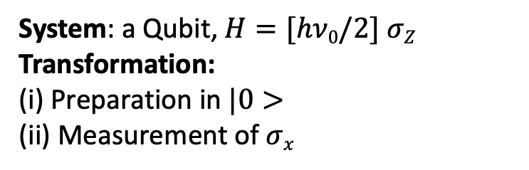


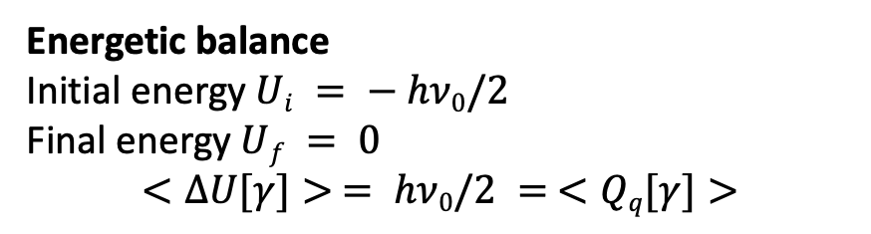

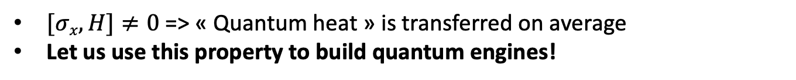


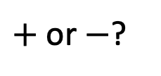
Example 2
System: a Qubit, $H=[hν0/2] σZ$
Transformation:
(i) Preparation in $|0>$
(ii) Measurement of $σx$
$$|1>$$
2 stochastic trajectories:
$γ1 = [|0>, |+>]$
$γ2 = [|0>, |−>]$
$$|− >$$
$$|+>$$
$$|0>$$
Energetic balance
Initial energy $Ui = − hν0/2$
Final energy $Uf = 0$
$$<ΔU[γ]> = hν0/2 = <Qq[γ]>$$
$$P\left(+\right)$$
$$P\left(−\right)$$
$$σ_{x}$$
$$|+x>$$
$+$ or $−$?
$[σx,H]≠0$=> « Quantum heat » is transferred on average
Let us use this property to build quantum engines!

Slide 18
Measurement-powered engines (MPE)
S
Work
Heat
S
« Quantum work »
« Quantum heat »

Slide 19
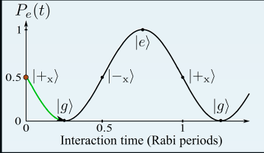
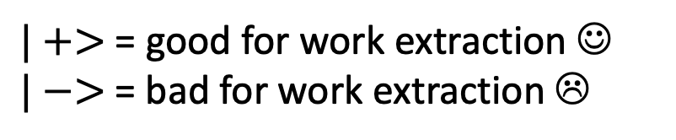




A simple measurement-powered engine
$$W$$
Coherent and reversible energy exchange between qubit and light
$$|1>$$
Resonant drive
$$|0>$$
Rabi oscillation
$$W≥0$$
$$W≤0$$
$|+>$ = good for work extraction ☺
$|−>$= bad for work extraction ☹

Slide 20
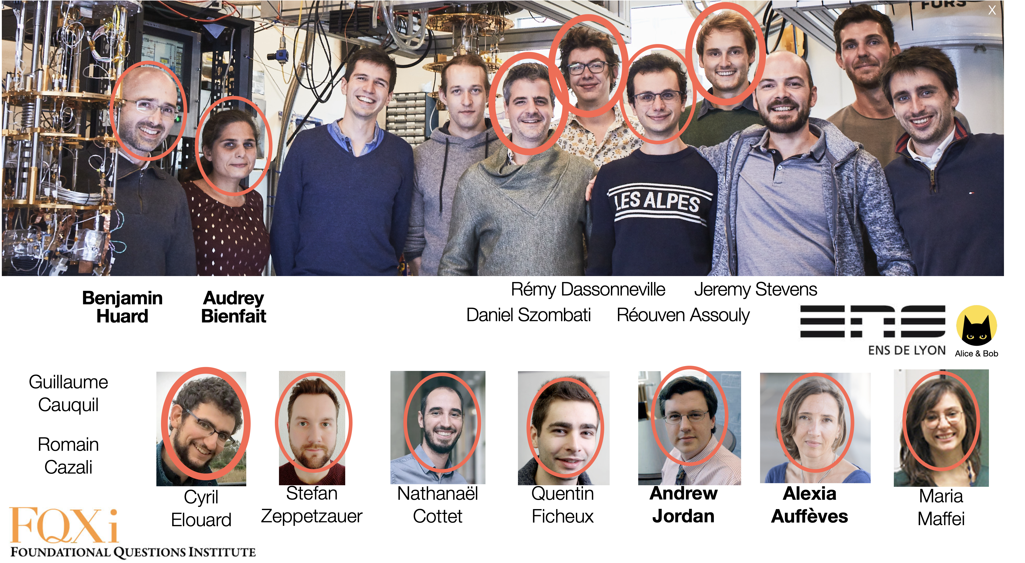
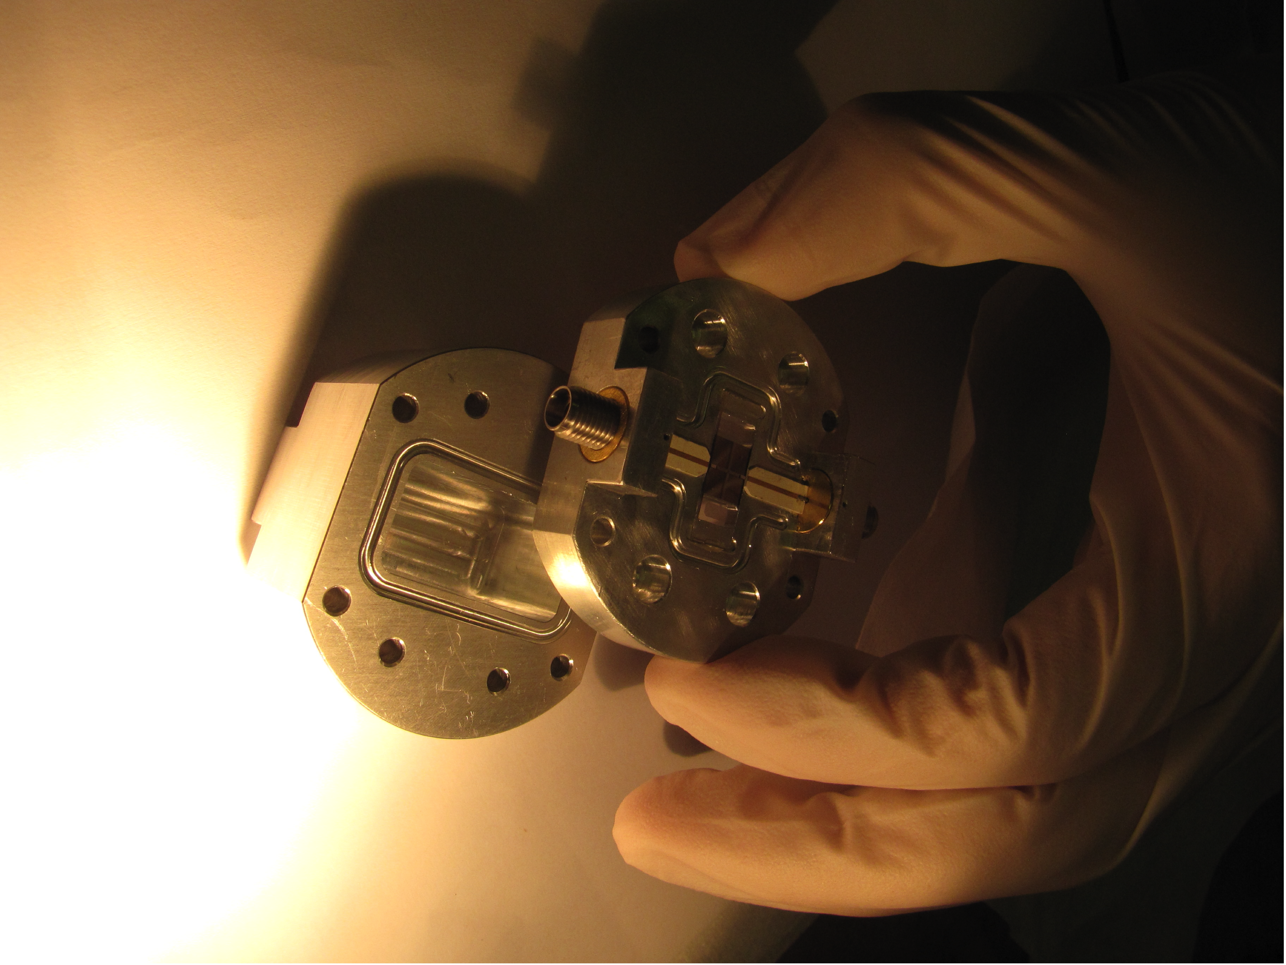

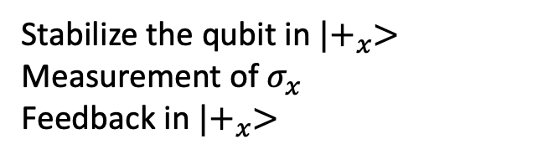




Experiment done @ ENS Lyon
$$|1>$$
Light
Stabilize the qubit in $|+_{x}>$
Measurement of $σ_{x}$
Feedback in $|+_{x}>$
$$W$$
$$|0>$$
$$Qq$$
$$σx$$
« Demonstration of a quantum engine fueled by qubit state measurement », writing in progress
New quantum Maxwell’s demon experiment
« Quantum heat » to work conversion

Slide 21
An idea that blossomed...

Slide 22
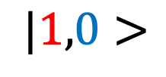


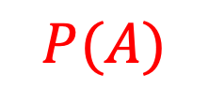

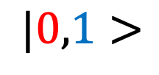

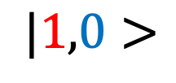
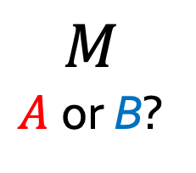
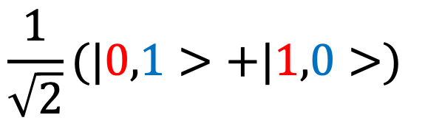
Measurement-powered engine, season 2
$$|1,0>$$
$$\frac{1}{\sqrt{2}}(|0,1>+|1,0>)$$
$$M$$
$A$or B?
$$A$$
$$B$$
$$t=t_{0}$$
$$t=0$$
$$P(A)$$
P(B)
Average energy gain!
Input of « quantum heat »
$$|1,0>$$
$$|0,1>$$

Slide 23
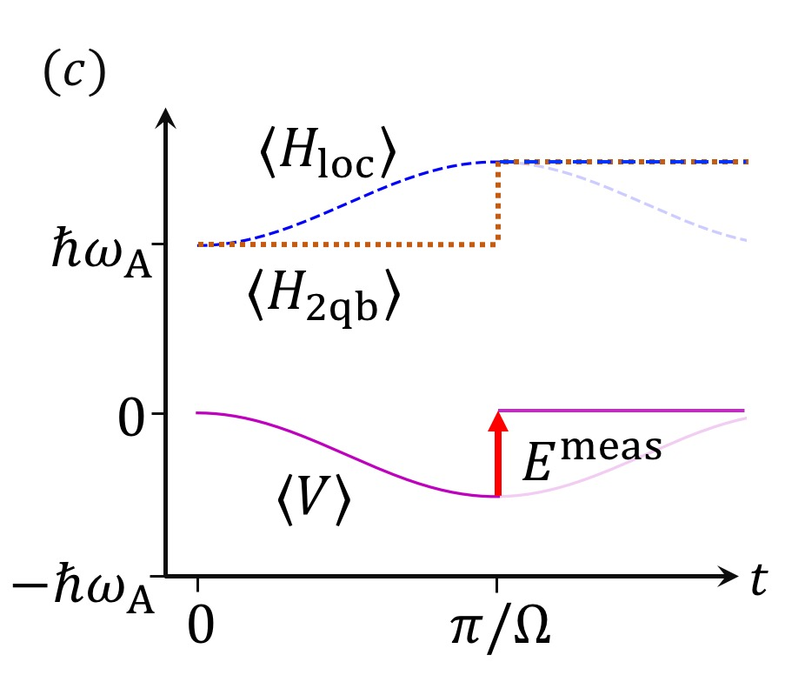
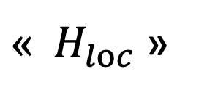

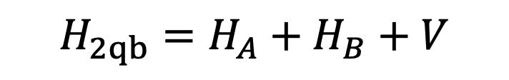
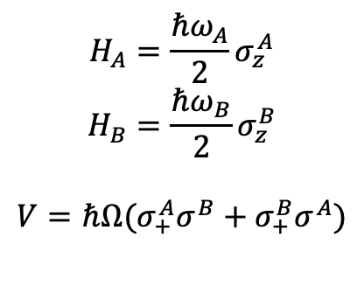

Measurement-powered engine, season 2
$$H_{2qb}=H_{A}+H_{B}+V$$
$$ℏω_{B}$$
$« { H}_{loc}$ »
$$H_{A}=\frac{ℏω_{A}}{2}σ_{z}^{A}$$
$$H_{B}=\frac{ℏω_{B}}{2}σ_{z}^{B}$$
$$V=ℏΩ(σ_{+}^{A}σ^{B}+σ_{+}^{B}σ^{A})$$
$V$ = correlation energy
$E^{meas}$= « measurement fuel » to erase correlations between qubits

Slide 24






Measurement-powered engine, season 2
A. Jordan, Chapman University, IQS
S. Rogers, Chapman University
K. Murch, Saint Louis University
P. Camati, I. Néel & Oxford
L. Bresque,
I. Néel

Slide 25




Characterizing the measurement fuel
Work or heat? Link with information extraction? Irreversible or controllable? Resource or cost?
=> One should model the measuring apparatus....
Wanted: theory of quantum measurement
Cours C. Cohen-Tannoudji, Coherence quantique et dissipation, 1989-1990
s
m
$$|+>|0_{m}>→\frac{1}{\sqrt{2}}(|{0,0}_{m}>+|{1,1}_{m}>)$$
For S: $« 0+1 »→ 0$ or $1$
For S+M: $|{00}_{m}> + \left|{11}_{m}> = \right|++_{m}> +|−−_{m}>$
No preferred basis
Pre-measurement
J. von Neumann
1903-1957

Slide 26

Characterizing the measurement fuel
Work or heat? Link with information extraction? Irreversible or controllable? Resource or cost?
=> One should model the measuring apparatus....
Wanted: theory of quantum measurement
Cours C. Cohen-Tannoudji, Coherence quantique et dissipation, 1989-1990
s
m
m
m
m
Gigantic entangled state
...
Pre-measurement
J. von Neumann
1903-1957

Slide 27
Characterizing the measurement fuel
Work or heat? Link with information extraction? Irreversible or controllable? Resource or cost?
=> One should model the measuring apparatus....
Wanted: theory of quantum measurement
Cours C. Cohen-Tannoudji, Coherence quantique et dissipation, 1989-1990
s
m
m
m
m
M
...
Collapse is necessary!
Pre-measurement
J. von Neumann
1903-1957

Slide 28








Energetics of the pre-measurement
$$H_{tot}=H_{A}+H_{B}+V+V_{m}(t)$$
Switch on @ $t_{0}$
Switch off @ $t_{m}$
g
$$|1, 0,0_{m}> →|1,0, 0_{m}>$$
$$|0,1,0_{m}> →|0,1, 1_{m}>$$
$$\frac{1}{\sqrt{2}}(\left|0,1>+\left|1,0>\right)\right|0_{m}>→\frac{1}{\sqrt{2}}(|{0,1,1}_{m}>+|{1,0,0}_{m}>)$$
$A$et $B$ $→A$ ou $B$
Erasure of correlations between A and B
From the qubits’ viewpoint: good measurement model

Slide 29




Energetics of pre-measurement
Dynamics of energy exchanges
Complete energy balance including the quantum meter and the agent
$$t_{0}$$
$$t_{m}$$
Pre-measurement = Relocalisation of the correlation energy
$E^{meas}=$Work paid by the agent during the switch-off

Slide 30







Measurement fuel: Work or heat?
$$M$$
Projective measurement of $AB$
Measurement postulate
Irreversible transfer of energy and entropy
« Heat »
$$A$$
$$B$$
Pre-measurement of AB with quantum meter $m$
for ABm: Unitary operation - Reversible, entropy preserving energy input => « Work » payed by the agent
for AB: Transfer of energy and entropy => « Heat »
$$A$$
$$B$$
$$m$$

Slide 31





Is quantum heat fundamental?
It depends on your favourite interpretation...
...
$$A$$
$$B$$
$$M$$
$$M$$
$$M$$
$$M$$
Everett, churches of unitarity...
Measurement = creation of massive entanglement by unitary transformations
Reversible, entropy preserving
Measurement fuel= Work

Slide 32




Is quantum heat fundamental?
It depends on your favourite interpretation...
$$M$$
$$…$$
$$A$$
$$M$$
$$M$$
$$B$$
Von Neumann’s legacy , Copenhagen, CSM...
Always a classical measurement to break the channel
Irreversible, not entropy preserving
Measurement fuel = heat

Slide 33
First conclusions on quantum energetics
Study of energy and entropy flows in the quantum realm
No temperature, but a source of randomness
Two typical situations:
S
S
Measurement backaction
Measurement-powered engines
Coupling with a non-equilibrium reservoir, driven-dissipative systems
These are open systems
Big debates about heat and work definitions, and how to measure them

Slide 34


A safer situation: bipartite quantum energetics
Bipartite isolated quantum system
Autonomous => Global energy conservation
Characterization of energy exchanges between A and B
A
B
P. Camati
I. Néel & Oxford
Work-like and heat-like energy flows, measurable quantities
A
I. Maillette de Buy Wenniger, Imperial College
P. Senellart C2N

Slide 35


Application of BQE: Energetics of qubit-light interactions
of linear quantum gates?
of quantum light sources?
Input field
Output field
Energy cost of a quantum gate?
BQE provides an excellent framework to analyze:
Fundamental mechanisms and devices of quantum optics
Energy cost of quantum technologies
of quantum interfaces?

Slide 36





Energetics of quantum primitives
Experiment
Experiment
Benjamin Huard
ENS Lyon
Kater Murch
Saint Louis, USA
Andrew Jordan
Chapman, USA
Theory
S. Wein Quandela
M. Maffei
Bari University

Slide 37
Outline
From classical thermodynamics to quantum energetics
Energetics of quantum measurement
Energy-efficient quantum technologies
|QET>

Slide 38





A very schematic view on human activities
Materials
Machine
Target result
Energy
Efficiency $η$
Performance metric $M$
$$η=M/ R$$
Resources $R$
Purpose of science and technology: increase efficiencies

Slide 39






Classical computing energy efficiency
$M$= Number of FLoating-point Operations Per second (FLOPs)
$R$= Power consumption
$η$ = Performance per Watt (FLOPs/W)
Supercomputers
Koomey’s law
$η$ doubles every 18 months
Saturation since 2010
ICT global electricity consumption in 2020: 11% (Puebla et al, 2020)
No expected gain in efficiency
due to end of Koomey’s law
MFlops per Watt

Slide 40
The promise of quantum computing
Performance = Computing power = “Problem size”/Time
Classical computing
13,8 billion years, for instance
“Quantum computational supremacy”
Computing time
“Quantum computational advantage”
Quantum computing
Problem size (N)

Slide 41
Quantum computing current challenges
Classical computing
Optimized classical algorithms???
Quantum computing community challenges
Noise resilience of quantum supremacy & advantage?
Computing time
FTQC-LSQ
Noisy QC
Error correction
Usecases of various computing regimes
FTQC
NISQ
Noiseless quantum computing
Problem size (N)

Slide 42
Boosting energy efficiency with quantum?
Optimized classical algorithms
Efficiency = Problem size/Energy
Classical computing
Nuclear plant
“Quantum energy advantage”: => when a quantum computer solves a problem with less energy than best in-class classical computers and algorithms.
=> when a qc solves larger problems with the same energy
“Quantum
energy advantage”
“Quantum energy supremacy”
Energy consumption
FTQC-LSQ
Error correction
FTQC
Fellous-Asiani et al, Optimizing Resource Efficiencies for Scalable Full-Stack Quantum Computers, arXiv 2209.05469
NISQ
Problem size (N)
Notes:
Not clear it works for NISQ

Slide 43


Energy hog or energy advantage?
The question must be tackled now

Slide 44


Need for interdisciplinarity
Few errors
Large $M$
Many errors
Small $M$
Control wins
Control
Noise
Noise wins
Quantum processor
☺
☹
Performance emerges at the quantum level

Slide 45



Need for interdisciplinarity
Resource
Control
$$η=M/ R$$
Few errors
Large $M$
Many errors
Small $M$
Control wins
Noise
Noise wins
Quantum processor
☺
☹
Resource-efficiency optimizations at the quantum level
Skills from quantum energetics / quantum information

Slide 46
Need for interdisciplinarity
Classical
Quantum
Control
Noise
Quantum processor
Creating a quantum/classical boundary = a non-equilibrium situation
Resource cost of trapping a Schrödinger cat?

Slide 47

Need for interdisciplinarity
Macro- resources
Macro- control
Classical context
« Enabling technologies »
Noise
Control
$$η=M/ R$$
Quantum processor
Resource efficiency = a hybrid figure of merit
Need to articulate different levels of description in a crossed-disciplinary research lines => the QEI

Slide 48



Timeline
Jun 2022 : PRXQ QEI Vision paper
Aug 2022 : QEI website & Manifesto
Jan 2023 : QEI board creation
May 2023 : QEI WG@IEEE kickoff
July 2023 : 325 participants, 49 countries, 29 partners
July 2023 : YouTube channel
Oct 2023 : COST network deadline
Nov 2023 : First QEI workshop, Singapore
www.quantum-energy-initiative.org
https://qei2023.sciencesconf.org/

Slide 49



Key scientific questions and missions
A worldwide, crossed-disciplinary community
Conditions of a quantum energy advantage
Fundamental bounds and relation to macroscopic energy costs...
Resource optimizations
Impact on industrial roadmaps
Standard of energy efficiency for quantum computing...
Extension to other quantum technologies
Quantum communications, sensors, machine learning...

Slide 50



https://qei2023.sciencesconf.org/
Scientific & Organizing committee
A.Auffèves (CNRS MajuLab CQT)
Y. Gao (NUS MajuLab CQT)
O. Ezratty (QEI)
Ye Jun (A*Star)
N. Ng (NTU MajuLab)
D. Poletti (SUTD MajuLab)
J. Splettstoesser (Chalmers Univ.)
R. Whitney (CNRS LPMMC)
Topics:
Fundamental quantum devices
Algorithmic resources
Classical information thermodynamics
Quantum hardware
High Performance Computing
Plenary speakers
M. Devoret (Yale)
S. Matsuoka (RIKEN)
M. Ueda (Tokyo)
P. Zoller (ICOQI)
Open for registrations!

Slide 51


Quantum Energetics
Foundations, Applications

