Slide 1

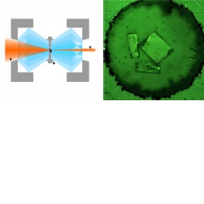
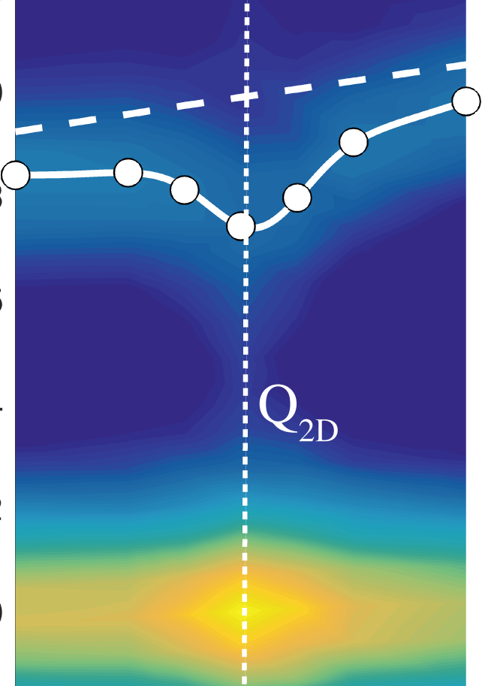
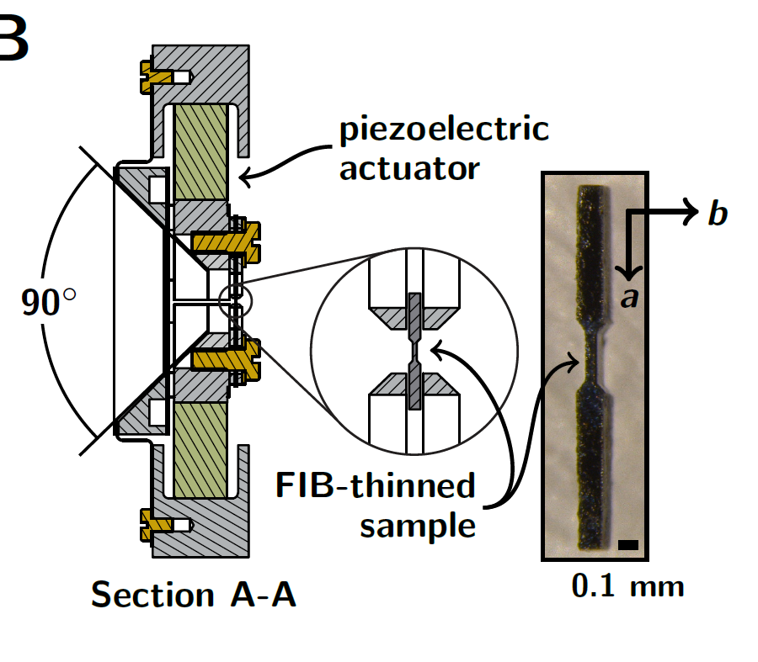
Tuning the electronic properties of Quantum Materials
Accorder les propriétés électroniques des matériaux quantiques
Matthieu Le Tacon
Institute for Quantum Materials and Technologies (IQMT)
V_{xy}
V_{xx}

Slide 2

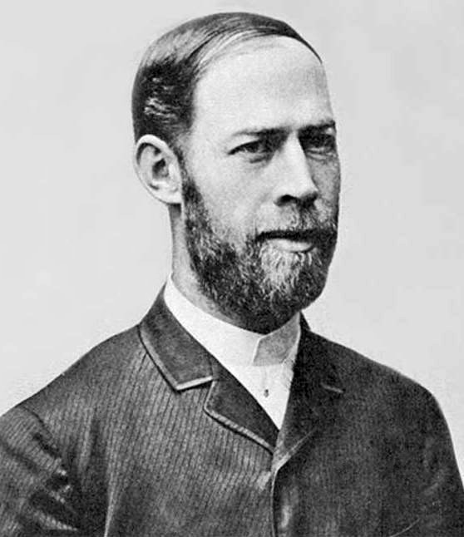
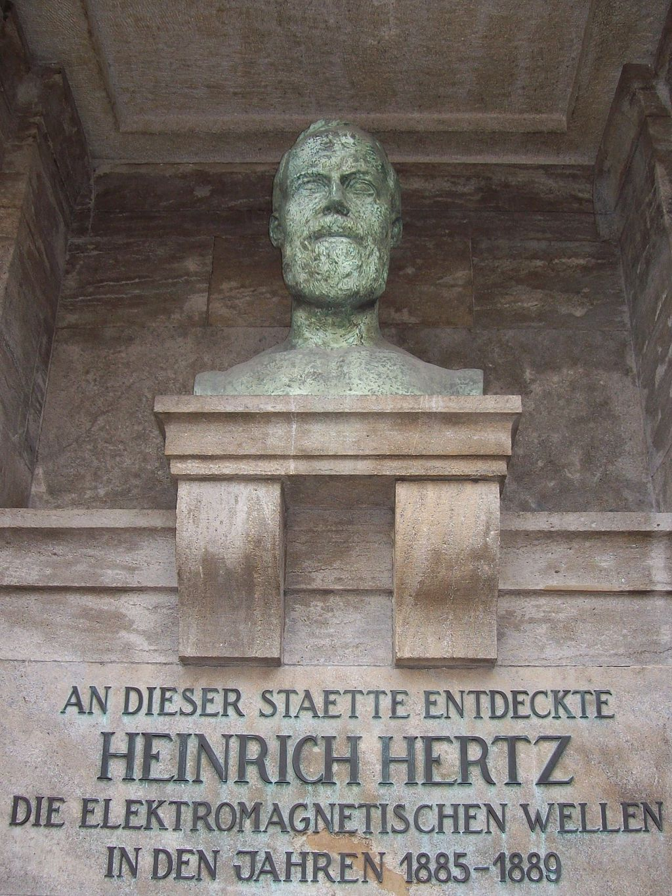
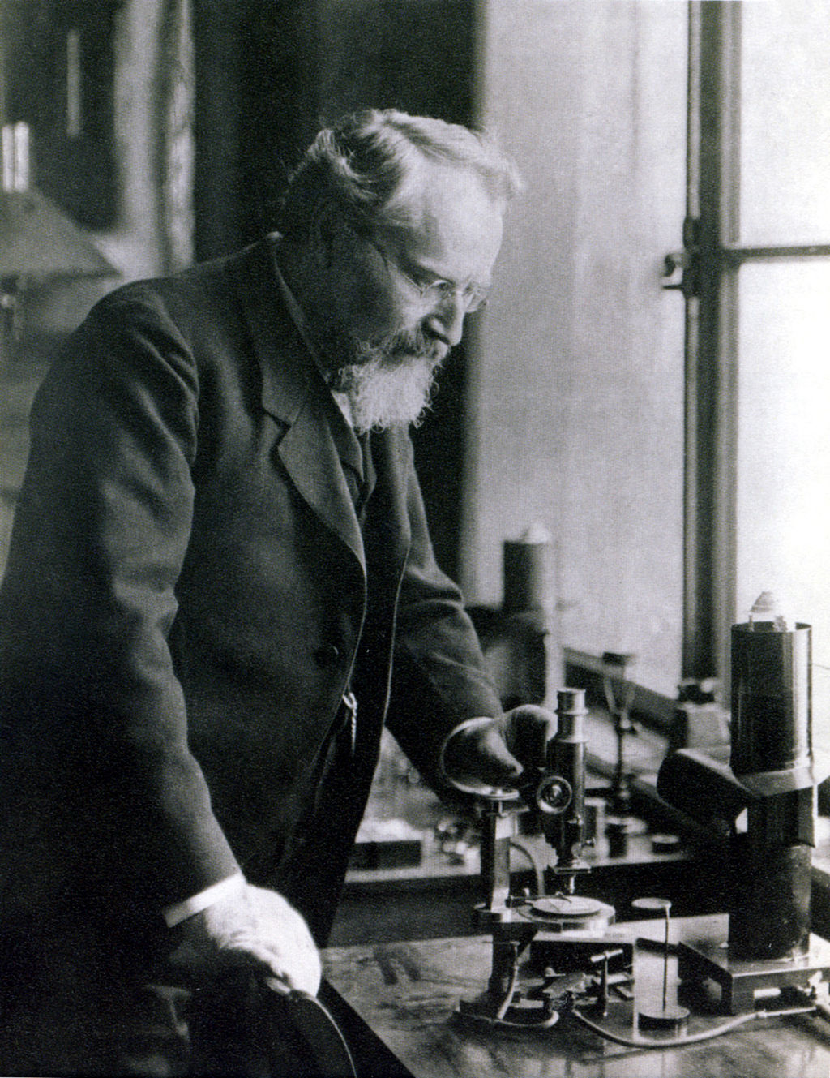
Heinrich Hertz (1857-1894)
Otto Lehmann
(1855-1922)
(Liquid Crystals)

Slide 3




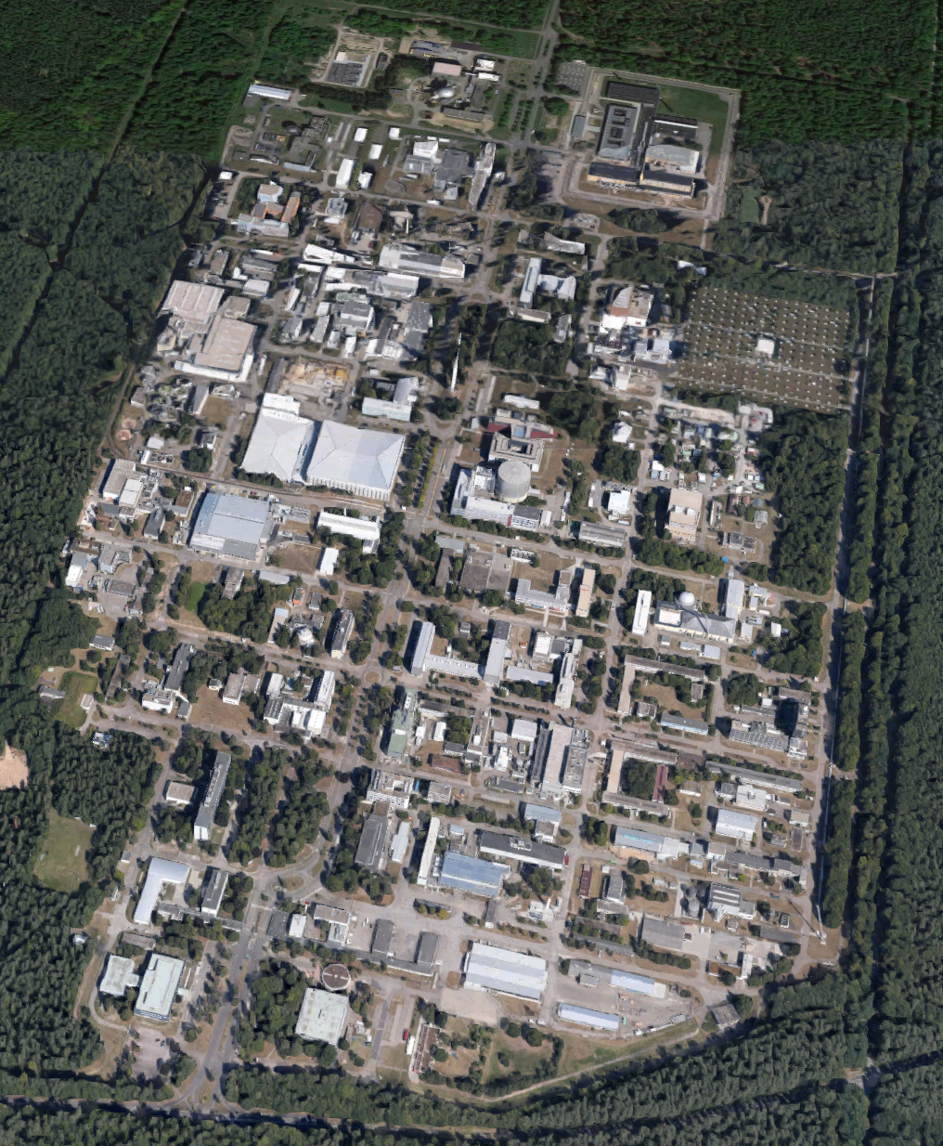



the Research University
in the Helmholtz Association
Exzellenzuniversität (2019)

Slide 4
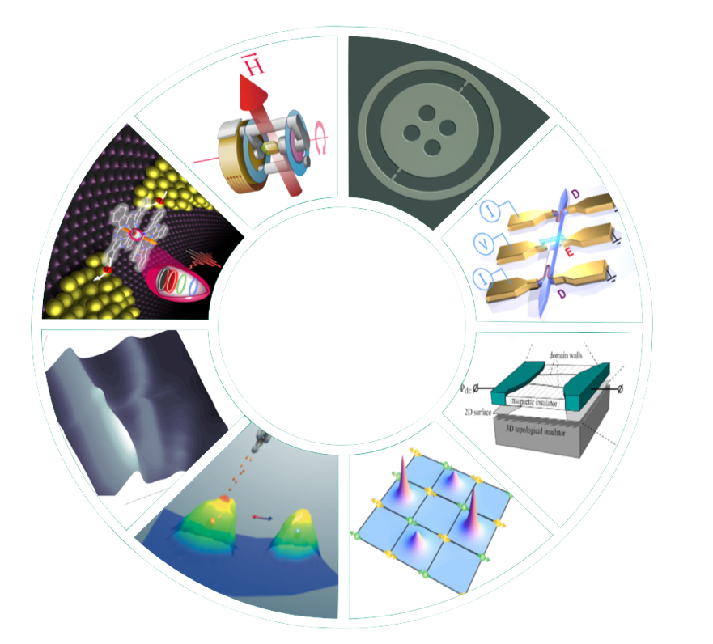

Institute for Quantum Materials & Technologies (IQMT)
New
Quantum materials
(C. Meingast)
Quantum
Circuits
(W. Wernsdorfer)
Materials &
Molecules
Quantum
Devices
8 9 Departments
ca. 120 staff (2022)
Close Theory-Experiment Interactions
Synthesis of new
Quantum Materials
Functionalisation
Devices for Quantum technologies
Building blocs for Quantum computer
Quantum
Molecular
Systems
(M. Ruben)
Quantum
Optical
Devices
(R. Krupke)
Spectroscopy of
Quantum Materials
(M. Le Tacon)
Mesoscopic Quantum Systems
(A. Mirlin)
Transport &
Spectroscopy
Theory
Quantum
Transport (W. Wulfhekel)
Theory of Quantum Materials
(J. Schmalian)

Slide 5
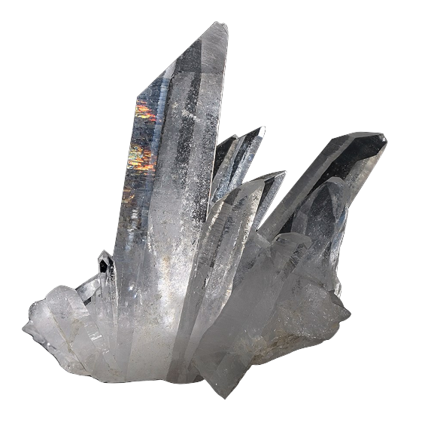
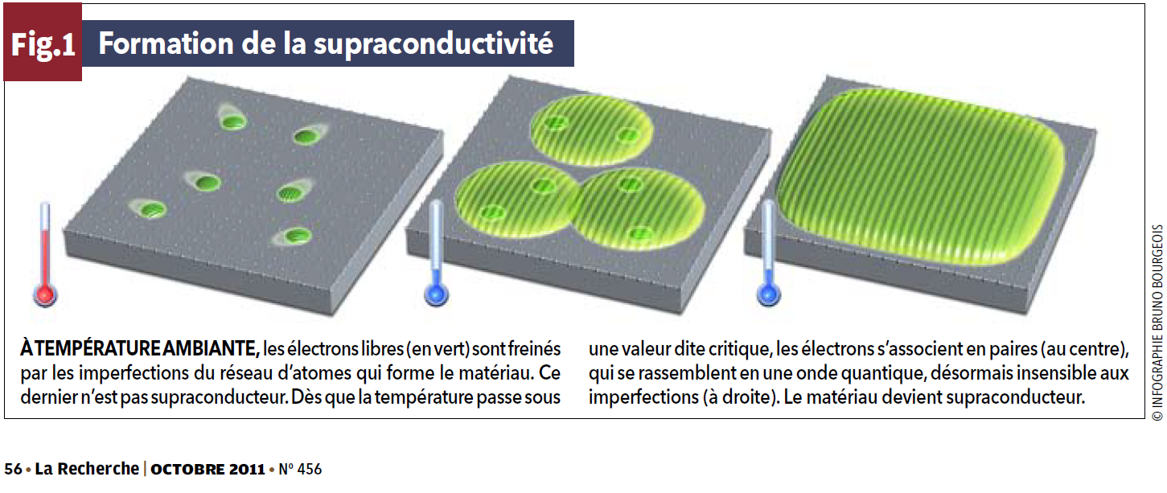

What are quantum materials?
Materials which electronic properties cannot be described as an assembly or essentially independent charge carriers (~ “electrons”)
  Semiconductors, band insulators or ‘simple metals’ on which most of our technology relies do generally not fall into the ‘quantum materials’ category
Copper
(Cu)
Silicium
(Si)
Quartz
(SiO₂)
  Superconductors in which the electrons condense into a macroscopic wavefunction, are.

Slide 6
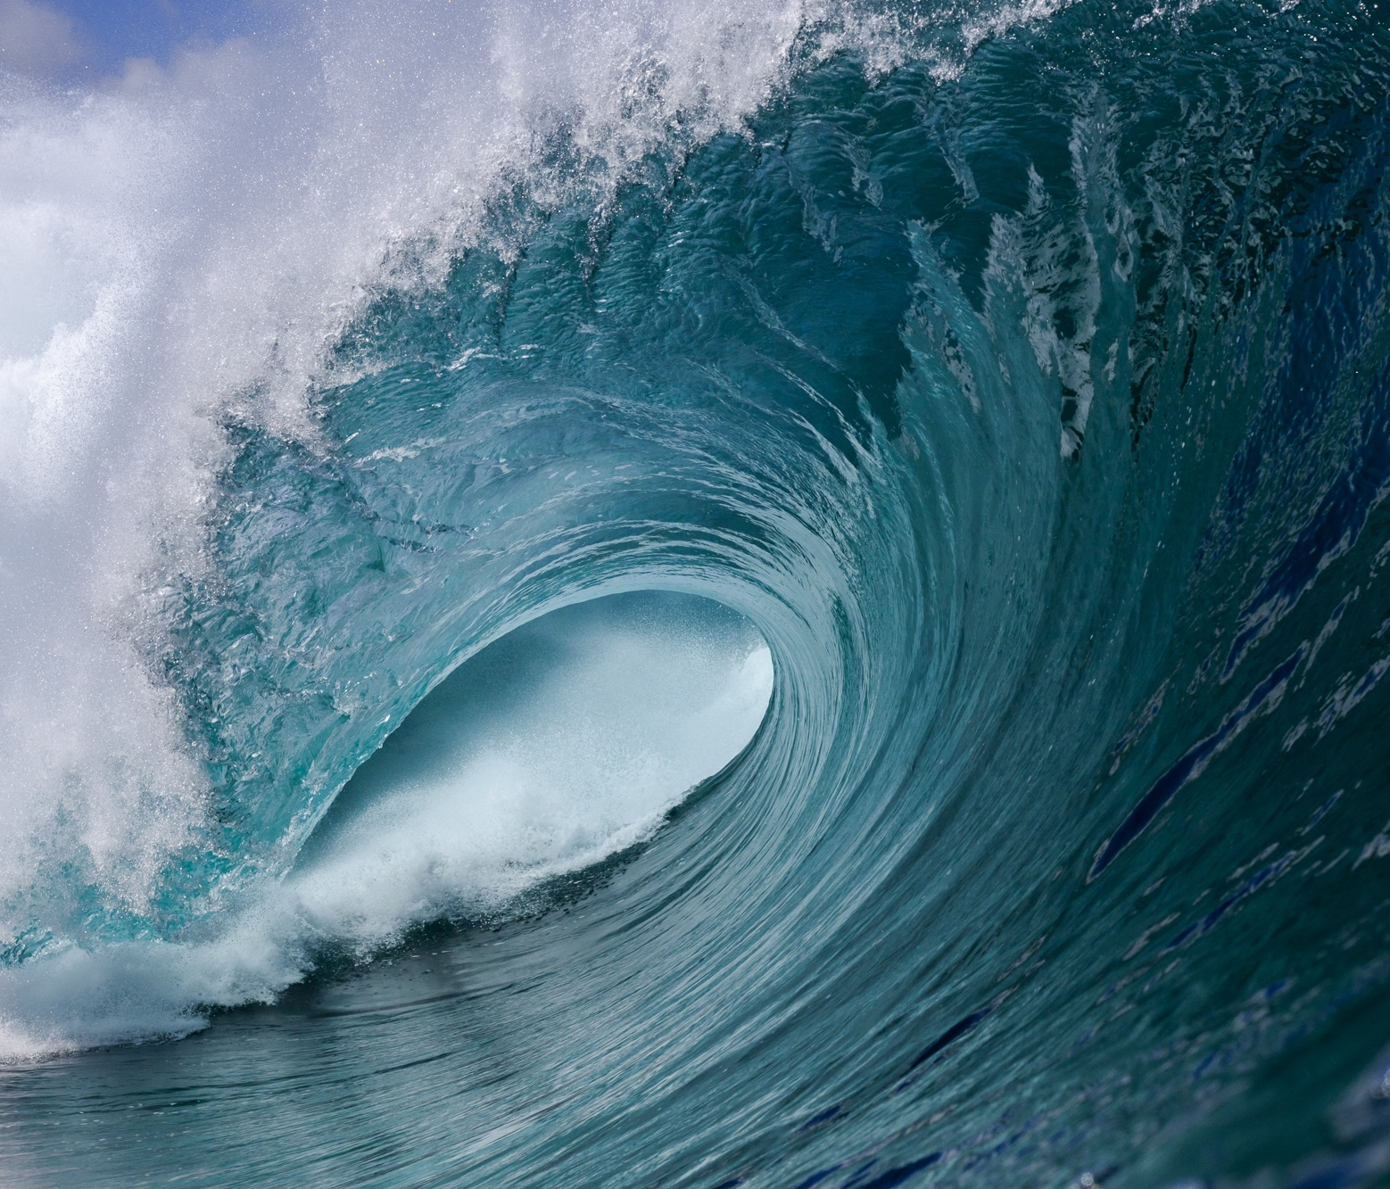
Quantum Materials
Emergence: ‚more is different‘
new properties or structures of a system as a result of the interaction of its elements
Topology: ‚not that different‘
Properties of mathematical structures that are preserved under continuous deformations.
Notes:
wir können den Becher kontinuierlich in den Donut verformen.

Slide 7
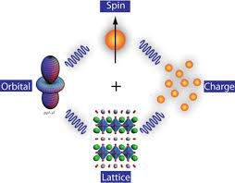
Quantum Materials: a matter of energy scales
exchange interactions (J)
Spin-orbit
coupling
(λ)
e⁻
hopping (t)
Coulomb Repulsion (U)

Slide 8
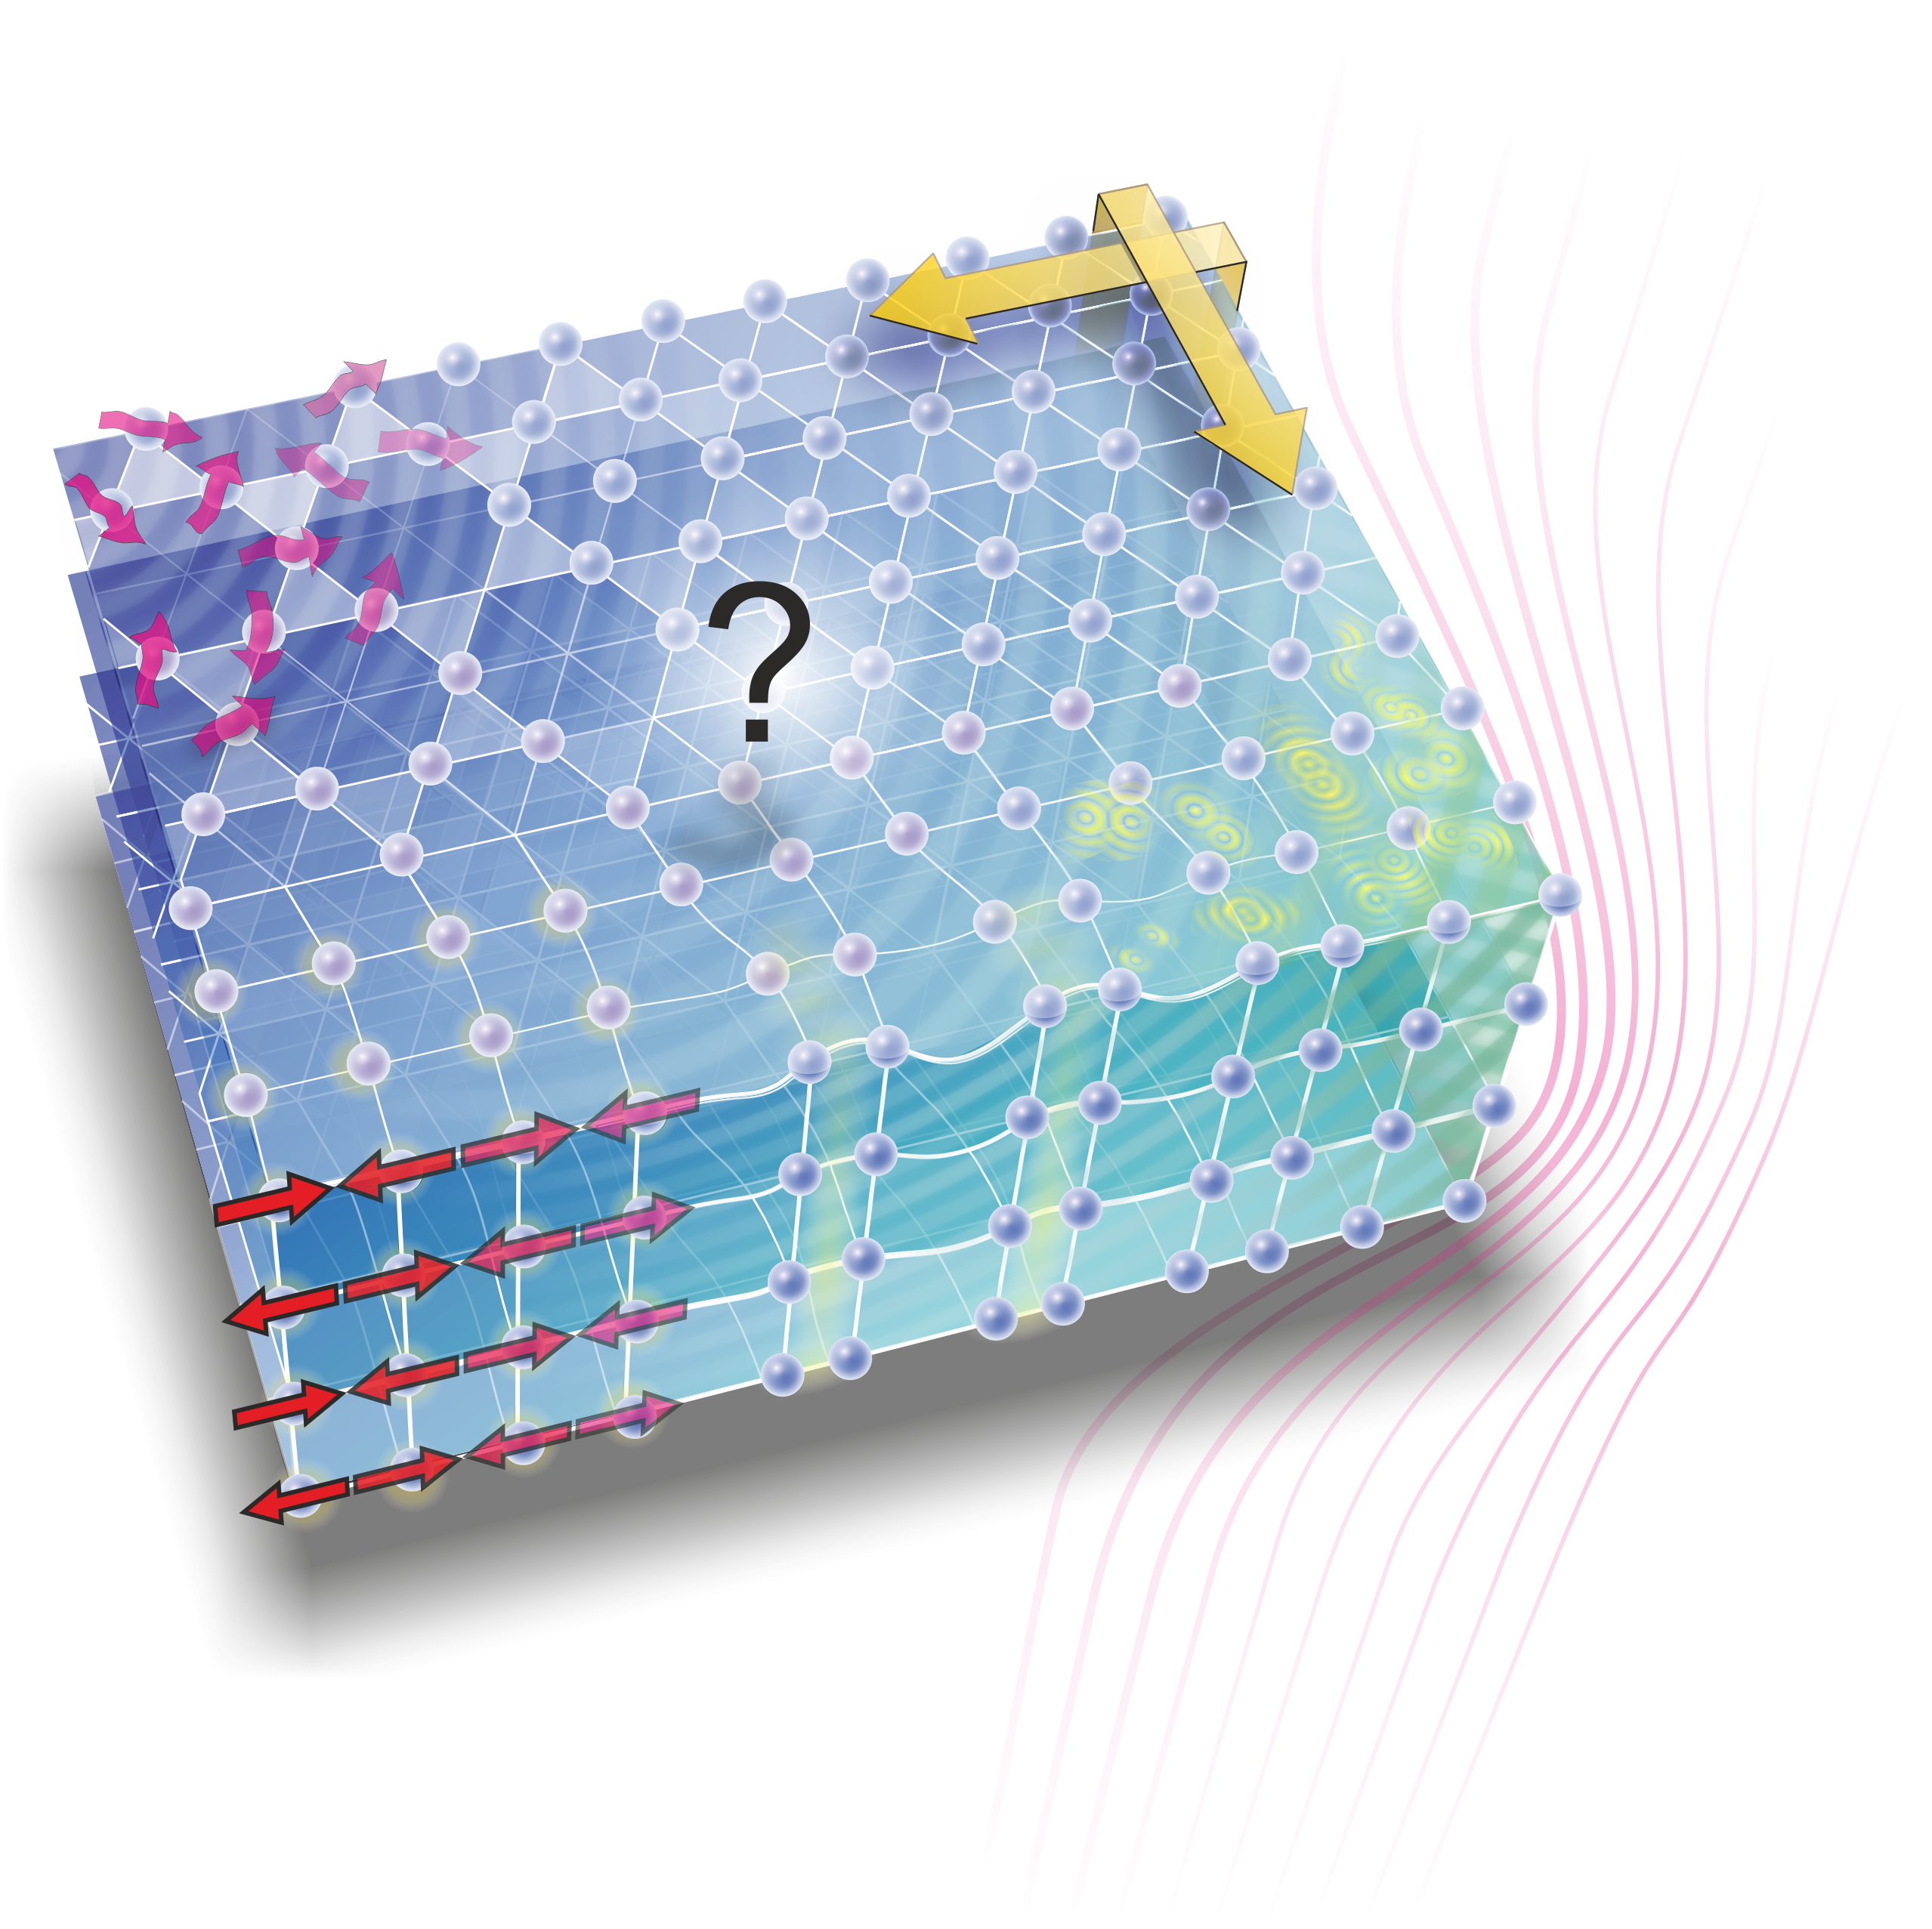
Quantum Materials
Topological Insulators
Weyl, Dirac Semimetals
Quantum Spin
Liquids
(unconventional)
Superconductivity
quantum
Magnetism
(charge/spin)
density waves
Wide variety of ‘emergent’ physical phenomena
Highly tunable materials: chemical composition, external stimuli (Pressure, Field etc..)
Goal: understand the interplay between electronic orders

Slide 9
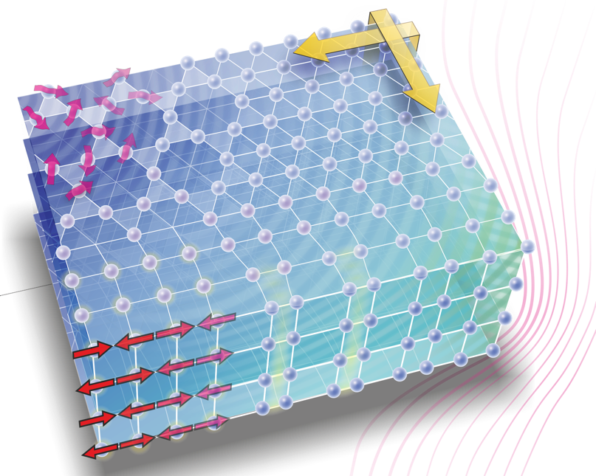
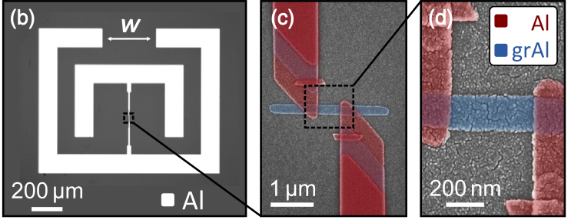
From quantum materials to quantum devices
A wealth of macroscopic quantum states
in quantum materials
Need for functional quantum devices
Single/entangled photon sources as quantum emitters
Topological states
Spin liquids
?
He et al. Nature Materials 2018
‘Artificial atoms’: superconducting circuits
Superconductivity
Winkel et al.
PRX 2020
Magnetism
Quantum materials are generally relevant for (quantum) technology
Quantum technology can accelerate the research on quantum materials
Notes:
Reply to the strategic recommendation ‘Sharpen the focus’

Slide 10
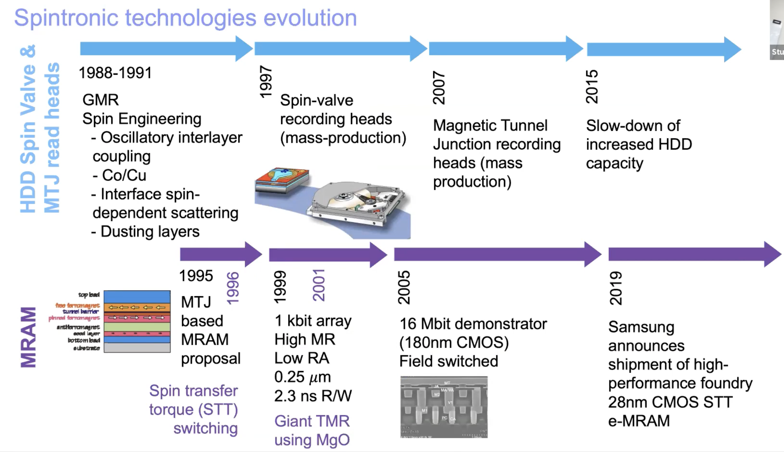
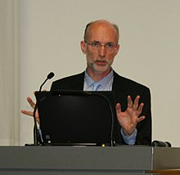
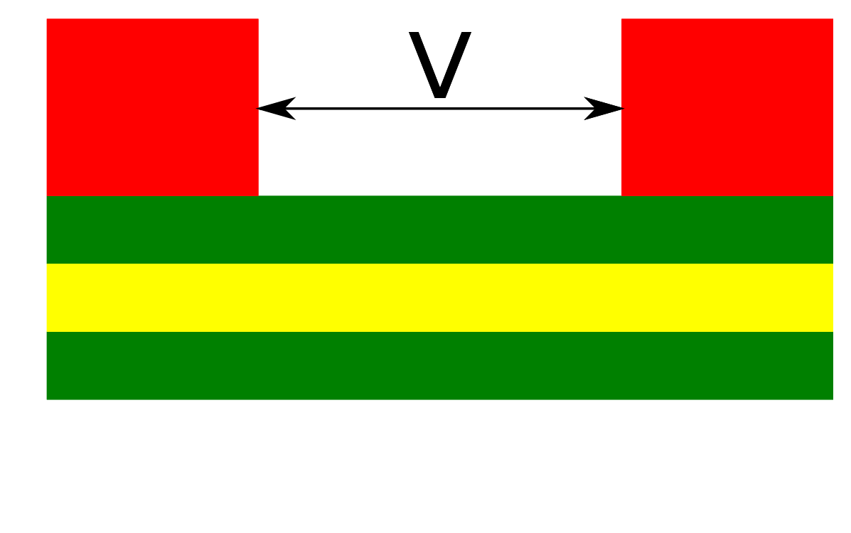
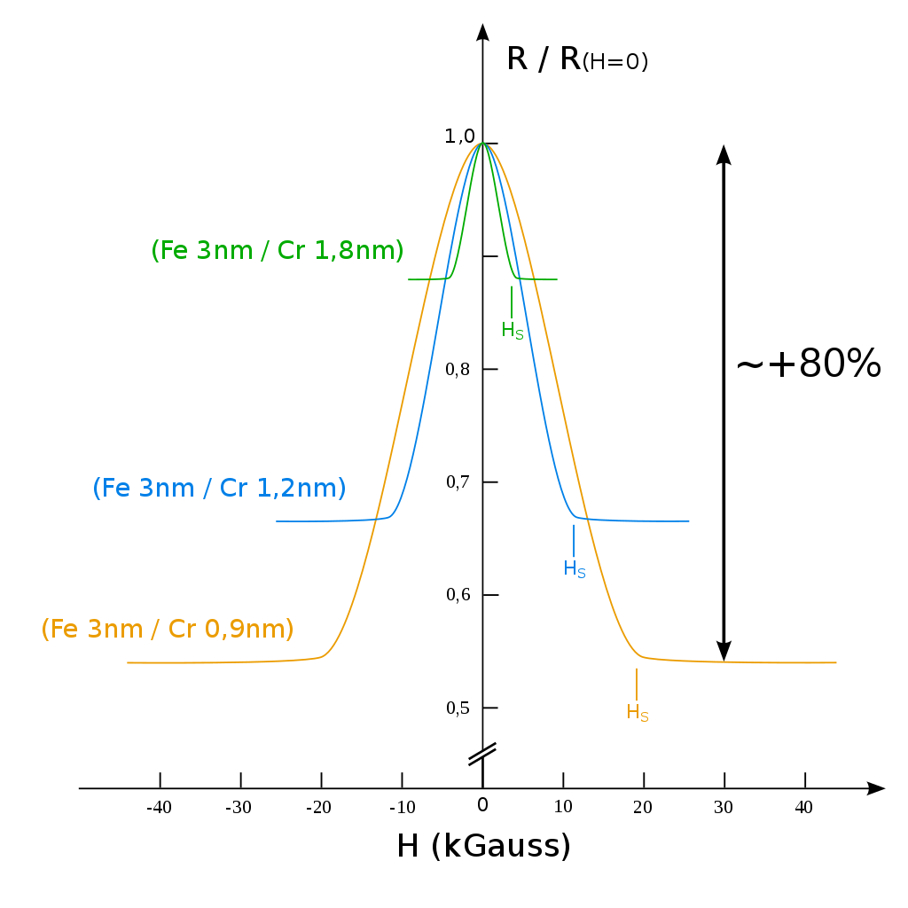
‘Was kann man damit bauen?’
‘A deeply original behavior always results – at some point – on an economically viable application’
(H. Alloul & H. J. Schulz – Physique des électrons dans les solides)
Stuart Parkin
MPI Halle
Fert, Grünberg (1987)

Slide 11
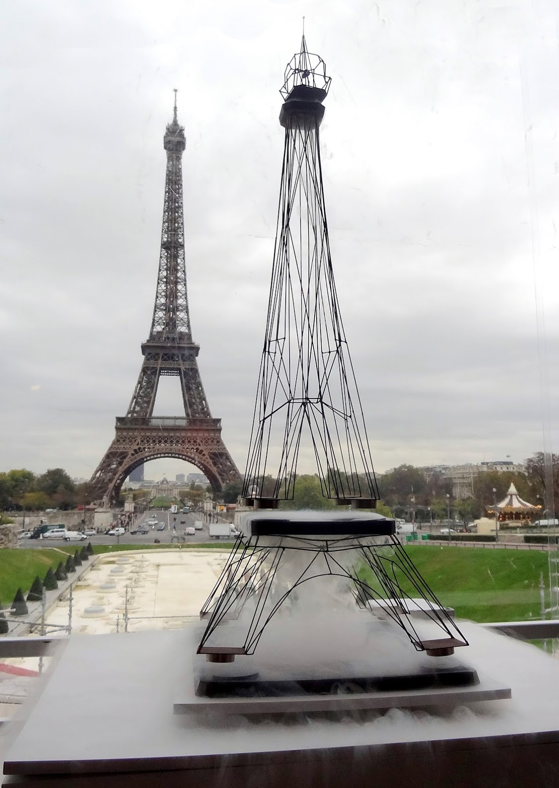

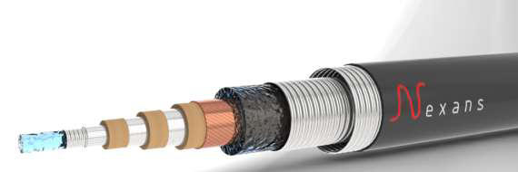



‘Was kann man damit bauen?’
‘A deeply original behavior always results – at some point – on an economically viable application’
(H. Alloul & H. J. Schulz – Physique des électrons dans les solides)
vulgarisation.fr

Slide 12
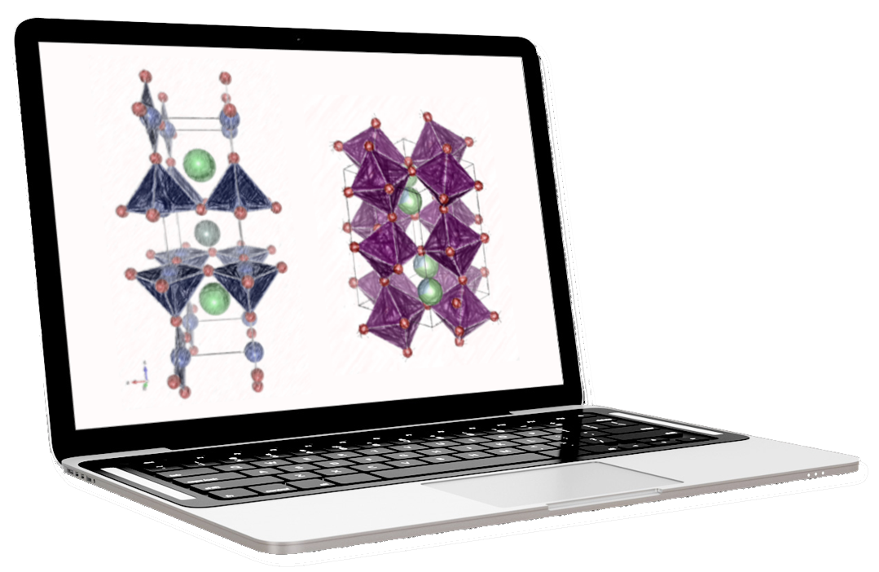
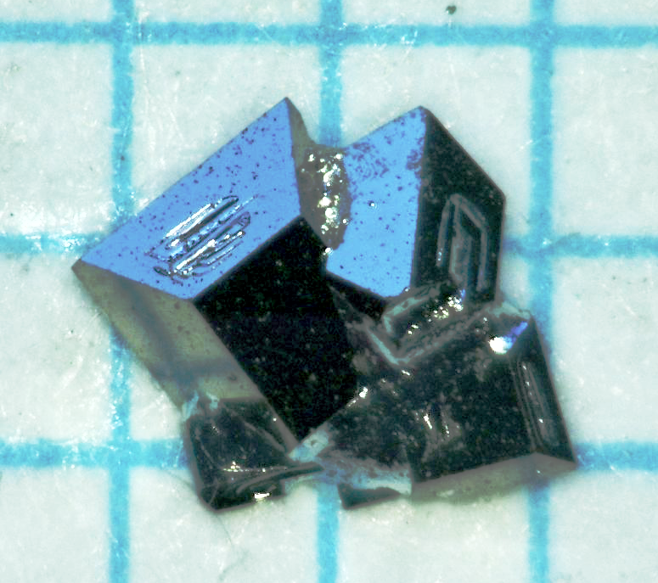
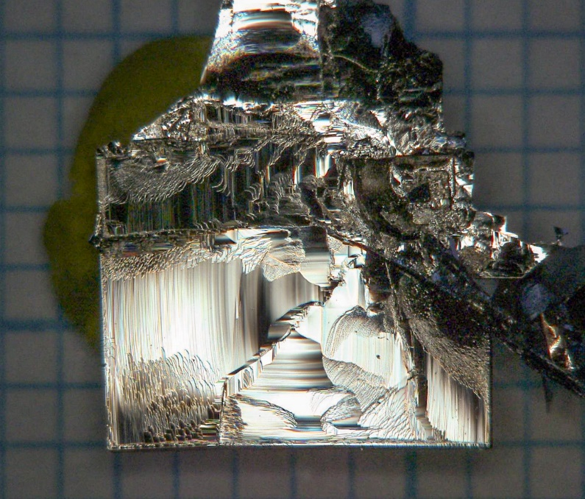
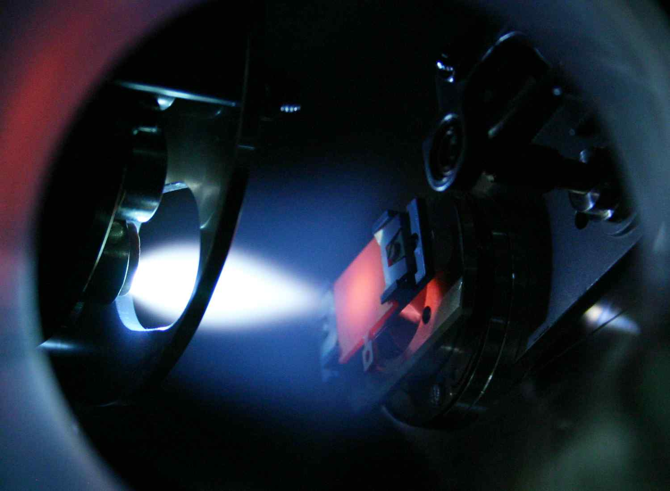
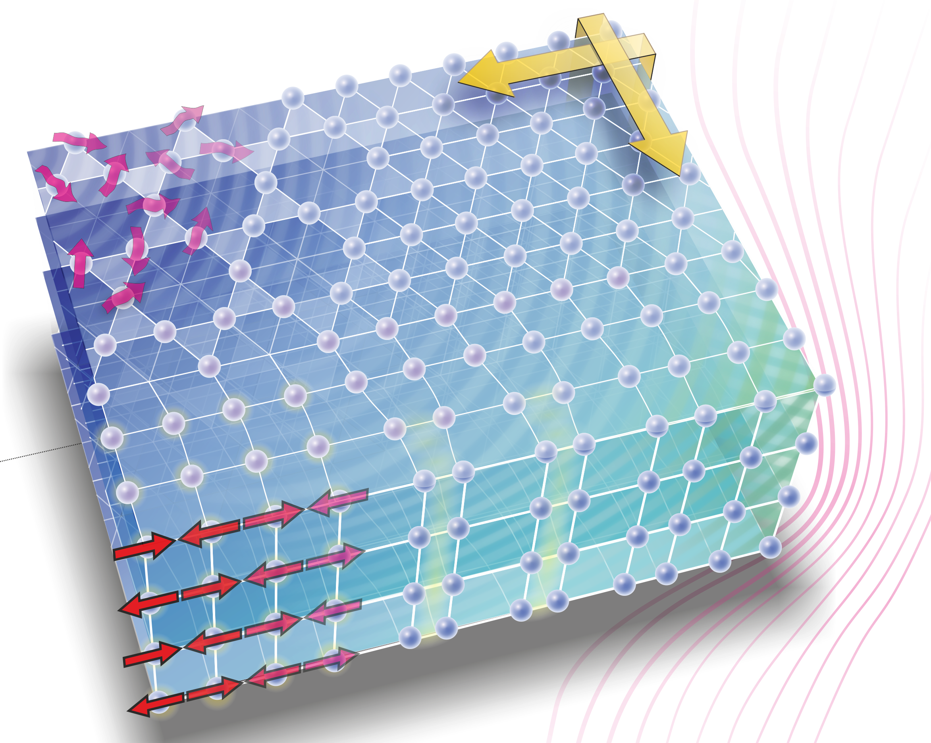
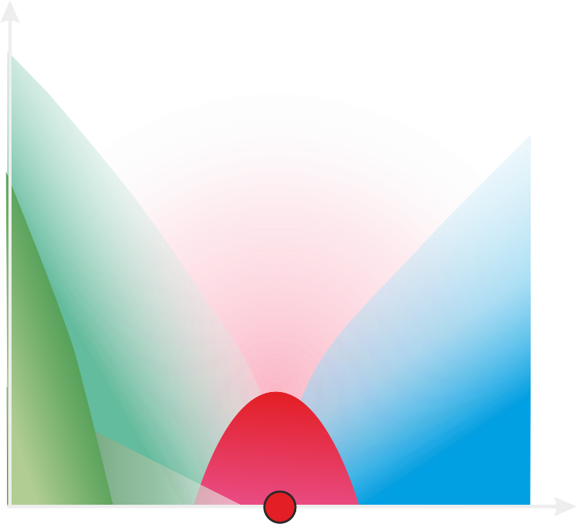
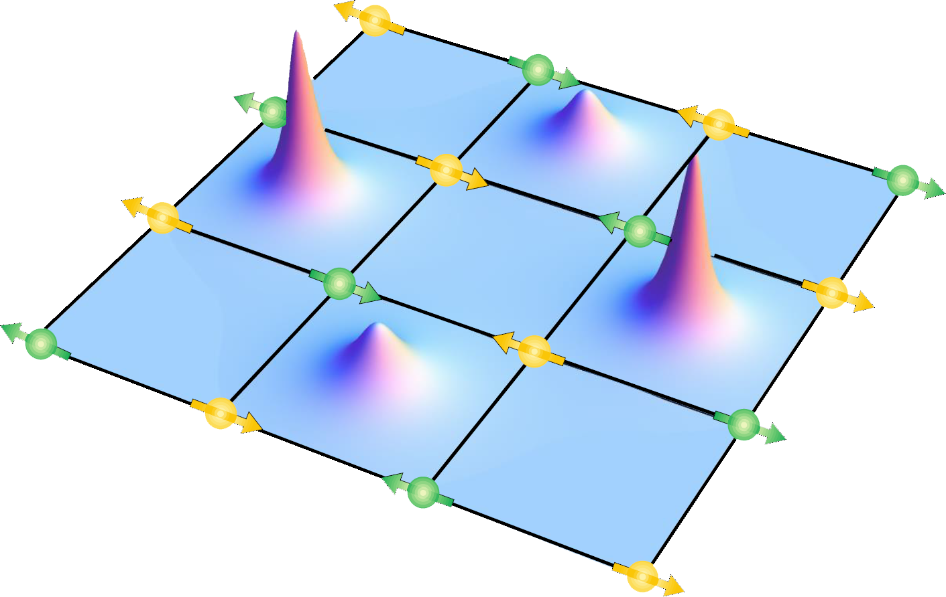
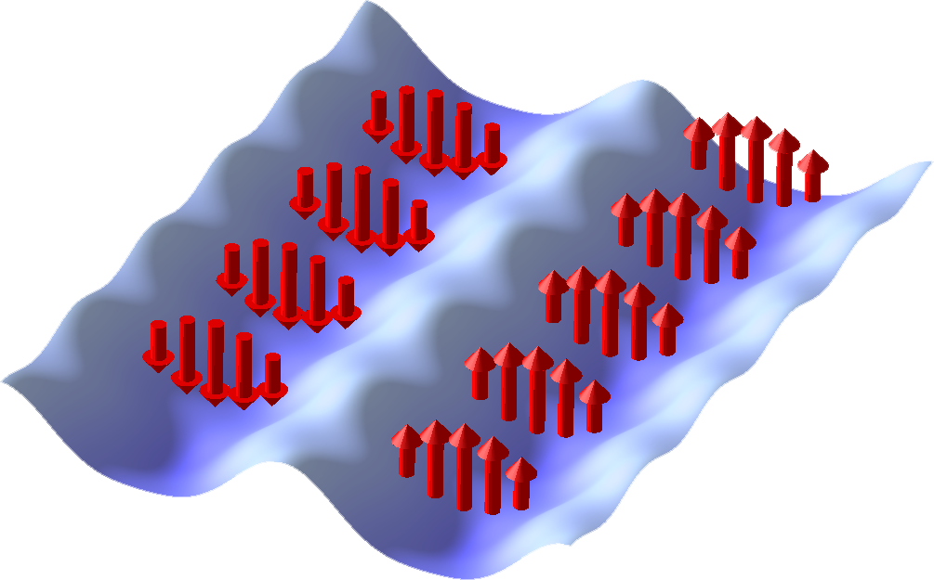
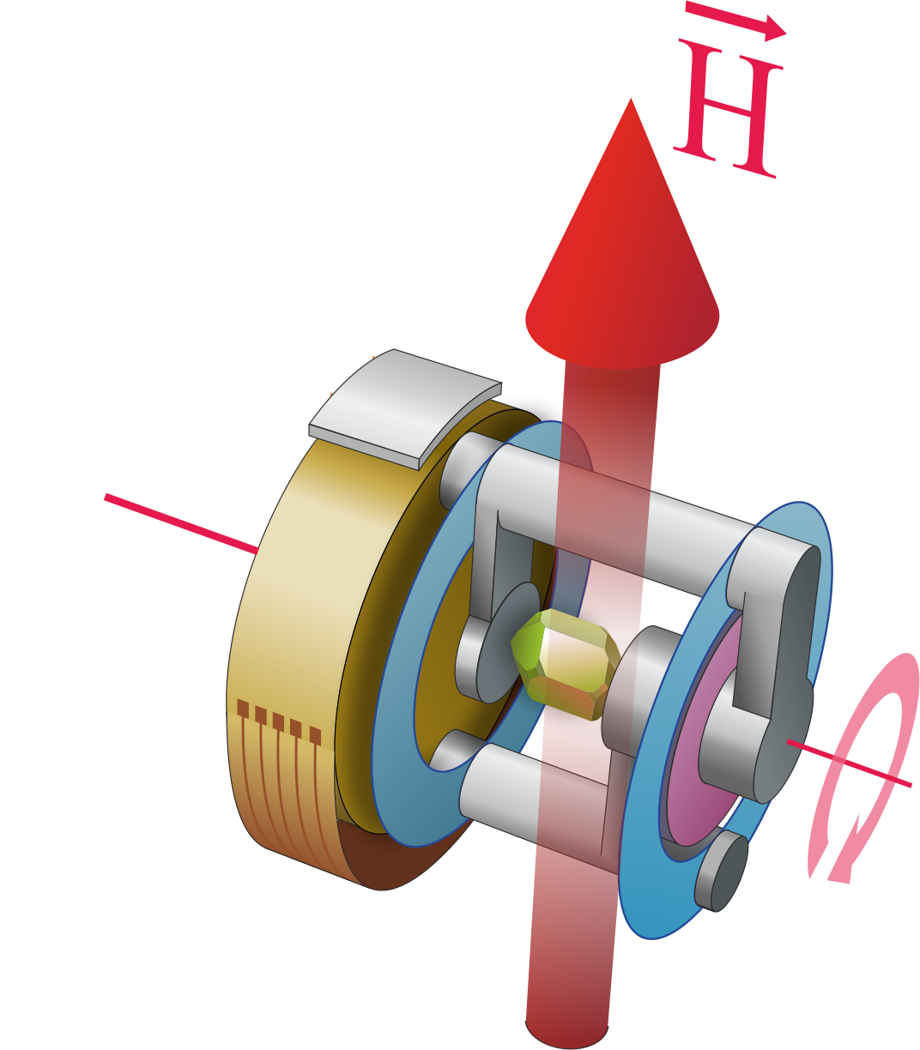
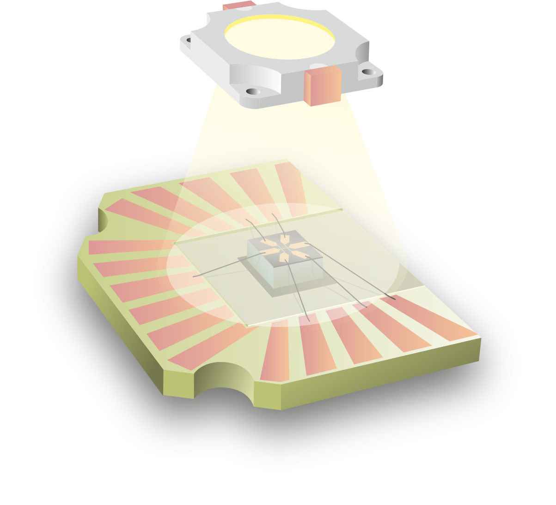
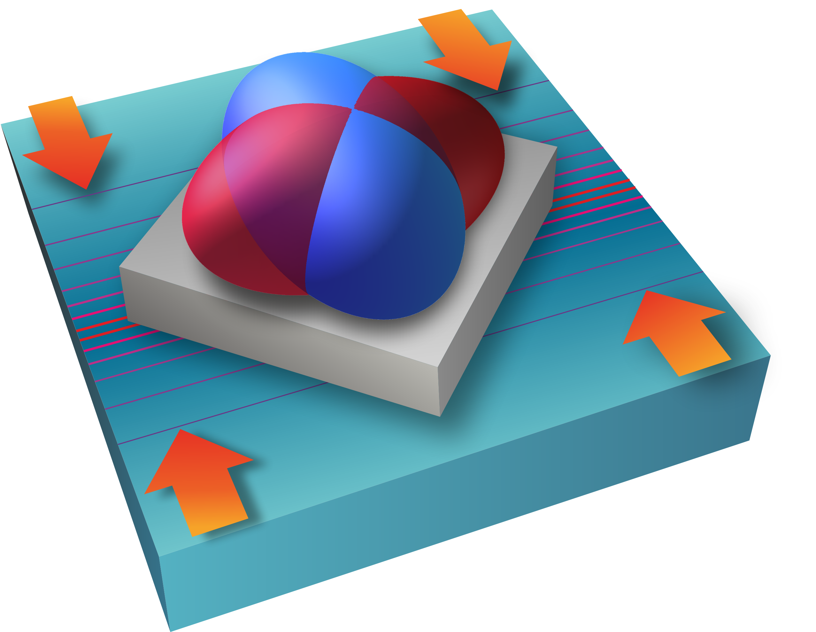
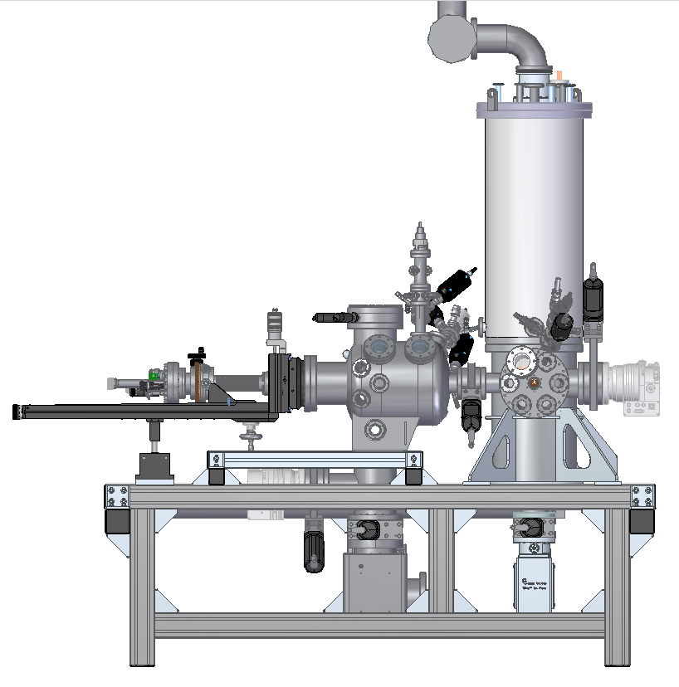
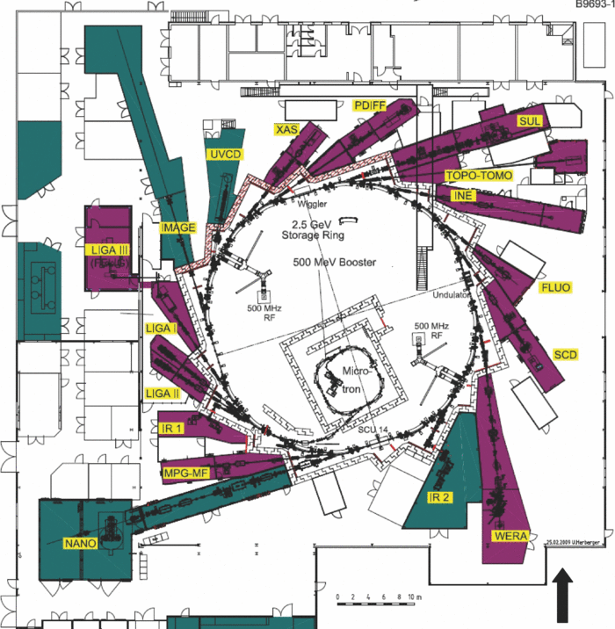
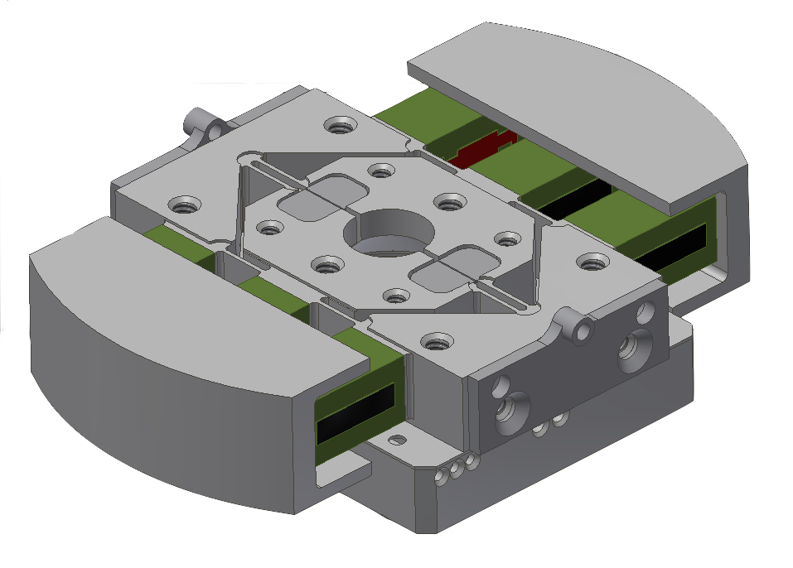
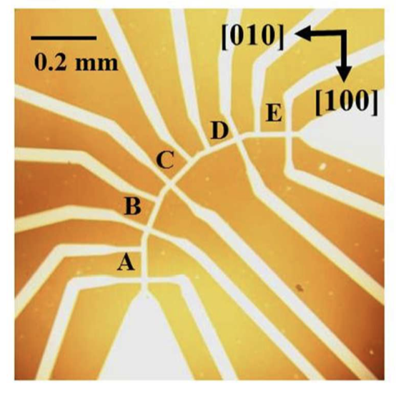

A Quantum Materials optimization loop
● Synthesis
Growth of new quantum materials
● Design materials
with tailored electronic properties
& functionalities
single crystals,
thin films,
interfaces,
monolayers
● Model
predict new electronic properties
● Mapping
electronic phase diagram
Control of the competing electronic phases
Design of new electronic phases
functionalisation of
Quantum materials
T
Curiosity driven
research at every
step!
g
Coexisting, competing & intertwined orders
● Develop new tuning knobs
to induce novel electronic states of matter
● Understand
electronic structure and dynamics
Strain tuning, symmetry breaking

Slide 13
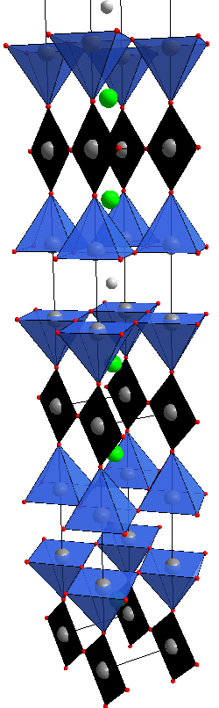
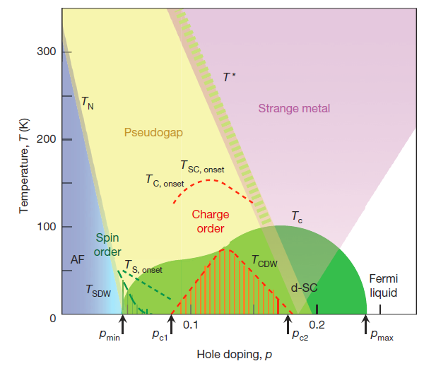
High-Tc Cuprates
YBa₂Cu₃O_{6+x}
e⁻
CuO_{x}
chains
CuO₂
planes
B. Keimer et al. Nature 518, 179 (2015)

Slide 14
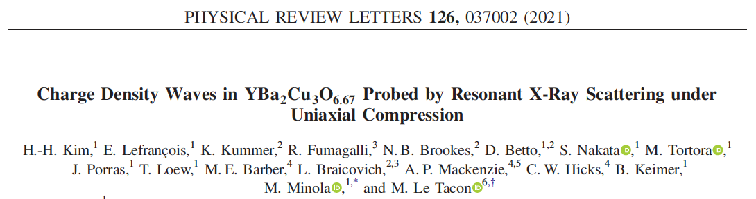
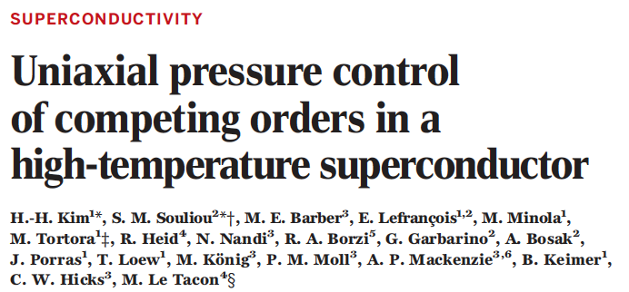
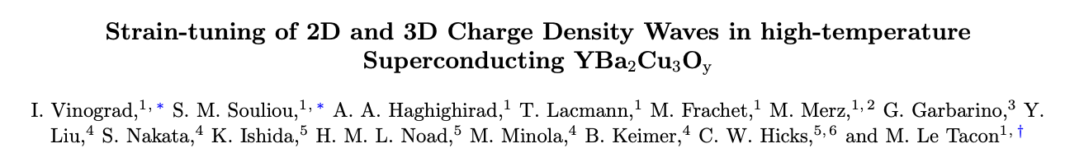



Elastic tuning of the electronic state of high-Tc cuprates
Cuprates
Pressure/stress is a good tool to investigate the interplay between SC and CDW orders
B. Keimer et al. Nature 518, 179 (2015)
S. M. Souliou, I. Vinograd, R. Heid
A. Haghighirad, M. Merz, T. Lacmann
C.W. Hicks, M. E. Barber,
H. Noad, K. Ishida, A.P. Mackenzie
H.-H. Kim, E. Lefrançois, H. Gretarsson, M. Minola, S. Nakata, B. Keimer
Bosak, G. Garbarino, M. Krisch
N. Brookes, K. Kummer

Slide 15
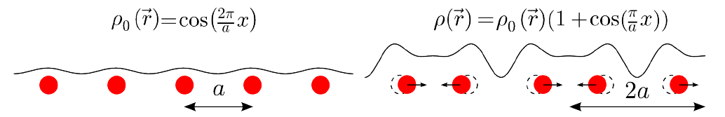
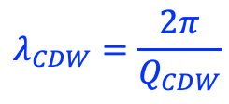
Charge Density Wave?
Metal
CDW
$$λ_{CDW}=\frac{2π}{Q_{CDW}}$$
M. Leroux
PhD thesis 2012
Instability of a metallic system towards the formation of a
periodic modulation of the charge density
Original prediction: R. Peierls in the 50s on 1D chains

Slide 16
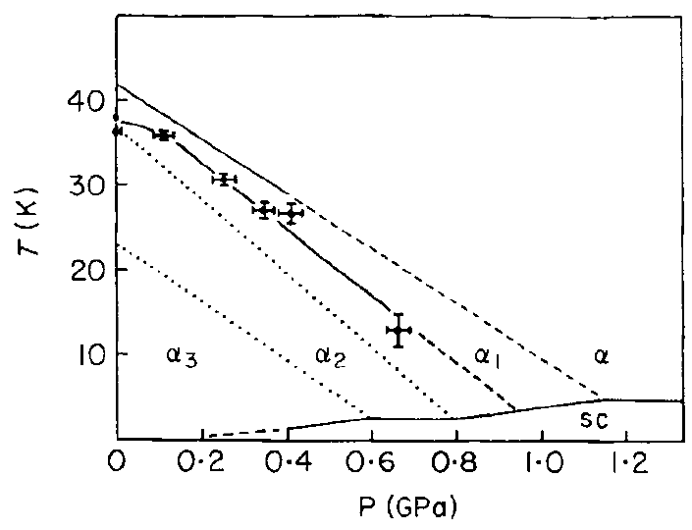
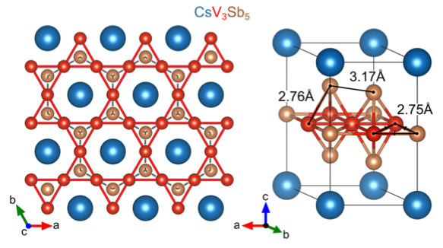
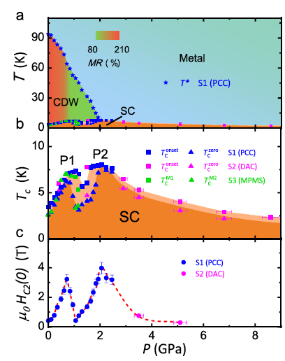
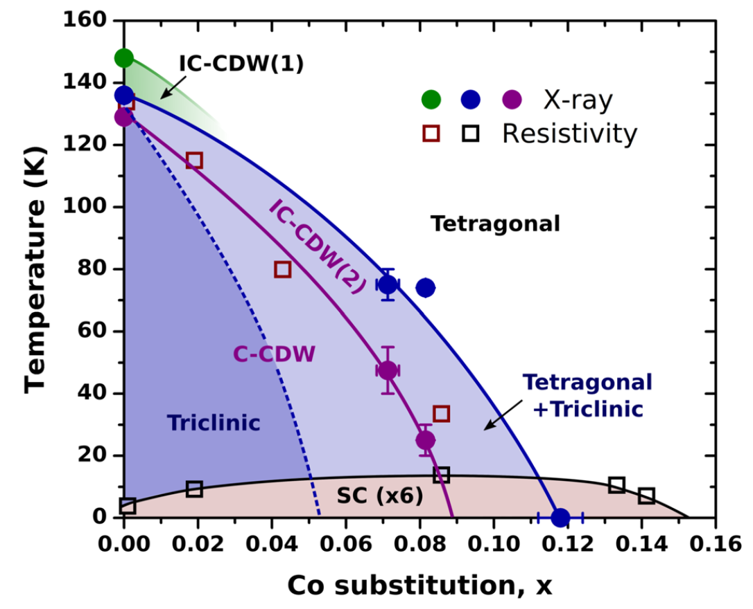
Charge density waves and superconductivity….
Cuprates
α-Uranium
Ortiz et al. Phys. Rev. Lett. 125, 247002 (2020)
CDWs appear close to superconductivity
in the phase diagrams of many quantum materials.
Key question: nature of the interplay between these two orders?
B. Keimer et al. Nature 518, 179 (2015)
Chu and Knapp Phys. Lett. 46A, 33 (1973)
BaNi₂As₂
dichalcogenides
Kagome
Lee et al. Phys. Rev. Lett. 122, 147601 (2019)
Feng et al. PNAS 109 7224 (2012)
Yu et al. Nat. Comm. 12, 3645 (2021)

Slide 17

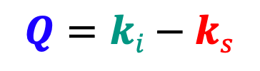


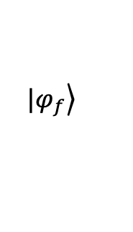
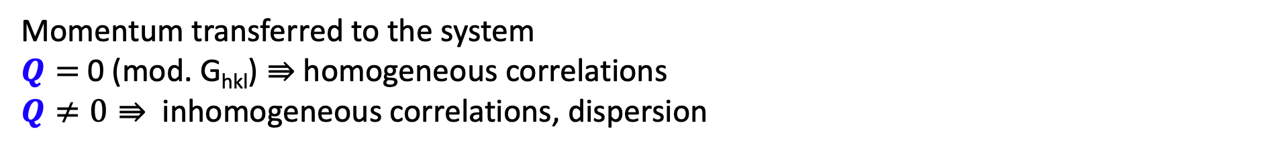




Scattering as a probe
Incident particle
Initial
Final
Neutrons
Photons
Electrons
$$ℏωi,ki$$
$$|\left.φ_{i}\right\rangle$$
$$⇛$$
$$|\left.φ_{f}\right\rangle$$
$$ℏω, \vec{Q}$$
System
Scattered particle
Conservation Laws
$$ℏωs,ks$$
$ℏω=$ $ℏω_{i} −ℏω_{s}$
Energy transferred to the system
$ℏω=0⇛$ Static correlations (Structure)
$ℏω≠0⇛$ dynamics - Excitations
$$Q=ki−ks$$
Momentum transferred to the system
$Q=$0 (mod. G_{hkl}) $⇛$ homogeneous correlations
$Q≠0$ $⇛$ inhomogeneous correlations, dispersion

Slide 18



Tuning parameters for superconductivity in the cuprates
Chemical doping
Magnetic field
Pressure
LNCMI Grenoble
Novel synthesis for each doping - disorder
Very large fields needed
to suppress SC
~25 T < H < ~150 T
Small quantities of materials to study

Slide 19



Charge Density Wave in the Cuprates
Reciprocal space
Real space

Slide 20


Charge Density Wave in the Cuprates
Brighter x-ray sources (synchrotron radiation facilities)
Latest generation detectors
Huge dynamical range
No background
No cross-talk

Slide 21



Charge Density Wave in the Cuprates
(0 K L) plane at Room Temperature
(0 K L) plane at 90 K
(0 0 L)
(0 0 L)
Short-range CDW: $ξ_{2D}\sim$60-80$Å$
Weak correlations along c: 2D order
(0 K 0)
(0 K 0)
Ghiringhelli, MLT et al. Science 337, 821 (2012)
MLT et al. Nat. Phys. 10, 52 (2014)

Slide 22

CDW ‚morphology‘ (RIXS - ID32/ESRF)
Anisotropic, unidirectional CDW domains (cf. Comin et al. Science 347, 1335(2015))
H.-H. Kim et al. Phys. Rev. Lett. 126 037002 (2021)

Slide 23





CDW in the Cuprates: effect of magnetic field
Short-range CDW: $ξ_{2D}\sim$60-80$Å$
Weak correlations along c: 2D order
Increase of CDW with H-field:
Evident competition with SC
Using very large pulsed fields:
long-range CDW: $ξ_{3D}\sim 2$00$Å$ at 26T
$ξ_{l}\sim$ $4$0$Å$ at 26T: 3D Order
Nature of the interplay between CDWs and Superconductivity?
Insights on the microscopic mechanism behind the CDW?
Relationship between the 2D CDW and the field-induced 3D CDW?
Gerber et al. Science 350, 949 (2015)
Chang et al. Nat. Com. 7, 11494 (2016)
Jang et al. PNAS 113, 14465 (2016)
Chang et al., Nat. Phys. 8, 871 (2012)
Blanco-Canosa et al., PRB 90, 054513 (2014)

Slide 24





Pressure vs Magnetic Field
Chang et al., Nat. Phys. 8, 871 (2012)
S. M. Souliou et al., PRB 97, 020503(R) (2018)
Cyr-Choinière et al. Phys. Rev. B 98, 064513 (2018)
Magnetic Field
Hydrostatic pressure
$$\frac{dT_{c}}{dH}<0$$
Yet what if we could suppress
superconductivity with pressure?
$$\frac{dT_{c}}{dP}>0$$
Enhances CDW
Suppresses CDW

Slide 25


Uniaxial stress device
Piezoelectric-based apparatus for uniaxial stress application
continuous, well-controlled uniaxial compression
C.W. Hicks et al., Rev. Sci. Instr. 85, 065003 (2014)
C. W. Hicks et al., Science 344, 283 (2014)
A. Steppke et al., Science 355, 1 (2017)
More information: Uniaxial Stress Technique and Investigations of Correlated Electron Systems,
Springer Thesis, M.E. Barber (2018)
modified version:
transmission geometry
adapted for HP cryostat
+
a-axis UD YBa₂Cu₃O_{6.67} needles
plasma-FIB thinned in the center

Slide 26



1.5 GPa ~
1% compression
T_{c} data under uniaxial stress
Homogeneous and efficient suppression of
superconductivity with uniaxial pressure //a
Barber, M. E. et al. Phys. Rev. B 106, 184516 (2022).

Slide 27






Uniaxial pressure dependence of the CDW
H.-H. Kim et al. Phys. Rev. Lett. 126 037002 (2021)

Slide 28









Uniaxial stress and 3D-order
$$ℓ$$
$$1$$
$$0.5$$
Q_{2D}
$$ℓ$$
Γ
$$𝓀$$
0
0.5
1
Q_{2D}
Q_{3D}
H.-H. Kim, S. M. Souliou et al. Science 362, 1040 (2018)

Slide 29





Uniaxial stress and 3D-order
$$ℓ$$
Q_{3D}
1% strain
long-range: $ξ_{3D}\sim 31$0$Å$
3D: $ξ_{l}\sim$ $94 Å$
$$1$$
$$0.5$$
Q_{2D}
H = 26T
long-range: $ξ_{3D}\sim 2$00$Å$
3D: $ξ_{l}\sim$ $4$0$Å$ at 26T
$$ℓ$$
Γ
$$𝓀$$
0
0.5
1
Q_{2D}
Q_{3D}
H.-H. Kim, S. M. Souliou et al. Science 362, 1040 (2018)
Chang et al. Nat. Com. 7, 11494 (2016)

Slide 30



Temperature dependence of the 3D-CDW
H = 26T
Q_{2D}
Q_{3D}
H.-H. Kim, S. M. Souliou et al. Science 362, 1040 (2018)
Gerber et al. Science 350, 949 (2015)
Complete suppression at low T: very strong competition with superconductivity
3D order present even above the uncompressed T_{c}

Slide 31







CDW signature in Phonon spectra
T = 50K < T_{c}
Inelastic x-ray Scattering
Phonon
$$ℏωI, \vec{k}I$$
$$ℏω$$
$$ℏωS, \vec{k}s$$
$$ℏω, \vec{Q}$$
Elastic line
$$\vec{Q}$$
GIANT superconductivity-induced Kohn anomaly at Q_{2D}
2D-CDW is not a soft-mode driven CDW
MLT et al. Nat. Phys. 10, 52 (2014)
H.-H. Kim, S. M. Souliou et al. Science 362, 1040 (2018)

Slide 32


Inelastic x-ray scattering: Phonon anomalies
DFT calculation
(0 0 7)
(0 0 7)
Q_{3D}
Z
*
Q_{2D}
*
T
Z
Q_{2D}
*
*
T
(0 0 6)
Y
Y
(0 0 6)
Q_{3D}
Complete Softening of an optical phonon associated with the formation of the 3CDW
SC-induced softening of the acoustic mode: extends along L
H.-H. Kim, S. M. Souliou et al. Science 362, 1040 (2018)

Slide 33
A few things we learned
Response of CDW to uniaxial stress is symmetric
  b-CDW domains grow under a-stress
  a-CDW domains grow under b-stress
          The CDW is unidirectional and biaxial
The formation of long-range CDW order is associated
with a lattice dynamics anomaly enhanced by stress as SC
is suppressed
The 3D CDW is soft-phonon-driven: lattice plays an active role
The CDW is seen in all cuprates and seem to be the main competitor to high-Tc superconductivity and the thermodynamically stable state when SC is suppressed.
Suppressing CDW ordering tendencies should yield better superconductors!

Slide 34
What do we do exactly to the crystal structure when we apply strain?

Slide 35



2D vs 3D CDW – an xrd study
Vinograd, Souliou et al. (2023)

Slide 36



Detailed structural refinement
Refined Poisson ratio
Bond lengths
Buckling etc…

Slide 37

XRD study of the 3D CDW
T_{CDW}
Quantitative determination of the strain and of its effects on the crystal structure
Strain-temperature phase diagram of the 3D CDW
Evidence for competition between 2D and 3D : the long-range 3D-CDW grows from the 2D correlations
Vinograd, Souliou et al. (2023)

Slide 38
More generally…
the crystal lattice can be used as a ‘clean’ way to tune the electronic phase of quantum materials (statically but also dynamically)
It can be combined with structural and spectroscopic studies to gain fresh insights on the nature of the interplay between competing electronic phases
It can ultimately guide the design of functional quantum materials with tailored electronic properties

Slide 40


Dimensional crossover in CDW
_{Short-range 2D CDW}
CuO₂
_{bilayer}
_{defect pins}
_{CDW maxima}
_{chain layer}
L=0.5
Caplan et al., PRL 119, 107002 (2017)
Notes:
If magnetic field or uniaxial strain is used to strengthen the CDW amplitude, at some point the Coulomb interaction will thus make that the inner layers between adjacent bilayers will be anti-aligned. The effective unit cell is a single unit cell, so long-range CDW peaks appear at integer L values. 30s

Slide 41
Dimensional crossover in CDW
_{Short-range 2D CDW}
_{Long-range 3D CDW}
CuO₂
_{bilayer}
_{defect pins}
_{CDW maxima}
_{chain layer}
_{minimal}
_{Coulomb repulsion}
L=0.5
L=1
Caplan et al., PRL 119, 107002 (2017)
Notes:
If magnetic field or uniaxial strain is used to strengthen the CDW amplitude, at some point the Coulomb interaction will thus make that the inner layers between adjacent bilayers will be anti-aligned. The effective unit cell is a single unit cell, so long-range CDW peaks appear at integer L values. 30s

Slide 42






Inelastic Photon Scattering
Raman Scattering: Inelastic scattering of ‘visible’ light
$ℏω_{I} \sim 1.5 −4$ eV
$λ_{I}\sim$ 3000 – 7000 Å >> a ($Q$~ 0 probe)
Energy resolution $\sim$ 0.1 meV
Selection rules:
- phonon symmetries
- k-space selectivity (electronic)
IXS: high resolution inelastic scattering x-ray scattering
$$ℏω_{I} \sim 17−23 keV$$
$λ_{I}\sim$ 0.5-0.7 Å < a ($Q≫$ 0 many BZ)
Energy resolution $\sim$ 1.5-3 meV
Mostly phonons
AQR Baron, arxiv: 1504.01098
Devereaux and Hackl RMP 79, 175 (2007)

