Slide 1
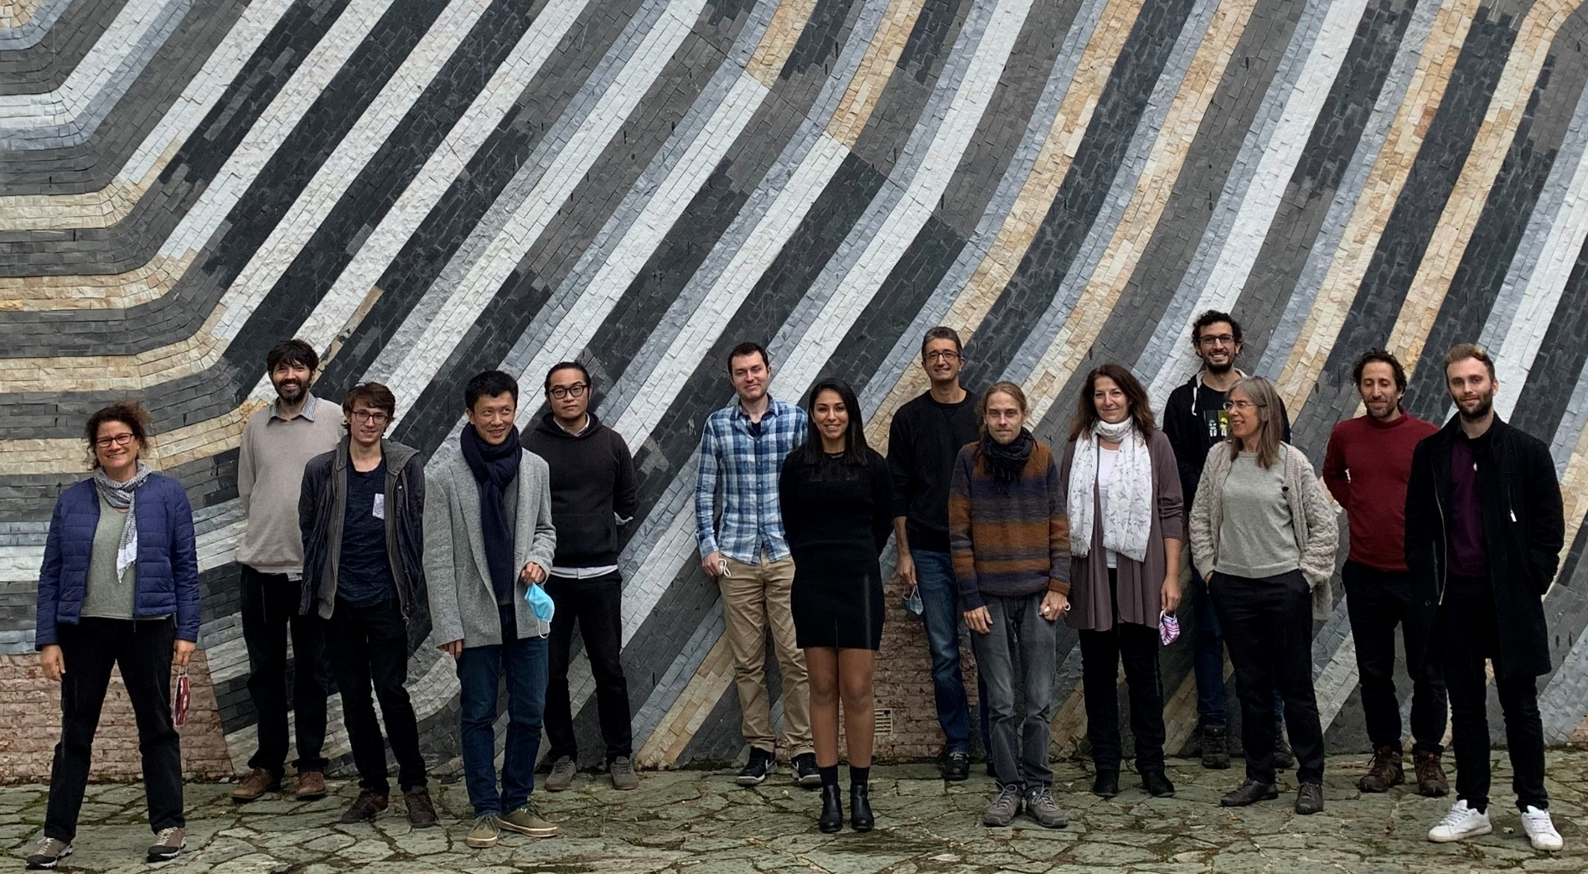
Orbital Diamagnetism and Paramagnetism of Graphene
Jorge Vallejo Bustamante, Matthieu Bard, Victor Wu,
Rebeca Ribeiro-Palau, Taro Wakamura, Claude Fermon,
Myriam Pannetier-Lecoeur, Sophie Guéron, Meydi Ferrier,
Richard Deblock, Sandrine Autier Laurent, Vincent Bouchiat,
Gilles Montambaux Jean-Noël Fuchs, Frédéric Piechon, Hélène Bouchiat
LPS CNRS Université Paris-Saclay
C2N, CNRS Université Paris-Saclay
SPEC, CEA, CNRS

Slide 2
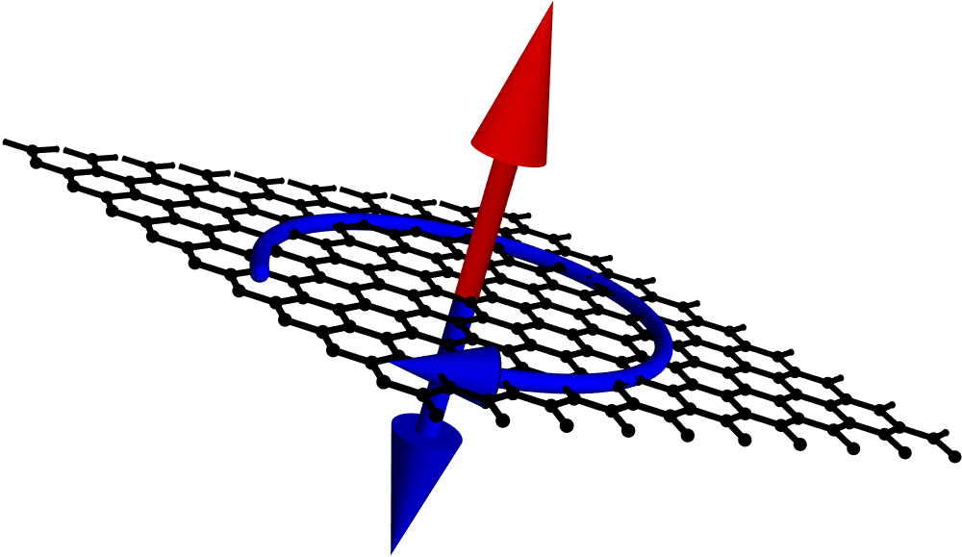


Why is orbital magnetism is interesting?
Thermodynamic property Reveals properties of electronic wave functions not accessible through transport
Meissner effect in superconductors 1933 …
Quantum oscillations in clean metals (de Haas van Alphen ) 1930…
Persistent currents in mesoscopic rings 1990…
2D materials 2020…
-Berry phase of Bloch wavefunctions
-van -Hove singularities in the presence of moiré potentials
-Valley Hall effect
Why no magnetisation measurements in graphene untill recently?
What is a good detector?
GMR sensor ideal tool for experiments at the single flake level
Controlling chemical potential
Experimental results
Low field Singular Diamagnetism at the Dirac point : Mc Clure peak
Crossover with de Haas van Alphen oscillations
Physics of Moiré : Orbital paramagnetism at van Hove singularities
Preliminary results on bilayer graphene
Φ
= 2π Φ/Φ₀
Φ₀ = h/e
$$\vec{B}$$
$$\vec{M_{orb}}$$

Slide 3
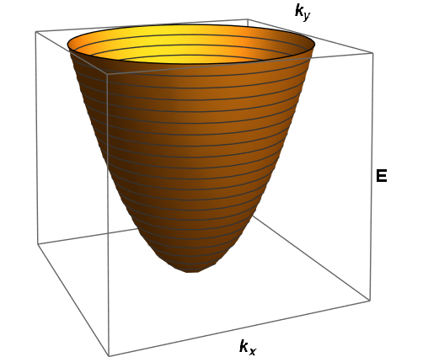
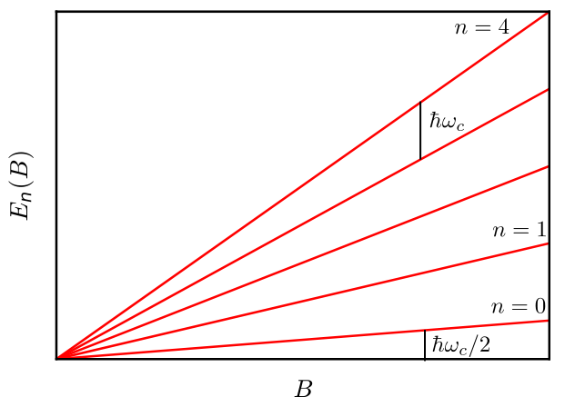
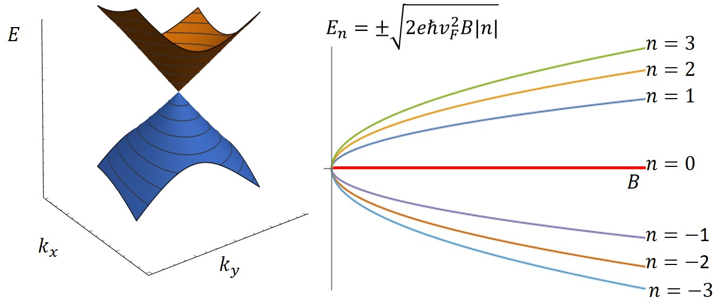
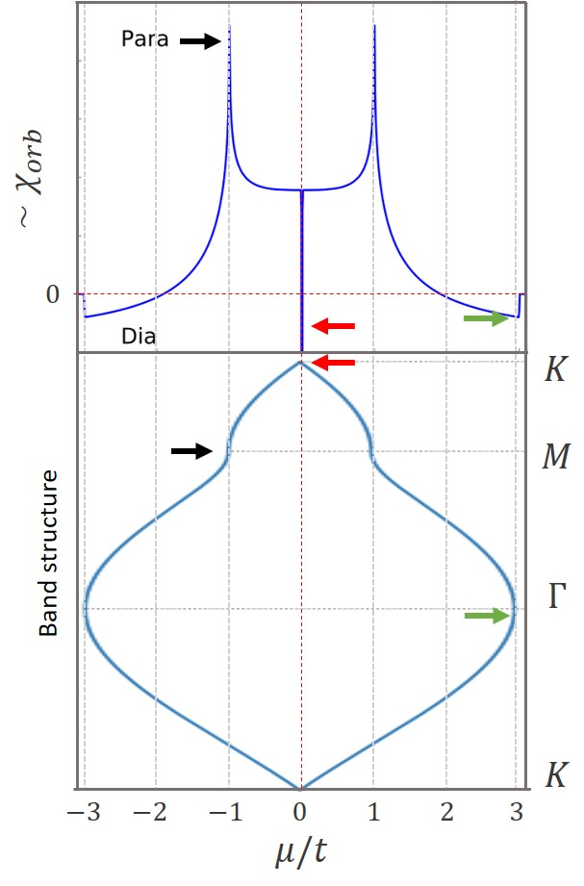
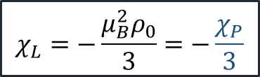



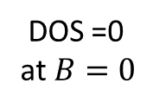

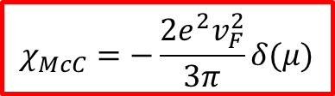
Singular orbital diamagnetic susceptibility in graphene Mc Clure 1956
Massive 2DEG
Landau levels
$$χ={\left.−\frac{∂^{2}Ω}{∂B^{2}}\right|}_{B→0}$$
$Ω=$ Grand potential
$$E_{n}=ℏω\left(n+\frac{1}{2}\right)$$
$$χ_{L}=−\frac{μ_{B}^{2}ρ_{0}}{3}=−\frac{χ_{P}}{3}$$
Low energy Dirac spectrum of Graphene
$$χ_{McC}=−\frac{2e^{2}v_{F}^{2}}{3π}δ(μ)$$
$$B≠0$$
DOS =0 at $B=0$
Raoux A. Thèse, 2017

Slide 4
Importance of the π Berry phase in graphene wave functions
Bloch waves in graphene 2 components on A and B atoms: pseudo spin
Geometrical phase acquired on trajectory C
in reciprocal space :
Φ_{B}
Berry curvature
Φ_{B} = π for Graphene
N
B
In magnetic field:
Φ_{B} also enters in the quantization condition of Landau levels
Landau level at zero energy !

Slide 5
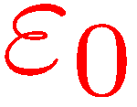
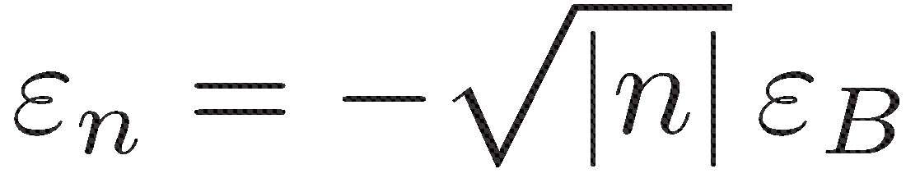

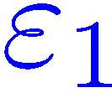

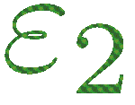
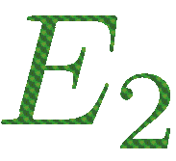
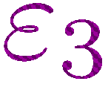
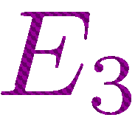
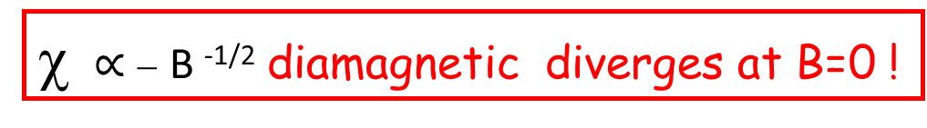
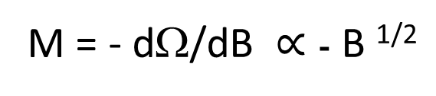
Landau levels in Graphene
Diamagnetic
contribution
Coalescence of the
B=0 spectrum into LL
1
ε_{B}=
300K at 1T
McClure 1956
Raoux, Fuchs,Piechon , Montambaux PRL 2014
2
small paramagnetic
contribution
of all these levels
2
2
(n +1/2 )
E_{n} = _
ΔΩ(Β)
increases with B !
0
M = - dΩ/dB $∝$ - B ^{1/2}
χ $∝$ − B ^{-1/2} diamagnetic diverges at B=0 !

Slide 6
Dice lattice
Paramagnetic divergence of the susceptibility at the Dirac point!
B
N
Φ_{B} = 0 for the Dice lattice

Slide 7
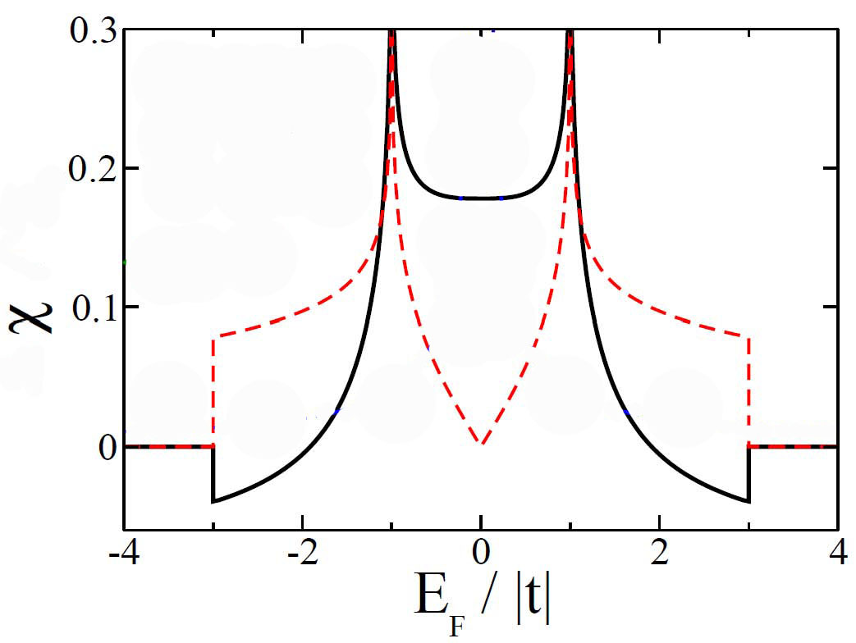
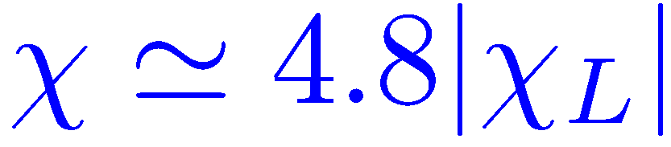

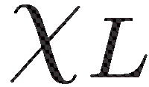
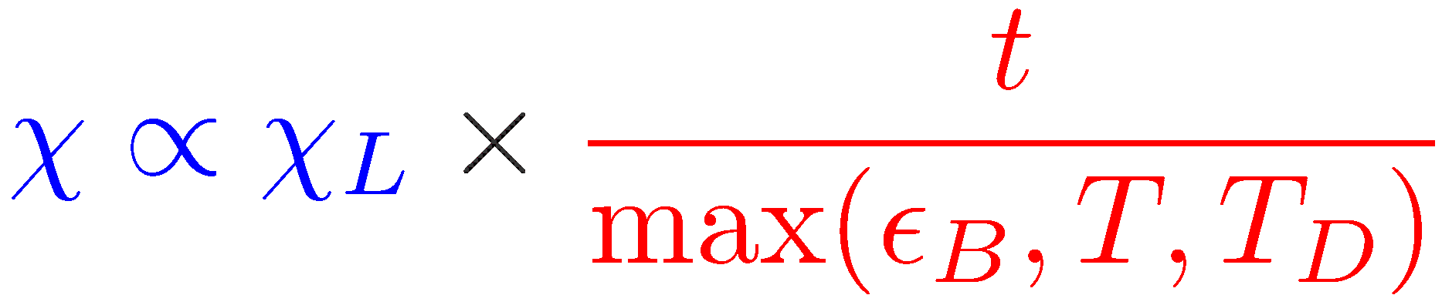
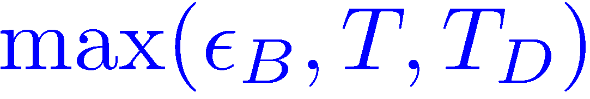
Diamagnetic McClure peak at μ=0 broaden with temperature and disorder
Paramagnetic peak at the saddle point
Raoux, Fuchs,Piechon , Montambaux PRL 2014
t =2.7 eV ~ 3 10 ⁴ K

Slide 8
Orders of magnitude:
₋χ₀ ₌
μ₀ e² v_{F}²
1
π
D
D
Importance of the quality of Graphene!
σ₀= k_{B} T_{D}= ħ /τ_{e}
Amplitude of disorder
l_{e}=1 μm
Width of the McCure peak σ₀= 10mev ~ 100K
Screening of magnetic field on a few micron size detector
δB/B = 10 ⁻⁶ very small effect!

Slide 9
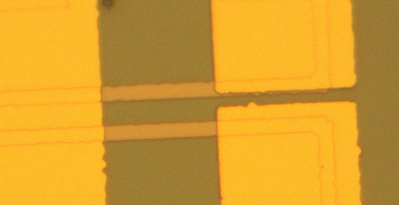
Requirements for magnetometry of a single graphene flake
-High sensitivity and Compatible with gating
Detectors we tried:
-Hall bars (but sensitive to the gate voltage)
-MicroSQUIDs (limited to low fields ~0.1 T)
-Giant Magnetoresistance probes : Ideal!
Sensitivity
δB= 10⁻⁸ T /Hz ^{½}
ReW+W bridges
δB= 10⁻⁹ T /Hz ^{½}
δB= 10⁻⁹ T /Hz ^{½}

Slide 10
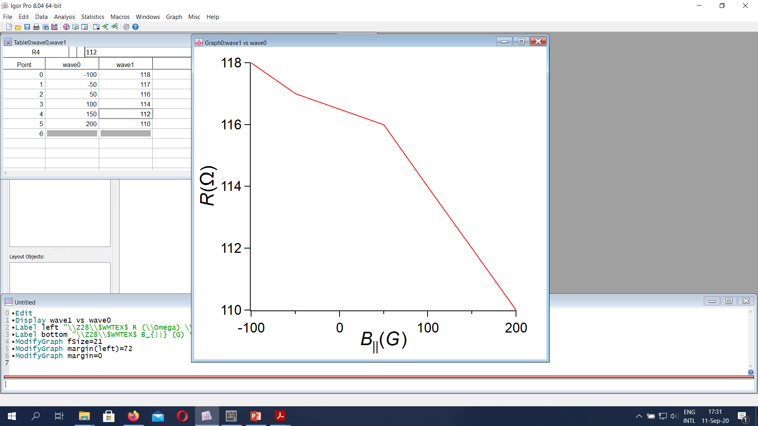
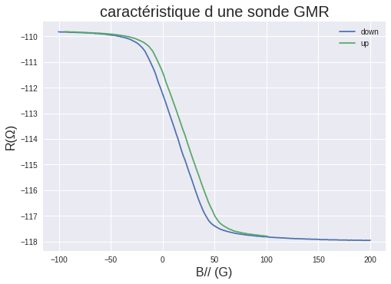
Giant Magnetoresistance Detector
Myriam Pannetier
Claude Fermon
CEA
Stack of hard and soft thin ferromagnetic layers:
only sensitive to in-plane component of the magnetic field
Aligned
layers
Anti-parallel
layers
1
soft
1
2
2
hard
Sensitivity: 0.1 nT for an applied out of plane field of B_{perp}= 0.1 T, 1nT for B_{perp} =1T
Most applications :
Industry, speed control in cars
Biomagnetism , very sensitive NMR

Slide 11
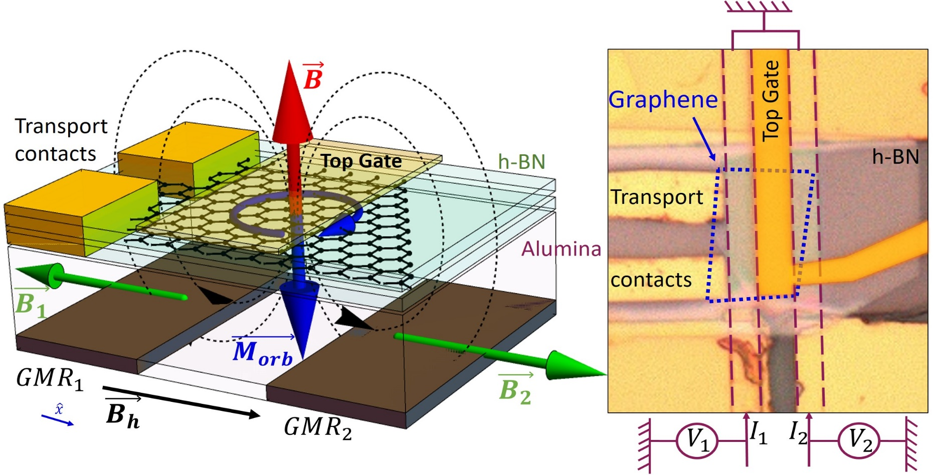
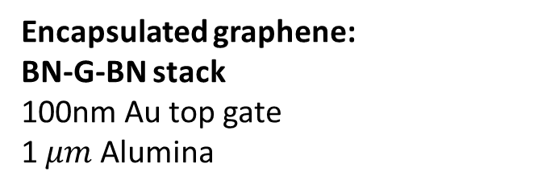

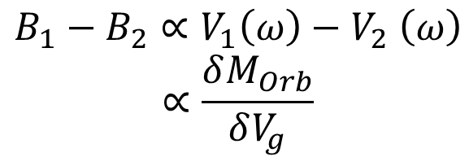
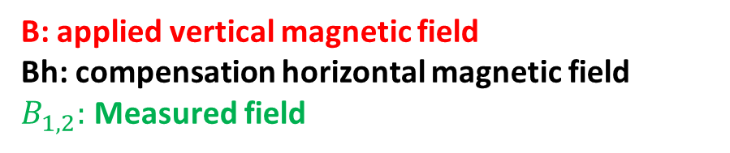
Measuring principle: GMRs and Gate modulation
Sensors: GMRs probes insensitive to perpendicular B. Collaboration: C Fermon et M Pannetier-Lecoeur, CEA
Gate modulation
$V_{g}=V_{DC}+δV_{g}\cos{ωt}$,
Encapsulated graphene:
BN-G-BN stack
100nm Au top gate
1 $μm$ Alumina
$$B_{1}−B_{2}∝V_{1}\left(ω\right)−V_{2} \left(ω\right)$$
$$∝\frac{δM_{Orb}}{δV_{g}}$$
B: applied vertical magnetic field
Bh: compensation horizontal magnetic field
$B_{1,2}:$ Measured field
Vallejo et al. Science 2021

Slide 12
Measuring gate voltage dependent magnetisation in Graphene
B=0.2 T
MC Clure Diamagnetic peak!
Thesis J.Vallejo 2023
Only adjustable parameter amplitude of disorder

Slide 13
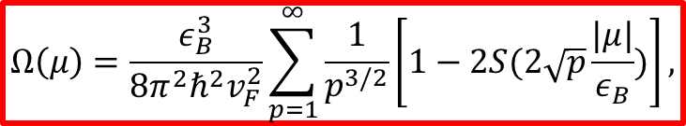


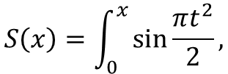
Theoretical interpretation of the data: interplay of disorder and magnetic field
G. Montambaux,
$$Ω\left(μ\right)=\frac{ε_{B}^{3}}{8π^{2}ℏ^{2}v_{F}^{2}}\sum_{p=1}^{∞}{\frac{1}{p^{3/2}}\left[1−2S(2\sqrt{p}\frac{|μ|}{ε_{B}})\right]},$$
$$S\left(x\right)=\int_{0}^{x}{\sin{\frac{πt^{2}}{2}}},$$
Fresnel integral
Gaussian distribution of chemical potential
Standard deviation σ
$$M=−\frac{∂Ω}{∂B}$$
σ=0
σ =0.1 $ε_{B}$

Slide 14
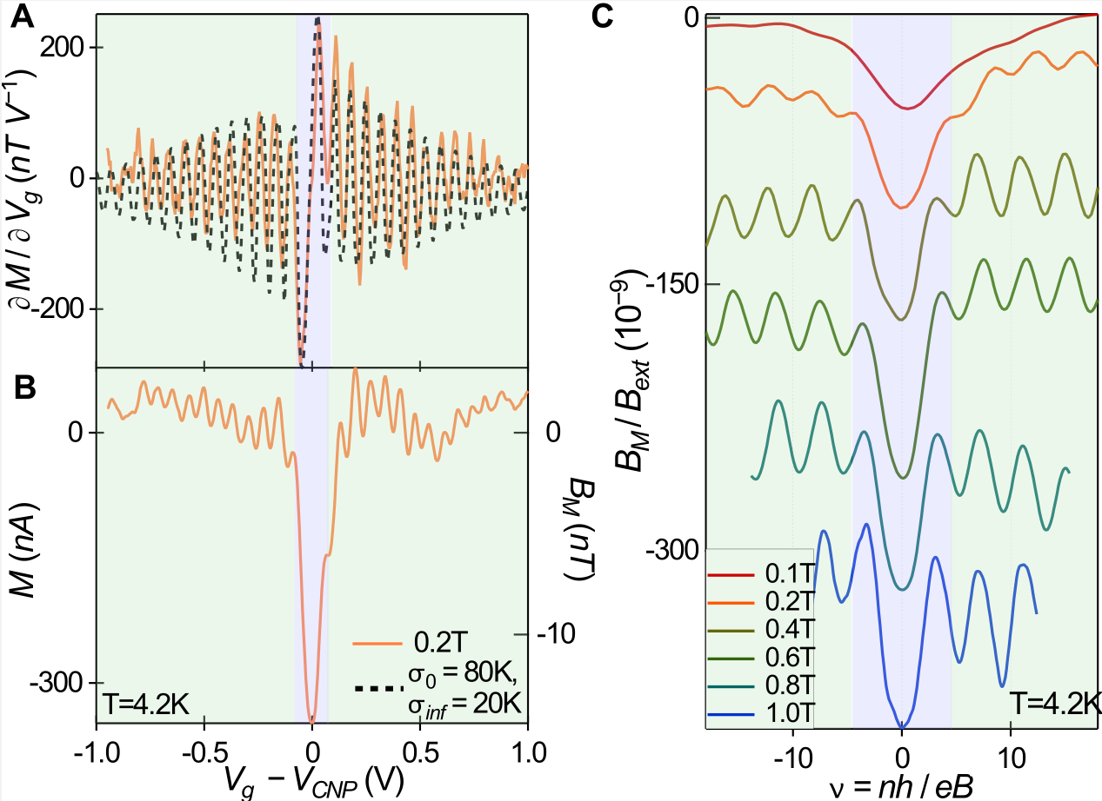
Doping dependent orbital magnetisation in Graphene
M(Vg)
Crossover between
Low field Diamagnetic
MC Clure peak
and dHvA oscillations
-----
G.Montambaux
Diamagnetic
MC Clure peak
M(Vg)

Slide 15
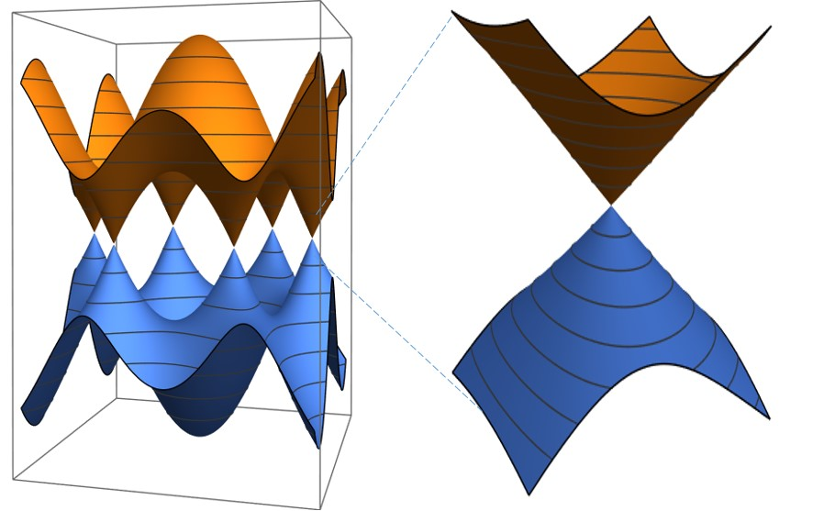
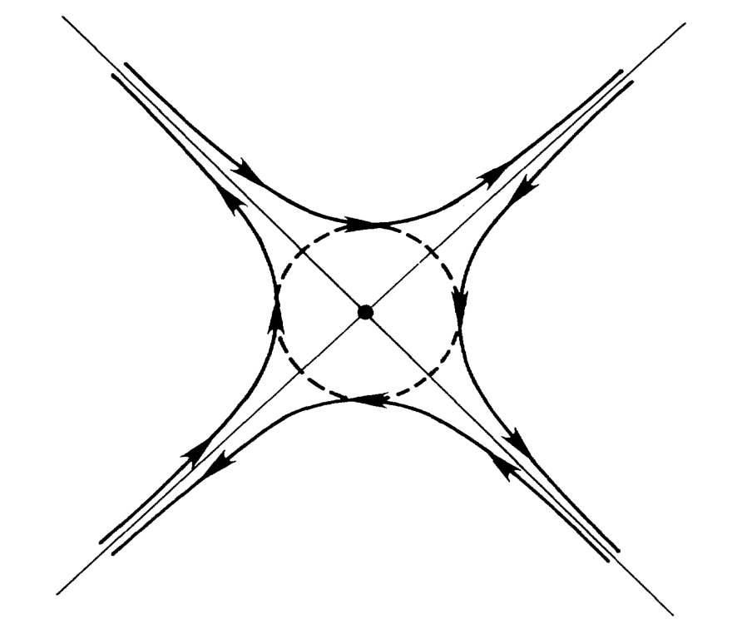
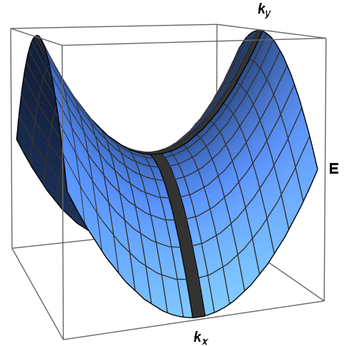
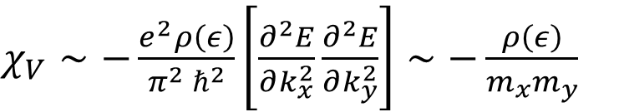
Orbital paramagnetism in 2D crystals
2D lattice: susceptibility is positive and diverges logarithmically near a saddle point in the band structure (vHs)
Near saddle point, hyperbolic open diamagnetic orbits
+ Tunneling
$χ_{V}∼−\frac{e^{2}ρ\left(ε\right)}{{π^{2} ℏ}^{2}}\left[\frac{∂^{2}E}{∂k_{x}^{2}}\frac{∂^{2}E}{∂k_{y}^{2}}\right]∼−\frac{ρ\left(ε\right)}{m_{x}m_{y}}$
Orbital paramagnetism:
Saddle points not accessible in pure graphene….
k space
Vignale PRL 1991
Raoux, et al. PRB. 2015.
Notes:
Eq.

Slide 16
Moiré potentials in Graphene
Super cell moiré lattice parameter
a_{M ~} 10 nm >> a_{g}
depends on the angle
between the 2 lattices

Slide 17
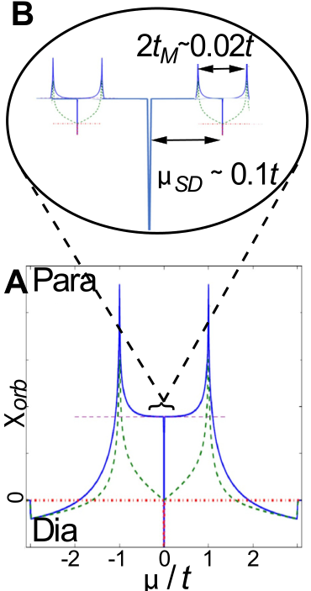
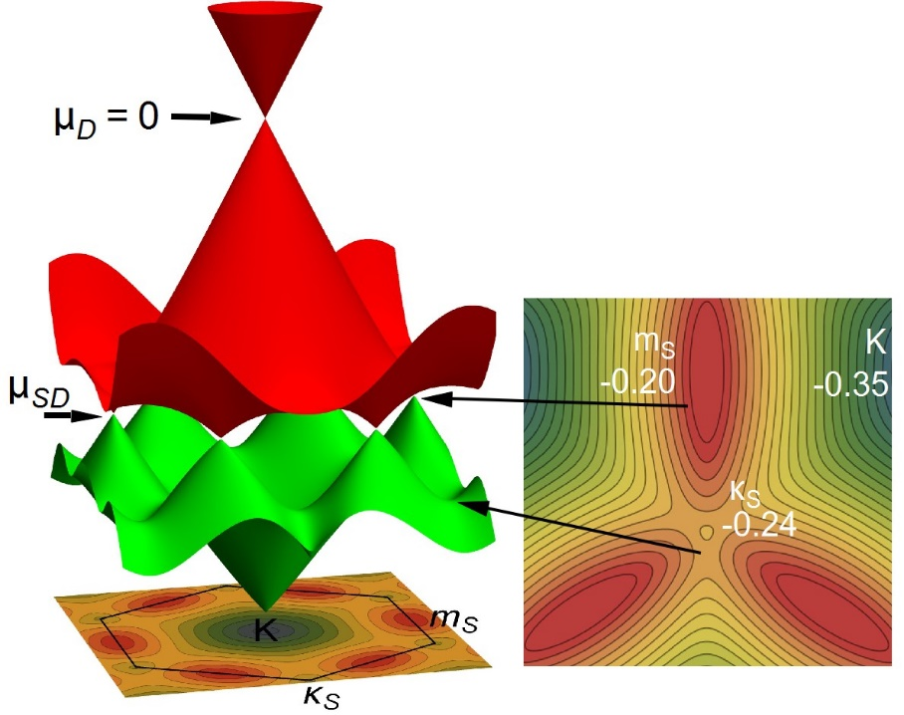

Graphene/BN moiré
Moiré superpotential modifies graphene’s band structure: satellite Dirac peaks
Saddle points appear with van Hove singularities at low energy
Orbital paramagnetism ?
Miniband spectrum
J.N. Fuchs, G.Montambaux, F.Piechon (Vallejo et al. 2023)
$$t∼2.7eV$$
satellite
saddle points

Slide 18
BN / Graphene nearly aligned: gate voltage dependent magnetisation
a_{M}= 9.5 ±0.5 nm
Resistance
Determined by
Raman spectroscopy
R.Ribeiro SPEC
Magnetisation
Paramagnetic peaks!
van Hove log. singularities
at Saddle points
sDP Diamagnetic Satellite Dirac peaks
McClure peak
n₀ Nb of carriers per moiré cell
Diamagnetic and paramagnetic orbital magnetisation
Positions and intensity of singularities can be understood theoretically
J.N. Fuchs, G.Montambaux, F.Piechon (Vallejo et al. 2023)

Slide 19
Miniband spectrum of Graphene with a moiré potential
Inspired from Yankowitz Nature Physics 2011
Mini Brillouin zone of the moiré band ~0.05 BZ graphene
Single parameter moiré potential t_{M}
Electron hole symmetry breaking
depends on the sign of t_{M}
Main Dirac Point
Very rich energy landscape!
- Satellite Dirac points seprated by
- Saddle points
J.N. Fuchs
F. Piechon
J. Vallejo
G. Montambaux

Slide 20
Determination of the moiré potential from the position of diamagnetic and paramagnetic peaks
Electron
bands
Split Dirac points
Asymmettry of paramagnetic peaks
Related to different curvatures at saddle points
Can we understand the relative order of
magnitude of the peaks?
Hole bands
bands

Slide 21
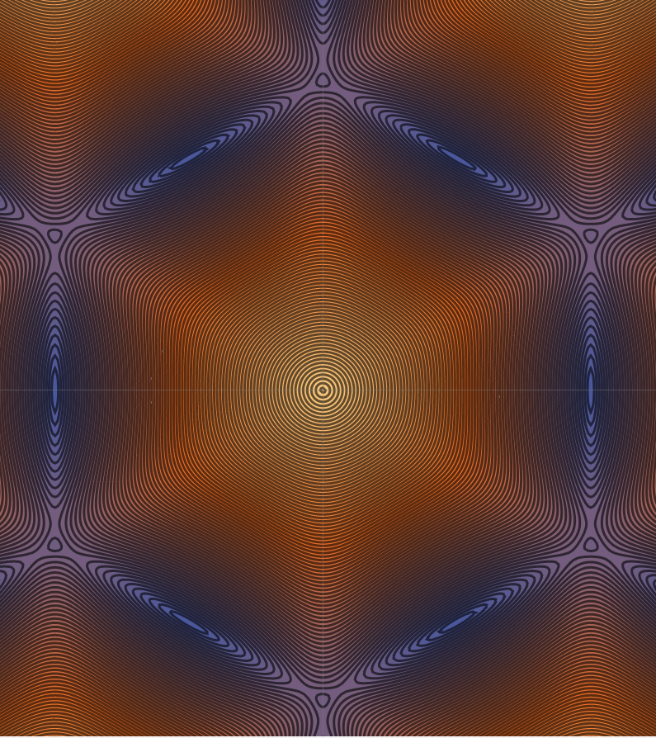
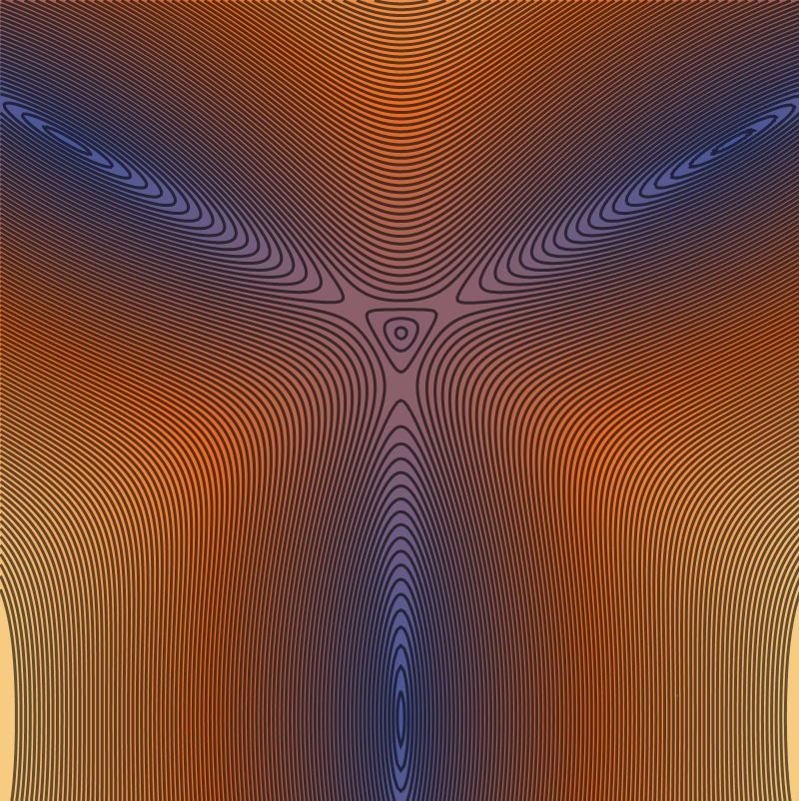
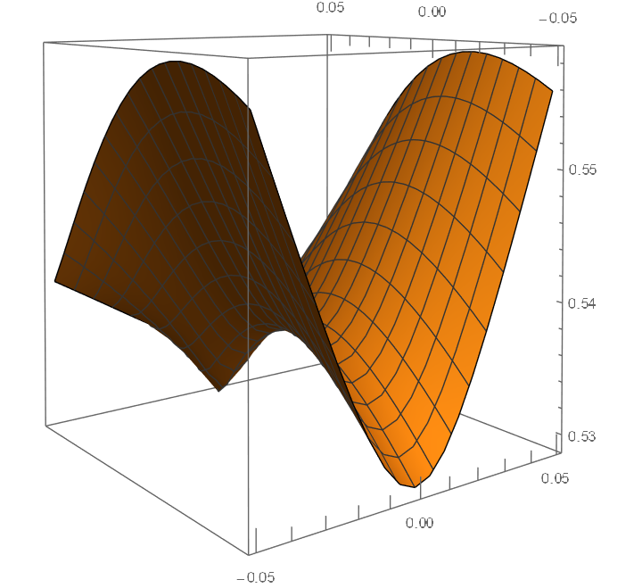
Anisotropic satellite Dirac and saddle points
V_{sx} a_{M} t_{M}/2h < V_{sy} ~ V_{F} (graphene)
$Band E2 tM=−23mev mx=−$0.33 $my= 0.01 me$
Y
m_{S}
x
m_{S}
K_{S}
K_{S}
F. Piechon and J.N. Fuchs

Slide 22
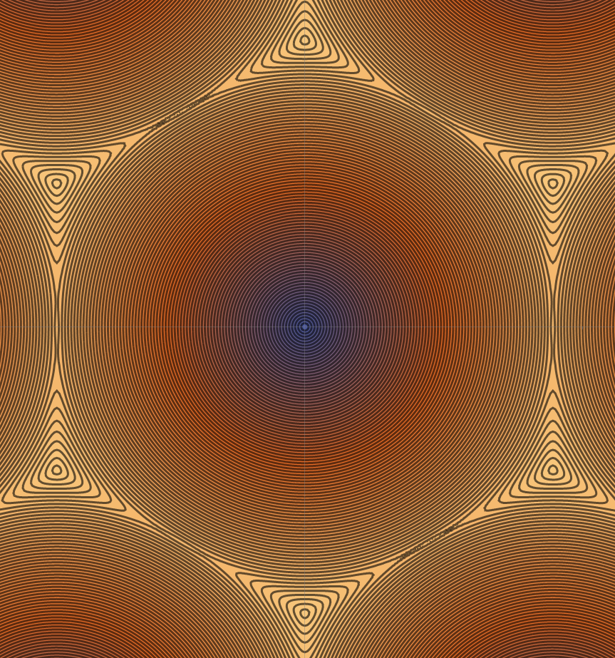
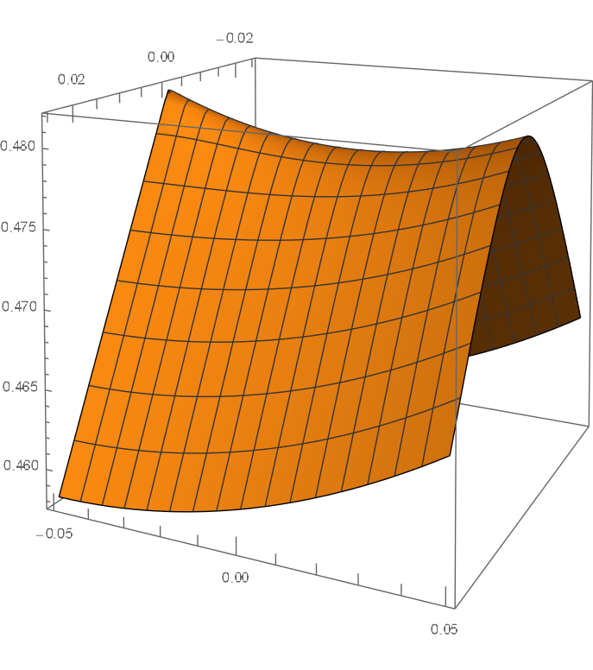
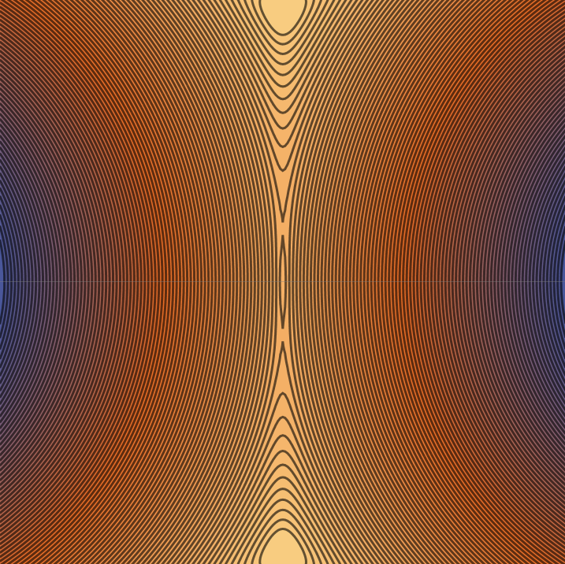

Very anisotropic saddle points for E1 and H1 bands
$Band E1 tM=−23mev mx=$0.015 $m y$
m_{S}
K_{S}
K_{S}
m_{S}
F. Piechon and J.N. Fuchs
Analytical model (m_{y} second order in t_{M})

Slide 23
κ_{S}
m_{S}
κ_{S}
Overlap between diamagnetic peaks at κ_{S} and m_{s} (satellite Dirac points)
and paramagnetic peaks at saddle points between κ_{S} and m_{s}
Energy positions and relative amplitude between peaks depend on the moiré pot. t_{M}
t_{M}=-15meV disorder: σ = 4.5 meV
t_{M}=-23meV
Para
Para
Dia
Dia
Good agreement between theory and experiments

Slide 24
Orbital magnetism in graphene bilayer
0
0
0
Gap opening with transverse electric field
0
0
0
Koshino PRB 2010
Susceptibility maximum in the gap
Paramagnetic peaks on the edge
Δ=0

Slide 25
Orbital magnetism in zero field:
valley Hall effect
Effect of interactions: orbital ferromagnetism
Mesoscopic effects and
edge physics in large supercell moirés:
Analogy with Persistent currents in arrays of Aharonov Bohm rings
Topological insulators
Perspectives
Orbital magnetism in zero field:
valley Hall effect in bi-layers
(Vignale 2021)
Orbital ferromagnetism in twisted bilayers?
Interaction induced valley symmetry breaking
Quantum anomalous Hall effect
Sharpe et al Science 2019
Field hysteresis in transport
Direct investigation of magnetism ?

Slide 26
Orbital magnetism in zero field:
valley Hall effect
Effect of interactions: orbital ferromagnetism
Mesoscopic effects and
edge physics in large supercell moirés:
Analogy with Persistent currents in arrays of Aharonov Bohm rings
Topological insulators
Perspectives
2D Topological insulators
Orbital ballistic currents along 1D phase coherent helical edge states
Expected:
Contribution of ballistic edge states current periodic in flux
amplitude ev_{F}/L
Small aperiodic contribution of diffusive surface states l_{e}/L( eV_{F}/L)
Bi and BiBr flakes
Monolayers of WTe₂
Periodic in flux with:
Φ₀=h/e

Slide 27
Mesoscopic effects and edge physics in large supercell graphene bilayer moirés:
Persistent currents in a network of (normal) ballistic Aharonov Bohm rings
Saw tooth like paramagnetic currents
Role of interactions?
Magnetisation of an ensemble of AB rings
h/2e periodic
<I>
ev_{F}/L
Currents spatial distribution
In a square network
M.Pascaud
G.Montambaux PRL 1999
ballistic
disordered
Φ₀=h/e

Slide 28
Orbital Diamagnetism and Paramagnetism of Graphene
Jorge Vallejo Bustamante, Matthieu Bard, Victor Wu,
Rebeca Ribeiro-Palau, Taro Wakamura, Claude Fermon,
Myriam Pannetier-Lecoeur, Sophie Guéron, Meydi Ferrier,
Richard Deblock, Sandrine Autier Laurent, Vincent Bouchiat,
Gilles Montambaux Jean-Noël Fuchs, Frédéric Piechon, Hélène Bouchiat
LPS CNRS Université Paris-Saclay
C2N, CNRS Université Paris-Saclay
SPEC, CEA, CNRS

Slide 29
Other possible detectors:
Nano SQUIDs: can operate at larger applied magnetic field can measure a single μ_{Β}
Less sensitive in magnetic field μT range δB= δΦ /S _{loop}
NV centers magnetometers: sensitivity
But difficult to operate in the T range δB= 10⁻⁹ T /Hz ^{½}

Slide 30
BN / Graphene nearly aligned: gate voltage dependent magnetisation
Moiré potential
a_{M}= 12.5 ±0.5 nm
Paramagnetic peaks!
1T data out of the linear
response regime
Diamagnetic and paramagnetic orbital magnetisation

Slide 31
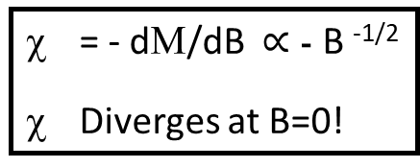


Singular orbital diamagnetic susceptibility in graphene Mc Clure 1956
Massive 2DEG
Landau levels
$$χ={\left.−\frac{∂^{2}Ω}{∂B^{2}}\right|}_{B→0}$$
$Ω=$ Grand potential
$$E_{n}=ℏω\left(n+\frac{1}{2}\right)$$
$$χ_{L}=−\frac{μ_{B}^{2}ρ_{0}}{3}=−\frac{χ_{P}}{3}$$
Low energy Dirac spectrum of Graphene
= - dΜ/dB $∝$ - B ^{-1/2}
Diverges at B=0!
at μ=0 M = - dΩ/dB $∝$ - B ^{1/2}
$$B≠0$$
$$χ_{McC}=−\frac{2e^{2}v_{F}^{2}}{3π}δ(μ)$$
Diverges!
but rounded with disorder
DOS =0 at $B=0$
Raoux A. Thèse, 2017

