Slide 1

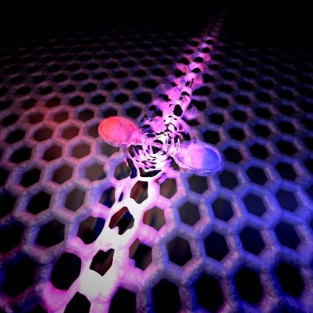
Mesoscopic Klein-Schwinger effect in graphene
Aurélien Schmitt, P. Vallet, D. Mele, M. Rosticher, T. Taniguchi, K. Watanabe, E. Bocquillon, G. Fève, J.M. Berroir, C. Voisin, J. Cayssol, M.O. Goerbig, J. Troost, E. Baudin and B. Plaçais
SFP 2023

Slide 2
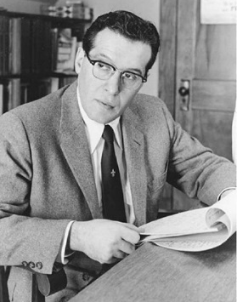
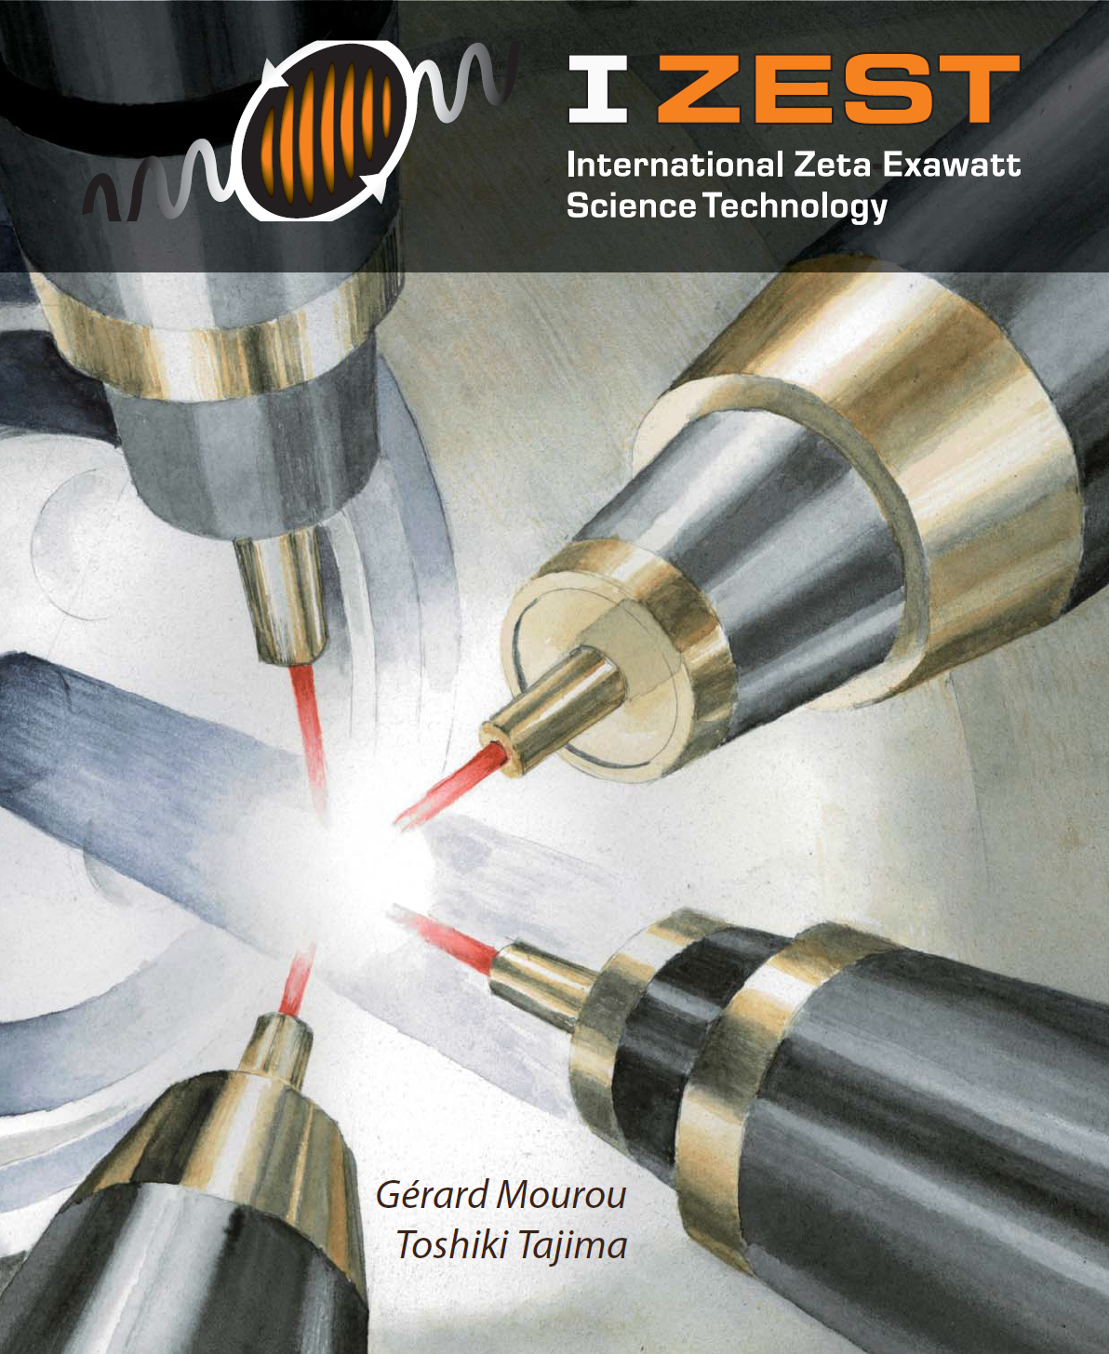
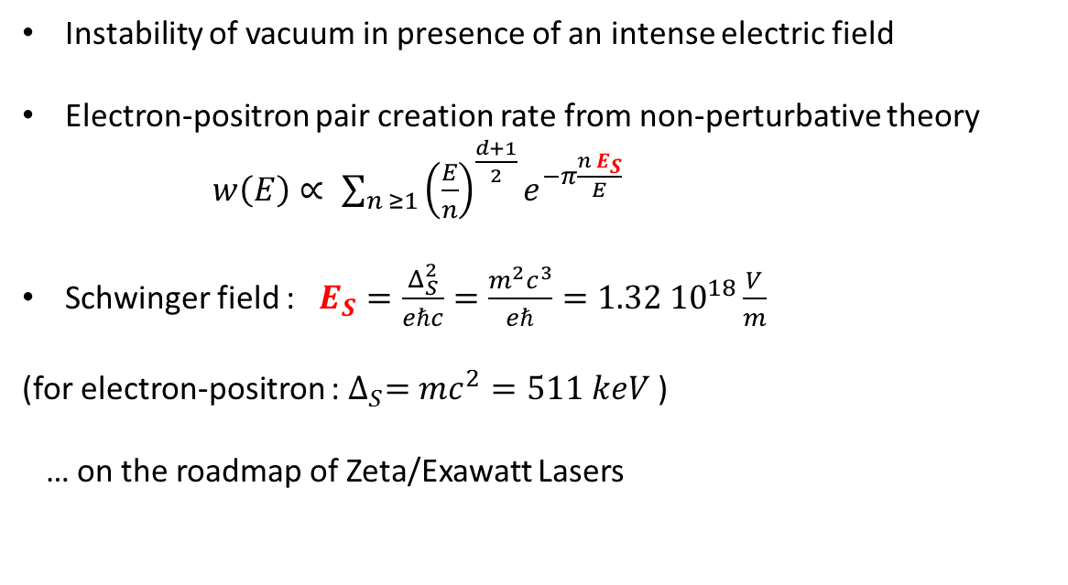
Schwinger effect: breaking vacuum in a high electric-field
Instability of vacuum in presence of an intense electric field
Electron-positron pair creation rate from non-perturbative theory
$w\left(E\right)∝ \sum_{n ≥1}{{\left(\frac{E}{n}\right)}^{\frac{d+1}{2}}e^{−π\frac{n E_{S}}{E}}}$
Schwinger field : $E_{S}=\frac{Δ_{S}^{2}}{eℏc}=\frac{m^{2}c^{3}}{eℏ}=1.32 {10}^{18}\frac{V}{m}$
(for electron-positron : $∆_{S}=mc^{2}=511 keV$ )
… on the roadmap of Zeta/Exawatt Lasers
d : spatial dimension
E : electric field
F. Sauter, Z. Phys. 1931
J. S. Schwinger, PRB 1951
Prefactors in C. Itzykson et J. B. Zuber, Quantum Field Theory, McGraw-Hill (2006)

Slide 3
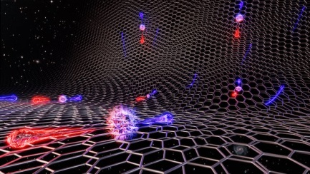
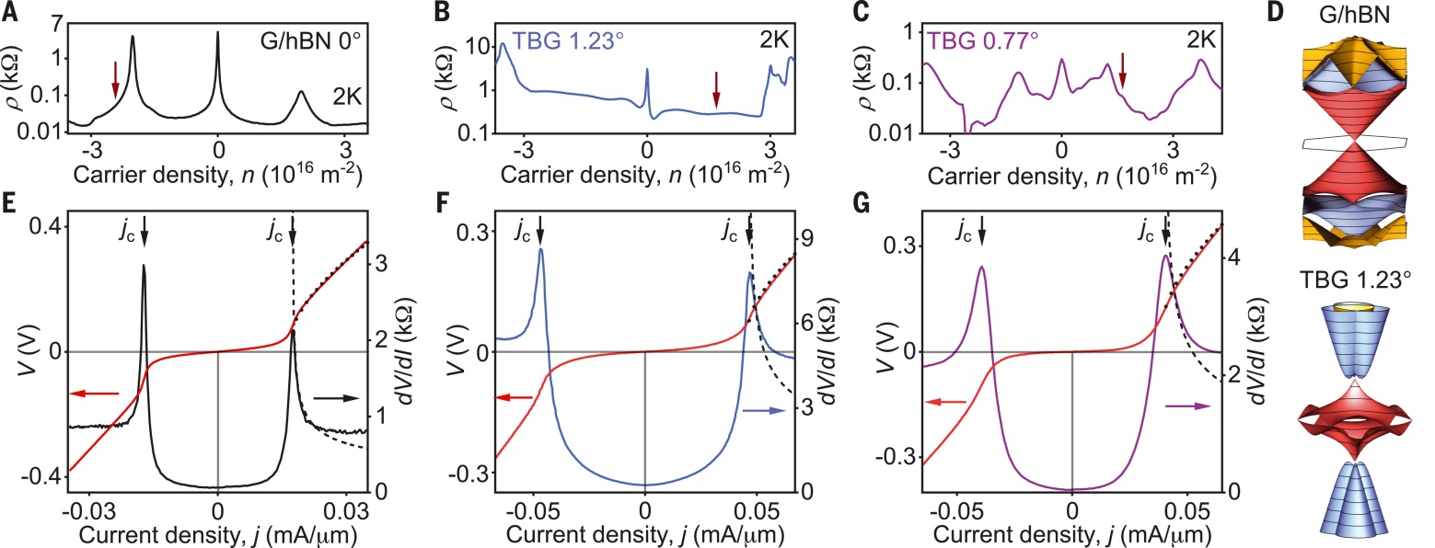
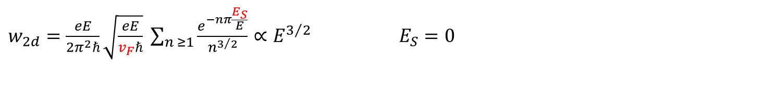
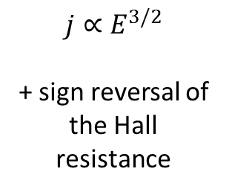
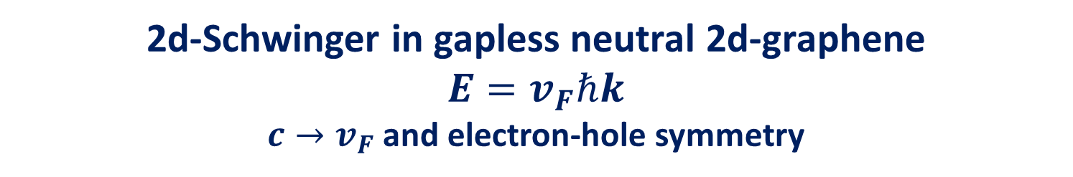
2d-Schwinger in gapless neutral 2d-graphene
$$E=v_{F}ℏk$$
$c→v_{F}$ and electron-hole symmetry
$w_{2d}=\frac{eE}{2π^{2}ℏ}\sqrt{\frac{eE}{v_{F}ℏ}} \sum_{n ≥1}{\frac{e^{−nπ\frac{E_{S}}{E}}}{n^{3/2}}}∝E^{3/2}$ $E_{S}=0$
Dora-Moessner, PRB (2010), Katsnelson-Volovik, ZhETF (2012),...
$$j∝E^{3/2}$$
+ sign reversal of the Hall resistance
Berdyugin, Science (2022)

Slide 4
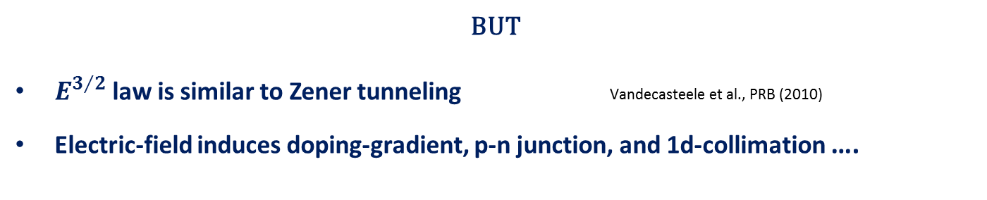
2d-Schwinger in gapless neutral 2d-graphene
$$E=v_{F}ℏk$$
$c→v_{F}$ and electron-hole symmetry
$w_{2d}=\frac{eE}{2π^{2}ℏ}\sqrt{\frac{eE}{v_{F}ℏ}} \sum_{n ≥1}{\frac{e^{−nπ\frac{E_{S}}{E}}}{n^{3/2}}}∝E^{3/2}$ $E_{S}=0$
Dora-Moessner, PRB (2010), Katsnelson-Volovik, ZhETF (2012),...
BUT
$E^{3/2}$law is similar to Zener tunneling Vandecasteele et al., PRB (2010)
Electric-field induces doping-gradient, p-n junction, and 1d-collimation ….

Slide 5
Klein-Schwinger effect

Slide 6


Klein collimation mimics massive 1d-Dirac fermions
Collimating p-n junction massive Dirac fermions
$E=∓\sqrt{{\left(v_{F}{ℏk}_{y}\right)}^{2}+{\left(v_{F}{ℏk}_{x}\right)}^{2}}$ $E=∓\sqrt{{\left(mc^{2}\right)}^{2}+{\left(cℏk\right)}^{2}}$
Long junction $T(k_{y})=e^{−πℏv_{F}k_{y}^{2}/{eE}_{x}}$ $T(k_{C})=e^{−πℏck_{C}^{2}/{eE}_{x}}$
$$2v_{F}{ℏk}_{y}$$
V. V. Cheianov, V. I. Falko, PRB-2006
J. Cayssol, B. Huard, D. Goldhaber-Gordon, PRB-2009
E.B. Sonin, PRB-2009
P.E. Allain, J.N. Fuchs, EPJB-2011
F. Sauter, Z-Phys 1931

Slide 7
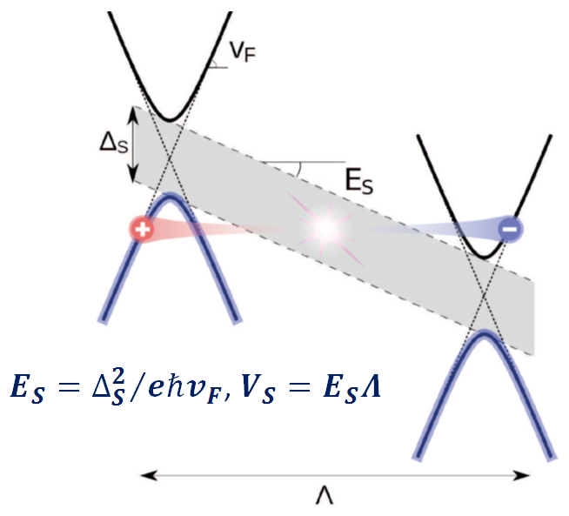

Schwinger effect with massive 1d Dirac fermions in graphene
a universal 1d-Schwinger pair-creation rate
$$w_{1d}=\left(\frac{2e}{h}\right)E\sum_{n ≥1}{\frac{e^{−nπ\frac{E_{S}}{E}}}{n}}$$
$$E_{S}=\frac{Δ_{s}^{2}}{eℏv_{F}}\sim 6 {10}^{7}\frac{V}{m}$$
$for$ $∆_{S}\sim ε_{F}≤0,2eV$

Slide 8
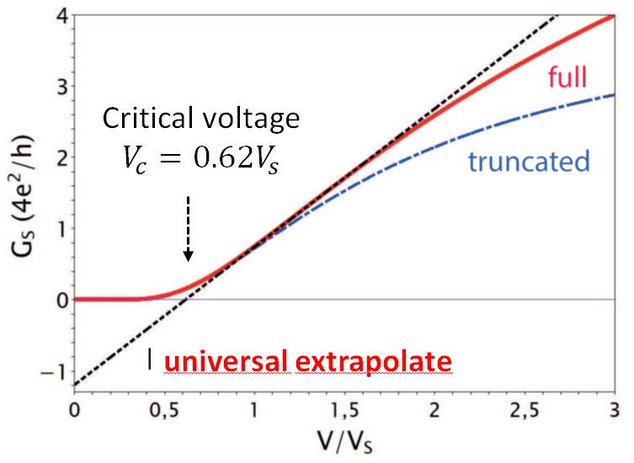
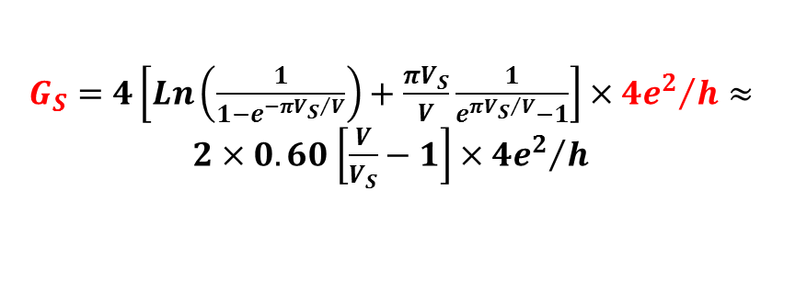

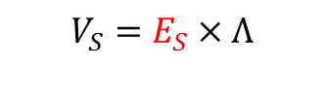
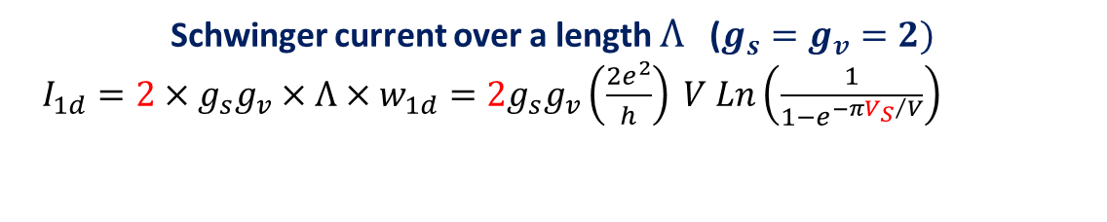
Universal quantized 1d-Schwinger conductance
Schwinger current over a length $Λ$ ($g_{s}=g_{v}=2)$
$I_{1d}=2×g_{s}g_{v}×Λ×w_{1d}=2g_{s}g_{v}\left(\frac{2e^{2}}{h}\right) V Ln\left(\frac{1}{1−e^{−π{V_{S}}/V}}\right)$
$$V_{S}=E_{S}×Λ$$
$G_{S}=4\left[Ln\left(\frac{1}{1−e^{−π{V_{S}}/V}}\right)+\frac{{πV}_{S}}{V}\frac{1}{e^{π{V_{S}}/V}−1}\right]×{4e^{2}}/h≈2×0.60$ $\left[\frac{V}{V_{S}}−1\right]×{4e^{2}}/h$
$$G_{0}=−0.186 mS$$

Slide 9
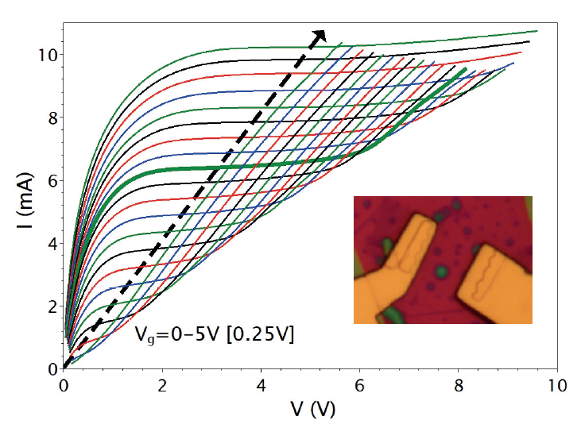
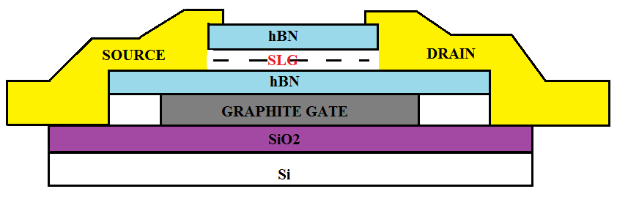
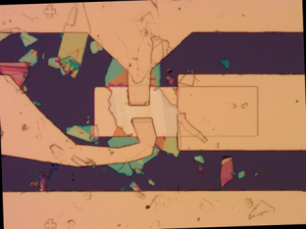
Current saturation in hBN-encapsulated graphene FET

Slide 10
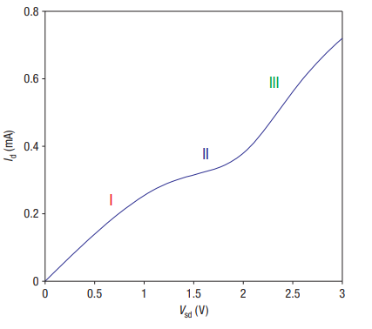



Current saturation in hBN-encapsulated graphene FET
Diffusive graphene
Meric et al. Nature Nanotechnology 3, 654–659 (2008)

Slide 11
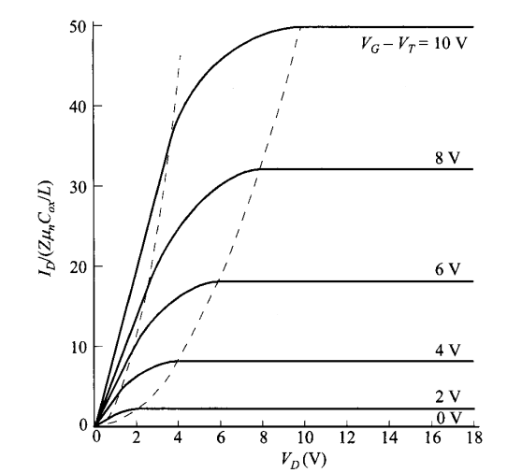
Current saturation in hBN-encapsulated graphene FET
Si MOSFET (Sze, 2006)
reminiscent of MOSFET pinchoff (carrier depletion at the drain side), albeit semimetallic

Slide 12
From current to differential conductance

Slide 13
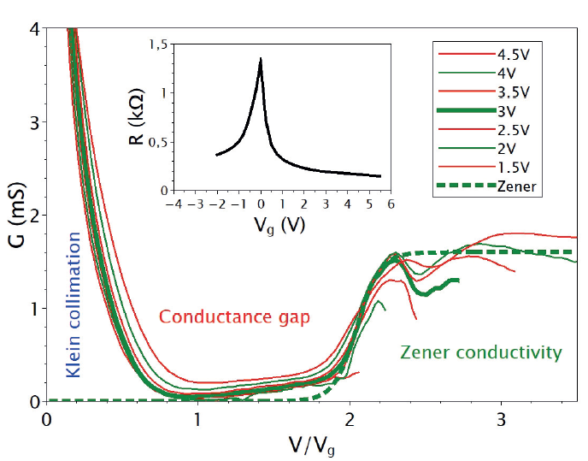
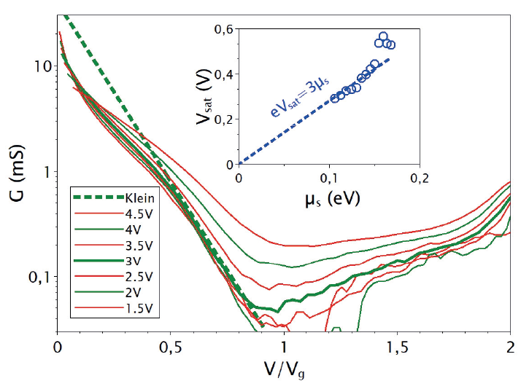
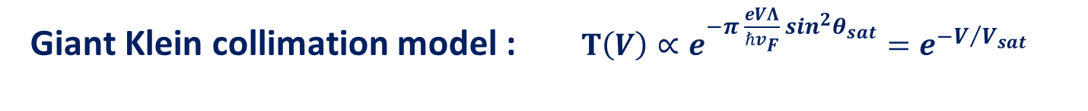
Vanishing Klein-tunneling conductance $G_{K}≈G(0)e^{−V/{V_{sat}}}$
Giant Klein collimation model : $T\left(V\right)∝e^{−π \frac{eVΛ}{ℏv_{F}} \sin^{2}θ_{sat}}=e^{−V/{V_{sat}}}$

Slide 14
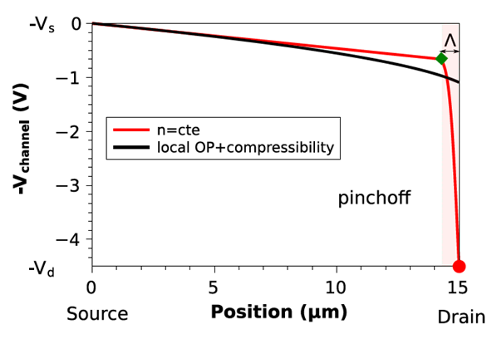

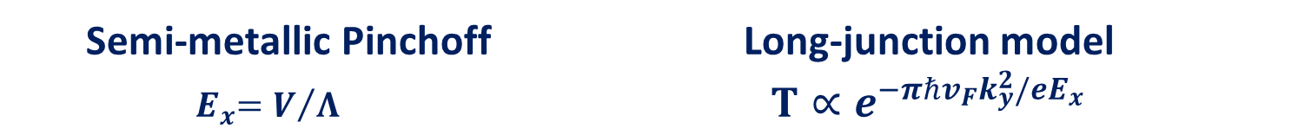


Toy-model of the Klein-collimation junction
Semi-metallic Pinchoff Long-junction model
${ E}_{x}=V/Λ$ $T∝e^{−πℏv_{F}k_{y}^{2}/{eE}_{x}}$
L
$$µ_{s}$$
$$eV≫µ_{s}$$
$$Λ<1 µm$$

Slide 15
noise signatures of Klein collimation

Slide 16
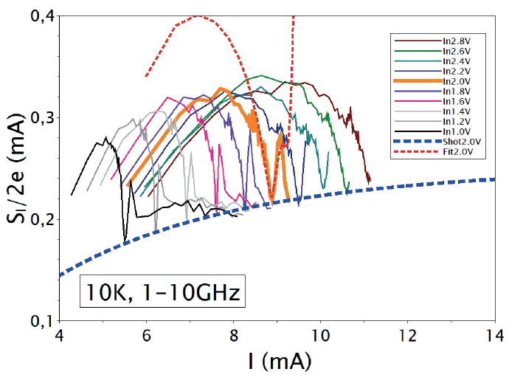
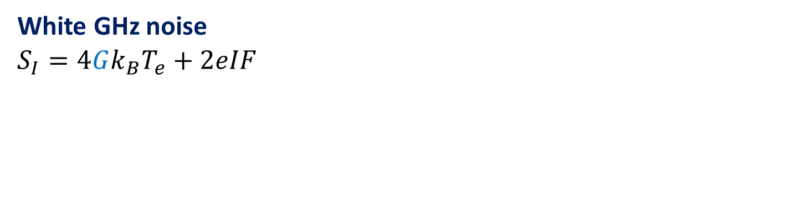
Klein tunneling junction : shot-noise
White GHz noise
$$S_{I}=4Gk_{B}T_{e}+2eIF$$

Slide 17

Klein tunneling junction : shot-noise
White GHz noise
$$S_{I}=4Gk_{B}T_{e}+2eIF$$
Sweet noise dip
$G→0$, $S_{th.}→0$
Shot-noise limited
$S_{I}(V_{dip})≈$ $2eIF$

Slide 18

Klein tunneling junction : shot-noise
White GHz noise
$$S_{I}=4Gk_{B}T_{e}+2eIF$$
Sweet noise dip
$G→0$, $S_{th.}→0$
Shot-noise limited
$S_{I}(V_{dip})≈$ $2eIF$
Mesoscopic junction with a Fano factor $F≤0.04$

Slide 19
Universal 1d Schwinger effect

Slide 20
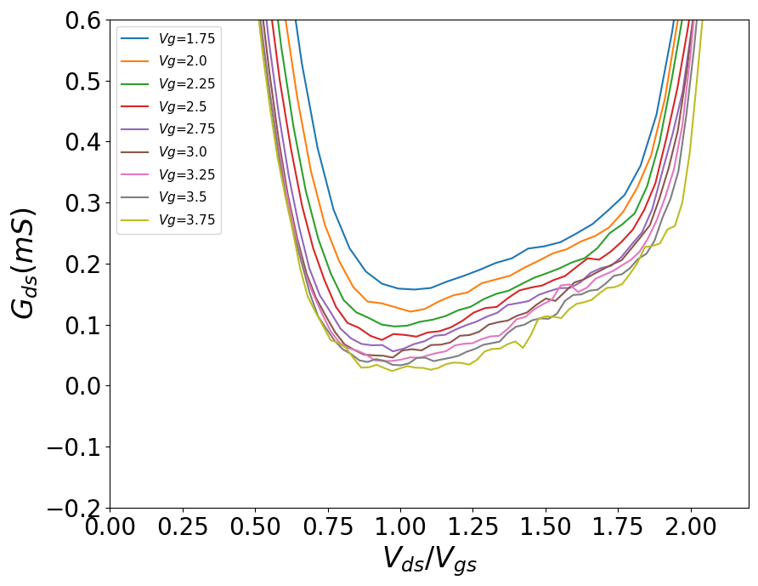
Evidence of mesoscopic Klein-Schwinger effect

Slide 21
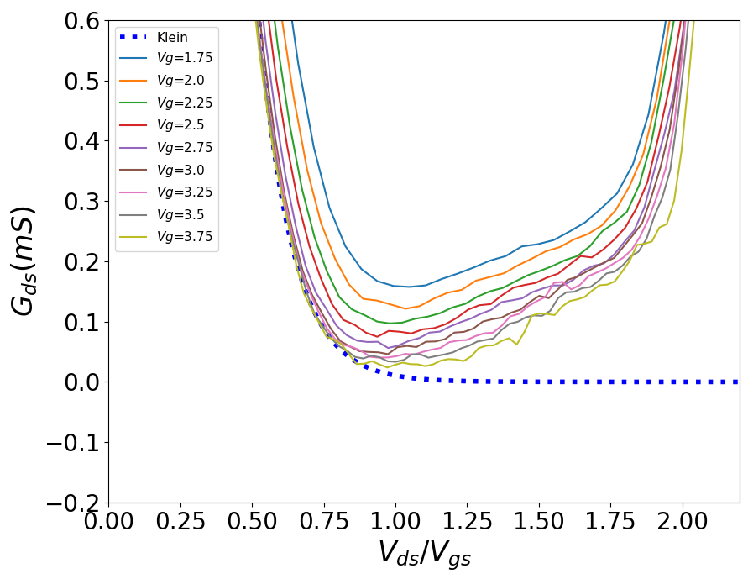
Evidence of mesoscopic Klein-Schwinger effect

Slide 22
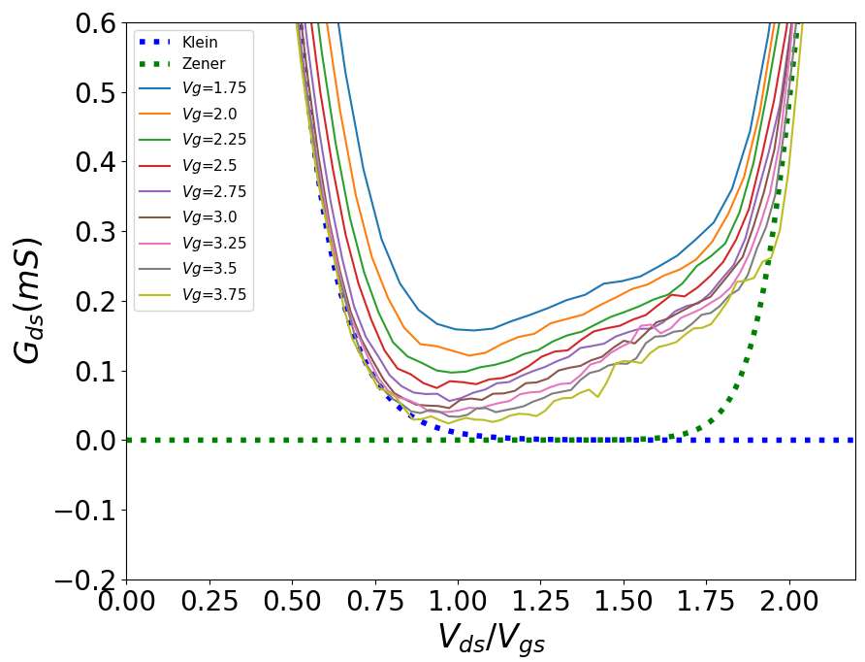
Evidence of mesoscopic Klein-Schwinger effect

Slide 23
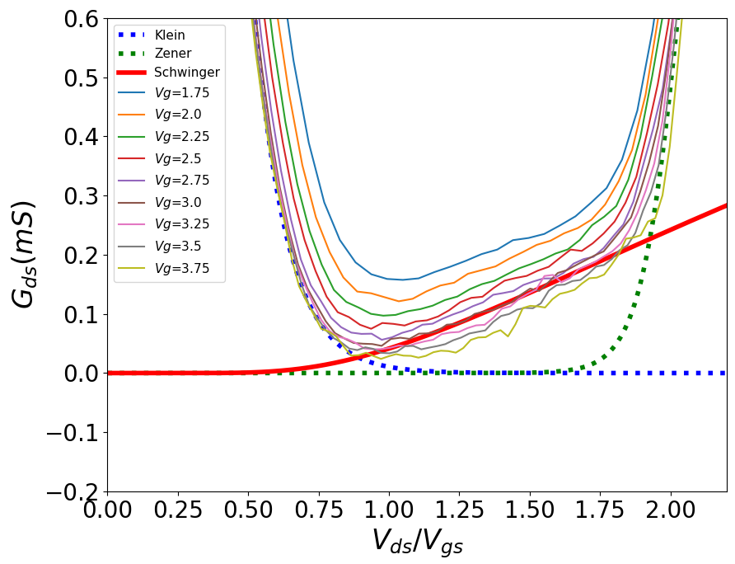

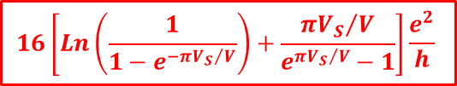
Evidence of mesoscopic Klein-Schwinger effect
$G≈$ $G_{S}\left(V\right)$
$$16\left[Ln\left(\frac{1}{1−e^{−π{V_{S}}/V}}\right)+\frac{{{πV}_{S}}/V}{e^{π{V_{S}}/V}−1}\right]\frac{e^{2}}{h}$$

Slide 24
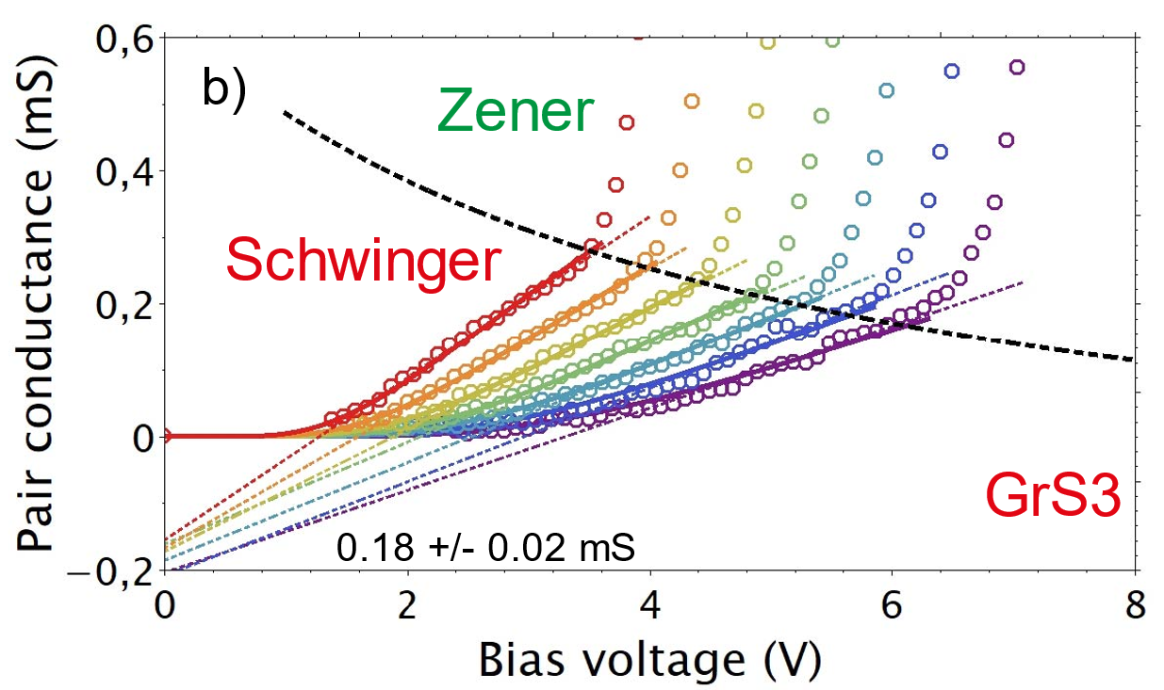
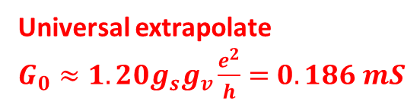
Universal 1d-Schwinger scaling: $G_{S}\left(V\right)=G−G(0)e^{−V/{V_{sat}}}$
Universal extrapolate
$G_{0}≈1.20g_{s}g_{v}\frac{e^{2}}{h}=$ $0.186 mS$
One parameter : Schwinger voltage $V_{S}$

Slide 25
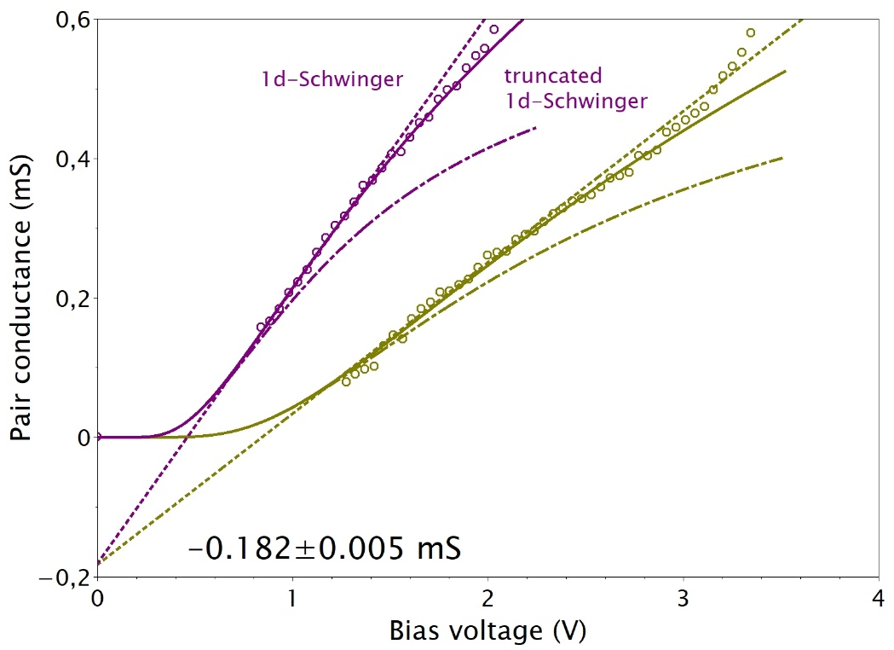

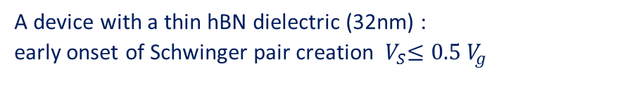
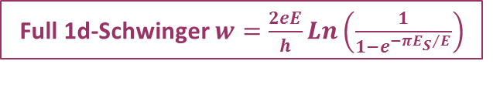

The N-loop Schwinger prediction verified in detail
A device with a thin hBN dielectric (32nm) :
early onset of Schwinger pair creation ${ V}_{S}≤0.5 V_{g}$
Full 1d-Schwinger $w=\frac{2eE}{h}Ln\left(\frac{1}{1−e^{−π{E_{S}}/E}}\right)$
truncated rate
$$w=\left(\frac{2e}{h}\right)Ee^{−π\frac{E_{S}}{E}}$$
an important result for field theory

Slide 26
Schwinger gap and length

Slide 27


Klein-collimation origin of the Schwinger gap
$$E=∓\sqrt{{\left(v_{F}{ℏk}_{y}\right)}^{2}+{\left(v_{F}{ℏk}_{x}\right)}^{2}}$$
$$∆_{S}=2v_{F}{ℏk}_{S}$$
Why finite-$k_{S}$ Schwinger pairs ?

Slide 28

Pauli-blocking of low-$k_{y}$ by collimated transmitted carriers
Collimated saturation current
$$µ_{s}$$
$$eV≫µ_{s}$$
$$Λ<1 µm$$
A$nsatz$: Schwinger-pairs created at a finite $k_{y}$with $∆_{S}\sim μ_{s}$

Slide 29
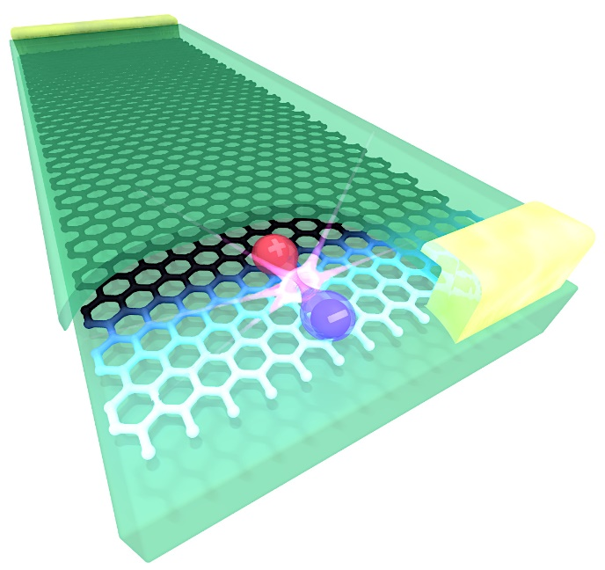
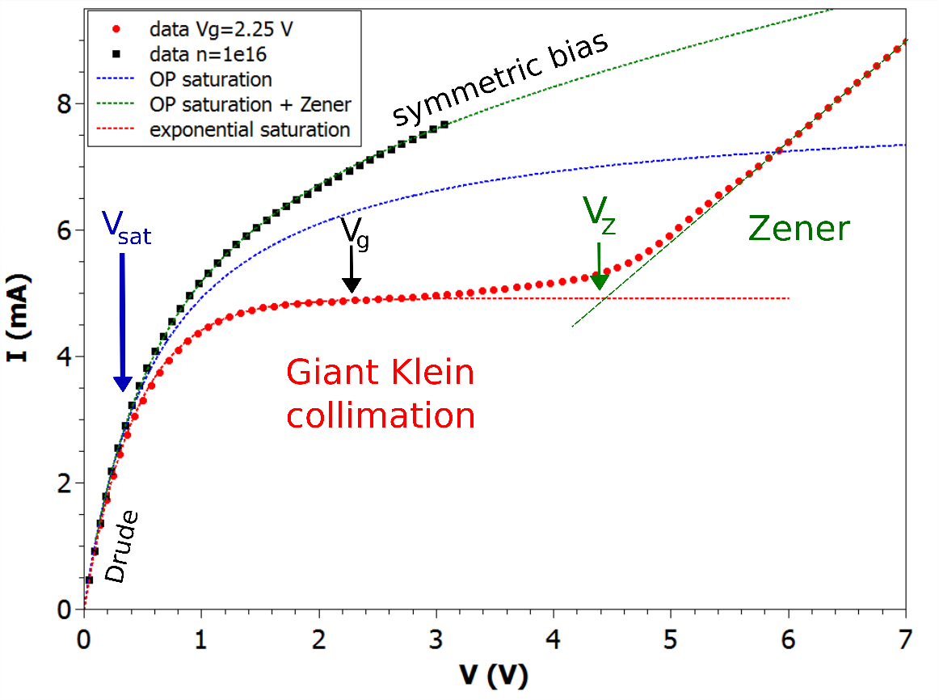
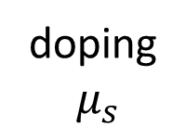


Schwinger as the intrinsic breakdown of Klein collimation
$$L≫Λ$$
doping
$μ_{s}$
Klein-tunneling
Schwinger-pair current
$$Λ$$
vacuum

Slide 30
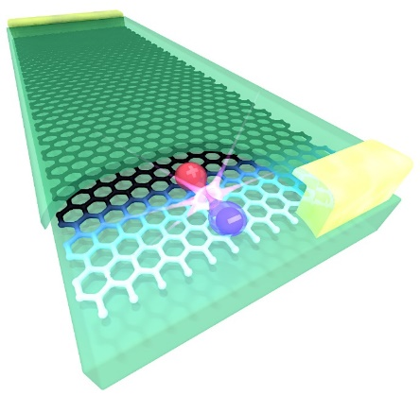


« QED in a pencil trace » $→$ « QED in a graphene mosfet »
Experimental observation of 1d-Schwinger effect
Schwinger is the breakdown of Klein collimation
Outlook: lifting spin/valley degeneracy ?
Outlook: Full counting statistics ? Vacuum polarization ?
A. Schmitt et al., Nat. Phys. 19, 830–835 (2023)
N&V R.K. Kumar 19, 768–769 (2023)
$$L≫Λ$$
Dirac matter
accelerator
$$Λ$$
vacuum

Slide 31
« QED in a pencil trace » $→$ « QED in a graphene mosfet »
Thank you !
A. Schmitt et al., Nat. Phys. 19, 830–835 (2023)
N&V R.K. Kumar 19, 768–769 (2023)

Slide 32
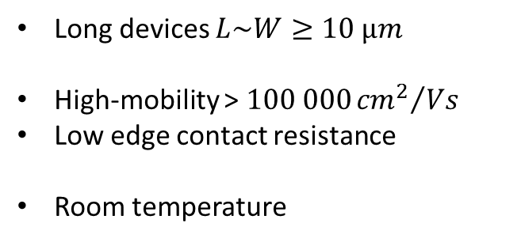
Current saturation in hBN-encapsulated graphene FET
Long devices $L\sim W≥10 µm$
High-mobility > $100 000{{cm}^{2}}/{Vs}$
Low edge contact resistance
Room temperature

Slide 33

Saturation controlled by a « Klein collimation junction »
bulk OP + Zener
bulk OP saturation
exponential Klein tunneling saturation
$$V_{Z}∝LV_{g}$$
Exponential saturation is extrinsically limited by a Zener instability

Slide 34
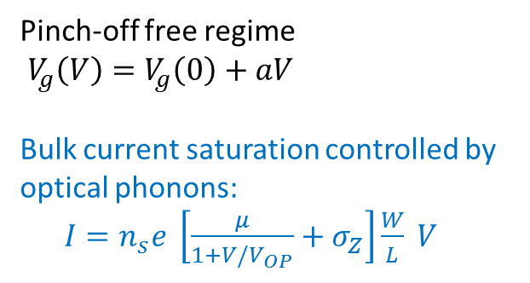
Saturation controlled by a « Klein collimation junction »
Pinch-off free regime
$V_{g}\left(V\right)=V_{g}\left(0\right)+aV$
Bulk current saturation controlled by optical phonons:
$I=n_{s}e \left[\frac{μ}{1+V/V_{OP}}+σ_{Z}\right]\frac{W}{L} V$

Slide 35
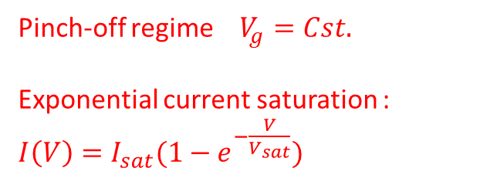
Saturation controlled by a « Klein collimation junction »
Pinch-off regime $V_{g}=Cst.$
Exponential current saturation : $I\left(V\right)=I_{sat}(1−e^{−\frac{V}{V_{sat}}})$

Slide 36
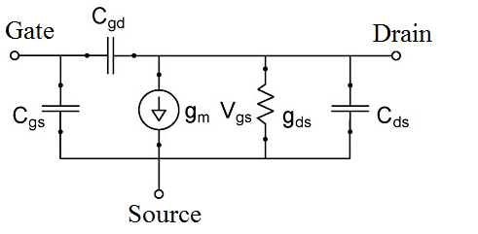

Pinchoff regime : RF measurements
Small-signal equivalent circuit
(cf Sze, 2006)
SOURCE
DRAIN
GATE

Slide 37


Pinchoff regime : RF measurements
Pinchoff region
Small-signal equivalent circuit
$$V_{g}=4V$$
(cf Sze, 2006)
SOURCE
DRAIN
GATE

Slide 38







Toy-model of the Klein-collimation junction
Pinchoff-free case : velocity saturation (OPs) + electronic compressibility + doping gradients in the presence of a local gate
Current density :
$$J=μ\left(E\right)n ∂_{x}μ_{c}^{∗}$$
$μ(0)$ : low-bias mobility
$E_{OP}$ : saturation field
w
$$μ\left(E\right)=μ(0)/(1+\frac{\left|E\right|}{E_{OP}})$$
where
$$μ_{c}^{∗}=μ_{c}\left(x\right)−e V_{c}(x)$$
(electrochemical potential)
For monolayer graphene on a local gate :
$$μ_{c}^{∗} −μ_{g}^{∗}=ℏv_{F}\sqrt{πn}+\frac{e^{2}}{C_{g}}n$$
$v_{F}$ : Fermi velocity
$C_{g}$ : areal gate capacitance
$n\left(x\right)$ : carrier density
$μ_{g}^{∗}$: electrochemical potential of the gate
+ electrostatics :
$$V_{c}\left(x\right)−V_{g}=\frac{−e}{C_{g}}n(x)$$

Slide 39


Toy-model of the Klein-collimation junction
Pinchoff-free case : velocity saturation (OPs) + electronic compressibility + doping gradients in the presence of a local gate
Pinchoff case : constant density in the channel → constant $μ_{c}^{∗}$ and uniform $E$
$$J=−\frac{μ\left(0\right)}{1+\frac{\left|∂_{x}V_{c}\right|}{E_{OP}}}n ∂_{x}V_{c}$$

Slide 40

Toy-model of the semi-metallic pinchoff
Local drift-diffusion model : velocity saturation + electronic compressibility + doping gradients with a local gate
Estimate of the voltage drop in the channel / in the pinchoff junction

Slide 41





Zener instability : flicker-noise
Klein collimation field
$$\frac{V}{Λ}≥{10}^{7} V/m$$
Bulk Zener field
$$\frac{V}{L}≤{10}^{5} V/m$$
$$V_{Z}∝LV_{g}$$
Zener instability is pushed to large
$V_{Z}≈2V_{g}$ in long ($L≥10 µm$) devices
A huge noise signals the destruction of the collimation junction

Slide 42






Evidence of mesoscopic Klein-Schwinger effect
$G≈$ $G_{S}\left(V\right)$
$$16\left[Ln\left(\frac{1}{1−e^{−π{V_{S}}/V}}\right)+\frac{{{πV}_{S}}/V}{e^{π{V_{S}}/V}−1}\right]\frac{e^{2}}{h}$$
$$V_{g}=3V :$$
$$V_{S}$$
$$V_{S}=4.2V$$
and
$$Λ∼t_{hBN}$$
$$E_{S}\sim 5. {10}^{7}V/m$$
,
$$Δ_{S}∼0.2eV∼μ_{S}$$

Slide 43
Evidence of mesoscopic Klein-Schwinger effect
$G≈$ $G_{S}\left(V\right)$
$$16\left[Ln\left(\frac{1}{1−e^{−π{V_{S}}/V}}\right)+\frac{{{πV}_{S}}/V}{e^{π{V_{S}}/V}−1}\right]\frac{e^{2}}{h}$$
$$V_{g}=3V :$$
$$V_{S}$$
$$V_{S}=4.2V$$
and
$$Λ∼t_{hBN}$$
$$E_{S}\sim 5. {10}^{7}V/m$$
,
$$Δ_{S}∼0.2eV∼μ_{S}$$
but obscured by Klein tunneling at low doping : $G=$ $G_{S}\left(V\right)+$ $G_{K}\left(V\right)$

Slide 44

Varied I-V according to hBN thickness / geometry ….
GrS1-25nm (L/W=0.75) GrS2-35nm (L/W=0.7) GrS3-42nm (L/W=1.5)
AuS1-34nm (L/W=0.75) AuS2-33nm (L/W=1.5) AuS3-90nm (L/W=1)

Slide 45


Same 1d-Schwinger scaling in various geometry !
GrS1-25nm (L/W=0.75) GrS2-35nm (L/W=0.7) GrS3-42nm (L/W=1.5)
AuS1-34nm (L/W=0.75) AuS2-33nm (L/W=1.5) AuS3-90nm (L/W=1)

Slide 46



The non-perturbative Schwinger prediction verified in detail
A device with a thin hBN dielectric (32nm)
Early onset of Schwinger pair creation ${ V}_{S}≤0.5 V_{g}$

Slide 47
The non-perturbative Schwinger prediction verified in detail
an important result for field theory

Slide 48
Measured $V_{S}(V_{g})$dependence
GrS1-25nm (L/W=0.75) GrS2-35nm (L/W=0.7) GrS3-42nm (L/W=1.5)
AuS1-34nm (L/W=0.75) AuS2-33nm (L/W=1.5) AuS3-90nm (L/W=1)

Slide 49

Length of the Klein collimation junction
interactions
electrostatics

Slide 50
Length of the Klein collimation junction
interactions
electrostatics
$$Λ≈2.8\frac{V_{S}}{V_{g}}t_{hBN}≈\left(1−2\right)t_{hBN}+\left(4 nm\right)×n_{s}t_{hBN}^{2}=(1−6)t_{hBN}$$
NB: $\frac{Λ(n_{s},t_{hBN})}{t_{hBN}}=\frac{{V_{S}}/{E_{S}}}{{V_{g}}/{E_{hBN}}}=4α_{g}\frac{V_{S}}{V_{g}}{\left(\frac{μ_{s}}{∆_{S}}\right)}^{2}≈2.8\frac{V_{S}}{V_{g}}$ with $α_{g}=\frac{e^{2}}{4πε_{0}ε_{hBN}ℏv_{F}}=0.70$

Slide 51
Length of the Klein collimation junction
interactions
electrostatics
$$Λ≈2.8\frac{V_{S}}{V_{g}}t_{hBN}≈\left(1−2\right)t_{hBN}+\left(4 nm\right)×n_{s}t_{hBN}^{2}=(1−6)t_{hBN}$$
The $∆_{S}≈μ_{s}$ ansatz gives consistent Klein-junction lengths

