Slide 1
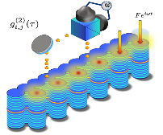
Measuring the topological properties of exciton-polariton lattices
Polariton quantum fluids at C2N
05/07/2023
Martin Guillot – 3rd year Ph.D.
Supervisors: Jacqueline Bloch and Sylvain Ravets
C2N – 10 Boulevard Thomas Gobert, 91120 Palaiseau / www.c2n.universite-paris-saclay.fr
ARQADIA

Slide 2
I. The valley Hall effect
Polariton quantum fluids at C2N
C2N – 10 Boulevard Thomas Gobert, 91120 Palaiseau / www.c2n.universite-paris-saclay.fr
ARQADIA

Slide 3
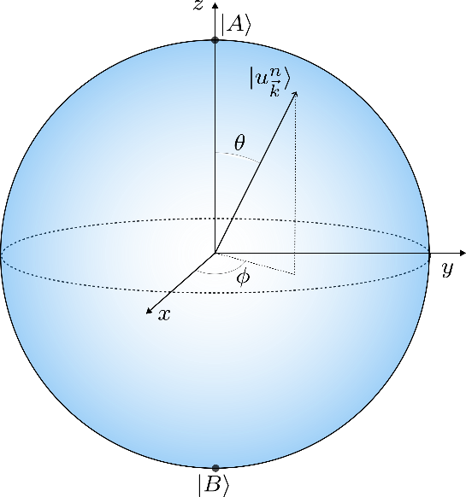
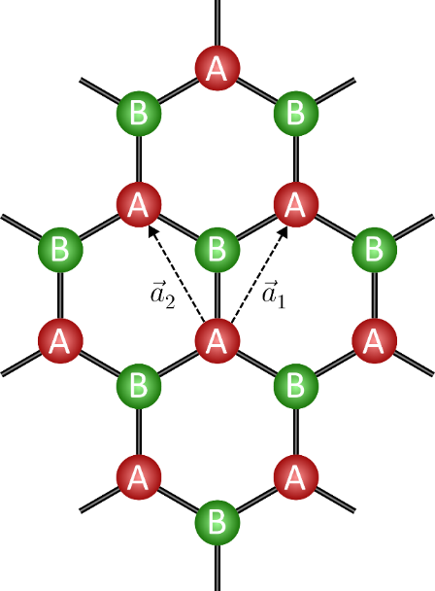
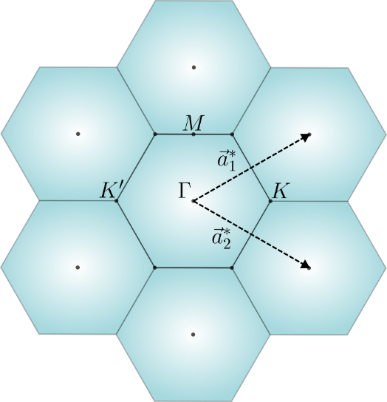
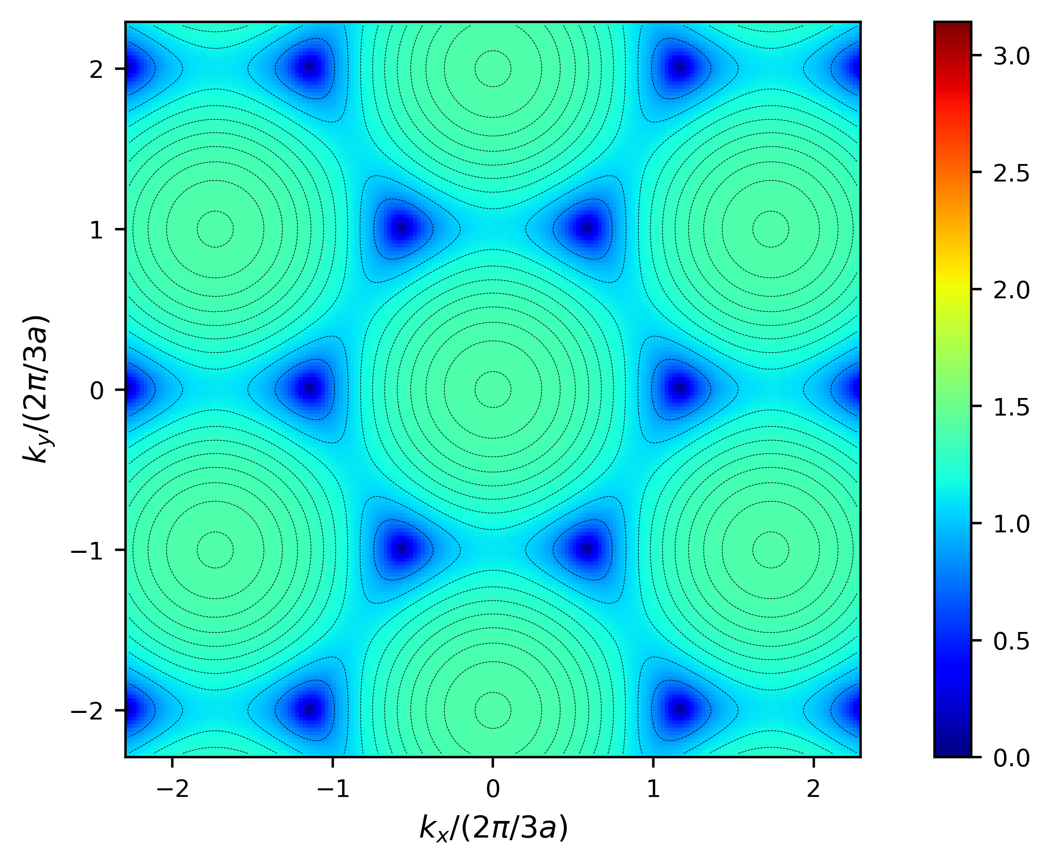
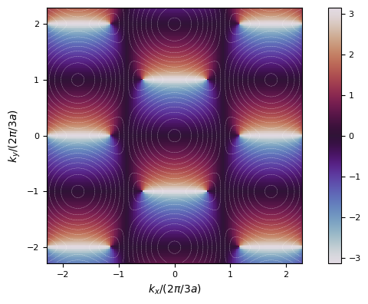
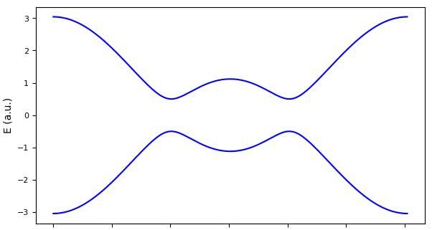
The staggered honeycomb lattice
$$θ$$
$$φ$$
Topological Origin of Zero-Energy Edge States in Particle-Hole Symmetric Systems
Shinsei Ryu and Yasuhiro Hatsugai
Phys. Rev. Lett. 89, 077002
$$Γ$$
$$K$$
$$M$$
$$K′$$
$$Γ$$

Slide 4
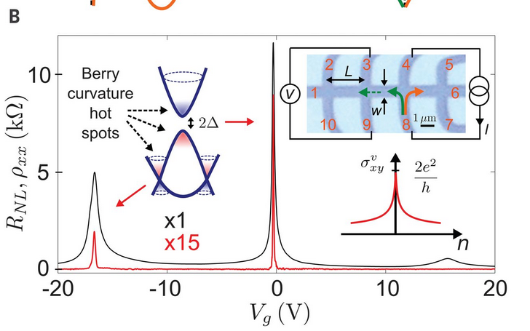
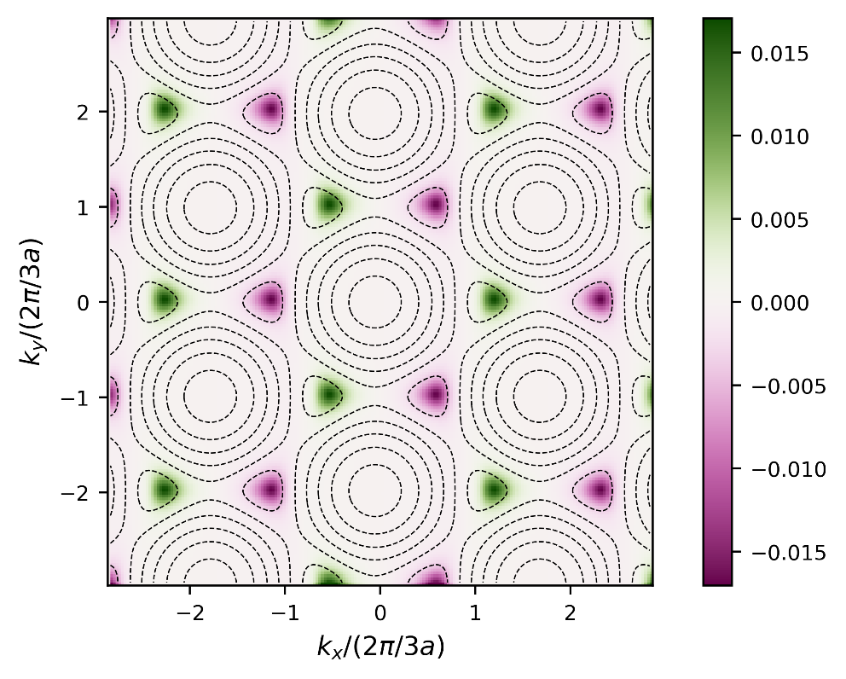
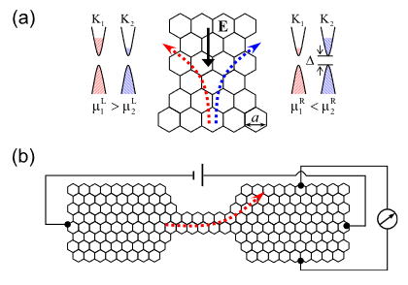
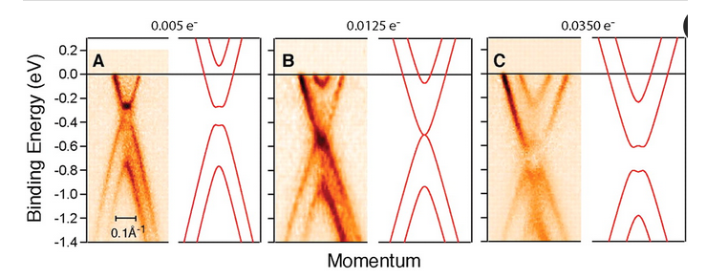
The valley Hall effect in condensed matter
Valley-Hall current measurements
Berry curvature
Theoretical proposals
R. V. Gorbachev et al., Detecting topological currents in graphene superlattices.
Science 346, 448-451 (2014)
Band imaging
Di Xiao, et al., Valley-Contrasting Physics in Graphene: Magnetic Moment and Topological Transport.
Phys. Rev. Lett. 99, 236809 (2007).
Rycerz, A., Tworzydło, J. & Beenakker, C. Valley filter and valley valve in graphene.
Nature Phys 3, 172–175 (2007).
Taisuke Ohta et al., Controlling the Electronic Structure of Bilayer Graphene.
Science 313, 951-954 (2006).

Slide 5
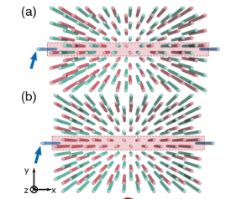
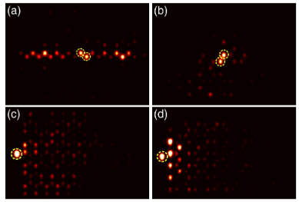
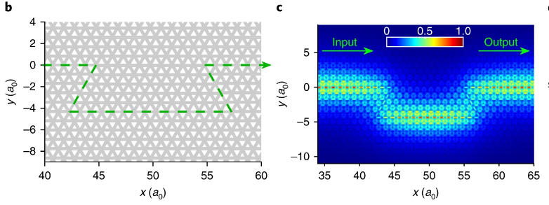
Photonic valley Hall insulators
In coupled waveguide arrays
In photonic crystals
Shalaev, M.I., Walasik, W., Tsukernik, A. et al. Robust topologically protected transport in photonic crystals at telecommunication wavelengths.
Nature Nanotech 14, 31–34 (2019).
Jiho Noh, et al., Observation of Photonic Topological Valley Hall Edge States.
Phys. Rev. Lett. 120, 063902 (2018)
Can we get to the eigenvector structure ?

Slide 6
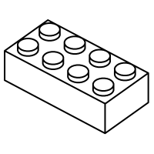
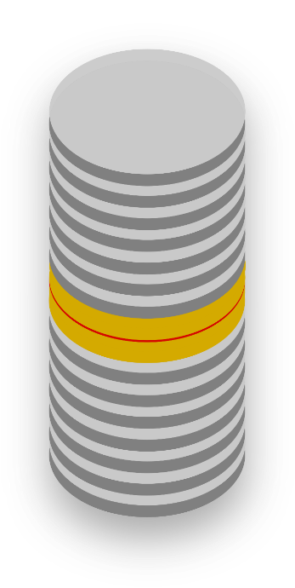
Engineering the photonic wavefunction
Experimental setup
Our bricks: Semiconductor micropillars
DBR
Cavity
Active material
“p”
1472
DBR
Energy (meV)
V_{eff}
“s”
1470
E₁
E₀
4 µm
2 µm
x
SEM
x

Slide 7
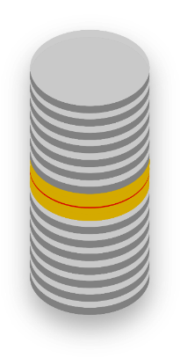
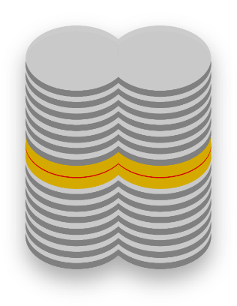
Engineering the photonic wavefunction
Coupling the bricks
2 µm
1472
Energy (meV)
1470
Galbiati et al., PRL 108, 126403 (2012)
4 µm
x
x

Slide 8
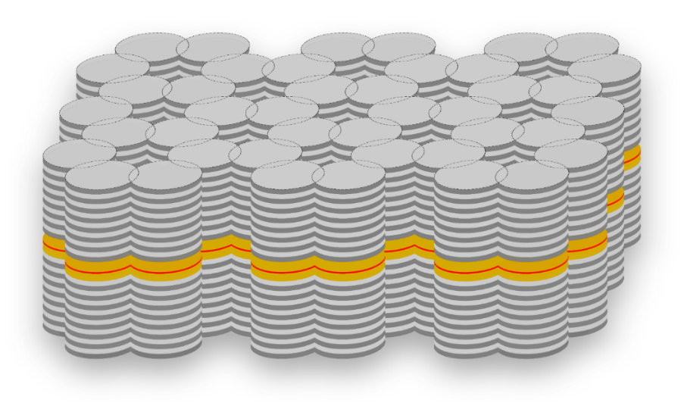
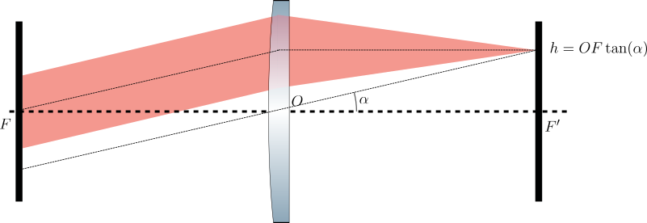
Engineering the photonic wavefunction
... And finally lattices
Optical Fourier transform: Imaging reciprocal space

Slide 9
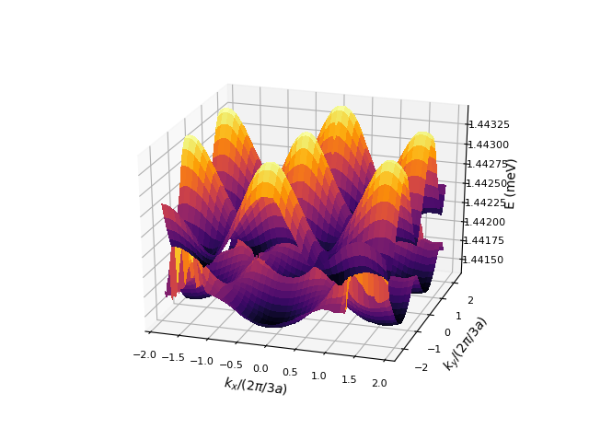
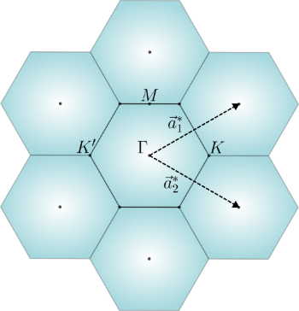
Engineering the photonic wavefunction
... And finally lattices

Slide 10
II. Valley Hall insulator in exciton-polaritons lattices
Polariton quantum fluids at C2N
How to probe the eigenvector structure of a polaritonic platform ?
C2N – 10 Boulevard Thomas Gobert, 91120 Palaiseau / www.c2n.universite-paris-saclay.fr
ARQADIA

Slide 11
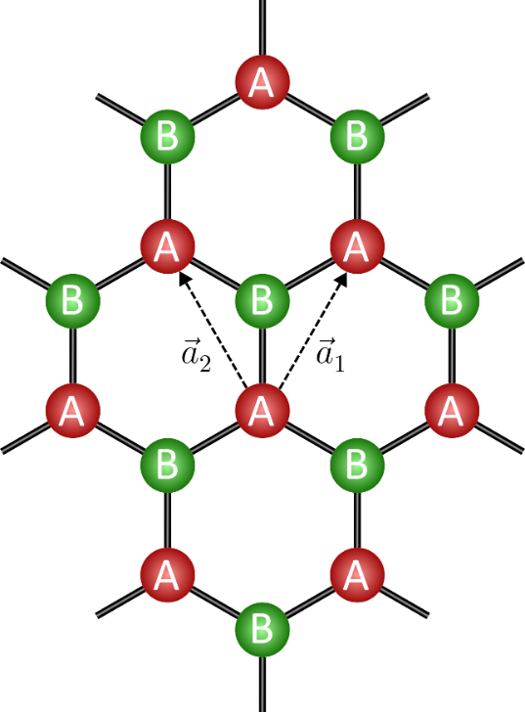
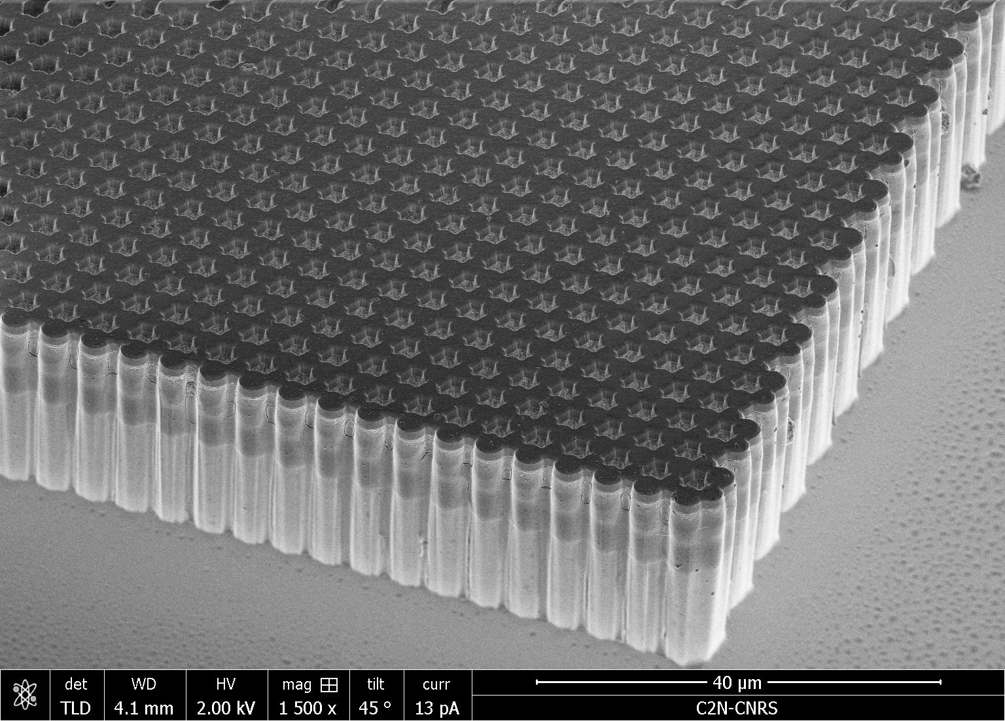
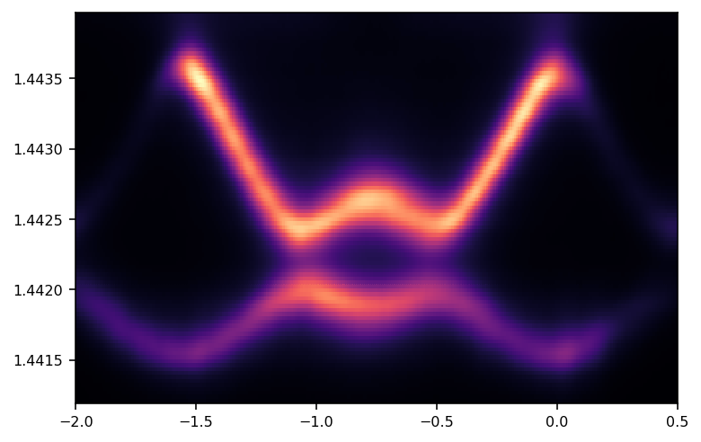
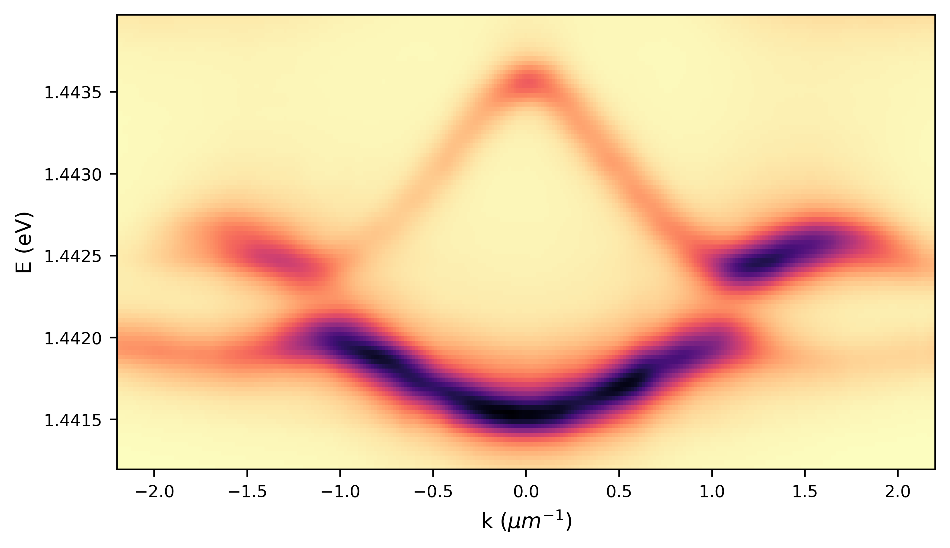
Polariton honeycomb lattices
The bloch’s eigenvectors are encoded in a sublattice pseudospin:

Slide 12
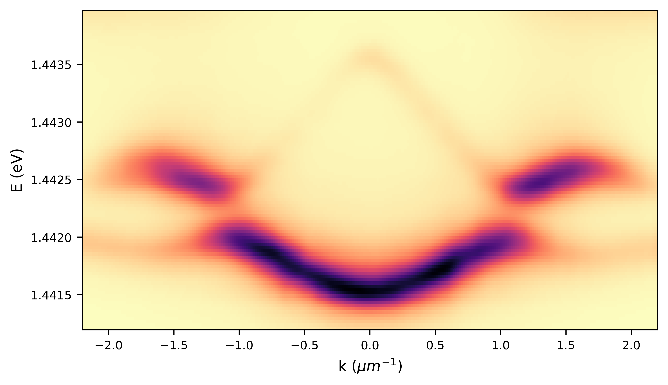
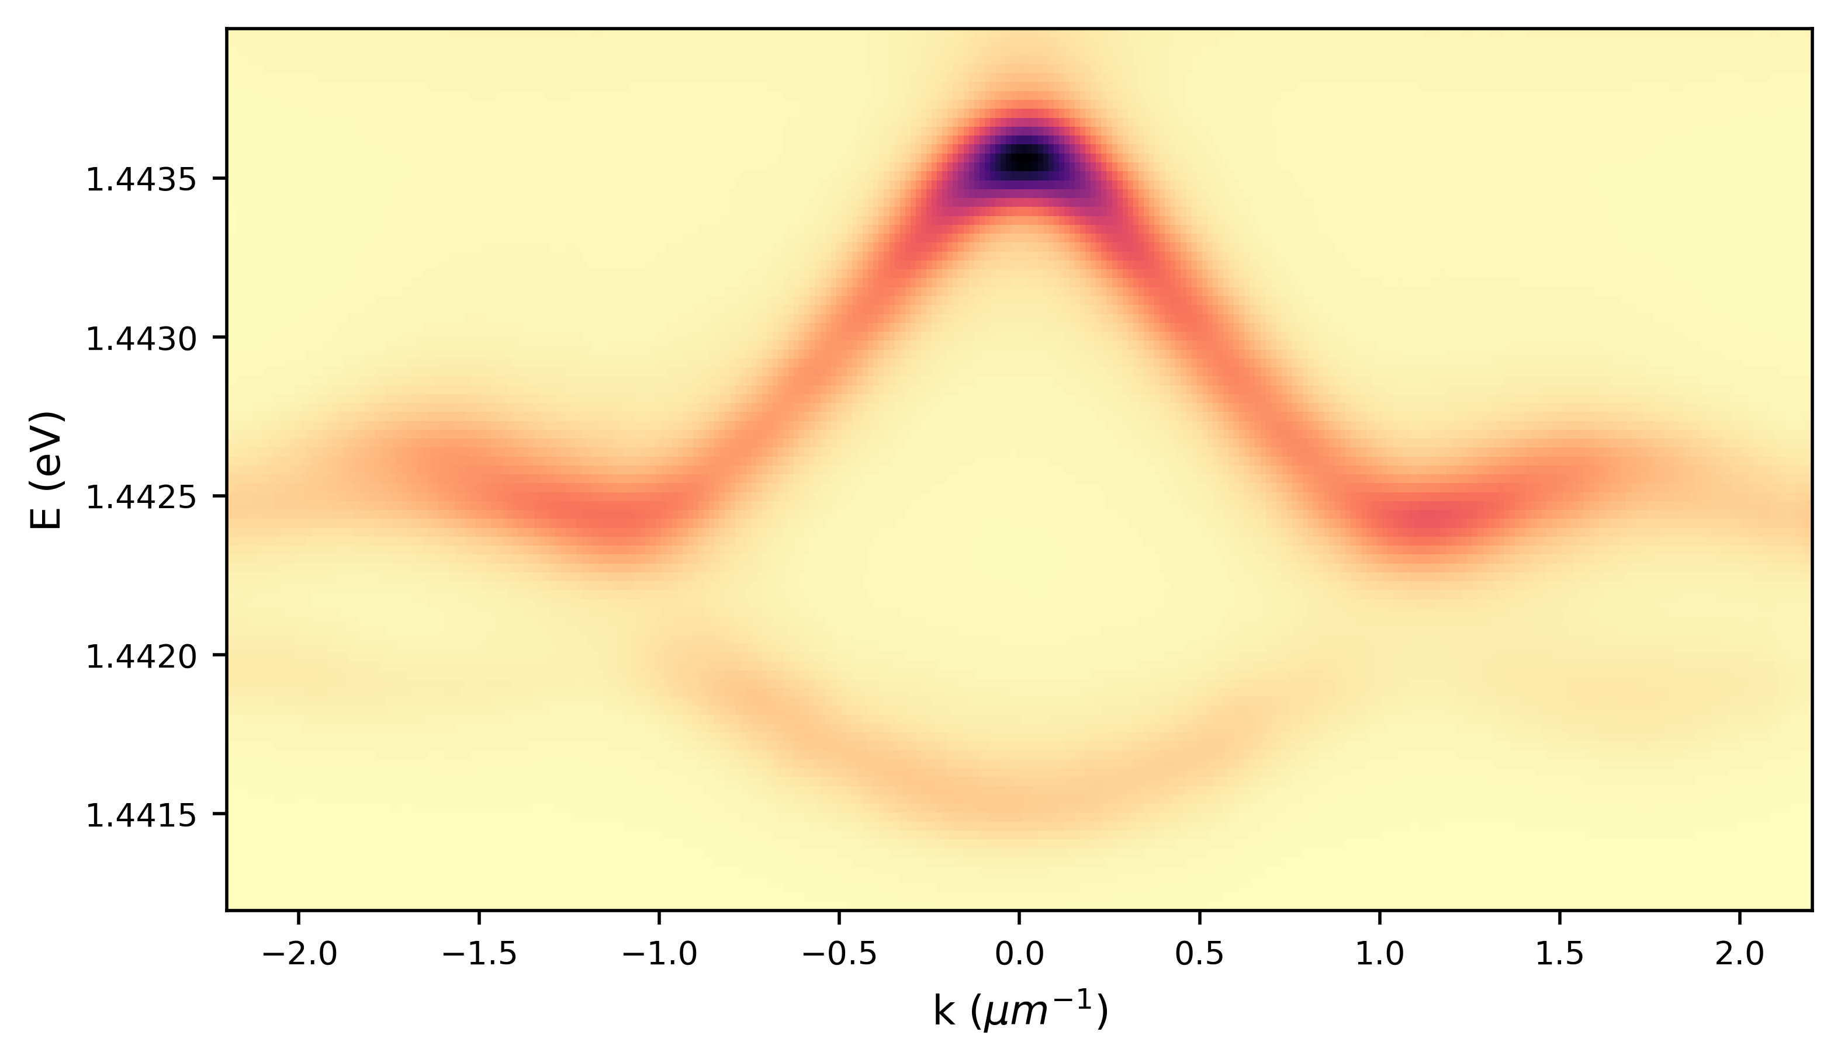
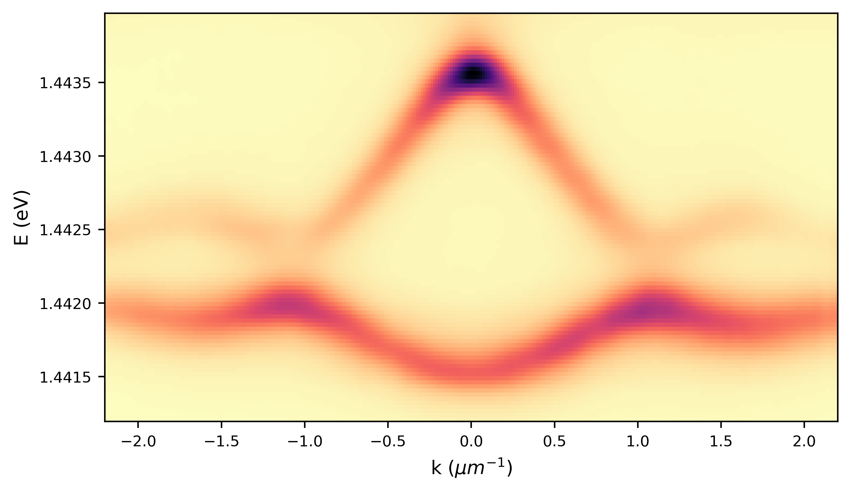
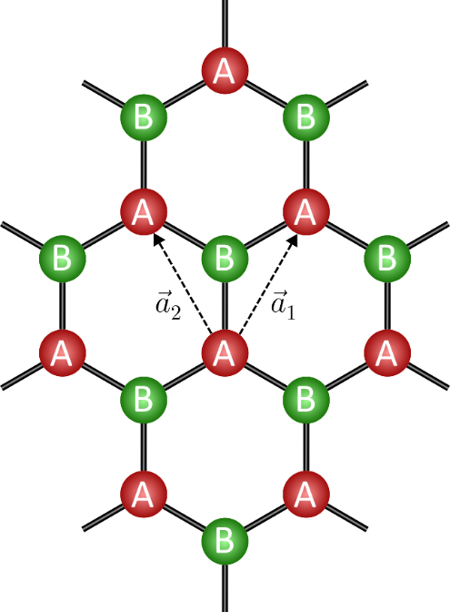
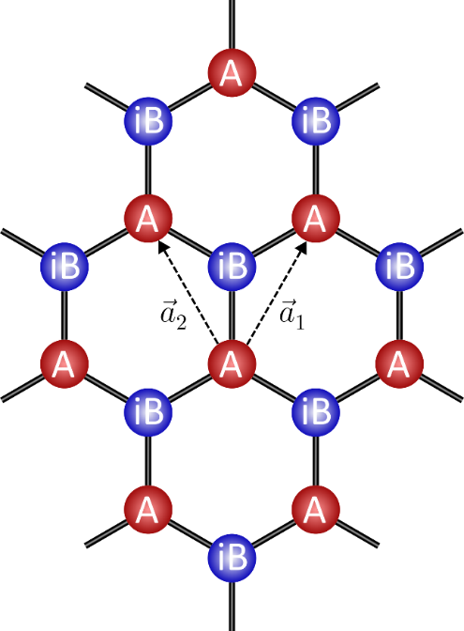
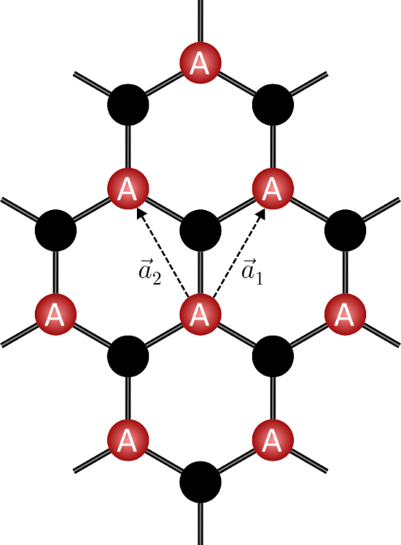
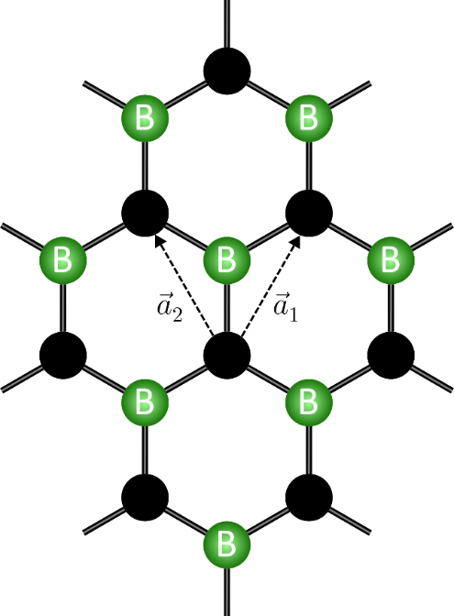
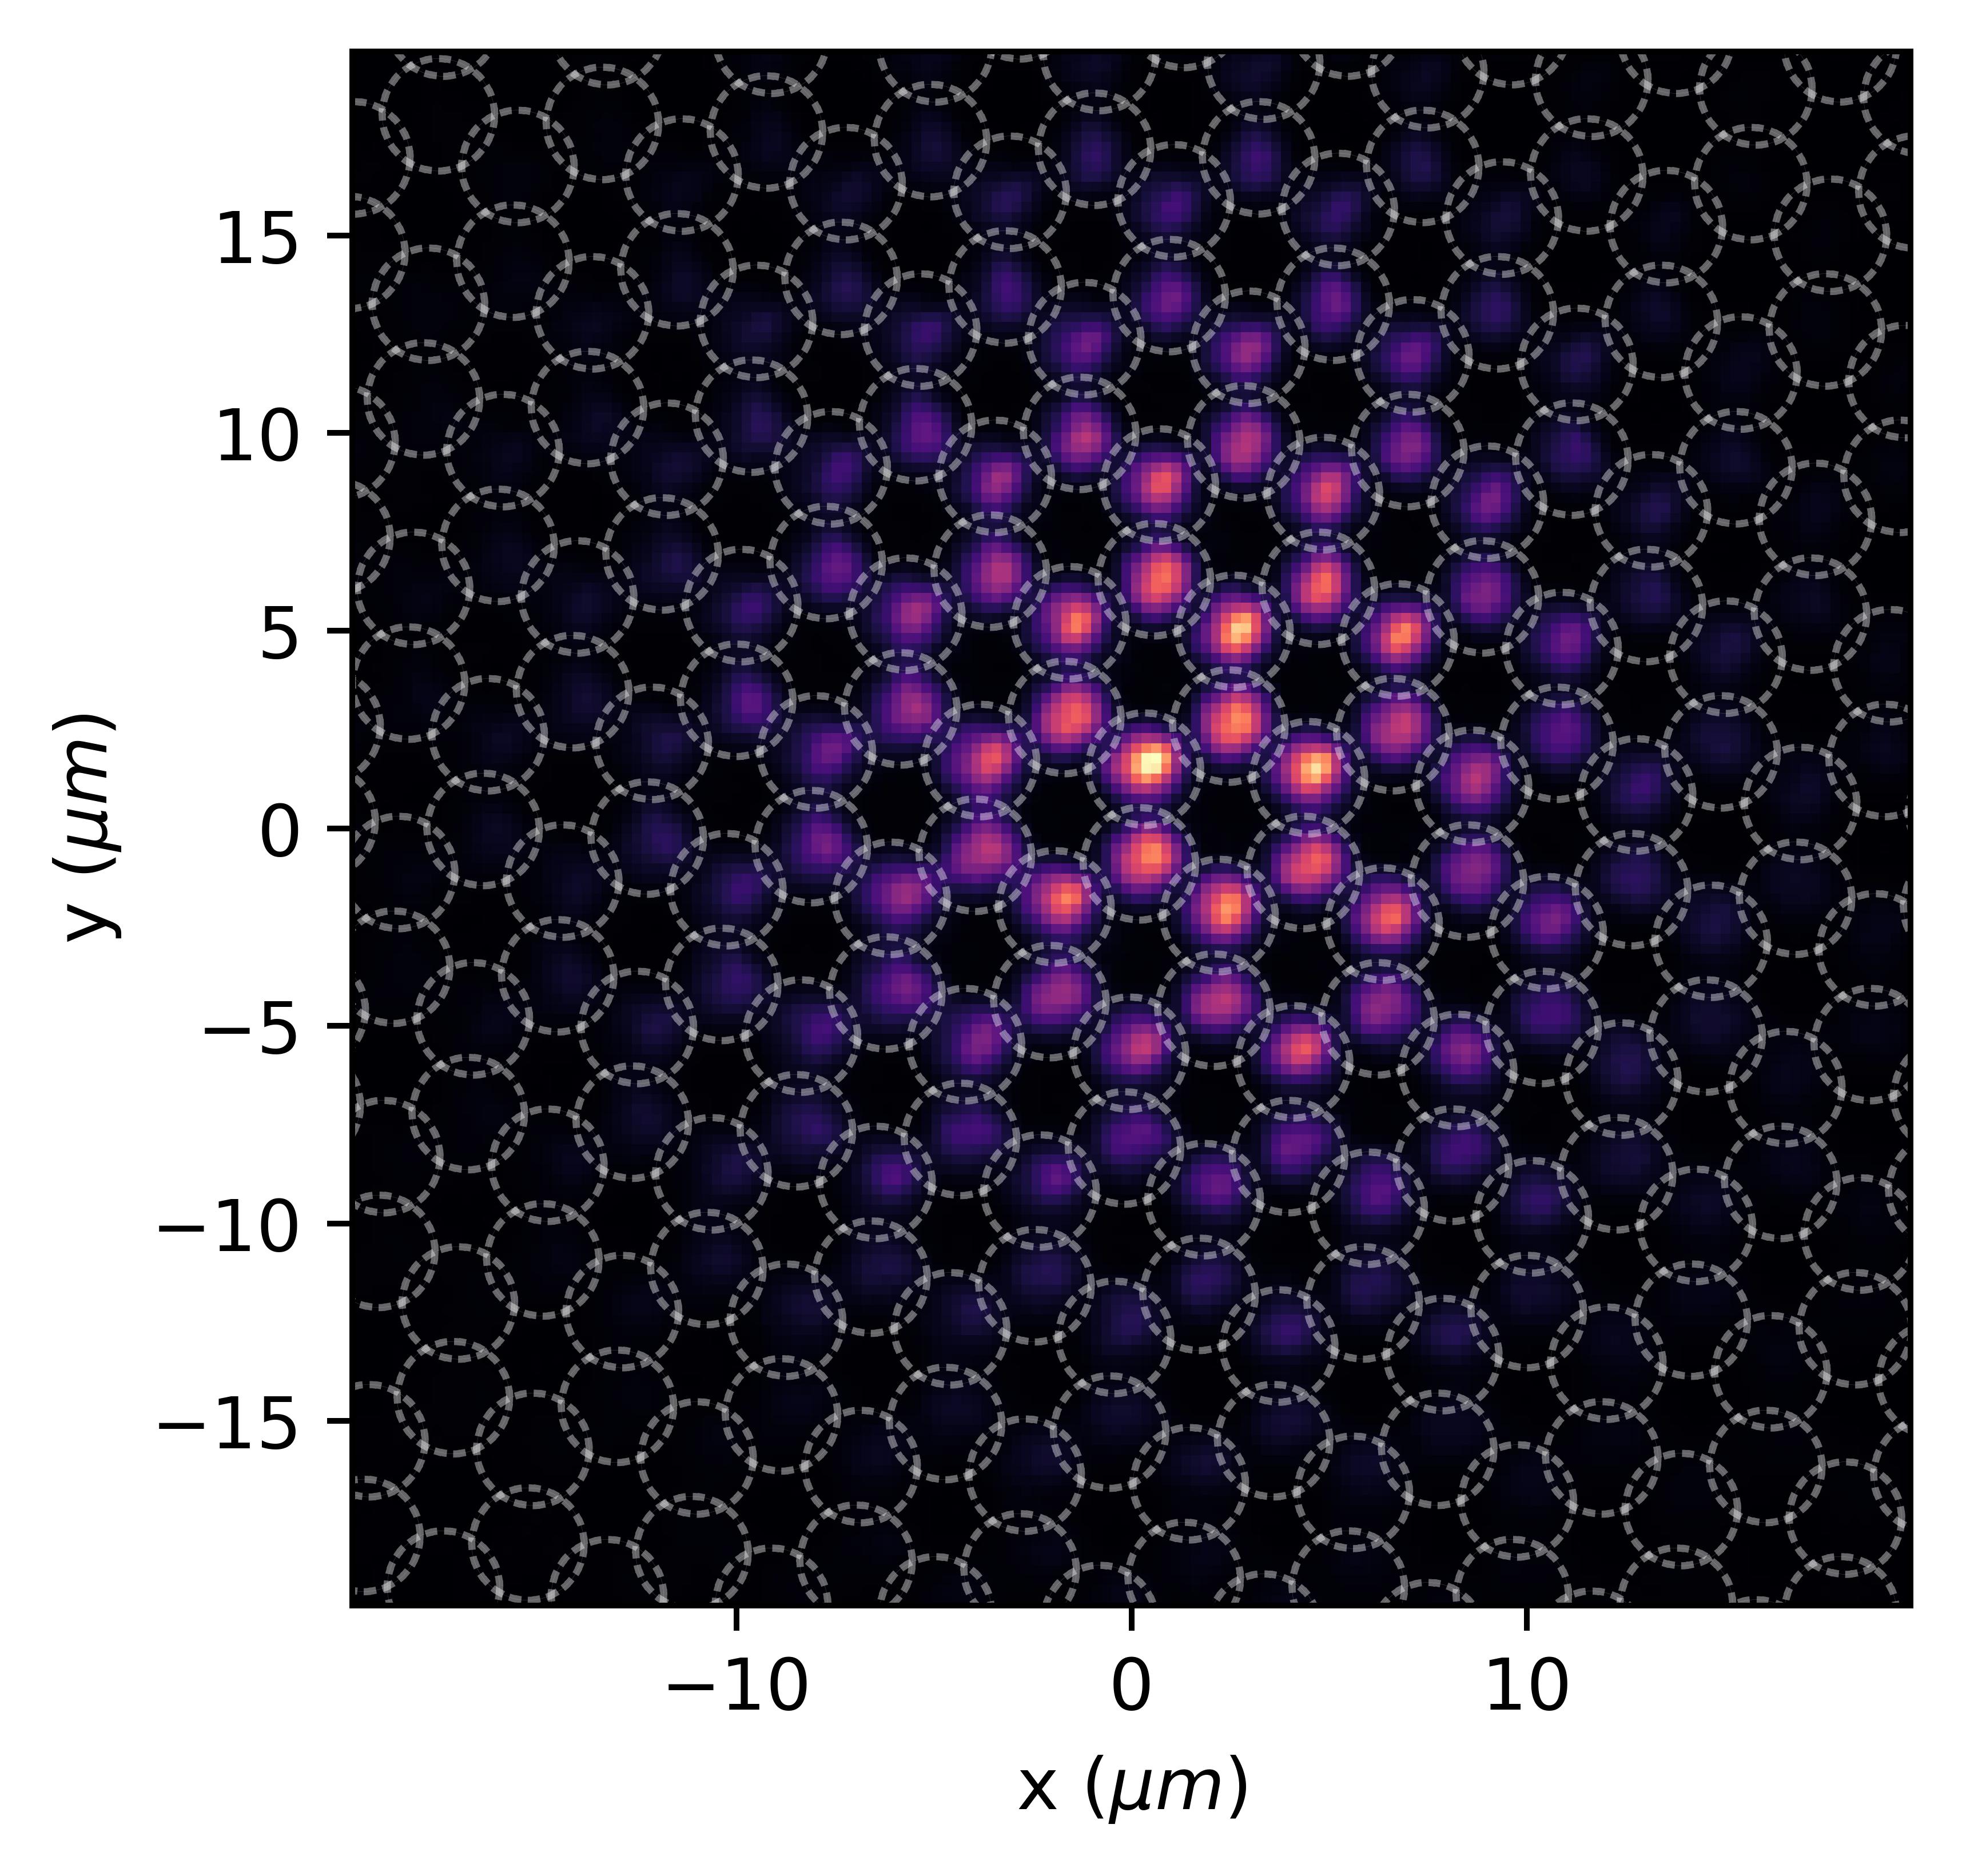
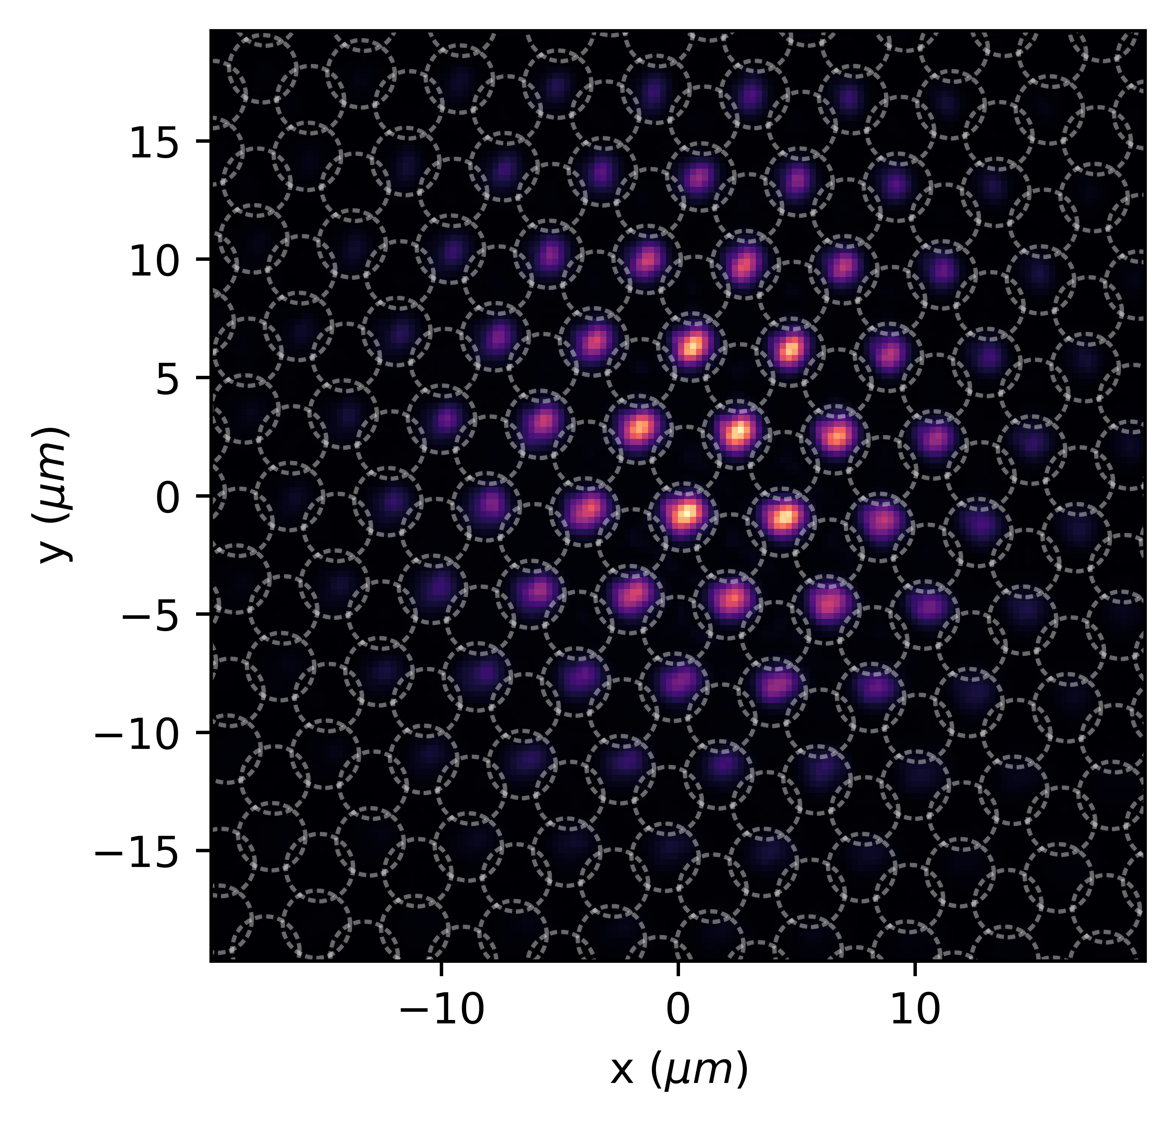
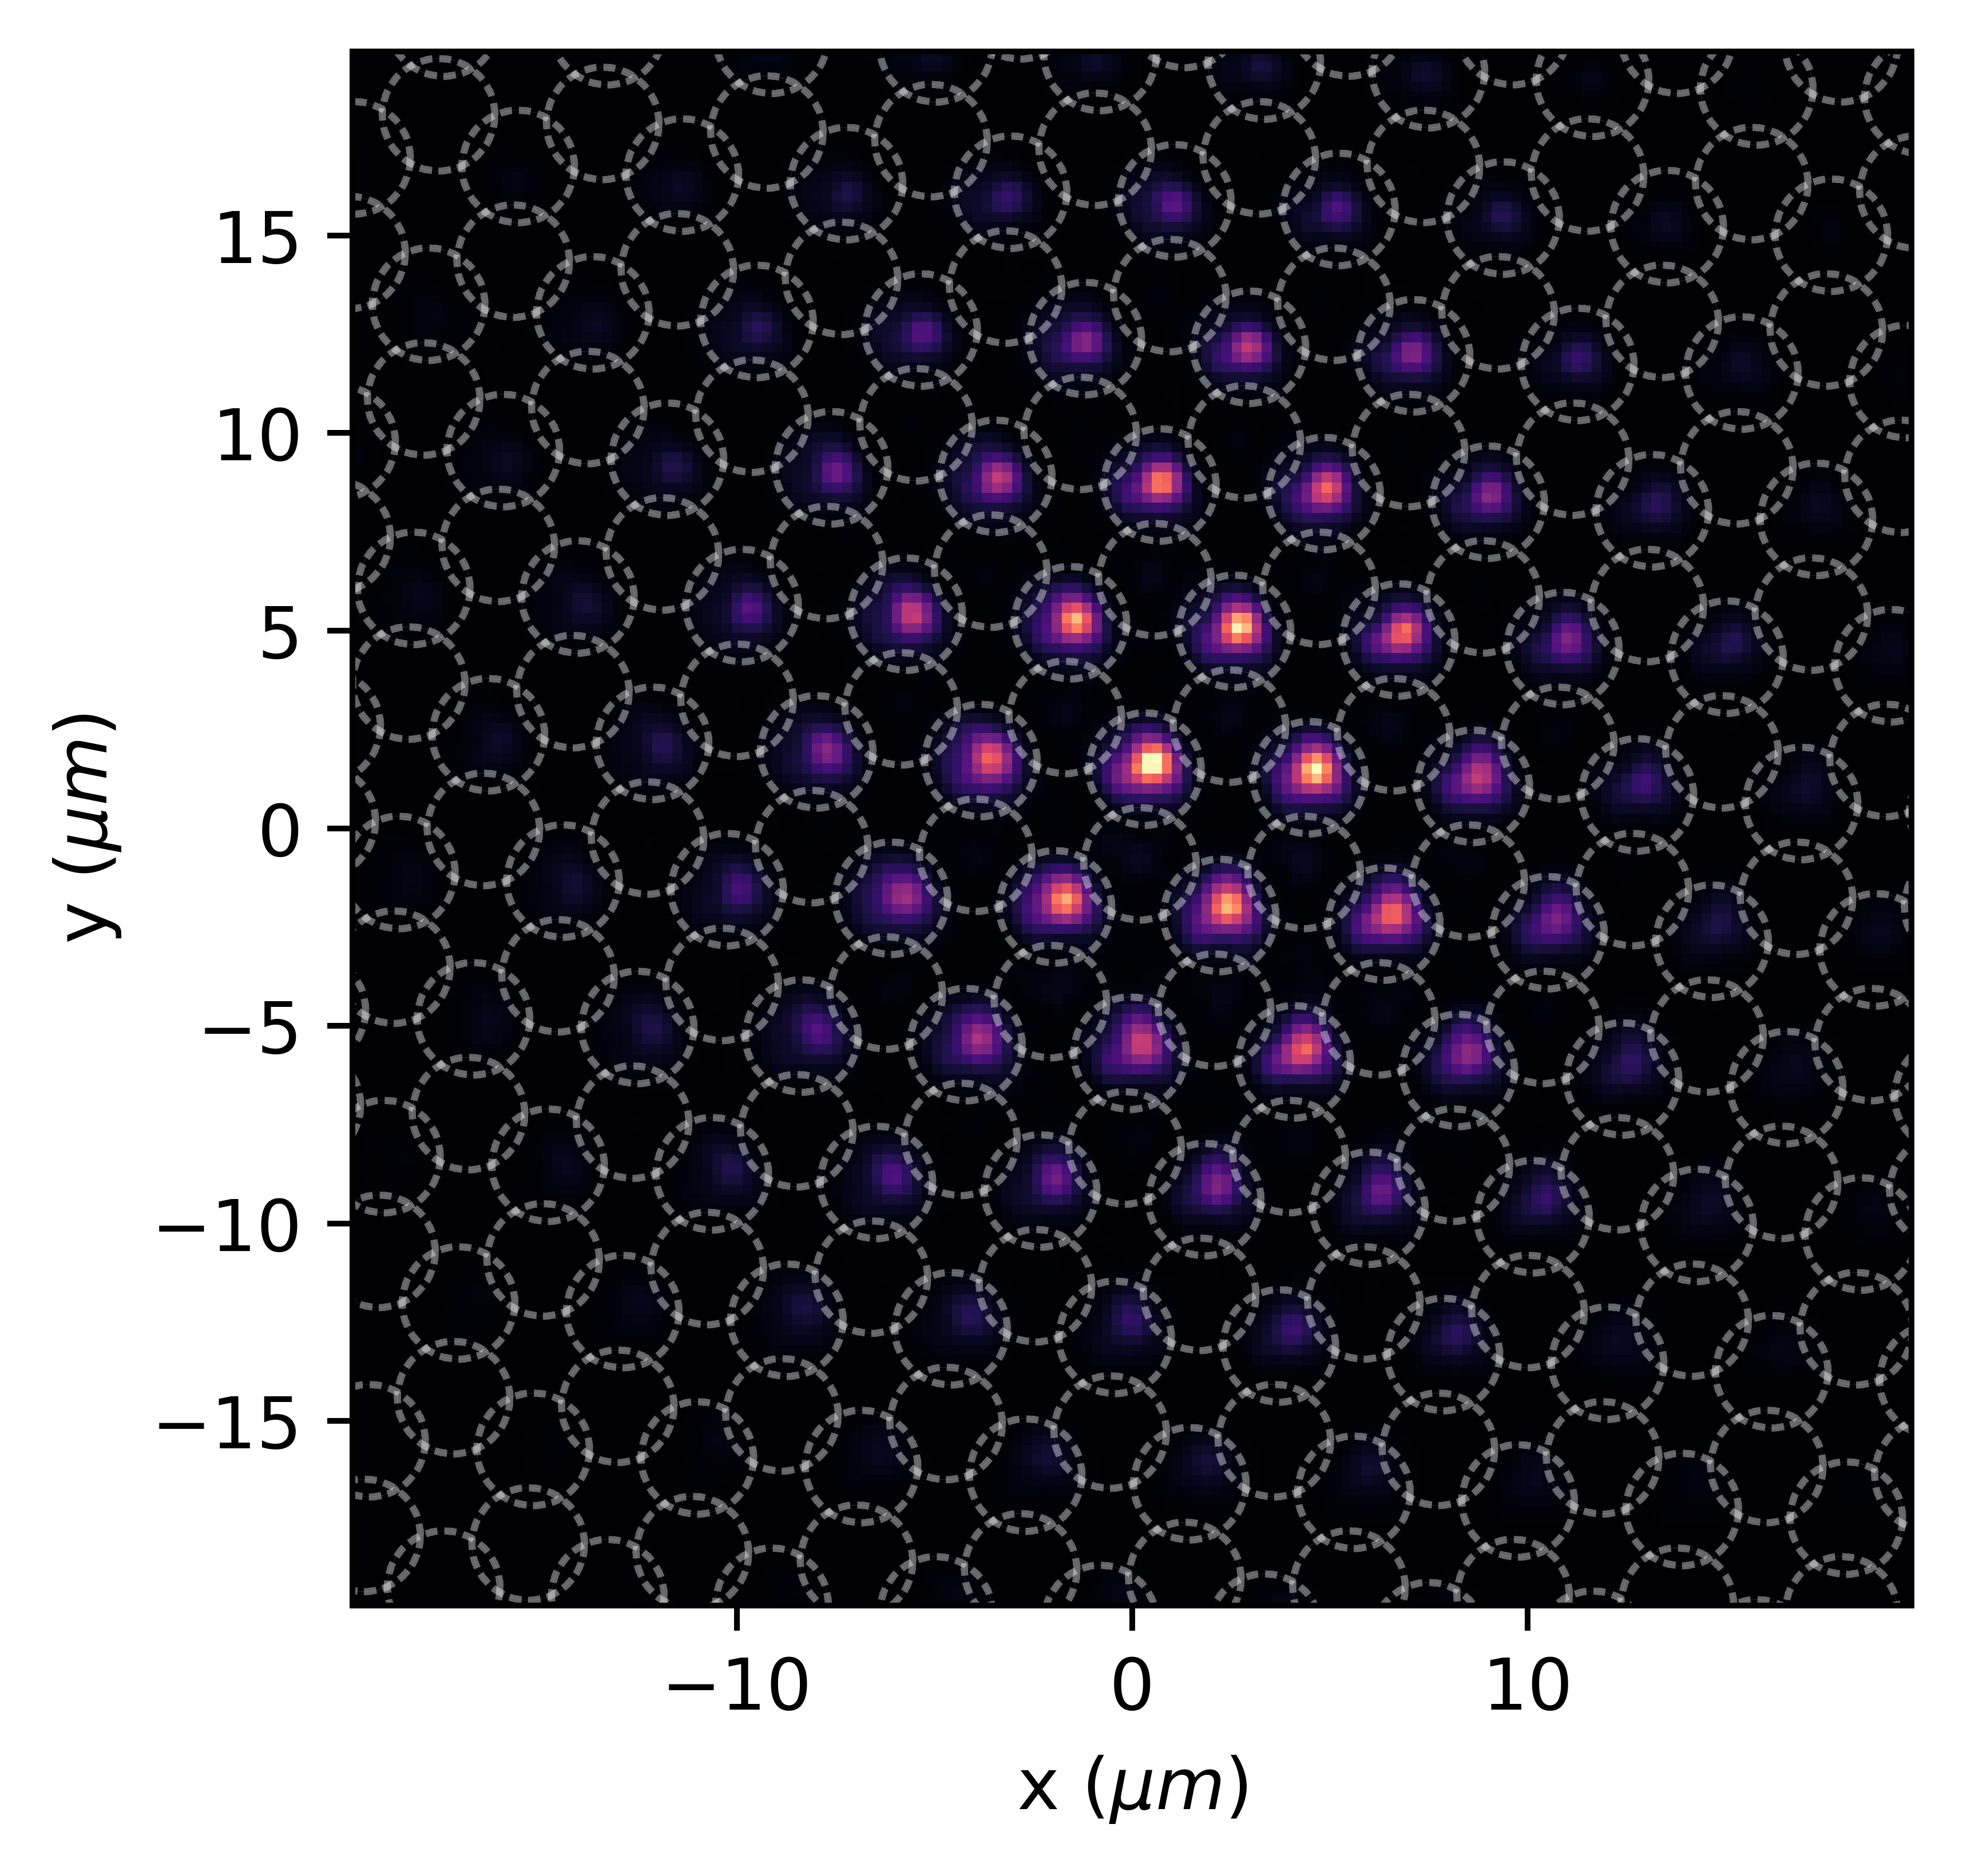
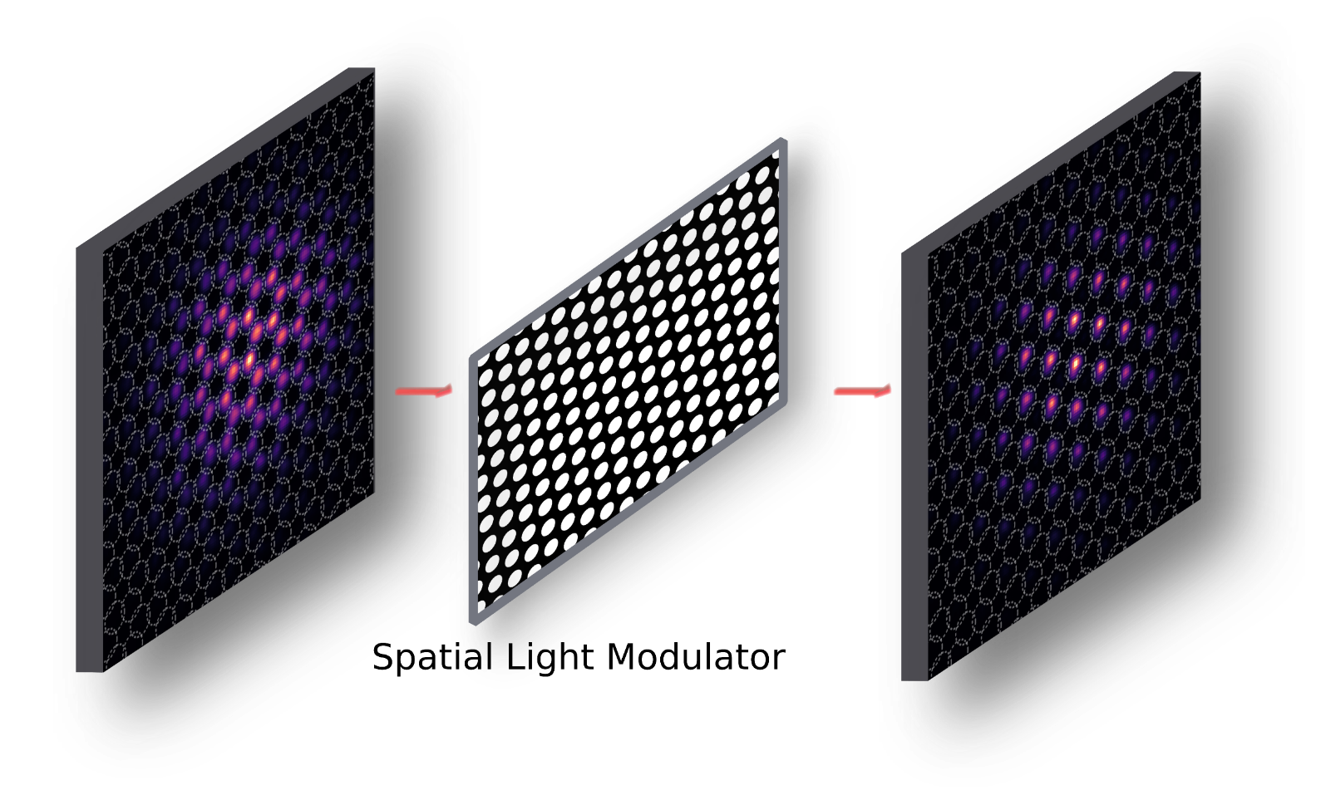
Accessing the eigenvector structure

Slide 13
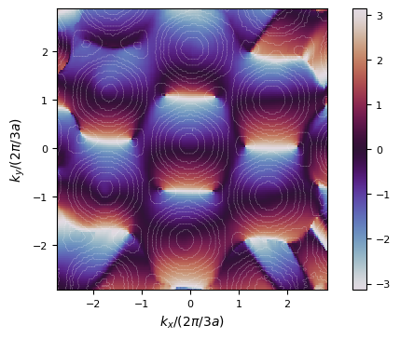
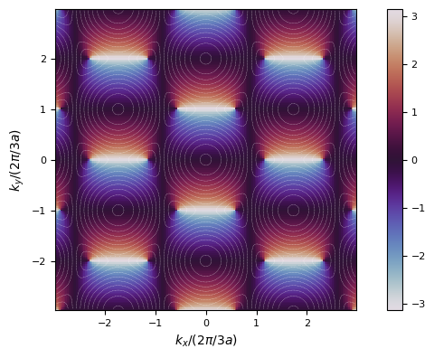
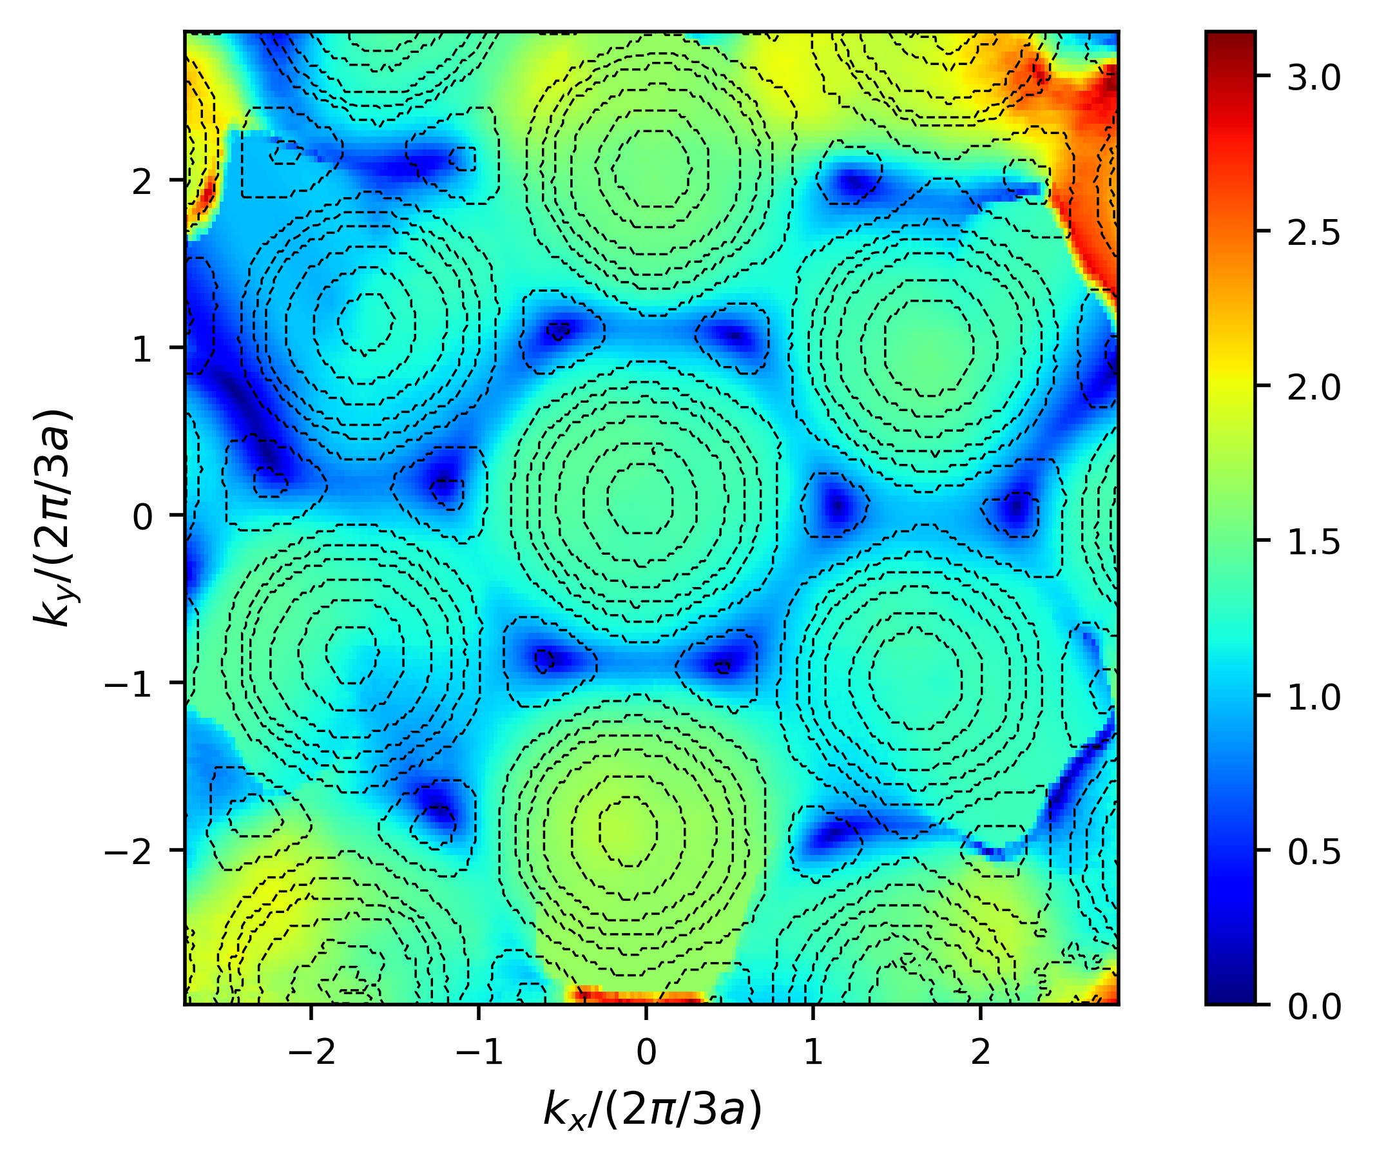
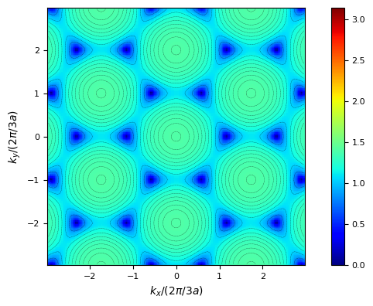
Experimental
Theory
Lower band
ϕ
θ

Slide 14
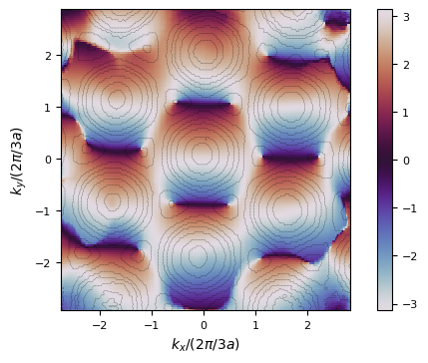
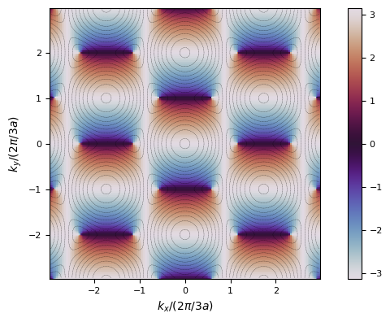
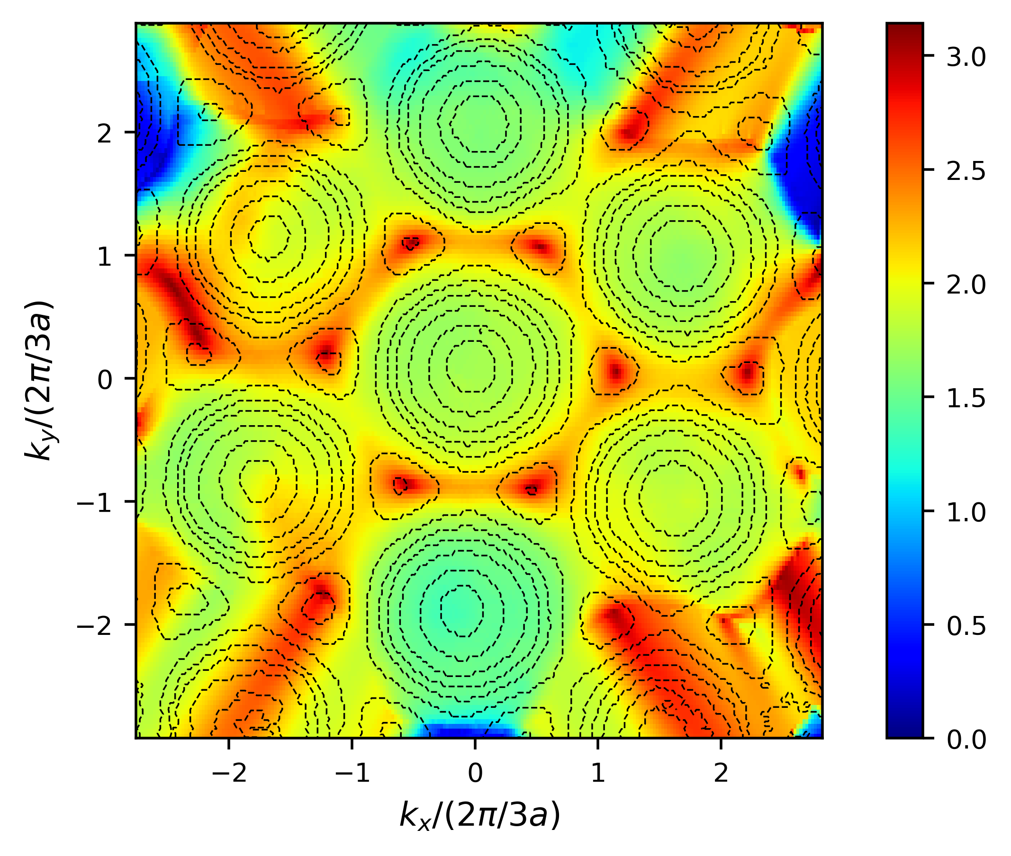
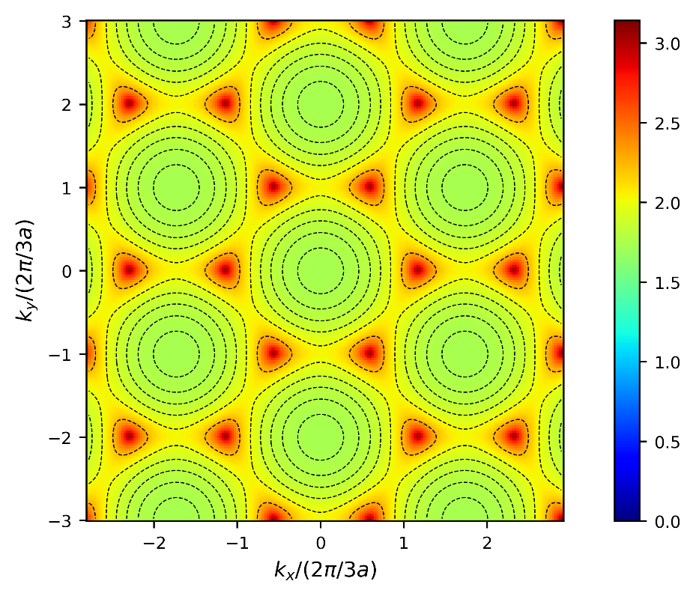
Experimental
Theory
Upper band
ϕ
θ

Slide 15
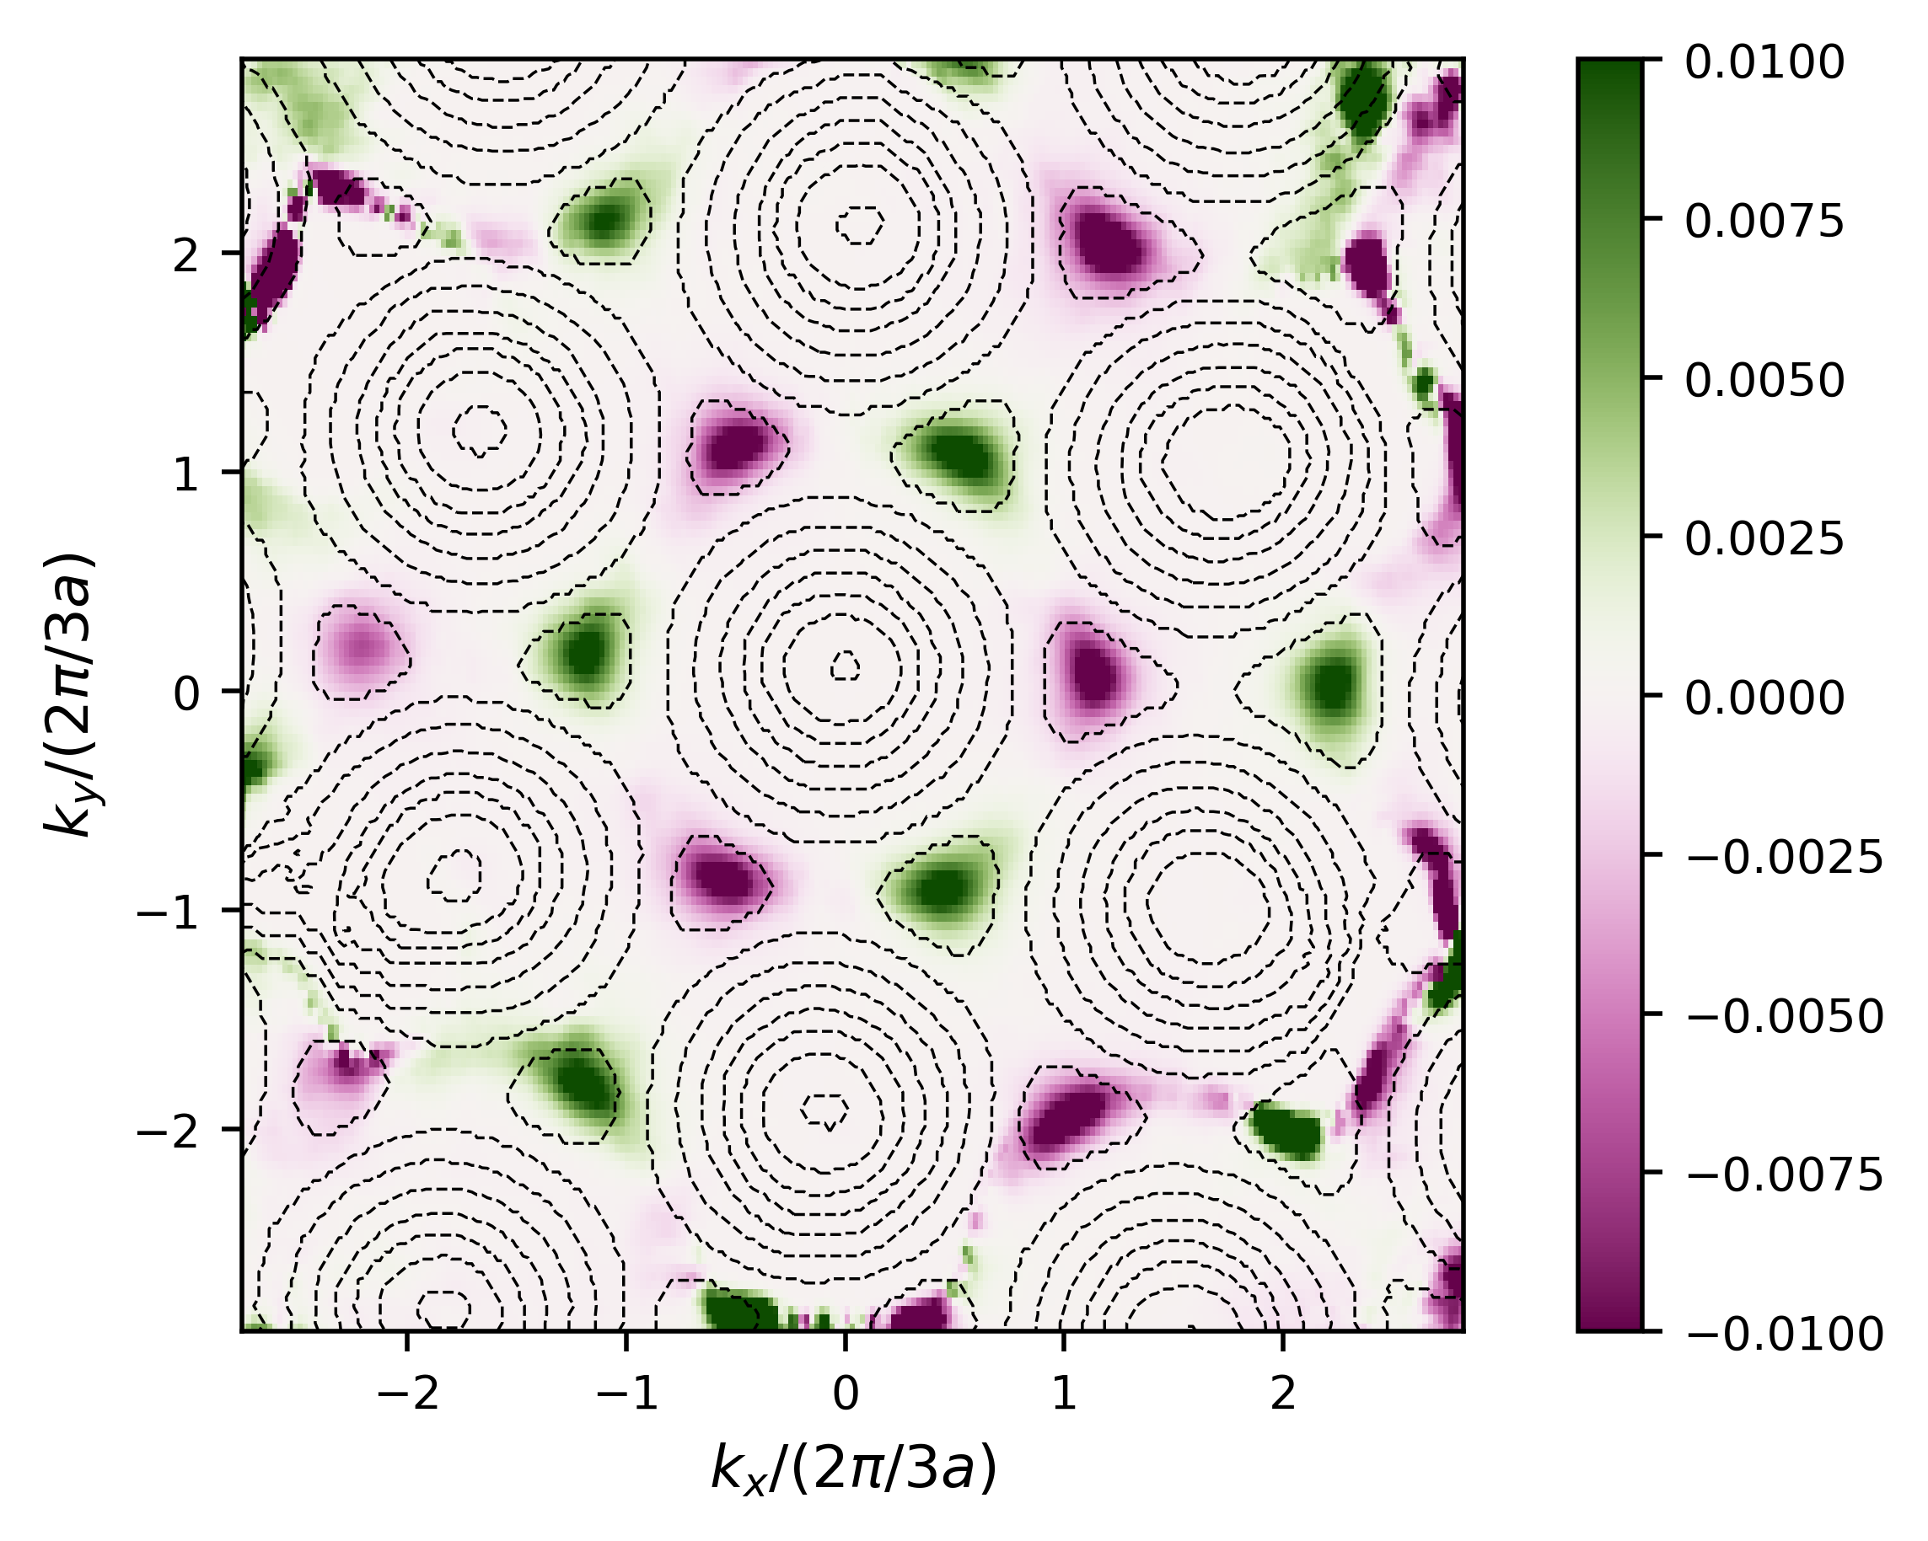
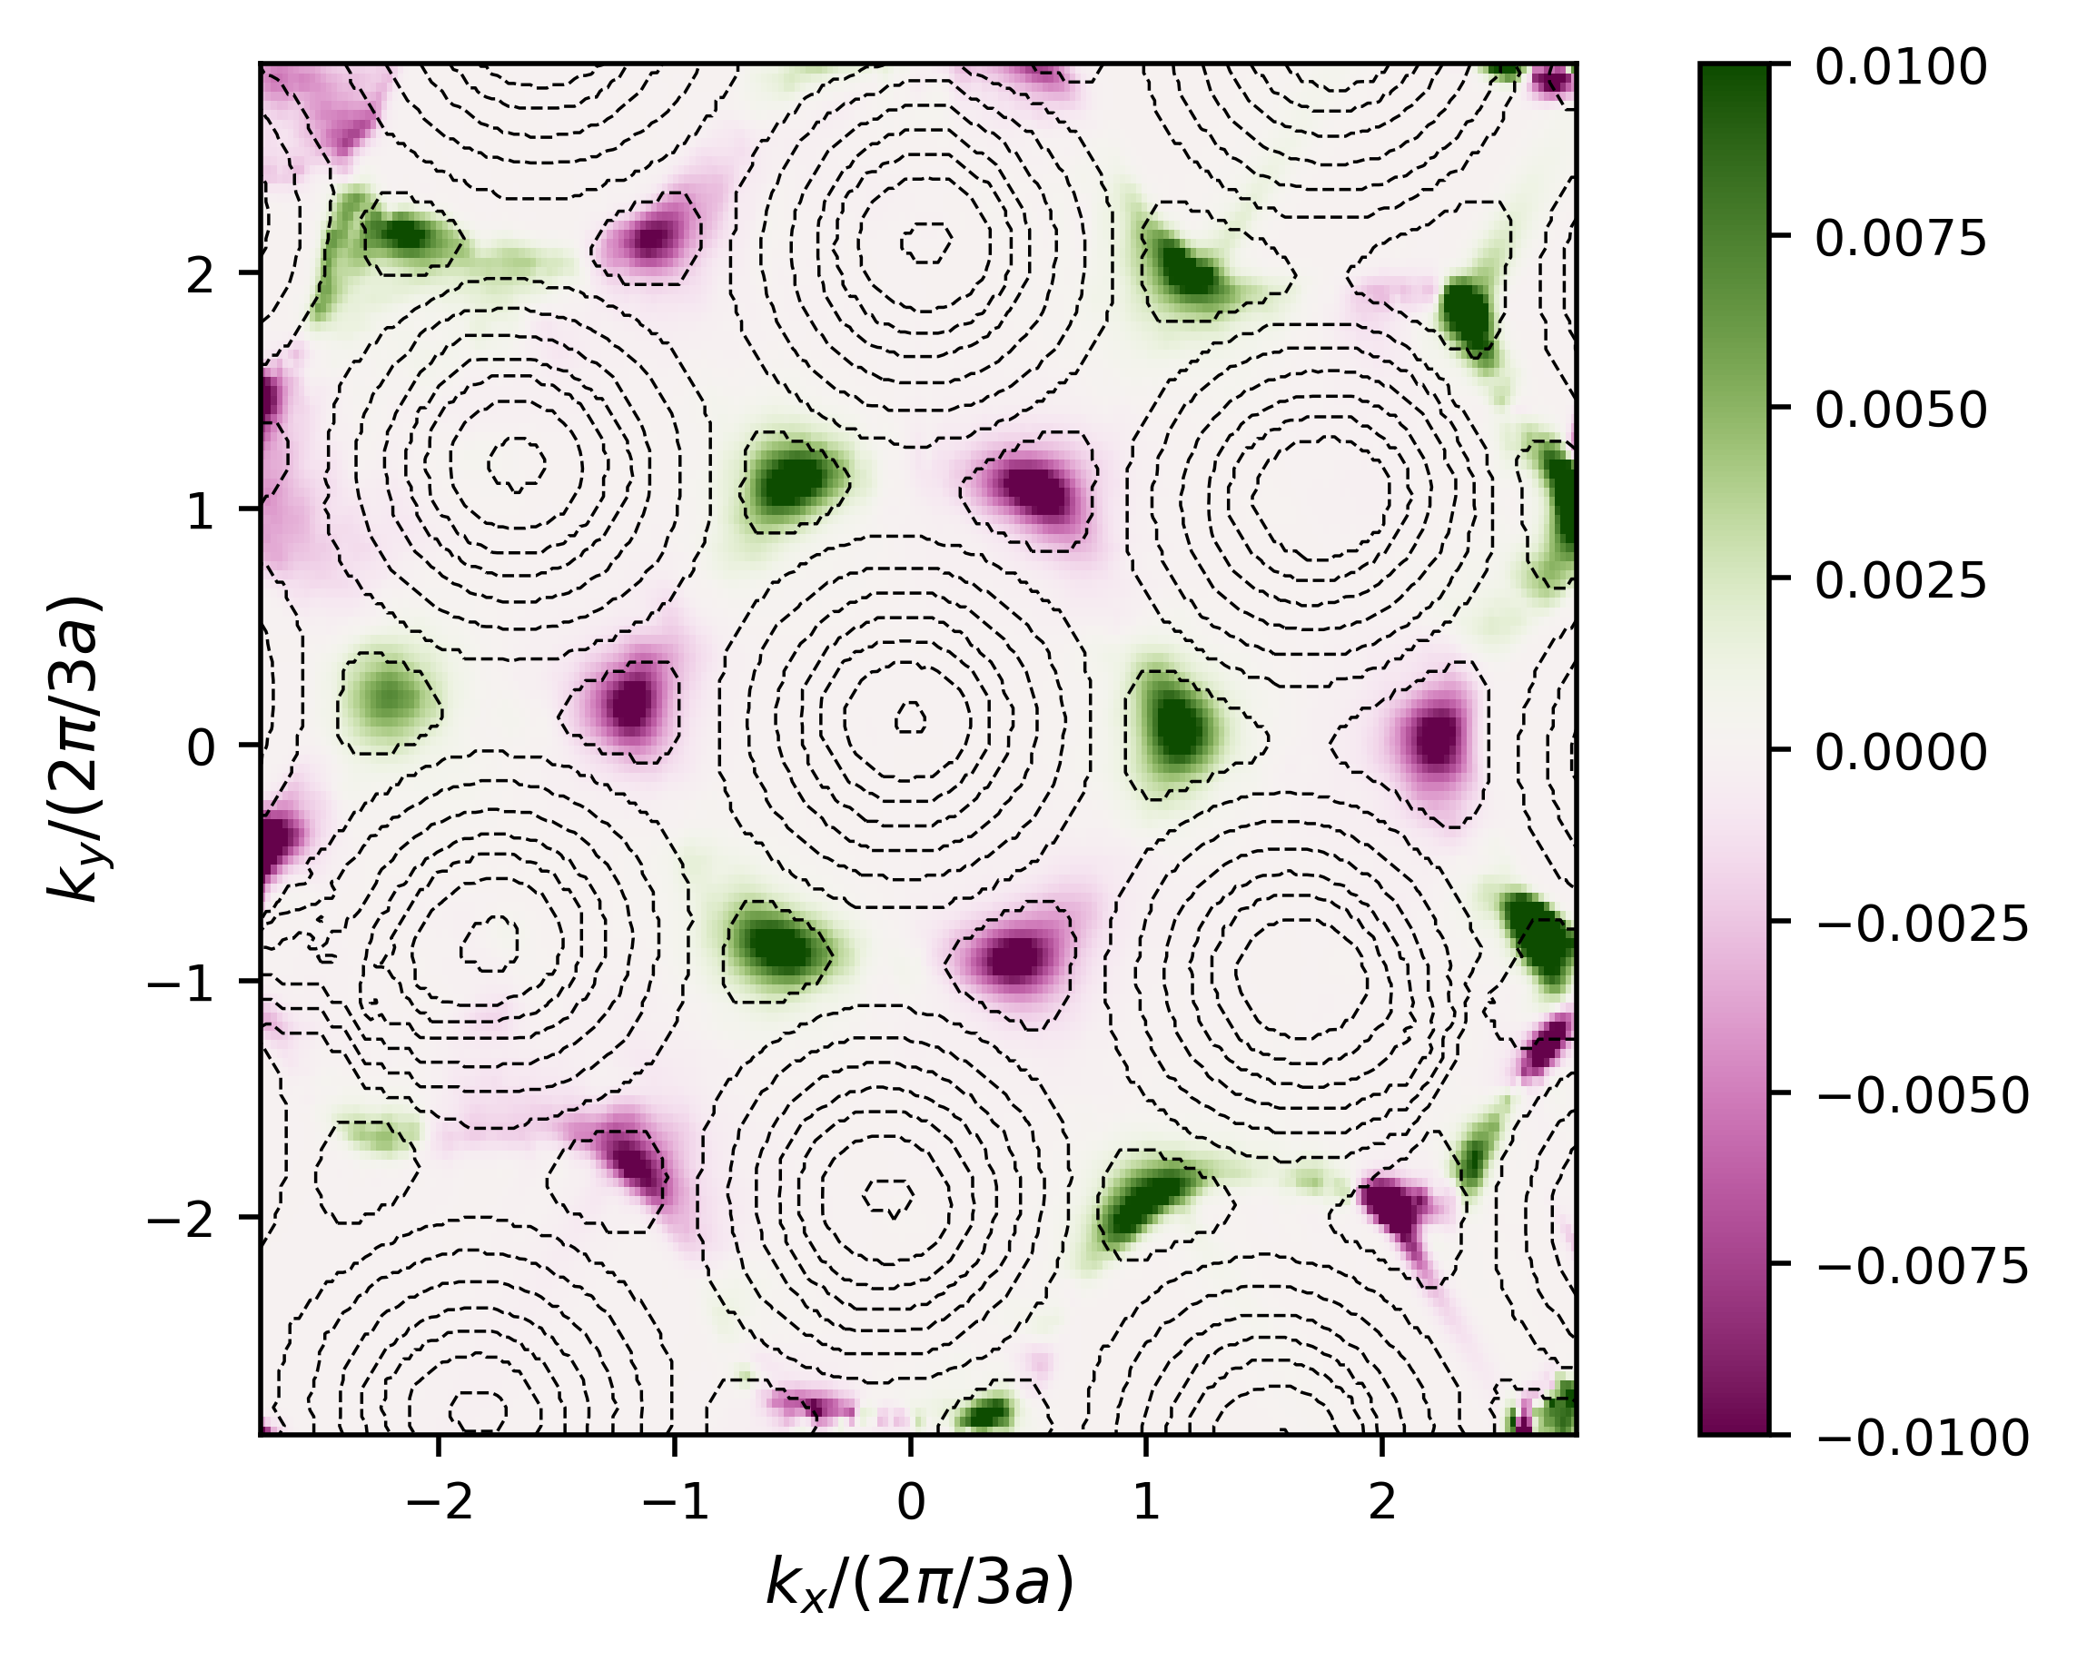
Berry curvature computation
Lower band
Upper band
Upper band (theory)
B_{z}
B_{z}
B_{z}
Berry curvature of opposite sign in both valleys

Slide 16
III. Outlook: The $ℤ$-topological insulator
Polariton quantum fluids at C2N
Resolving the band inversion in a 4-band system
C2N – 10 Boulevard Thomas Gobert, 91120 Palaiseau / www.c2n.universite-paris-saclay.fr
ARQADIA

Slide 17
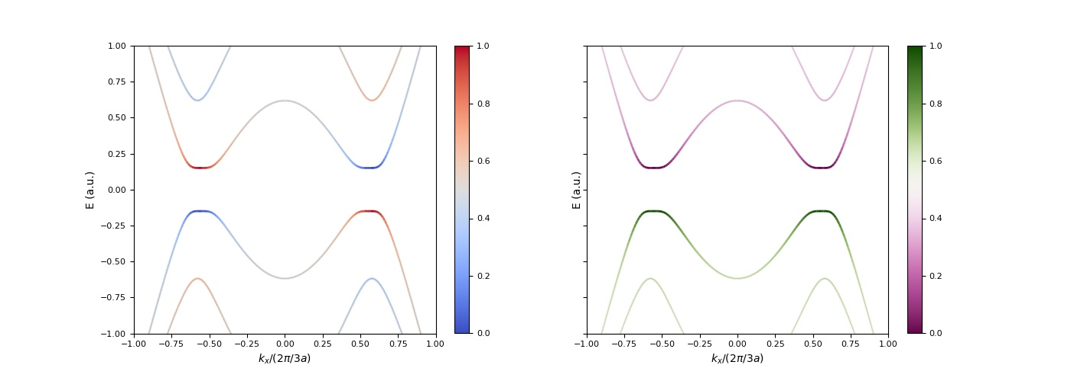
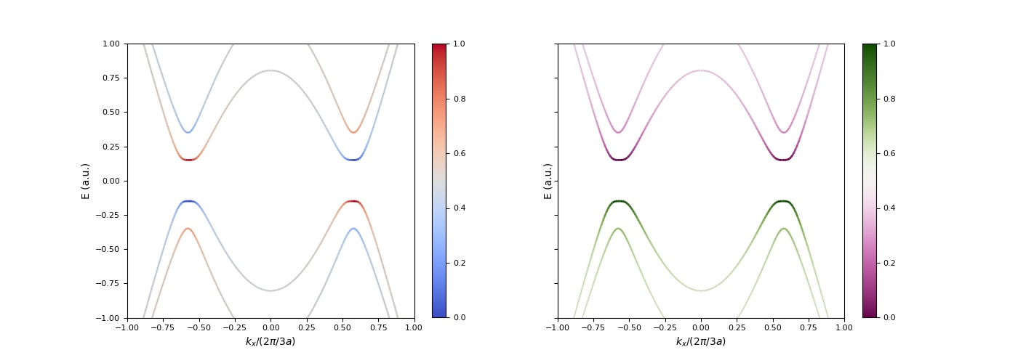
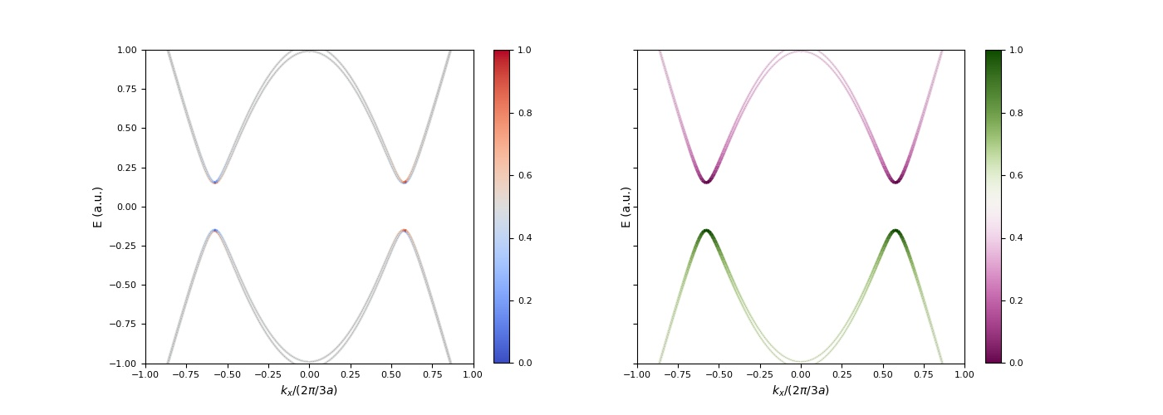
Tunable spin-orbit coupling
$$σ^{+}$$
$$A$$
$$σ^{−}$$
$$B$$
Polariton Z Topological Insulator
A. V. Nalitov, D. D. Solnyshkov, and G. Malpuech
Phys. Rev. Lett. 114, 116401 (2015)
Klembt, S., Harder, T.H., Egorov, O.A. et al. Exciton-polariton topological insulator.
Nature 562, 552–556 (2018)

Slide 18
Optical Zeeman splitting
$$σ^{+}$$
$$A$$
Topological gap
$$C= ±2$$
$$\vec{B}$$
$$\vec{B}$$
$$σ^{−}$$
$$B$$
Polariton Z Topological Insulator
A. V. Nalitov, D. D. Solnyshkov, and G. Malpuech
Phys. Rev. Lett. 114, 116401 (2015)
Klembt, S., Harder, T.H., Egorov, O.A. et al. Exciton-polariton topological insulator.
Nature 562, 552–556 (2018)

Slide 19
Polariton quantum fluids at C2N
Acknowledgements
Christian Kriso
Nicolas Pernet
Quentin Fontaine
Jacqueline Bloch
Sylvain Ravets
Théo Colomer
Daniela Pinto Dias
And many others…
C2N – 10 Boulevard Thomas Gobert, 91120 Palaiseau / www.c2n.universite-paris-saclay.fr
ARQADIA

