Slide 1
RF cavities in French Accelerators
Lu ZHAO
Synchrotron SOLEIL
Section: MC2 Contributions des laboratoires français aux futurs grands collisionneurs

Slide 2
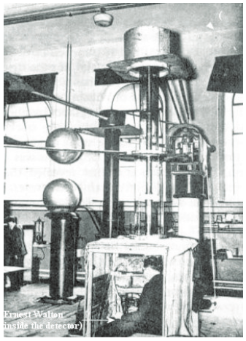
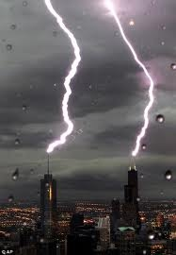
How to accelerate a charged particle?
How to accelerate a charge particle ?
++++++++++++++++++++
E
E
v
Discharge
e
------------------------------------
‘Electrostatic’ accelerators
1932, the first Cockcroft–Walton electrostatic generator (with E. Walton inside the detector), 400kV
CAS CERN Accelerator School : RF for accelerators 2010

Slide 3
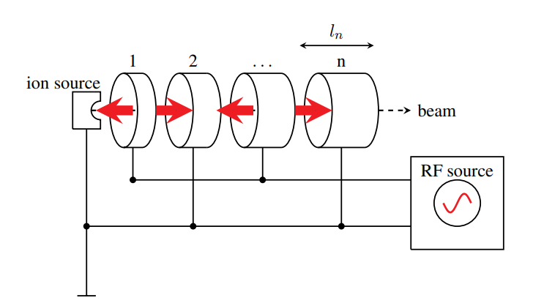
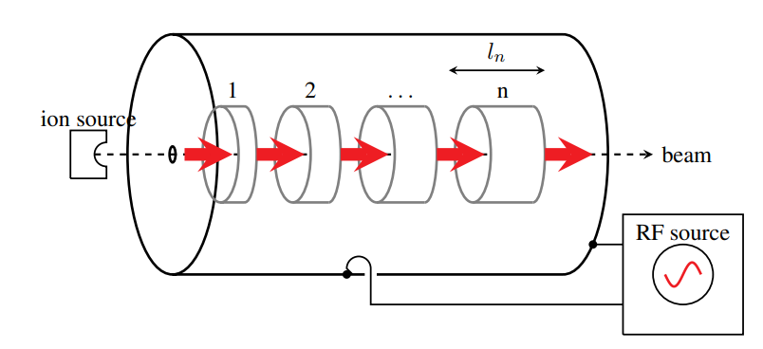
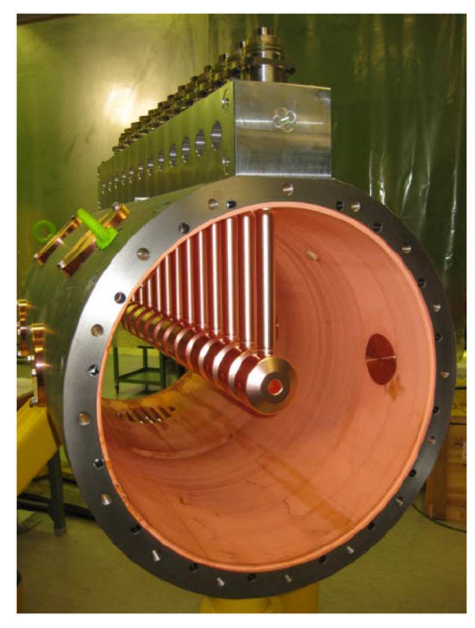
The precursor of RF linear accelerator
Principle of Wideröe’s RF linear accelerator
RF electric fields between drift tubes accelerate the particle
Principle and field profile of an Alvarez linac
Synchronism condition :
$$l_{n}= \frac{v}{2f}$$
CERN Linac-4 DTL prototype
F. Gerigk, Cavity types,CERN
Notes:
Les cavités radiofréquences sont des résonateurs, un peu comme les caisses de résonance des instruments de musique, qui permettent de stocker et d’amplifier le champ électrique destiné à accélérer un faisceau de particules chargées dans un accélérateur.

Slide 4
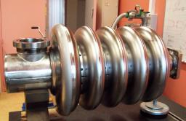
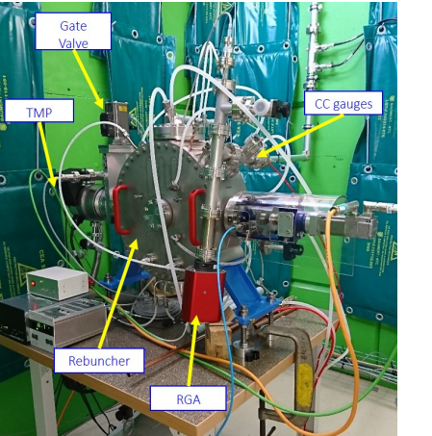
Cavity types
Accelerating cavity
Superconducting cavities (cryomodule)
Niobium Bulk
Niobium thin film
Normal-conducting cavities
Copper Bulk
Copper thin film
Non-accelerating cavity
RF bunching
RF Deflection
Lengthening/shorting (harmonic)
700-MHz superconducting elliptical cavity
LEP Radio Frequency Copper Cavity
SARAF 2 buncher cavity
Nassiri, A., et al. "History and technology developments of radio frequency (RF) systems for particle accelerators." IEEE Transactions on Nuclear Science 63.2 (2015): 707-750.
Zhao, Lu, et al. "Study and test of the rebuncher for SARAF-LINAC phase II." Nuclear Instruments and Methods in Physics Research Section A: Accelerators, Spectrometers, Detectors and Associated Equipment 986 (2021): 164716.
Ferdinand, Robin, et al. "Spiral2 RFQ design." 9th European Particle Accelerator Conference (EPAC 2004). 2004.

Slide 5
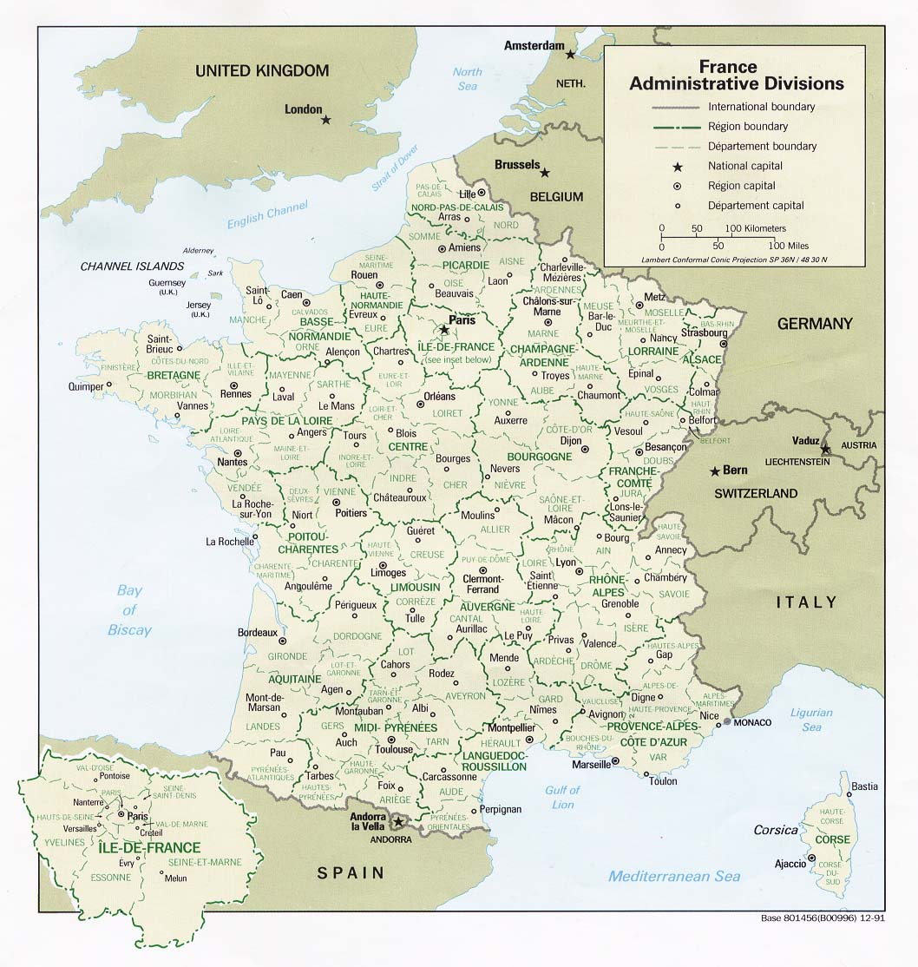
French particle accelerators
Linear particle accelerator
GANIL - SPIRAL2
Circular Accelerator
Synchrotron Soleil
European Synchrotron Radiation Facility (ESRF)
THOMX (Une source de lumière compacte, X ray)
Accelerator application
CEMHTI (Conditions Extrêmes et Matériaux : Haute Température et Irradiation, Orléans, France)
ARRONAX (Accelerator for Research in Radiochemistry and Oncology in Nantes,France)
Notes:
ThomX est un accélérateur d'électrons ayant pour but de générer des rayons X. Il est installé dans l'IGLEX, sur la faculté de Paris-Saclay à Orsay (France).

Slide 6
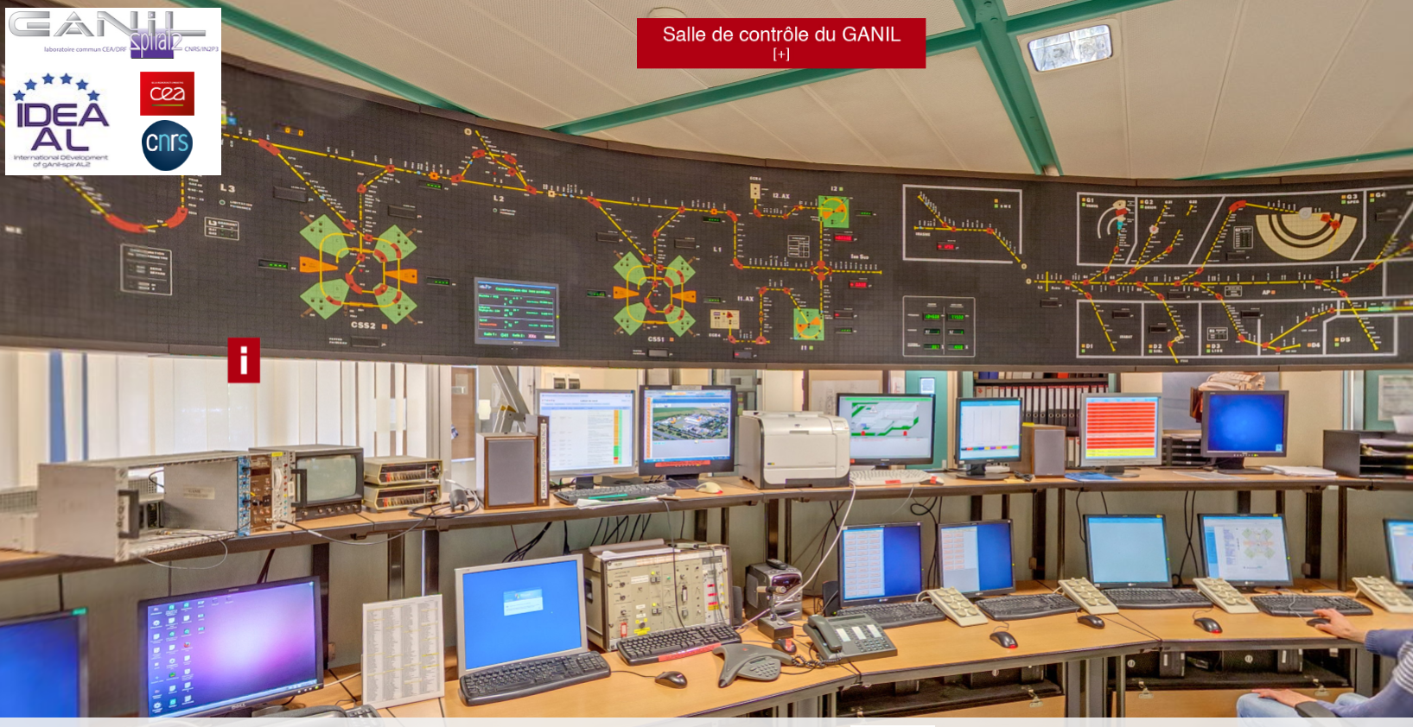
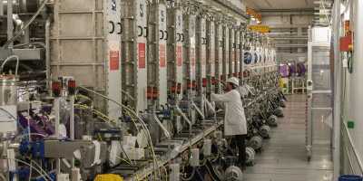
GANIL since 1983
Cyclotrons complex
Five cyclotrons and hundred meters of beamline
2 compact cyclotrons (C01 and C02): Beam energy < 1 MeV/A
2 separated sector cyclotrons (CSS1 and CSS2): 13.5 MeV/A < Beam energies < 100 MeV/A
1 compact cyclotron SPIRAL1 for radioactive beams: Beam energy < 25 MeV/A
SPIRAL-2 superconducting LINAC
Accelerate lighter nuclei (protons, deuterons, helium)
26 accelerating cavities, enclosed in 19 cryomodules
33 MeV for protons
40 MeV for deuterons
< 14.5 MeV/A for heavy ions
High intensities:up to 5 mA for deuterons
< 1mA for heavier ions
Control room of GANIL CYCLOTRONS
IRRSUD: one of experiment room
Bernaudin, P. E., et al. "Status of the SPIRAL 2 Superconducting LINAC." 1st International Particle Accelerator Conference (IPAC'10). Joint Accelerator Conferences Website, 2010.
Junquera, T., et al. "The high intensity superconducting Linac for the SPIRAL 2 project at GANIL." proc LINAC. 2006.
https://u.ganil-spiral2.eu/virtualvisit_fr/
SPIRAL2

Slide 7
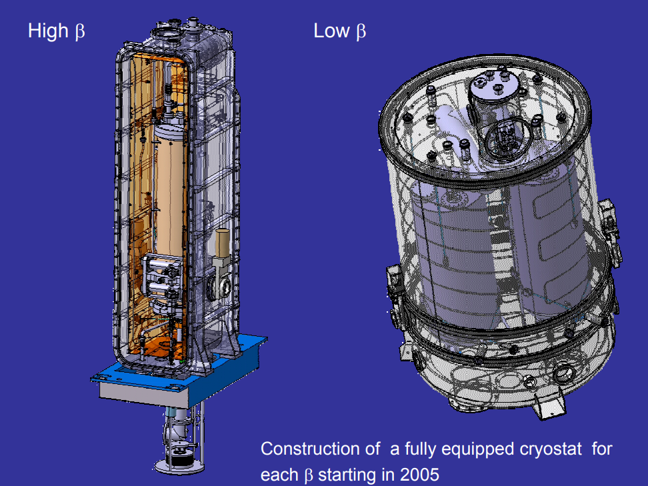
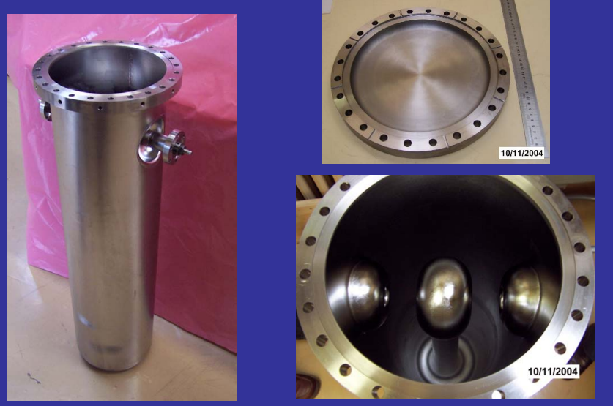
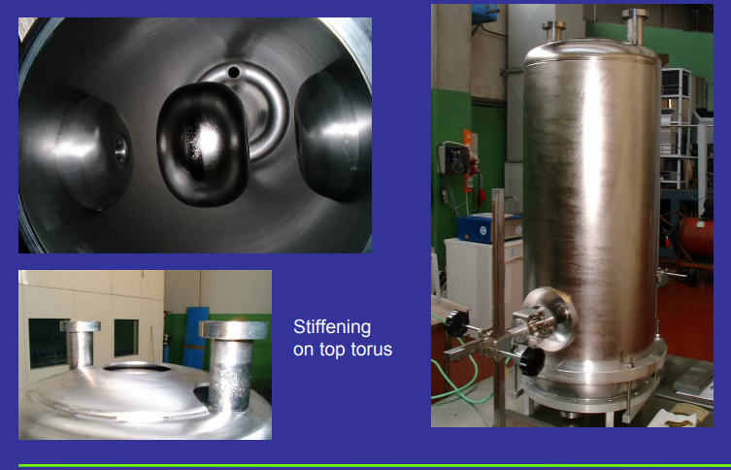
RF superconducting cavity in SPIRAL2
Radio Frequency Cavity (RFQ) in tunnel of Spiral2
the RFQ is a 4-vane, 5-meter copper cavity, ensuring acceleration up to 0.75 MeV/u (β=0.04)
It is composed of niobium and cooled by liquid helium. Working at 4,5 K @ frequency 88 MHz
Type A , $β=0,07$, CEA-Saclay, accelerating field ~0,49MV/m
Type B, $β=0,12$IPN-Orsay , accelerating field 6,5MV/m
P-E. Bernaudin, P. Bosland, S. Chel, P. de Girolamo, G. Devanz, P. Hardy, F. Michel, “Design of the LowBeta, Quater-Wave Resonnator and its Cryomodule for the SPIRAL2 Project”, EPAC’06, Lucerne, July 2004, G. Devanz, “SPIRAL2 Resonators”, 12th SRF Workshop 2005, Cornell University, July 2005.
THE SPIRAL-2 SUPERCONDUCTING LINAC, PAC09, R. Ferdinand, GANIL
SPIRAL 2 RFQ DESIGN,EPAC2004, R. Ferdinand,etc CAEN

Slide 8
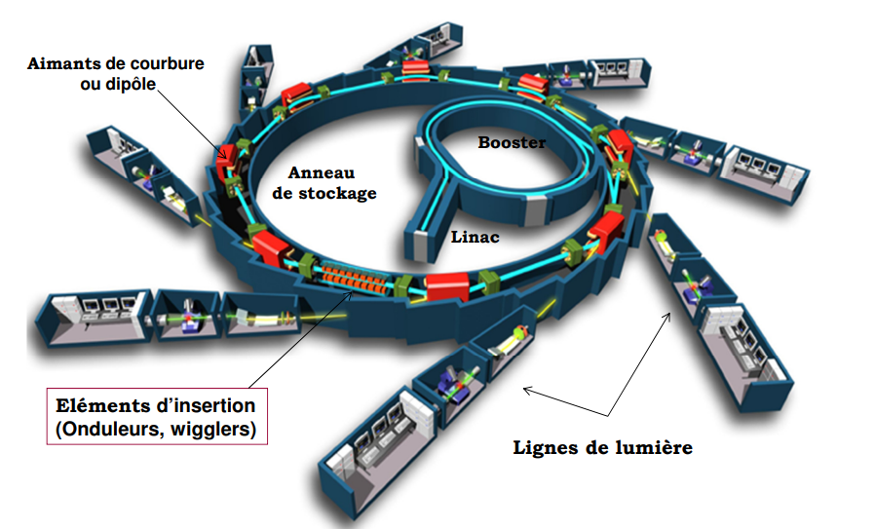
Synchrotron Soleil since 2006
Soleil is a 3rd generation light source.
from the far infrared to hard X-rays
354 m circumference Circular Accelerator of 2.75 GeV
Linac : buncher + 2 x accelerating sections
Booster: LEP cavity ( 5-cell copper cavity)
Storage ring : 4x HOM free Superconducting cavities

Slide 9
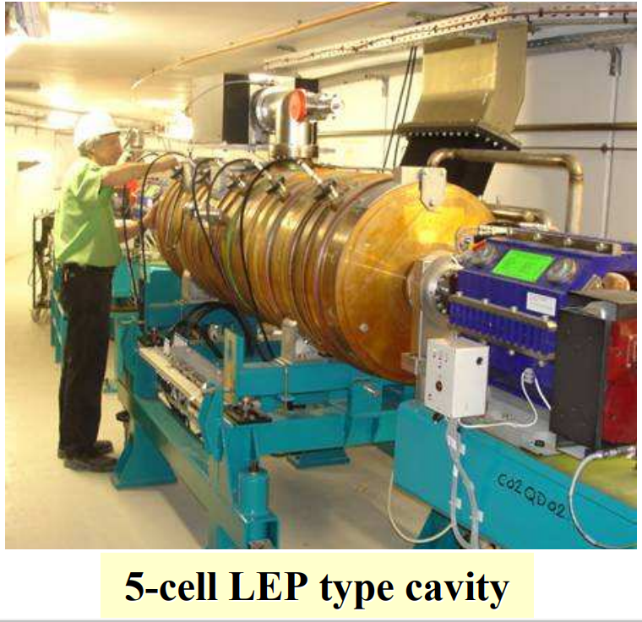
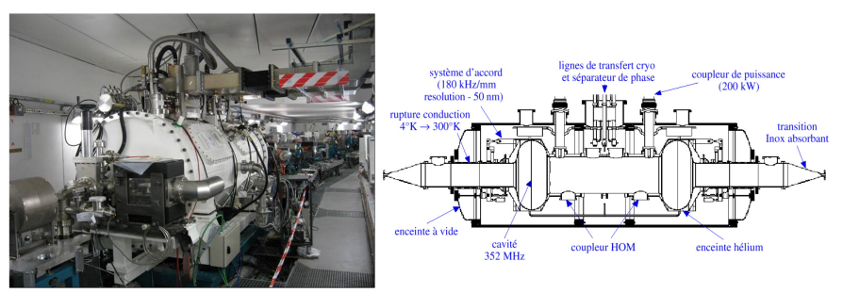
RF cavities in Soleil
one meter long and 43 cells (22 for accelerating)
3 GHz
A 5-cell Copper LEP type
cavity
T = 4,5K
2 cavities per cryomodule @ 352 MHz, 1.1MV/cav
Design and built by CEA and CERN
352 MHz, 900 kV
Marchand, P., et al. "Operation of the SOLEIL RF Systems." 2007 IEEE Particle Accelerator Conference (PAC). IEEE, 2007.
Loulergue, 20015 PAC, STATUS OF THE SOLEIL BOOSTER SYNCHROTRON
B. Pottin, , 2005, PAC, HELIOS, THE LINAC INJECTOR OF SOLEIL: INSTALLATION AND FIRST RESULTS
Notes:
580 kW (500 mA) & 4 MV @ 352 MHz 2 cryomodules, each containing a pair of single-cell s.c. cavities Each cavity powered by a 180 kW solid state amplifier Both CM supplied with LHe (4.5 K) from a single cryo-plant

Slide 10
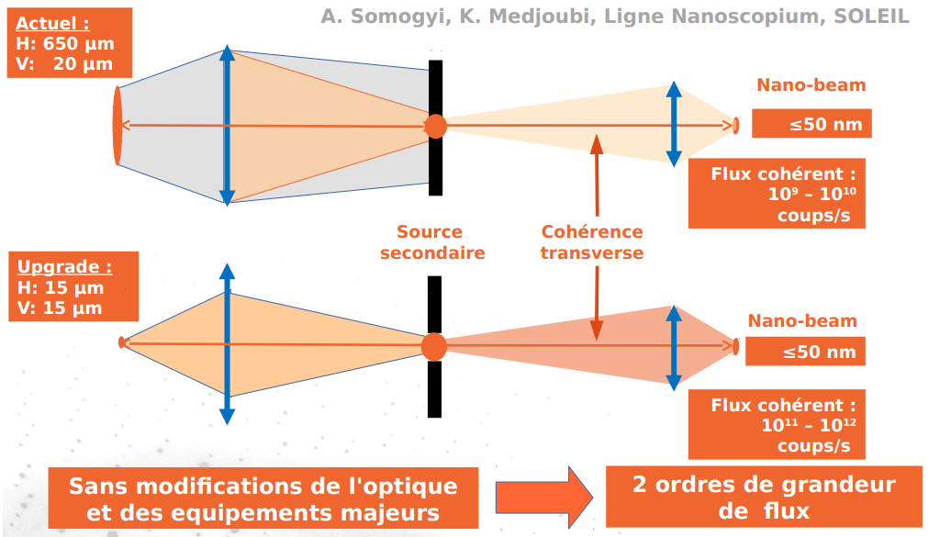
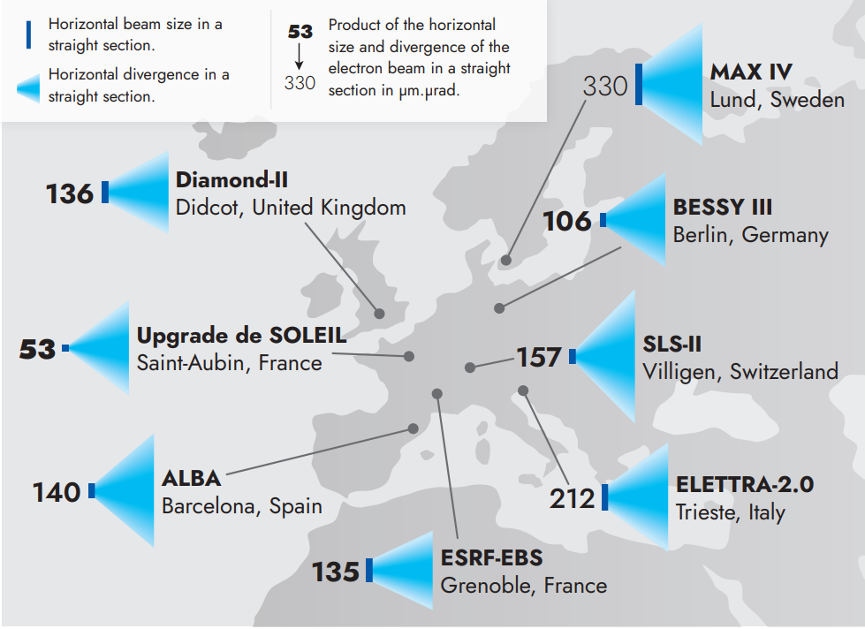
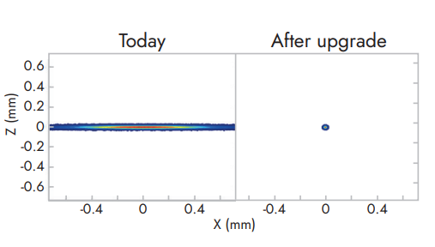
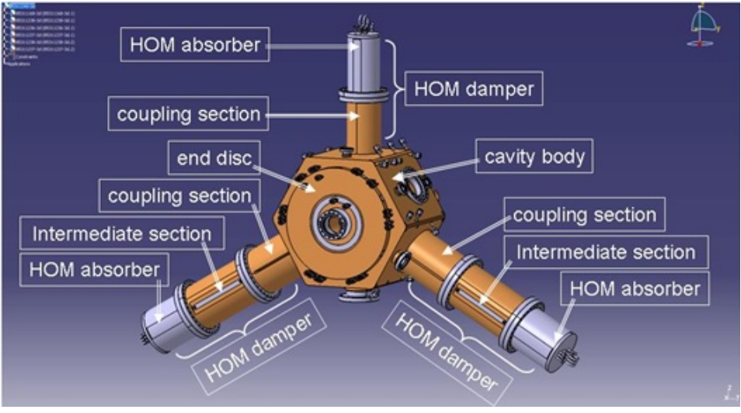
SOLEIL Ⅱ - A new soleil
The world’s most compact and highest-performance facility in the intermediate energy range (around 3 GeV)
electron beam 50 times smaller (nature horizontal emittance 80 pm.rad)
the photon beams will be at least 100 times brighter and more coherent in the X-ray range
ESRF 352 MHz HOM damped copper cavity
Alexandre Loulergue, Journées Accélérateurs Roscoff, 2019, Projet d'upgrade majeur pour SOLEIL

Slide 11
ESRF since 1992
Circ = 844m
Up to 100 KeV X-ray
200MeV LINAC + 6GeV booster
6GeV storage ring 200 mA
2020 New Extremely Brillant Source (EBS)
The European Synchrotron Radiation Facility – located in Grenoble, France

Slide 12
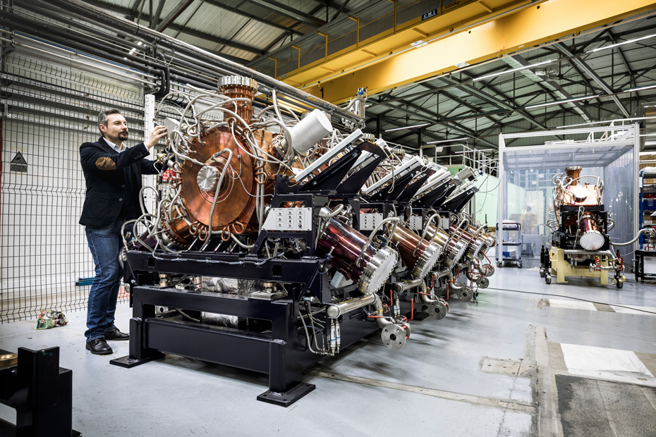
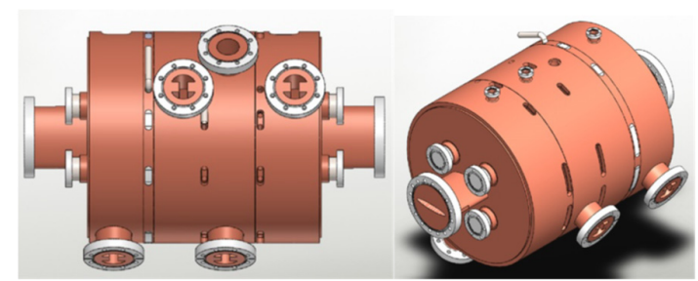
Now ESRF-EBS(2020)
Normal conducting cavity (copper)
1,4 GHz Harmonic cavity under development
13 cavities 352MHz in ESRF-EBS with $V_{acc }=750kV$ per cavity
Jörn Jacob, Harmonic RF project for ESRF-EBS, HarmonLIP Workshop,2022
Jörn Jacob, ESRF-EBS 352.37 MHz RADIO FREQUENCY SYSTEM,2021

Slide 13
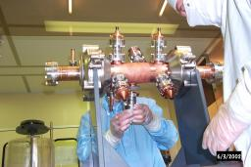
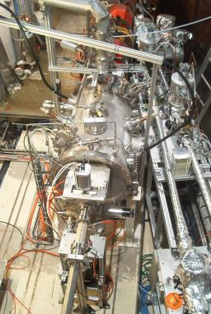
International projects
SOLEIL, CEA, PSI and ELETTRA
SUPER-3HC Project: a collaboration between CEA-Saclay, Paul Scherrer Institut (PSI) and Sincrotrone Trieste (ELETTRA)
“scaling to 1.5 GHz” of the 352 MHz cavity developed for the SOLEIL project.
SLS Super-3HC cryomodule being tested
Cryomodule Super-3HC installed in the Elettra Storage Ring
https://irfu.cea.fr/en/Phocea/Vie_des_labos/Ast/ast_visu.php?id_ast=825
M.Svandrlik, THE SUPER-3HC PROJECT: AN IDLE SUPERCONDUCTING HARMONIC CAVITY FOR BUNCH LENGTH MANIPULATION

Slide 14
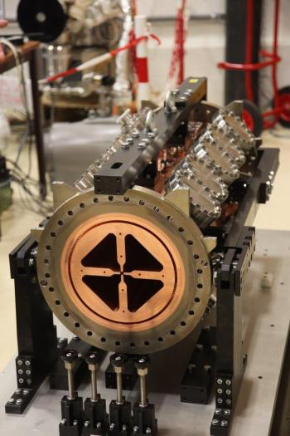
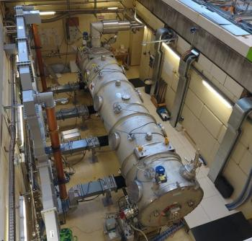
International projects
CEA and CNRS
ESS: European Spallation Source is under construction on the outskirts of Lund, a city in southern Sweden. ESS is a pan-European project with 13 European nations as members, including the host nations Sweden and Denmark.
First section of RFQ for ESS
RFQ cavities for $β=0,5$, operating at 352 MHz
704 MHz elliptical cavities for $β=0.67$ and $β=0.86$, Each medium- and high-beta cavity will be designed to deliver an accelerating voltage of 14.3 MV and 18.2 MV respectively.
Cryomodules ESS – 4 cavities

Slide 15
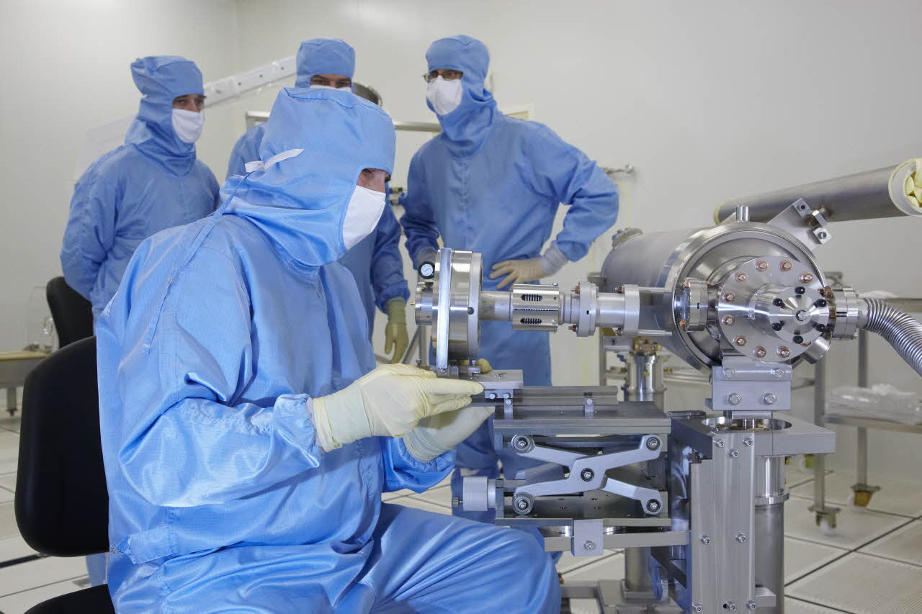
International projects
CEA
SARAF(Soreq Applied Research Accelerator Facility, Israel)
based on a 40 MeV, 5 mA CW proton/deuteron superconducting linear accelerator.
CEA and LAL(IJCLAB)
European XFEL
3.4 km long European XFEL generates extremely intense X-ray flashes, it current uses 768 cavities (1.3 GHz TESLA-type SC RF cavities) with Eacc=23.6 MV/m)
Cavity SARAF 176MHz
https://irfu.cea.fr/dacm/Phocea/Vie_des_labos/Ast/ast_visu.php?id_ast=4072
https://www.cea.fr/presse/Pages/actualites-communiques/sciences-de-la-matiere/XFEL-2017.aspx
Assembling the XFEL's accelerator cavities in a clean room @CEA

Slide 17
Merci!

Slide 18
RFQ vs groupeur
Gamme d'énergies : Un RFQ peut accélérer les particules sur une large gamme d'énergies. Il est capable d'accélérer des particules depuis une énergie relativement faible jusqu'à une énergie plus élevée, en fonction de la conception du RFQ. Cela en fait un choix polyvalent pour différents types d'accélérateurs.
Compacité : Les RFQ sont souvent plus compacts que les regroupeurs, ce qui est avantageux lorsque l'espace est limité. La taille réduite du RFQ permet également de l'intégrer plus facilement dans un système d'accélérateur existant.
Stabilité du faisceau : Les RFQ peuvent fournir une meilleure stabilité du faisceau en raison de leur conception. Ils sont capables de produire un faisceau de particules bien focalisé et de faible émittance, ce qui est important pour de nombreuses applications, telles que la physique des particules, la recherche en physique nucléaire, la médecine et l'industrie.
Coût : Dans certains cas, les RFQ peuvent être moins coûteux à construire et à entretenir que les regroupeurs. Cela peut rendre les RFQ plus attrayants du point de vue économique, en particulier pour les applications qui ne nécessitent pas des énergies d'accélération extrêmement élevées.

