Slide 1
Design and performance challenges of the future high energy colliders
B. Dalena (CEA, Irfu, DACM, Paris-Saclay University)
With contributions from: C. Antoine, P. Bosland, P. Bredy, V. Calvelli, A. Chance, E. Cenni, T. Lecrevisse, C. Lorin, C. Marchand, D. Minenna, L. Quettier, E. Rochepault, D. Uriot and all DACM teams!

Slide 2
Outline
Future Colliders projects
Design and performance optimization
High Field Magnets (HFM) R&D
Super Conductive Cavities (SRF) R&D

Slide 3
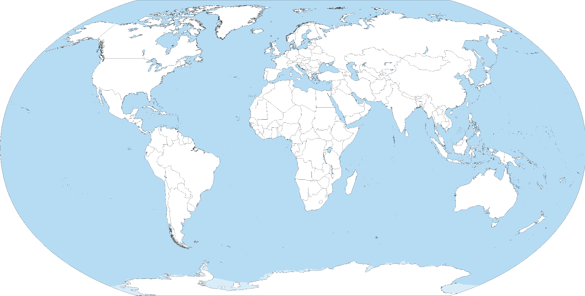
Future HEP Accelerators
Muon Collider
LHeC
HE-LHC
PIP I
PIP II
HE-eLHC
HL-LHC
FCC-hh
C³
RHIC EIC
FCC-he
FCC-ee
ILC
Muon Collider
SppC
JPARC MR
CLIC
superKEKB
BEPCII
CepC
CEA-DACM is presently implicated in the HL-LHC, EIC, ILC, FCC and Muons Colliders projects

Slide 4
Design and performance optimization
1

Slide 5

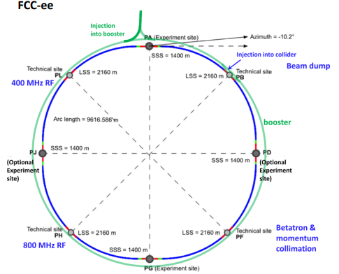
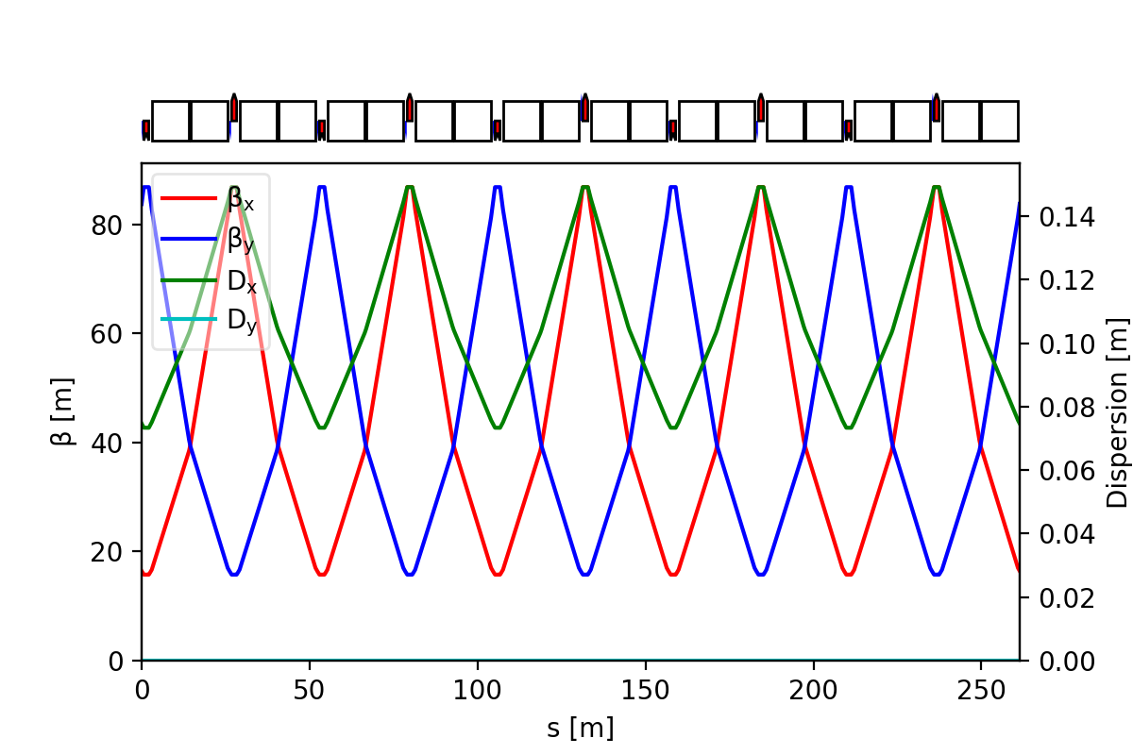
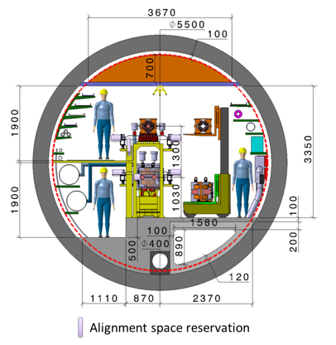
Arcs design and performance
(FCC-ee Booster)
Pre-injectors input parameters
& Booster cycle
Civil engineer constraints
Magnets min gradient and Field Quality
FODO cell not optimum
alternative under study
*N-times
Collective effects: mitigate the impact of impedance and IBS optimizing the optics of the arc cells
Integration of the Booster and the collider in the same tunnel
On momentum and off momentum particles stability

Slide 6

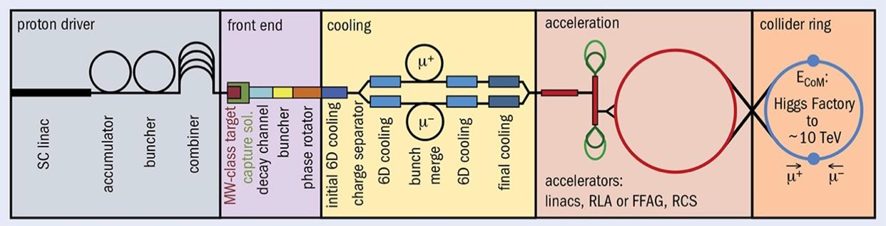
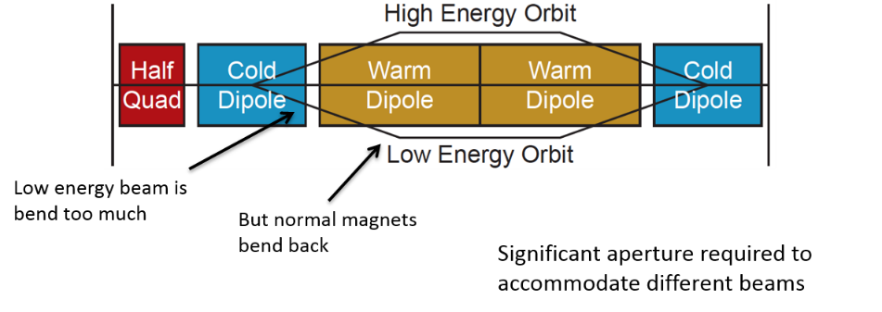
Rapid Cycling Synchrotrons (RCS) design (Muons)
Courtesy of A. Chance
Find the best ratio extraction/injection ratio between the different acceleration stages.
Muons decay very fast (Rest lifetime: 2.2 µs)
Accelerate fast (~10 ms)
Chain of rapid cycling synchrotrons, counter-rotating µ⁺/µ⁻ beams
→ 63 GeV → 0.31 TeV → 0.75 TeV → 1.5 TeV (→ 5 TeV)
hybrid
RCS
5 TeV
hybrid
RCS
1.5 TeV
norm. cond. RCS
hybrid RCS
*N-times
Both in the same tunnel
Objectives:
  Beamline in a parameter table
  Full set of lattices with critical technologies identified
  Start-2-end tracking to demonstrate luminosity performance and to validate the bunch compression and emittance preservation during the acceleration process
Optimize the total voltage and energy gain per turn
Optimize the dipole ramp to minimize the power consumption
Fit existing tunnels

Slide 7









Laser wakefield accelerator design
Courtesy of D. Minenna
01
Design of accelerators
EARLI project
Design of a laser wakefield accelerator for electron injection
  Transition toward user facilities
  First step: numerical design, prototypes and viability studies
For the AWAKE collaboration
  As an alternative design for AWAKE
  Comparison with a CERN electron gun will be made
Setting component parameters
02
LASER-plasma Simulation
Multi-parameters (laser + plasma profiles)
Cross-checking
03
Transfer Line design
Development of the TraceWin code
06
optimisatioN of accelerators
Numerical optimisation (Machine learning)

Slide 8
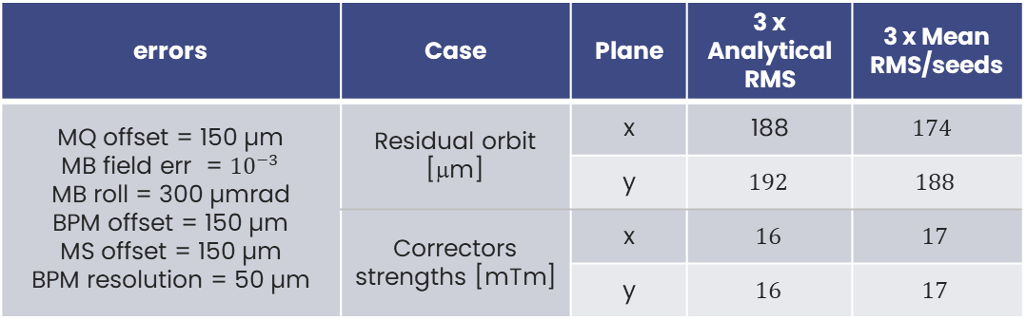
Optics Corrections strategy (FCC-ee Booster case)
Motivation
Evaluate specifications of the main magnets misalignment of the High Energy Booster arcs cells and of magnets field error
Definition of the orbit correction strategy and of correctors specifications for the booster
Orbit correction
errors | Case | Plane | 3 x Analytical RMS | 3 x Mean RMS/seeds
MQ offset = 150 µm MB field err = ${10}^{−3}$ MB roll = 300 µmrad BPM offset = 150 µm MS offset = 150 µm BPM resolution = 50 µm | Residual orbit [μm] | x | 188 | $${174}^{ }$$
 |  | y | $${192}^{ }$$ | $${188}^{ }$$
 | Correctors strengths [mTm] | x | $${16}^{ }$$ | $${17}^{ }$$
 |  | y | $${16}^{ }$$ | $${17}^{ }$$
roll
Improvements and related work:
Other methods than SVD - AI ?
Full emittance tuning
Study the impact of booster support vibrations on emittance
Study the impact of energy ramp during the booster cycle
offset

Slide 9

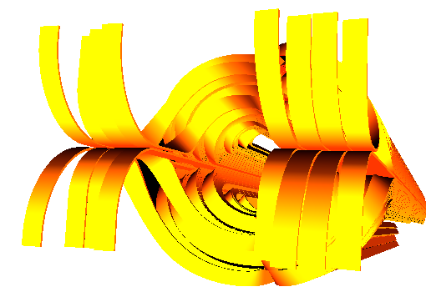
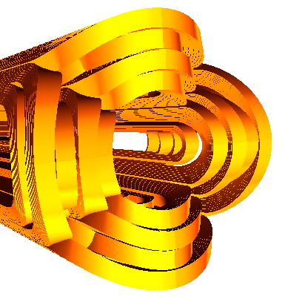
Improve modeling of non-linear magnetic field in tracking simulations
T. Pugnat PhD thesis
Accurate and efficient modeling of the magnet field extremities required to see their effects on the beam
In the High Luminosity IRs the variation of the beta function along a single magnet is not small, the longitudinal distribution of field errors may impact beam based quantities
Aim: understanding and correction of non-linear effects on the beams
Courtesy of S. Bagnis

Slide 10
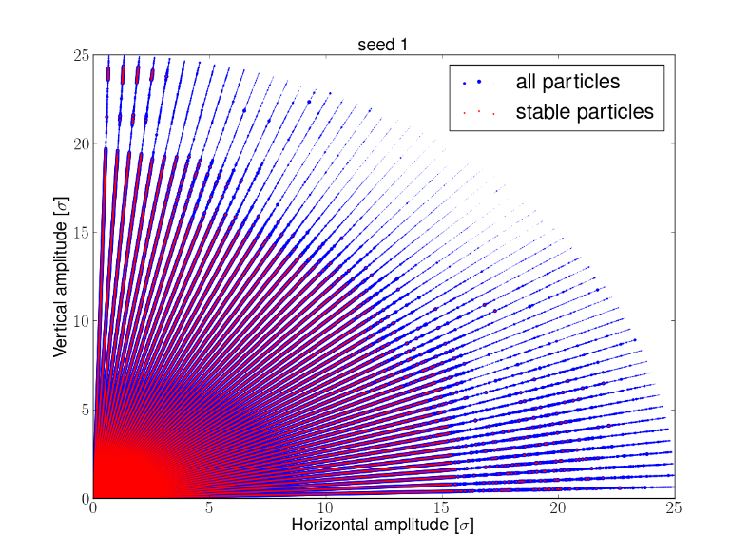
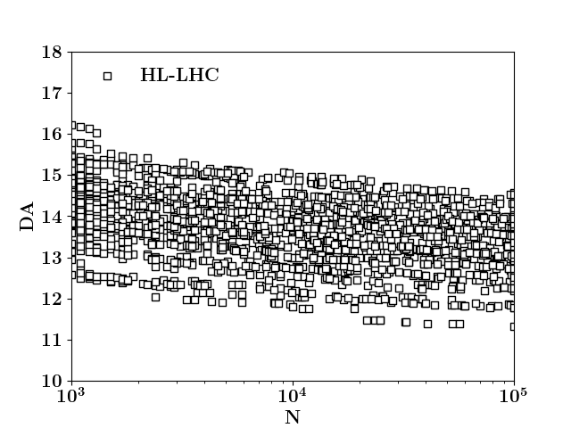
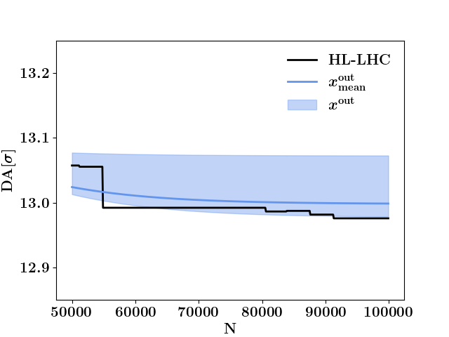
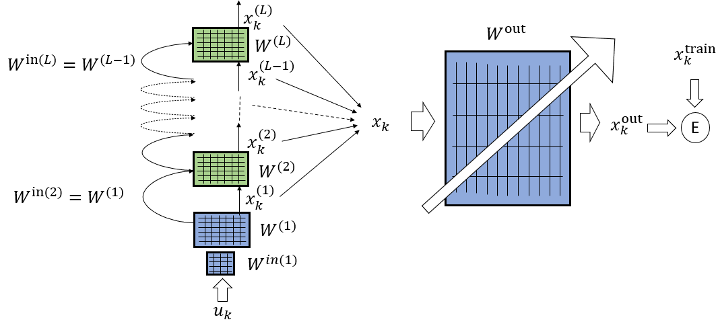
Prediction of Phase-Space Stable Region for Hadron Storage Rings (HL-LHC case)
?
Replace CPU costly tracking simulations with fast surrogate model of the time evolution of Dynamic Aperture
M. Casanova et al.
https://doi.org/10.1140/epjp/s13360-023-04167-y
Deep Echo State Networks (DeepESN)

Slide 11
High Field Magnets (HFM) R&D
2

Slide 12
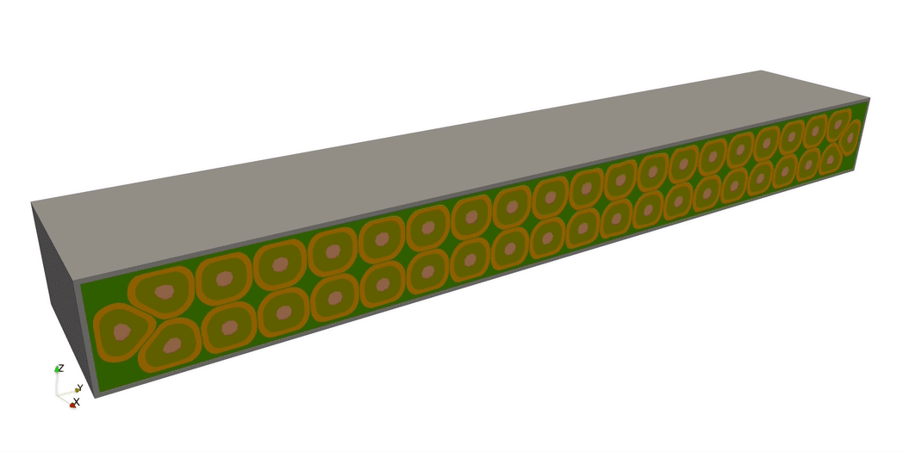
Expertise and infrastructures
Courtesy of L. Quettier
Magnetic calculations
Conductor design
Magnets Mechanics
Magnets Cryogenics
Quench analysis and magnet protection
Magnet safety and magnet control systems (DIS)
Industrial follow-up
DIS

Slide 13
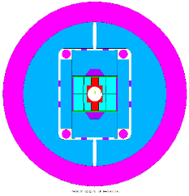
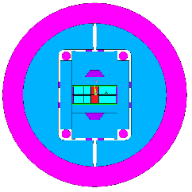
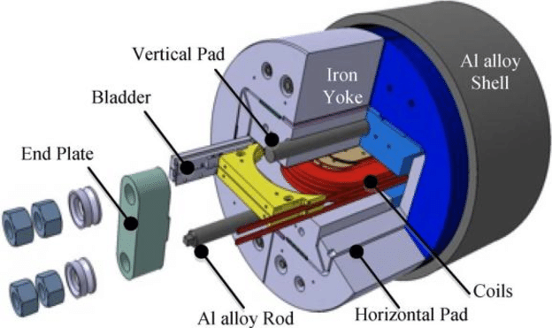
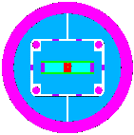
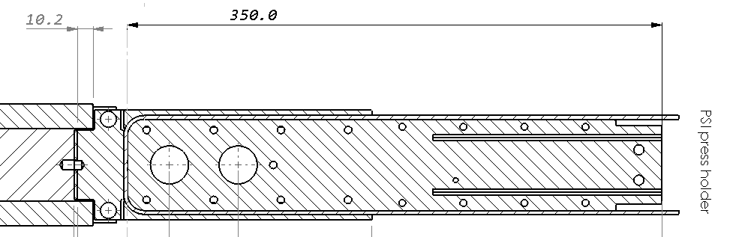
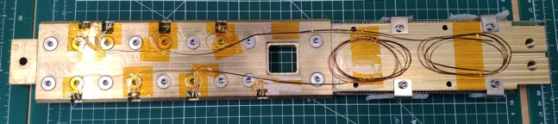
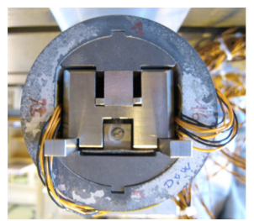
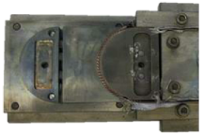
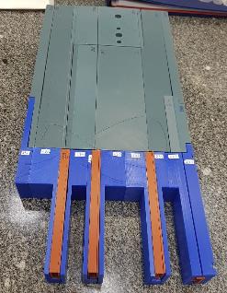
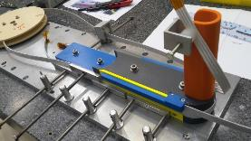
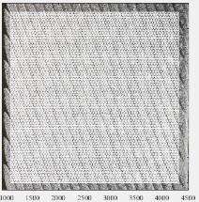
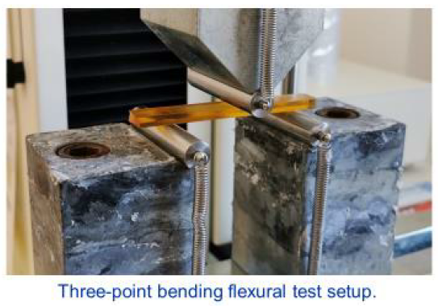
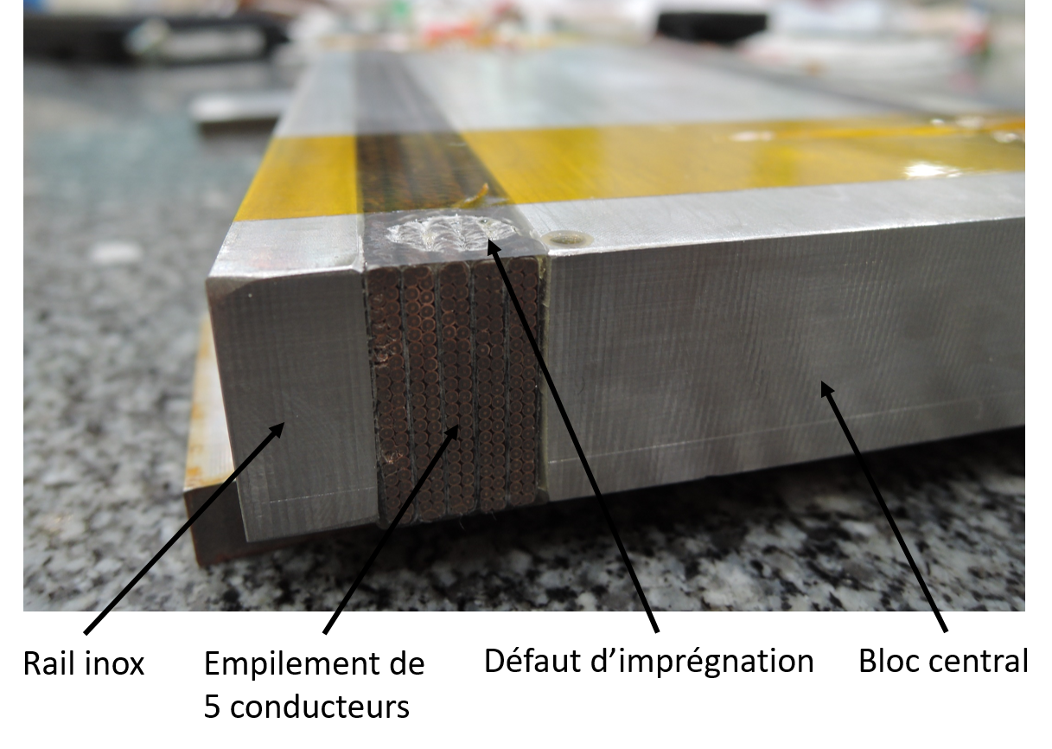
Development plan toward 16 T Nb₃Sn Dipoles
16 T
demo
12-14 T demo
Subscales
Powered samples
Non-powered samples
Courtesy of E. Rochepault
F2D2
D5
2026-2027
FD
D5
2025-2026
SMC
D3
R2D2
D4
Racetrack Dipoles
On-going

Slide 14
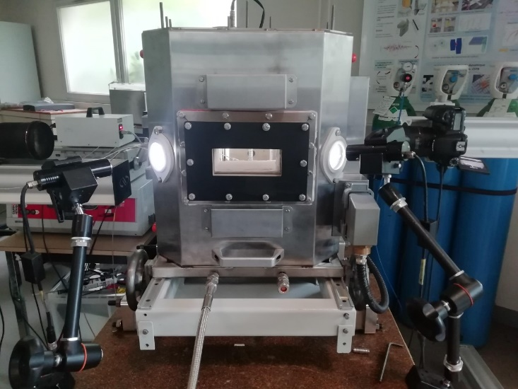
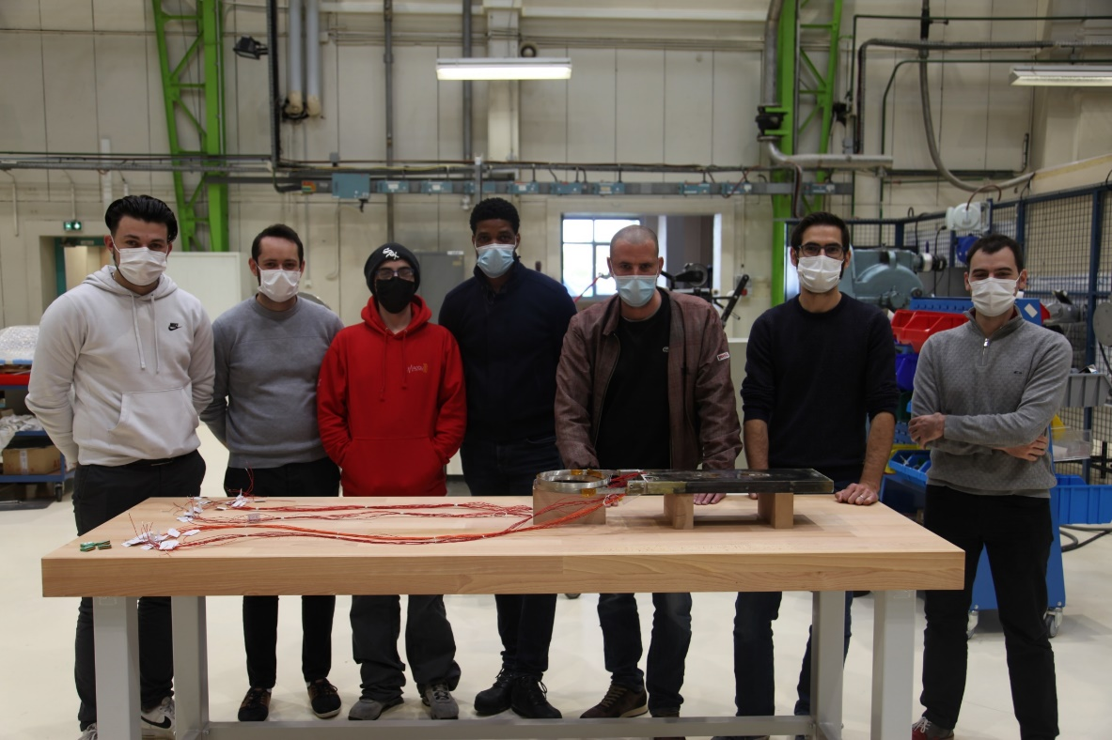
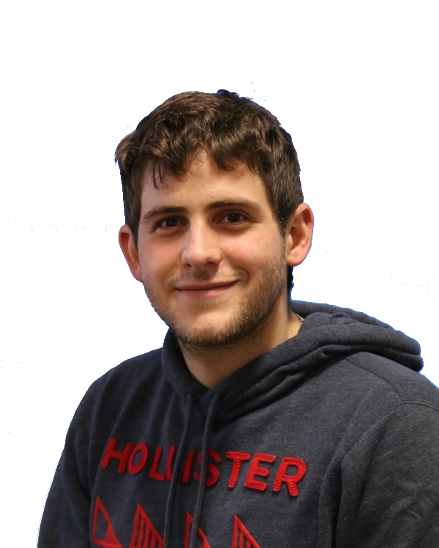
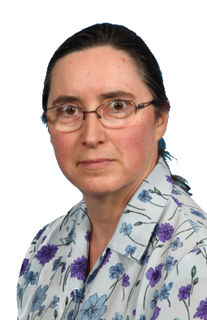
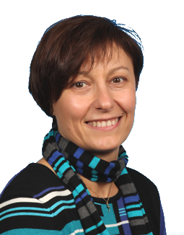
Development of Nb₃Sn magnets towards 16 T
« Non-powered samples » → Characterizations of materials, development of processes, validation of concepts
« Powered samples » → Study of performances of Nb₃Sn
Model coil SMC : successful test! → Development of fabrication processes, infrastructure, gain of experience
R2D2 12T: CEA conceptual design validated by an external committee
Characterization of conductors during heat treatment at 650°C → PhD M. Abdel Hafiz
R2D2 = Research Racetrack Dipole Demonstrator

Slide 15
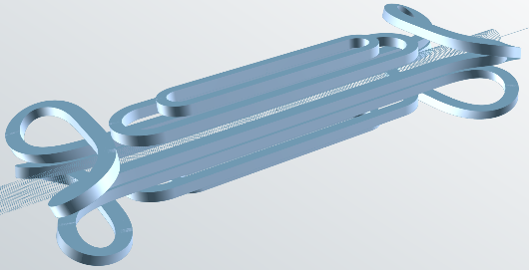
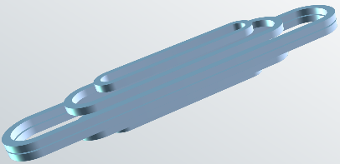
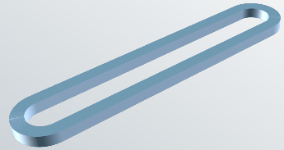
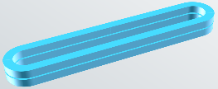
Development Plan towards 20 T HTS Dipoles
Courtesy of T. Lécrevisse
Phase 3 :
« EuCARD V3 »
MI cold bore 16 T+
magnet
Phase 2 :
magnet MI 16 T+
« EuCARD V2 »
Phase 1 2023-2025:
Racetrack MI
On-going Project
Adapt and validate the numerical tools for electromagnetic + thermal + quench models
Characterize specific parameters of Metal Insulated windings (Turn-to-turn thermal conduction…)
Develop the technologies from winding to assembly including electrical connections
Evaluate the options of conduction cooled dipole
Fabricate and test one racetrack coil for models benchmark

Slide 16
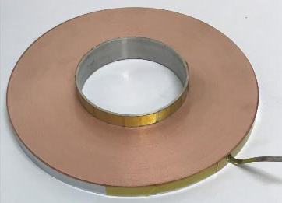
HTS solenoids R&D
Courtesy of L. Quettier, P. Fazilleau
High Field MI magnet (NOUGAT)
Long-lasting R&D on HTS solenoid @DACM
(example: NOUGAT magnet)
Use «Metal-insulated (MI)» winding:
Concepts:
  20 T @ 4.2K
  Or 16 T @ 20 K → opportunity to lower exploitation costs or simplify cryogenics
NOUGAT pancake (MI)
Target capture solenoid: 20 T with 150 mm aperture
Final cooling solenoids: 40 T with 50 mm aperture
NOUGAT magnet
2018 tests at LNCMI
⇒ The Muon collider project fit the on-going R&D of Irfu

Slide 17
Super conductive cavities (SRF) R&D
3

Slide 18

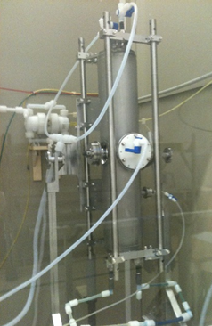
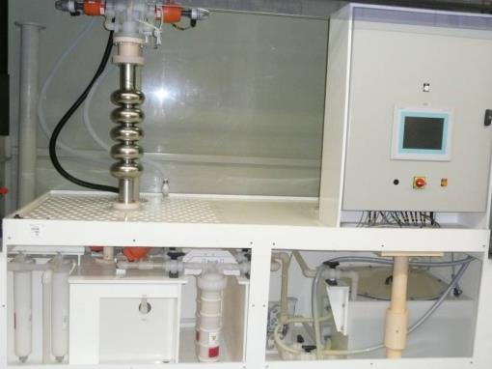
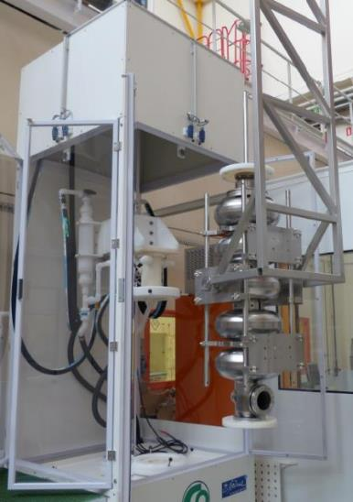
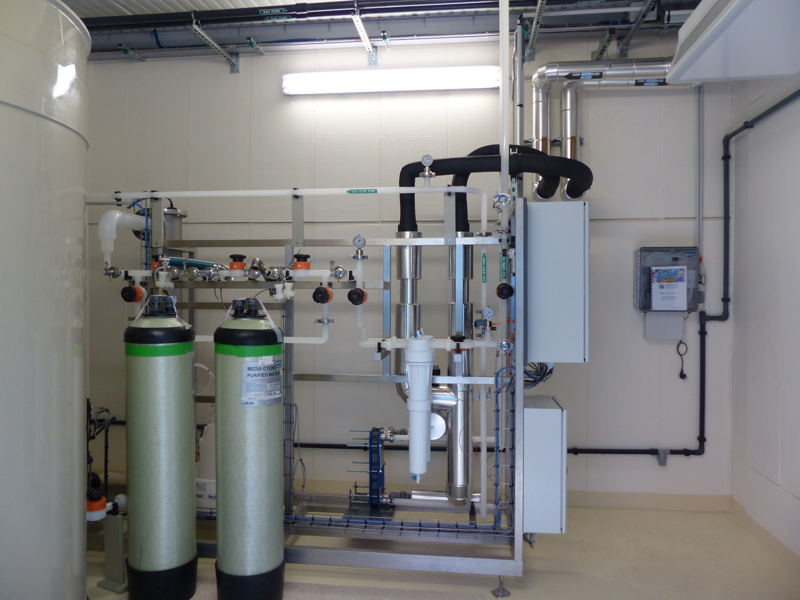
SUPER CONDUCTIVE CAVITY: SURFACE PREPARATION
Vertical electropolishing cabinet
Integrated chemistry cabinets (BCP)
  Buffer Chemical Polishing
  HF,HNO₃,H₃PO₄: 1/1/2.4
  200 l tank
  HF,H₂SO₄
  300 l tank
2 systems for production of
18 MΩ ultrapure water for the chemical treatments and for the 2 clean rooms

Slide 19
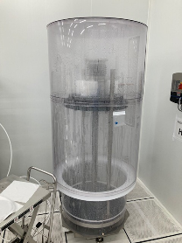
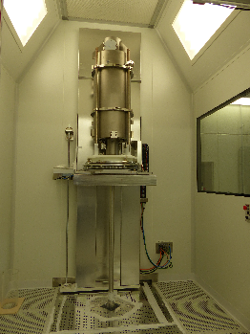
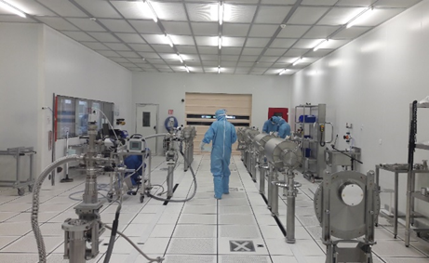
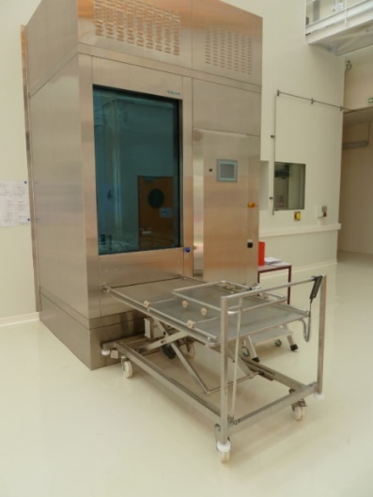
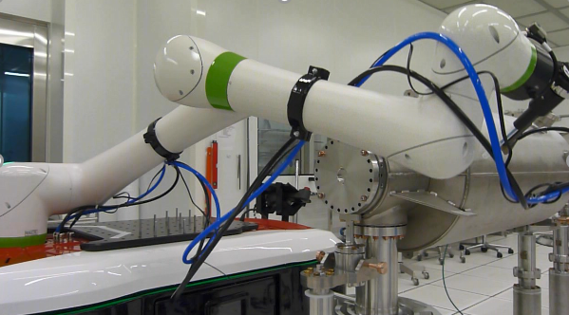
CLEAN ROOMs
ISO4: XFEL, ESS cryomodule assembly ISO5/7 R&D, IFMIF, SARAF
ISO4
112 m²
ISO 7
28 m²
6.0 m
ISO 5
38 m²
7.8 m
15.6 m
HPR rinsing in ISO4 clean room
HPR rinsing in ISO5 clean room
ESS
Washing machine
COBOT in clean room

Slide 20

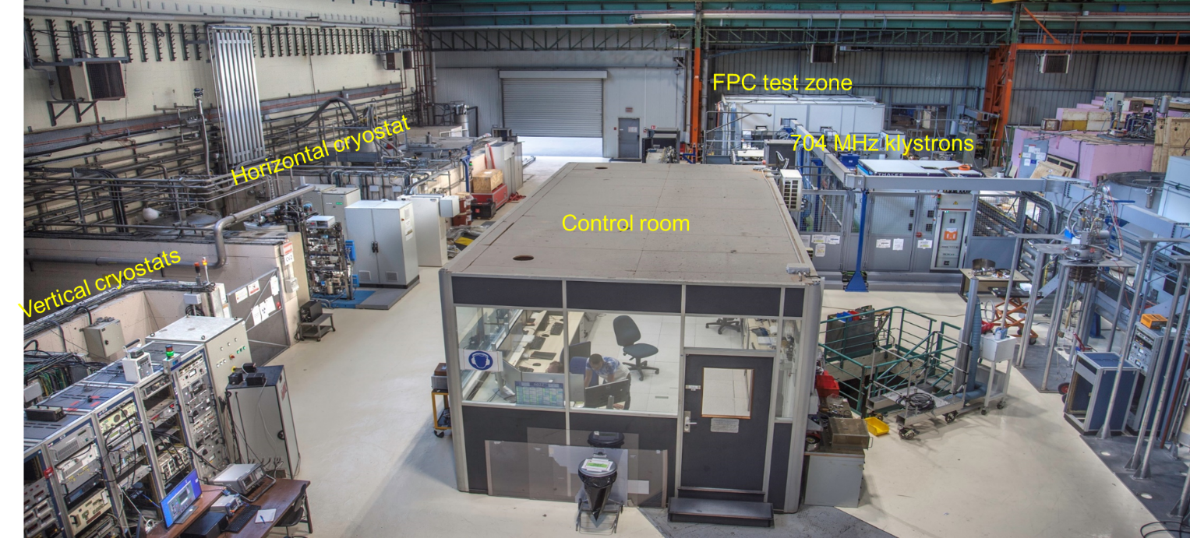
Supratech Cryo-HF : infrastructures
Courtesy of P. Bosland, E. Cenni, P. Bredy
Helium Cryogenic plant
The Helium cryogenic system is going to be upgraded for PIP-II (40 K He for thermal shield, supercritical He for cryomodule supply, fast cool down step , increase of LHe production and of 2K He pumping unit)
Two vertical cryostats: Test single and multicell cavities with high frequency (175MHz, 704MHz and 1.3 GHz)
One horizontal cryostat: Enable a complete cavity package test (cavity+tuner+fundamental power coupler)
Two 704 MHz High power klystrons: high power cryomodule test and fundamental power coupler conditioning
One bunker for testing complete cryomodule under HF power and cryogenic conditions

Slide 21
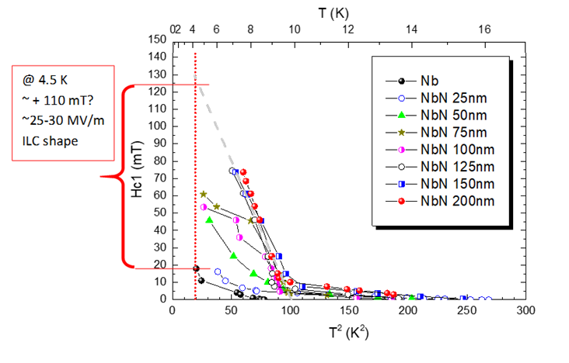
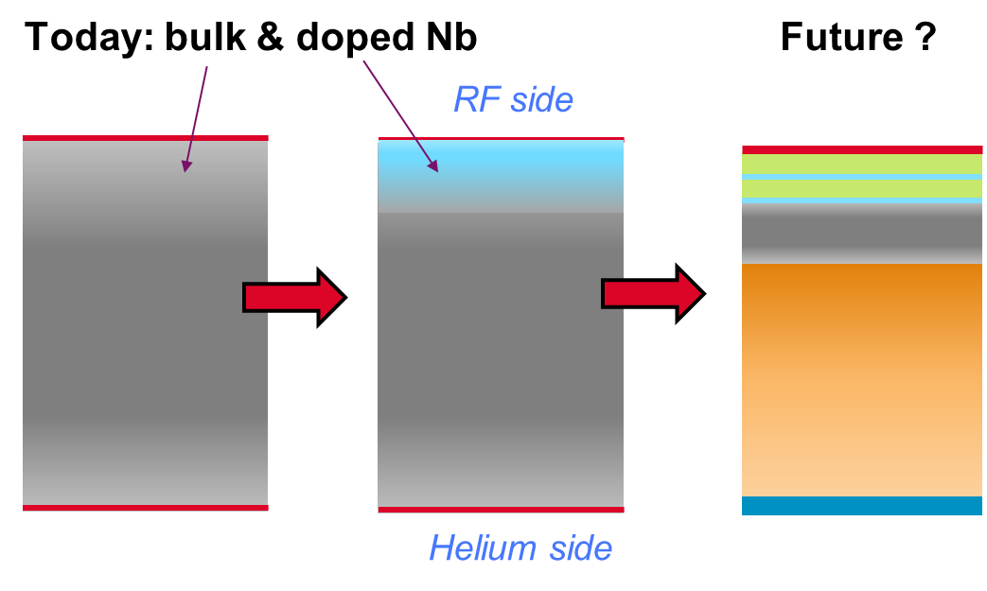
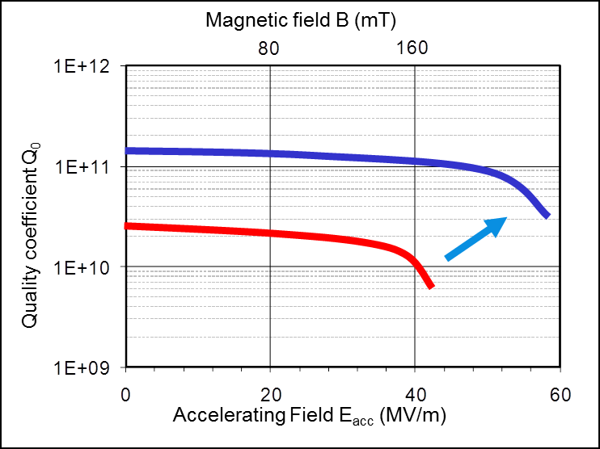

SRF R&D: Thin films (multilayers concept)
  High Quality factor for colliders (ILC, FCC, …and EVERY other types of accelerators!!!)
    => possibility of operation at 4.5 K or even higher (instead of 2k)
    => investment (~35-40%) and operation cost ( ~60% ) savings in cryogenic installations
    => lower plug power (greener operation)
    => opens the way to new cooling processes (He issues)
Courtesy of A. Claire
  High accelerating gradients for colliders (ILC… and compact small machines for medical/industrial applications)
    => investment savings in building, superconducting material, RF installations….
Measured
Future : totally functionalized material, each layer its own role (thermal conductivity, high superconducting performance, multipacting mitigation….)
Expected

Slide 22
Implication in FCC
Courtesy of P. Bosland
Booster
MACSE
SOLEIL
TTF, SLS
SPIRAL2XFEL
IFMIF LIPAc
ESS, SARAF
PIP-II
DONES
Others
Future
FCC ?
CEA has a long experience in SRF technology and can contribute to FCC:
Cavity preparation recipe and industrialization R&D
Cryomodule assembly
Clean room robotization development

Slide 23




Implication in Muon Colliders
Courtesy of C. Marchand
RF cavities for muon cooling cells
Normal conducting cavities
$f \sim 325 MHz, 650 MHz$
Short RF pulses (~𝜇𝑠)
High acceleration gradients (~30 MV/m)
High magnetic solenoidal field (up to 14 T)
Objective:
  find best cavities & RF properties to minimize breakdown due to High Gradient in high magnetic field
Methodology:
  1/scaling using no-diffusion beamlet model (done)
  2/develop semi-analytical model based on simulations of the electron beam in the cavity (like done in US beamlet approach Palmer et.al PRAB 2009, Stratakis et.al NIMPR 2010, Bowring et.al PRAB 2020)
  3/adjust coefficients of semi-analytical model on existing and new experimental data foreseen in RF test stands
  4/test new ideas (cavity length, couplers,..)
Benefits of short pulse and aluminum multiply

Slide 24
Conclusions
We are participating in international collaborations to design future HEP Collider projects
We are pursuing R&D on high field magnets, SRF cavities and cryomodules, beam dynamics modeling, and laser-plasma acceleration that can meet some of the challenges of several future collider projects
We continue to upgrade the infrastructures to test, develop and assemble key technological systems for several future colliders
⇒ We are looking forward the next future collider

Slide 25
Back-up
3

Slide 26


Arcs design and performance (FCC-hh Collider)
Civil engineer constraints
Magnets max gradient and Field Quality
Beam-screen design
Half arcs cell including
linear and non-linear correctors
*N-times
213/2 m
Integrations of experimental IRs (correction schemes)
Beam-stability:
Integration of Landau Damping octupoles
Collimation requirements

Slide 27





MARCO Solenoid
32.7 mm
2T Solenoid for the EIC ePIC detector @ BNL
Copper stabilized RIC NbTi conductor (Iseult inspiration)
Inner wounded on a brass mandrel
Parameter | Parameter Value | Units
Bore diameter | 2.84 | m
Coil Rin | 1.501 | m
Coil thickness | 32.7 | mm
Coil Length | 3492 | m
Nominal Current | 3924 | A
Turns | 1668
Layers | 6
Modules | 3
B₀ | 2.00 | T
Bpeak+self field | 2.67 | T
Stored Energy | 45.3 | MJ
Projectivity | 2.41 | Tmm²/A
Homogeneity | 12.3 | %
Transparency Thickness/nuclear interaction length | 0.468
Coil cross-section & materials
30 mm
MARCO Conductor
MARCO Solenoid
STATUS
90% design forecast in October
(DOI CD2/3A November 2023)
Conductor R&D started in 05/2023
tender → forecast in 2024

Slide 28
What is a good thin film superconductor ?
Courtesy of A. Claire
  A compromise between:
    High superconducting/RF performance (High Tc, High superheating field)
    Easy fabrication process,
      ≡ high reproducibility at “industrial scale”
      Easy process to go from 1-cell to multi-cells or complex shapes
      Easy process to adapt to various frequencies
    Tunability
      Beware of brittle materials !
    Low sensitivity to trapped flux upon cooling down
      Few crystalline defects or a structure not too sensitive to them (e.g. SIS)
  Thin films on copper are the only route to help cost savings
    Cheaper manufacturing
    Higher operation temperature
    Higher gradients : lower capital costs

