Slide 1







Ion-Ion Collisions for Atomic Physics at CRYRING@ESR, GSI/FAIR
E. Lamour, M. Jolly, S. Macé, C. Prigent, S. Steydli, M. Trassinelli, D. Vernhet
A. Méry, J. Rangama, J‐Y Chesnel, P. Rousseau
A. Bräuning‐Demian, R. Grisenti, A. Gumberidze, M. Lestinsky, U. Spillmann, T. Stöhlker
P.‐M. Hillenbrand, S. Schippers
H. Savajols, C. Stodel, R Levallois
MC2 : Contributions des laboratoires français aux futurs grands collisionneurs

Slide 2
Ion-Ion Collisions for Atomic Physics at CRYRING@ESR, GSI/FAIR
GSI/FAIR facilities in Germany (Darmstadt), Research @ GSI/FAIR
the SPARC collaboration: CRYRING@ESR
Atomic structure of HCI : QED effects
Future ion-ion collisions @: CRYRING@ESR
MC2 : Contributions des laboratoires français aux futurs grands collisionneurs

Slide 3
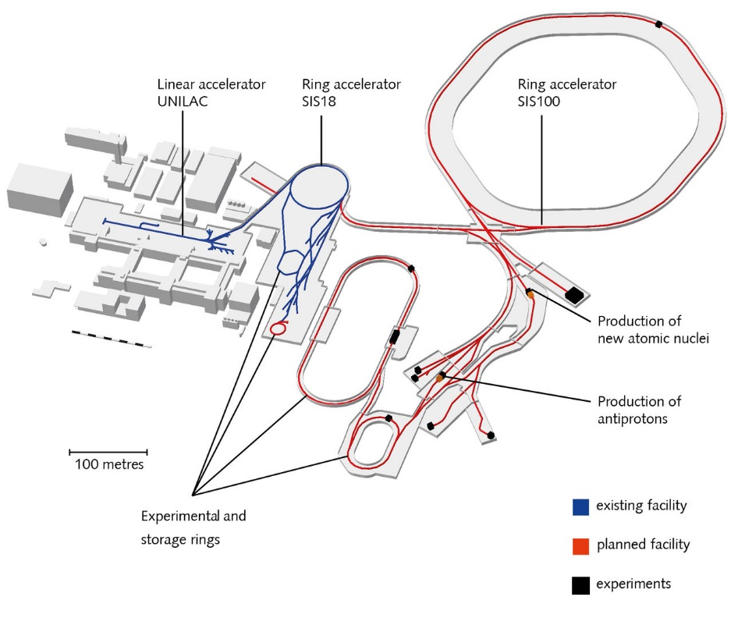
Ion-Ion Collisions for Atomic Physics at CRYRING@ESR, GSI/FAIR
GSI/FAIR Facility
Ability to provide charged particle beams of all the chemical elements, as well as antiprotons.
Heavy particles with velocities from almost the speed of light to almost at rest.
a superconducting ring accelerator with a circumference of 1100 meters, storage rings and ion traps.
⇒ several kilometers of beam line in total.

Slide 4
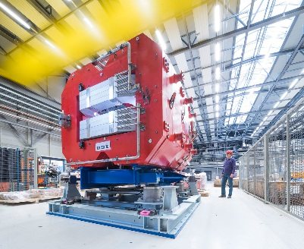
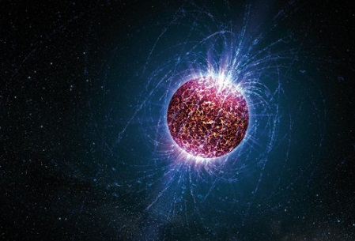
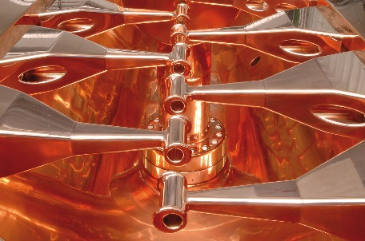
Ion-Ion Collisions for Atomic Physics at CRYRING@ESR, GSI/FAIR
Four research pillars
NUSTAR
CBM
Nuclear Structure. Astrophysics and Reactions. Experiments with atomic nuclei are the key to understanding stars.
Compressed Baryonic Matter. The collision of atomic nuclei at high speeds can simulate the conditions inside supermassive objects for a split second.
A magnet of the future Super-FRS.
Artist's impression of a neutron star.
PANDA
APPA
Atomic, Plasma Physics and Applications. From the investigation of atomic and macroscopic effects in materials or biological tissues
Antiproton Annihilation. How can antimatter help us understand the mass of matter and the strong force?
Inner structure of a decelerator
The PANDA detector

Slide 5
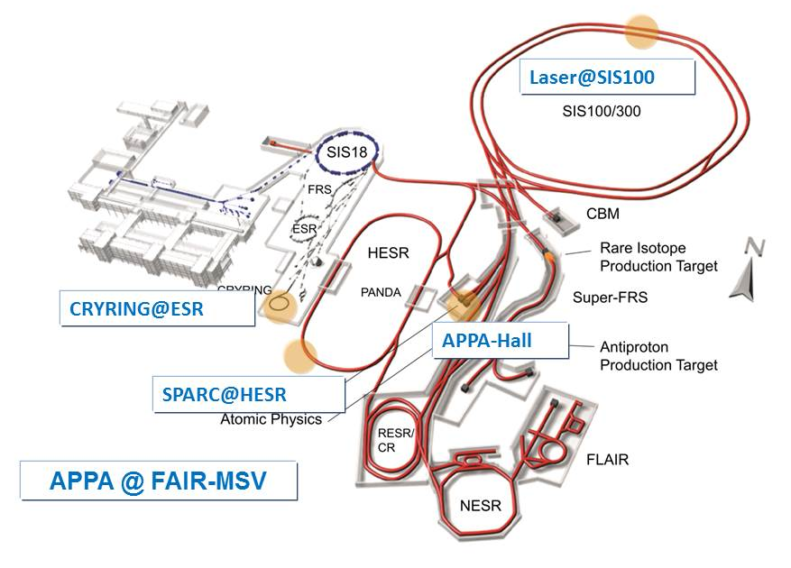

Ion-Ion Collisions for Atomic Physics at CRYRING@ESR, GSI/FAIR
APPA @ FAIR
Stored Particles Atomic Physics Research Collaboration
Atomic physics, quantum electrodynamics, ultra-high electro-magnetic fields studies with beams of highly-charged heavy ions

Slide 6
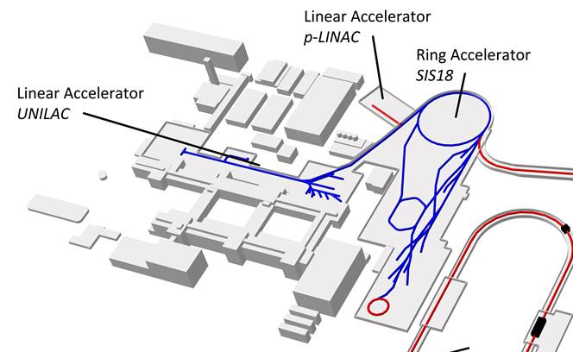
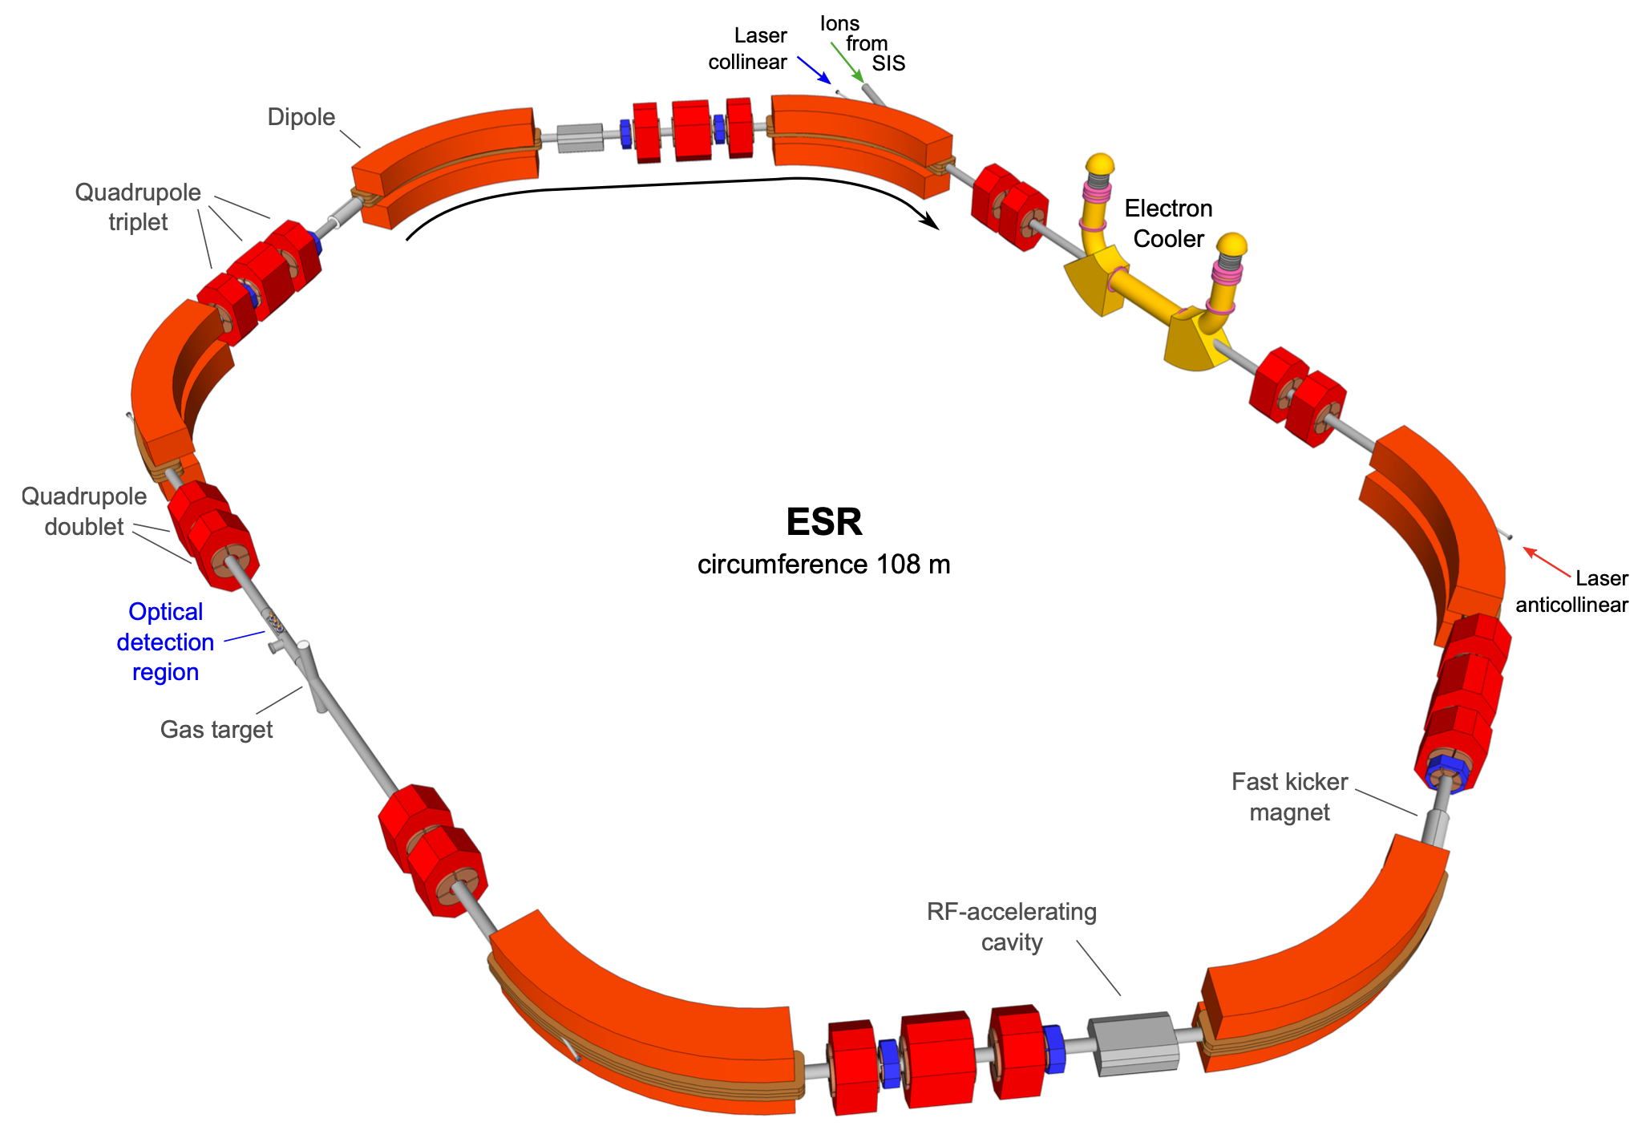
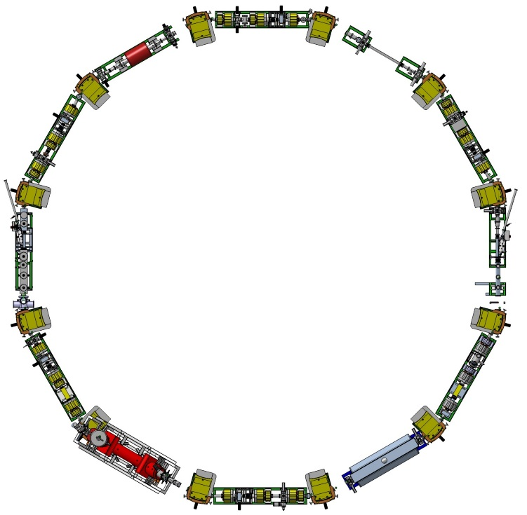
Ion-Ion Collisions for Atomic Physics at CRYRING@ESR, GSI/FAIR
Electron cooler
circumference of 108,36 m
magnetic rigidity of 10 Tm
Beam transfer from ESR to CRYRING
Gas jet
possibility to store U ions at an energy of 560MeV/u and then to cool them
¹²C⁶⁺ : 24.7 MeV/u
²³⁸U⁹²⁺ : 14.8 MeV/u
circumference of 54,17 m
rigidity of 0.054 – 1.44 Tm
Vacuum conditions : 10⁻¹¹ – 10⁻¹² mbar
10⁶ – 10⁸ stored ions

Slide 7
Ion-Ion Collisions for Atomic Physics at CRYRING@ESR, GSI/FAIR
Uranium
Electron cooler
Atomic structure of highly charges ions
Quantum Electrodynamics (QED)
effects enhanced
Argon
circumference of 108,36 m
magnetic rigidity of 10 Tm
He-like U
Neon
1s2p ¹P₁
Gas jet
E1
1s2p ³P₂
1s2s ¹S₀
1s2p ³P₀
1s2s ³S₁
1s2p ³P₁
M2
Hydrogen
M1E1
M1
2E1
E1
possibility to store U ions at an energy of 560MeV/u and then to cool them
1s² ¹S₀
Self Energy
Vacuum conditions : 10⁻¹¹ – 10⁻¹² mbar
10⁶ – 10⁸ stored ions
High precision measurements sensitive to 2nd order QED effects
Nuclear size
Vacuum
Polarization

Slide 8
Ion-Ion Collisions for Atomic Physics at CRYRING@ESR, GSI/FAIR
Uranium
Electron cooler
Atomic structure of highly charges ions
Quantum Electrodynamics (QED)
effects enhanced
Argon
circumference of 108,36 m
magnetic rigidity of 10 Tm
He-like U
Neon
Gas jet
Hydrogen
possibility to store U ions at an energy of 560MeV/u and then to cool them
Self Energy
Collaboration : INSP, LKB (France)
Nuclear size
GSI, Jena university, Helmholtz-Institut Jena, NOVA University Lisbon
Vacuum
Polarization

Slide 9


Ion-Ion Collisions for Atomic Physics at CRYRING@ESR, GSI/FAIR
Different electronic processes in atomic collisions
Ionization
0
Excitation
Electronic transfer
0
$$Z_{P} , \vec{V_{P}}$$
$$Z_{T} , \vec{V_{T}}$$
⇒ Probabilities (i.e. cross sections) depend on the atomic numbers and the collision energy

Slide 10
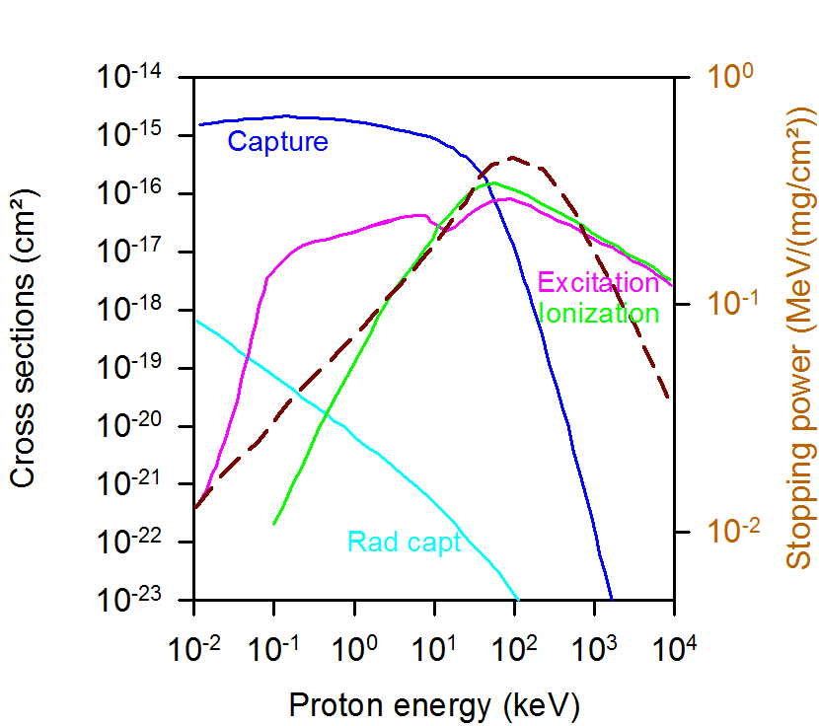






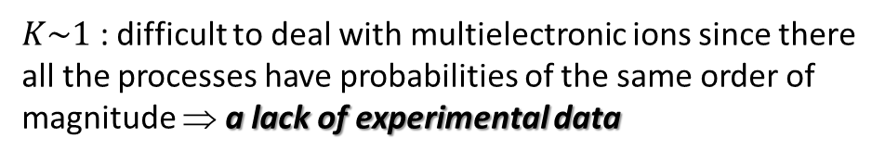
Ion-Ion Collisions for Atomic Physics at CRYRING@ESR, GSI/FAIR
Proton on H
Collision strength parameter:
$$K=\frac{v_{e}}{v_{p}}×\frac{Z_{T}}{Z_{P}}$$
$K\sim 1$ : difficult to deal with multielectronic ions since there all the processes have probabilities of the same order of magnitude ⇒ a lack of experimental data
Proton in Al
Theoretical approaches
$$ZP/Z_{T}$$
100
10
CDW
1
MO
Born
AO
$$K >>1$$
$$K\sim 1$$
$$K <<1$$
0.1
$$Vp/v_{e}$$
0.1
1
10
100
non-pertubative….....to……. pertubative regime
Formation of a transient molecule
Fast collision, small perturbation

Slide 11



Ion-Ion Collisions for Atomic Physics at CRYRING@ESR, GSI/FAIR
$$K_{p}≫1$$
$$K_{p}\sim 1$$
$$K_{p}≪1$$
non-pertubative……....to…..…. pertubative regime
Ion-atom collisions
(N-body collision system!)
Difficulty to determine absolute cross sections of elementary collision processes
Ion-ion collisions
From a pure 3-body system…….
to a N-body system
to benchmark the theoretical approaches
projectile
to explore the role of additional electrons
– one by one –
    effect of electron – electron interactions
target
    multiple processes… often neglected !
    ….

Slide 12
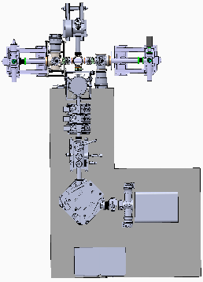



Ion-Ion Collisions for Atomic Physics at CRYRING@ESR, GSI/FAIR
CRYRING : ions with ∼ 1 to a few 10 MeV/u energies
$$ZP/Z_{T}$$
100
10
FISIC experiments
CDW
1
MO
Born
AO
0.1
0.1
1
10
100
$$Vp/v_{e}$$
FISIC@CRYRING
Beam line
FISIC : ions with energies of
a few keV/u
From symmetric (C^{Q+} on C^{q+} for instance) to very asymmetric collision systems (U^{Q+} on Ar^{q+} for instance) and a large range of charge states
Ion source
A cross-beam arrangement for Multipass experimental configuration

Slide 13
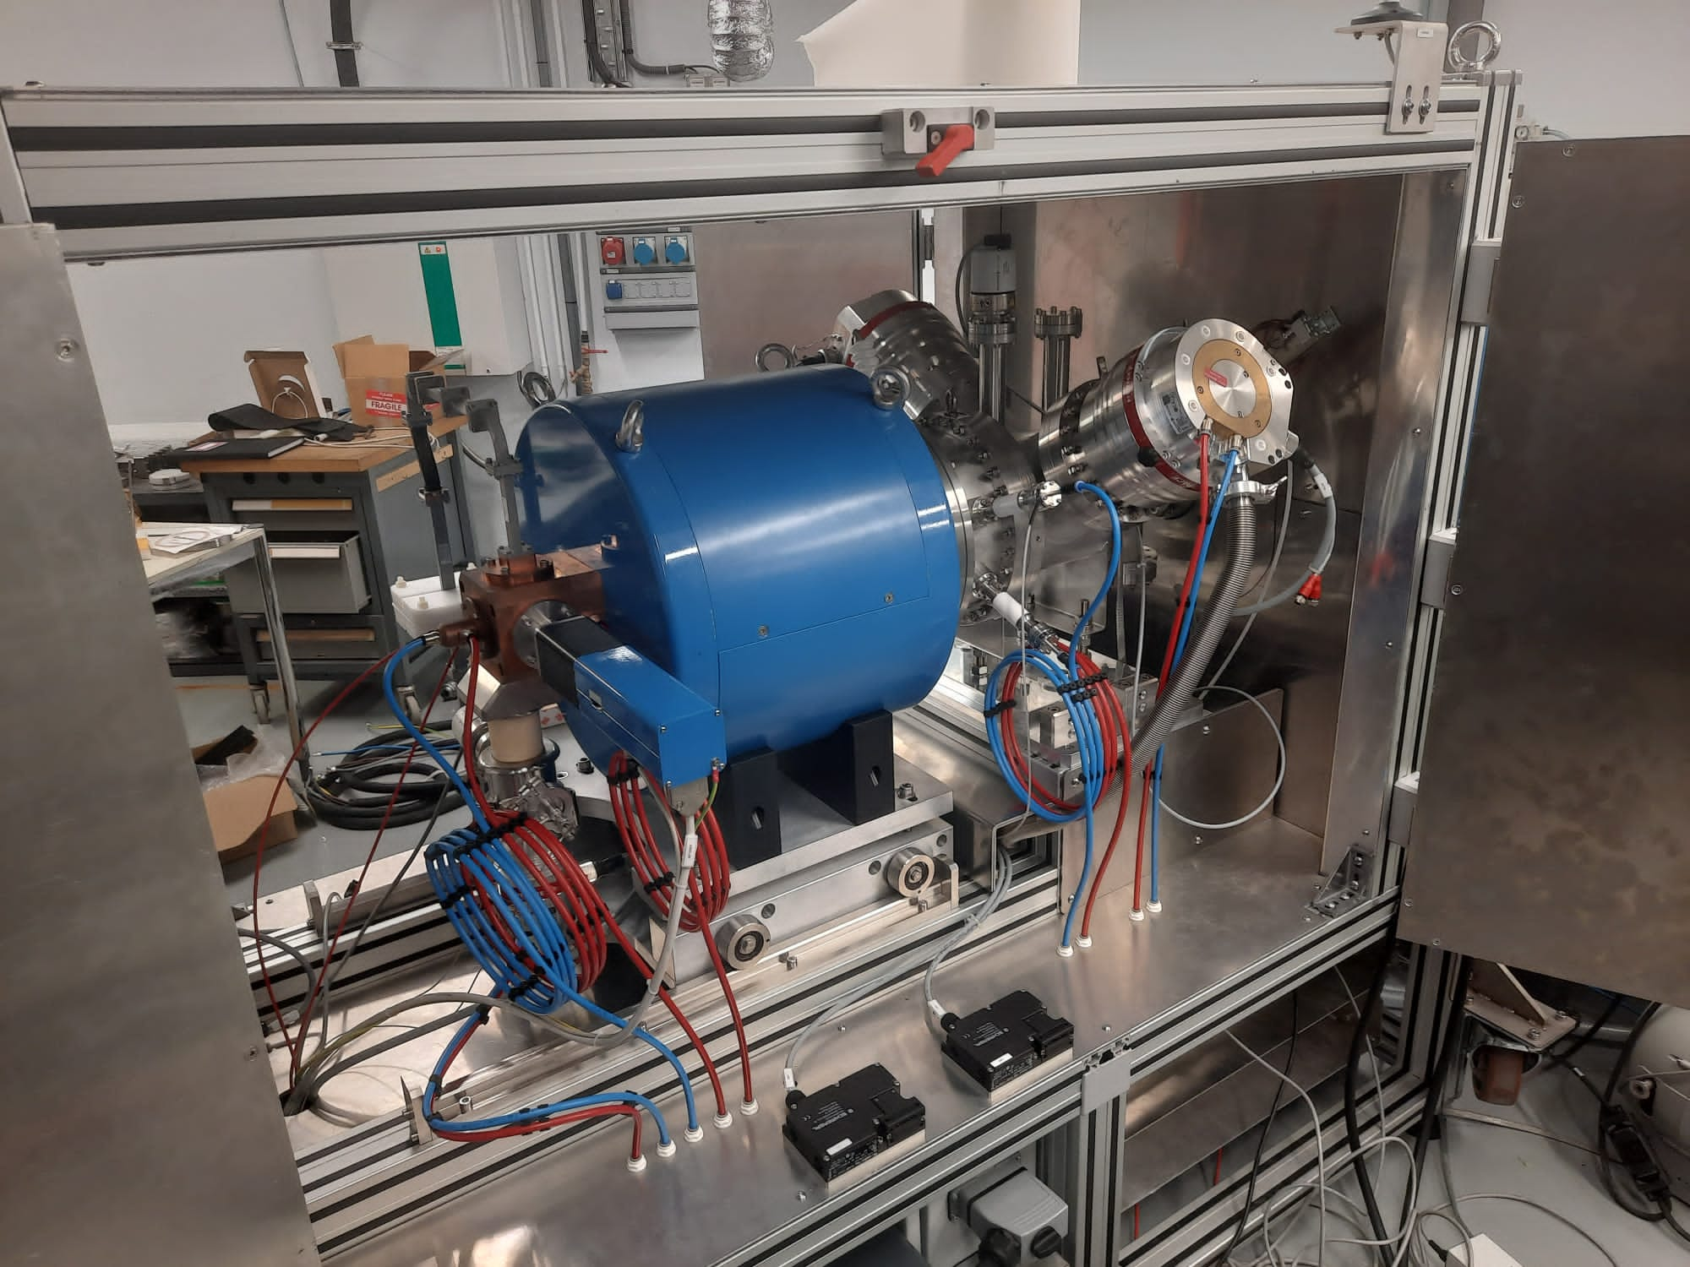
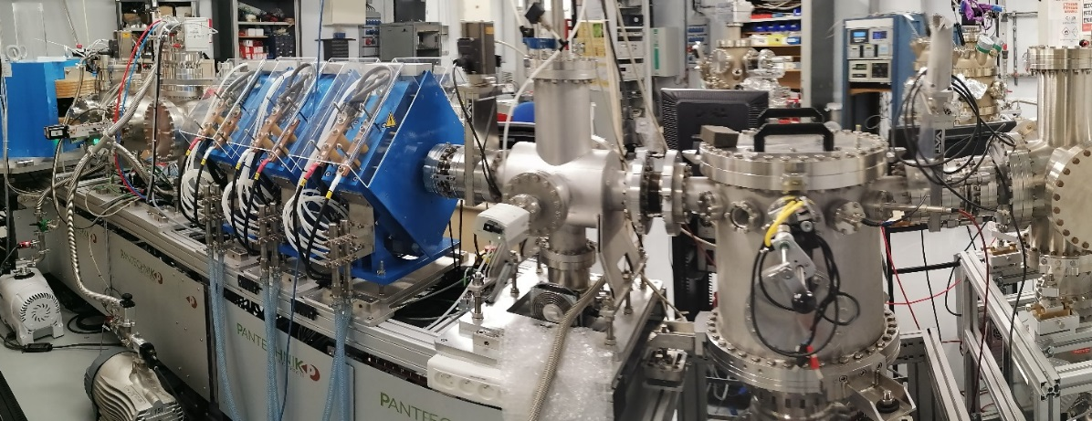
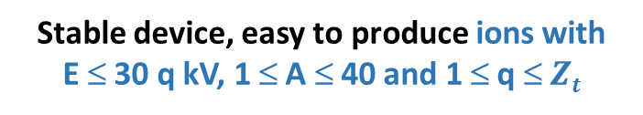
Ion-Ion Collisions for Atomic Physics at CRYRING@ESR, GSI/FAIR
Low energy ion beams (keV/u) with control of the ionization state
ECR Ion Source (2022) :
Connected to a dedicated Beam line (2018) :
Stable device, easy to produce ions with
E ≤ 30 q kV, 1 ≤ A ≤ 40 and 1 ≤ q ≤ $Zt$
To monitor and shape the beam and to purify it in terms of charge states before the interaction

Slide 14
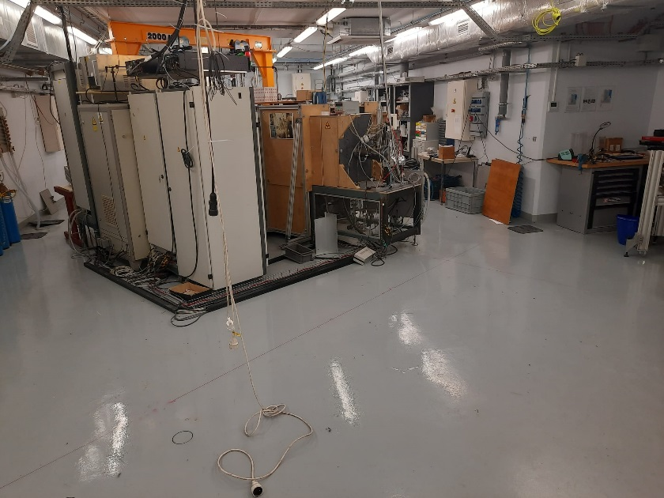
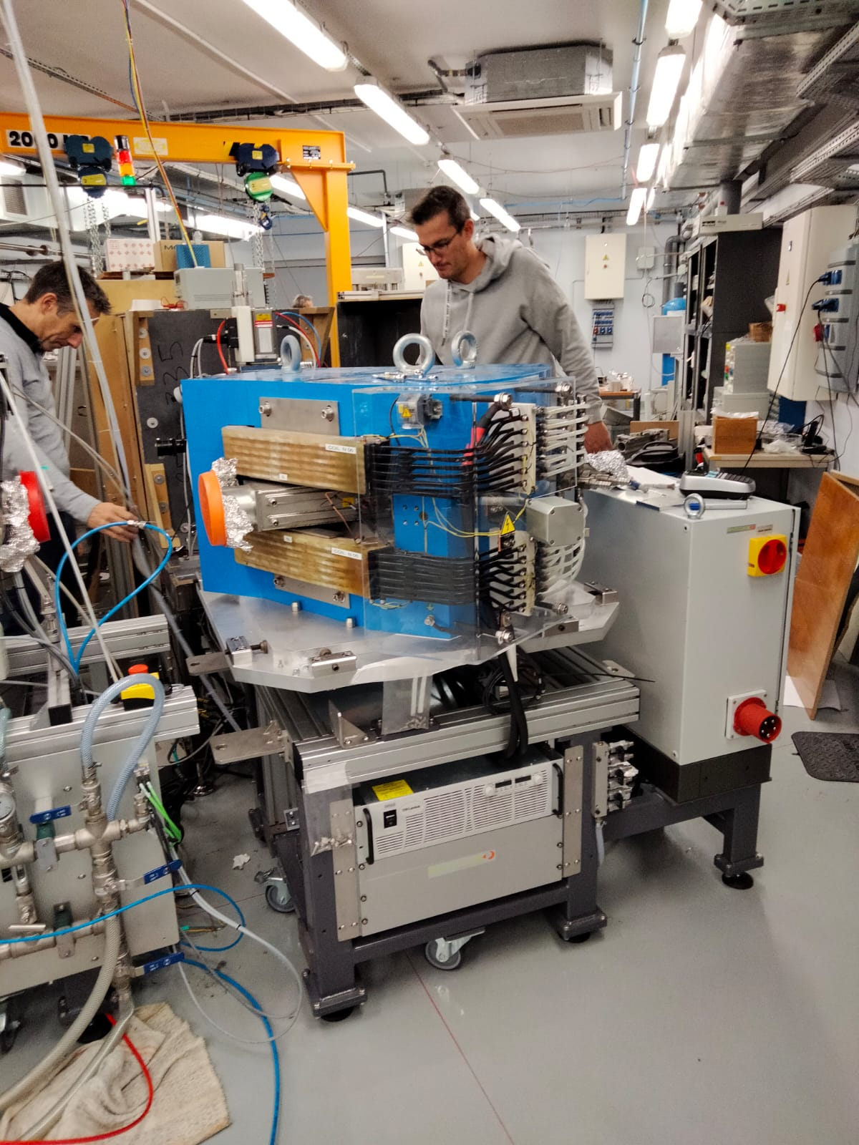
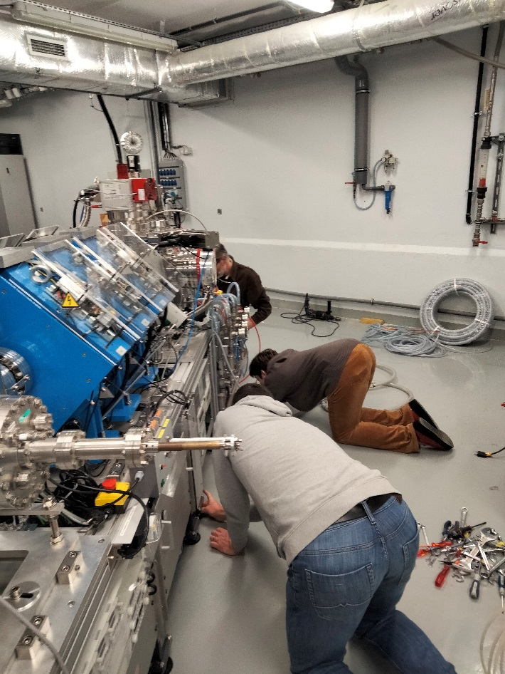
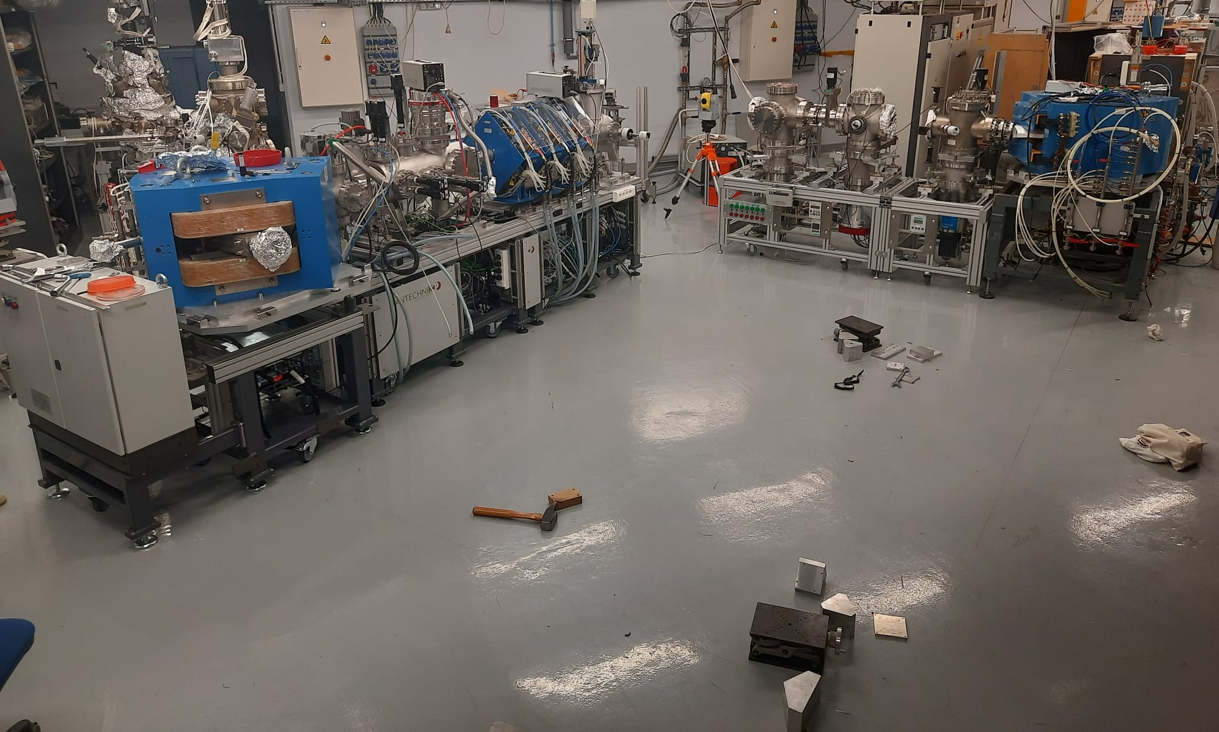
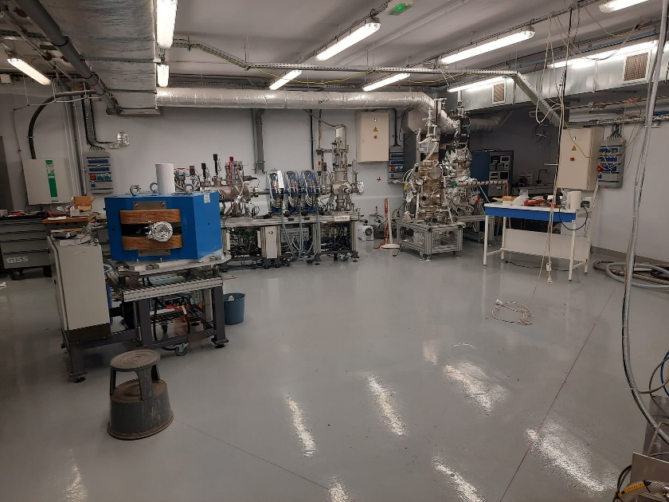
Ion-Ion Collisions for Atomic Physics at CRYRING@ESR, GSI/FAIR
Low energy ion beams (keV/u) with control of the ionization state : commissioning @INSP

Slide 15
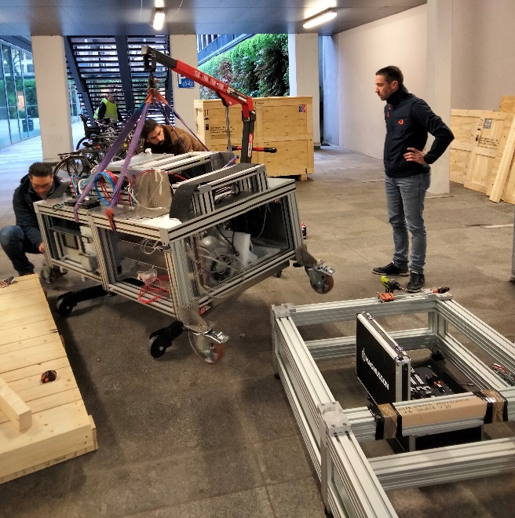
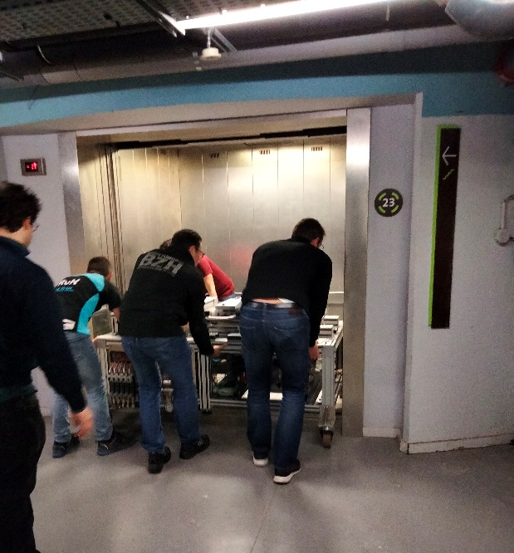
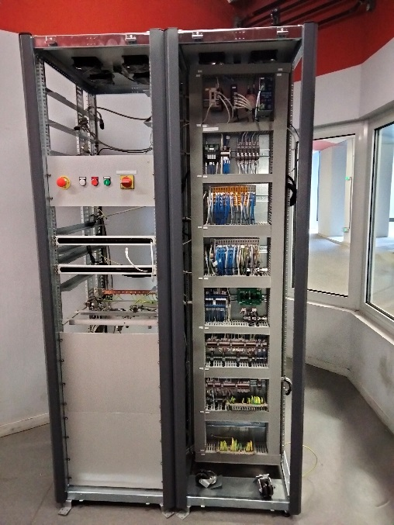
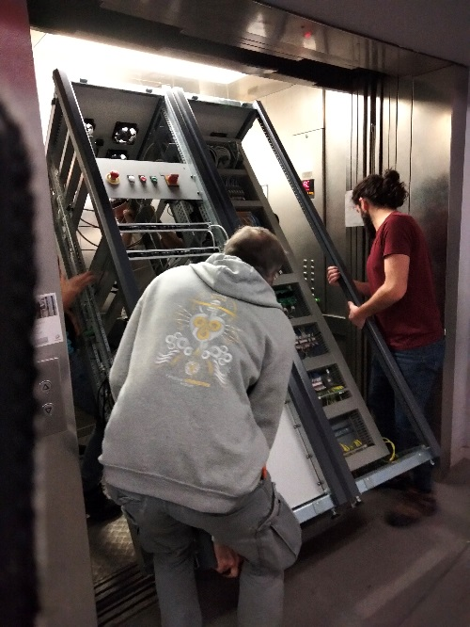
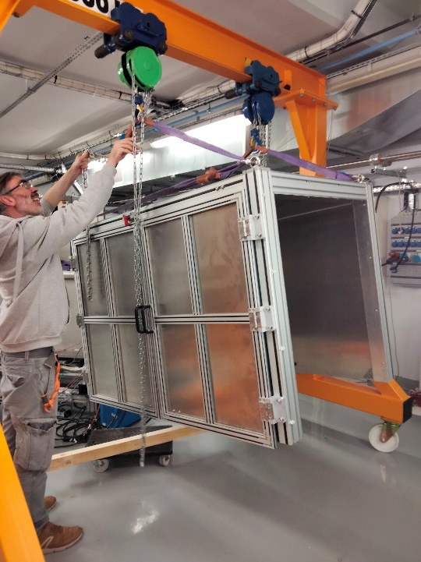
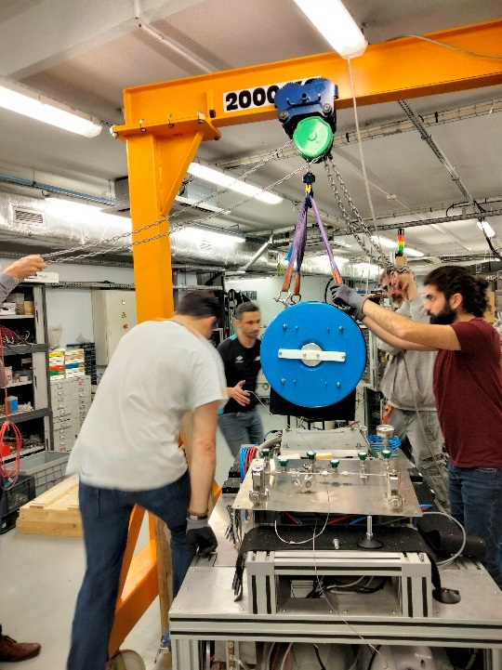
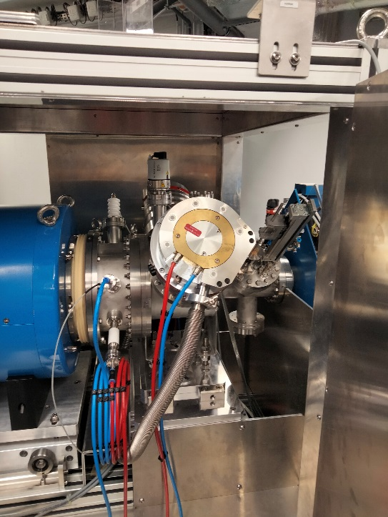
Ion-Ion Collisions for Atomic Physics at CRYRING@ESR, GSI/FAIR
Low energy ion beams (keV/u) with control of the ionization state : commissioning @INSP

Slide 16
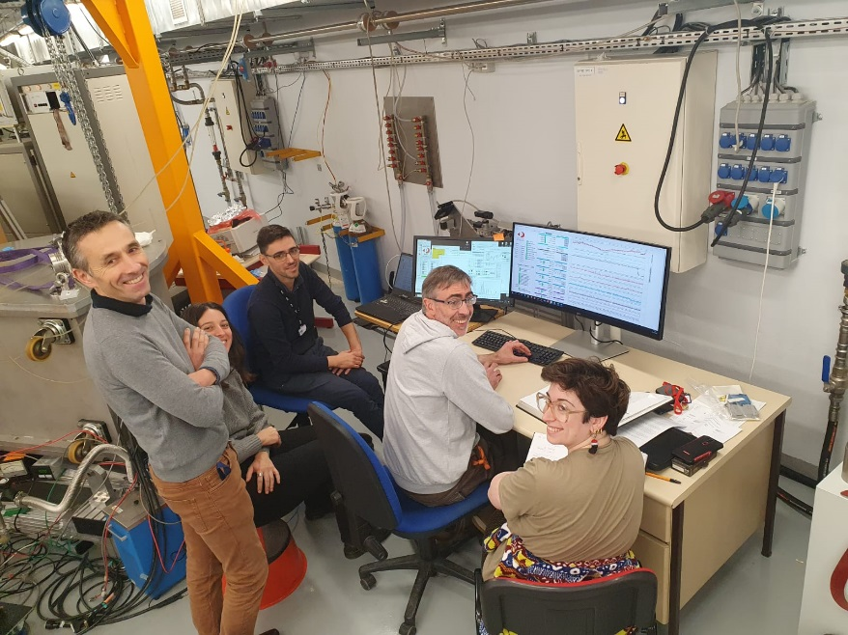
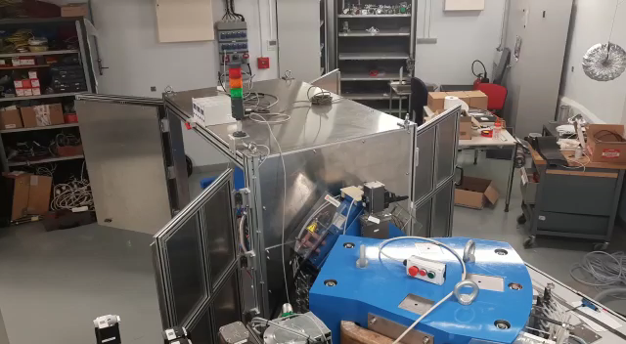
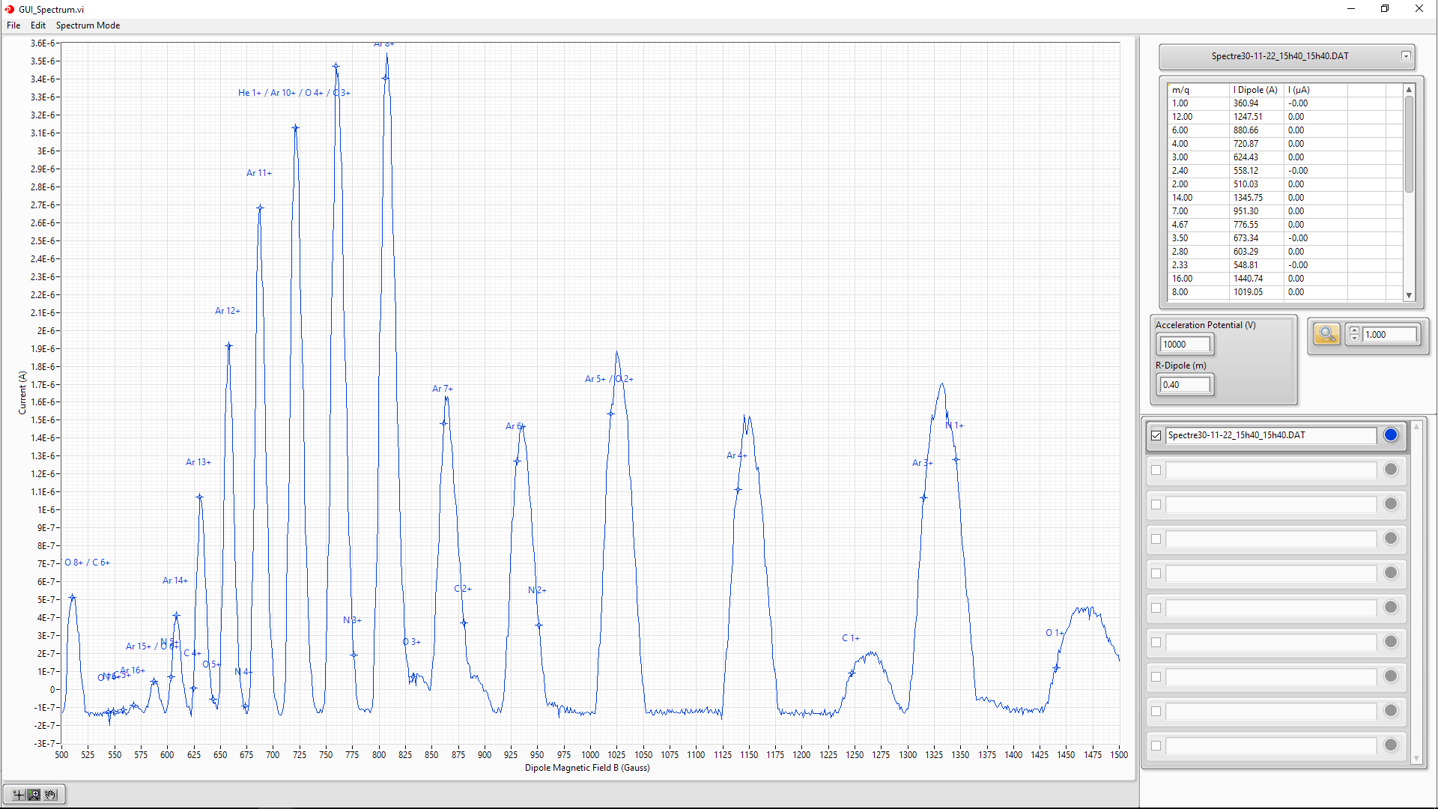
Ion-Ion Collisions for Atomic Physics at CRYRING@ESR, GSI/FAIR
Low energy ion beams (keV/u) with control of the ionization state : commissioning @INSP

Slide 17
Ion-Ion Collisions for Atomic Physics: commissioning @INSP

Slide 18
Ion-Ion Collisions for Atomic Physics: commissioning @INSP
Collision Zone

Slide 19
Ion-Ion Collisions for Atomic Physics at CRYRING@ESR, GSI/FAIR
New challenging experiment of ion-ion collision at the intermediate velocity regime
Heavy-light or light-light ion collisions planned
Data acquisition at CRYRING in 2024/2025
Possible combined experimental ste-ups FISIC+CARME for ion-ion collision of interest for nuclear reaction physics
possibility to measure bare cross-sections at stellar energies
crossing beams at CRYRING

Slide 20
Ion-Ion Collisions for Atomic Physics at CRYRING@ESR, GSI/FAIR
E. Lamour, M. Jolly, S. Macé, C. Prigent, S. Steydli, M. Trassinelli, D. Vernhet
A. Méry, J. Rangama, J‐Y Chesnel, P. Rousseau
A. Bräuning‐Demian, R. Grisenti, A. Gumberidze, M. Lestinsky, U. Spillmann, T. Stöhlker
P.‐M. Hillenbrand, S. Schippers
H. Savajols, C. Stodel, R Levallois
MERCI
MC2 : Contributions des laboratoires français aux futurs grands collisionneurs

