Slide 1
XUV and X-ray spectroscopy of phthalocyanines in the gas-phase
Gildas Goldsztejn
Institut des Sciences Moléculaires d’Orsay (ISMO)
SFP-MC14, July 5th 2023

Slide 2
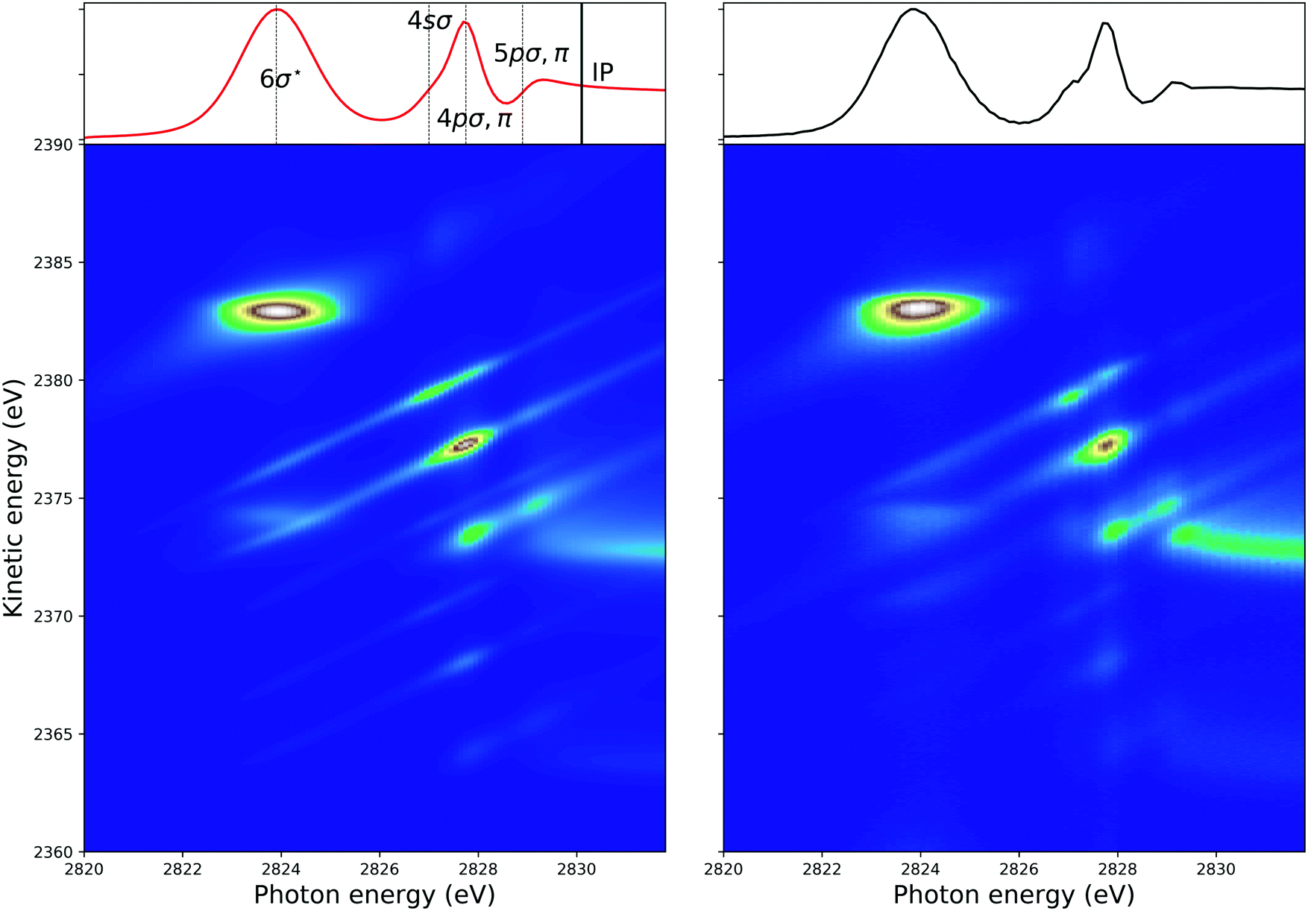
The ideal case: a diatomic molecule (HCl)
(Relatively) Simple equations
can describe everything
G. Goldsztejn et al., PCCP, 2022, 24, 6590
SFP 2023: XUV and X-ray spectroscopy of phthalocyanines in the gas-phase
1/11

Slide 3
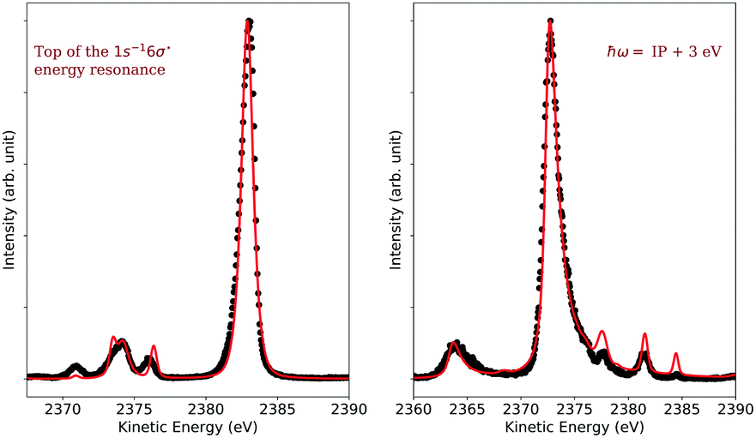
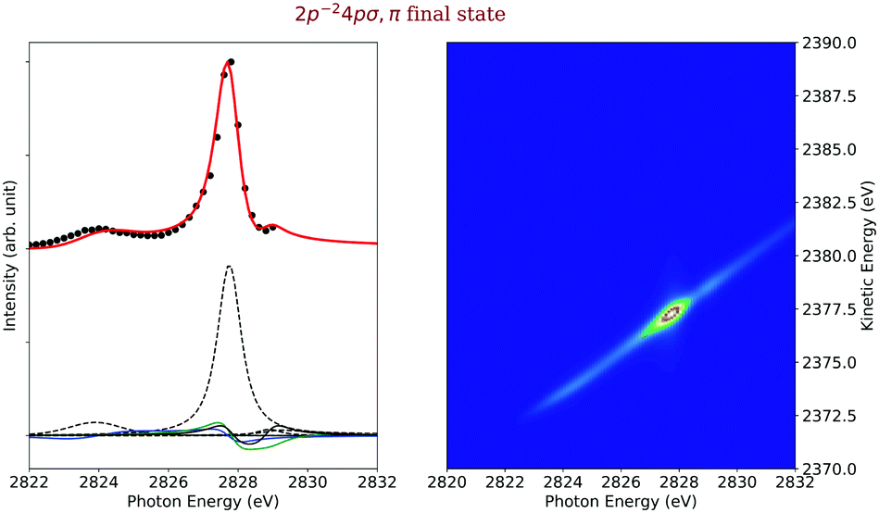
The ideal case: a diatomic molecule (HCl)
It can be used to simulate resonant and normal Auger spectra
Or study a particular final electronic state and highlight (for instance) interferences between different intermediate states.
G. Goldsztejn et al., PCCP, 2022, 24, 6590
SFP 2023: XUV and X-ray spectroscopy of phthalocyanines in the gas-phase
2/11

Slide 4
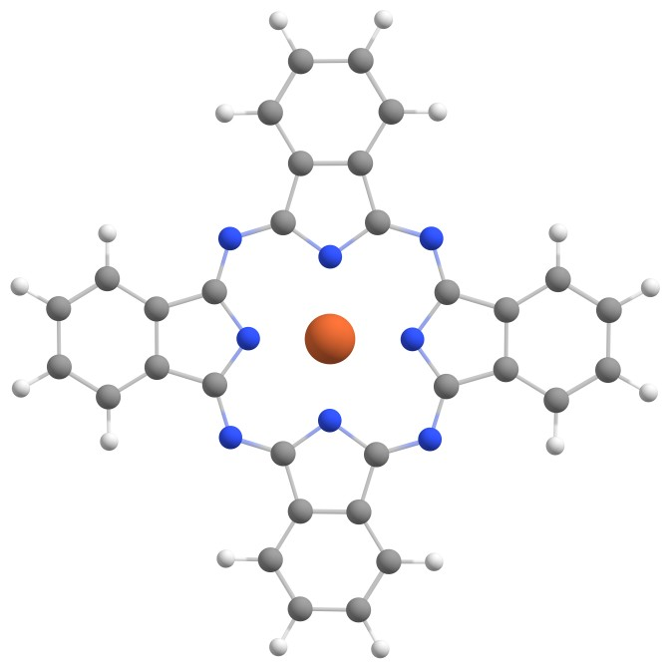
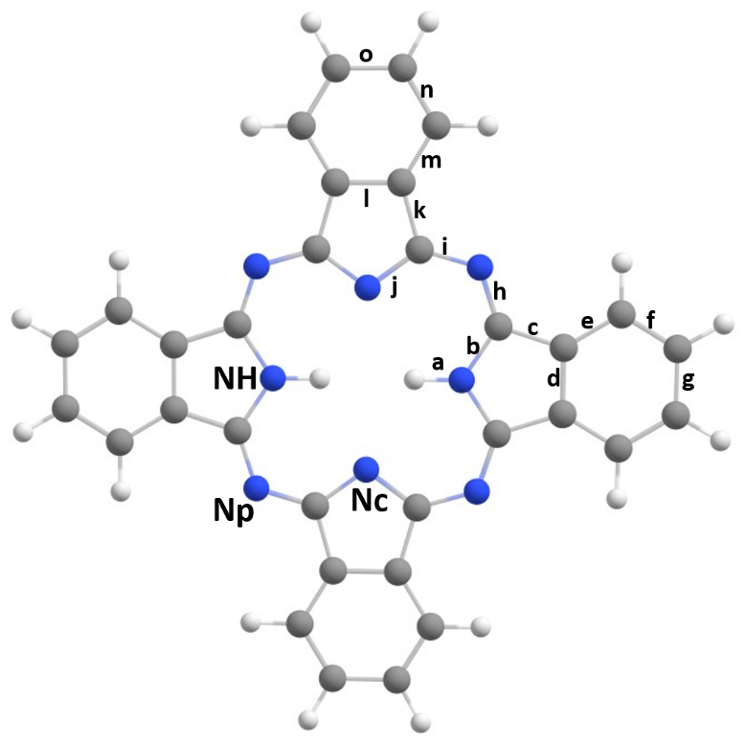
How much can be transferred to complex molecular systems?
(Metallo-)phthalocyanines in the gas phase: a good benchmark molecule
MPc
H₂Pc
Np
Nc
Large molecule with a rich photophysics
Transition metal: strong interaction 3d(M)/π(L)
Symmetry helps
SFP 2023: XUV and X-ray spectroscopy of phthalocyanines in the gas-phase
3/11

Slide 5
How much can be transferred to complex molecular systems?
(Metallo-)phthalocyanines in the gas phase: a good benchmark molecule
MPc
H₂Pc
Np
Nc
Large molecule with a rich photophysics
Transition metal: strong interaction 3d(M)/π(L)
Symmetry helps
Electron spectroscopy to:
Determine the electronic configuration within M
Resonant Auger spectroscopy as local probe of:
The chemical environment
The ultrafast electronic rearrangement
SFP 2023: XUV and X-ray spectroscopy of phthalocyanines in the gas-phase
3/11

Slide 6
How much can be transferred to complex molecular systems?
(Metallo-)phthalocyanines in the gas phase: a good benchmark molecule
MPc
H₂Pc
Np
Nc
Large molecule with a rich photophysics
Transition metal: strong interaction 3d(M)/π(L)
Symmetry helps
Electron spectroscopy to:
Determine the electronic configuration within M
Resonant Auger spectroscopy as local probe of:
The chemical environment
The ultrafast electronic rearrangement
Experiments done at PLEIADES (SOLEIL): gives access to valence and core shells. In the gas phase with an oven we designed specifically for this beamline
SFP 2023: XUV and X-ray spectroscopy of phthalocyanines in the gas-phase
3/11

Slide 7
What do we need to determine the metal’s electronic configuration?
SFP 2023: XUV and X-ray spectroscopy of phthalocyanines in the gas-phase
4/11

Slide 8
What do we need to determine the metal’s electronic configuration?
Answer: a lot of spectra and (at least) two theoretical methods to simulate them
SFP 2023: XUV and X-ray spectroscopy of phthalocyanines in the gas-phase
4/11

Slide 9
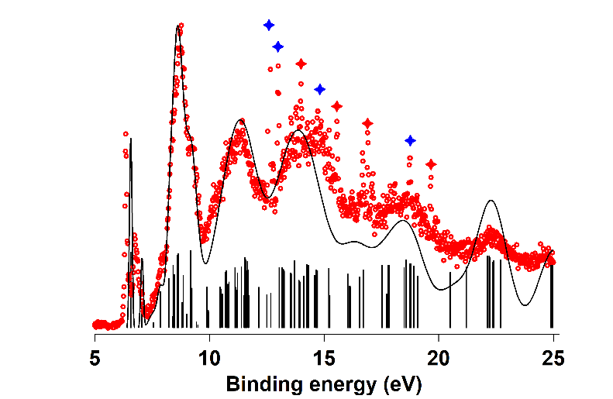
What do we need to determine the metal’s electronic configuration?
Answer: a lot of spectra and (at least) two theoretical methods to simulate them
Valence photoelectron spectra + DFT calculation
Pollutants
b_{1g} (x²-y²)
a_{1g} (z²)
³E_{g}
e_{g} (xz, yz)
b_{2g} (xy)
J. Laurent, …, and G. Goldsztejn, Phys. Chem. Chem. Phys., 2022, 24, 2656
SFP 2023: XUV and X-ray spectroscopy of phthalocyanines in the gas-phase
4/11

Slide 10
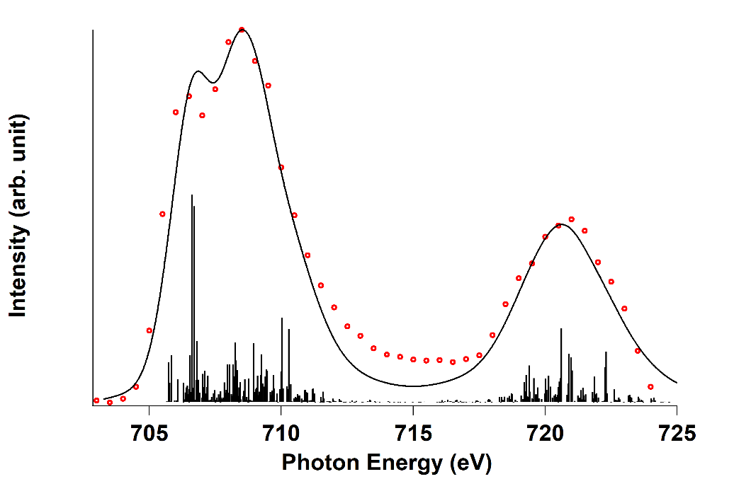
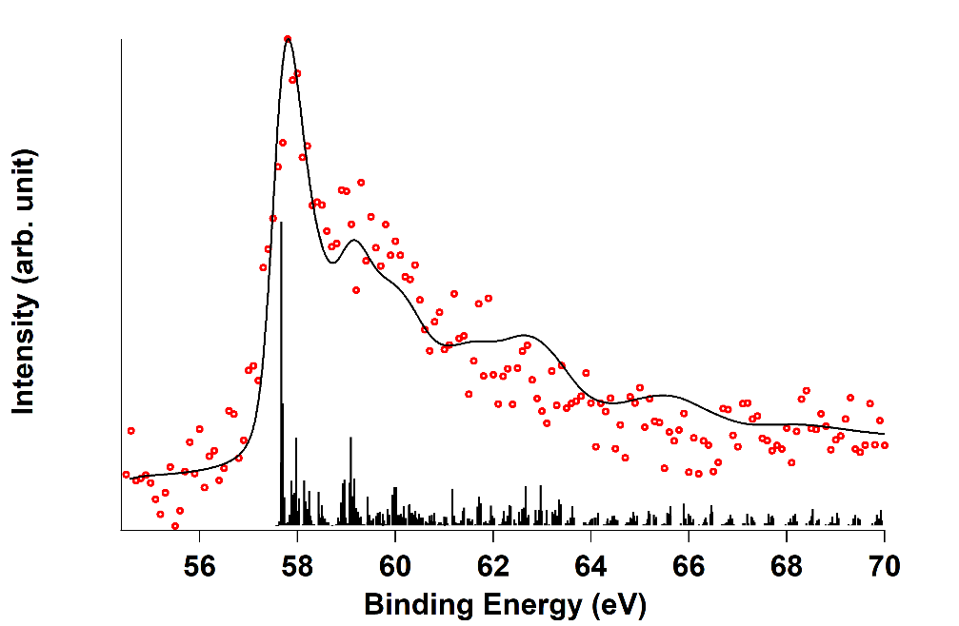
What do we need to determine the metal’s electronic configuration?
Answer: a lot of spectra and (at least) two theoretical methods to simulate them
Valence photoelectron spectra + DFT calculation
Pollutants
b_{1g} (x²-y²)
a_{1g} (z²)
³E_{g}
e_{g} (xz, yz)
Fe 2p absorption + Fe 3p photoelectron spectra + CTM calculations
b_{2g} (xy)
J. Laurent, …, and G. Goldsztejn, Phys. Chem. Chem. Phys., 2022, 24, 2656
SFP 2023: XUV and X-ray spectroscopy of phthalocyanines in the gas-phase
4/11

Slide 11
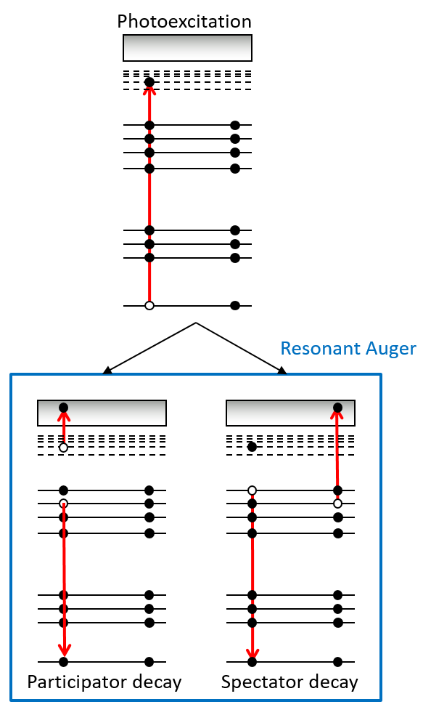
How sensitive are we to the chemical environment?
H₂Pc
Resonant Auger spectroscopy:
Local character of the core-shell excitation
Sensitive to chemical environment because of valence holes
SFP 2023: XUV and X-ray spectroscopy of phthalocyanines in the gas-phase
5/11

Slide 12
How sensitive are we to the chemical environment?
Same formula, but… few approximations later
SFP 2023: XUV and X-ray spectroscopy of phthalocyanines in the gas-phase
6/11

Slide 13
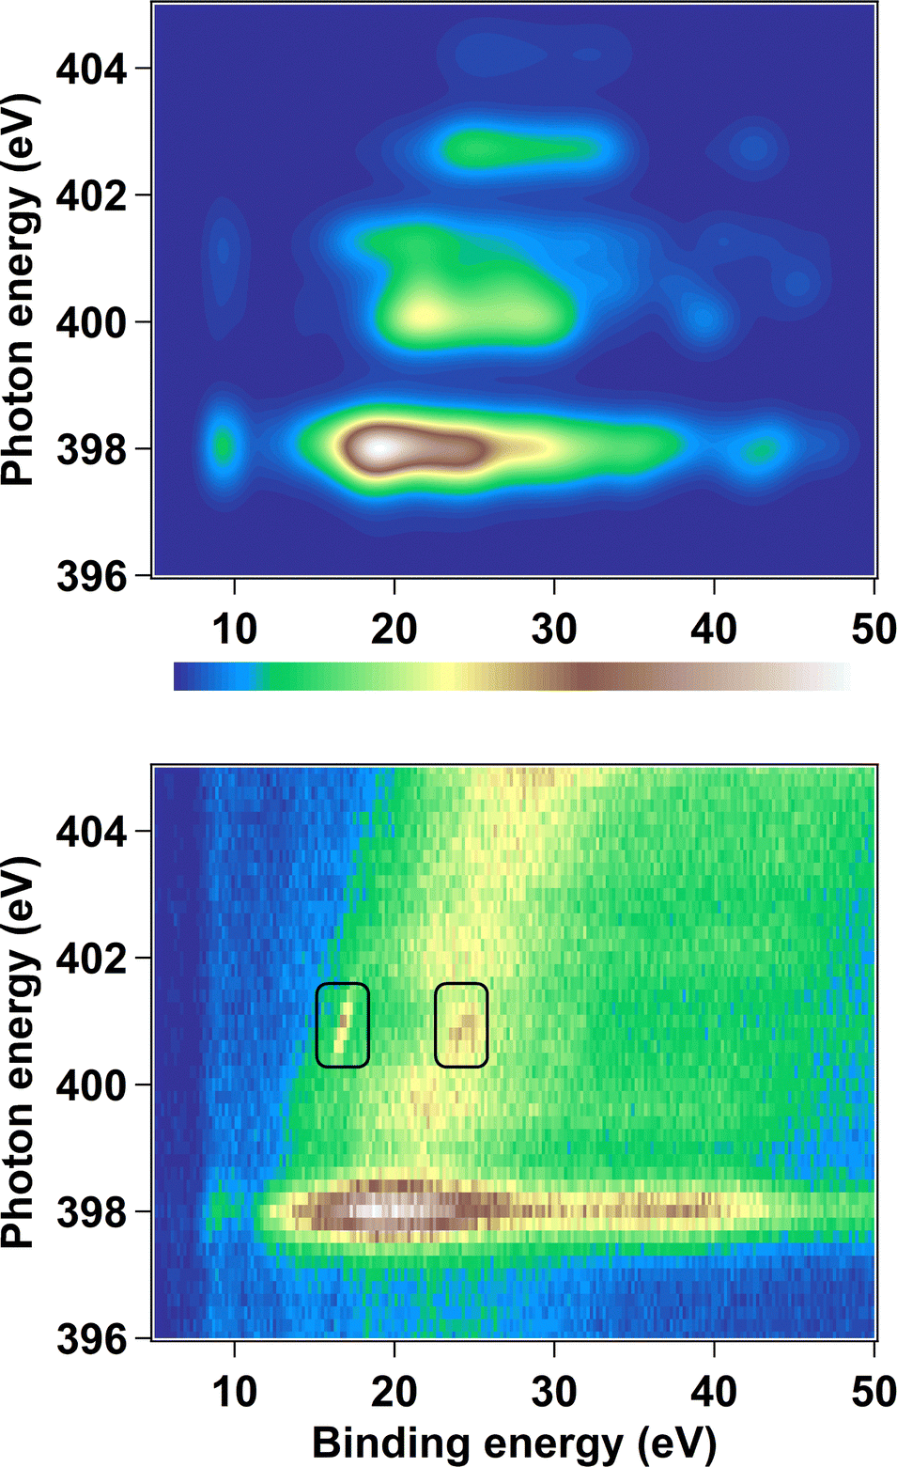
How sensitive are we to the chemical environment?
Same formula, but… few approximations later
2D-map: x-axis = binding energy; y-axis = incident energy
C.E.V de Moura, …, and G. Goldsztejn, Phys. Chem. Chem. Phys., 2023, 25, 15555
SFP 2023: XUV and X-ray spectroscopy of phthalocyanines in the gas-phase
6/11

Slide 14
How sensitive are we to the chemical environment?
Same formula, but… few approximations later
2D-map: x-axis = binding energy; y-axis = incident energy
Vertical lines = participator Auger decay at fixed binding energies
C.E.V de Moura, …, and G. Goldsztejn, Phys. Chem. Chem. Phys., 2023, 25, 15555
SFP 2023: XUV and X-ray spectroscopy of phthalocyanines in the gas-phase
6/11

Slide 15
How sensitive are we to the chemical environment?
Same formula, but… few approximations later
2D-map: x-axis = binding energy; y-axis = incident energy
Vertical lines = participator Auger decay at fixed binding energies
Diagonal lines = spectator Auger decay
C.E.V de Moura, …, and G. Goldsztejn, Phys. Chem. Chem. Phys., 2023, 25, 15555
SFP 2023: XUV and X-ray spectroscopy of phthalocyanines in the gas-phase
6/11

Slide 16
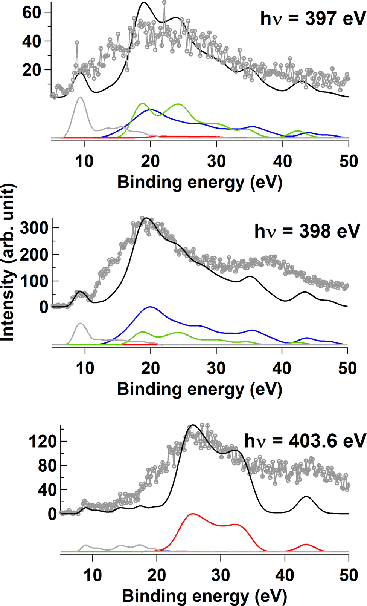
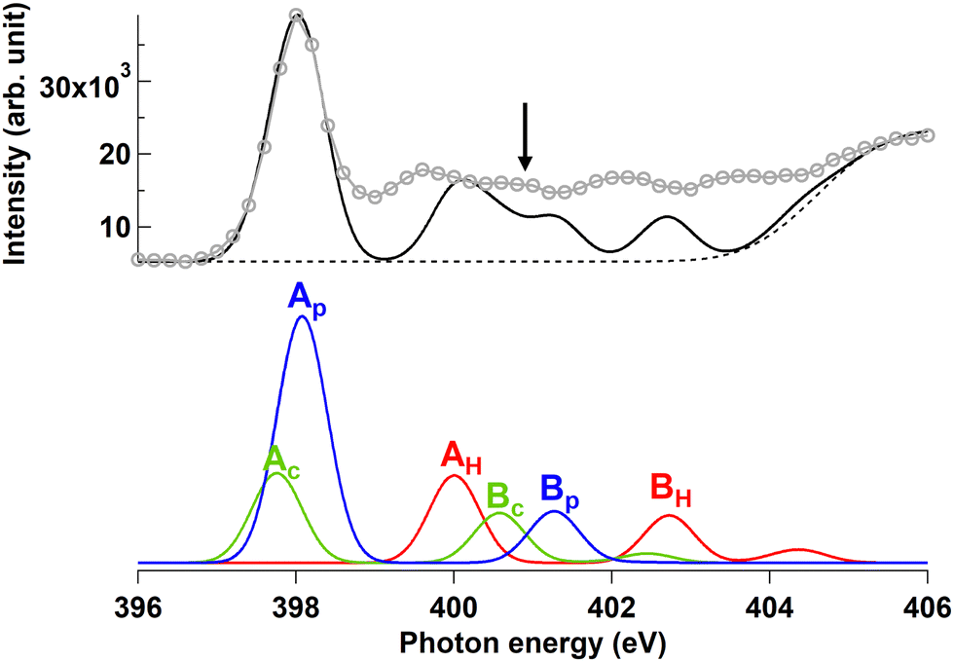
How sensitive are we to the chemical environment?
Resonant Auger spectroscopy more sensitive than absorption spectroscopy, but…
C.E.V de Moura, …, and G. Goldsztejn, Phys. Chem. Chem. Phys., 2023, 25, 15555
SFP 2023: XUV and X-ray spectroscopy of phthalocyanines in the gas-phase
7/11

Slide 17
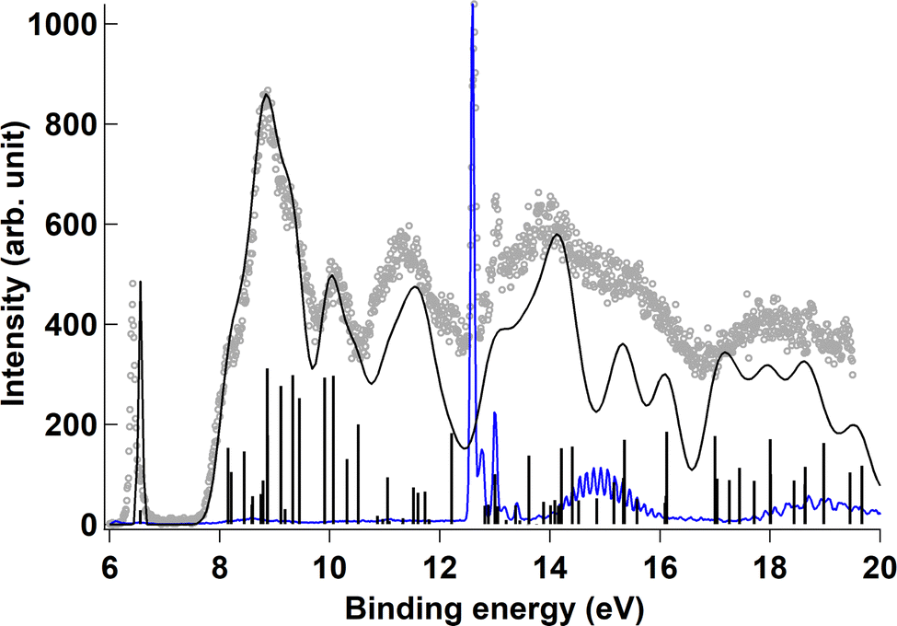
How sensitive are we to the chemical environment?
Resonant Auger spectroscopy more sensitive than absorption spectroscopy, but…
… valence spectroscopy helped us interpret the resonant Auger spectra
C.E.V de Moura, …, and G. Goldsztejn, Phys. Chem. Chem. Phys., 2023, 25, 15555
SFP 2023: XUV and X-ray spectroscopy of phthalocyanines in the gas-phase
7/11

Slide 18
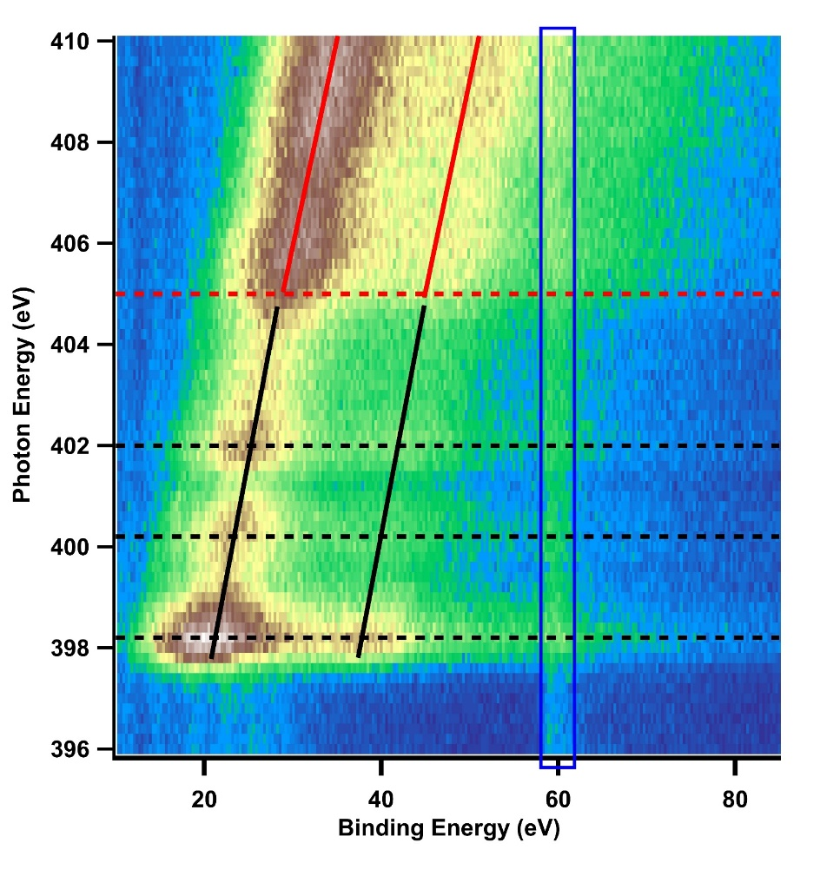
Can we probe localized ultrafast electronic processes?
Np
Nc
SFP 2023: XUV and X-ray spectroscopy of phthalocyanines in the gas-phase
8/11

Slide 19
Can we probe localized ultrafast electronic processes?
Continuum
3d⁶
4s⁰
Np
Nc
3p⁶
3s²
2p⁶
2s²
1s²
Fe²⁺
SFP 2023: XUV and X-ray spectroscopy of phthalocyanines in the gas-phase
8/11

Slide 20
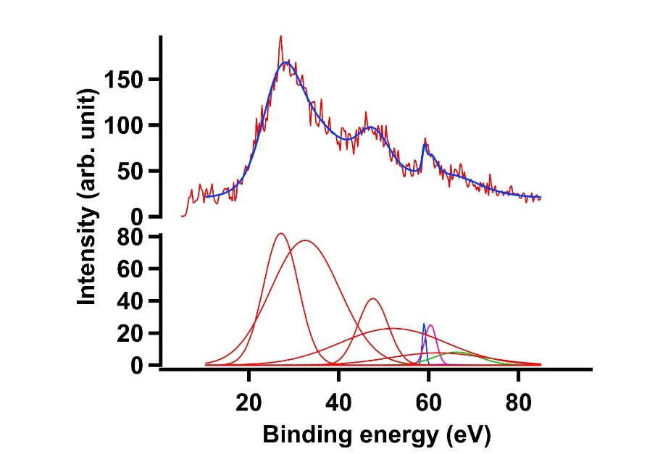
Can we probe localized ultrafast electronic processes?
Continuum
3d⁶
4s⁰
Np
Nc
3p⁶
3s²
2p⁶
2s²
1s²
Fe²⁺
Step-by-step fitting methodology to extract the cross section (see Manon’s poster)
SFP 2023: XUV and X-ray spectroscopy of phthalocyanines in the gas-phase
8/11

Slide 21
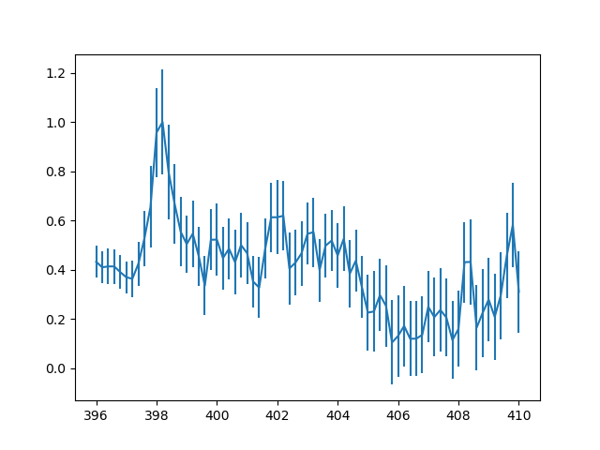
Can we probe localized ultrafast electronic processes?
Photon energy (eV)
M. Carrière, …, and G. Goldsztejn, in preparation
SFP 2023: XUV and X-ray spectroscopy of phthalocyanines in the gas-phase
9/11

Slide 22
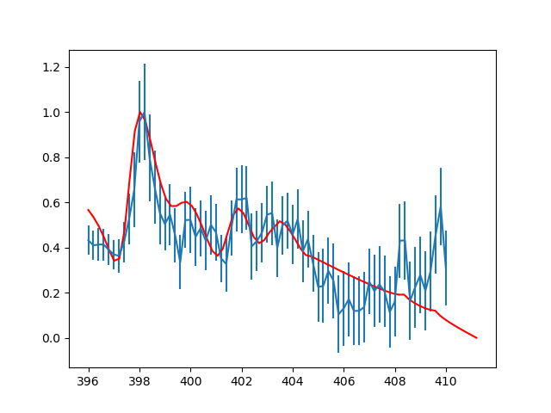
Can we probe localized ultrafast electronic processes?
Same formula, but… few approximations later
Photon energy (eV)
M. Carrière, …, and G. Goldsztejn, in preparation
SFP 2023: XUV and X-ray spectroscopy of phthalocyanines in the gas-phase
9/11

Slide 23
Can we probe localized ultrafast electronic processes?
Same formula, but… few approximations later
Resonance from a N 1s discrete state
Decrease after ionization threshold
Photon energy (eV)
M. Carrière, …, and G. Goldsztejn, in preparation
SFP 2023: XUV and X-ray spectroscopy of phthalocyanines in the gas-phase
9/11

Slide 24
Can we probe localized ultrafast electronic processes?
Same formula, but… few approximations later
Resonance from a N 1s discrete state
Decrease after ionization threshold
Plateau due to electronic interferences between discrete states
Photon energy (eV)
M. Carrière, …, and G. Goldsztejn, in preparation
SFP 2023: XUV and X-ray spectroscopy of phthalocyanines in the gas-phase
9/11

Slide 25
Can we probe localized ultrafast electronic processes?
Same formula, but… few approximations later
Resonance from a N 1s discrete state
Decrease after ionization threshold
Plateau due to electronic interferences between discrete states
Fano-type interferences between continua states
Photon energy (eV)
M. Carrière, …, and G. Goldsztejn, in preparation
SFP 2023: XUV and X-ray spectroscopy of phthalocyanines in the gas-phase
9/11

Slide 26
Can we probe localized ultrafast electronic processes?
OM*
Interatomic Coulomb decay (ICD) like
+ electronic states’ interferences
3p
60 eV
398 eV
1s
N
Fe
M. Carrière, …, and G. Goldsztejn, in preparation
SFP 2023: XUV and X-ray spectroscopy of phthalocyanines in the gas-phase
10/11

Slide 27
Can we probe localized ultrafast electronic processes?
OM*
Interatomic Coulomb decay (ICD) like
+ electronic states’ interferences
3p
60 eV
398 eV
1s
N
Fe
Is it related to a particular transition metal?
M. Carrière, …, and G. Goldsztejn, in preparation
SFP 2023: XUV and X-ray spectroscopy of phthalocyanines in the gas-phase
10/11

Slide 28
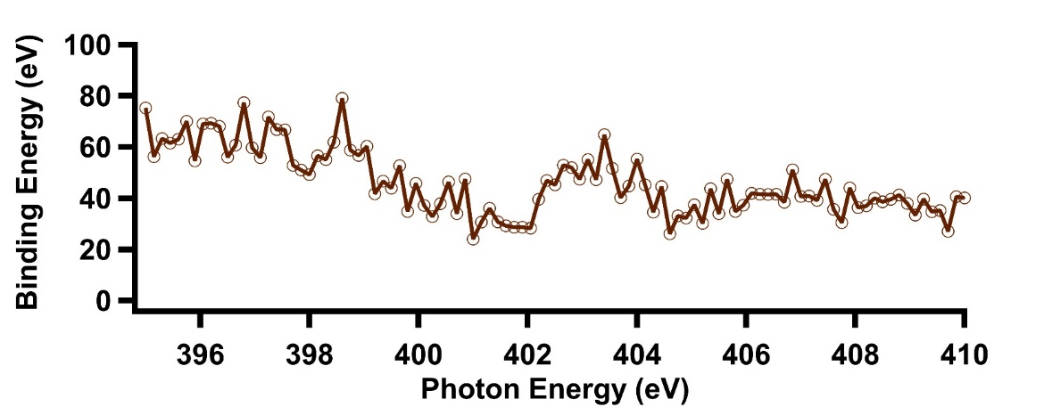
Can we probe localized ultrafast electronic processes?
OM*
Interatomic Coulomb decay (ICD) like
+ electronic states’ interferences
3p
60 eV
398 eV
1s
N
Fe
Cobalt phthalocyanine = no clear sign of ICD
Is it related to a particular transition metal?
M. Carrière, …, and G. Goldsztejn, in preparation
SFP 2023: XUV and X-ray spectroscopy of phthalocyanines in the gas-phase
10/11

Slide 29
Can we probe localized ultrafast electronic processes?
OM*
Interatomic Coulomb decay (ICD) like
+ electronic states’ interferences
3p
60 eV
398 eV
1s
N
Fe
Cobalt phthalocyanine = no clear sign of ICD
Is it related to a particular transition metal?
Can you tell us why?
M. Carrière, …, and G. Goldsztejn, in preparation
SFP 2023: XUV and X-ray spectroscopy of phthalocyanines in the gas-phase
10/11

Slide 30
Can we probe localized ultrafast electronic processes?
OM*
Interatomic Coulomb decay (ICD) like
+ electronic states’ interferences
3p
60 eV
398 eV
1s
N
Fe
Cobalt phthalocyanine = no clear sign of ICD
Is it related to a particular transition metal?
Can you tell us why?
NO
M. Carrière, …, and G. Goldsztejn, in preparation
SFP 2023: XUV and X-ray spectroscopy of phthalocyanines in the gas-phase
10/11

Slide 31
Takeaway message
It is possible to have access to subtle, ultrafast, localized dynamical processes or to electronic configurations:
Information is a bit more blurry
Requires more spectra in various regions of the incident energy
And on related molecules
To accept doing (severe) approximations in the simulations
Ways to improve:
Having a better-resolved spectroscopy
New evaporation method
Supersonic expansion to cool the molecules
New spectrometer
Having better theoretical methods
Currently under development, see A. Piard’s poster
SFP 2023: XUV and X-ray spectroscopy of phthalocyanines in the gas-phase
11/11

Slide 32
Acknowledgments
ISMO
Collaborations
PLEIADES
M. Carrière
A. Piard (master student)
A. Kumar (post-doc)
J. Laurent (master student, 2021)
D. Cubaynes
N. Shafizadeh
B. Soep
P. Çarçabal
R. Püttner (Freïe Universitat, Berlin)
M. Briant (NIMBE, CEA Saclay)
M. Simon (LCPMR, Paris)
J. Bozek
A. Milosavljević
E. Robert
Thank you for your attention

Slide 33
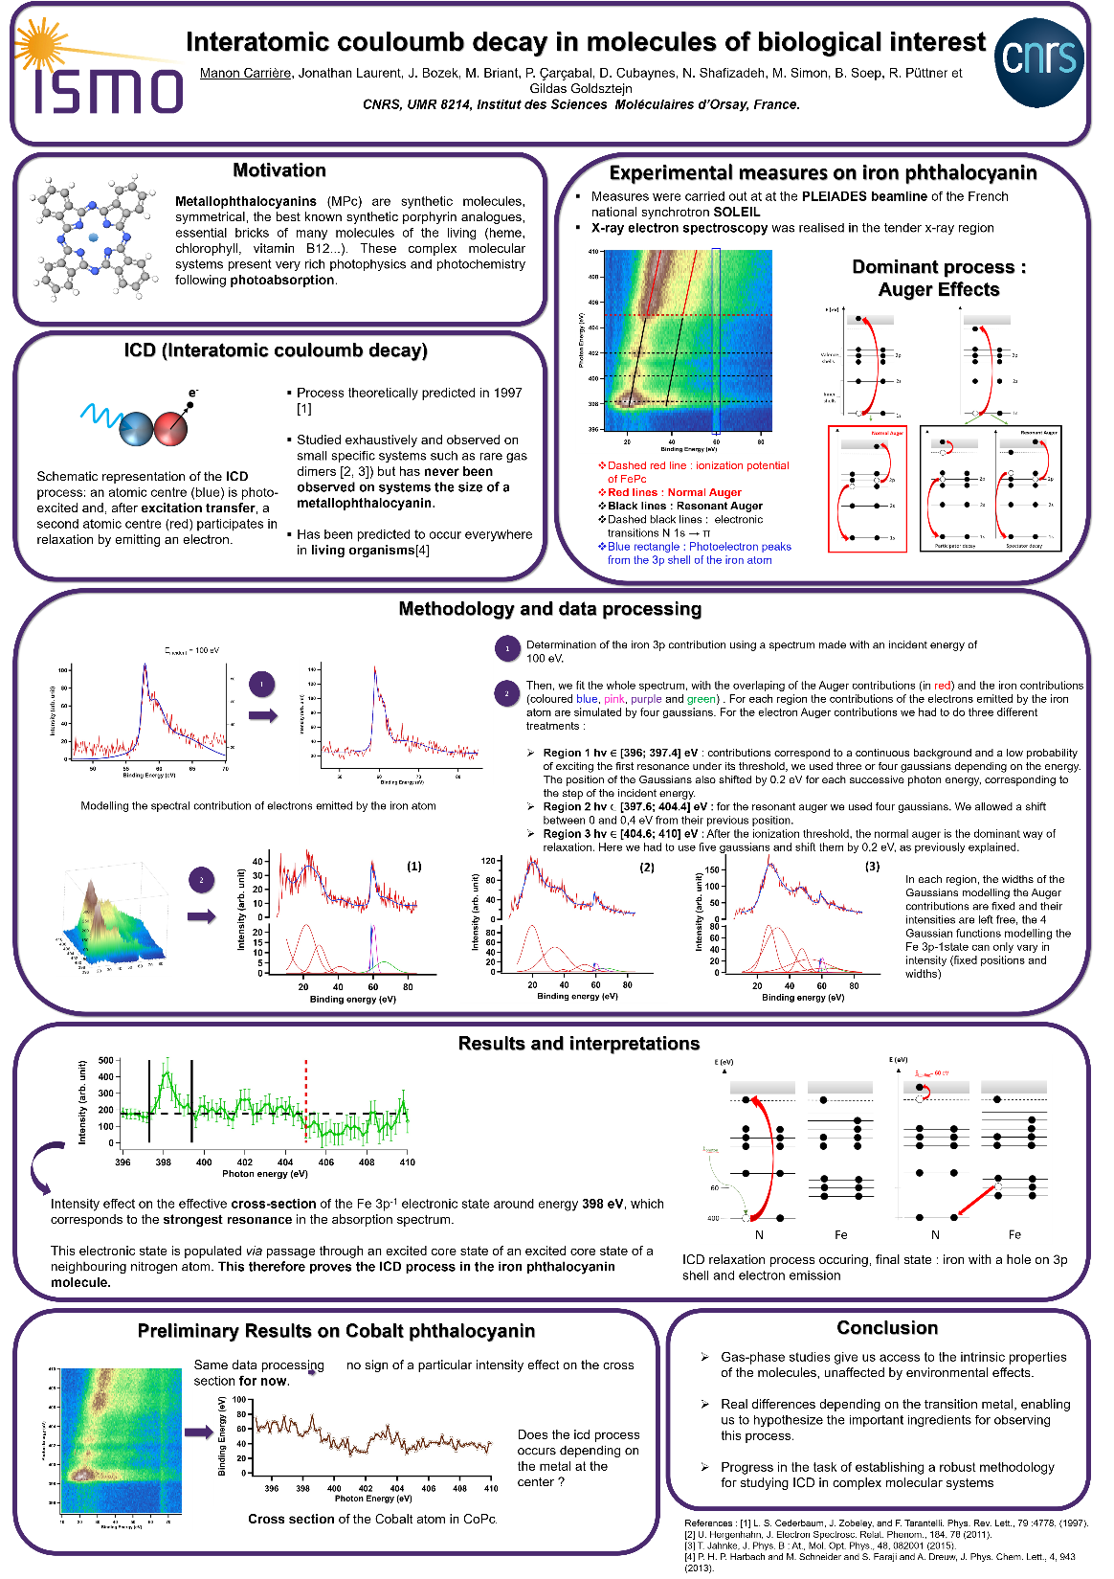
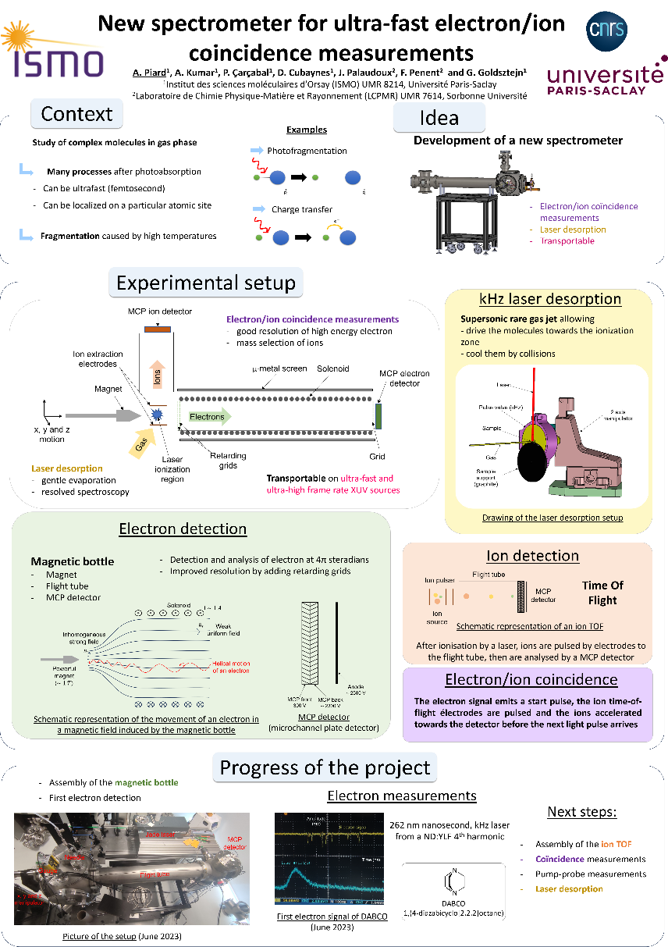
Don’t forget the posters
Manon Carrière
Apolline Piard

