Slide 1






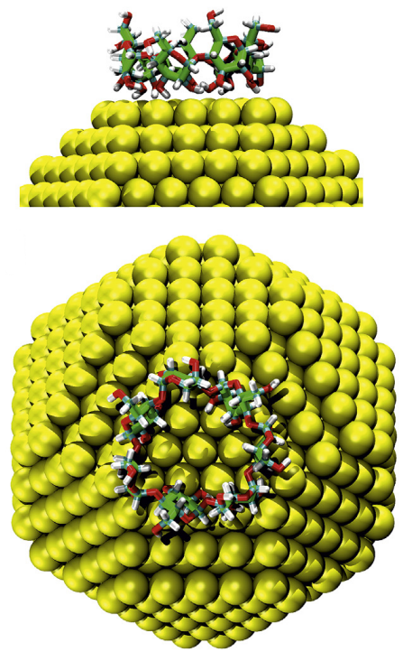
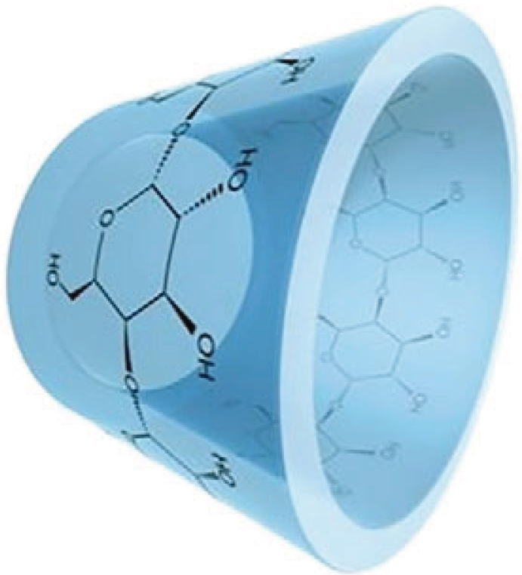
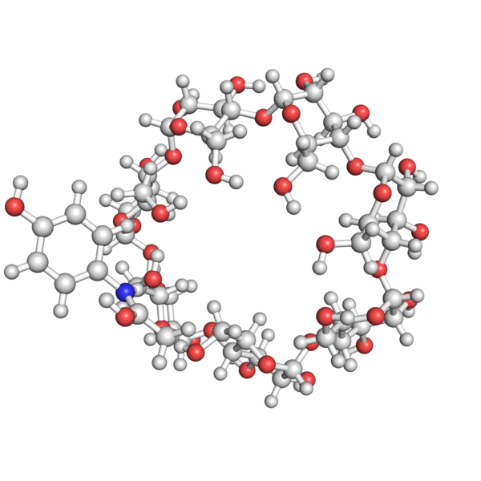
Host-guest complexes
between β-cyclodextrins and small drugs
for SERS detection in drinking water
Nicolas Nieuwjaer
Biomolecules and Spectroscopy team

Slide 2
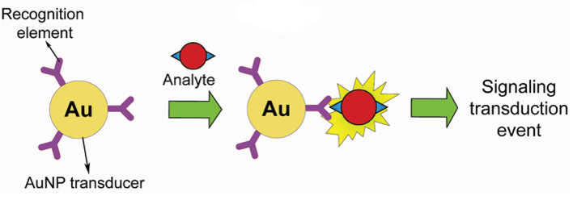
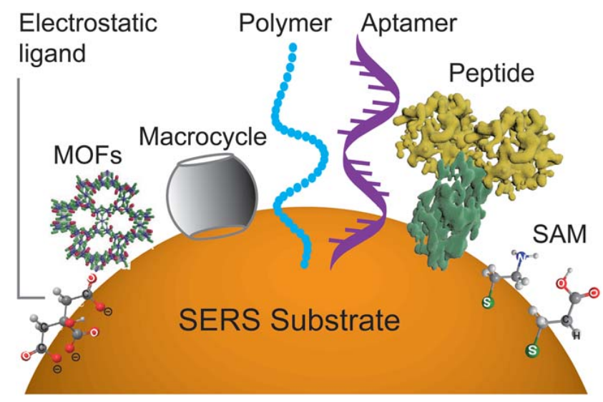
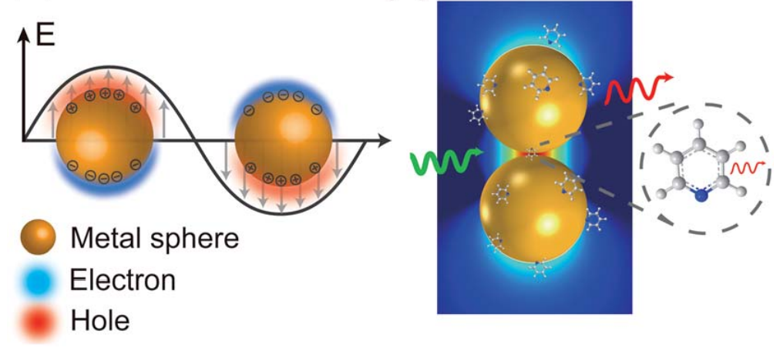
Biological sensing – SERS detection
Gold Nanoparticles in Chemical and Biological Sensing
Chem. Rev. 2012, 112, 5, 2739–2779
Chem. Sci. 2020, 11, 4563
Surface-enhanced Raman spectroscopy : benefits, trade-offs and future developments
Chem. Sci. 2020, 11, 4563
2

Slide 3
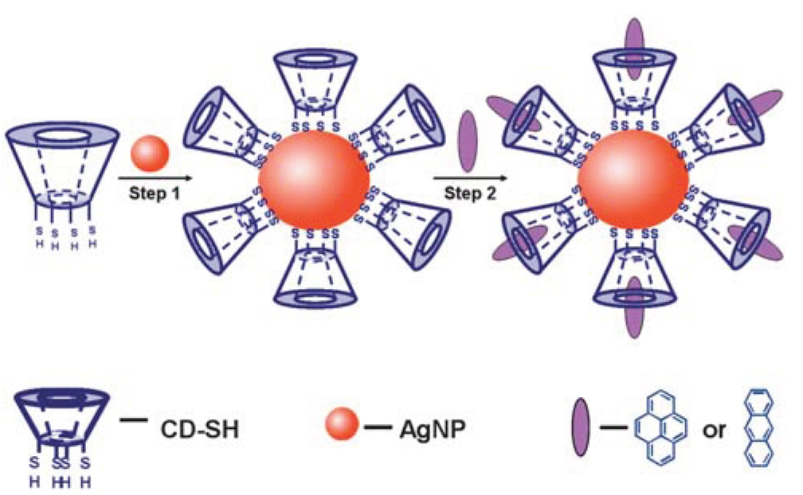
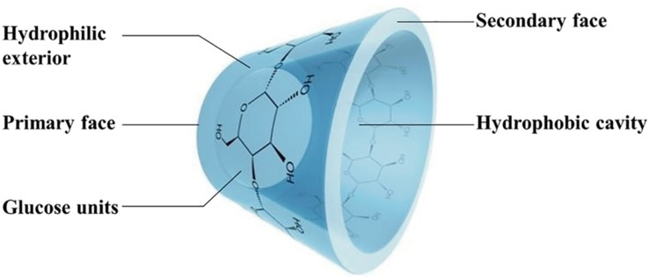
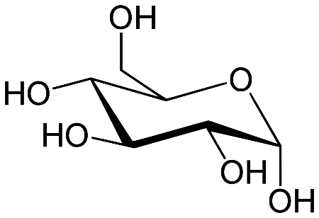
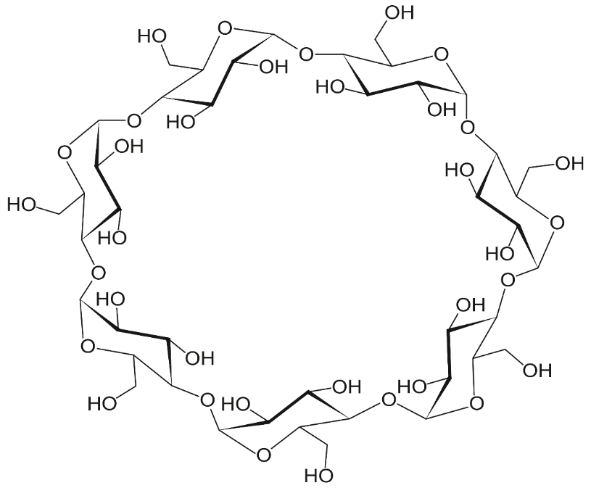
Cyclodextrin
Analyst 2010, 135, 5, 21389-1394
α-D-glucopyranosil
7 units connected by
α-(1 4)-glycosidic linkages
β-cyclodextrin
Journal of Molecular Graphics and Modelling 2020, 94, 107483
3

Slide 4
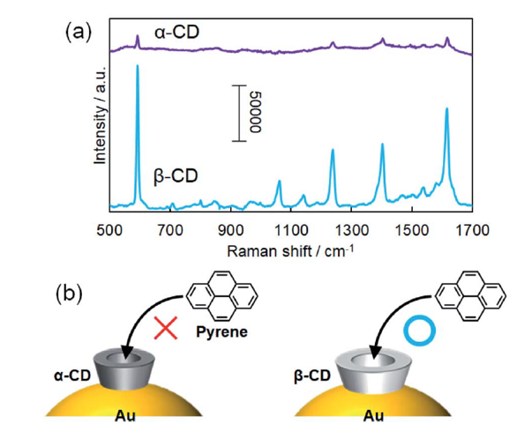
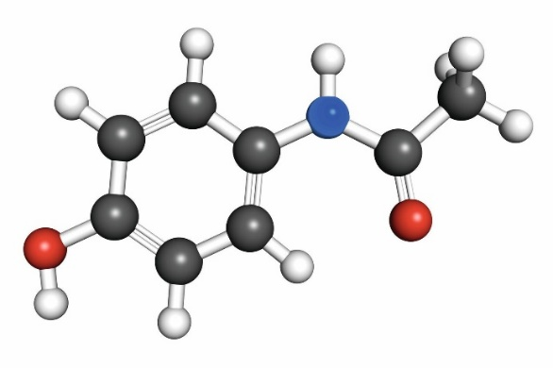


Molecular funnel
Paracetamol
$$°$$
7,9 A
$$°$$
6,4 A
Nanoscale Adv., 2021, 3, 3272
4

Slide 5
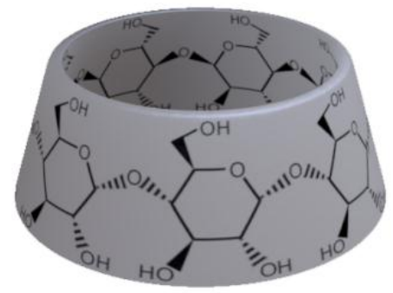
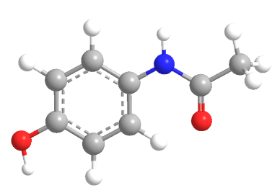

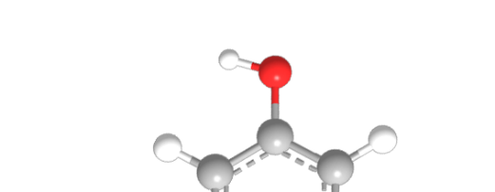
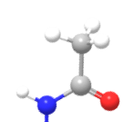
DFT Calculations
B3LYP 6-31+G(d,p)
Grimme’s empirical dispersion
Out / secondary face
+120 kJ/mol
Out / primary face
+53 kJ/mol
Protonation on the primary face
Proton shared
between paracetamol and β-cyclodextrin,
or between hydroxyl groups of the primary face
Out
Lying on primary face
+18 kJ/mol
In
+12 kJ/mol
In
0 kJ/mol
5

Slide 6
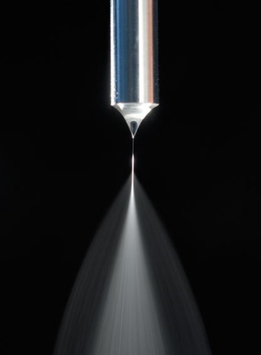
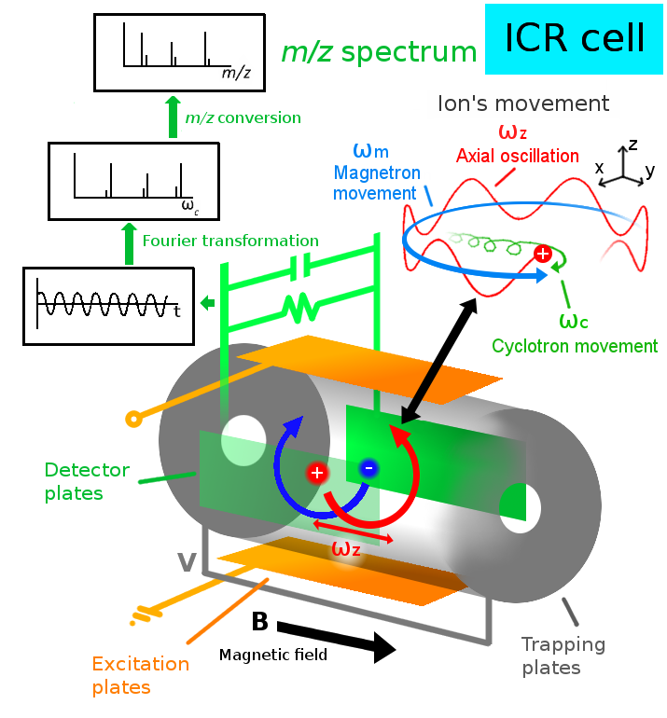
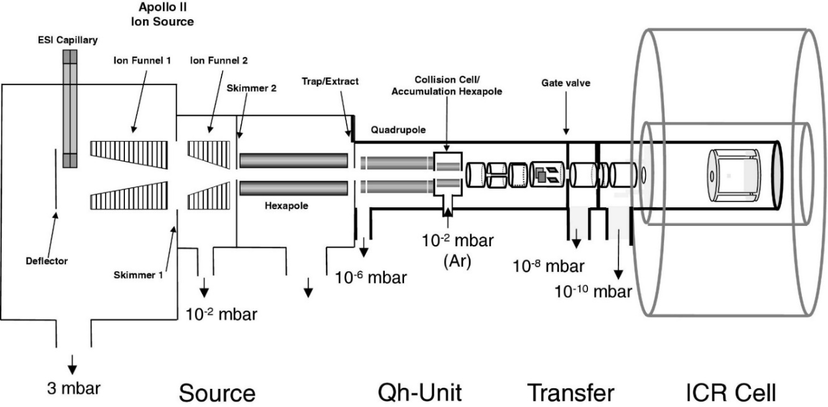
Mass spectrometry
Debora Scuderi
Estelle Loire
7T hybrid FT-ICR APEX-Qe Bruker
6

Slide 7
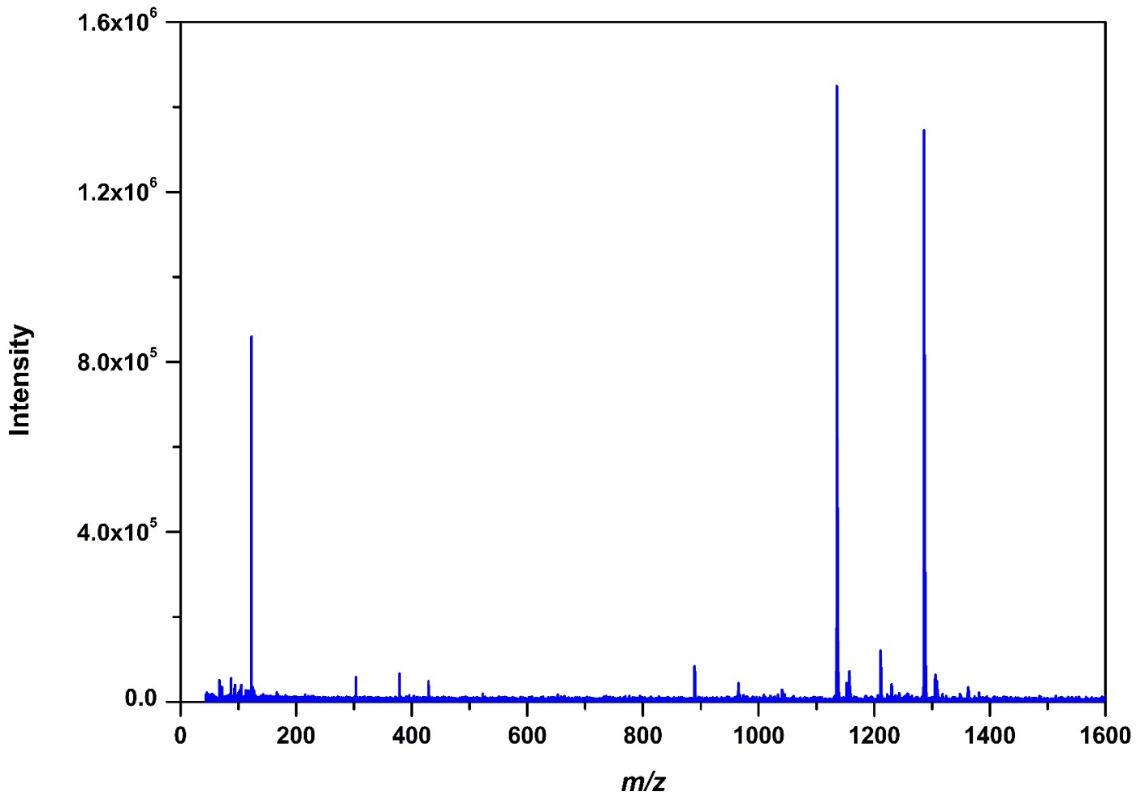


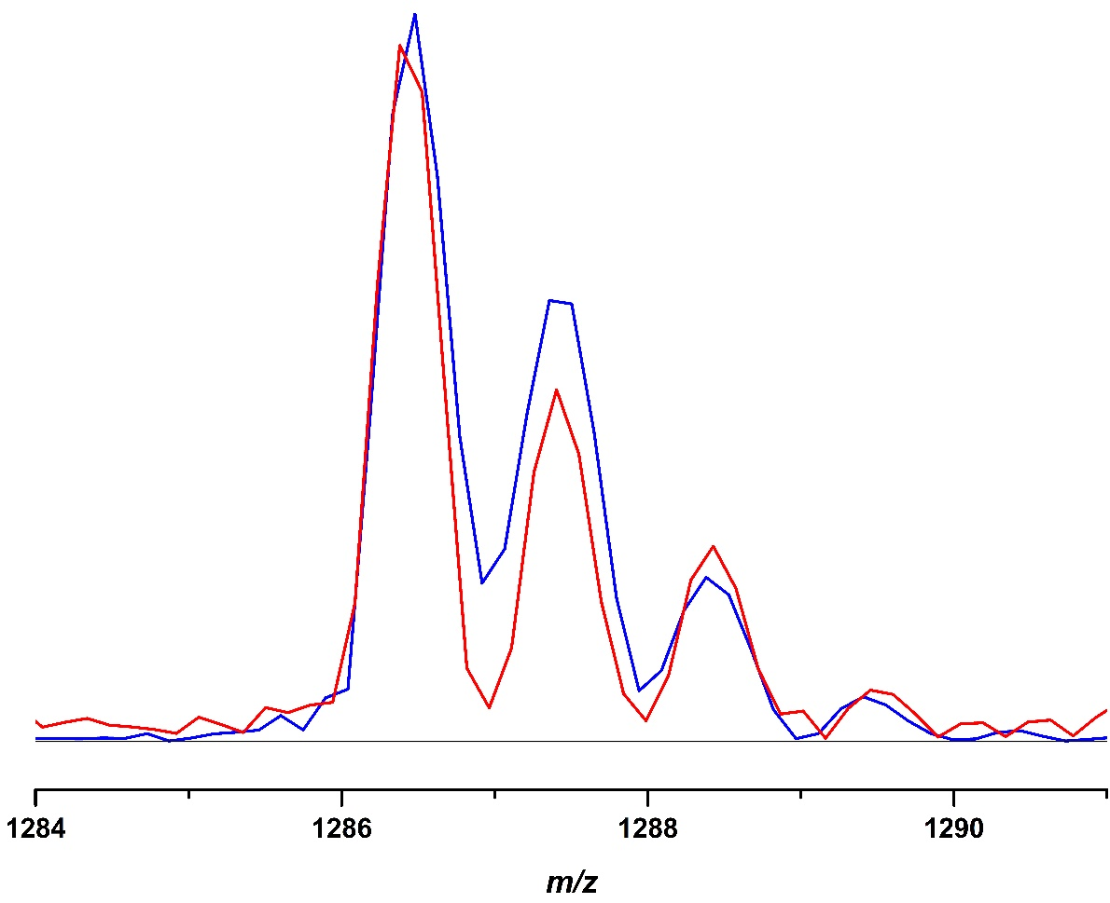
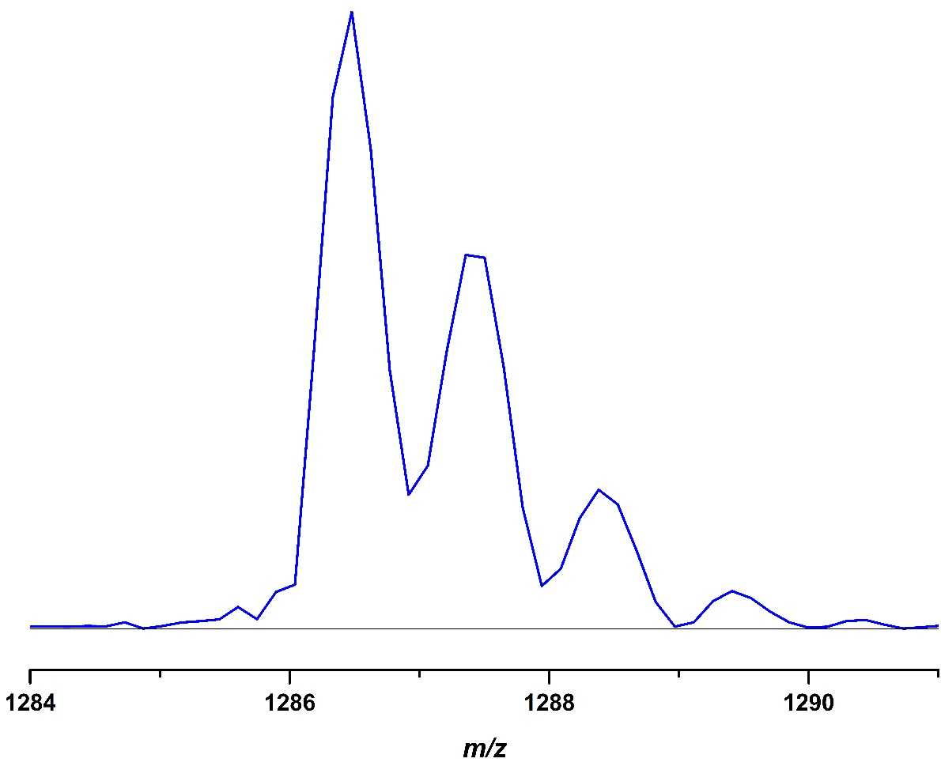
Mass spectrometry
1135
m/z 1135
β-cyclodextrin + H⁺
1286
m/z 1211
2 β-cyclodextrin + Paracetamol + 2 H⁺
+
1211
m/z 1286
β-cyclodextrin + Paracetamol + H⁺
MS / MS (CID)
ESI source conditions
7

Slide 8
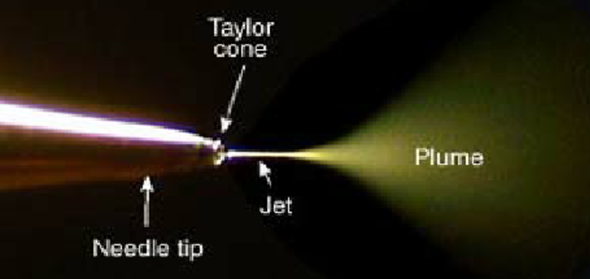

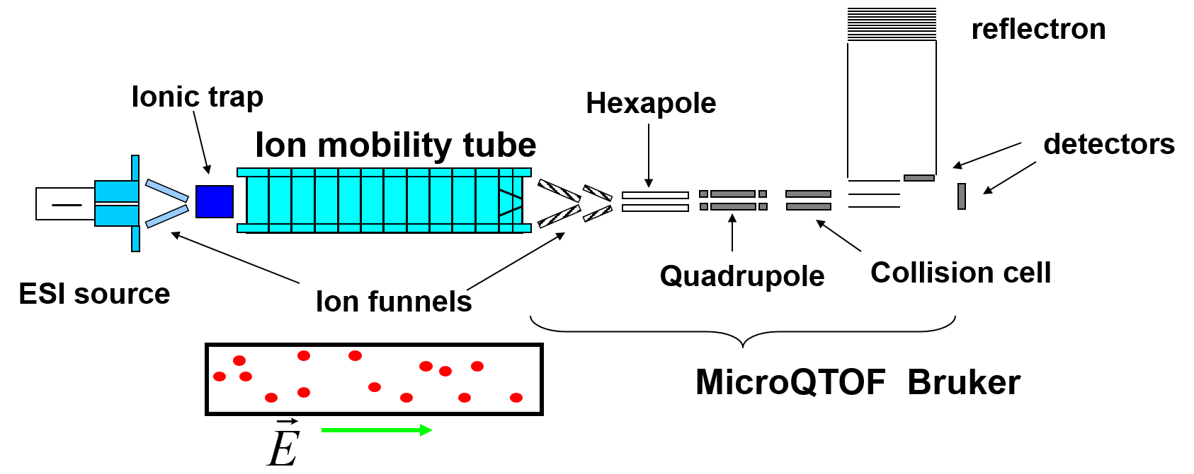
Ion Mobility Spectroscopy
Fabien Chirot
Rodolphe Antoine
Global probe of the secondary structure
8

Slide 9
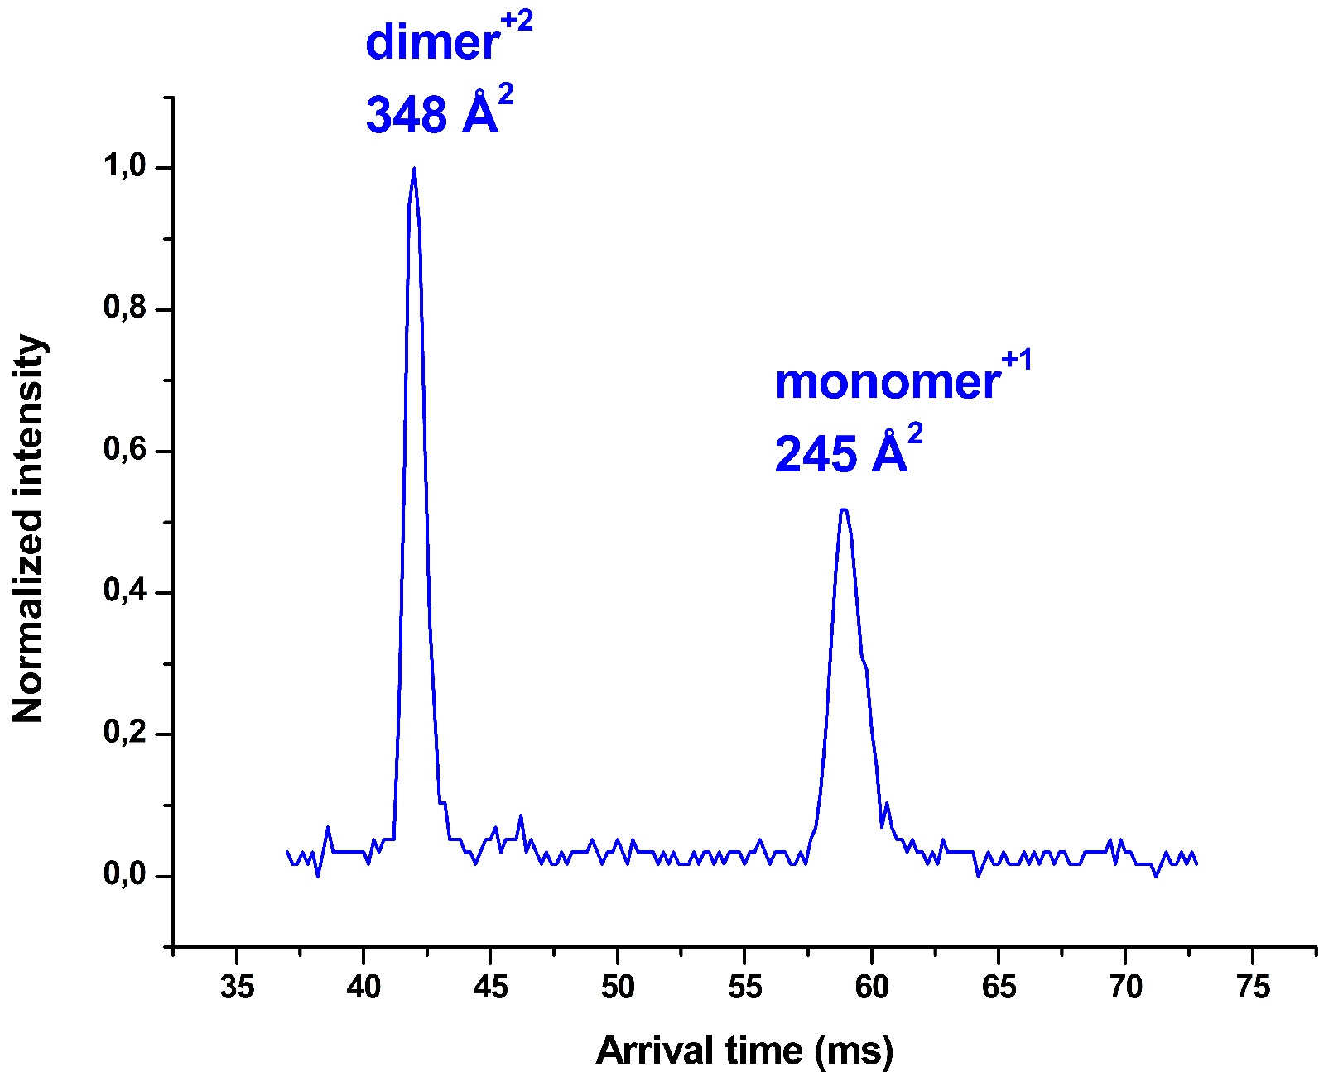





Ion Mobility Spectroscopy
Calculated collisional cross sections : Trajectory method
Collidoscope J. Am. Soc. Mass Spectrom. 2017, 28(4), 587
Incertitude $\sim$ 2%
Ω_{exp} $∈$ $\left[240 ;250\right]$A²
In
249 A²
Out
Lying on
primary face
247 A²
Out
primary face
253 A²
9

Slide 10
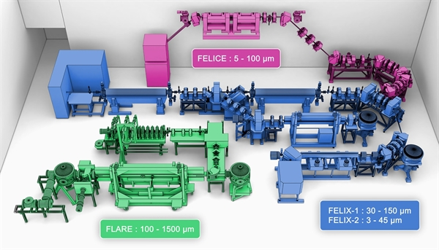
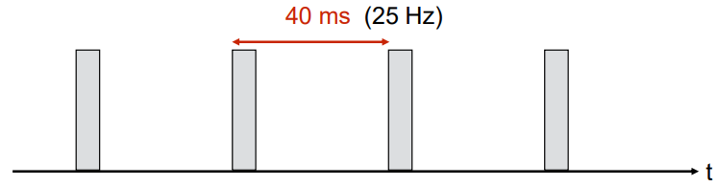
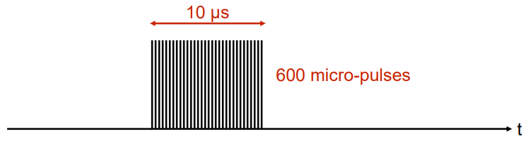
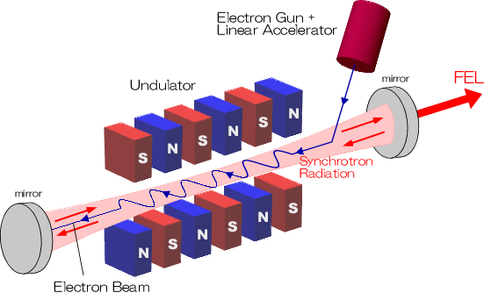
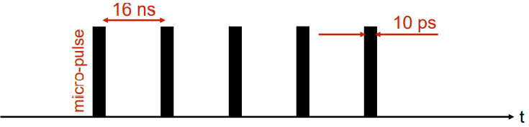
IRMPD FELIX– Fingerprint region
100 ms
(10 Hz)
7 μs
7000 micro-pulses
1 ns
6 ps
40-100 mJ / macropulse
400-1800 cm⁻¹
Bandwith = 0.4% of the central frequency
10

Slide 11
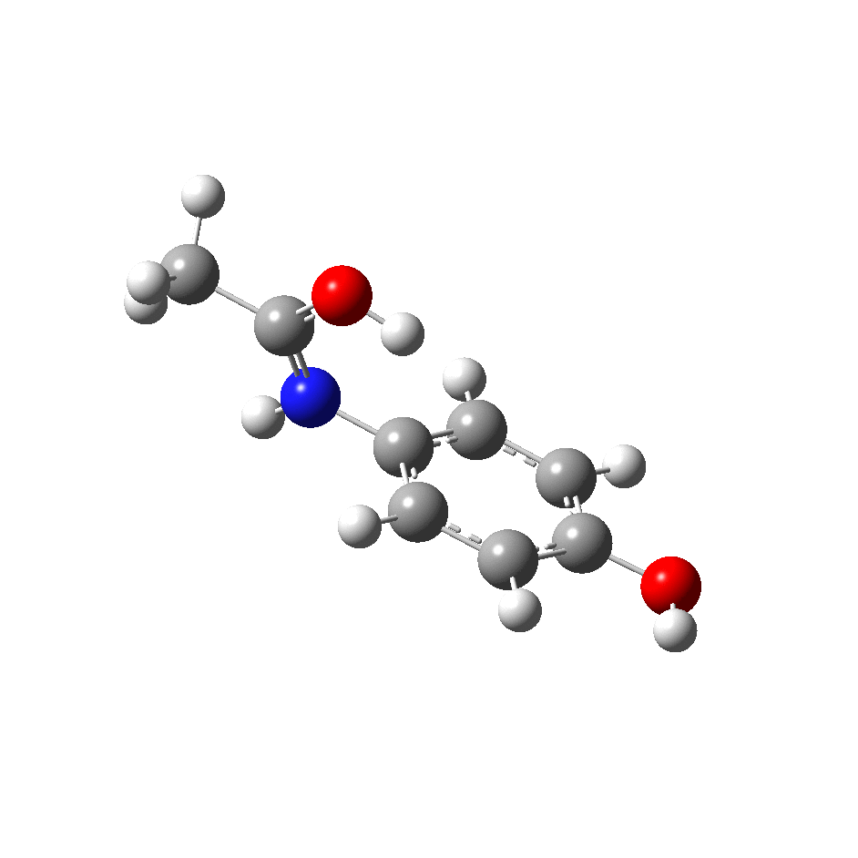
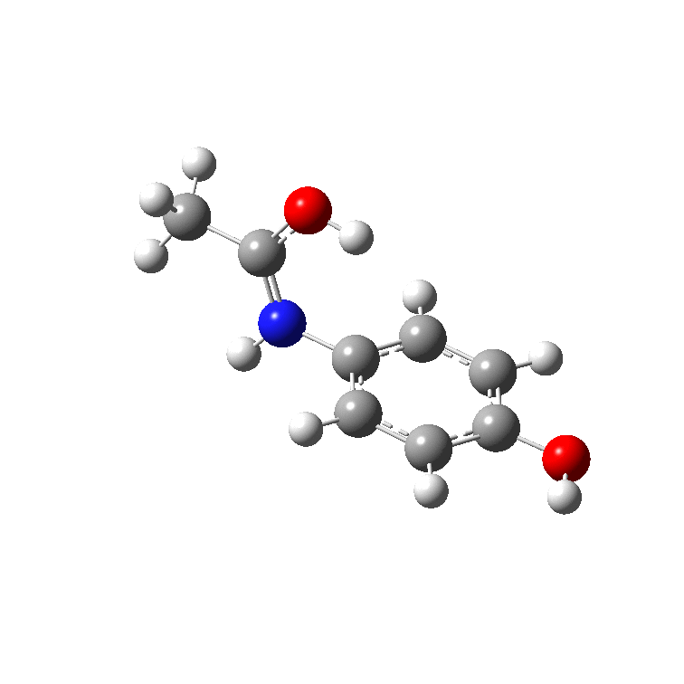
IRMPD – Fingerprint region
The paracetamol β-CD complex spectrum is dominated by the vibration modes of the cage.
Specific vibration modes of paracetamol are still visible.
C-H rocking
Butterfly mode
-
C-0 streching
Complex
β-cyclodextrin
Paracetamol
11

Slide 12
IRMPD – Fingerprint region
Intense bands
X 1/2
FELIX experiments
Complex
12

Slide 13


IRMPD – Fingerprint region
C-O
stretching
Calculation
B3LYP 6-31+G(d,p)
Grimme’s empirical dispersion
Scaling factor 0.97
Butterfly mode
C-H rocking
paracetamol
C-O-H,
R-C-H bendings
CH₂ deformations
O-H
out of plane bending
C-O
bending
C-C
stretching
C O stretching
N-H bending
In1 0 kJ/mol
FELIX experiments
Complex
13

Slide 14
IRMPD – Fingerprint region
C-H rocking
paracetamol
C O stretching
Butterfly mode
Out1 +18 kJ/mol
In1 0 kJ/mol
FELIX
experiments
14

Slide 15
IRMPD – Fingerprint region
N-H bending
Butterfly mode
C-H rocking
paracetamol
C O stretching
In2 +29 kJ/mol
Out1 +18 kJ/mol
In1 0 kJ/mol
FELIX
experiments
15

Slide 16
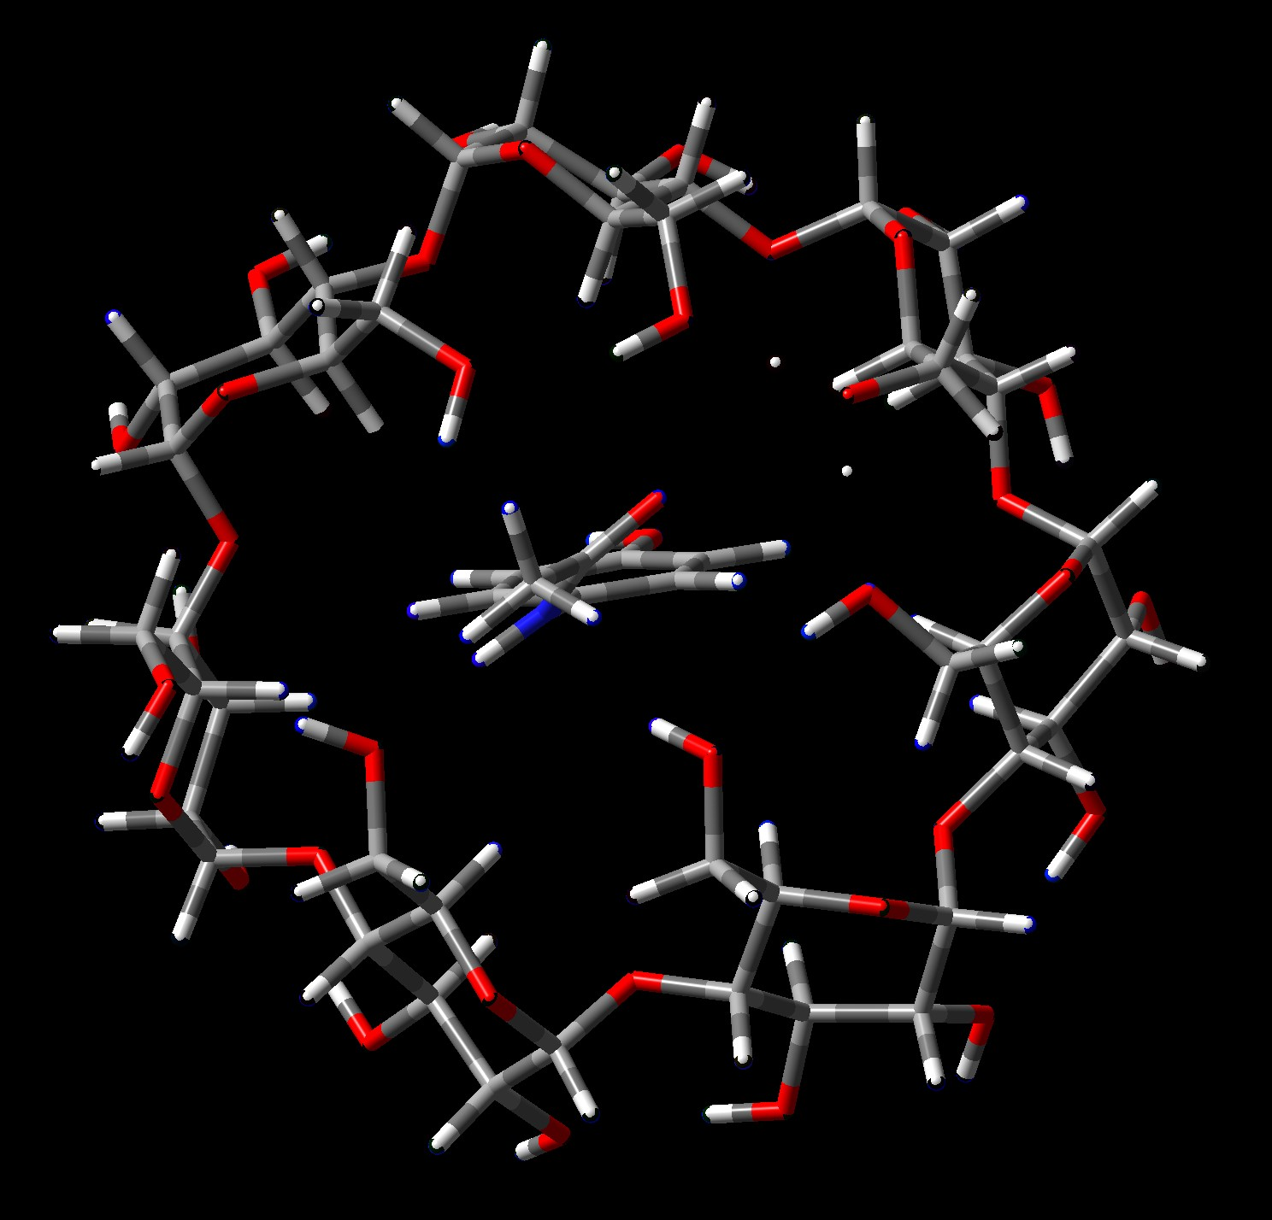
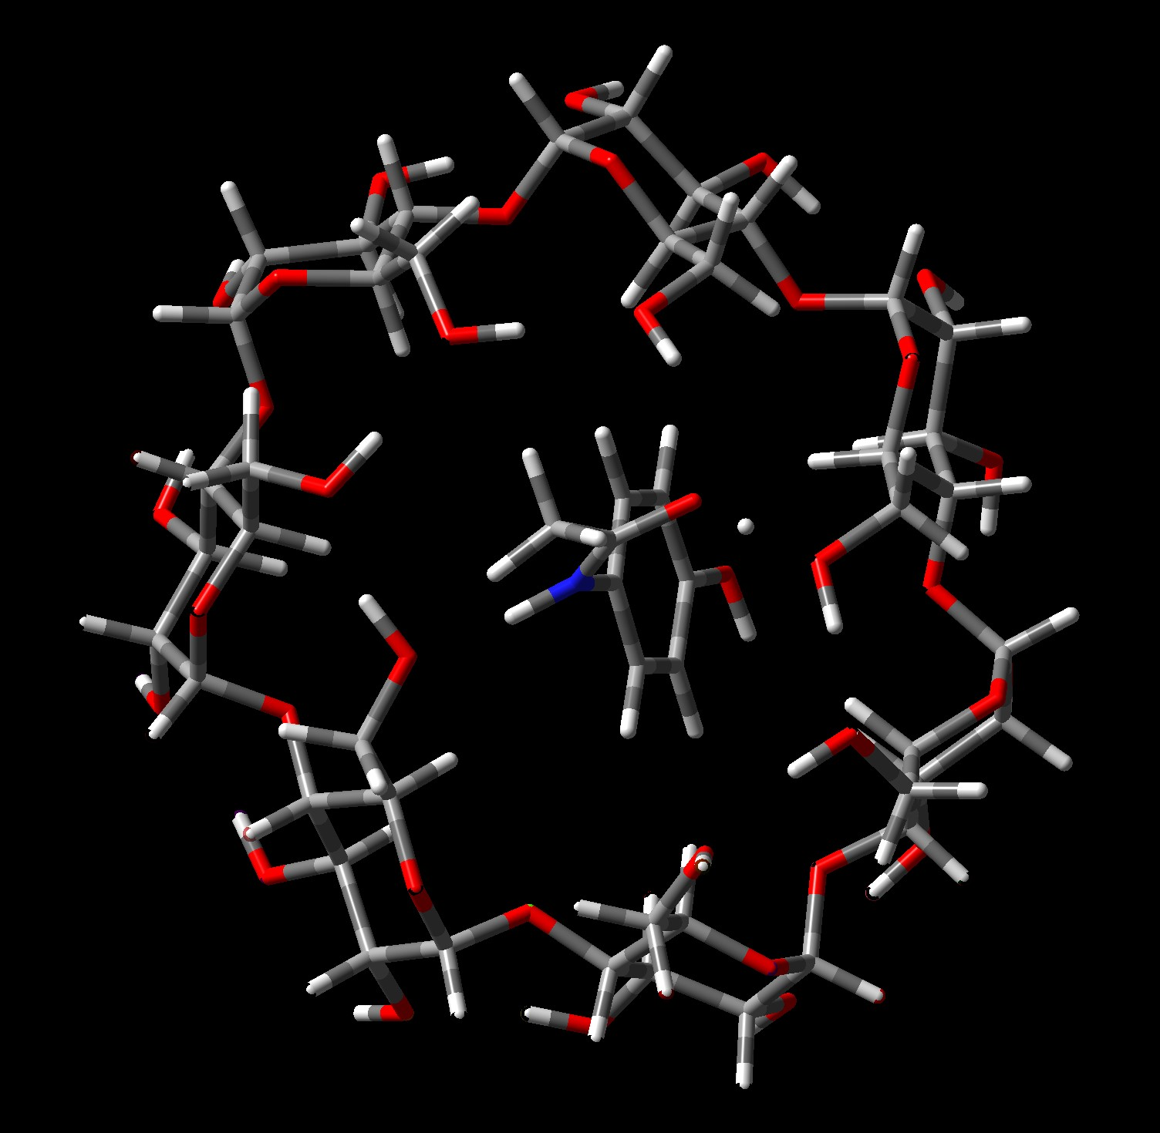
IRMPD – Fingerprint region
Very good agreement between
the experimental spectra and the B3LYP/6-31+G(d,p) calculation
Intensity of the C-H rocking vibration mode
Paracetamol forms an inclusion complex
with β-cyclodextrin in the gas phase.
In2 +29 kJ/mol
In1 0 kJ/mol
16

Slide 17
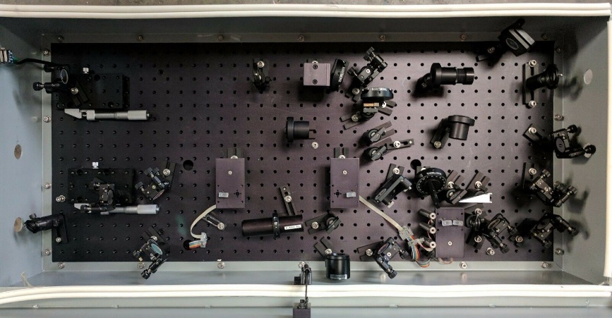
IRMPD – 3 microns region
Debora Scuderi
Estelle Loire
OPO
10 Hz
100 mW
17

Slide 18
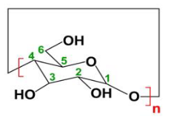
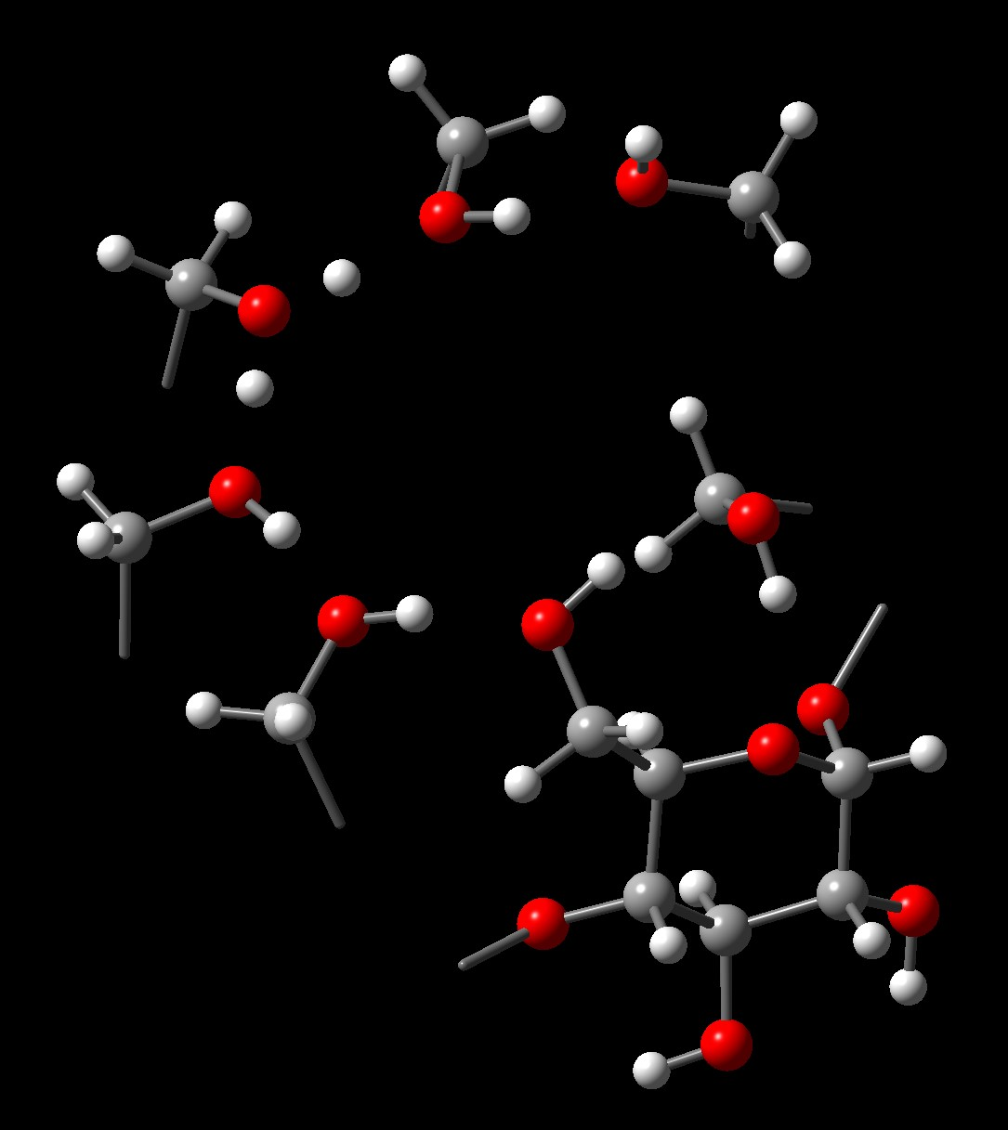
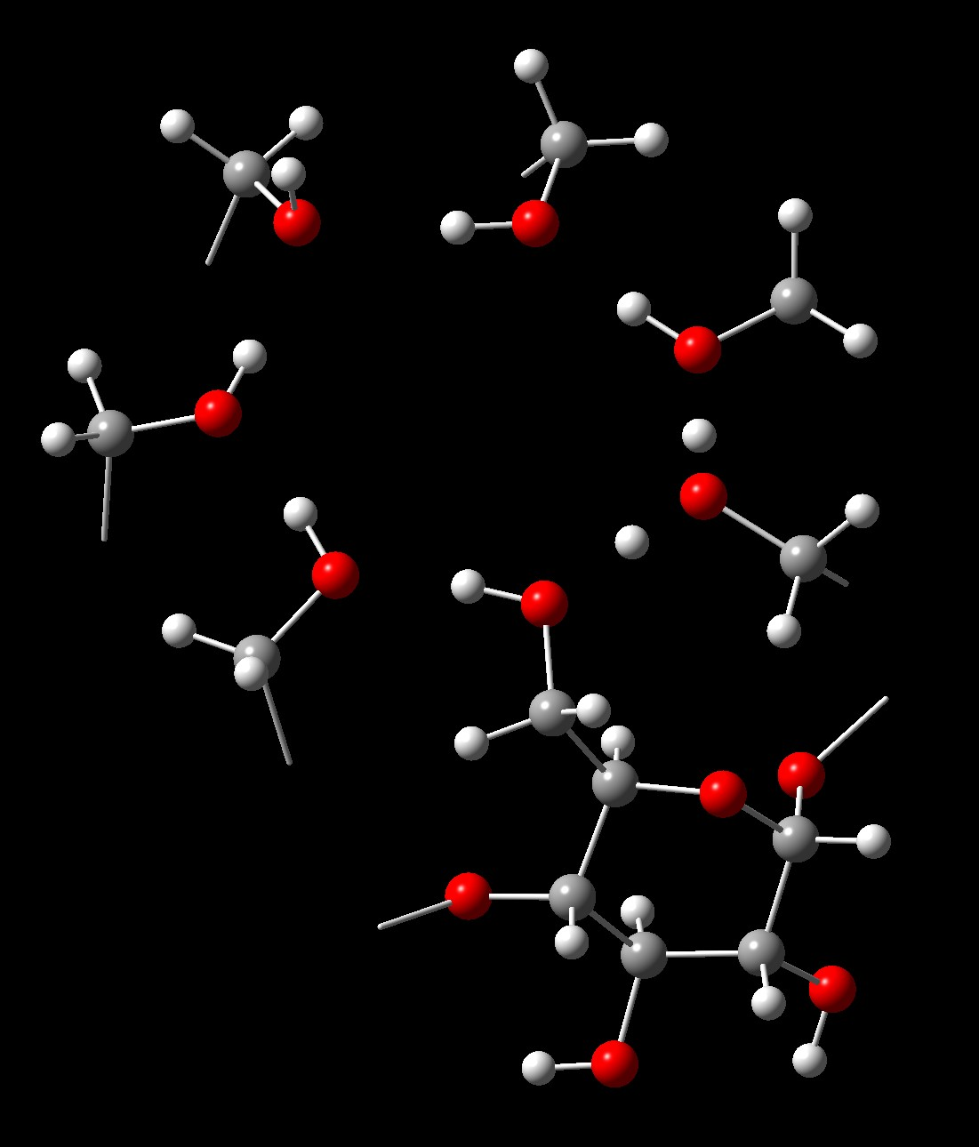
IRMPD – 3 microns region
Calculation
B3LYP 6-31+G(d,p)
Grimme’s empirical dispersion
Scaling factor 0.955
O6-H 06’
secondary face
+98 kJ/mol
O6-H 05’ (x2)
primary face
+42 kJ/mol
O6-H 05’ (x1)
primary face
+20 kJ/mol
O6-H 06’
primary face
0 kJ/mol
CLIO
experimental spectrum
18

Slide 19
IRMPD – 3 microns region
Calculation
B3LYP 6-31+G(d,p)
Grimme’s empirical dispersion
Scaling factor 0.955
Bound O-H
Secondary face
Bound O-H
Primary face
Free O-H
Secondary face
Free O-H
Primary face
O6-H 06’
primary face
CLIO
experimental spectrum
19

Slide 20


IRMPD – 3 microns region
Bound O-H
Secondary face
Free O-H
Secondary face
Free O-H
Paracetamol
Red-shift of the secondary face
bound 0-H stretching
In2
Complex
Slight deformation of the molecular cage
β-cyclodextrin
Diameter of the secondary face
B-cyclodextrin : 12.8
B-cyclodextrin + paracetamol : 13.4
$$Å$$
$$Å$$
20

Slide 21
Conclusion
Paracetamol is inside the box !
IRMPD spectroscopy and quantum chemistry calculations
allow to determine that
paracetamol and β-cyclodextrin form an inclusion complex
Additional information
on the position of paracetamol inside the molecular cage
and on the H-bond network
21

Slide 22
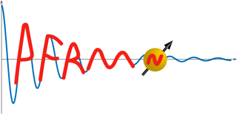
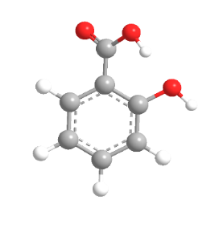
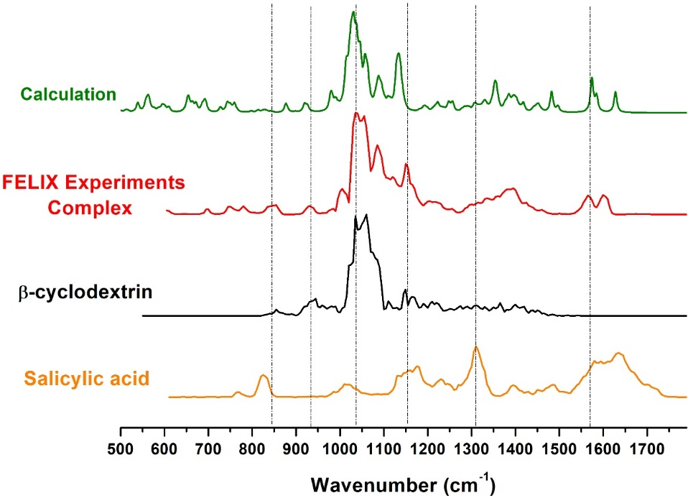
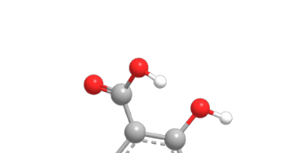
Perspectives
NMR experiments
Structure in the liquid phase
Salicylic acid + β-cyclodextrin
In
(0 kJ/mol)
Out
(+19,7 kJ/mol)
22

Slide 23
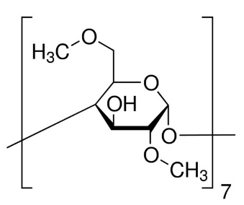
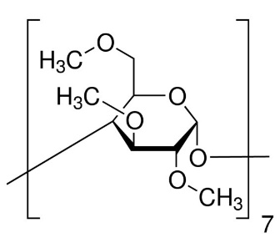

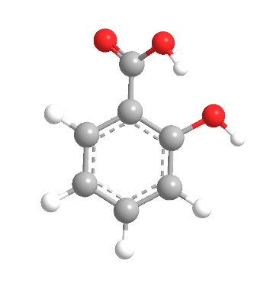

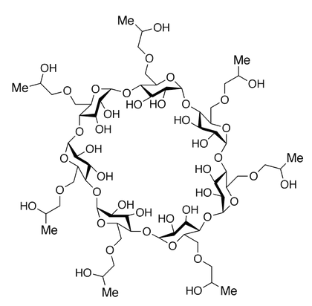
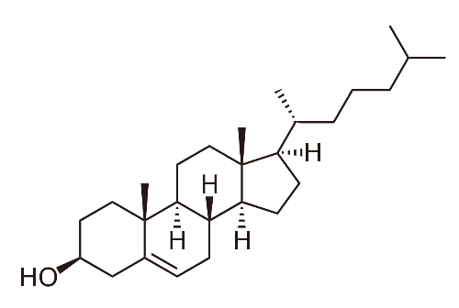
Perspectives
Methylated β-cyclodextrins
Influence of the degree of methylation on complex formation,
toxicity and solubility for the included guest molecule.
(2:1) complexes
Encapsulation for vectorization.
Hydroxypropyl cyclodextrins
+ cholesterol
Manipulation of cholesterol levels of biomembranes.
Reduction of the chronic inflammatory response to stroke.
Promising experimental therapy for neurodegenerative
cholesterol storage disorder.
23

Slide 24


Thanks
Ayoub Badri
Ali Beydoun
Charles Desfrançois
Debora Scuderi
Frédéric Lecomte
Estelle Loire
Bruno Manil
Nicolas Nieuwjaer
Fabien Chirot
Jos Oomens
Rodolphe Antoine
Giel Berden
24

Slide 25

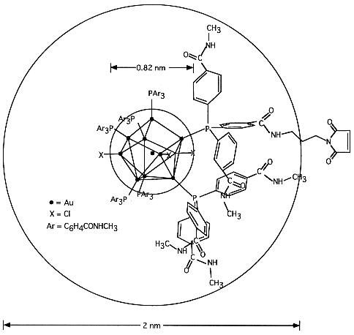
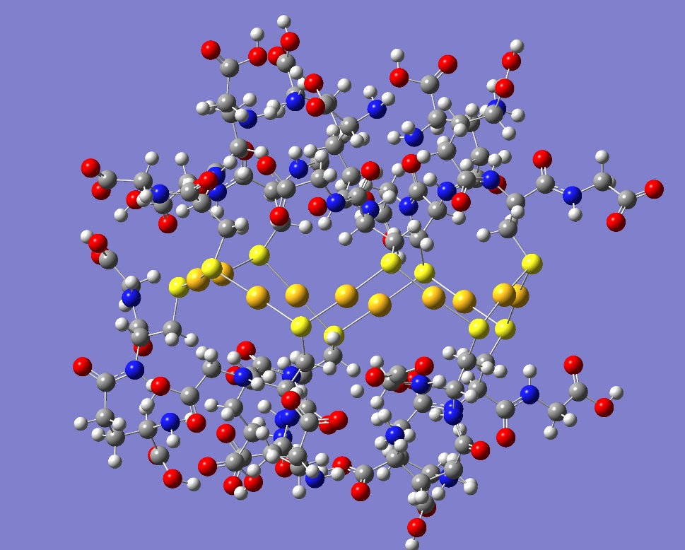
IRMPD spectroscopy
on mass-selected metal-ligand complex ions
Ayoub Badri
25

