Slide 1



Mapping the electronic transitions of protonation sites in peptides using NEXAMS
Juliette Leroux, 2nd year PhD student
Paris, July 5th 2023

Slide 2

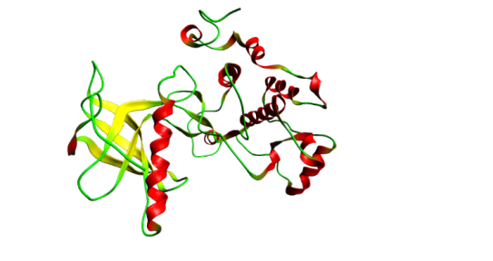
Biomolecules in the gas phase
Structure
Radiation damage
Electronic structure
Cleavage site
Dissociation processes
Dissociation dynamics
Three-dimensional structure
Molecular environment
(water, protein complexes)

Slide 3
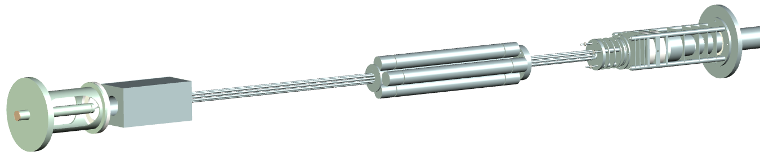
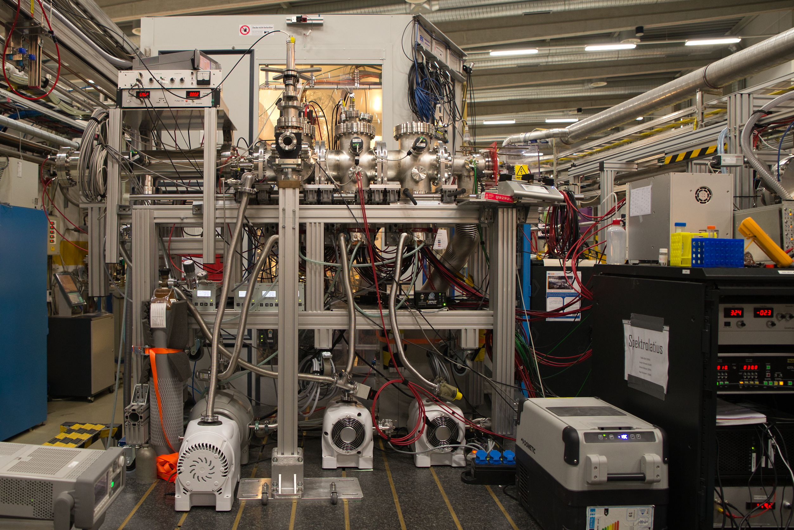
Tandem mass spectrometry
Studying protonated gas-phase ions
Photons
Quadrupole mass filter
Ion trap
Time-of-flight
mass spectrometer
Electrospray
ionization
source
m/z selection
Trapping
Irradiation
Time-of-flight MS
Picture of the setup when implemented at PETRA III, Hamburg, Germany

Slide 4
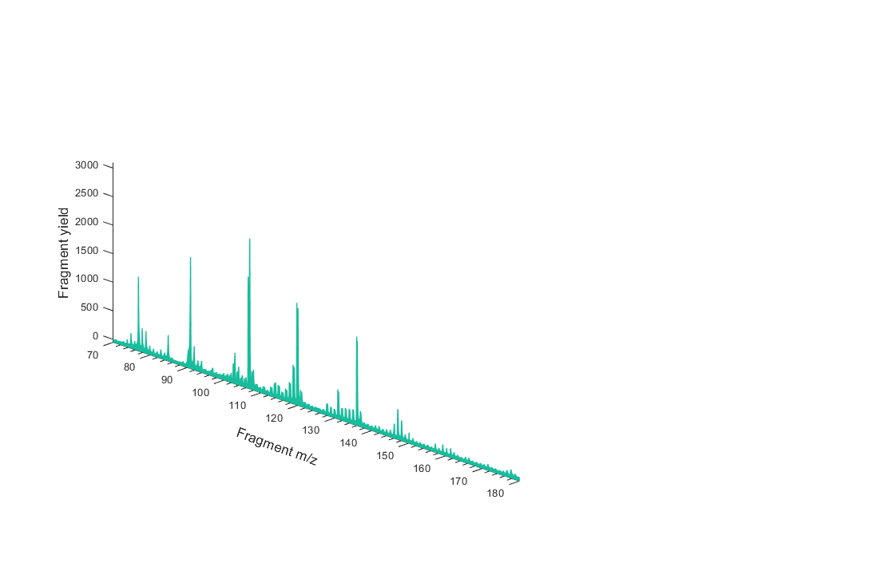
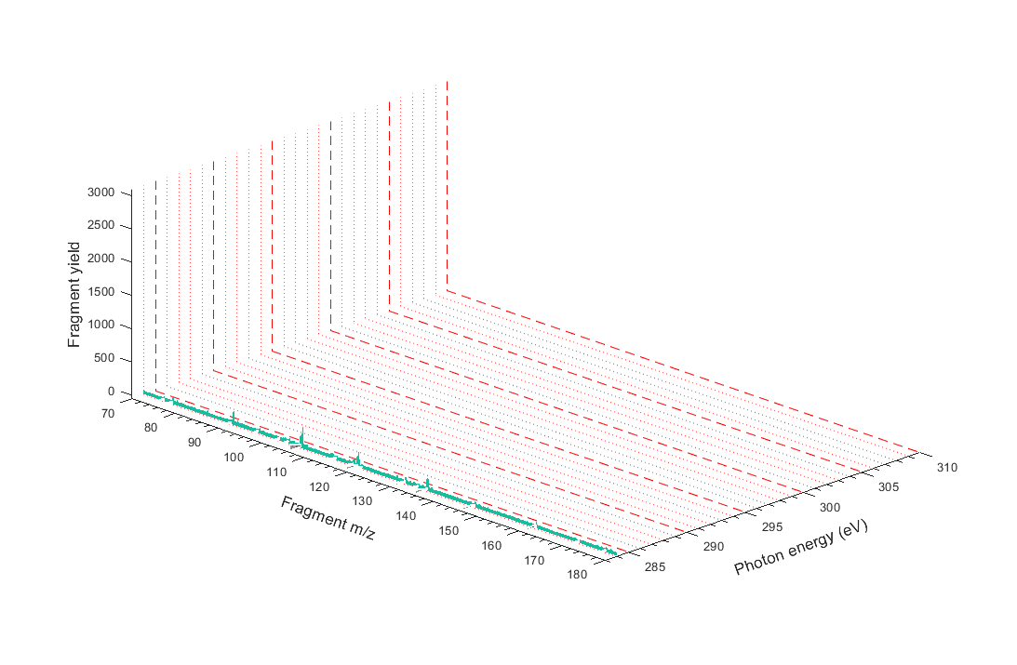
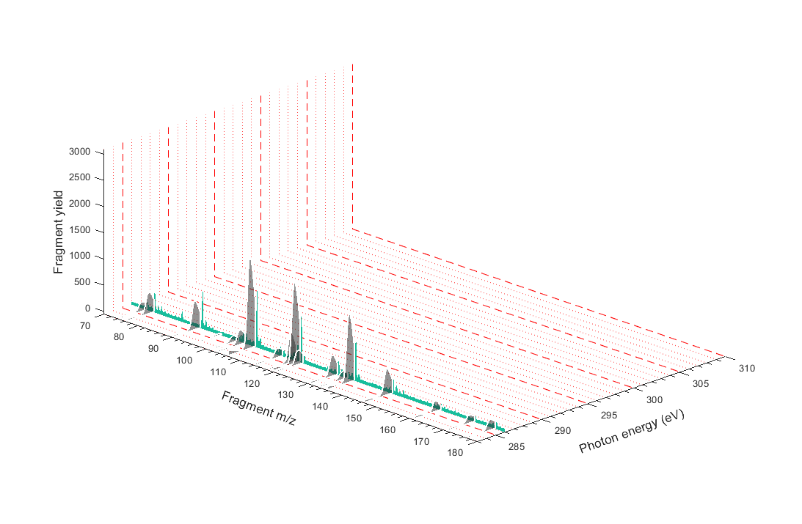
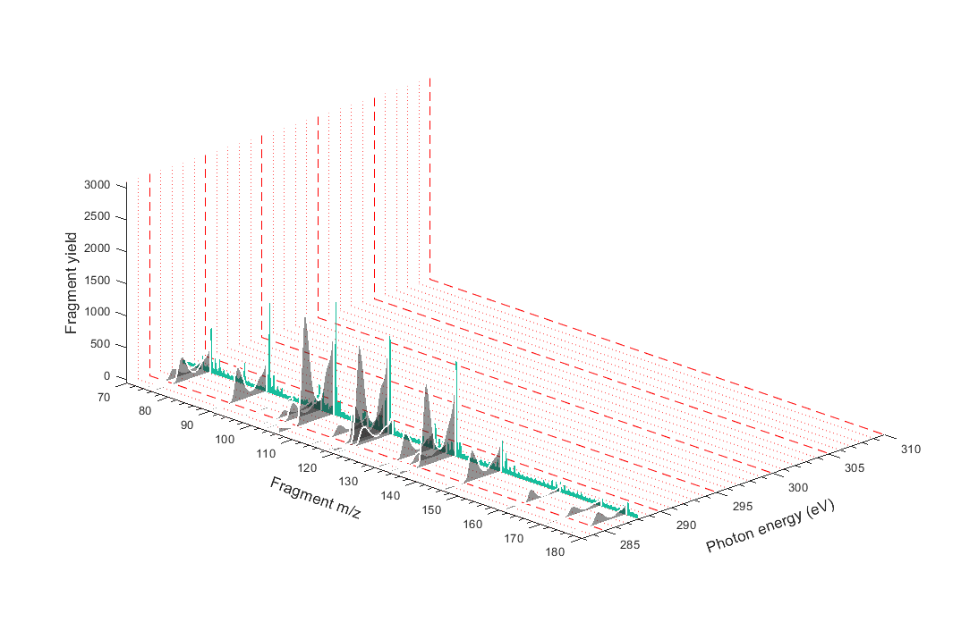
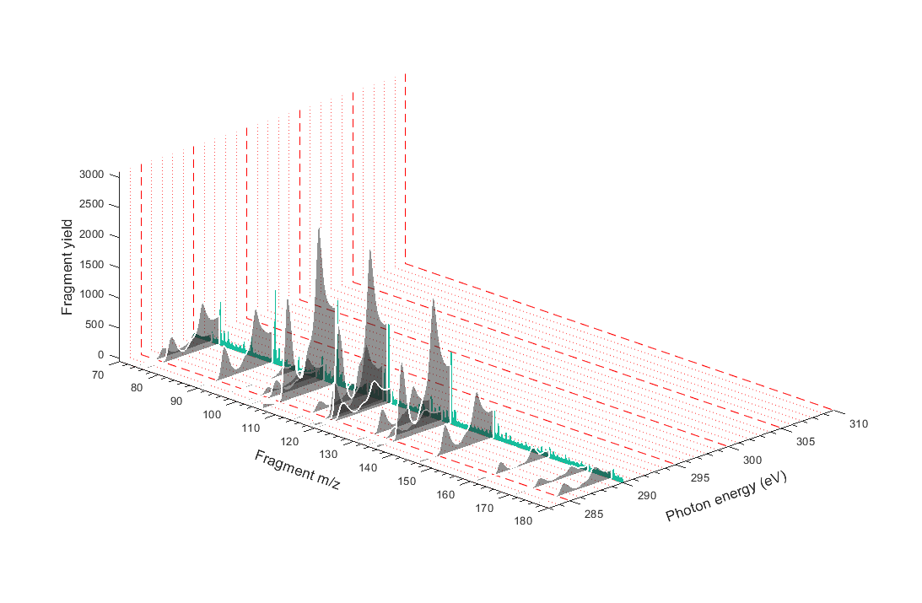
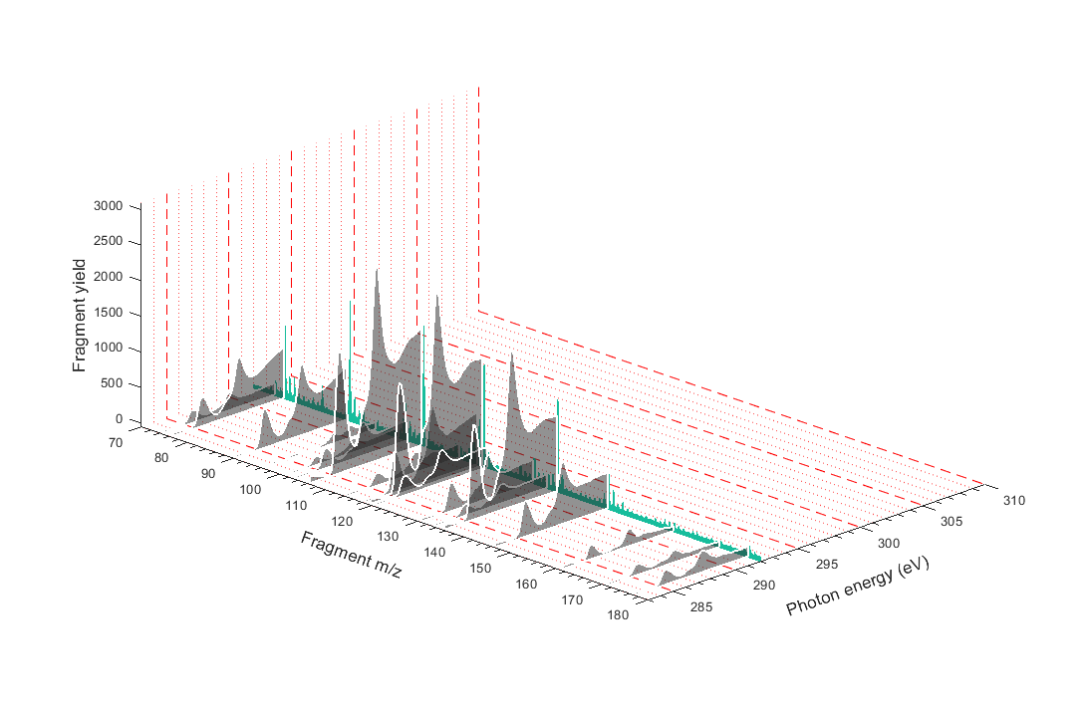
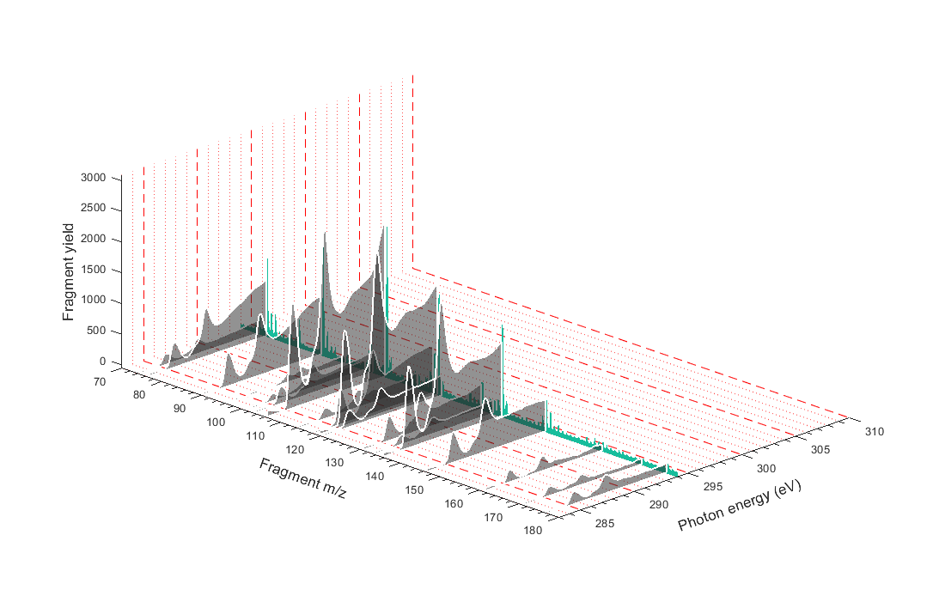
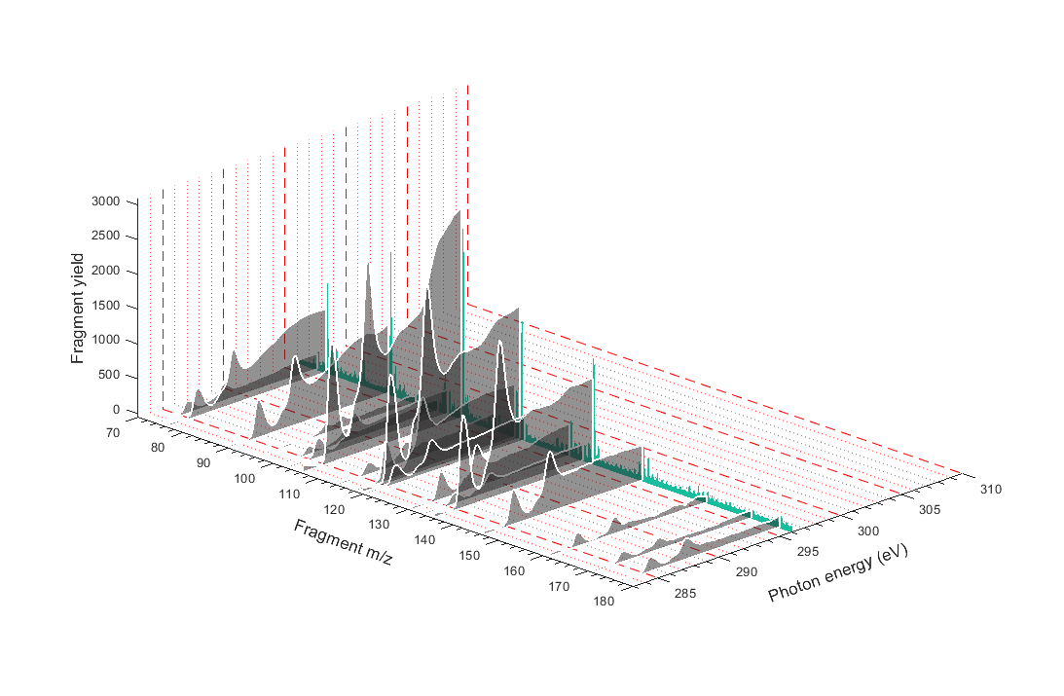
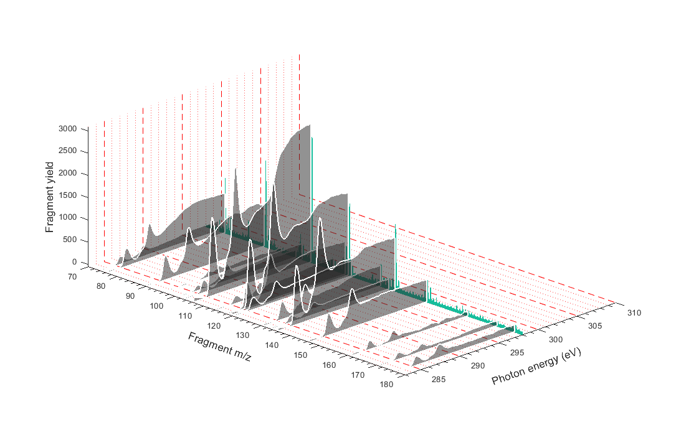
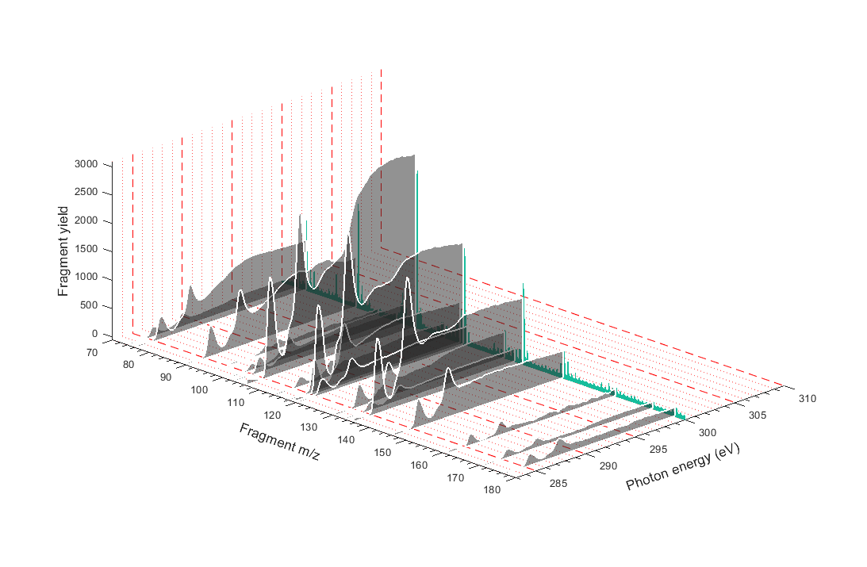
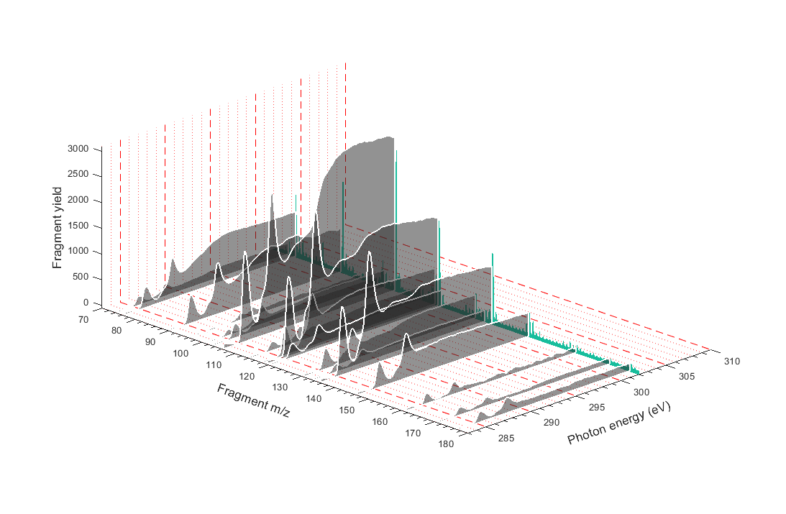
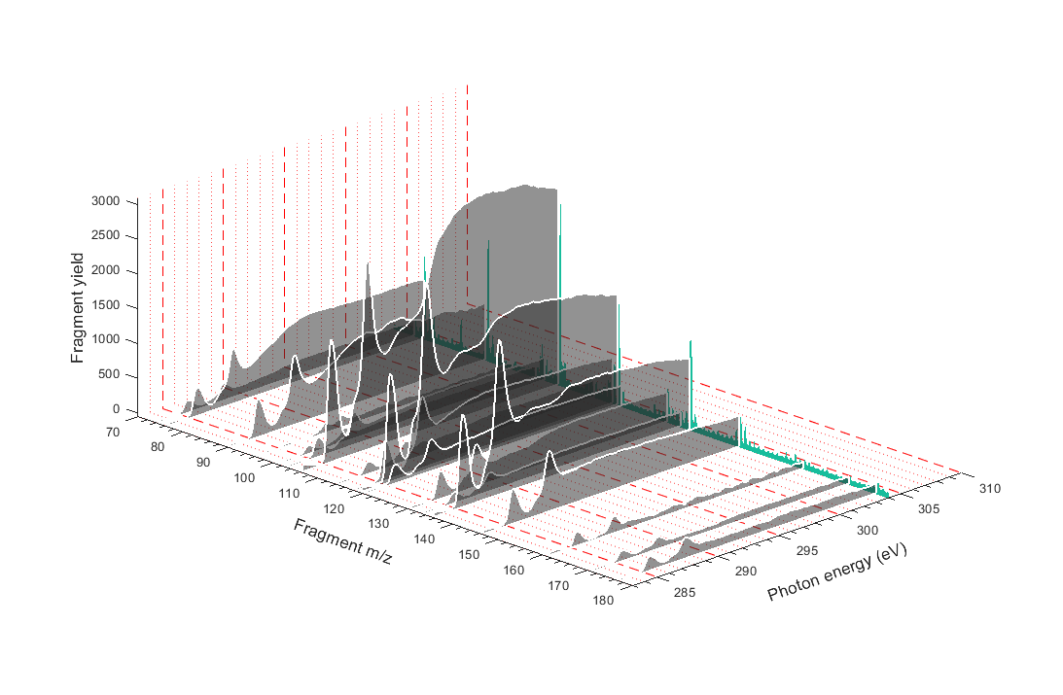
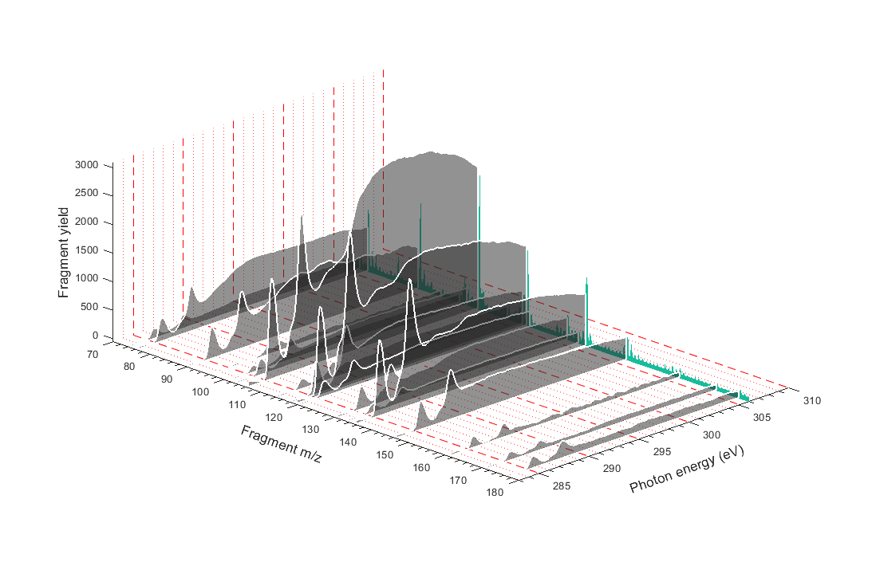
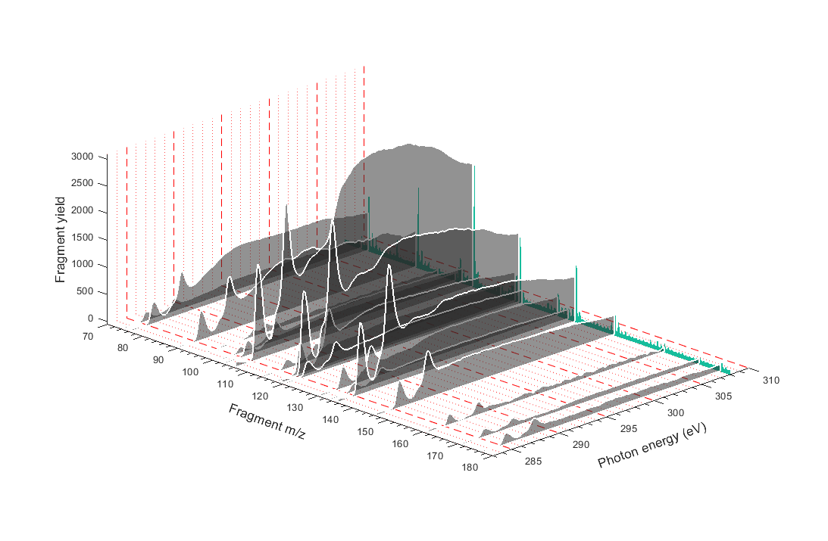
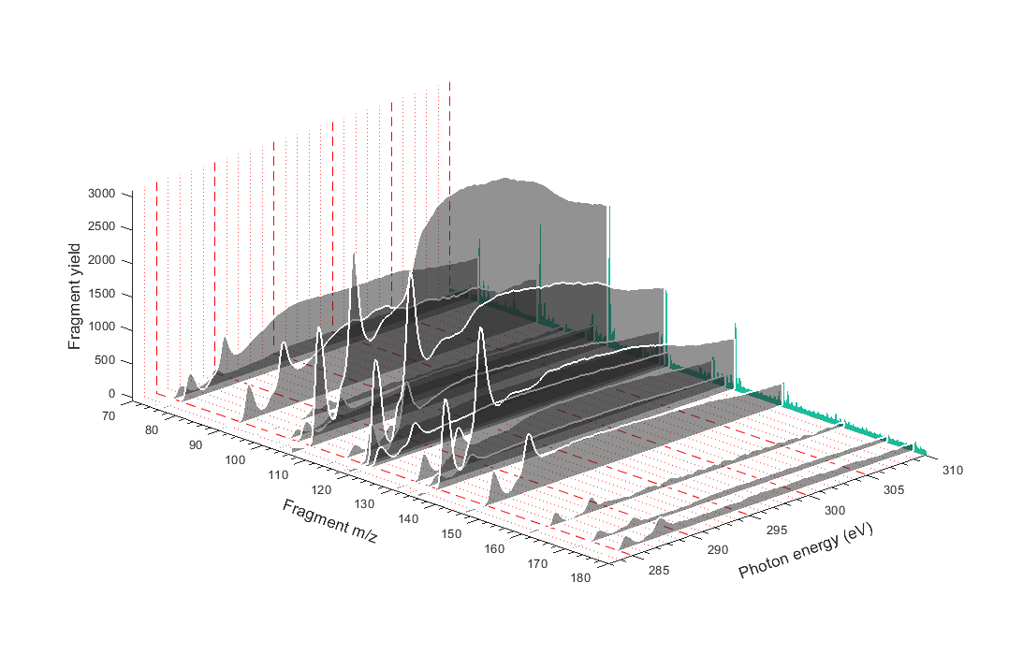
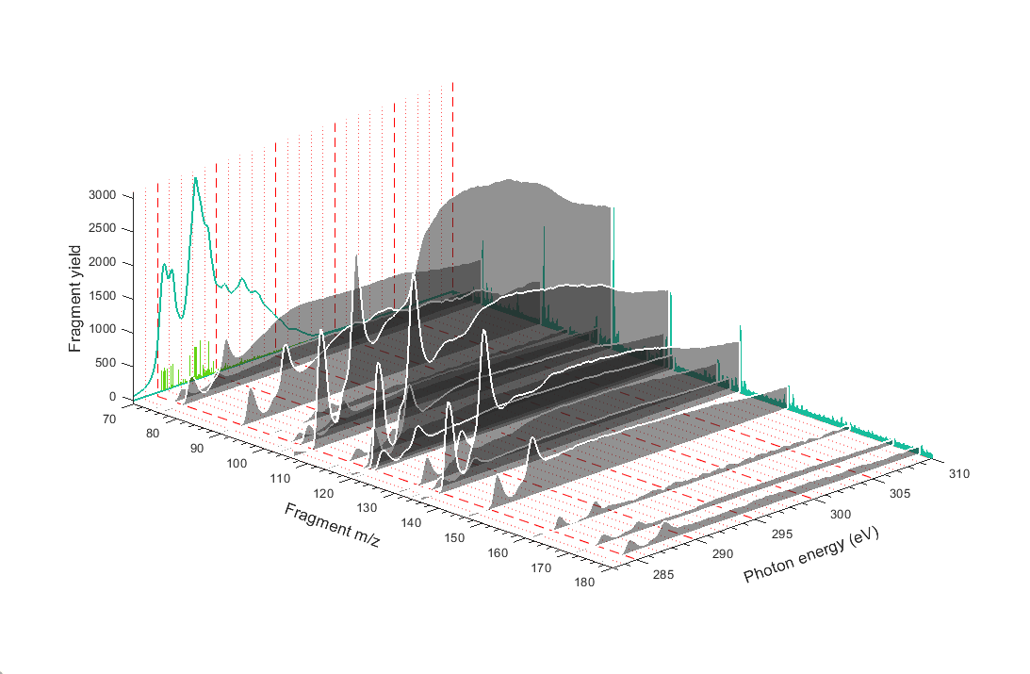
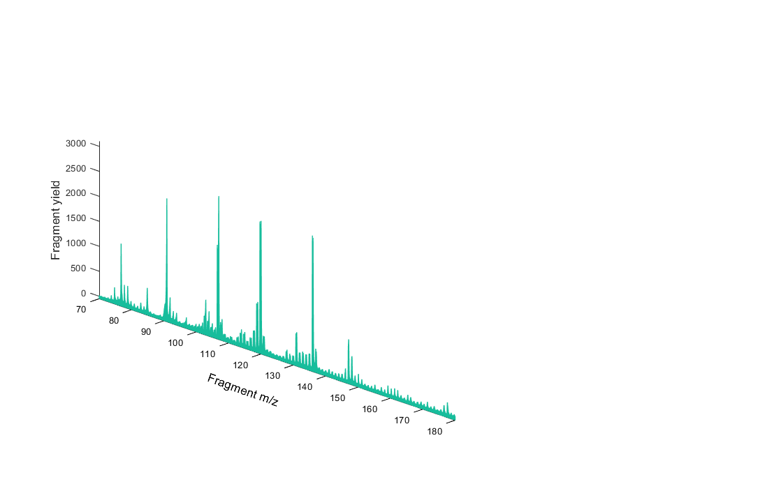
NEXAMS
Near Edge X-ray Absorption Mass Spectrometry
Calculation DFT / ROCIS
π*_{CONH}
Studied system
π*_{C=C}
σ*_{C-N}
σ*_{C-H}
S. Dörner et al. J. Am. Soc. Mass Spectrom., 32, 3, 670–684 (2021)

Slide 5
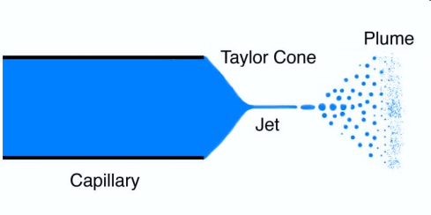
Application of NEXAMS: mapping the protonation site of biomolecular ions
Electrospray ionization source
The case of a small ion: 4-Amino Benzoic acid
NEXAMS of peptides with different protonation site
[M+H]⁺
Needle tip
Experiments done at P04, PETRA III, Hamburg
At BESSYII UE52_PGM Ion trap, Berlin

Slide 6
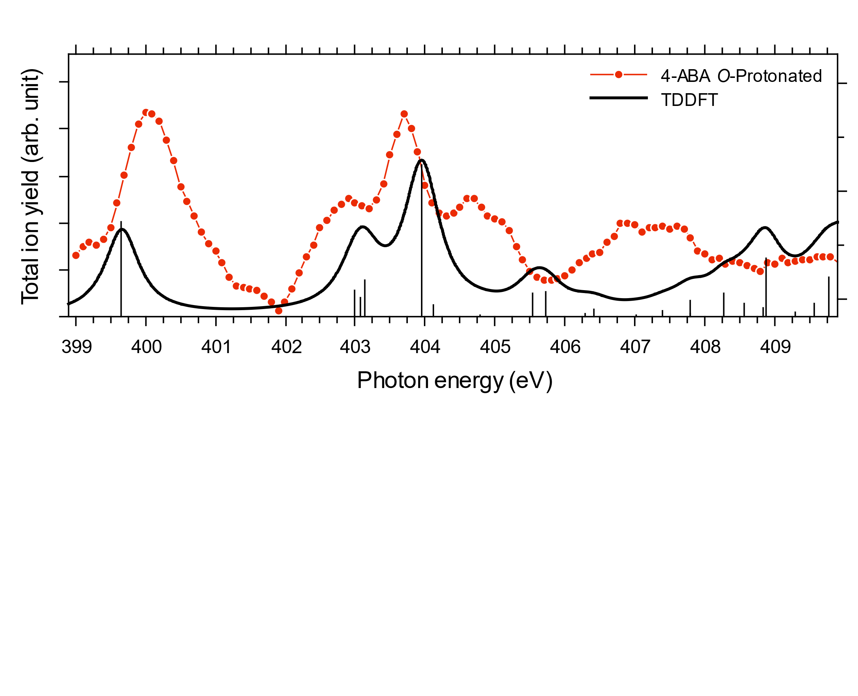
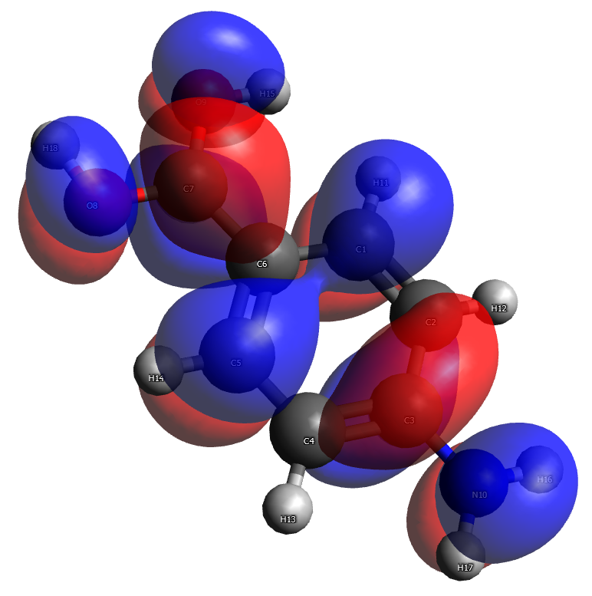
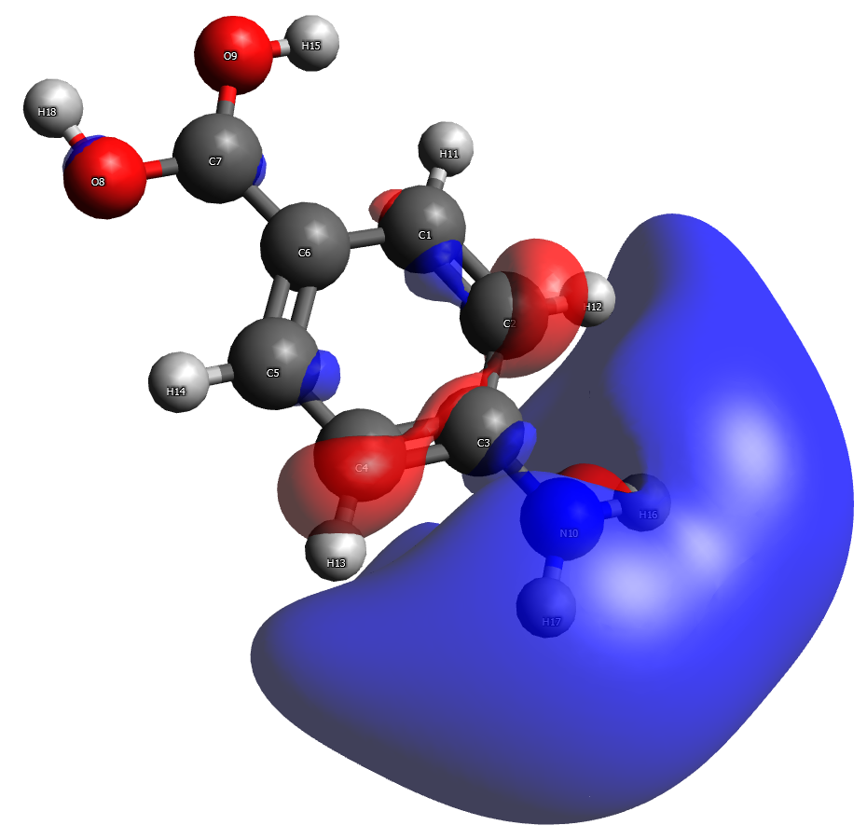
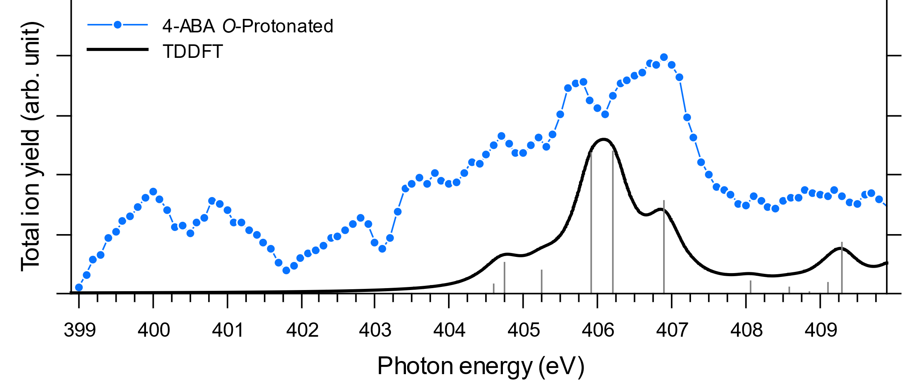
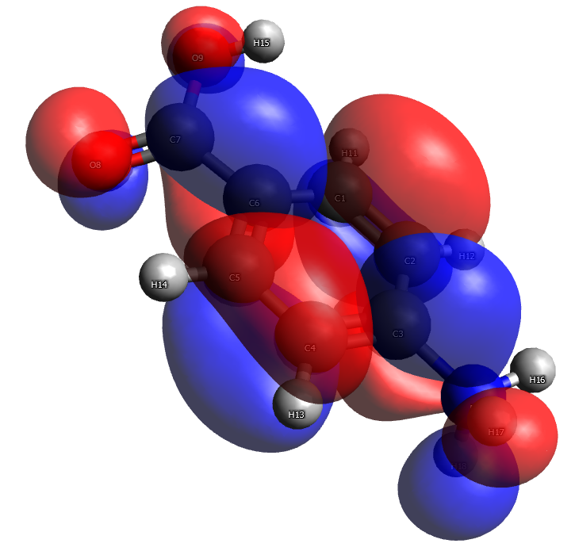
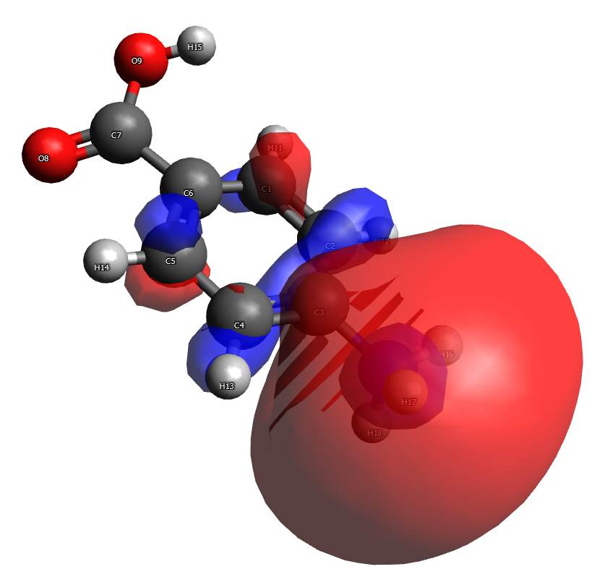



The case of 4-Amino Benzoic Acid
Nitrogen K-edge
Transitions to:
Aromatic ring
Amino group
Carboxyl group
$$σ_{NH_{2}}^{∗}$$
LUMO
LUMO+5
$$σ_{NH_{3}^{+}}^{∗}$$
LUMO
LUMO+2
Protonation on nitrogen shifts resonances to higher energies
Distinct resonances $N_{1s}→σ_{NH_{2}}^{∗}$ VS $N_{1s}→σ_{NH_{3}^{+}}^{∗}$

Slide 7
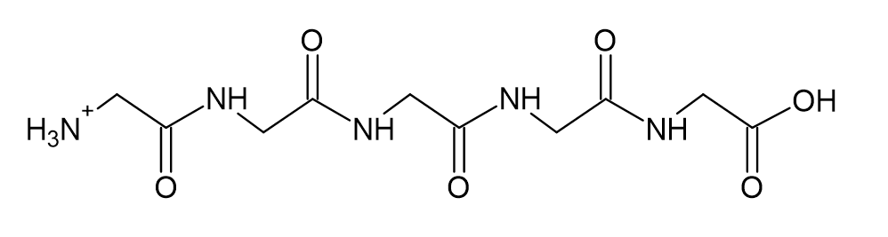
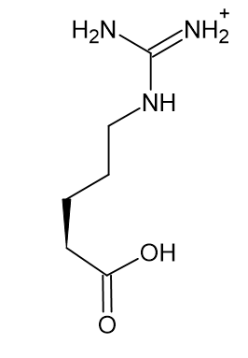
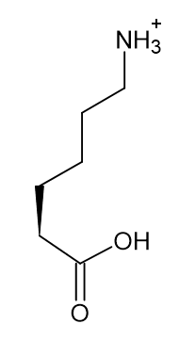
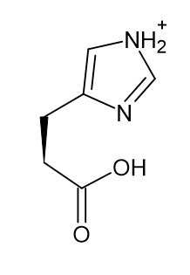
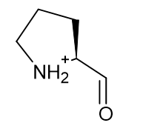
Mapping the protonation site in peptides
To which extent is NEXAMS sensitive to protonation?
Peptides of interest:
G: Glycine-based pentapeptides
GGGGG
Arginine (R)
Histidine (H)
Lysine (K)
Proline (P)
GGGGR
GGGGH
GGGGK
PGGGG

Slide 8
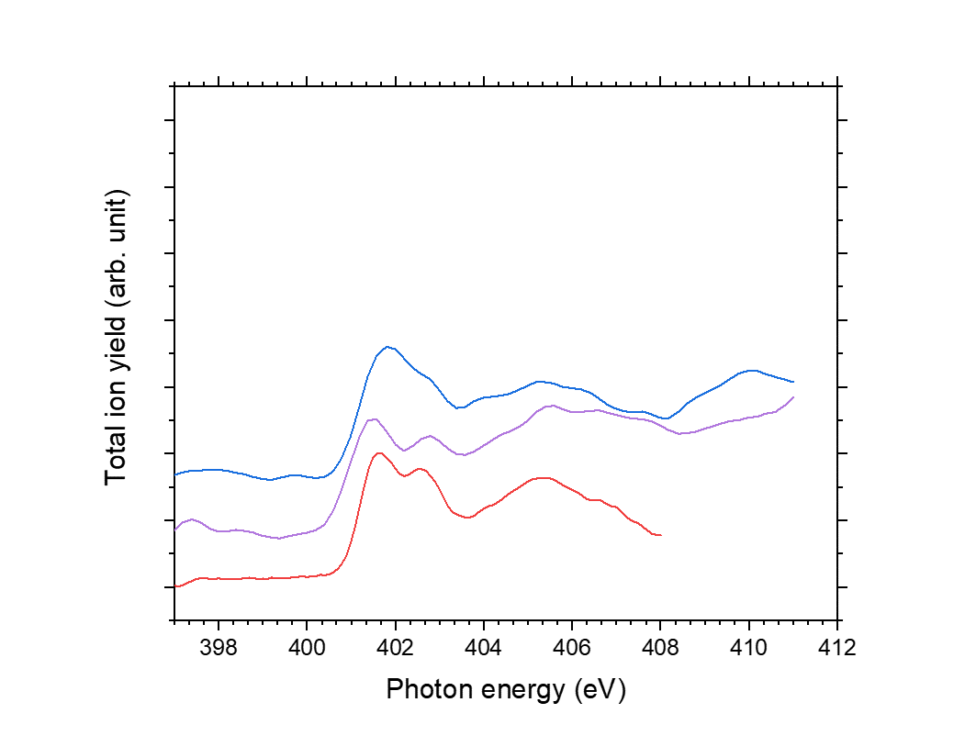


NEXAMS spectra of model peptides
Nitrogen K-edge
A
B
C
A$: N_{1s}→π_{CONH}^{∗}$
within a peptide bond
B$: {Ni }_{1s}→π_{CON_{j}H}^{∗}$
to neighboring peptide bond
C: $N_{1s}→σ_{CH}^{∗}$and $σ_{NH}^{∗}$
including $N_{1s}→σ_{NH_{3}^{+}}^{∗}$
~402 eV $N_{1s}→π_{C=N}^{∗}$ in arginine and histidine
403,1 eV $N_{1s}→σ_{NH}^{∗}$
in histidine
[GGGGG+H]⁺
[GGGGH+H]⁺
[GGGGR+H]⁺
[PGGGG+H]⁺
[GGGGK+H]⁺
Info on the protonated N
covered under $σ^{∗}$ transitions in the feature C

Slide 9
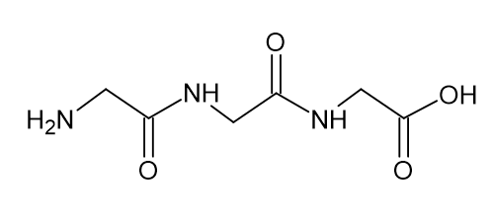

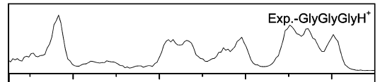
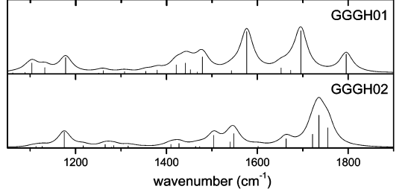
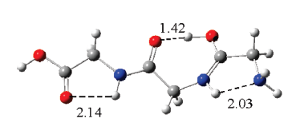

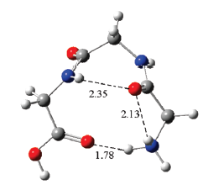
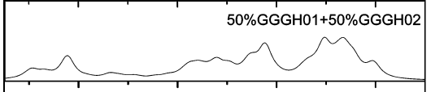
A controversial protonation site
The case of triglycine
Previous IRMPD study
GGG
Amide oxygen as protonation site
Amine nitrogen as protonation site
Both isomers exist under their experimental condition
R. Wu and T.B McMahon, J. Phys. Chem. B 2009, 113, 8767–8775
Theory: DFT/B3LYP, basis set 6-311+G(d,p), scaling factor 0,99.

Slide 10
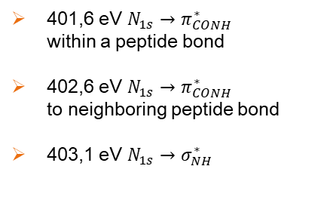
A controversial protonation site
The case of triglycine
At the Nitrogen K edge
At 8K
π*_{CONH}
π*_{CONH}
σ*(NH)
σ*(CH)
401,6 eV $N_{1s}→π_{CONH}^{∗}$
within a peptide bond
402,6 eV $N_{1s}→π_{CONH}^{∗}$
to neighboring peptide bond
403,1 eV $N_{1s}→σ_{NH}^{∗}$
π*_{CONH}
σ*(NH)
BESSY II UE52_PGM Ion trap

Slide 11
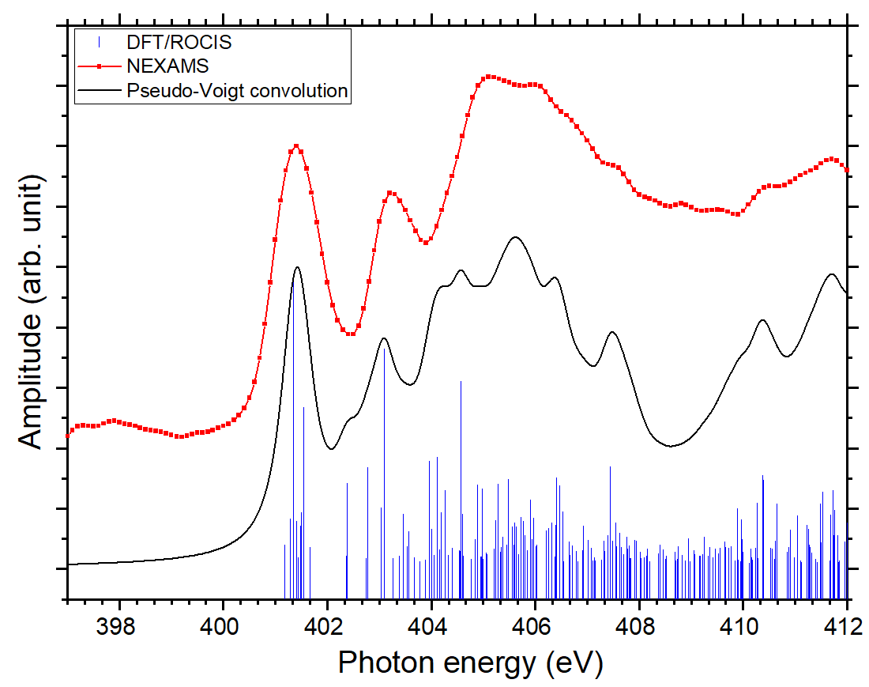
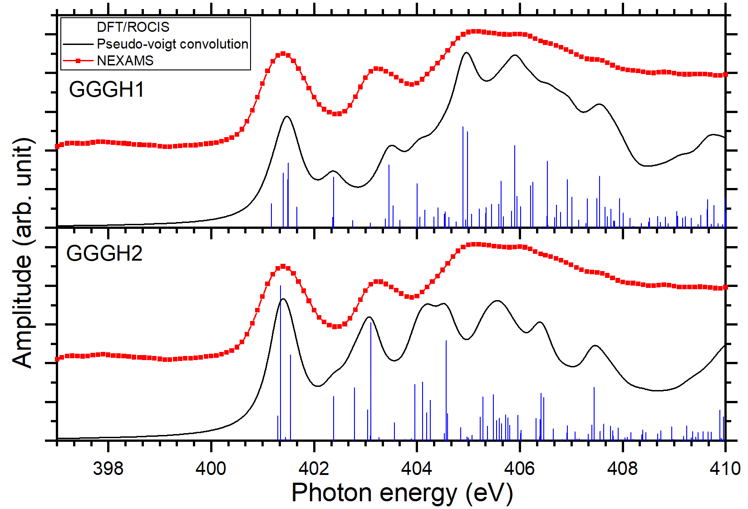
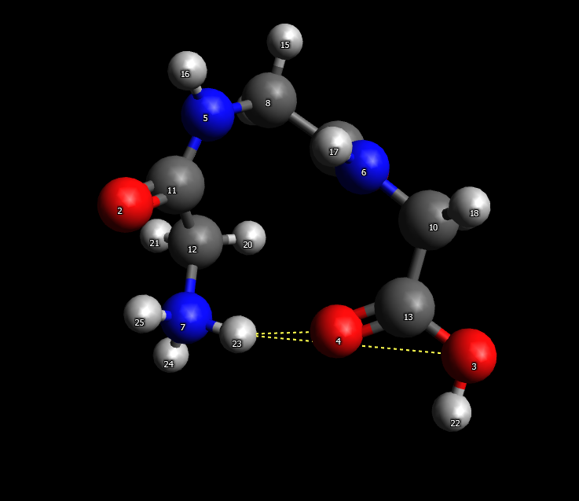
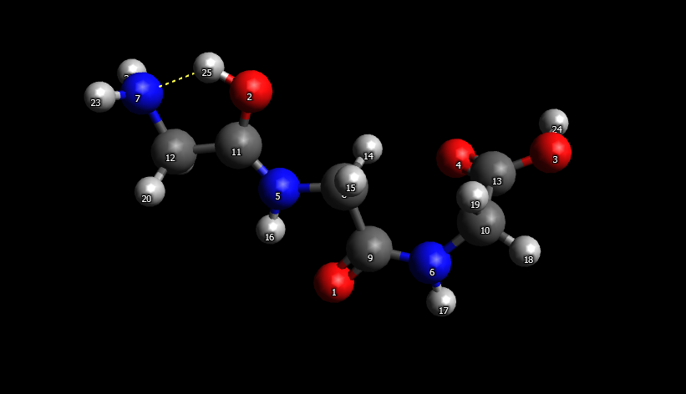
N K-edge NEXAMS of protonated triglycine
Comparison with calculations for different protomers
N-protonated structure
Backbone protonation
30% of N-protonated triglycine and 70% of backbone protonation
Computational method
-Geometry: PBE0, TS-vdW
-Transition: DFT ROCIS: B3LYP Zora-def2-tzvp

Slide 12
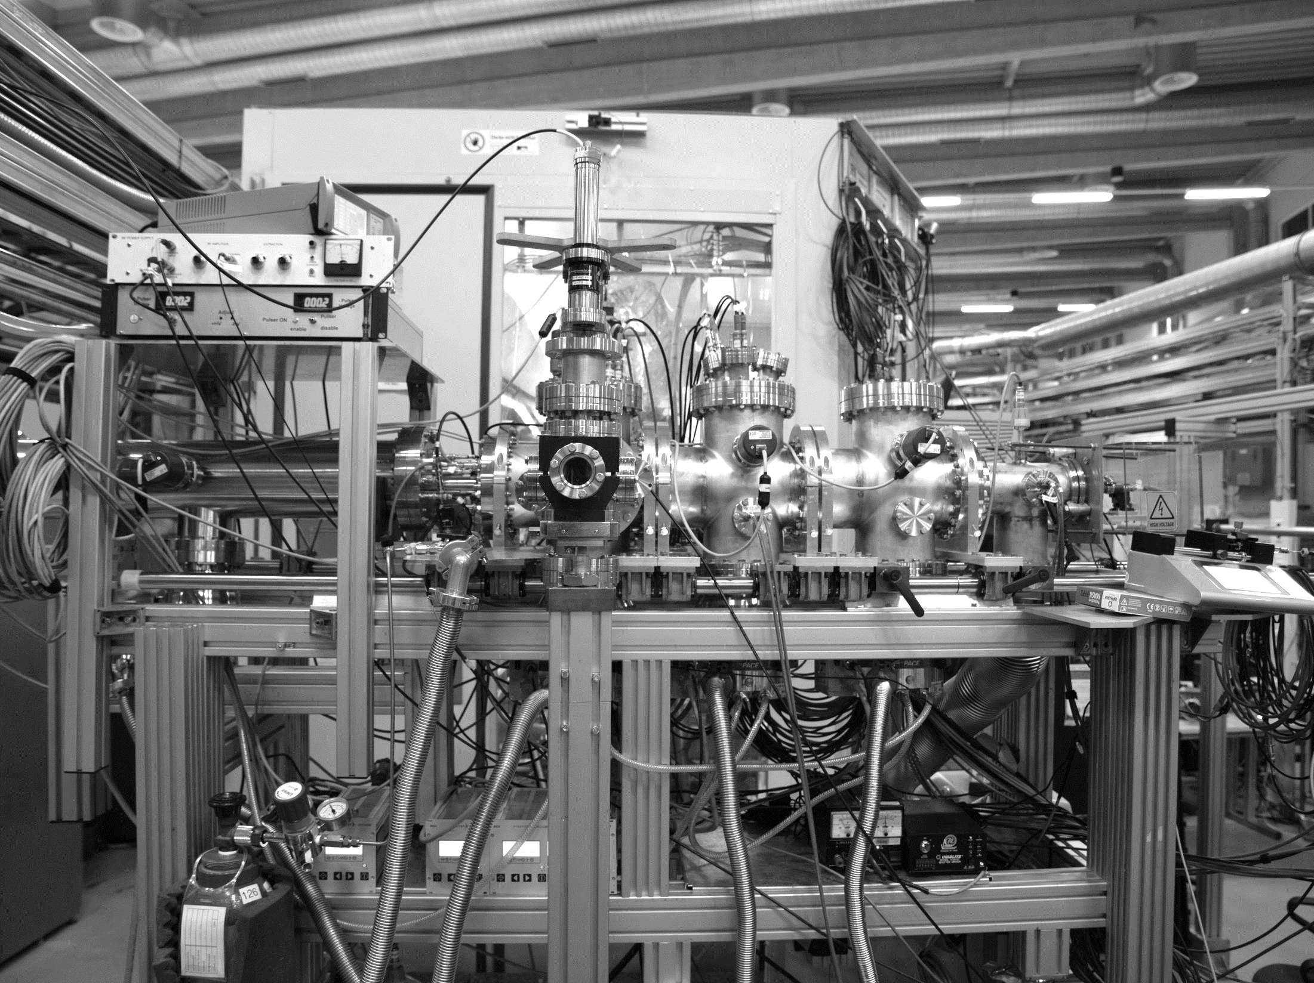

Summary and outlook
NEXAMS at the nitrogen K-edge can be used for identifying protonation site
in small molecules: $N_{1s}→σ_{NH_{2}}^{∗} ≠N_{1s}→σ_{NH_{3}^{ +}}^{∗}$ by ~2 eV
in larger peptides: multiplicity of $σ_{NH}^{∗}$ and $σ_{CH }^{∗}$complexifies the identification
N-term and backbone protonation have clear differences
Possibility to evaluate conformer population
Information at the carbon and oxygen K-edges?
Identification of deprotonation sites?
Effect of solvent on the (de)protonation site?
Submitted:
J. Leroux et al., Mapping the electronic transitions of protonation sites in peptides using soft X-ray action spectroscopy, PCCP
DESY.
Page 12

Slide 13
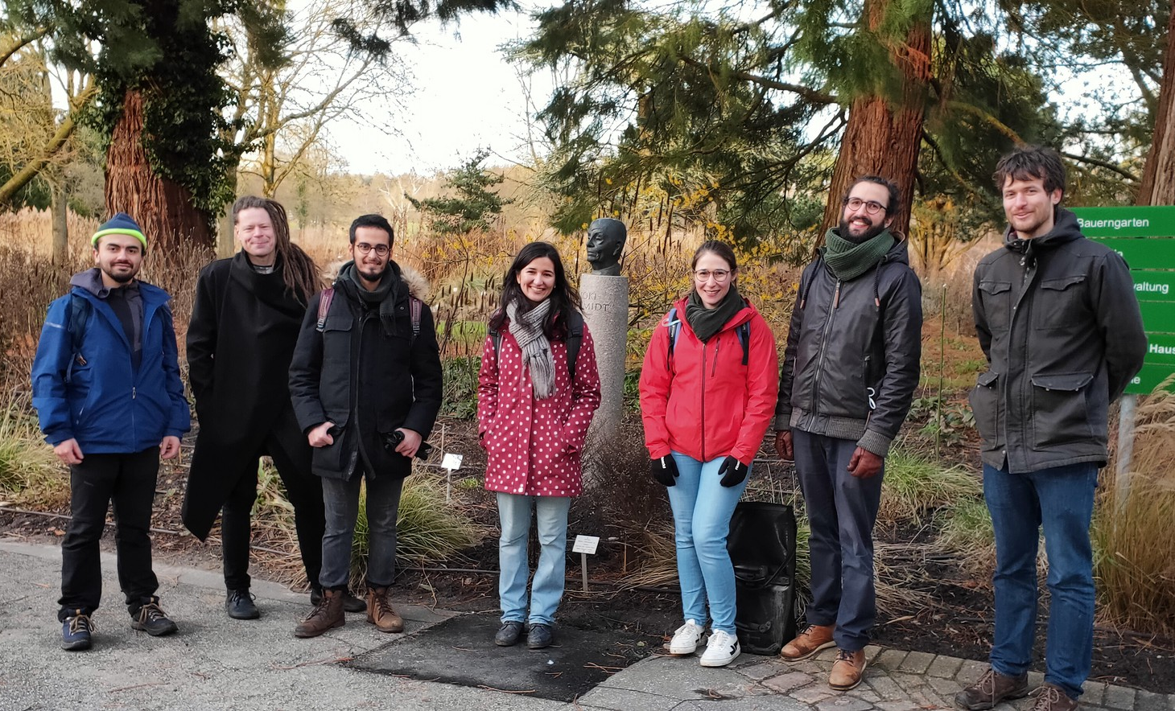



Thank you
FS-BIG
Sadia Bari
Lucas Schwob
Bart Oostenrijk
Amir Kotobi
Carlos Mahecha
Laura Pille
Aarathi Nair
CIMAP
Jean-Yves Chesnel
Julie Douady
PETRA III P04
Moritz Hoesch
Florian Trinter
Kai Bagschik
Frank Scholz
BESSY II
UE52_PGM beamline
Vicente Zamudio-Bayer
Martin Timm
Tobias Lau
Christine Bülow

Slide 15
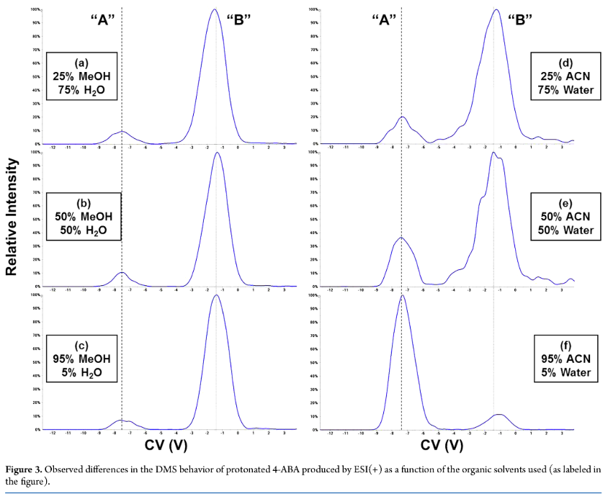
The case of 4-Amino Benzoic Acid
N-protonated VS O-protonated
Ion mobility spectrometry revealed 2 existing protomers
Ratio between protomers depends on solvent.
“B”
“A”
O-protonated
O-protonated
J.L.Campbell, J.C.Y. Le Blanc, and B.B. Schneider
Analytical Chemistry 2012 84 (18), 7857-7864

Slide 16
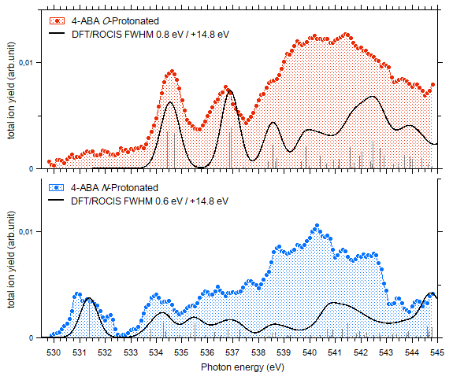










The case of 4-Amino Benzoic Acid
Oxygen K-edge
$$O→π_{C=C}^{∗}$$
$$O→σ_{OH}^{∗}$$
$$O→π_{C=C}^{∗}$$
LUMO+2
LUMO+4
$$O_{COH}→π_{C=C}^{∗}$$
$$O_{C=O}→π_{C=C/C=O}^{∗}$$
$$O_{COH}→σ_{OH}^{∗}$$
$$O_{COH}→π_{C=O}^{∗}$$
LUMO
LUMO+7
In –COOH, O_{C=O} different from O_{COH}, lead to separate resonances
Protonation on O gives similar character to both oxygens: bands are merging

Slide 17

Comparison with theoretical calculation
The example of GGGGG
C
A
B
A: N 1s → π*(CONH)
B: N 1s → π*(CONH)
C: N 1s → σ*(CH)
C: N 1s → σ*(NH)
Computational method
Calculations performed with the ORCA program by A. Kotobi.
-Geometry: B3LYP DFT, TZVP basis set
-Transition: DFT ROCIS

Slide 18




NEXAMS spectra of model peptides
Nitrogen K edge
401,6 eV $N_{1s}→π_{CONH}^{∗}$
within a peptide bond
402,6 eV $N_{1s}→π_{CONH}^{∗}$
to neighboring peptide bond
404 eV to 407 eV
$N_{1s}→σ_{CH}^{∗}$and $N_{1s}→σ_{NH}^{∗}$
including $N_{1s}→σ_{NH_{3}^{+}}^{∗}$
403,1 eV $N_{1s}→σ_{CH}^{∗}$
in Histidine sidechain
[GGGGG+H]⁺
$σ_{CH}^{∗}$
[GGGGH+H]⁺
[GGGGR+H]⁺
[PGGGG+H]⁺
$$σ_{NH}^{∗}$$
$$σ_{CH}^{∗}$$
[GGGGK+H]⁺
$π_{CONH}^{∗}$
The transition due to the protonated group is located between 404 eV and 407 eV

Slide 19

Subtracted spectrum of [PGGGG+H]+ at 401,6 eV

Slide 20

Subtracted spectrum of [GGGGR+H]+ at 401,6 eV

