Slide 1
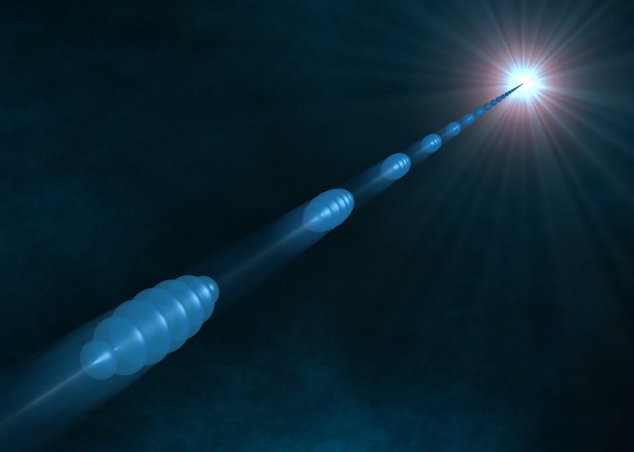
26th General Congress of the SFP
New opportunities for THz-XUV pump probe experiments after 2020+ upgrade at FLASH, DESY
Ekaterina Zapolnova
05 July 2023, Paris
Notes:
Self introduction
Outline
FELs are fantastic tools to look into femtosecond dynamics of materials. As

Slide 2
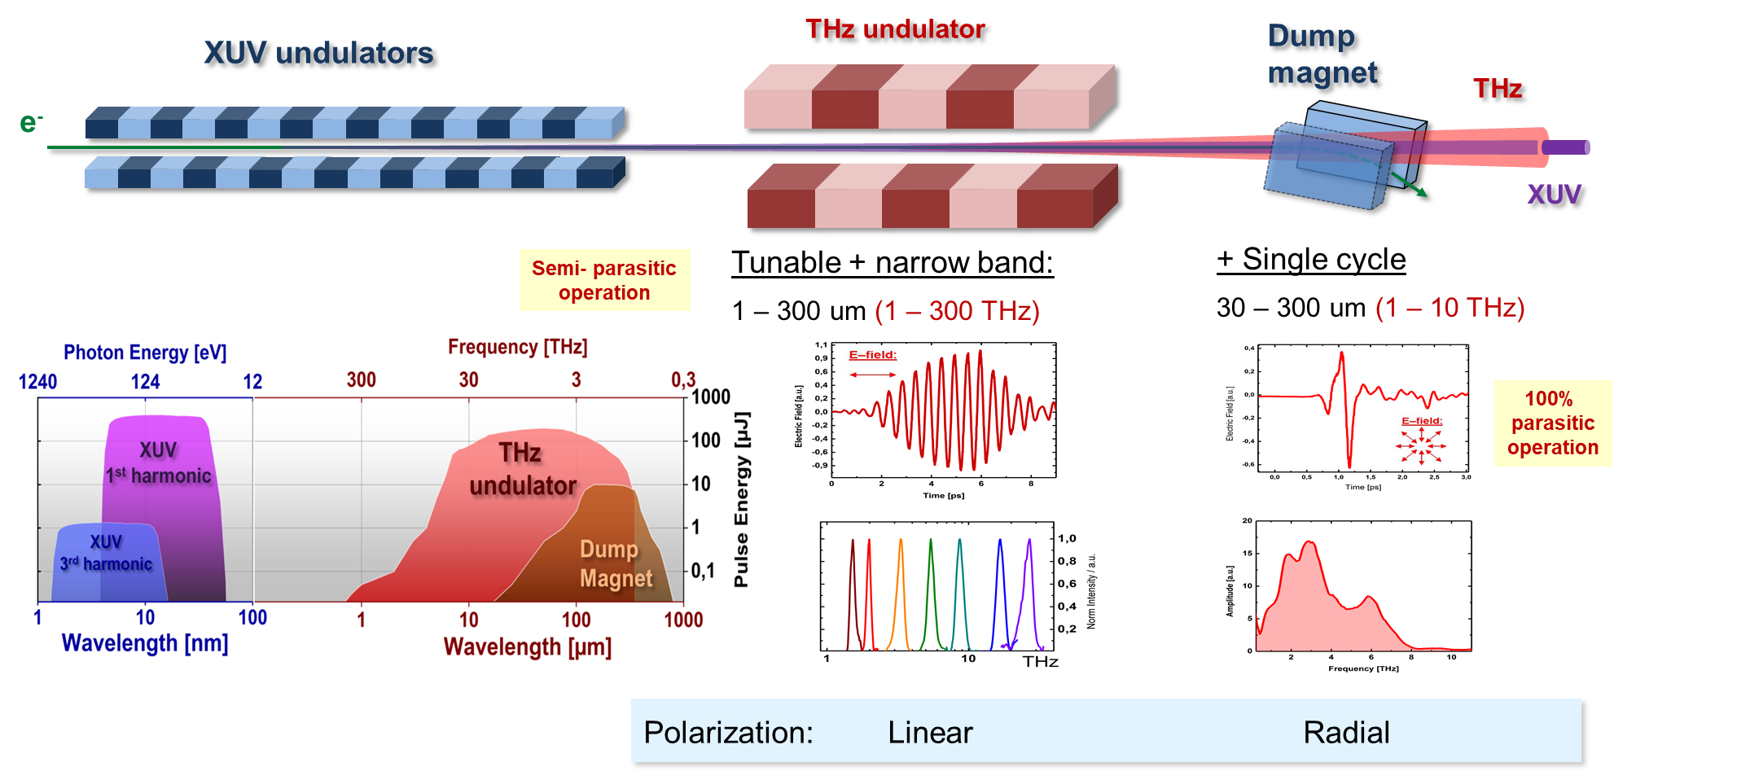
THz beam at FLASH
Intense XUV and THz radiation at FLASH
Intense pulse energy (150 µJ)
High-repetition rete (1MHz)
Wavelength tunable (1-300THz)
High THz frequency (over 3THz)
Multi-cycle + single cycle
Strong longitudinal e-field
XUV/THz jitter free
XUV+THz+Pump-probe laser
Notes:
unique features of the THz beam at FLASH. These features provide unique possibilities in science, and are of interesting for the user community. Eg: soft modes in perovskites, optical photon modes in dielectric, or stretching , vibration, rotation modes in molecules.
THz source at FLASH is based on accelerator. After XUV undulator, electron bunches directly pass through THz undulator and the dump magnet, and generate two type of THz radiation: multi-cycle and single-cycle THz radiation.

Slide 3
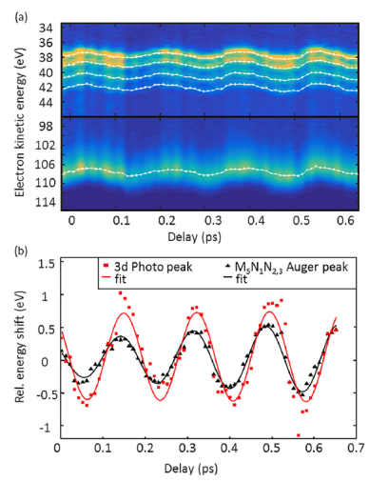
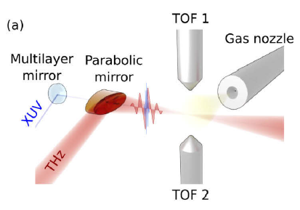
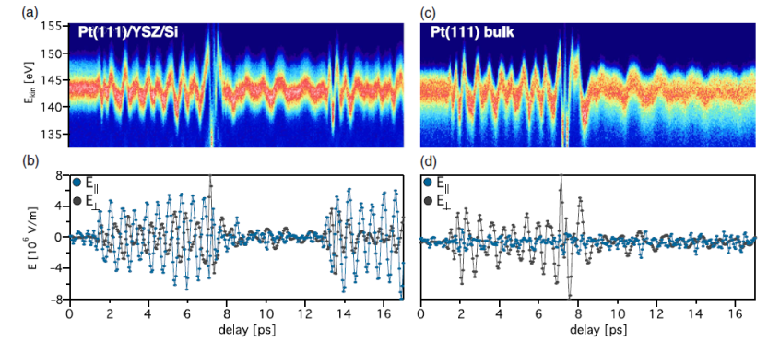
Applications: structural and electron dynamics of molecules
THz streaking for clocking molecules, ultrafast electronic decays, photoemission of solids
Adapted from
M. Krikunova, Technische Universität Berlin:
THz streak camera performance for single-shot characterization of XUV pulses with complex temporal structures,
Opt. Express 28, 20686-20703 (2020).
Adapted from
U. Fruehling, DESY: Electronic decay in a dissociating molecule: THz streaking of core-excited HCl molecules”,
Structural Dynamics, 6, 034301, (2019).
Adapted from
L. Castiglioni, University of Zurich: Polarization-sensitive reconstruction of transient
local THz fields at dielectric interfaces
Optica 6, 1431-1436 (2019).
Notes:
Fruehling and Krikunova use THz streaking to clock molecules/atoms, and reconstruct complex XUV temporal profile.
HCl (Hydrogen chloride), krypton
The ultrafast electronic decay of HCl molecules in the time domain after resonant core excitation was measured.
First succesfull THz/XUV pump probe experiment, using photoemission from solids: Castiglioni uses THz photoelectron streaking on thin Pt (Platinum) and bulk Pt surface. Distinct differences in the THz response are found. The two THz polarization components are measured simultaneously the first time.
Glenzer/Chen measures evolution of DC electrical conductivity on warm dense matter which can provide insights in materials at extreme temperatures and pressures. It is the first time to combine XUV, THz and IR laser in one experiment at the THz beamline. The result is accepted by nature communications recently.
Radu and Gruebel/Mueller studied magnetization dynamics with THz pump and XUV probe. With intense THz beam, one can resonant pump and select excitations of quasiparticles in magnetic solids, drive spin excitations in nonlinear regime, coherent control electronic and magnetic states. We are designing a permanent endstation for studying femto-magnetism.
Note:
(metallic islands and local field interaction)

Slide 4
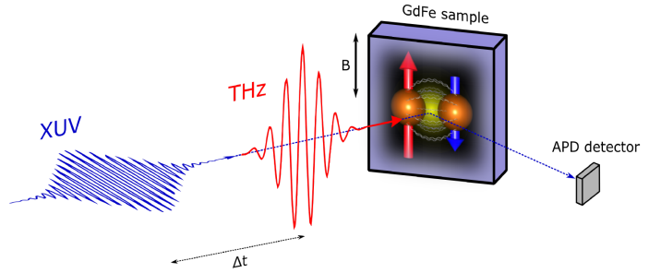
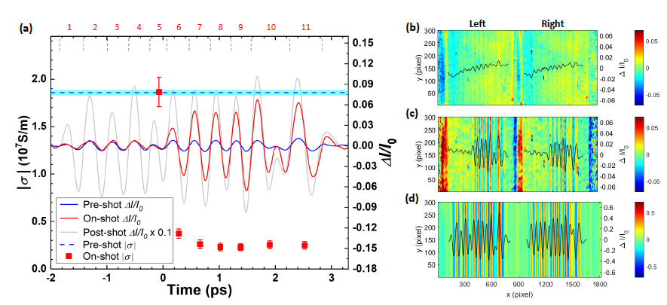
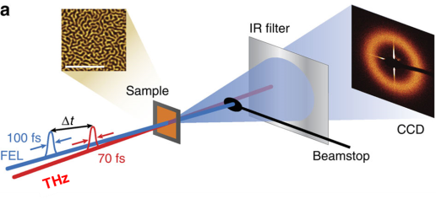
Applications: solid state ultrafast pump-probe experiments
Warm dense matter, magnetization dynamics
I. Radu, MBI
THz pump and XUV probe on ferrimagnetic GdFe alloy by transverse MOKE. A magnetization switching level of ~40% is reached within ~500fs after THz excitation.
(Publication in preparation)
Adapted from S. Glenzer/Z. Chen, SLAC:
Ultrafast Multi-cycle Terahertz Measurements of the Electrical Conductivity in Strongly Excited Solids
Nat Comm 12, 1638 (2021)
G. Gruebel/ L. Mueller, DESY
THz driven magnetization dynamics by magnetic small-angle scattering
Notes:
Glenzer/Chen measures evolution of DC electrical conductivity on warm dense matter which can provide insights in materials at extreme temperatures and pressures. It is the first time to combine XUV, THz and IR laser in one experiment at the THz beamline. The result is accepted by nature communications recently.
Radu and Gruebel/Mueller studied magnetization dynamics with THz pump and XUV probe. With intense THz beam, one can resonant pump and select excitations of quasiparticles in magnetic solids, drive spin excitations in nonlinear regime, coherent control electronic and magnetic states. We are designing a permanent endstation for studying femto-magnetism.

Slide 5
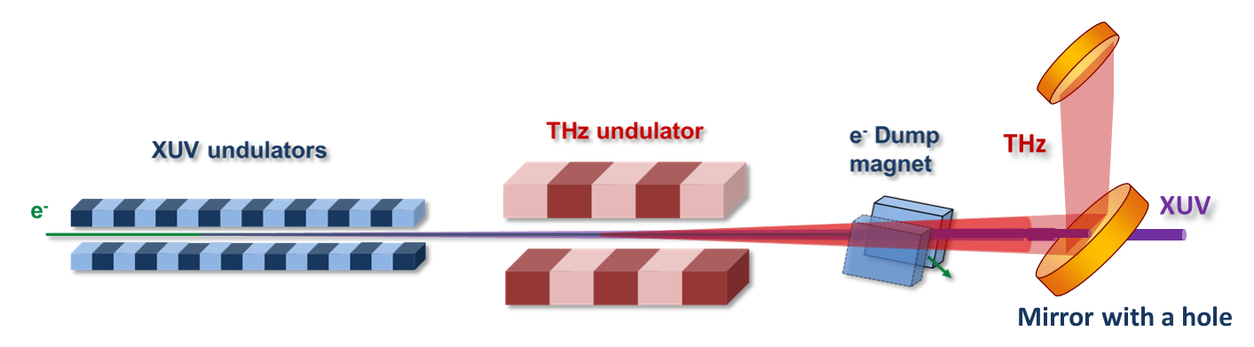
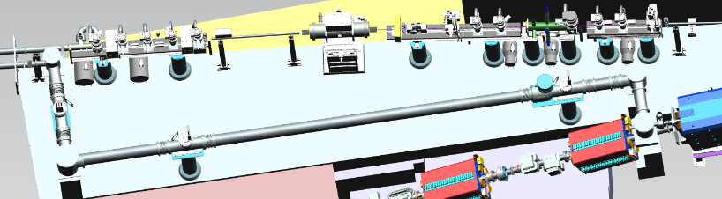
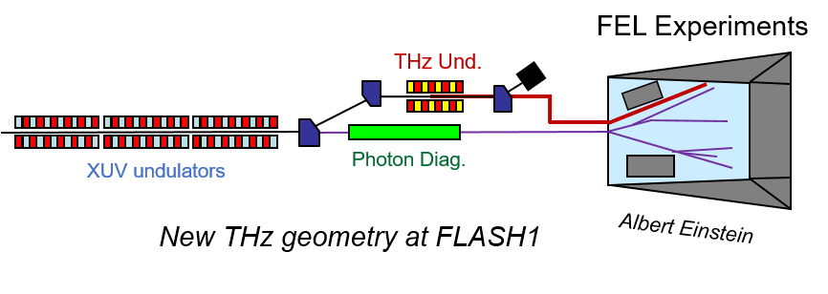
FLASH2020+: THz Beamline upgrading
THz beamline in FLASH1 tunnel
Current: XUV undulators and THz undulator are in line
New: THz undulator is separated from XUV source
Current THz geometry at FLASH1
Benefits
Completely parallel operation of THz-only experiments (laser safety)
More freedom (flexible) on THz tuning
Expected parameters
 | Wavelength range @ 1350 MeV | Wavelength range @ 950 MeV | Wavelength range @ 750 MeV | Pulse energy | Timing jitter
XUV | 3.6nm-18.8nm | 7.2nm-38.0nm | 11.5nm-60.9nm | >5 μJ | < 20fs rms
THz | 10μm-26μm | 26μm-55μm | 41μm-85μm | >100 μJ
* 85μm-300μm covered by edge radiation and OTR
Notes:
85 um => 3.5 THz
60 um => 5 THz
conservative

Slide 6
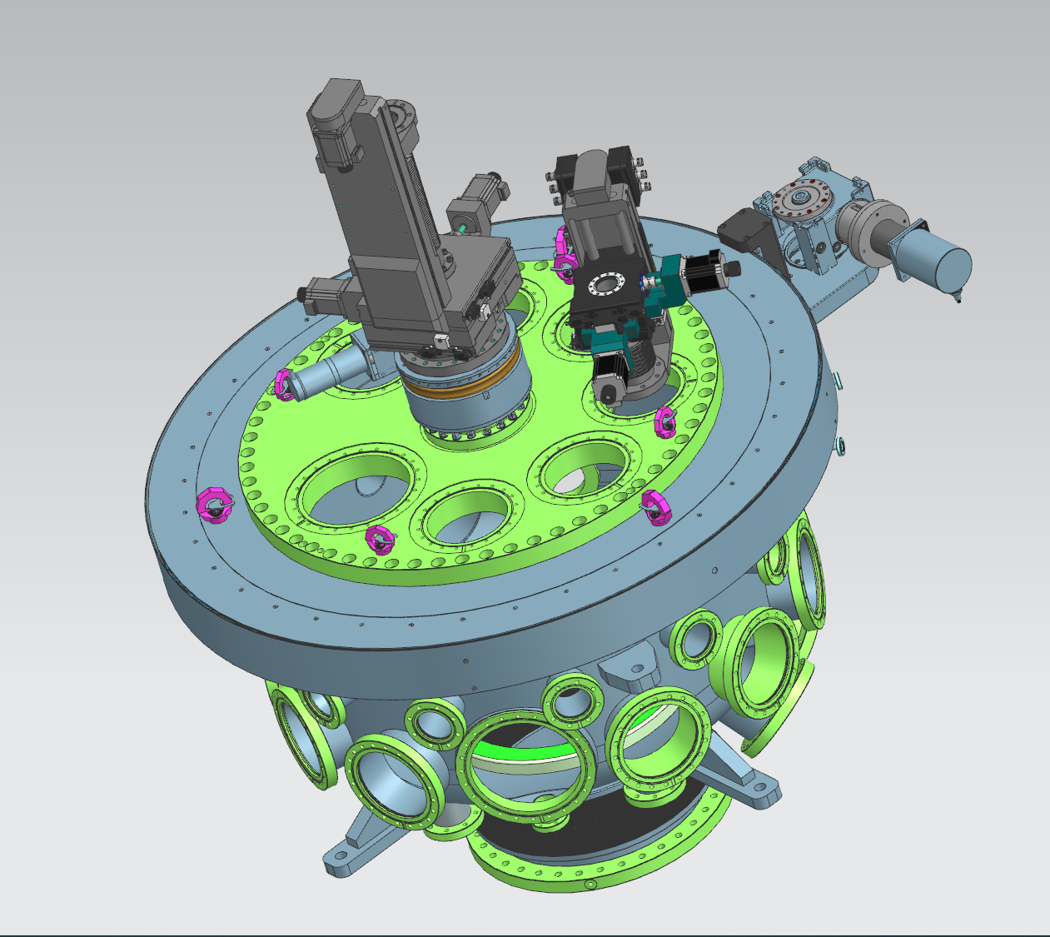
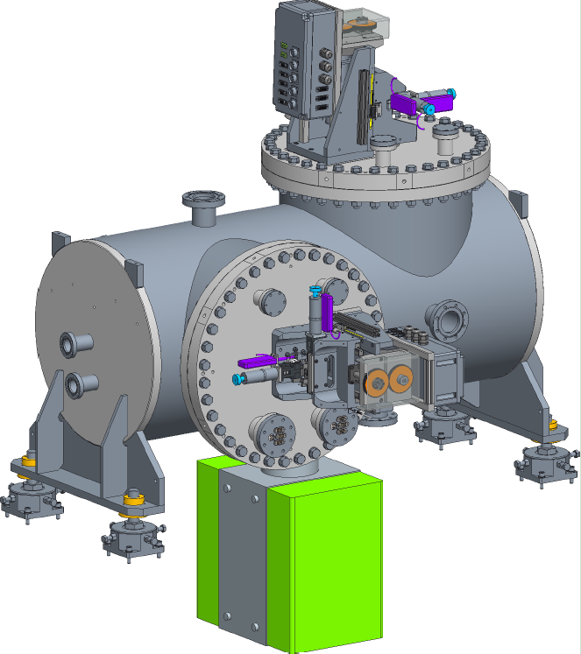
New FL11 beamline
BL1
FL11
Laser
BL1
FL11
PG2
PG1
Raman
spectrometer
  Possible for “high-energies”-beyond C k-edge with appropriate coatings and 2° grazing incidence
  bendable KB optics (2m-5m focus length; <2μm for 2m focus;)
  Split-and-delay unit (SDU)
  Semi-permanent endstation for THz-XUV pump-probe (may use the THz doubler concept and opt. laser-XUV pump-probe)
    -- femto-magnetism
    -- solid-state dynamics
    Features: Cryo-magnet system; Cryogenic system for sample; XUV, THz and PP laser, etc.
  Regularly open port for special applications at FLASH1
BL2
BL3
Opt. laser
beamlines
THz
diagnostics
hutch
Pump-probe
laser system
THz beamline
Exp. hall photon diagnostics
Gas-filed attenuator
Tunnel photon diagnostics
THz
FEL
Notes:
2 degree, shorter wavelength possible (>1.4 nm, or 885.6 eV)
C edge: carbon K-edge (4.4. nm, or 283.8 eV)
Combine BL2 and BL3 into one new improved endstation
→ transmission for Pt 1 nm = 1.4 %; Pt 1.5 nm = 1.8 %; Ni 1.8 nm = 17 %
New endstation focusing on femto-magnetism and solid-state dynamics experiments .

Slide 7
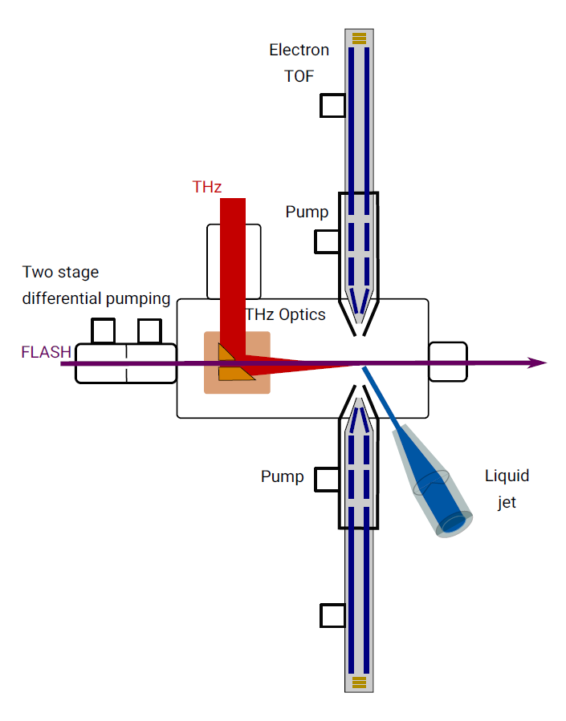
ErUM-pro THz projects
DYLIXUT
An instrument for probing the DYnamics in LIquids
by XUV and THz pump-probe photoelectron spectroscopy
Granted by the BMBF via ErUM-Pro
Zhong Yin(Tohoku University, Sendai)
Michael Martins (UoH, CFEL)
European XFEL SCS group
Sergio Carbajo (UCLA and Stanford)
DESY
Instrument mainly design for usage at FLASH/BL3/FL11
Main application will be experiments on liquids, but also studies on isolated molecules are feasible
Three eTOF spectrometers in the beginning
Scheme of THz streaking on liquids
Notes:
Universitaet Hamburg and Centre for Free Electron Laser Science

Slide 8
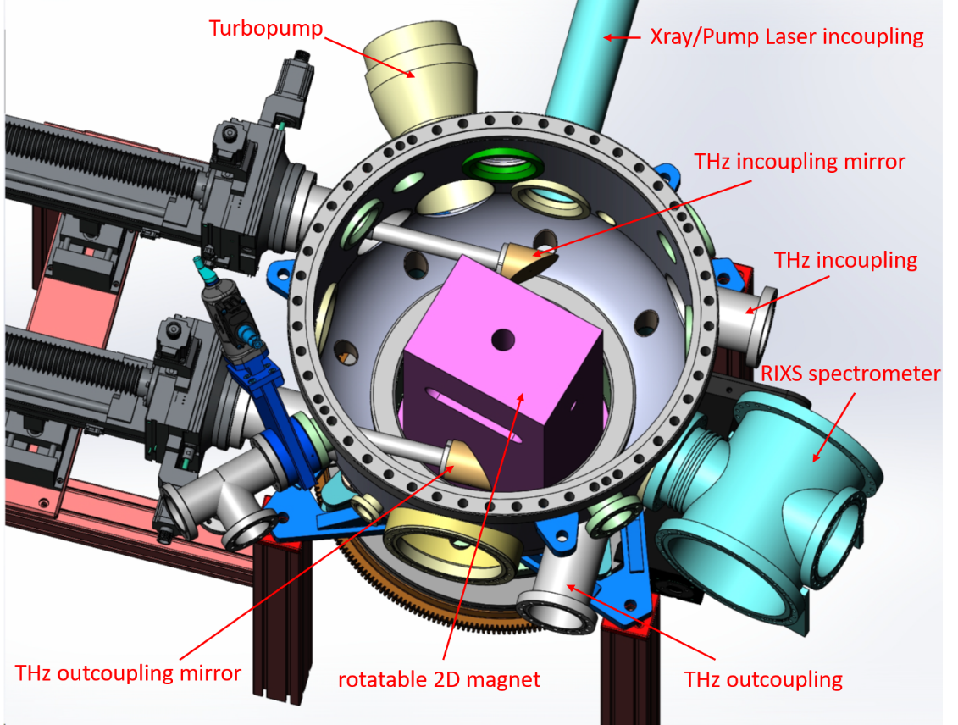
ErUM-pro THz projects
New Endstation for XUV/THz pump-probe experiments
Solid state- and surface physics/surface chemistry, Femto-magnetism
The endstation is funded through ErUM-Pro by collaboration of M. Weinelt (Freie Universität Berlin) , C. Schüßler-Langeheine (HZB), S. Eisebitt (MBI), M. Beye (DESY).
On going
Pump-probe experiments with three different radiations
- XUV, pump-probe laser and THz radiation.
Cryo-magnet system with rotation provides homogeneous magnetic field up to 2T along the beam direction or up to 1.5T in vertical direction at light-matter interaction on sample.
RIXS spectrometer for investigation of electronic structure of molecules and materials
New Endstation design

Slide 9
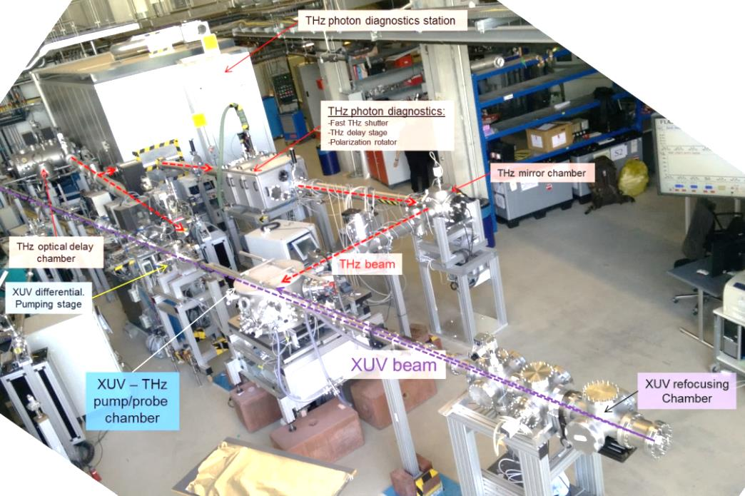
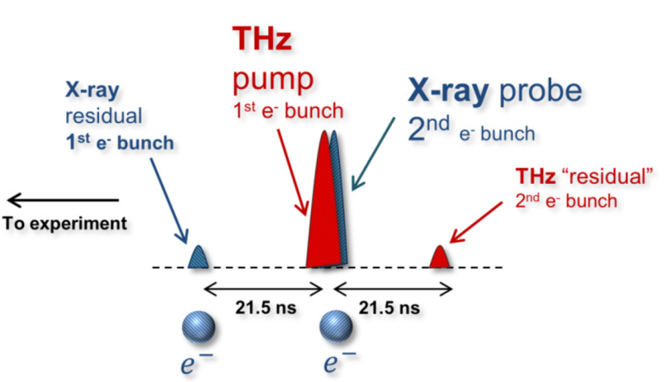
FLASH2020+: THz Beamline upgrading
THz Operation modes
J. Synchrotron Rad. 27, 11-16., (2020).
36 periods (27.6 ns, or 8.29m)
Backup plan: Back reflection scheme
Normal operation: THz doubler scheme
+ | -
Mature scheme Max THz pulse energy (150 uJ) Max XUV pulse energy Timing jitter 5fs Pure pulse | XUV reflection mirror(narrow bandwidth, limited wavelength selection, reduced energy, beamsize>100um) Complex geometry in chamber
+ | -
Without XUV reflection mirror (full energy, full bandwidth, small beamsize) Simpler geometry in chamber | In development XUV suppression (SASE): 1:100 Current THz pulse energy: 4 uJ Current XUV pulse energy: 40 uJ Timing jitter <19fs (limited by detection) Online diagnostics

Slide 10
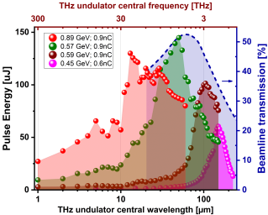
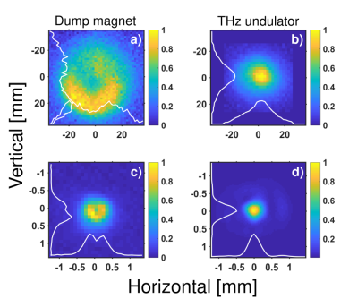
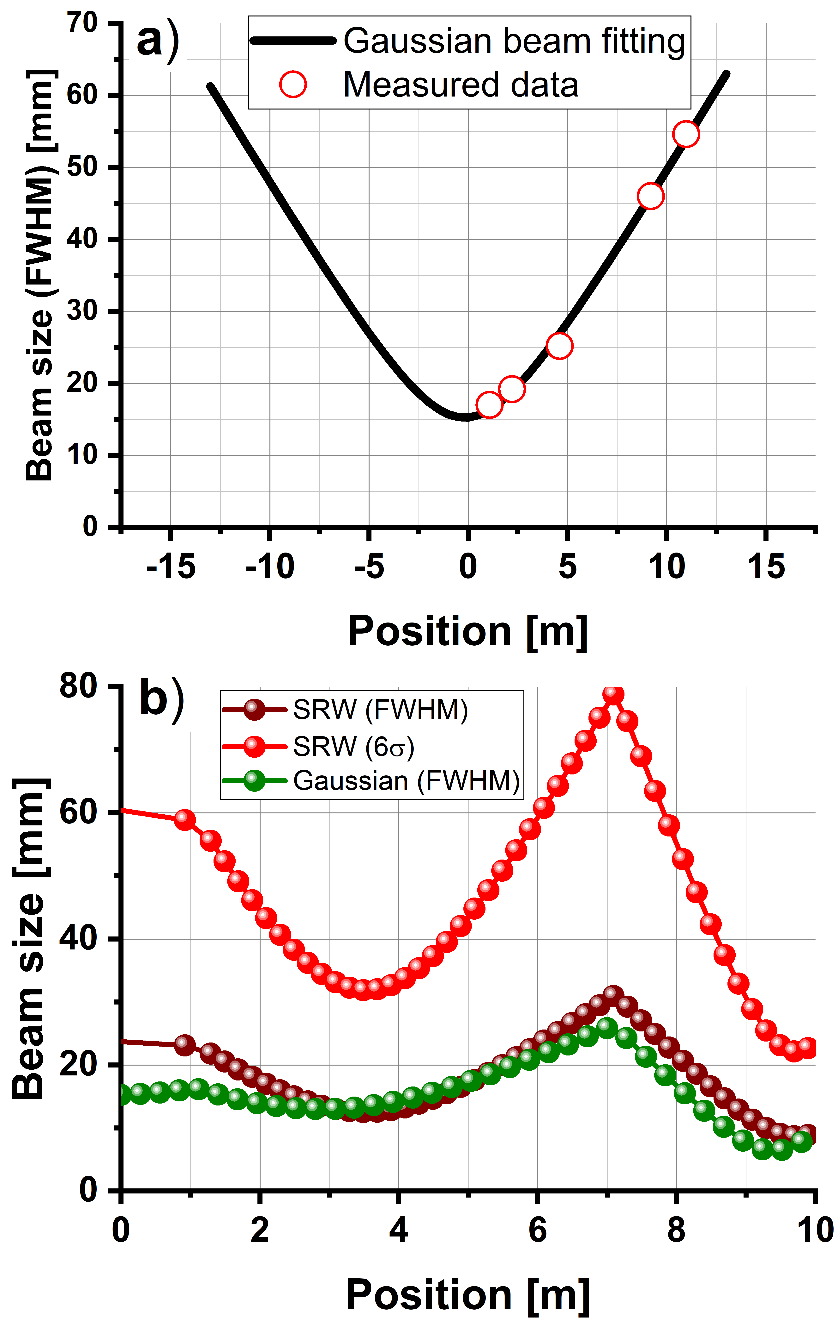
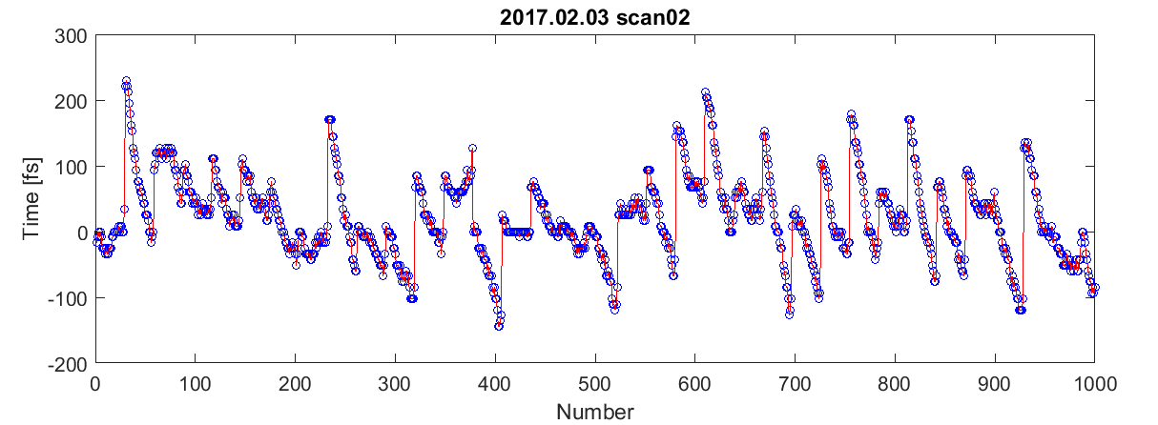
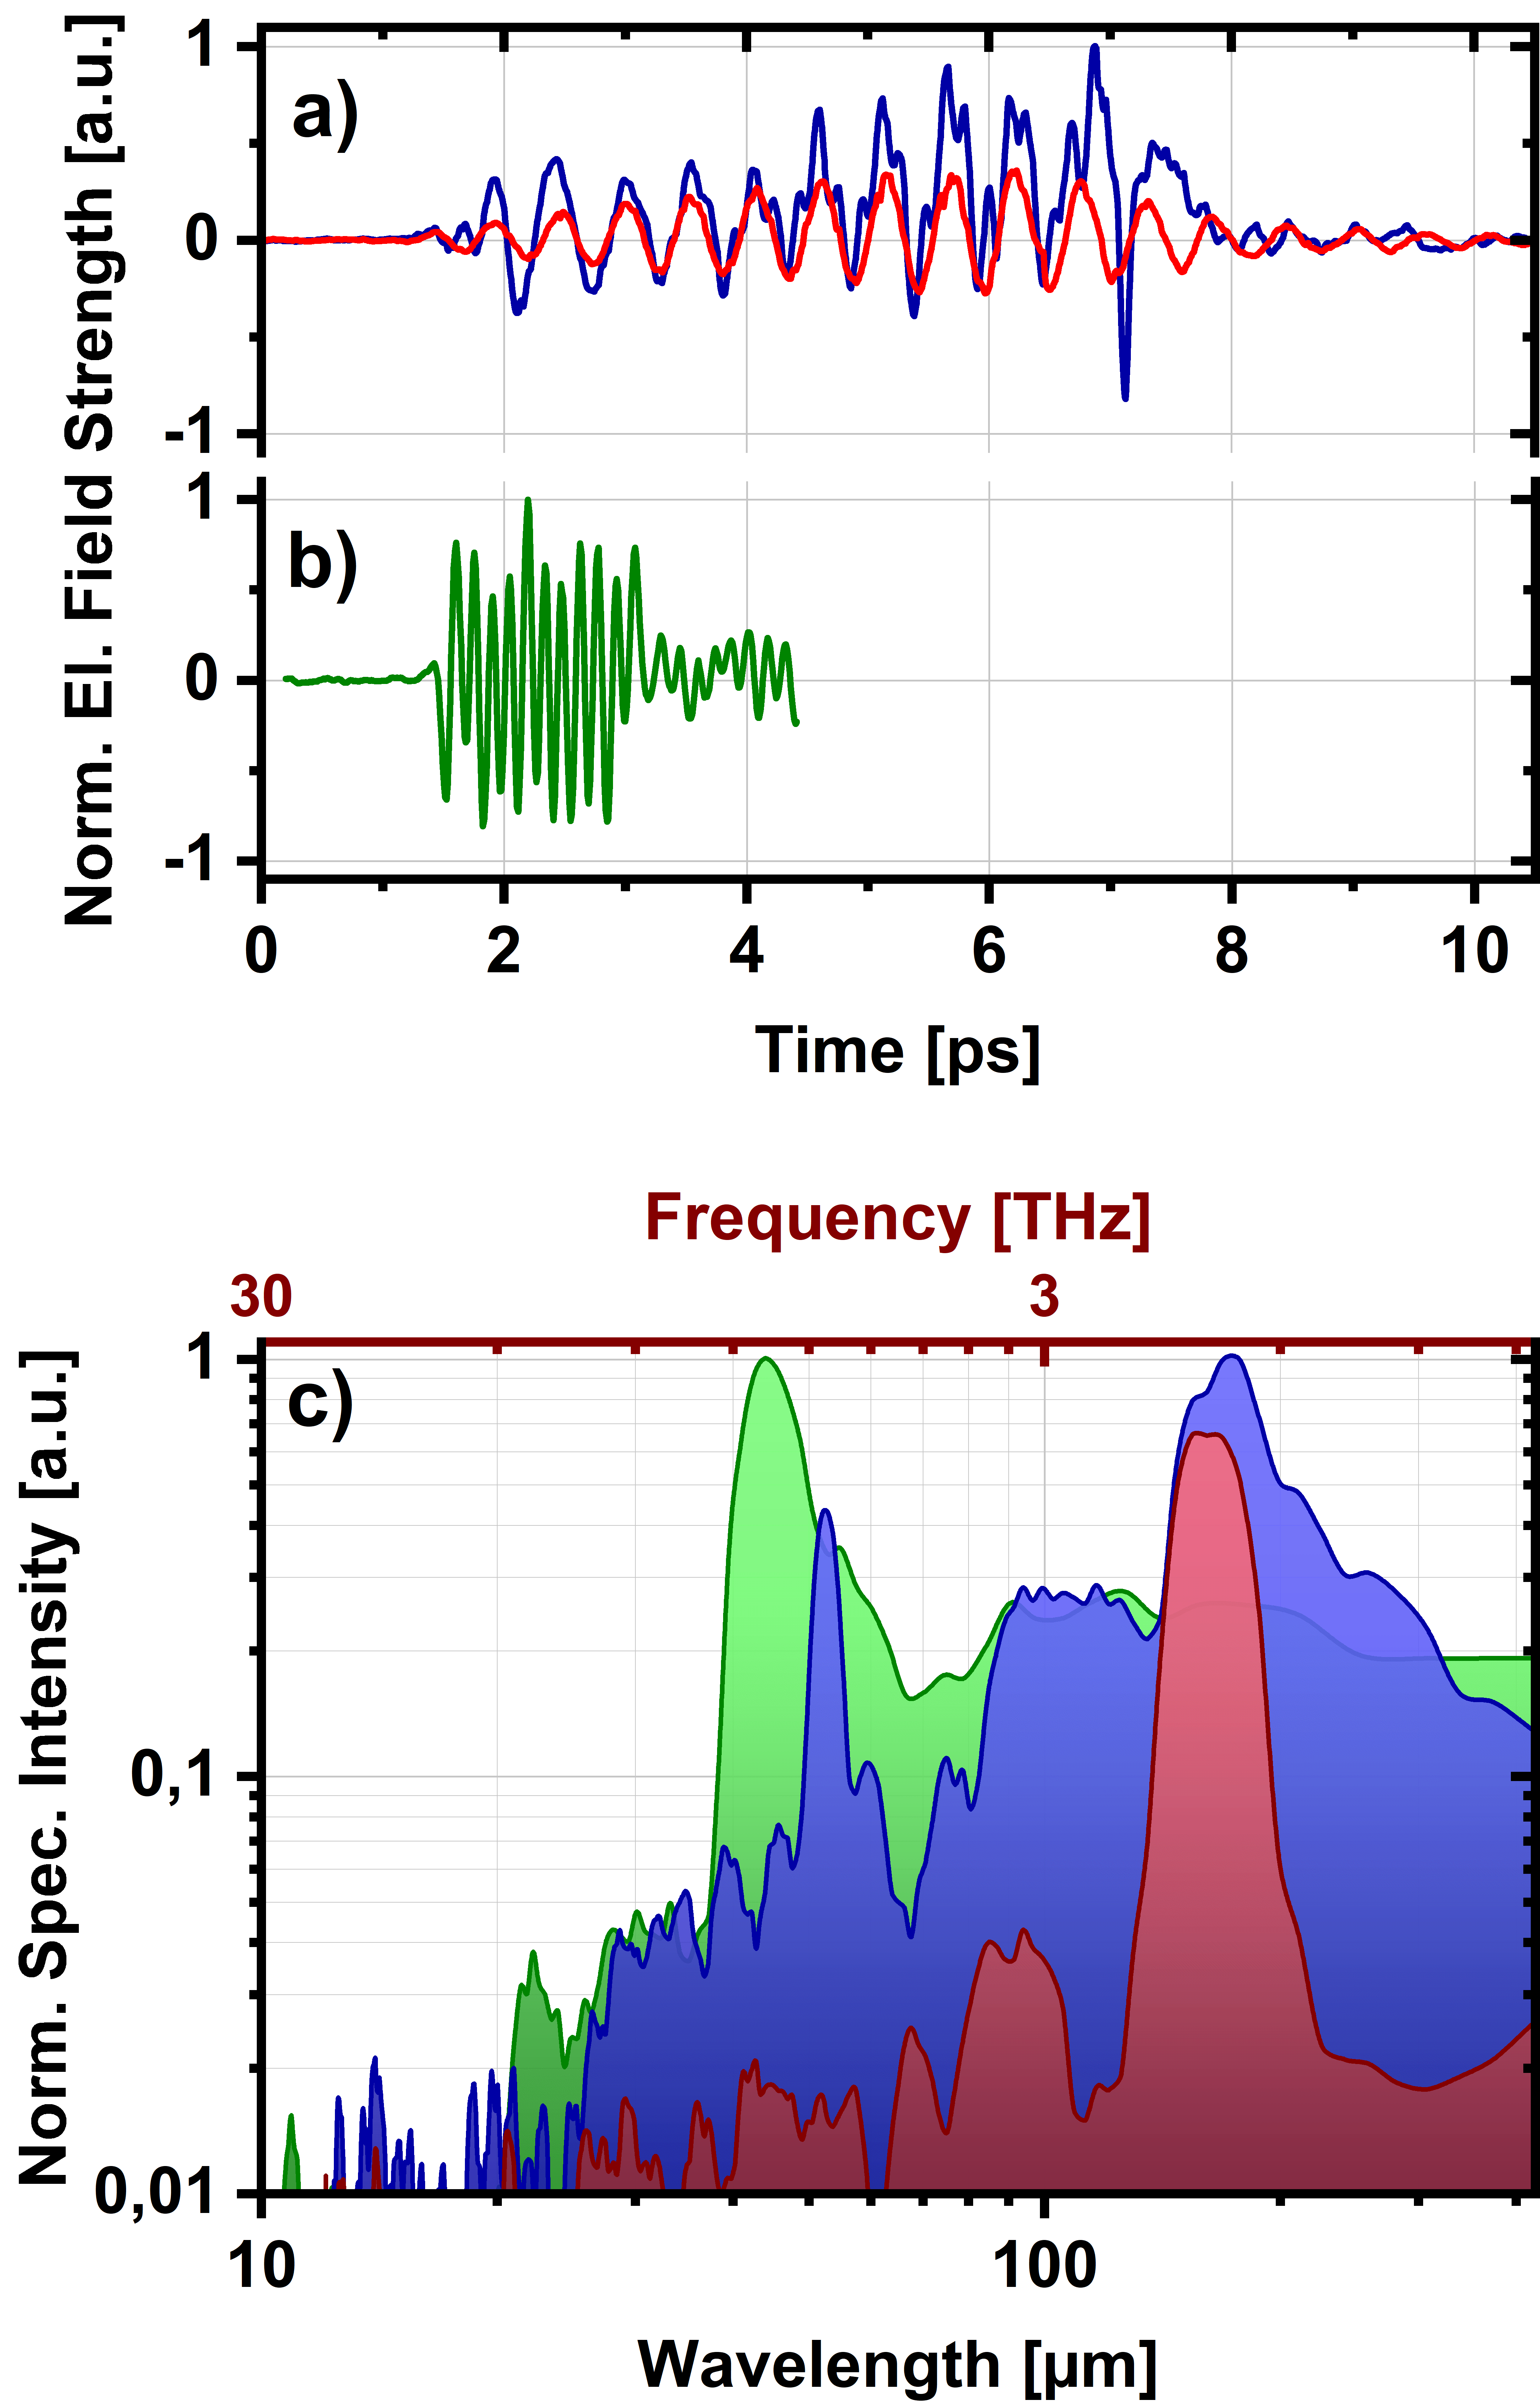
Current Diagnostics
1. THz power
THz pulse energy vs. wavelength
Help operator for FLASH tuning
2. Transverse beam profile
Detector dia. 2mm (with extra pinhole)
Beam divergence and propagation
Design for users’ individual experiments
3. Arrival time by EOSD
single shot arrival time correction down to 8.5 fs (rms)
burst mode capability at 200 kHz (1MHz with KALYPSO)
Simulation on beam propagation
4. Temporal profile by EOS
Distortion free THz electric field resolved detection
broad THz detection range from 40 µm – 3000 µm (7.5 THz – 0.1 THz)
Bandwidth resolution 0.05 THz (~20 ps)
Credits: R. Pan
Notes:
In order to use it in experiments, knowing THz structure is very important. These THz diagnostics have been developed.
THz power measurement : for tuning, online in future
A Fourier transform infrared spectrometer provides THz spectrum measurement. It now can be put in vacuum to remove the air absorption in air.
I extract the THz beam parameters in the transvers profile measurement, and use it to calculate the beam propagation in SRW in order to optimized the beamline transport for users. It is used in Luca Castiglioni’s experiment.
The THz arrival time and temporal profile measurements are based on electro-optical techniques. The arrival time monitor can be used in correcting jitter for individual THz pulses at 200kHz. With KALYPSO line camera, it can reach 1MHz and use the full capability of FLASH.
The temporal profile monitor can cover from 0.1 THz to 8THz (upgrading to 30THz). It enable high resolution characterization of the THz pulses used as a pump in THz/XUV pump probe experiments.
I am working on developing single-shot methods for transverse profile, temporal profile and arrival time measurements.

Slide 11
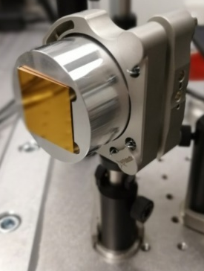
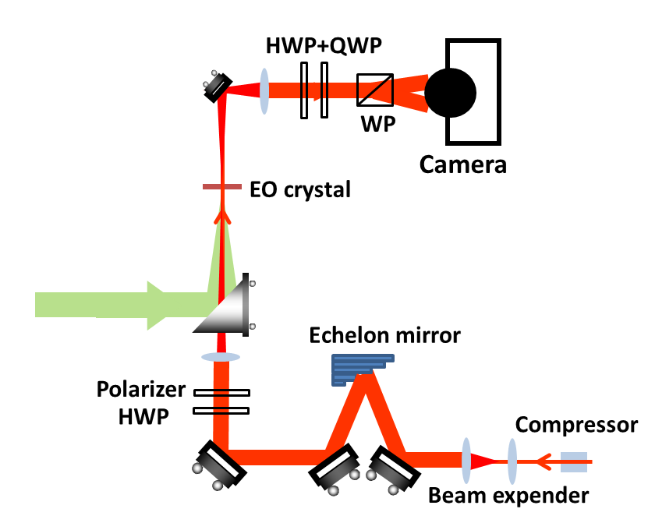
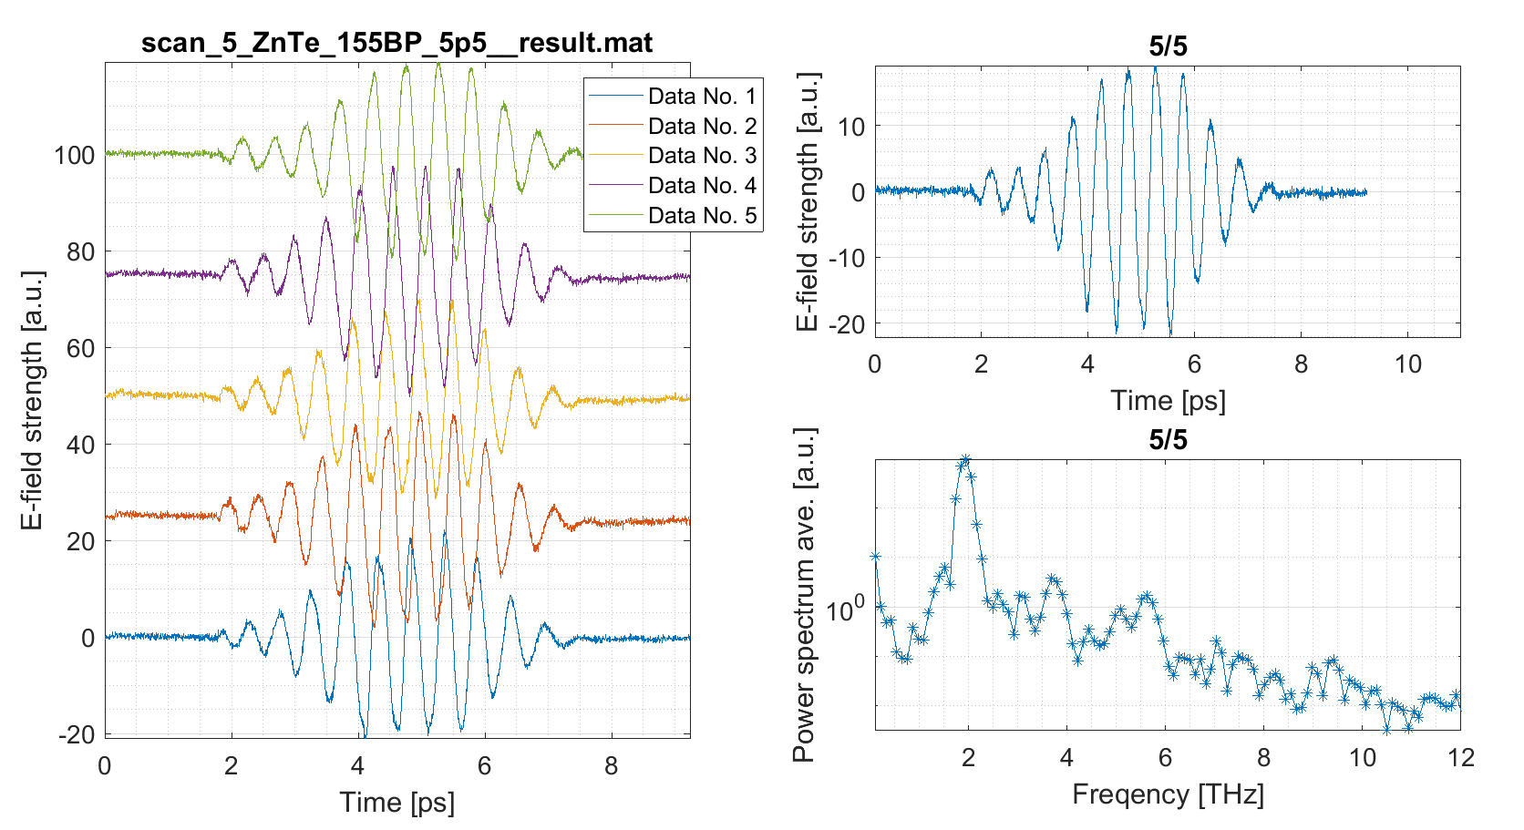
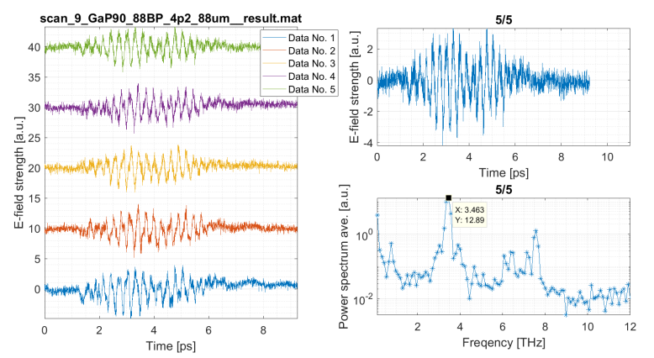
Diagnostics Developement
IR laser
Single-shot EOS
THz
Time/position
Arrival time
Temporal profile
Spectrum
Transverse profile (modify)
Single-shot monitor for THz temporal profile and spectrum
30 mm * 30 mm size
Time step: 50 fs
Time window: 10 ps
Stephenson Distinguished Programme: Z.Chen, SLAC, USA
Single-shot measurement by 2mm ZnTe with 155µm Bandpass filter in air
Single-shot measurement by 100µm GaP with 88µm Bandpass filter in air
Credits: R. Pan
Notes:
It covers up to 8 THz which is similar with sequential EOS.
I plan to develop both THz temporal profile and transverse profile measurements in single-shot and integrate them into the XUV-THz endstation.

Slide 12
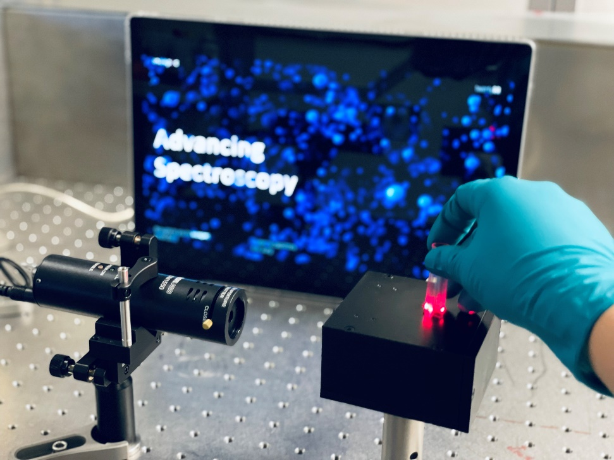
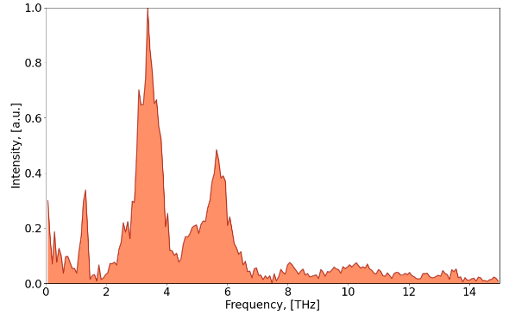
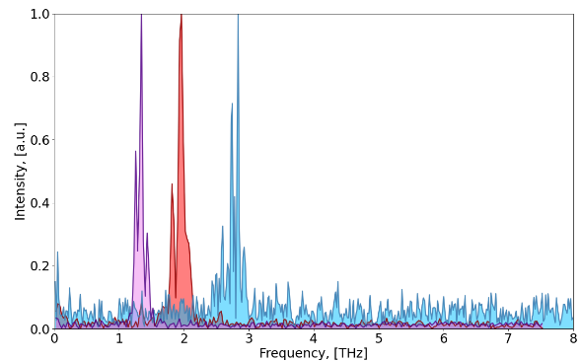
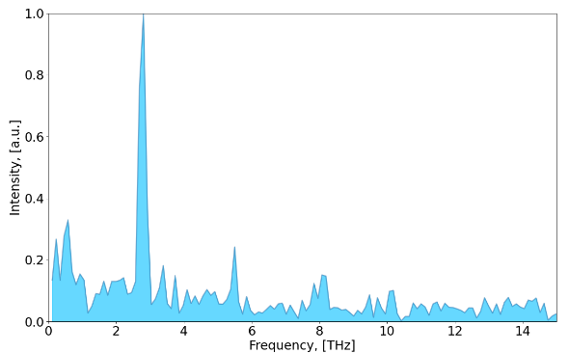
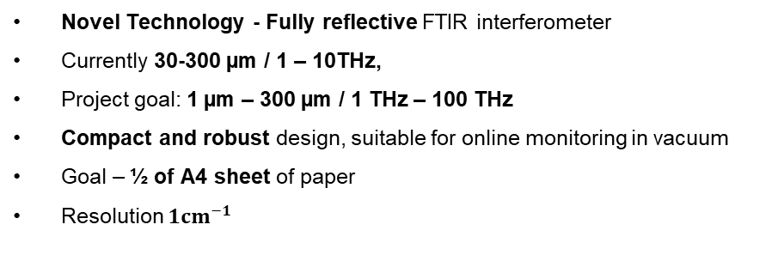
Spectral Diagnostics
Most compact ultra-broadband FTIR Spectrometer
Novel Technology - Fully reflective FTIR interferometer
Currently 30-300 µm / 1 – 10THz,
Project goal: 1 µm – 300 µm / 1 THz – 100 THz
Compact and robust design, suitable for online monitoring in vacuum
Goal – ½ of A4 sheet of paper
Resolution $1cm^{−1}$
Various Band-Pass Filters
Broadband THz Dump Magnet
THz Undulator @ 105µm
I want to test it everywhere! Please get in touch ☺
Notes:
It covers up to 8 THz which is similar with sequential EOS.
I plan to develop both THz temporal profile and transverse profile measurements in single-shot and integrate them into the XUV-THz endstation.

Slide 13





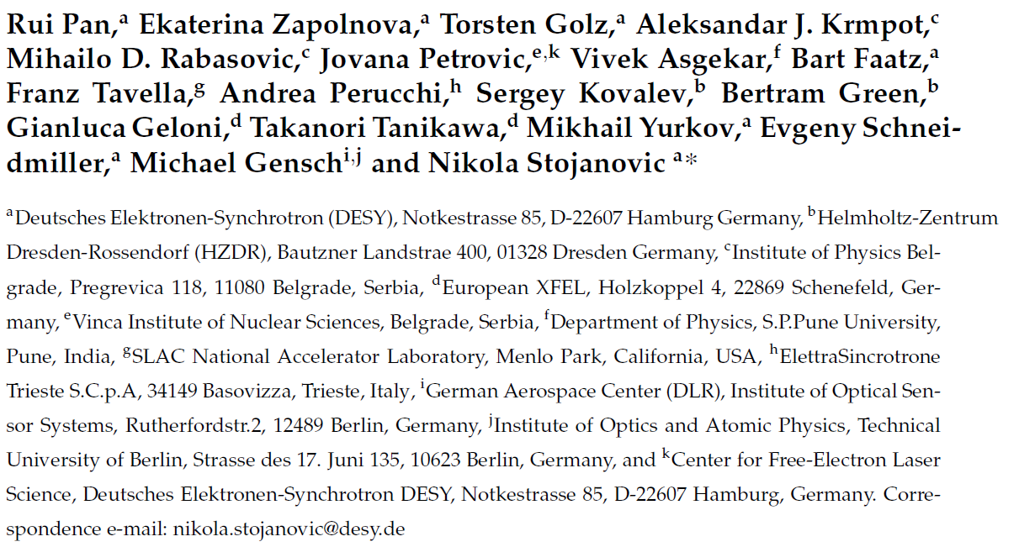
THz beamline: people
Acknowledge
The whole FLASH Team and FS groups: FS-BT, FS-EC,…
DESY M-division + FLASH operators
THz team (FL-FS-B)
Seung-gi Gang: Scientist
Ekaterina Zapolnova : Scientist
Marc Temme: Engineer
Rui Pan: Scientist
S. Bajt, M. Foerst (CFEL)
M. Schulz, R. Riedel, M. Prandolini
S. Kovalev, B. Green (HZDR)
F. Tavella, A. Fischer (SLAC)
Alumni
M. Gensch (DLR)
Nikola Stojanovic
Torsten Golz
Financial support from German Academic Exchange Service (DAAD Grant Numbers 57219839 and 57393513).
And everyone who contributes:
Thanks for your attention!

