Slide 1


Fission cross sections
Ludovic MATHIEU
Laboratoire de Physique des 2 infinis de Bordeaux
(LP2i Bordeaux)

Slide 2
I) Cross Section introduction
Physical principles
A cross section is linked to the probability of reaction
Cross sections are mandatory to calculate reaction rates (fission rate, capture rate...) in nuclear reactors or physic experiment.
Once the neutron interacts, the nucleus can decay into different channels:
≈ 10 fm
≈ 10⁻¹² cm
fission
Neutron impinging on this area (= cross section, aka XS)
will interact with the nucleus
radiative capture
^{A+1}X
In classical physic, the cross section equals the frontal area of the nucleus: ~ 10⁻²⁴ cm²
n
elastic scattering
^{A}X
n
^{A}X
The unit of cross section is then: 1 barn = 10⁻²⁴ cm²
(n,2n) reaction
n
^{A-1}X
and a lot more...

Slide 3
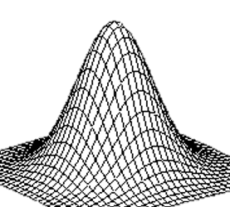
I) Cross Section introduction
Physical principles
In quantum physic, it depends on the nuclei nuclear structures and neutron energy. The XS can be larger or smaller than the nucleus area.
For low slow neutrons :
For epithermal neutrons, IF E_{n} corresponds exactly to an excited state:
slow neutrons
=> large wave functions
epithermal neutrons
Very high XS
for a precise E_{n}
=> resonance
High XS
because of
wave-functions overlap
A cross section is a complex property depending on :
- isotope
- neutron energy
- reaction

Slide 4
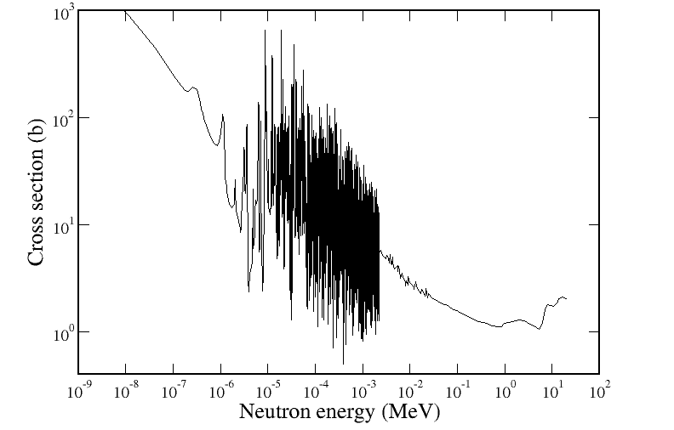
I) Cross Section introduction
Example of Cross section
Fission cross section of ²³⁵U, called ²³⁵U(n,f), is composed of several regimes:
- Thermal part (no corresponding state)
RRR
- Resolved Resonance Range (when the neutron energy corresponds to an existing state)
Thermal part
- Unresolved Resonance Range (too many states to be resolved)
URR
- Continuum
Continuum

Slide 5
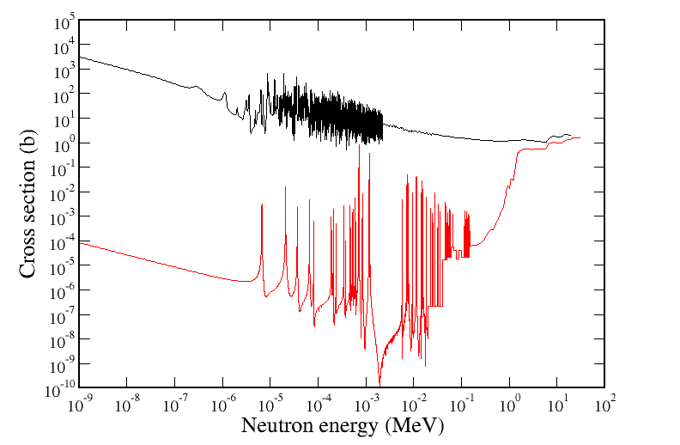
I) Cross Section introduction
Fissile and fertile nuclei
A fissile nucleus can undergo fission when impinged by a thermal neutron
Comparison between binding energy and fission barrier:
- binding energy > fission barrier => fissile
- binding energy < fission barrier => fertile
Additional kinetic energy => fission becomes possible
²³⁵U(n,f)
Enough energy to fission
Due to pairing effect, half of nuclei are fissile, and half are fertile:
- fissile: ^{233,235}U, ^{239,241}Pu
- fertile : ²³²Th, ^{234,236,238}U, ^{240,242}Pu
²³⁸U(n,f)
Only sub-barrier fission
(tunnel effect)
.

Slide 6
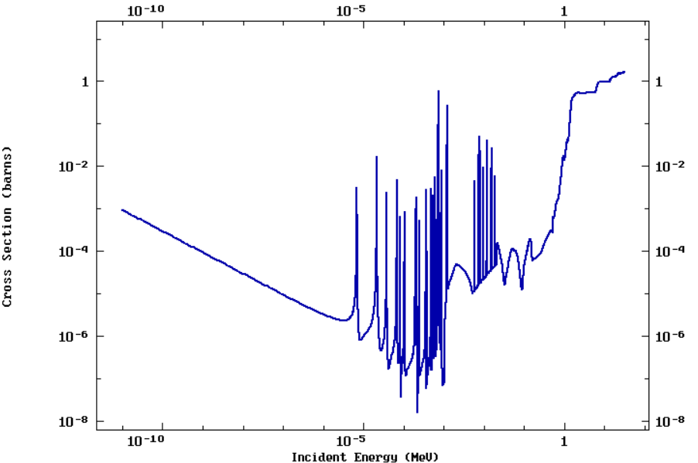
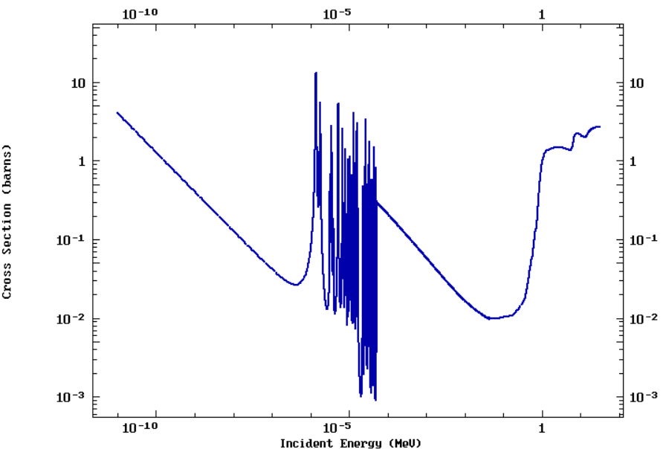
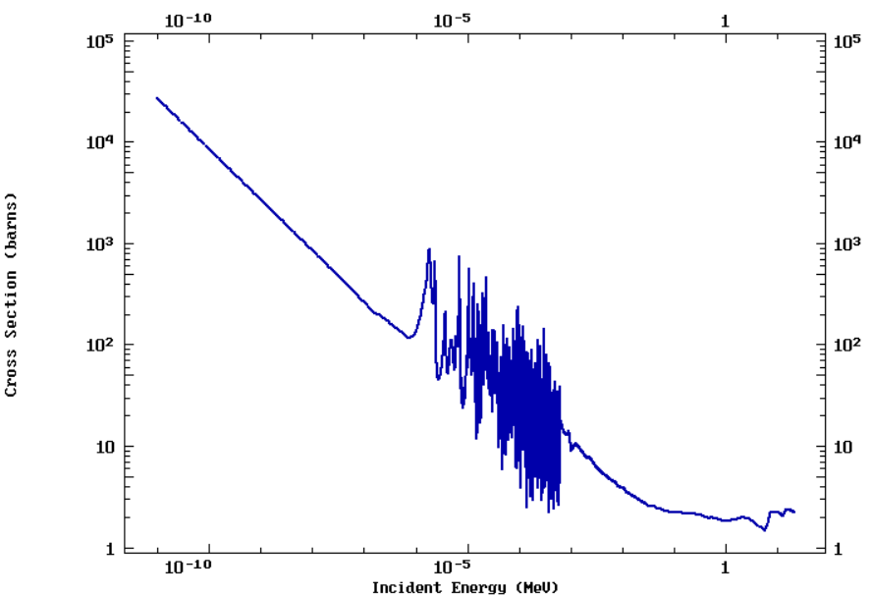
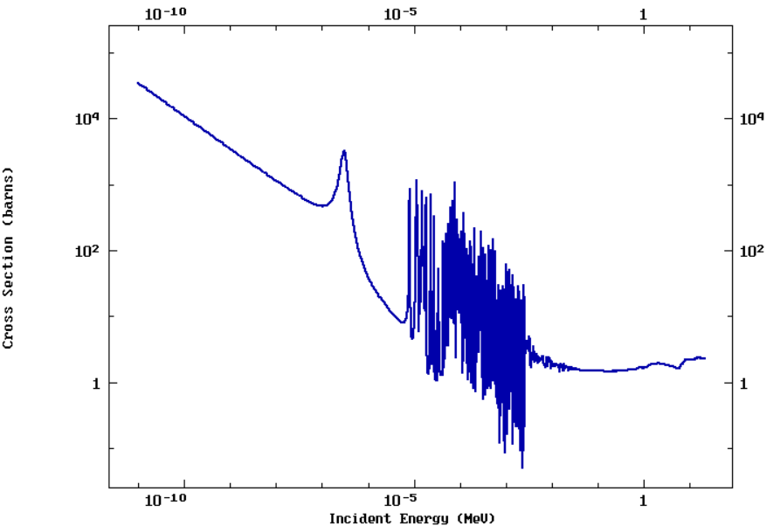
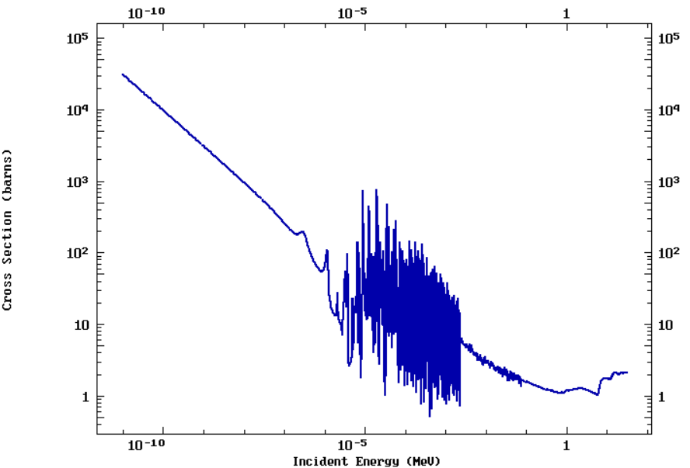
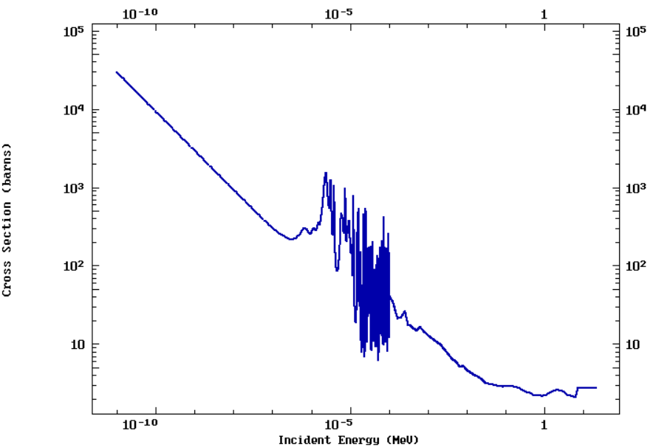
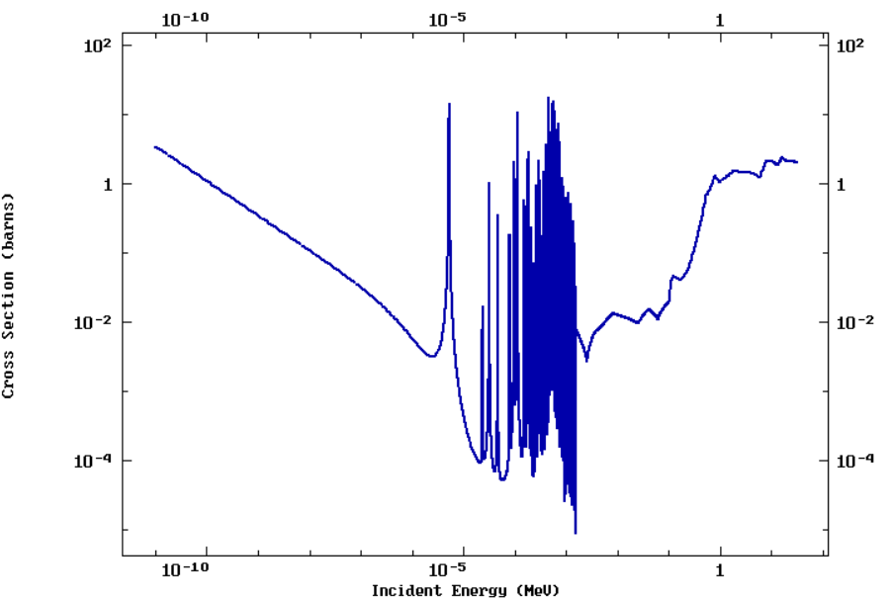
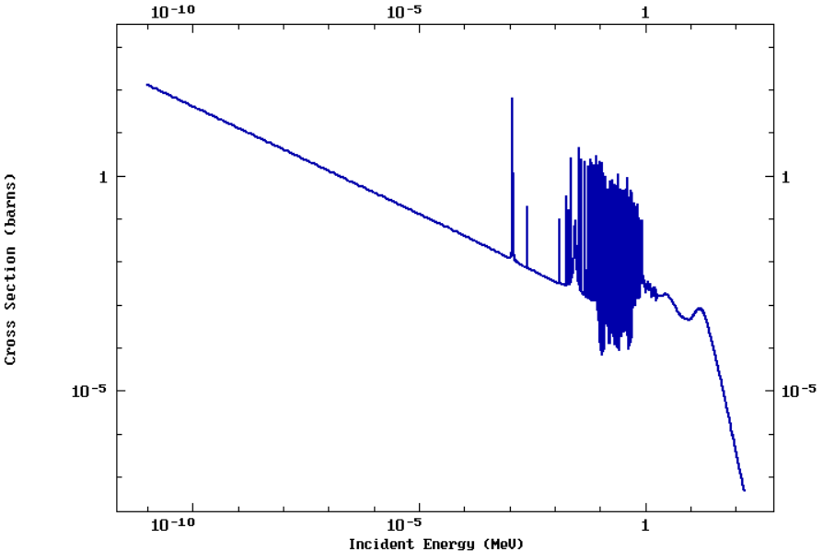
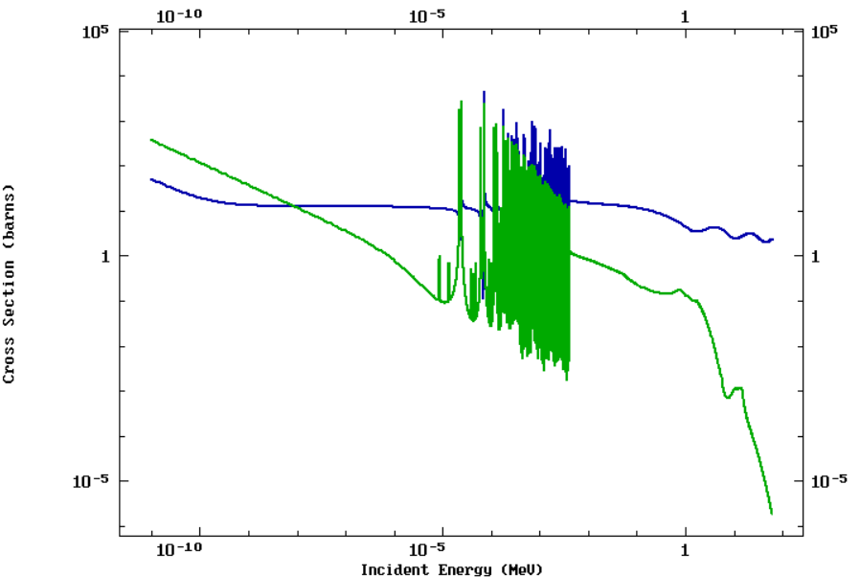
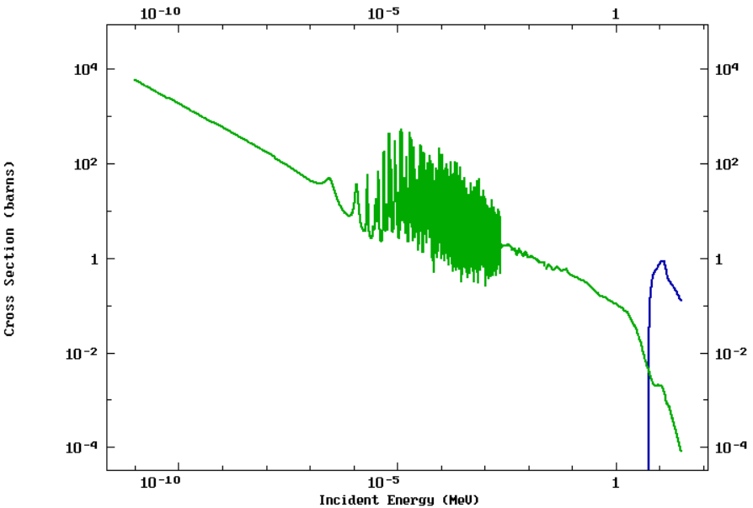
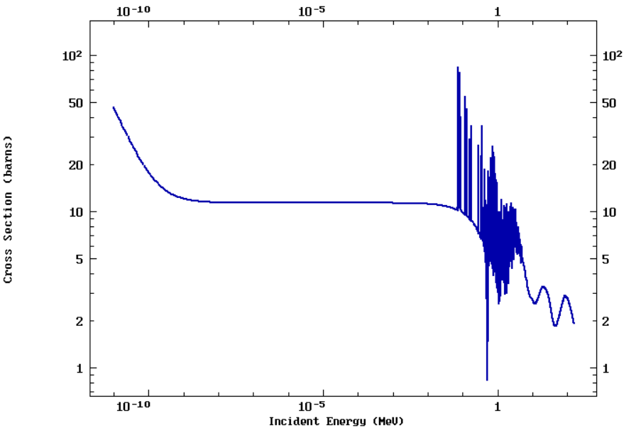
II) Cross Section data
Existing data
Cross sections are measured since the beginning of nuclear science.
as well for fission...
²³⁸U(n,f)
²⁴³Am(n,f)
²³³U(n,f)
²³⁹Pu(n,f)
²⁴³Cm(n,f)
²³⁵U(n,f)
²³⁴U(n,f)
²³⁵U(n,γ) et (n,2n)
⁵⁶Fe(n,γ)
But all these are not experimental data
²³²Th(n,n) et (n,γ)
than for other reactions...
²⁰⁸Pb(n,n)

Slide 7
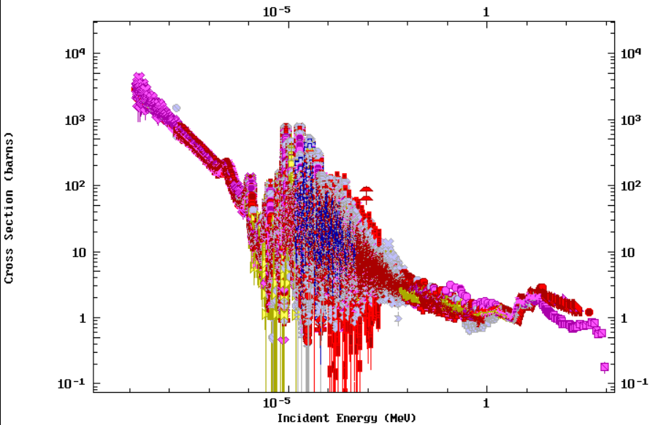
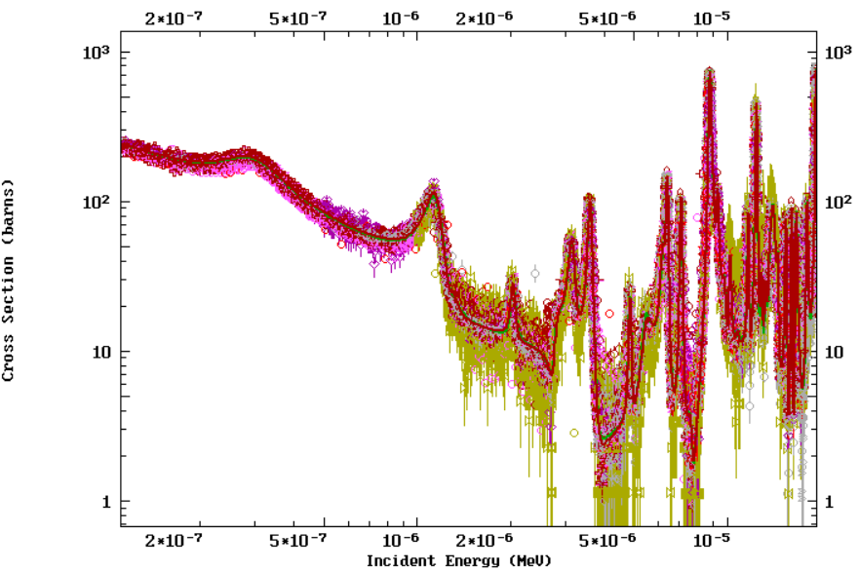
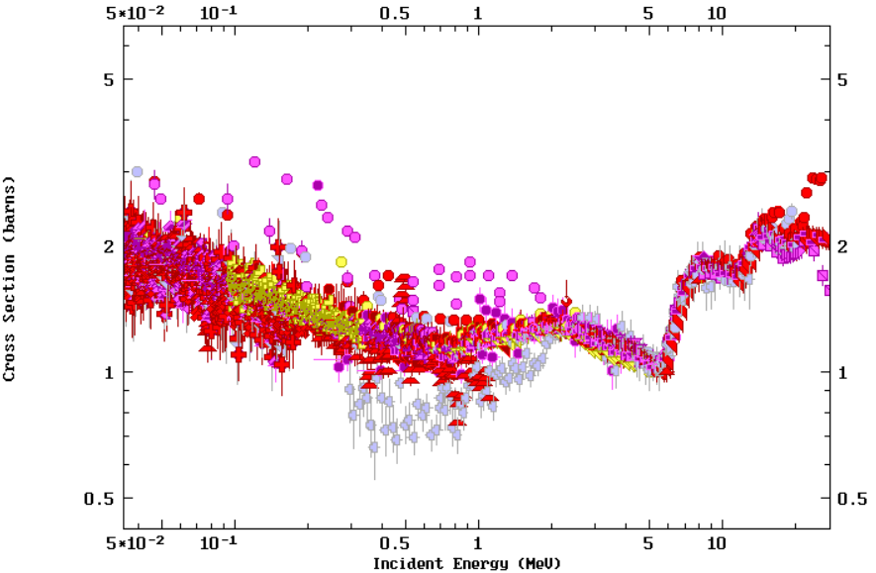
II) Cross Section data
Experimental data
The extensive experimental data are compiled in databases, but cannot be used “directly”.
A simple average
is not the
true cross section value.
The more precise the experimental data, the closer they are from the true value.
However, measurements are not enough...

Slide 8
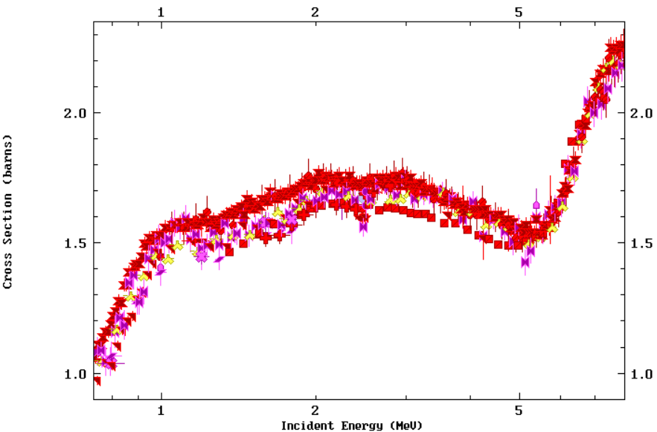
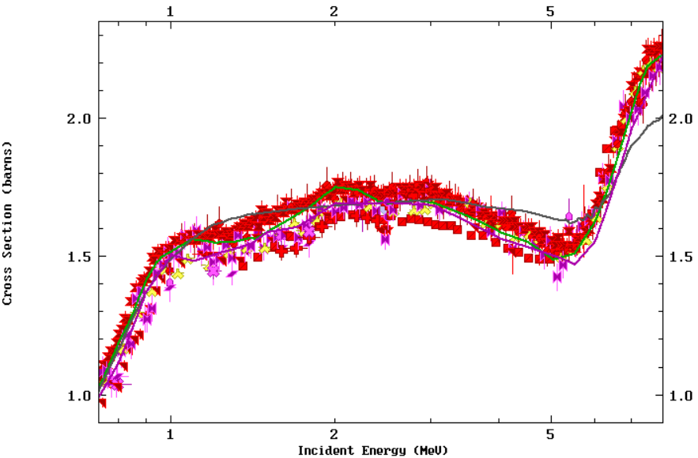
II) Cross Section data
Evaluations
Theoretical calculations with models are carried out to re-create the cross sections
Physical ingredients and models depends on the energy range considered
(thermal range, resonance range, continuum...)
Some experimental data may be difficult to reproduce
(unknown phenomenon)
The agreement between evaluations and with experimental data may vary
Different choices
are made by evaluators
=> different evaluations
Experimental data are investigated to check their consistency and looking for their bias. Evaluators require high quality and highly accurate experimental data (including uncertainties, covariances, experimental parameters...)
.

Slide 9

III) Measurement principles
Back to basic
The measurement of a neutron-induced reaction cross section requires :
1- a sample to be irradiated by neutrons
2- a way to detect the expected reactions
3- a way to produce neutrons
sample
?
neutrons
detector
1- Fission cross section are mainly measured for actinides radioactive target (uranium isotopes, plutonium isotopes, etc.). This has consequences :
- on the experimental setup
- on the administrative paper work and delays

Slide 10
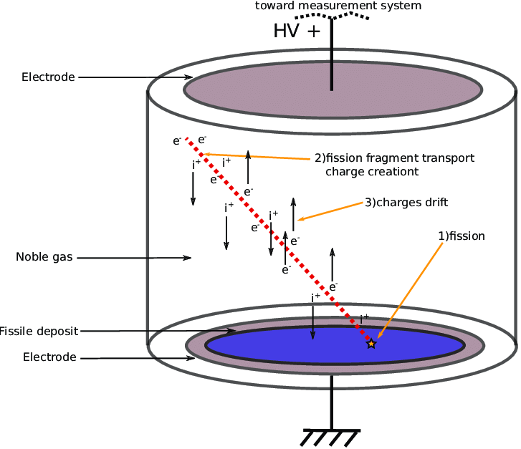
III) Measurement principles
2- Fission detection
Fission process emits:
- two Fission Fragments with high energy (few 10 MeV each)
- several γ-rays (6-8 in average)
- several neutrons (2-3 in average)
Easiest way:
- exactly two FF
- charged particle (high detection efficiency)
- no background
Usual detector: a fission chamber
Principle:
- FF create e-/hole pair in a gas
- charge drift thanks to an electric field
- signal collection
Properties:
possibly compact
high efficiency
radiation resistant (gas)
G. de Izarra, Eur. Phys. J. Conf. 225 (1):10003

Slide 11
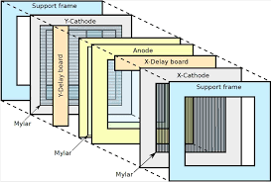
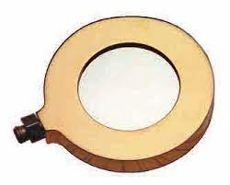
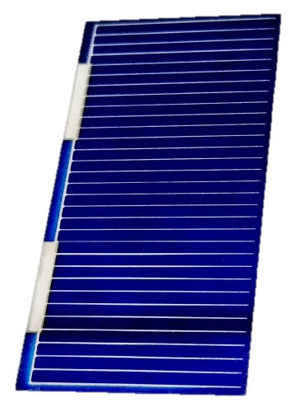
III) Measurement principles
2- Fission detection
Fission process emits:
- two Fission Fragments with high energy (few 10 MeV each)
- several γ-rays (6-8 in average)
- several neutrons (2-3 in average)
Easiest way:
- exactly two FF
- charged particle (high detection efficiency)
- no background
Other detectors:
Parallel Plate Avalanche Counter:
provides FF positions
radiation resistant
Silicon detector:
easy to use
100% efficient
not radiation resistant
Solar cells
easy to use
radiation resistant
and others...
The detector used is adapted to experiment constraints.

Slide 12
III) Measurement principles
3- Neutron production
No isolated neutron exists in nature. They have to be produced with nuclear reactions : ⁷Li(p,n), D(d,n), T(p,n), T(d,n), ⁷Be(α,n), ²³⁸U(γ,n), ...
target
neutrons
beam
E_{n} depends on the angle => for a given angle, quasi-monoenergetic neutrons
This production method:
is quite simple
produces quasi-monoenergetic neutrons
is applicable for E_{n} > few 100 keV
Cross section are then measured at specific neutron energies and only at high energy.

Slide 13
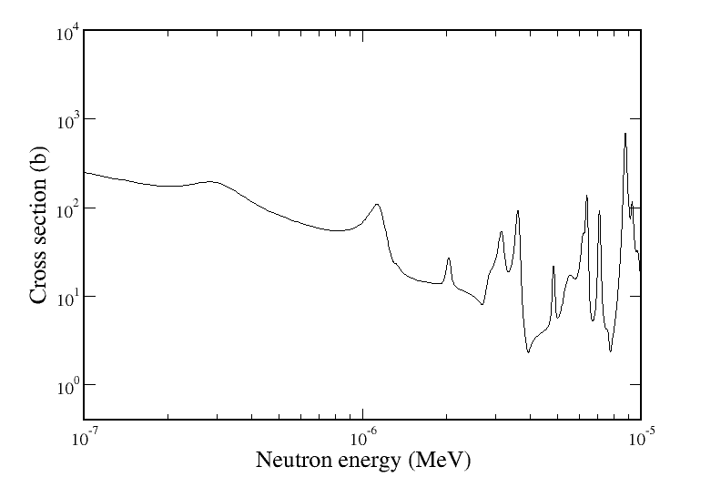
III) Measurement principles
3- Neutron production
No isolated neutron exists in nature. They have to be produced with nuclear reactions : ⁷Li(p,n), D(d,n), T(p,n), T(d,n), ⁷Be(α,n), ²³⁸U(γ,n), ...
A completely different technique can be used: Time of Flight (ToF)
t₁ : high E
neutron source
thermalizer
irradiated target
t₂ : medium E
t₃ : low E
t₄ : very low E
pulsation !
ToF technic enables the different energies to be disentangled
The cross section can be measured for a lot of different neutron energies “simultaneously”
.

Slide 14
Conclusion
Physical principles
Neutron induced cross sections are related to the ability of the nucleus to absorb the neutron and decay in a given reaction channel
They are mandatory to calculate reaction rates
Cross section data
Cross section have been measured for several decades and a large amount of data have already been gathered
The evaluation process is crucial to obtain usable cross section from experimental data
This process need high quality and highly accurate data
Measurement principles
1- sample to irradiate: all “fission” samples are radioactive
2- fission detector: usually a ionisation chamber but a large diversity exists
3- neutron source:
. charge particle induced nuclear reaction
. the Time of Flight technique enables to obtain all energy at once

Slide 15
Merci de votre attention

