Slide 1
Studies of the global solar wind-magnetosphere system through soft X-ray imaging
Dimitra Koutroumpa¹, Ronan Modolo¹, Yevhen Tkachenko², Hyunju Connor³, Steve Sembay⁴, Tianran Sun⁵, Qiuyu Xu^{1,5}, Brian Walsh⁶
¹ LATMOS, CNRS, UVSQ Paris Saclay, Sorbonne Université, ² LERMA, Observatoire de Paris,
³ NASA-GSFC, ⁴ U. of Leicester, ⁵ NSSC-CAS
Congrès Général de la SFP, Cité des Sciences, 4 Juillet 2023

Slide 2
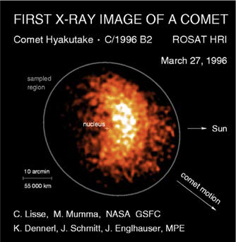
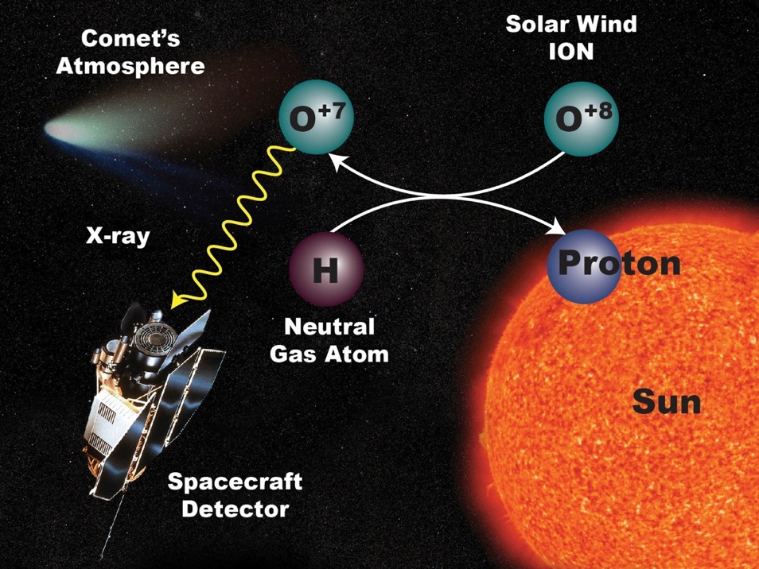
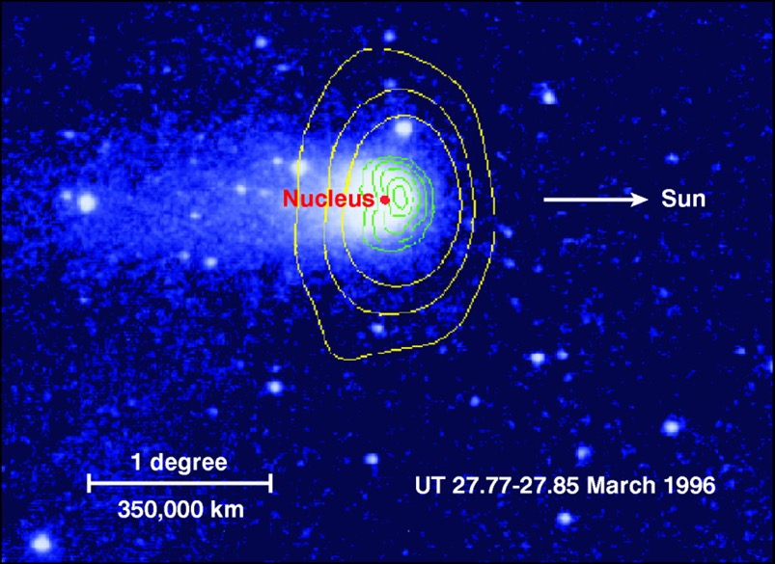
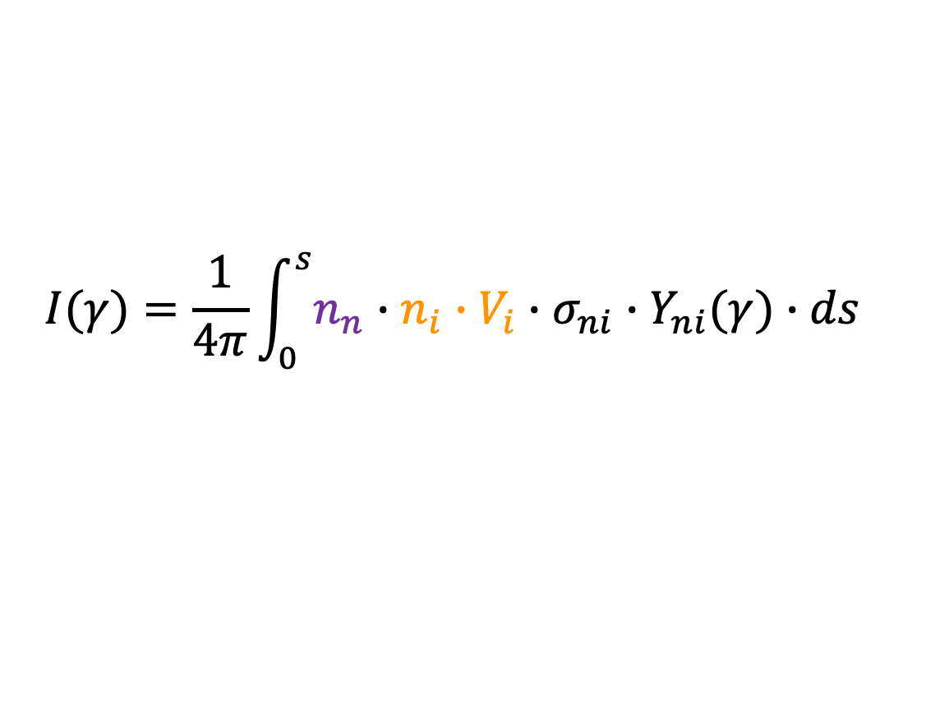
Solar Wind Charge-exchange X-rays (SWCX)
Comet Hyakutake 1996 B2
ROSAT observations (Lisse et al. 1996)
Excited ion
1MK
corona
SWCX emission proposed by Cravens (1997):
The line emission is proportional
to the neutral target density, and the SW source ion flux :
$$N+I^{q+} ⟶N^{+}+ I^{\left(q−1\right)+∗} ⟶N^{+}+ I^{\left(q−1\right)+}+γ_{X}$$
$$I(γ)=\frac{1}{4π}\int_{0}^{s}{n_{n}∙n_{i}∙V_{i}∙σ_{ni}}∙Y_{ni}(γ)∙ds$$
Atomic data

Slide 3
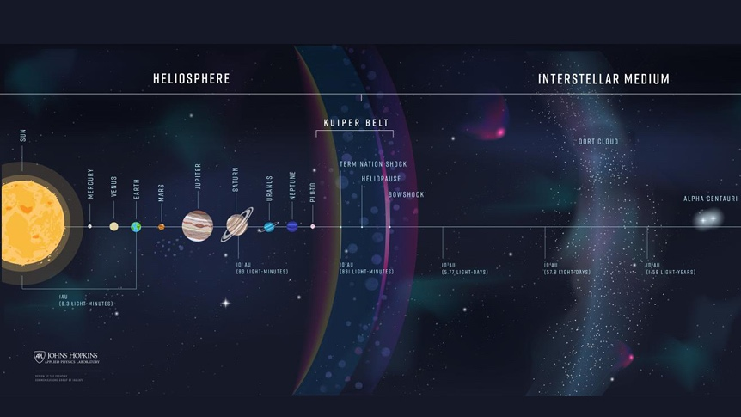
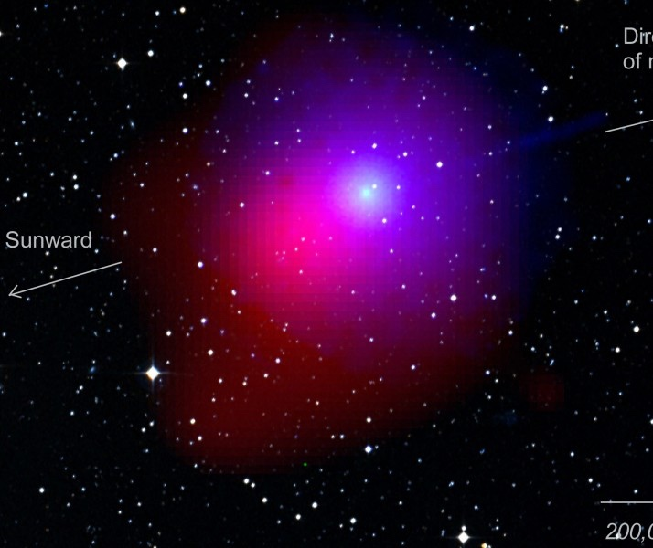
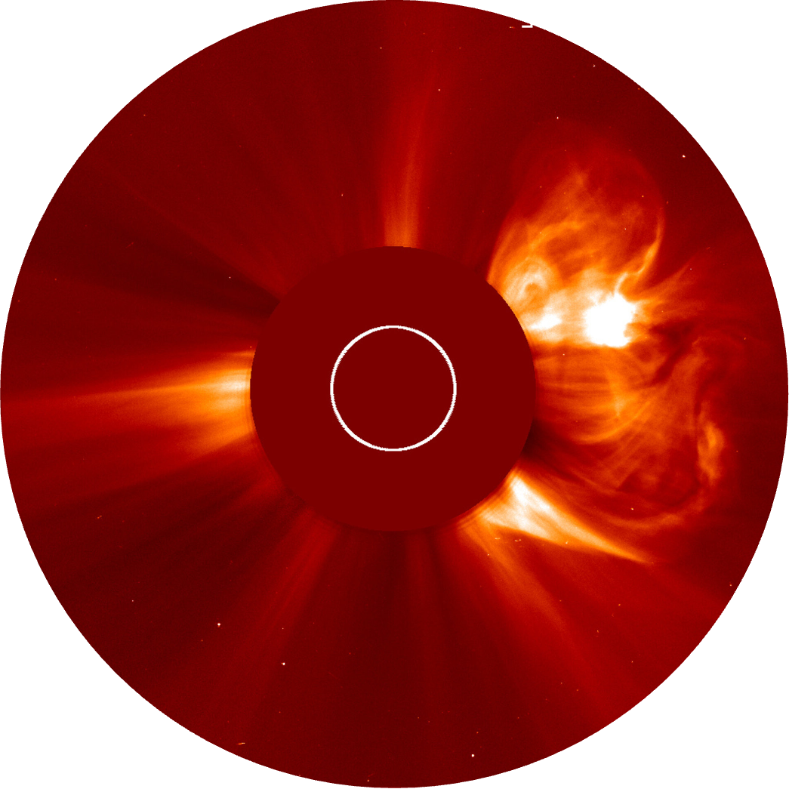
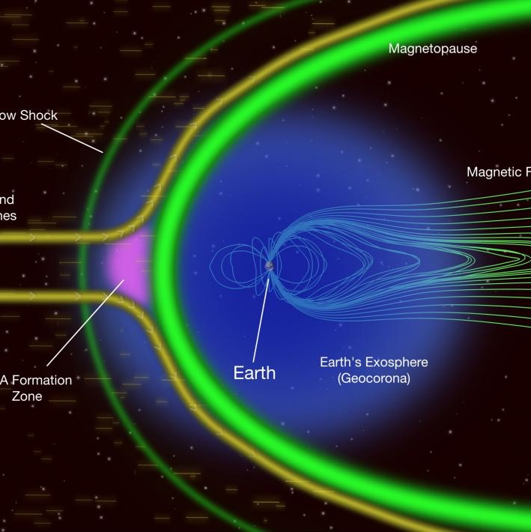
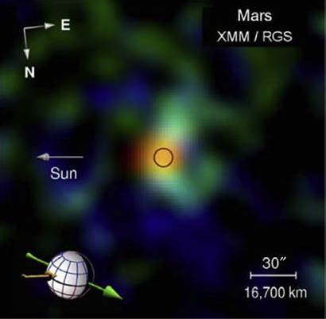
Where is SWCX found?
Interplanetary space
Interstellar H + 15% He
Emission volume ~[150 AU]³
Comet Lulin
Credit: U. of Leicester
SWIFT Observatory
Solar Wind
200 000 km
SUN
Jupiter’s X-ray aurora
Large dots (>2 keV) : Electron bremsstrahlung
Small dots (<2 keV): SWCX (precipitating ions)
Branduardi-Raymond et al. (2008)
Mars in X-rays
Disk (orange): Fluorescence
Exosphere (green): SWCX
Dennerl et al. (2006)
Earth’s exosphere
Em. volume ~[10 Re]³

Slide 4
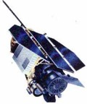

Measurements of magnetospheric SWCX
ROSAT scanning mode
perpendicular to the Sun-Earth line
RASS complete in ~6 months
ROSAT All-Sky Survey (RASS 1990-1991)
Full-sky map in 0.1-0.3 keV energy range in Gal. Coordinates
-Astrophysical telescopes in Earth-bound orbits routinely observe the soft X-ray signal (magnetospheric and heliospheric).
e.g. RASS Long Term Enhancements (LTEs; Snowden et al. 1994)
-As predicted by theory, signal strengths track solar wind fluxes (Cravens et al. 2001)
-Their fields of view (FOV) are too small for m-SWCX studies.
RASS flux correlated with the Solar Wind proton flux
Cravens et al. (2001)

Slide 5
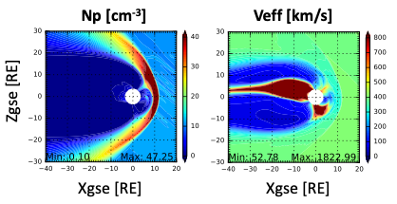
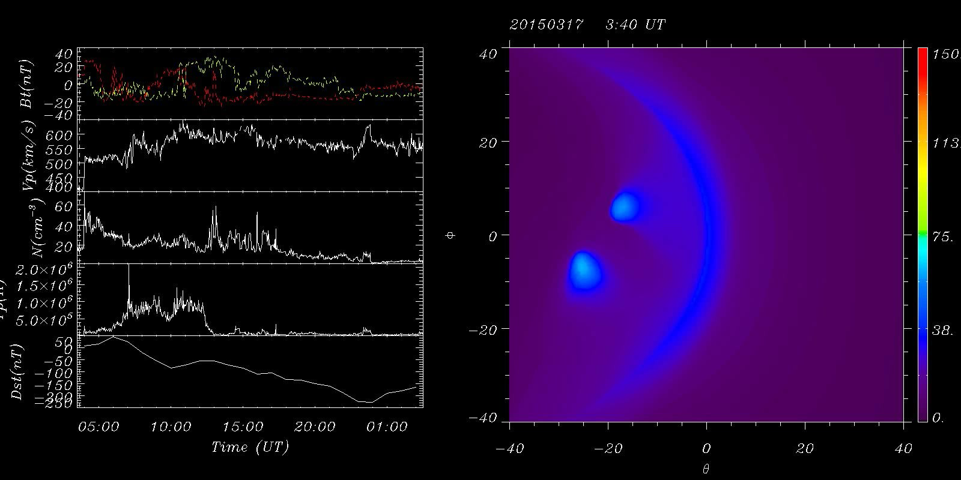
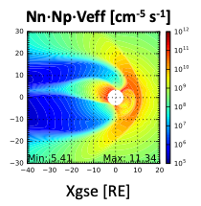
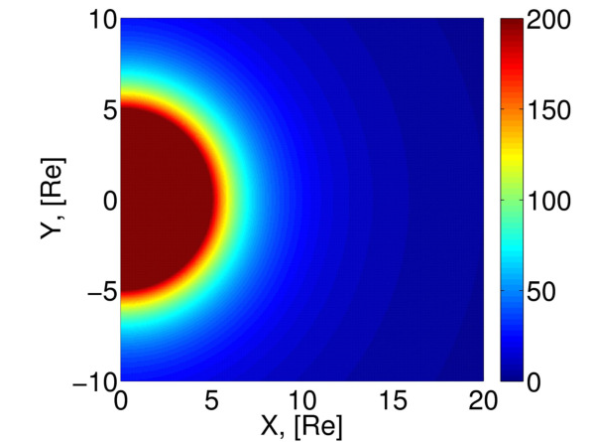
SWCX: an asset for heliophysics
Ions
SWCX “illuminates” the magnetospheric boundaries
X-ray emissivity
Nn [cm-3]
Neutrals
Credit: Tianran Sun (NSSC-CAS)
https://www.mssl.ucl.ac.uk/SMILE/simulations.html
Two missions for Global imaging of the magnetosphere:
ESA-China SMILE mission in Earth orbit
NASA’s LEXI mission to be deployed on the Moon

Slide 6
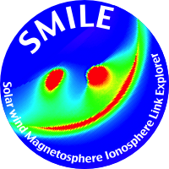


SMILE
Solar wind Magnetosphere Ionosphere Link Explorer
High Elliptical Polar Orbit:
120,000 km apogee,
51 hr orbit (~41 hr SXI and UVI science operations, LIA & MAG monitor continuously)
~41 h Science
(UK)
(Canada)
MAG
(China)
~9 h
(China)
Credit: ESA

Slide 7
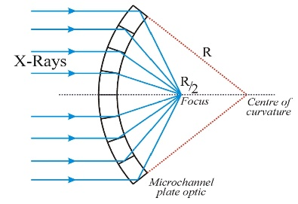
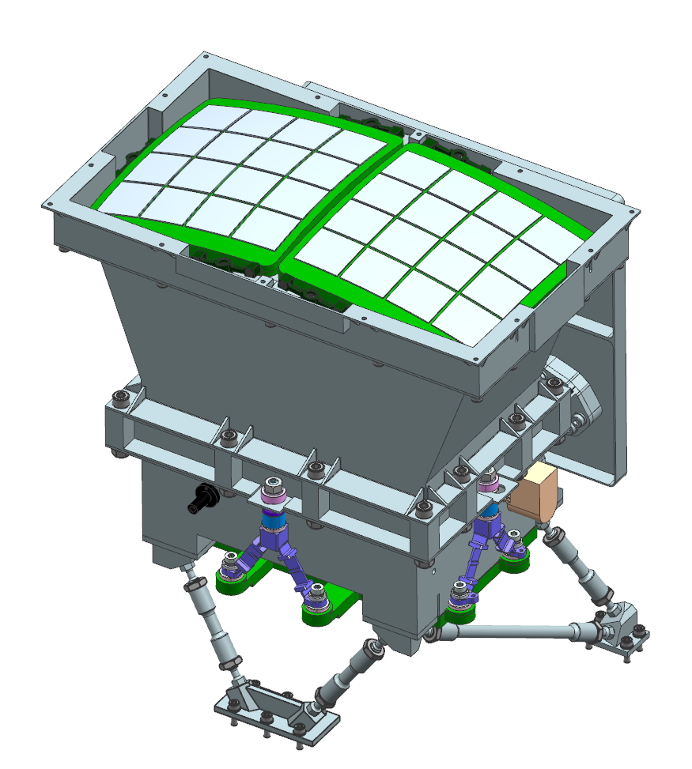
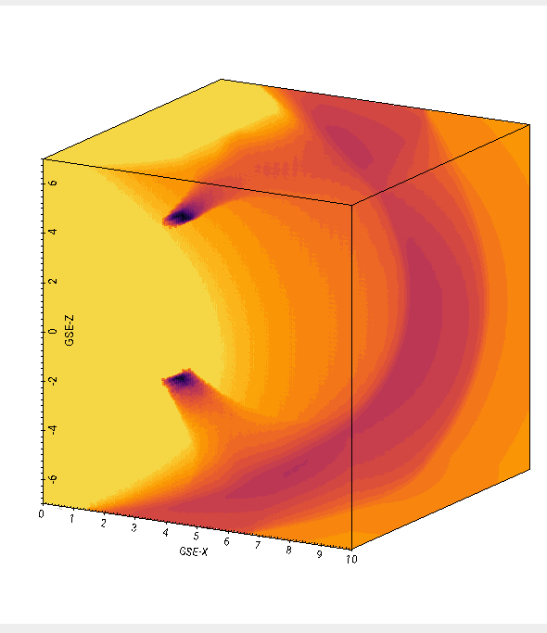
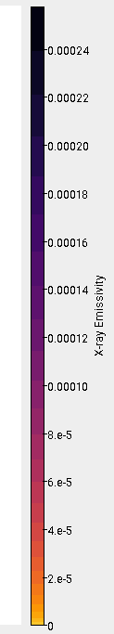
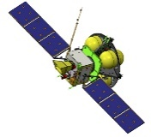
SMILE Soft X-ray Imager (SXI)
8 x 4 Array of MPOs
Lobster-eye Micropore
Optic
Ultra-wide field of view
~16° x 26°
Focal length 30 cm
Optic Mass < 1kg
Instrument ~36 kg
Detectable X-ray emission
calculated by integrating
along the line of sight
through the modelled
X-ray emissivity cube
CCD Detector Plane
Photon counting: Photon lists
with ~4 s time resolution
High QE in soft X-rays
~90% at 500 eV
Medium energy resolution
~50 eV FWHM at 500 eV
➔ SXI_SIM produces expected count maps

Slide 8
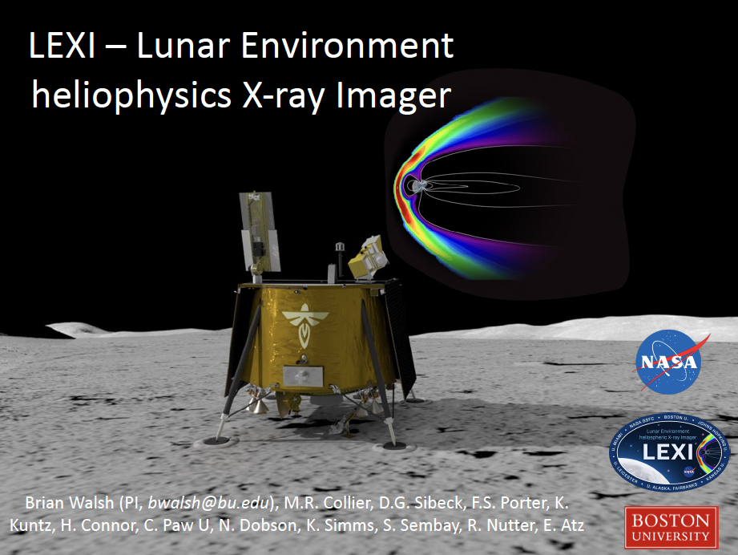
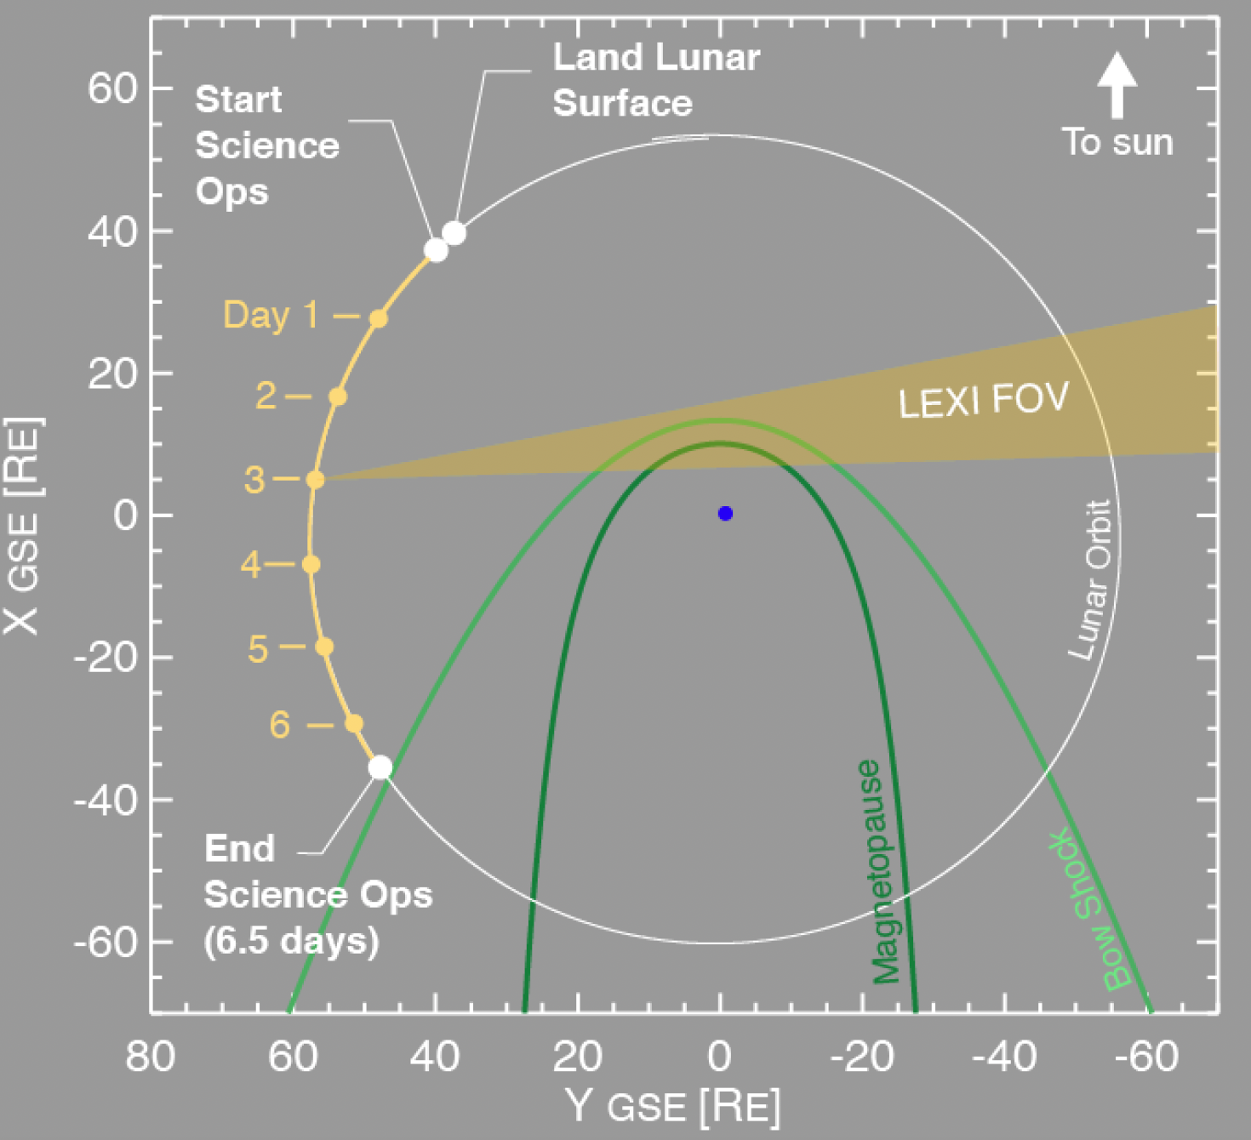
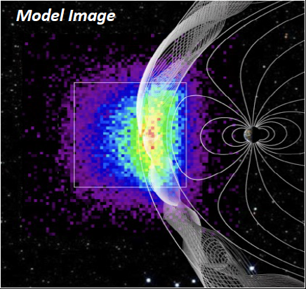
SWCX imaging of the magnetopause from the Moon
NASA CLPS (Commercial Lunar Payload Services) program
2024 Deploy on lunar surface at Mare Crisium
Soft X-ray (0.1 – 2 keV) imaging with micropore optics (9.1 x 9.1deg)
Science: Macro-scale properties of magnetopause reconnection
Courtesy B. Walsh & LEXI team
Why the Moon?
1. Far enough away to get a global view for many hours
2. Steady stable viewing platform
  – no loss of data from perigee passes
3. Good telemetry
4. Can adjust telescope orientation with time to keep target in view.
300 s (5 min) of integration

Slide 9
LATMOS Test-Particle simulations of SWCX emission
2-step approach
Compute the solar wind interaction with the planet’s neutral environment (MHD or hybrid/kinetic model) including
  Neutrals
  Electromagnetic fields
  Solar wind
Compute the CX production between heavy and multiply charged solar wind ions and the exosphere – test-particle run.
Then to compute the luminosity:
SW ion considered (1 test-particle simulation per ion species)
C⁶⁺ / C⁵⁺ / N⁷⁺ / N⁶⁺ / O⁸⁺ / O⁷⁺ etc.
This methodology was successfully implemented to characterize Solar Wind Charge Exchange X-ray emission at Mars (Koutroumpa et al, 2012)

Slide 10
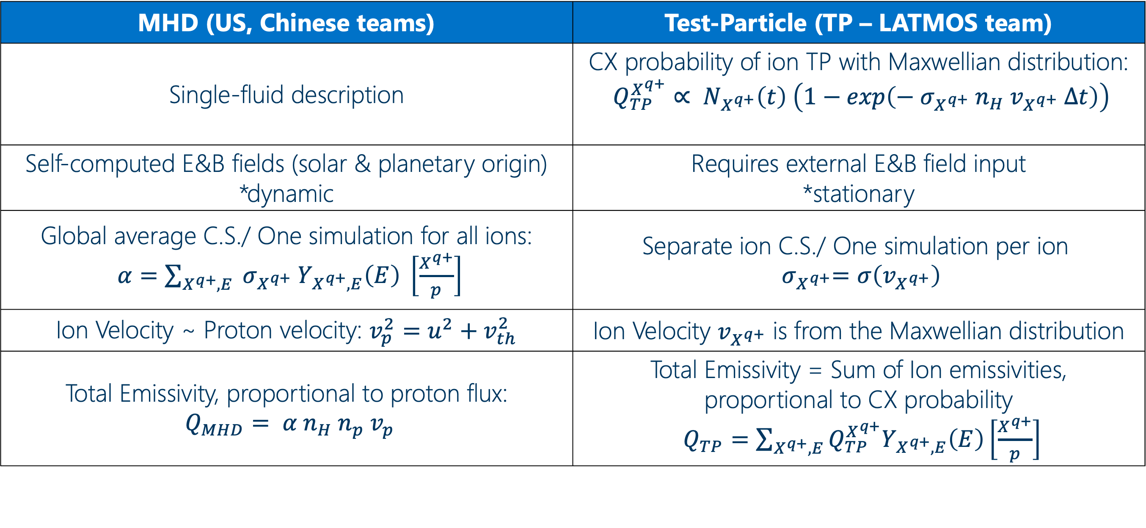
SWCX emission models: MHD vs TP approaches
MHD (US, Chinese teams) | Test-Particle (TP – LATMOS team)
Single-fluid description | CX probability of ion TP with Maxwellian distribution: $Q_{TP}^{X^{q+}}∝ N_{X^{q+}}\left(t\right) \left(1−exp\left(−{ σ}_{X^{q+}}{ n}_{H}{ v}_{X^{q+}} ∆t\right)\right)$
Self-computed E&B fields (solar & planetary origin) *dynamic | Requires external E&B field input *stationary
Global average C.S./ One simulation for all ions: $α=\sum_{X^{q+},E}{{ σ}_{X^{q+}}{ Y}_{X^{q+},E}\left(E\right) \left[\frac{X^{q+}}{p}\right]}$ | $$\text{Separate} \text{ion} \text{C}\text{.}\text{S}\text{.}\text{/ }\text{One} \text{simulation} \text{per} \text{ion}$$ ${ σ}_{X^{q+}}=σ\left(v_{X^{q+}}\right)$
Ion Velocity ~ Proton velocity: $v_{p}^{2}=u^{2}+v_{th}^{2}$ | Ion Velocity $v_{X^{q+}}$ is from the Maxwellian distribution
Total Emissivity, proportional to proton flux: $Q_{MHD}= α{ n}_{H} n_{p} v_{p}$ | Total Emissivity = Sum of Ion emissivities, proportional to CX probability $Q_{TP}=\sum_{X^{q+},E}{Q_{TP}^{X^{q+}}Y_{X^{q+},E}\left(E\right)\left[\frac{X^{q+}}{p}\right]}$
Notes:
Test-particle Monte Carlo simulations [Haviland, 1965] – the density in a given volume of phase space is proportional to the residence time of the test-particles (TP) in this volume.
Heavy Ions: weighted macro-particles, injected with random velocity from a SW Maxwellian distribution, and random position on the injection surface YZ at X= +20R_{E} (entrance of the simulation box)
For each particle at each time step the probability of CX collision is:
$$P=1−exp\left({−σ}_{X^{q},H}{ n}_{H}\left(\vec{r}\right){ V}_{X^{q}} ∆t\right)$$
The weights of the source and produced particle are adjusted accordingly.
TPs injected in the simulation box consecutively and followed until either:
they exit the box
they are « absorbed » by the obstacle
their weight is below 1.e-6 (normalized unit; e.g., the source TP X^{q+} has completely CX into X^{(q-1)+})

Slide 11
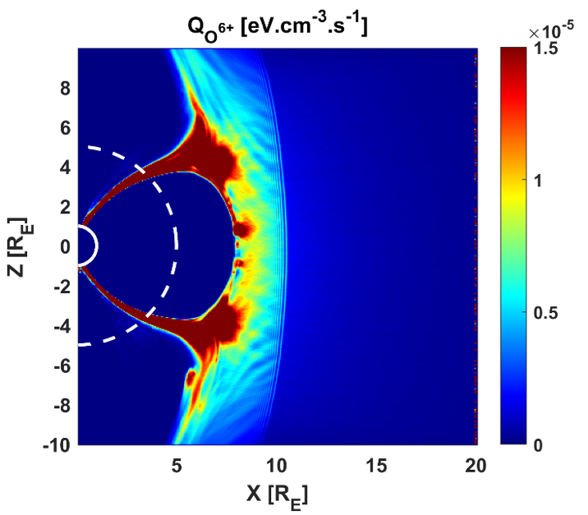
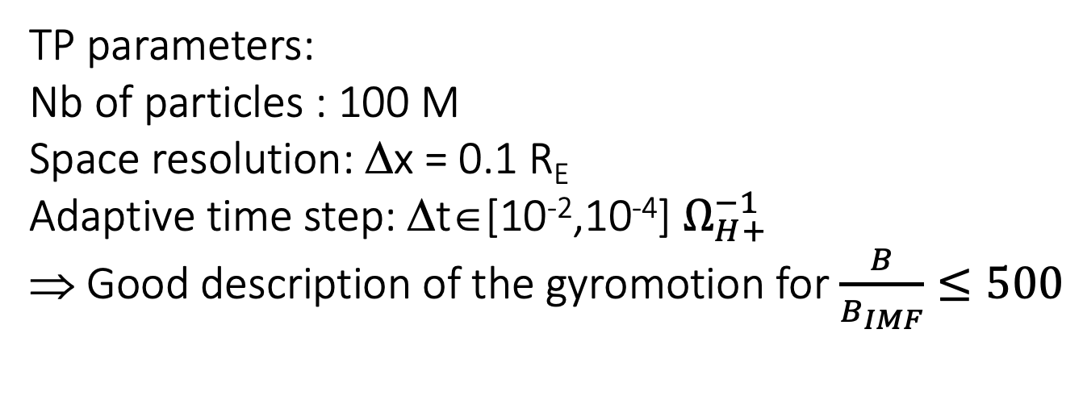
MHD vs TP approaches: Results
Emissivity Cuts
based on Tkachenko et al. 2021
MHD
TP
TP parameters:
Nb of particles : 100 M
Space resolution: Δx = 0.1 R_{E}
Adaptive time step: Δt∈[10⁻²,10⁻⁴] $Ω_{H+}^{−1}$
⇒ Good description of the gyromotion for $\frac{B}{B_{IMF}}≤500$
Solar wind conditions
Np = 12.5 cm⁻³
V = 400 km/s
Bz = -5nT

Slide 12
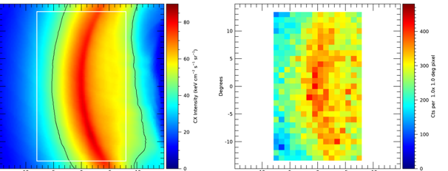
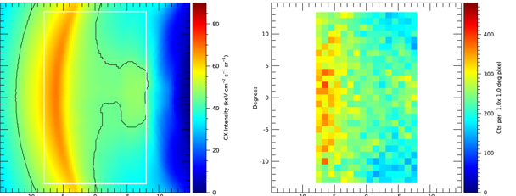
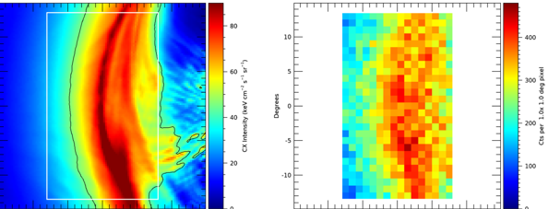
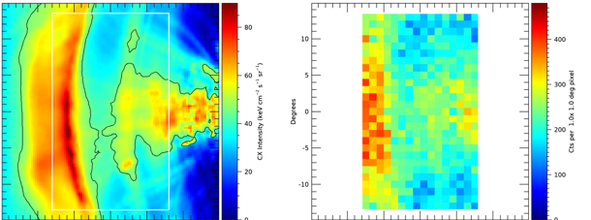
SXI simulator X-ray maps
Tkachenko et al. 2021
Koutroumpa et al. 2022
SXI Detector Image: 1200 s
SXI Detector Image: 1200 s
Input Simulation
Input Simulation
Orbit Position 3.76, 7.46, 17.97 GSE,
Aim Point 8.04, 0, 0 GSE
Orbit Position 1.03, 0.04, 15.29 GSE,
Aim Point 6.66, 0, 0 GSE

Slide 13
Summary
Magnetospheric boundary positions are sensitive indicators of the global solar wind-magnetosphere interaction and provide insight of space weather conditions.
Soft X-ray emissions generated by solar wind charge exchange with exospheric neutrals map out the bow shock and magnetopause.
The SMILE and LEXI missions are the first X-ray imaging missions dedicated to global imaging of the magnetosphere.
LEXI will be the first X-ray instrument to be deployed on the Moon. The moon offers a steady, stable vantage point with a global perspective.
LATMOS teams support the science return of these missions through Test-Particle modeling.
The MHD and TP approaches offer complementary information of the SWCX emission imaging.

