Slide 1
Congrès général
SFP
Microhydration of Mg²⁺(CH₃COO–) ion pairs followed by IR laser spectroscopy:
insights into the water-mediated ionic interactions in the magnesium transport channel
Jean-Xavier bardaud
Supervisor : Eric Gloaguen
Lab : ISMO
Notes:
Peut etre juste dire investiguer les interactions au sein de ces clusters

Slide 2
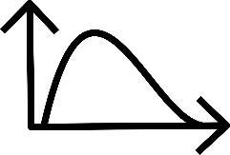
Outline of the presentation
Motivations for the study
Experimental & theoretical IR spectroscopy results
Conclusions & prospects
Notes:
For my presentation, I will present you the motivations of this study, then the differents results of IR spectroscopy and finish on Conclusion and prospects

Slide 3
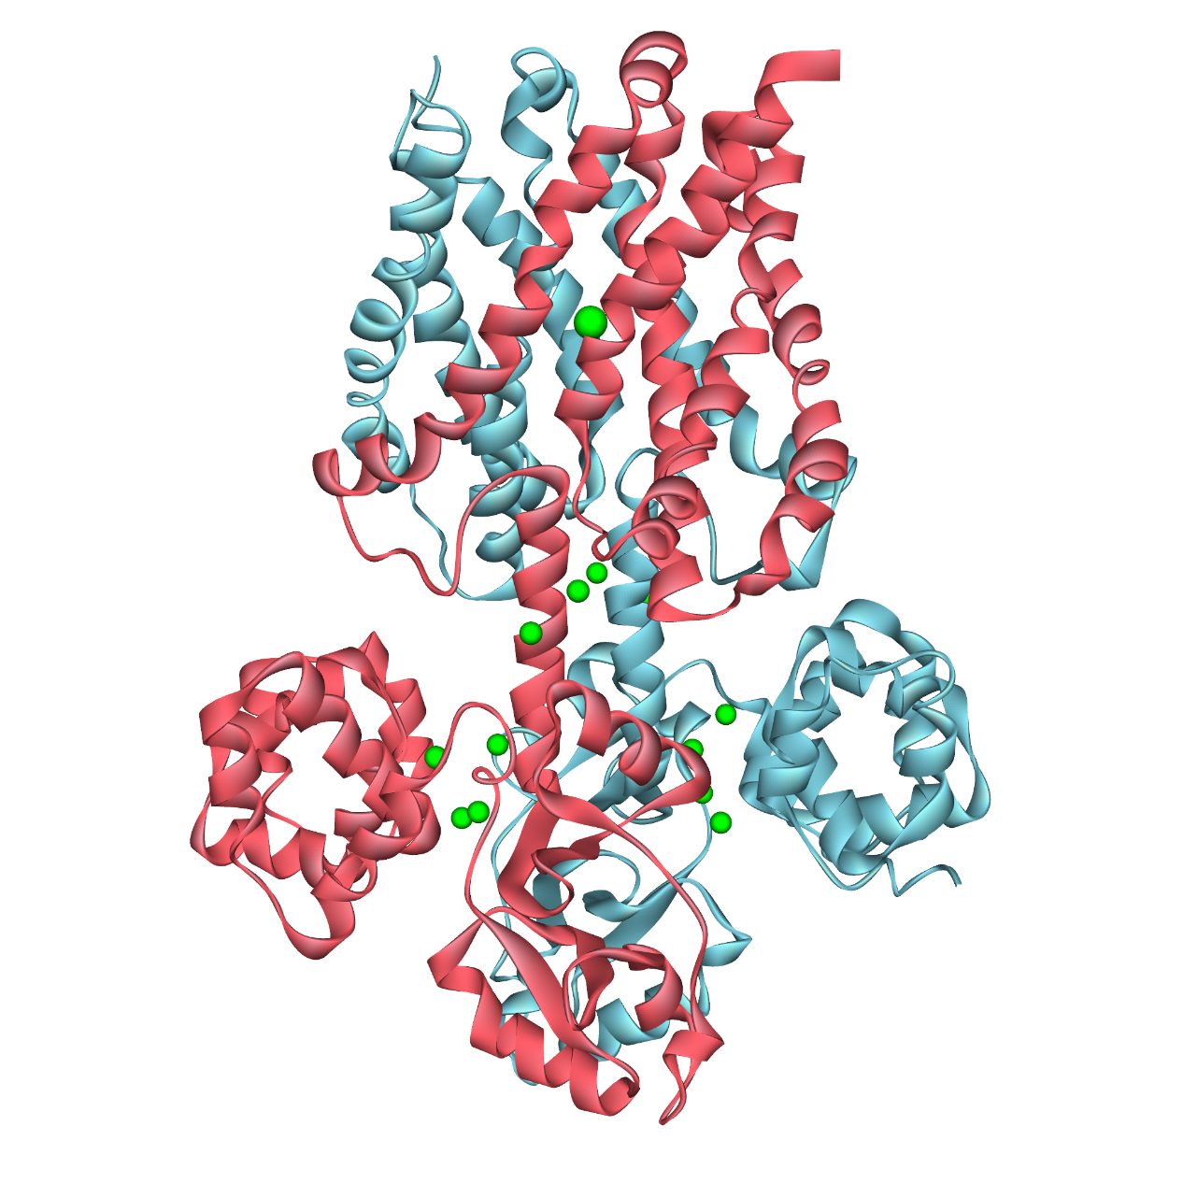
Motivations for the study
Magnesium transport channel
Structural basis for ion selectivity revealed by high-resolution crystal structure of Mg2+ channel MgtE Takeda H., Hattori M., Nishizawa T., Yamashita K., Shah S.T.A., Caffrey M., Maturana A.D., Ishitani R., Nureki O. Nature Communications 2014 5374, 5
Notes:
Juste descriptif sur le transporter
Toute la fonction biologique se fait sans interaction direct entre les deux ions au travers des molécules d’eau
Il y a deux interactions avec des carboxylates.

Slide 4
Motivations for the study
Mg²⁺
Magnesium transport channel
Structural basis for ion selectivity revealed by high-resolution crystal structure of Mg2+ channel MgtE Takeda H., Hattori M., Nishizawa T., Yamashita K., Shah S.T.A., Caffrey M., Maturana A.D., Ishitani R., Nureki O. Nature Communications 2014 5374, 5
Notes:
Image de la protéine + zoom + fonction bio : filtre / sélection
Mettre le magnésium en plus gros et plus clair
Mettre sélection filter area
Magnesium transporter channel selection filter
Toute la fonction biologique se fait sans interaction direct entre les deux ions au travers des molécules d’eau
Il y a deux interactions avec des carboxylates.

Slide 5
Motivations for the study
Mg²⁺
Selectivity filter
Magnesium transport channel
Structural basis for ion selectivity revealed by high-resolution crystal structure of Mg2+ channel MgtE Takeda H., Hattori M., Nishizawa T., Yamashita K., Shah S.T.A., Caffrey M., Maturana A.D., Ishitani R., Nureki O. Nature Communications 2014 5374, 5
Notes:
Image de la protéine + zoom + fonction bio : filtre / sélection
Mettre le magnésium en plus gros et plus clair
Mettre sélection filter area
Magnesium transporter channel selection filter
Toute la fonction biologique se fait sans interaction direct entre les deux ions au travers des molécules d’eau
Il y a deux interactions avec des carboxylates.

Slide 6
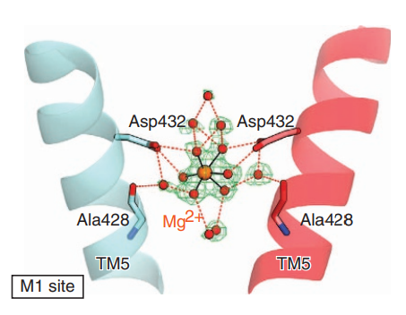
Motivations for the study
Selectivity filter
Structural basis for ion selectivity revealed by high-resolution crystal structure of Mg2+ channel MgtE Takeda H., Hattori M., Nishizawa T., Yamashita K., Shah S.T.A., Caffrey M., Maturana A.D., Ishitani R., Nureki O. Nature Communications 2014 5374, 5
Notes:
Image de la protéine + zoom + fonction bio : filtre / sélection
Mettre le magnésium en plus gros et plus clair
Mettre sélection filter area
Magnesium transporter channel selection filter
Toute la fonction biologique se fait sans interaction direct entre les deux ions au travers des molécules d’eau
Il y a deux interactions avec des carboxylates.

Slide 7
Motivations for the study
H₂O
RCOO⁻
RCOO⁻
Mg²⁺
Selectivity filter
Structural basis for ion selectivity revealed by high-resolution crystal structure of Mg2+ channel MgtE Takeda H., Hattori M., Nishizawa T., Yamashita K., Shah S.T.A., Caffrey M., Maturana A.D., Ishitani R., Nureki O. Nature Communications 2014 5374, 5
Notes:
Image de la protéine + zoom + fonction bio : filtre / sélection
Mettre le magnésium en plus gros et plus clair
Mettre sélection filter area
Magnesium transporter channel selection filter
Toute la fonction biologique se fait sans interaction direct entre les deux ions au travers des molécules d’eau
Il y a deux interactions avec des carboxylates.

Slide 8
Motivations for the study
H₂O
RCOO⁻
RCOO⁻
Mg²⁺
The fully hydrated Mg²⁺ is recognized by the two carboxylate groups
Selectivity filter
Structural basis for ion selectivity revealed by high-resolution crystal structure of Mg2+ channel MgtE Takeda H., Hattori M., Nishizawa T., Yamashita K., Shah S.T.A., Caffrey M., Maturana A.D., Ishitani R., Nureki O. Nature Communications 2014 5374, 5
Notes:
Image de la protéine + zoom + fonction bio : filtre / sélection
Mettre le magnésium en plus gros et plus clair
Mettre sélection filter area
Magnesium transporter channel selection filter
Toute la fonction biologique se fait sans interaction direct entre les deux ions au travers des molécules d’eau
Il y a deux interactions avec des carboxylates.

Slide 9
Motivations for the study
H₂O
RCOO⁻
RCOO⁻
Water-mediated ionic interactions: Interactions between the two ions through water molecules
Mg²⁺
The fully hydrated Mg²⁺ is recognized by the two carboxylate groups
Selectivity filter
Structural basis for ion selectivity revealed by high-resolution crystal structure of Mg2+ channel MgtE Takeda H., Hattori M., Nishizawa T., Yamashita K., Shah S.T.A., Caffrey M., Maturana A.D., Ishitani R., Nureki O. Nature Communications 2014 5374, 5
Notes:
Il s’agit d’une WM2I
Colombic intercation

Slide 10
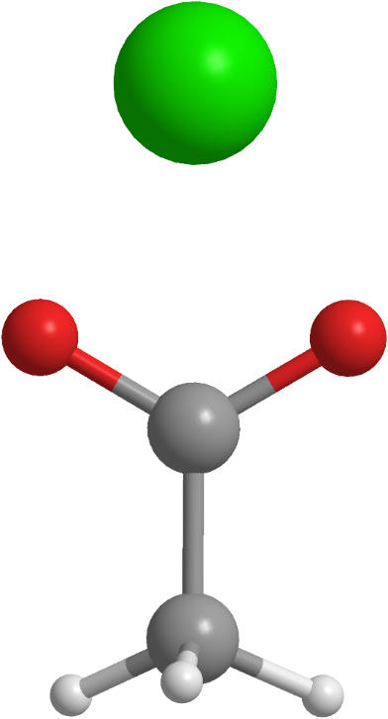
Motivations for the study
H₂O
Mg²⁺
RCOO⁻
RCOO⁻
Water-mediated ionic interactions: Interactions between the two ions through water molecules
Mg²⁺
CH₃COO⁻
Selectivity filter
Structural basis for ion selectivity revealed by high-resolution crystal structure of Mg2+ channel MgtE Takeda H., Hattori M., Nishizawa T., Yamashita K., Shah S.T.A., Caffrey M., Maturana A.D., Ishitani R., Nureki O. Nature Communications 2014 5374, 5
Notes:
Image de la protéine + zoom + fonction bio : filtre / sélection
Mettre le magnésium en plus gros et plus clair
Mettre sélection filter area
Magnesium transporter channel selection filter
Toute la fonction biologique se fait sans interaction direct entre les deux ions au travers des molécules d’eau
Il y a deux interactions avec des carboxylates.

Slide 11
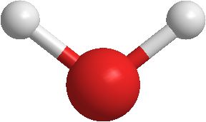
Motivations for the study
H₂O
Mg²⁺
RCOO⁻
RCOO⁻
H₂O
Water-mediated ionic interactions: Interactions between the two ions through water molecules
Mg²⁺
CH₃COO⁻
Selectivity filter
selected model system :
Mg²⁺ + CH₃COO⁻ + nH₂O
Structural basis for ion selectivity revealed by high-resolution crystal structure of Mg2+ channel MgtE Takeda H., Hattori M., Nishizawa T., Yamashita K., Shah S.T.A., Caffrey M., Maturana A.D., Ishitani R., Nureki O. Nature Communications 2014 5374, 5
Notes:
Image de la protéine + zoom + fonction bio : filtre / sélection
Mettre le magnésium en plus gros et plus clair
Mettre sélection filter area
Magnesium transporter channel selection filter
Toute la fonction biologique se fait sans interaction direct entre les deux ions au travers des molécules d’eau
Il y a deux interactions avec des carboxylates.

Slide 12
Motivations for the study
Different types of ion pair solvation
Notes:
Model pas modelize

Slide 13
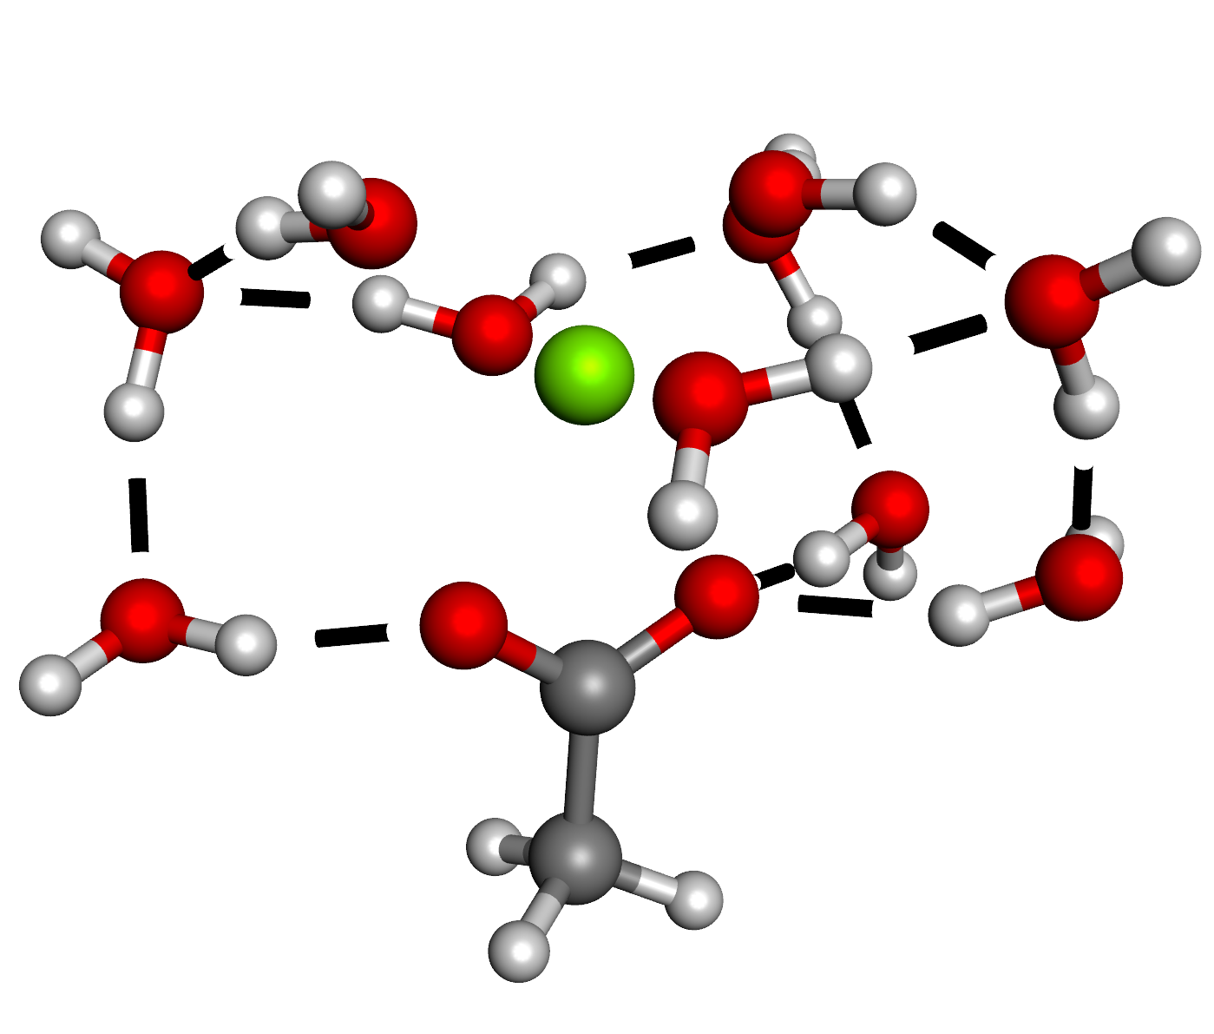
Motivations for the study
Different types of ion pair solvation
Fully associated
(bidentate)
Notes:
Model pas modelize

Slide 14
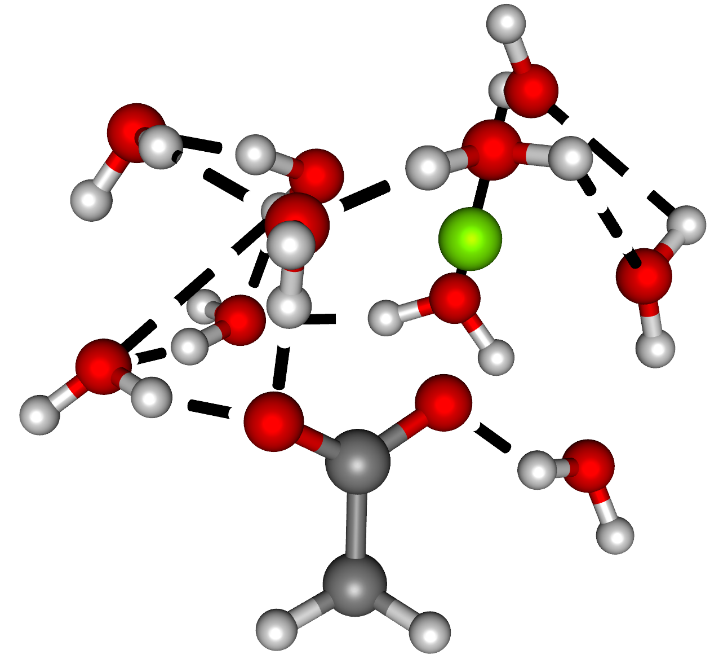
Motivations for the study
Different types of ion pair solvation
Fully associated
(bidentate)
Partially-separated
(monodentate)
Notes:
Model pas modelize

Slide 15
Motivations for the study
Different types of ion pair solvation
Separated
Fully associated
(bidentate)
Partially-separated
(monodentate)
Notes:
Model pas modelize

Slide 16
Motivations for the study
Different types of ion pair solvation
Separated
Water-mediated ionic interactions
Fully associated
(bidentate)
Partially-separated
(monodentate)
Notes:
Model pas modelize

Slide 17
Motivations for the study
How many molecules of water are needed to form separated ion pairs?
Can this approach help us to characterize the water-mediated ionic interactions in the magnesium transport channel?
Notes:
Quels sont les différents signatures ? Signature spécifique à cette interaction ?
The conformational landscape is complex so that an experimental and theoretical study of the IR spectroscopy of these clusters : Pas fini et moins lourd !
On est plus dans les motivations – Questions et façon de chercher

Slide 18
Motivations for the study
How many molecules of water are needed to form separated ion pairs?
Can this approach help us to characterize the water-mediated ionic interactions in the magnesium transport channel?
Laser IR spectroscopy provides interesting probe of structuring interactions
Notes:
Quels sont les différents signatures ? Signature spécifique à cette interaction ?
The conformational landscape is complex so that an experimental and theoretical study of the IR spectroscopy of these clusters : Pas fini et moins lourd !
On est plus dans les motivations – Questions et façon de chercher

Slide 19
Motivations for the study
How many molecules of water are needed to form separated ion pairs?
Can this approach help us to characterize the water-mediated ionic interactions in the magnesium transport channel?
Complex conformational landscape
Laser IR spectroscopy provides interesting probe of structuring interactions
experimental and theoretical study
Notes:
How many water molecules .. To form separated
To model / characterize / inverstigate
To probe these structuring …
Plus interpretation de l’experience

Slide 20
Experiments

Slide 21
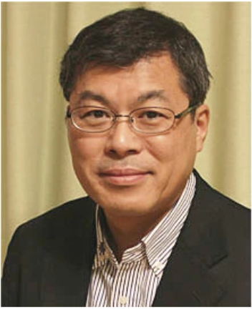
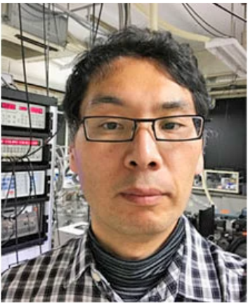
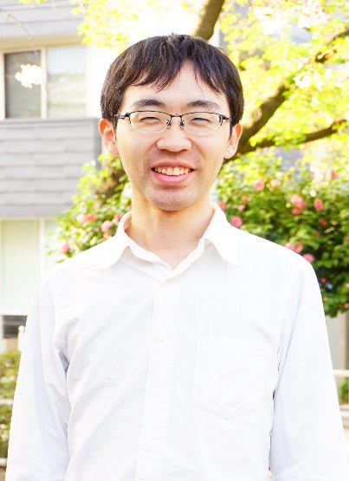
Experiments
Collaboration with the team of Prof. Fujii and Prof. Ishiuchi at Tokyo Tech institute in Japan
Masaaki Fujii
Shun-ichi Ishiuchi
Keisuke Hirata
Hikaru Takayanagi
IR photodissociation laser spectroscopy of
H₂-tagged mass selected clusters
Notes:
Tokyo Tech in Japan

Slide 22
Experimental setup
Aqueous solution with
Mg²⁺ + CH₃COO⁻
Electrospray ion source (ESI)
IR photodissociation laser spectroscopy of
H₂-tagged mass selected clusters

Slide 23
Experimental setup
Aqueous solution with
Mg²⁺ + CH₃COO⁻
Formation of the clusters
Mg²⁺ + CH₃COO⁻ + nH₂O
He/H₂O
Electrospray ion source (ESI)
Clustering ion trap
at 130 K
IR photodissociation laser spectroscopy of
H₂-tagged mass selected clusters

Slide 24
Experimental setup
Aqueous solution with
Mg²⁺ + CH₃COO⁻
Formation of the clusters
Mg²⁺ + CH₃COO⁻ + nH₂O
IR Spectroscopic
analysis
He/H₂
He/H₂O
IR tunable laser
Electrospray ion source (ESI)
Clustering ion trap
at 130 K
Cold ion trap
at 4 K
IR photodissociation laser spectroscopy of
H₂-tagged mass selected clusters

Slide 25
Experimental setup
Aqueous solution with
Mg²⁺ + CH₃COO⁻
Formation of the clusters
Mg²⁺ + CH₃COO⁻ + nH₂O
IR Spectroscopic
analysis
He/H₂
He/H₂O
IR tunable laser
Electrospray ion source (ESI)
Experimental IR spectra
Clustering ion trap
at 130 K
Cold ion trap
at 4 K
IR photodissociation laser spectroscopy of
H₂-tagged mass selected clusters

Slide 26
Experimental data

Slide 27
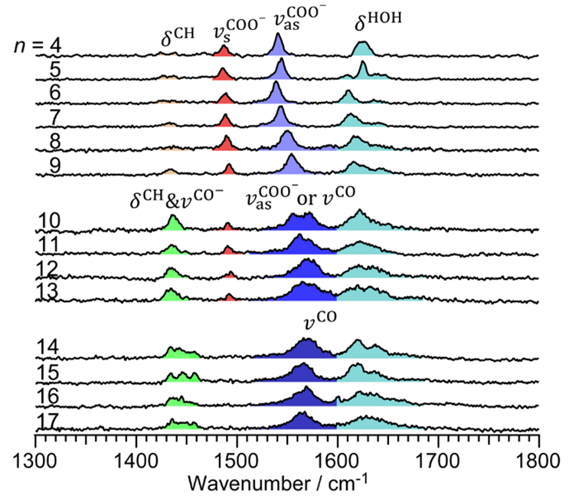
Experimental data
n = 1-4 : DePalma, Joseph W.; Kelleher, Patrick J.; Tavares, Laís C.; Johnson, Mark J. Phys. Chem. Lett. 2017, 8, 2, 484–488 A.
Notes:
Cité Mark Johnson / Paula

Slide 28
Experimental data
n = 1-4 : DePalma, Joseph W.; Kelleher, Patrick J.; Tavares, Laís C.; Johnson, Mark J. Phys. Chem. Lett. 2017, 8, 2, 484–488 A.
Number of water molecules

Slide 29
Experimental data
n = 1-4 : DePalma, Joseph W.; Kelleher, Patrick J.; Tavares, Laís C.; Johnson, Mark J. Phys. Chem. Lett. 2017, 8, 2, 484–488 A.
Number of water molecules
IR range

Slide 30
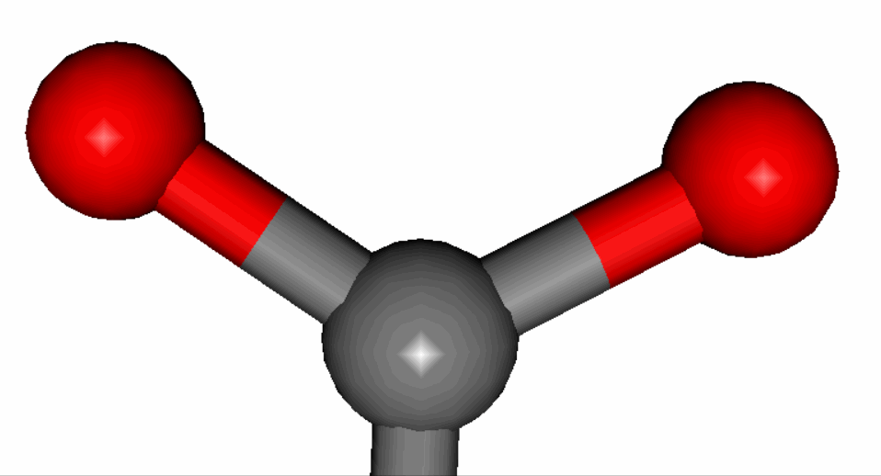
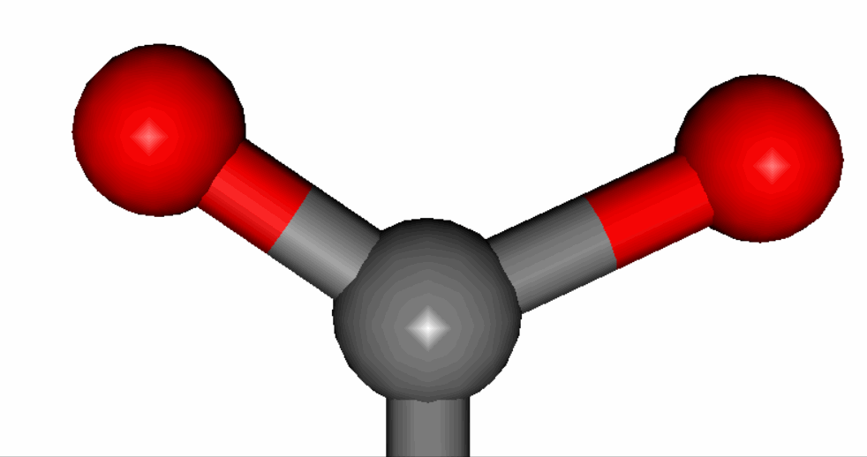
Experimental data
Number of water molecules
Symmetric and antisymetric stretching of COO⁻
IR range

Slide 31
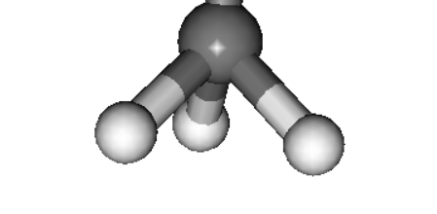
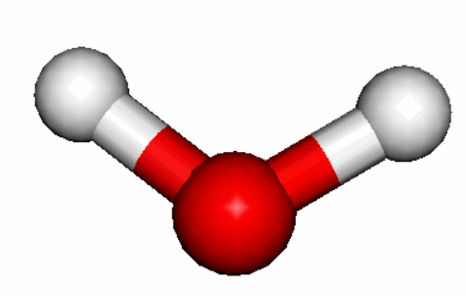
Experimental data
Number of water molecules
Symmetric and antisymetric stretching of COO⁻
Bending of OH and CH
IR range

Slide 32
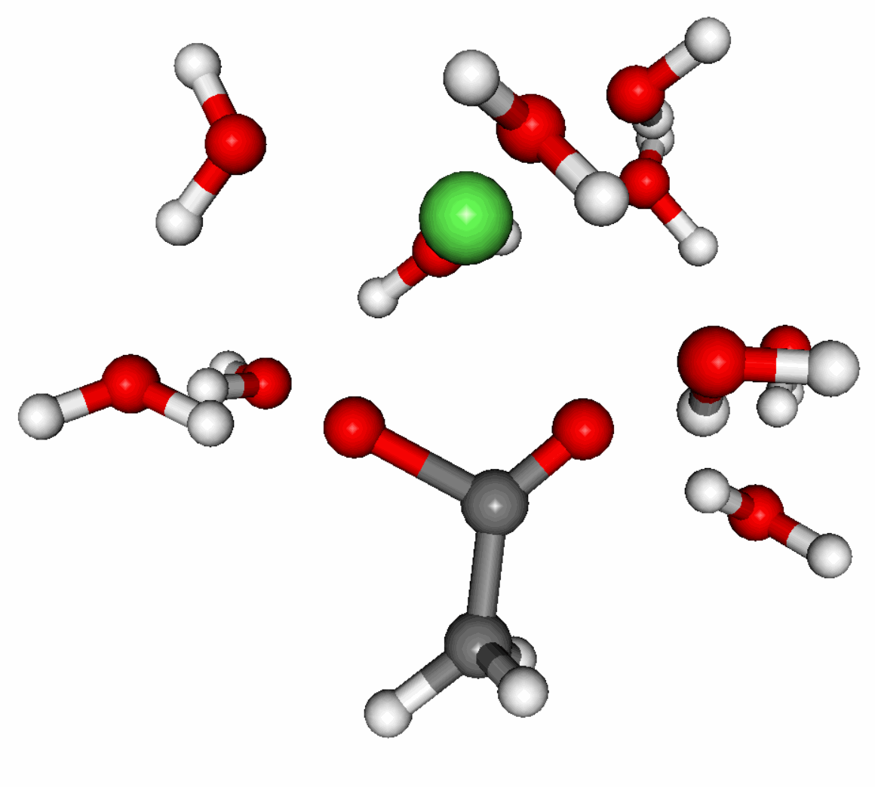
Experimental data
Number of water molecules
Symmetric and antisymetric stretching of COO⁻
Bending of OH and CH
IR range
+
Coupling between these modes

Slide 33
Experimental data
Number of water molecules
What are the significant spectroscopic changes induced by the addition of water molecules to a cluster?
Symmetric and antisymetric stretching of COO⁻
Bending of OH and CH
IR range
+
Coupling between these modes
Notes:
Montrer l’interprétation et les transitions qui ont lieu par la suite

Slide 34
Experimental data
Smooth evolution of the spectroscopic signature
Notes:
Fully consistant with fully associated ion pair

Slide 35
Experimental data
Presence of two maxima
Appearance of new band

Slide 36
Experimental data
Presence of two maxima
Appearance of new band
Smooth evolution of the spectroscopic signature

Slide 37
Experimental data
Presence of two maxima
Appearance of new band
Disappearance of this band

Slide 38
Experimental data
Presence of two maxima
Appearance of new band
Disappearance of this band
Smooth evolution of the spectroscopic signature
Notes:
Entourer que celle qui est bleu pour le dark blue

Slide 39
Experimental data
These new signatures come from a change in the type of ion pairs
Presence of two maxima
Appearance of new band
Disappearance of this band

Slide 40
Experimental data
These new signatures come from a change in the type of ion pairs
Presence of two maxima
Appearance of new band
Study of n = 10 and 14 with computational chemistry
Disappearance of this band
Calculations of
vibrational frequencies

Slide 41
Computational chemistry
Eric Gloaguen
Valérie Brenner
Jean-Xavier Bardaud
DFT-D calculations of energy and vibrational frequencies

Slide 42
General methodology for frequency calculations

Slide 43
General methodology for frequency calculations
Initial structure
Notes:
Well-known methodology

Slide 44
General methodology for frequency calculations
minimization of the potential energy of the system by DFT-D
Initial structure
Optimized structure
Notes:
Well-known methodology

Slide 45
General methodology for frequency calculations
Gibbs energy of the system at 130 K
minimization of the potential energy of the system by DFT-D
Mode-dependent scaled hamornic
vibrational frequencies
Initial structure
Optimized structure
Notes:
Well-known methodology

Slide 46
Methodology for frequency calculations of the study
Notes:
To avoid a full exploration procedure and because we only want to know the spectroscopic signatures induce by the different types of ion pair. We use a special methodology to obtain a set of initial structure using fully-associated ion pairs as benchmark

Slide 47
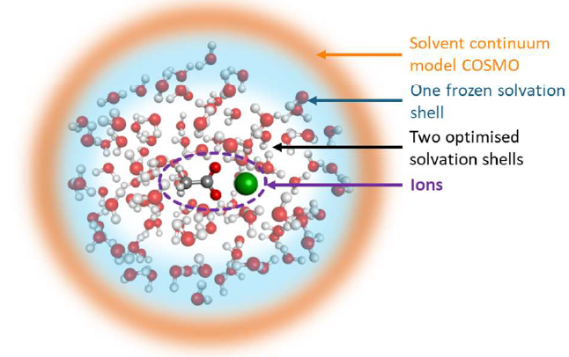
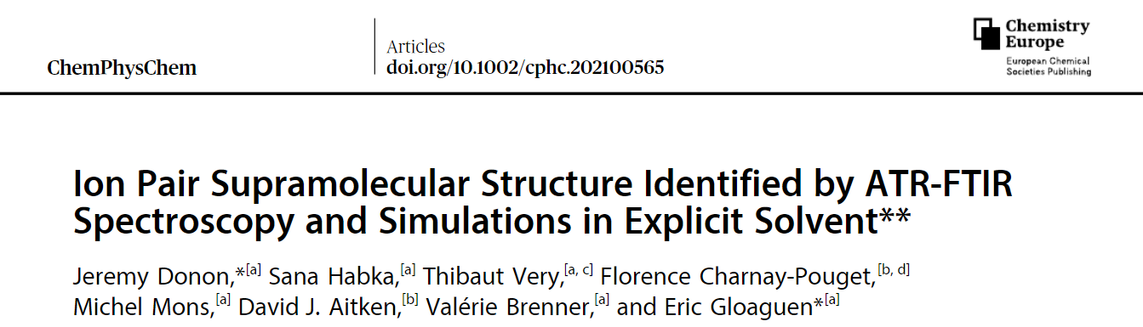
Methodology for frequency calculations of the study
Change of the ion (Na⁺→ Mg²⁺)
Selection of water molecules
Series of aggregates previously calculated for the structure of AcO⁻Na⁺+nH₂O (n ≈ 100)
Set of different clusters for 10 and 14 water molecules
Notes:
I used previous study on solvation of sodium acetate. The structures of the clusters were obtained with MD simulations and optimized by DFT-D calculations.

Slide 48
Methodology for frequency calculations of the study
Performing geometric optimization
RI-B97-D3/dhf-TZVPP level
Change of the ion (Na⁺→ Mg²⁺)
+
frequency calculations
RI-B97-D3/dhf-TZVPP level
Selection of water molecules
Series of aggregates previously calculated for the structure of AcO⁻Na⁺+nH₂O (n ≈ 100)
Set of different clusters for 10 and 14 water molecules
same calculation method as with hydrated sodium acetate aggregates: same level of precision

Slide 49
Methodology for frequency calculations of the study
Performing geometric optimization
RI-B97-D3/dhf-TZVPP level
Change of the ion (Na⁺→ Mg²⁺)
+
frequency calculations
RI-B97-D3/dhf-TZVPP level
Selection of water molecules
Series of aggregates previously calculated for the structure of AcO⁻Na⁺+nH₂O (n ≈ 100)
Set of different clusters for 10 and 14 water molecules
Calculations of 15 clusters for each type of ion pair solvation :
Fully associated
Partially-separated
Separated

Slide 50
Result of the computational study
Gibbs energy at 130 K

Slide 51
Result of the computational study
Gibbs energy at 130 K
n = 10
For n = 10, the energy calculations do not allow us to conclude on the type of ion pairs present
[CH₃COOMg]⁺(H₂O)₁₀

Slide 52
Result of the computational study
Gibbs energy at 130 K
n = 10
n = 14
For n = 10, the energy calculations do not allow us to conclude on the type of ion pairs present
For n = 14, the energy calculations allow us to suggest the absence of fully associated ion pairs
[CH₃COOMg]⁺(H₂O)₁₀
[CH₃COOMg]⁺(H₂O)₁₄

Slide 53
Result of the computational study
Weighted averaged frequecies

Slide 54
Result of the computational study
Weighted averaged frequecies
n = 9
n = 10
Fully-associated
Partially-separated
Notes:
Attribution the vibrational modes for the fully associated ion pairs with particularly a coupling between de sym COO and the bending of CH

Slide 55
Result of the computational study
Weighted averaged frequecies
n = 9
n = 10
Fully-associated
Partially-separated
Notes:
Attribution the vibrational modes for the fully associated ion pairs with particularly a coupling between de sym COO and the bending of CH

Slide 56
Result of the computational study
Weighted averaged frequecies
n = 9
n = 10
Fully-associated
Partially-separated
Notes:
Comparing the spectroscopic evolution and particularly with n=9, we are able to attribute the band which come from fully-associated ion pairs

Slide 57
Result of the computational study
Weighted averaged frequecies
n = 9
n = 10
Fully-associated
For n = 10, the new spectroscopic signatures correspond to a mixture of fully-associated and partially-separated ion pairs
Partially-separated

Slide 58
Result of the computational study
Weighted averaged frequecies
n = 10
Fully-associated
For n = 10, the new spectroscopic signatures correspond to a mixture of fully-associated and partially-separated ion pairs
Partially-separated
n = 14
For n = 14, the new spectroscopic signatures may correspond to a mixture of partially-separated and possibly separated ion pairs
Partially-separated
Separated
Notes:
Mixture aussi

Slide 59
Conclusions & prospects
Conclusions
Even with 14 water molecules and up to 17, it was not possible to confirm the presence separated ion pairs in the gas phase
The involvement of a second carboxylate seems necessary to induce water-mediated ionic interactions

Slide 60
Conclusions & prospects
Conclusions
Even with 14 water molecules and up to 17, it was not possible to confirm the presence separated ion pairs in the gas phase
The involvement of a second carboxylate seems necessary to induce water-mediated ionic interactions
Prospects
Add more water molecules to see the appearance of water-mediated ionic interactions
Change of cation to observe the appearance of this kind of interaction
Notes:
La proteine a un role à jouer dans l’étude …

Slide 61
Acknowledgements
My team
Eric Gloaguen
Valérie Brenner
Michel Mons
Collaborators
Masaaki Fujii
Shun-ichi Ishiuchi
Keisuke Hirata
Hikaru Takayanagi
Grants

Slide 62
Acknowledgements
My team
Eric Gloaguen
Valérie Brenner
Michel Mons
Collaborators
Masaaki Fujii
Shun-ichi Ishiuchi
Keisuke Hirata
Hikaru Takayanagi
Grants
Thank you for your attention
Notes:
Ajouter JSPS

Slide 63
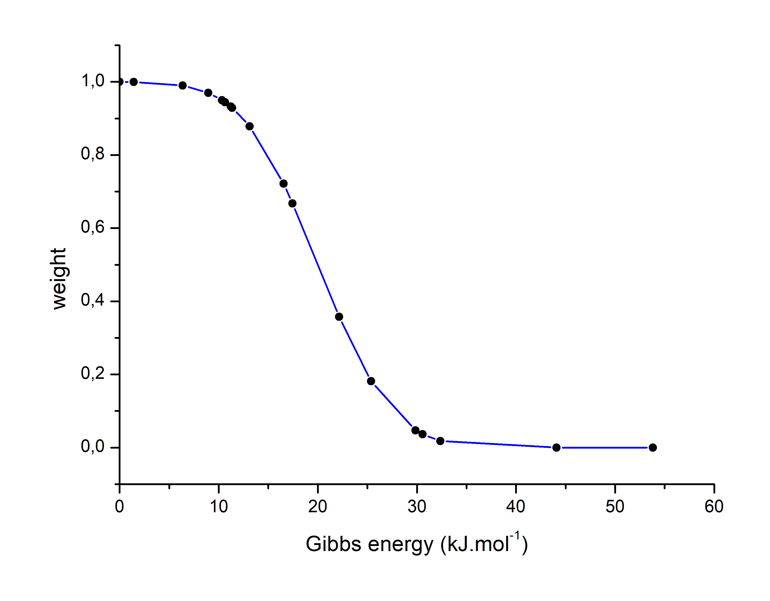
Methodology for weighted average
Purpose : make the weighted average of the frequencies according to the energy distribution.
Context
Need a statistic on the average because the variability of the frequencies.
Error on the calculated energies (5-10 kJ.mol⁻¹ ?) : several structures must be taken into account.
Thermodynamic equilibrium ? Problem of viability of the energetic criterion.
fully associated (AcOMg)+∙(H₂O)₁₀
ΔGc = 20 kJ.mol⁻¹ and β = 1,2
Function used
$$w=\frac{1−signe\left(ΔG−ΔG_{c}\right)∗\operatorname{erf}\left(\left|ΔG−ΔG_{c}\right|∗β\right)}{2∗α}$$
$ΔG$ : free energy of the cluster at 130 K.
$ΔG_{c}$ : cutoff energy
$β$: bending coefficient

Slide 64
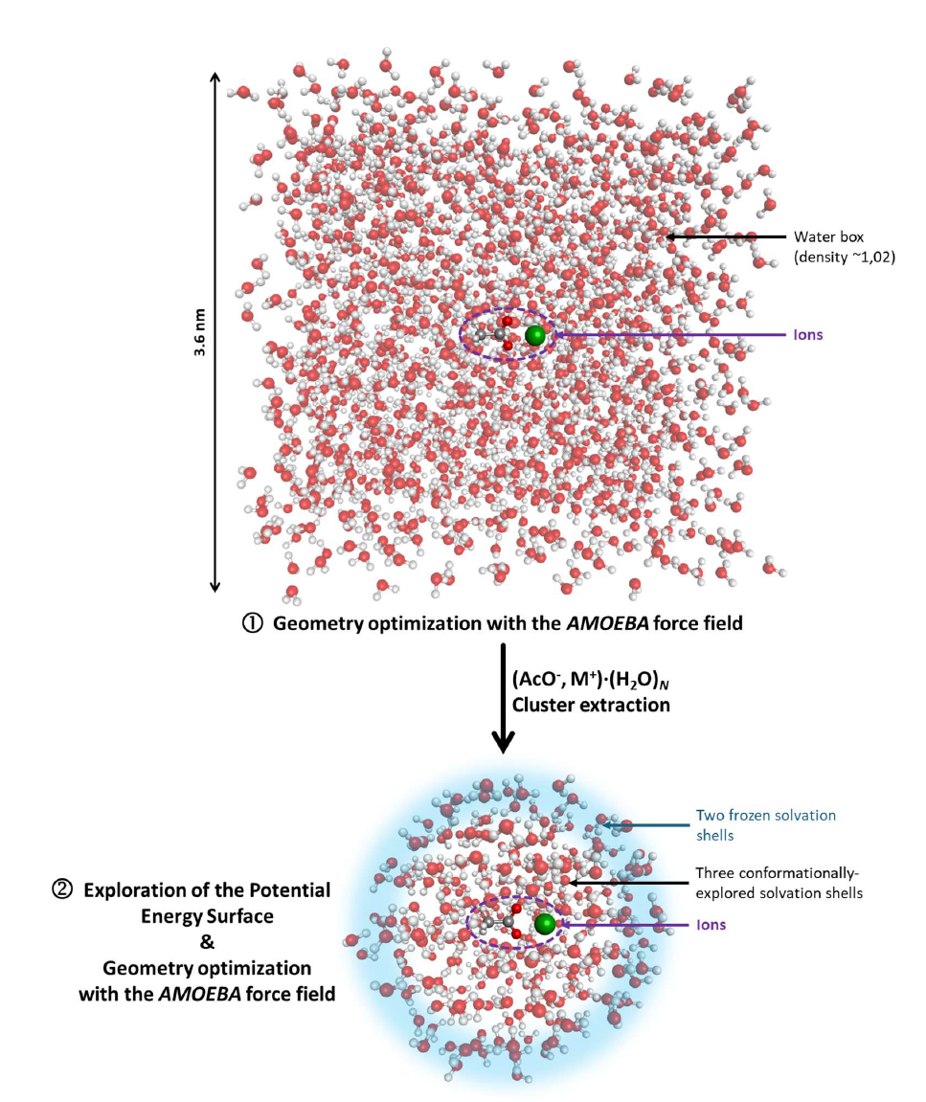
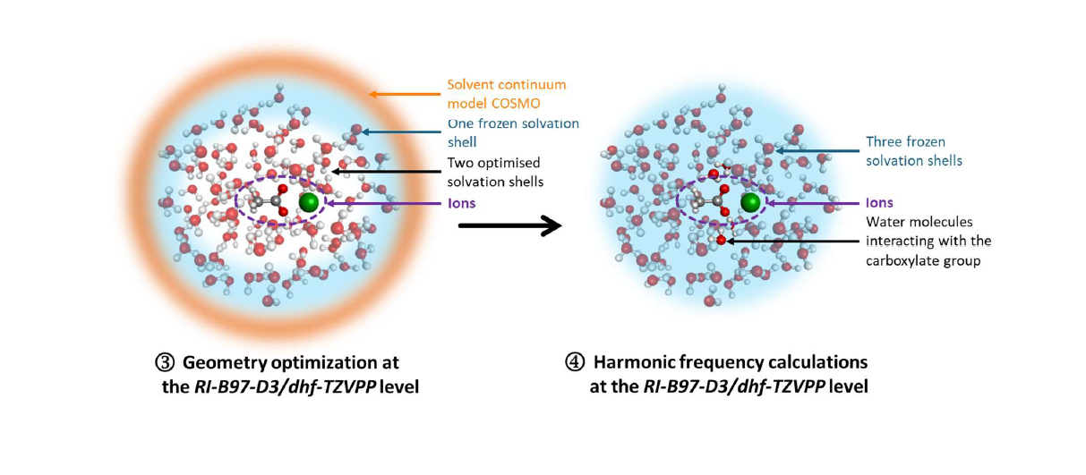
Method for conformational study of sodium acetate in solution

