Slide 1




Vibrational Circular Dichroism as a probe of the structure of crystals
Anne Zehnacker, Katia Le Barbu-Debus, Titouan Martenot
Institut des Sciences Moléculaires d’Orsay (ISMO)
CNRS – Université Paris Saclay
Adam Sklenář
Institute of Organic Chemistry and Biochemistry Prague
Sascha Jähnigen, Rodolphe Vuilleumier
Laboratoire PASTEUR
CNRS-Ecole Normale Supérieure Paris

Slide 2
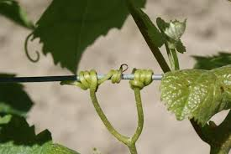
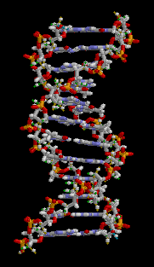
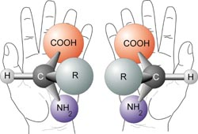
Chirality
A chiral object cannot be superimposed to its mirror image
DNA
Stereogenic centre
2

Slide 3
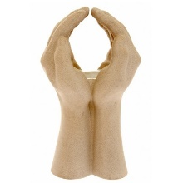
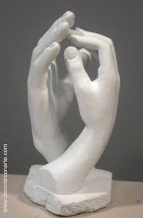
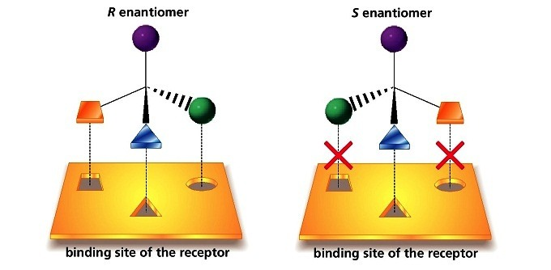
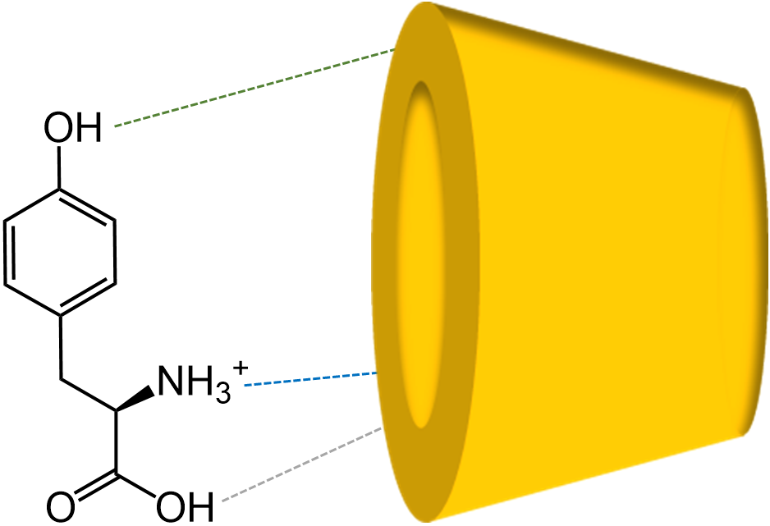
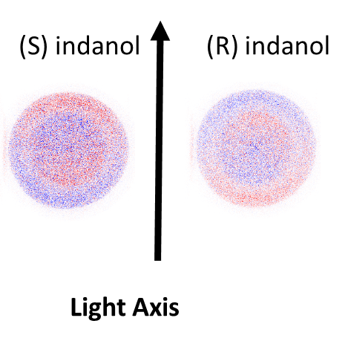
To distinguish between enantiomers?
Chemical probe
  Spectroscopic studies of complexes of chiral molecules/ gas phase
Physical probe : circular polarised light
  Photoelectron circular dichroism
  Vibrational Circular Dichroism (VCD)

Slide 4
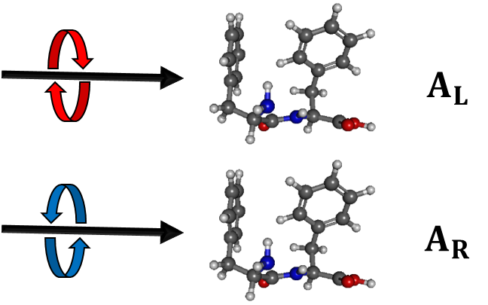
Vibrational Circular Dichroism(VCD)
Circularly polarised light
CPL
VCD = tiny difference in absorption between right and left CPL by a chiral molecule (< 10⁻⁴ absorption)
For chiral molecules only
Determination of absolute configurations

Slide 5
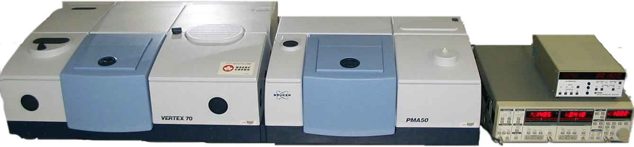
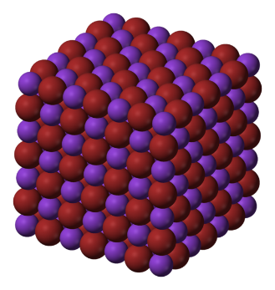
Solid-Phase Studies Experimental Setup
PMA50
PEM: Photo-elastic Modulator
IR- Signal
FT-IR Spectrometer
VCD- Signal
Source
Filter
PEM
Sample
Detector
Polarizer
Lock-in detection
Chiral molecule
Grinding/Solvent assisted grinding
Pellet
IR- Spectrum
+
=
VCD- Spectrum
Simulation
KBr Pellet

Slide 6
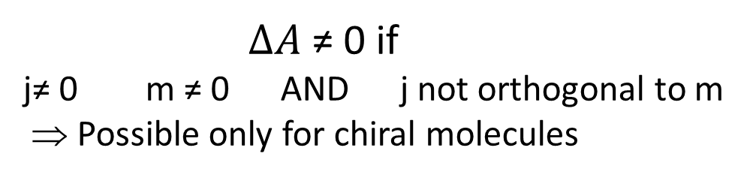

VCD Intensity
$$∆A ∝\left(\frac{∂\vec{j}}{δQ}\right).\left(\frac{∂\vec{m}}{δ\vec{Q}}\right)$$
Electric dipole moment (IR)
Magnetic dipole moment
$∆A$≠ 0 if
j≠ 0 m ≠ 0 AND j not orthogonal to m
⇒ Possible only for chiral molecules
Sensibility to molecular conformation
Sensibility to environnment and molecular interactions

Slide 7
Solid phase ?
Experimental artefacts
Theoretical bottlenecks
Strong interactions
Infinite Solid (periodic boundary conditions)
Non local effects
Nuclear Velocity Perturbation Theory (NVPT) (S. Jähnigen, R. Vuilleumier )
Compatible with molecular dynamics simulations
First principle MD in periodic boundary conditions
Inclusion of non-local effects
Notes:
Nuclear Velocity Perturbation Theory (NVPT) (Nafie, Vuilleumier Sebastiani, Jähnigen )
(compatible with molecular dynamics simulations)

Slide 8
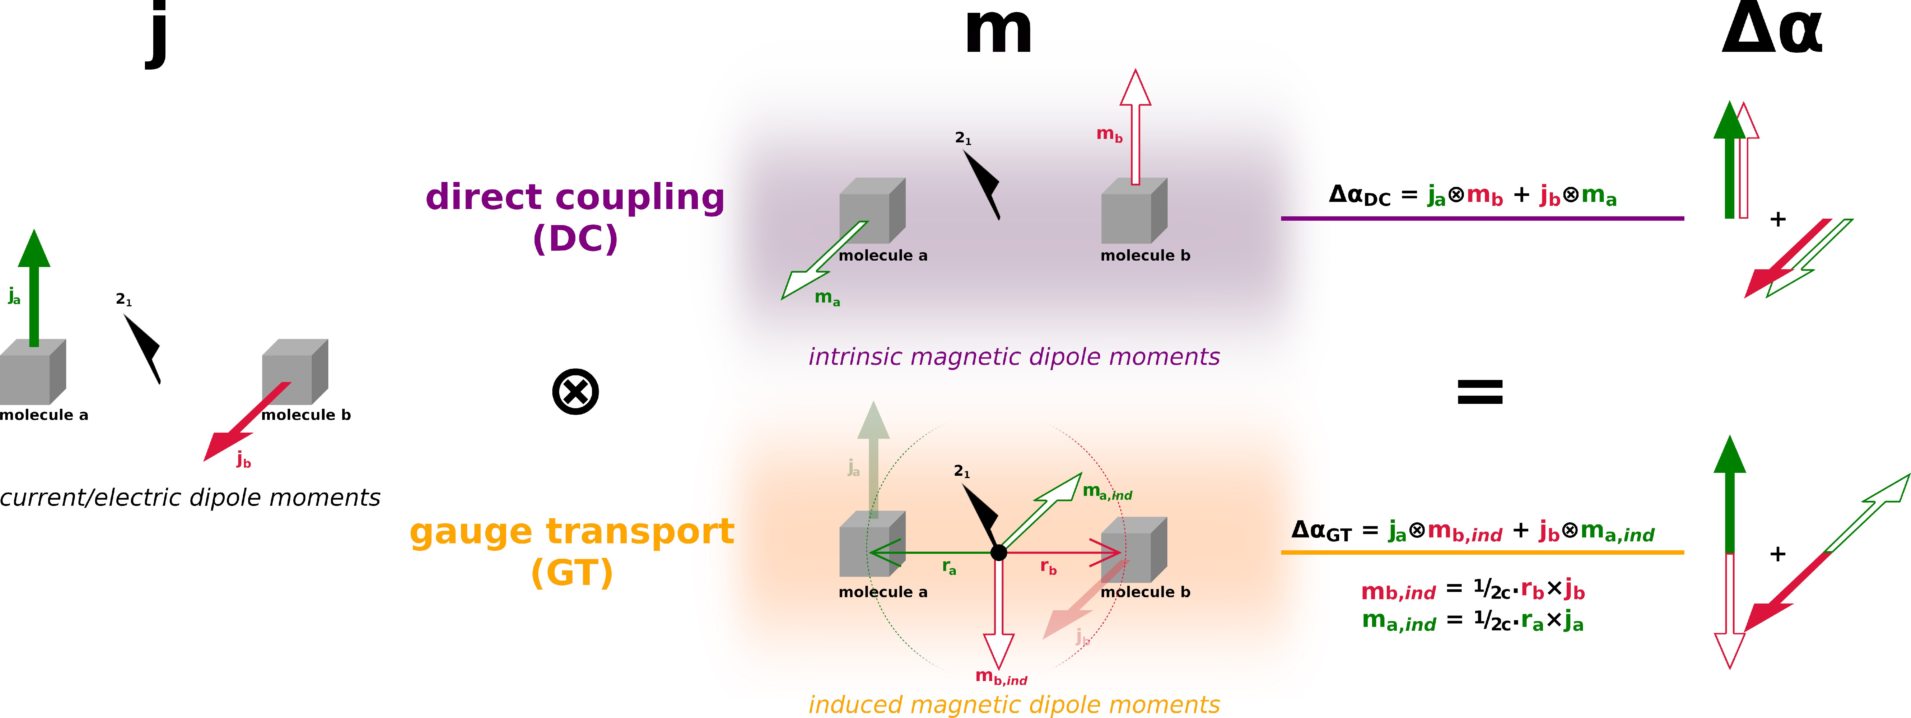
Non local effects in VCD
Local term: j_{a}.m_{a}
Non Local term : direct coupling, gauge transfer
Depend on the symmetry relation between a and b ⇒ crystal signature

Slide 9
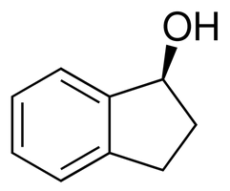
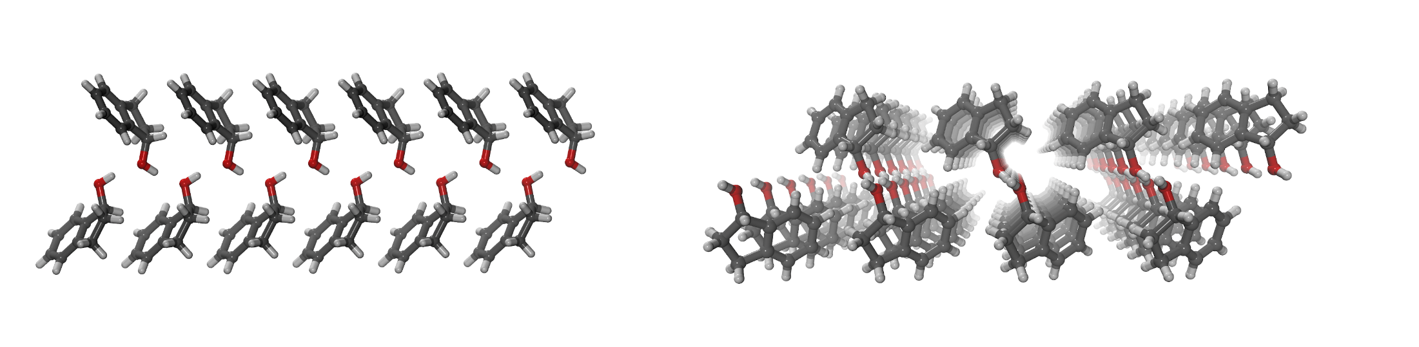
Application to (S) 1-indanol
Space group P2₁ : Screw axis 2₁
Jähnigen et al. Angewandte Chemie 2023
Notes:
Monoclinic Sohncke group

Slide 10
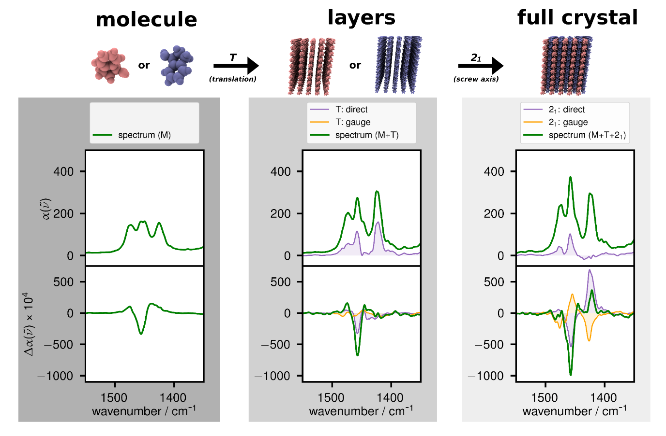
Application to (S) 1-indanol
EXPERIMENT
LOCAL
TRANSLATION
SCREW AXIS
δ (CH2) + δ (OH)

Slide 11
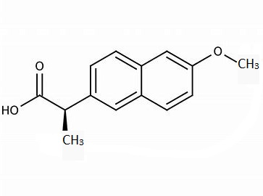
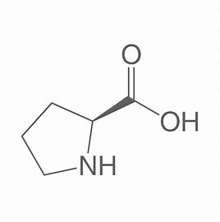
Co-crystals studies
Co-crystal formation: Improved solubility and bio availability
Polymorphism: Major problem in pharmacology
Naproxen/Proline system:
Polymorphism for the RD pair
Only one phase for the RL pair
R- Naproxen
L-Proline
Notes:
PRLOLINO01

Slide 12
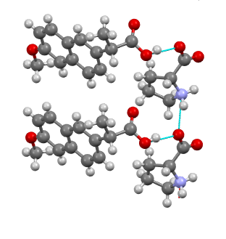
Co-crystal R Naproxen L Proline
Test system: only one phase
X-ray diffraction obtained
Easy to prepare
Space group P2₁ : Screw axis 2₁

Slide 13
Co-crystal R Naproxen L Proline

Slide 14
Conclusion
Non local effects are of tremendous importance
VCD can be used as a probe of polymorphism
Thank you

Slide 16
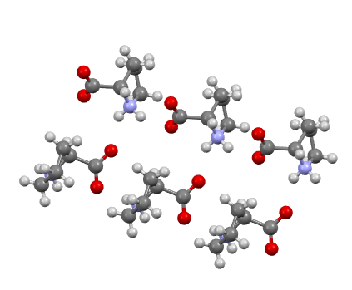
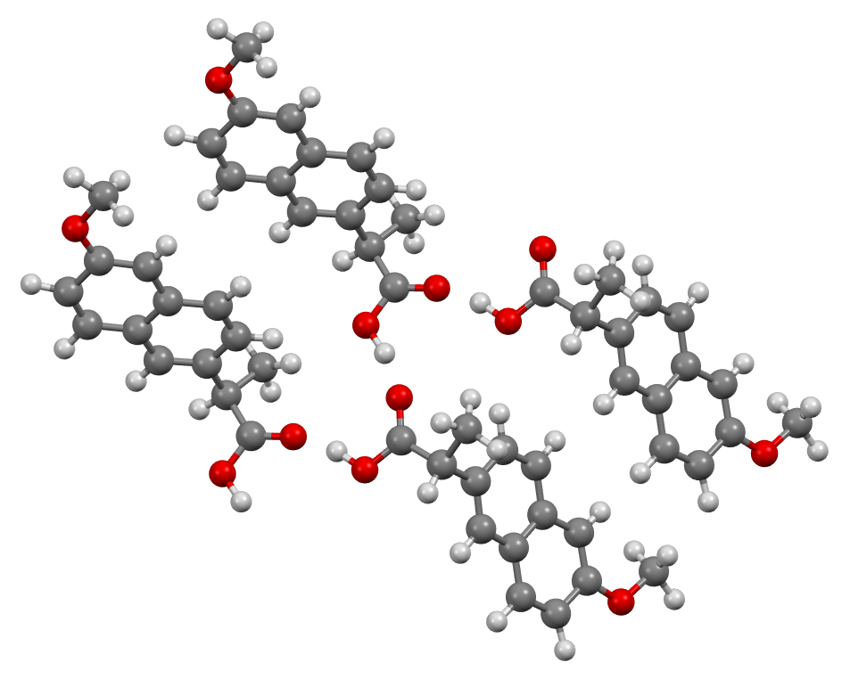
Co-crystals studies
Naproxen
Prolin
Space group P2₁2₁2₁ : 3 screw axes 2₁
Space group P2₁ : Screw axis 2₁

