Slide 1



Two-photon conformer-specific Photoelectron Circular Dichroism (PECD) of 1-Indanol
Etienne ROUQUET ^{a,} ^{b}
Gustavo GARCIA ^{b} , Laurent NAHON ^{b}
Valéria LEPÈRE ª , Anne ZEHNACKER ª
Institut des sciences Moléculaires d’Orsay (ISMO)
Synchrotron SOLEIL
Congrès général des 150 ans de la Société Française de Physique 06/07/2023

Slide 2
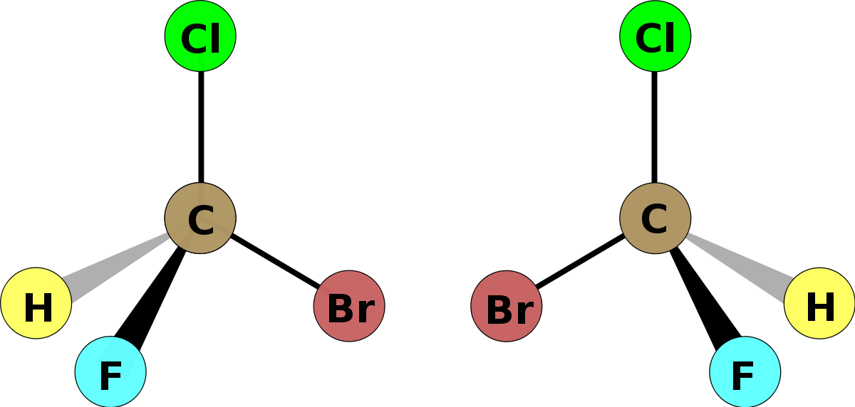
Motivation
PECD
Chirality

Slide 3
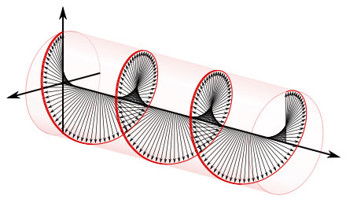
Motivation
PECD
Physical chiral probe :
chiral photons -> Circularly polarized light (CPL)
Chirality

Slide 4
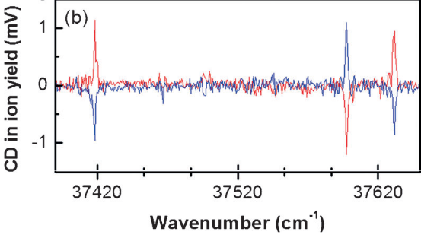
Motivation
PECD
Physical chiral probe :
chiral photons -> Circularly polarized light (CPL)
Chirality
Circular dichroism in absorption (ECD)
ECD spectra of both enantiomer of pseudoephedrin
A. Hong et al. (2014), Angew. Chem. Int. Ed., 53, 7805 –7808

Slide 5
Motivation
PECD
Physical chiral probe :
chiral photons -> Circularly polarized light (CPL)
Chirality
Circular dichroism in absorption (ECD)
ECD spectra of both enantiomer of pseudoephedrin
A. Hong et al. (2014), Angew. Chem. Int. Ed., 53, 7805 –7808
Circular dichroism in the angular distribution of photoelectron : PECD

Slide 6
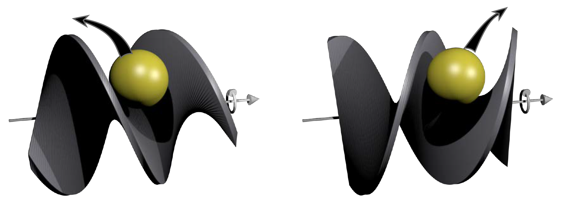
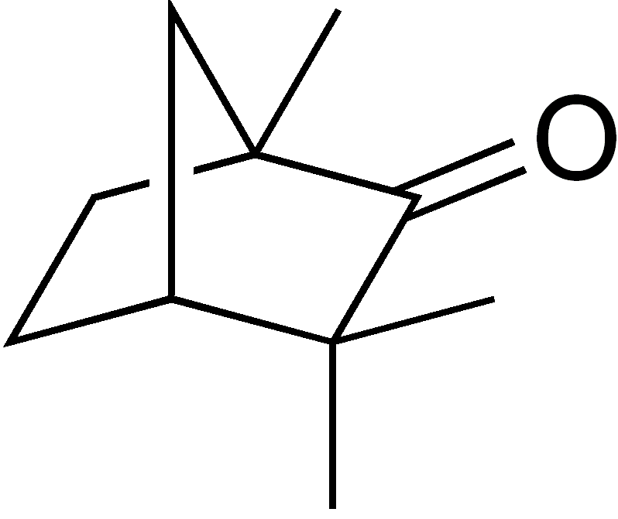
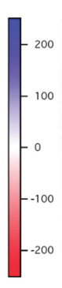
Motivation
PECD
Right helix
Left helix
Example :
Light axis
*
Typical forward/backward asymetry in the photoelectron angular distribution
*
Fenchone
Abel inversed PAD images difference (LCP – RCP)
Fenchone
By A. Comby
General idea of PECD: the electron formed by the laser pulse is scattered backward or forward along the photon axis

Slide 7
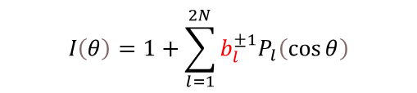
Motivation
PECD
Right helix
Left helix
Example :
Light axis
*
Typical forward/backward asymetry in the photoelectron angular distribution
*
Fenchone
Abel inversed PAD images difference (LCP – RCP)
Fenchone
By A. Comby
General idea of PECD: the electron formed by the laser pulse is scattered backward or forward along the photon axis
$$I\left(θ\right)=1+\sum_{l=1}^{2N}{b_{l}^{±1}P_{l}\left(\cos{θ}\right)}$$
Give access to molecular information: (PES → b₀), anisotropy parameter (β → b₂), and PECD (→ b₁)
PECD: allowed in the electric dipole approximation → intense effect, up to 40 % of the Photoelectron Spectra (PES)
Developed first on synchrotron facility in early 2000, PECD was then studied using multiphoton fs-laser, and now ns-laser
Normalized photoelectron angular distribution is expressed as a sum of Legendre polynomials
Eland, Photoelectron spectroscopy, 1983

Slide 8
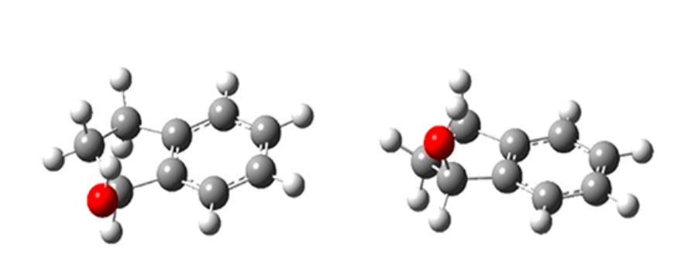
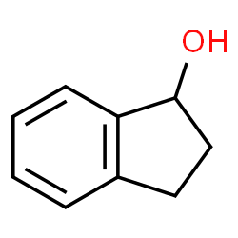
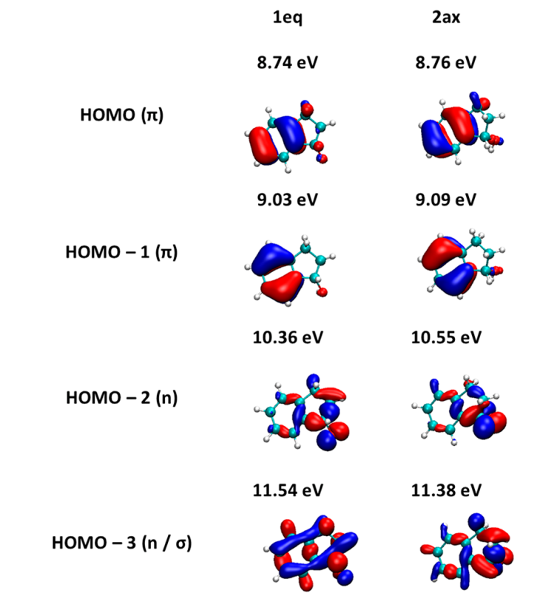
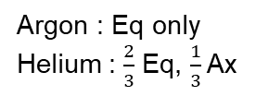
Motivation
1-photon PECD
Equatorial conformer (Eq)
Axial conformer (Ax)
*
Argon : Eq only
Helium : $\frac{2}{3}$ Eq, $\frac{1}{3}$ Ax
1-Indanol
J. Dupont et al., J. Phys. Chem. Lett. (2022) 13, 2313-2320

Slide 9
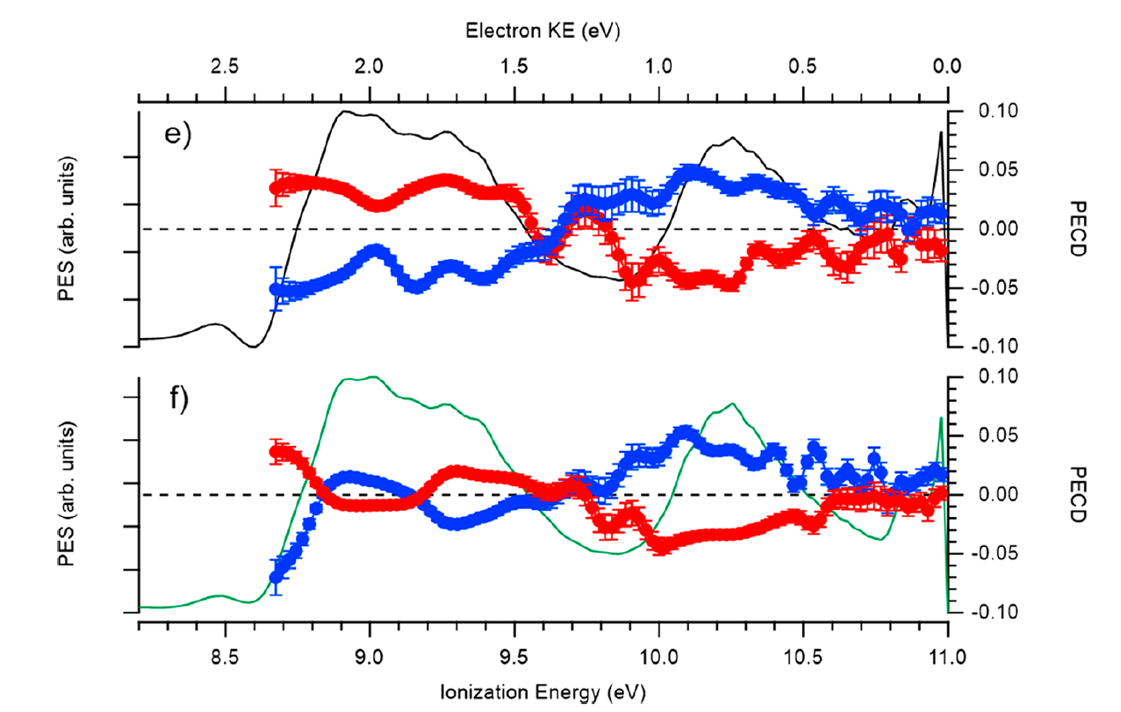
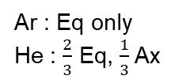
Motivation
1-photon PECD
*
a)
b)
Ar : Eq only
He : $\frac{2}{3}$ Eq, $\frac{1}{3}$ Ax
1-Indanol structure
Equatorial conformer (Eq)
Axial conformer (Ax)
Ar
He
PECD and PES of 1-Indanol at 11.0 eV in Ar (top) and He (bottom)
J. Dupont et al., J. Phys. Chem. Lett. (2022) 13, 2313-2320

Slide 10
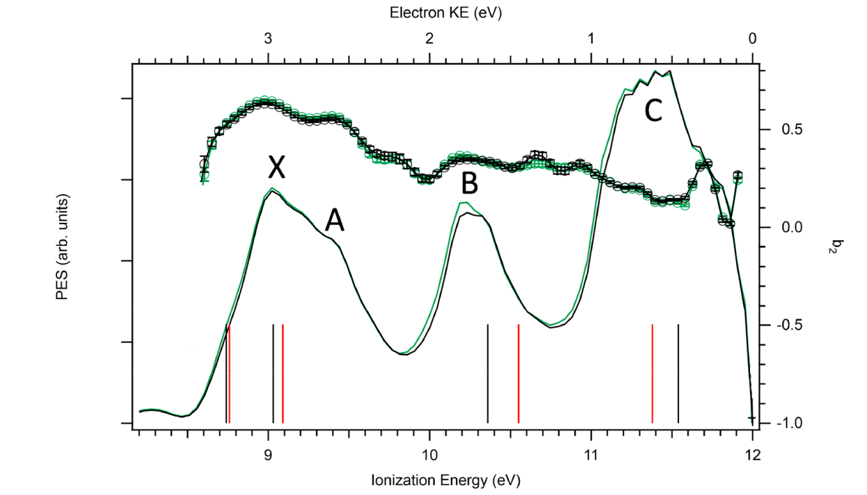
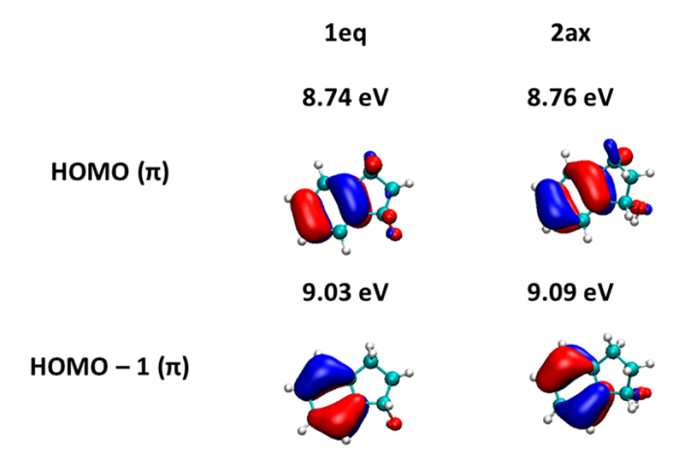
Motivation
1-photon PECD
*
a)
b)
Ar : Eq only
He : $\frac{2}{3}$ Eq, $\frac{1}{3}$ Ax
1-Indanol structure
Equatorial conformer (Eq)
Axial conformer (Ax)
Ar
He
PECD and PES of 1-Indanol at 11.0 eV in Ar (top) and He (bottom)
PECD and b₂ of 1-Indanol at 11.0 eV in Ar (black) and He (green)
J. Dupont et al., J. Phys. Chem. Lett. (2022) 13, 2313-2320

Slide 11
Motivation
1-photon PECD
*
a)
b)
Ar : Eq only
He : $\frac{2}{3}$ Eq, $\frac{1}{3}$ Ax
1-Indanol structure
Equatorial conformer (Eq)
Axial conformer (Ax)
Ar
Energy
Typical energy of one photon : 4.6 eV
Resonance condition: conformer specific
I⁺
S₁
He
S₀
Resonance enhanced two-photon ionization (RE2PI)
PECD and PES of 1-Indanol at 11.0 eV in Ar (top) and He (bottom)
PECD and b₂ of 1-Indanol at 11.0 eV in Ar (black) and He (green)
J. Dupont et al., J. Phys. Chem. Lett. (2022) 13, 2313-2320

Slide 12
Experimental setup
Frequency doubling cristal
Green : vertical linear polarization
Purple : horizontal linear polarization
Linear polarizer
Quarter waveplate (λ/4) : circular polarization
VMI detector

Slide 13
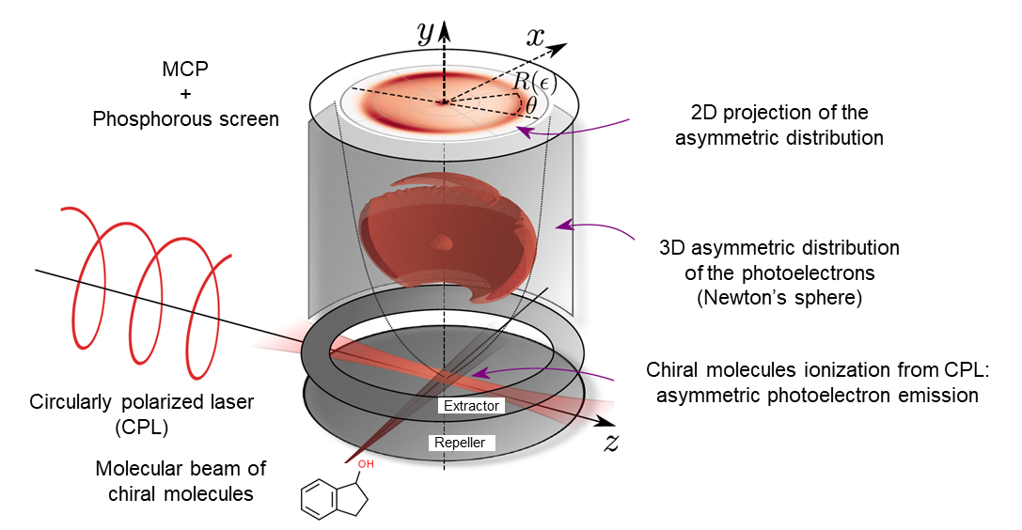
Experimental setup
Frequency doubling cristal
Green : vertical linear polarization
Purple : horizontal linear polarization
Linear polarizer
Quarter waveplate (λ/4) : circular polarization
VMI detector
By A. Comby

Slide 14
Experimental setup
Frequency doubling cristal
Green : vertical linear polarization
Purple : horizontal linear polarization
Linear polarizer
Quarter waveplate (λ/4) : circular polarization
VMI detector
By A. Comby
Pulsed setup at 10 Hz : laser and valve
ns laser : fine energy selection – tunability
Energy
I⁺
Energy
I⁺
S₁
Each conformer→ different S₁ energy:
Selection
S₁*
S₀
S₀
Equatorial conformer
Axial conformer

Slide 15
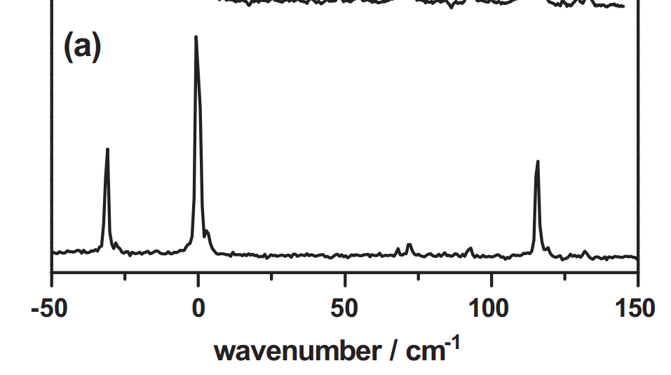
Results – 1-Indanol
Equatorial
Axial
Equatorial
S₀-S₁ spectrum of 1-indanol in He. Transition origin 37073 cm⁻¹
A. Bouchet et al. Journal of Molecular Structure (2014) 1076, 344-351

Slide 16
Results – 1-Indanol
Equatorial

Slide 17
Results – 1-Indanol
Axial

Slide 18
Results – 1-Indanol
Equatorial
Axial
PECD and PES of 1-Indanol
Left: 0-0 transition of the equatorial conformer
Right: 0-0 transition of the axial conformer

Slide 19
Results – 1-Indanol
Equatorial
Equatorial
PECD and PES of 1-Indanol
Left: 0-0 transition of the equatorial conformer
Right: higher energy transition of the equatorial conformer

Slide 20
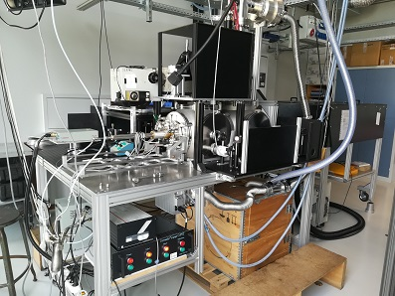

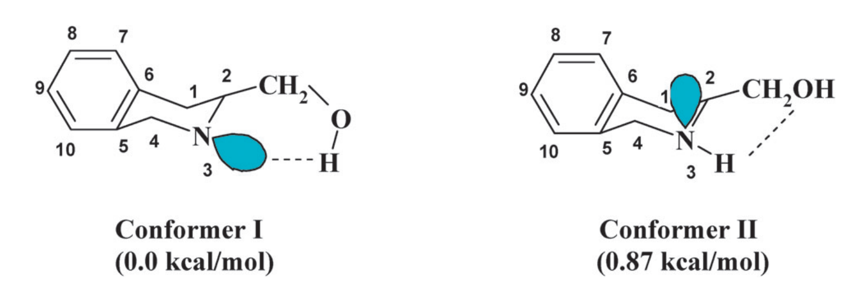
Conclusion
First ever conformer specific PECD
  Use of a ns-laser + RE2PI → conformer selection
  PECD: particularly sensitive to molecular structure and conformation
  Analytical potential, chiral recognition…
What’s next ?
  Two-color RE2PI energy scheme
    Allowing us to go higher in energy
    With the two colors: CPL on both or either one of the photon
  Different molecules : THIQM, …
Energy
I⁺
S₁
S₀
Two-color RE2PI energy scheme
Two THIQM conformers:

Slide 21



Acknowledgments
Lionel Poisson
Jennifer Dupont
And you for your attention !

