Slide 1
Measuring the spatially resolved rapidities distribution of a 1D Bose gas
Léa Dubois, Guillaume Thémèze, Isabelle Bouchoule
Jérôme Dubail, Florence Nogrette
04/07/2023 – SFP 150 ans

Slide 2
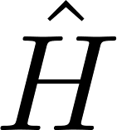
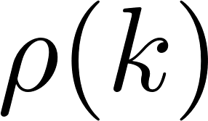
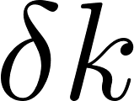
Context
1
Homogeneous 1D Bose gas with contact repulsive interactions :
Lieb Liniger Hamiltonian :
Integrable system: the eigenstates of are the Bethe Anzatz states labelled by N numbers called the rapidities.
Rapidities distribution : is the number of rapidities in the range.
is conserved during the out-of-equilibrium dynamics of the system
The relaxed state is described by the rapidities distribution !
Notes:
Pi ?
Citation
Dire que c’est une physique différentes des systèmes chaotiques.

Slide 3
Context
Rapidities distribution can be measured: after a 1D longitudinal expansion of the cloud, the profile density converges towards the rapidities distribution.
Density profile:
Rapidities distribution:
« Generalized hydrodynamics in strongly interacting 1d Bose gases », Malvania, N. & co, Science373(6559)

Slide 4
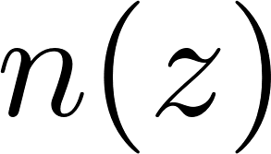
Objectives
Local Density Approximation :
Local Density Approximation (Euler scale):
A spatially resolved rapiditiy distribution can be defined.
Objective :
Measuring experimentally the spatially resolved rapidity distribution

Slide 5
Outline
Asymptotic regime of a 1D expansion
Hydrodynamics for integrable systems
Domain Wall Dynamics
Preparing initial conditions
1D expansion
Generalized HydroDynamics
Dynamics of 1D expansion
Domain Wall Dynamics protocol
Domain Wall Dynamics reconstruction

Slide 6
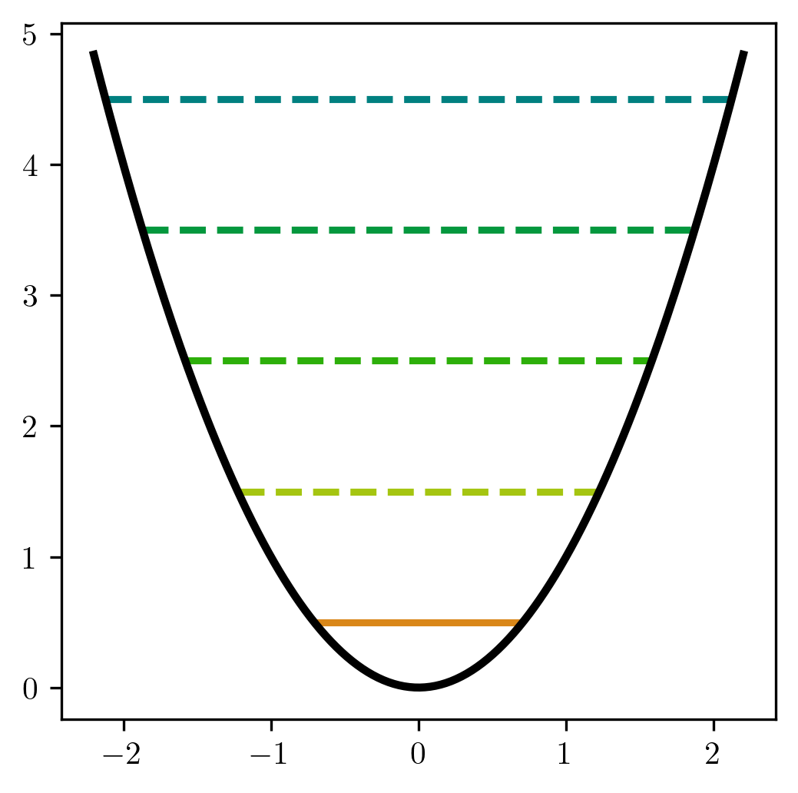
Preparing initial conditions
How to reach the 1D regime?
Transverse Energies states
Excited states
Ground state
If , the gas is frozen in the transverse direction !

Slide 7
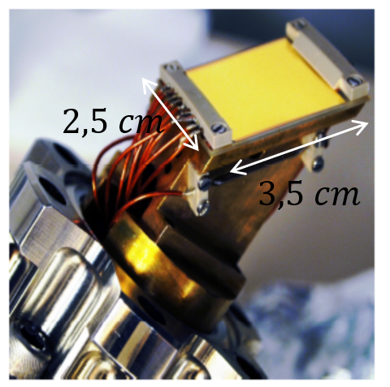
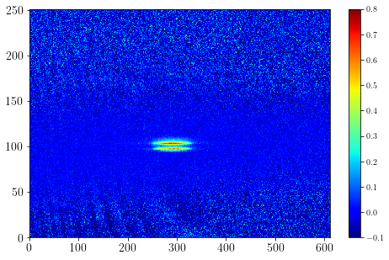
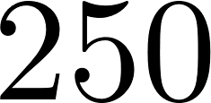
Preparing initial conditions
How to reach the 1D regime?
How do we produce a 1D Bose gas ?
Atoms used : Rubidium 87 in the atomic state.
Transverse Energies states
Atom chip experiment: the atoms magnetically trapped thanks to micro-wires deposited on a chip.
Excited states
Properties :
Independent control of the longitudinal coupling and the transverse one
Longitunal trapping:
Ground state
If , the gas is frozen in the transverse direction !
Notes:
Préciser que l’image est déformée
Dire que c’est parce que le pièégeage est magnétique avec des fils où l’on peut être très proche que le piégeage peut être transversalement très fort → régime 1D

Slide 8
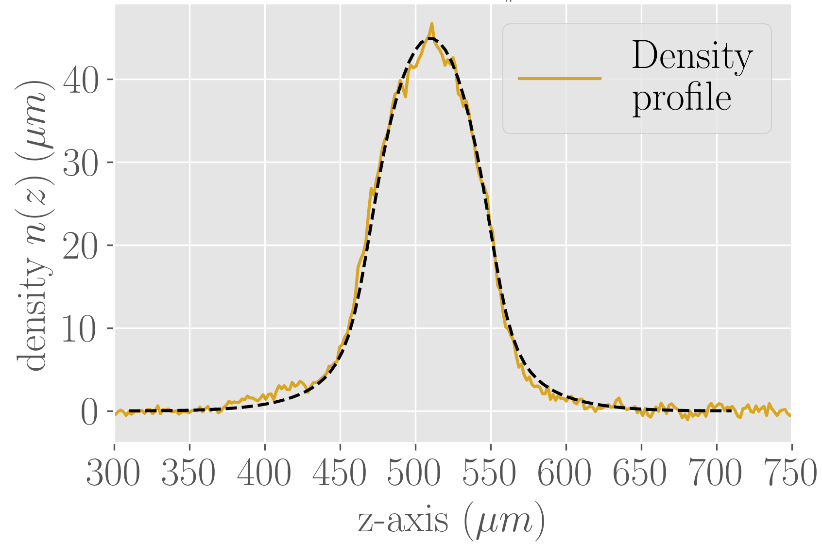
Preparing initial conditions
How do we produce a 1D Bose gas ?
Density profile of the cloud in the harmonic trap before the selection
Assumption : system described by a Gibbs ensemble
Atoms used : Rubidium 87 in the atomic state.
Atom chip experiment: the atoms magnetically trapped thanks to micro-wires deposited on a chip.
Properties :
Independent control of the longitudinal coupling and the transverse one
Longitunal trapping:

Slide 9
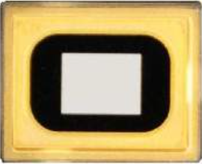
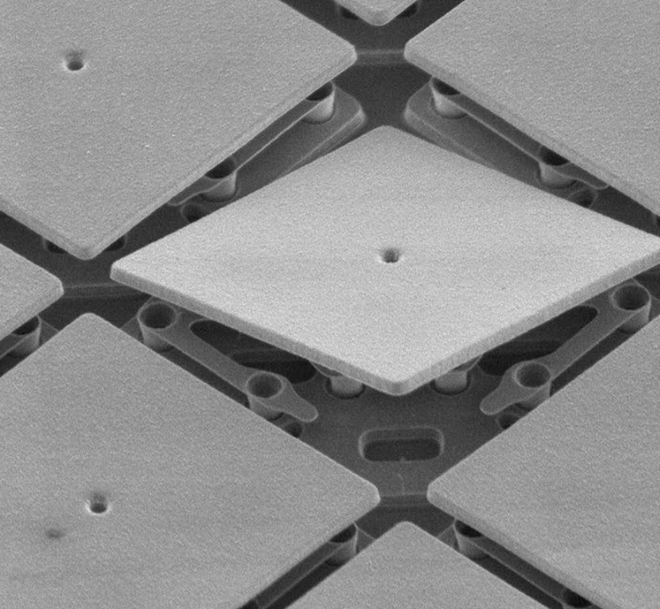
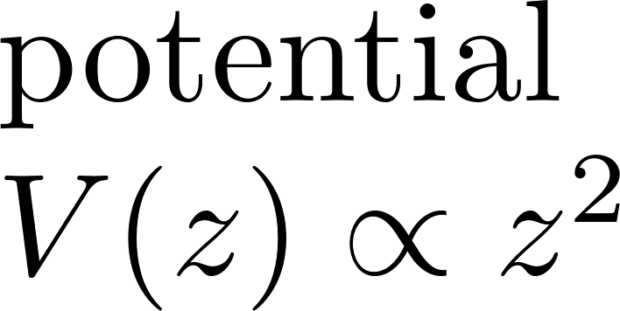
Preparing initial conditions
Objective: measure the spatially resolved rapidities distribution
Implementation of a selection spatial tool
Use of the radiation pressure
Implementation of a DMD to shape the beam.
DMD
Digital Micromirrors Device
Features
1024 x 768 mirrors
1 mirror : 14 µm x 14 µm

Slide 10
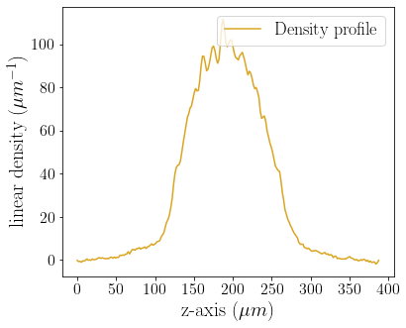
Preparing initial conditions
Experimental setup to obtain a homogeneous 1D gas before imaging it:
Optical fiber
DMD
Optical system
High-resolution objective
Vacuum chamber
CCD
Beam splitter 90/10
Atom chip
Trapped atoms

Slide 11
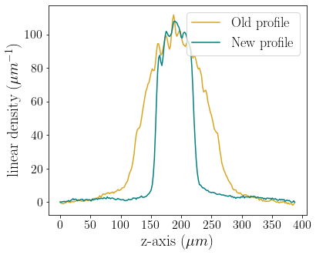
Preparing initial conditions
Experimental setup to obtain a homogeneous 1D gas before imaging it:
Optical fiber
DMD
Optical system
High-resolution objective
Vacuum chamber
CCD
Beam splitter 90/10
Atom chip
Trapped atoms

Slide 12
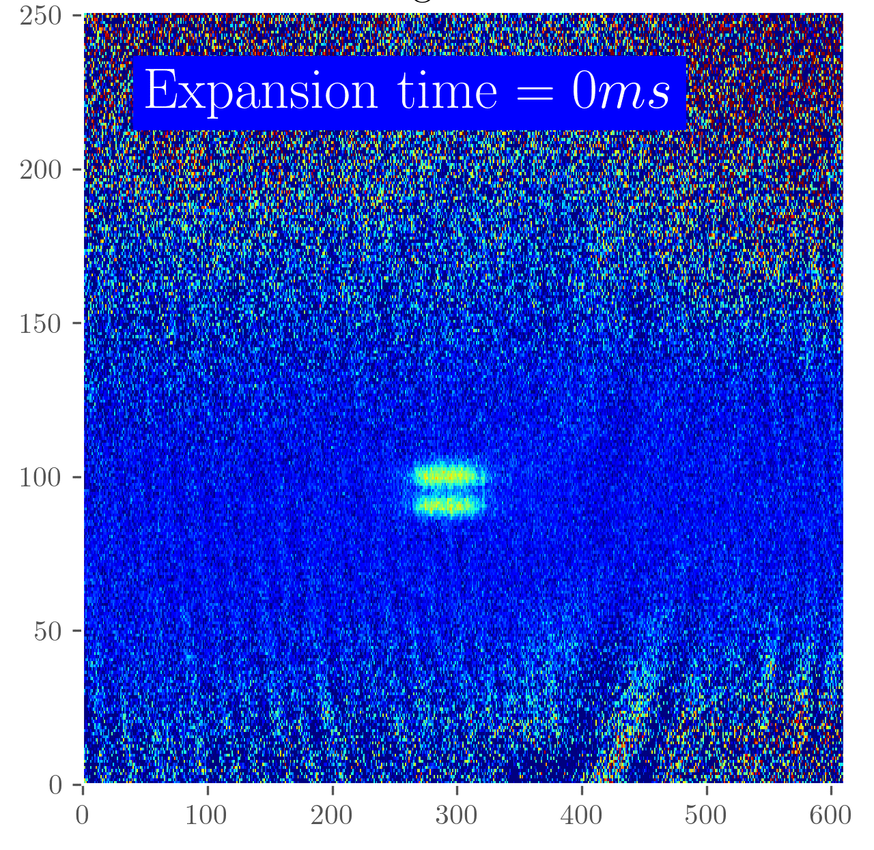
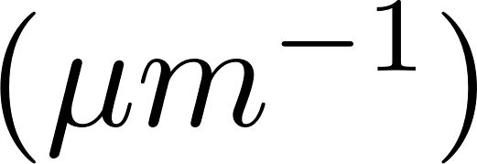
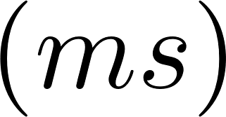
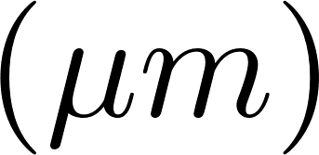
1D expansion
The longitudinal confinement is removed,
The transverse one is maintained
Density profile of a 1D gas after different times of expansion:
Linear density
Pixels
Time of expansion
Longitudinal axis
Pixels

Slide 13
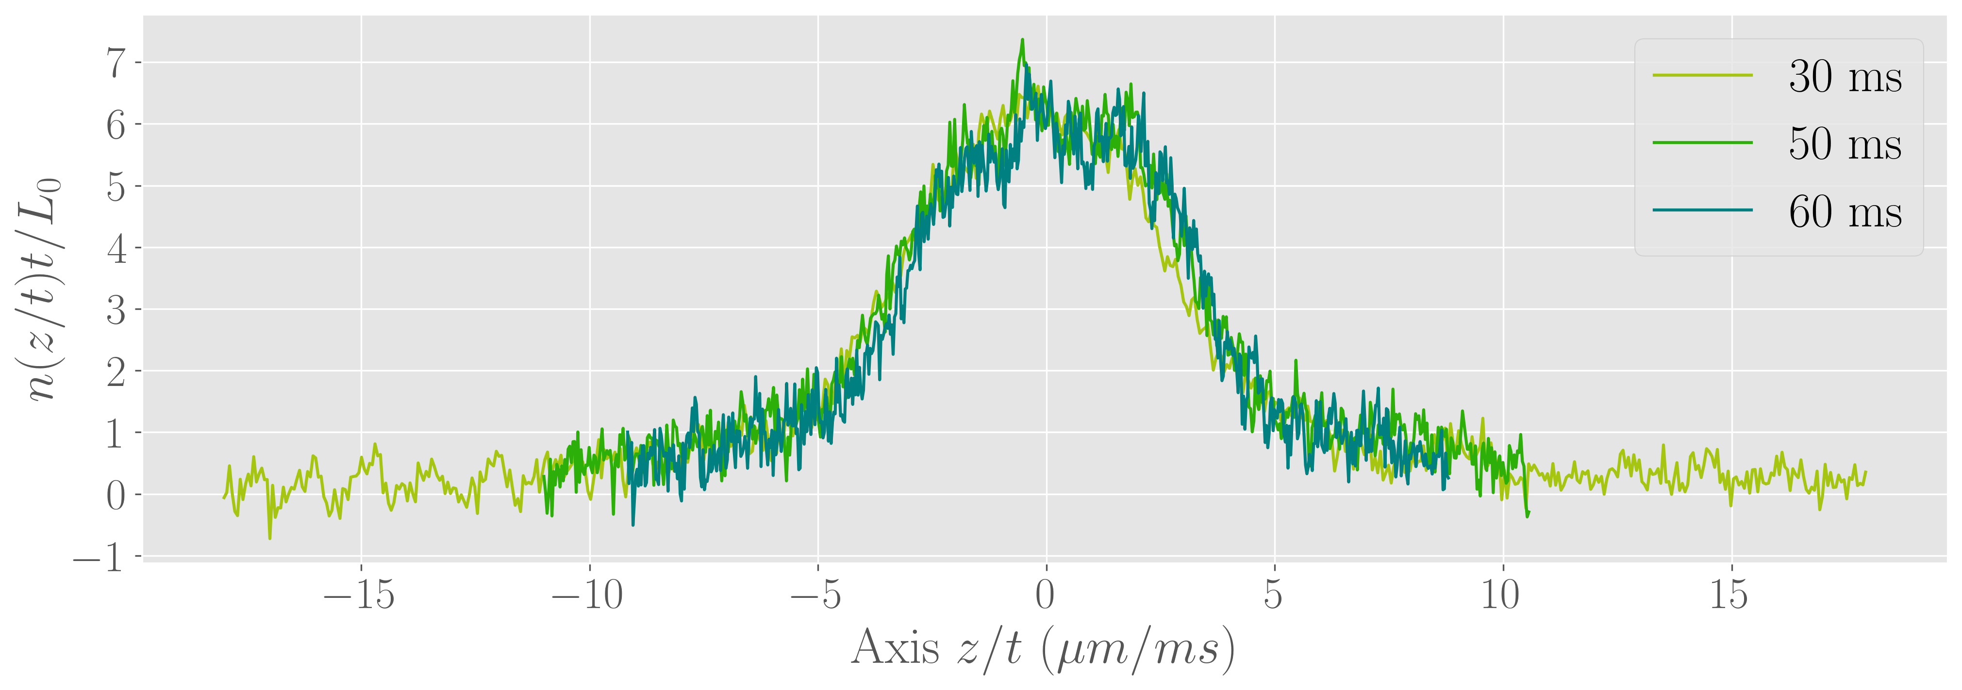
1D expansion
Rescaled profile denstity:
We look at the profile densities after 50 ms of expansion
Profiles rescaled with the time
An asymptotic regime seems to be reached, it corresponds to the rapidities distribution
Notes:
Enlever 7ms
Changer normalised density

Slide 14
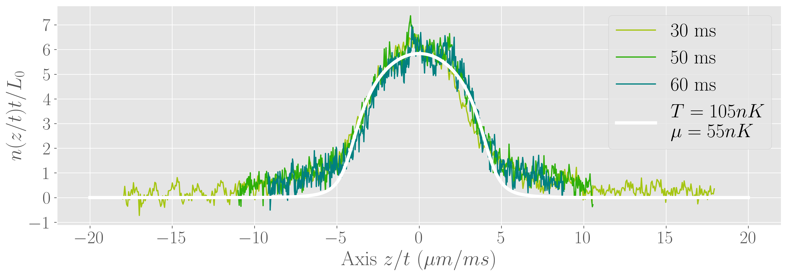
1D expansion
Rapidities distribution obtained with
Conclusion:
Differences between the datas and the rapidities distriution : Non thermal distribution?
Do we reach an asymptotic regime ? Look at the dynamics

Slide 15
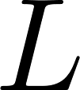
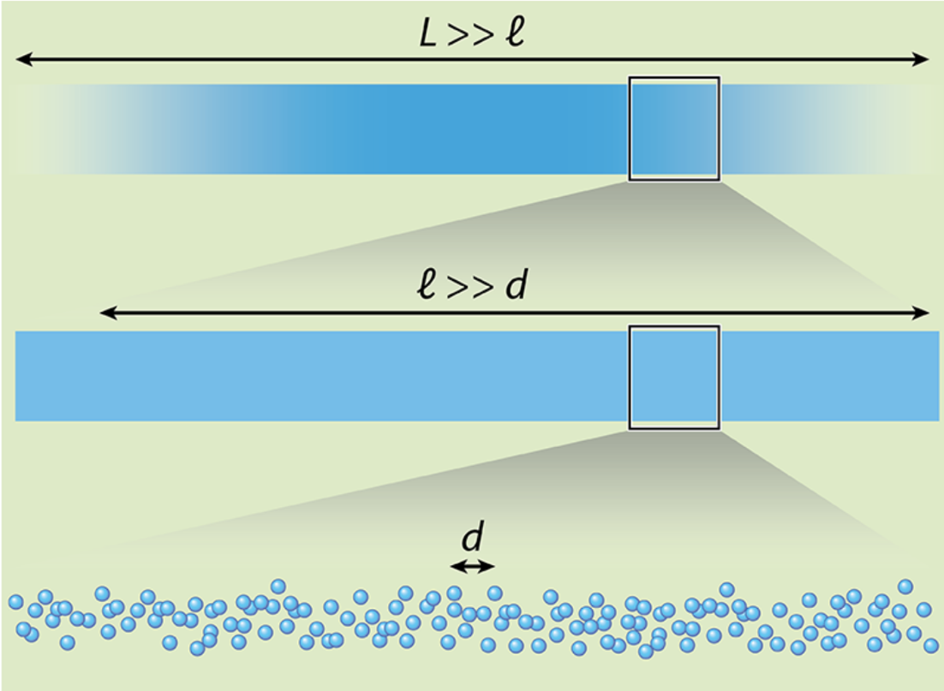
Generalised HydroDynamics (GHD)
Hydrodynamic approach : continuum of locally homogeneous cells of fluid of size with where
is the microscopic length scale
is the macroscopic one

Slide 16
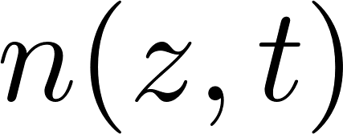
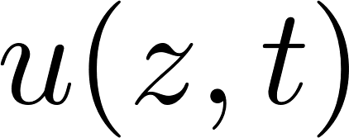
Generalised HydroDynamics (GHD)
Classical Hydrodynamics :
Classical HydroDynamics (CHD) : a non integrable system can locally be described by a Gibbs state with , and .
Conservation of the atom number :
Conservation of total momentum :
Conservation of total energy :
Atomic
density
Hydrodynamic velocity
momentum
Pressure
Energy per atom

Slide 17
Generalised HydroDynamics (GHD)
Classical Hydrodynamics :
General HydroDynamics (GHD) : an integrable system can locally be described by the spatially resolved rapidity distribution .
Conservation of the rapidity distribution on a slice:
with
and
General Hydrodynamics :
is conserved
Bertini et al. (2016), Castro-Alvaredo et al. (2016)

Slide 18
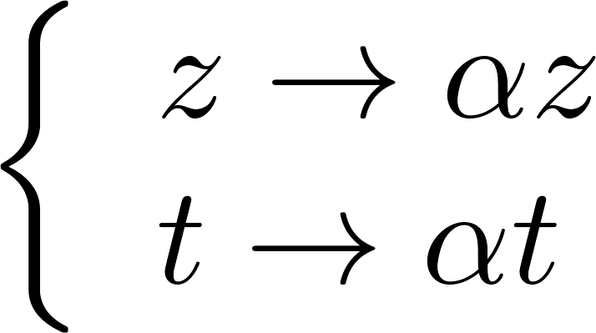
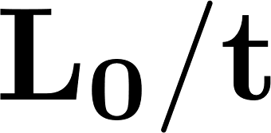
Dynamics of 1D expansion
Generalised HydroDynamics Equation :
Equation invariant to
With
For different initial sizes: the dynamics must be the same to within .
Notes:
Regarder pour des T/L qui correspondent bien

Slide 19
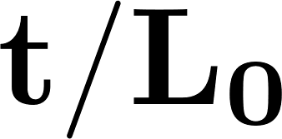
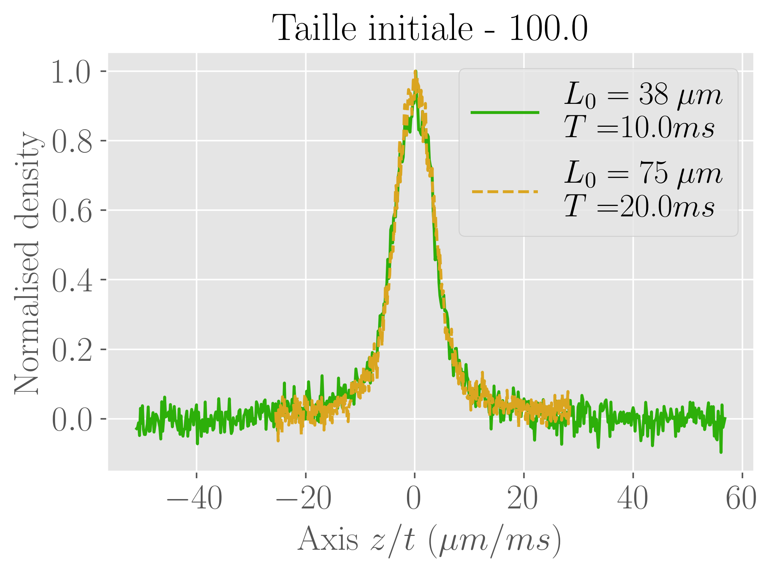
Dynamics of 1D expansion
Generalised HydroDynamics Equation :
Superimposition of profiles for different initial sizes but with the same ratio.
Equation invariant to
With
For different initial sizes: the dynamics must be the same to within .
Notes:
Regarder pour des T/L qui correspondent bien

Slide 20
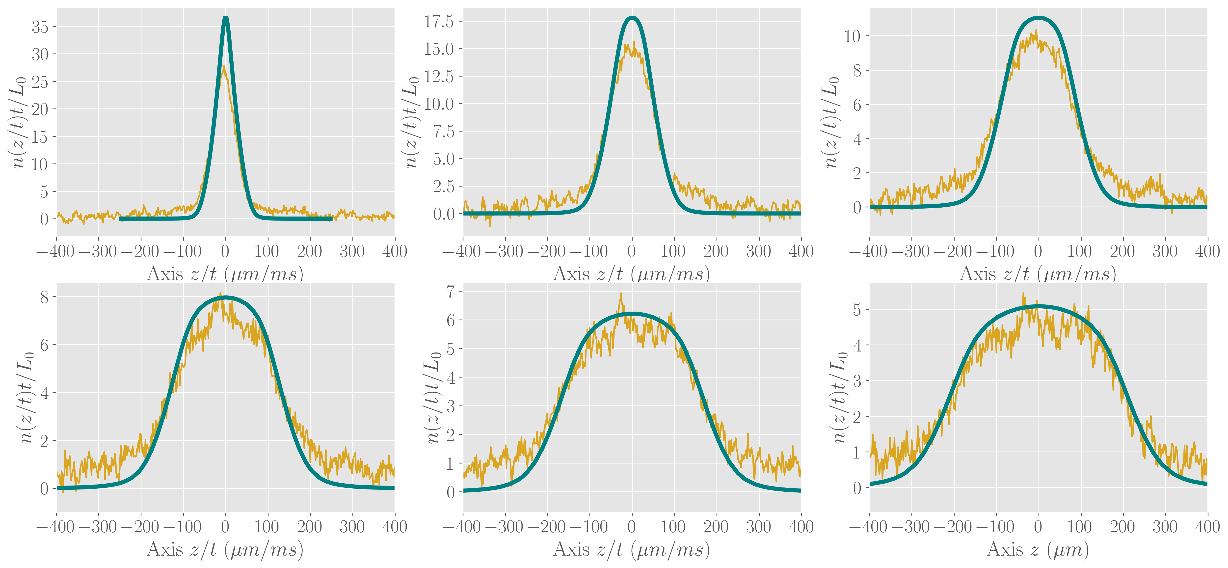
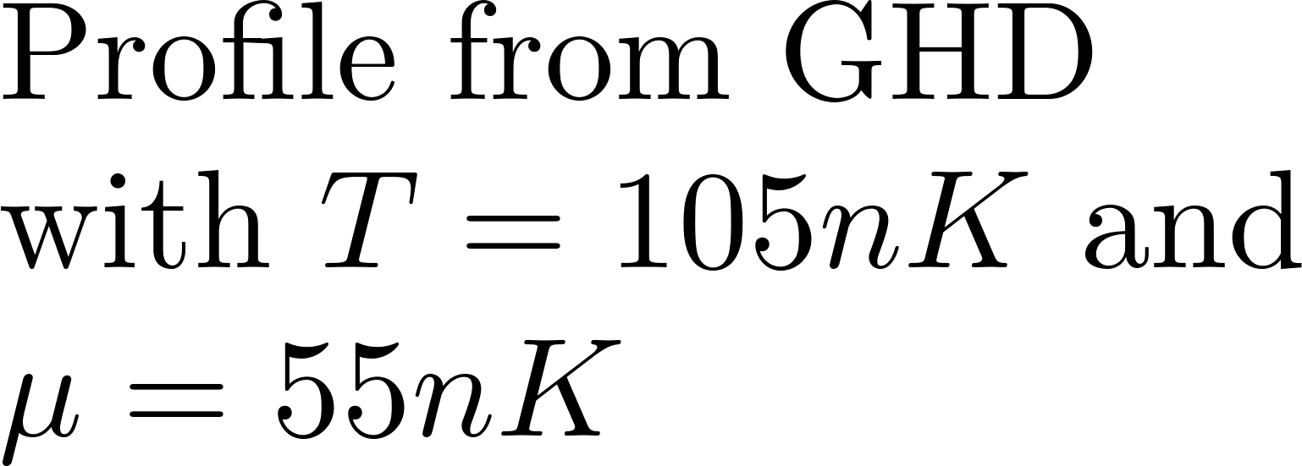
Dynamics of 1D expansion
Comparison between experimental profiles for different times and dynamics obtained by Generalised HydroDynamics:

Slide 21
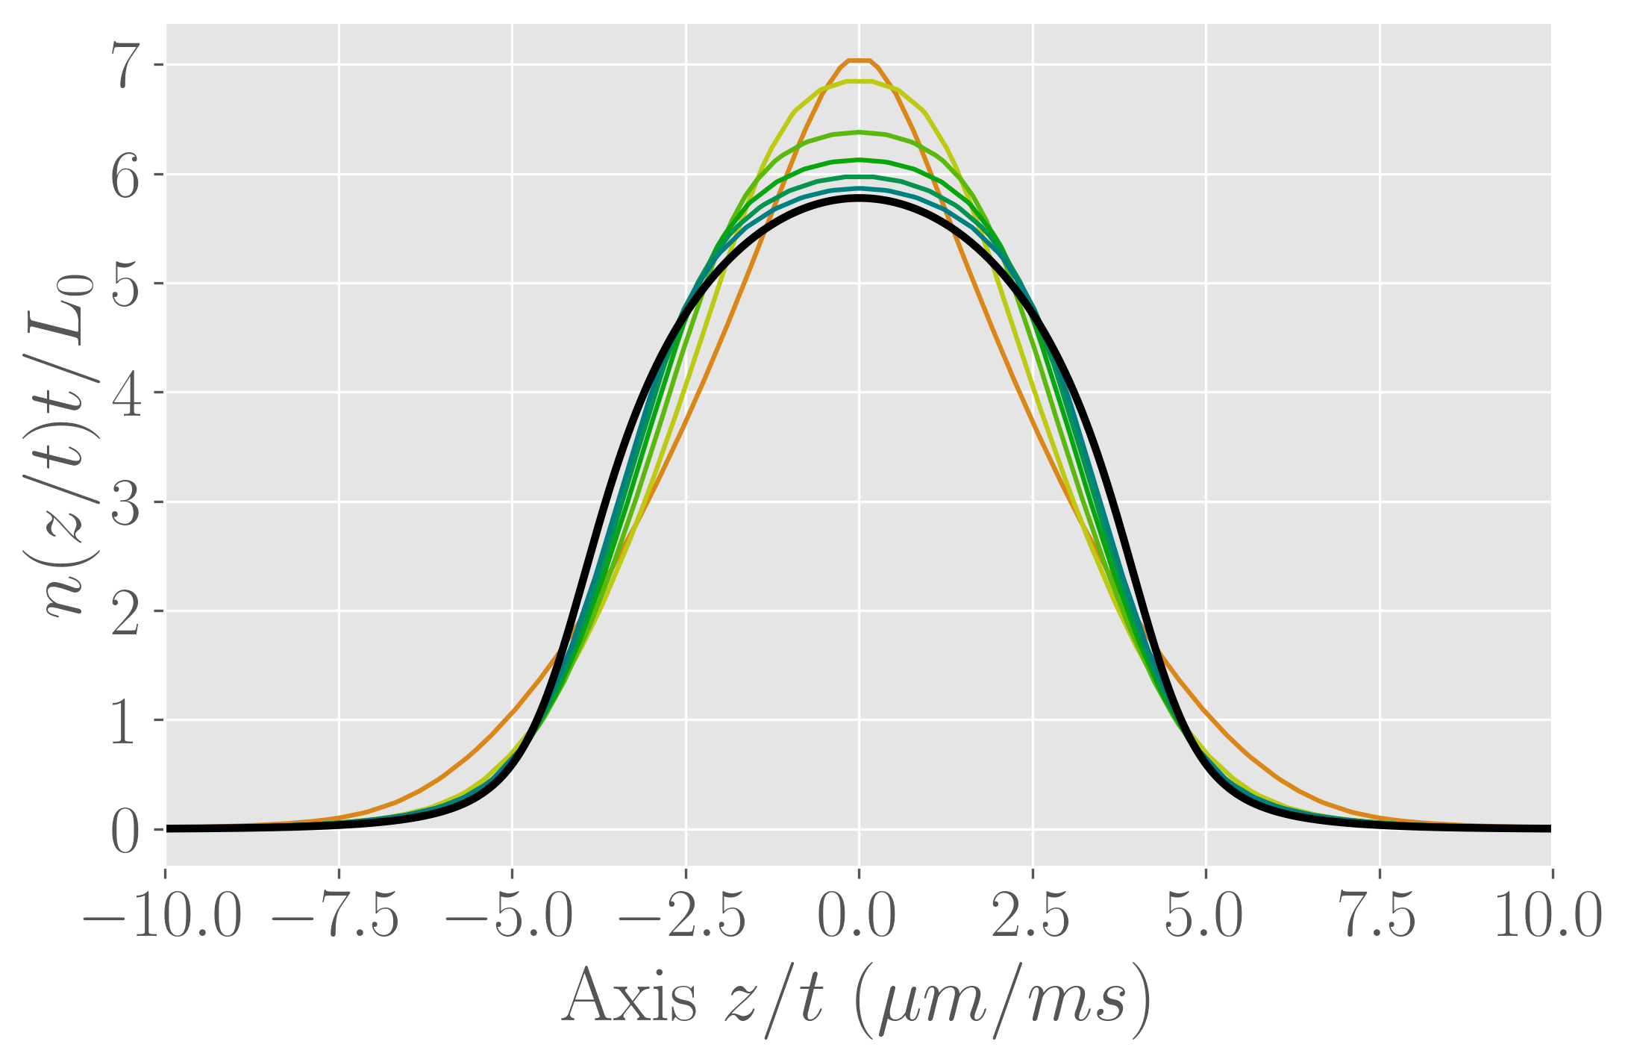
Dynamics of 1D expansion
Comparison between experimental profiles for different times and dynamics obtained by Generalised HydroDynamics:
The asymptotic regime almost but not completely reached.

Slide 22
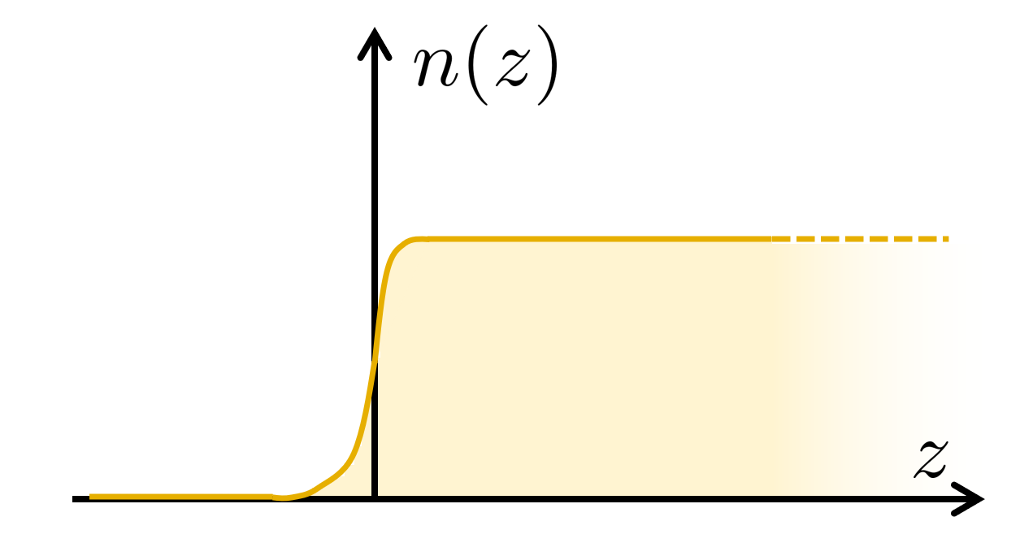
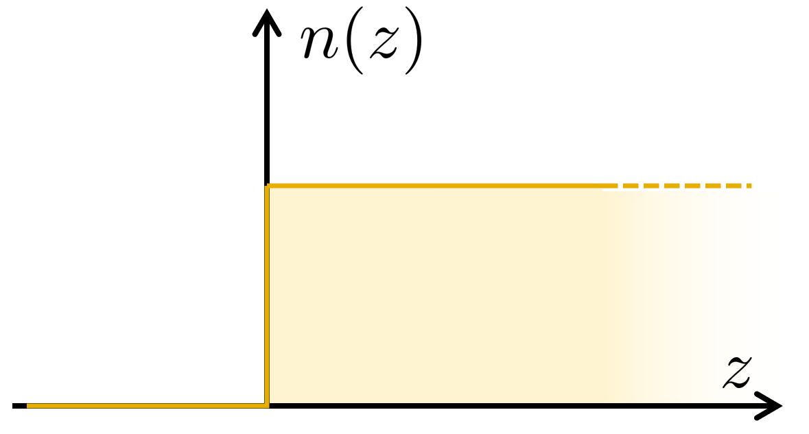
Domain Wall Dynamics protocol
Domain Wall Dynamics : edge deformation dynamics of an initially homogeneous, semi-infinite gas
GHD theory was developed to solve the problem of Domain Wall Dynamics.
Bertini et al. (2016), Castro-Alvaredo et al. (2016)
Notes:
Rendre cohérent les graphes entre eux !

Slide 23
Domain Wall Dynamics protocol
Domain Wall Dynamics : edge deformation dynamics of an initially homogeneous, semi-infinite gas
GHD theory was developed to solve the problem of Domain Wall Dynamics.
Bertini et al. (2016), Castro-Alvaredo et al. (2016)
Generalised HydroDynamics Equation :
Translation-invariant system along z-axis
For different initial sizes: the dynamics must be the same to within .
The edge profile is a function of
Notes:
Rendre cohérent les graphes entre eux !

Slide 24
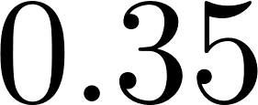
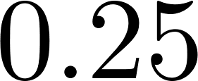
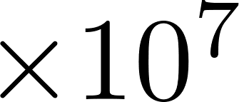
Domain wall dynamics
Dynamics of the edge:
Experimentally : The atoms are trapped in a quartic potential so that the quasi-homogeneous zone is large enough.
Then :
The longitudinal quartic confinement is removed,
The transverse one is maintained

Slide 25
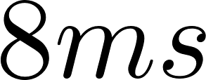
Domain wall dynamics
Dynamics of the edge:
Conclusion : after , a ballistic dynamics well described the dynamics of the edge.

Slide 26
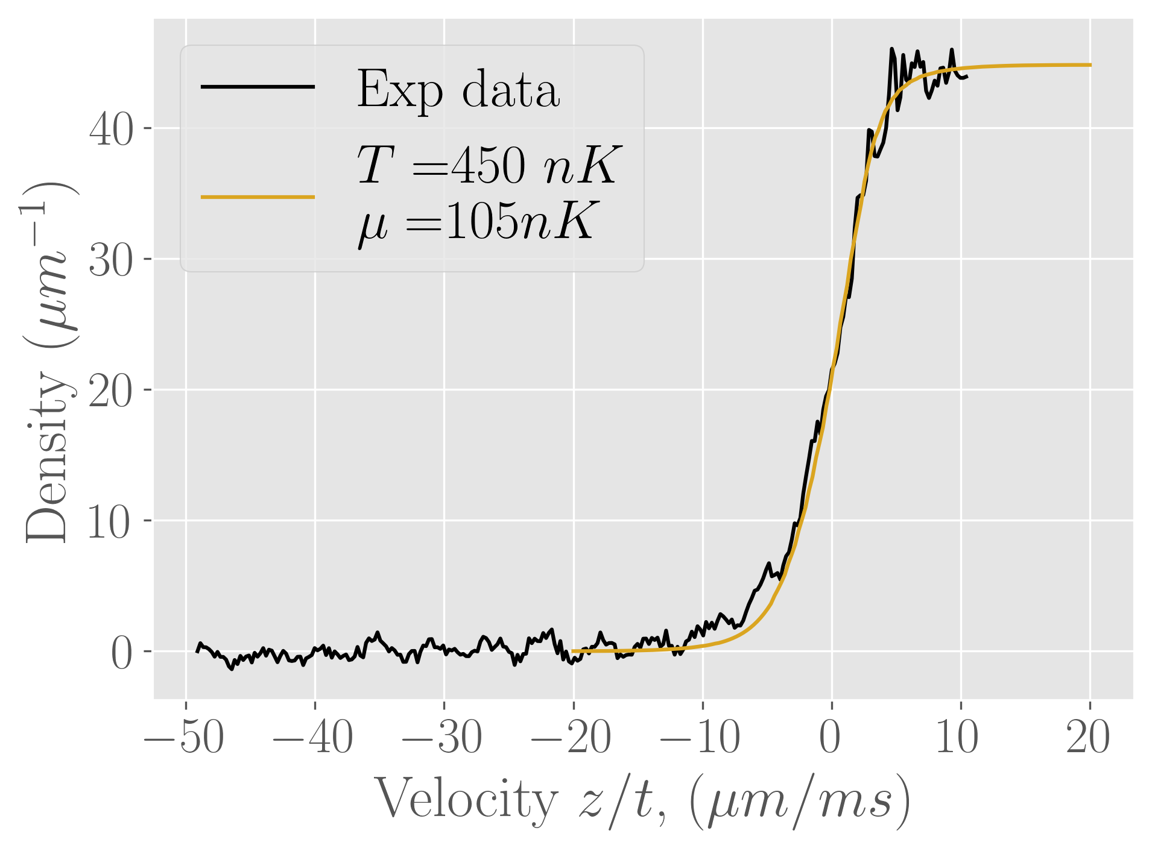
Domain Wall Dynamics reconstruction
Edge profile after
Reconstruction of the rapidities distribution : In first approximation we suppose that we have a thermic cloud
Fit with a Gibbs ensemble: the temperature and the chemical potential are the fit parameters.
Fitting parameters:

Slide 27
Conclusion
Implementation of a spatial selection tool
Longitudinal expansion of a homogeneous gas :
Asymptotic regime is almost reached
Expansion agrees with Generalized Hydrodynamics
Domain wall dynamics protocol :
Ballistic evolution well observed
Extraction of rapidities distribution

Slide 28
Thank you for your attention !

Slide 29
Outline
Asymptotic regime of a 1D expansion
Hydrodynamics for integrable systems
Domain Wall Dynamics
Preparing initial conditions
1D expansion
Generalized HydroDynamics
Dynamics of 1D expansion
Domain Wall Dynamics protocol
Domain Wall Dynamics reconstruction

Slide 30
Outline
Asymptotic regime of a 1D expansion
Hydrodynamics for integrable systems
Domain Wall Dynamics
Preparing initial conditions
Radiation pressure
1D expansion
Generalized HydroDynamics
Dynamics of 1D expansion
Domain Wall Dynamics protocol
Domain Wall Dynamics reconstruction

Slide 31
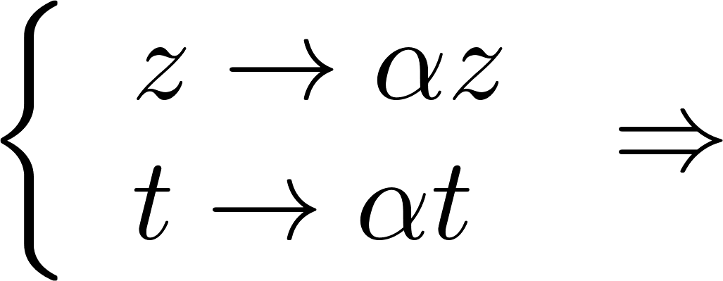
Dynamics of 1D expansion
Generalised HydroDynamics Equation :
Let a solution of the GHD equation
is also a solution of the GHD equation.
With
Notes:
Regarder pour des T/L qui correspondent bien

Slide 32
Outline
Asymptotic regime of a 1D expansion
Hydrodynamics for integrable systems
Domain Wall Dynamics
Preparing initial conditions
Radiation pressure
1D expansion
Generalized HydroDynamics
Dynamics of 1D expansion
Domain Wall Dynamics protocol
Domain Wall Dynamics reconstruction

Slide 33
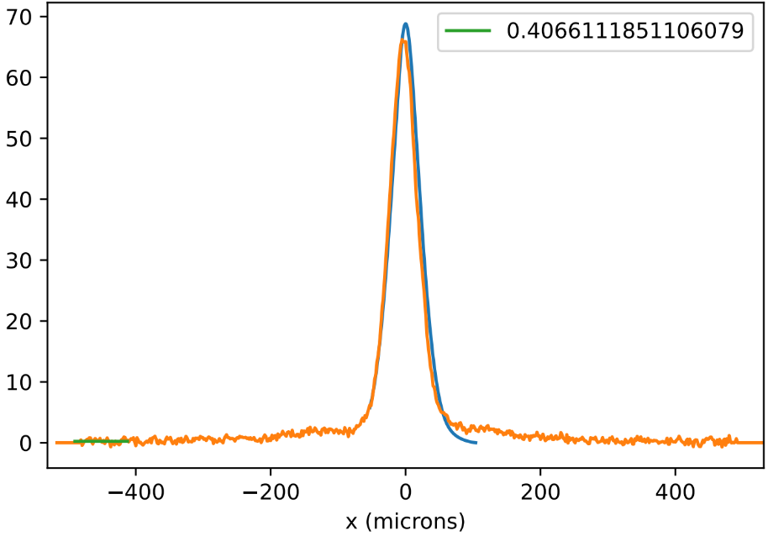
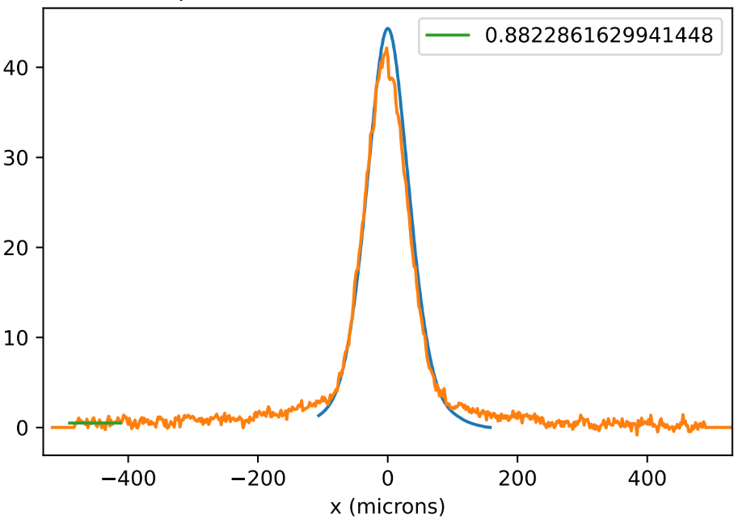
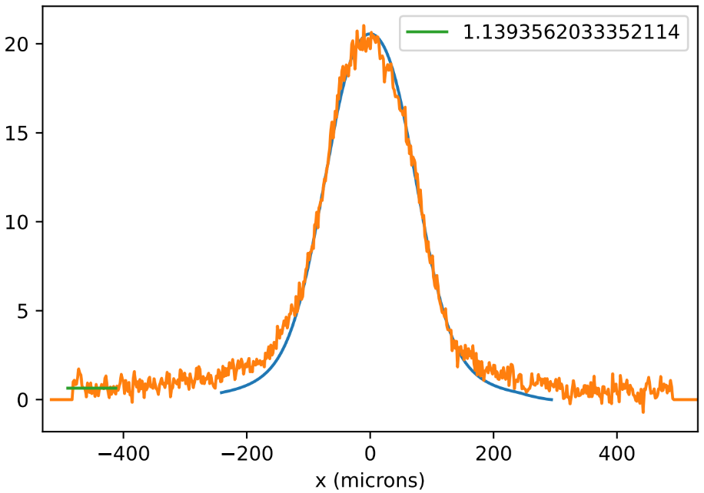
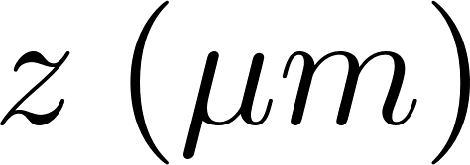
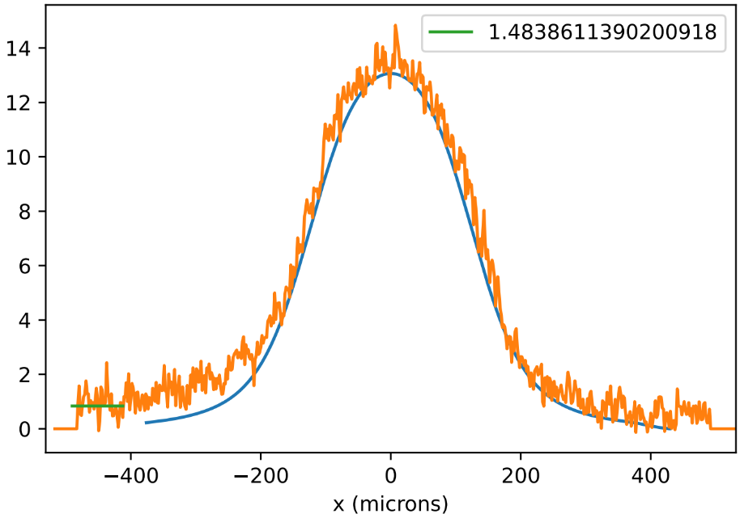
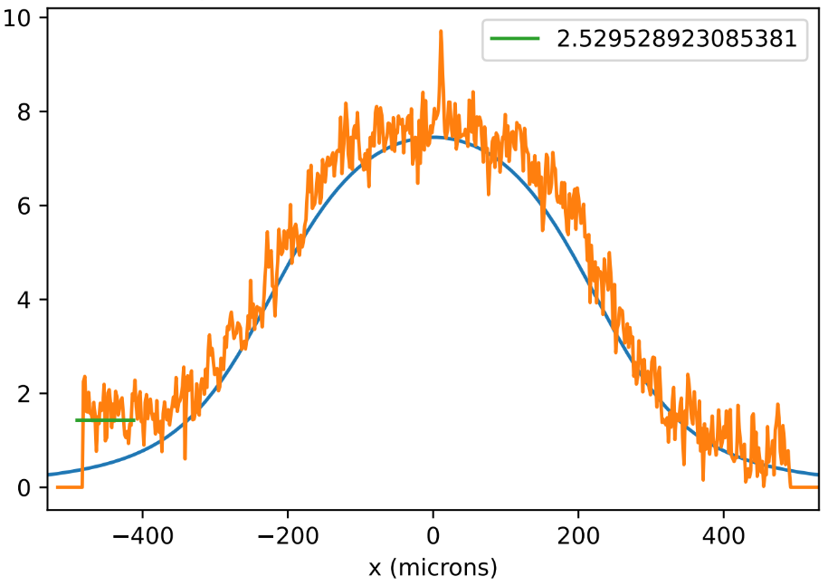
Dynamics of 1D expansion
Comparison between experimental profiles for different times and the dynamics obtained by Generalised HydroDynamics:

Slide 34
Dynamics of 1D expansion
Comparison between experimental profiles for different times and the dynamics obtained by Generalised HydroDynamics:
The asymptotic regime is not completely reached.

Slide 35
Radiation pressure
Pushing away the atoms with radiation pressure:
For one photon absorbed, .
photons.
Chip
Cloud
Cloud

Slide 36
Radiation pressure
Pushing away the atoms with radiation pressure:
For one photon absorbed, .
photons.
Measure of with fluorescence imaging:
What is the minimum power needed to remove all the atoms ?
Chip
Cloud
Cloud
Notes:
Pourcentage d’atomes enlevés

Slide 37
Domain Wall Dynamics reconstruction
Edge profile after
Reconstruction of the rapidities distribution : In first approximation we suppose that we have a thermic cloud
Fit with a Gibbs ensemble: the temperature and the chemical potential are the fit parameters.

Slide 38
Radiation pressure
Pushing away the atoms with radiation pressure:
For one photon absorbed, .
photons.
Measure of with fluorescence imaging:
Optical
density
Area illuminated
Fluorescence
Chip
Cloud
Photon
number
Cloud
Experimental parameters : ,
Fluorescence measurement :
scattered photons / atoms
Notes:
Dire à l’oral que c’est cohérent avec le temps du pulse

Slide 39
Radiation pressure
Take into account the level structure, the magnetic field and the beam polarisation, with
Measure of with fluorescence imaging:
Optical
density
Area illuminated
Experimentally :
Fluorescence
Photon
number
Experimental parameters : ,
Fluorescence measurement :
scattered photons / atoms

Slide 40
Limitations
Limitations :
Image of an edge is not perfect
What do we see :

Slide 41
Limitations
Limitations :
Image of an edge is not perfect
What do we see :

Slide 42
Limitations
Limitations :
Image of an edge is not perfect
What do we see :

Slide 43
Limitations
Limitations :
Image of an edge is not perfect
Photon reabsorption in the remaining cloud
Diffusion of light by the optical system can lead to absorption photon in the remaining cloud
What do we see :

Slide 44
Limitations
Limitations :
Image of an edge is not perfect
Photon reabsorption in the remaining cloud
Diffusion of light by the optical system can lead to absorption photon in the remaining cloud
What do we see :
The density of remaining atoms doesn’t change

Slide 45
Generalised HydroDynamics (GHD)
General HydroDynamics (GHD) : an integrable system can locally be described by the spatial resolved rapidity distribution .
Conservation of the rapidity distribution on a slice:
with
and
General Hydrodynamics :
is conserved
Bertini et al. (2016), Castro-Alvaredo et al. (2016)

Slide 46
Limitations
Limitations :
Image of an edge is not perfect
Photon reabsorption in the remaining cloud
Diffusion of light by the optical system can lead to absorption photon in the remaining cloud
What do we see :
The density of remaining atoms doesn’t change
Phonon temperature doesn’t change before and after the selection
Transverse size after a time of flight doesn’t change.

Slide 47
Domain Wall Dynamics reconstruction
Occupation factor :
Conservation along a trajectory
Occupation factor at : there is no dependance on z.
Notes:
Rendre cohérent les graphes entre eux !
Enlever

Slide 48
Domain Wall Dynamics reconstruction
Occupation factor :
Conservation along a trajectory
Occupation factor at :
The edge dynamic is obtained with the effective velocities where is the truncated initial occupation factor
For each , doesn’t depend on time The edge profile is a function of
Notes:
Rendre cohérent les graphes entre eux !

Slide 49
Domain Wall Dynamics reconstruction
Reconstruction of the occupation factor directly with the density profile
Little by little, in a discretized space
With , and
,

Slide 50
Dynamics of 1D expansion
Occupation factor :
Conservation along a trajectory
Occupation factor at : there is no dependance on z.
Notes:
Présenter la méthode pour regarder la dynamique d’un rectrangle

Slide 51
Dynamics of 1D expansion
Occupation factor :
Conservation along a trajectory
the edges dynamic are obtained
Occupation factor at :
with the effective velocities
where is the initial occupation factor truncated between and
.
Notes:
Présenter la méthode pour regarder la dynamique d’un rectrangle

Slide 52
Context
Lieb parameter: with the 1D interaction parameter and the density:
: hardcore regime
: 1D quasi-condensate (qBEC)
Rapidity distribution for a homogeneous gas
Half-circle equation
Objective : Measuring experimentally the rapidity distribution for a qBEC and recovering the half-circle distribution.
Notes:
Parler du cas homogène

Slide 53
Context
Lieb parameter: with the 1D interaction parameter and the density:
: hardcore regime
: 1D quasi-condensate (qBEC)
With .
Rapidity distribution for a homogeneous gas for :
For and :
Half-circle equation
“ Exact analysis pf an interacting Bose Gas ”, Lieb & Liniger, 1963
Notes:
Peut être en deux diapos pour anomations

Slide 54
1D expansion
Rescaled profile denstity:
We look at the profile densities after 40 ms of expansion
Profiles rescaled with the time
Half circle distribution expected for the ground state
An asymptotic regime seems to be reached, it corresponds to the rapidities distribution
Notes:
Refaire avec le bon demi cercle

Slide 55
1D expansion
For different initial sizes:
- is constant
Asymptotic regime seems to be reached
The rapidities distribution obtained for is in agreement with the other initial sizes

Slide 56
1D expansion
Density profile of the cloud in the harmonic trap before the selection :
Approximation : the gas is thermic
Expected profile for
Notes:
Regarder en zoom la distribution

Slide 57
Preparing initial conditions
The two protocols concern homogeneous bose gas ! Initially, the gas is in a quadratic / quartic trap.
Implementation of a selection spatial tool
Use of the radiation pressure
Implementation of a DMD to shape the beam.
Domain Wall Dynamics
1D homogeneous expansion

Slide 58
Context
1
Homogeneous 1D Bose gas with contact repulsive interactions :
Lieb Liniger Hamiltonian :
Kinetic part
Interaction term
Integrable system: the eigenstates are known
Notes:
Dire que bcp de recherches niveaux scientifiques
+ exemples comme GHD
Citation
Dire que c’est une physique différentes des systèmes chaotiques.

Slide 59
Context
2
Integrable system: the eigenstates of are the Bethe Anzatz states labelled by N numbers called the rapidities.
Wavefunction :
Sum over the permutations
Prefactor
Rapidities distribution : is the number of rapidities in the range.
is conserved during the out-of-equilibrium dynamics of the system
The relaxed state is described by the rapidities distribution !

Slide 60
Domain Wall Dynamics protocol
Domain Wall Dynamics : edge deformation dynamics of an initially homogeneous, semi-infinite gas
GHD theory was developed to solve the problem of Domain Wall Dynamics.
Generalised HydroDynamics Equation :
The edge profile is a function of
Experimentally : The atoms are trapped in a quartic potential so that the quasi-homogeneous zone is large enough.
Notes:
Rendre cohérent les graphes entre eux !

Slide 61
1D expansion
Occupation factor :
Conservation along a trajectory
Notes:
Présenter la méthode pour regarder la dynamique d’un rectrangle

Slide 62
Obtaining a 1D Bose gaz
How to reach the 1D regime?
How do we produce a 1D Bose gas ?
3D harmonic oscillator:
- longitudinal trapping
- transverse trapping
Atoms used : Rubidium 87 in the atomic state.
Atoms are trapped by a magnetic field created with wires deposited on a chip.
Energy
Excited states
Potential felt by the atoms under a magnetic field :
Ground state
Bohr Magneton
If , , the gas is frozen in the transverse direction !
Landé factor
The atom chip

Slide 63
Preparing initial conditions
Atom chip experiment: the atoms magnetically trapped thanks to micro-wires deposited on a chip.
1D quasi-BEC
Longitudinnaly trapping :
In the experiment, we are working with harmoninc and quartic potential.

Slide 64
Obtaining a 1D Bose gaz
5
the ‘D’ wires
The three wires : producing a quadrupole with a zero magnetic field above the central wire: transverse confinement
The ‘D’ and ‘d’ wires : creating a longitudinal confinement.
the ‘d’ wires
3 wires
Atom chip
Independent control of the longitudinal coupling and the transverse one
Typical longitudinal quadratic potential :
Au
SiC

Slide 65
Extracting rapidities distribution
Yang-Yang entropy:
Construction of conserved quantities:
…
Yang, Yang (1969)
The moments of the rapidities distribution are conserved quantities
Notes:
Rappeler Yang Yang

Slide 66
Extracting rapidities distribution
Yang-Yang entropy:
Construction of conserved quantities:
…
Entropy maximisation:
Yang, Yang (1969)
The moments of the rapidities distribution are conserved quantities
Thermic distribution:
Lagrange multpliers
Notes:
Rappeler Yang Yang

Slide 67
1D expansion
Rescaled profile denstity:
We look at the profile densities after 30ms of expansion
Profiles rescaled with the time
The asymptotic regime seems to be reached, a rapidity distribution can be fitted
Good shape but high temperature ?

Slide 68
Occupation factor
Bethe equations :
with
if is odd, if is even.
The are called the Bethe integers.
is the strength repulsion term.
System:
: atoms number
: size of the system
Periodic boundary conditions

Slide 69
Occupation factor
Bethe equations :
with
if is odd, if is even.
The are called the Bethe integers.
is the strength repulsion term.
System:
: atoms number
: size of the system
Periodic boundary conditions
Density of state:

Slide 70
Occupation factor
Bethe equations :
with
if is odd, if is even.
The are called the Bethe integers.
is the strength repulsion term.
: number of rapidities in
Occupation factor :
System:
: atoms number
: size of the system
Periodic boundary conditions
Density of state:

Slide 71
Occupation factor
Occupation factor :
Relation between the rapidity distribution and the occupation factor :
New hydrodynamics equation on the occupation factor :
Conservation along a trajectory
Notes:
Définir l’entropie de Yang Yang, en parlant de micro-états
Remettre la valeur du déphasage

Slide 72
Occupation factor
Occupation factor :
Relation between the rapidity distribution and the occupation factor :
New hydrodynamics equation on the occupation factor :
Yang-Yang entropy
Conservation along a trajectory
Yang, Yang (1969)
Notes:
Définir l’entropie de Yang Yang, en parlant de micro-états
Remettre la valeur du déphasage

Slide 73
High temperatures
Change of the height of the spatial selection beam :
Density profile of the cloud in the harmonic trap before the selection
The rapidity distribution is obtained with entropy maximization + thermic distribution ( and are fit parameters).

Slide 74
High temperatures
Change of the height of the spatial selection beam :
Density profile of the cloud in the harmonic trap before the selection
The rapidity distribution is obtained with entropy maximization + thermic distribution ( and are fit parameters).
Diffusion of photons with the optical system.
Reducing this effect gives reasonnable temperature

Slide 75
Time of flight
Time of flight : longitudinal and transverse confinement are removed.

Slide 76
Time of flight
Time of flight : longitudinal and transverse confinement are removed.
Density distribution :
Density fluctuations
Mean profile
Quasi BEC (in situ) :
small density fluctuations
phase fluctuations
with

Slide 77
Time of flight
Time of flight : longitudinal and transverse confinement are removed.
Density distribution :
Density fluctuations
Mean profile
Quasi BEC (in situ) :
small density fluctuations
phase fluctuations
with

Slide 78
Obtaining a 1D Bose gaz
4
To trap the atoms, one needs:
A current through a wire
The atom chip
Potential felt by the atoms under a magnetic field :
infinite wire
Notes:
Mettre un schéma pour les différents pièges
Est-ce qu’il faut mettre des axes ?
Champ magnétique

Slide 79
Obtaining a 1D Bose gaz
4
To trap the atoms, one needs:
A current through a wire
A homogeneous transverse field to have a minimum of potentiel
The atom chip
Potential felt by the atoms under a magnetic field :
infinite wire
Notes:
Mettre un schéma pour les différents pièges
Est-ce qu’il faut mettre des axes ?

Slide 80
Obtaining a 1D Bose gaz
4
To trap the atoms, one needs:
A current through a wire
A homogeneous transverse field to have a minimum of potentiel
A longitudinal field to have a non zero of potentiel
The atom chip
Potential felt by the atoms under a magnetic field :
infinite wire
Notes:
Mettre un schéma pour les différents pièges
Est-ce qu’il faut mettre des axes ?

Slide 81
Perspectives
Measurement of rapidity distribution for a homogeneous gas / spatially resolved rapidity distribution
Longitudinal
potential
Selection spatial impulsion
Transverse confinement
Focalisation
impulsion
Image
1D expansion
n(k) measurement

