Slide 1



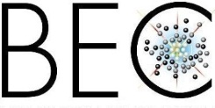










Kardar Parisi Zhang universal scaling
in the coherent emission of polariton condensates
Jacqueline Bloch
Centre de Nanosciences et de Nanotechnologies
Université Paris Saclay - CNRS
L. Canet
A. Minguzzi
D. Squizzato
K. Deligiannis
F. Helluin
F. Vercesi
I. Carusotto
I. Amelio
S. Ravets
Q. Fontaine
D. Pinto Dias
A. Lemaître
I. Sagnes
M. Morassi
L. Legratiet
Harouri
F. Baboux
Amo
M. Richard
M. Wouters

Slide 2
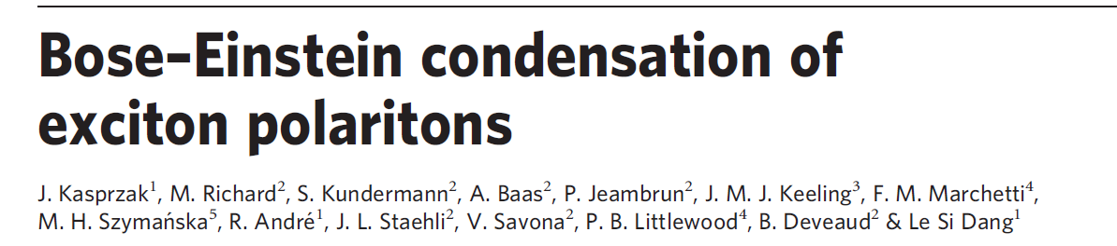
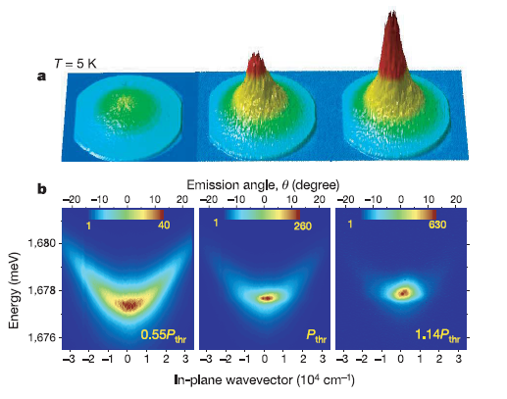
Similarities with atomic BEC
BUT
Driven dissipative system
Out of equilibrium
Different universality class than their equilibrium counterpart
k_{y}
k_{x}
Increase excitation power
Kasprzak et al. Nature, 443, 409 (2006)
Also H. Deng et al. Science (2002), R. Balili et al., Science (2007),…..

Slide 3
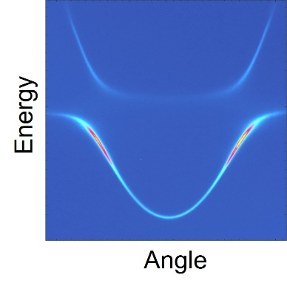
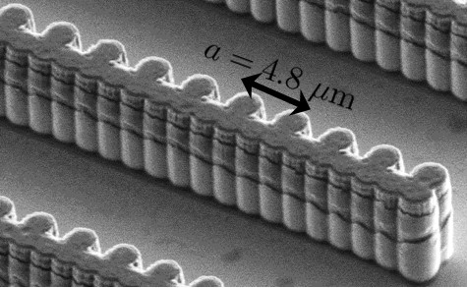
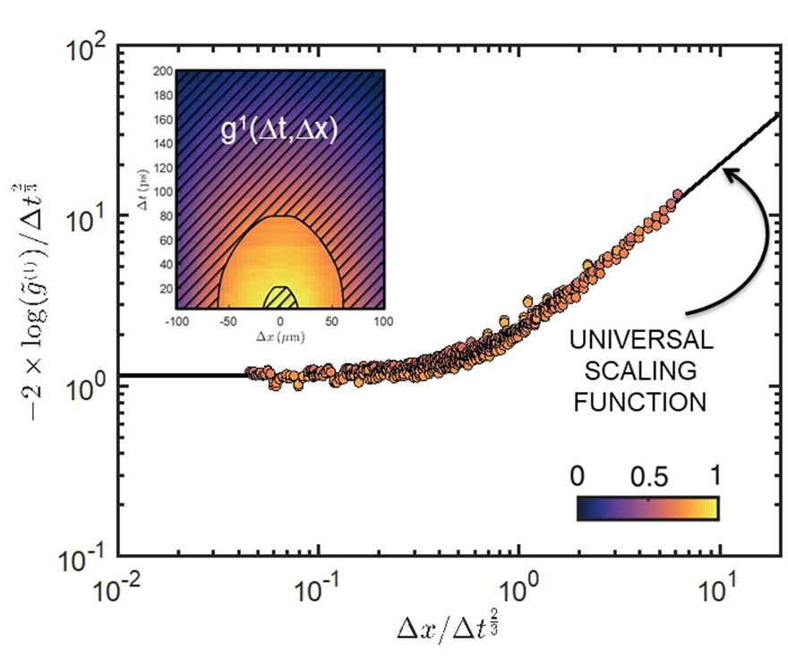
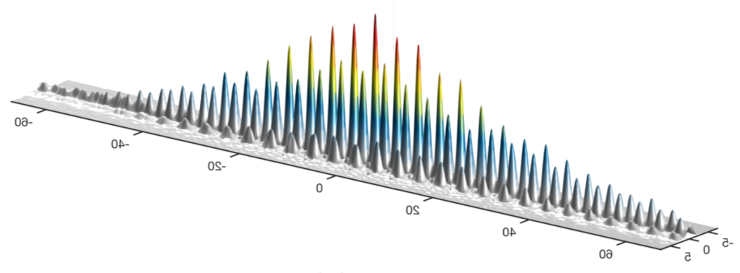
Outline of the talk
Introduction : synthetic polariton matter
Polariton condensates belong to the Kardar Parisi Zhang universality class

Slide 4
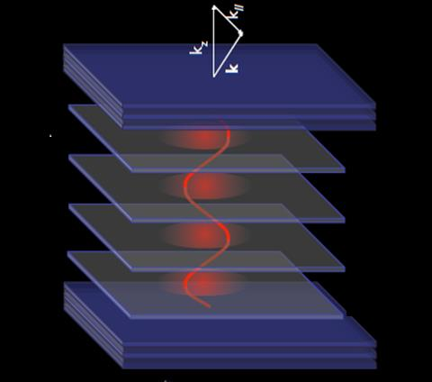
Microcavity polaritons
Angle θ (º)
Mirror
k_{in-plane}
Quantum
wells
Photon
Cavity
Emission energy (eV)
Exciton
Mirror
k_{in-plane} (μm⁻¹)
Notes:
The partial photonic character renders a very low mass
The partial excitonic character provides the system with strong non-linearities

Slide 5
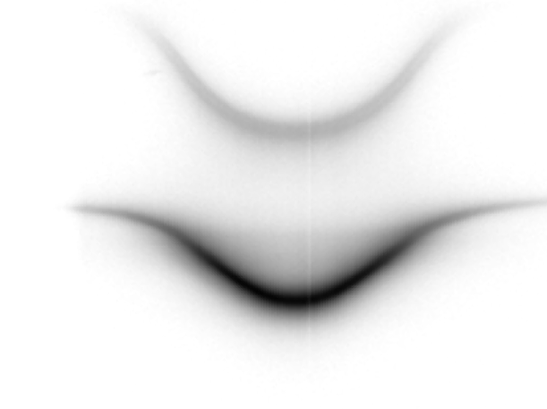
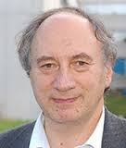
Microcavity polaritons
Angle θ (º)
Mirror
Upper polariton
k_{in-plane}
Quantum
wells
Photon
Cavity
Emission energy (eV)
Exciton
~ 5meV
Mirror
Lower polariton
Microcavity polaritons : mixed exciton-photon states
k_{in-plane} (μm⁻¹)
AlGaAs
GaAs
AlGaAs
Cavity
e⁻
polariton
h⁺
Claude Weisbuch
PRL 69, 3314 (1992)
QW
Courtesy D.Sanvitto
Notes:
The partial photonic character renders a very low mass
The partial excitonic character provides the system with strong non-linearities

Slide 6
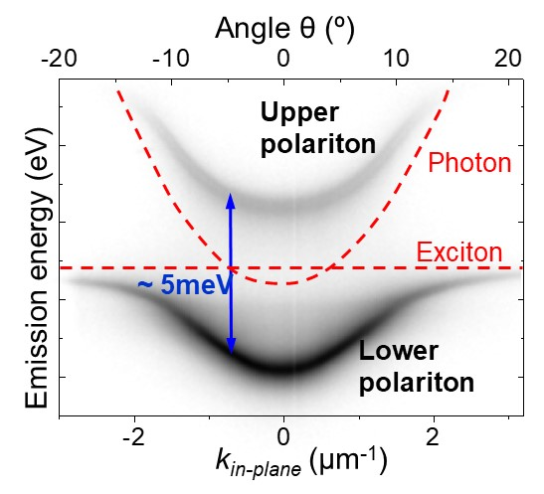
Microcavity polaritons
Mirror
k_{in-plane}
Cavity
Quantum
wells
Mirror
Microcavity polaritons : mixed exciton-photon states
Properties
Photons
Excitons
Photonic component Confinement in microstructures
Dissipation
Excitonic component
Interactions - χ⁽³⁾ (dominated by exchange)
Gain (lasing)
Sensitivity to magnetic field
Claude Weisbuch PRL 69, 3314 (1992)
C. Ciuti & I. Carusotto, Rev. Mod. Phys. 85, 299 (2013)

Slide 7
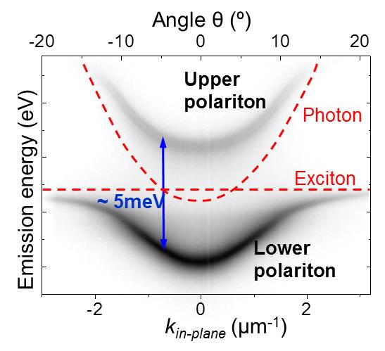
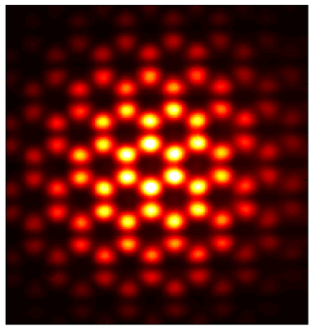

Probing polariton states
Imaging of k-space
θ
k// = ω/c sin(θ)
Imaging of real space
1
0
10 μm
Density
Interferometry
Coherence
g⁽¹⁾
g⁽²⁾
- vortices
- solitons
Notes:
The partial photonic character renders a very low mass
The partial excitonic character provides the system with strong non-linearities

Slide 8
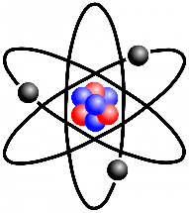
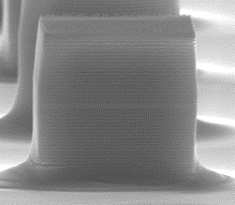
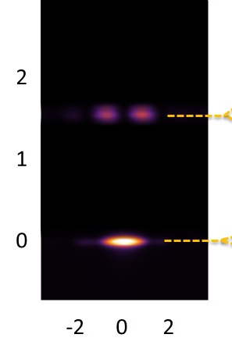
Lattices of coupled micropillars
Building block
Energy (meV)
x (µm)

Slide 9
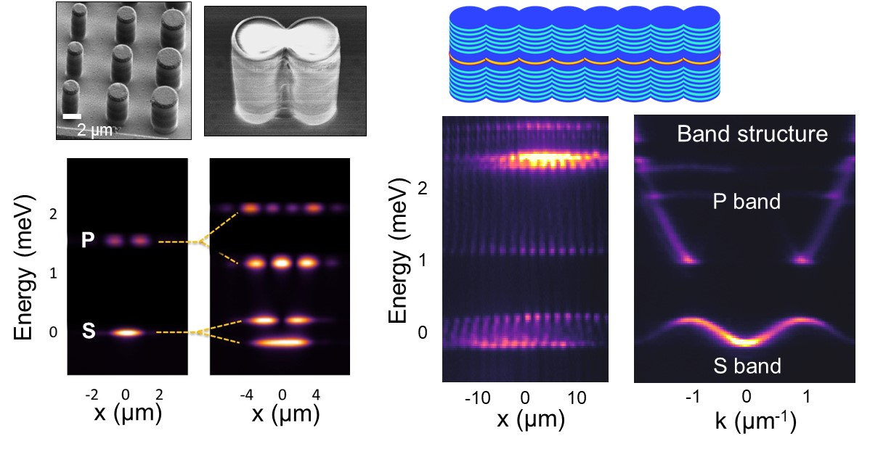
Lattices of coupled micropillars

Slide 10
Lattices of coupled micropillars
Correspondance : Wavefunction = electric field
Spin = Polarisation
C. Ciuti & I. Carusotto, Rev. Mod. Phys. 85, 299 (2013)
Compte Rendus Physique Vol. 17, Issue 8, Pages 805-956 (2016) Physique des polaritons: Edité par A. Amo, J. Bloch and I. Carusotto

Slide 11
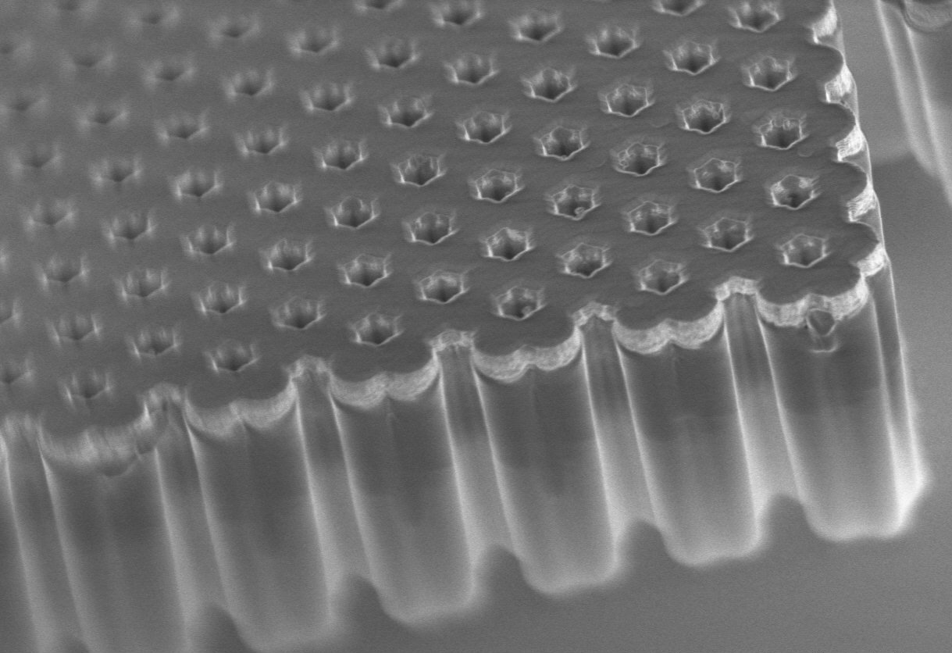
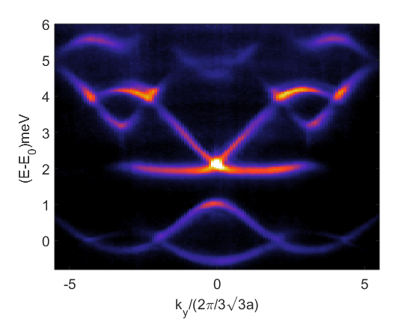
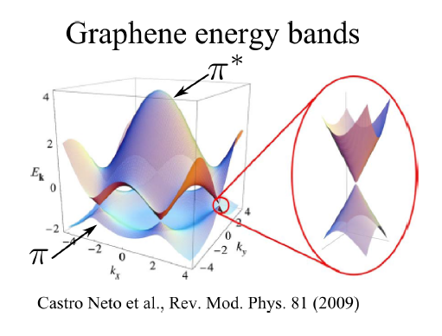
Polariton honeycomb lattice
k_{y}/(2π/3√3a)
k_{x}/(2π/3a)
Pillar diameter = 3 µm
Interpillar distance a = 2.4 µm
4 μm
P bands
S bands
Jacqmin et al., PRL 112, 116402 (2014)
M. Milićević et al., Phys. Rev. X 9, 31010 (2019)
B. Real et al., Phys. Rev. Lett. 125, 186601 (2020)

Slide 12
Outline of the talk
Introduction : synthetic polariton matter
Polariton condensate belong to the Kardar Parisi Zhang universality class

Slide 13
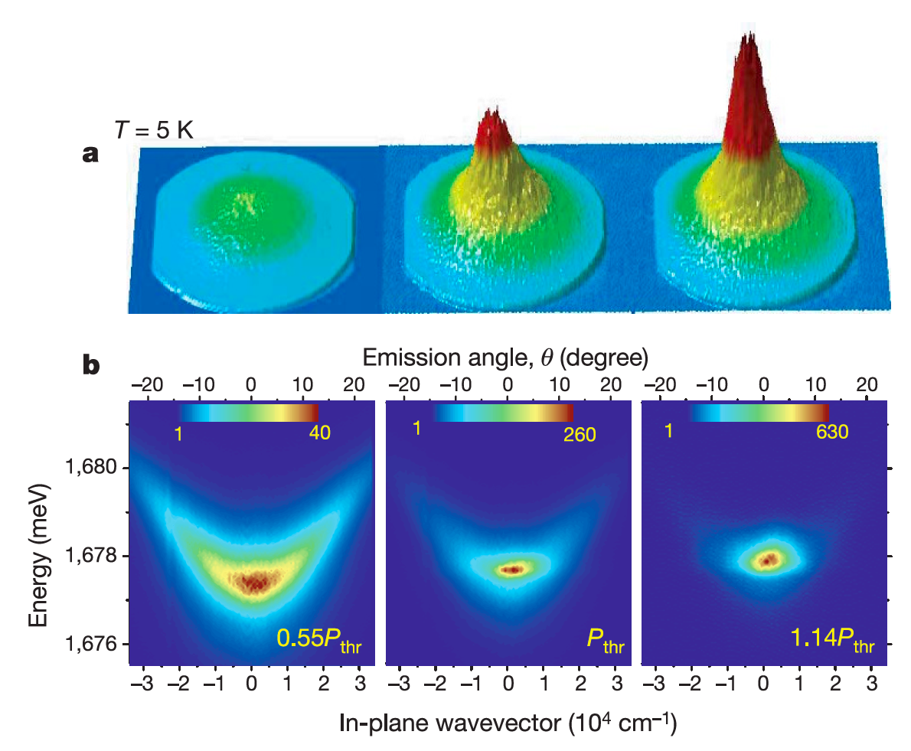

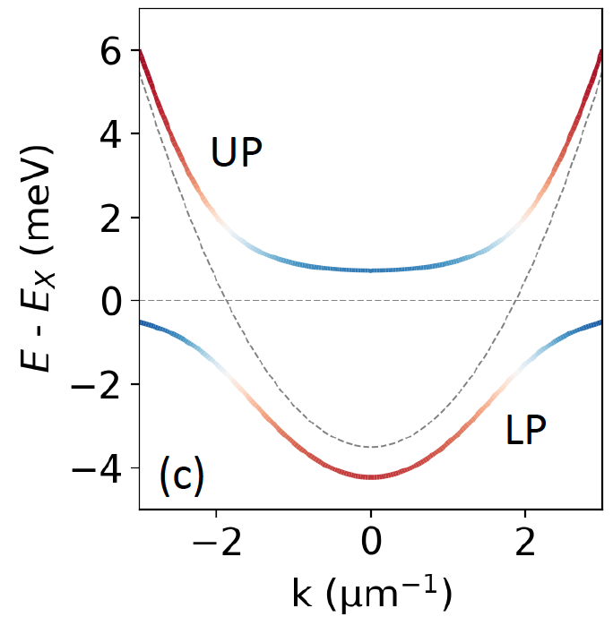


Polariton Bose Einstein condensation
QW free carrier states
CW Ti-Saph
@ 735 nm
Kasprzak, Jacek, et al. Nature (2006)
Relaxation
Exciton states
Reservoir
Kasprzak et al. Nature, 443, 409 (2006)
See also H. Deng et al. Science (2002), R. Balili et al., Science (2007)
J. Bloch, I. Carusotto and M. Wouters, Spontaneous coherence in spatially extended photonic systems: Non-Equilibrium Bose-Einstein condensation, Nature Review Physics (2022) (https://doi.org/10.1038/s42254-022-00464-0)

Slide 14
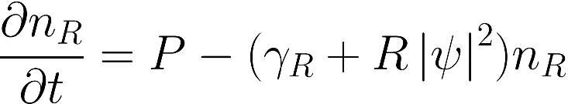



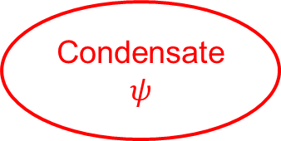
Polariton Bose Einstein condensation
Pump P
QW free carrier states
CW Ti-Saph
@ 735 nm
Reservoir
n_{R}
Decay
Relaxation
$$Rn_{R}\left|ψ^{2}\right|$$
$$γ_{r}$$
Exciton states
Condensate
$$ψ$$
Reservoir
Decay
$$γ$$
MEAN FIELD DESCRIPTION OF THE POLARITON FLUID
(Incoherent Pumping = GPE + Reservoir)
noise
J. Bloch, I. Carusotto and M. Wouters, Spontaneous coherence in spatially extended photonic systems: Non-Equilibrium Bose-Einstein condensation, Nature Review Physics (2022) (https://doi.org/10.1038/s42254-022-00464-0)

Slide 15
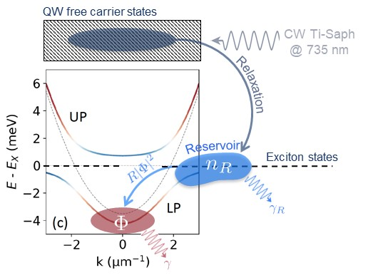
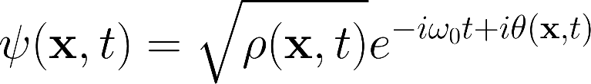
Phase coherence in a polariton condensates
E. Altman, S. Diehl, M. Wouters 2015
Density-phase representation :
Assume different time scales for density and phase fluctuations :
E. Altman, et al., PRX 5, 011017 (2015)
K. Ji, et al., PRB 91, 045301 (2015)
L. He, et al., PRB 92, 155307 (2015)

Slide 16
Phase coherence in a polariton condensates
E. Altman, S. Diehl, M. Wouters 2015
Density-phase representation :
Assume different time scales for density and phase fluctuations :
This is the famous Kardar Parisi Zhang equation!!
E. Altman, et al., PRX 5, 011017 (2015)
K. Ji, et al., PRB 91, 045301 (2015)
L. He, et al., PRB 92, 155307 (2015)

Slide 17
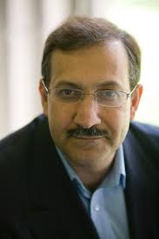
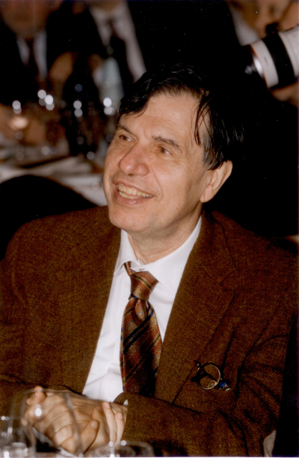
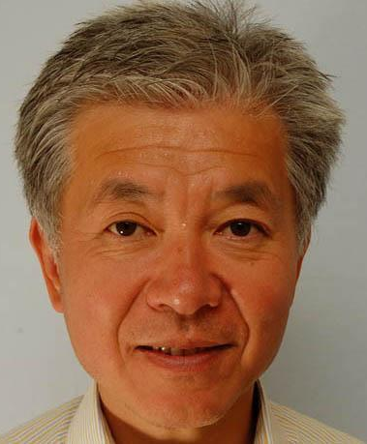
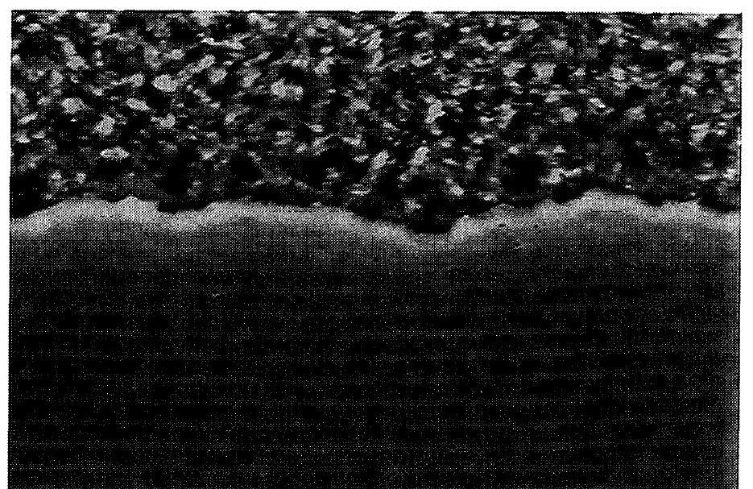
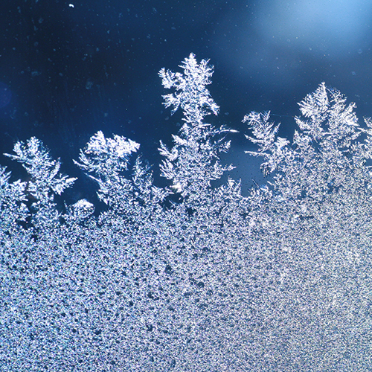
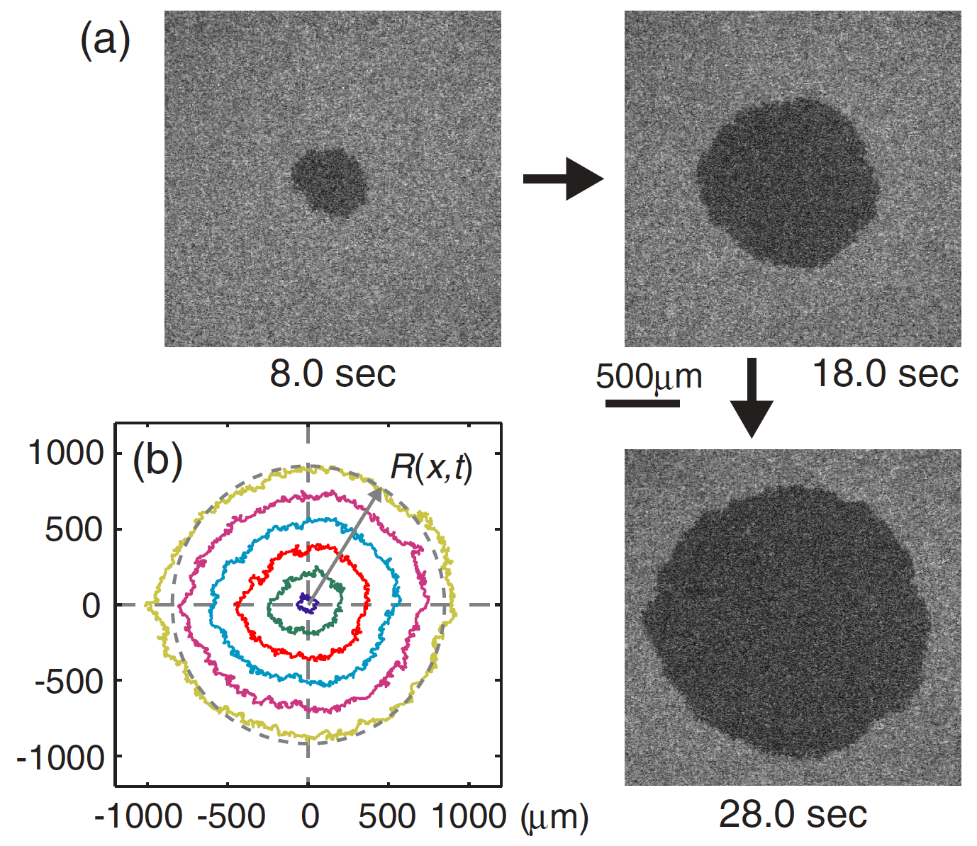
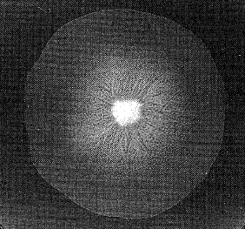
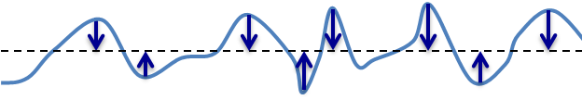
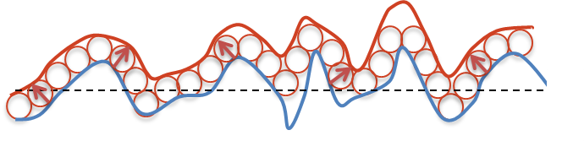
Kardar-Parisi-Zhang theory of interface stochastic growth
Kardar
Parisi
Zhang
Kardar, Parisi and Zhang, PRL (1986)
Frost on a window
Bacteria
Liquid crystals
1D antiferromagnet (Nature Phys. 2021)
See also D. Wei, Science 376 716 (2022)
Diffusion term
smoothens the surface
Stochastic term (fluctuations)
White Gaussian noise
Growth term (nonlinear)
Orthogonal to the surface
Non-equilibrium

Slide 18
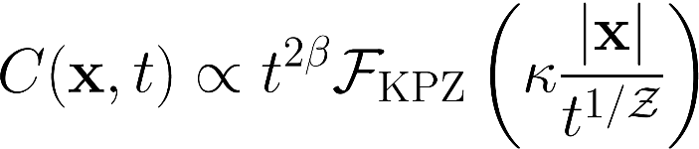



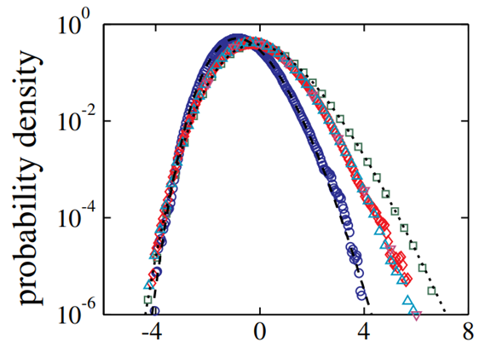
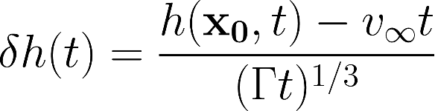


Landmark signatures of KPZ physics
Kardar
Parisi
Zhang
Self-organized scale invariance
⟹ Critical exponents (universal)
Kardar, Parisi and Zhang, PRL (1986)
1D KPZ universality class
KPZ universal scaling function (tabulated)
Non-Gaussian probability distribution of height fluctuations
T. Halpin-Healy, & Y.-C. Zhang, Phys. Rep. 254, 215 (1995)
J. Krug, Adv. Phys. 46, 139 (1997)
K. A. Takeuchi, Physica A 504, 77 (2018)
K. A. Takeuchi, PRL 110, 210604 (2013)

Slide 19
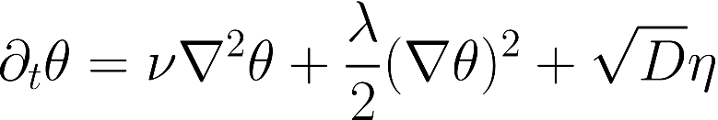
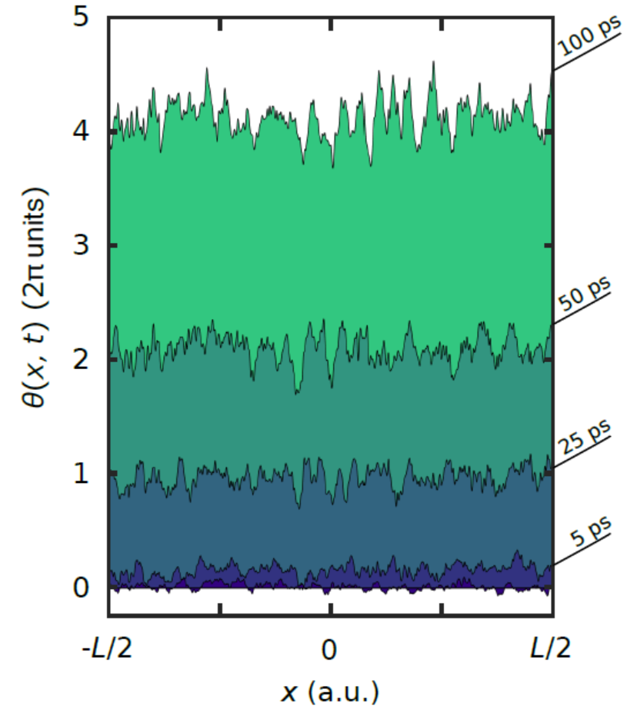
Polariton condensates
The phase front behaves as a growing interface
KPZ scaling expected in the spatio- temporal correlations of the phase
Instantaneous phase : difficult to access in the experiment …
How to probe KPZ scaling ???
E. Altman, et al., PRX 5, 011017 (2015)
K. Ji, et al., PRB 91, 045301 (2015)
L. He, et al., PRB 92, 155307 (2015)

Slide 20
Polariton condensates
We can measure amplitude amplitude correlations of the field (first order coherence :
If phase fluctuations are independent of density fluctuations and for small density fluctuations :
See derivation in Q. Fontaine, et al, Nature 608, 687 (2022)

Slide 21
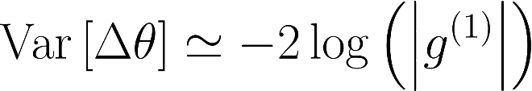
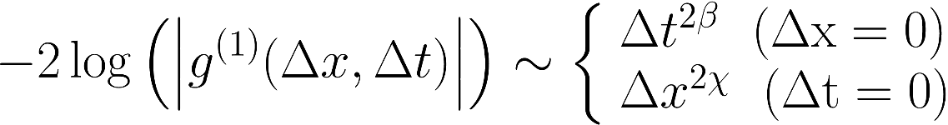
Polariton condensates
We can measure amplitude amplitude correlations of the field (first order coherence :
If phase fluctuations are independent of density fluctuations and for small density fluctuations :
For small phase fluctuations :
In 1D:
See derivation in Q. Fontaine, et al, Nature 608, 687 (2022)

Slide 22

KPZ physics in polariton condensates
The phase is a compact variable : $θε\left[0, 2π\right]$
Even in 1D : Space time vortex
Effective 2D system: 1st order phase transition
Polaritons
L. He, L.M. Sieberer and S. Diehl, Phys. Rev. Lett. 118, 085301 (2017)

Slide 23
KPZ physics in polariton condensates
The phase is a compact variable : $θε\left[0, 2π\right]$
Even in 1D : Space time vortex
Effective 2D system: 1st order phase transition
Polaritons
L. He, L.M. Sieberer and S. Diehl, Phys. Rev. Lett. 118, 085301 (2017)
In 2D: Space time AND spatial vortices
KPZ scaling in 2D open condensates? ⟹ Still actively debated
E. Altman, et al., PRX 5, 011017 (2015)
A. Zamora, et al., PRX 7, 041006 (2017)
Q. Mei, et al., PRB 103, 045302 (2021)
A. Ferrier, et al., PRB 105, 205301 (2022)

Slide 24
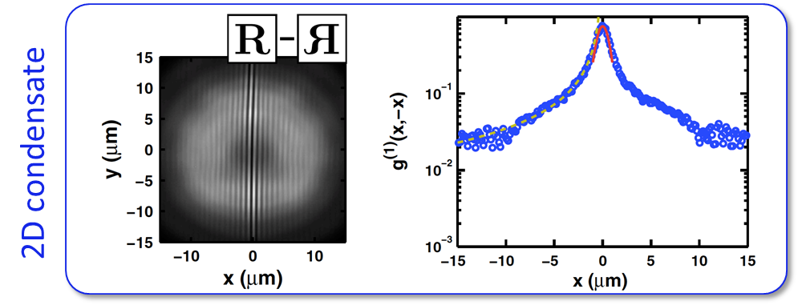
Experimental observation?
Small size effects
Weak overlap with the reservoir
G. Roumpos et al., PNAS109 (17) 6467 (2011)
See also J. Fischer et al., Phys. Rev. Lett. 113, 203902 (2014)
D. Caputo et al., Nature Materials 17, 145 (2018)
D. Ballarini et al, Phys. Rev. Lett. 118, 215301 (2017)

Slide 25
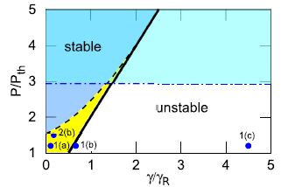
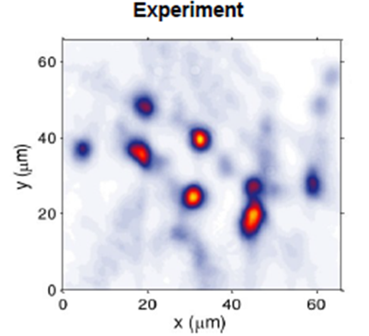
Experimental observation?
Small size effects
Weak overlap with the reservoir
G. Roumpos et al., PNAS109 (17) 6467 (2011)
See also J. Fischer et al., Phys. Rev. Lett. 113, 203902 (2014)
D. Caputo et al., Nature Materials 17, 145 (2018)
D. Ballarini et al, Phys. Rev. Lett. 118, 215301 (2017)
Condensation within an large excitation spot
Modulation instability
☹ ☹
F. Baboux et al., Optica 5, 1163 (2018)
M. Wouters et al., Phys. Rev. B 77, 115340 (2008)
N. Bobroska et al., PRB 90, 205304 (2014),
N. Bobrovska and M. Matuszewski,PRB 92, 035311 (2015)

Slide 26
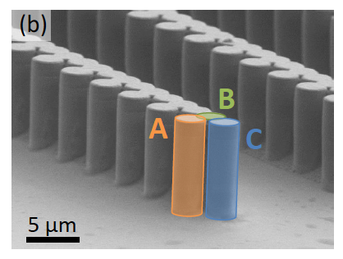
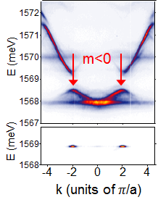
Taming the instability : condensation in a negative mass band
P<P_{th}
F. Baboux et al., Optica 5, 1163 (2018)
P>P_{th}
Review on polariton lattice engineering: C. Schneider et al., Rep. Prog. Phys. 80, 16503 (2017)

Slide 27

Taming the instability : condensation in a negative mass band
P<P_{th}
F. Baboux et al., Optica 5, 1163 (2018)
P>P_{th}
Review on polariton lattice engineering: C. Schneider et al., Rep. Prog. Phys. 80, 16503 (2017)
Quentin Fontaine
x (µm]
Q. Fontaine, et al, Nature 608, 687 (2022)

Slide 28
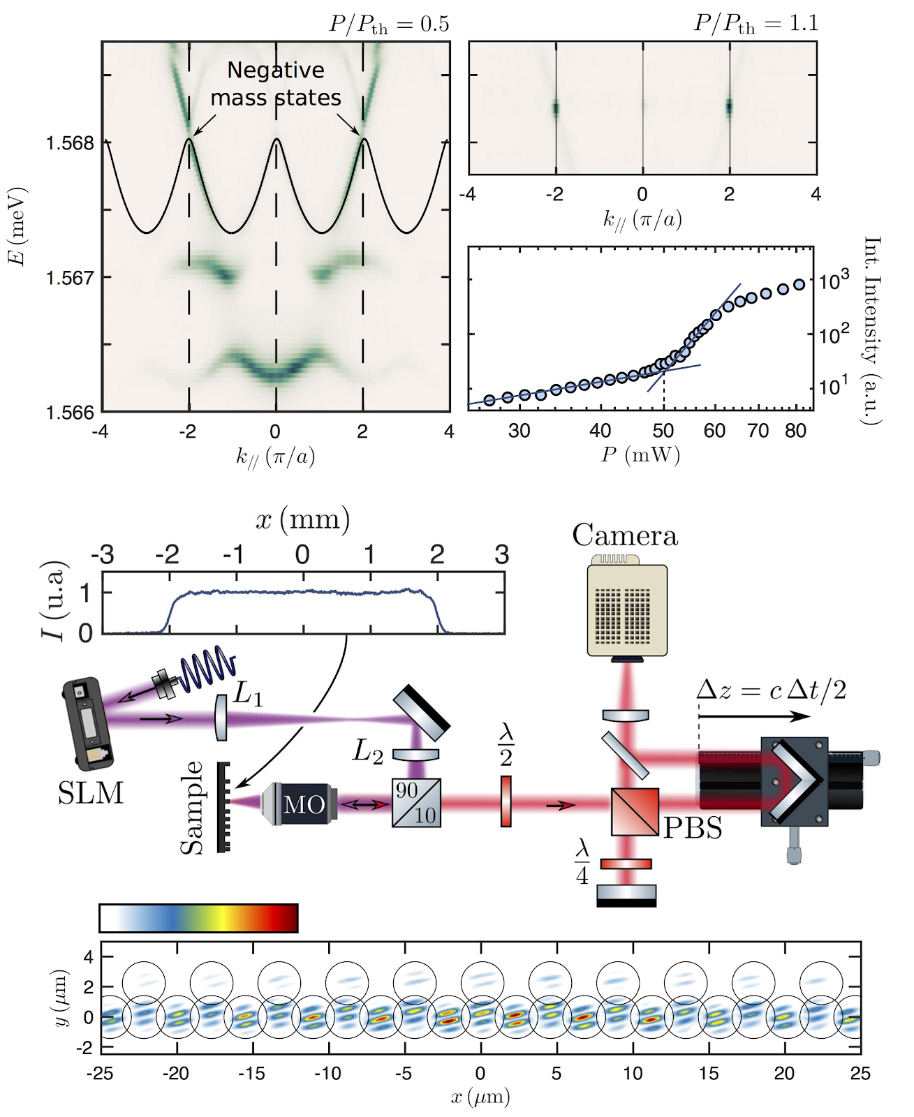

KPZ physics in 1D polariton condensates
$$Δt=0$$

Slide 29
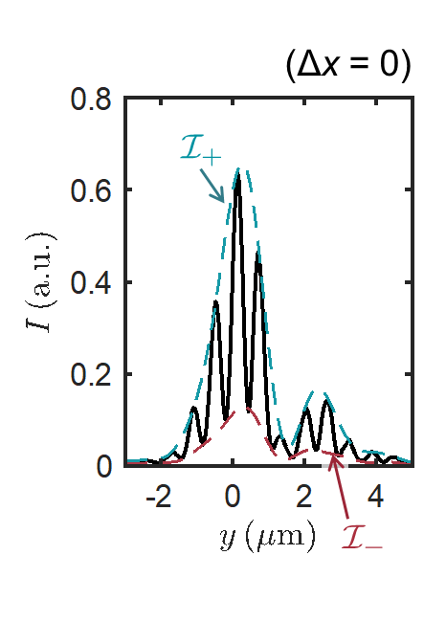
KPZ physics in 1D polariton condensates
$$Δt=0$$

Slide 30

KPZ physics in 1D polariton condensates
g¹(Δt,Δx)

Slide 31



KPZ physics in 1D polariton condensates
g¹(Δt,Δx)
“SURFACE ROUGHNESS”
WE EXPECT:
for $Δx=0$
for $Δt=0$
Δx = 0

Slide 32
KPZ physics in 1D polariton condensates
g¹(Δt,Δx)
“SURFACE ROUGHNESS”
WE EXPECT:
for $Δx=0$
for $Δt=0$
Δt = 0
Δx = 0

Slide 33
KPZ physics in 1D polariton condensates
g¹(Δt,Δx)
“SURFACE ROUGHNESS”
WE EXPECT:
for $Δx=0$
for $Δt=0$
Δt = 0
Δx = 0

Slide 34

KPZ scaling laws in 1D polariton condensates
KPZ scaling
where is the UNIVERSAL KPZ SCALING FUNCTION.
Q. Fontaine, et al, Nature 608, 687 (2022)

Slide 35

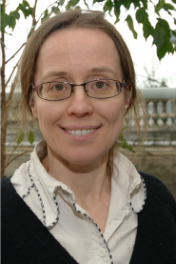


SIMULATIONS - COMPARISON WITH EXPERIMENTS
Integrate numerically the two coupled equations model
D. Squizzato
A. Minguzzi
L. Canet
Q. Fontaine, et al, Nature 608, 687 (2022)

Slide 36
SIMULATIONS - COMPARISON WITH EXPERIMENTS
Experiment
Simulations
D. Squizzato
A. Minguzzi
L. Canet
Q. Fontaine, et al, Nature 608, 687 (2022)

Slide 37
Phase dynamics (simulations)
Calculate total phase (unwrapped) difference for several noise realisations:
Q. Fontaine, et al, Nature 608, 687 (2022)

Slide 38

Phase dynamics (simulations)
Calculate total phase (unwrapped) difference for several noise realisations:
Q. Fontaine, et al, Nature 608, 687 (2022)

Slide 39
Phase dynamics (simulations)
Calculate total phase (unwrapped) difference for several noise realisations:
Occasional 2π phase jumps.
Q. Fontaine, et al, Nature 608, 687 (2022)

Slide 40

Phase dynamics (simulations)
Calculate total phase (unwrapped) difference for several noise realisations:
Occasional 2π phase jumps.
KPZ “piecewise” ?
Pairs of vortex and antivortex appear in effective 2D space (Δx, Δt).
Q. Fontaine, et al, Nature 608, 687 (2022)

Slide 41





Amplitude distribution of phase fluctuations
For Δx and Δt within KPZ window is a random variable expected to obey Tracy-Widom statistics (non-Gaussian).
Q. Fontaine, et al, Nature 608, 687 (2022)

Slide 42
Conclusion and prospects
1D driven-dissipative condensates belong to the KPZ universality class
Compact version of KPZ with a phase variable
⟹ topological defects
KPZ scaling can be resilient to these defects
Turbulent phase for higher noise / pump power?
L. He, L. M. Sieberer, & S. Diehl, PPRL 118, 085301 (2017)

Slide 43
Conclusion and prospects
In 2D: Space time AND spatial vortices
Vortex proliferation kills KPZ correlations?
Debated topics!
E. Altman, et al., PRX 5, 011017 (2015)
A. Zamora, et al., PRX 7, 041006 (2017)
Q. Mei, et al., PRB 103, 045302 (2021)
A. Ferrier, et al., PRB 105, 205301 (2022)
KPZ predicted in recent simulations using 2D discrete (lattice) model
K. Deligiannis, et al., Phys. Rev. Research 4, 043207 (2022)

Slide 44
Conclusion and prospects
In 2D: Space time AND spatial vortices
Vortex proliferation kills KPZ correlations?
Debated topics!
E. Altman, et al., PRX 5, 011017 (2015)
A. Zamora, et al., PRX 7, 041006 (2017)
Q. Mei, et al., PRB 103, 045302 (2021)
A. Ferrier, et al., PRB 105, 205301 (2022)
KPZ predicted in recent simulations using 2D discrete (lattice) model
K. Deligiannis, et al., Phys. Rev. Research 4, 043207 (2022)

Slide 45


Conclusion and prospects
Negative mass condensates in 2D
Preliminary results
in 2D

Slide 46

Conclusion and prospects
Negative mass condensates in 2D
KPZ scaling predicted
in the OPO regime
Preliminary results
in 2D
A. Zamora, et al., PRX 7, 041006 (2017)
Polariton lattices may provide the first experimental platform to probe KPZ physics in 2D

