Slide 1

Cell lineage statistics and fitness with incomplete population trees
A. Genthon, L. Peliti, T. Nozoe and D. Lacoste
Laboratory Gulliver, ESPCI and Tokyo University
Arxiv.org/abs/2305.05406 (under review)

Slide 2
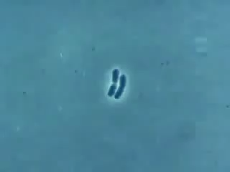
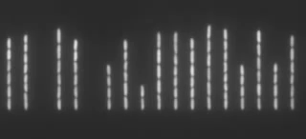
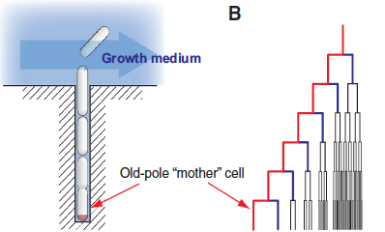
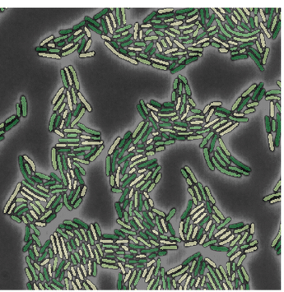
Various types of single-cell experiments
Time-lapse video-microscopy Mother machine :
Snapshot of live cells
P. Wang et al. 2010

Slide 3
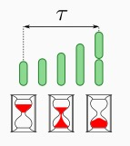
Statistical biais in a population of cells
Powell relation (1956)
: population growth rate
Two kinds of averages:
pop : « snapshot » average in a population
lin : average along a lineage of cells
Powell inequalities :
doubling time of the population
Stochasticity of division time affects the population growth rate

Slide 4
Backward (retrospective) sampling
Weight :
Probability to select a lineage :
Population growth rate :
History
t=0 t

Slide 5
Forward (chronological) sampling
Weight on a lineage with K divisions :
Probability of a lineage with K divisions :
number of cells
at time t from lineages
with K divisions
Here
Forward lineage
t=0 t

Slide 6
Inference of population growth rate
A. Genthon and D. L.,
Sci. Rep., 10, 11889 (2020)
Mother machine data : Tanouchi et al. (2015)
Convergence as function of time Convergence as function of the number of samples

Slide 7
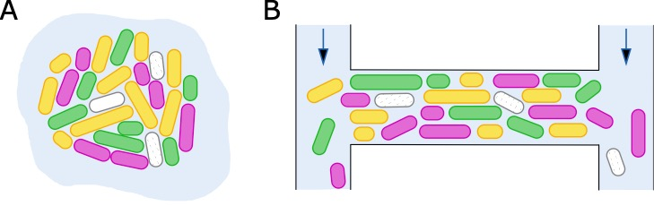
Incomplete cell lineages
  Cells can stop dividing or die because of changes in their environment
  Cells can be flushed away/diluted as in open microfluidic devices
  In either cases, the corresponding cell lineages are incomplete :
  How should we treat dead lineages statistically ?

Slide 8
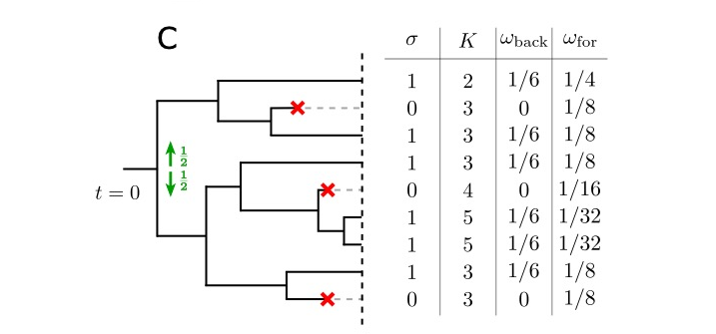
  Dead lineages should have no weight for backward sampling :
  Forward distribution conditioned on survival :
  Forward probability of survival and its rate G_{t}
  lineage is alive at time t
  lineage is dead at time t

Slide 9
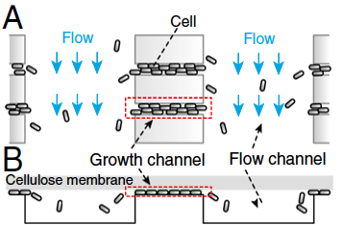
Cell death induced by dilution
  Data from in an open channel
  that maintains a population of about 40 cells constant
  despite the loss due to dilution
  Death is equivalent to a reduction of fitness Universal inequalities bound the
  population growth rate
M. Hashimoto et al. 2015

Slide 10
The fitness landscape
Given a trait s and n(s,t) the number of lineages displaying this trait at time t :
and
Fitness landscape h(s) ignores the distinction between dead and surviving lineages :
Proper fitness landscape :
The survivor bias :
T. Nozoe et al. 2017

Slide 11
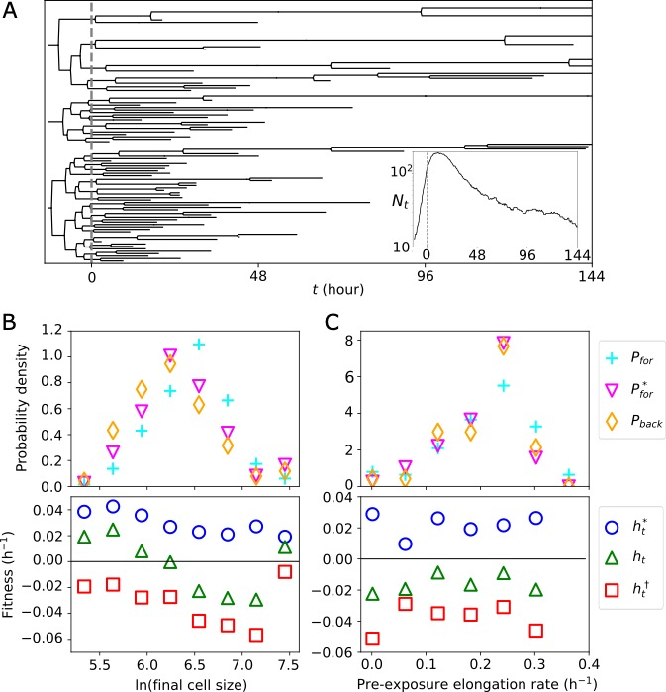
Cell death induced by drug exposure
Drug exposure
Logarithmic cell-size measured at the end of the lineage (trait 2)
Pre-exposure single cell growth rate (trait 1)
Results of the analysis :
Independance of trait 1 with survival and with the fitness of lineages
The decrease of the landscape of trait 2 is not meaningful but is mainly due to the survivor bias

Slide 12
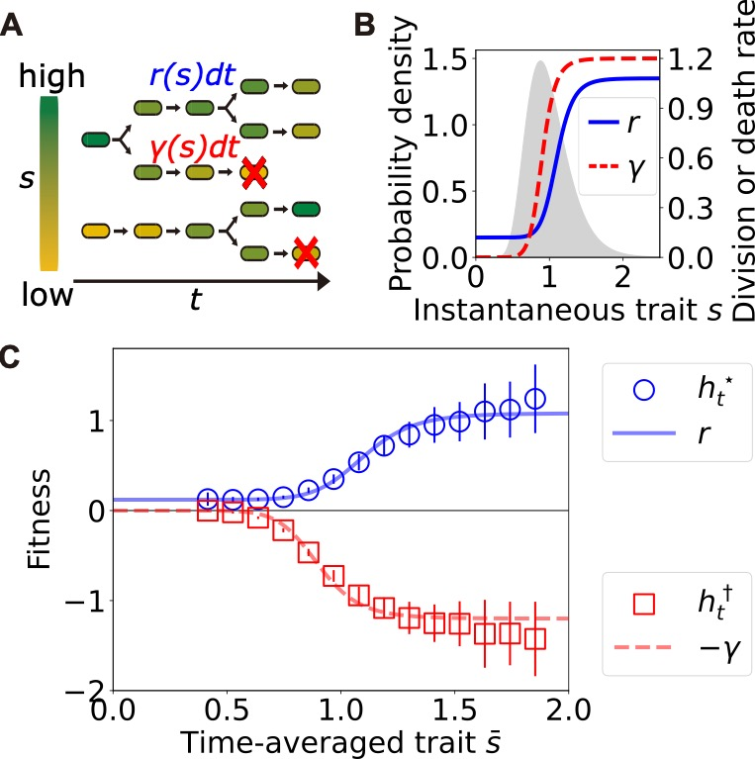
Inference of division and death rates from fitness landscapes
Using the time-averaged trait
division rate
death rate
Conditions:
trait can fluctuate in time but should be unaltered at division
Division rate is wealkly non-linear or the autocorrelation time of the trait is large with respect to observation time

Slide 13
Strength of selection
Strength of selection acting on trait s in the absence of death
becomes in the presence of death
and
death induced part
Some observations :
Selection can not be estimated only from growth rates, death rates matter too
Selection is increased by death only when cells that divide faster also die faster
but selection can be also decreased or be unaffected by death
Variability of death rates among lineages leads to fitness gain for the population
T. Nozoe et al. 2017

Slide 14
Conclusion
A general framework for the statistical lineage trees
Inference of selection and fitness from lineage trees data
Inference of division rate and death rate from lineage statistics
Death matters for measuring the strength of selection
A. Genthon et al., Arxiv.org/abs/2305.05406 (under review)
R. Garcia-Garcia et al. Phys. Rev. E (2019)
A. Genthon et al., Sci. Rep. (2020)
A. Genthon et al., Phys. Rev. Res. (2021)
A. Genthon, J. Roy. Soc. Interface (2022)
A. Genthon et al., J. Phys. A (2022)

