Slide 1
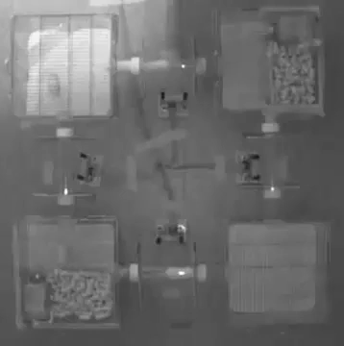
Inferring collective behavior in social mice
Nencki Institute of Experimental Biology,
Polish Academy of Science
Maciej Winiarski
Alicja Puścian
Ewelina Knapska
LPENS, CNRS
Thierry Mora
Aleksandra Walczak
Xiaowen Chen
LPENS, CNRS
3/7/2023 @ MC3, Congrès Général de la SFP

Slide 2


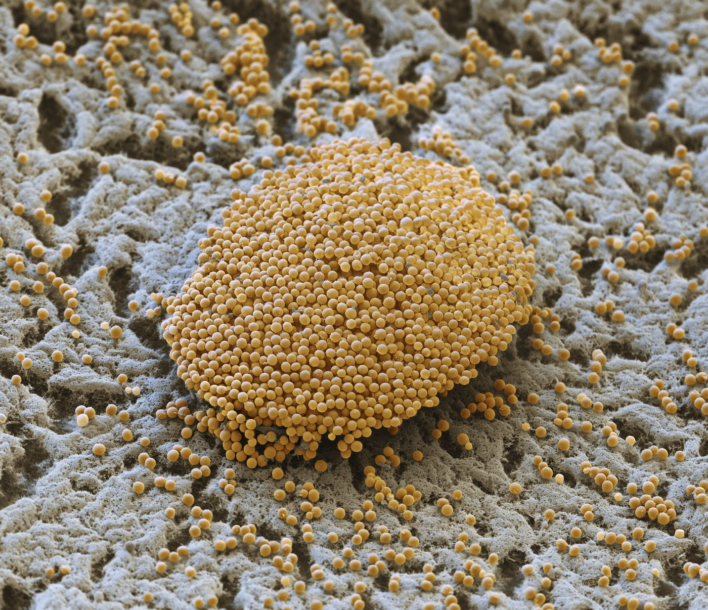
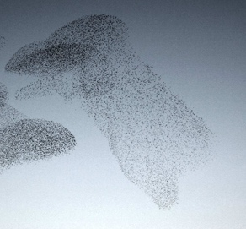
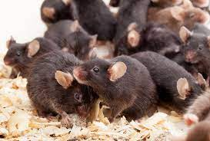
Collective behavior
statistical inference
Bacteria colony
Bird flocks
Social behavior
?
Complexity:
e.g. heterogeneity, internal states
Can we still explain the emergent complexity
Need social animal in controlled environment

Slide 3



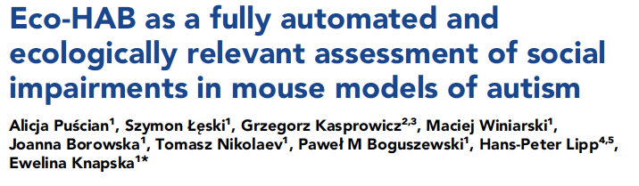
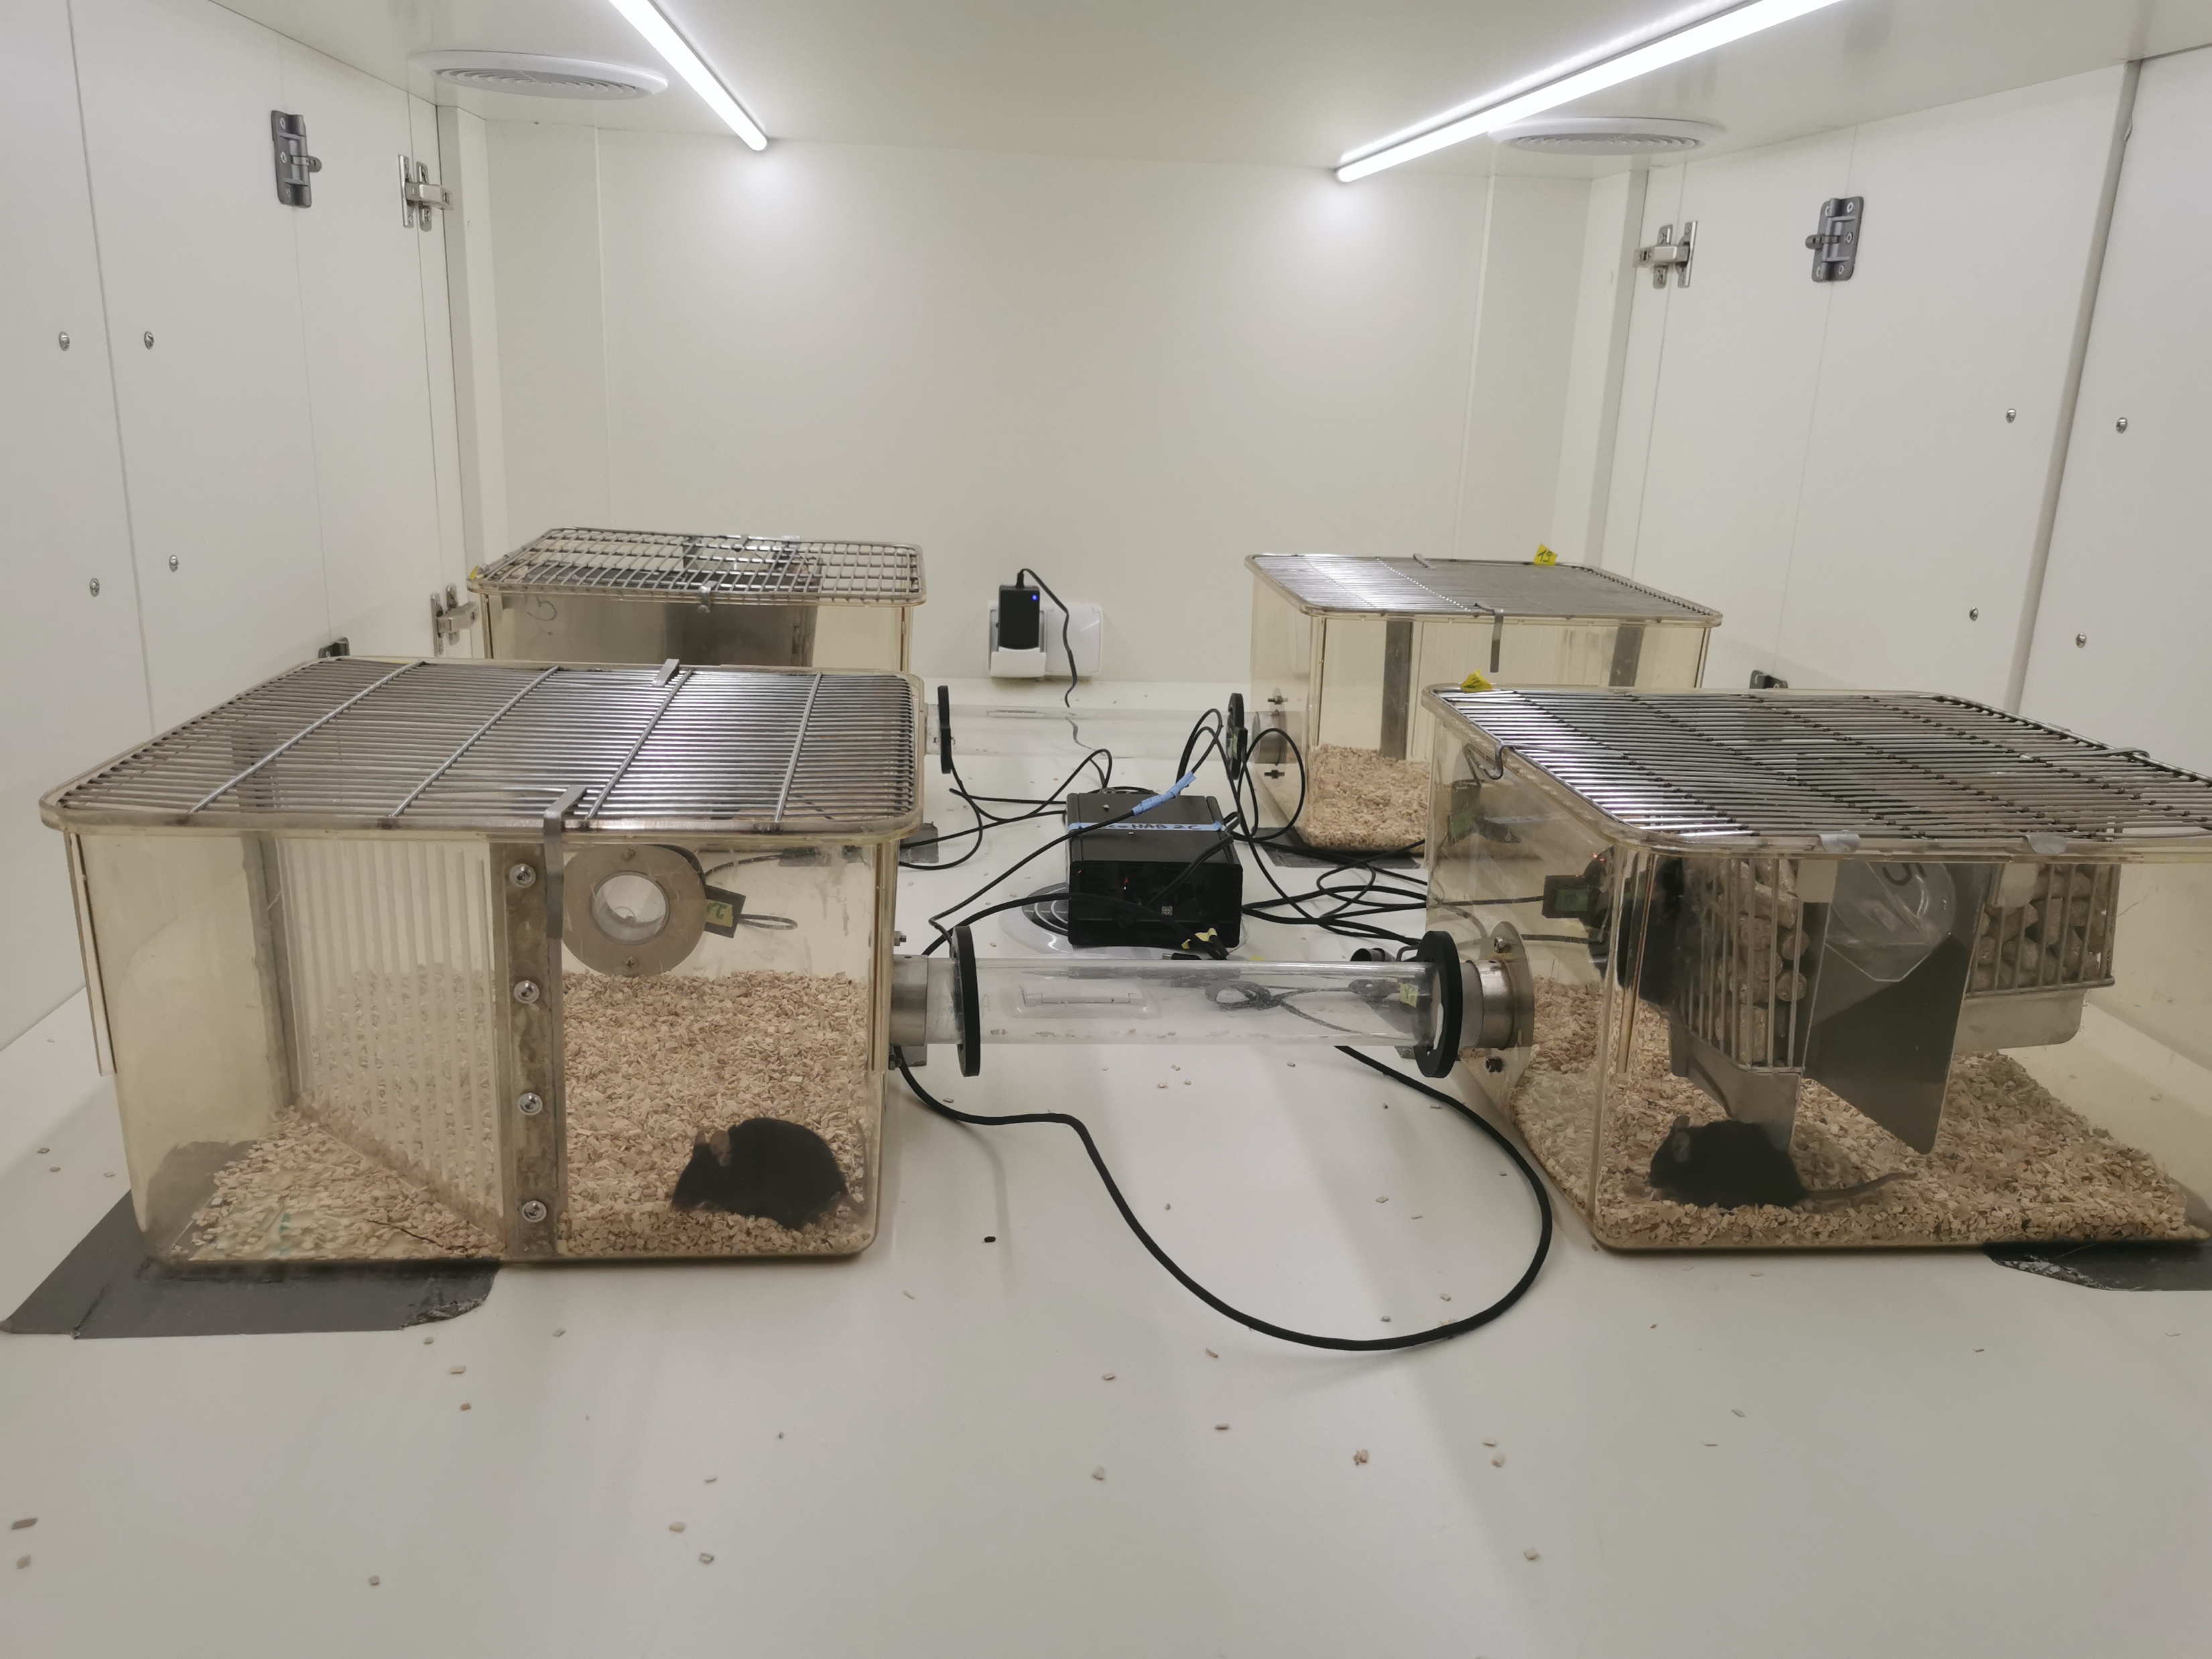
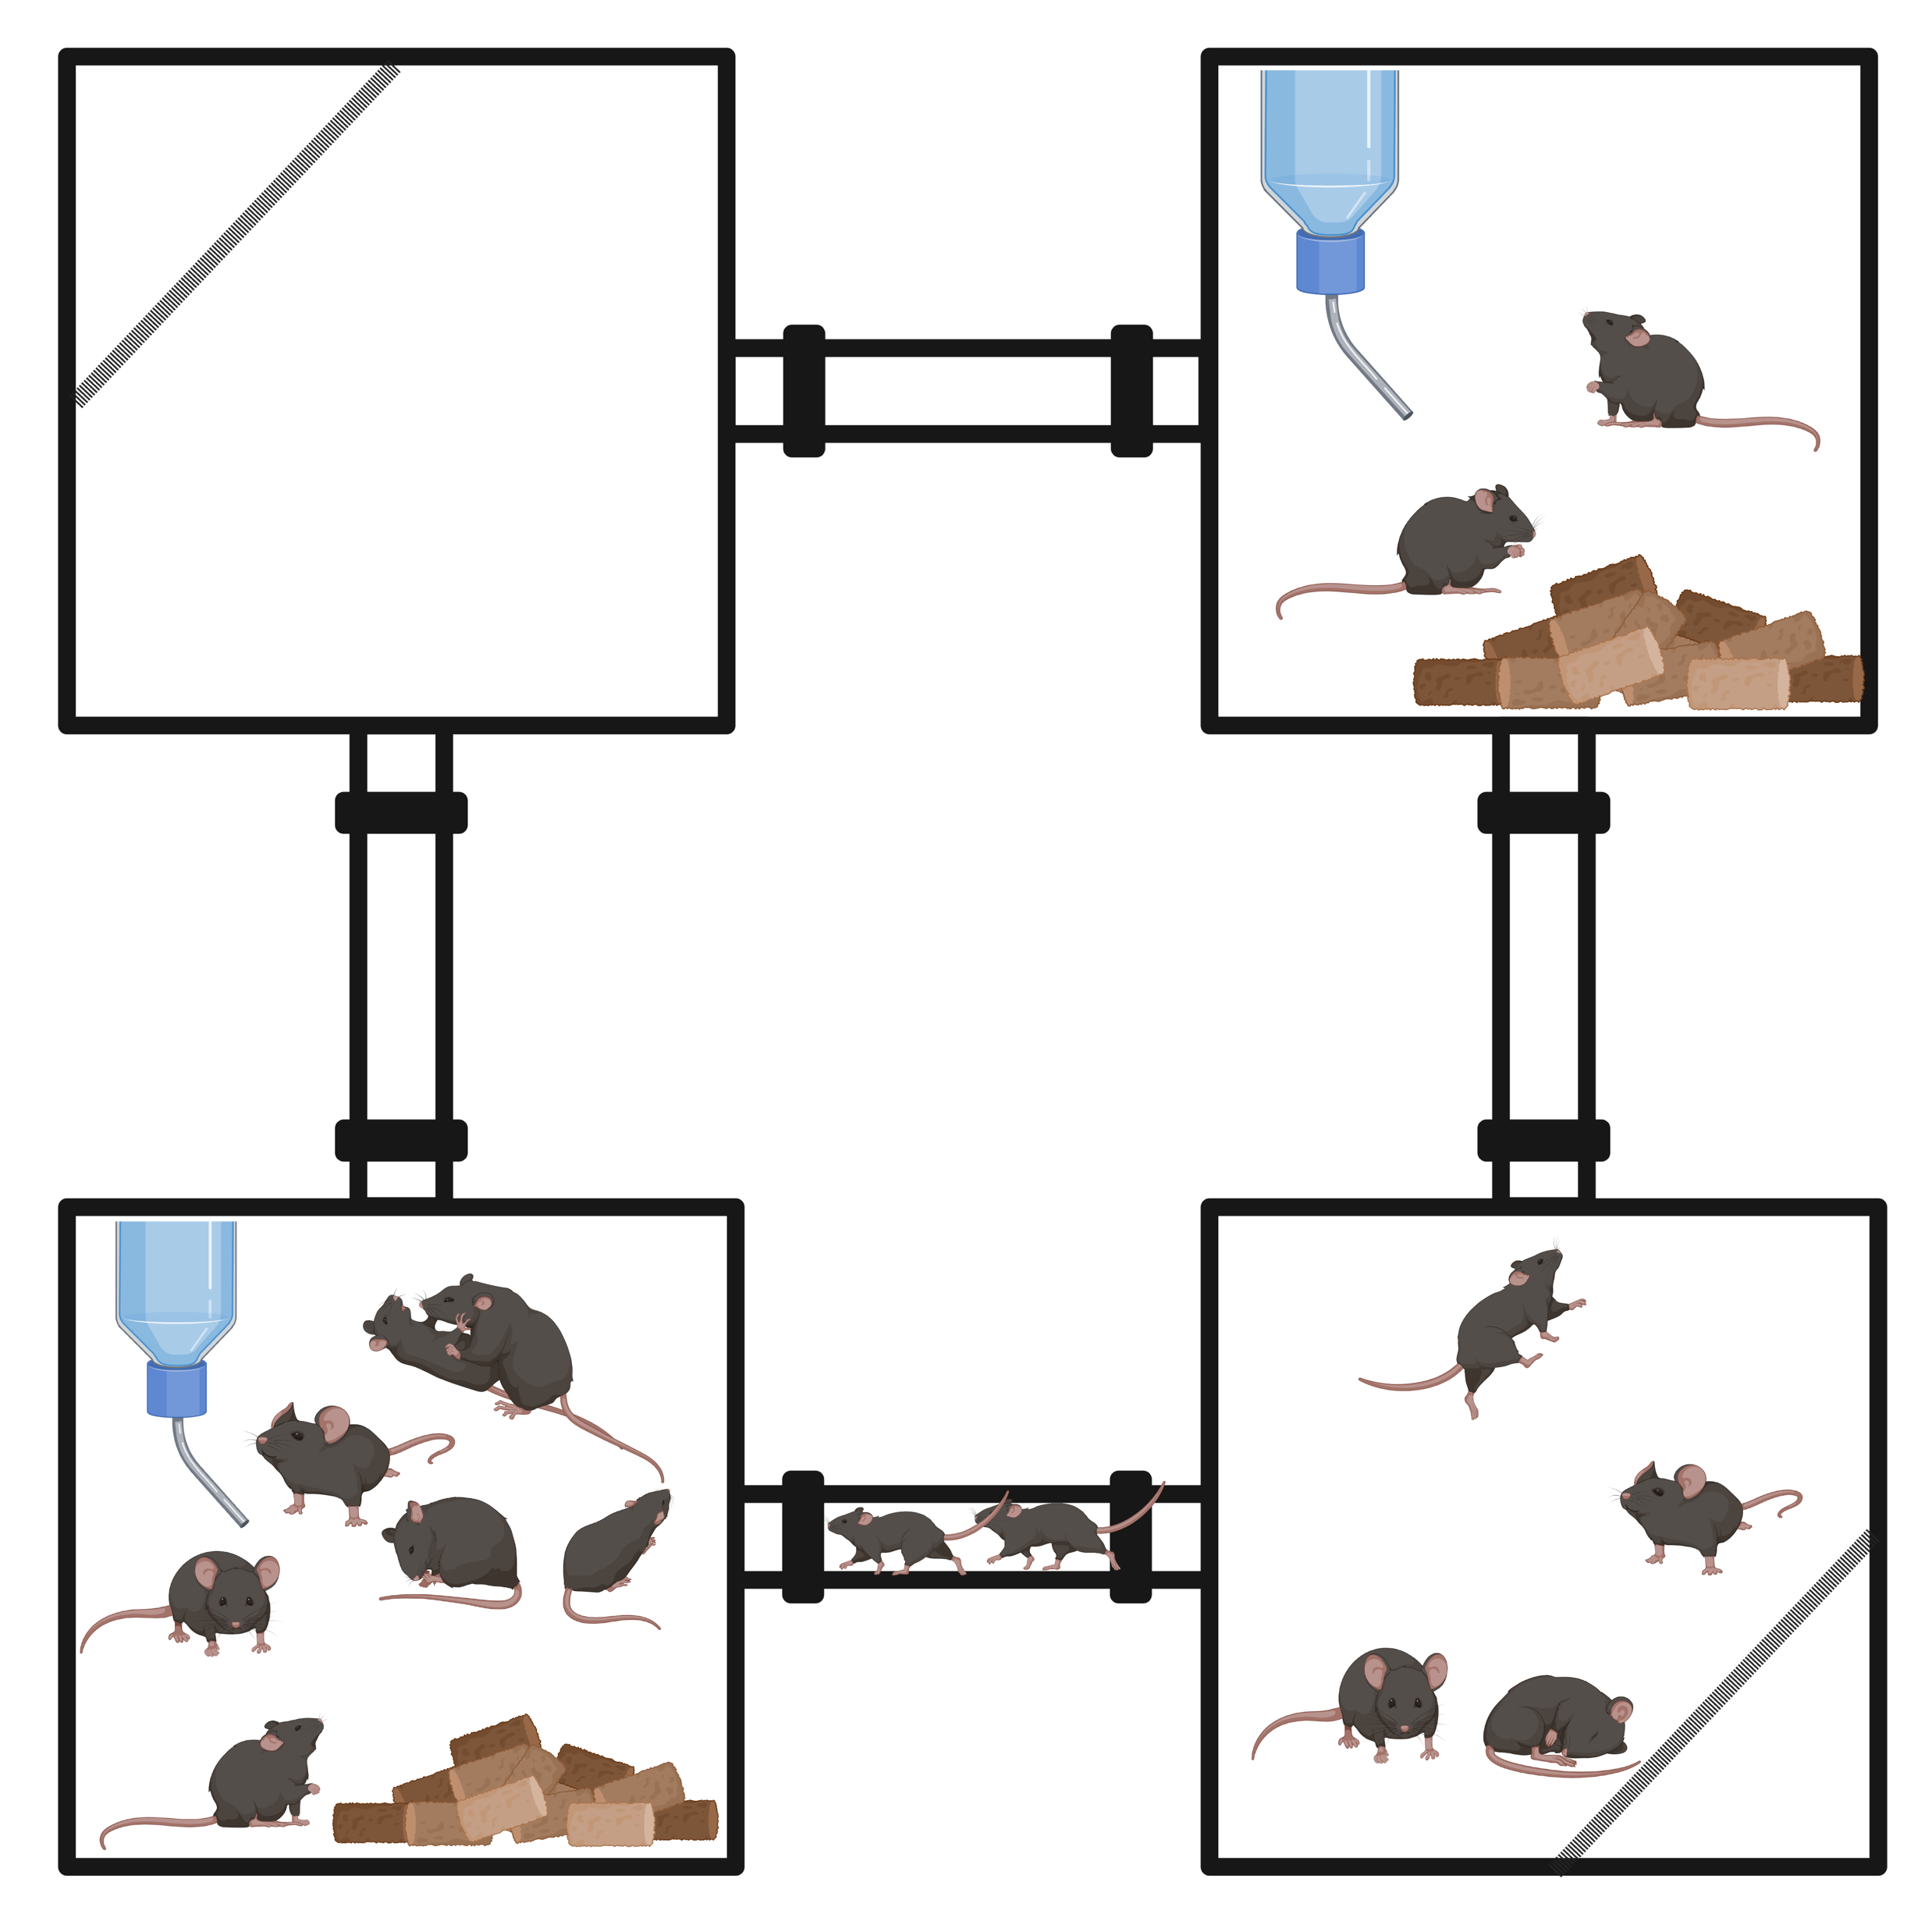
the Eco-HAB experiment
Alicja Puścian
Ewelina Knapska
Maciej Winiarski
15 mice, longitudinally tested for 10 days
RFID
Antenna ~ kHz

Slide 4
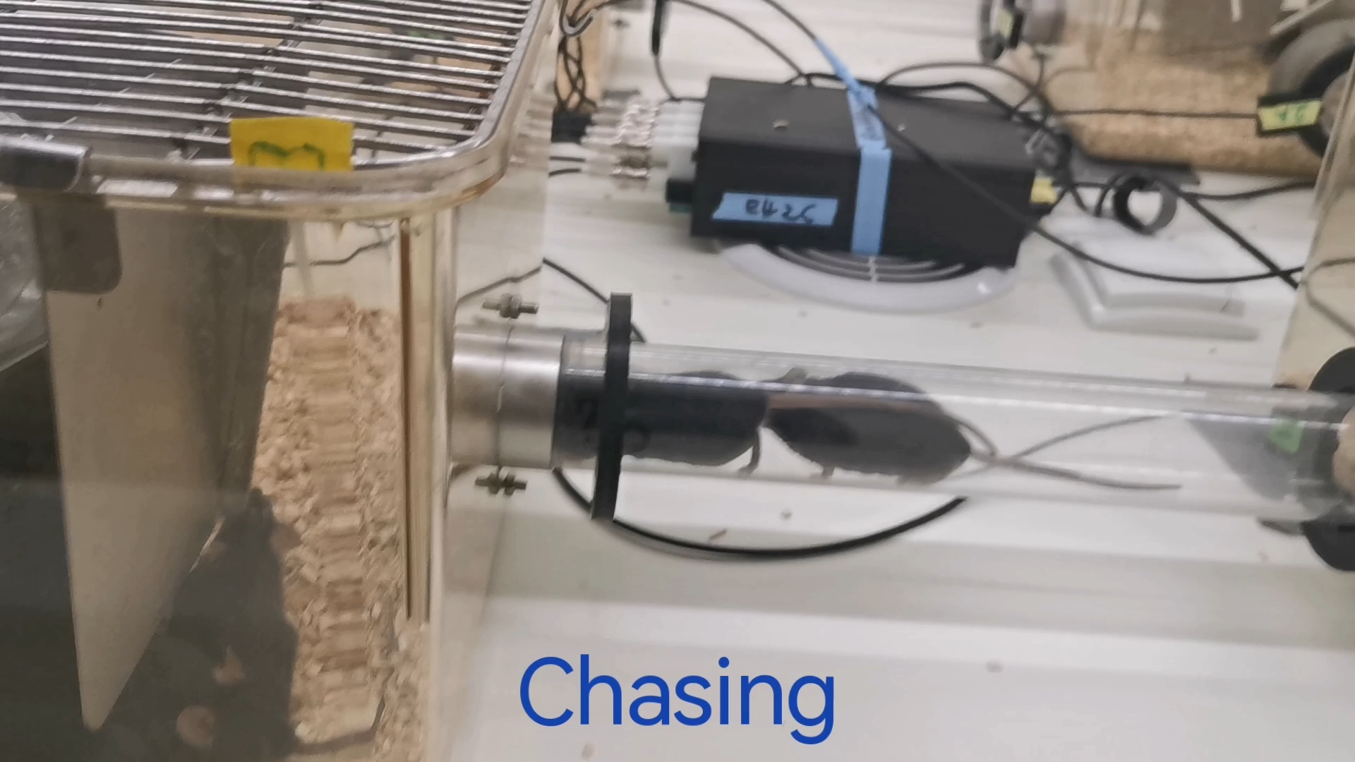
mice exhibits complex social behavior

Slide 5
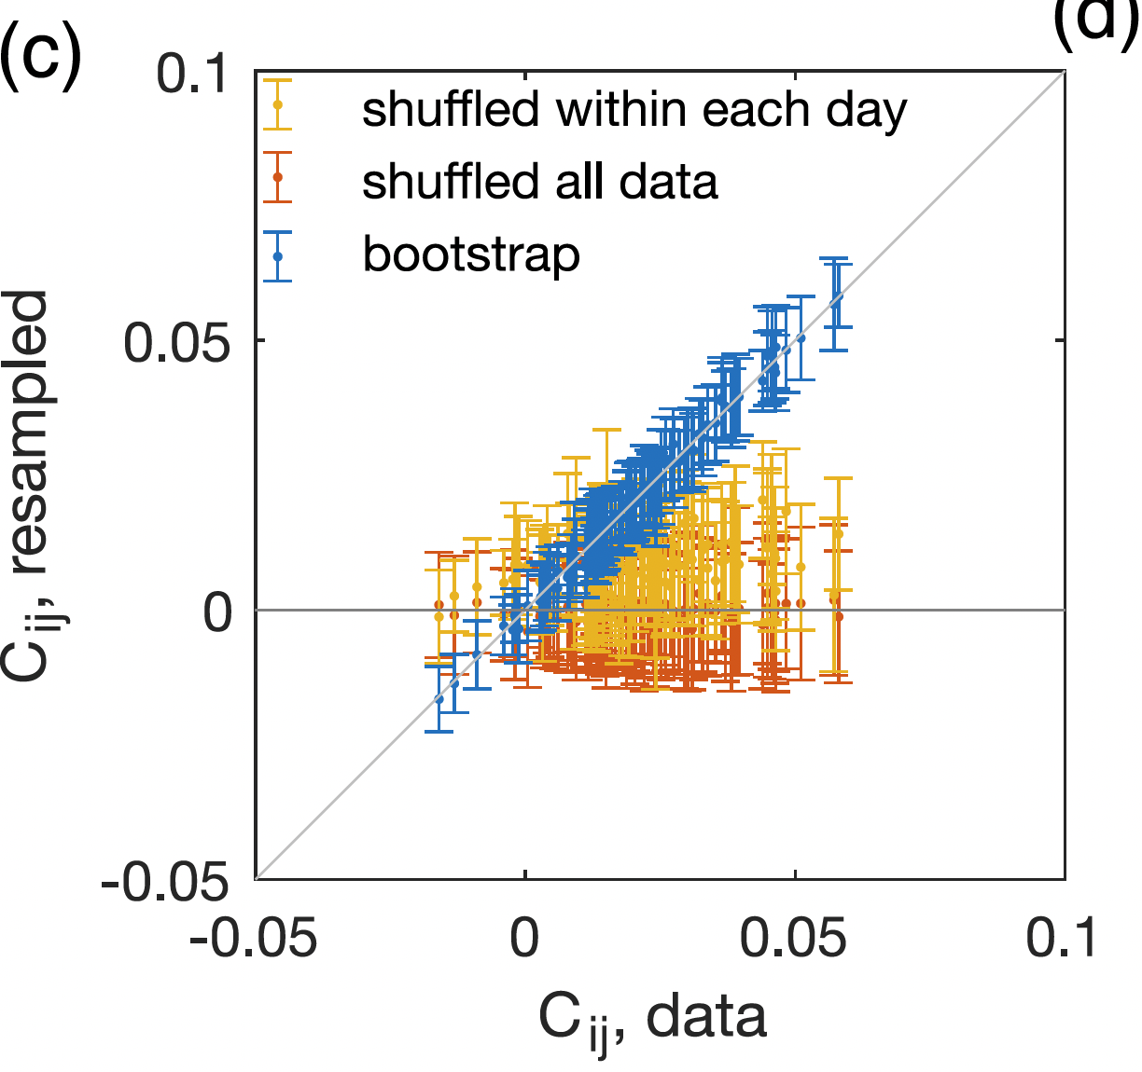
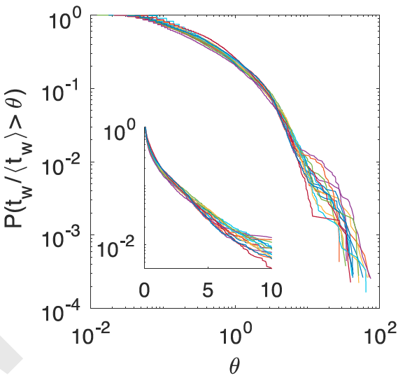
signatures of collective behavior
long correlation time (0.5hr) for the macrostates
fat tail in the waiting time distribution
In-cohort sociability
Autocorrelation of # of mice in each box
Can we learn the interaction rules?

Slide 6
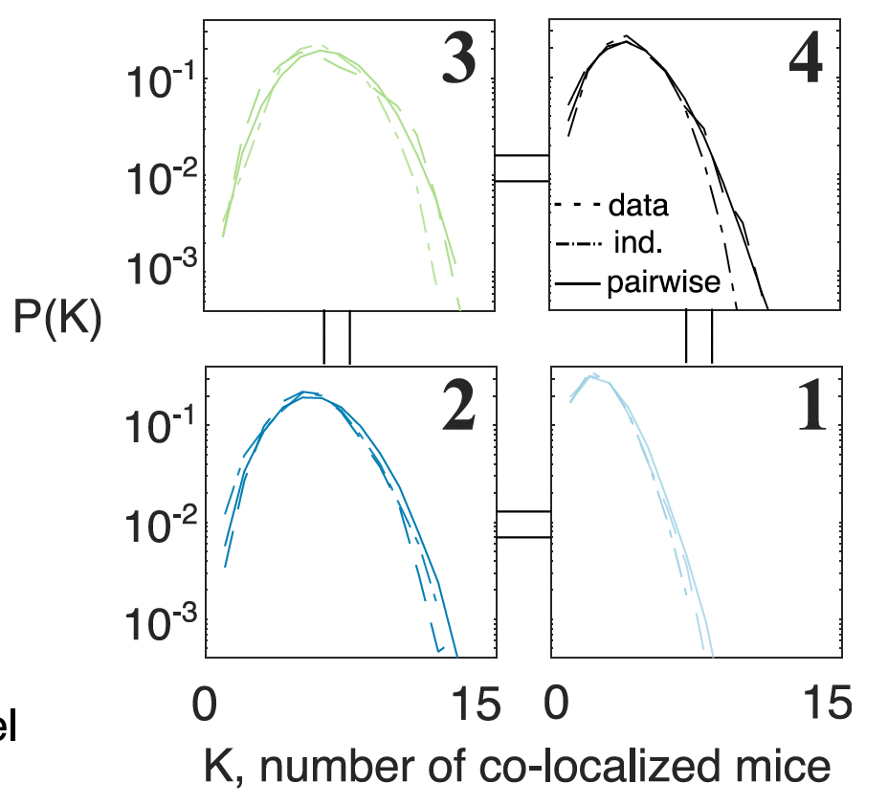
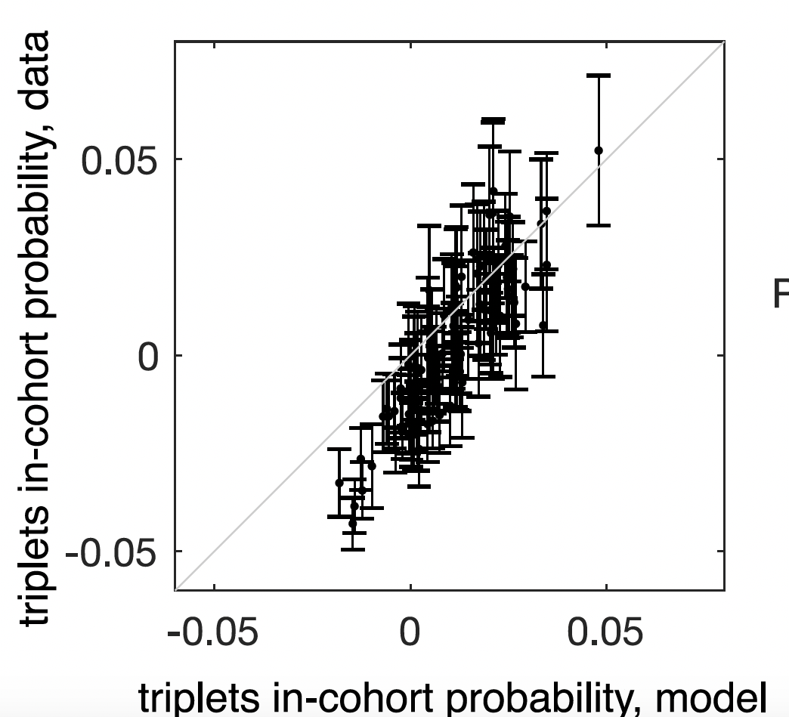
Model co-localization patterns
Energy
Maximum entropy model
Pairwise model can predict higher order correlation
probability of K mice in the same box
Triplet correlation

Slide 7
Model dynamics using transition probabilities
Energy
Maximum entropy model
Dynamic
Static energy -> predict transition rates between boxes
Assume detailed balance:
Glauber dynamics predicts the mean transition rate!

Slide 8
… but not the fat tail in waiting time distribution, needs memory
Hints from the data:
the longer one stays, the less likely is one to leave
Probability of transition (leaving a box)

Slide 9

generalized Glauber dynamics (GGD)
Inspired by generalized Langevin dynamics & the Caldeira-Leggett model for quantum dissipation
Oscillator bath
Hamiltonian
Integrate over the Hamiltonian dynamics for the oscillators
Dynamics
‘static' local field
memory
colored noise
Notes:
[Say in 10 seconds. Suppress animation. Make the rest one. ]
Refer to Zwanzig, and refer to generalized Langevin dynamics.
Go with the integrating over oscillators to show the idea. For single Ising spin.
Show the figure.
Show the whole integration procedure… it’s helpful as a tutorial. At least I didn’t know it until I wrote it out.
Add some intuition.

Slide 10
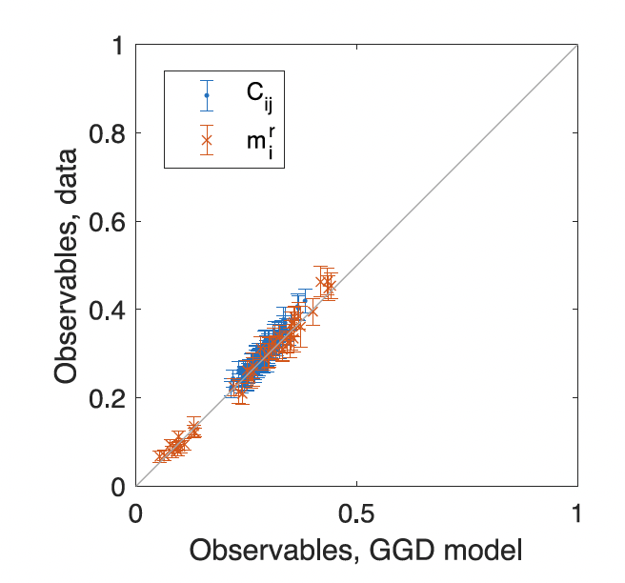
inference for collective dynamics in social mice
Learn static parameters
Parametrize the memory kernel:
Learn A, τ from observed waiting time distribution (heuristically minimizing KS distance / EM)
Naïve Glauber dynamics
Generalized Glauber dynamics with single exponential decay

Slide 11
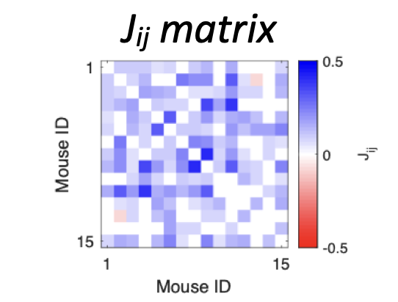
Interaction matrix -> social network?
unstable specific interaction J_{ij}
Jij statistics consistent across days & experiments
-> no inferred social network
-> reproducibility
Social information encoded in the ensemble statistics

Slide 12
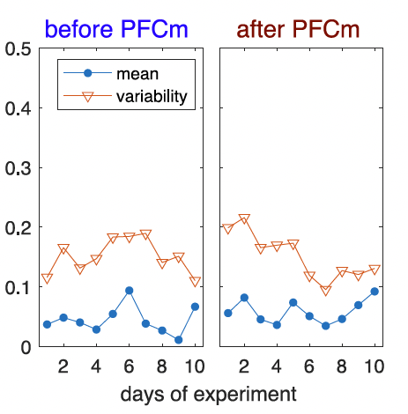
Encode social interactions in autistic mice
TIMP reduces sociability in PFC
Frustration
  Cannot communicate preferences
Interaction, J_{ij}
Male / TIMP
Male / Control
Female / TIMP
days
days
days
Spread of interaction increase
Effect of TIMP lasts for ~ 5 days
TIMP increases frustration
Notes:
Combine 9 and 10

Slide 13
Summary
Generalized Glauber dynamics :
  learn dynamics while keeping the statics fixed
Pairwise interaction model describes Eco-HAB mice data
Socially impaired mice -> quenched interactions
Thank you!
Chen, Winiarski, Puścian, Knapska, Walczak, Mora,
“Generalized Glauber dynamics for inference in biology”,
arxiv 2208.03483

Slide 17
Extra slides

Slide 18
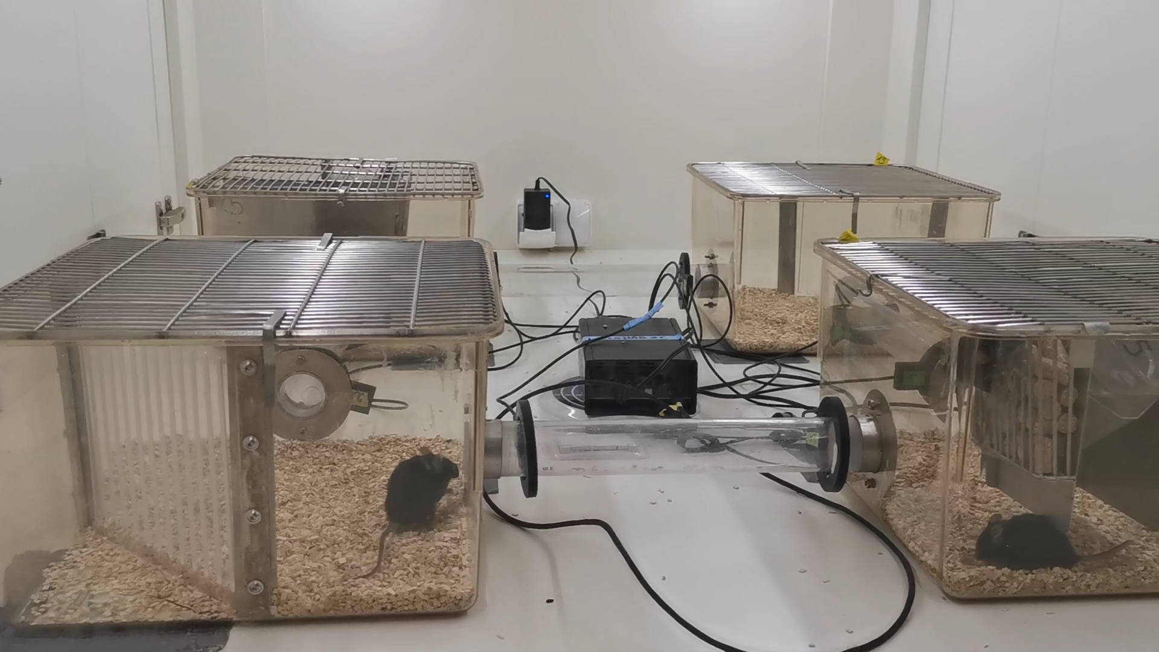
not all social behavior recorded

Slide 19
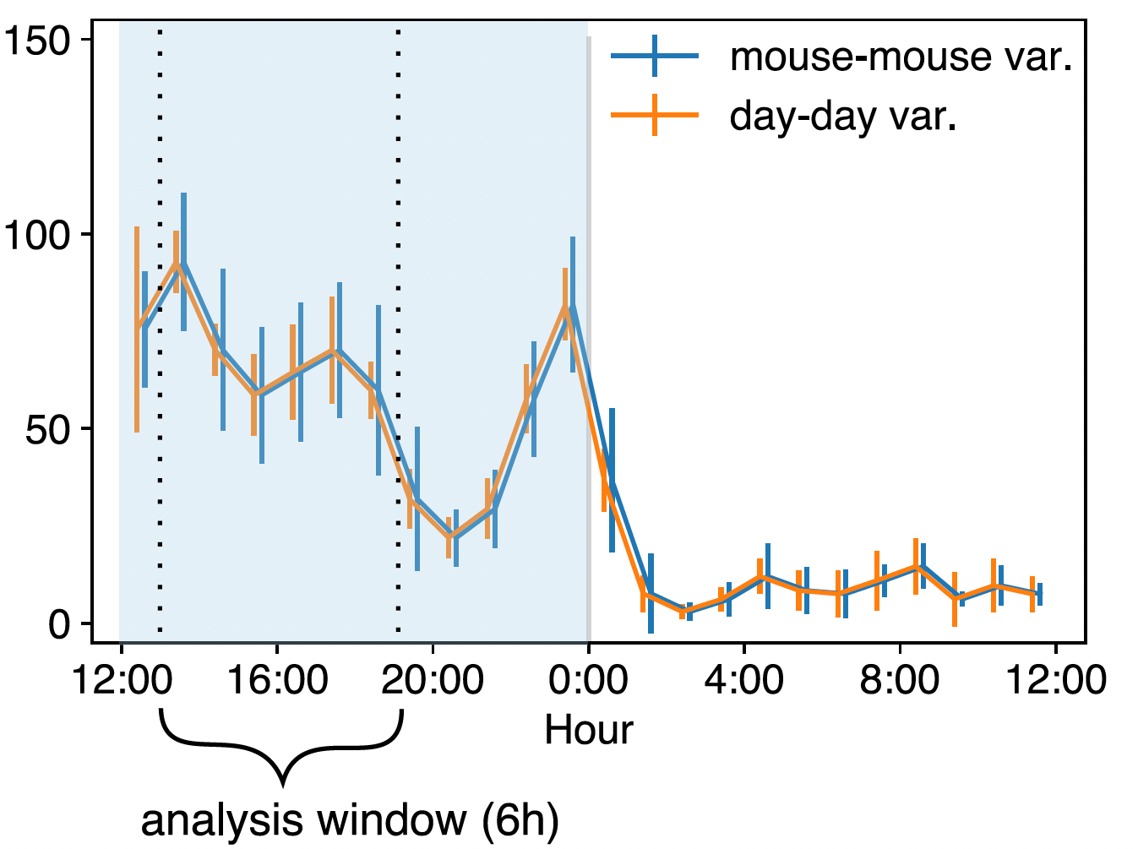

data: co-localization of mice
Rate of activity
Latent variables (sleeping) create spurious correlation
Use only partial data
Notes:
l structure is actually cool. Should we show something to it? This is related to the waiting time. So maybe later?
[Title: the data: and we exclude latent variable]

Slide 20


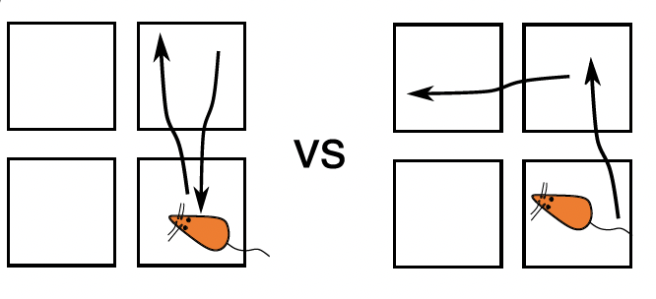
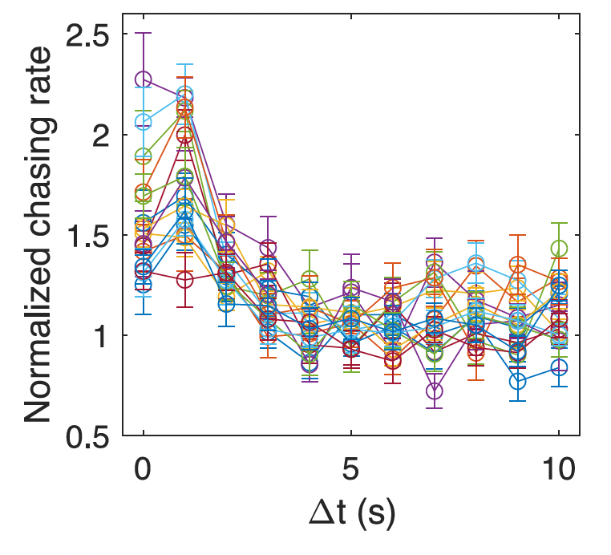
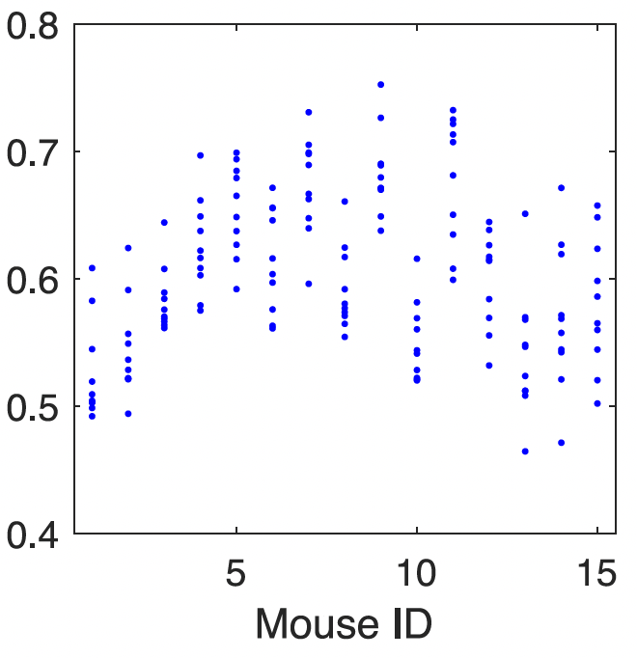
Mice dynamics
Active chasing
Adventurousness
C
More likely!
B
B
Time 1
Time 2
Time 3
Δt
A
A
P(A->B->C)
Notes:
These few slides are too busy, need to find a better way to make it easier to understand
[Add some equations there]

Slide 21
learn the static interaction model
Pairwise model can predict higher order correlation
Triplet correlation
position of mouse i
Maximum entropy model constrains:
… while maximizing entropy
1. Pairwise correlation:
2. Probability of staying in a box:
probability of K mice in the same box
Energy
Parameters to learn:
Pairwise interaction
Box preference
Notes:
[Shorten this part. Just a very brief overview. March meeting tempo]
Delete everything above the box. Merge with the next slides.

Slide 22
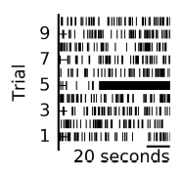
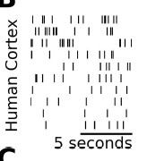
dynamical inference is difficult
Maximum Caliber :
  Constraining both the equal-time correlation, and cross-correlation
  Difficult to train
Generalized linear model (GLM) :
  Generate spikes based on self-memory and memory of other spins
  No longer equilibrium dynamics, no energy landscape
  Not a good generative model & doesn’t recover equal-time statistics well
Data
Model
Gerhard et al. 2016
Can we tune the dynamics while keep the steady state distribution?
Notes:
Using Ising spin as an example. (Maybe we go up to 10 spins to show the problem with GLM near criticality?)
GLM and other transition state model. What’s the issue?
Why don’t we like it. Maybe show some reasoning of why we started with GLM on social mice, but then stopped. Hard to tune the parameters.

Slide 23
generalized Glauber dynamics (GGD): detailed derivation
Assume spin is fixed, solve for the Hamiltonian dynamics of the oscillators
Equipartition
+
random initial conditions
define
Notes:
Use animation
[can skip if not enough time]

Slide 24
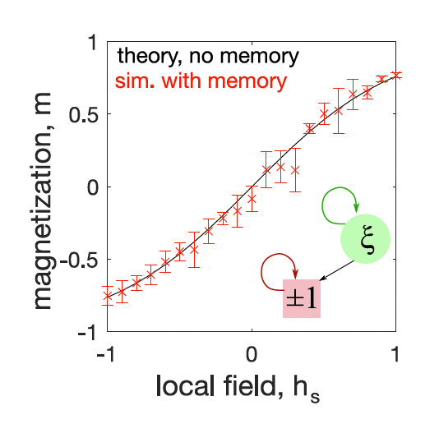
Test GGD on single Ising spin
Memory kernel: single exponential decay
-> Fatter tails in the waiting time distribution
Notes:
These few slides are too busy, need to find a better way to make it easier to understand

Slide 25
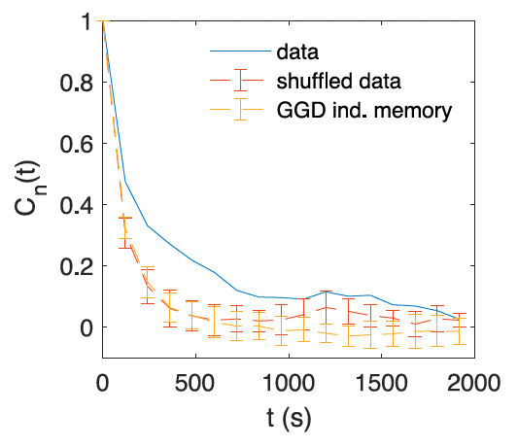
Autocorrelation of microstate not reproduced
Autocorrelation of # of mice in each box not reproduced

Slide 26
Active chasing
GGD on 10 Ising spins
Mice actively chase others
Equal-time
Memory kernel
Time 1
Time 2
Time 3
Δt
Coupled memory kernel -> transition depends on other spins
Limitation: GGD has symmetric interaction
Notes:
These few slides are too busy, need to find a better way to make it easier to understand
[Add some equations there]

Slide 27
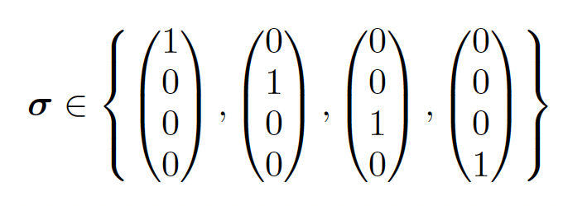
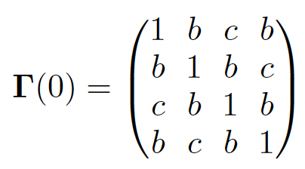
Inertia
GGD on Potts spins couples each state (box) -> flow
Each mouse has its own “adventurousness”
C
More likely!
A 4-state Potts spin
B
B
A
Memory kernel matrix
A
P(A->B->C)
Limitation: P(A->B->C)_{GGD} < 0.5
Notes:
These few slides are too busy, need to find a better way to make it easier to understand

