Slide 1
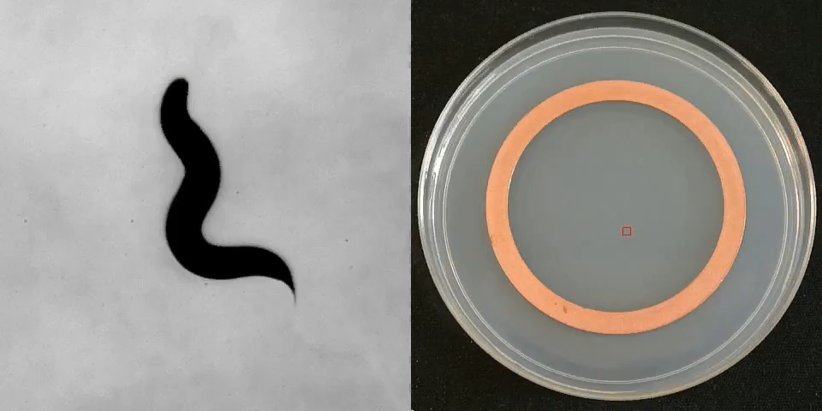

Physics of behavior across scales
Congrès Général SFP 2023 - Antonio Carlos Costa - JRC @ ENS Paris
Notes:
Hi everyone, I’m Antonio, I’m a JRC fellow at ENS in Paris, and today I’ll be telling you about some aspects of the modelling of animal behavior and in particular how the multiplicity of scales that is inherent to behavior gives rise to nontrivial and rather universal statistical properties.
Even in the case of this simple nematode worm searching for food in an empty plate, behavior exhibits multiple time scales:
So on the one hand we can quantify the fine scale details of how the shape of the animal changes over time, and the waves that propagate through the worms body, and on the other hand we can also study the resulting navigation trajectories on much larger spatiotemporal scales

Slide 2
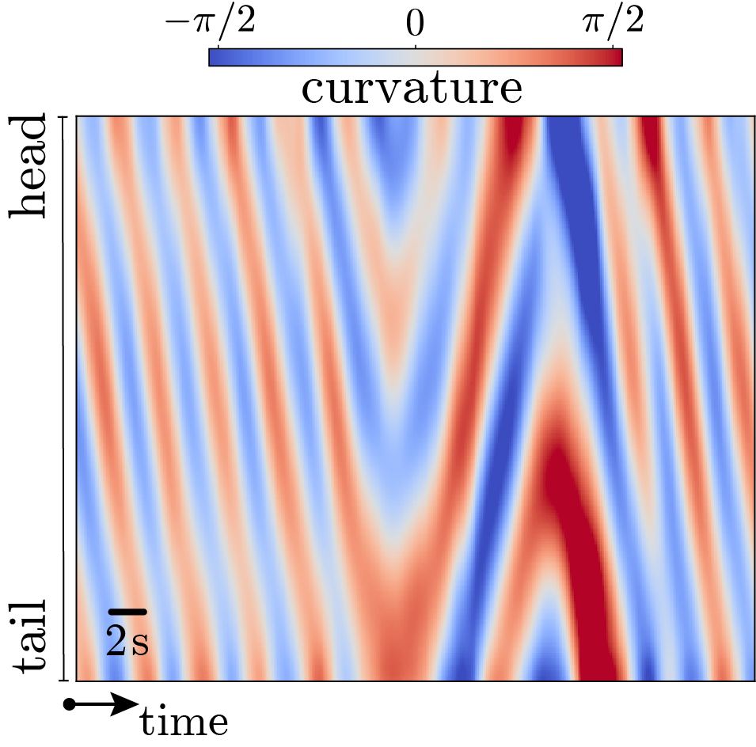
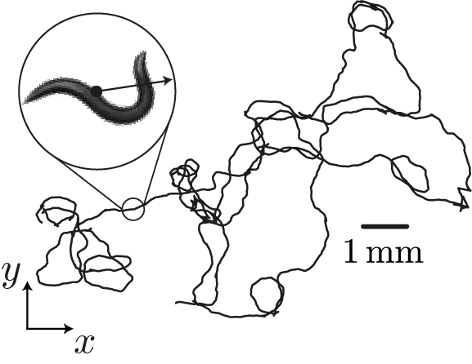
bridging scales in animal behavior
an unsupervised approach
small scales: pose dynamics
large scales: navigation strategies
Hebert*, …, Costa*, Stephens (2021) PLoS Comput Biol
Helms*, …, Costa*, …, Shimizu (2019) J. R. Soc. Interface
Costa, Ahamed, Jordan, Stephens (2021) bioRxiv
1
Notes:
Even in the case of this simple nematode worm searching for food in an empty plate, behavior exhibits multiple time scales:
So on the one hand we can quantify the fine scale details of how the shape of the animal changes over time, and the waves that propagate through the worms body, and on the other hand we can also study the resulting navigation trajectories on much larger spatiotemporal scales
Now, even though it is clear that foraging strategies result from combining a large number of shorter timescale movements, (click) it is far less obvious how to bridge across these scales in a quantitative fashion
What we need is a predictive model that accurately captures the statistics of long time scale behaviors from the fine scale posture dynamics.

Slide 3
bridging scales in animal behavior
an unsupervised approach
small scales: pose dynamics
large scales: navigation strategies
how can we bridge across scales?
Costa, Ahamed, Jordan, Stephens (2021) bioRxiv
1
Notes:
Even in the case of this simple nematode worm searching for food in an empty plate, behavior exhibits multiple time scales:
So on the one hand we can quantify the fine scale details of how the shape of the animal changes over time, and the waves that propagate through the worms body, and on the other hand we can also study the resulting navigation trajectories on much larger spatiotemporal scales
Now, even though it is clear that foraging strategies result from combining a large number of shorter timescale movements, (click) it is far less obvious how to bridge across these scales in a quantitative fashion
What we need is a predictive model that accurately captures the statistics of long time scale behaviors from the fine scale changes in the animal’s posture

Slide 4
bridging scales in animal behavior
an unsupervised approach
infer dynamical model: predict long-time statistics
Costa, Ahamed, Jordan, Stephens (2023) Chaos
2
Notes:
What we need is a predictive model that accurately captures the statistics of long time scale behaviors from the fine scale changes in the animal’s posture
But from equations of motion like these it's not obvious what the long-term behavior of the system is, specially in such complex systems where the solutions are only available through simulations. In order to access long timescales more directly, I trade the nonlinear and noisy functions that evolve the behavior of the worm, for an equivalent representation in terms of the Markov operator for the evolution of probability distributions. In this way the full nonlinear dynamics are encoded into a linear operator, (click)
whose eigenspectrum provides a direct means to extract modes that evolve on different timescales, revealing the longer timescale behaviors and separating them from the faster posture dynamics.

Slide 5
bridging scales in animal behavior
an unsupervised approach
infer dynamical model: predict long-time statistics
Costa, Ahamed, Jordan, Stephens (2023) Chaos
2
Notes:
What we need is a predictive model that accurately captures the statistics of long time scale behaviors from the fine scale changes in the animal’s posture
But from equations of motion like these it's not obvious what the long-term behavior of the system is, particularly in such complex systems where the solutions are only available through simulations. In order to access long timescales more directly, I trade the nonlinear and noisy functions that evolve the behavior of the worm, for an equivalent representation in terms of the Markov operator for the evolution of probability distributions. In this way the full nonlinear dynamics are encoded into a linear operator, (click)
whose eigenspectrum provides a direct means to extract modes that evolve on different timescales, revealing the longer timescale behaviors and separating them from the faster posture dynamics.

Slide 6
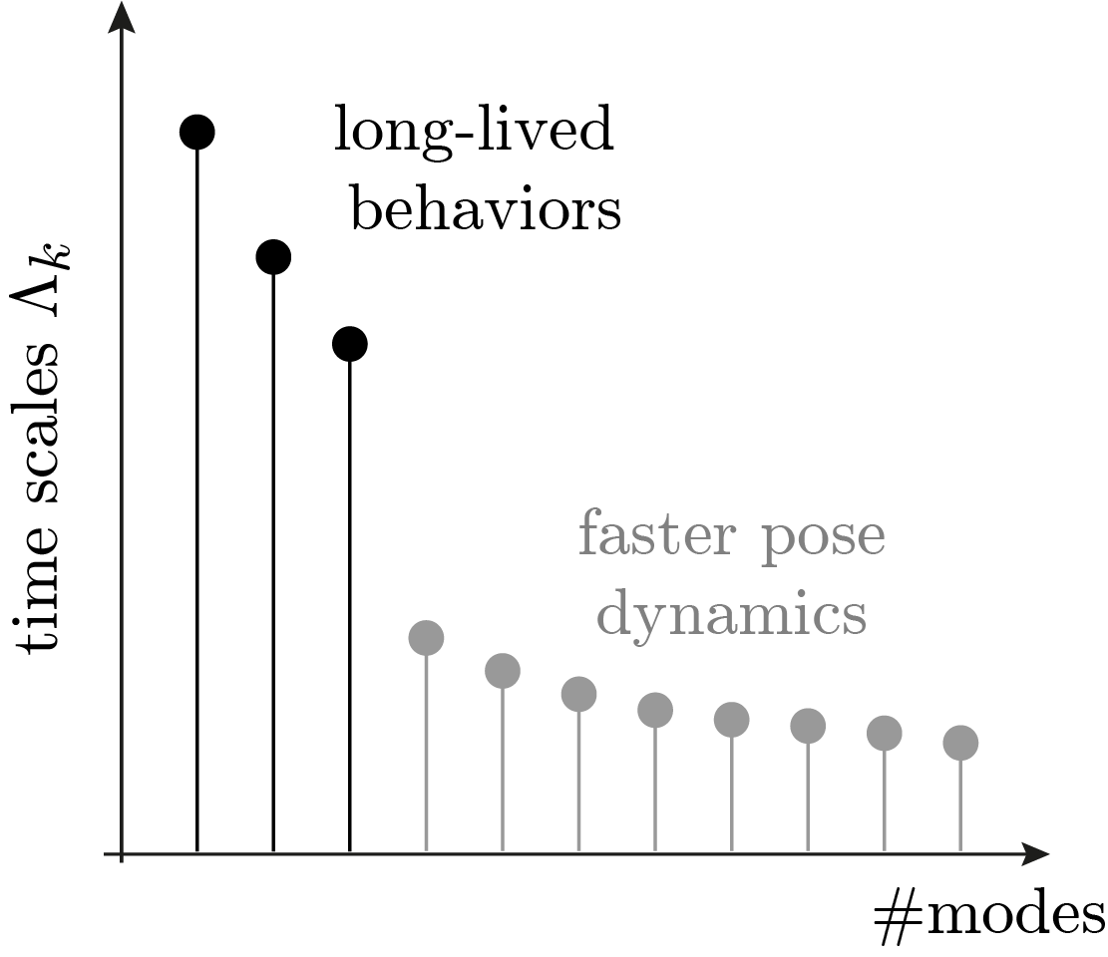
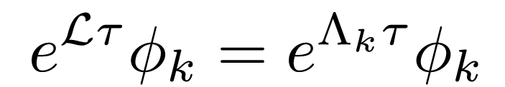
bridging scales in animal behavior
an unsupervised approach
infer dynamical model: predict long-time statistics
eigenspectrum: behavioral modes across scales
Costa, Ahamed, Jordan, Stephens (2023) Chaos
2
Notes:
What we need is a predictive model that accurately captures the statistics of long time scale behaviors from the fine scale changes in the animal’s posture
But from equations of motion like these it's not obvious what the long-term behavior of the system is, particularly in such complex systems where the solutions are only available through simulations. In order to access long timescales more directly, I trade the nonlinear and noisy functions that evolve the behavior of the worm, for an equivalent representation in terms of the Markov operator for the evolution of probability distributions. In this way the full nonlinear dynamics are encoded into a linear operator, (click)
whose eigenspectrum provides a direct means to extract modes that evolve on different timescales, revealing the longer timescale behaviors and separating them from the faster posture dynamics.
In practice, to find an accurate Markovian approximation of the dynamics, I leverage a time-delay embedding of the time series of postures and redefine the behavioral state (click)

Slide 7
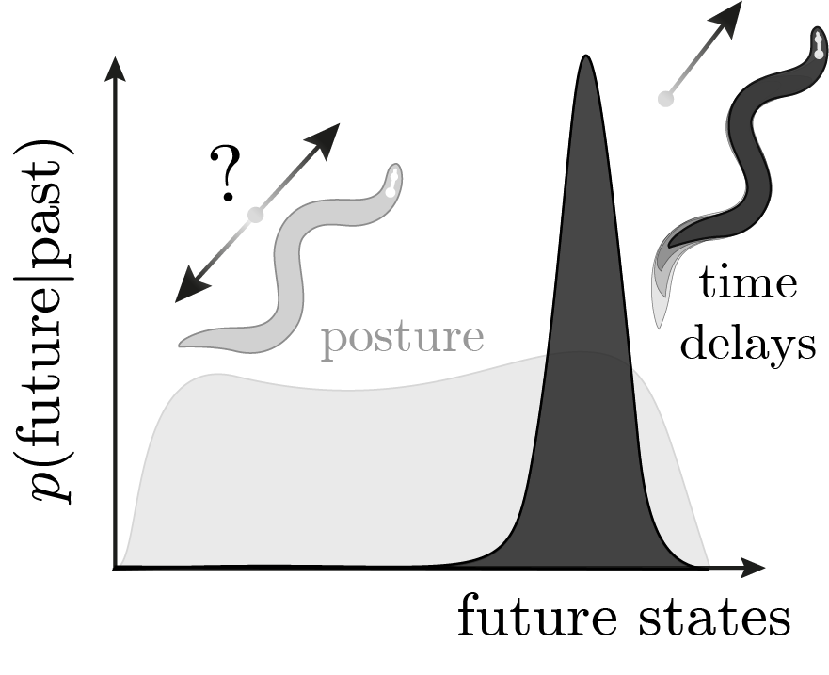
bridging scales in animal behavior
an unsupervised approach
use time delays to maximize predictive information - accurate Markov model
Costa, Ahamed, Jordan, Stephens (2023) Chaos
2
Notes:
In practice, to find an accurate Markovian approximation of the dynamics, I leverage a time-delay embedding to redefine the behavioral state
(click)
as a short-time sequence of postures. The intuition is that while the instantaneous posture isn’t enough to predict where the animal is going, including past time delays helps narrow down the prediction of the future. In other words, the instantaneous posture measurements yield non-Markovian dynamics, but if we change our representation to include time delays and obtain a maximally predictive state, then the time evolution becomes closer to Markovian.
Using such maximally predictive states we can accurately approximate the dynamics through a carefully crafted Markov chain, which we can then use both as a predictive model and as a means to identify long lived behavioral states through the eigenvalue spectrum. (click)

Slide 8
bridging scales in animal behavior
an unsupervised approach
use time delays to maximize predictive information - accurate Markov model
Costa, Ahamed, Jordan, Stephens (2023) Chaos
2
Notes:
In practice, to find an accurate Markovian approximation of the dynamics, I leverage a time-delay embedding of the time series of postures and redefine the behavioral state
(click)
as a short-time sequence of postures. The intuition is that while the instantaneous posture isn’t enough to predict where the animal is going, including past time delays helps narrow down the prediction of the future. In other words, the instantaneous posture measurements yield non-Markovian dynamics, but if we change our representation to include time delays and obtain a maximally predictive state, then the time evolution becomes closer to Markovian.
Using such maximally predictive states we can accurately approximate the dynamics through a carefully crafted Markov chain, which we can then use both as a predictive model and as a means to identify long lived behavioral states through the eigenvalue spectrum. (click)

Slide 9
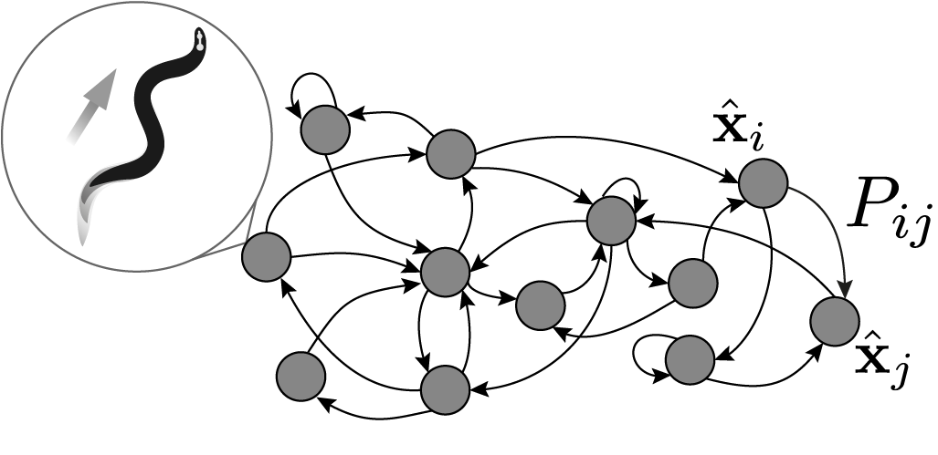
bridging scales in animal behavior
an unsupervised approach
use time delays to maximize predictive information - accurate Markov model
Costa, Ahamed, Jordan, Stephens (2023) Chaos
2
Notes:
Using such maximally predictive states we can accurately approximate the dynamics through a carefully crafted Markov chain, which can then be used both as a predictive model and as a means to identify long lived behavioral states through the eigenvalue spectrum. (click)
When we apply this formalism to the time series of C. elegans postures we find that the behavioral state space, where each point now corresponds to a short sequence of postures, naturally distinguish different short-time behaviors.

Slide 10
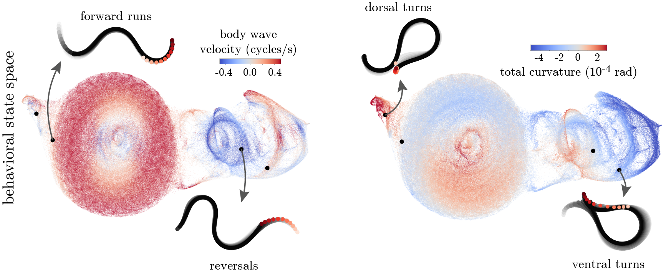
bridging scales in animal behavior
maximally predictive states naturally distinguish different behaviors
Costa, Ahamed, Jordan, Stephens (2021) bioRxiv
3
Notes:
When we apply this formalism to the time series of C. elegans postures we find that the behavioral state space, where each point now corresponds to a short sequence of postures, naturally distinguish different short-time behaviors.
(click)
And the Markov chain built from these microscopic states results in a powerful predictive model of the worm behavior across scales. It captures the finescale details of the posture dynamics, making it difficult to distinguish data with simulations.
And the way in which these waves propel the animal to give rise to different navigation strategies.

Slide 11
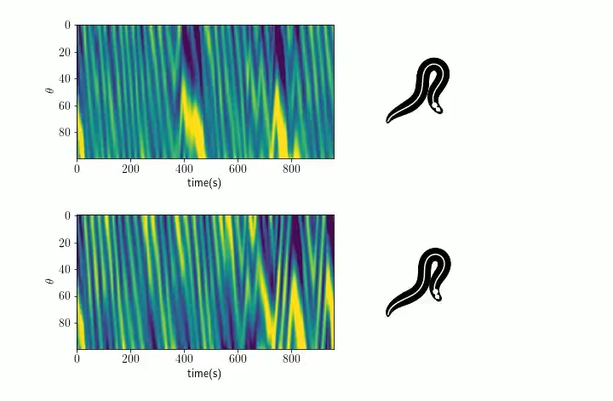
bridging scales in animal behavior
maximally predictive states yield an accurate generative model
simulation
curvature
data
curvature
time
Costa, Ahamed, Jordan, Stephens (2021) bioRxiv
3
Notes:
And the Markov chain built from these microscopic states results in a powerful predictive model of the worm behavior across scales. It captures the finescale details of the posture dynamics, making it difficult to distinguish data with simulations (click).
(click)
And the way in which these waves propel the animal to give rise to different navigation strategies

Slide 12
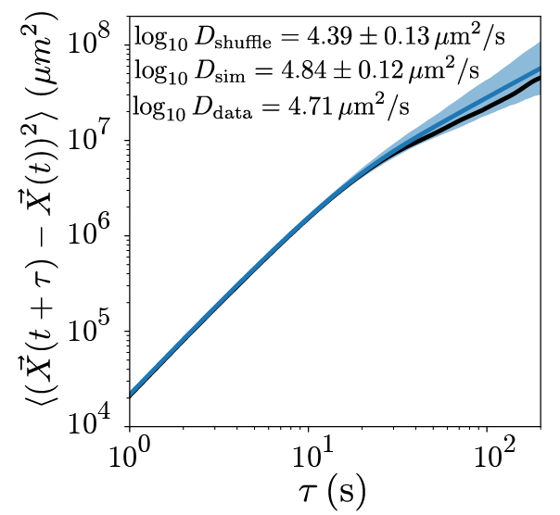
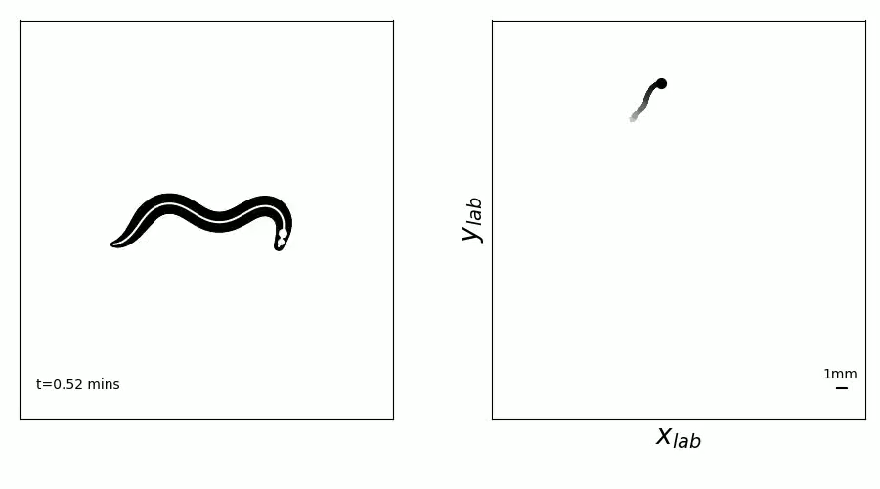
bridging scales in animal behavior
maximally predictive states yield an accurate generative model
predicting foraging trajectory from simulated pose dynamics
data
simulation
Costa, Ahamed, Jordan, Stephens (2021) bioRxiv
3
Notes:
And the way in which these waves propel the animal to give rise to different navigation strategies on much longer time scales:
not only we get simulations that qualitatively resemble what is observed in real worms, but we can obtain quantitative agreement over multiple orders of magnitude in space and time.
Now, besides being an accurate predictive model, the Markov evolution operator also provides a means for a principled coarse-graining of the dynamics through its eigenspectrum, revealing the multiple scales of C. elegans foraging behavior.

Slide 13
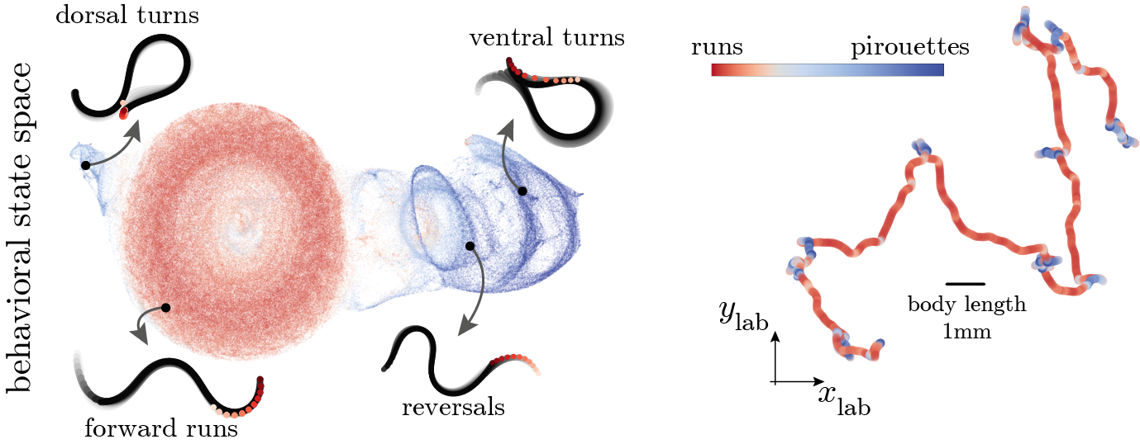

bridging scales in animal behavior
eigenspectrum reveals multiple scales of behavior
Costa, Ahamed, Jordan, Stephens (2021) bioRxiv
4
Notes:
Now, besides being an accurate predictive model, the Markov evolution operator also provides a means for a principled coarse-graining of the dynamics through its eigenspectrum, revealing the multiple scales of C. elegans foraging behavior.
(click)
In particular, the slowest mode identifies long-lived states that correspond to sequences of shorter time scale movements: so what I'm showing here on the left is a sketch of the free energy landscape along the slowest mode of the dynamics, and captures transitions between relatively straight paths and more abrupt reorientation events, a bit like in e coli but here for a much more complex organism where this subdivision is a much more subtle.

Slide 14
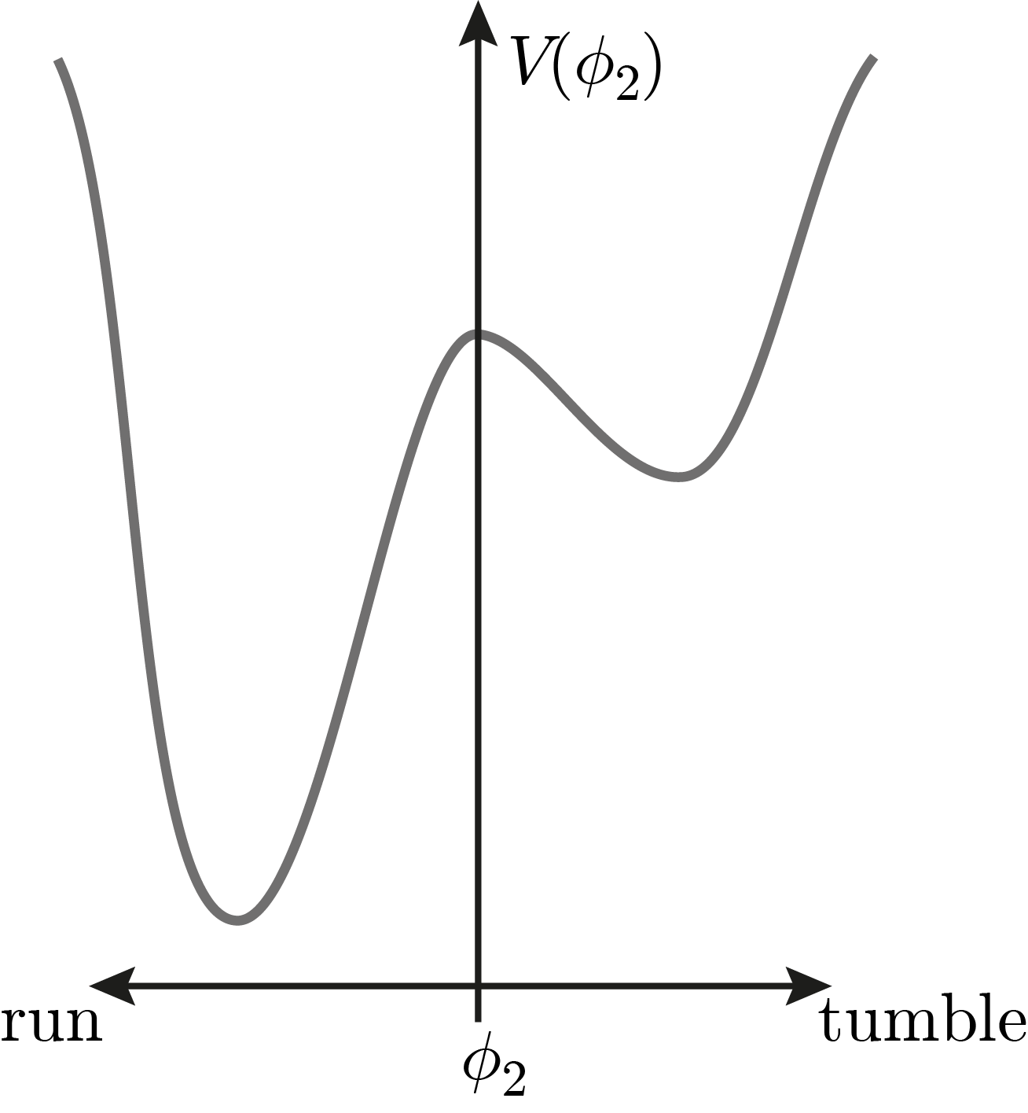


bridging scales in animal behavior
eigenspectrum reveals multiple scales of behavior
Costa, Ahamed, Jordan, Stephens (2021) bioRxiv
4
Notes:
Now, besides being an accurate predictive model, the Markov evolution operator also provides a means for a principled coarse-graining of the dynamics through its eigenspectrum, revealing the multiple scales of C. elegans foraging behavior.
(click)
In particular, the slowest mode identifies long-lived states that correspond to sequences of shorter time scale movements: so what I'm showing here on the left is a sketch of the free energy landscape along the slowest mode of the dynamics, and captures transitions between relatively straight paths and more abrupt reorientation events, a bit like in e coli but here for a much more complex organism where this subdivision is a much more subtle.
Now if we focus on the hopping between these two states, what we find is that (click)

Slide 15
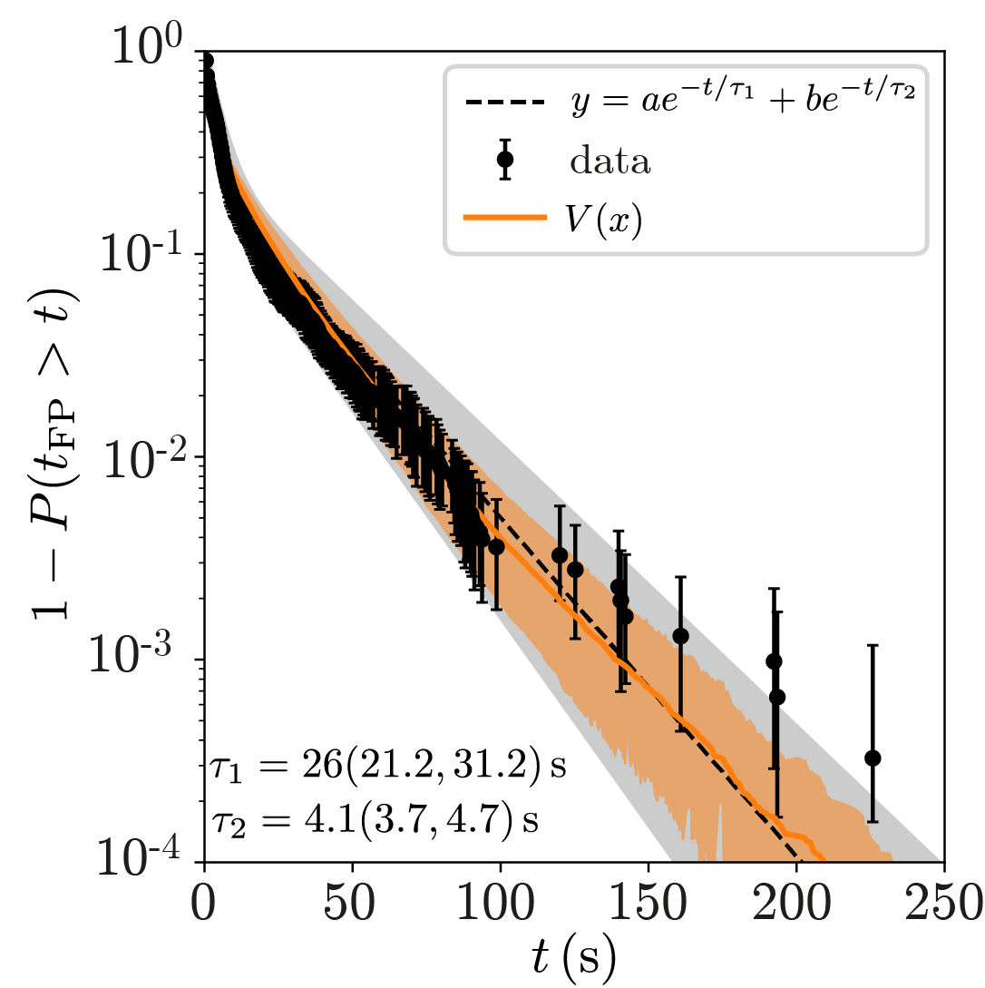
heavy-tailed hopping dynamics
slowly varying landscape picture
5
Notes:
Now if we focus on the hopping between these two states, what we find is that (click)
The distribution of the time spent in these two states exhibits two main exponential time scales: a longer one that corresponds to the runs, and a shorter on that corresponds to the tumbles. The predictions of our model (here in orange) accurately capture these time scales, but the data also exhibits a heavier tail that we couldn't predict. So even though our model captures a lot of C. elegans foraging behavior, it seems to be incomplete. So what are we missing?
(click)
Well, our model can only account for stationary dynamics that admit a steady-state solution, (click) so one hypothesis is that maybe the evolution operator itself is time dependent.

Slide 16
heavy-tailed hopping dynamics
slowly varying landscape picture
5
Notes:
Well, our model can only account for stationary dynamics that admit a steady-state solution, (click) so one hypothesis is that the steady-state itself is time dependent, which would mean that the evolution operator itself is time dependent.
(click)
In fact, in these experiments the worms are in a plate where there is no food, and so as they gather information about the environment their prior over the spatial distribution of food changes slowly over time, resulting in an adaptation of their search strategy.
In order to capture the influence of this slowly varying internal state, we introduced a time-dependent potential landscape for the dynamics of this slow mode (click)

Slide 17
heavy-tailed hopping dynamics
slowly varying landscape picture
5
Notes:
Well, our model can only account for stationary dynamics that admit a steady-state solution, (click) so one hypothesis is that the steady-state itself is time dependent, which would mean that the evolution operator itself is time dependent.
(click)
In fact, in these experiments the worms are in a plate where there is no food, and so as they gather information about the environment their prior over the spatial distribution of food changes slowly over time, resulting in an adaptation of their search strategy.
In order to capture the influence of this slowly varying internal state, we introduced a time-dependent potential landscape for the dynamics of this slow mode (click)

Slide 18
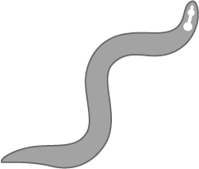
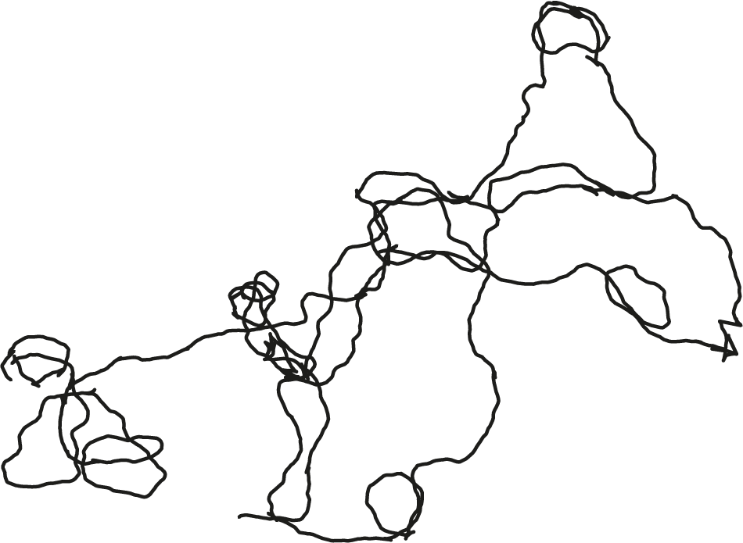
heavy-tailed hopping dynamics
slowly varying landscape picture
Wait, there’s no food?
5
Notes:
Well, our model can only account for stationary dynamics that admit a steady-state solution, (click) so one hypothesis is that the steady-state itself is time dependent, which would mean that the evolution operator itself is time dependent.
(click)
In fact, in these experiments the worms are in a plate where there is no food, and so as they gather information about the environment their prior over the spatial distribution of food changes slowly over time, resulting in an adaptation of their search strategy.
In order to capture the influence of this slowly varying internal state, we introduced a time-dependent potential landscape for the dynamics of this slow mode (click)

Slide 19
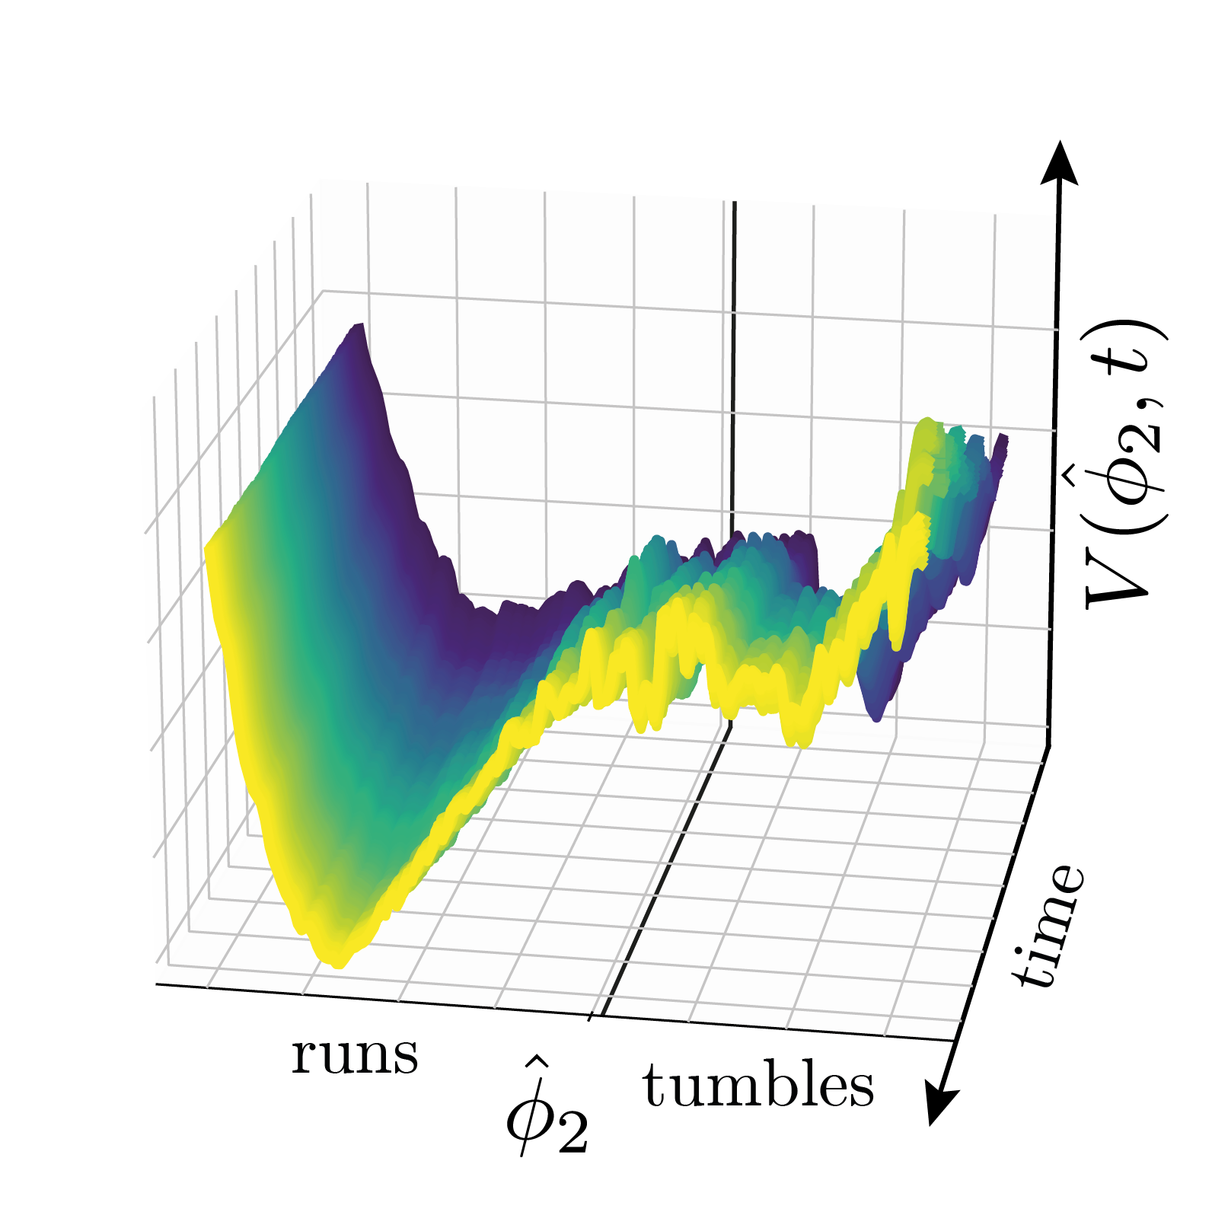

heavy-tailed hopping dynamics
slowly varying landscape picture reflects strategy adaptation
5
Notes:
In order to capture the influence of this slowly varying internal state, we introduced a time-dependent potential landscape for the dynamics of this slow mode (click)
So now we allow the parameters to change over time and what we find is that as time passes we observe a biasing of the worm behavior to increasingly perform runs, which is probably driven by the fact that the animal is getting hungrier as time goes on: they can’t find food so they increase the time spent in the run state to explore more of the space.
(click)
Now, to test whether this might account for the heavy-tailed distributions, we can make simulations.
(click)
What we find is that if we now allow the potential to change in time

Slide 20
heavy-tailed hopping dynamics
slowly varying landscape picture captures heavy-tails
5
Notes:
In order to capture the influence of this slowly varying internal state, we introduced a time-dependent potential landscape for the dynamics of this slow mode (click)
So now we allow the parameters to change over time and what we find is that as time passes we observe a biasing of the worm behavior to increasingly perform runs, which is probably driven by the fact that the animal is getting hungrier as time goes on: they can’t find food so they increase the time spent in the run state to explore more of the space.
(click)
Now, to test whether this might account for the heavy-tailed distributions, we can make simulations.
(click)
What we find is that if we now allow the potential to change in time

Slide 21
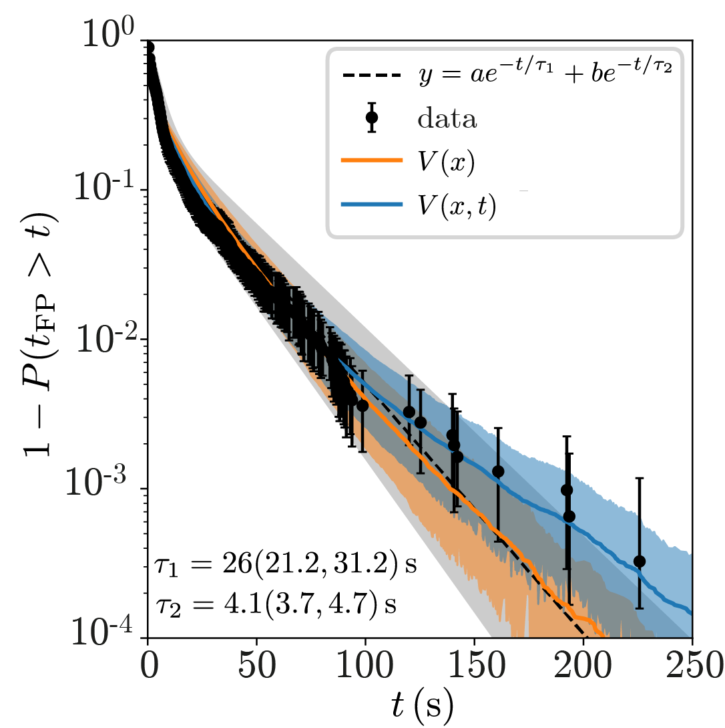
heavy-tailed hopping dynamics
slowly varying landscape picture captures heavy-tails
5
Notes:
What we find is that if we now allow the potential to change in time we are able to capture the nontrivial heavy tail of the distribution
So it seems as if having such an explicit time-dependence to the model parameters allows us to capture these changing internal states that give rise to heavy tailed dwell time distributions.
Now, could this actually be a general property of behavior?
(click)
Well, let’s consider a conceptual picture of behavior as evolving on a complex potential landscape, where each well corresponds to a different stereotyped behavior and the barrier heights set the probability of transitioning among different states.

Slide 22
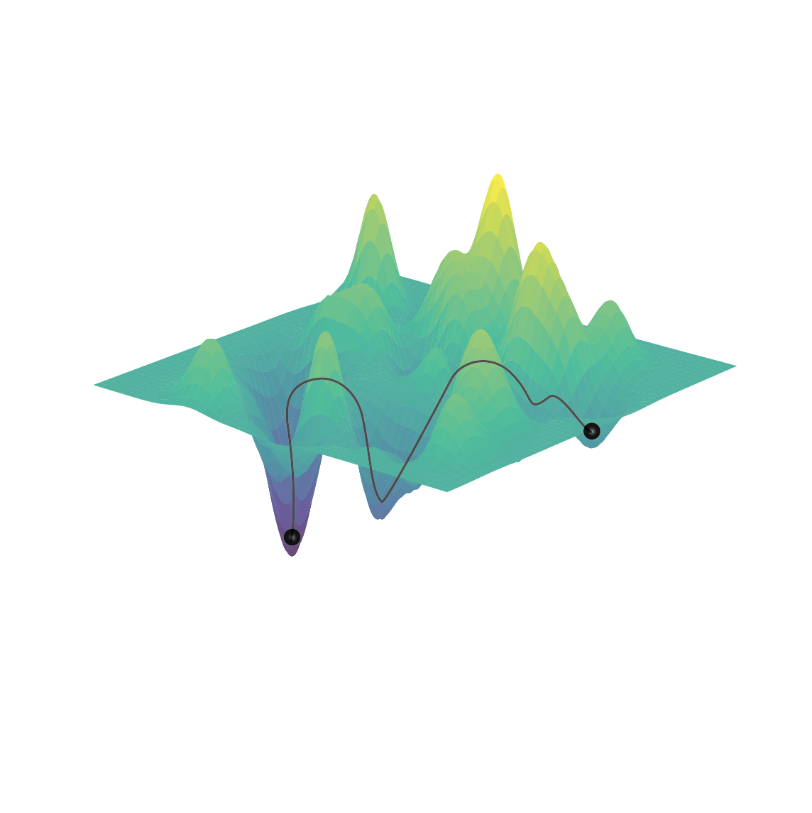
general picture of behavior
evolving in a slowly varying potential landscape
Costa, Vergassola (2023) arXiv
6
Notes:
Well, let’s consider a conceptual picture of behavior as evolving on a complex potential landscape, where each well corresponds to a different stereotyped behavior and the barrier heights set the probability of transitioning among different states.
Now, to account for slowly varying internal states, like the animal getting hungry, let’s assume that the potential landscape can fluctuate over time, such that while the animal hops among stereotyped behaviors, the probability of transitioning among different behaviors changes slowly (click)
And so we basically get a phenomenological picture of behavior in which we decompose the dynamics into ergodic/mixing terms, x, that admit a quasi-stationary description within the experimental time scales and a slower non-ergodic mode lambda that modulates the potential landscape U on a slow time scale tau_lambda comparable to the observation time.
Okay so in this picture, the time spent in a given behavior is given by the time it takes to escape from a potential well, which is a problem that has been extensively studied in statmech

Slide 23
general picture of behavior
evolving in a slowly varying potential landscape
Costa, Vergassola (2023) arXiv
6
Notes:
Well, let’s consider a general picture of behavior as evolving on a complex potential landscape, where each well corresponds to a different stereotyped behavior and the barrier heights set the probability of transitioning among different states.
Now, to account for slowly varying internal states, like the animal getting hungry, let’s assume that the potential landscape can fluctuate over time, such that while the animal hops among stereotyped behaviors, the probability of transitioning among different behaviors changes slowly (click)
And so we basically get a phenomenological picture of behavior in which we decompose the dynamics into ergodic/mixing terms, x, that admit a quasi-stationary description within the experimental time scales and a slower non-ergodic mode lambda that modulates the potential landscape U on a slow time scale tau_lambda comparable to the observation time.
Okay so in this picture, the time spent in a given behavior is given by the time it takes to escape from a potential well, which is a problem that has been extensively studied in statmech

Slide 24
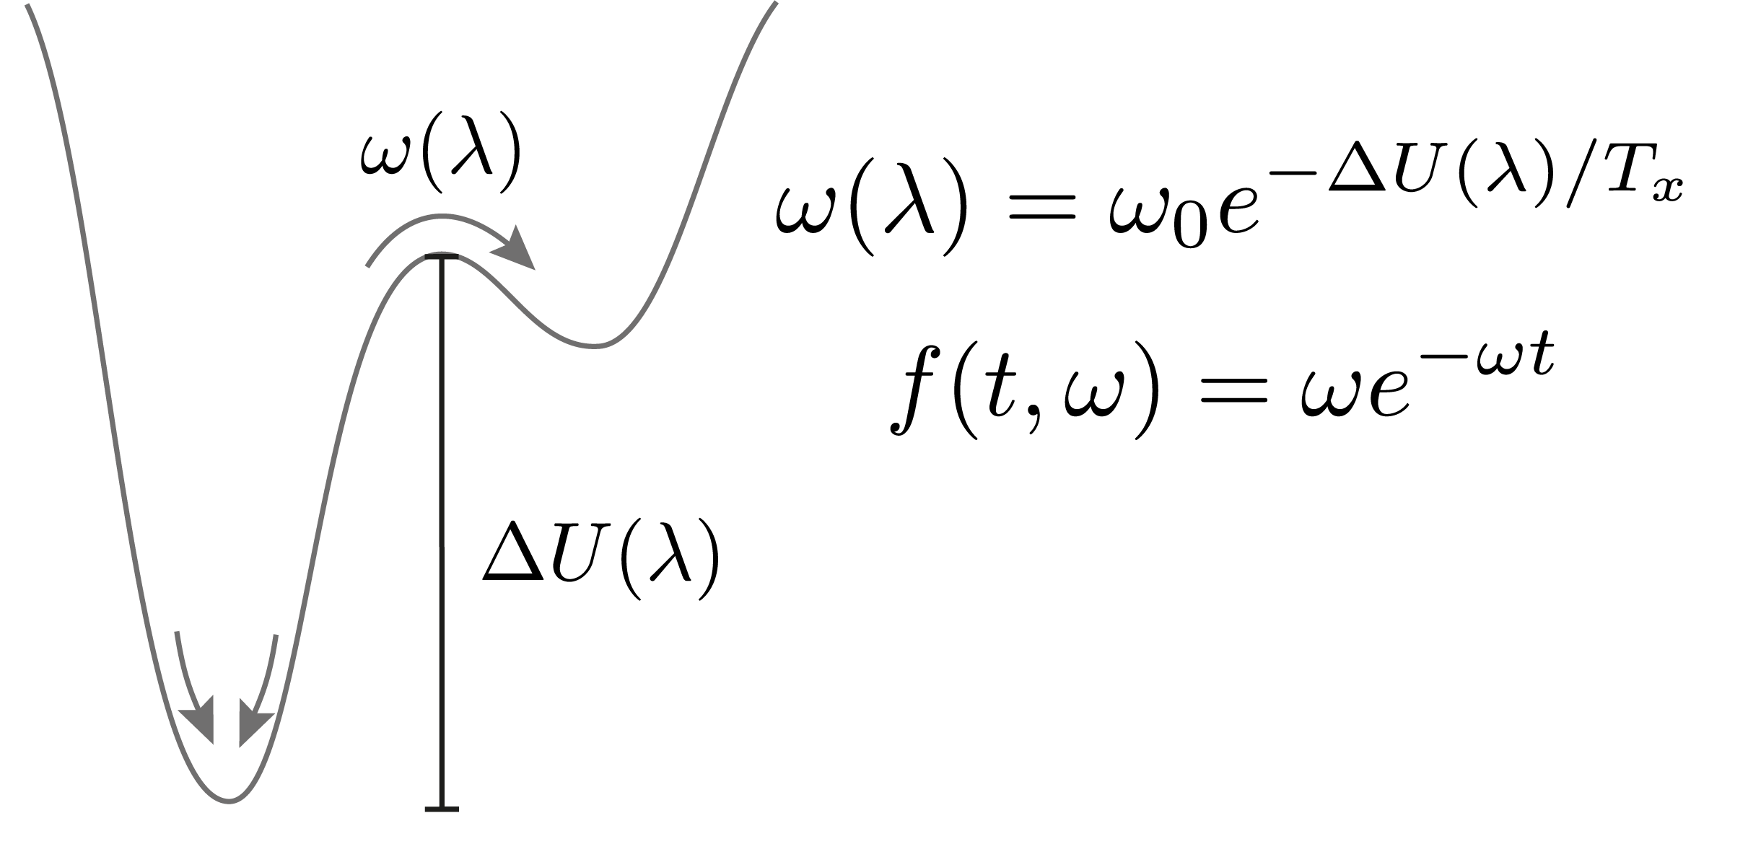
Fluctuating landscape dynamics
yields heavy-tailed first-passage time distributions
Costa, Vergassola (2023) arXiv
7
Notes:
Okay so in this picture, the time spent in a given behavior is given by the time it takes to escape from a potential well, which is a problem that has been extensively studied in statmech
For a static potential, when the potential is deep enough with the respect to the level of fluctuations, the distribution of FPT, so the time it takes to escape the potential well, is exponential, with a decay rate that is given by Kramers formula, which equates the hopping rate with the ratio between the barrier height and the temperature: the higher the barrier height and the lower the noise, the longer it takes for the particle to reach the energy barrier and escape the well. (click)
Now instead of a stationary potential, let’s consider that the barrier height can fluctuate according to the slow parameter lambda.

Slide 25
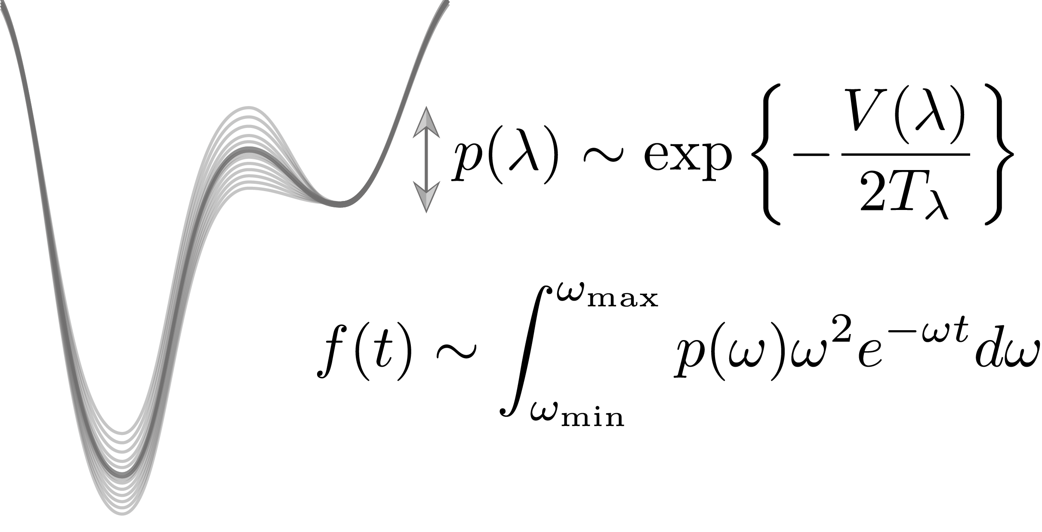
Fluctuating landscape dynamics
yields heavy-tailed first-passage time distributions
Costa, Vergassola (2023) arXiv
7
Notes:
(click) Now instead of a stationary potential, let’s consider that the barrier height can fluctuate according to the slow parameter lambda.
Assuming that the modulation of the landscape is much slower than the characteristic time it takes to escape the well, we can take an adiabatic approximation and consider that each escape event occurs within a nearly static potential.
So over time we get a whole distribution of hopping rates, which we essentially need to integrate out in order to obtain the final distribution of first passage times.
(click)
and so from this we can derive that asymptotic behavior at large times is indeed heavy-tailed, and in the limit of slow and large enough fluctuations it is dominated by a power law with an exponent of -2.
Interestingly, it turns out that this type of distribution has been found extensively across multiple organisms (click): from bacteria to ants, rats, marine animals and even humans

Slide 26
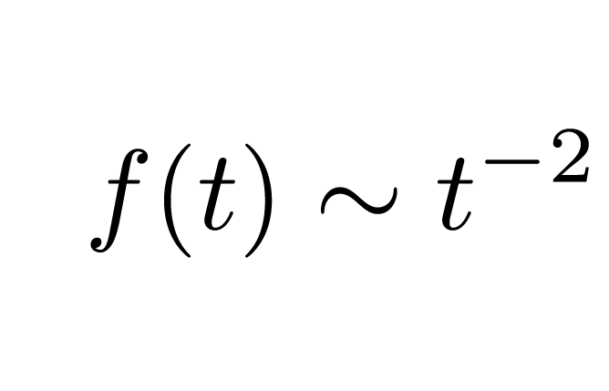
Fluctuating landscape dynamics
yields heavy-tailed first-passage time distributions
large and slow enough fluctuations: emergent power law behavior
Costa, Vergassola (2023) arXiv
7
Notes:
(click) Now instead of a stationary potential, let’s consider that the barrier height can fluctuate according to the slow parameter lambda.
Assuming that the modulation of the landscape is much slower than the characteristic time it takes to escape the well, we can take an adiabatic approximation and consider that each escape event occurs within a nearly static potential.
So over time we get a whole distribution of hopping rates, which we essentially need to integrate out in order to obtain the final distribution of first passage times.
(click)
and so from this we can derive that asymptotic behavior at large times is indeed heavy-tailed, and in the limit of slow and large enough fluctuations it is dominated by a power law with an exponent of -2.
Interestingly, it turns out that this type of distribution has been found extensively across multiple organisms (click): from bacteria to ants, rats, marine animals and even humans

Slide 27
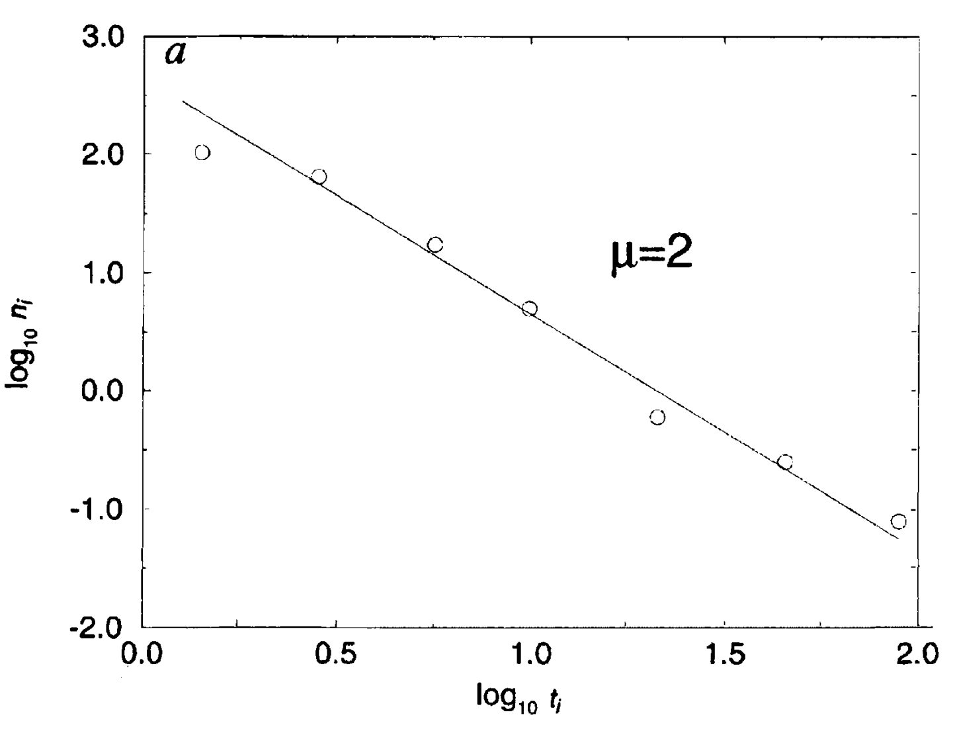
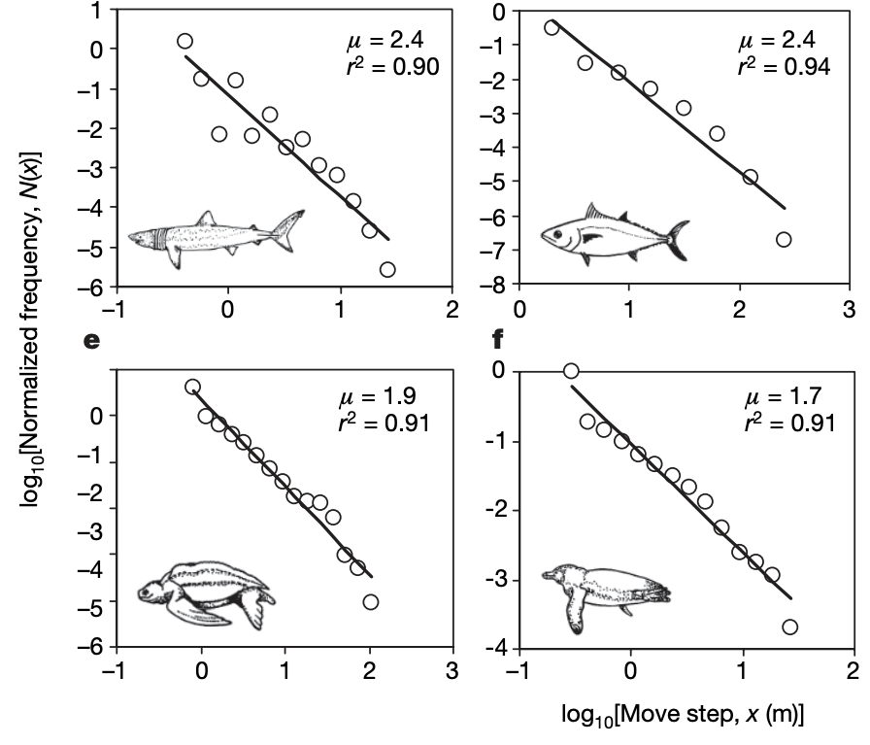
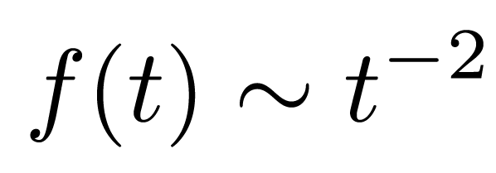
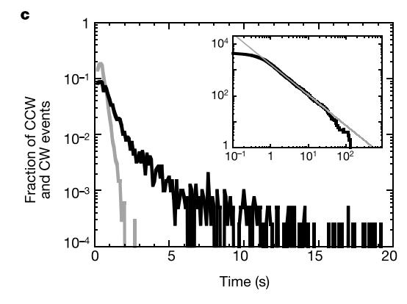
Fluctuating landscape dynamics
recovers phenomena found across species
associated with optimal search strategies
Viswanathan et al. Nature 1996; Korobkova et al. Nature 2004; Sims et al. Nature 2008
8
Notes:
Interestingly, it turns out that this type of distribution has been found extensively across multiple organisms (click): from bacteria to ants, rats, marine animals and even humans
And it has been hypothesized that power laws with particular exponent of -2 result in optimal search strategies, and so it has been argued that this particular distribution must therefore somehow result from (click) evolution, because it allows animals to efficiently explore space in search for food
We here show these power laws can actually emerge simply from the fact that the animal slowly adapts its behavior over time as they gather information about the environment (click)
In fact, I’d argue that this is probably a general property of multiscale systems that extends beyond the realm of animal behavior
(click) Okay so, I’ve shown you how we can leverage a first principles approach to quantitatively bridge across scales in animal behavior,

Slide 28
Fluctuating landscape dynamics
recovers phenomena found across species
associated with optimal search strategies
evolution?
Viswanathan et al. Nature 1996; Korobkova et al. Nature 2004; Sims et al. Nature 2008
8
Notes:
Interestingly, it turns out that this type of distribution has been found extensively across multiple organisms (click): from bacteria to ants, rats, marine animals and even humans
And it has been hypothesized that power laws with particular exponent of -2 result in optimal search strategies, and so it has been argued that this particular distribution must therefore somehow result from (click) evolution, because it allows animals to efficiently explore space in search for food
We here show these power laws can actually emerge simply from the fact that the animal slowly adapts its behavior over time as they gather information about the environment (click)
In fact, I’d argue that this is probably a general property of multiscale systems that extends beyond the realm of animal behavior
(click) Okay so, I’ve shown you how we can leverage a first principles approach to quantitatively bridge across scales in animal behavior,

Slide 29
Fluctuating landscape dynamics
recovers phenomena found across species
associated with optimal search strategies
evolution?
Viswanathan et al. Nature 1996; Korobkova et al. Nature 2004; Sims et al. Nature 2008
8
Notes:
Interestingly, it turns out that this type of distribution has been found extensively across multiple organisms (click): from bacteria to ants, rats, marine animals and even humans
And it has been hypothesized that power laws with particular exponent of -2 result in optimal search strategies, and so it has been argued that this particular distribution must therefore somehow result from (click) evolution, because it allows animals to efficiently explore space in search for food
We here show these power laws can actually emerge simply from the fact that the animal slowly adapts its behavior over time as they gather information about the environment (click)
In fact, I’d argue that this is probably a general property of multiscale systems that extends beyond the realm of animal behavior
(click) Okay so, I’ve shown you how we can leverage a first principles approach to quantitatively bridge across scales in animal behavior,

Slide 30
summary
bridge across scales in animal behavior
Notes:
(click) Okay so, I’ve shown you how we can leverage a first principles approach to quantitatively bridge across scales in animal behavior,
I’ve also showed that how we can capture the effects of adaptation in a behaving animal through an explicit time-dependent model
And, how we can draw inspiration from animal behavior to derive new theory: finding that power laws are ubiquitous in the presence of slow non-ergodic drives
With that, I’d just like to thank everyone involved in these projects, and I’d be happy to take any questions.

Slide 31
summary
bridge across scales in animal behavior
time-dependent potential landscape adaptation/neuromodulation
Notes:
(click) Okay so, I’ve shown you how we can leverage a first principles approach to quantitatively bridge across scales in animal behavior,
I’ve also showed that how we can capture the effects of adaptation in a behaving animal through an explicit time-dependent potential landscape model
And, how we can draw inspiration from animal behavior to derive new theory: finding that power laws are ubiquitous in the presence of slow non-ergodic drives
With that, I’d just like to thank everyone involved in these projects, and I’d be happy to take any questions.

Slide 32
summary
bridge across scales in animal behavior
time-dependent potential landscape adaptation/neuromodulation
inspiration from behavior for new theory
non-ergodic dynamics; power laws
Notes:
(click) Okay so, I’ve shown you how we can leverage a first principles approach to quantitatively bridge across scales in animal behavior,
I’ve also showed that how we can capture the effects of adaptation in a behaving animal through an explicit time-dependent model
And, how we can draw inspiration from animal behavior to derive new theory: finding that power laws are ubiquitous in the presence of slow non-ergodic drives
With that, I’d just like to thank everyone involved in these projects, thank the organizers for the opportunity to speak ehre today and I’d be happy to take questions.

Slide 33




acknowdgements
ENS Paris
Massimo Vergassola
ICM Paris
Claire Wyart
Gautam Sridhar
VU Amsterdam
Greg Stephens
Liam O’Shaugnessy
AMOLF
Tom Shimizu
Mathijs Rozemuller
Stephen Helms
U. Cambridge
David Jordan
Janelia Research Campus
Tosif Ahamed
OIST Okinawa
Laetitia Hebert
@antoniocbscosta
antonio.costa@phys.ens.fr
Notes:
With that, I’d just like to thank everyone involved in these projects, thank the organizers for the opportunity to speak ehre today and I’d be happy to take questions.

