Slide 1
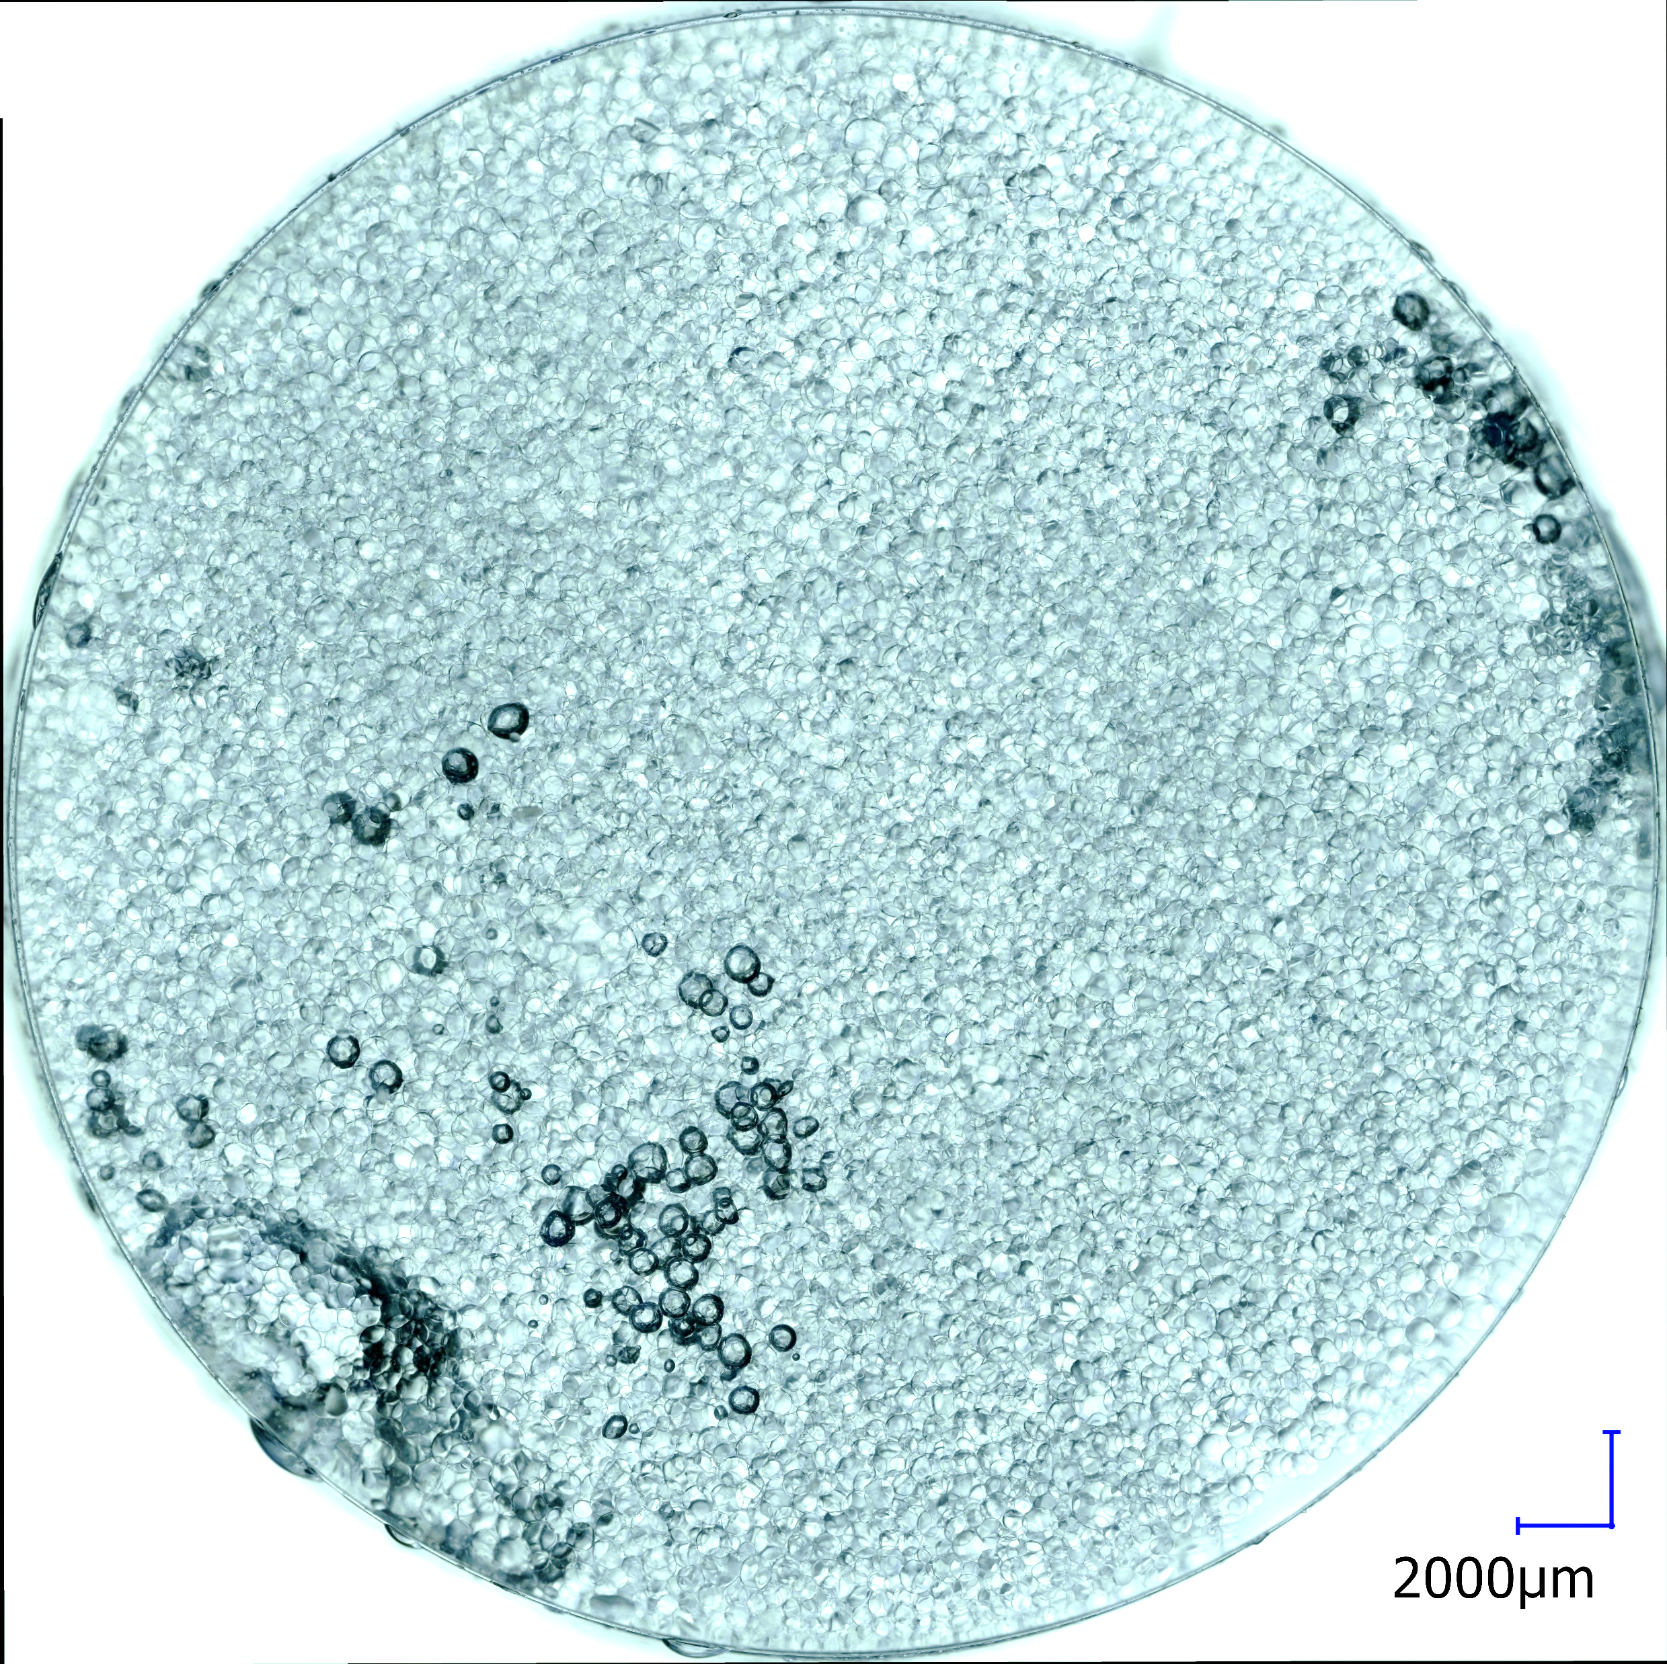
Perles liquides dans une matrice solide : rhéologie des émulsions solides
Congrès de la Société Française de Physique - 2023
Elina Gilbert, Anniina Salonen, Christophe Poulard
elina.gilbert@universite-paris-saclay.fr
Laboratoire de Physique des Solides, CNRS, Université Paris-Saclay, France

Slide 2
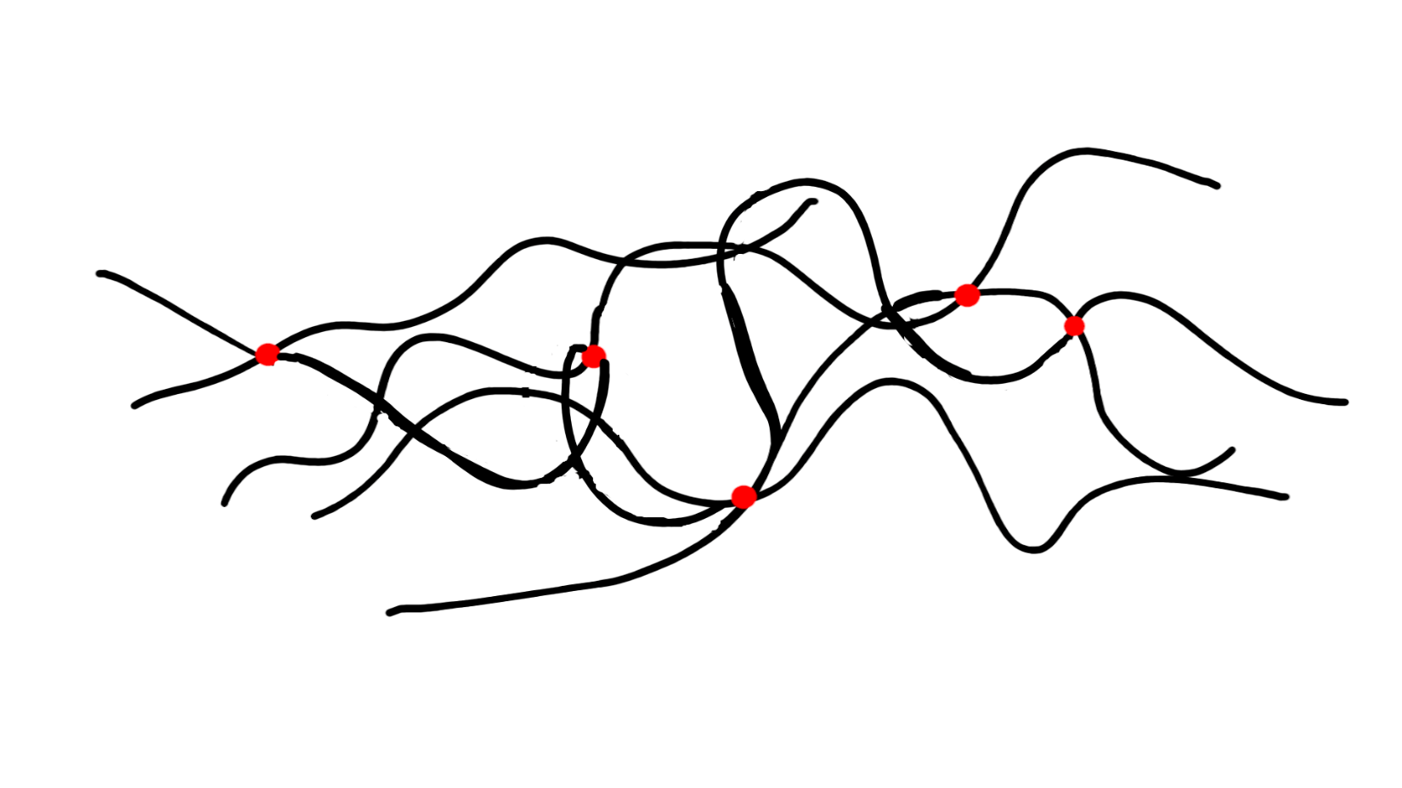
Motivation
logG’, logG’’
log$ω$
Elastomer: crosslinked polymer chains

Slide 3
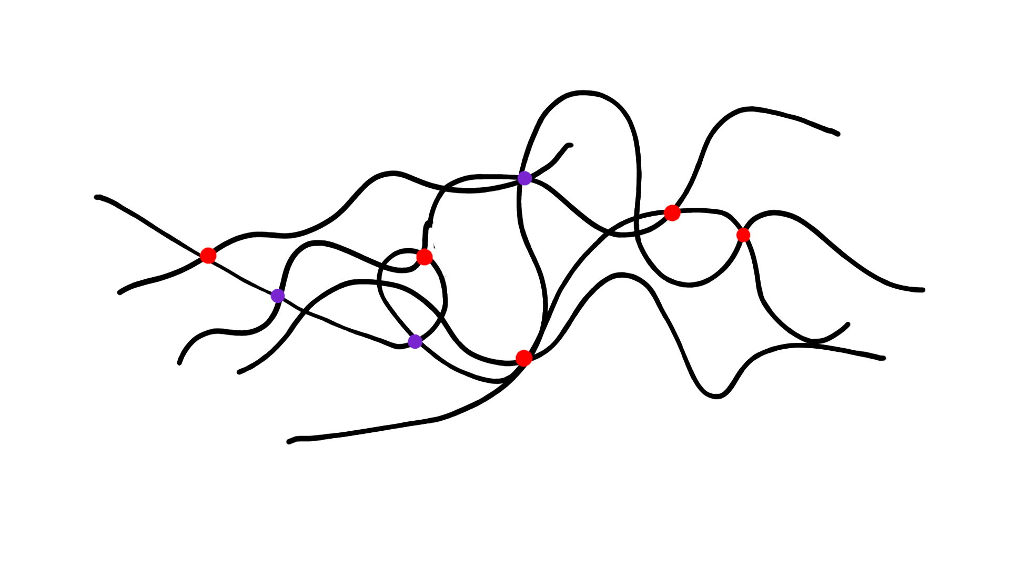
Motivation
logG’, logG’’
log$ω$
Elastomer: crosslinked polymer chains
+ crosslinks = less flow, more stiffness
“coupling” of G’ and G’’ wrt physical chemistry
Elastomer-like material with separate control over G’ and G’’ ?

Slide 4
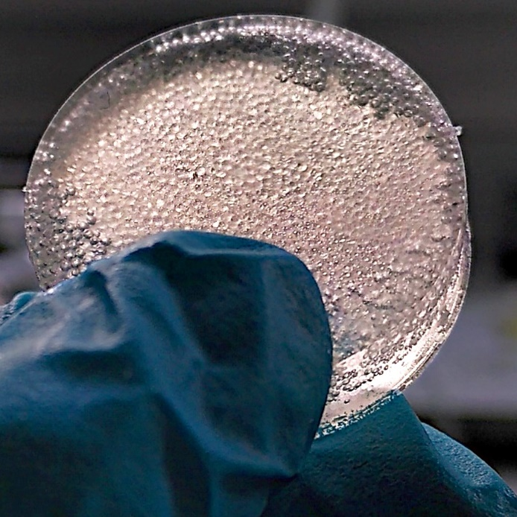
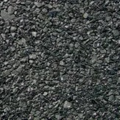
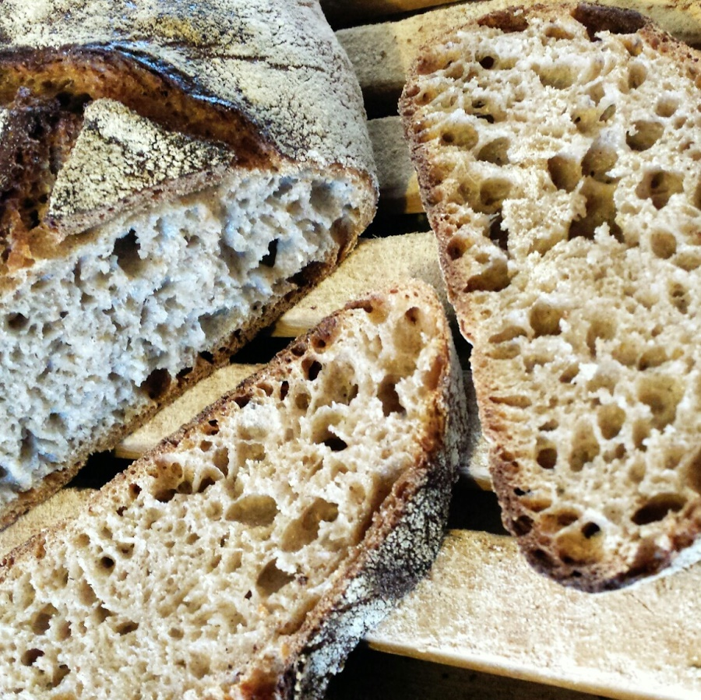
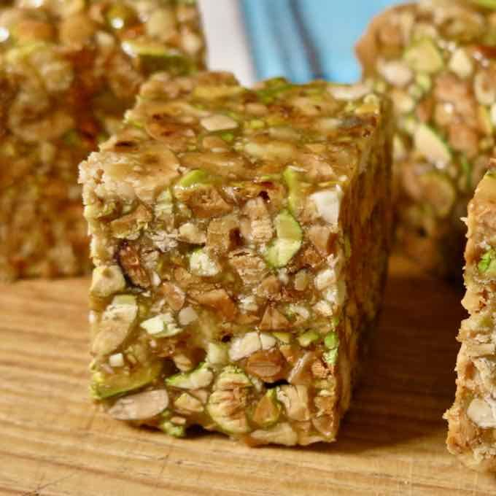
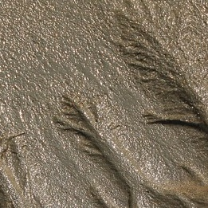
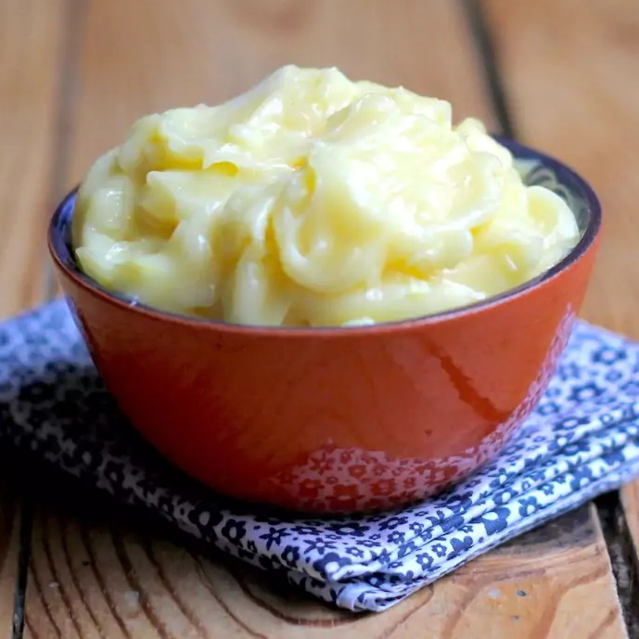
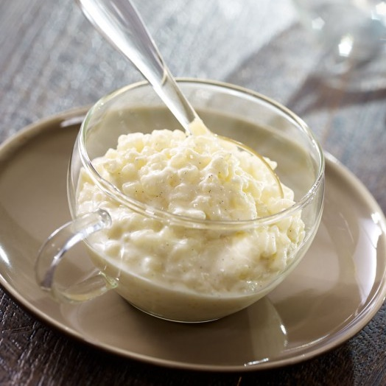
Inclusion systems
Gas
Liquid
Solid
CONTINUOUS PHASE
Solid
Solid foam
Solid emulsion
Solid toughener
Liquid
Liquid foam
Liquid emulsion
Solid dispersion / granular media
DISPERSED PHASE
Notes:
Need to take a step back → broader point of view
Phases with different degrees of condensation

Slide 5
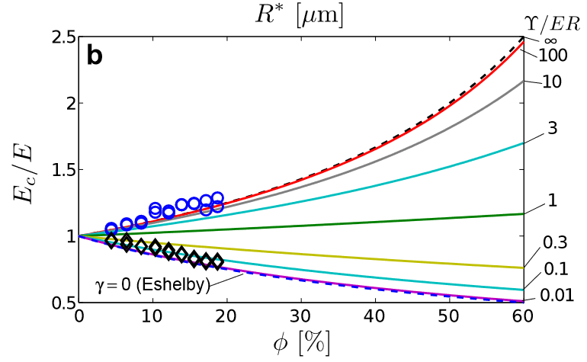
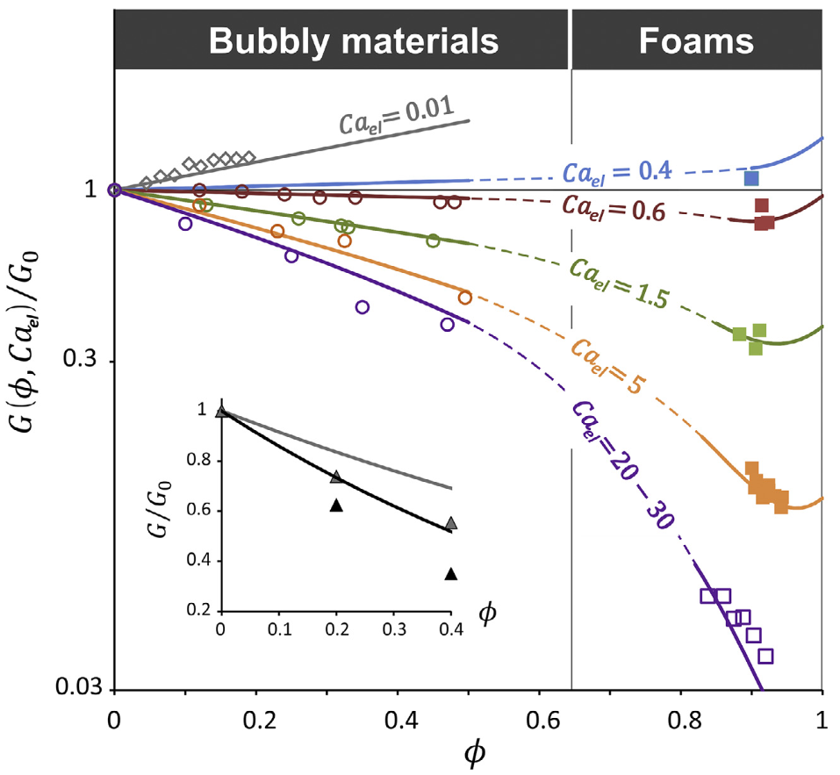
First approach for solid emulsions with liquid inclusions
Elastocapillary number accounts for all liquid inclusions, and yield stress foamy liquids
$${Ca}_{El}=\frac{G^{′}R}{γ}$$
$$φ={V_{void}}/V$$
$$φ={V_{dispersed}}/V$$
$${Ca}_{el}$$
0
0.01
0.1
1/3
$$G^{′}/G_{0}^{′}$$
1
3
10
100
$$∞$$
Gorlier et al., 2017, Journal of Colloid and Interface Science, 501
Style et al., 2014, Nature Physics, 11, 2
Experimental data for monodisperse inclusion corresponds to the literature for elasticity:
Influence of volume fraction $Φ$ modulated by elasto-capillary number $Ca_{El}$
Notes:
Confrontation experiments (emulsion + bubbly mat)
Correspond ok
Monodisperse
G’
=> What about G’ AND G’’

Slide 6
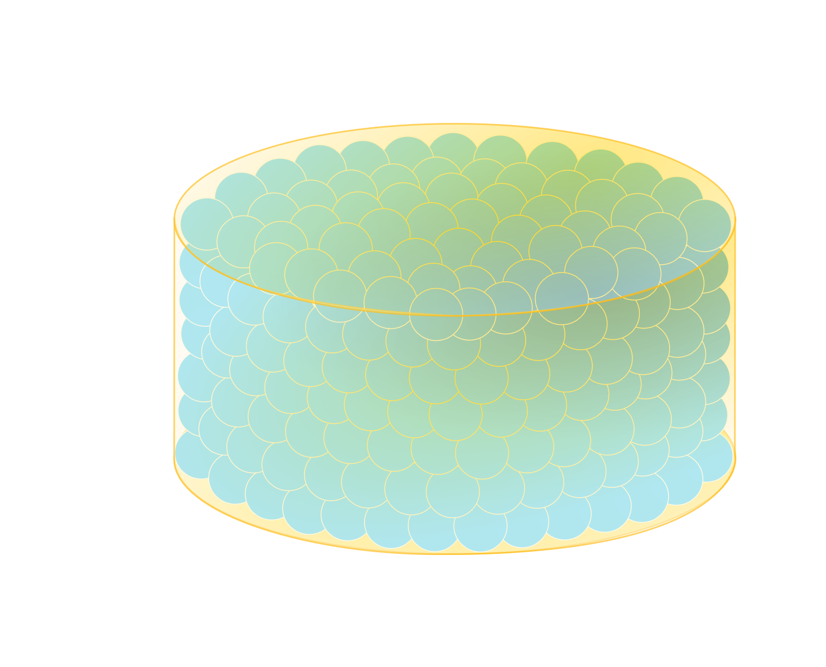
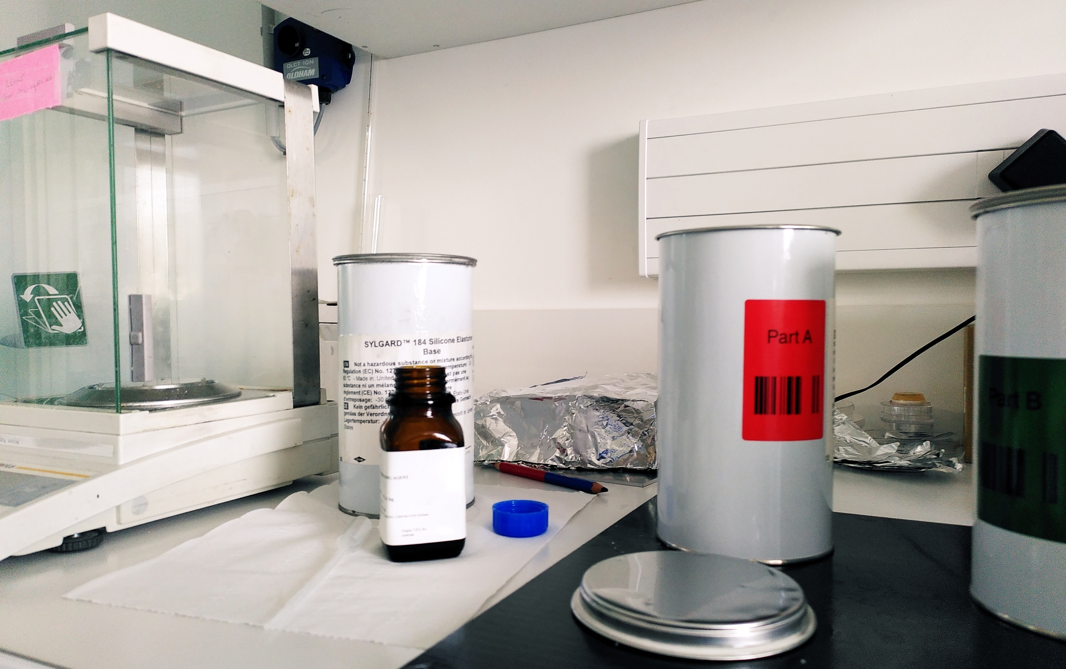
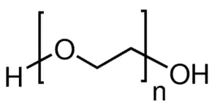
Controlling the rheology of a solid emulsion with liquid droplets
Solid
Silicone-based resin
Sylgard 184 / Sylgard 527 mixture :
Sylgard 184: purely elastic $E≈1$ MPa
Sylgard 527: mainly elastic $E≈1$kPa
Curing at ambient temperature for 2 days
Liquid
PEG 600
PEG 600 (n=15) :
melting temperature: $\sim 18°C$
Control parameters: $Φ, R, G_{PDMS}^{∗}, γ,η_{droplets}$
Notes:
My: peg in silicone
Peg 600 small, Tcryst=18°C
Mix sylgard: lower modulus→eCa→influence droplets
Parameters studied: Phi, R

Slide 7
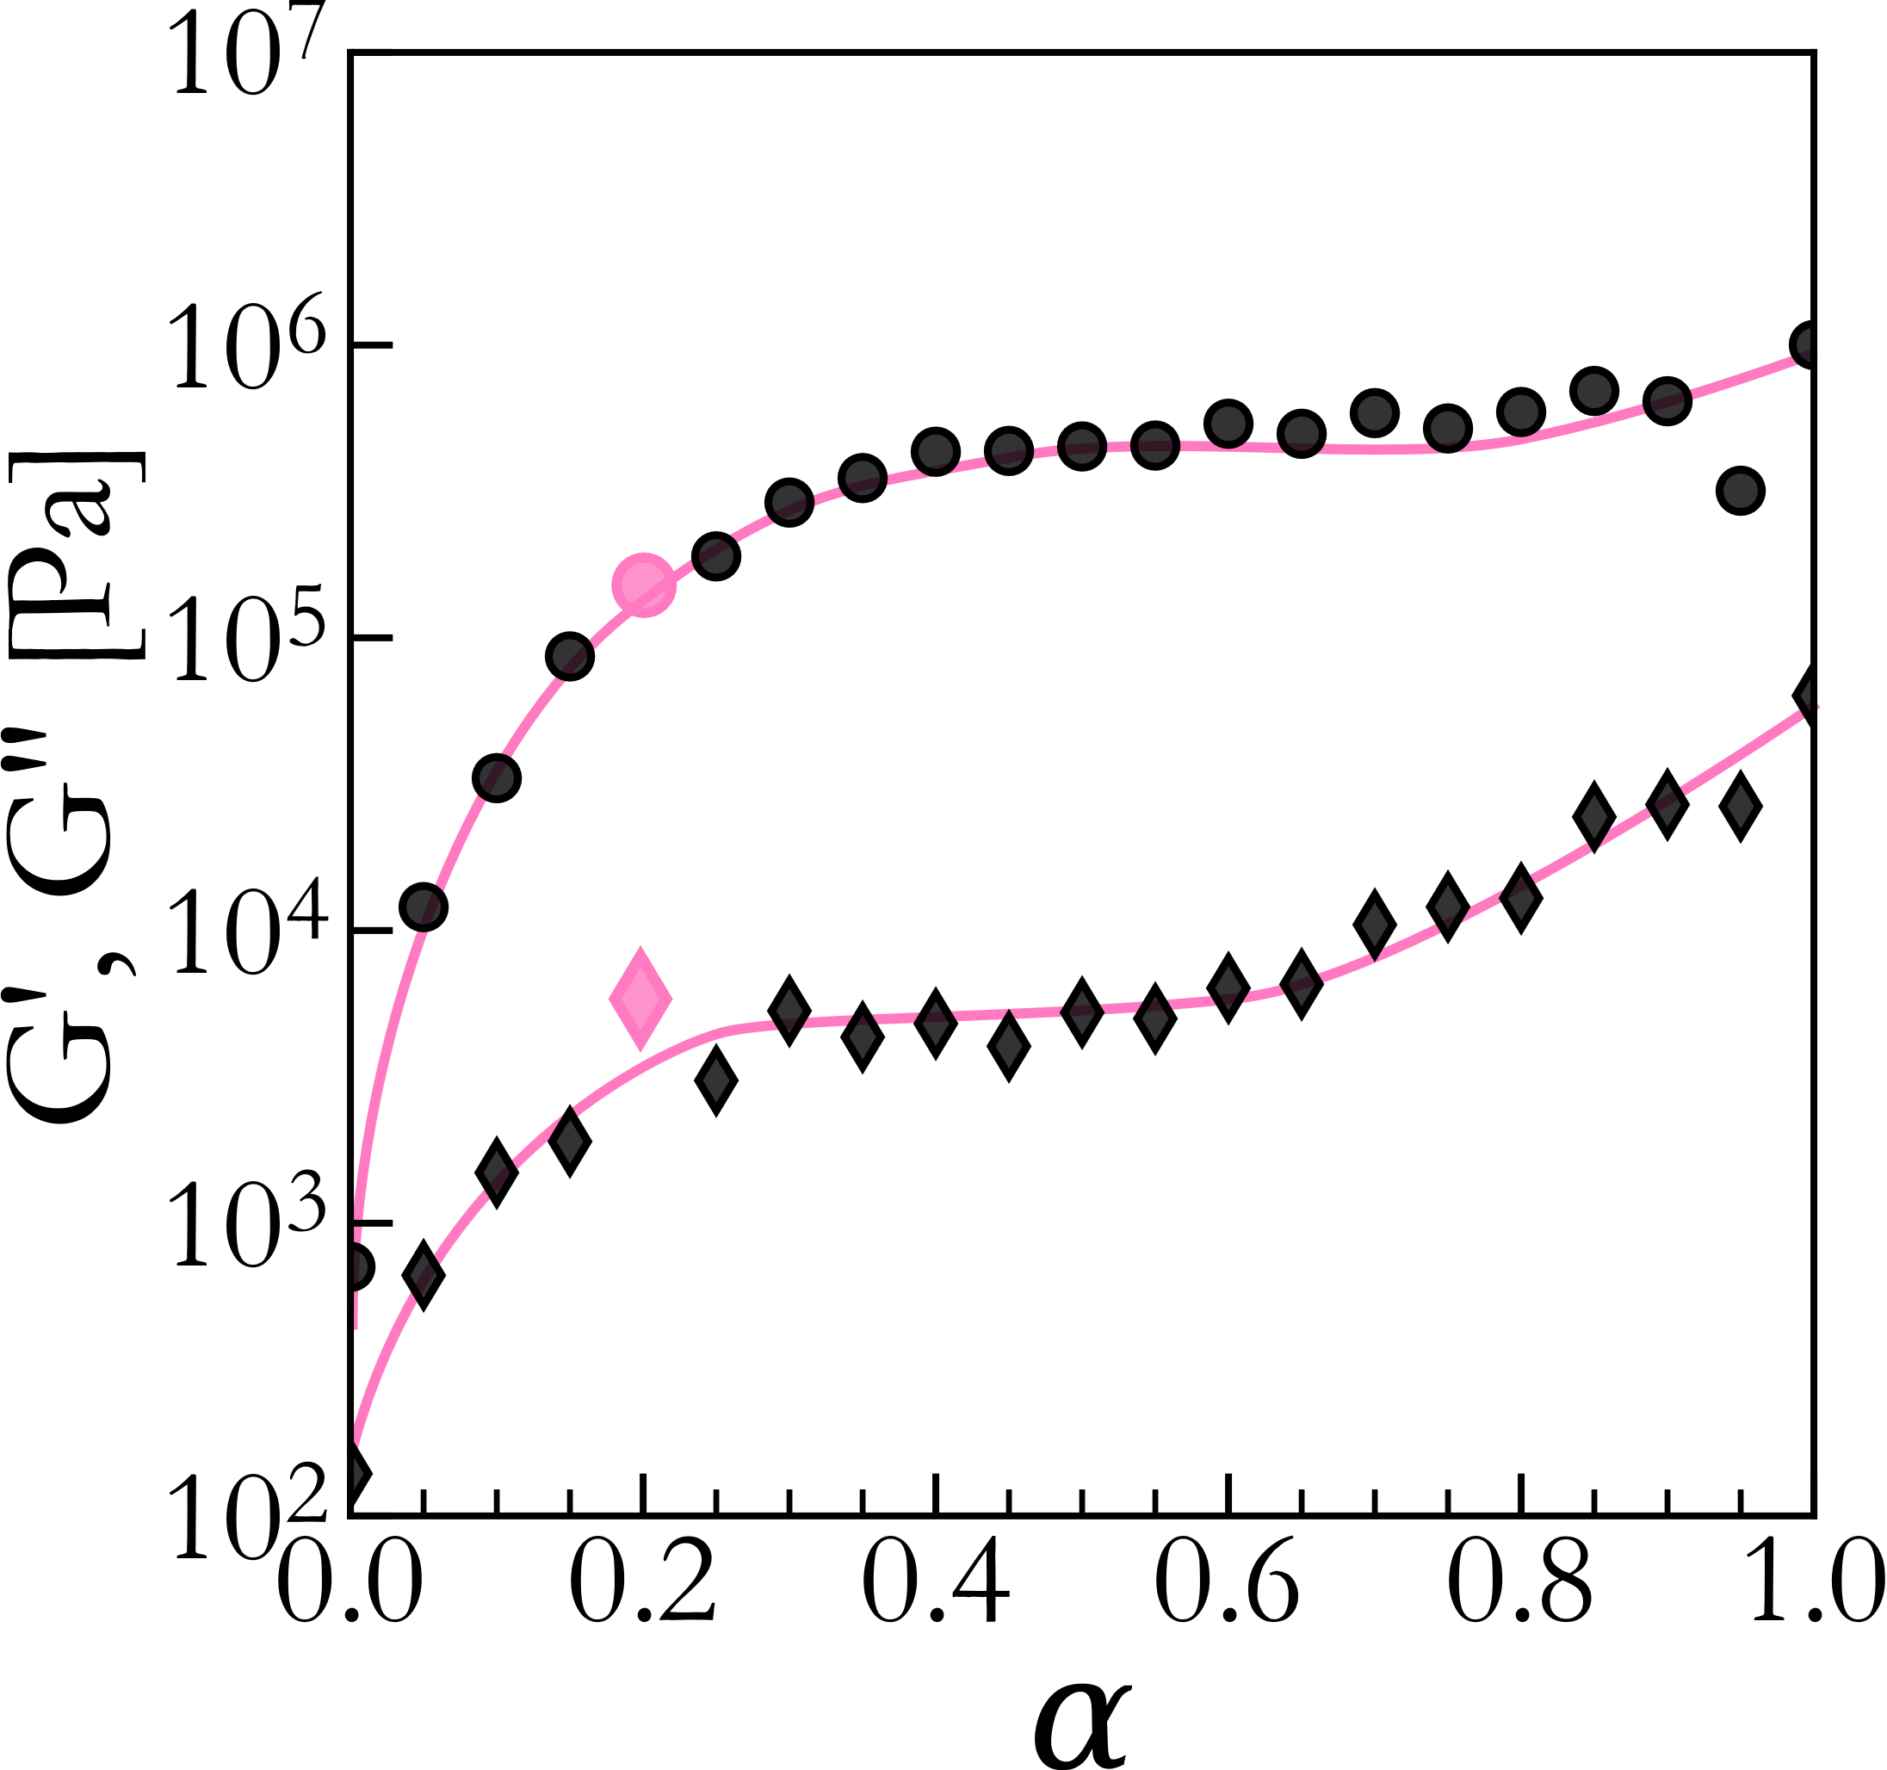
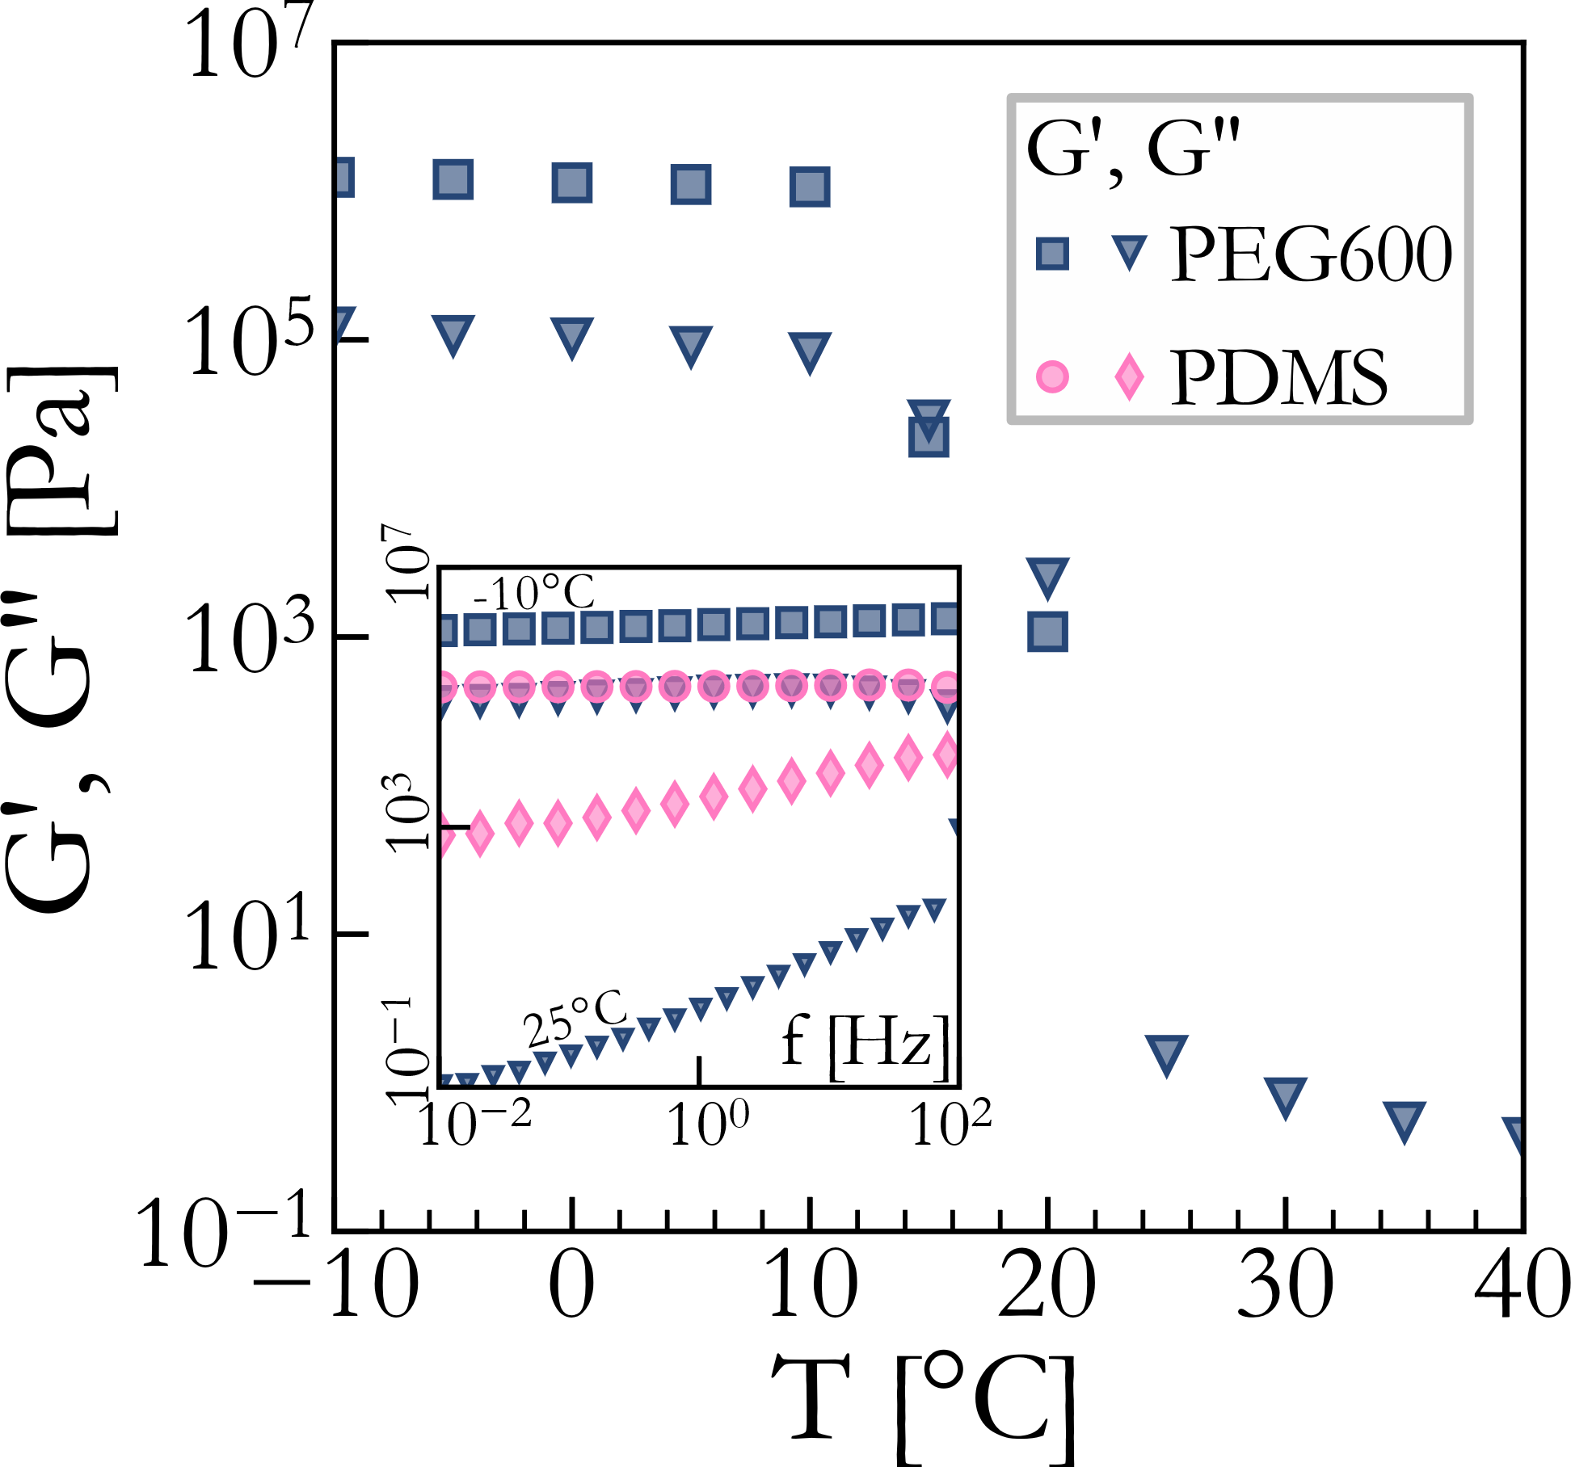
Dispersed and continuous phases
Sylgard 527
Sylgard 184
Moduli of the dispersed phase increase above the continuous phase at colder temperature

Slide 8
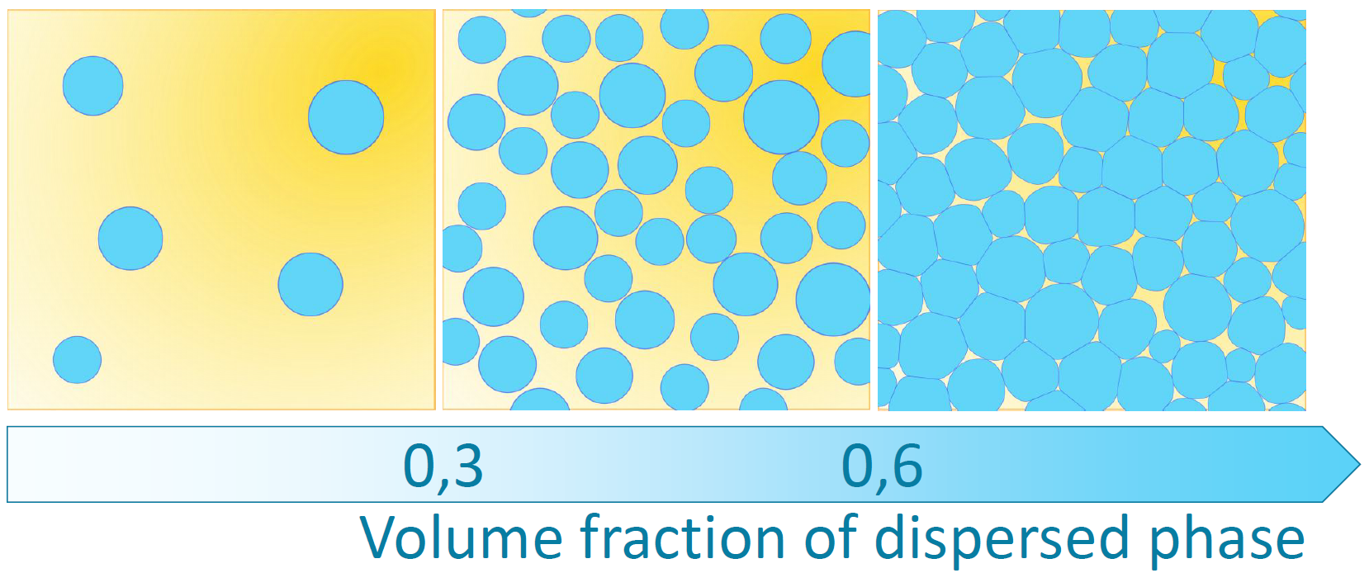
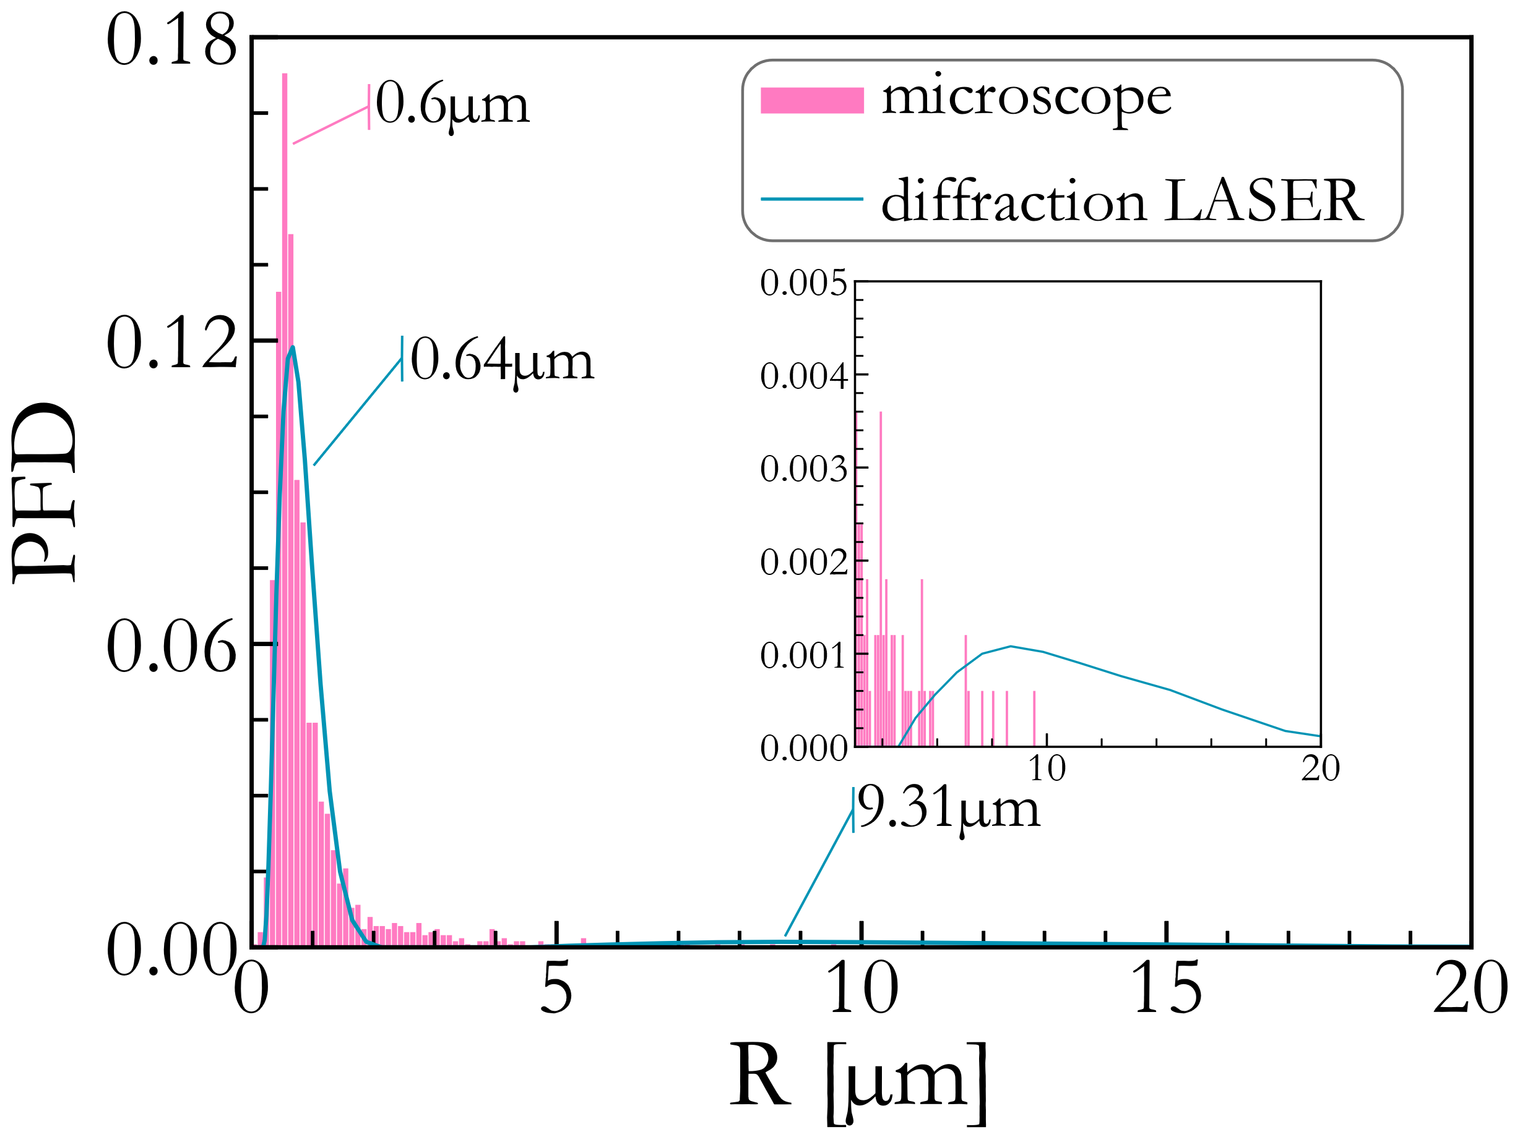
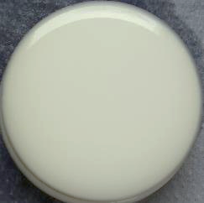
Generation of solid emulsions by breakup under shear
Rotation: aspiration between rotating rod and stator
Shearing between wall and rotor: breaking into droplets
9mN.m⁻¹
1cm
Dimethylsiloxane-ethylene glycol 70:30
block copolymer

Slide 9
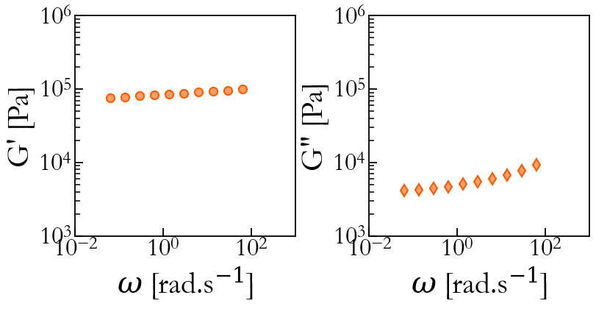
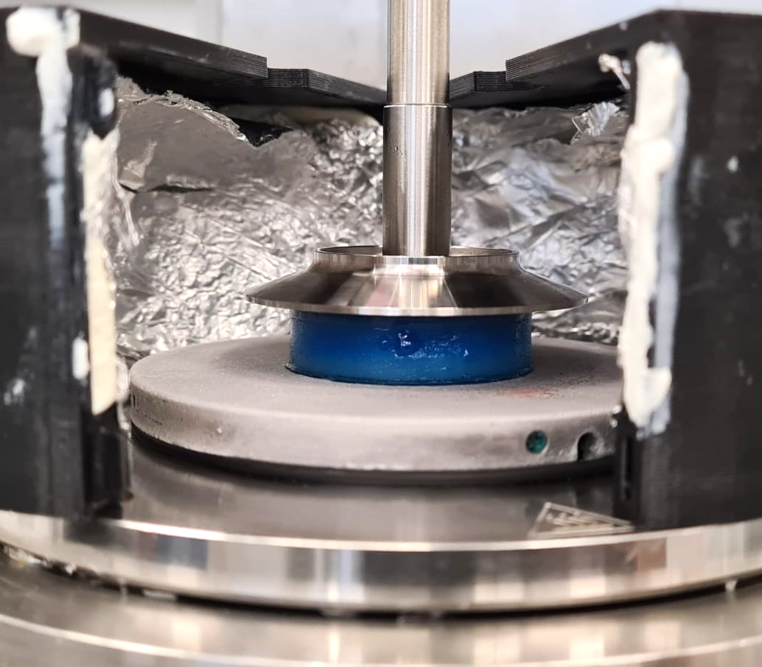
Typical linear viscoelastic response of solid emulsions
Loss modulus:
2 apparent slopes
Low frequencies: almost flat
High frequency: same slope as continuous phase
Storage modulus:
very similar to elastomeric plateau

Slide 10
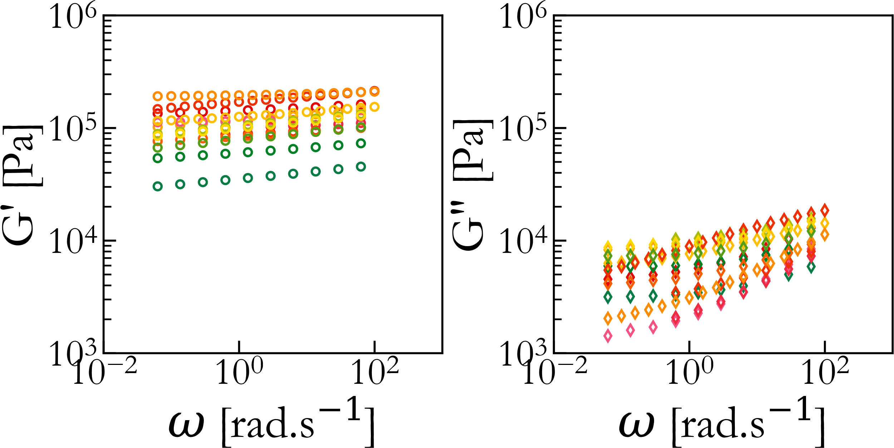
Evolution of linear viscoelasticity with volume fraction
$$Φ$$
$$0 0.3 0.65$$
Almost no change in the slopes of either moduli
In G’:
No tendency in plateau evolution at low volume fraction
Decrease at higher volume fraction

Slide 11
Evolution of linear viscoelasticity with volume fraction
$$Φ$$
In G’’:
Slope at high frequency $≡$ PDMS slope
Slope is lower than 1, close to 0.4 (usual for elastomers) → fractional rheology ?
$$0 0.3 0.65$$
Almost no change in the slopes of either moduli
In G’:
No tendency in plateau evolution at low volume fraction
Decrease at higher volume fraction

Slide 12
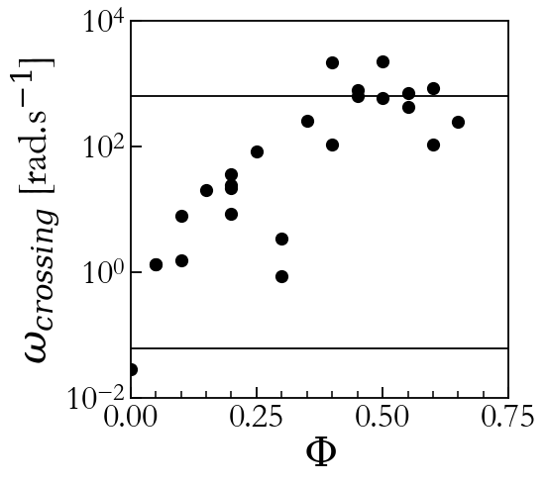
Evolution of linear viscoelasticity with volume fraction
$$Φ$$
In G’’:
Slope at high frequency $≡$ PDMS slope
Slope is lower than 1, close to 0.4 (usual for elastomers) → fractional rheology ?
$$0 0.3 0.65$$
Almost no change in the slopes of either moduli
In G’:
No tendency in plateau evolution at low volume fraction
Decrease at higher volume fraction
Crossing frequency between plateau and power-law increase increases with volume fraction

Slide 13
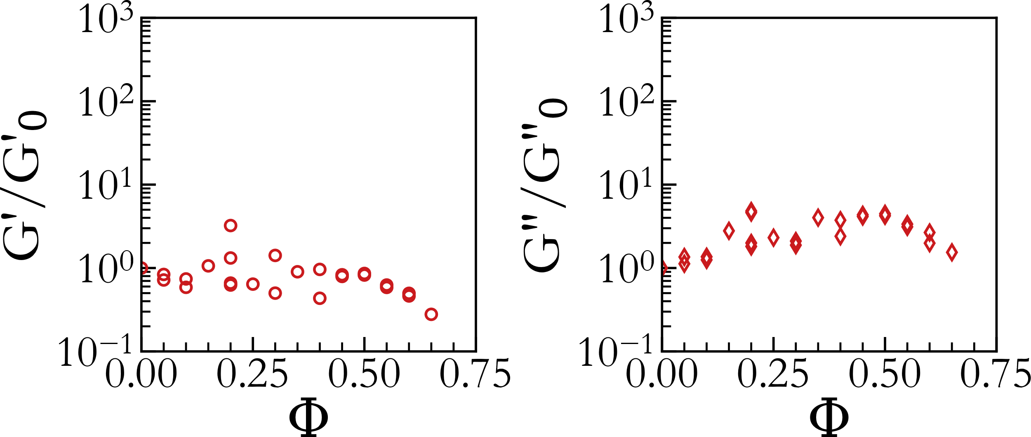
Evolution with volume fraction for liquid inclusions
Unexpected non-monotonous moduli → polydispersity ?
$Φ<0.4$ :
Almost constant G’
Increasing G’’
decorrelation of G’ and G’’ with regards to $Φ$

Slide 14
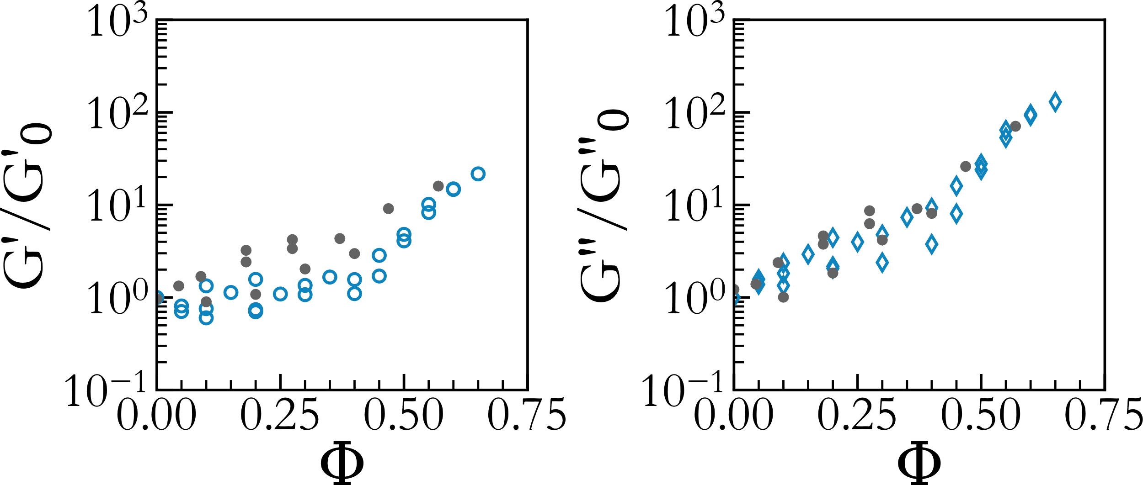
Evolution with temperature
Recovery of monotonous behavior
Comparison with rigid inclusions (glass beads):
Similar evolution in G’’
Discrepancy in G’
→ First hypothesis: polydispersity

Slide 15
Conclusions
Viscoelastic influence of liquid droplets in a soft matrix
Modelling work in progress with fractional rheology
Decorrelations of storage and loss moduli with regards to volume fraction
Influence of polydispersity on elastocapillary number
Interesting unexplained behavior with the temperature transition
Discrepancy with existing models already with liquid droplets
Non-trivial mechanical reponse from a mix of model materials
Interesting for tunable materials
Encapsulation of a phase-transition dispersed phase: thermal energy storage

Slide 16
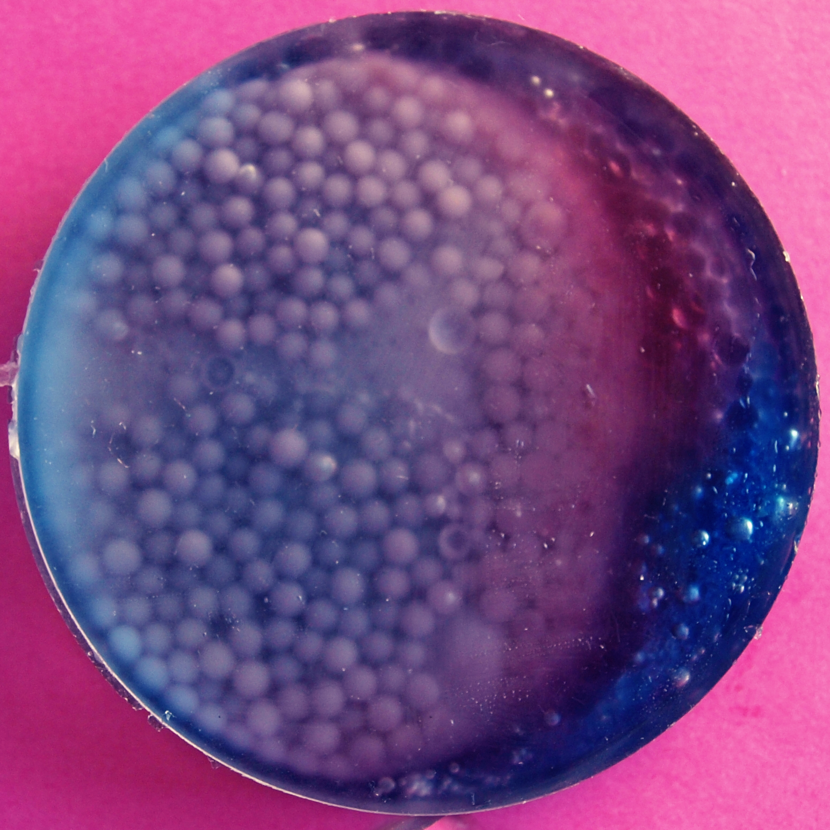
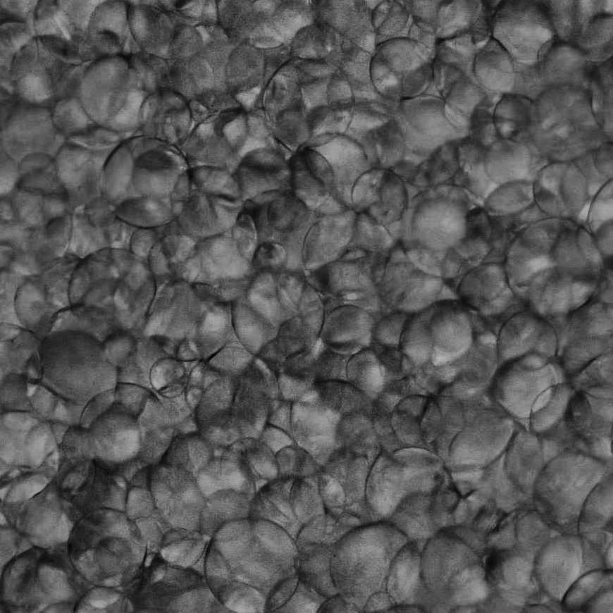
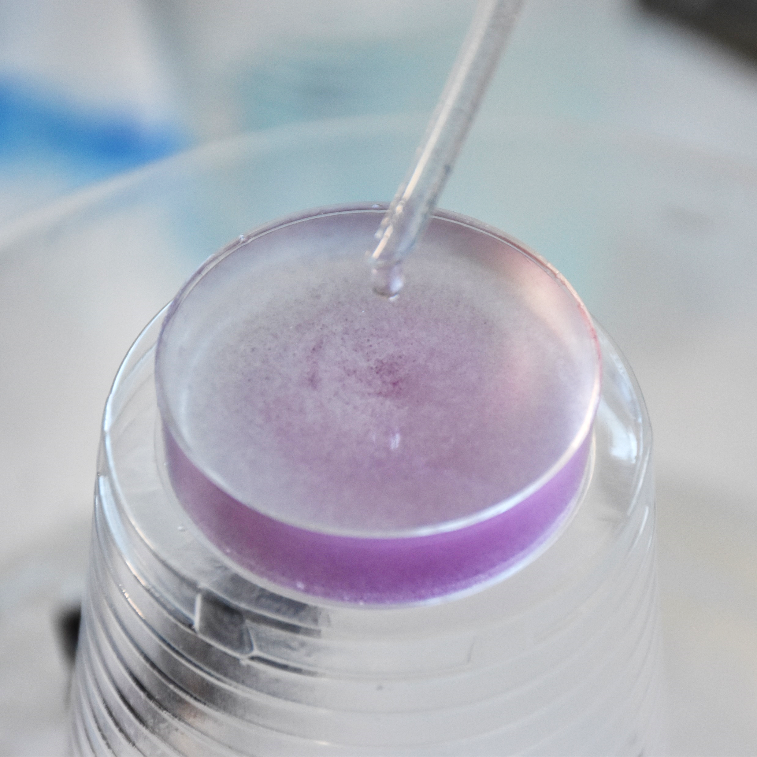
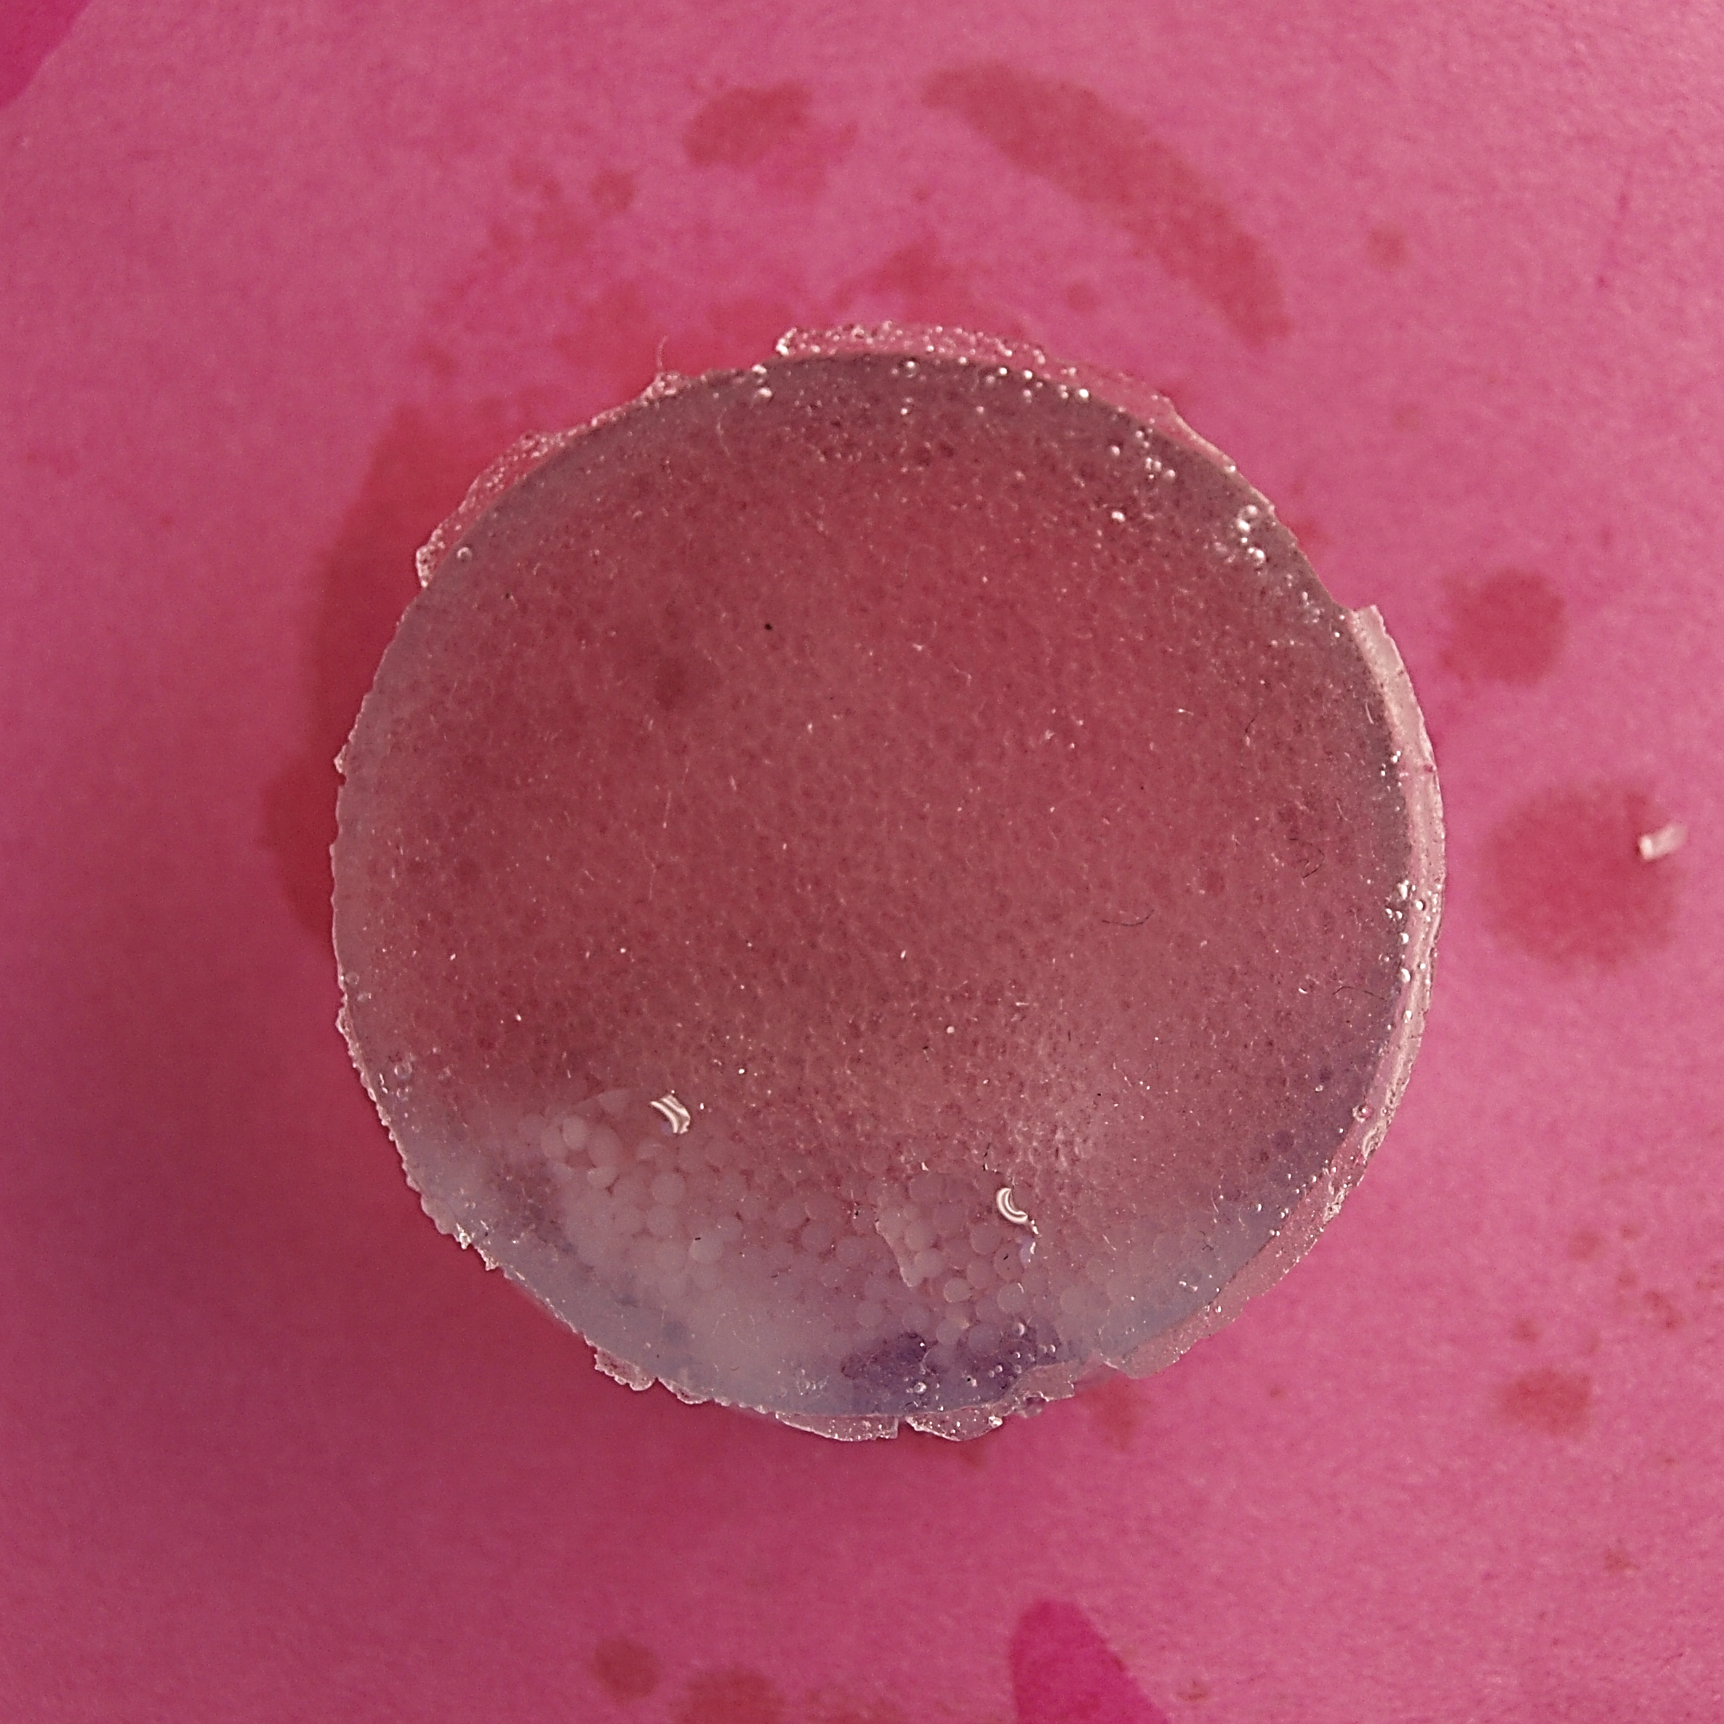
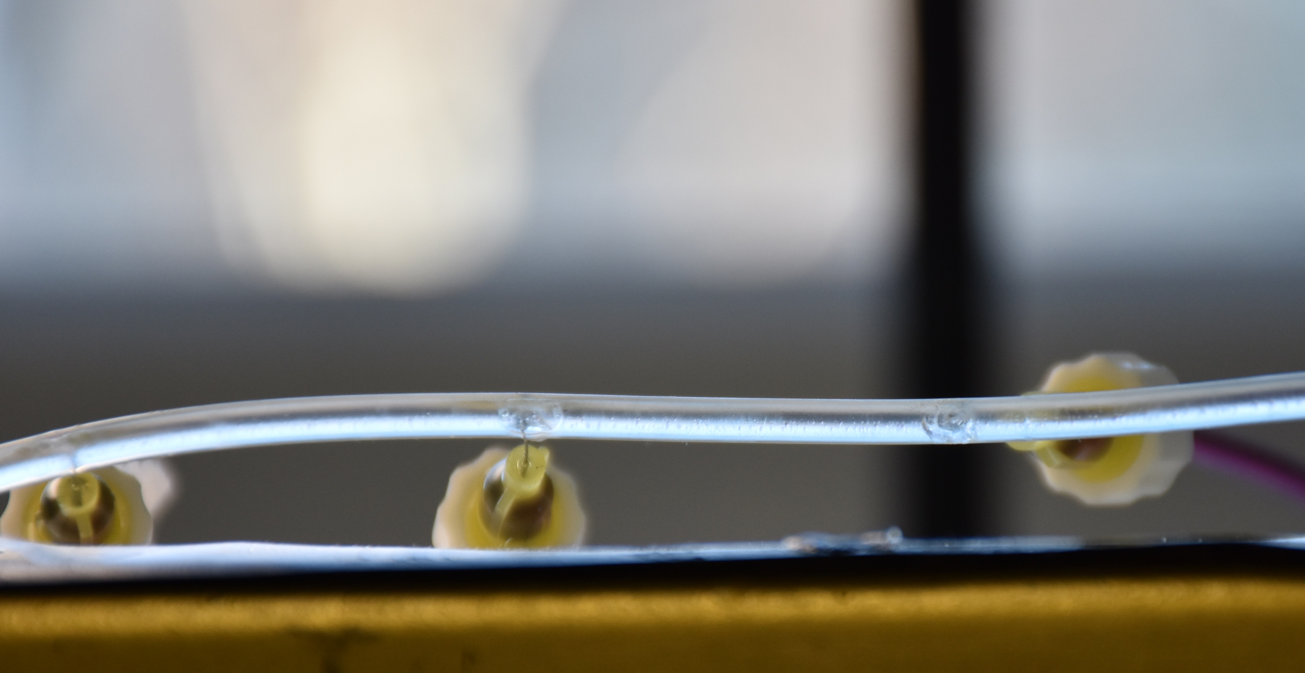
Thank you for your attention !

Slide 17
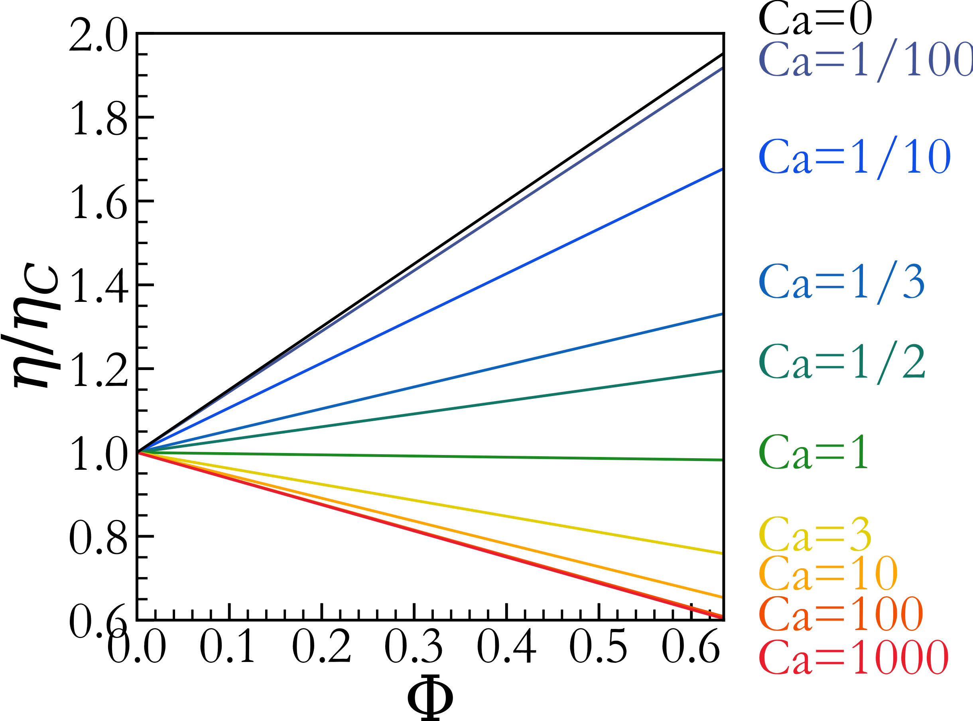
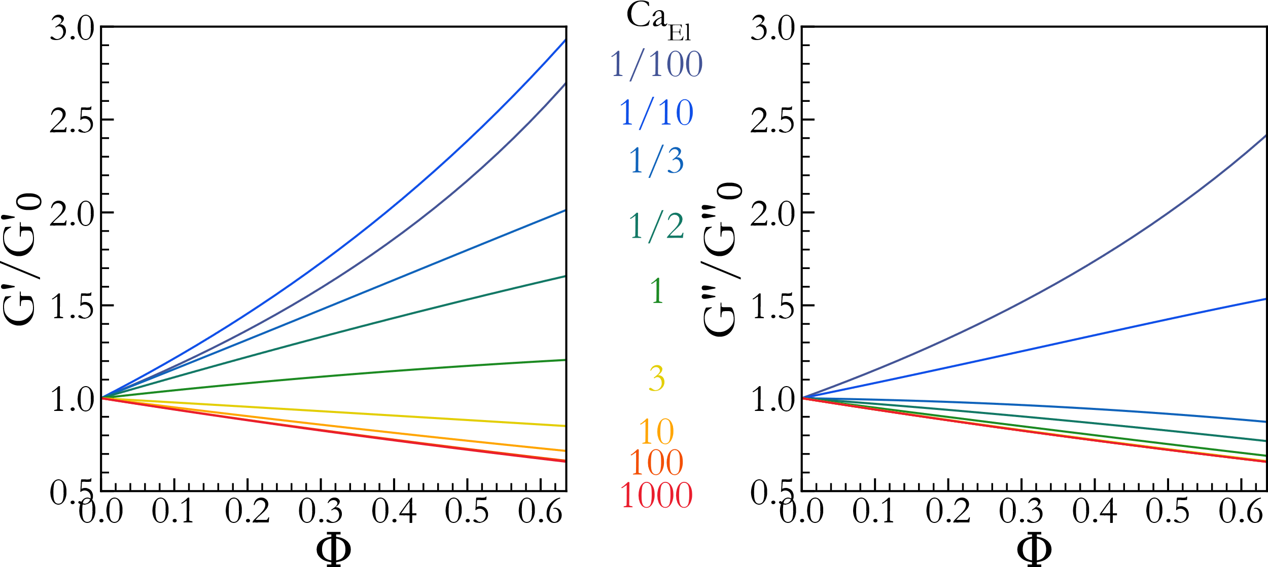
Rheology of liquid emulsions
Viscosity for emulsions based on Newtonian liquids (Frankel & Acrivos, 1970):
Rheology of liquid emulsions (Palierne, 1990):
$$φ={V_{dispersed}}/V$$
$$Ca=\frac{ηU}{γ}$$
$${Ca}_{El}=\frac{G^{′}R}{γ}$$
Influence of the volume fraction $Φ$ on viscosity
Ca_{el} influences the way $Φ$ changes the rheological parameters
Notes:
Extension to oscillatory + viscoelastic : Palierne
! ECA ! Elastic modulus vs capillary pressure
→ Determine influence inclusions

Slide 18
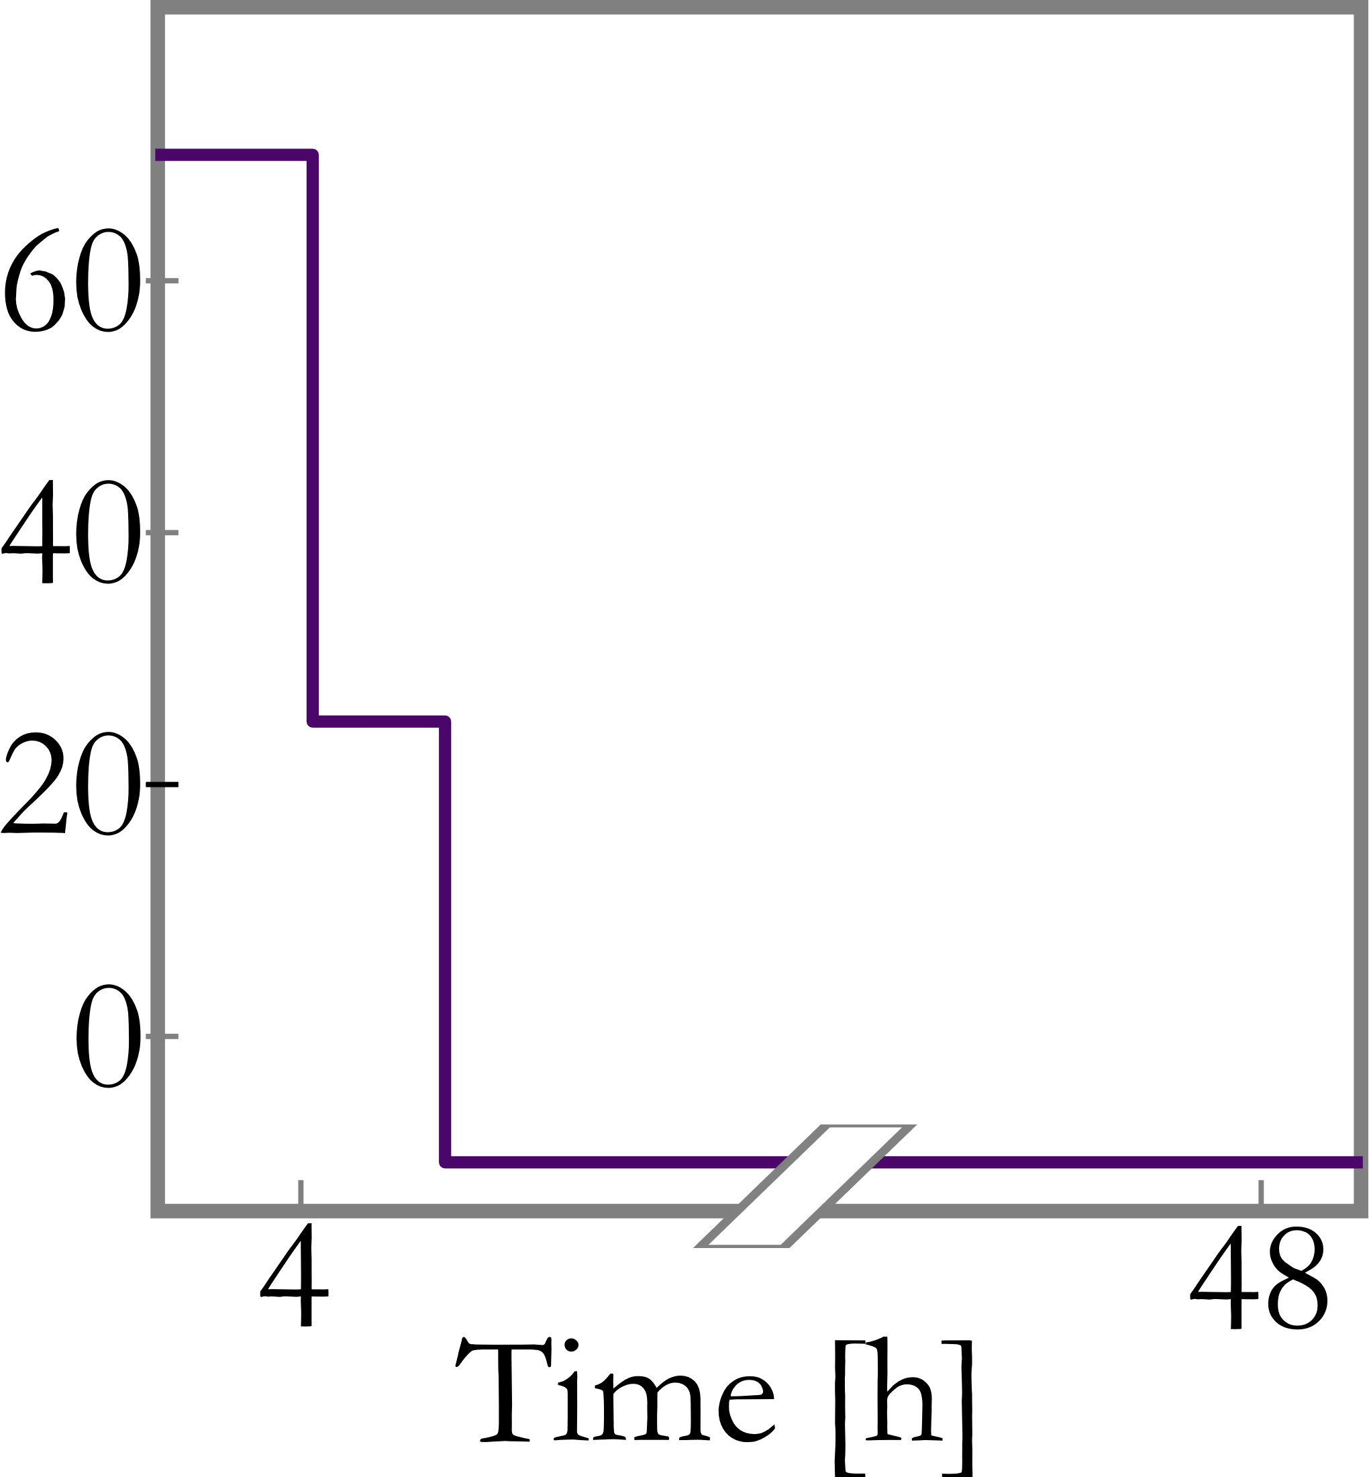
Rheological characterization
Frequency sweep between 0.01Hz and 100Hz
Deformation $ε=$0.1%
Constant normal force 2N during temperature change
4
2
1
Temperature [°C]
4h 70°C: crosslinking sample to rheometer
3
2h 25°C equilibrating frequency sweep
Sample
Plate-plate configuration
Peltier plate
Insulating box
2d -10°C crystallization frequency sweep

Slide 19
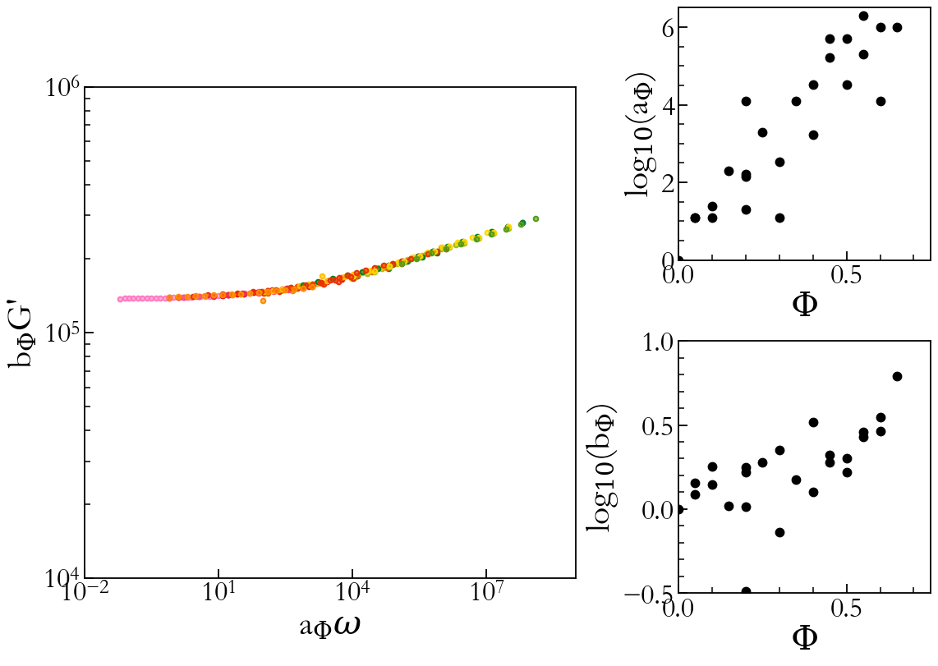
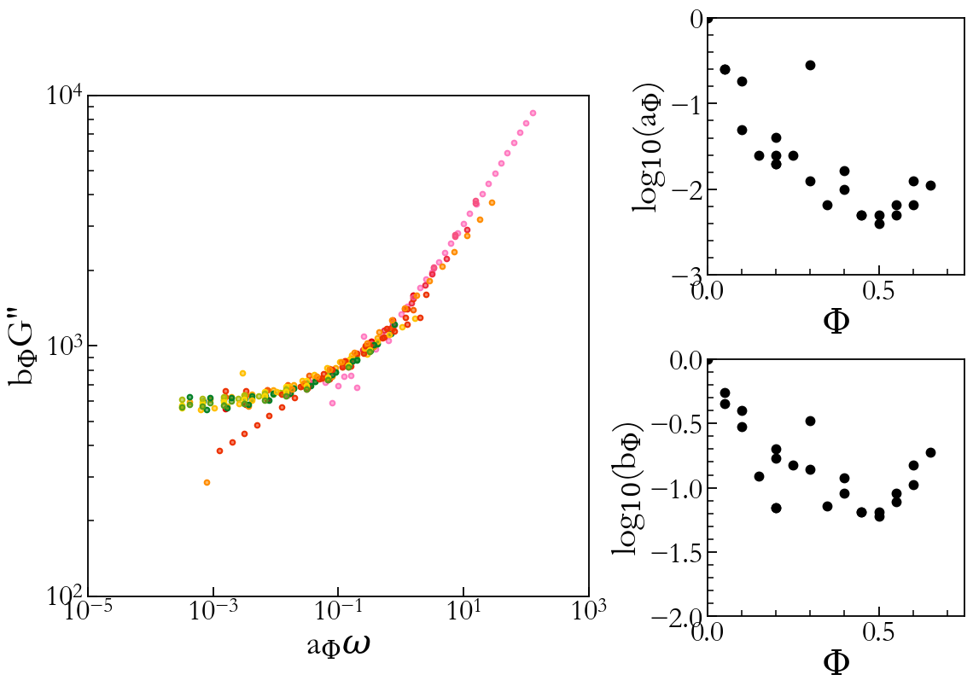
Master curve ?

Slide 20
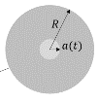
Adhesion first results with JKR experiment
Jonhson, Kendall, Roberts, 1971, RSPA, 324, pp301-313
G
~
Compression
Linearization of the force-contact relation:
Compression
$$\tilde{F}=Kã −\sqrt{WK}$$
Traction
$$\tilde{F}=Kã −\sqrt{\text{G}K}$$
Traction
$$K=\frac{4}{3}\frac{E}{1−ν^{2}}$$
Compression work
$$W=γ_{1}+γ_{2}$$
Energy release rate
G = W + dissipations

Slide 21
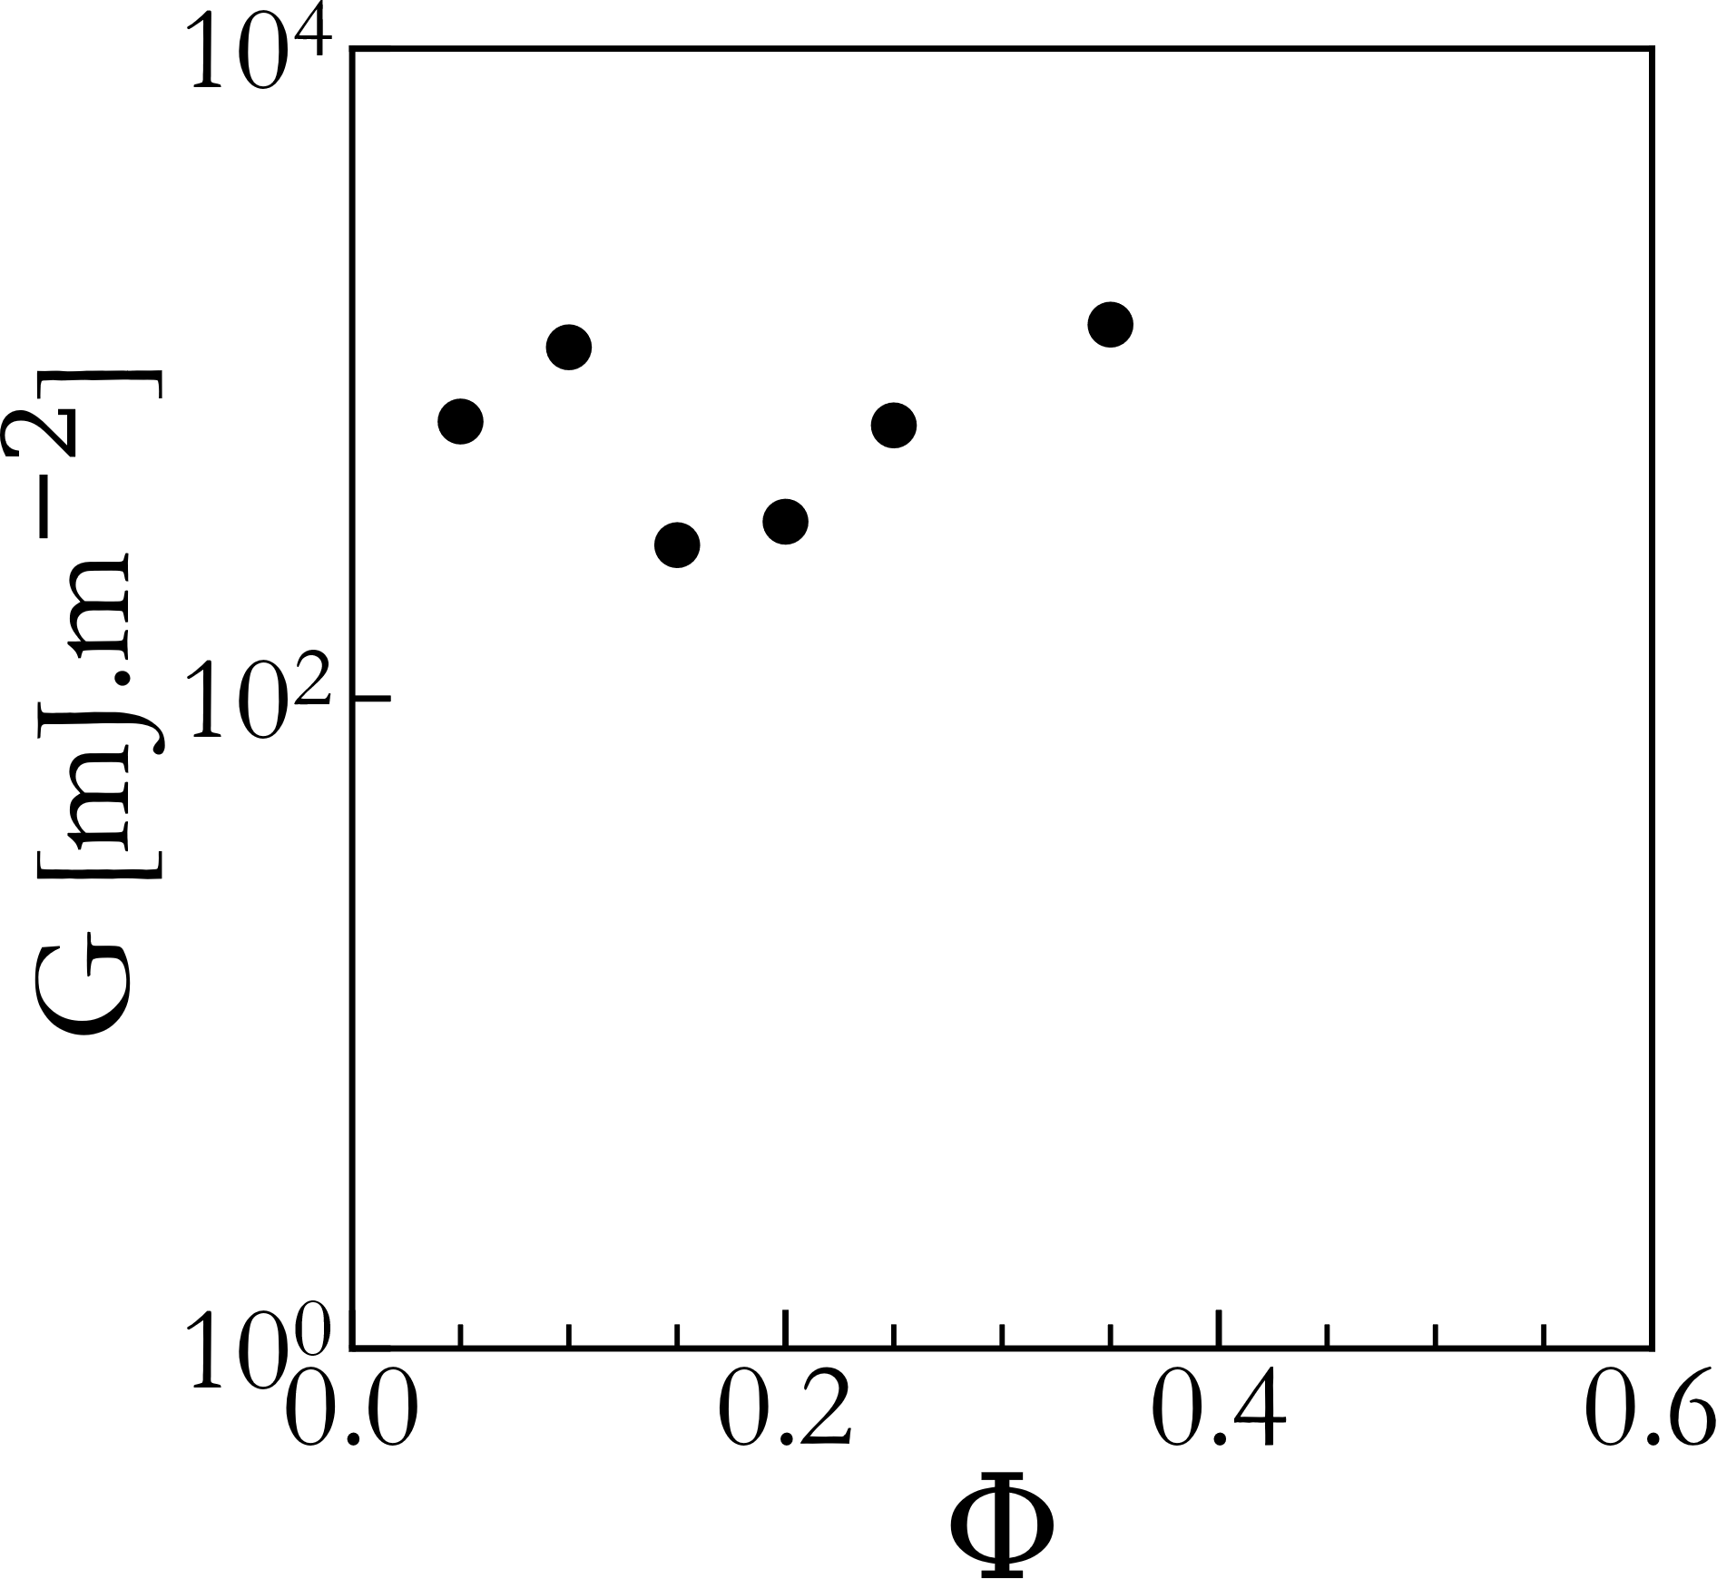
Preliminary JKR results
$$2γ_{glass}$$
$$E≈1MPa$$
$$\underset{⇒}{}\text{G}=\frac{E}{2(1+ν)}$$ $≈300kPa$
G = W + dissipations
G $>$ W
→ adhesion
$$2γ_{PDMS}$$
G
$$2γ_{surfactant}$$
Adhesion in all the samples
Preliminary data shows apparent influence of volume fraction
G

Slide 22
Typical rheometry for solidified inclusions (T=-10°C)
$$Φ<0.4$$
$$Φ≥0.4$$
G’ almost constant for $Φ≤0.4$, increasing with $Φ$ above $Φ=0.4$
G’’ increases strongly with $Φ$

Slide 23
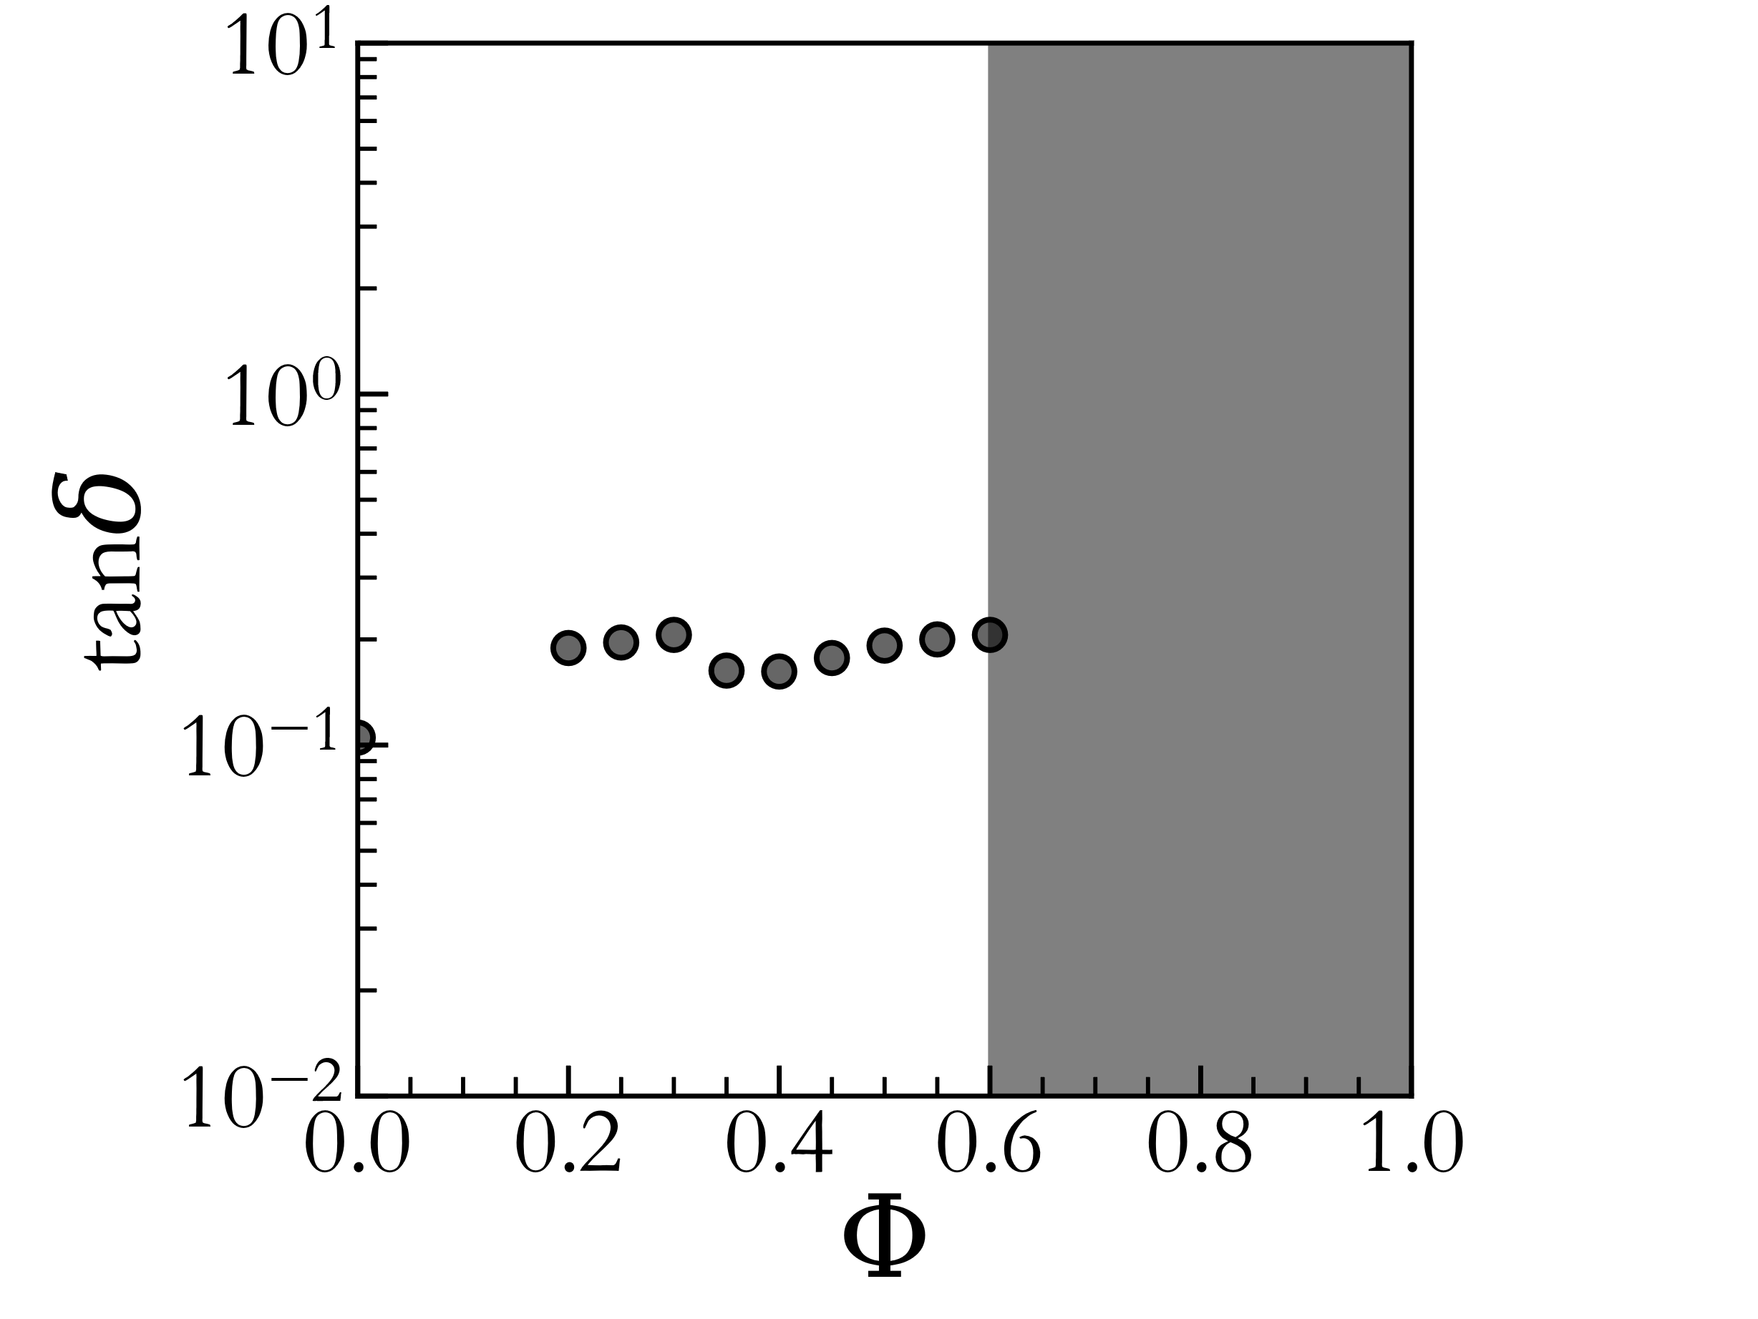
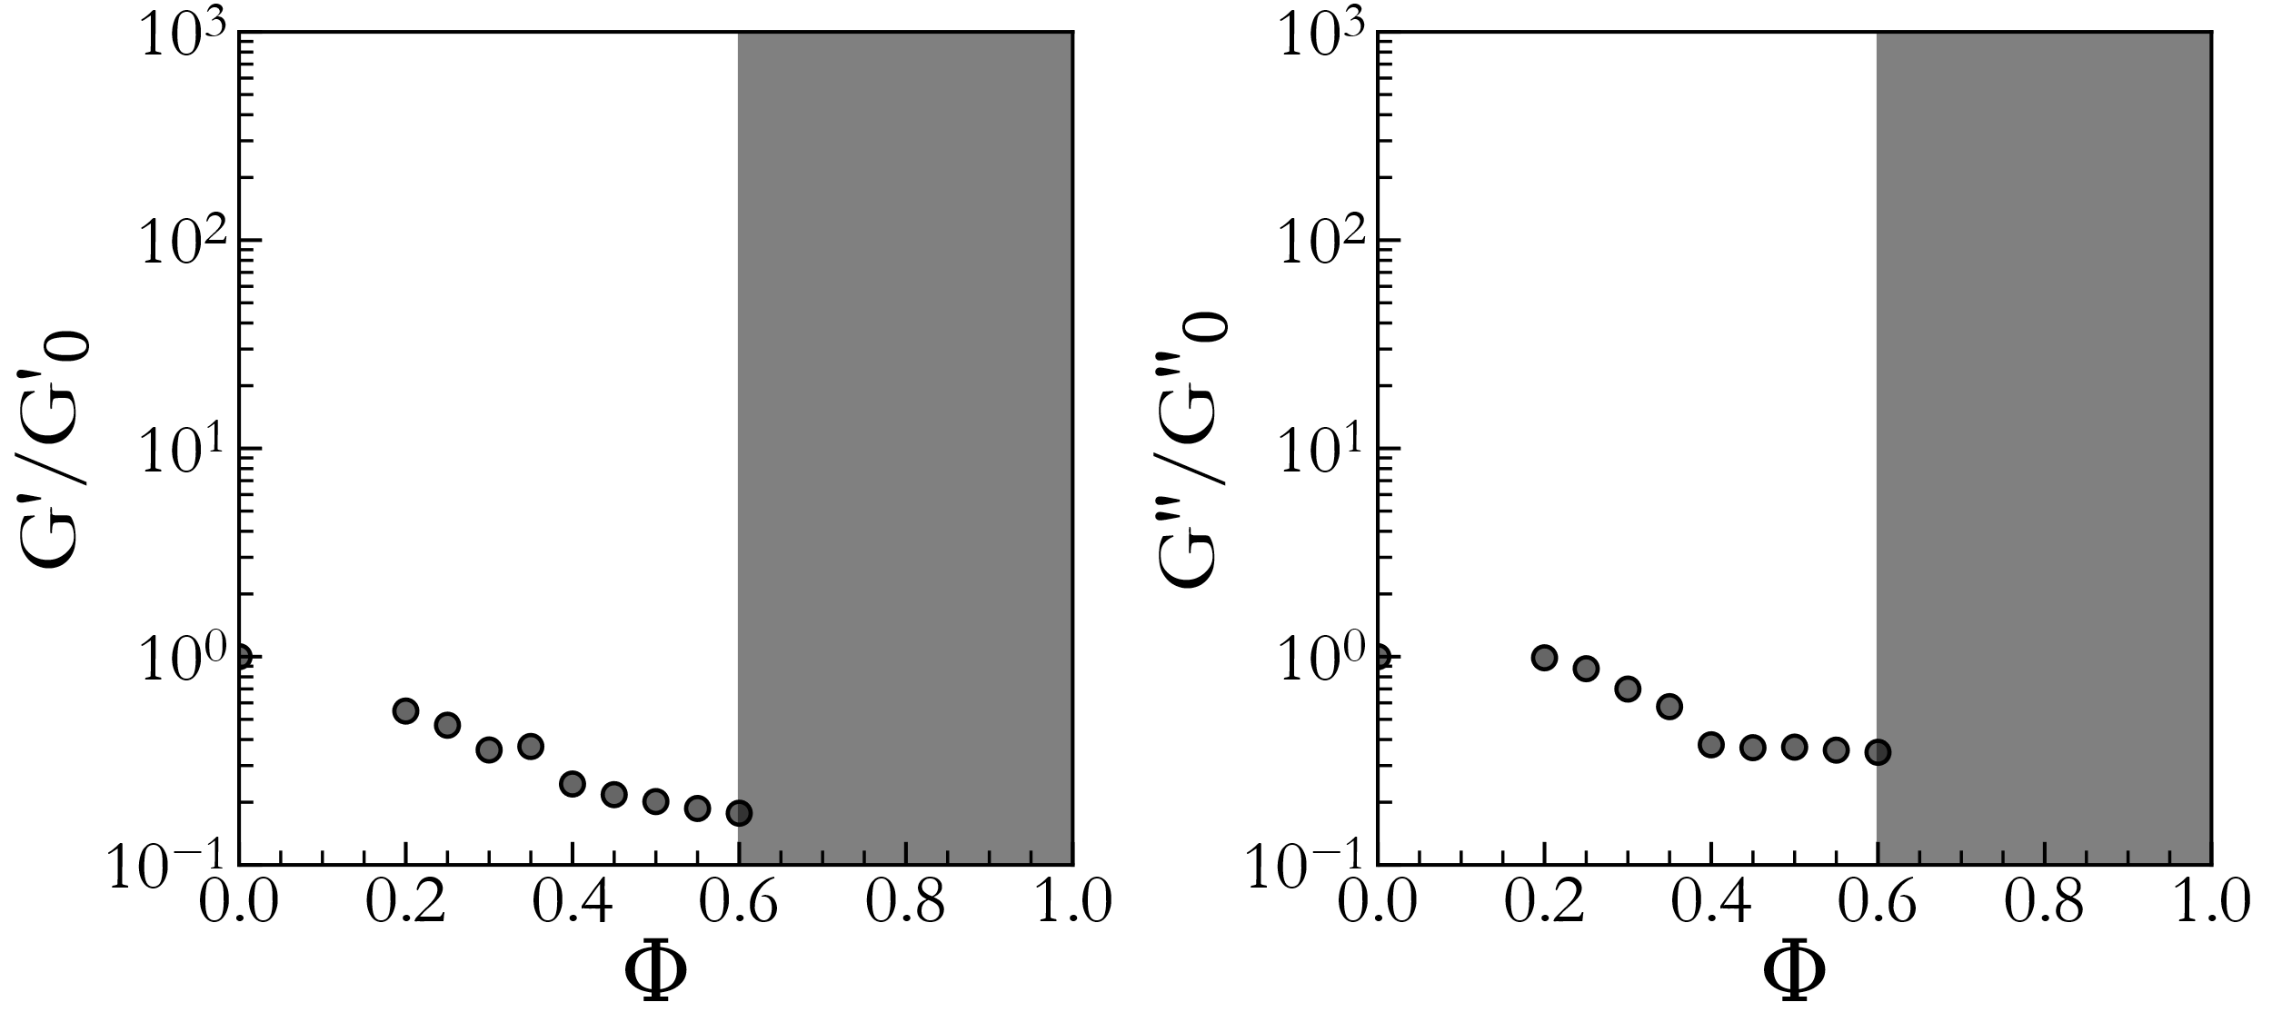
Sylgard 184 continuous phase
Little variation compared to the continuous phase: dominated by elasticity
Modulus decreases as thin films are formed
Same variation for G’ and G’’

Slide 24
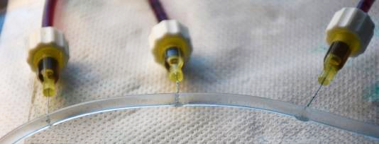
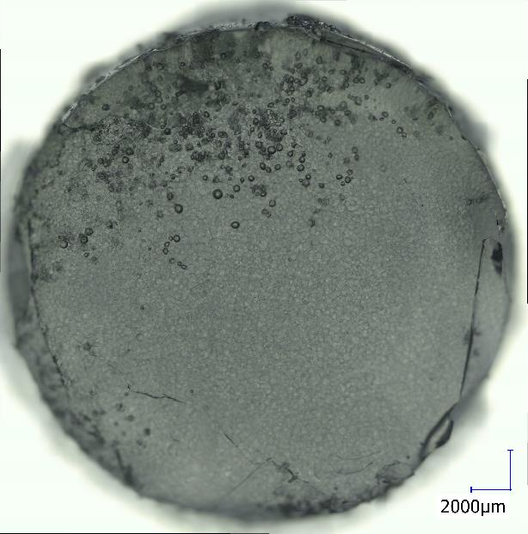
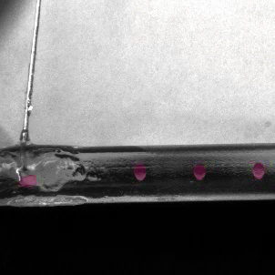
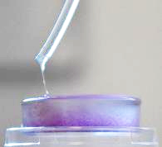
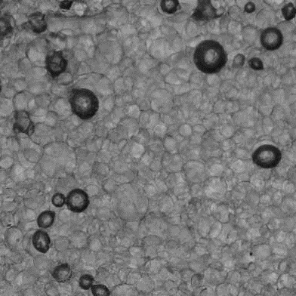
Microfluidics-generated samples
PDMS cooled down and pushed through a peristaltic pump, allowing for reuse on the excess oil
PEG600 pushed through 10 syringes in the flow of PDMS
Sedimentation of the droplets leading to $Φ≈rcp$ and curing at room temperature
R≈150µm

Slide 25
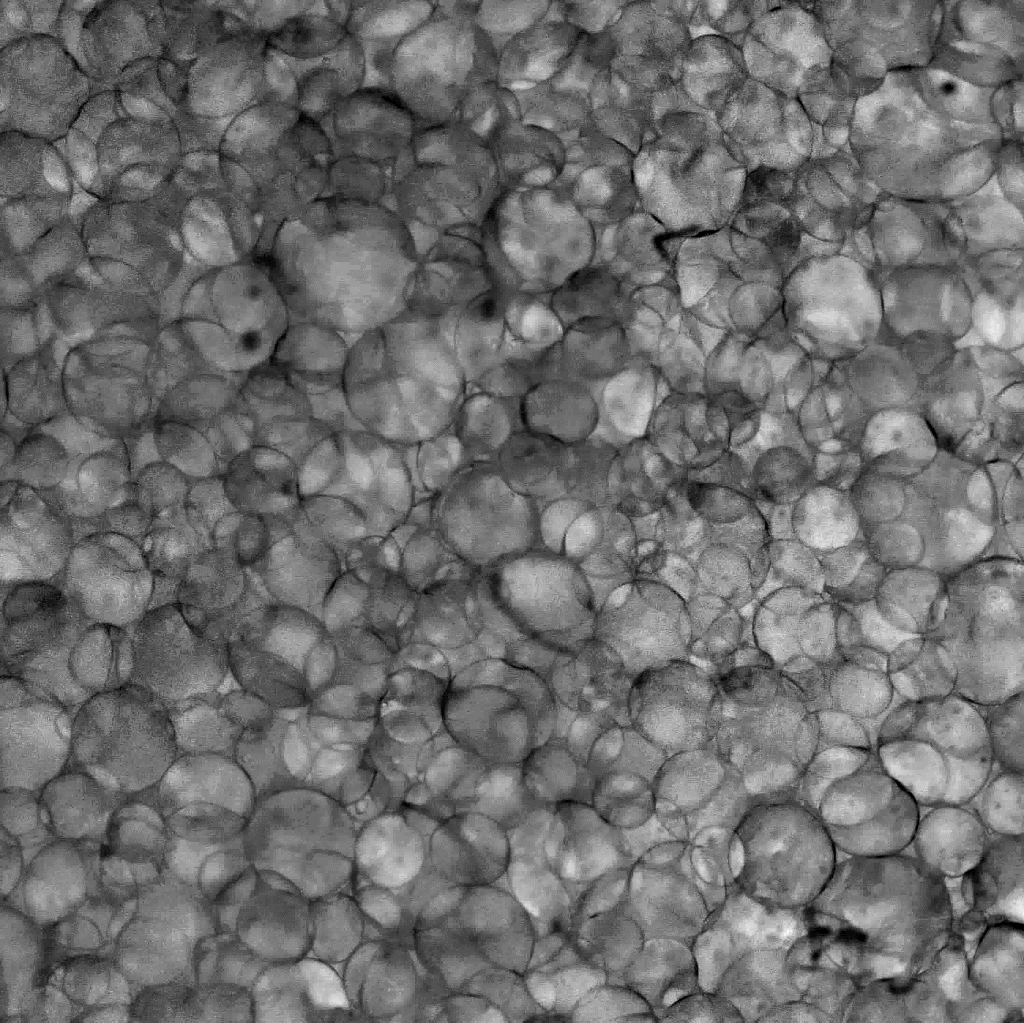
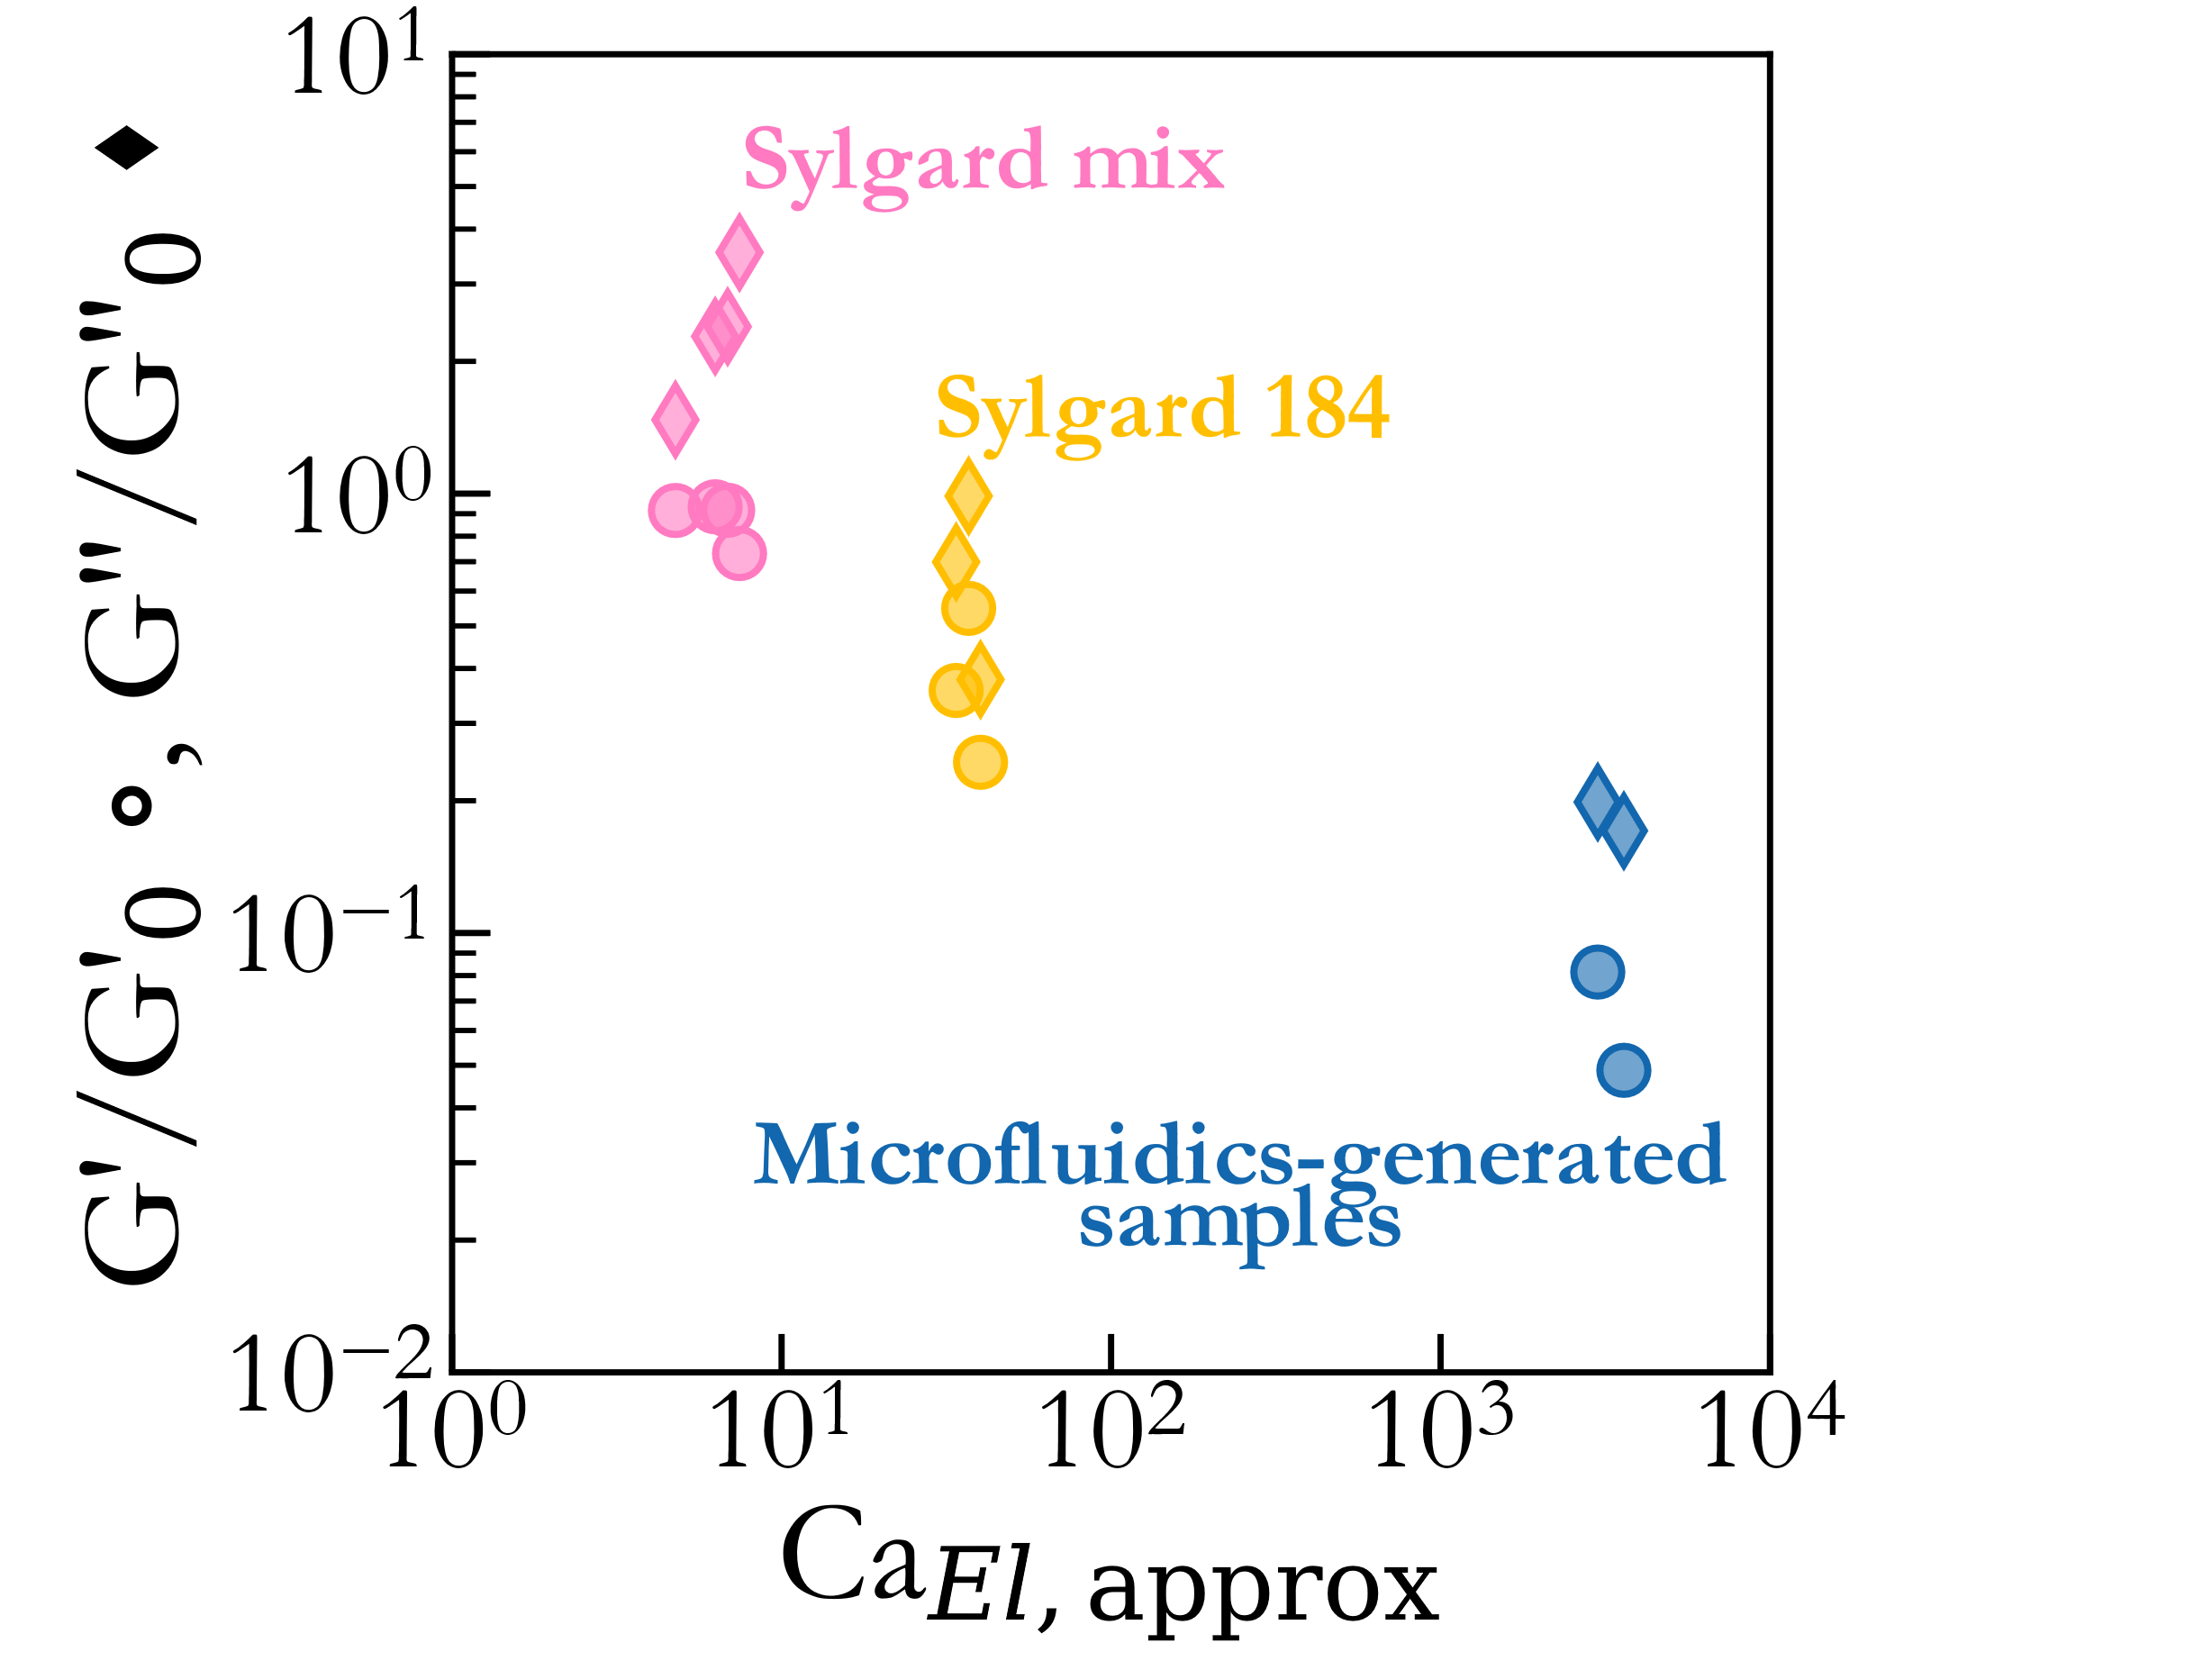
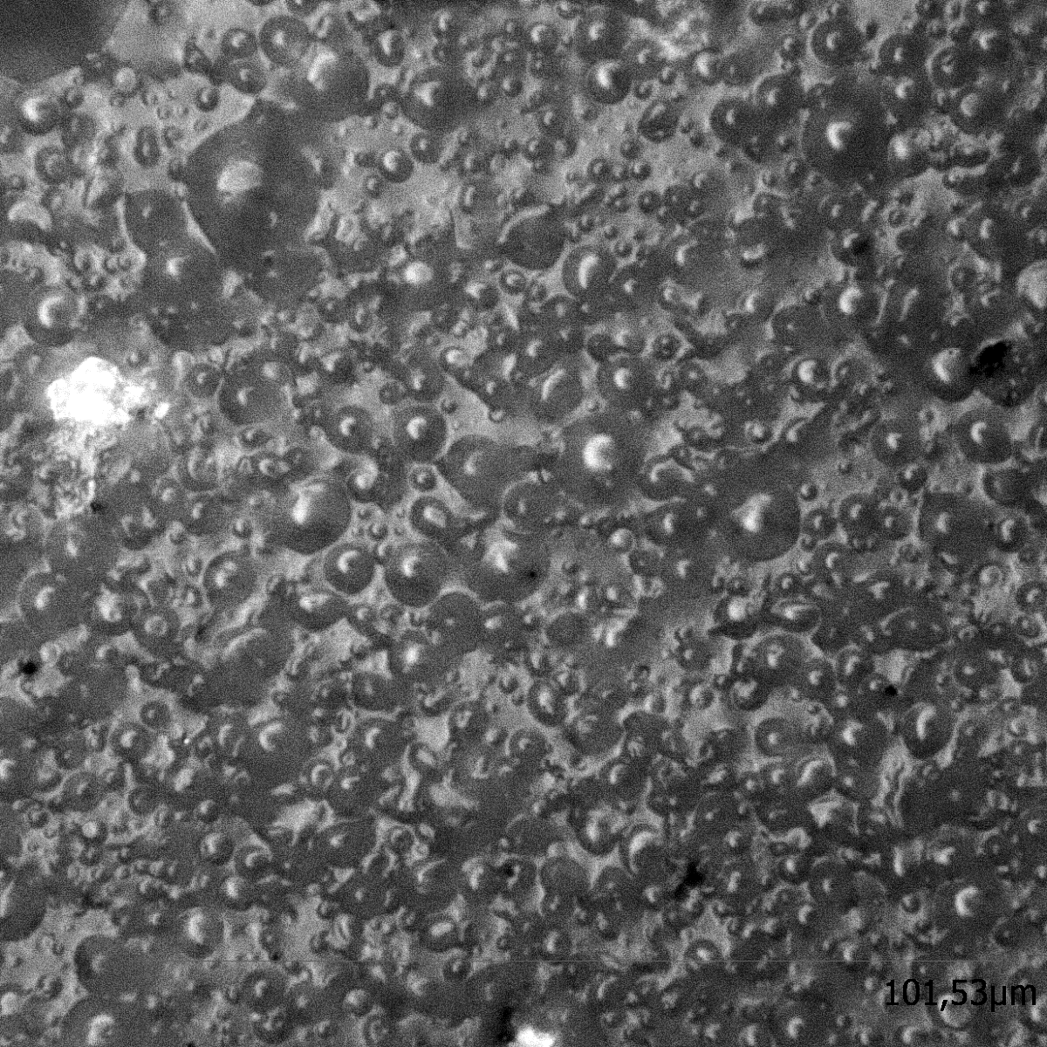
Influence of the elastocapillary number
40%
1000µm
Sylgard mix
Coherent : much larger droplets lead to a larger elastocapillary number, thus softening the sample
50µm

Slide 26
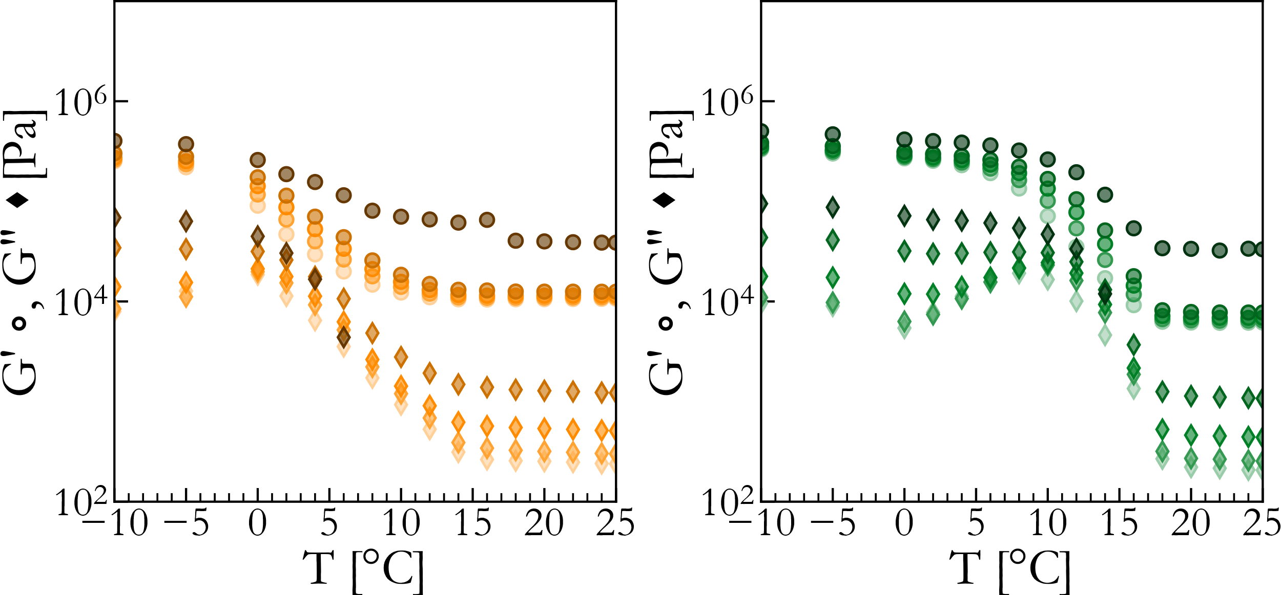
Temperature transition for the larger droplets
Much clearer transition
Sample with smaller droplets shows a flatter curve
Multiple behaviors in frequency sweep depending on the temperature showing the influence of the progressive solidification of the dispersed phase

Slide 27
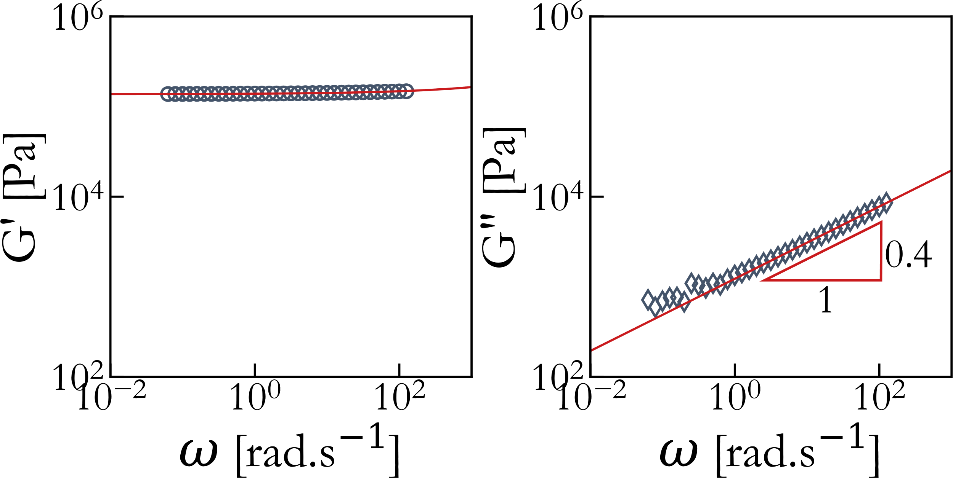
Fractional rheology model
How can we model a solid emulsion ?
V, $α$
G
Elastomeric continuous phase: already a power-law material
« spring-pot » with intermediate behavior:
$$τ=V\frac{d^{α}γ}{dt^{α}}$$
$$τ^{∗}=V{\left(iω\right)}^{α}γ^{∗}$$
$$G_{PDMS}^{∗}=G_{0}+V{\left(iω\right)}^{α}$$
$$α≈0.4$$
Another way to view it:
Infinite amount of relaxation times from small statistical events
Droplets: modelized as an ensemble
$G_{droplets}^{∗}=C{\left(iω\right)}^{δ}$
Solid emulsion: simple mixing model
$$G_{emulsion}^{∗}=f\left(Φ\right){ G}_{PDMS}^{∗}+g\left(Φ\right){ G}_{droplets}^{∗}$$

Slide 28
Preliminary fit results
$$G_{emulsion}^{∗}=f\left(Φ\right){ G}_{PDMS}^{∗}+g\left(Φ\right){ G}_{droplets}^{∗}$$
$$G_{PDMS}^{∗}=G_{0}+V{\left(iω\right)}^{α}$$
$$α≈0.4$$
$$G_{droplets}^{∗}=C{\left(iω\right)}^{δ}$$
$δ$ constant across all $Φ$
$$δ≈0.75$$
Change from linear behavior around $Phi=0.35$ van also be lack of high frequency information
Similar frequency behavior across volume fraction
let’s compare the samples at a given frequency

