Slide 1

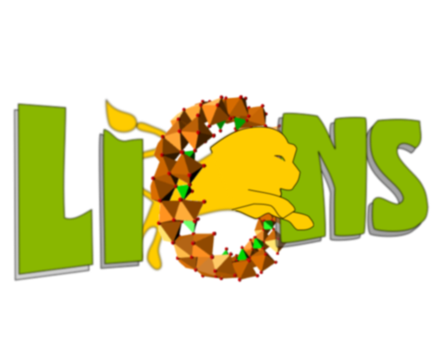





Multi-scale characterization of hydrogels of biological interest
Deformation of colloidal gel
Cryo-SEM of hydrogel
Supervisors:
FAST : Frédérique GIORGIUTTI – Ludovic PAUCHARD
CEA : Patrick GUENOUN – Jean-Philippe RENAULT
Souhaila N’MAR – 3rd year PhD Student

Slide 2
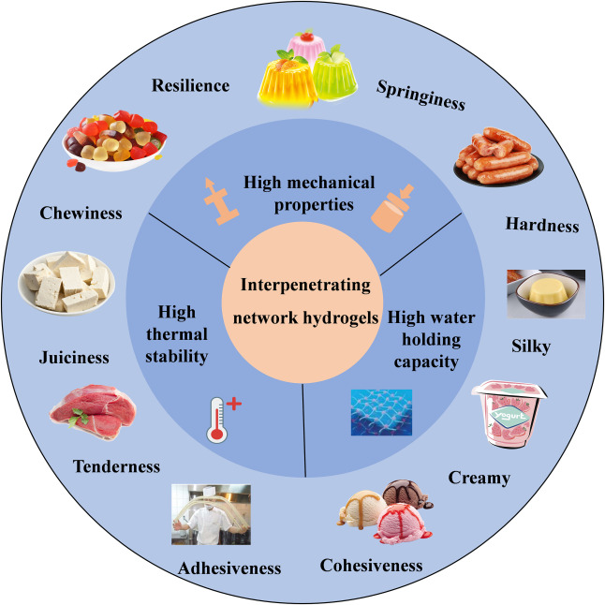
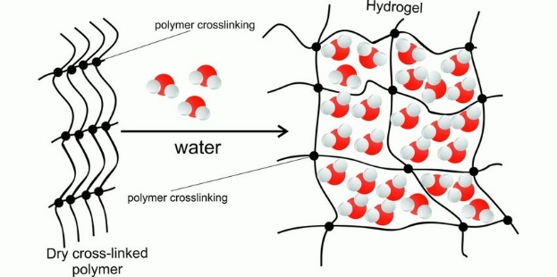
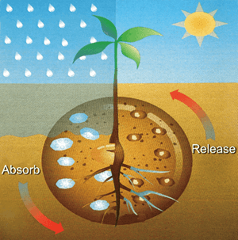
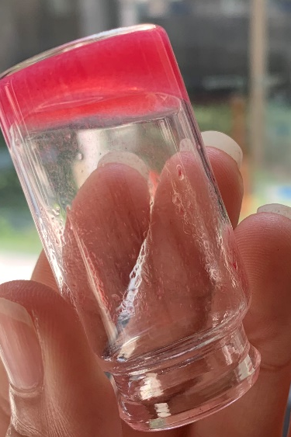
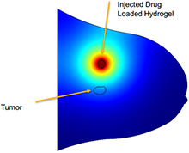
Context
Hydrogel 3D structure
Besarab (2021)
Food industry
Du et al (2021)
Agriculture
Sabbagh et al. (2019)
Hydrogel
Drug delivery
Cluff et al. (2014)

Slide 3
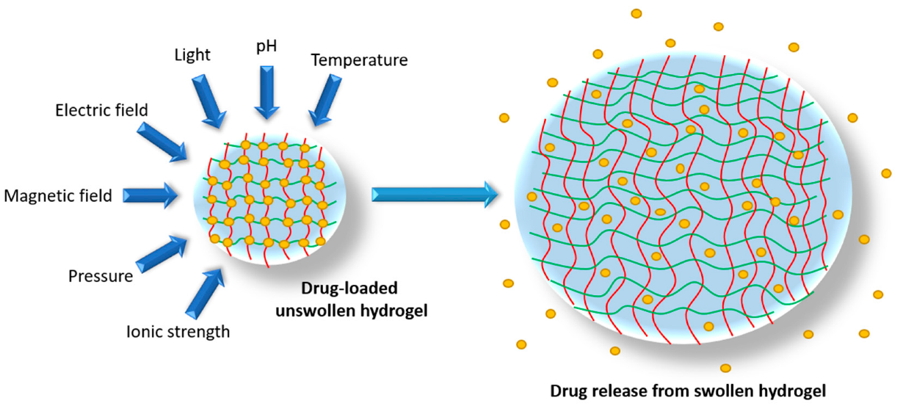

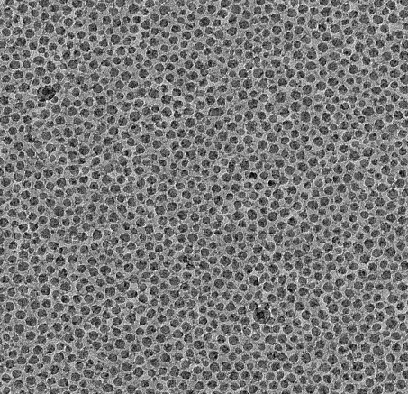

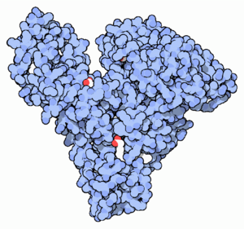
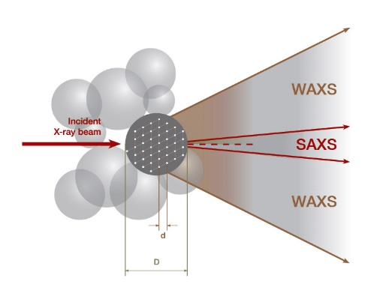
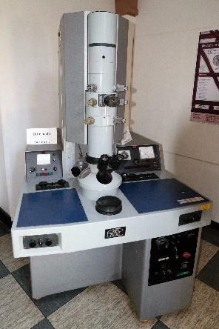
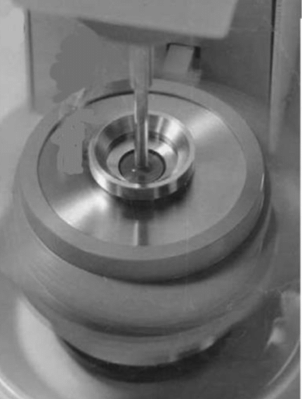
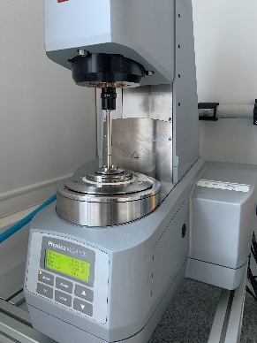
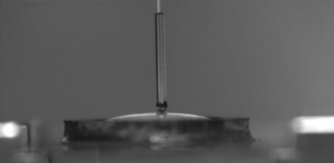
Context
1
Why ?
Biomedical applications (drug delivery)
2
Objective
Develop hybrids hydrogels based on nanoparticles and macromolecules (proteins).
Imbibition
Dry gel
Silica
+
ionic species
(NaCl)
Swollen gel
200 nm
Silica
nanoparticles
3
How ?
Microscopic scale
Macroscopic scale
Bovine serum albumin
Main goal:
Link between structure and mechanical properties of the gel
SAXS
Nanoindentation
Cryo-TEM/SEM
Rheology

Slide 4
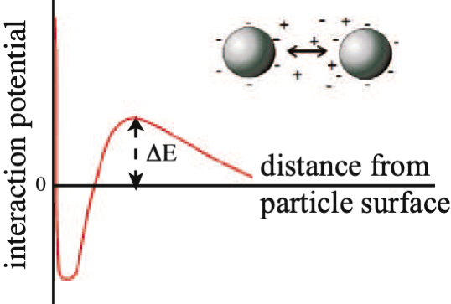
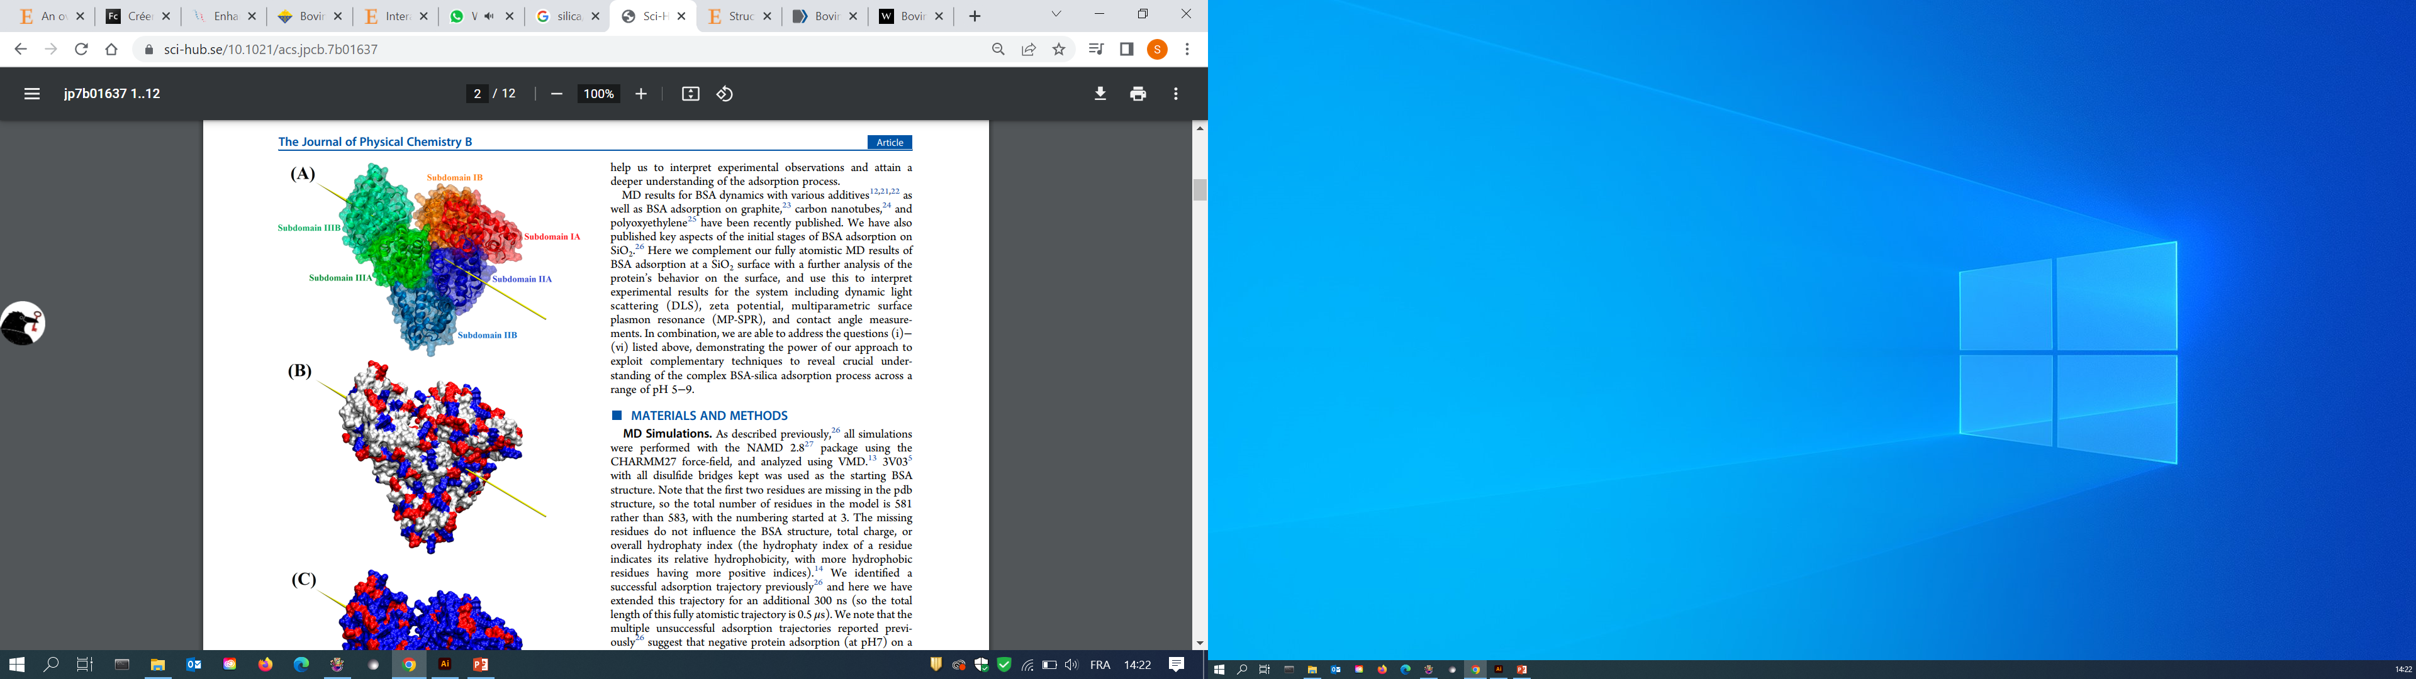
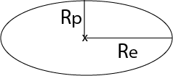
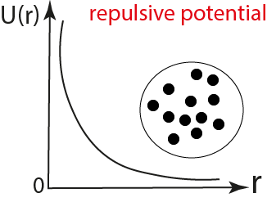
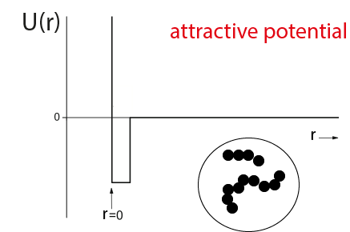
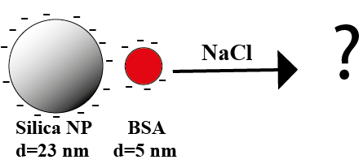


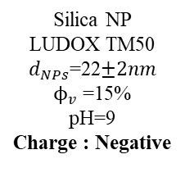

Two types of gels
Hydrogel (onlyNP) - Silica + ionic species (NaCl)
Biohydrogel (NP+protein)
Silica / ionic species / BSA
Silica NP
LUDOX TM50 $d_{NPs}$=22$±2nm$
$ϕ_{v}$ =15%
pH=9
Charge : Negative
Silica NP
(A) Structure of
protein : Bovine Serum Albumin (BSA)
$$∆E= E_{att }\left(VDW\right)+ E_{re}$$
DLVO theory
$$R_{p}(polar radius)=19 nm$$
$R_{e}(equatorial radius)=$ 44 nm
Without ionic species
With ionic species
(B) Distribution of charge of BSA
positive-blue
negative-red
neutral-white
At pH=7 , BSA is globaly negatively charged
I=Ionic strength=[$NaCl]$
System:
*NP=nanoparticle

Slide 5
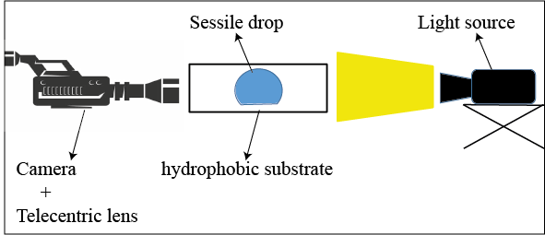
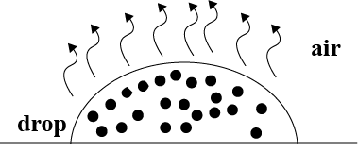
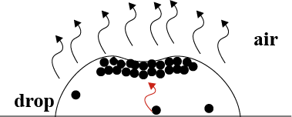



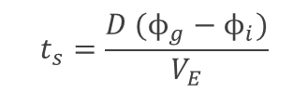




Macroscopic characterization : Phase diagram (OnlyNP)
$$Ve=−\frac{1}{S}\frac{dV}{dt}$$
G$elation time t_{g}$
$$t_{g}=aexp(−\frac{b}{I}) ^{c}$$
$$t_{E}$$
Drying time $t_{E}$
$$t_{E}=\frac{R}{V_{E}}$$
R
$$t_{s}=\frac{D (ϕ_{g}−ϕ_{i})}{V_{E}}$$
Accumulation of particles at the surface of the drop
Skin formation time $t_{s}$

Slide 6
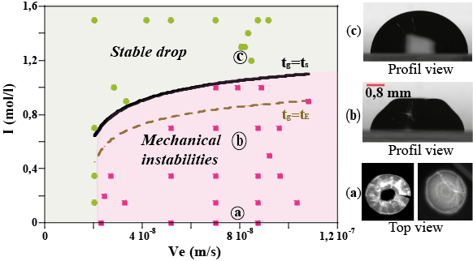
Macroscopic characterization : Phase diagram (OnlyNP)
R
Crack
Buckling
N’MAR et al. , Soft Matter , 2023

Slide 7
Before gelation ? Rheology
Variation of the elastic modulus with the concentration of BSA
Hydrogel (onlyNP)

Slide 8
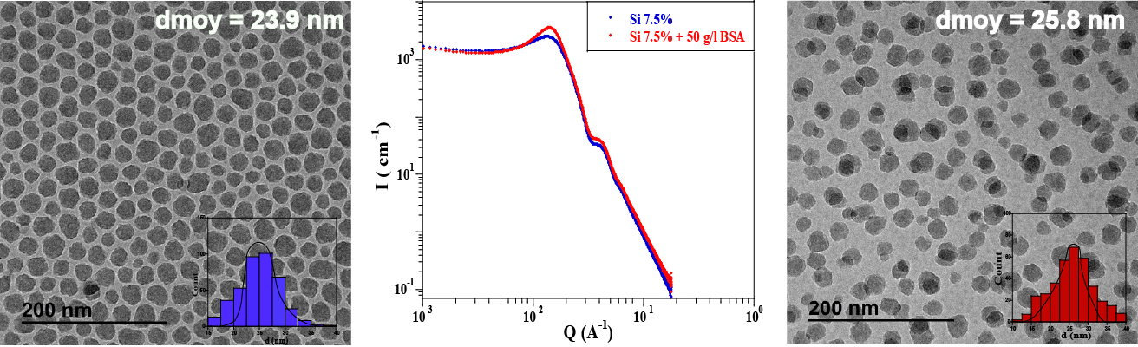
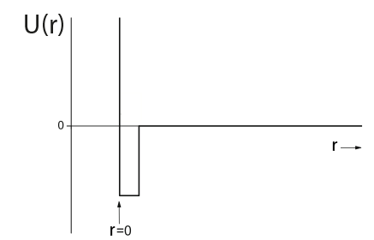
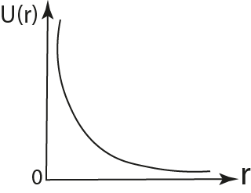
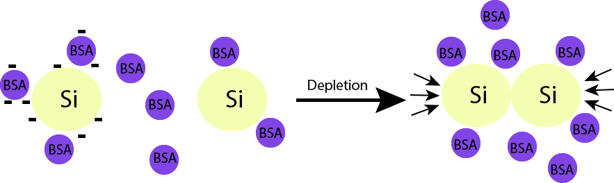
Microscopic characterization : Mixture of Silica and BSA
SAXS measurements
CryoTEM images
SAXS measurements
Silica dispersion
Silica + BSA dispersion
Depletion process

Slide 9
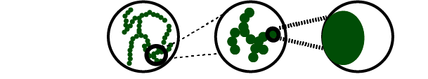
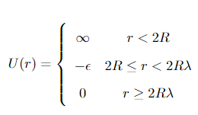
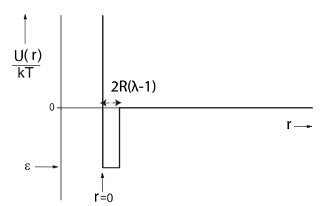

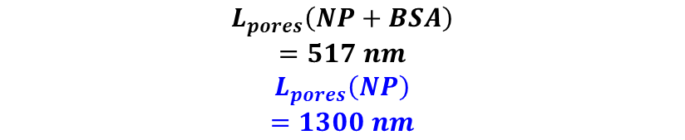
Microscopic characterization : SAXS measurements - Gels
Attractive potential
$${\sim D}_{f }fractal$$
$$dimension$$
Size of cluster
Porod
CryoSEM images
$$L_{pores}\left(NP+BSA\right)$$
$$=517 nm$$
$$L_{pores}\left(NP\right)$$
$$=1300 nm$$
« Biohydrogel porosity
is lower than
the hydrogel »

Slide 10
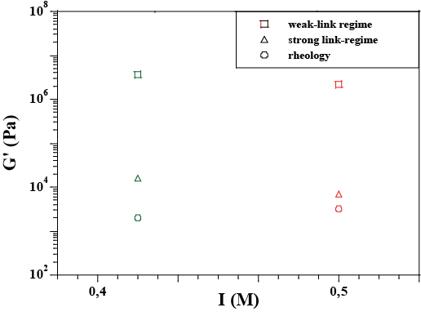
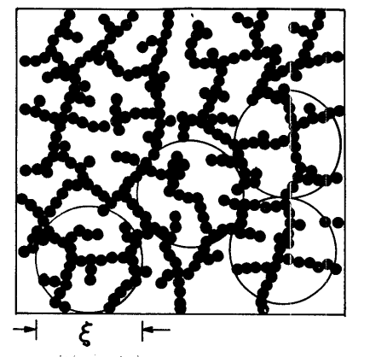
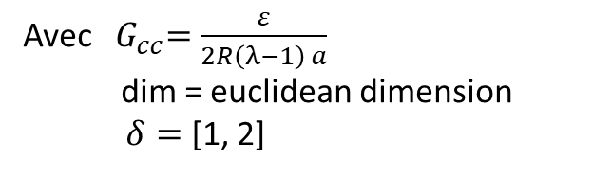
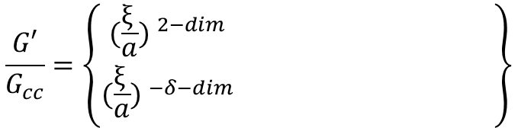
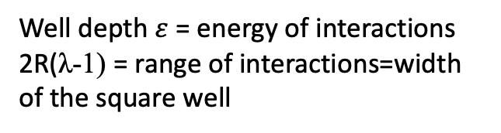
Link between structure and mechanical properties of the gel
Phi-power-law models:
$$\frac{G′}{G_{cc}}=\left\{{(\frac{ξ_{ }}{a}) ^{2−dim} \atop (\frac{ξ_{ }}{a}) ^{−δ−dim}} \right\}$$
Attractive potential
Weak-link regime
Strong-link regime
Avec ${ G}_{cc}=\frac{ε}{2R\left(λ−1\right) a}$
dim = euclidean dimension
$δ=$ [1, 2]
Well depth $ε$= energy of interactions
2R(λ-1) = range of interactions=width of the square well
Intersection model
ζ= agregate size
Shih et al (1990)

Slide 11
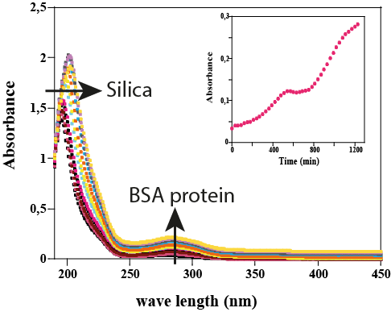
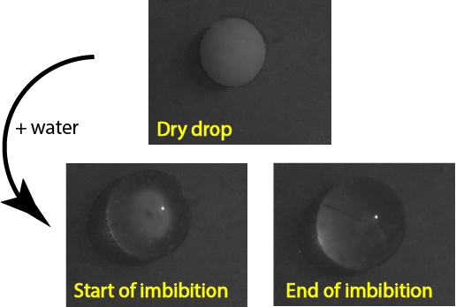
Perspectives / Study of imbibition of sessile drops and release of BSA protein
release of BSA
Imbibition – swelling and apparition of
mechanical instabilities
Crack

Slide 12

Thank you for your attention

Slide 13
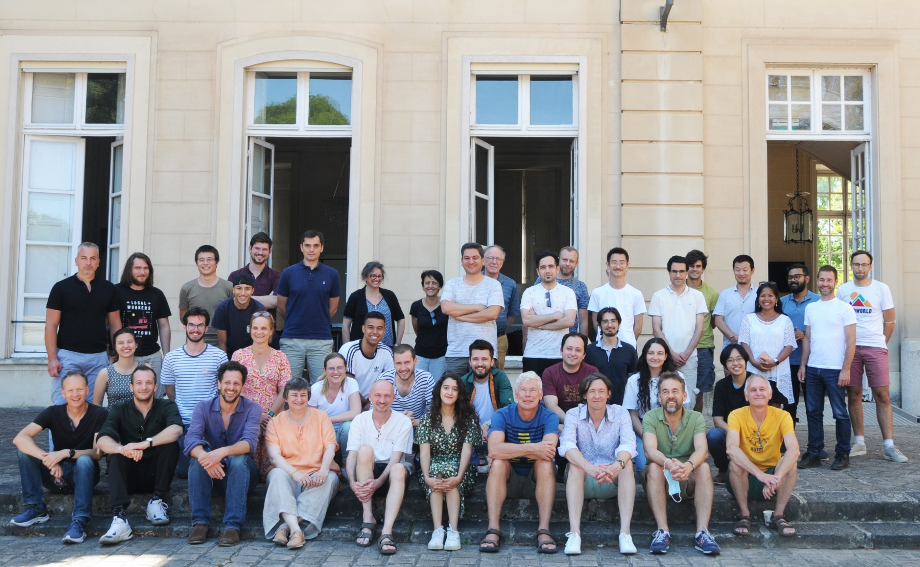
Thank’s to:
Frédérique GIORGIUTTI
Ludovic PAUCHARD
Patrick GUENOUN
Jean-Philippe RENAULT
Thomas GIBAUD
Frédéric GOBEAUX
François Boulogne
Alain CARVALHO
Raphaël PIDOUX
Javier PEREZ
Soleil Synchrotron
FAST Laboratory
More details available in :
Souhaila N’Mar et al. ; Structuration and deformation of colloidal hydrogels. Soft Matter, 2023.

