Slide 1
The natural bubble size distribution of coarsening liquid foams
N. Galvani (a,b), S. Cohen-Addad (a), D. Durian (c), R. Höhler (a), D. Langevin (d), M. Pasquet (d), O. Pitois (b), A. Requier (d), E. Rio (d), A. Salonen (d)
INSP Sorbonne Université b) Navier Université Gustave Eiffel
c) University of Pennsylvania d) LPS Université Paris Saclay
Institutions
Foundings
26ème Congrès Général de la SFP – Paris – 5 July 2023

Slide 2
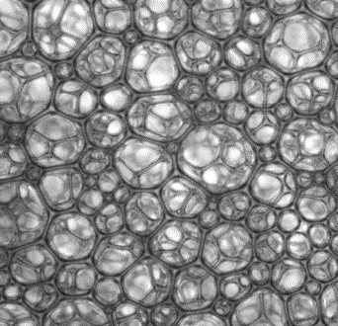
Structure of liquid foams
250 µm
1% 10% $φ_{rcp}$ Liquid fraction $φ$
Dry foams Wet foams Jamming transition Bubbly liquid
Unstable on earth
Bubble radius $R$
Liquid volume fraction $φ= \frac{V_{liq}}{V_{liq}+V_{air}}$
Gravitational drainage limits the experiments performed in wet foams

Slide 3
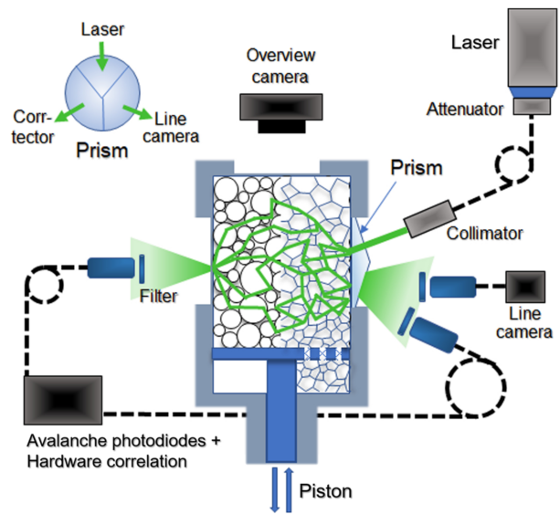
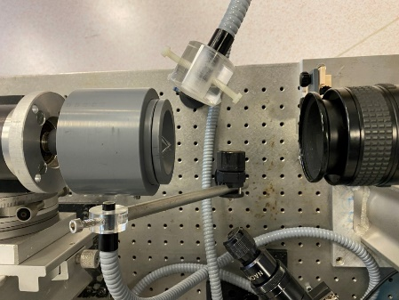
How to study a stable wet foam
Experiments on the ISS
Microgravity experiment TTAB 5g/L + Air φ=15%
Microgravity
$$15\%≤φ≤50\%$$
Born et al., Rev. Sci. Instrum. (2021)
Pasquet et al., C. R. Méca. (2023)
Experiments on Earth with clinostat
Continuous rotation
$$φ≤8\%$$
Top view
Total duration: 6h

Slide 4
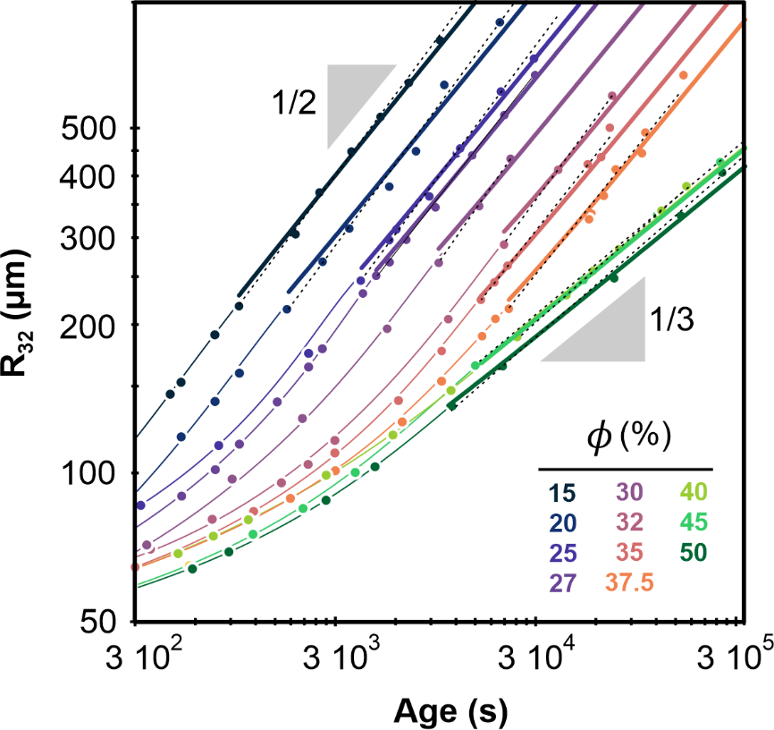
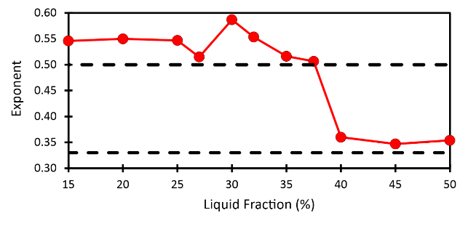
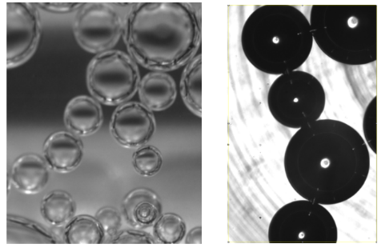
Coarsening of wet foams
$$φ^{∗}≈39\%$$
Foam Regime
Lemlich (1978)
$$R_{32}(t)={\left(R_{32}^{2}\left(0\right)+ Ω_{p}t\right)}^{1/2}$$
Average bubble radius $R_{32} (µm^{2})$
Ostwald Regime
Baldan (2002)
Adhesive foam
$$R_{32}(t)={\left(R_{32}^{3}\left(0\right)+Ω_{c}t\right)}^{1/3}$$
Pasquet et al. arXiv:2304.11206

Slide 5
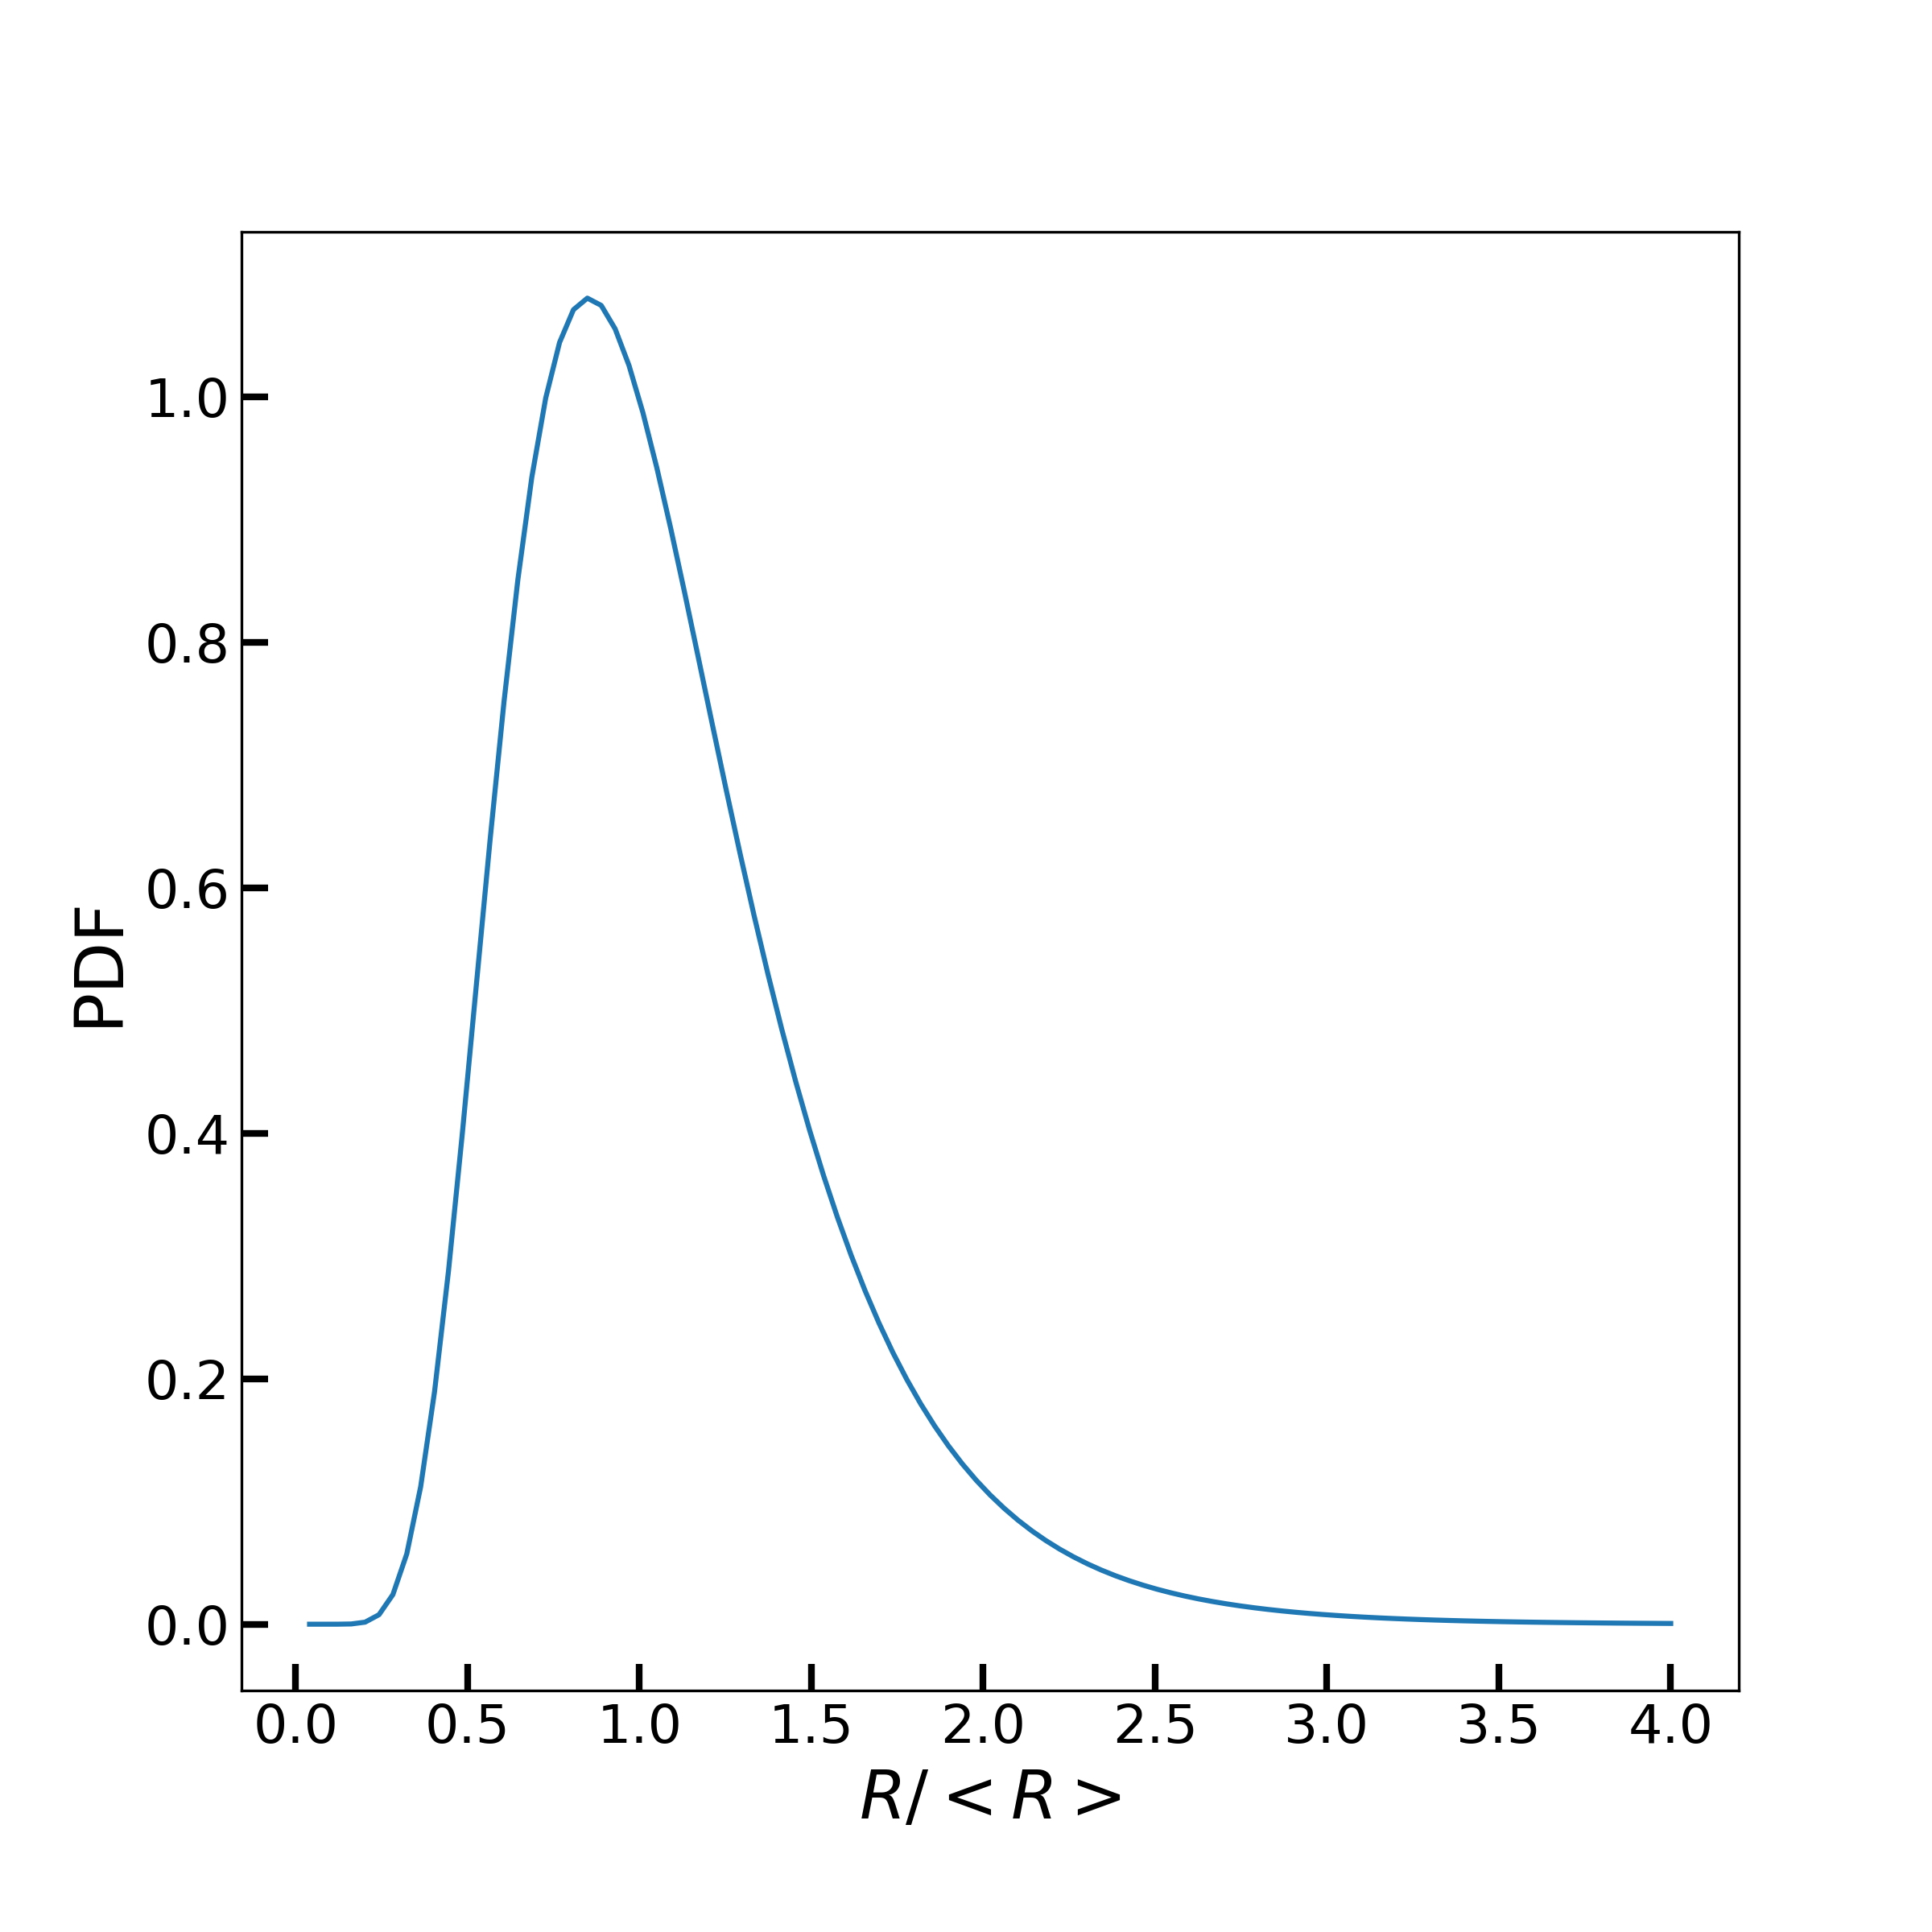
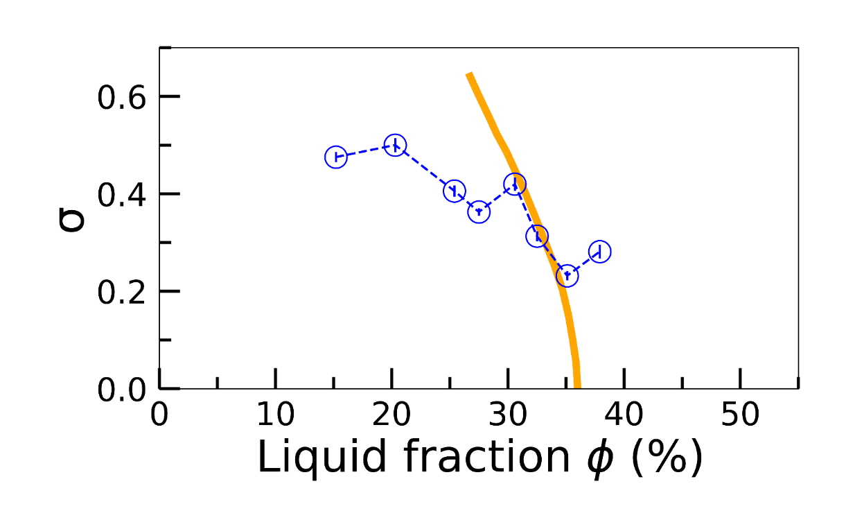
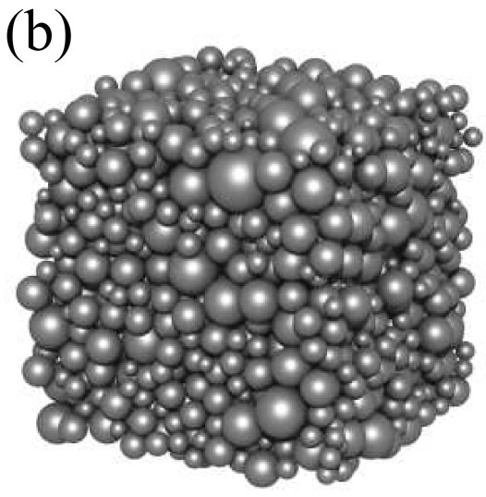
Random close pack density in coarsening foams
For randomly packed hard spheres $φ_{rcp}=0.36−f(σ)$
Lognormal distribution
$$ℒ\left(ρ,m,σ\right)=\frac{1}{ρσ\sqrt{2π}}\exp\left(−\frac{log²(ρ/m)}{2σ²}\right)$$
σ=0.3
$φ_{rcp}$
$$φ^{∗}$$
Experiment
Farr and Groot, JCP (2009)
Coarsened foam simulation
Farr, Powder Technol. (2013)
$$ρ= R/\overline{R}$$
Large gap between close packing $(φ_{rcp}≈31\%)$ and unjamming $(φ^{∗}≈39\%)$

Slide 6
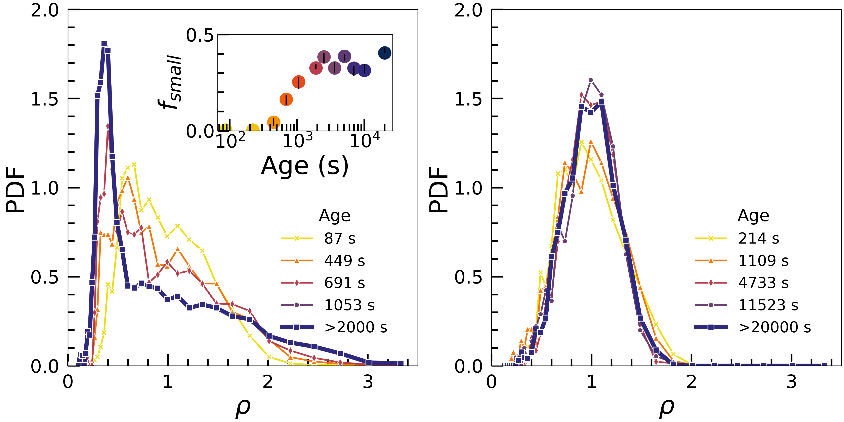
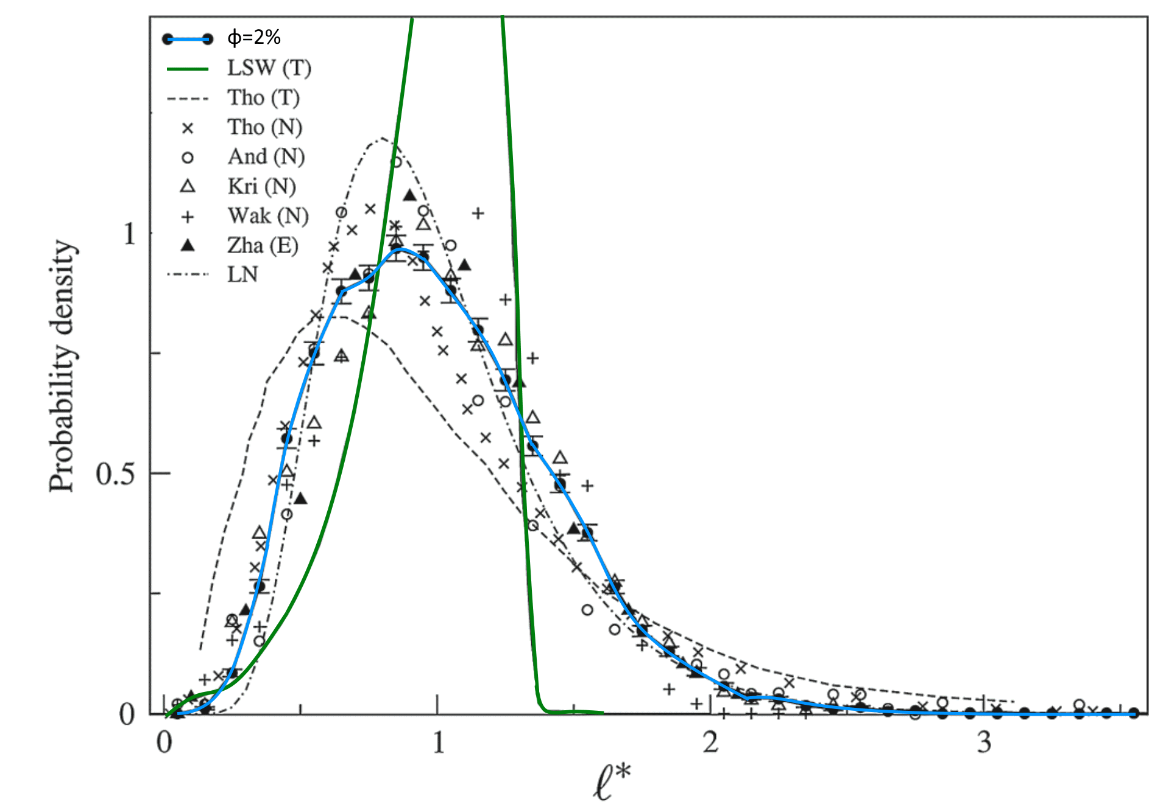
Bubble size distributions in the foam regime
Microgravity $φ=15\%$
Dry foam on Earth $φ=2\%$
Ostwald ripening prediction
Scaling state
$$R/\overline{R}$$
$$R/\overline{R}$$
Lambert et al., PRL (2010)
Prominent peak of bubbles with small size, unprecedented in dry foams or bubbly liquids.

Slide 7
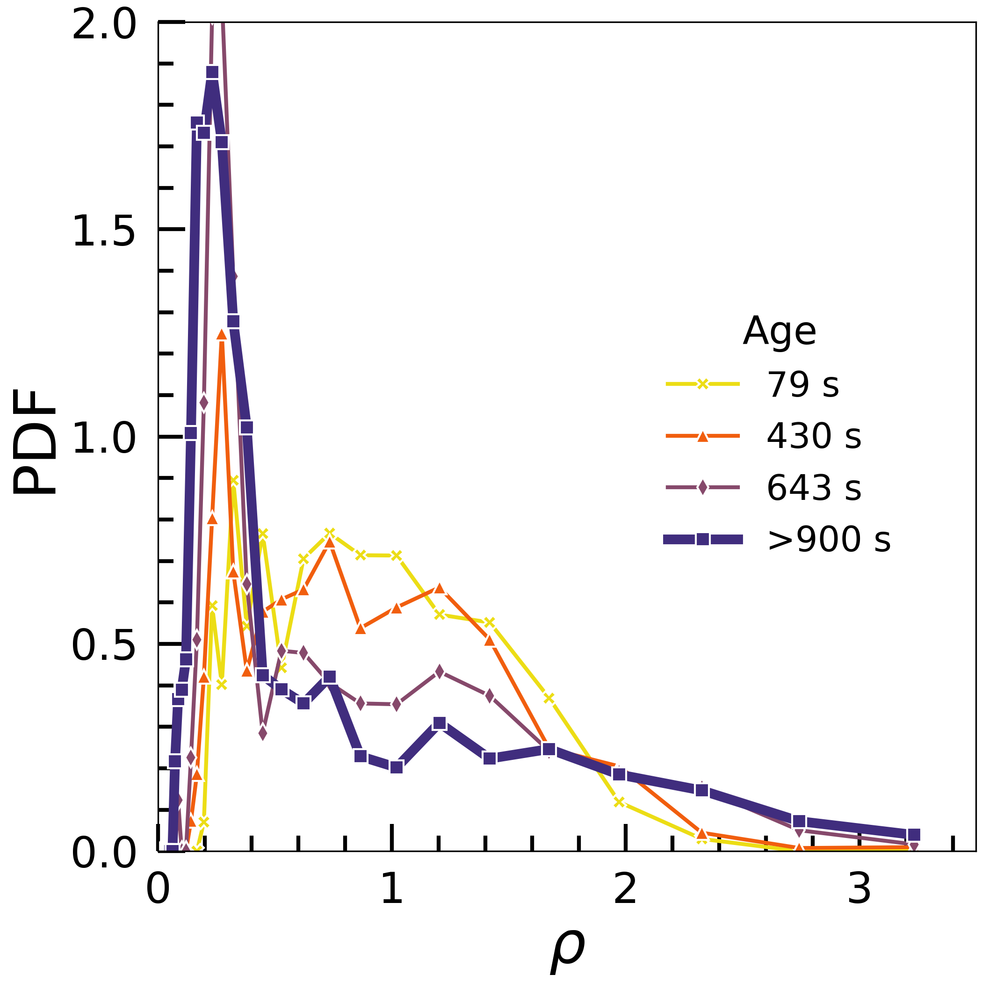
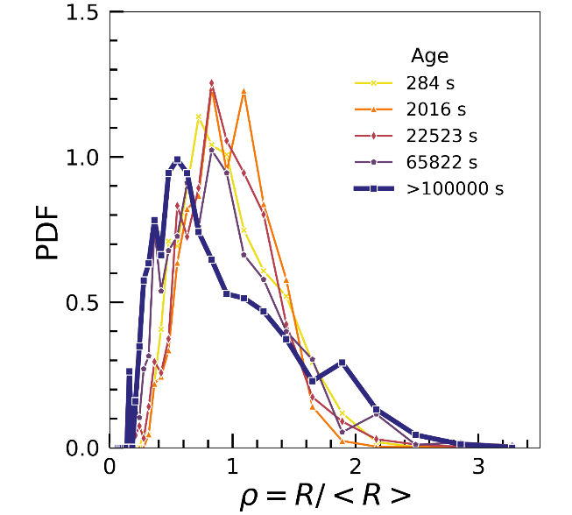
Effect of the liquid fraction
Clinostat $φ=8\%$
$$φ=15\%$$
$$φ=38\%$$
$$φ=50\%$$
$$R/\overline{R}$$
$$R/\overline{R}$$
$$R/\overline{R}$$
$$R/\overline{R}$$

Slide 8
Roaming bubbles
φ=15%
Age = 5000s
How to explain these roaming bubbles?

Slide 9
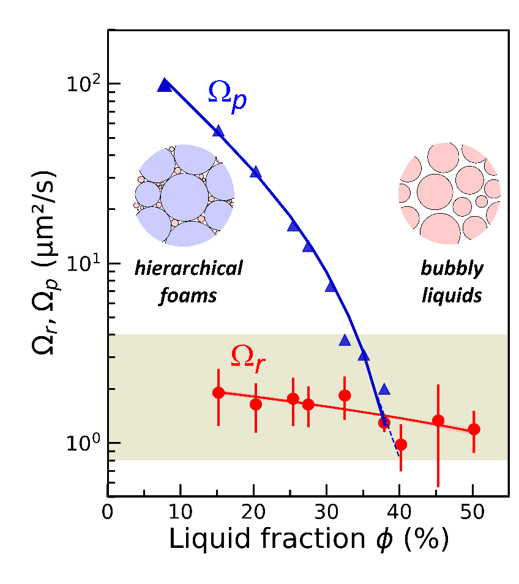
Evolution of individual bubbles: roaming transition
$$φ_{rcp}≈31\%$$
$$φ^{∗}≈39\%$$
$$A_{t}=πR_{t}^{2}$$
Bubble Area A (µm²)
Slope $Ω_{r}$
Time (s)
Roaming bubble $R^{2}≈ R_{t}^{2} − Ω_{r}\left(t−t_{t}\right)$
Coarsening foam $R_{32}^{2}= R_{0}^{2}+ Ω_{p}\left(t−t_{0}\right)$
What determines the roaming transition?
Notes:
9
I followed for each of the experiments a dozen roaming bubbles during all the duration of the experiment. Looking at the temporal evolution of their area, we observed a sharp variation of the dissolution rate:
Initially, it is of the same order of magnitude of the coarsening rate of the foam, omegap; then it falls down to a rate omegar, of the same magnitude for all the roaming bubbles, which doesn’t have a strong dependence on the liquid fraction.
The comparison of the two rates is crucial to understand the phenomenon: a wet foam is composed by two populations, of bubbles connected by films and of roaming bubbles, evolving with different rates. This difference is the reason of the roaming bubbles accumulating in the nodes, and the corresponding peak in the bsd.
Since we observed a scaling between the bubble size at the moment of the transition, called here Rt, and the elapsed time, we investigated Rt.

Slide 10
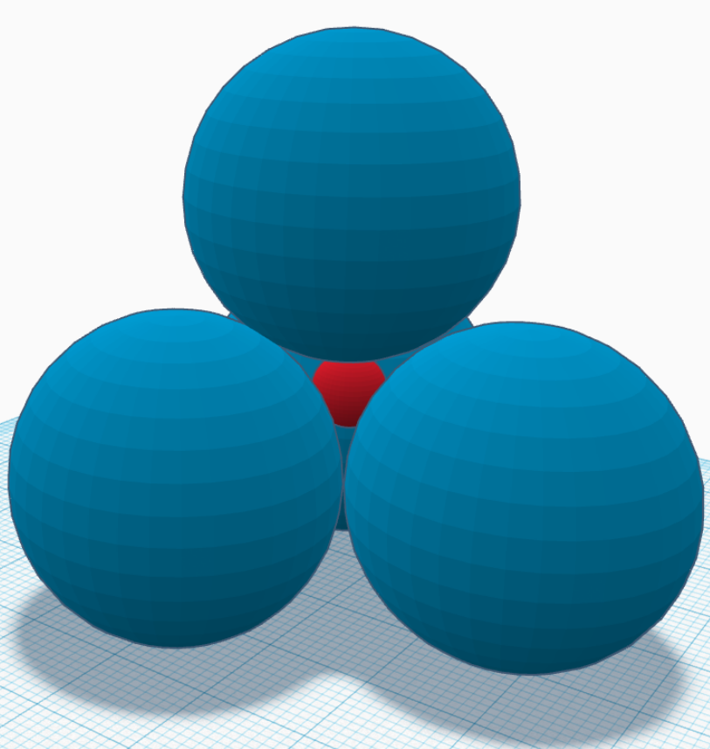
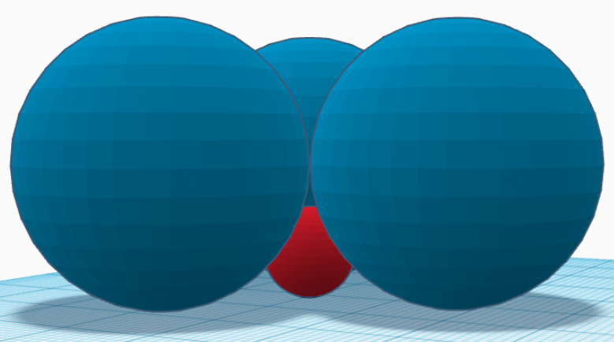
Physical mechanism for roaming transition
Conjecture: $R_{t}$ is set by the maximum radius for a sphere fitting inside a node.
Effective pore radius
$$\frac{R_{t}}{R_{32}}=ξ\sqrt{\frac{8\tilde{K}\left(φ\right)}{\tilde{σ}\left(φ\right)}}$$
$ξ$nondimensional factor
$\tilde{K}\left(φ\right)$ dimensionless permeability
$\tilde{σ}\left(φ\right)$ relative conductivity
Equation for $ξ=2.2$
Experiment
Johnson et al., PRL (1986)
Louvet et al., PRE (2010)
Rouyer et al., PoF (2010)
Feitosa et al., J. Phys.: Condens. Matter (2005)
Surface node Bulk node
Wall observations, but not wall specific
$$ξ=2.2$$
$$ξ≈1.5$$
Notes:
10

Slide 11
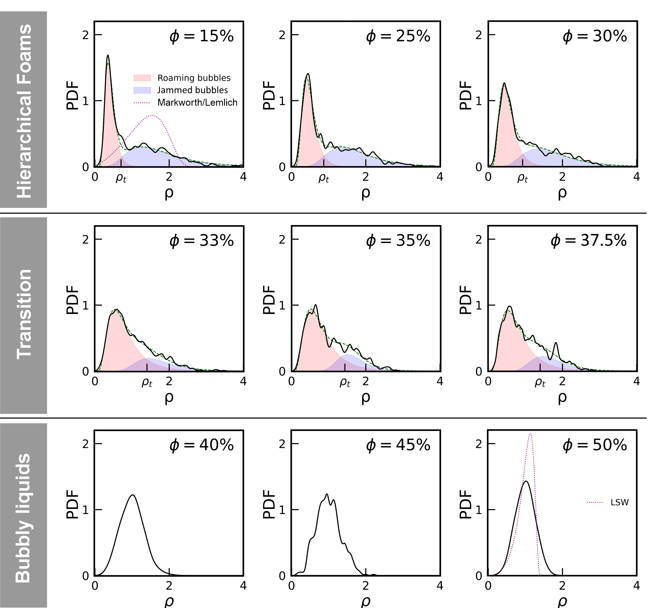
Hierarchical structure in the scaling state
Hierarchical structure composed of two populations, distinct by size
Bubble size distribution
Roaming bubbles
Jammed bubbles
$$ℱ=wℒ\left(ρ,m_{1},σ_{1}\right)+(1−w)ℒ\left(ρ,m_{2},σ_{2}\right)$$
Lognormal distribution
$$ℒ\left(ρ,m,σ\right)=\frac{1}{ρσ\sqrt{2π}}\exp\left(−\frac{log²(ρ/m)}{2σ²}\right)$$
Bubbly liquid: only one population, lognormal distribution no more suitable
Evolution toward the typical dilute system distribution (LSW)
$$φ_{rcp}$$
$$=R/\overline{R}$$
$$φ^{∗}$$
Galvani et al. arXiv:2304.11543

Slide 12
Conclusions
Distinction between jamming and close-packing in adhesive foams
Roaming transition: a new mechanism characteristic of coarsening foams
Naturally developed hierarchical bubble size distribution
Colloidal-like glass phase in $φ_{rcp}≤φ≤φ^{∗}$?
Tunable hierarchical foams?
Perspectives

Slide 13
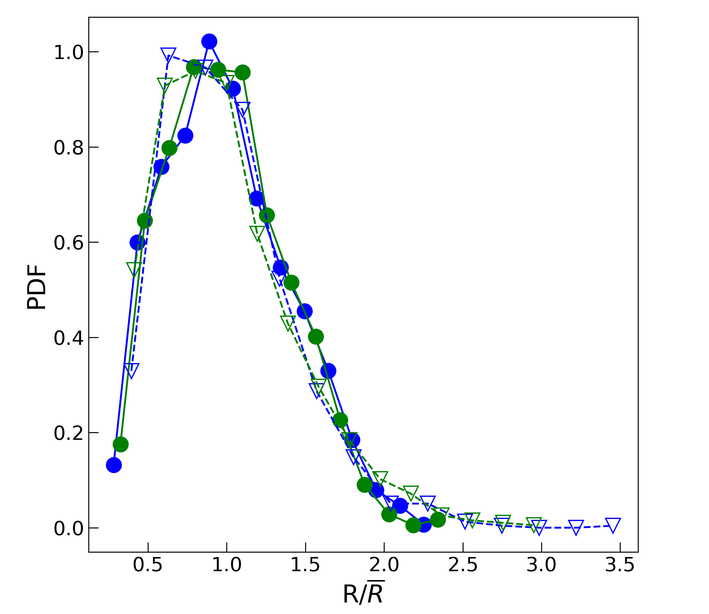
Appendix: Measuring bubble size from the surface
$ε$
Monolayer
Foam
15% 30%
Foam
Monolayer
Extracted from the same foam sample
Dispersed in the foaming liquid
Observed against a glass window
For a given fresh wet foam sample, the surface size distribution is representative of the bulk size distribution.
13
Pasquet et al., C. R. Méca. (2023)

Slide 14
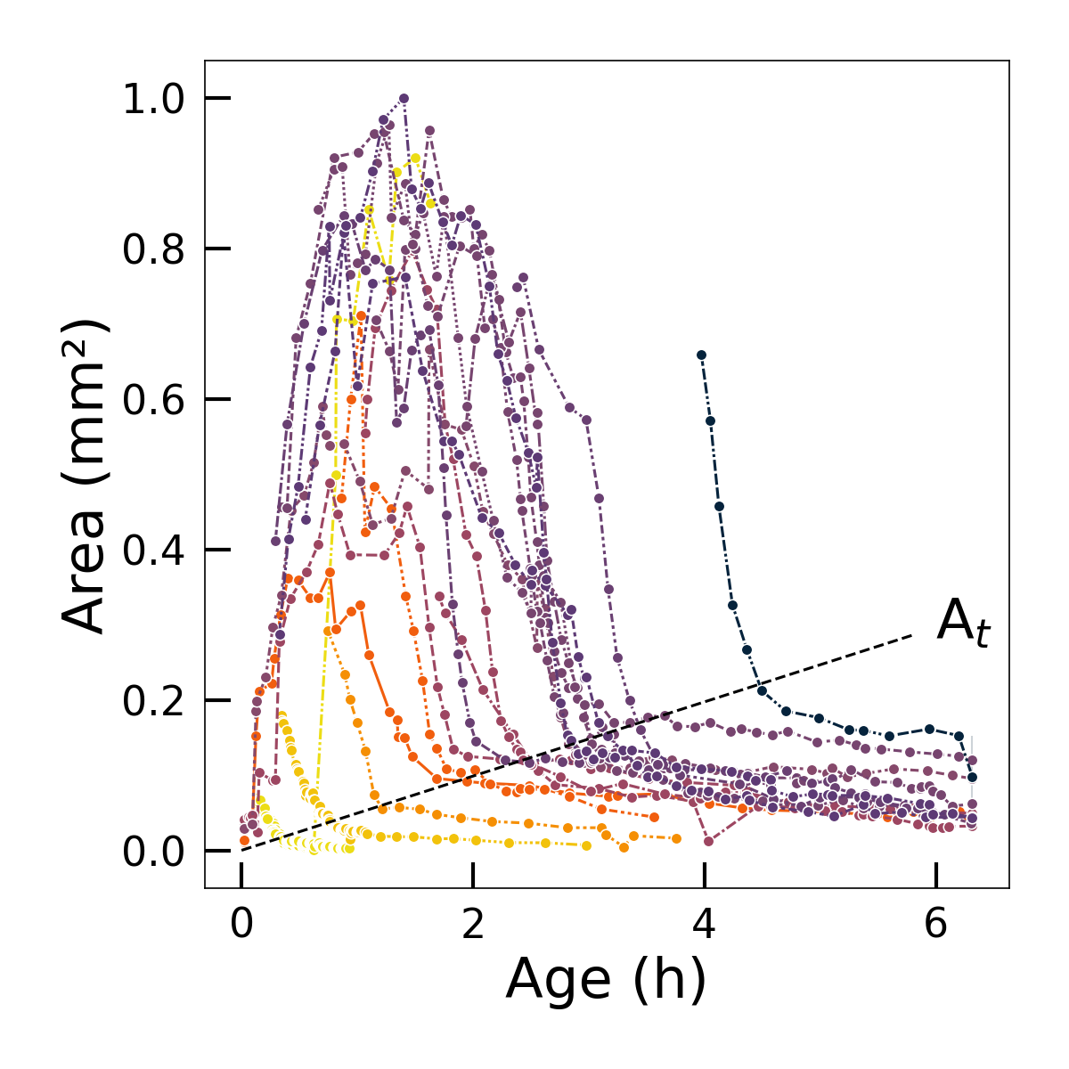
Appendix: Temporal evolution of roaming bubbles
$$φ=15\%$$

Slide 15
Appendix: Fitted parameters for bubble size distributions
$m_{2}=1.66$ fixed
Bimodal Lognormal distribution
$$ℱ=wℒ\left(ρ,m_{1},σ_{1}\right)+(1−w)ℒ\left(ρ,m_{2},σ_{2}\right)$$
Where the lognormals are parametrized as:
$$ℒ\left(ρ,m,σ\right)=\frac{1}{ρσ\sqrt{2π}}\exp\left(−\frac{log²(ρ/m)}{2σ²}\right)$$

Slide 16
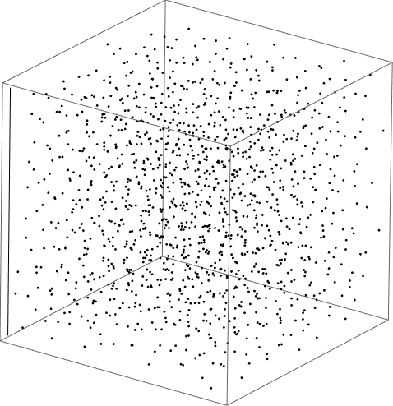
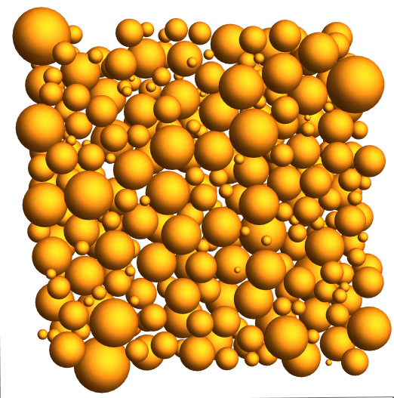
Appendix: Simulation on coarsened foam
MD code LAMMPS
10³ – 10⁴ hard spheres
Repulsive Hertzian interactions
5 random seeds
Two packing driving forces:
Simulated gravity
Uniform compression
Bubble centers
Section of the packing

