Slide 1
Delayed coating of a liquid film on a deformable substrate, in a partially wetted condition
Thesis Director: Philippe Brunet
Co-director: Laurent Limat
Supervisor: Julien Dervaux
Co-supervisor: Matthieu Roché
ANTHONY VARLET

Slide 2
Introduction : Wetting statics
Red dot: contact line
$θ$: contact angle (°) (at equilibrium)
$γ_{ij}$: Surface energy between phases i and j (J/m²)

Slide 3
Introduction : Wetting dynamics
Drop in movement → induces viscous stress
→ $Ca= \frac{ηU}{γ_{LG}}$: Capillary number
$θ_{f}= θ+f(Ca)>θ$
→ forward contact angle (°)
$θ_{b}= θ−f(−Ca)<θ$
→ backward contact angle (°)
Above a critical droplet speed
→ liquid deposition regime
Ph.D. of M. Oléron, 2022

Slide 4
Context of this study
Rigid
Soft
Questions
Deformation at contact line → Additional dissipation →What changes?
Substrate deformation → Favors or damps instabilities at contact line?

Slide 5
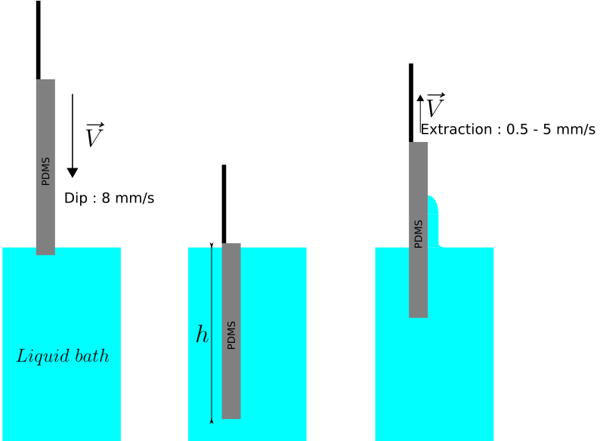
Experimental set-up
Sliding droplet
2 classic set-ups:
Dip-coating
Straight contact line
Pulling speed: controlable parameter
Liquid used : Pure Glyverol ($η=1,291 ±0,301 Pa.s$)
Sylgard 184™ Elastomeric Gel (Dow Corning)
→ Young modulus : 7 kPa – 1,6 MPa *
* Glover, J. D. et al, 2020 JOURNAL OF POLYMER SCIENCE

Slide 6
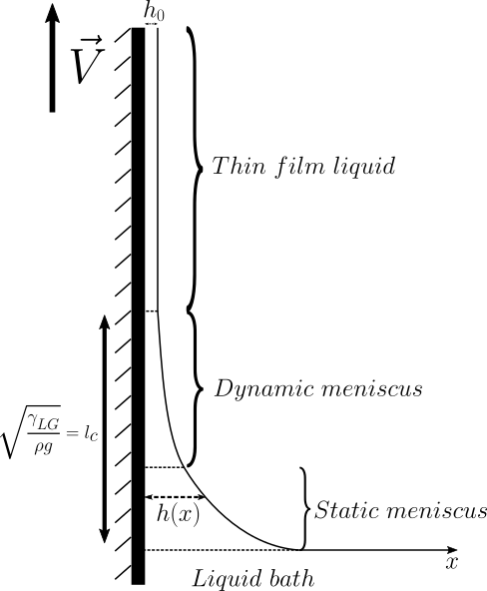
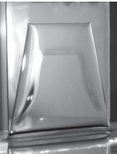
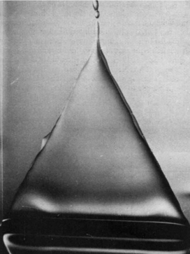
Dip-coating : Non-deformable case
Total wetting
Partial wetting
For any $Ca$
Criteria of coating
$${⇐Ca}_{thresh}$$
Uniform thickness $h_{0}$
Landau-Levich-Derjaguin*:
$$h_{0}∝l_{c}{Ca}^{2/3}$$
Snoeijier, J. et al., 2006 PRL
T. D. & Ruschak, K. J., 1979 Nature
Trapezoidal shape
Contact line on the side receding during extraction
Bulge near the contact line
Separate edge of contact line with rest of the film (LLD-like)
*L. D. Landau and B. V. Levich, 1942 Acta Physicochim.

Slide 7
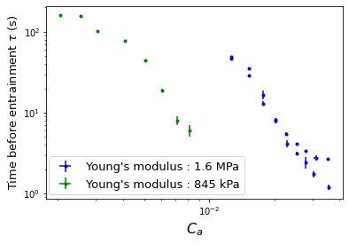
Observation with deformable substrate
Coating with treshold in $Ca$, like rigid case
Coating not instantaneous, unlike rigid case
→Delay of liquid entrainment
1 mm
Support
Lower Young Modulus shifts the range toward lower $Ca$
Sharp decrease of τ with $Ca$
V
PVC
Origin?
PDMS
Contact line

Slide 8
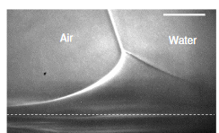
Phenomenom 1 : Slowly deforming surface of substrate
Force balance at contact line:
Horizontal: balance of capillary forces and viscous shear stress
Vertical: elasticity of substrate counterbalances capillary force
Deformation at contact line
Elastocapillary length: $l_{s} ∝ \frac{γ_{s}}{Y}$
$$l_{s}(t)$$
More (slowly increasing) dissipation
Inside the solid
Contact line in movement → Propagating ridge
Slow & progressive growth of the ridge
S.J. Park et al., 2014 Nature

Slide 9
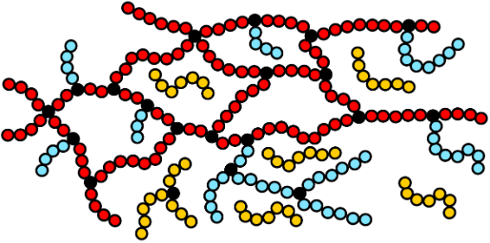
Phenomenom 2 : Free-chains slowly moving toward the surface
Polymer network
Free-chain washing
Entrainement delay should be suppressed
Ph.D. of M. Oléron, 2022
Red chain
Blue chain
During extraction
Close to the contact line
Slow reorganization of free-chains
Yellow chain « Free-chain »
Poroelasticity

Slide 10
Conclusion
Unlike rigid case: delay for liquid entrainment
$⇒$ delay time decreases strongly with $C_{a}$
Possible mechanisms underlying delay:
presence of free-chains in substrate $⇒$ Work in progress
substrate deformability $⇒$ Smaller range of $C_{a}$ for a smaller Young’s modulus
$⇒$ favor liquid entrainment?

Slide 11
Thanks everyone for your attention !!!

Slide 12
Introduction : Context of this work
*
Above a critical droplet speed→ liquid deposit regime
α
Characterize this regime with θ
Contradiction with the experiment not well understood
→ back of a drop not fully understood
In theory
In practice
$C_{a}↗ ⇒ θ↘$
$C_{a}↗ ⇒ θ↘$
$$C_{a_{c}}⇒θ=0$$
$$C_{a_{c}}⇒θ≠0$$
(near 30°)
Change experimental system
→ study contact line with simpler geometry
*Ph.D. of M. Oléron, 2022

Slide 13
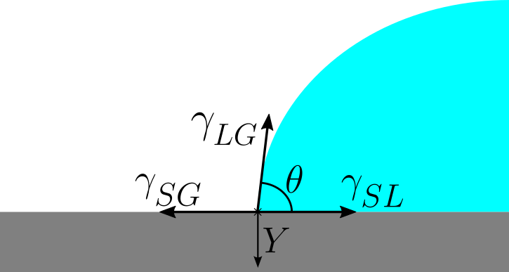
Origin 1 : Deformable surface
Force balance at contact line:
Horizontal: balance of capillary forces ($γ_{SL}∼γ_{SG}$)
Vertical: elasticity of substrate meet capillary force
Deformation at contact line
Elastocapillary length: $l_{s} ∝ \frac{F_{cap}}{Y}$
$$l_{s}$$
$${GP}_{a}>Y>{MP}_{a}$$
$${10}^{−11}m<l_{s}<{10}^{−8} m$$
S.J. Park et al., 2014 Nature
Rigid
Soft
Deformation
[Thickness film ~ 10-100 µm]
Can impact the flow
Slow & progressive growth of the ridge at contact line in movement

Slide 14
Dip-coating : Non-deformable case
Total wetting
Partial wetting
For any Ca
Criteria of coating
$${⇐Ca}_{thresh}$$
Viscous dissipation $D=f\left(Ca\right)>D_{thresh}$
Uniform thickness $h_{0}$
Landau-Levich-Derjaguin:
$$h_{0}∝l_{c}{Ca}^{2/3}$$
Snoeijier, J. et al., 2006 PRL
T. D. & Ruschak, K. J., 1979 Nature
Trapezoidal shape
Contact line on the side receding during extraction
Bump at contact line
Separate edge of contact line with rest of the film (LLD-like)

Slide 15
Properties of sample & liquid used
Sample used : PDMS (polydimethyl-siloxane) used:
Sylgard 527™ Dielectric Gel (Dow Corning) → Young’s modulus : 3 kPa
Sylgard 184™ Elastomeric Gel (Dow Corning) → Young’s modulus : 7 kPa – 1,6 MPa
Liquid used :
Glycerol (more & less) pure, G100 :
$γ\sim \left(63,1±0,5\right){10}^{−3} J/m²$, $η\sim 1,291±0,301 Pa.s$
Ucon (lubricant, Dow Corning) :
$γ\sim \left(40,7±0,9\right){10}^{−3} J/m²$, $η\sim 50,638±1,647 Pa.s$

Slide 16
Dissipation ratio
Liquid in movement
Viscous energy dissipation in the liquid
Propagation of the deformation
→ Energy dissipation in solids of viscoelastic origin
Importance of viscoelastic energy dissipation: relaxation ratio 𝑅 $∝ \frac{E_{solid}}{E_{liquid}}$
$R≫1$, most of the energy dissipated in the solid state
$R\sim 1$, equivalent energy dissipation in solids and liquids
$R=0$, energy dissipation exclusively in the liquid

Slide 17
Phenomenom 2 : Free-chains slowly moving toward the surface
Polymer network
Free-chain washing
Entrainement delay should be suppressed
Ph.D. of M. Oléron, 2022
During extraction
Close to the contact line
Slow reorganization of free-chains
Red chain
Under stress: stretch and store elastic energy
Blue chain
Under stress: can relax and/or move in the network
Yellow chain « Free-chain »
mechanical response with viscoelastic contribution
Poroelasticity

Slide 18
Phenomenom 1 : Slowly deforming surface of substrate
Force balance at contact line:
Horizontal: balance of capillary forces and viscous shear stress
Vertical: elasticity of substrate compete capillary force
Deformation at contact line
Elastocapillary length: $l_{s} ∝ \frac{F_{cap}}{Y}$
More (slowly increasing) dissipation
Inside the solid
Contact line in movement → Propagating ridge
Slow & progressive growth of the ridge

Slide 19
Time condition
Transition time : time between of dip velocity to pulling velocity
In experiment : 200-500 ms
Augment this time $⇒$ Influence?
Waiting time between diping
How many secondes waiting?
Substrate as a time to come-back to is initial state
Influence the coating $⇒$ Have an « history »
Experiment at fixed Ca and compared coating delayed for 30, 100 and 1000 secondes
Video 2 – Time between dip : 30 secondes.
Left : n°1, middle : n°3, right : n°5.

Slide 20
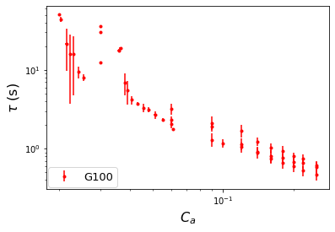
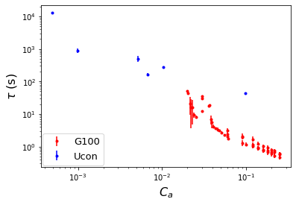
Observation with deformable surfaces
Coating not instantaneous, unlike rigid case
→Delay at liquid entrainment
1 mm
Support
Possible master curve guiding the delay time with $C_{a}$
Origin?
PVC
V
PDMS
Contact line

Slide 21
Origin 1 : Young modulus effect
Sylgard 184 :
1,6 Mpa → Shift lower Ca for delay (~${10}^{−2}$)
845 kPa → Shift less lower Ca for delay (~${10}^{−3}$)
Less free chain in Sylgard 184
add free-chain ?
Same results with lower Young’s modulus (7, 59, 245 & 845 kPa) ?

Slide 22
Introduction : Context of this study
In theory
In practice
$Ca↗ ⇒θ_{back}↘$
$Ca↗ ⇒θ_{back}↘$
$${Ca}_{c}⇒θ_{back}=0$$
$${Ca}_{c}⇒θ_{back}≠0$$
(near 30°)
Contradiction with the experiment not well understood
→ back of a drop not fully understood
Change experimental system
→ study contact line with simpler geometry

Slide 23
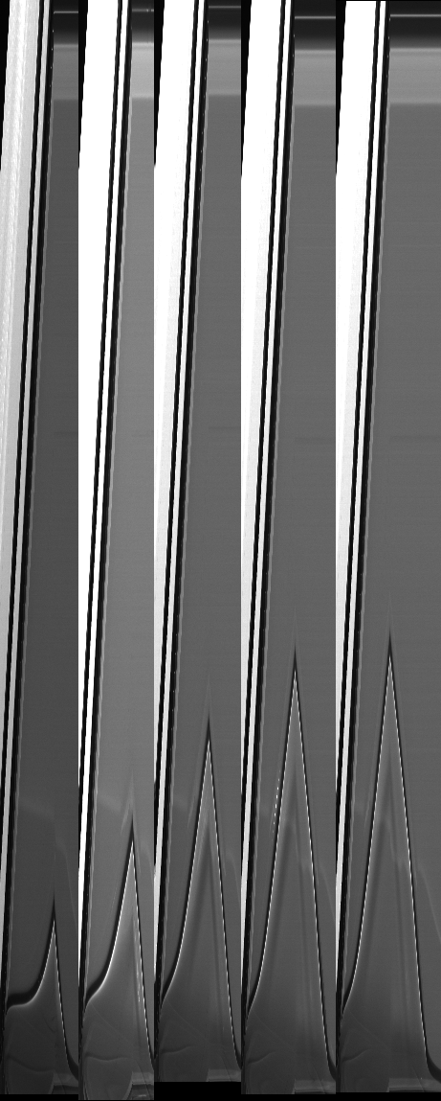
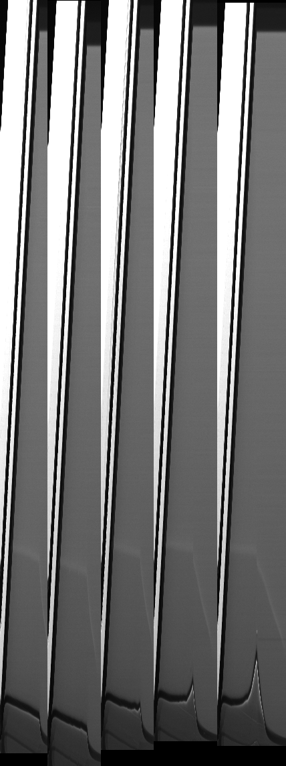
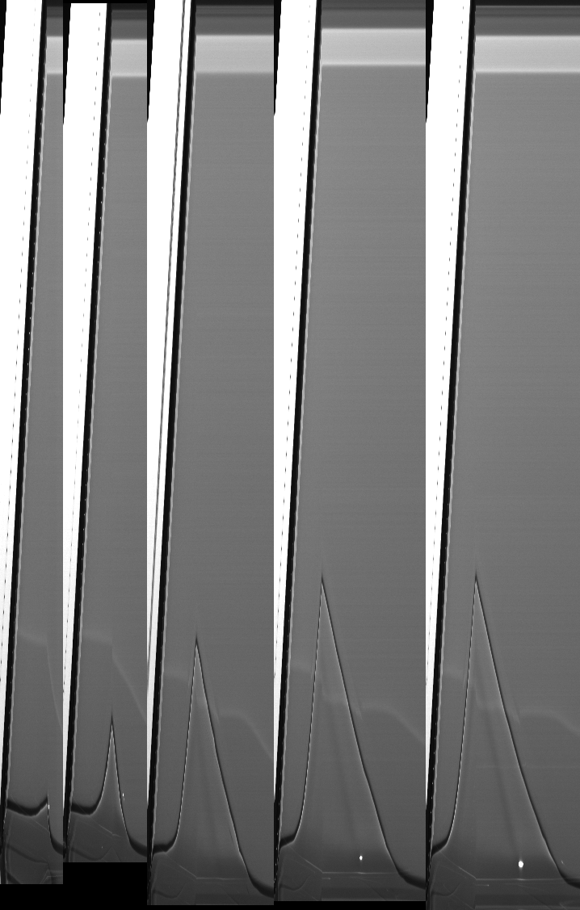
Time condition : Sylgard 527 (3 kPa)
Figure 11 – Waiting time for Sylgard 527 between dipping of the substrate at Ca = 4 10⁻² .
Left : Wait time = 30s. Middle : 100s. Rigth : 1000s.
Sylgard 527 → not reliable enough

Slide 24
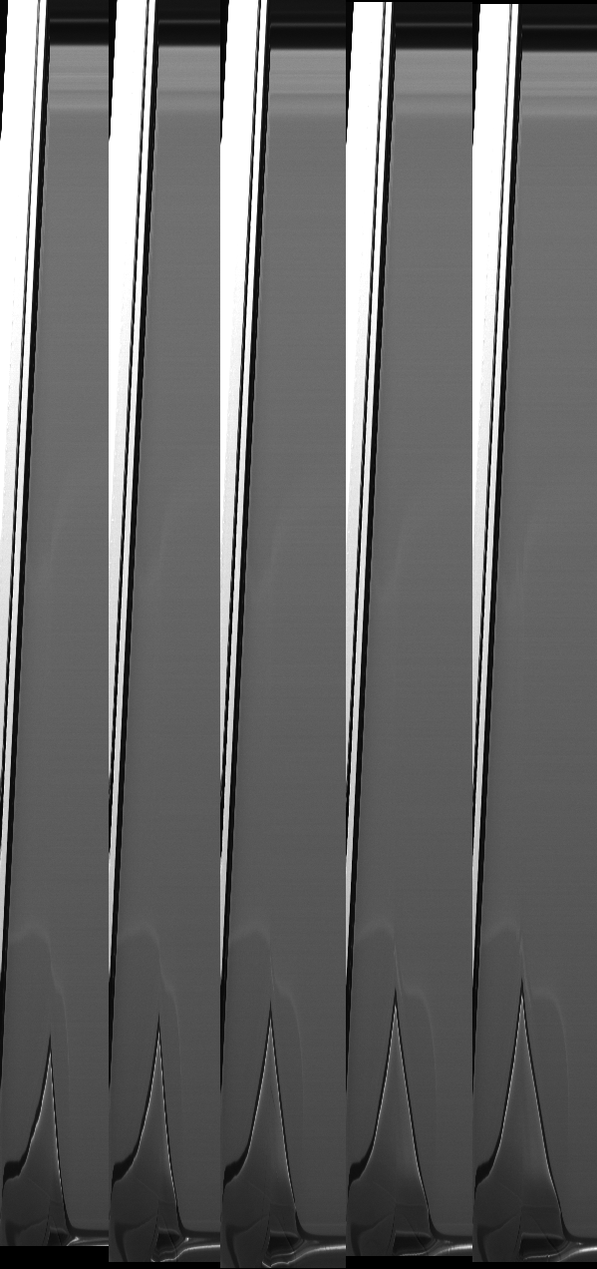
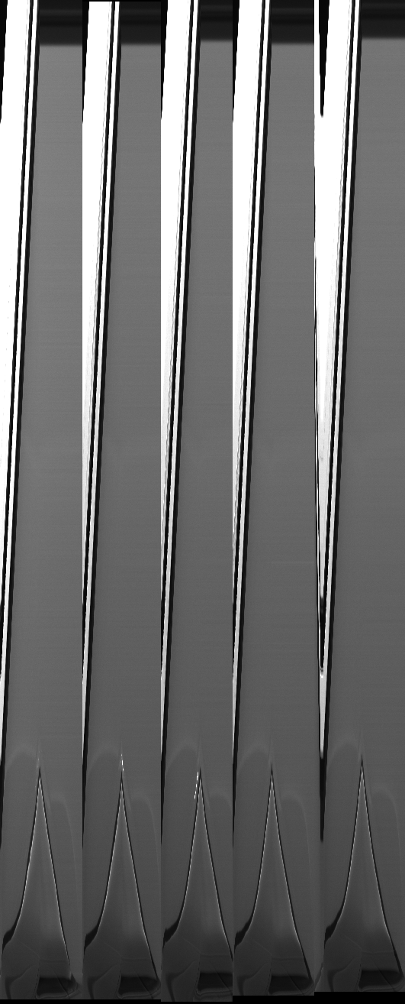
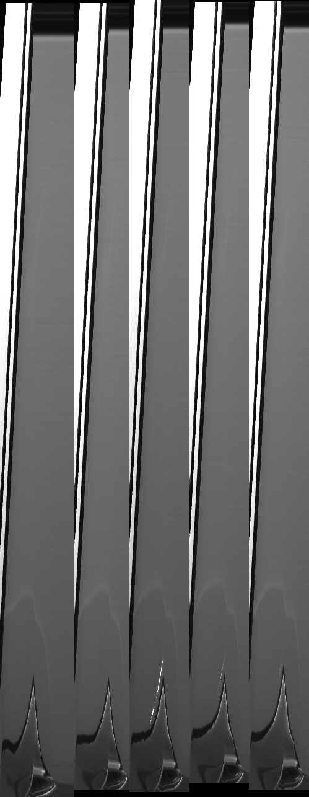
Time condition : Sylgard 184 (1,6 MPa)
Figure 12 – Waiting time for Sylgard 184 between dipping of the substrate at Ca = 4 10⁻² .
Left : Wait time = 30s. Middle : 100s. Rigth : 1000s.
Sylgard 184 at 1,6 MPa → wait time of 100s sufficient reliable

Slide 25
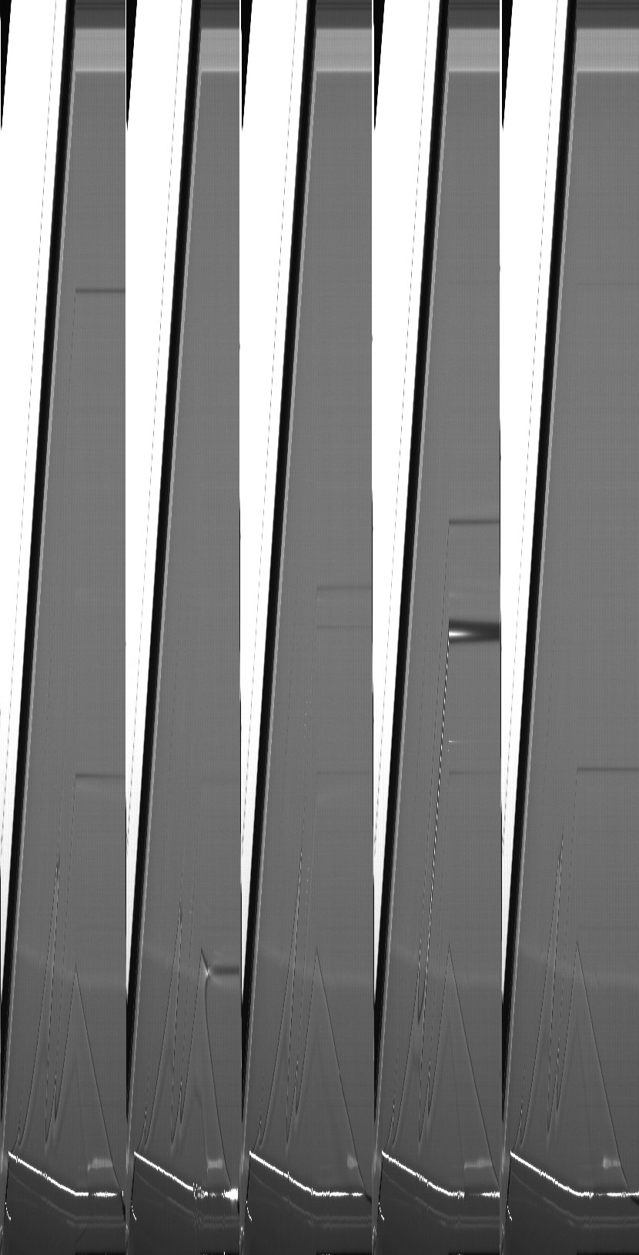
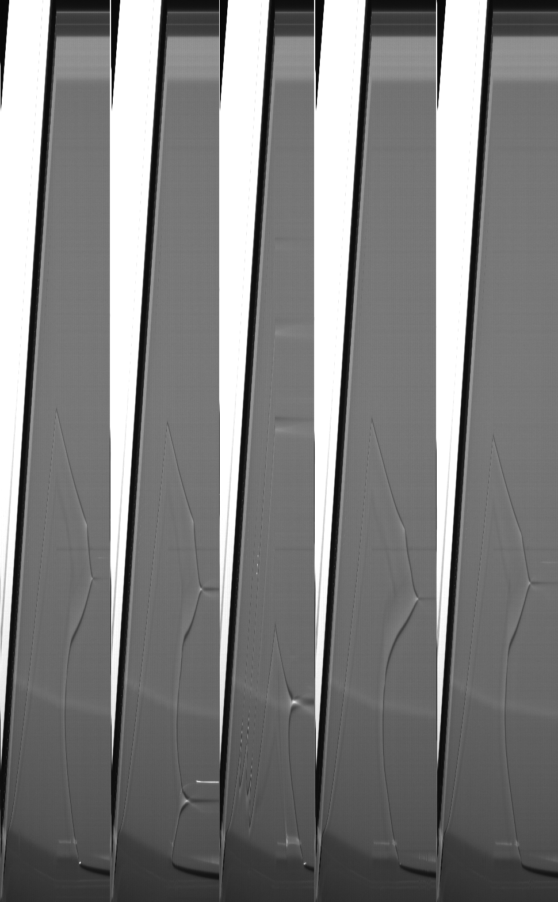
Time condition : Sylgard 184 (7 kPa)
Figure 13 – Waiting time for Sylgard 184 between dipping of the substrate at Ca = 9,4 10⁻⁵ .
Left : Wait time = 100s. Rigth : 1000s.
Sylgard 184 at 7 kPa → Hard to define wich waiting time

Slide 26
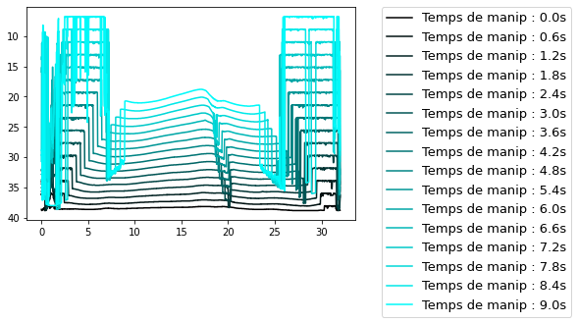
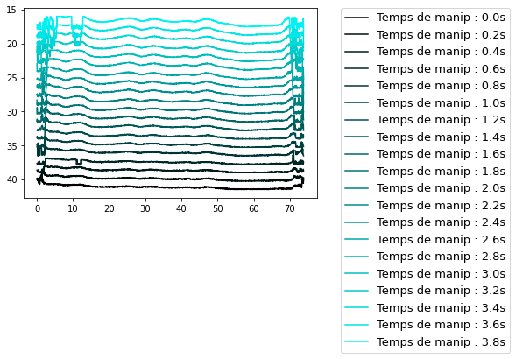
Perspectives : Shape of contact line
Figure 12 – Shape of contact line.
Sample’s width : 30,25 mm
Figure 13 – Shape of contact line.
Sample’s width : 69 mm
Instability-like?
Average « wavelength » of ondulation?
Size dependent?
Upgrade program & ligthing of set-up

Slide 27
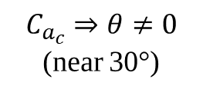
Introduction : Context of this work
From a critical droplet speed
→ liquid deposit regime
Characterize this regime as a function of the contact angle
Same in rigid case
$$Bo =\frac{ΔρgR²}{γ_{LG}}⇒{Bo}_{α}=Bo×sinα$$
Figure 2 - Shape of droplet in function of Bond number ${Bo}_{α}$(PHD of M. Oléron, 2022).
The images framed in red are for the case of a rigid (T. Podgorski et al., PRL 2001)
Contradiction with the experiment not well understood because the back of a drop not fully understood
Theoretically
(rigid and soft)
In practice
(rigid and soft)
$C_{a}↗ ⇒ θ↘$
$C_{a}↗ ⇒ θ↘$
Need to change experimental system to study contact line with simpler geometry
$$\left[Capillary number Ca= \frac{ηU}{γ_{LG}}\right]$$
$$C_{a_{c}}⇒θ≠0$$
(near 30°)
$$C_{a_{c}}⇒θ=0$$

Slide 28
Origin 2 : Presence of free-chain in the substrate
Yellow chain
« Free-chain »
Red chain
Blue chain
Under stress:
stretch and store elastic energy
Under stress: can relax and/or move in the network
mechanical response with viscoelastic contribution
Free-chain extract
If coating instantaneous
1 lead for delayed coating:
slow reorganization of free chains near the contact line during extraction

Slide 29
Experimental set-up
Sliding droplet
α
2 classical set-up :
Dip-coating
Sample used : PDMS (polydimethyl-siloxane) used:
Sylgard 527™ Dielectric Gel (Dow Corning) → Young’s modulus : 3 kPa
Sylgard 184™ Elastomeric Gel (Dow Corning) → Young’s modulus : 7 kPa – 1,6 MPa
Liquid used :
Glycerol (more & less) pure, G100 :
$γ\sim \left(63,1±0,5\right){10}^{−3} J/m²$, $η\sim 1,291±0,301 Pa.s$
Ucon (lubricant, Dow Corning) :
$γ\sim \left(40,7±0,9\right){10}^{−3} J/m²$, $η\sim 50,638±1,647 Pa.s$
Figure 3 – Experimental set-up : dip-coating
Straight contact line
Pulling speed : controlable parameter

