Slide 1
Interaction ion-ion véhiculée par la contrainte dans les cristaux dopés aux ions de terres rares
Anne Louchet-Chauvet, Thierry Chanelière
Congrès SFP 2023, 3-7 juillet 2023

Slide 2
Quantum technologies and decoherence
Quantum conversion
Quantum sensors
Quantum bits /
Quantum computation
Quantum storage /
Quantum repeaters
Quantum optomechanics
$$\left.|e\right\rangle$$
$$\frac{\left.|g\right\rangle +e^{iφ(t)}\left.|e\right\rangle }{\sqrt{2}}$$
$$\left.|g\right\rangle$$
Decoherence!
Atomic two-level system in a superposition state

Slide 3
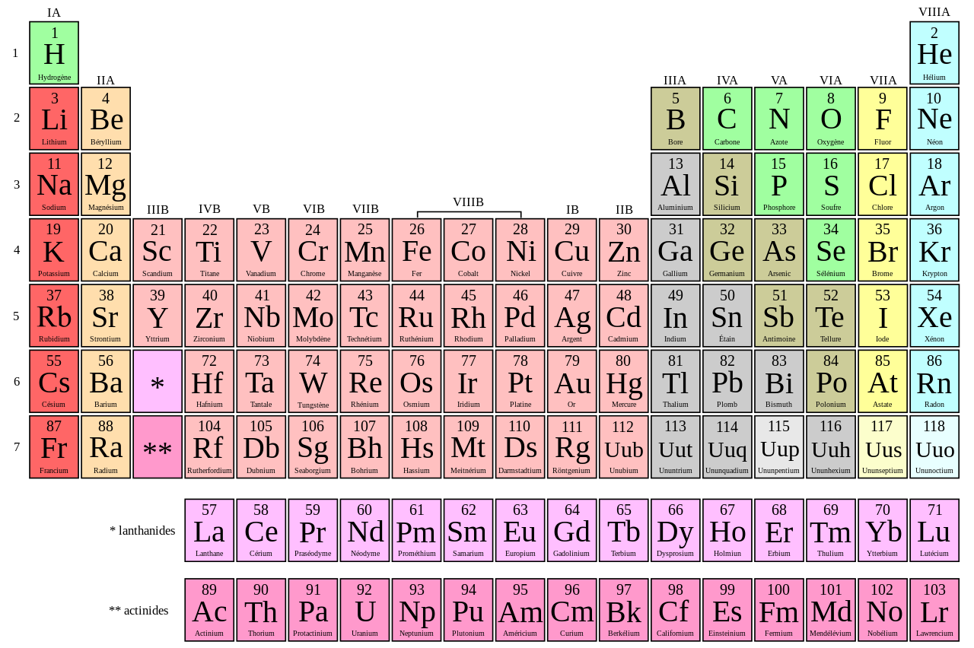
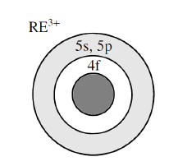
Quantum technologies and decoherence
Quantum conversion
Quantum sensors
Quantum bits /
Quantum computation
Quantum storage /
Quantum repeaters
5
Rare-earth ion-doped crystals:
Ultra-coherent solid-state quantum systems
Quantum optomechanics
$$\left.|e\right\rangle$$
$$\frac{\left.|g\right\rangle +e^{iφ(t)}\left.|e\right\rangle }{\sqrt{2}}$$
$$\left.|g\right\rangle$$
Decoherence!
At $<4K$:
Exceptionally
narrow lines
Optical $Γ_{h}≤100 kHz$ ($→100Hz$)
Spin $Γ_{h}≤100 Hz$($→10µHz$)
Atomic two-level system in a superposition state

Slide 4
Quantum technologies and decoherence
Quantum conversion
Quantum sensors
Quantum bits /
Quantum computation
Quantum storage /
Quantum repeaters
Quantum optomechanics
$$\left.|e\right\rangle$$
$$\frac{\left.|g\right\rangle +e^{iφ(t)}\left.|e\right\rangle }{\sqrt{2}}$$
Intrinsic decoherence
→ homogeneous width $Γ_{h}$
Non-stationary environment
→ spectral diffusion
$$\left.|g\right\rangle$$
Decoherence!
Atomic two-level system in a superposition state

Slide 5
Environment-induced decoherence
Example #1: magnetic noise induced spectral diffusion
Random, spontaneous spin flips
in the vicinity of the quantum system
→ Magnetic field noise
$$\left.|e\right\rangle$$
If Zeeman sensitivity → Spectral diffusion
$$\left.|g\right\rangle$$
Example #2: Electric noise induced spectral diffusion
$$\left.|e\right\rangle$$
Random, spontaneous movements of electric dipoles or charges in the vicinity of the quantum system
→ Electric field noise
$$\left.|g\right\rangle$$
If Stark sensitivity → Spectral diffusion

Slide 6
Environment-induced decoherence
Example #3: Acoustic noise (in condensed matter systems)
$$\left.|e\right\rangle$$
Time-dependent strain
If stress sensitivity → Spectral diffusion
$$\left.|g\right\rangle$$
Piezospectroscopic effect
Stress
Lineshift
Absorption
Hooke’s law
Interatomic distances change
$$Δν=G_{stress}σ$$
Modifies the local crystal field
Frequency

Slide 7
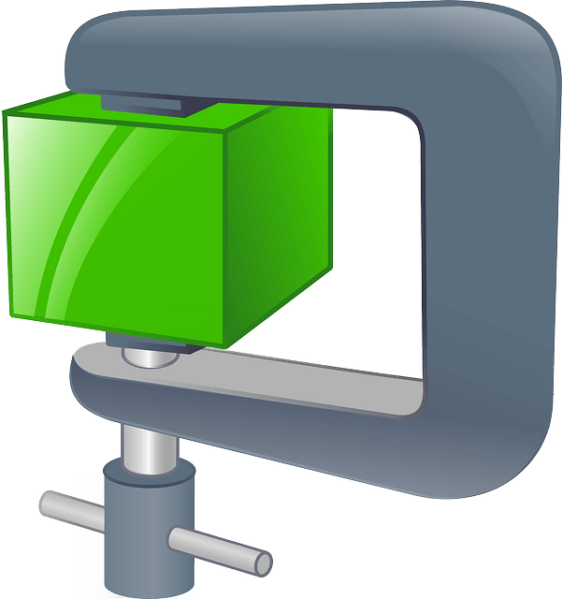
Excitation-induced decoherence
Electric
dipole-dipole
interaction
Magnetic dipole moment (spin) change
+ Zeeman effect
Electric dipole
moment change
+ Stark effect
Magnetic
dipole-dipole
interaction
2 atoms at close distance
Ion-ion
interaction
Excitation-induced strain
+ piezospectroscopic effect
$$\left.|e\right\rangle$$
$$\left.|g\right\rangle$$

Slide 8
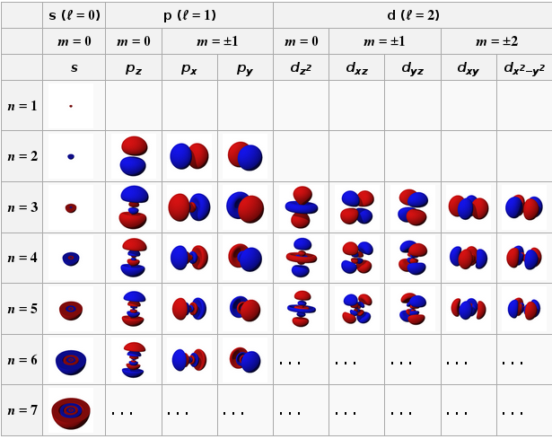
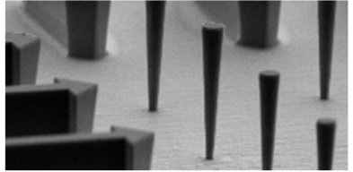
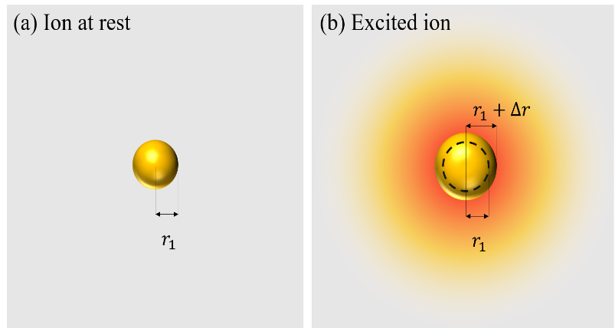
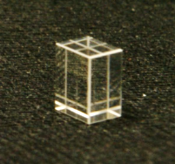
Excitation-induced strain
Outer atomic size depends on
electronic configuration (orbitals)
Piezo-excitonic backaction in embedded quantum dots
J. Kettler et al. Nature nanotechnology, 16(3), 283-287 (2021)
Piezo-orbital backaction in
rare-earth ion-doped crystals
Optical excitation
Stress
A. Louchet-Chauvet et al., arXiv:2109.06577 (2021).
Electronic orbital shape change
Hooke’s law
Strain in crystal

Slide 9
Excitation-induced strain + piezospectroscopic effect
in rare-earth ion-doped crystals
Hooke’s
law
Interatomic distances change
Modifies the local crystal field
Optical excitation
Piezo-orbital backaction
Stress
Piezospectroscopic effect
Line shift
Keating, K. B. et al. (1961) Effect of pressure on the spectra of rare earth ions in crystals. The Journal of Chemical Physics, 34(1), 143-151.
$$\left.|e\right\rangle$$
Electronic orbital shape change
Hooke’s law
$$\left.|g\right\rangle$$
Strain in crystal

Slide 10
Excitation-induced decoherence
Electric
dipole-dipole
interaction
Magnetic dipole moment (spin) change
+ Zeeman effect
Electric dipole
moment change
+ Stark effect
Magnetic
dipole-dipole
interaction
2 atoms at close distance
Ion-ion
interaction
Excitation-induced strain
+ piezospectroscopic effect
Strain-mediated
ion-ion interaction
$$\left.|e\right\rangle$$
$$\left.|g\right\rangle$$

Slide 11
Ion-ion interactions in RE-doped crystals
$$ΔE=ℏ\frac{A}{r^{3}}$$
Three different ion-ion interactions with similar scaling law:
Magnetic dipole-dipole interaction
Electric dipole-dipole interaction
Strain-mediated interaction
$$A_{mag}=\frac{μ_{0} Δμ_{mag}^{2}}{4π}$$
$$A_{el}=\frac{Δμ_{el}^{2}}{4πε_{0}ε_{r}ℏ}$$
$$A_{strain}=h E\frac{κ^{2}}{1+ν}$$
Ion with electronic
or nuclear spin
(Kramers/non-Kramers)
$${1:10}^{6}$$
Expected
variability for $A$

Slide 12
Ion-ion interactions in RE-doped crystals
$$ΔE=ℏ\frac{A}{r^{3}}$$
Three different ion-ion interactions with similar scaling law:
Magnetic dipole-dipole interaction
Electric dipole-dipole interaction
Strain-mediated interaction
$$A_{mag}=\frac{μ_{0} Δμ_{mag}^{2}}{4π}$$
$$A_{el}=\frac{Δμ_{el}^{2}}{4πε_{0}ε_{r}ℏ}$$
$$A_{strain}=h E\frac{κ^{2}}{1+ν}$$
Ion with electronic
or nuclear spin
(Kramers/non-Kramers)
Site symmetry allowing permanent dipole moment
$${1:10}^{6}$$
Expected
variability for $A$
$${1:10}^{6}$$

Slide 13
Ion-ion interactions in RE-doped crystals
$$ΔE=ℏ\frac{A}{r^{3}}$$
Three different ion-ion interactions with similar scaling law:
Magnetic dipole-dipole interaction
Electric dipole-dipole interaction
Strain-mediated interaction
$$A_{mag}=\frac{μ_{0} Δμ_{mag}^{2}}{4π}$$
$$A_{el}=\frac{Δμ_{el}^{2}}{4πε_{0}ε_{r}ℏ}$$
$$A_{strain}=h E\frac{κ^{2}}{1+ν}$$
Ion with electronic
or nuclear spin
(Kramers/non-Kramers)
Site symmetry allowing permanent dipole moment
Mechanical characteristics
of crystal
$κ=$ $40 Hz/Pa →250Hz/Pa$
$${1:10}^{6}$$
Expected
variability for $A$
$${1:10}^{6}$$
$$1:20$$

Slide 14
Ion-ion interactions in RE-doped crystals
$$ΔE=ℏ\frac{A}{r^{3}}$$
Three different ion-ion interactions with similar scaling law:
Magnetic dipole-dipole interaction
Electric dipole-dipole interaction
Strain-mediated interaction
$$A_{mag}=\frac{μ_{0} Δμ_{mag}^{2}}{4π}$$
$$A_{el}=\frac{Δμ_{el}^{2}}{4πε_{0}ε_{r}ℏ}$$
$$A_{strain}=h E\frac{κ^{2}}{1+ν}$$
Ion with electronic
or nuclear spin
(Kramers/non-Kramers)
Site symmetry allowing permanent dipole moment
Mechanical characteristics
of crystal
$${1:10}^{6}$$
Expected
variability for $A$
$${1:10}^{6}$$
$$1:20$$

Slide 15
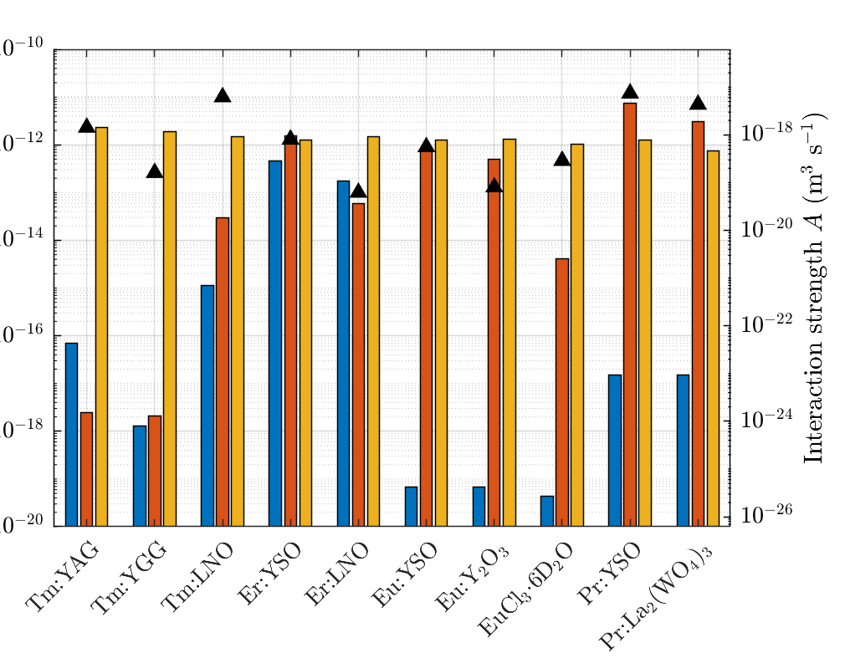
Comparing ion-ion interactions in RE-doped materials
Excitation-induced decoherence in atomic ensembles:
Usually explained with only magnetic and electric dipole-dipole interactions
→ Mostly works !
Magnetic
dipole-dipole
interaction
Electric
dipole-dipole
interaction
10 orders of magnitude!
Strain-mediated
ion-ion interaction
except in high-symmetry, low spin compounds
Experimental measurements via excitation-induced decoherence
… in 10 rare-earth-doped compounds
Including the strain-mediated contribution
→ better understanding

Slide 16
Conclusion
Excitation-induced decoherence in rare-earth ion-doped crystals
3 different mechanisms with same spatial scaling:
→ magnetic dipole-dipole interaction
→ electric dipole dipole interaction
→ strain-mediated interaction (never negligible!)
Ion-ion
interaction
Quantum storage /
Quantum repeaters
Quantum conversion
Quantum sensors
$$\left.|e\right\rangle$$
Quantum bits /
Quantum computation
Quantum optomechanics
$$\left.|g\right\rangle$$
A. Louchet-Chauvet, T. Chanelière, Strain-mediated ion-ion interaction in rare-earth-doped solids. Journal of Physics: Condensed Matter 35, 305501 (2023)

Slide 17
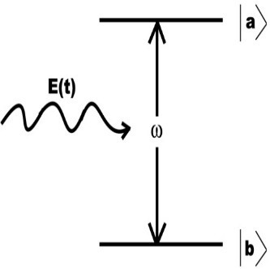
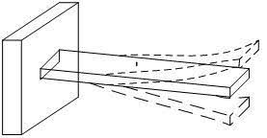
Perspectives
Source of decoherence
Ion-ion interactions
Building block for quantum computing
Compounds where only the strain-mediated ion-ion interaction dominates
→ Pure ion-ion interaction mechanism
Ion-ion
interaction
Interesting perspectives in hybrid optomechanics
Piezospectroscopic effect
$$\left.|e\right\rangle$$
Mechanical degree of freedom
Strain-coupling
Quantum
degree of freedom
$$\left.|g\right\rangle$$
Piezo-orbital backaction
A. Louchet-Chauvet, T. Chanelière, Strain-mediated ion-ion interaction in rare-earth-doped solids. Journal of Physics: Condensed Matter 35, 305501 (2023)

Slide 18
Acknowledgments
Pierre Verlot
Rose Ahlefeldt
Julian Dajczgewand
Jean-Louis Le Gouët
Lucile Veissier
Thibault Courageux
Hans Lignier
Thierry Chanelière
Jean-Philippe Poizat
Ludovic Bellon
Loïc Morvan
Perrine Berger Sacha Welinski
Lothaire Ulrich
Yoann Attal
Alban Ferrier
Philippe Goldner
François Ramaz
Xiaoping Jia
Thomas Llauze
Félix Montjovet

Slide 19
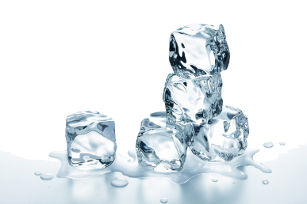
Cryogenic or room temperature ?
$Γ_{inh}$ : crystalline matrix defects and disorder
→ insensitive to temperature
$Γ_{h}$: dynamic processes (phonons) $∝T^{7}$
$$T=3K$$
$$Γ_{h}≪Γ_{inh}$$
Absorption
$$Γ_{inh}$$
$$=20GHz$$
$$T=300K$$
$$Γ_{h}≫Γ_{inh}$$
Absorption
$$Γ_{h}=3kHz$$
Frequency
$$Γ_{h}≃700GHz$$
Ions not identical
→ Selection of a ion subset with SHB
Frequency
Collective enhancement
All ions identical!

Slide 20
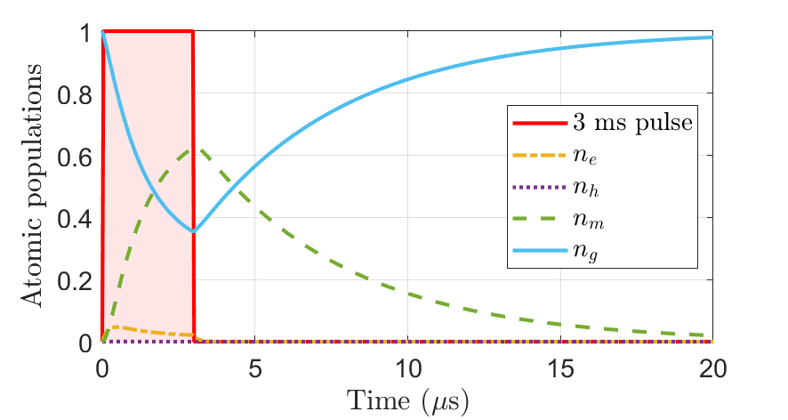
Modeling the piezo-orbital backaction
$$y$$
Surface
displacement
$e(y,t)$
$$z$$
$$x$$
Pump
beam spot
$$D_{0}$$
Time ($ms$)
Atomic population evolution in the whole crystal volume
Corresponding volumic change assuming simple ionic radius change $ξ=Δr/r$
Propagate strain towards the surface
Calculate the surface displacement $e_{piezo}(y,t)$
Derive the corresponding deflection angle

Slide 21
Modeling the resonant photothermal backaction
$$y$$
Surface
displacement
$e(y,t)$
$$z$$
$$x$$
Pump
beam spot
$$D_{0}$$
Calculate the time-dependent phonon heatload in the whole crystal volume

Slide 22
Modeling the resonant photothermal backaction
Resonant photothermal effect:
Very well known in RE-doped crystals!
(including at room temperature)
Wavenumber (${cm}^{−1}$)
$$12600$$
$${}_{}^{3}{H_{4}} (e)$$
$$8300$$
$${}_{}^{3}{H_{5} (h)}$$
$$5500$$
$${}_{}^{3}{F_{4}} (m)$$
$$0$$
$${}_{}^{3}{H_{6} (g)}$$

Slide 23
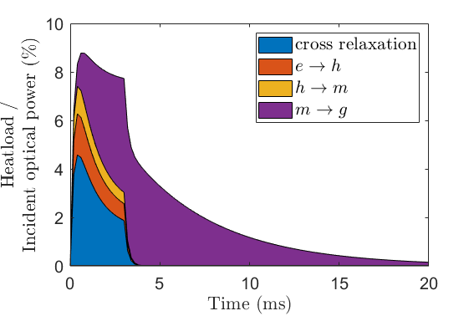
Modeling the resonant photothermal backaction
Resonant photothermal effect:
Very well known in RE-doped crystals!
(including at room temperature)
Rate equations for this 4-level system
→ Time-dependent phonon rate generation (heatload)
Wavenumber (${cm}^{−1}$)
$$12600$$
$${}_{}^{3}{H_{4}} (e)$$
$$80$$
$$31$$
$$580$$
$$4200$$
$$8300$$
$${}_{}^{3}{H_{5} (h)}$$
Non-radiative relaxation
(phonons)
$$786 nm$$
$$578$$
$$4200$$
$$5$$
$$77000$$
$$5500$$
$${}_{}^{3}{F_{4}} (m)$$
Radiative relaxation
(fluorescence)
$$299$$
$$10−100$$
Tm-Tm cross relaxation
$$106$$
$$4200$$
$$0$$
$${}_{}^{3}{H_{6} (g)}$$
Energy levels and relaxation rates ($s^{−1}$)
for room-temperature Tm:YAG
Caird, J. et al., (1975). Characteristics of room-temperature 2.3-µm laser emission from Tm³⁺ in YAG and YAlO₃. IEEE Journal of Quantum Electronics, 11(11), 874-881.

Slide 24
Modeling the resonant photothermal backaction
$$y$$
Surface
displacement
$e(y,t)$
$$z$$
$$x$$
Pump
beam spot
$$D_{0}$$
Calculate the time-dependent phonon heatload in the whole crystal volume
Feed heatload in heat equation to derive temperature in the whole crystal volume
Corresponding volumic change using thermal expansion coefficient for YAG
Propagate strain towards the surface
Calculate the surface displacement $e_{therm}(y,t)$
Derive the corresponding deflection angle

Slide 25
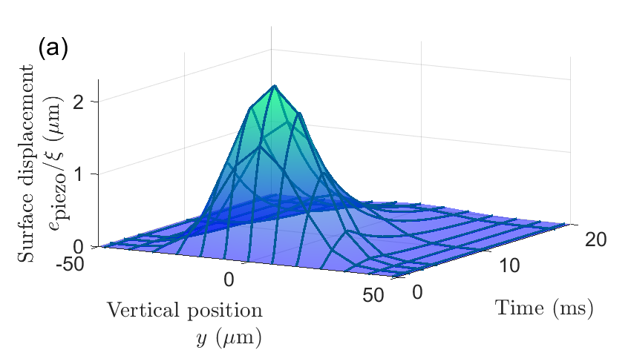
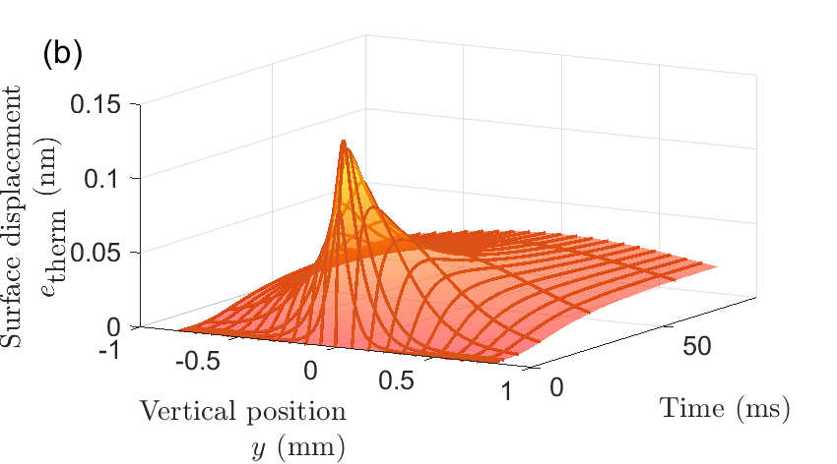
Model results
Piezo-orbital backaction
Photothermal backaction
$$e_{piezo}\left(y,t\right)=B\left(y\right)∗ g_{m}\left(t\right)$$
$$e_{therm}\left(y,t\right)$$
Time evolution:
given by atomic populations in $m$
(instantaneous effect)
Spatial shape:
narrow bump with constant width
Time evolution:
Instantaneous at center
Delayed at a distance
Spatial shape:
progressive broadening (heat diffusion)

Slide 26
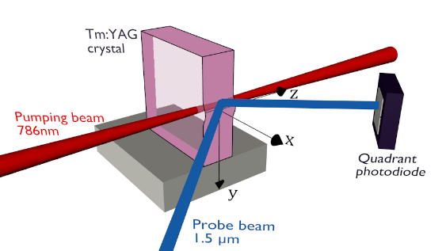
Optomechanical backaction in a rare-earth ion-doped crystal
A conservative, piezo-orbital effect
(geometric shape of the electronic orbitals)
A dissipative, photothermal effect
(phonons generated throughout relaxation)
Both effects are connected to atomic internal dynamics
No parasitic photothermal contribution
Demonstration in a bulk sample, enabling time- and space-resolved tomography
Louchet-Chauvet, A. et al. (2021). Optomechanical backaction processes in a bulk rare-earth doped crystal. arXiv preprint arXiv:2109.06577.

Slide 27
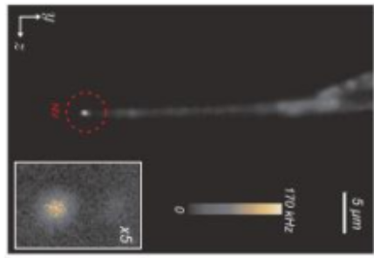
Challenges of observing piezo-orbital backaction
$$y$$
Typical relative ionic radius change upon excitation:
$\frac{Δr}{r}≃1\%$ ($r≃1 Angstrom )$
$$z$$
$$x$$
Very small
piezo-orbital effect!
Pump
beam spot
Surface
displacement
$e(y,t)$
Collective enhancement with a large number of identical ions
$$D_{0}$$
$$10 mm$$
Bulk object:
Large number of atoms / quantum systems (limited by beam size)
No mechanical resonance
weak response but time-resolved study
Usually in optomechanics: Mechanical resonator
Sharp mechanical resonance
→ large response
Low number of atoms / quantum systems
Room temperature:
All ions identical

Slide 28
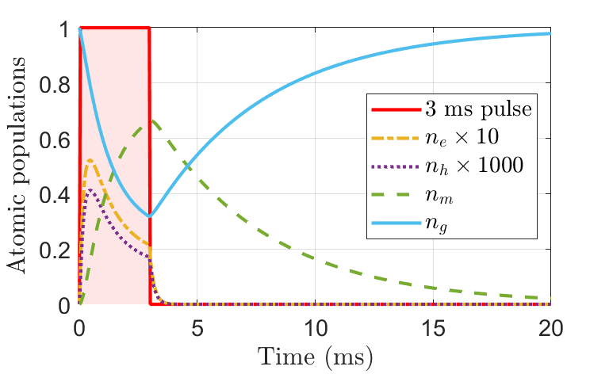
Which quantum system / ion ?
$65\%$ of ions in level $m$ after
$3 ms$ resonant excitation
Goal: long-lived energy levels
to maximize the population transfer
Wavenumber (${cm}^{−1}$)
$$500 µs$$
$$12600$$
$${}_{}^{3}{H_{4}} (e)$$
$$\sim µs$$
$$8300$$
$${}_{}^{3}{H_{5} (h)}$$
$$786 nm$$
$$5500$$
$$∼7 ms$$
$${}_{}^{3}{F_{4}} (m)$$
Incoherent optical pumping for $3ms$
$$0$$
$${}_{}^{3}{H_{6} (g)}$$
Energy levels and transitions for $Tm:YAG$
Enhancement factor
$∼4×{10}^{14}$ identical ${Tm}^{3+}$ ions in laser beam transferred to a different electronic state

Slide 29
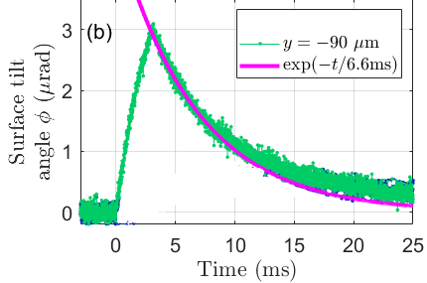
Excitation-induced motion in a bulk Tm:YAG crystal
(c)
Close to bump center
$3 µrad$ deflection
Time evolution resembles the $n_{m}\left(t\right)$ evolution
$$x$$
Further away
Attenuated deflection
!!! Delayed actuation !!!
$$y$$
Is it really a piezo-orbital signal ?
→ Photothermal contribution !? ←

Slide 30
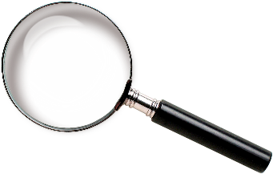
Elucidating the optomechanical processes 1) resonant nature ?
Wavenumber (${cm}^{−1}$)
Scan the pumping laser wavelength around $786 nm$
$$12600$$
$${}_{}^{3}{H_{4}} (e)$$
Many transitions between Stark multiplets
$$8300$$
$${}_{}^{3}{H_{5} (h)}$$
$$5500$$
$${}_{}^{3}{F_{4}} (m)$$
Deflection signal is resonant!
$$0$$
$${}_{}^{3}{H_{6} (g)}$$
Resonant piezo-orbital backaction?
Resonant photothermal backaction?

Slide 31
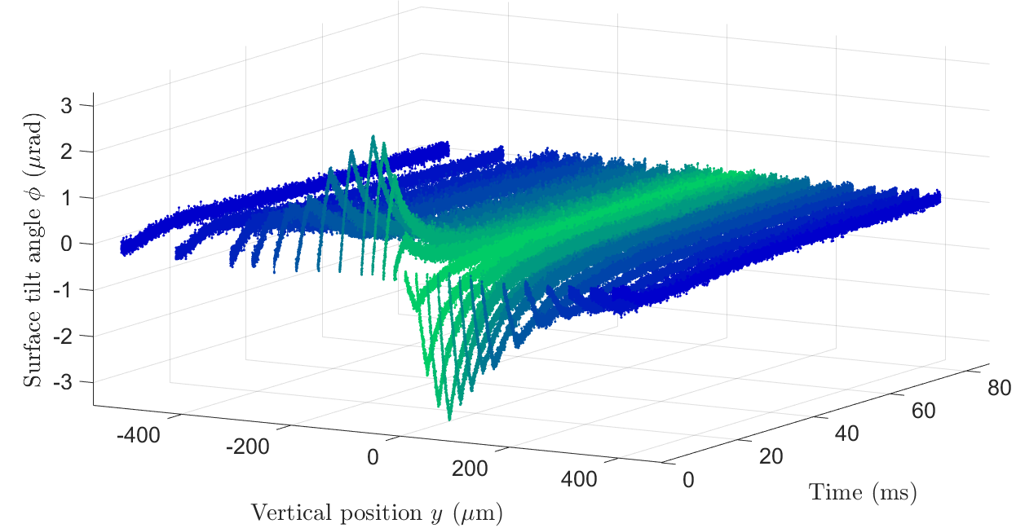
Elucidating the optomechanical processes 2) spatio-temporal dynamics ?
?
Bulk crystal
→ Time-resolved measurements
→ Spatially-resolved measurements!
Resonant piezo-orbital backaction
Resonant photothermal backaction
Model both piezo-orbital and photothermal effects
(in time and space)
$$x$$
$$y$$

Slide 32
Resonant photothermal effect model
Calculate phonon heatload over time
Population dynamics and relaxation processes
Wavenumber (${cm}^{−1}$)
$$12600$$
$${}_{}^{3}{H_{4}} (e)$$
$$80$$
$$31$$
$$580$$
$$4200$$
$$8300$$
$${}_{}^{3}{H_{5} (h)}$$
Non-radiative relaxation
(phonons)
$$786 nm$$
$$578$$
$$4200$$
$$5$$
$$77000$$
$$5500$$
$${}_{}^{3}{F_{4}} (m)$$
Radiative relaxation
(fluorescence)
$$299$$
$$10−100$$
Tm-Tm cross relaxation
$$106$$
$$4200$$
Heat diffusion equation
$$0$$
$${}_{}^{3}{H_{6} (g)}$$
→ Temperature distribution $T(x,y,z,t)$
Energy levels and relaxation rates ($s^{−1}$)
for room-temperature $Tm:YAG$
Linear thermal expansion ($\sim 6×10^{−6} K^{−1}$)
→ photothermal surface displacement
→ photothermal deflection angle $Φ_{therm}(y,t)$
Caird, J. et al., (1975). IEEE Journal of Quantum Electronics, 11(11), 874-881.

Slide 33
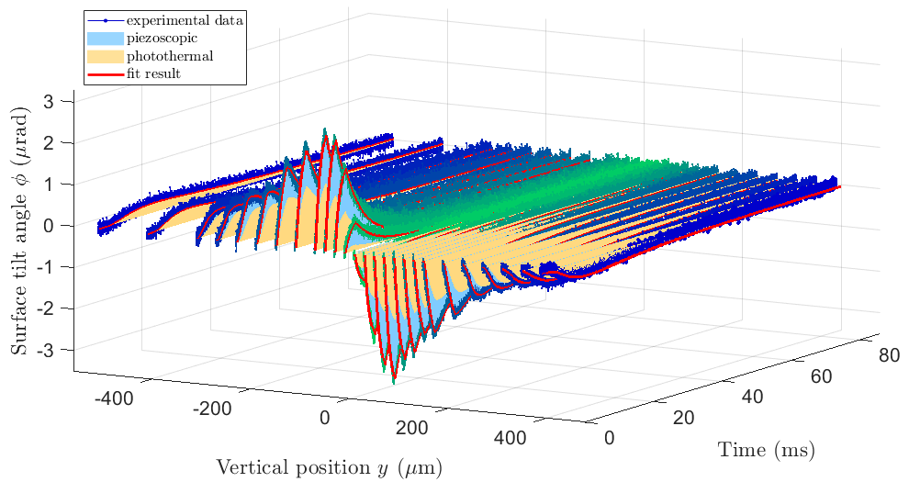
Model vs experimental data
Fit to the experimental data
$$Φ_{exp}\left(y_{i},t\right)=Φ_{i}×g_{m}\left(t\right)+η Φ_{therm}(y_{i},t)$$
Piezo-orbital part with
time evolution imposed by $n_{m}(t)$
Photothermal part
fully imposed by model
Excellent agreement with data
Piezo-orbital part:
Lorentzian bump with $230 pm$ height
at its maximum
Overall force to distort the surface : $0.27N$
($700 aN/ion$)
(compare 50aN/quantum dot)
A. Louchet-Chauvet, P. Verlot, J.-P. Poizat and T. Chanelière, arXiv:2109.06577 (2021).
J. Kettler et al. Nature nanotechnology, 16(3), 283-287 (2021)

