Slide 1
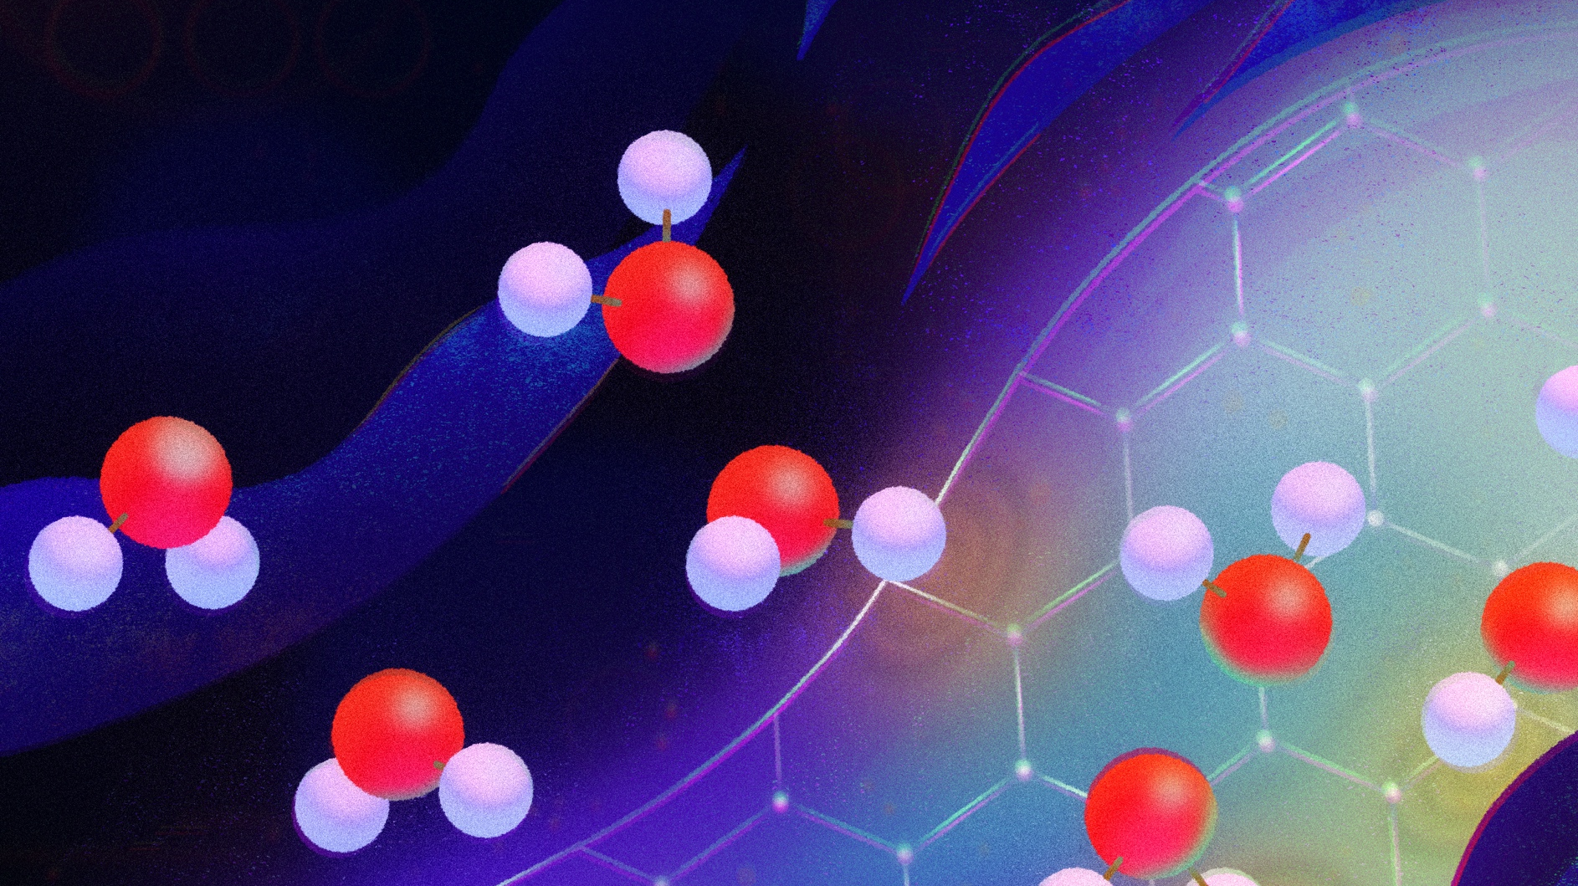
Dynamical couplings at the liquid-solid interface
Mathieu Lizée
Ecole Normale Supérieure de Paris

Slide 2
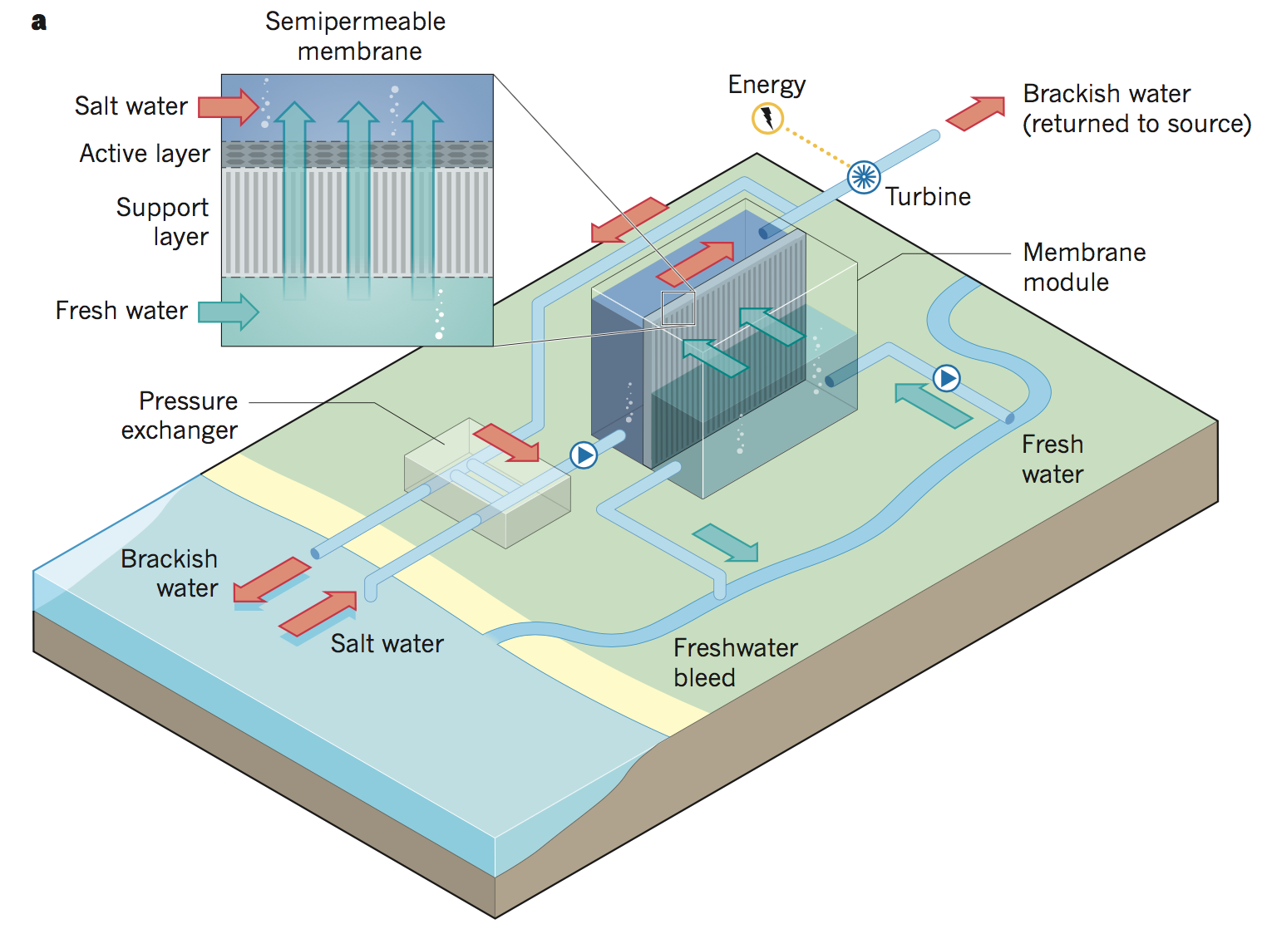
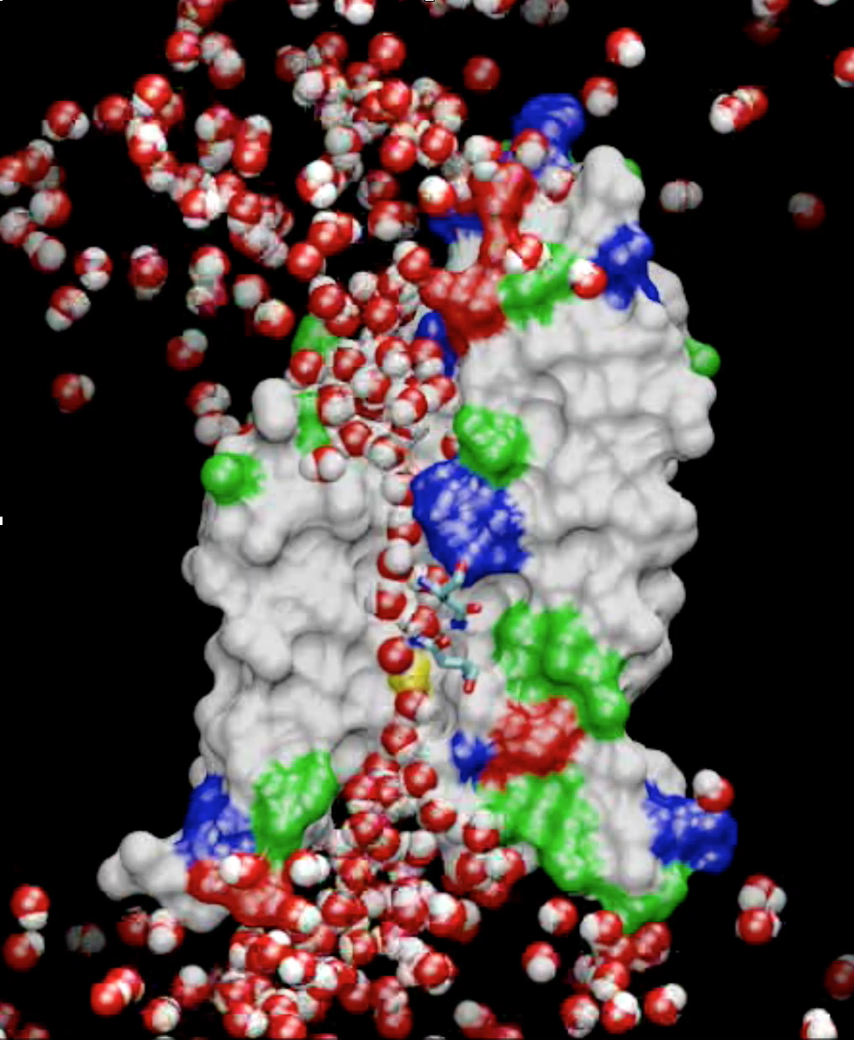
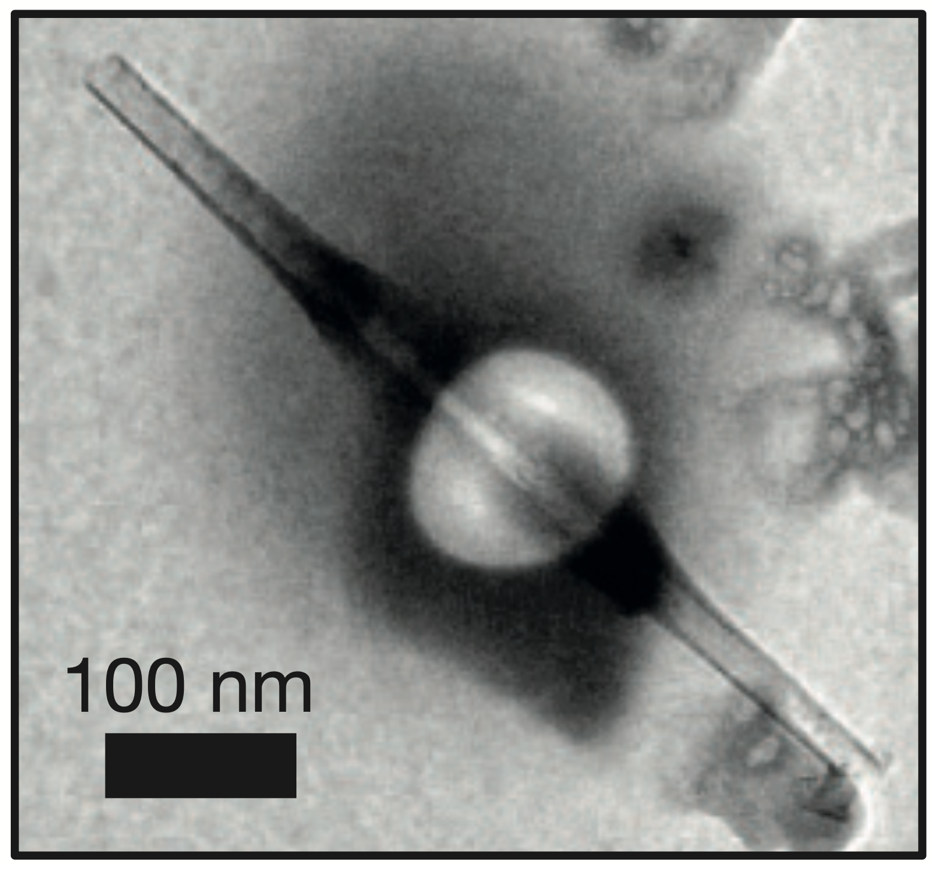
Nanofluidics, everywhere
From biological ion machinery…
…to artificial nanochannels…
… to large-scale membranes
for desalination and energy harvesting.

Slide 3
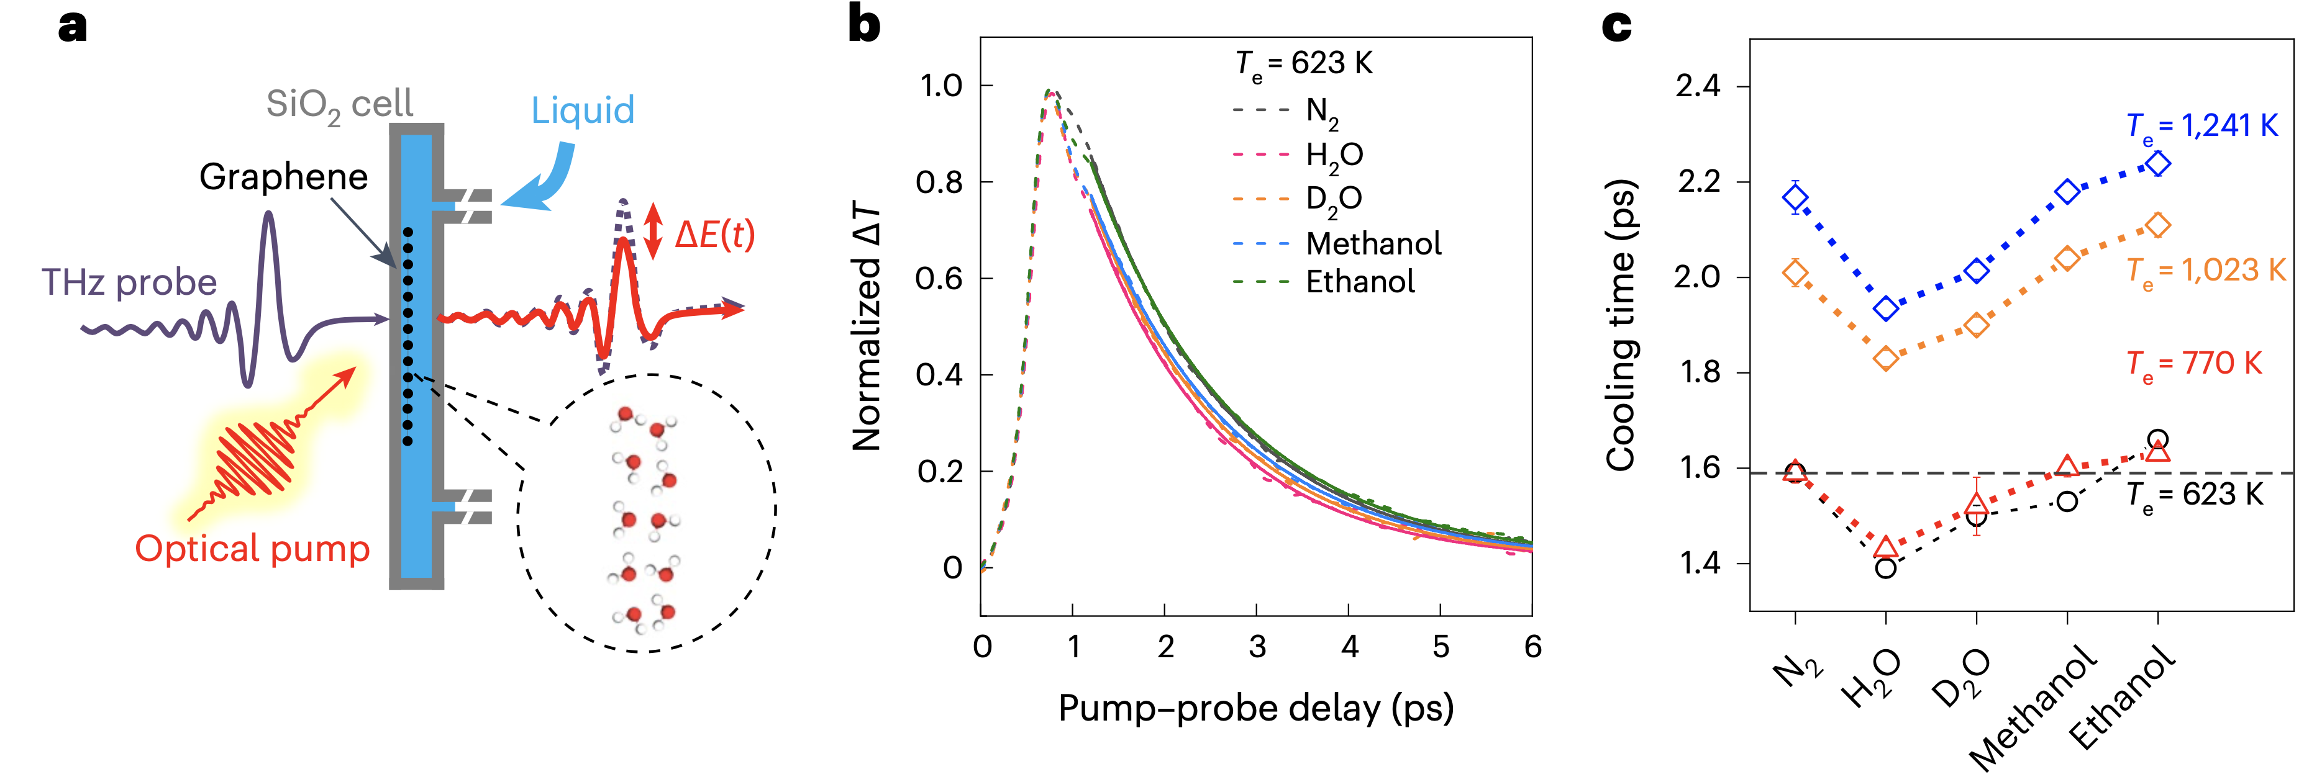
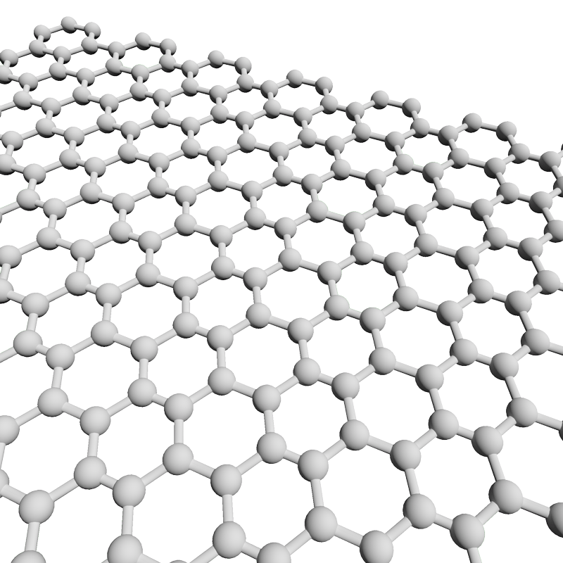
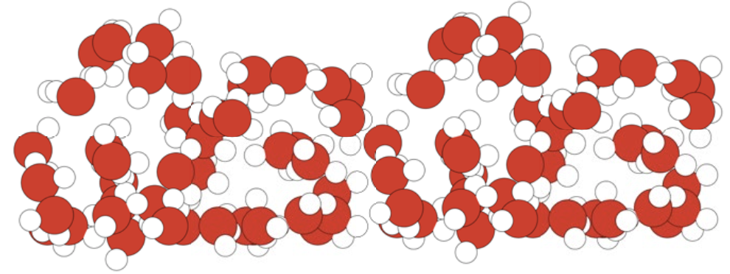
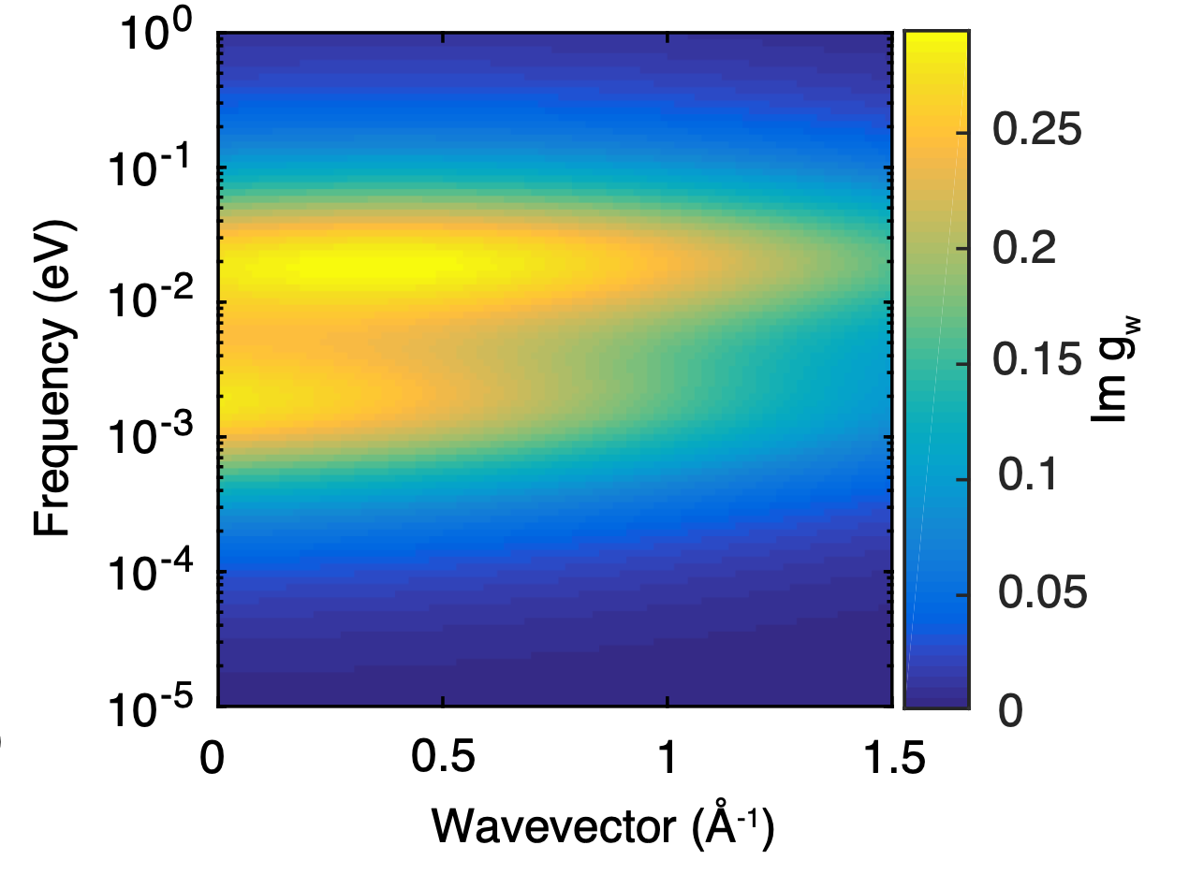
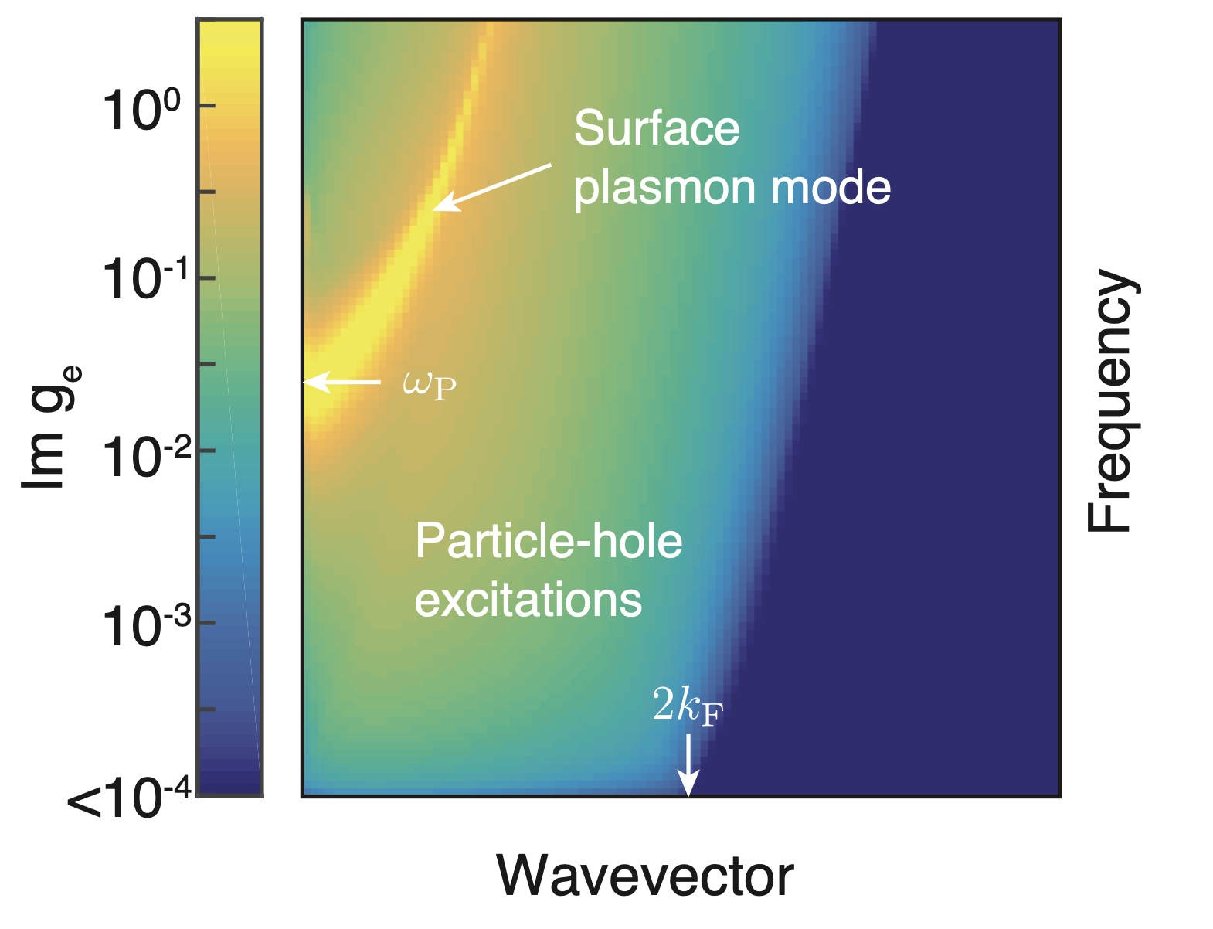
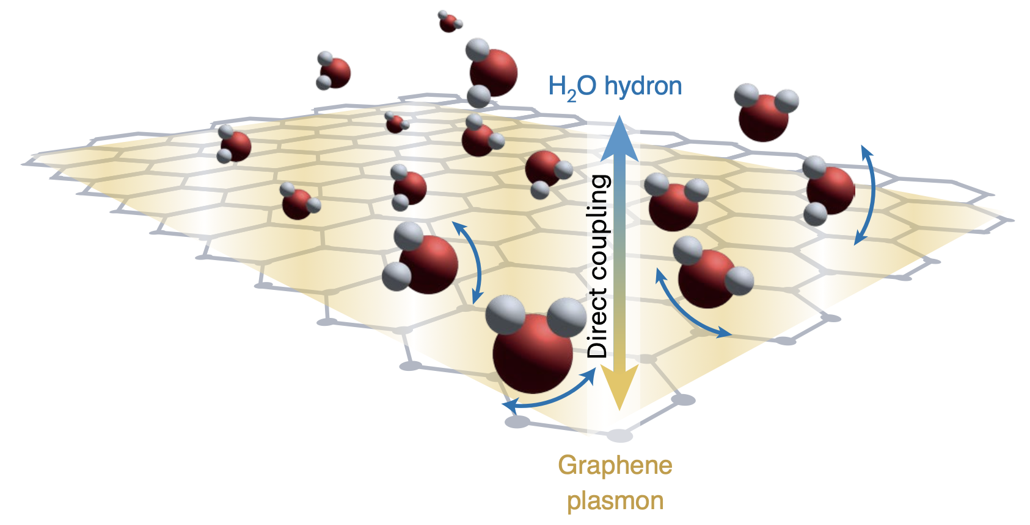
Dynamical couplings at the liquid solid interface
For long, the liquid solid interface has remained a static problem
Double layer capacitance, Stern layer…
Carbon nanotube friction is controlled by interlayer graphite plasmon
Coupling with water can even cool down electrons !
These dynamical couplings rely on the interplay between liquid and solid excitation spectrum
Secchi, Nature 2016
Kavokine et al, Nature 2022
Yu, Bonn, Kavokine et al, Nature Nano 2023

Slide 4
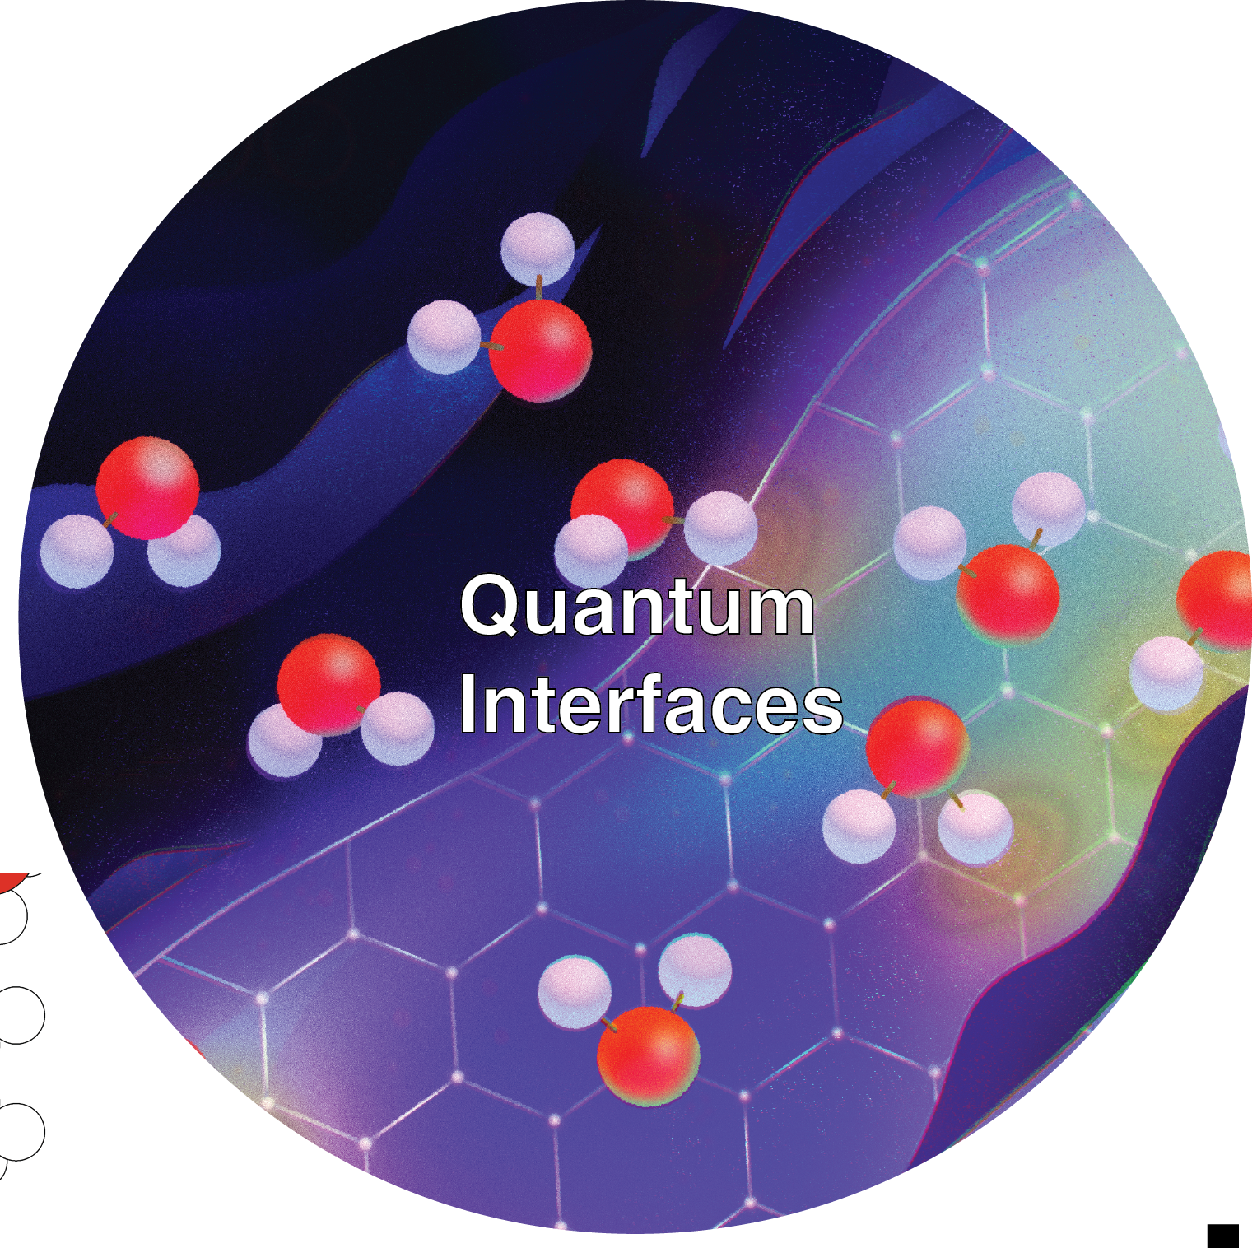





New effects at the liquid solid interface
In nanoscale hydrodynamics, excitation spectrum of the solid state matters
Liquid slip
Liquid flow
Electron cooling
$$e^{−}$$
$$e^{−}$$
$$e^{−}$$
$$e^{−}$$
$$I$$
Electron flow ?

Slide 5
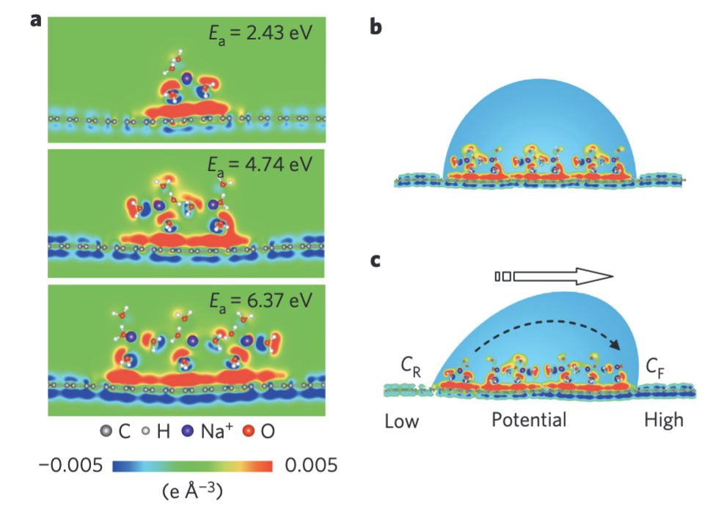
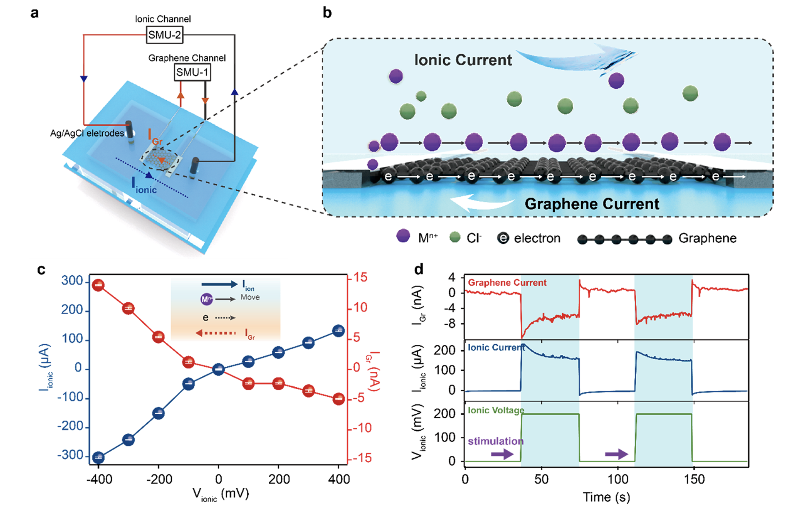
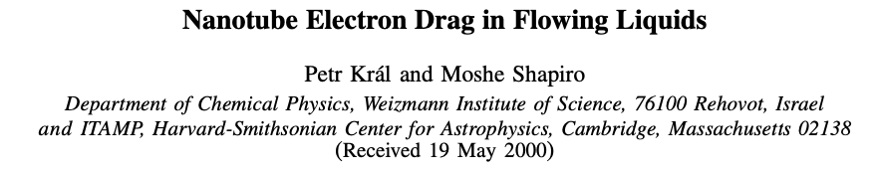
Current generation mechanisms
Coulomb drag
Capacitive charging
Water + Salt droplet moving on graphene surface
Yin et al, Nature Nano 2014
Phonon drag ?
Rabinowitz et al, Nano Letter 2020
Chen et al, Nano Letter 2023
Kral & Shapiro, PRL 2001

Slide 6

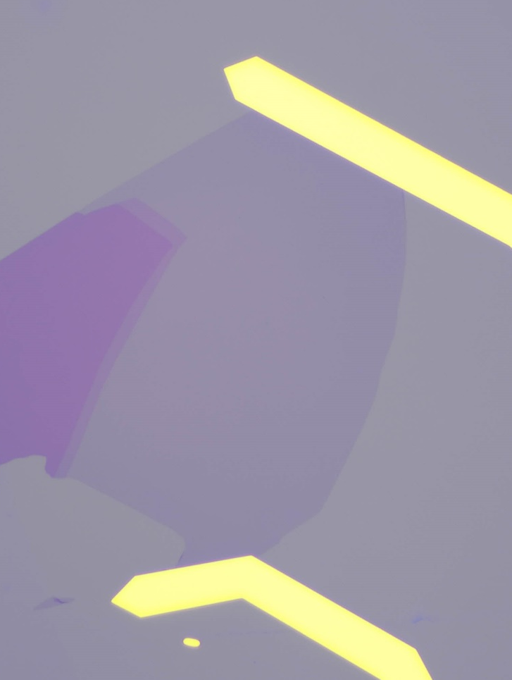
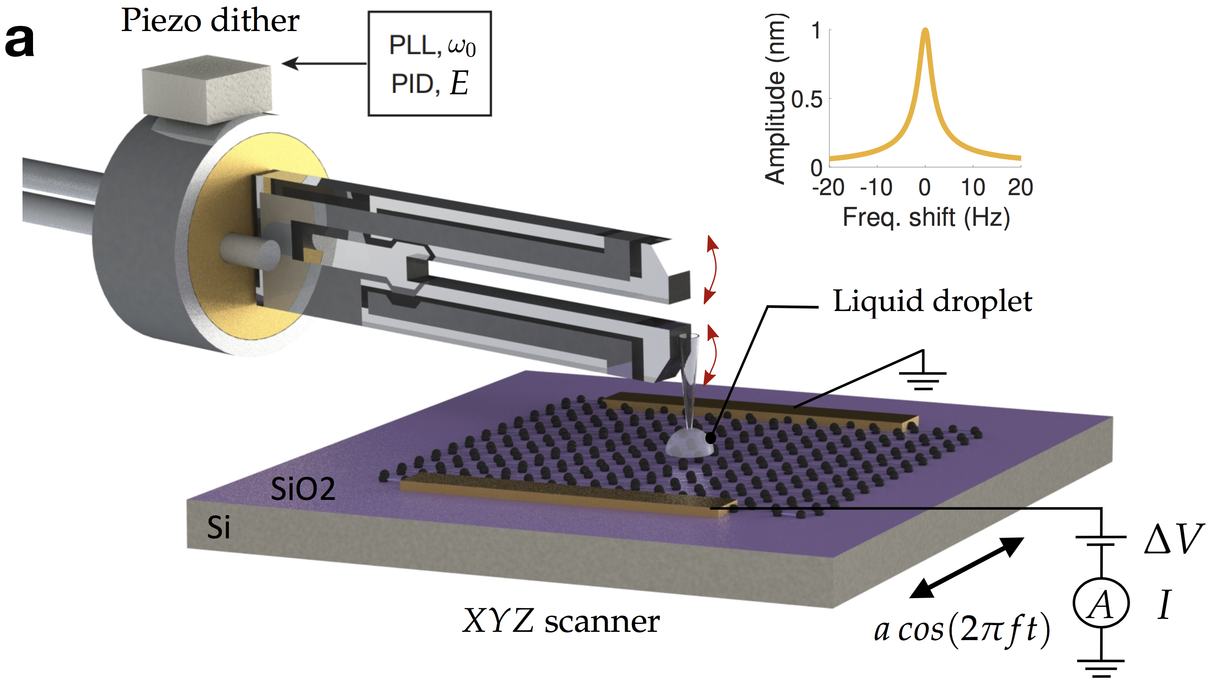
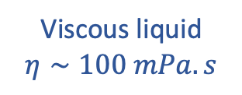
Micrometric flow on graphene transistor
Graphene transistor as flow sensor
50 𝜇m
Homemade AFM deposits a small droplet
Viscous liquid
$$η∼100 mPa.s$$
Alice Marcotte
Solid

Slide 7
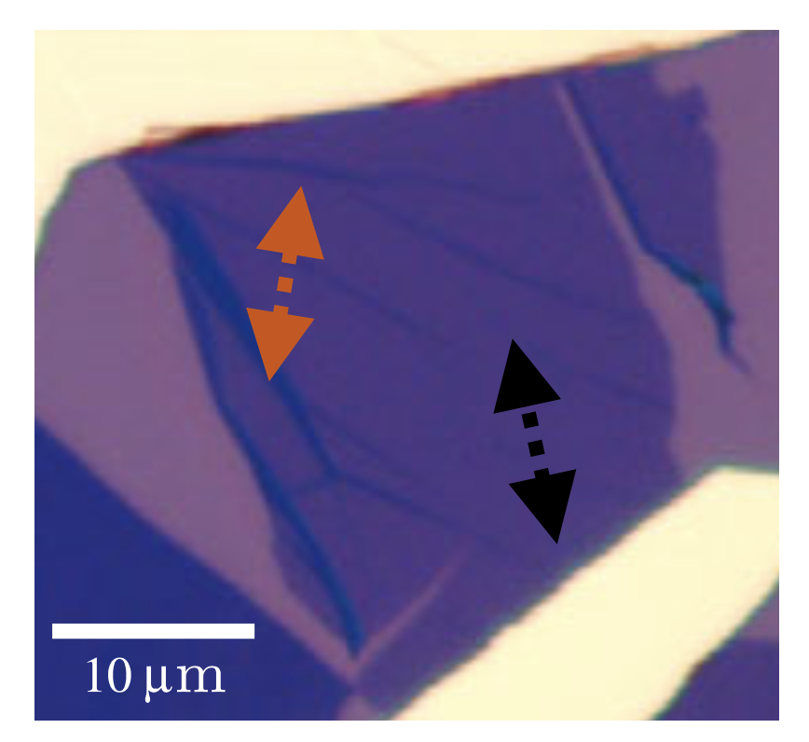
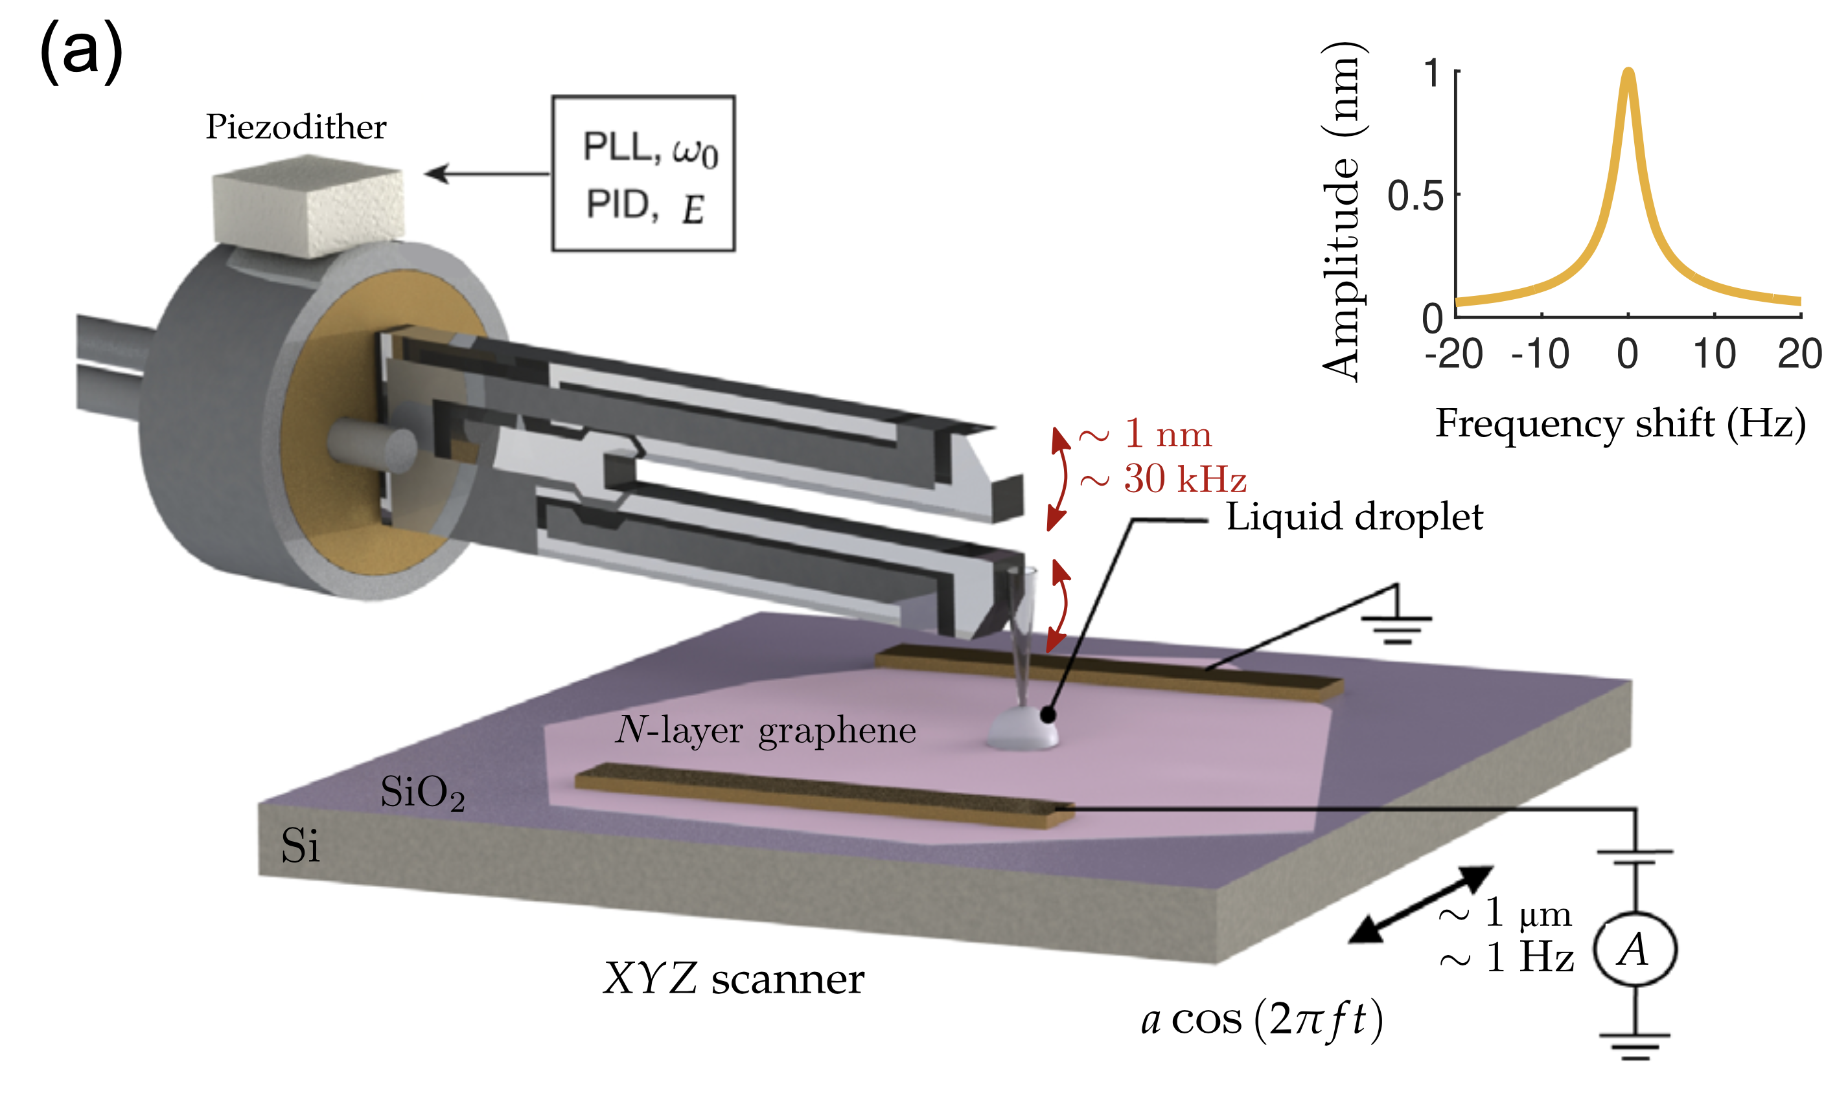
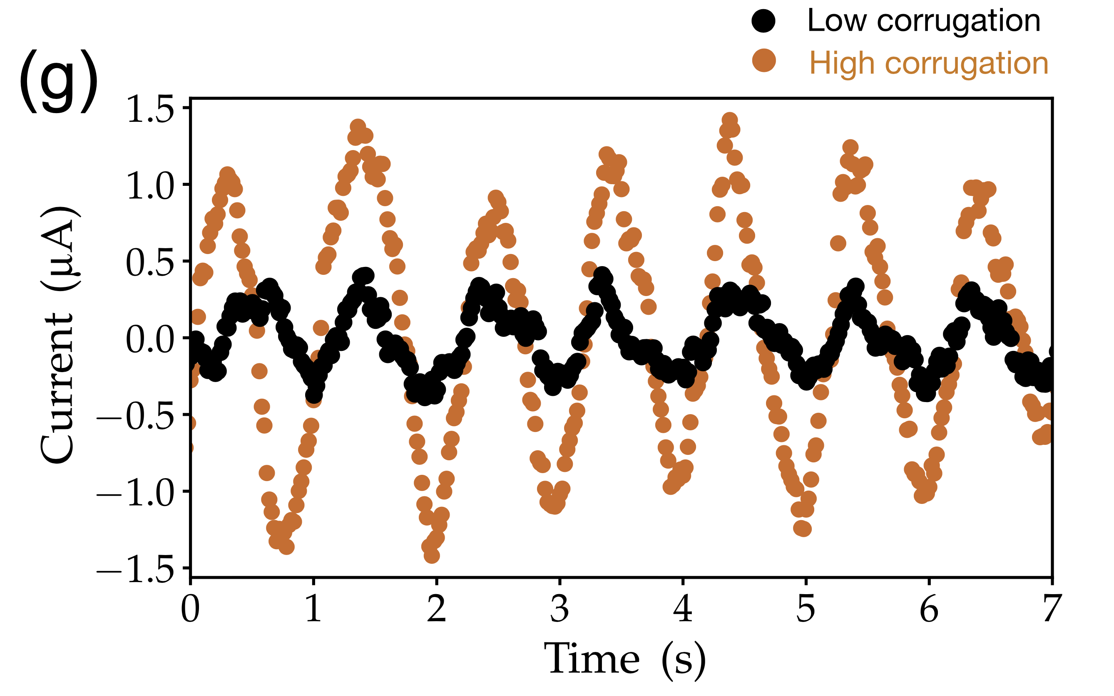
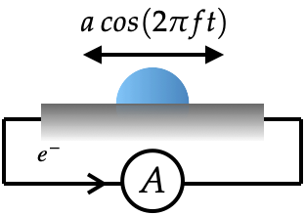
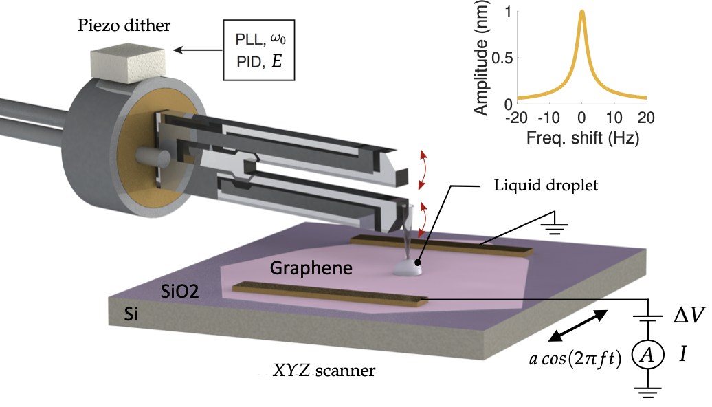

Let us move the droplet
$$e^{−}$$
A
Droplet motion induces current in the flake

Slide 8
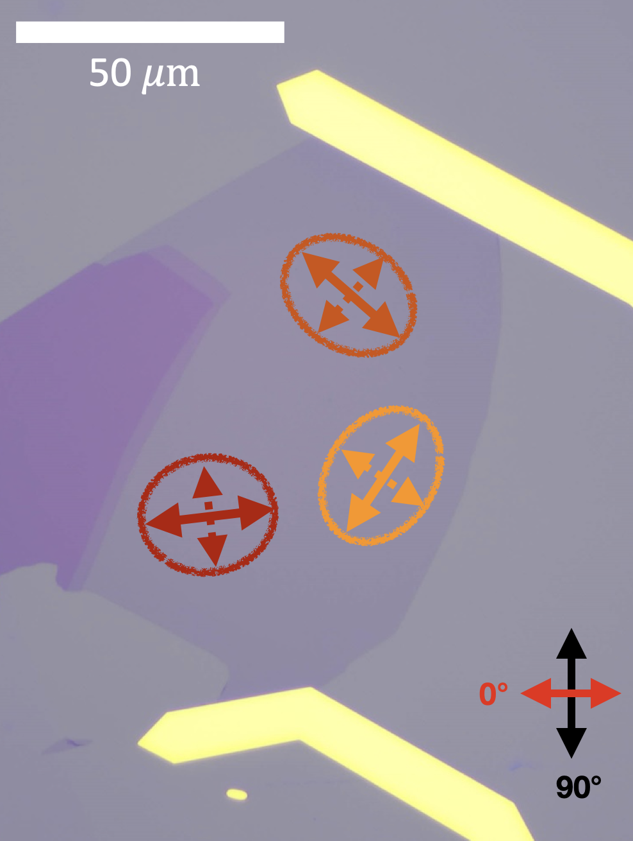
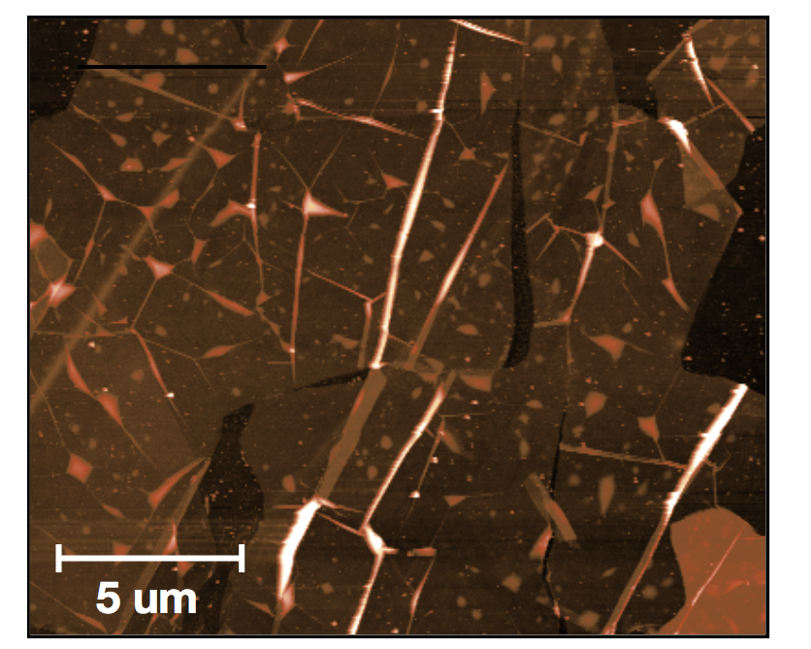
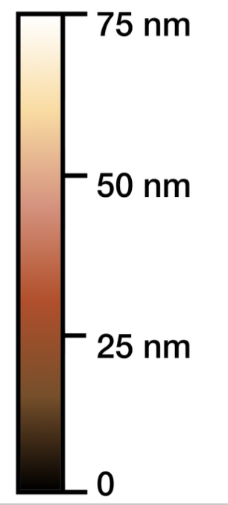
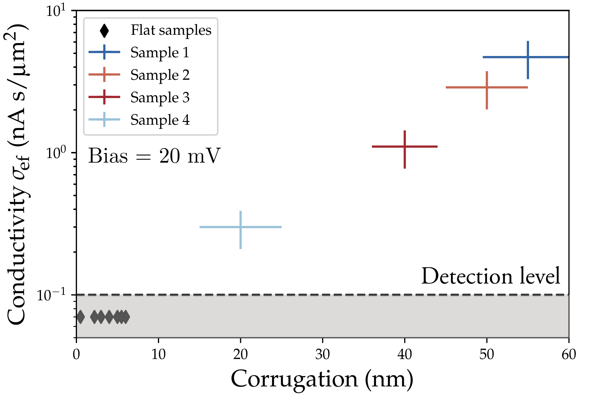
Roughness controls the generated current
Generated current depends on position and direction…
3 liquids : apolar, polar, ionic
Glycerol, Ionic liquid and silicon oil
All yield similar current
…because of the random orientation of wrinkles.
(Cartoon)
- Instrumental role of corrugations
- Nature of liquid is not relevant
Driving mechanism is viscous friction and not a moving potential or charge adsorption-desorption

Slide 9
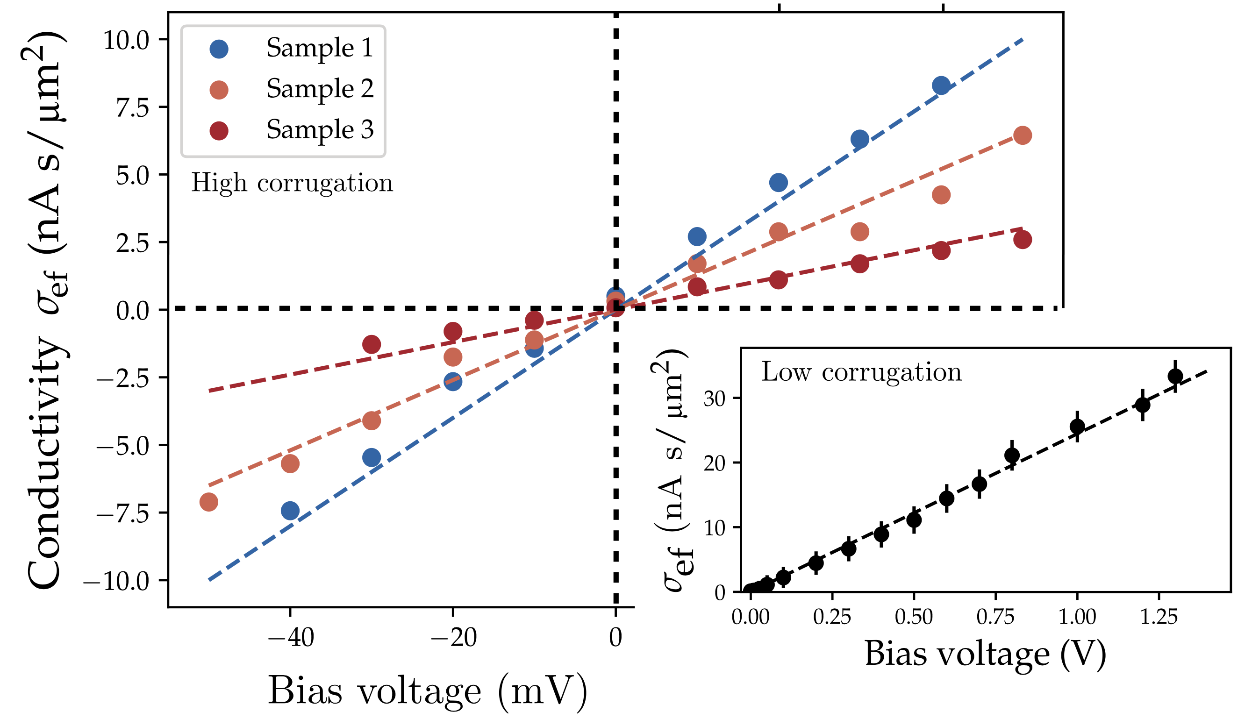



Tuning electronic properties ?
Graphene is one of the rare materials where charge carrier density is easily tunable
$$E(k)$$
$$E_{F}$$
$$|k|$$
Generated current is proportional to bias but also measured at zero bias

Slide 10
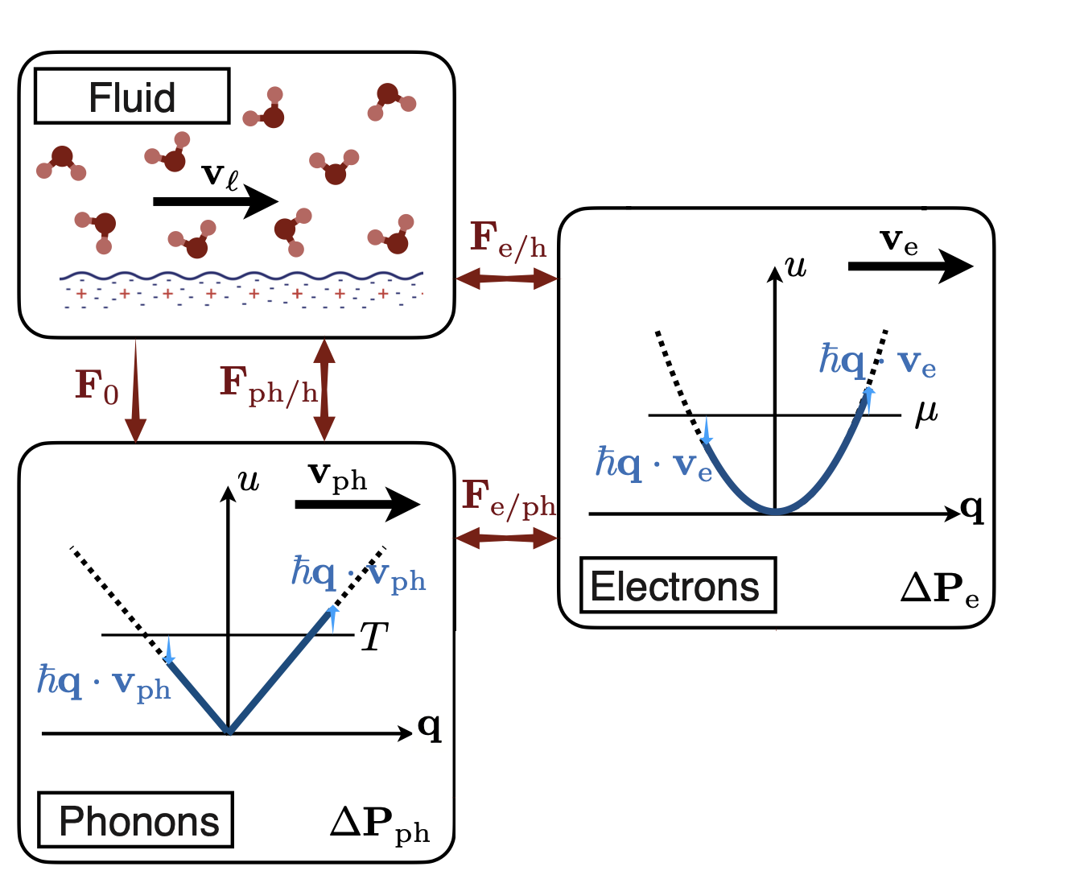
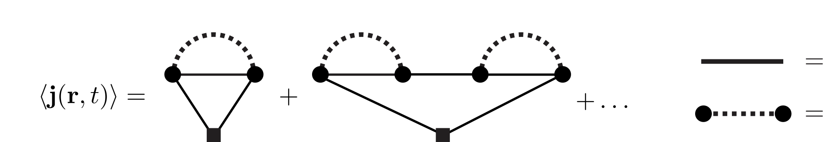



A unified picture of liquid-solid interface dynamics
Out of equilibrium perturbation theory in the Keldysh formalism
$$+$$
$+$ …
Electronic propagator
Bosonic propagator
Coquinot et al, PRX 2023
This formalism allows to write on the fame footing phonon and electron transfer
Fully unified picture of dynamics at liquid-solid interfaces
Heat Transfer, Friction, Current generation…
Baptiste Coquinot

Slide 11


Phonon wind blows on Fermi sea
Bosonic wind
Electrode probes current
Fermi Sea
- Instrumental role of corrugations
- Nature of liquid is not relevant
Phonon wind
dominates

Slide 12
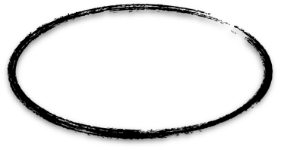
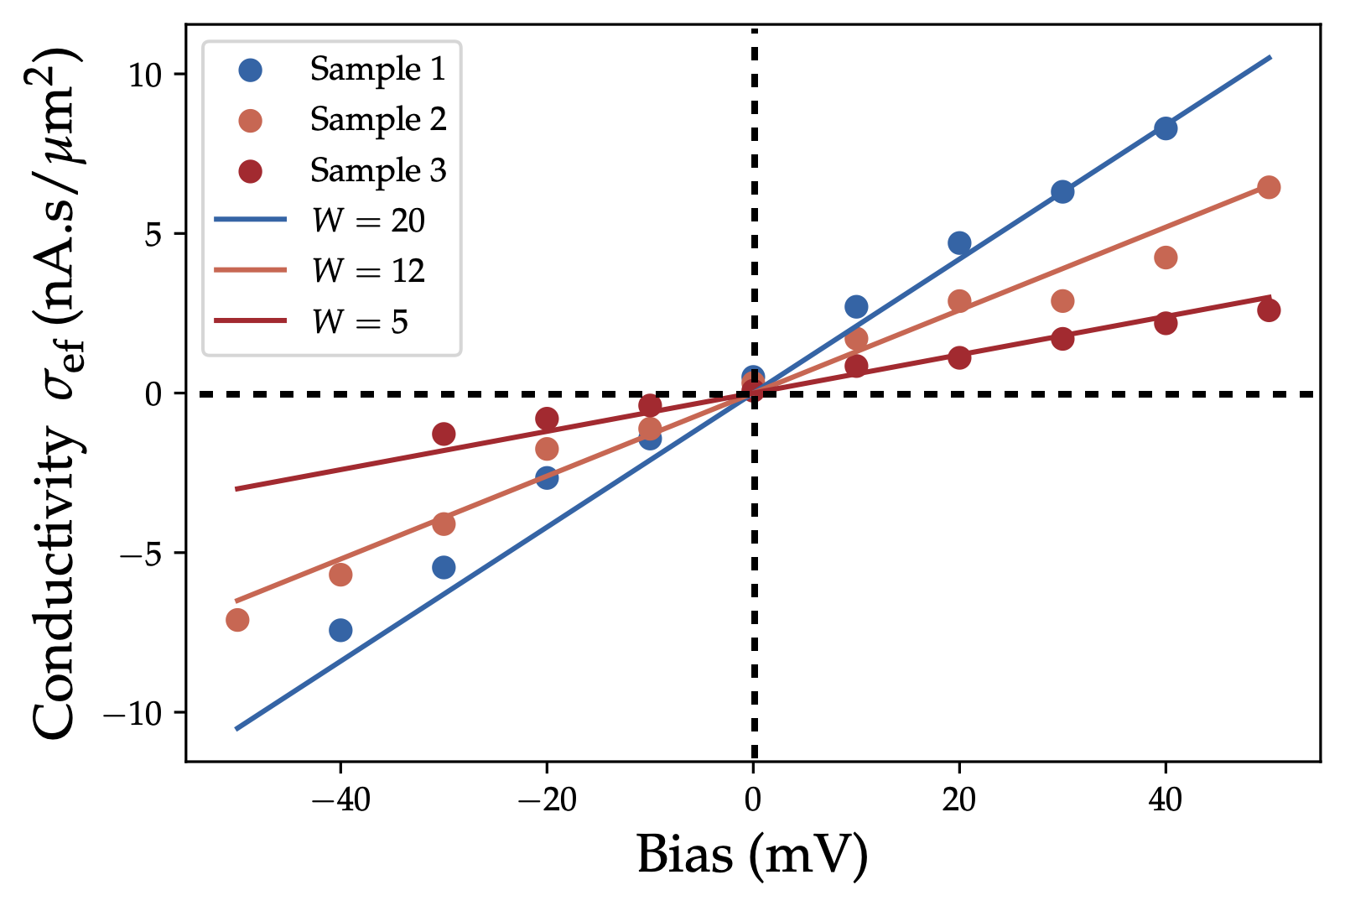
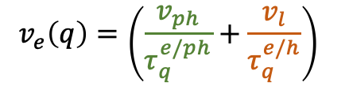
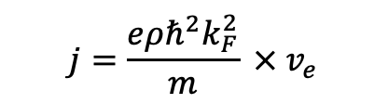
Quantitative agreement !
Phonon wind velocity computed using momentum balance
Electronic distribution :
$$v_{e}\left(q\right)=\left(\frac{v_{ph}}{τ_{q}^{e/ph}}+\frac{v_{l}}{τ_{q}^{e/h}}\right)$$
Electronic current :
$$j=\frac{eρℏ^{2}k_{F}^{2}}{m} ×{ v}_{e}$$
We model graphite as a 2DEG
Band structure
Comparison with experiment : $W$ is the non-dimensional corrugation
Friction induced current mediated by phonon wind

Slide 13

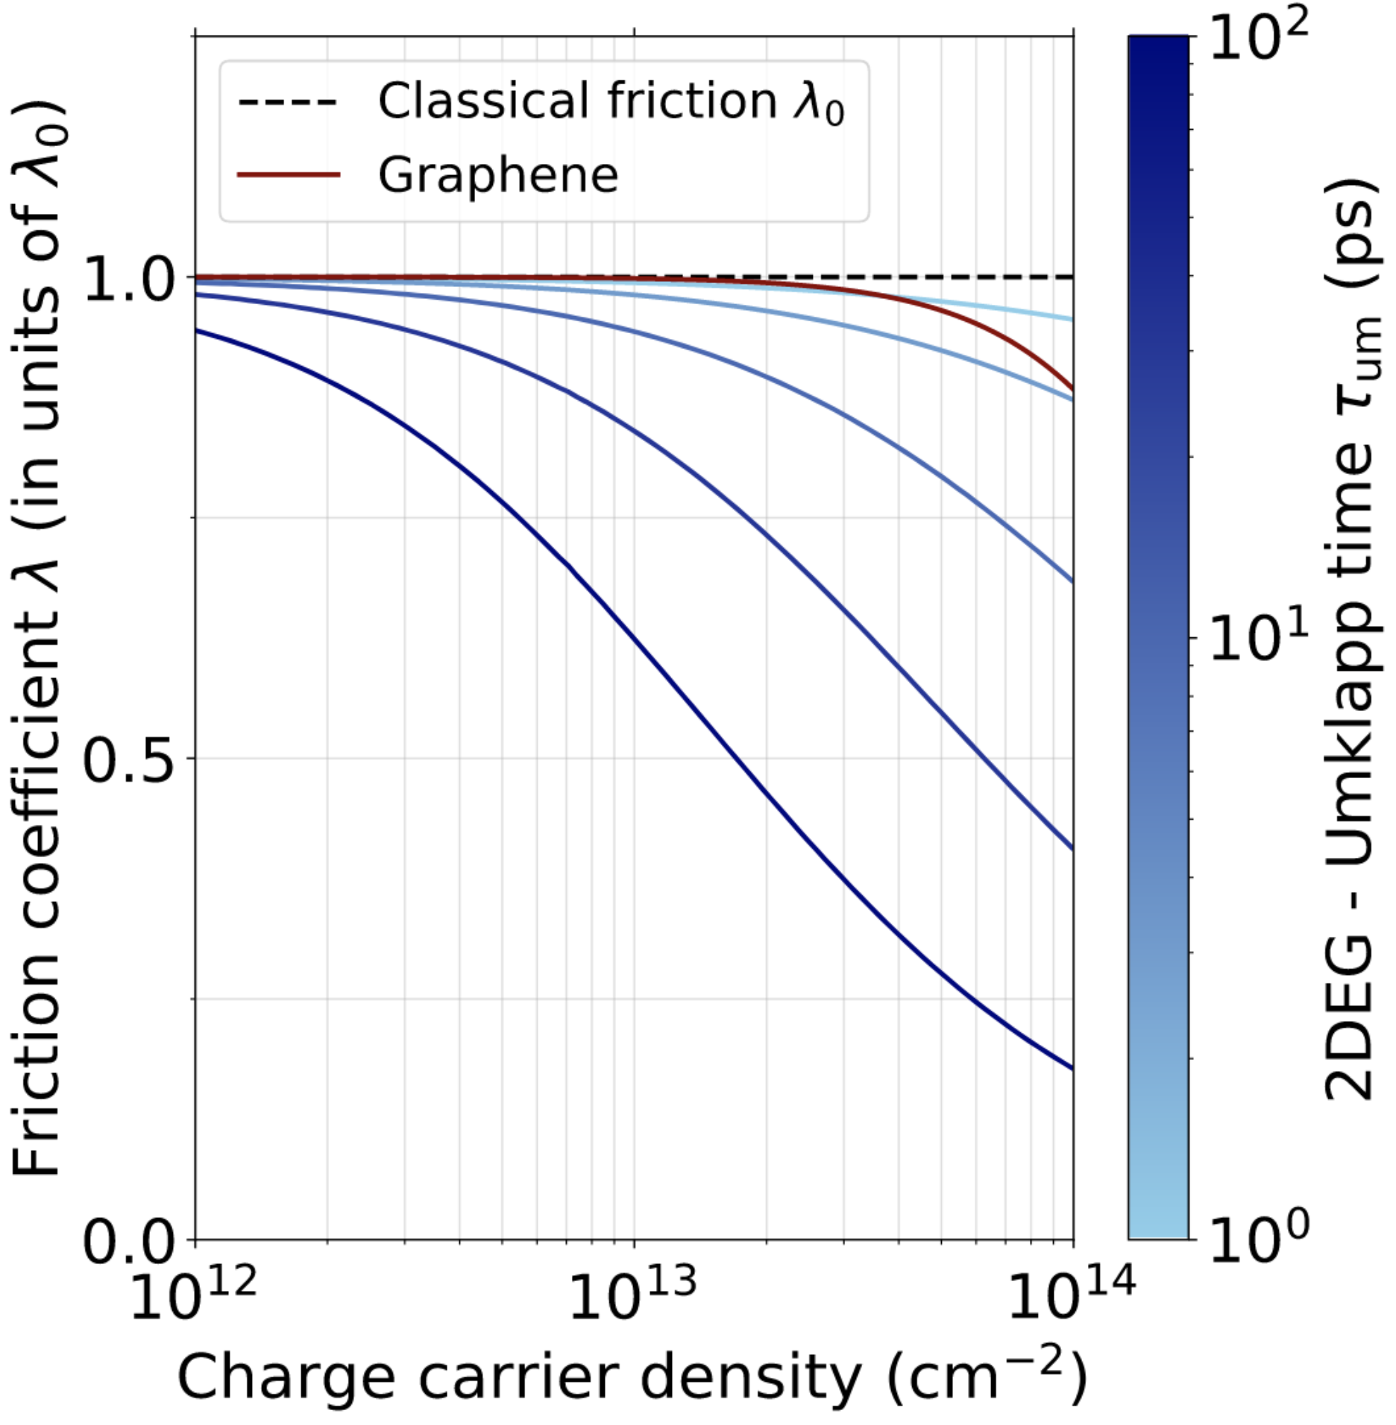


Negative quantum friction
When phonon drag dominates, $v_{e}$ can overtake $v_{l}$
$→$ electrons will give back momentum to the liquid
Quantum feedback
$→$ if the solid is unable to relax momentum,
then all momentum is given back to liquid
Huge reduction of friction
Coquinot et al, PRX 2023

Slide 14
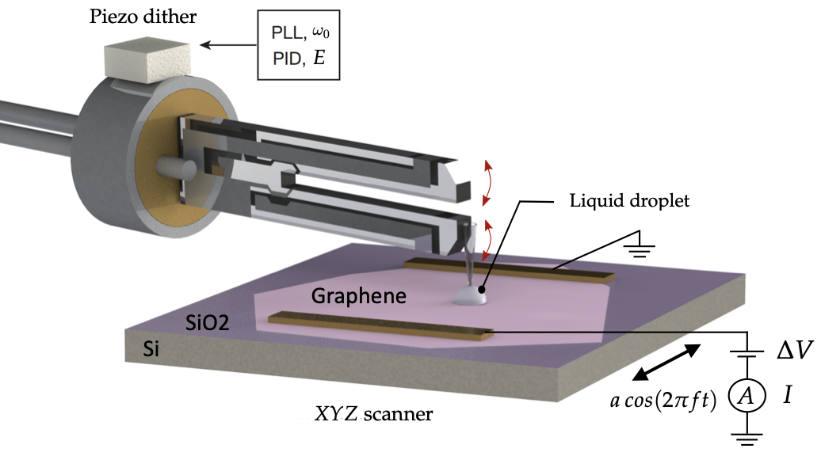
New paradigm : liquid-solid coupling
We probe a phonon wind mediated electric current
Very peculiar setup :
High viscosity, small droplet, 2d material, wrinkles
We predict a reduction of friction by metallic electrons

Slide 15

Follow-up here :
Phonon drag current (experiment)
Lizée & Marcotte et al, PRX 2023
Quantum feedbacks (theory)
Coquinot et al, PRX 2023

Slide 16
Solid-liquid friction
No slip
Partial slip
Slip length
Slippage is very important in nanoscale channels!

Slide 17
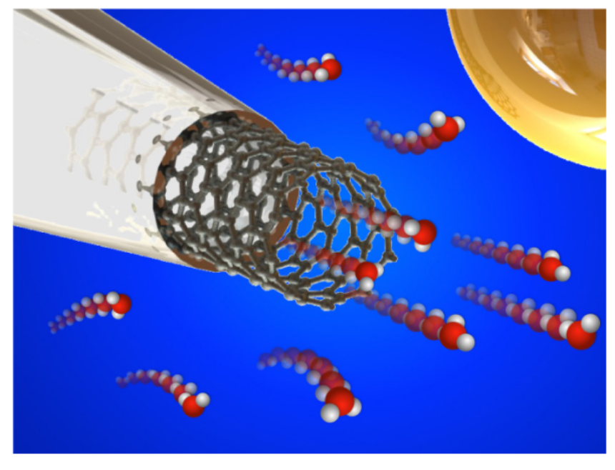
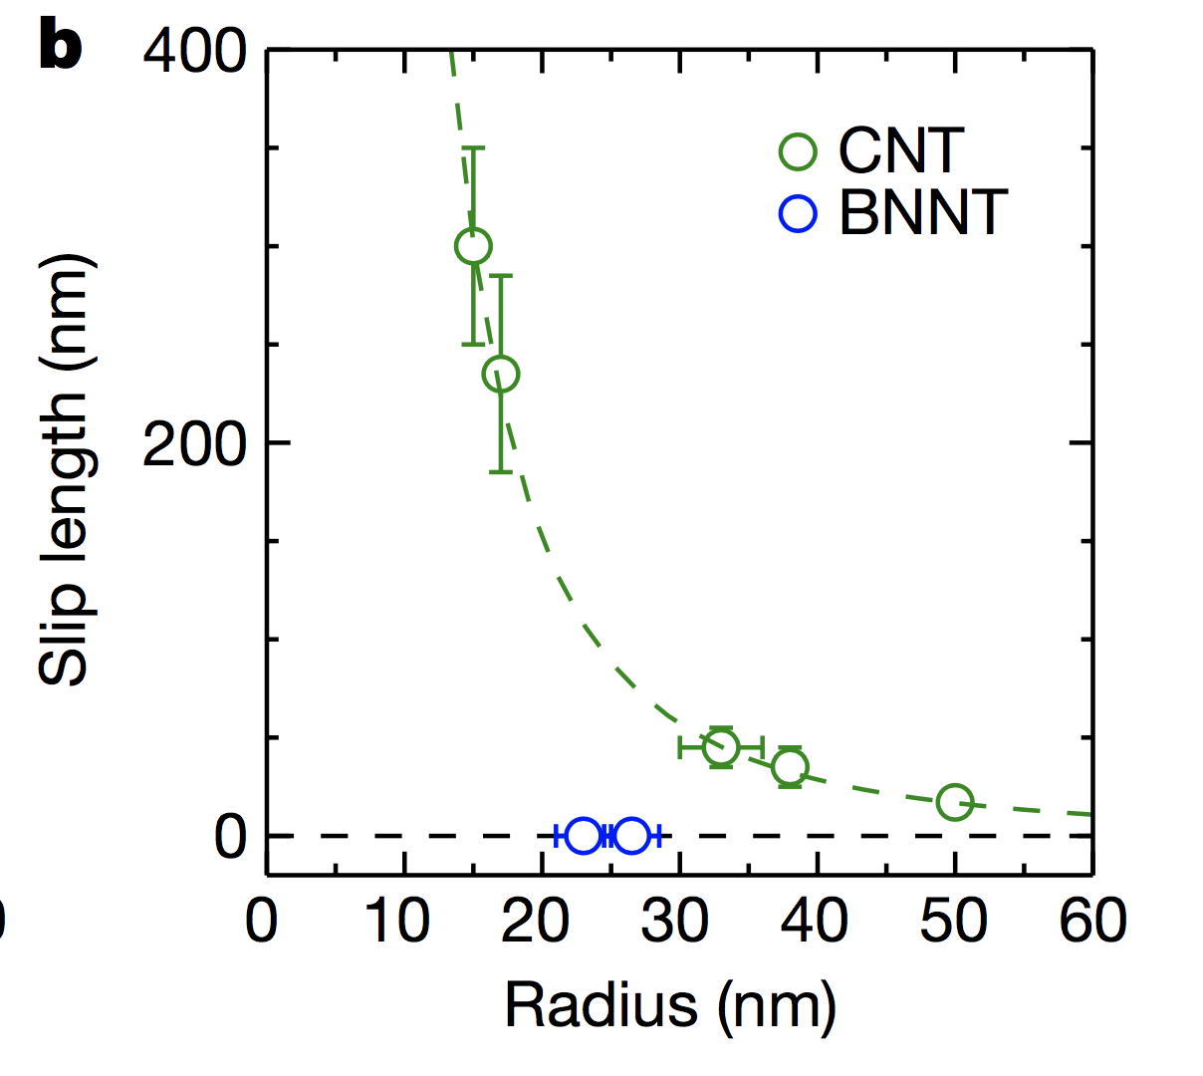
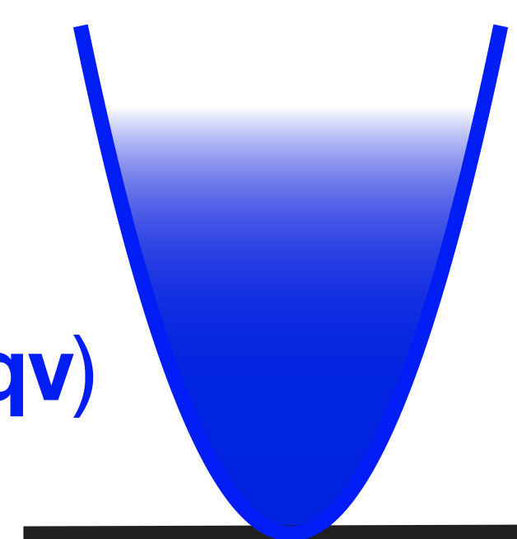
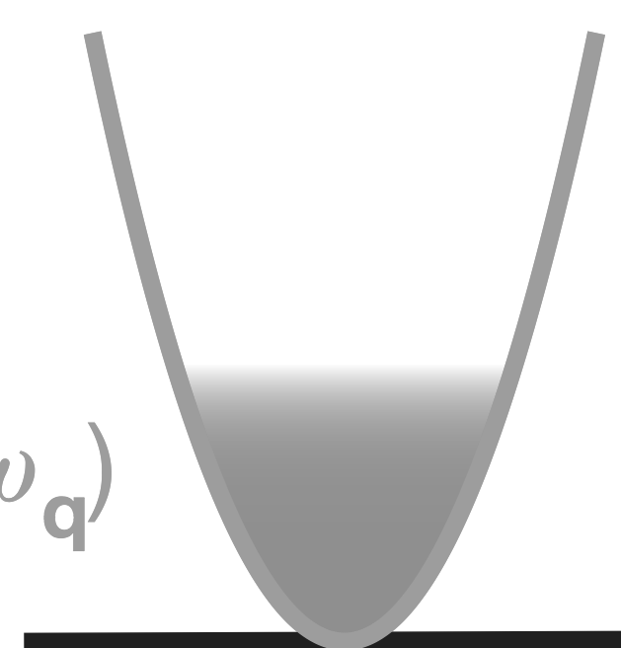
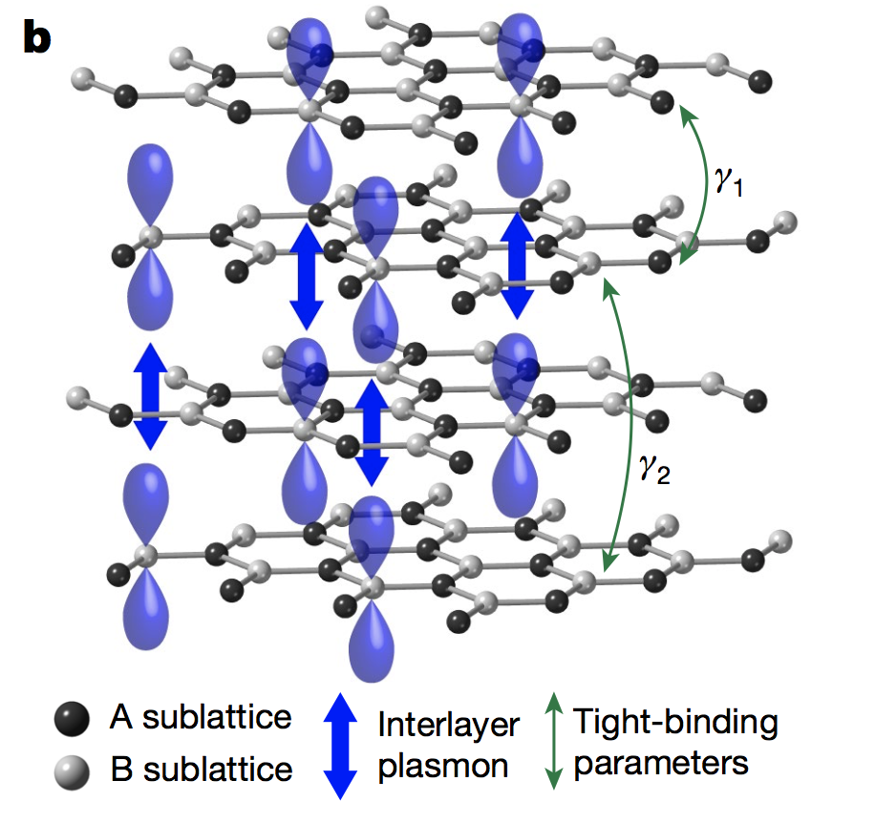
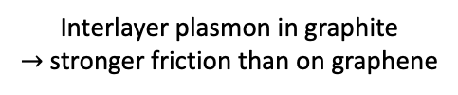



Quantum friction
« Quantum friction » due to electronic fluctuations coupled to water
Liquid
Solid
Coulomb interaction
Hydron $q$
Surface plasmons, Phonons
The stronger the quasiparticle overlap, the stronger the friction
Small radius
Large radius
Interlayer plasmon in graphite
$→$ stronger friction than on graphene
Misaligned layers $→$ Graphene like
Aligned layers $→$Graphite like wall
Electronic properties of the solid walls influence friction
Kavokine et al, Nature 2022
Secchi et al, Nature 2016

