Slide 1
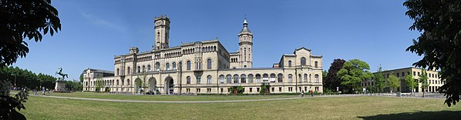
Quantum gases of polar molecules
Mara Meyer zum Alten Borgloh
Leibniz Universität Hannover,
Germany
Notes:
Thank you very much for the introduction. I am giving this talk on behalf of Silke Ospelkaus, because she is unfortunately sick and I had to fill in on very short notice. The title of this talk is quantum gases of polar molecules and during the talk I would like to take you on a tour through the field which started roughly 10 years ago with the first preparation of a near-quantum degenerate gas of polar molecules.

Slide 2
Outline
Why quantum gases of molecules?
How to prepare?
Collisions and collisional control
Outlook
Notes:
Here is the outline of my talk, …
I will motivate why we should produce quantum gases of molecules and how we prepare them, later on it is crucial to understand and control collisions in such a gas

Slide 3
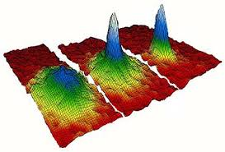
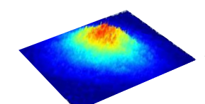
Our research
Quantum degenerate gases
T<1 μΚ
Notes:
general goal of our work: extend the world of ultracold quantum gases that means xxxx
from simpler atomic to more complex molecular systems, in particular to the simplest conceivable molecules namely diatomic molecules. But why? Well, the motivation is twofold.

Slide 4
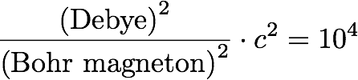
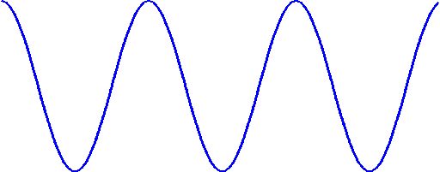
Perspectives: Quantum physics
Polar molecules: Electric dipoles
+
Quantum phases and dynamics of many-body systems
with finite range interactions
+
_
R
_
d ~ Debye
Contact interactions
E_{I}
Atoms: Magnetic dipoles
Dipole-dipole interactions
R
+
d ~ Bohr magneton
Notes:
intriguing interactions (heteronuclear molecules)
electric dipole moment (asymmetry in el. charge distr.)
Resulting interactions: anisotropic, long-range, strong in character
Degenerate molecular gases, strong electric DDI, become dominant energy
->enter regime of strong correlations
particularly interesting with polar molecules (LR)
Example: lattices, contact interactions+ finite range interactions (adjacent lattice sites)
->intriguing phenomena concerning quantum phases and dynamics of these systems.
Question: why moleculess, atoms dipole moment (though it is magnetic)
~el.DM 1 Debye, magDM atom ~DM of e- (1Bohr magneton)
Comparing dip. IE->10^4 -> polar mol. -> enter completely different regime of interactions.

Slide 5
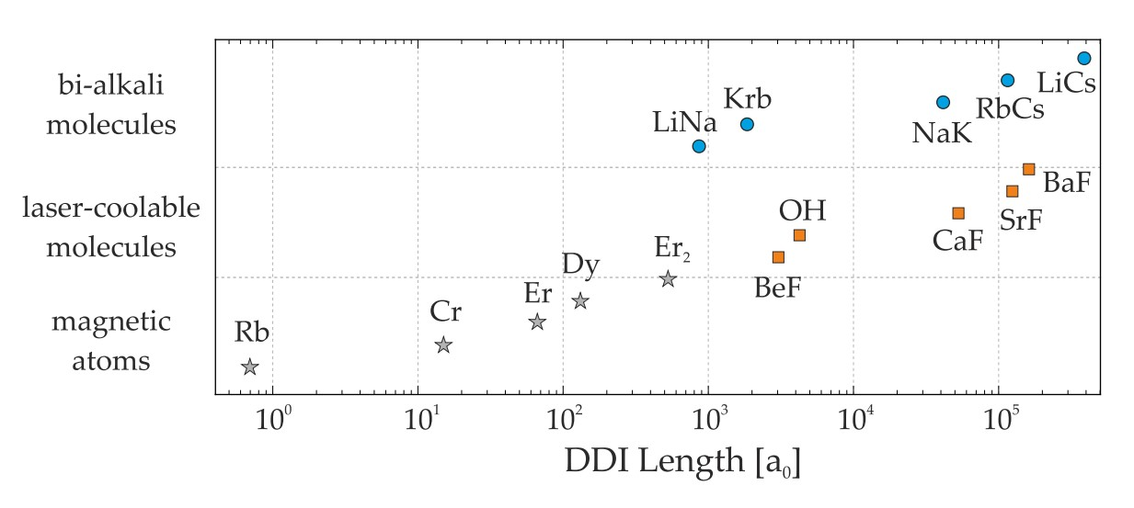
Why ultracold molecules?
Dipole dipole interactions length selected atoms/molecules
Notes:
Reality: depends on the exact choice of the atomic and molecular species:

Slide 6
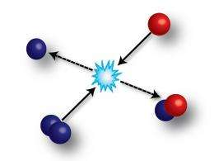
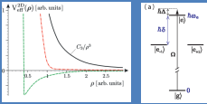
Perspectives: Collisions
Collisions and collisional control
Collisions and collisional control
Quantum chemistry
Complex formation and
sticky collisions
Notes:
On the way: study collisions /collisional control -> long-lived molecular quantum systems.
Furthermore, -> study true quantum chemistry accessible with ultracold molecules (never achieved before)
Dealing with high quantum state density system -> ultracold collisions never investigated
Turns out :even the simplest molecules -> completely unexpected behaviour, hides a couple of secrets.

Slide 7
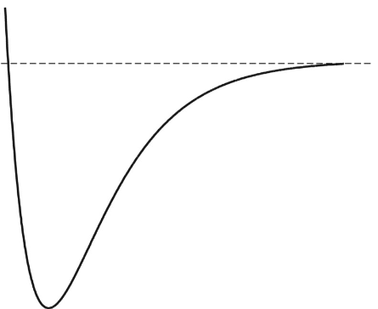
Preparing ultracold molecules
E
Quantum degrees of freedom
Complicates
Interaction with light
Collisional processes
Rotation
Hyperfine
R
Notes:
To get there: prepare dense clouds of molecules
Not simple!
Many degrees of freedom electronic, fine and hyperfine + rotational, vibrational
-> complicates both essential elements for the preparation of ultracold gases: interaction with light, collisional processes
-> not possible to simply copy atomic cooling methods and transfer them to molecular systems
-> completely new cooling methods need to be invented
successful during the last few years.

Slide 8
Two approaches to ultracold molecules
Direct laser cooling of molecules
Association of ultracold atoms
to bialkali molecules
Notes:
direct laser cooling, carefully selected molecules. -> recently preparation of ultracold clouds of molecules
association of ultracold atoms into bialkali molecules , most advanced technique, even resulted in preparation of a quantum degenerate Fermi gas.
In Silkes groups :both approaches, today only second,…. Currently most advanced, near quantum degenerate gas of molecules in our lab.

Slide 9


Association of atoms to molecules
Controlled chemistry at ultracold temperatures
Advantage: Start ultracold
Challenge: Staying ultracold
10 000 K
Notes:
What is the general idea of this approach, well the general idea is to prepare all ground state molecules through controlled chemistry starting from ultracold atomic ensembles. The approach starts by cooling atomic ensembles to quantum degeneracy – something that we know to do since about 25 years and then associate colliding atoms into ultracold molecules by means of a controlled chemical reaction at ultracold temperatures. The Advantage of this approach is obvious, you start from ultracold temperatures. The challenge is to stay ultracold……

Slide 10
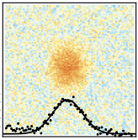
Ultracold dense gas of bosonic ²³Na³⁹K
Hannover
15 000 molecules in rovibrational ground state
300 nK in cODT at 1064 nm
ρ~0.6
Li
Na
Hannover
bosonic NaK
Quantum gas of bosonic
polar ²³Na³⁹K molecules
Cs
K
JILA
Fermionic KRb
Phys. Rev. Lett. 125, 083401 (2020)
New J. Phys. 21, 123034 (2019)
Rb
Notes:
Following this idea, in Hannover,
experimental signal that confirms molecule creation.

Slide 11

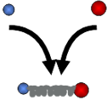
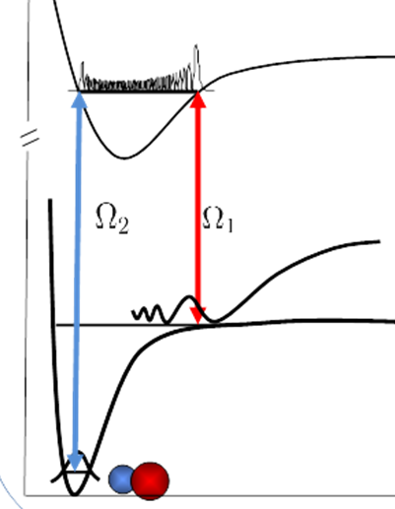
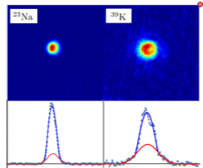
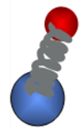

Preparation of ultracold bialkali molecules
Preparation follows the three-step process from the pioneering ⁴⁰K⁸⁷Rb JILA experiment.
Ni, Ospelkaus et al. Science 322, 231 (2008), Ospelkaus, Ni et al. Faraday Discussions 142, 351 (2009).
Dual species quantum gas mixture
Feshbach molecule creation
Two-photon transfer (STIRAP) to rovibrational ground state (v=0, N=0)
Notes:
creation in all these experiments same way..
Three-step method introduced in 2008 at JILA (Silke postdoc)…..
specific hyperfine state within the rovibrational ground state

Slide 12
Energy scale
hyperfine(Zeeman)
binding energy
rotational
translational
vibrational
150 THz
(10 000K)
7 kHz (350nK)
2 THz (100K)
6 GHz
(~ 1 K)
800 kHz
(38μK)
Notes:
Can control all quantum degrees of freedom

Slide 13
Molecule-molecule collisions
Notes:
molecules prepared. ready to study collisions.
Understanding of ultracold collisions (both…) interesting in itself (regime never accessed before)
-> evaporative/sympathetic cooling + realization of strongly correlated dipolar quantum many-body systems (molecules large DDI)
Literally nothing was known about collisional processes of molecules in this ultracold regime of almost vanishing collisional energy and single partial wave scattering
As you will see, there have been a couple of surprises during the investigations which have taken place during the past 10 years.
Start really simple: collisional processes expected to happen in molecular gases? Loss processes are expected to occur?

Slide 14

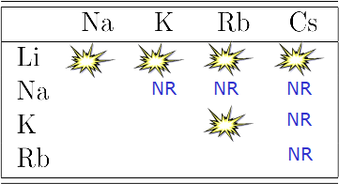
Collisions of ultracold molecules?
Chemically reactive molecules:
Exoergic chemical reaction
XY+ XY → X2+Y₂ +
Non-chemically reactive molecules:
Endoergic exchange reaction
Forbidden at ultracold temperature
Notes:
Well, it depends.
bi-alkali polar molecules divides into two groups. explain….

Slide 15
Collisions of ultracold molecules?
74,3 cm⁻¹
Na₂+K₂
Phys. Rev. A 81, 060703 (2010)
0 cm⁻¹
NaK+NaK
Chemically reactive molecules:
Exoergic chemical reaction
XY+ XY → X2+Y₂ +
0 cm⁻¹
KRb+KRb
Non-chemically reactive molecules:
Endoergic exchange reaction
Forbidden at ultracold temperature
-10,4 cm⁻¹
Rb₂+K₂
Phys. Rev. A 81, 060703 (2010)
Notes:
Pick two examples to illustrate this.
NaK
This is different for the KRb molecule, …

Slide 16
Collisions of ultracold molecules?
0 cm⁻¹
KRb+KRb
-10,4 cm⁻¹
Rb₂+K₂
Phys. Rev. A 81, 060703 (2010)
Chemically reactive molecules:
Exoergic chemical reaction
2010: Fast two-body loss at universal limit due to exoergic exchange
reaction in KRb
2019: Direct observation using VMI
XY+ XY → X2+Y₂ +
Two-body loss
S.Ospelkaus et al., Science 327, 853 (2010)
Notes:
chemically reactive: already in 2010 fast two body loss at the universal limit observed->attributed to exoergic exchange reactions.
reaction products directly detected in 2019.

Slide 17
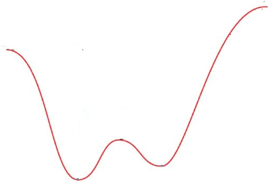
Chemical reactions rate – simple model
Long-range: e.g.
van der Waals interaction
Dipole-dipole interactions
Centrifugal energy barriers
0 cm⁻¹
KRb+KRb
Reaction coordinate
Notes:
How can the loss be explained? Two molecules approach…
within a certain distance, within short range, the chemical reaction happens with almost unity probability.
But what then sets the rate for the loss.?

Slide 18
Chemical reactions rate – simple model
Short-range
→ Unity probability for loss
Long-range: e.g.
van der Waals interaction
Dipole-dipole interactions
Centrifugal energy barriers
Long-range for ⁴⁰K⁸⁷Rb molecules?
Single quantum state fermionic
molecules
Ultracold
→ p-wave scattering
→ centrifugal energy barrier ~16µK
0 cm⁻¹
KRb+KRb
Reaction coordinate
S. Ospelkaus et al., Science 327, 853 (2010)
Notes:
Rate for loss set by LR potential
Ultracold ->almost no kinetic energy -> any small LR potential barrier prevents (classically) reaching SR-> chemical reaction
Tunneling through the LR potential barrier ->rate, chemical reaction happens.
What is now this LR potential barrier for two KRb molecules? Well, Silkes group: single quantum state fermionic, ultracold molecules.
Ultracold: scattering restricted to lowest l
Fermions: p-wave (1 ang. Mom. quant) centrifugal energy barrier of 16µK
chemical reaction rate= tunnel rate

Slide 19
Collisions of ultracold molecules?
74,3 cm⁻¹
Na₂+K₂
Phys. Rev. A 81, 060703 (2010)
0 cm⁻¹
NaK+NaK
Non-chemically reactive molecules:
Endoergic exchange reaction
Forbidden at ultracold temperature
Notes:
our case in Hannover: ultracold bosonic NaK molecules -> exchange reaction is endoergic -> forbidden at ultracold temperatures

Slide 20
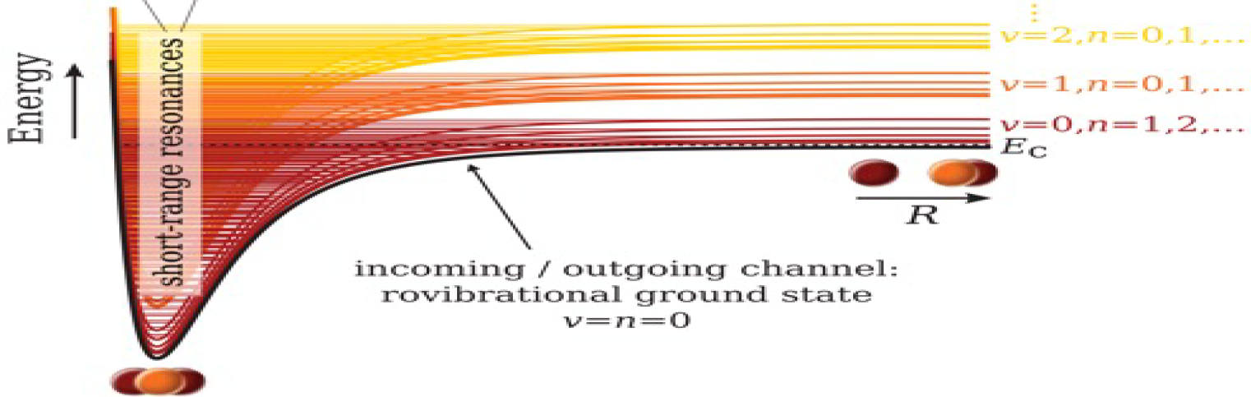
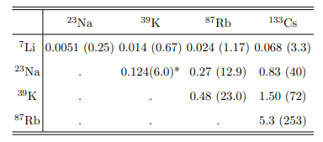
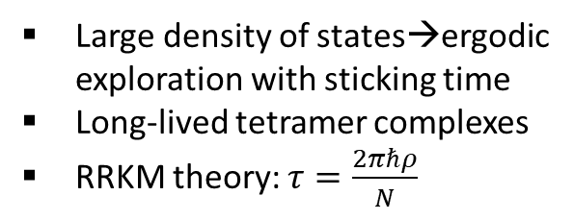
Non-chemically reactive molecules - simplified
Mayle et al., Phys. Rev. A 87, 012709
Long-range
Short-range
74,3 cm-1
Na₂+K₂
Phys. Rev. A 81, 060703 (2010)
Na₂K₂
0 cm-1
NaK+NaK
Large density of states→ergodic exploration with sticking time
Long-lived tetramer complexes
RRKM theory: $τ=\frac{2πℏρ}{N}$
0,25µs
0,67µs
1,17µs
3,3µs
Reaction coordinate
6µs
12,9µs
40µs
23µs
72µs
253µs
Adapted from Phys. Rev. A 100, 032708 (2019)
Notes:
How does a typical picture for the processes that can happen upon a collision look like for non-chemically reactive molecules?
overall picture: not so different from …
Approach… However, no chemical reaction pathway!
Nevertheless, it turns out -> two-body loss. What happens?
For this class of molecules, J. Bohn and coworkers pointed out a different loss mechanism: loss through so-called sticky collisions. What is this?
Deep tetramer potential of Na2K2 tetramers, enormous DOS -> dense manifold of Feshbach resonances -> so dense, that together with possible broadening at short range in most of the cases not resolvable
Ergodic exploration with sticking time RRKM
Removed by additional mechanisms: collisions/photoinduced processes -> Loss

Slide 21
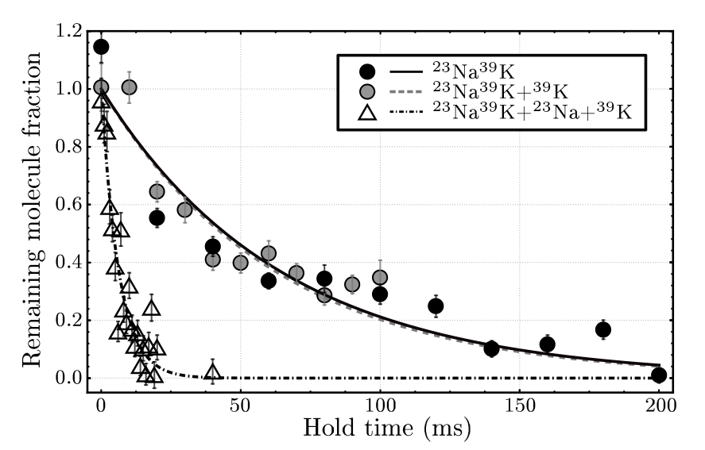
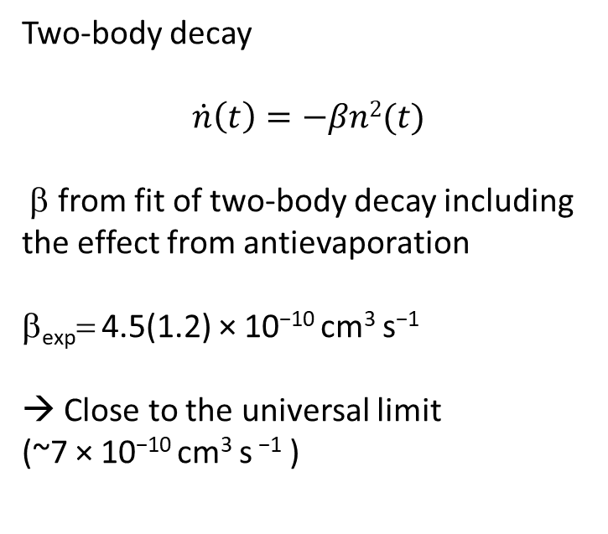
Molecule-molecule collisions of NaK molecules
Two-body decay
$$\dot{n}\left(t\right)=−βn2(t)$$
β from fit of two-body decay including the effect from antievaporation
β_{exp}= 4.5(1.2) × 10⁻¹⁰ cm³ s⁻¹
→ Close to the universal limit
(~7 × 10⁻¹⁰ cm³ s ⁻¹ )
Similar observations
Takekoshi et al., Phys. Rev. Lett., 113, 205301 (2014);
Park et al., Phys. Rev. Lett., 114, 205302 (2015);
Guo et al., Phys. Rev. Lett., 116, 205303 (2016);
Gregory et al., Nat Commun, 10, 3104 (2019);
Notes:
NaK: strong two-body decay on a time scale of a couple of hunded ms.
Analysing the data (2body+antievap) -> we extract a two body decay coefficient close to the universal limit
More or less every collision reaching SR leads to loss!

Slide 22
Measure complex lifetime
τ
Excited tetramer states
Trap light
0,25µs
0,67µs
1,17µs
3,3µs
6µs
12,9µs
40µs
23µs
72µs
253µs
A. Christianen et al.
Phys. Rev. Lett. 123, 123402 (2019)
Adapted from Phys. Rev. A 100, 032708 (2019)
Notes:
Well, the loss process itself, complex formation followed by photoinduced loss is by now well accepted in the community, however, what is still a mystery is actually the complex lifetimes. Simple RRKM theory predicts the lifetime to be…..

Slide 23
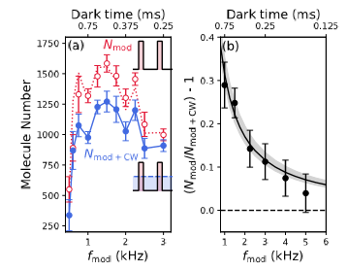
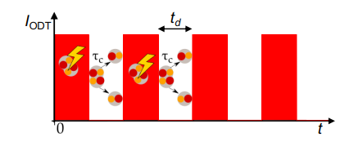
Collisions of nonreactive molecules -RbCs
First evidence for photoinduced loss
by Durham group with RbCs
Chopped trap
(N_{mod}-N_{mod+cw}) / N_{mod+cw}
Gregory et al., Phys. Rev. Lett. 124, 163402 (2020)
Measured complex lifetime ~500µs
within a factor of two of predicted lifetime!
Notes:
The Durham group measured the lifetime for the RbCs molecules
…..and found them to be within a factor of 2 of the predicted lifetime.

Slide 24
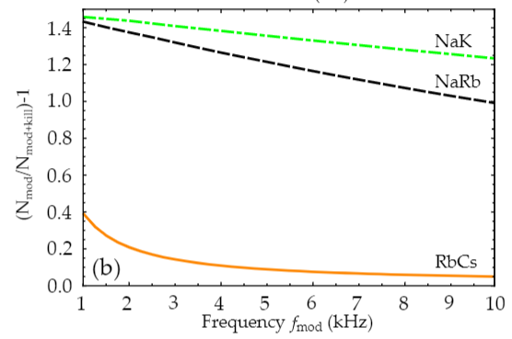
Collisions of nonreactive molecules - NaK
Short expected complex lifetime of ~6µs; t_{d}>>τ
Molecule number should double in chopped trap!
Chopped trap
Notes:
For us, this turned out to be really different
Predicted to be just 6µs –(2 orders of manitude smaller than RbCs)
-> dark time in the chopped trap typically 2 orders of magnitude larger than the complex lifetime
-> suppression of loss expected much more pronounced
Plot assuming the predicted lifetime of the complexes of 6µs, the number of molecules for the NaK case should more than double for typical experimentally accessible chopping frequencies.

Slide 25
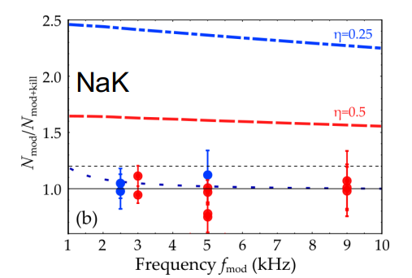
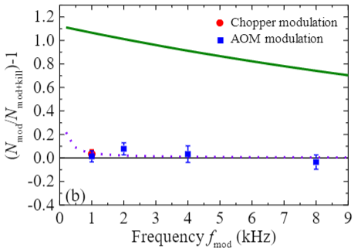
Collisions of ultracold NaK molecules
NaK
NaRb
τ>1 ms
τ>4 ms
P. Gersema et al. , Phys. Rev. Lett. 127, 163401 (2021)

Slide 26
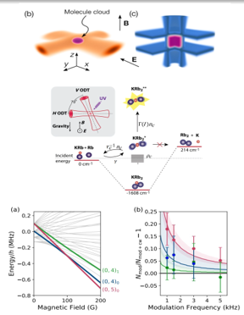
Related results
fermionic NaK (Munich): no enhancement at low trap intensities
Bause et al., Phys. Rev. Res., 3, 033013 (2021)
trimer complex lifetime of ⁴⁰K⁸⁷Rb^{2∗} much longer than expected
Nichols et al., Phys. Rev. X 12, 011049 (2022)
RbCs: τ^{c} ≈ 0.5 ms ≈ τ^{cth} for spin-stretched state but disagreement for other states
Gregory et al., Phys. Rev. Lett. 124, 163402 (2020)
Gregory et al., New J. Phys. 23, 125004 (2021)
Anomalous lifetimes of ultracold complexes
with few open channels
Croft et al., Phys. Rev. A 107, 023304 (2023)
Severely underestimated DOS? Nuclear spin changes?
Jachymski et al. Phys. Rev. A106, L041301 (2022)
Roaming pathways in real-time collisional simulations
Kłos et al., Sci Rep 11, 10598 (2021)

Slide 27
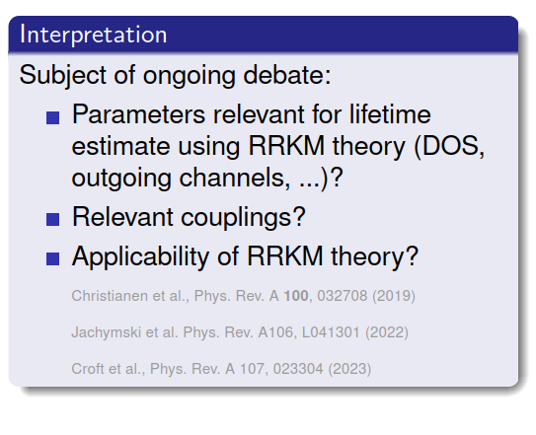
Related results
fermionic NaK (Munich): no enhancement at low trap intensities
Bause et al., Phys. Rev. Res., 3, 033013 (2021)
trimer complex lifetime of ⁴⁰K⁸⁷Rb^{2∗} much longer than expected
Nichols et al., Phys. Rev. X 12, 011049 (2022)
RbCs: τ^{c} ≈ 0.5 ms ≈ τ^{cth} for spin-stretched state but disagreement for other states
Gregory et al., Phys. Rev. Lett. 124, 163402 (2020)
Gregory et al., New J. Phys. 23, 125004 (2021)
Anomalous lifetimes of ultracold complexes
with few open channels
Croft et al., Phys. Rev. A 107, 023304 (2023)
Severely underestimated DOS? Nuclear spin changes?
Jachymski et al. Phys. Rev. A106, L041301 (2022)
Roaming pathways in real-time collisional simulations
Kłos et al., Sci Rep 11, 10598 (2021)

Slide 28
Controlling collisions
Notes:
Simle way: manipulating the long range….. And this is what Silkes group has done at JILA and what we are preparing right now as well..

Slide 29
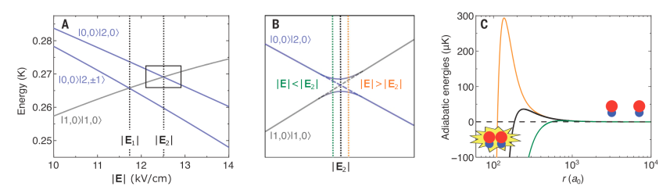
Manipulating the long-range
Quantum statistics
S.Ospelkaus et al.,
Science 327, 853 (2010)
0 cm⁻¹
KRb+KRb
Dipolar interactions +
confinement in restricted geometries
K. K. Ni, S. Ospelkaus et al.,
Nature 464(7293) (2010)
Nature Physics 7, 502 (2011)
Reaction coordinate
Avoided crossings in static electric fields
Science 370, 1324 (2020)
Notes:
Manipulating the long range
Designing potential energy barriers
Prevent the molecules from getting within SR

Slide 30
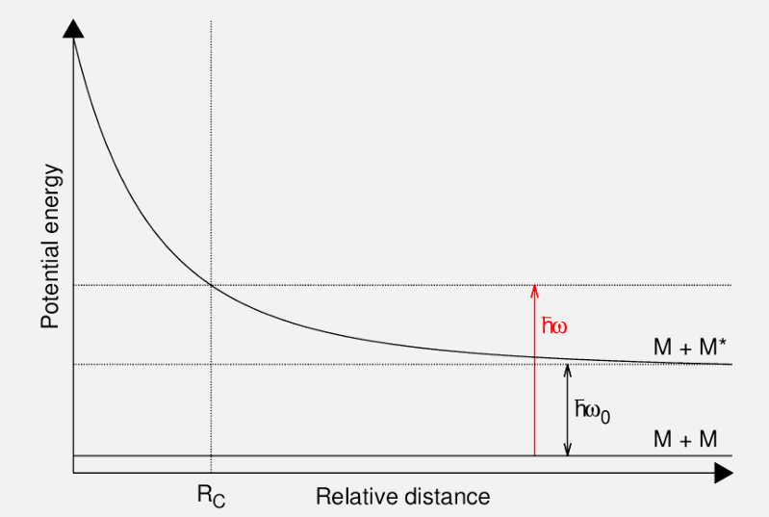
Controlling collisions – blue shielding
Figure courtesy:
Maxence Lepers
Notes:
And this is the so-called blue shieldding of collisions.

Slide 31
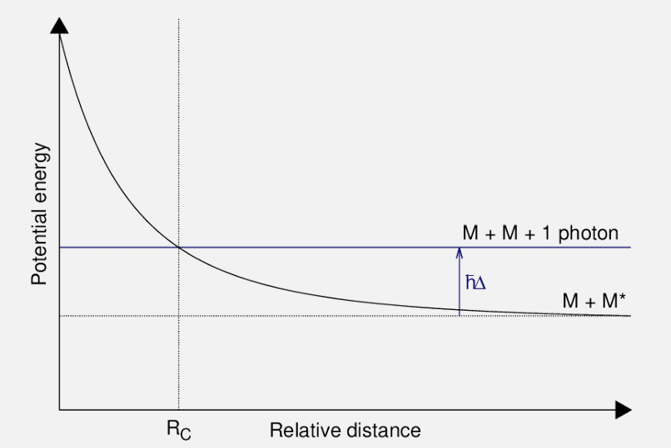
Controlling collisions – blue shielding
Figure courtesy:
Maxence Lepers

Slide 32
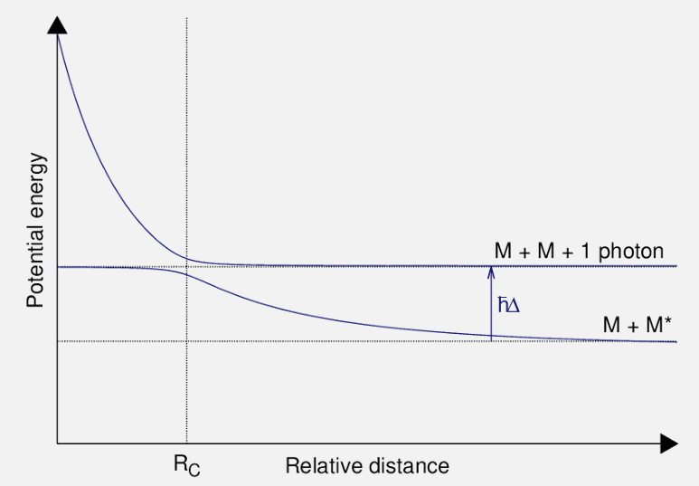
Controlling collisions – blue shielding
Figure courtesy:
Maxence Lepers

Slide 33
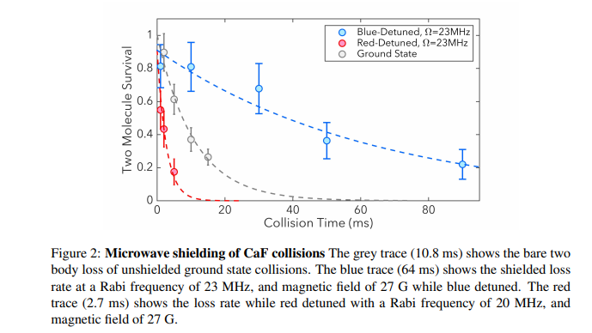
MW blue shielding of collisions
Molecules: Blue shielding of collisions using microwave coupling within the rotational structure
Experiment with CaF molecules
MPQ with fermionic NaK:
Schindewolf et al., Nature 607, 677 (2022)
HongKong with bosonic NaRb
Lin et al., arXiv:2304.08312
Cornell university with bosonic NaCs
Bigali et al., arxiv: 2303.16845
Anderegg et al. , Science 373, 779 (2022)
Notes:
And indeed it works

Slide 34
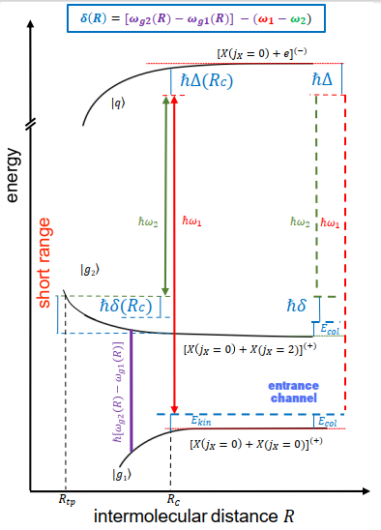
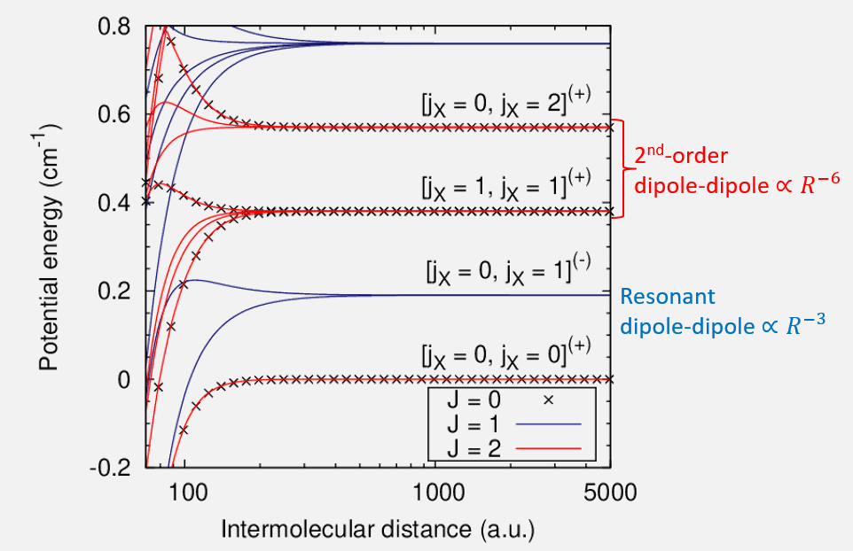
Optical shielding of collisions
Figure courtesy:
Maxence Lepers
Hannover + Orsay proposal:
arXiv:2211.08950, accepted in PRR
Notes:
Experimentally more flexible

Slide 35
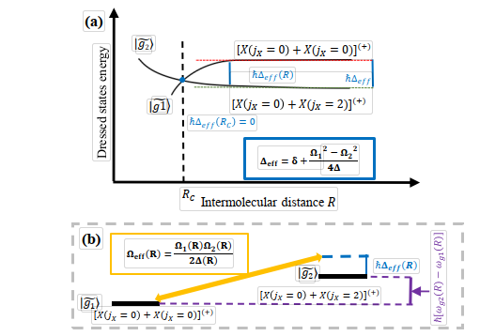
Optical shielding of collisions
Effective 2-level system
adiabatic elimination ⇒ effective 2-level coupling
difference: need to couple states with same parity
C. Karam et al. arXiv:2211.08950 (2022)
Notes:
Delta = 0

Slide 36
Atom-molecule collisions
Notes:
What we can also investigate in these kinds of systems is ultracold collisions of molecules with atoms

Slide 37
Atom-molecule collisions for the NaK molecule
NaK+Na
NaK+K
Exoergic chemical reaction
NaK+Na→ Na₂+K+
0 cm⁻¹
NaK+Na
Reaction coordinate
Notes:
In our experiments, we can easily study NaK +Na and NaK + K
What do we now know about these two experimental systems?
NaK + Na might lead to chemical reactions since NaK+Na-→ Na_2+ K exoergic -> allowed at ultracold ttemperatures.
-> expect rapid loss to Na_2+K channel.
Indeed what we observed

Slide 38
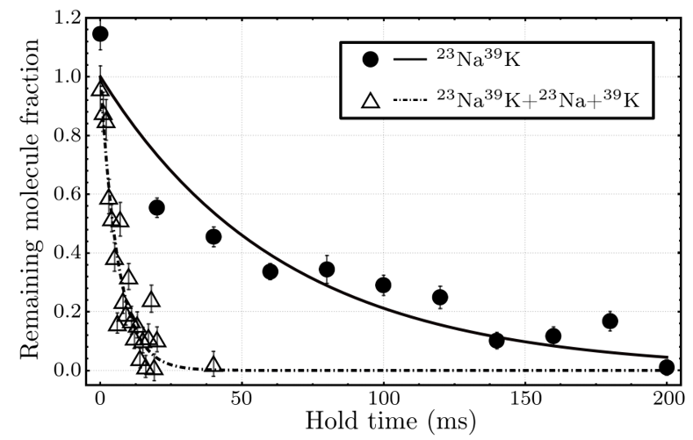
Atom-molecule collisions for the NaK molecule
NaK+Na
Exoergic chemical reaction
NaK+Na→ Na₂+K+
NaK+Na: β_{exp}= 1.25(14) × 10⁻¹⁰ cm³ s⁻¹
→ consistent the universal limit
(~1.3 × 10⁻¹⁰ cm³ s⁻¹ )

Slide 39
Atom-molecule collisions for the NaK molecule
NaK+K
K₂+Na
K₂Na
0 cm-1
NaK+K
Endoergic chemical reaction
NaK+K→ K₂+Na
forbidden at ultracold temperatures
ρ~2x10⁻⁵/µK (arxiv: 200805439)
Reaction coordinate
Notes:
2nd case: NaK+K, situation is more involved
Chemical reaction XXX is endoergic (not happening ultracold)
But of course there is again a trimer potential with possible scattering resonances, possible trimer formation and basically again the same questions can be asked:
DOS of the trimer states.?
Resonances resolvable?
Trimer complex lifetime?
However, we do know by now: DOS much less than for the tetramer systems.
NaK : expected DOS ~2x10-5/µK -> collisional resonances might be resolvable.
What do we observe?

Slide 40
Collisions of ultracold NaK molecules
Surprising: NaK + K in |1,-1> state
Very low loss coefficient
β<10⁻¹⁴cm³/s
Much lower than universal loss of
~10⁻¹⁰cm³/s
Notes:
First of all:
extremely low loss when mixing NaK molecules with K a particular hyperfine state.
*Black and grey dots*
Despite large potassium density, do not observe any change in decay
-> loss coefficient smaller than 10-14cm^3/s (4 orders of magnitudes lower than the universal rate)

Slide 41
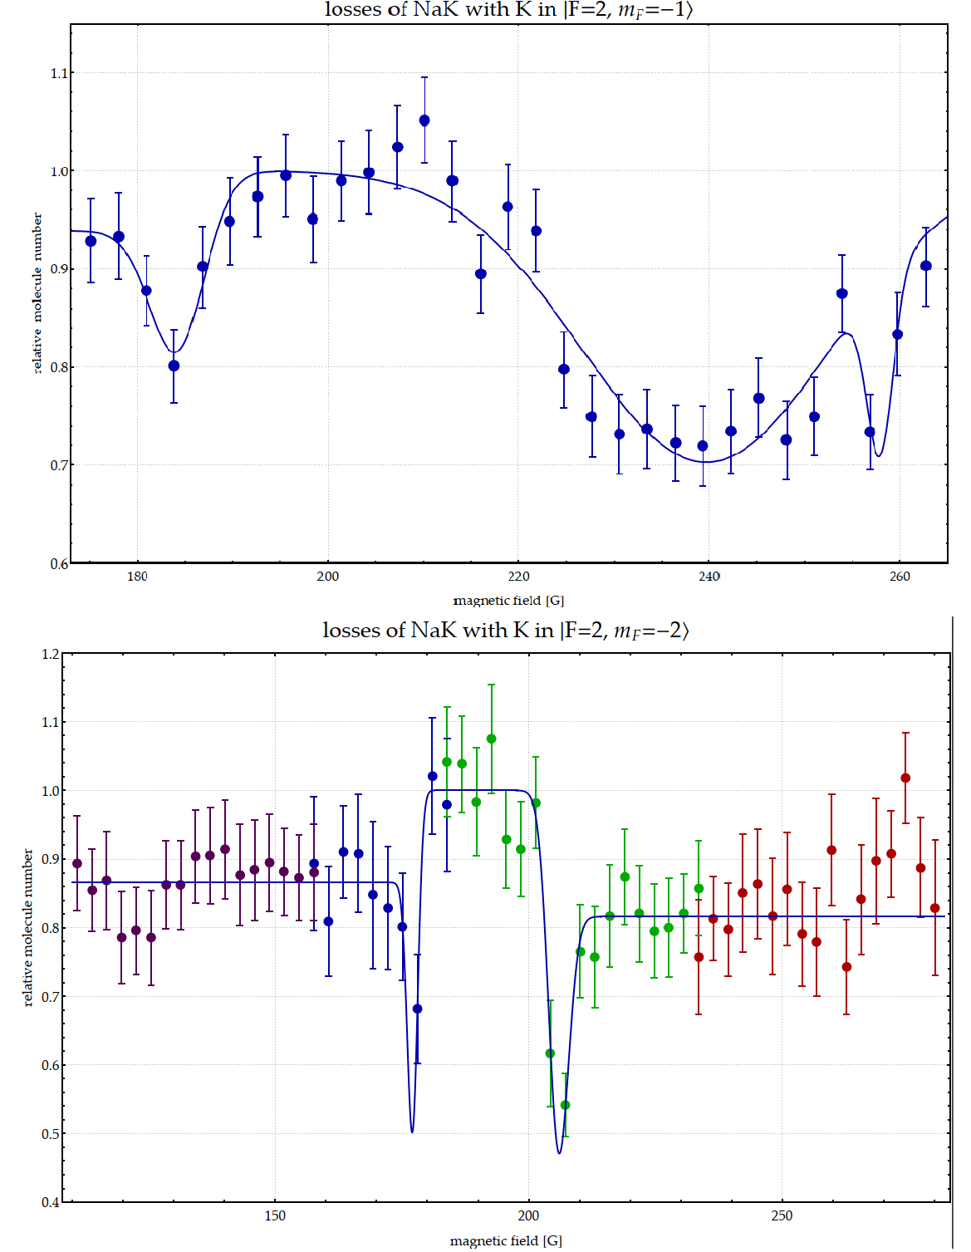
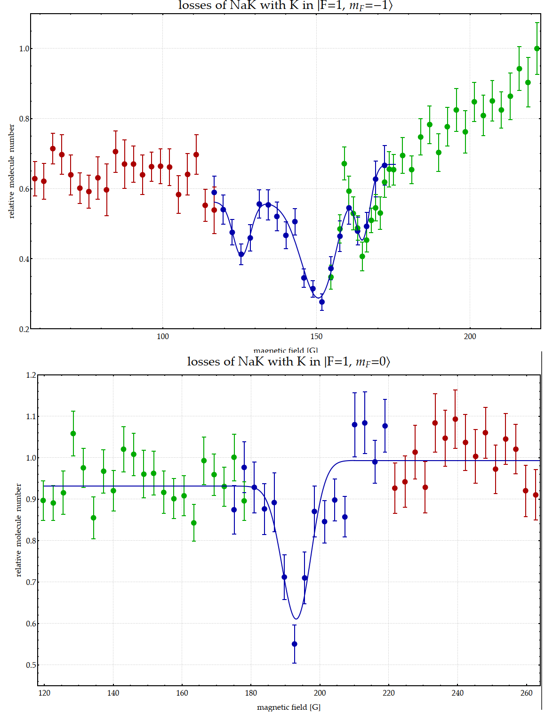
Atom-molecule Feshbach resonances
Preliminary!!
Theory of atom-molecule Feshbach resonances: M. Frye, J. Hutson arxiv:221208030
J.W. Pan: Fermionic NaK
W. Ketterle: Triplet LiK
Tuning of elastic atom-
molecule interactions?
Notes:
Furthermore, we observe Feshbach resonances between atoms and molecules in various spin states pointing clearly at a low denssity of states!

Slide 42
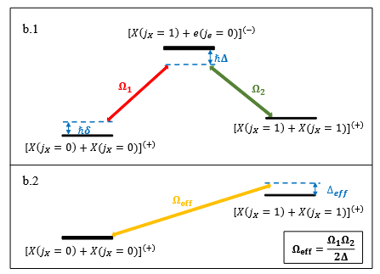

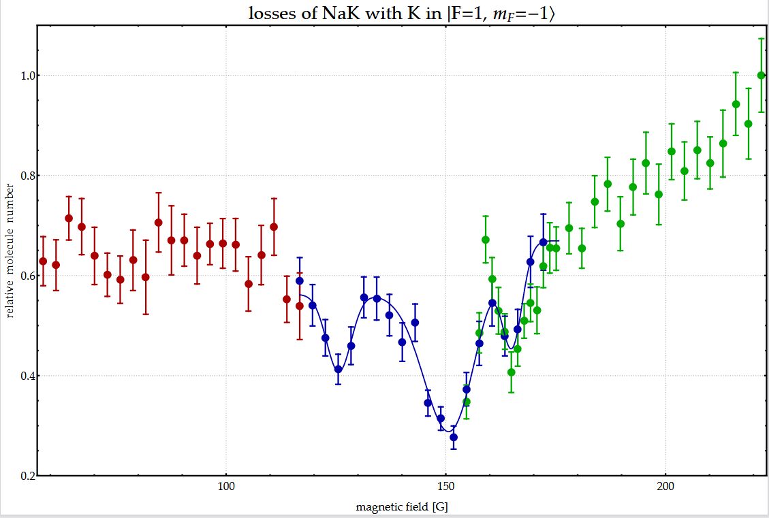
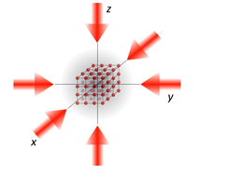
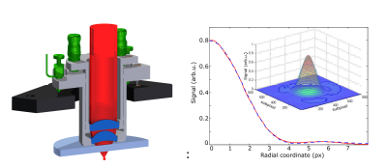
Outlook
Collisional control: Two-photon shielding
Long-lived molecular BEC?
Trimer and tetramer states
Understanding collisions?
Ultracold polyatomic molecules?
Tunable strongly interacting
atom-molecule mixtures?
Dipolar many-body physics in lattices

Slide 43

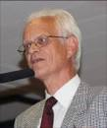


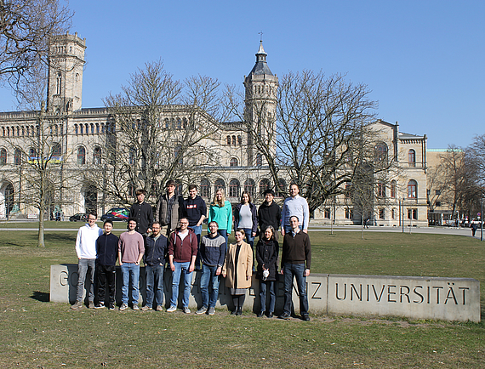

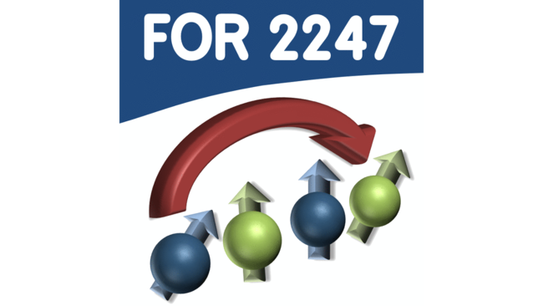

Thank you!
O. Dulieu E. Tiemann
C. Karam
R. Vexiau,
M. Lepers,
N. Bouloufa-Maafa
Funding
The experimental team at LUH
Open postdoc and PhD positions!

