Slide 1





Physique des décharges capacitives radiofréquence
Congrès Général de la Société Française de Physique, 2023
Pascal Chabert
Laboratoire de Physique des Plasmas
Ecole Polytechnique, France

Slide 2
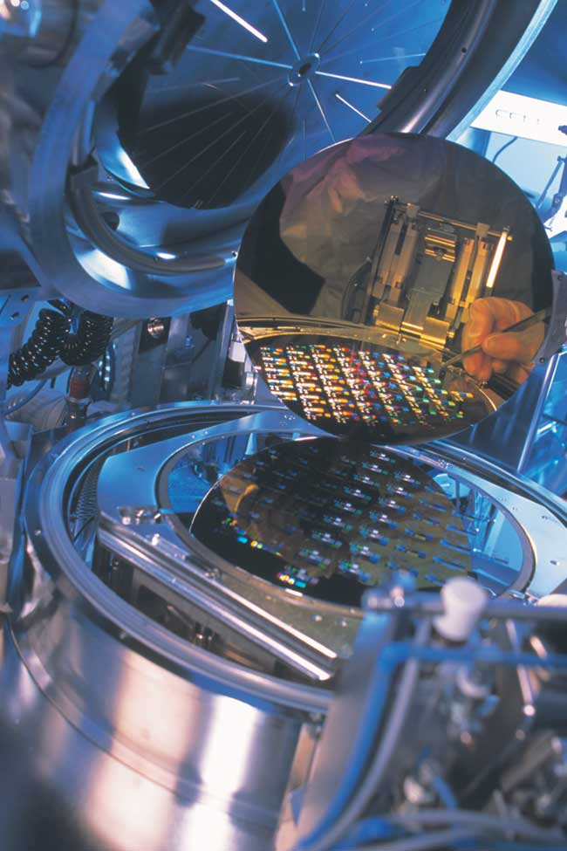
RF Plasmas in industry
Plasma
P = 0.1-10 Pa
Cl
Cl
+
+
+
e⁻
Cl
+
Cl
+
Cl
Cl_{x}⁺
SiCl_{y}
Si
Plasma etching
Plasma deposition

Slide 3
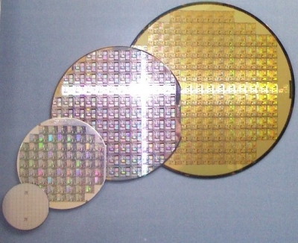
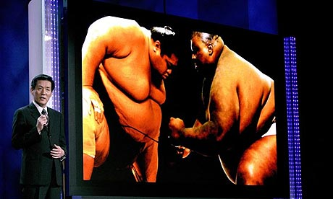
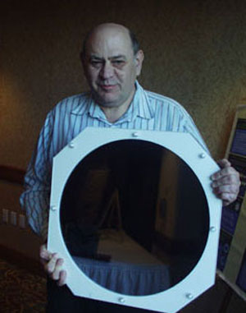
Industrial Challenges for RF Plasmas
Patern size shrinks while substrate size increases
Need stability, reproductibility and uniformity
μ-electronics
LCD - Flat Panel Displays

Slide 4
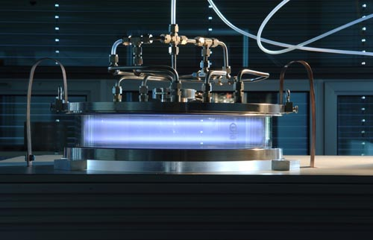
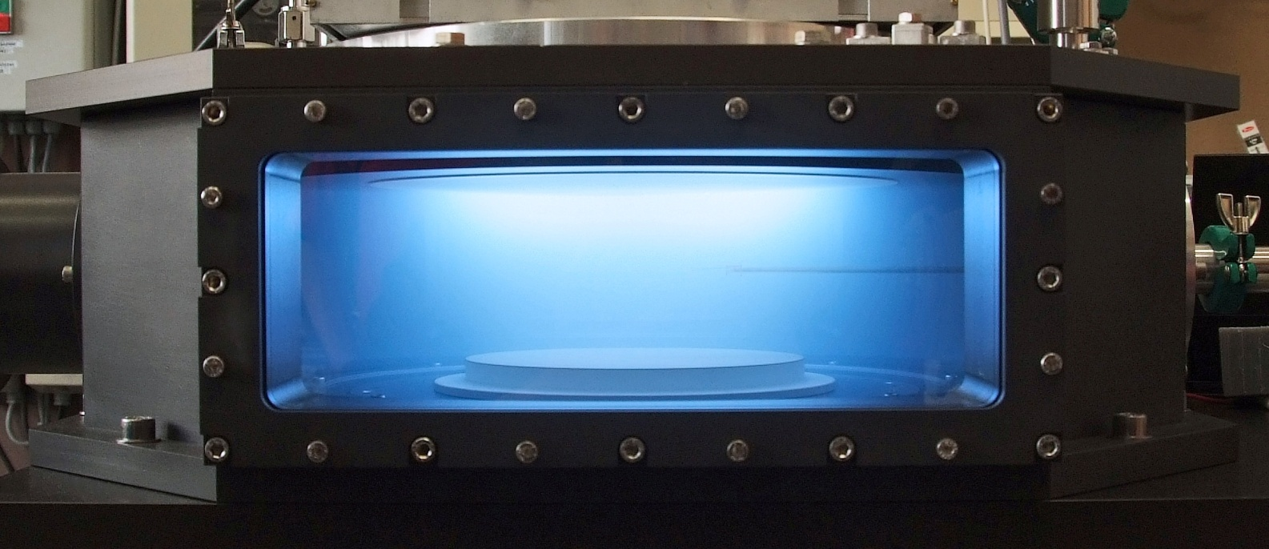
Capacitive discharges
Inductive discharge

Slide 5
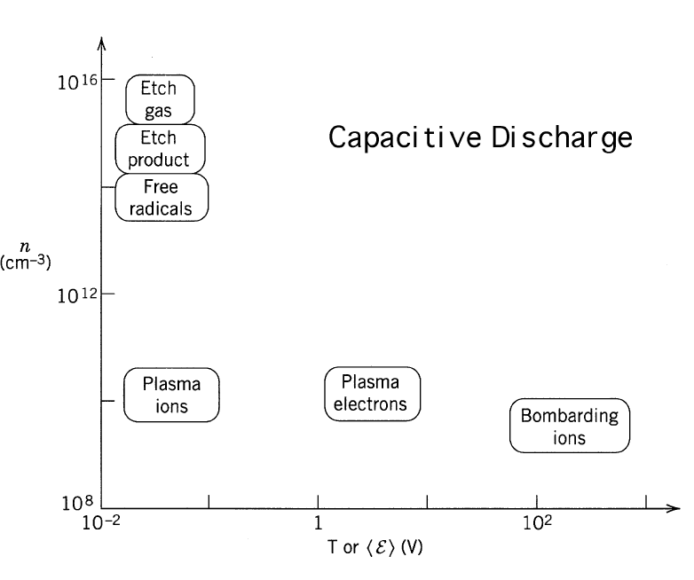
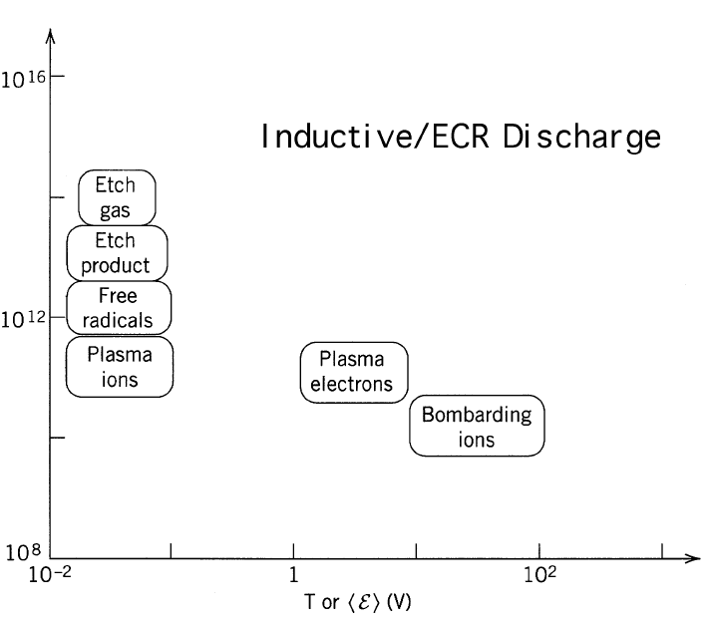
Energies and densities

Slide 6
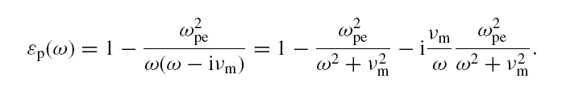
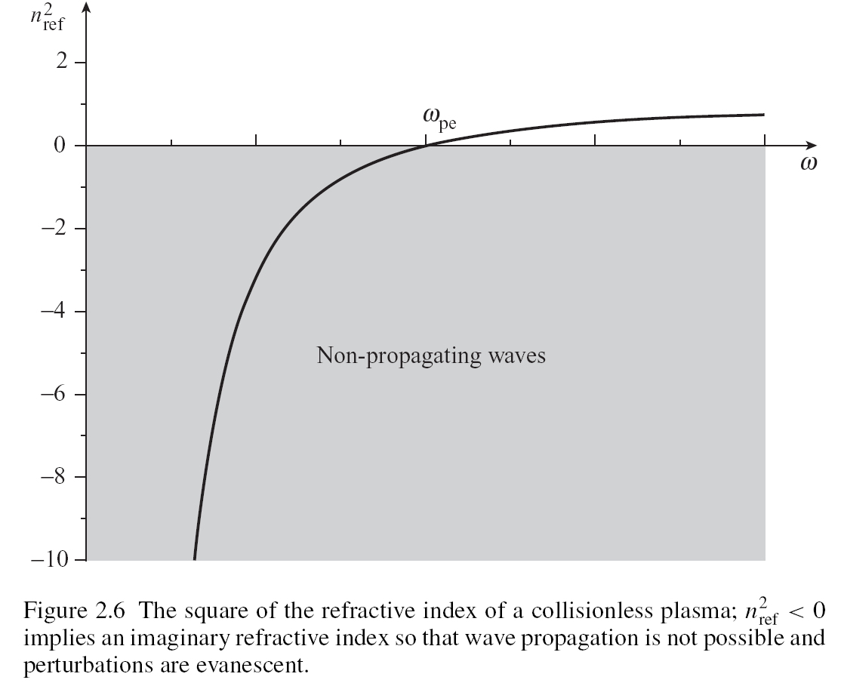
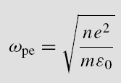
Dispersion relation of EM waves
Non-magnetized plasmas behave like conductors at low frequency and like dielectrics at high frequency

Slide 7
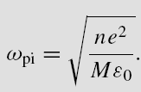
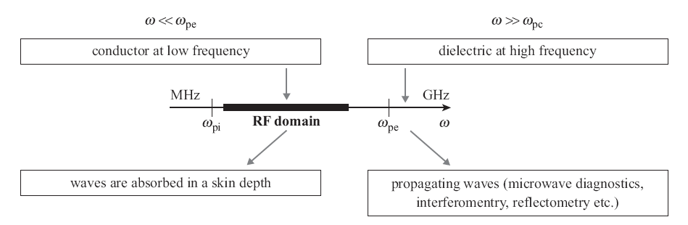
Electrodynamics in the RF domain
EM waves are evanescent (without B field); they penetrate deeper than electrostatic fields
Electrons follow the RF field
Ions do NOT follow the RF field

Slide 8
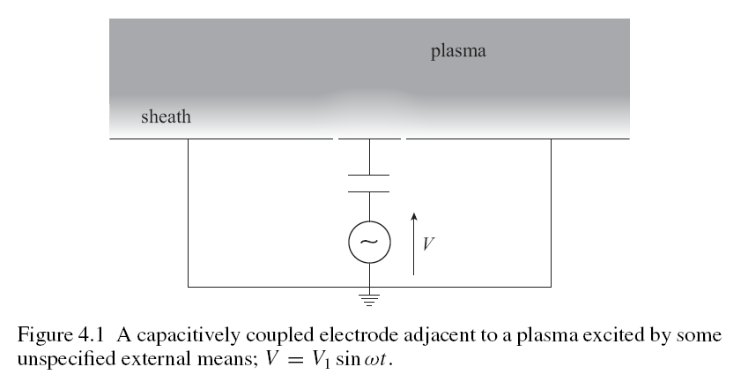
The radiofrequency sheath

Slide 9
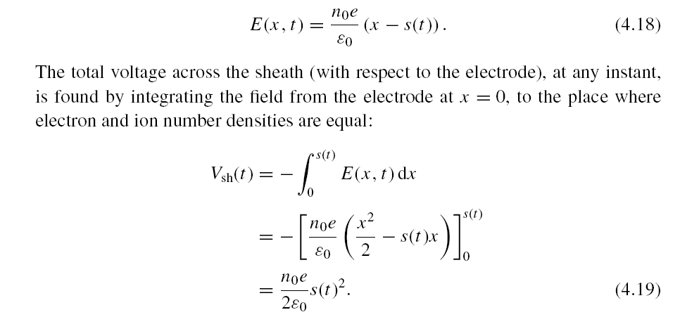
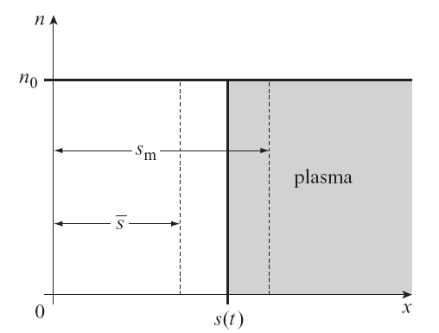
Electron dynamics: the homogeneous (matrix) sheath
Assumes electrons follow the rf field
Assume frozen ions
Sheath motion non-linear with voltage

Slide 10
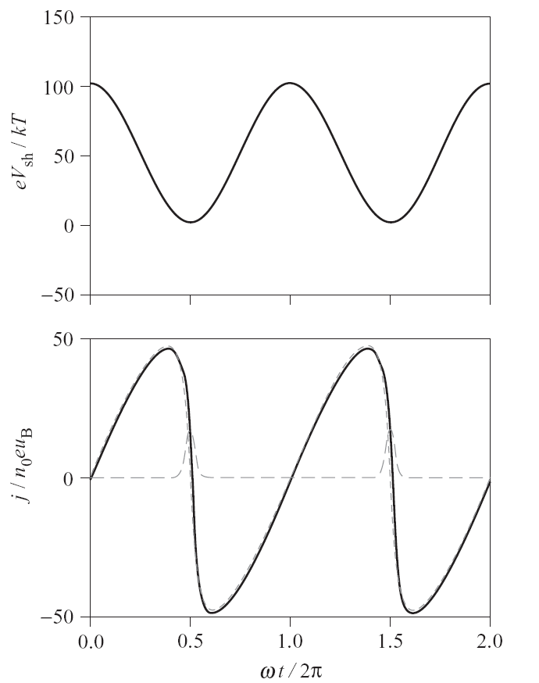
Voltage drive: voltage and current waveforms
Sinusoidal voltage drive
Non-linear current waveform
Small contribution of the
conduction current
Sheath response is non-linear

Slide 11
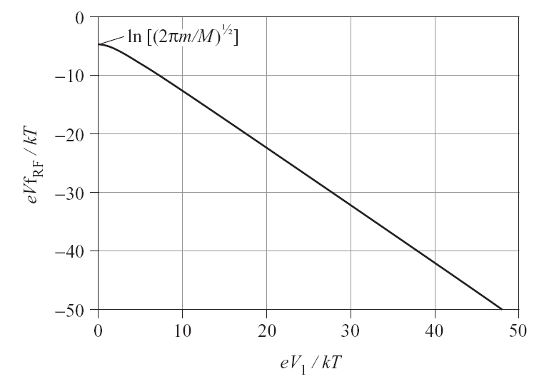
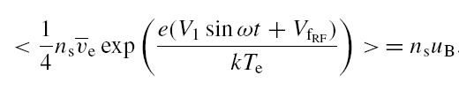
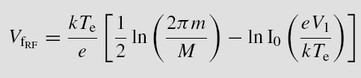
Conduction current balance
Self bias formation

Slide 12
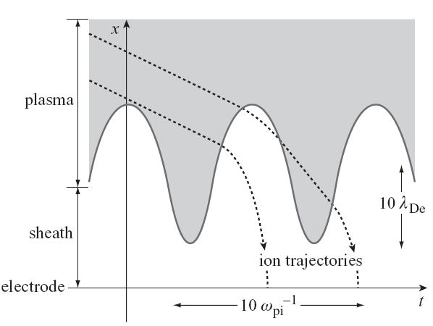
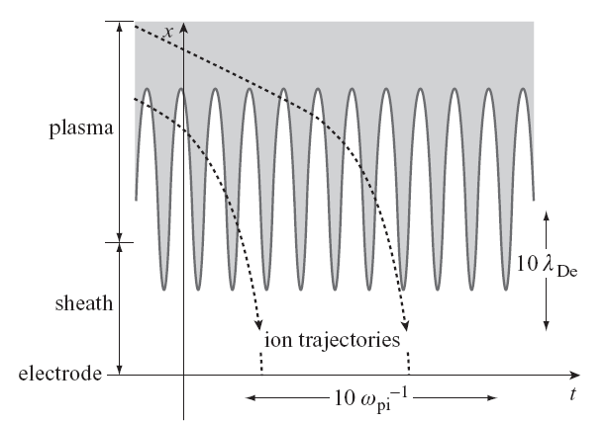
Ion dynamics in the sheath
Low frequency
High frequency

Slide 13
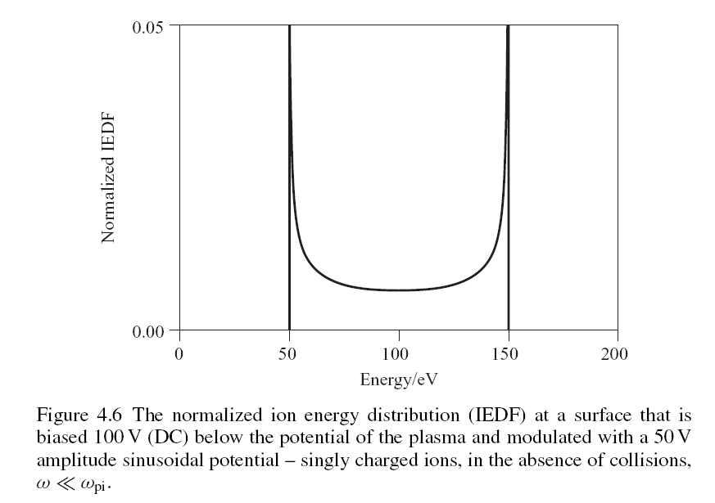
Resulting « bi-modal » energy distribution

Slide 14
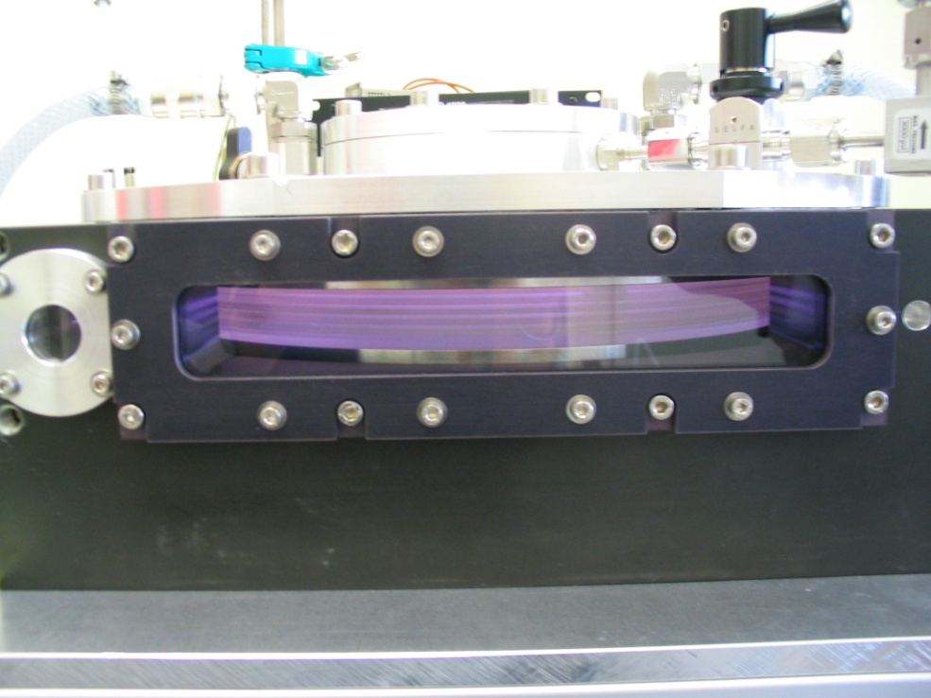
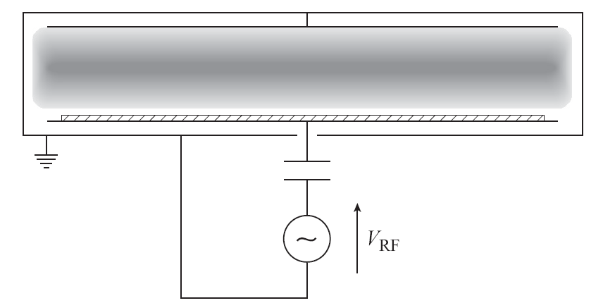
Capacitive discharges at low pressure

Slide 15
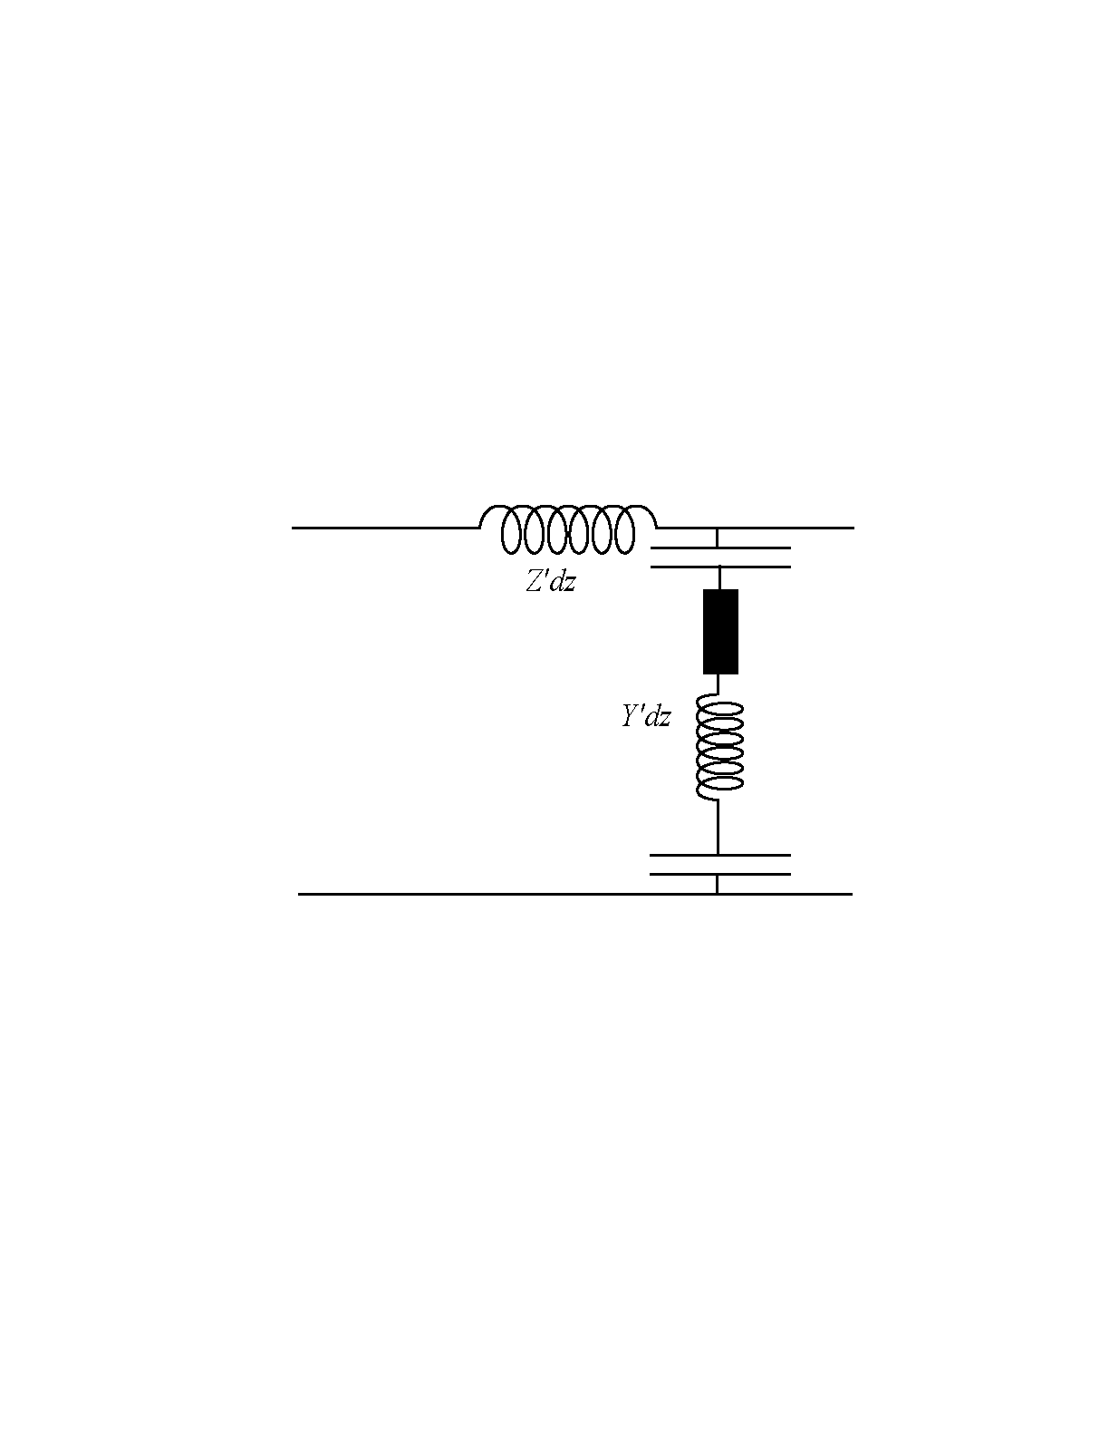
Circuit model of capacitive discharges
Time-averaged potential
Z_{sheath}=1/(jc_{s}ω)
s_{a}(t)
Plasma
V_{rf}
Z_{plasma}=R_{p}+jL_{p}ω
E_{z}
E_{z}
s_{b}(t)
Impedance depends on :
Voltage, V_{rf}
Electron density, n_{e}
Sheath size, s_{m}
To find a self-consistent solution:
Child law
Particle balance
Power balance

Slide 16
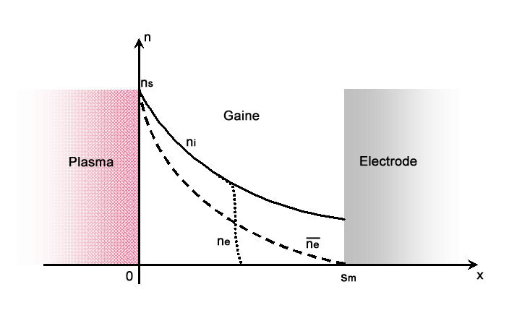
Collisionless power absorption
Importance of sheath dynamics
Two approaches:
Kinetic model « Hard wall »
(Fermi stochastic acceleration)
M.A. Lieberman, IEEE Plasma Sci. 16 (1988) 638
I.D. Kaganovich, Phys. Rev. Lett. 89 (2002) 265006
Fluid model « pressure heating »
G. Gozadinos et al., Phys. Rev. Lett. 87 (2001) 135004
R_{p}
R_{stoc}
Collisionless power dissipation in the sheath
Equivalence of the hard-wall and kinetic-fluid models of collisionless electron heating in capacitively coupled discharges
T Lafleur, P Chabert, M M Turner and J P Booth
Plasma Sources Sci. Technol. 23 (2014) 015016

Slide 17
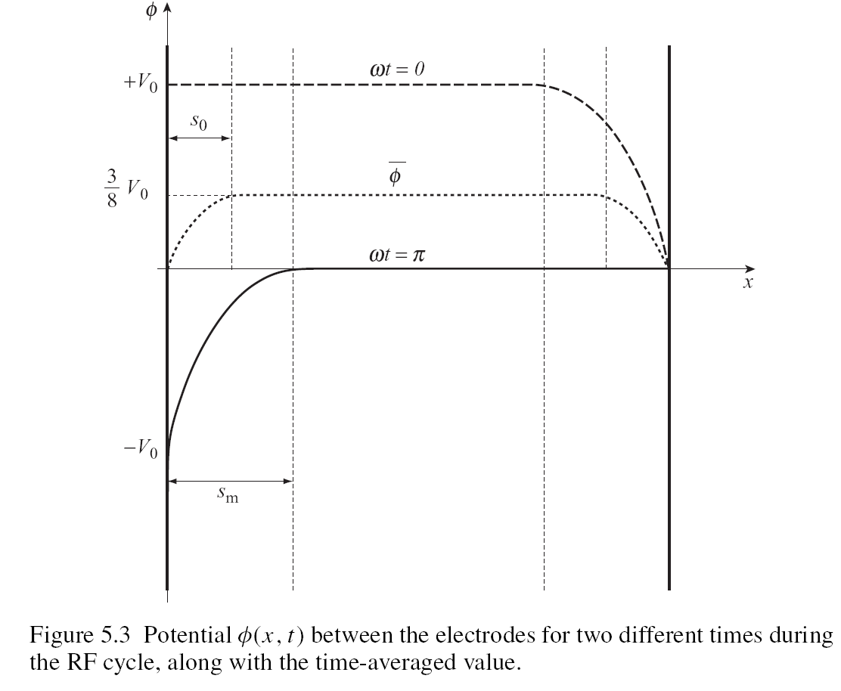
Potential profile in single frequency symetric discharges
The potential in the plasma is always higher than (or equal to) the potential of the two electrodes

Slide 18
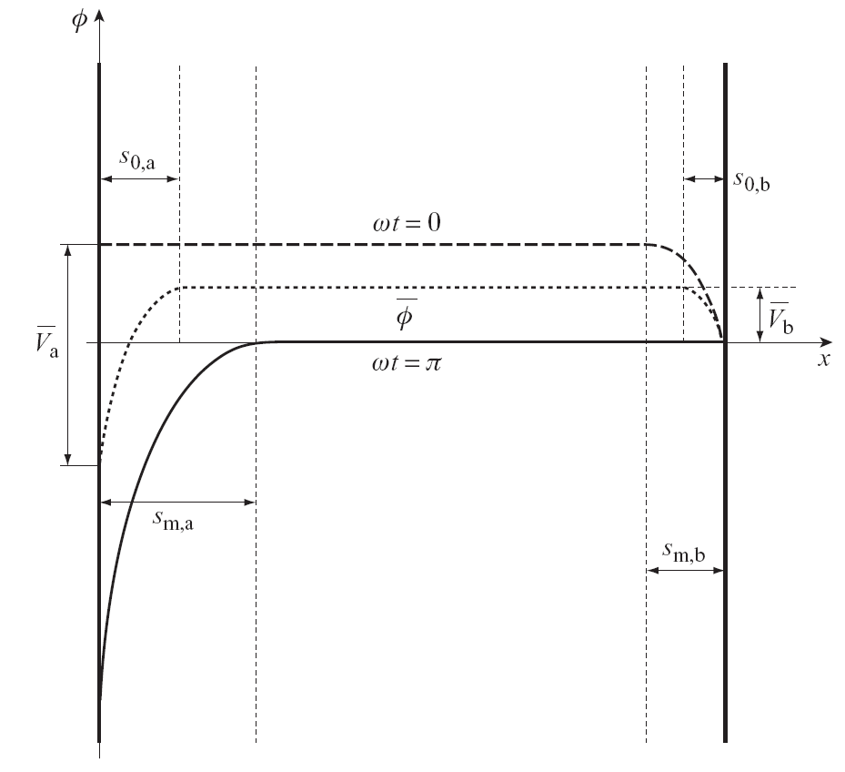

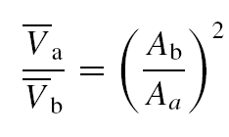
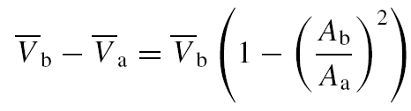
Potential profile in single frequency assymetric discharges
Within the homogeneous model :
A DC self-bias develops:
The larger voltage across the smaller electrode

Slide 19
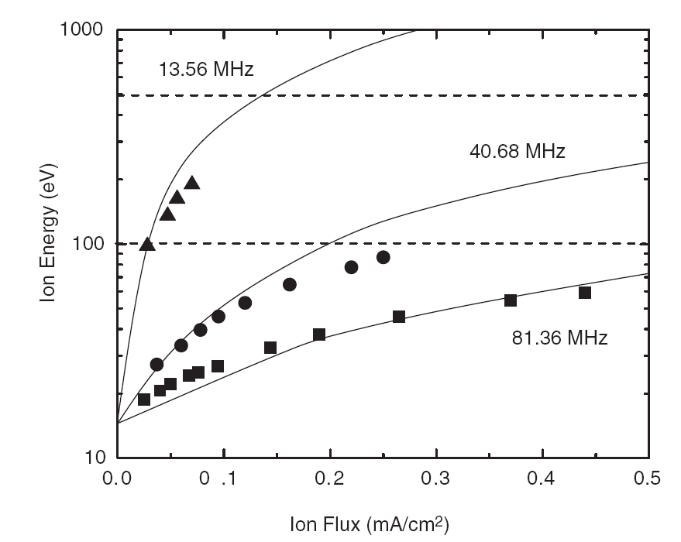
Dual Frequency with well separated frequencies
■●▲ : Experiments
----- : model
V_{rf}
HF drive for high flux
LF bias for tunable ion energy
Dual Frequency Capacitive (DFC)
A. Perret et al., Appl. Phys. Lett 86 ( 2005) 021501

Slide 20


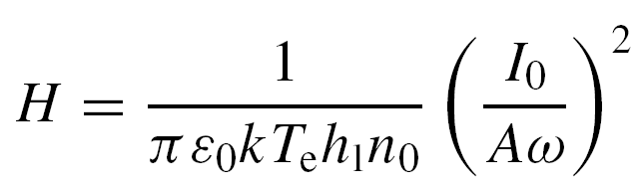
Dual frequency sheath
M. A. Lieberman, IEEE Trans. Plasma Sci. 16, 638 (1988)
J. Robiche et al, J. Phys. D. 36 (2003) 1810

Slide 21
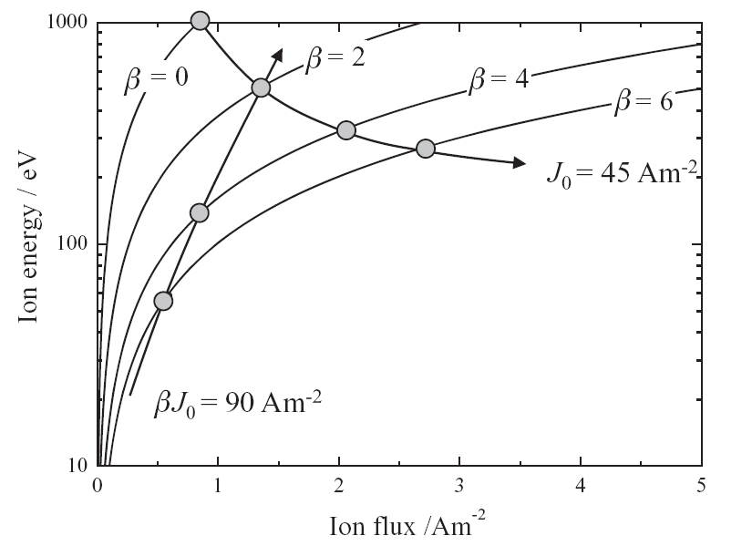
Indepenedent control not achieved

Slide 22
Ion energy distribution
13.56 MHz
15 mTorr
s_{m} = 7 mm
λ_{i} = 2 mm
Analyzer :
L = 1 mm
81.36 MHz
s_{m} = 1.2 mm

Slide 23
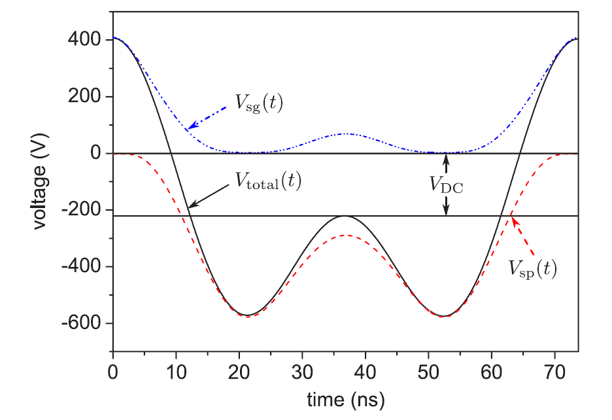
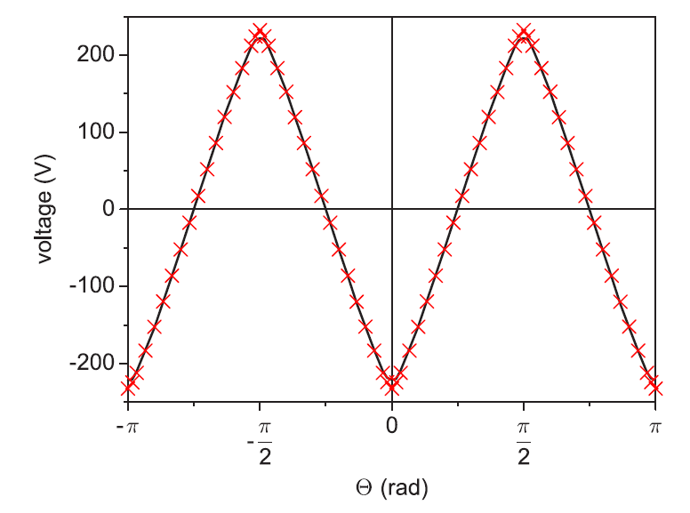
Electrical assymmetry effect in dual-frequency symmetrical discharges
It is possible to change the self-bias by changing the phase between the two frequencies, even when geometrically symmetrical
The asymmetry is generated by the voltage waveform
B. G Heil, U. Czarnetzki, RP Brinkmann and T.Mussenbrock, J. Phys. D: Appl. Phys. 41 (2008) 165202

Slide 24
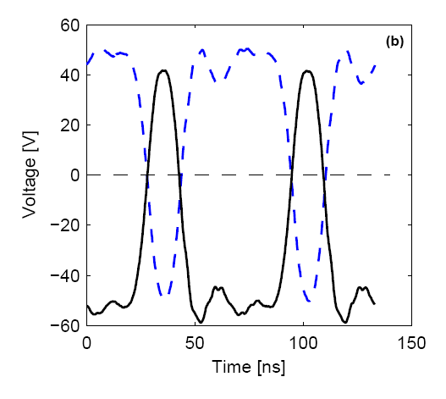
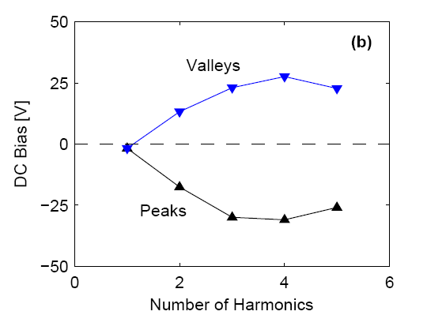
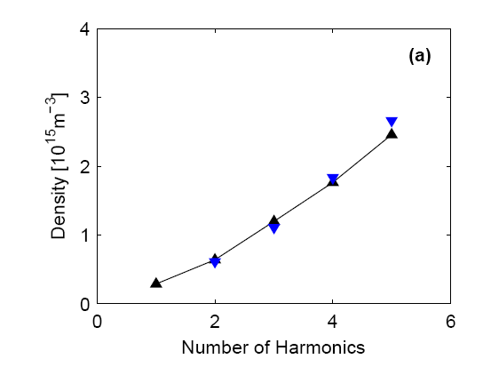
Complex waveforms
This is a generalization to complex waveforms
Electron heating is also affected
T. Lafleur, P.A. Delattre, E.V. Johnson, and J.P. Booth, Appl. Phys. Lett. 101 (2012) 124104

Slide 25
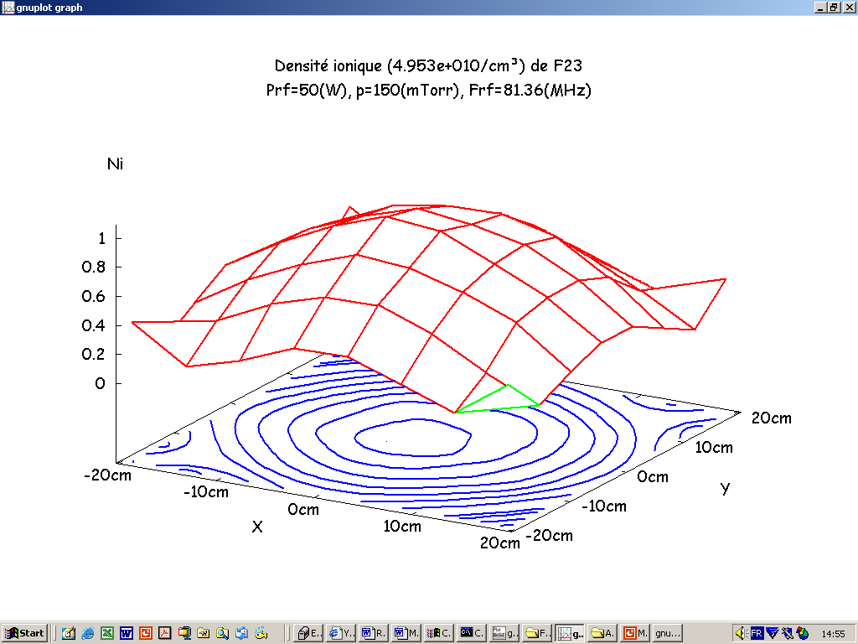
Capacitive discharges at Very High Frequency

Slide 26
The electromagnetic regime
z
R
E_{z}
0
H_{f}
E_{r}
r
M.A. Lieberman et al., Plasma Sources Sci. Technol. 11 (2002) 283
L. Sansonnens et al., Plasma Sources Sci. Technol. 15 (2006) 302
~
Solve Maxwell’s equations for given s and n_{e} (not self-consistent):
λ ∼ R : Standing wave effect (E_{z})
δ ∼ d : Skin effect (E_{r})
Edge effects
P. Chabert, J Phys D, 40 (2007) R63 (Review article)

Slide 27
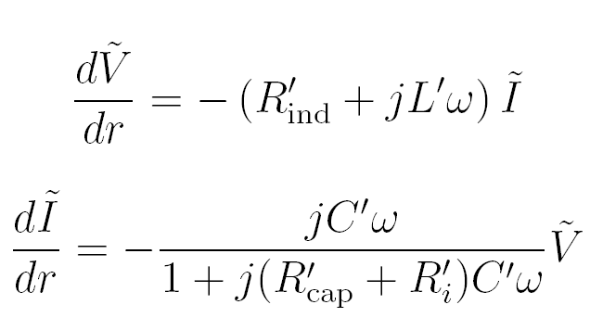
Transmission line model
z
R’_{ind}
L’
C’
R’_{cap}
0
r
2R’_{i}
dr
dr
TL elements depends on:
Local voltage and/or current (V_{rf}, I_{rf})
Electron density, n_{e}
Sheath size, s_{m}
Use:
Child law
Particle balance
Power balance
Self-consistent solutions for:
V_{rf} (r) and I_{rf} (r)
n_{e}(r)
s_{m}(r)
P. Chabert et al., Physics of Plasmas 11 (2004) 1775
P. Chabert et al., Physics of Plasmas 11 (2004) 4081
P. Chabert et al., Phys. Rev. Lett. 95 (2005) 205001

Slide 28
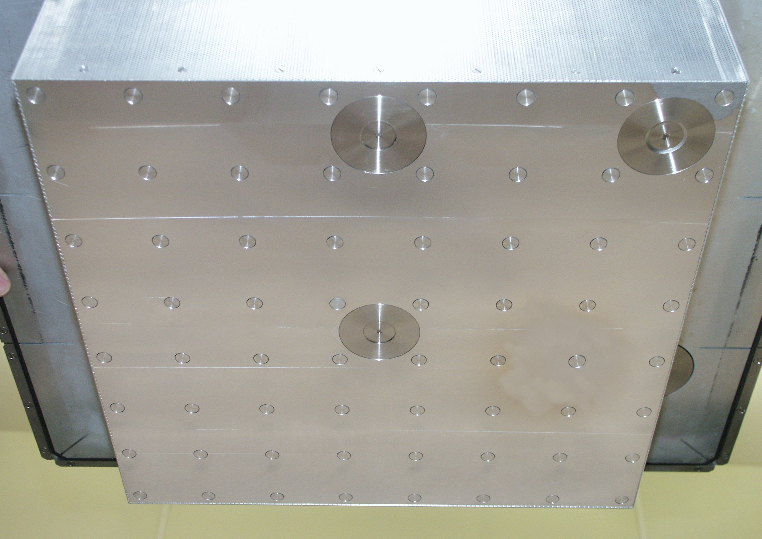
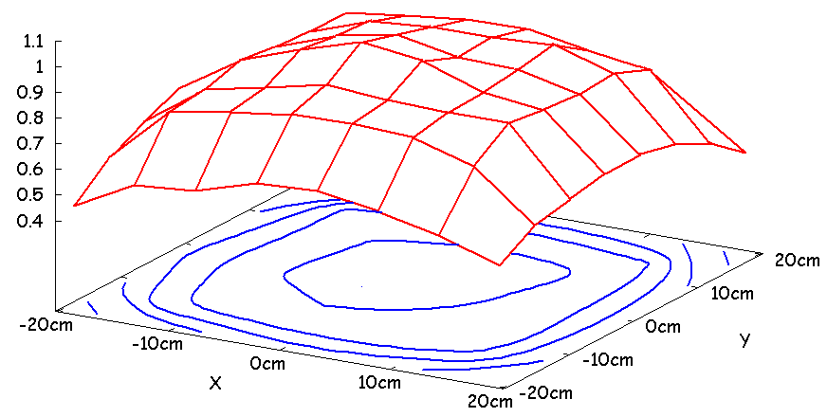
Experiments
Top-grounded electrode
3 RFEA
Retarding Field Energy Analyser
Ion energy uniformity
64 planar probes
Cartography of the ion flux

Slide 29
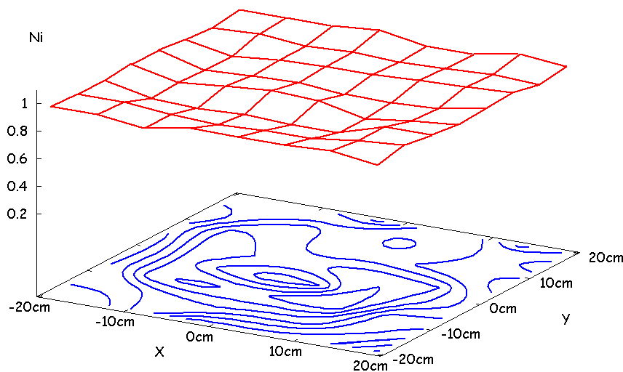
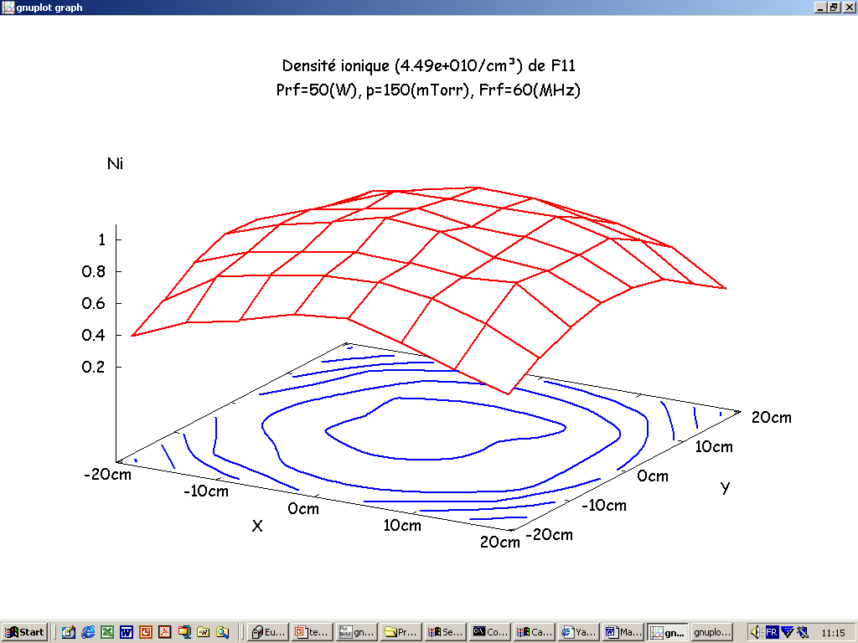
The standing wave effect
50 W, 200 mTorr (local heating)
J_{i}/J_{imax}
60 MHz
J_{i max} = 0.15 mA.cm⁻²
J_{i}/J_{imax}
81.36 MHz
J_{i max} = 0.17 mA.cm⁻²
13.56 MHz
J_{i max} = 0.07 mA.cm⁻²
J_{i}/J_{imax}
A. Perret et al., Appl. Phys. Lett 83 ( 2003) 243

Slide 30
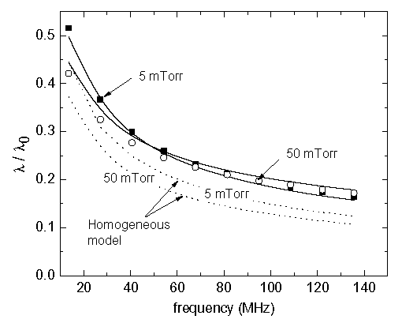

The standing wave effect
0,18
Experiments
TL Theory
0,16
Worsening factor
0,14
)
0,12
-2
0,10
(mA.cm
0,08
J
i
0,06
81.36 MHz
200 mTorr (local heating)
50 W
0,04
0,02
0,00
-20
-10
0
10
20
X (cm)
Fairly insensitive to the gas composition
P. Chabert et al., Physics of Plasmas 11 (2004) 1775

Slide 31
Cancel the standing wave effect: the lens concept
rf
Electrode
Plasma
Substrate
Electrode
Vacuum or dielectric
L. Sansonnens and J.P.M. Schmitt, Applied Phys. Lett. 82 (2003) 182:
The electrode must have a Gaussian shape (in vacuum, from a solution of Maxwell’s equations)

Slide 32
Capacitive discharges at high pressure

Slide 33
Intermediate pressure: non-uniform ionization
The electron temperature is strongly non uniform due to strong energy dissipation by collisions
Ionization is strongly localized
Plasma density profiles are strongly affected
Low-pressure transport and power disspation theories are not correct
T. Lafleur and P. Chabert Plasma Sources Sci. Technol. 24 (2015) 025017

Slide 34
Intermediate pressure: “passive bulk”
Strong power absorption and dissipation in the bulk
But NO ionization because the high energy tail of eedf is strongly depleted
Strong electron heat flux from the sheath towards the bulk
Active-sheath and passive-bulk models
E. Kawamura et al. J. Vac. Sci. Technol. A 38(2) 2020

Slide 35
Intermediate pressure: γ mode
Primary e-
When the pressure increases there is a sheath breakdown phenomenon when secondary electron emission is present
This well known transition is potentially unstable for large area – high frequency CCP’s
Photon
Positive ion
Secondary e-
Metastable
New theories needed for EM regime with γ electrons
E. Kawamura et al. J. Vac. Sci. Technol. A 38(2) 2020
Emi Kawamura, Michael A Lieberman, Allan J Lichtenberg and Pascal Chabert Plasma Sources Sci. Technol. 30 (2021) 035001
M A Lieberman, E. Kawamura and P. Chabert Plasma Sources Sci. Technol. 31 (2022) 114007

Slide 36
Atmospheric pressure CCP’s
~
The RF field does penetrate the plasma because of nearly dielectric limit
The electron temperature oscillates in time during an RF cycle because of very fast energy relaxation by collisions
Penning ionization in the sheath is very important
Electrode
He/O₂
Plasma bulk
1 mm
Electrode
V. Schulz-von der Gathen et al., J. Phys. D 41 (2008) 194004
J. Waskoenig, Thesis, Queen’s University Belfast (2010)
J. Waskoenig et al. PSST 19 (2010) 045018
C Lazzaroni, P Chabert, M A Lieberman, A J Lichtenberg and A Leblanc, Plasma Sources Sci. Technol., 21, 035013 (2012)
C Lazzaroni, M A Lieberman, A J Lichtenberg and P Chabert
J. Phys. D : Appl. Phys. 45, (2012) 495204
E Kawamura, M A Lieberman, A J Lichtenberg, P Chabert and C Lazzaroni
Plasma Sources Sci. Technol. 23 (2014) 035014

Slide 37
Conclusions
Capacitive discharges are essential for plasma processing
After decades of research, there are still a lot of unknown phenomenon
Multi-frequency excitation is needed to control (almost) independently the ion flux and the ion energy to the wafer
However, it increases the complexity and the non-linear response of RF sheaths and the higher frequencies lead to non-uniformity
Higher pressure regimes are subject to mode transitions and related instabilities
Atmospheric pressure operation is possible but in small gap devices

Slide 38

To learn more..
Principles of Plasma Discharges and Materials Processing,
M.A. Lieberman and A.J. Lichtenberg,
2nd Edition, John Wiley and Sons Inc., New York, 2005
Physics of Radiofrequency Plasmas
P. Chabert and N. Braithwaite,
Cambridge University Press, 2011
Foundations of capacitive and inductive radio-frequency (RF) discharges,
P. Chabert, T. Tsankov and U. Czarnetzki
Plasma Sources Science and Technology, 30 (2021) 024001

