Slide 1

Procédés plasmas de microélectronique sur substrats refroidis à des températures cryogéniques
T. Tillocher¹, J. Nos¹, R. Ettouri¹, P. Lefaucheux¹, R. Dussart^{1,}
1 GREMI, Université d’Orléans, CNRS, Orléans, France

Slide 2
Outline
1) Introduction : Basics of plasma etching
2) Deep cryoetching of silicon
3) Cryogenic etching processes

Slide 3
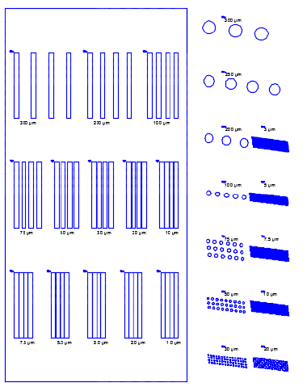
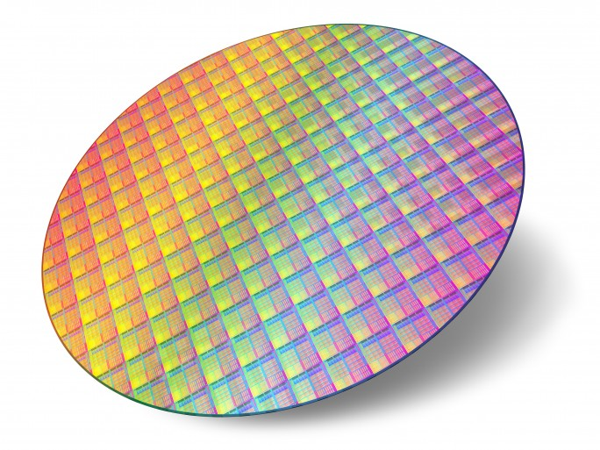
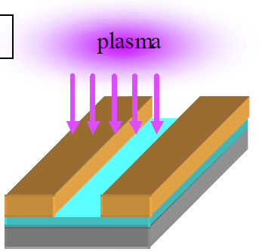
1) Introduction: Basics of plasma etching
Quick definition
Plasma etching consists in using a plasma to transfer a mask pattern in a layer or the substrate itself
=> physico-chemical interaction between the plasma and the substrate
Masked wafer
Radicals
Mask
Mask
Layer
Cross section view
Substrate
Chang & Cchen

Slide 4
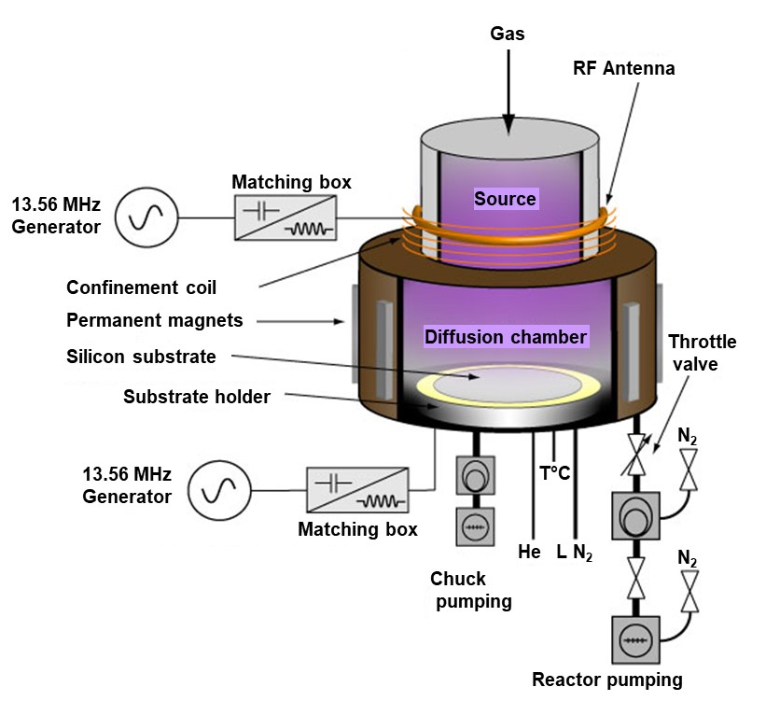
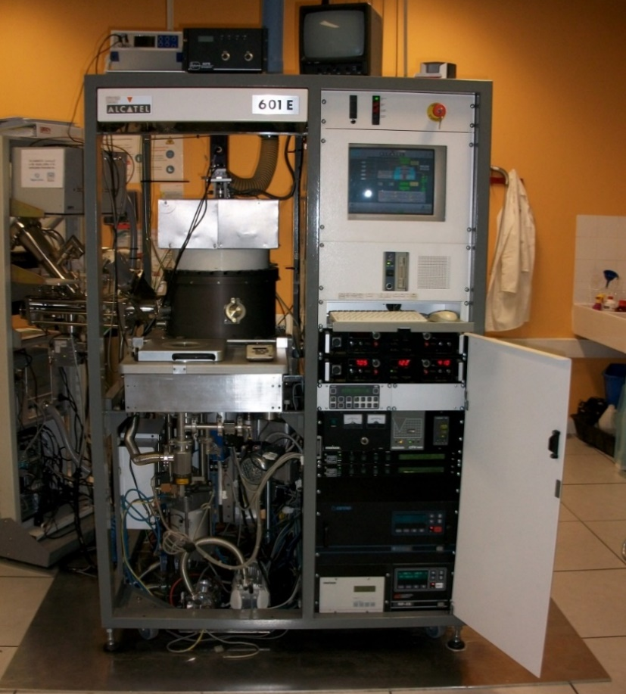
1) Introduction: Basics of plasma etching
Plasma reactors
- Low pressure plasma reactors : mostly RF plasma etching tools (ICP, CCP), see P. Chabert’s talk
- Example below : industrial ICP etching reactor with loadlock (13.56 MHz RF frequencies)

Slide 5
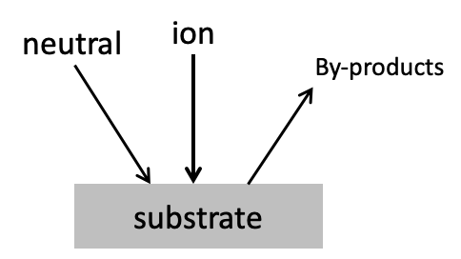
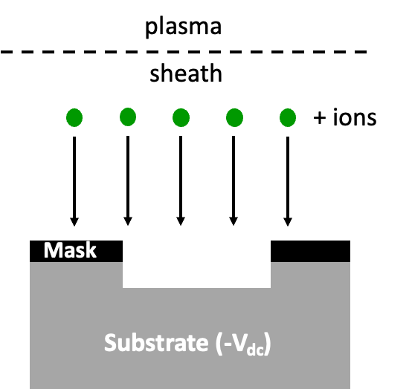
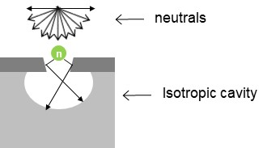
1) Introduction: Basics of plasma etching
Basic etching mechanisms in low pressure plasmas
- Plasmas of reactive gases (mostly halogen-containing molecules)
- Both radicals and ions produced in the plasma are involved in the etch process
- Chemical etching (spontaneous):
Adsorption, chemical reaction between radicals and the surface and desorption of etch product
- Physical etching:
Ion bombardment at the surface
Ion induced etching, sputtering
- In an etch process, these 2 mechanisms happen at the same time… and more…

Slide 6
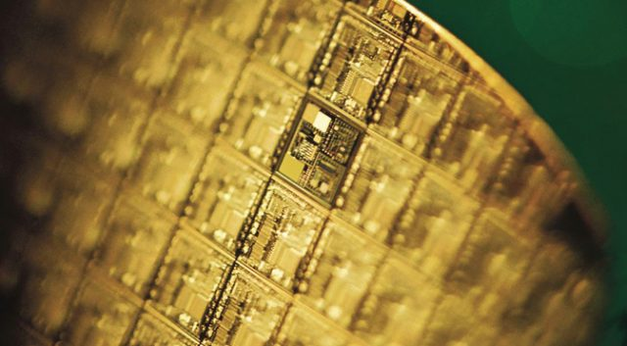
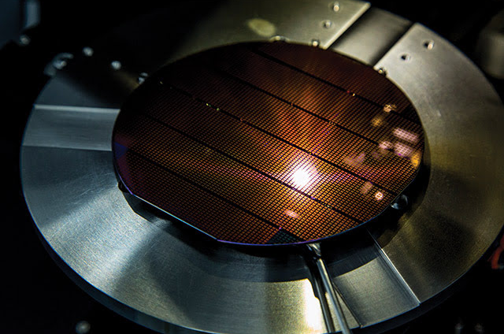
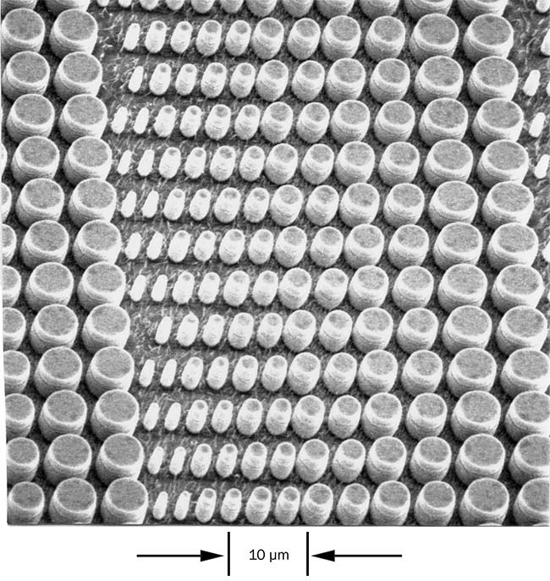
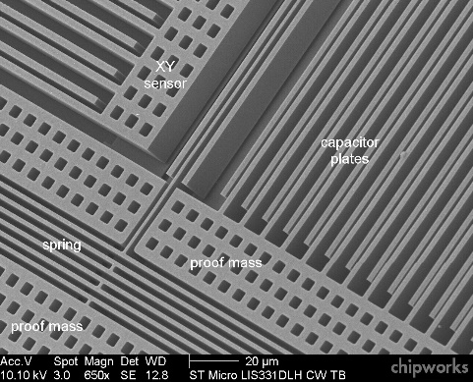
1) Introduction: Basics of plasma etching
Fields of application (very general)
Microelectronics
Optoelectronics
https://www.extremetech.com
https://www.photonics.com
Microsystems – MEMS
https://www.memsjournal.com
Main features of plasma etching : anisotropy, downscaling

Slide 7
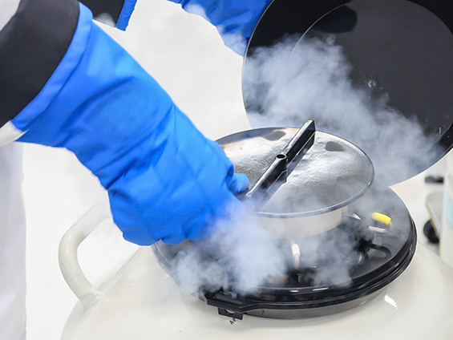
1) Introduction: Basics of plasma etching
Cryogenic etching
Plasma etching with substrate temperature < -90°C
=> Use of liquid nitrogen
=> Specific design of the substrate holder (-150°C => 30°C)
First question: Can we etch at such low temperature?
=> YES, if the etch product is still volatile
=> Case of silicon compounds etched with F-based plasmas
Second question: Why etching at such low temperatures?
=> Etching of high aspect ratio profiles (deep silicon etching)
=> Specific behavior at cryogenic temperature (passivation, increased surface residence time)
=> Low damage etching and significantly reduced contamination of reactor walls

Slide 8
2) Deep cryoetching of silicon
Principle of the standard cryogenic process
Monocyclic SF₆/O₂ plasma
ions
S
Fx
Chemical etching (selective)
SiF₄ : main etch product
F
O
✓ Passivation layer (SiO_{x}F_{y})
⇨ Forms only at very low temperature
SiO₂ mask
Passivation layer (SiO_{x}F_{y})
⇨ Fragile passivation layer, easily removed by ion bombardment
Si
F
4
Simultaneous mechanisms
Etching of high aspect ratio features
=> Depth >> Critical Dimension (CD)
Silicon (100) cooled down at -100°C and negatively biased

Slide 9
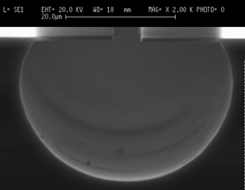
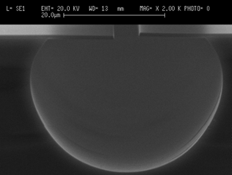
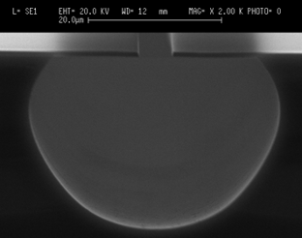
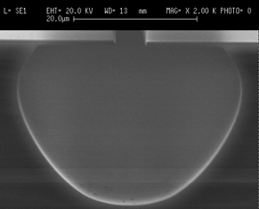
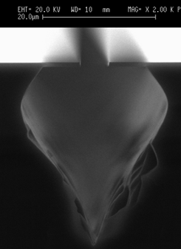
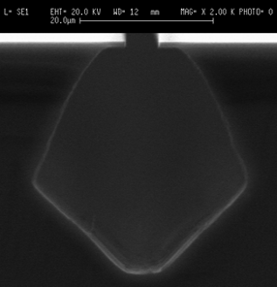
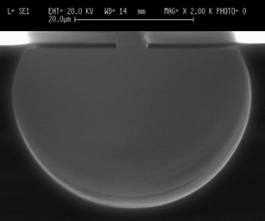
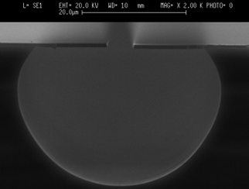
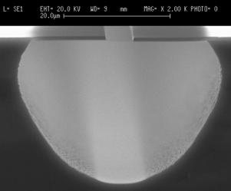
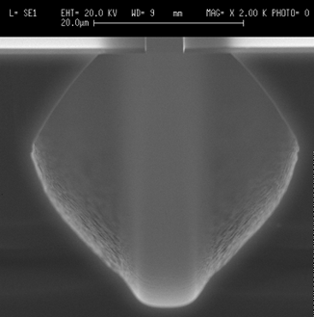
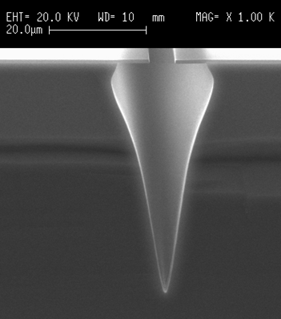
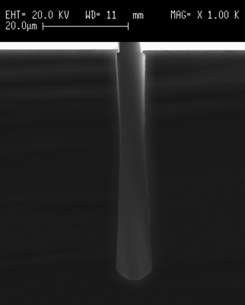
2) Deep cryoetching of silicon
Low temperature + oxygen + bias = anisotropic structures
20 µm
20 µm
20 µm
20 µm
SF₆ without bias
+30°C
-50°C
-80°C
-110°C
20 µm
20 µm
20 µm
20 µm
Isotropic profile for all temperatures between +30 and -110°C
20 µm
20 µm
SF₆ /O₂ without bias
-80°C
+30°C
-50°C
-110°C
20 µm
20 µm
20 µm
20 µm
20 µm
With oxygen, the profile is changed at very low temperature
Lozenge shape due to crystallographic effect at -110°C
SF₆ /O₂ with bias
-50°C
+30°C
-110°C
Passivation layer
formation on the sidewalls
-80°C
Anisotropic etching at -110°C, with oxygen
and bias

Slide 10
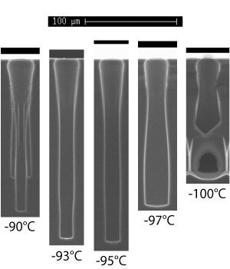
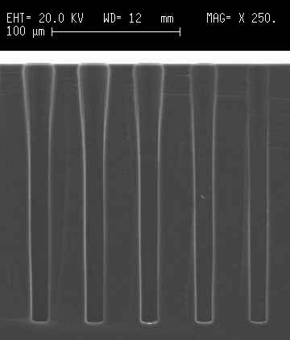
2) Deep cryoetching of silicon
Performances of the cryogenic process
100 µm
100 µm
Example of profiles :
Holes (TSV)
CD = 14 µm
30 minutes
Depth = 210 µm
AR = 15
ER (30’) = 7 µm/min
Positive slope
Negative slope
T°C 
T°C 
Advantages
Monocyclic process
⇨ High etch rates, smooth sidewalls
Desorption of the passivation layer at room temperature ⇨ clean process
Drawbacks
Very sensitive to temperature and O₂ flow variations
Requires liquid nitrogen
ARDE is quite pronounced

Slide 11
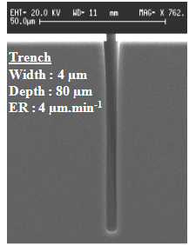
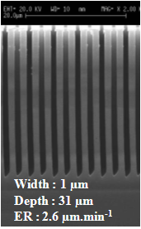
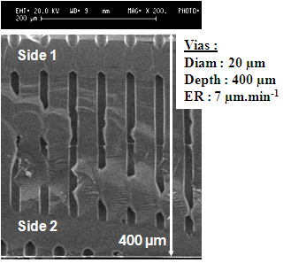
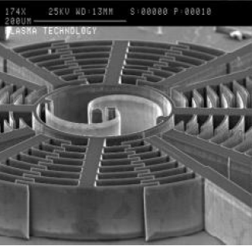
2) Deep cryoetching of silicon
Applications
Deep Etching is intensively in MEMS and microlectronic industries
Deep Trench Insulation
3D capacitors
MOEMS
50 µm
20 µm
20 µm
TSV for interconnects
MEMS
200 µm
200 µm

Slide 12
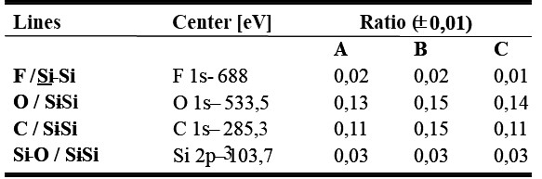
2) Deep cryoetching of silicon
Passivation mechanism
- SF₆/O₂ plasma interacting with a cooled silicon wafer
- The passivation layer is composed of silicon, oxygen and fluorine (~SiOF₃, shown by XPS analyses)
⇨ It is formed at the surface from SiF_{x} and O species at the surface (not in gas phase)
⇨ The passivation layer is more fluorinated as the temperature decreases
⇨ The physisorbed layer desorbs at room temperature, which releases SiF₄ (desorption mass spectrometry)
- The passivation layer is almost entirely removed when the substrate is warmed back up to room temperature
SiO₂ mask
Ex-situ XPS
A
70 µm
Etched part
B
400 µm
C
Bulk Si
R. Dussart et al J. Micromech. Microeng., 14, 190-196 (2004)

Slide 13
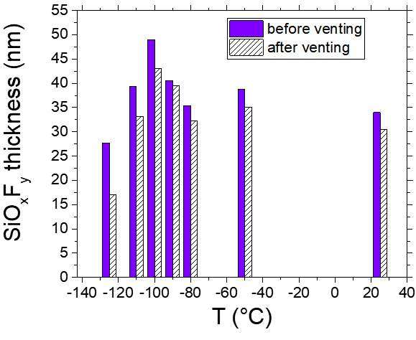
2) Deep cryoetching of silicon
Passivation mechanism
- A SiF₄/O₂ plasma can be used to grow a SiO_{x}F_{y} passivation layer on flat surfaces
⇨ monitoring of growth by in-situ ellipsometry for different substrate temperatures
- Thicker layer by decreasing the temperature
from 20 to -100°C
O₂ flow = SiF₄ flow = 50 sccm
P_{source} = 1000 W
P_{bias} = 0 W
Pressure = 3 Pa
Process duration: 30 s
- During venting/warming of the sample, a part of the layer desorbs.
- Below -100°C, the deposited layer thickness decreases
G. Antoun et al. JJAP, 58, SEEB03 (2019)

Slide 14
2) Deep cryoetching of silicon
Passivation mechanism
- Both SiF_{x} species and O atoms are required to form the SiO_{x}F_{y} layer
- Decomposition of their role…
R. Dussart et al., J. Phys. D: Appl. Phys. 47 123001 (2014)
- Alternation of O₂ plasma and SiF₄ plasma
30 s
O₂
1000 W
30 s
SiF₄
1000 W
10 s
Ar purge
w/o plasma
- Growth during the SiF₄ plasma
- Thicker SiO_{x}F_{y} layer at low temperature
    Physisorption and accumulation of SiF_{x} at the surface favored at low temperature
    Higher surface residence time
    Oxidation of the SiF_{x} during the oxygen plasma (not detected by ellipsometry)

Slide 15



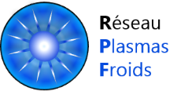
2) Deep cryoetching of silicon
Passivation mechanism
OPTIMIST Platform (IMN, Nantes) => Quasi in-situ XPS
Hemispherical analyzer
4 gas feed
Electron multiplier
Electrostatic lenses
X-ray source
T controller
Plasma
source
Load lock
Sample rod
-180°C < T < +1100°C
Differential pumping
Surface analysis

Slide 16
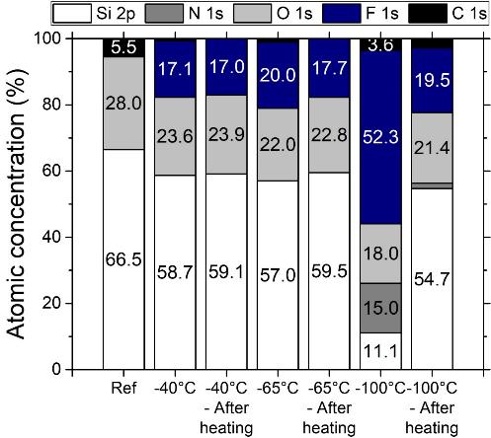
2) Deep cryoetching of silicon
Passivation mechanism : in-situ XPS analyses
- SiO_{x}F_{y} layer growth at 3 different temperatures : -40, -65 and -100°C
a-Si sample ; 30 s ; SiF₄ /O₂ : 25 % ; 3.0 Pa ; 200 W ICP power ; no bias
- At -40°C, 17.1% [F] ; 23.6% [O]
=> After heating: no significant change
- At -65°C, 20.0% [F] ; 22.8% [O]
=> After heating: a little decrease of [F]
- At -100°C, 52.3% [F] ; 18.0% [O] ; 15% [N] (stoechiometry of ~SiOF₃)
After heating: a large part of F-based species has desorbed (~SiO₂)
Optical index n of the order of 1.2 , which indicates that the remaining layer is quite porous
G. Antoun et al 2022 ECS J. Solid State Sci. Technol. 11 013013

Slide 17
2) Deep cryoetching of silicon
Passivation mechanism: summary
- SiF₄/O₂ plasma can reinforce the passivation layer => Time-multiplexed cryoetching
- Enhanced physisorption at cryogenic temperature
  => Low-damage cryogenic etching of low-k materials (not presented)
  => Cryogenic Atomic Layer Etching

Slide 18
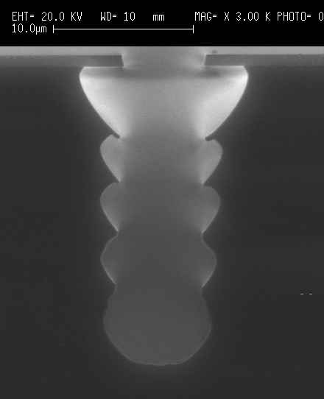
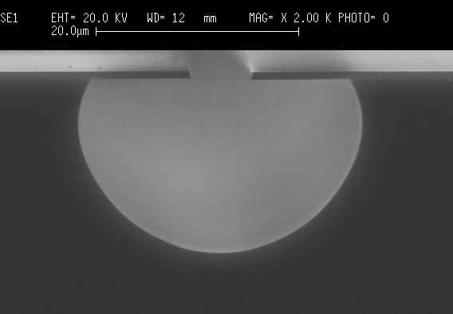
3) Cryogenic processes
STiGer process
–83°C
Alternated cryogenic process
SF₆ plasma step
SiF₄/O₂ passivation step
A few seconds to a few 10s µs for each step
➲ Anisotropic profiles
Same experiment at
0°C
Role of substrate temperature
➲ 4 alternances 1min SF₆ etching - SiF₄/O₂ deposition + a final 1 min etch
Anisotropic microstructures can be eched provided the substrate is cooled at cryogenic temperature
T. Tillocher et al., J. Electrochem. Soc., Vol. 155, 3, D187-D191 (2008)

Slide 19

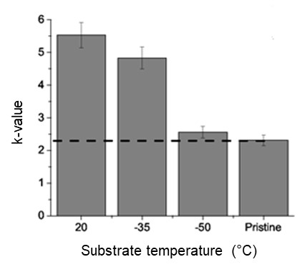
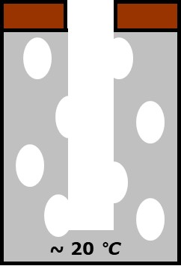
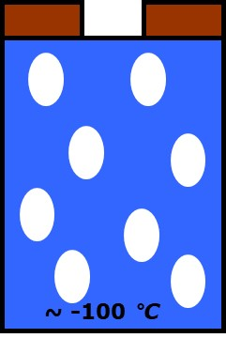
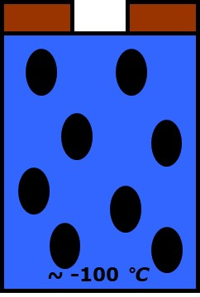
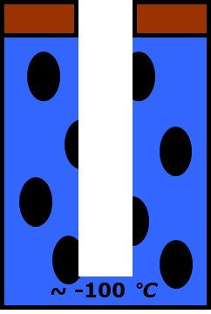
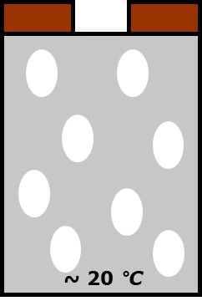


3) Cryogenic plasma processes
Cryoetching of low-k materials
- Porous Organosilicate Glasses (p-SiOCH) are low-k materials used for advanced interconnects
⇨ Very sensitive to plasma species (decrease of k-value)
Reduction of PID by cryogenic etching
Process based on capillary condensation of a high boiling point organic (HBPO) at low temperature
❶ Cooling at -50°C
❷ Pore Condensation of HBPO (flow of
SF₆/HBPO, 3 Pa)
SF₆ or SF₆/HBPO plasma (500W, 3 Pa, 1 min)
$❹$ Heating/Unloading
50°C
50°C
50°C
$❺$ Annealing at 400°C under N₂ (10 min)
- Densified material is etched with strongly reduced diffusion of radicals and anisotropic profiles
⇨ Almost no PID at -50°C
- The k-value is very close to its initial value after process at -50°C

Slide 20

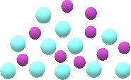

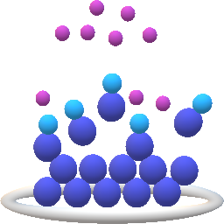
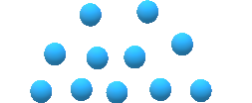

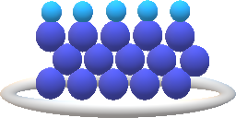
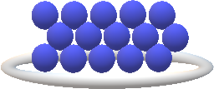

3) Cryogenic plasma processes
Cryogenic Atomic Layer Etching (CryoALE) of SiO₂
Cooled
susbtrate holder
Precursor
w/o plasma
Ar plasma
Adsorbed
layer
SiO₂ substrate
Purge
Pumping
Self-Limiting Etching
Why Atomic Layer Etching (ALE) ?
- Atomic precision (scale reduction of Integrated Circuits)
- Etching of thin layers with no damage to underlying layers
- « Infinite » selectivity
C₄F₈
Ar gas
Ar Plasma
Pumping
C₄F₈
0
Ar
0
Plasma
(ICP + bias)
Why CryoALE of SiO₂ ?
- Prevent process drift due to reactor wall contamination
0
Physisorption
Purge
Etching
Time

Slide 21
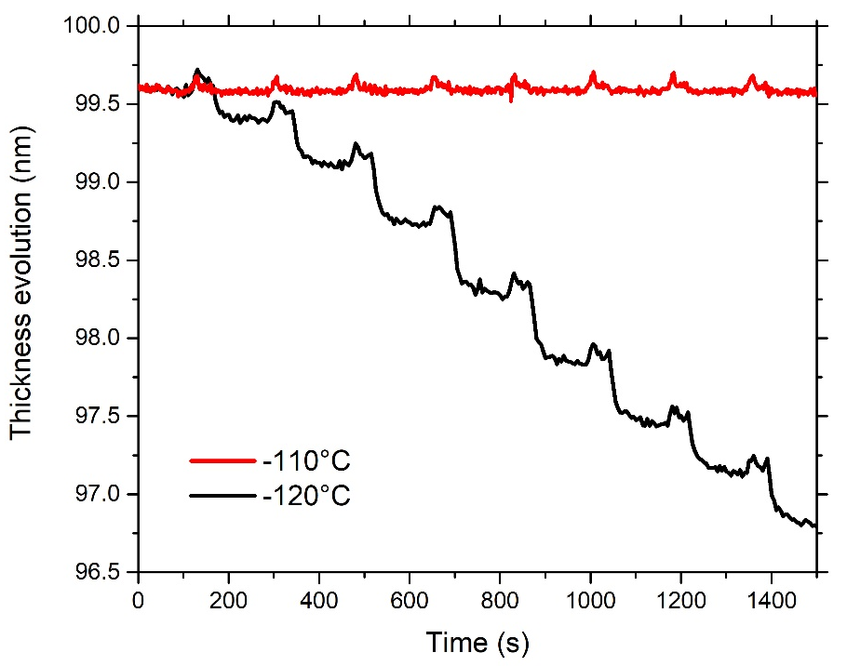
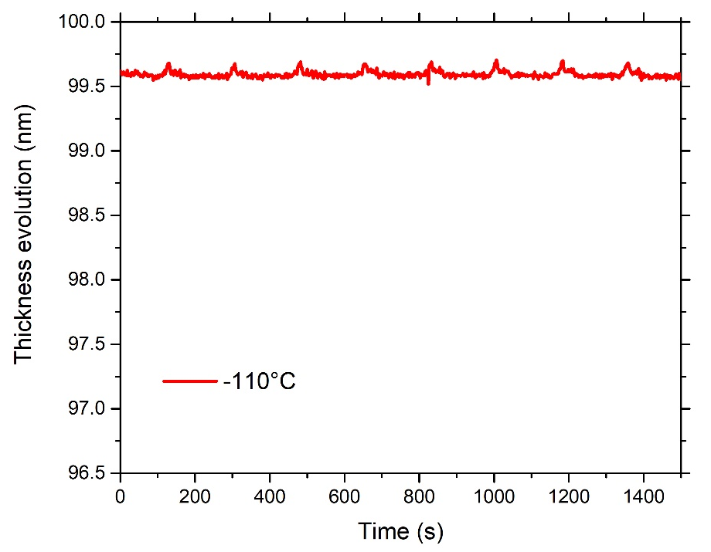


3) Cryogenic plasma processes
Cryogenic Atomic Layer Etching (CryoALE) of SiO₂
Adsorption
Purge
Etching
Pumping
  C₄F₈ gas flow
  10 s
  Ar gas flow
  30 s
  Ar plasma
  2 min
  Source: 400 W
  Bias: -20 V
  w/o gas
  15 s
C₄F₈
8 cycles
Etching
SLE
Purge
- Self-Limiting Etch was reached
- No etching at -110 °C (and higher temperatures)
- Regular EPC 0.4 nm/cycle over 70 cycles
G.Antoun et al, Appl. Phys. Lett. 115, 153109 (2019)
- No drift, no wall contamination

Slide 22

To summarize…
Benefit of cryogenic cooling of substrates for plasma etching
⇨ Increased surface residence time of species => passivation, capillary condensation, physisorption…
⇨ Less plasma induced damage
⇨ Less contamination of chamber walls (layers deposited only on cooled surfaces)
Renewed interest of cryogenic industries in the industry… but little communication
⇨ Alternative designs of cooling technologies (without liquid Nitrogen)
⇨ Main argument = less damaging (lower radical diffusion)
⇨ example: Flash Memories (vias in 3D NAND)
Thank you !
The authors would like to thank
for their valuable financial and scientific supports
This research was supported by CERTeM 5.0 platform, which provides most of the equipment, and funded by the European Union under project no EX004028. Europe is committed to the Centre-Val de Loire region with the European regional development fund

