Slide 1
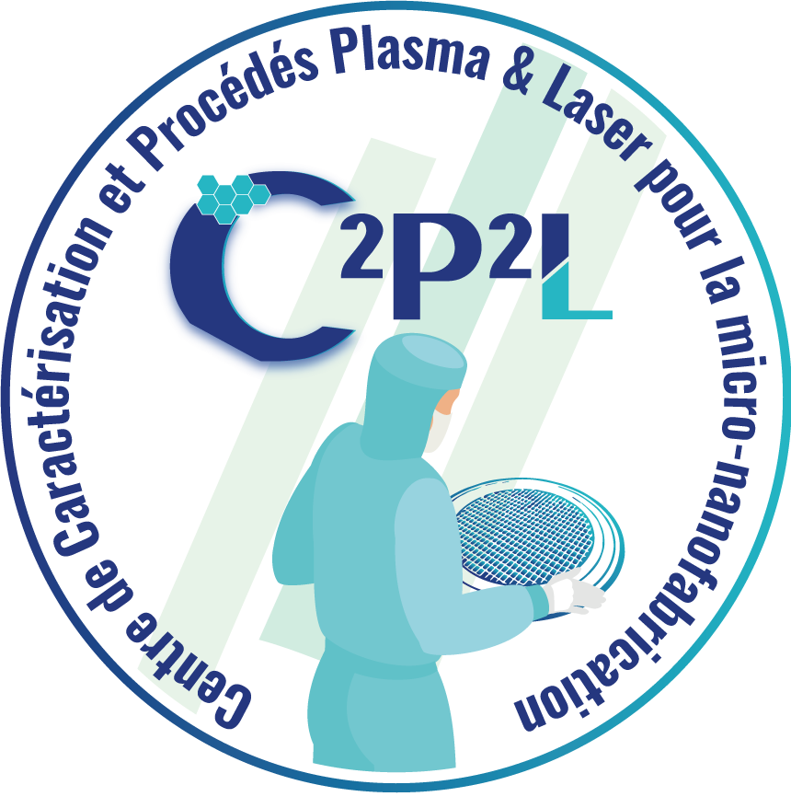
MC23 Plasmas industriels pour la microélectronique et les nouveaux matériaux
Gravure par Plasma du Titane :
une technique innovante pour la miniaturisation des dispositifs médicaux implantables
Rim Ettouri¹, Thomas Tillocher¹, Philippe Lefaucheux¹, Bertrand Boutaud² et Rémi Dussart¹
¹ Groupe de Recherches sur l’Energétique des Milieux Ionisés (GREMI), 45067 Orléans, France
² MISTIC SAS, Issy-les-Moulineaux, 92130, France
rim.ettouri@univ-orleans.fr

Slide 2
MC23 Plasmas industriels pour la microélectronique et les nouveaux matériaux
Plasma Etching of Titanium :
An Innovative Technique for Miniaturizing Implantable Medical Devices
Rim Ettouri¹, Thomas Tillocher¹, Philippe Lefaucheux¹, Bertrand Boutaud² et Rémi Dussart¹
¹ Groupe de Recherches sur l’Energétique des Milieux Ionisés (GREMI), 45067 Orléans, France
² MISTIC SAS, Issy-les-Moulineaux, 92130, France
rim.ettouri@univ-orleans.fr

Slide 3
Overview
Introduction to Titanium-based MEMS for Biomedical Applications
Active Implantable Medical Devices (AIMD)
Why Titanium?
Sampling of Current Projects
Introduction to Microsystems and Microfabrication
The Microelectronics Paradigm
Microsystems Fabrication Schemes
Microsystems Materials Landscape
Critical Tasks in High-Aspect-Ratio Titanium Deep Etching
High-Aspect-Ratio (HAR) Titanium Etching
Study of Etching Residues and Contamination of the Plasma Reactor
Process Flow Optimization for Reproducible Microfabrication Processes
Rim Ettouri
rim.ettouri@univ-orleans.fr
3

Slide 4
Introduction to Titanium-based MEMS for Biomedical Applications
Rim Ettouri
rim.ettouri@univ-orleans.fr
4
4

Slide 5
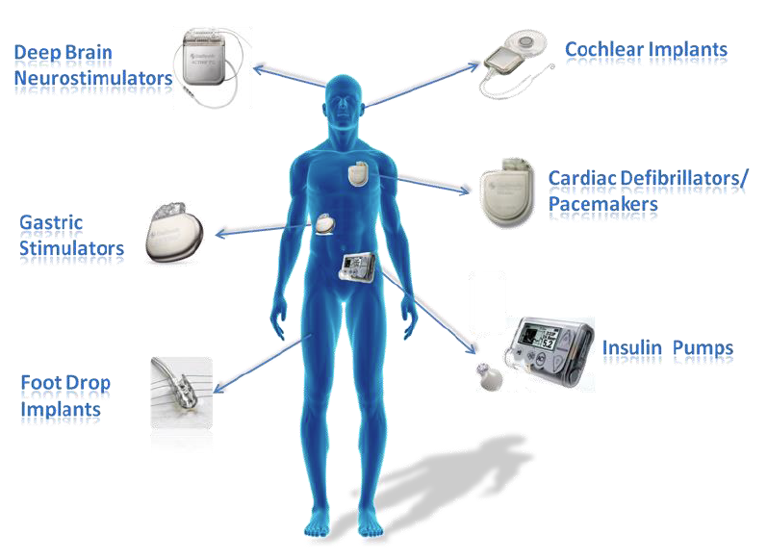
Active Implantable Medical Devices (AIMD)
Devices implanted in the human body > 29 days
Detection, monitoring, treatment of diseases
Implanted as close as possible to organs
Evolution of AIMD
Smaller: Ease implantation by surgeons, closer to areas to be treated
Smarter: more functions (communication, monitoring…)
Longer lifetime
AIMD are embedded in a sealed titanium-based housing
Functionalization of the housing to miniaturize AIMD and integrated more functions
Rim Ettouri
rim.ettouri@univ-orleans.fr
5

Slide 6
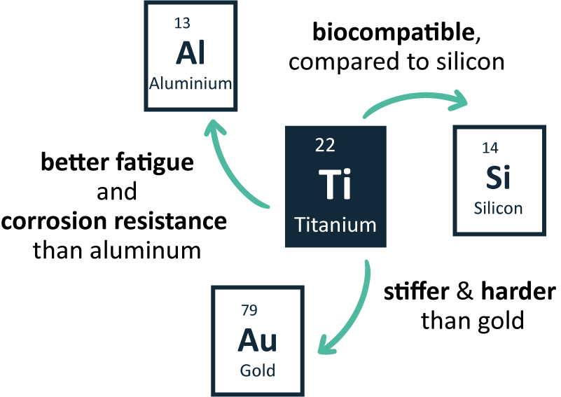
Why Titanium?
“Bio-MEMS”
Functionalizing the titanium-based housing of medical implants:
Feedthroughs
Embedded capacitive filter
RF Antenna
Electrodes / Sensors
The aerospace, chemical and medical sectors rely on titanium’s strength-to-weight ratio, biocompatibility and corrosion properties.
Rim Ettouri
rim.ettouri@univ-orleans.fr
6

Slide 7
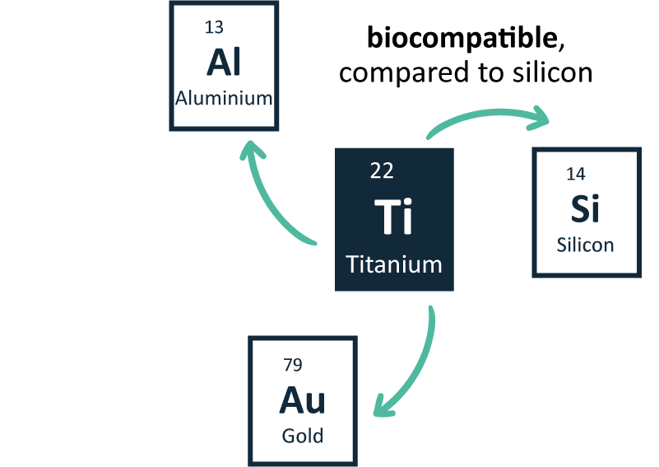
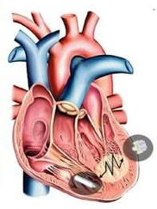
Why Titanium?
“Bio-MEMS”
Functionalizing the titanium-based housing of medical implants:
Feedthroughs
Embedded capacitive filter
RF Antenna
Electrodes / Sensors
Courtesy of MicroPort CRM
(ex SORIN CRM)
Rim Ettouri
rim.ettouri@univ-orleans.fr
7

Slide 8
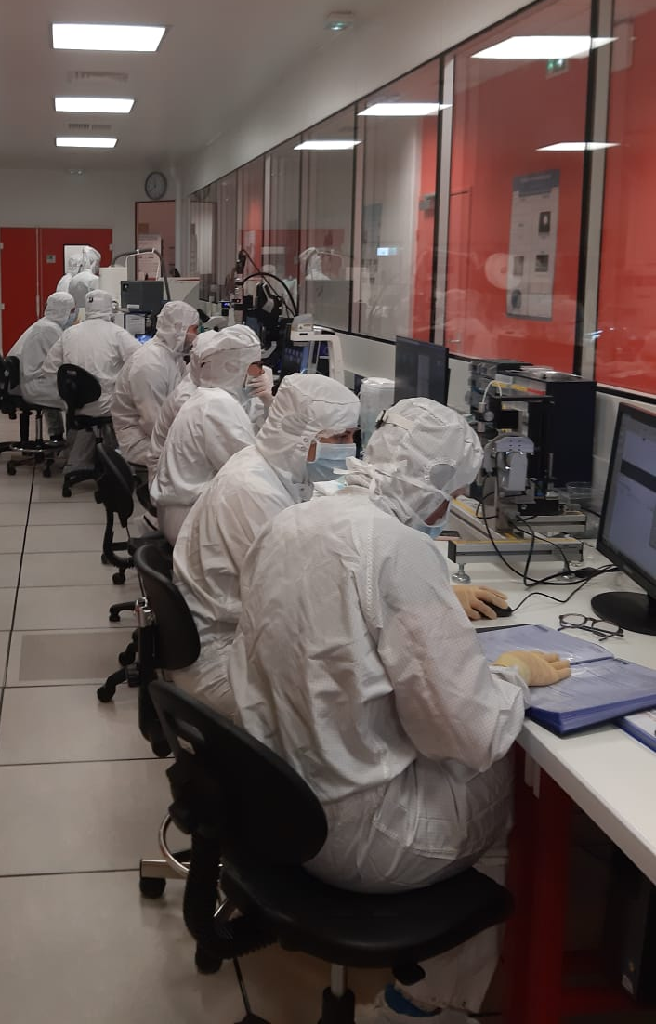
Sampling of Current Projects
ProTiMe
Realization and characterization of micro/nano-structured titanium-based surfaces
Micro/nanostructuring of titanium by etching it through micro/nanostructured polymer surfaces.
Analysis of the structure and chemical composition of titanium after etching.
Characterization of processed titanium surfaces
Influence of the nature of the titanium surface on the biocompatibility.
Study of the contamination the substrate surface.
2021 - 2024
ProTiMe
ARD CVL Microélectronique
Post-process characterization of titanium-based surfaces for implantable medical devices.
C²P²L Platform
Clean room (GREMI)
Rim Ettouri
rim.ettouri@univ-orleans.fr
8

Slide 9
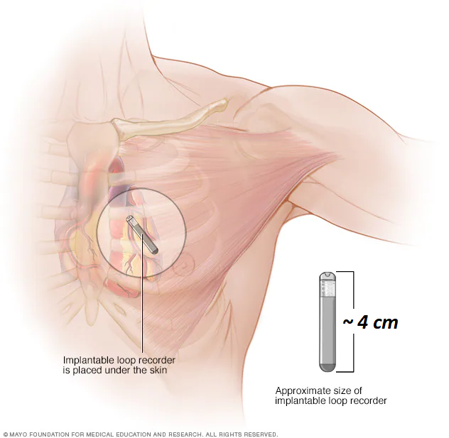
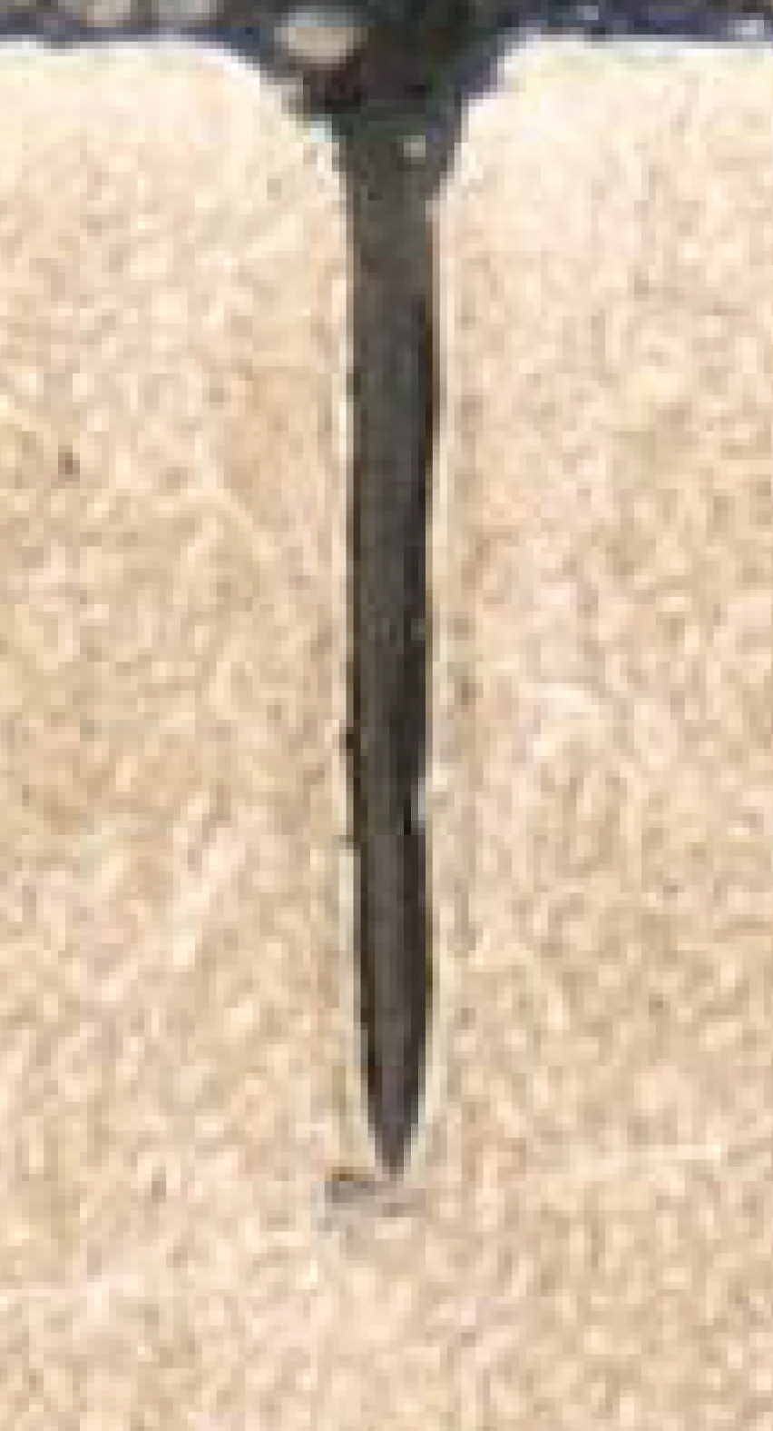
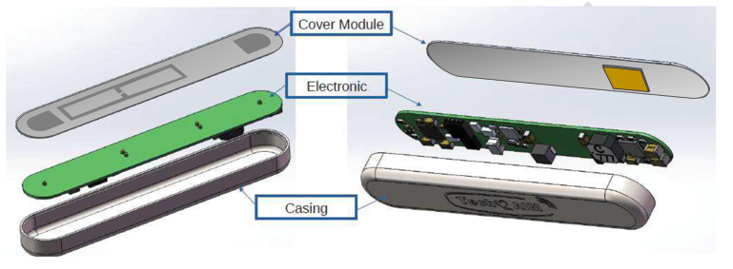
Sampling of Current Projects
2020 - 2023
Tech2AIM
5 µm
Turnkey TECHnologies to enable next generation Active Implantable Medical devices
Development of an ultrasound recharging system.
Communication by antenna integrated on the titanium housing.
Electrodes for electrocardiogram (ECG) detection also integrated on the titanium housing.
Rim Ettouri
rim.ettouri@univ-orleans.fr
9

Slide 10
Overview
Introduction to Titanium-based MEMS for Biomedical Applications
Active Implantable Medical Devices (AIMD)
Why Titanium?
Sampling of Current Projects
Introduction to Microsystems and Microfabrication
The Microelectronics Paradigm
Microsystems Fabrication Schemes
Microsystems Materials Landscape
Critical Tasks in High-Aspect-Ratio Titanium Deep Etching
High-Aspect-Ratio (HAR) Titanium Etching
Study of Etching Residues and Contamination of the Plasma Reactor
Process Flow Optimization for Reproducible Microfabrication Processes
Rim Ettouri
rim.ettouri@univ-orleans.fr
10

Slide 11
Introduction to Microsystems and Microfabrication
Courtesy of STMicroelectronics
Rim Ettouri
rim.ettouri@univ-orleans.fr
11
11

Slide 12
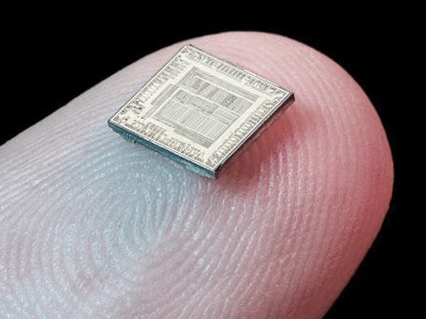
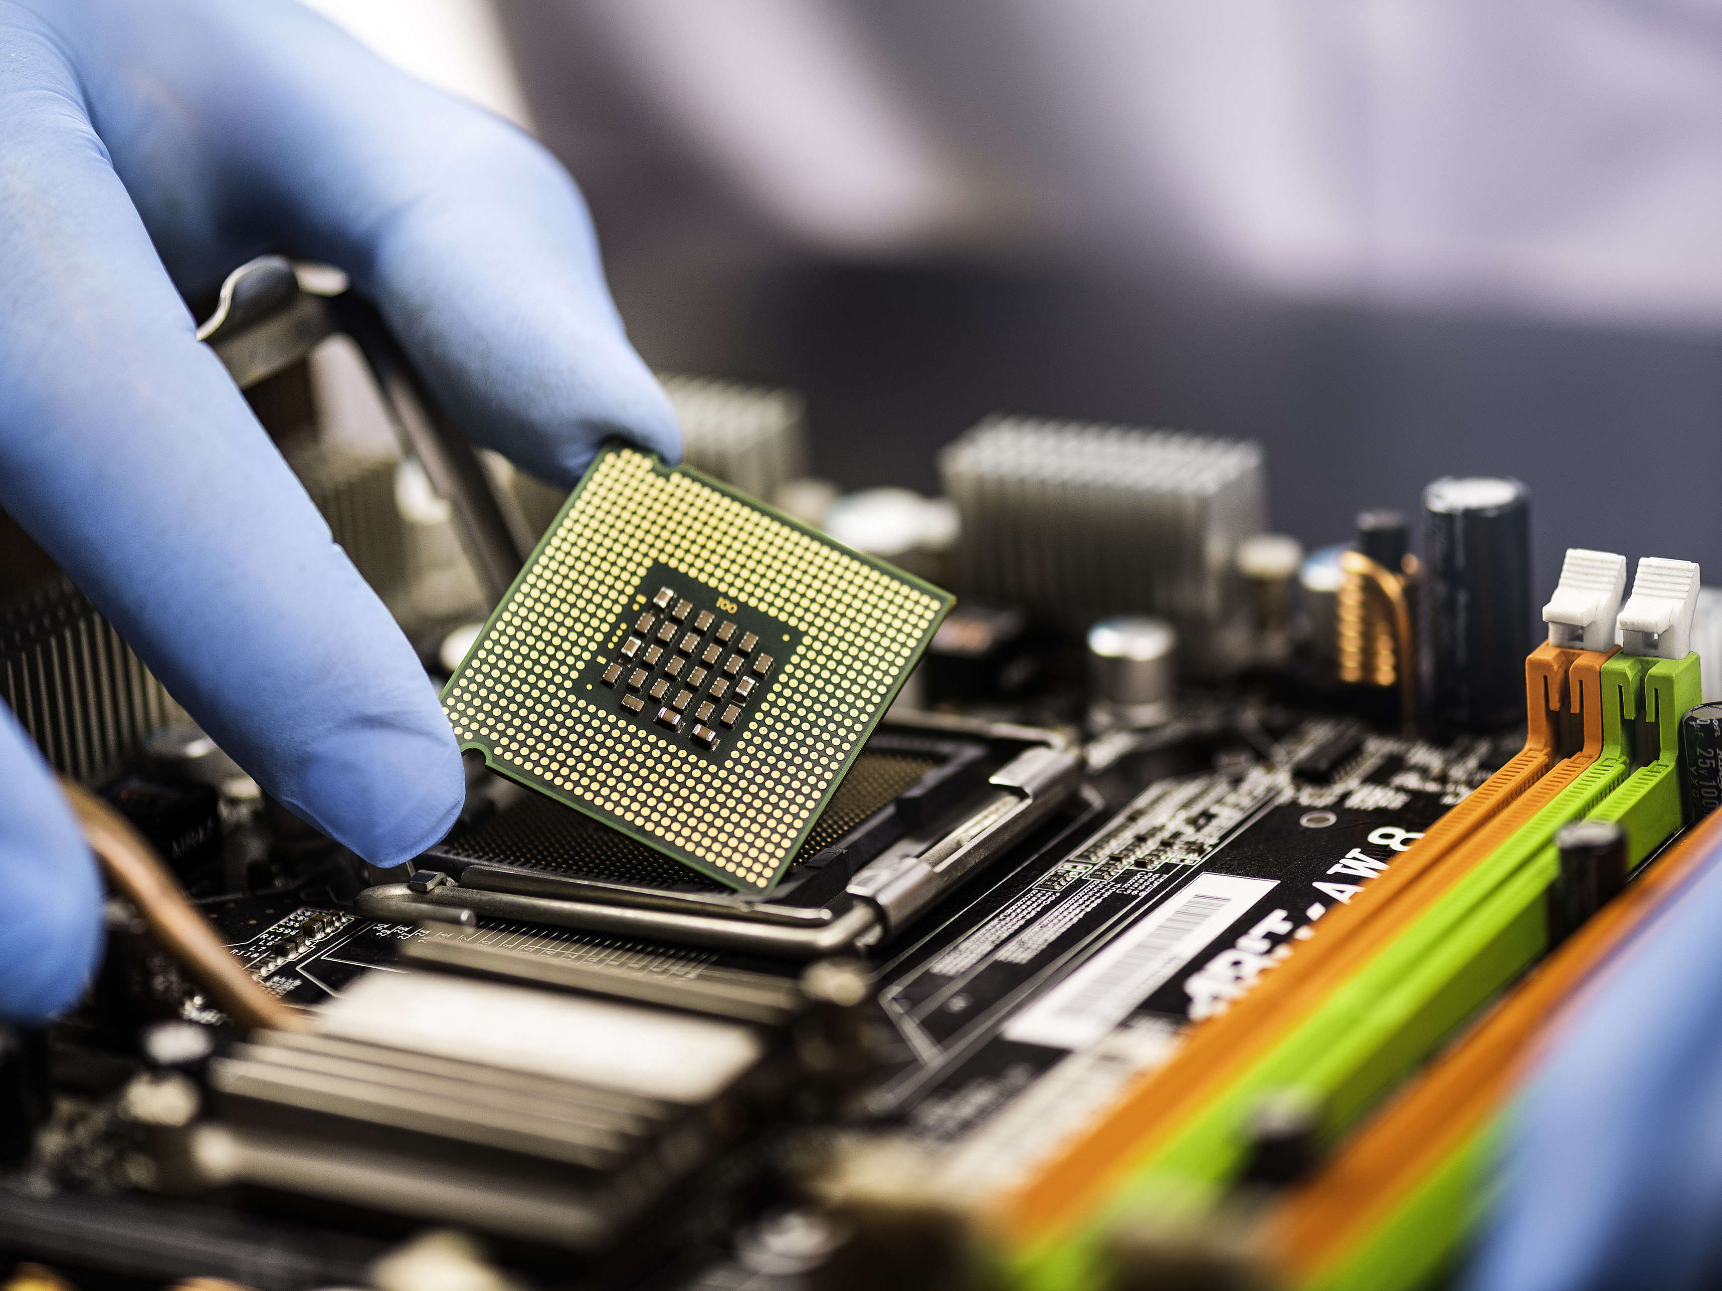
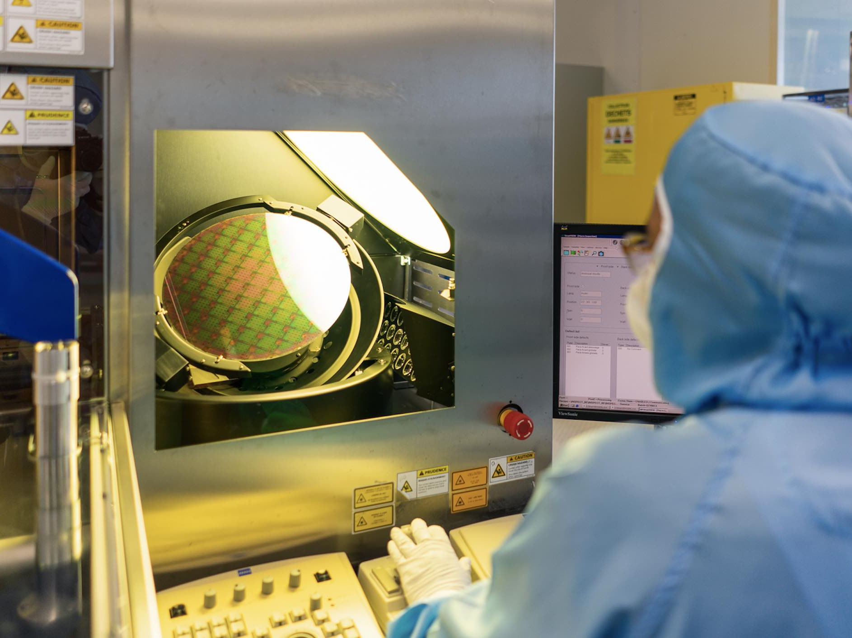
The Microelectronics Paradigm
Courtesy of IBM
Courtesy of Intel
Courtesy of STMicroelectronics
Miniaturization
Large Scale Integration
Batch Fabrication
Devices vary from below one micron up to several millimeters.
Trends towards shrinking down size and volumes.
Better shielding of weak electric signals from sensors.
Reduction of connection cables.
Save cost on extra electronics housing.
Lower the price by collective fabrication on planar substrates.
Improved reproducibility, accuracy and reliability.
Rim Ettouri
rim.ettouri@univ-orleans.fr
12

Slide 13
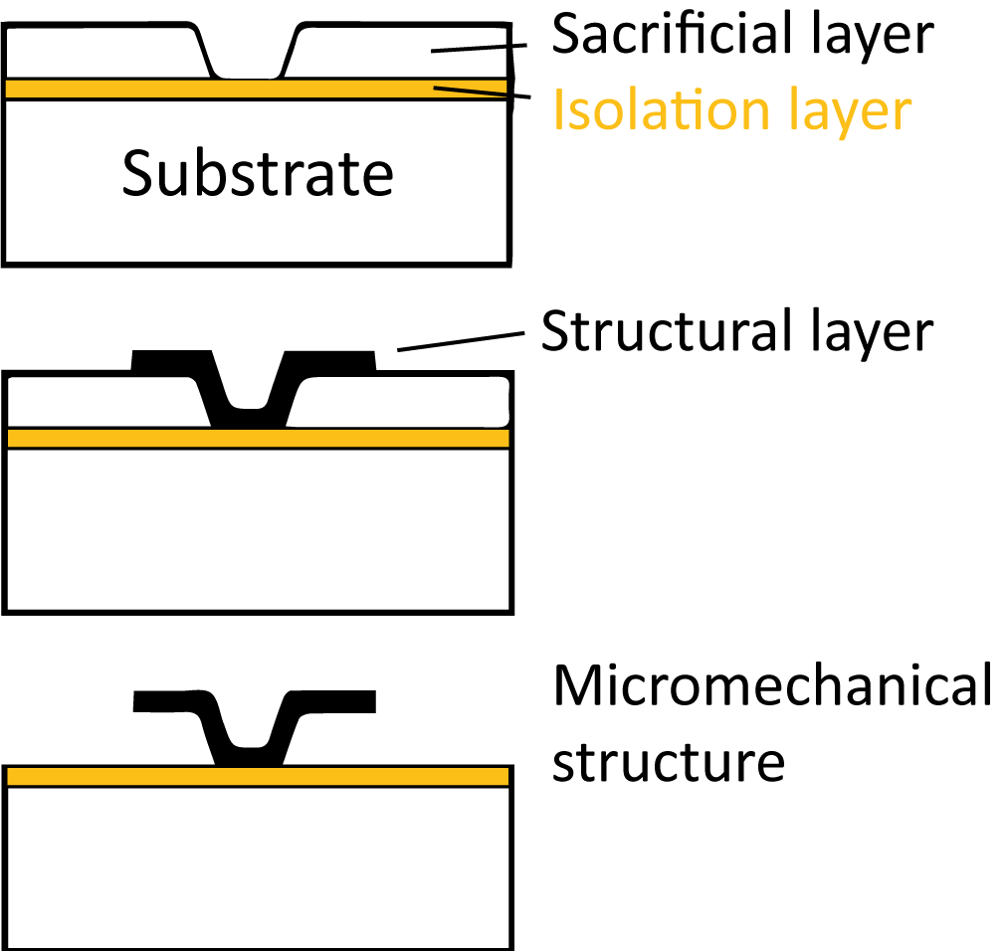
Microsystems Fabrication Schemes
Surface micromachining
Additive
Bottom-up approach
+
Complex multi-layer structures possible
Freedom of integration
-
Constrained to thin layers
Quality of deposited materials can be problematic
Adapted from: Understanding Smart Sensors, Third Edition, 2013, Artech House.
Rim Ettouri
rim.ettouri@univ-orleans.fr
13

Slide 14
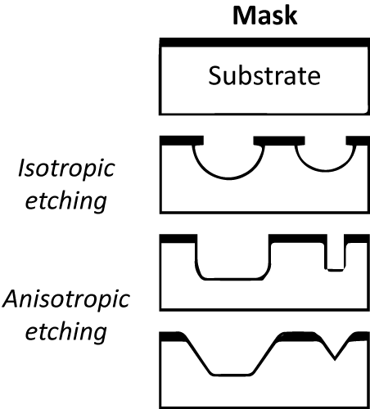
Microsystems Fabrication Schemes
Bulk micromachining
Subtractive
Top-down approach
+
Greater structural thickness
Good material reliability
-
Constrained to single layer structures
Materials selection is limited
Adapted from: Understanding Smart Sensors, Third Edition, 2013, Artech House.
Rim Ettouri
rim.ettouri@univ-orleans.fr
14

Slide 15
Microsystems Materials Landscape
Single crystalline substrates
Silicon, quartz (crystalline SiO₂), gallium arsenide (GaAs), silicon carbide (SiC), lithium niobate (LiNbO₃) and sapphire (Al₂O₃).
Amorphous substrates
Glass, fused silica (pure SiO₂; chemically it is identical to quartz) and alumina (Al₂O₃).
Polymers
SU-8, PDMS, etc.
Metals
Al, Ni, Cu, Au, etc.
Silicon & Si-based materials predominate as materials of choice for microsystems, largely due to microelectronics legacy.
→ New applications, performance, and cost requirements are driving development of alternatives.
→ Bulk Titanium .
Rim Ettouri
rim.ettouri@univ-orleans.fr
15

Slide 16
Overview
Introduction to Titanium-based MEMS for Biomedical Applications
Active Implantable Medical Devices (AIMD)
Why Titanium?
Sampling of Current Projects
Introduction to Microsystems and Microfabrication
The Microelectronics Paradigm
Microsystems Fabrication Schemes
Microsystems Materials Landscape
Critical Tasks in High-Aspect-Ratio Titanium Deep Etching
High-Aspect-Ratio (HAR) Titanium Etching
Study of Etching Residues and Contamination of the Plasma Reactor
Process Flow Optimization for Reproducible Microfabrication Processes
Rim Ettouri
rim.ettouri@univ-orleans.fr
16

Slide 17
Critical Tasks in High-Aspect-Ratio Titanium Deep Etching
17
17

Slide 18
Basic Etching Mechanisms
ions
S
Fx
F-based plasma chemistry
Cl-based plasma chemistry
F
O
Mask
Passivation layer (TiO_{x}F_{y})
Synergistic process between chemically active species and energetic ion bombardment.
Ti
F
4
Substrate
Rim Ettouri
rim.ettouri@univ-orleans.fr
18

Slide 19
High-Aspect-Ratio (HAR) Titanium Etching
Titanium can be etched provided thermodynamically stable and volatile by-products are formed
Reaction pathway
F-based plasma chemistry
Cl-based plasma chemistry
Ti
Ti
F
Cl
Endothermic
New scheme
TiF
TiCl
F
Cl
Cl
TiF₂
TiCl₂
F
TiF₃
TiF_{x}Cl_{y}
Cl
TiCl₃
F
Cl
TiF₄
Cl
TiCl₄
Synergistic effect between F and Cl radicals*, which increases the etch rate
Low volatility
Each basic scheme presents one limitation
35 µm
* d’Agostino et al., Journal of Applied Physics 72 (1992),
Rim Ettouri
rim.ettouri@univ-orleans.fr
19

Slide 20
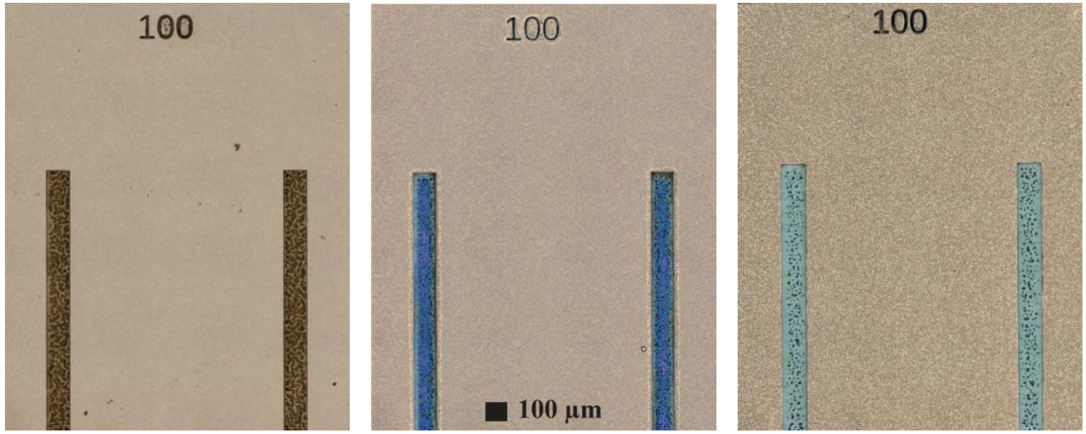
Effect of Process Gases on Fabricating Anisotropic Ti Structures: Oxidation Behavior of Ti in an SF₆/O₂/Ar plasma
(a) (b) (c)
Sequence of colors obtained as a function of oxide layer thickness in the range of 0-90 nm.
[5] Antończak, A.J., Stępak, B., Kozioł, P.E. et al. The influence of process parameters on the laser-induced coloring of titanium. Appl. Phys. A 115, 1003–1013 (2014).
yellow (17nm); light brown (24nm); brown (28nm); violet (31nm); dark blue (40nm); sky blue (46nm); green
(a) SF₆:O₂:Ar = 80:40:20 (b) SF₆:O₂:Ar = 80:20:20 (c) SF₆:O₂:Ar = 60:40:40
Cross sections of 25 μm wide trenches & top view images of 100 μm wide trenches
etched under various O₂-based etching environments: (a) SF₆:O₂:Ar = 80:40:20,
(b) SF₆:O₂:Ar = 80:20:20 and (c) SF₆:O₂:Ar = 60:40:40.
Conditions: 10 mTorr, P_{ICP}=1200 W, P_{bias}=250 W and Δt=30 min.
Rim Ettouri
rim.ettouri@univ-orleans.fr
20

Slide 21
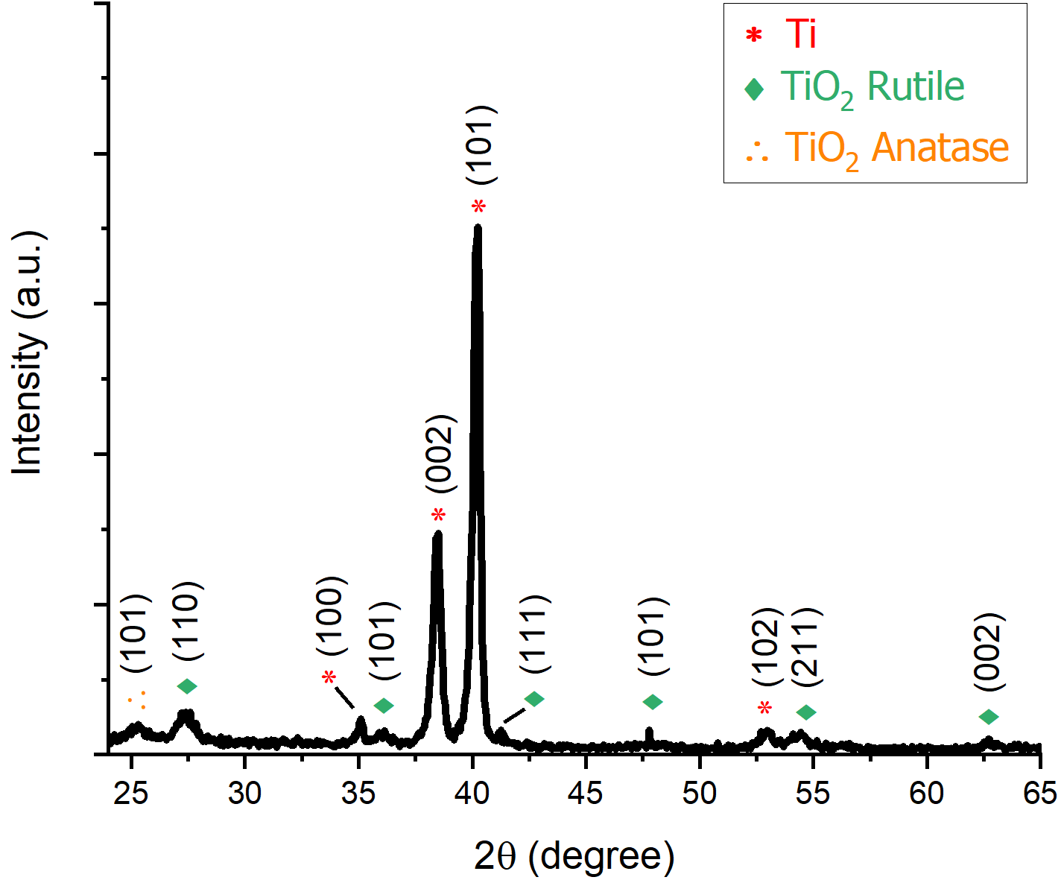
Effect of Process Gases on Fabricating Anisotropic Ti Structures: Oxidation Behavior of Ti in an SF₆/O₂/Ar plasma
yellow (17nm); light brown (24nm); brown (28nm); violet (31nm); dark blue (40nm); sky blue (46nm); green
(a) SF₆:O₂:Ar = 80:40:20 (b) SF₆:O₂:Ar = 80:20:20 (c) SF₆:O₂:Ar = 60:40:40
Cross sections of 25 μm wide trenches & top view images of 100 μm wide trenches
etched under various O₂-based etching environments: (a) SF₆:O₂:Ar = 80:40:20,
(b) SF₆:O₂:Ar = 80:20:20 and (c) SF₆:O₂:Ar = 60:40:40.
Conditions: 10 mTorr, P_{ICP}=1200 W, P_{bias}=250 W and Δt=30 min.
Grazing incidence X-ray diffraction (GiXRD) patterns of a bulk titanium sample after etching in an SF₆/O₂/Ar = 60:40:40 plasma.
Rim Ettouri
rim.ettouri@univ-orleans.fr
21

Slide 22
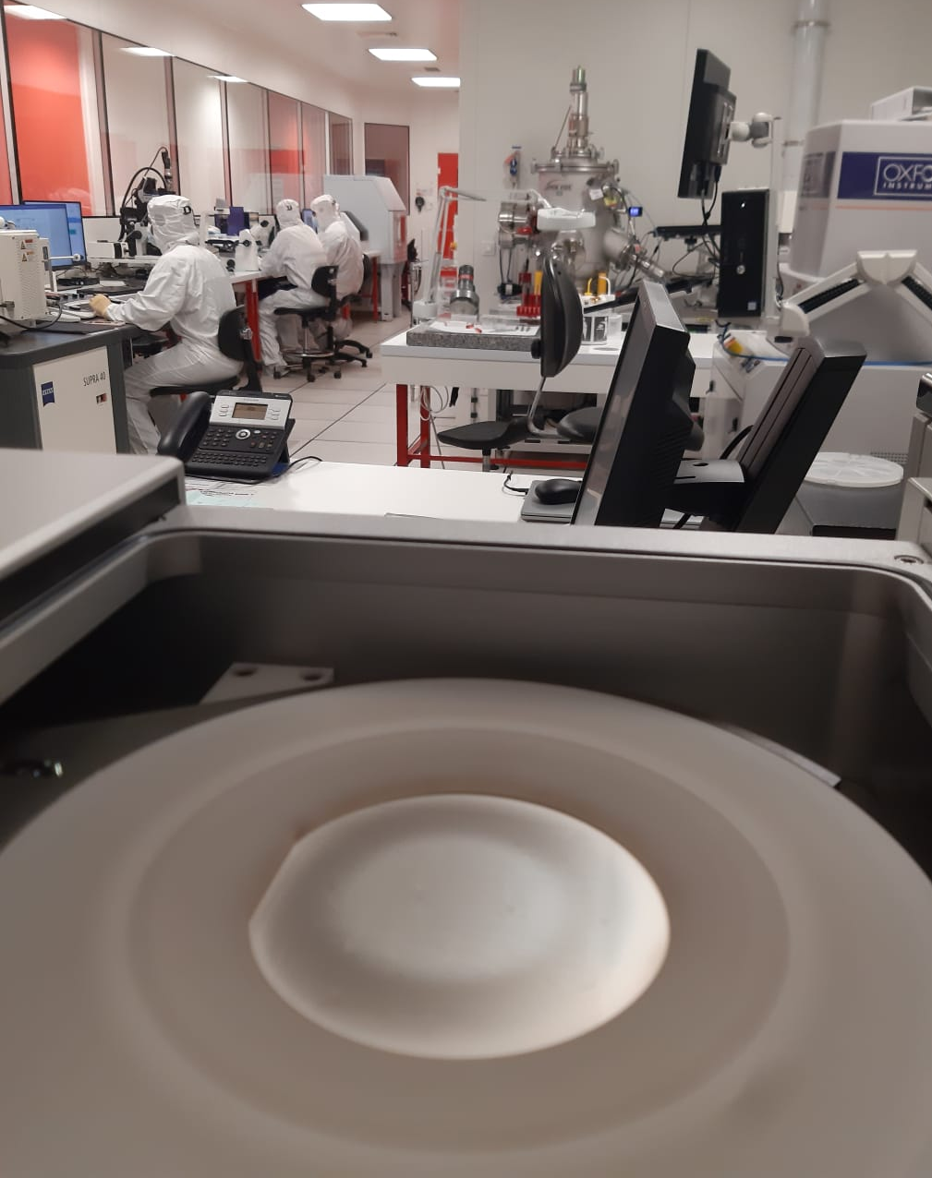
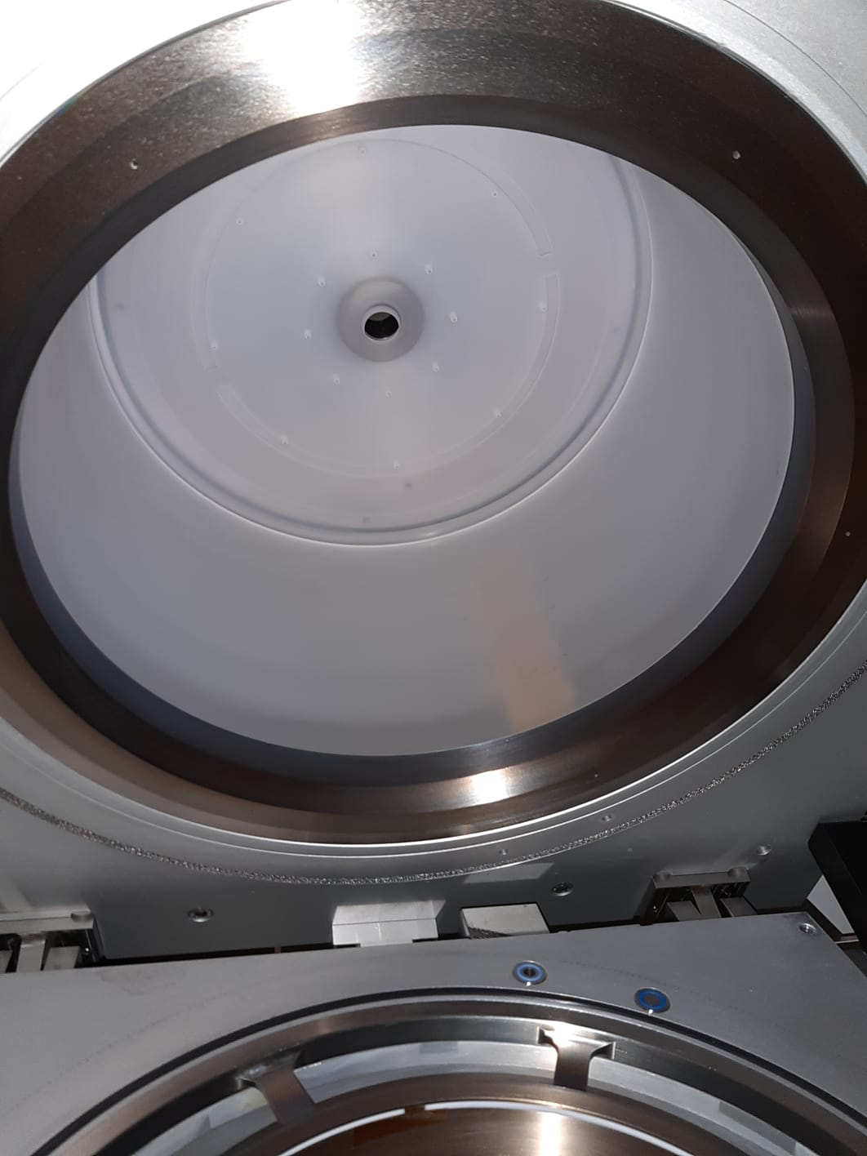
Path to Manufacturability: Influence of the Reactor Walls on the Reproducibility
Semiconductor processing infrastructure
Sub-μm resolution & tolerances
High fabrication yield
Large scale integration
Excellent reproducibility
Prevention of contamination and defects
Quartz Shuttle Substrate Holder
Quartz Reactor Walls
Rim Ettouri
rim.ettouri@univ-orleans.fr
22

Slide 23
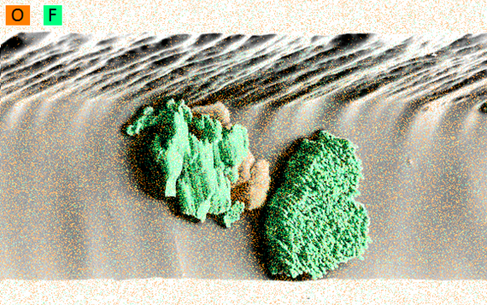
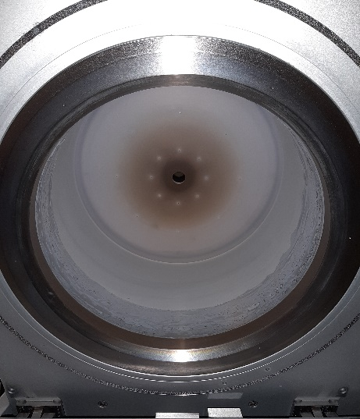
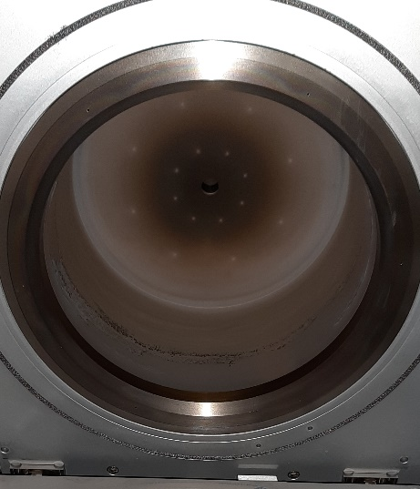
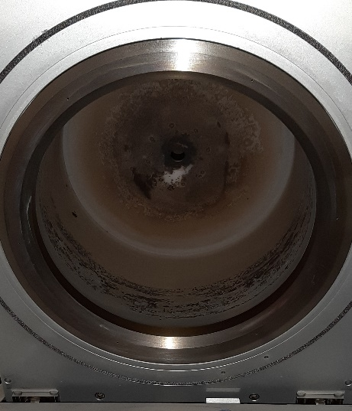
Path to Manufacturability: Study of Etching Residues and Contamination of the Plasma Reactor
(a) (b) (c)
Evolution of Reactor Wall Contamination During Plasma Etching Of Cl₂/SF₆/O₂ after (a) 30, (b) 120 and (c) 360 minutes respectively.
EDS mapping of the composition of the residues deposited in the titanium trench after etching.
Rim Ettouri
rim.ettouri@univ-orleans.fr
23

Slide 24
Summary
Fabrication of Titanium-based MEMS for Biomedical Applications
Titanium: particularly interesting for many applications
Critical Tasks in High-Aspect-Ratio Titanium Deep Etching
Anisotropic features can be etched by a fluorine based plasma (SF₆/Ar/O₂)
Necessary to heat the substrate for both etching and passivation
TiO_{x}F_{y} passivation layer at the sidewalls
High aspect ratio features can be etched by Cl₂/SF₆/O₂ plasma
Synergistic effect of F and Cl radical
Increase of both etch rate selectivity to the Ni mask
Enhancement of anisotropy with addition of O₂
Aspect ratio as high as 12 could be obtained
Process Flow Optimization for Reproducible Microfabrication Processes
Rim Ettouri
rim.ettouri@univ-orleans.fr
24

Slide 25
Acknowledgements
The work has been supported by the Centre val de Loire Region under the PSPC-Regions project n°1, Project Tech2AIM
Turnkey TECHnologies to enable next generation Active Implantable Medical devices
and within the framework of the CERTeM 5.0, through the ProTiMe project.
GREMI
Prof. Rémi Dussart
Dr. Thomas Tillocher
Mr. Philippe Lefaucheux
Dr. Tinghui Zhang
MISTIC
Mr. Bertrand Boutaud
Dr. Gwenaël Bécan
Mr. Hadrien Philippe
Ms. Jodie Phung
Thank You!
Rim Ettouri
rim.ettouri@univ-orleans.fr
25

