Slide 1
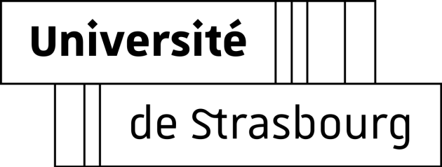
Cosmological structure formation with negative mass
Giovanni Manfredi
Centre National de la Recherche Scientifique
Institut de Physique et Chimie des Matériaux de Strasbourg
Gabriel Chardin, CNRS, France
Bruce Miller, Texas Christian University, USA
Jean-Louis Rouet, Université d’Orléans, France

Slide 2
Antimatter and gravitation
Why we see no antimatter in today’s universe?
Antimatter created in the primordial universe, but…
Observations exclude large amounts of antimatter in visible universe
No signature of gamma rays produced during annihilations
CP violation cannot explain observed asymmetry
Open questions on gravitation
Acceleration of the expansion of the universe (1998) ‒ Dark Energy
Matter content of the universe ‒ Dark Matter
Primordial inflation (~1980) ‒ Inflaton field
Gravitational behavior of antimatter
Current experiments at CERN: GBAR, ALPHA-g, AEGIS

Slide 3
Cosmological models
The standard model: ΛCDM
Λ → dark energy (70%) → accelerated expansion (≈ repulsive gravity!)
CDM (Cold Dark Matter): 25%
Ordinary matter (baryonic) : 5%
Scale factor:
$a\left(t\right)\sim { t}^{2/3}$ (matter-dominated age)
$a\left(t\right) \sim e^{Λt}$ (Λ-dominated age)
Dirac-Milne universe
Matter-antimatter symmetric universe
Repulsion between matter and antimatter (negative mass)
Antimatter spreads almost uniformly across the universe
Total matter content = 0 ($Ω_{M}=0)$
No cosmological constant ($Ω_{Λ}=0)$; No need for inflationary phase
Scale factor: $a\left(t\right)\sim t$
(see: A. Benoit-Lévy and G. Chardin, A&A 537, A78 (2012))

Slide 4
Mass in Newtonian mechanics
Active gravitational mass $m_{a}$:
Passive gravitational mass $m_{p}$:
Inertial mass $m_{i}$:
Equation of motion:
$$EP: m_{p}=m_{i}$$

Slide 5
Mass in Newtonian mechanics
Active gravitational mass $m_{a}$:
Passive gravitational mass $m_{p}$:
Inertial mass $m_{i}$:
Equation of motion:
$$EP: m_{p}=m_{i}$$
Bondi: runaway acceleration

Slide 6
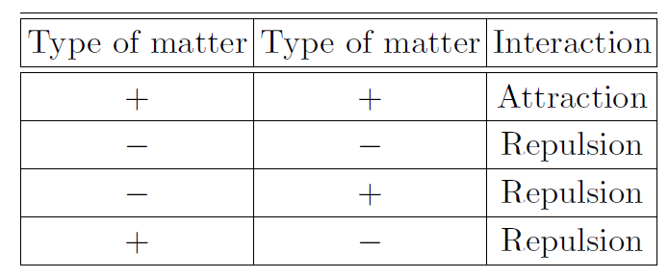
Dirac-Milne scenario
However, the above scenarios are not suited to model the Dirac-Milne universe
Antiplasma:
Does not respect the EP
Allows formation of negative mass structures
Bondi:
Requires negative inertial mass to ensure energy conservation
Unlikely features such as runaway acceleration
We need a generalization of Newtonian gravity for two particle species
Cannot be realized with a single Poisson’s equation
Antimatter spreads uniformly
Matter coalesces into structures

Slide 7
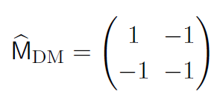
General matrix formalism
Matrix Poisson’s equation
Since there are 2³ = 8 possible cases (one trivial, with all elements = +1)
Antiplasma
Bondi
Anti-inertia
Dirac-Milne
Open question: how to incorporate this approach into General Relativity
Bimetric theory?

Slide 8
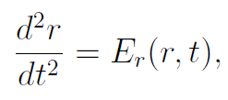
Expanding universe ‒ Comoving coordinates
Equation of motion
Scale factor
$$a\left(t\right)∝e^{Λt}$$
ΛCDM late times
$a(t)$ ~ $t^{2/3}$
Einstein–de Sitter (ΛCDM early times)
$a(t)$ ~ $t$
Dirac – Milne
$$a(t)$$

Slide 9
One-dimensional geometry
1D
3D
r
x
x

Slide 10
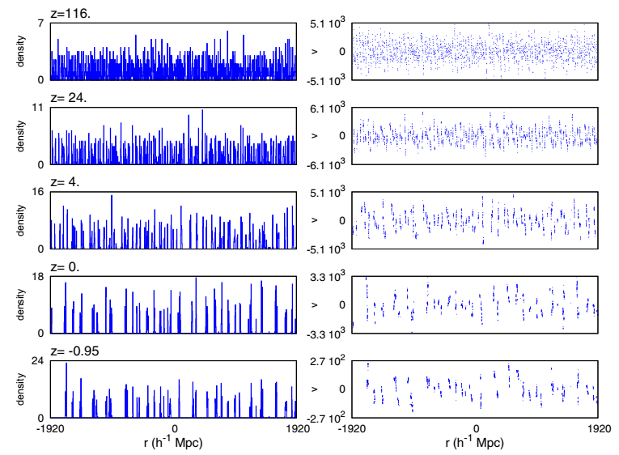
ΛCDM cosmology
Density
Phase space
Now

Slide 11
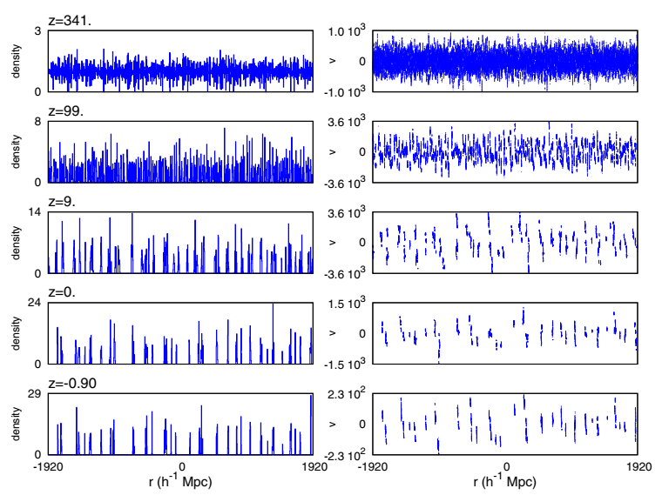
Dirac-Milne cosmology
Density
Phase space
Now

Slide 12
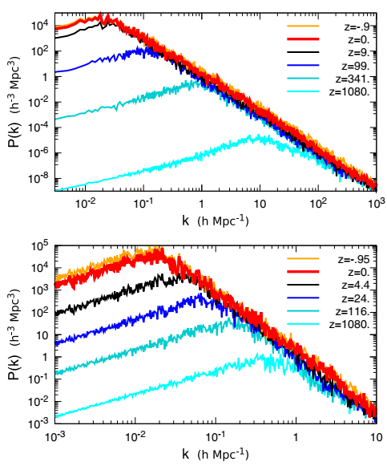
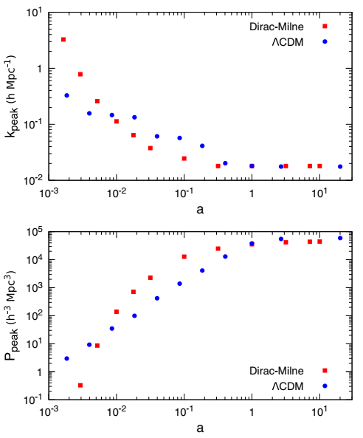
Matter-density power spectrum
Dirac-Milne
ΛCDM

Slide 13
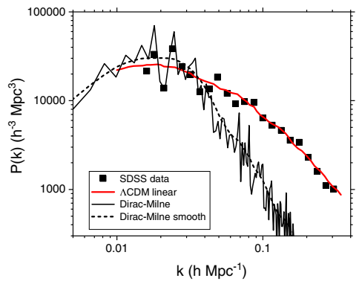
Matter-density power spectrum
∧CDM data from: M. Tegmark et al., Astrophys. J. 606, 702 (2004)

Slide 14
Two-component Dirac-Milne system

Slide 15
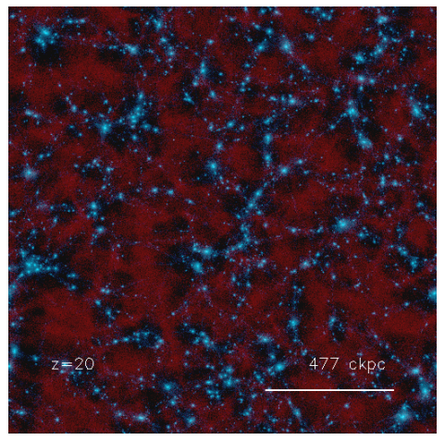
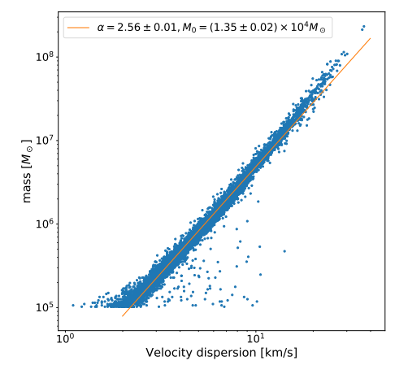
3D simulations and dark matter/MOND
RAMSES code simulation
Faber-Jackson relation
$$m∝v^{α}, α≈2.6$$

Slide 16
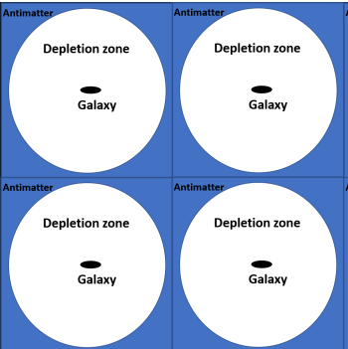
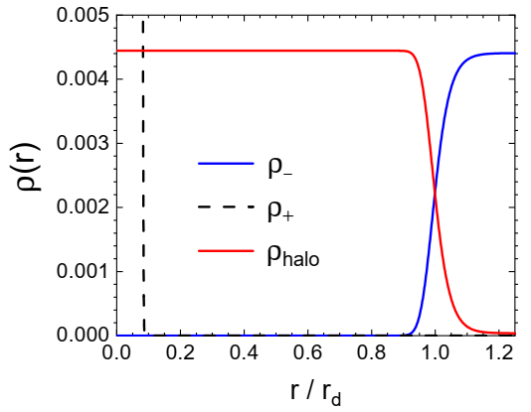
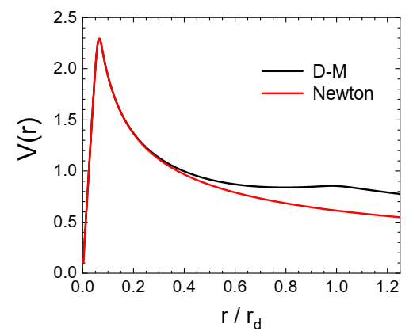
3D simulations and dark matter/MOND
Neg. mass
“Galaxy”
Pos. mass

Slide 17
Conclusions
Newtonian gravity with negative mass
Standard cases with various choices of m_{i}, m_{a}, m_{p} (Bondi, antiplasma,…)
Alternative “bimetric” theories → Dirac-Milne
Cosmological structure formation with negative mass
Comparison between ΛCDM and Dirac-Milne
In Dirac-Milne universe, structure formation begins at an earlier epoch and freezes before ≈ 10¹⁰ Gy
Present power spectra are qualitatively similar to ΛCDM
Local MOND-like behavior
3D simulations show depletion zone and antimatter halos
Compatible with Faber-Jackson relation with exponent 2.6
Flattening of rotation curves

Slide 18
Bibliography
G. Manfredi, J.-L. Rouet, B. Miller, G. Chardin, Cosmological structure formation with negative mass, Phys. Rev. D 98, 023514 (2018).
G. Chardin, G. Manfredi, Gravity, antimatter and the Dirac-Milne universe, Hyperfine Interactions, 239: 45 (2018)
G Manfredi, JL Rouet, BN Miller, G Chardin, Structure formation in a Dirac-Milne universe: comparison with the standard cosmological model, Physical Review D 102, 103518 (2020)
G. Chardin, Y. Dubois, G. Manfredi, B. Miller and C. Stahl, MOND-like behavior in the Dirac–Milne universe: Flat rotation curves and mass versus velocity relations in galaxies and clusters, Astronomy & Astrophysics 652, A91 (2021).

