Slide 1


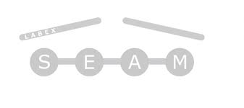

Disentangling lattice and electronic instabilities in the excitonic insulator candidate Ta₂NiSe₅ by non-equilibrium spectroscopy
Yann Gallais
Katsumi et al. Phys. Rev. Lett. 130, 106904 (2023)

Slide 2





Main players
Tr-Raman
Kota Katsumi
Alexandr Alekhin
S. Houver, M. Cazayous, A. Sacuto
Sample growth and characterization
Matthieu Le Tacon
Amir Haghighirad
M. Merz, S. Souliou

Slide 3
Excitonic insulator: the concept
N. Mott Phil. Mag. ‘1961
D. Jérôme, T.M. Rice and W. Kohn, Phys. Rev. ‘1967
BCS
BEC

Slide 4
TNS: an excitonic insultator ?
Ta₂NiSe₅
2D material
Small (zero?) direct band-gap at high-temperature
Semi-metal to insultator transition at 326K
transport
optics
Larkin et al. Nat. Comm. ‘2017

Slide 5
TNS: an excitonic insultator ?
Ta₂NiSe₅
2D material
Small (zero?) direct band-gap at high-temperature
Semi-metal to insultator transition at 326K
ARPES experiments on TNS
transport
optics
Seki et al. Phys. Rev. B ‘2014

Slide 6
Structural transition
Simultaneous structural transition
DFT calculations
Ortho. Phase: interchain Ni-Ta hopping is forbidden by mirror symmetry
Finite hybrization: gap opening and monoclinic distortion
Is the insulating state a result of lattice distortion transition ?
Subedi et al. Phys. Rev. Mat. ‘2020
Watson et al. Phys. Rev. Res. ‘2020
Non-equillibrium approach

Slide 7
Time-resolved Raman scattering set-up
ω_{i}
Raman shift ω_{i}-ω_{s}:
energy of excitation
ω_{s}
Raman : probe optical phonon and electronic excitations
Light polarizations: lattice symmetry
Stokes/anti-Stokes: excited state populations

Slide 8
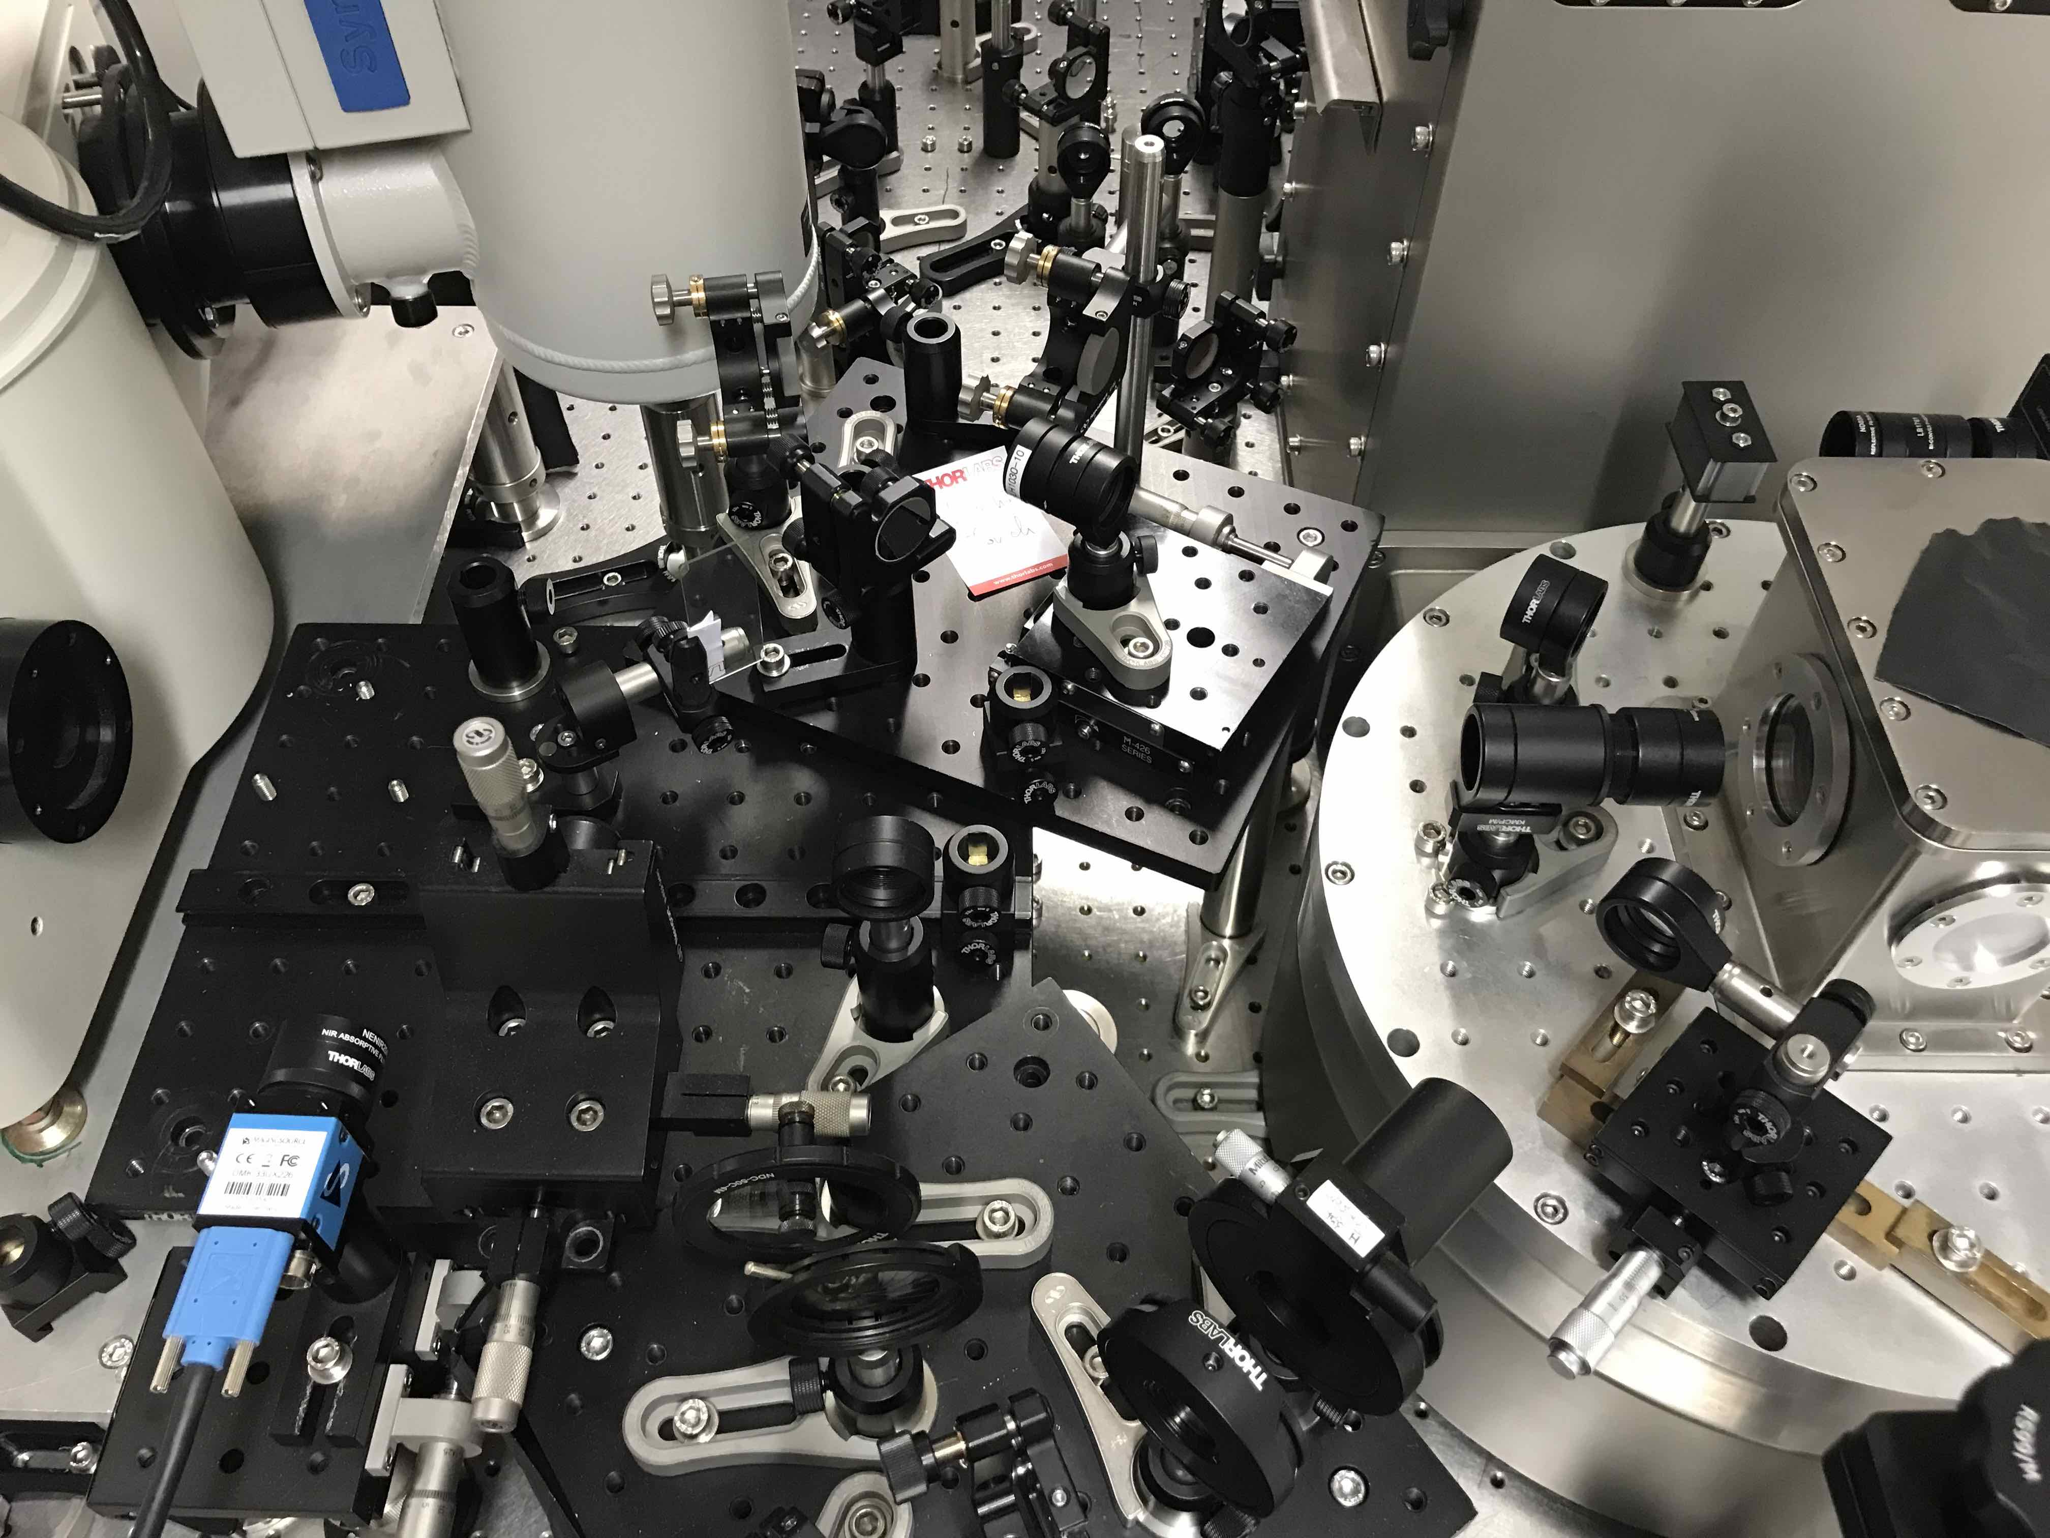
Time-resolved Raman scattering set-up
2-color set-up
spectrometer
Recent upgrade: pulse compressor (50 fs pulses)
Cryostat (3-300K)

Slide 9
Static Raman scattering: phonon
Mode 2: « monoclinic » B_{2g} optical phonon
Raman selection rules: activated in aa geometry in monoclinic phase
Polarization dependence: marker of lattice distorsion
1

Slide 10
Optical emission in the insulating phase
Look for fingerprint of insulating gap at high Raman shift
Not Raman but Photoluminescence (PL) process !
Opening of gap: quench of non-radiative processes
Increase of emission across the gap

Slide 11
Out of equilibrium lattice dynamics
Polarization resolved measurements
5
3
2
2
Time resolution: 2.5 ps
Energy resolution: 9 cm⁻¹
Lattice distortion is weakened in the first 4 ps but recovers afterwards
Remains in the monoclinic phase at all times

Slide 12
Metastable gapless state
After 4 ps: optical emission is quenched to above Tc-like spectrum
Gapless metastable state with monoclinic structure
Favors excitonic scenario
Time resolution: 0.7 ps
Energy resolution: 3 cm⁻¹

Slide 13




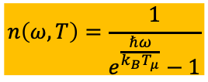
Phonon Mode effective temperature
$$I_{Anti−Stokes}=n\left(ω,T_{μ}\right)χ^{′′}(ω)$$
$$n\left(ω,T\right)=\frac{1}{e^{\frac{ℏω}{k_{B}T_{μ}}}−1}$$
$$I_{Stokes}=(n\left(ω,T_{μ}\right)+1)χ^{′′}(ω)$$
Effective phonon temperature:
$$T_{μ}$$
Phonon Raman response:
$$χ^{′′}$$
Preferential coupling of photo-induced carriers to mode 2 phonon
Back to quasi-equilibrium after 15ps
Gapless state: not a thermal state (i.e. simple heating)

Slide 14
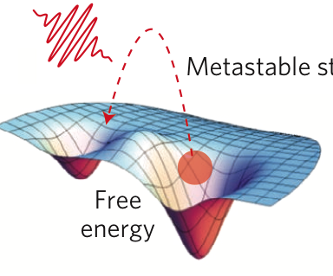
Summary
Katsumi et al. Phys. Rev. Lett. 130, 106904 (2023)
Metastable gapless state….
….with preserved monoclinic distortion
An example of light induced metastable state with unique properties

Slide 15
Origin of metastable state ?
Metastable red-shift of mode 5 optical phonon
Mode 5 is symmetry preserving: not related to monoclinic distortion
Not a simple heating effect
Possible metastable change of the lattice

Slide 16
Raman spectra in equilibrium with CW laser
Above T_{c}
T_{c} = 326 K
Black: A_{g}, Magenta: B_{2g} defined above T_{c}
Mode 2 (70 cm⁻¹) appears in aa below T_{c}
Mode 2 in ac shows assymetric broadening
→ Fano lineshape due to the strong electron-phonon coupling
K. Kim et al., Nat. Comunn. 12, 1969 (2021)
P. A. Volkov, et al., npj Quantum Mater. 6, 52 (2021) from G. Blumberg Gr. [P2]

Slide 17
Raman spectra in equilibrium with CW laser
Above T_{c}
T_{c} = 326 K
Raman selection rule
 | aa | ac
Above T_{c} | A_{g} | B_{2g}
Below T_{c} | A_{g}
Mode 2: Reporter of the structural symmetry breaking

Slide 18
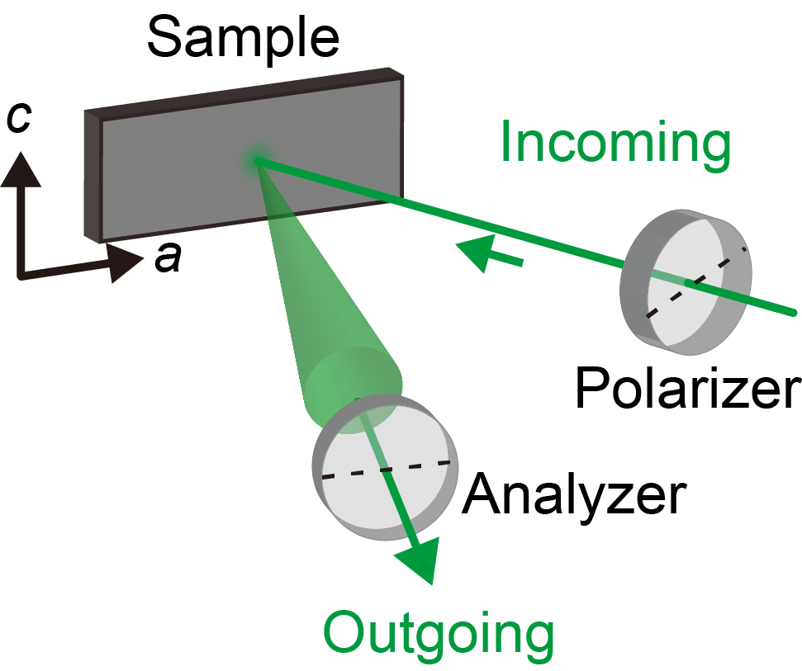
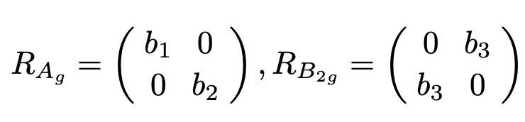
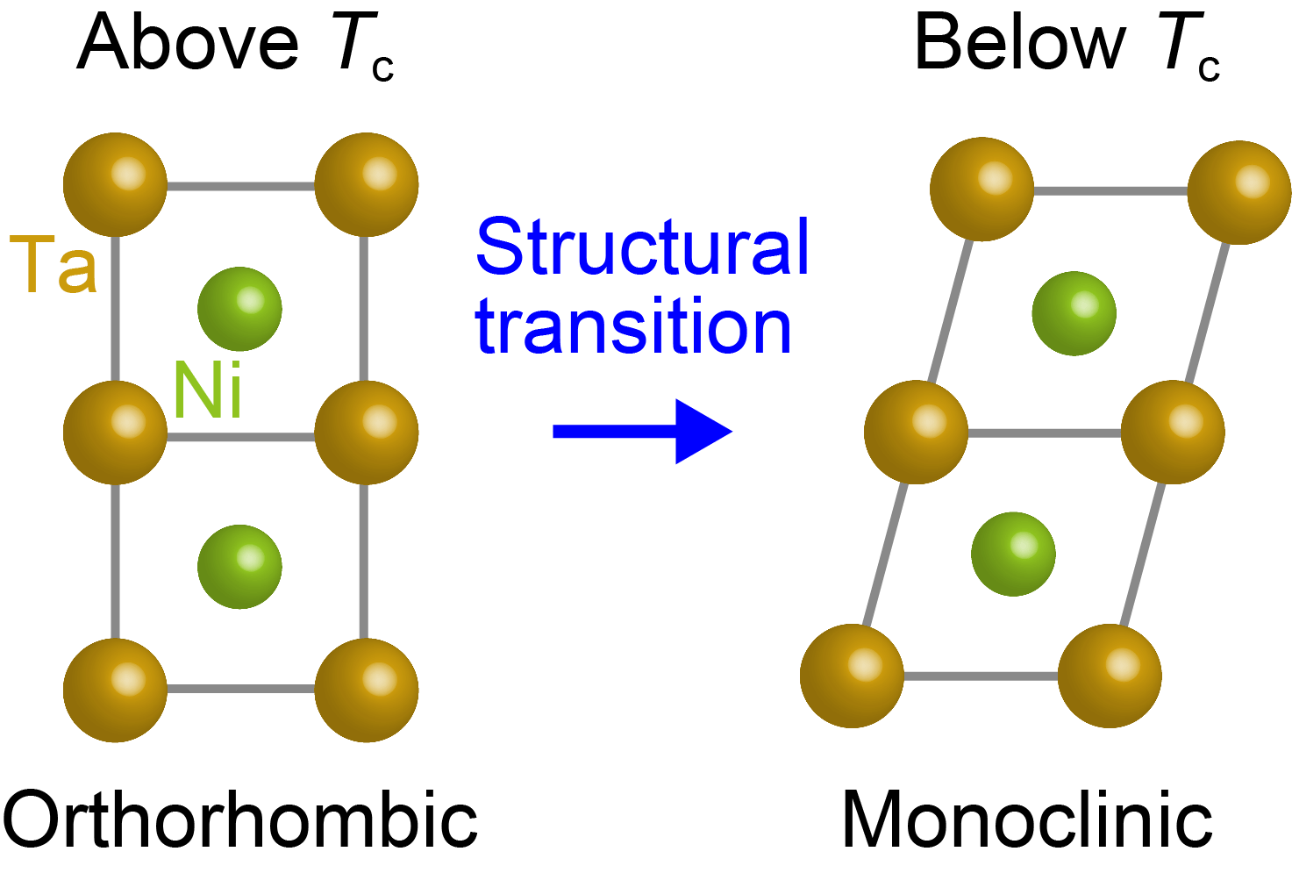
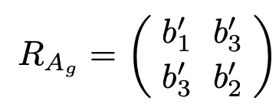
Raman spectroscopy in equilibrium
Raman intensity
Raman tensors in ac-plane above T_{c}
CW laser
(514.5 nm)
Definition
aa : e_{i} // a, e_{o} // a
ac : e_{i} // a, e_{o} // c
Raman selection rule
Raman tensor below T_{c}
No separation
 | aa | ac
Above T_{c} | A_{g} | B_{2g}
Below T_{c} | A_{g}

Slide 19
Pump-probe Raman spectrosopy: Results
5
3
2
2
Pump fluence 1.7 mJ/cm²
Mode 2 and 3 intensities increases, while mode 5 intensity decreases.
Mode 2 in aa is finite after photoexcitation!

Slide 20
Pump-probe Raman spectrosopy: Results
Mode-2 intensity ratio
1.7 mJ/cm²
Mode-2 ratio decreases after pump: weakening monoclinic distortion
Note: time-resolution is 2.5 ps
After 5 ps, it is always greater than that above T_{c}
Up to 2.8 mJ/cm²
Structural symmetry remains in low-T monoclinic phase after photoexcitation

Slide 21




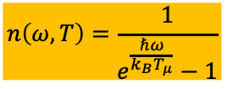
Phonon Mode effective temperature
Anti-Stokes
Stokes
$$I_{Anti−Stokes}=n\left(ω,T_{μ}\right)χ^{′′}(ω)$$
$$I_{Stokes}=(n\left(ω,T_{μ}\right)+1)χ^{′′}(ω)$$
$$n\left(ω,T\right)=\frac{1}{e^{\frac{ℏω}{k_{B}T_{μ}}}−1}$$
Effective phonon temperature:
$$T_{μ}$$
Phonon Raman response:
$$χ^{′′}$$
Preferential coupling of photo-induced carriers to mode 2 phonon
Back to quasi-equilibrium after 15ps
Gapless state: not a thermal state (i.e. simple heating)

Slide 22
Pump probe reflectivity

Slide 23
Out of equilibrium spectroscopy
principle
implementation

Slide 24
Discussion : Metastable state with reduced PL
PL
Phonon temperatures
Temperature recovers to below T_{c}
→ Not the temperature increase
Long-lived photoexcited carrier
→ Screen the Coulomb interaction

Slide 25
Electronic or structural instability ?
Excitonic instability -> finite hybridization -> lattice distortion
Lattice distortion -> finite hybridization -> gap opening
U-V Hartree Fock calculations: finite « excitonic » OP region
DFT: unstable optical phonon mode in ortho phase
Ta
Mazza et al. Phys. Rev. Lett. ‘2020
Ni
Sudebi, Phys. Rev. Mat. ‘2020
Windgatter et al. npj Comput. Mater. ‘2022
Out-of-equilibrium approach: decouples fast electronic from slow lattice degrees of freedom

