Slide 1
Solid State Neuroscience
M. Rozenberg
Laboratoire de Physique des Solides (Orsay)
CNRS & Université Paris-Saclay
why do Neuroscience in a Solid State Physics Lab??

Slide 2
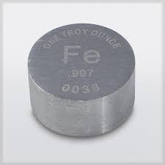
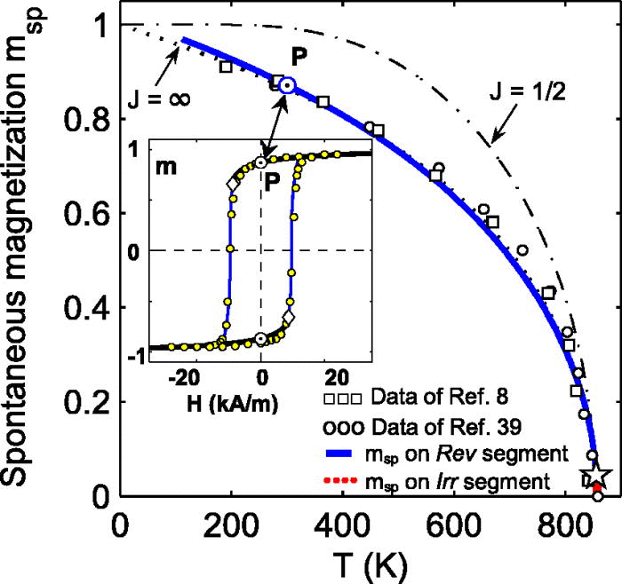
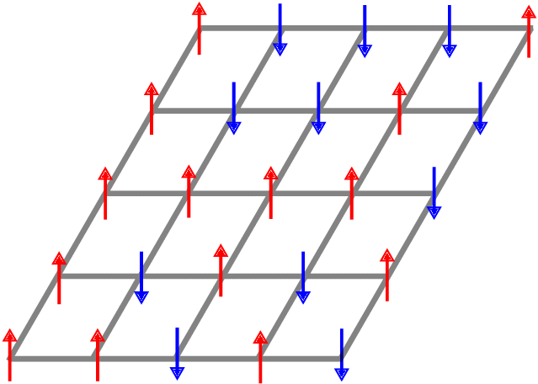
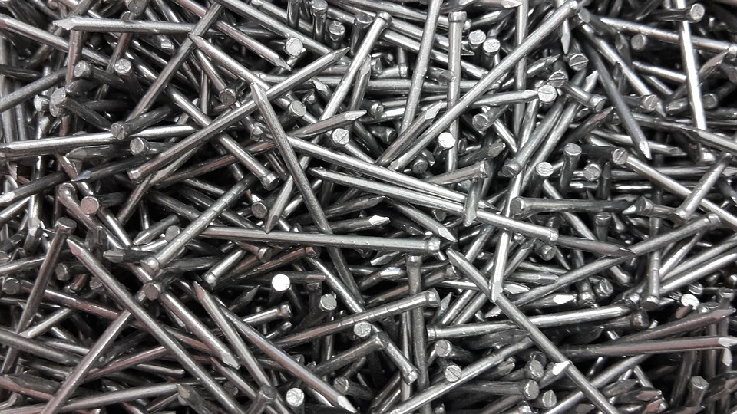
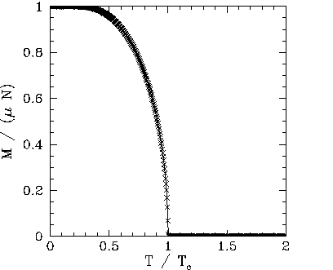
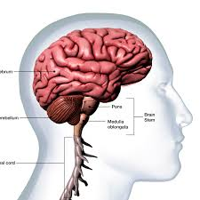
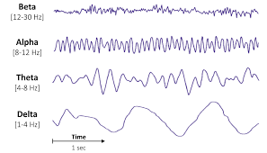
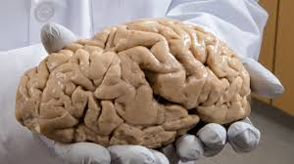
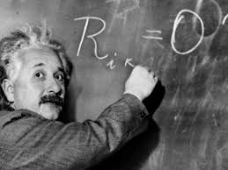
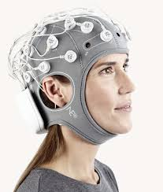
An analogy
Material
Functionality
State of matter
Modeling
?

Slide 3
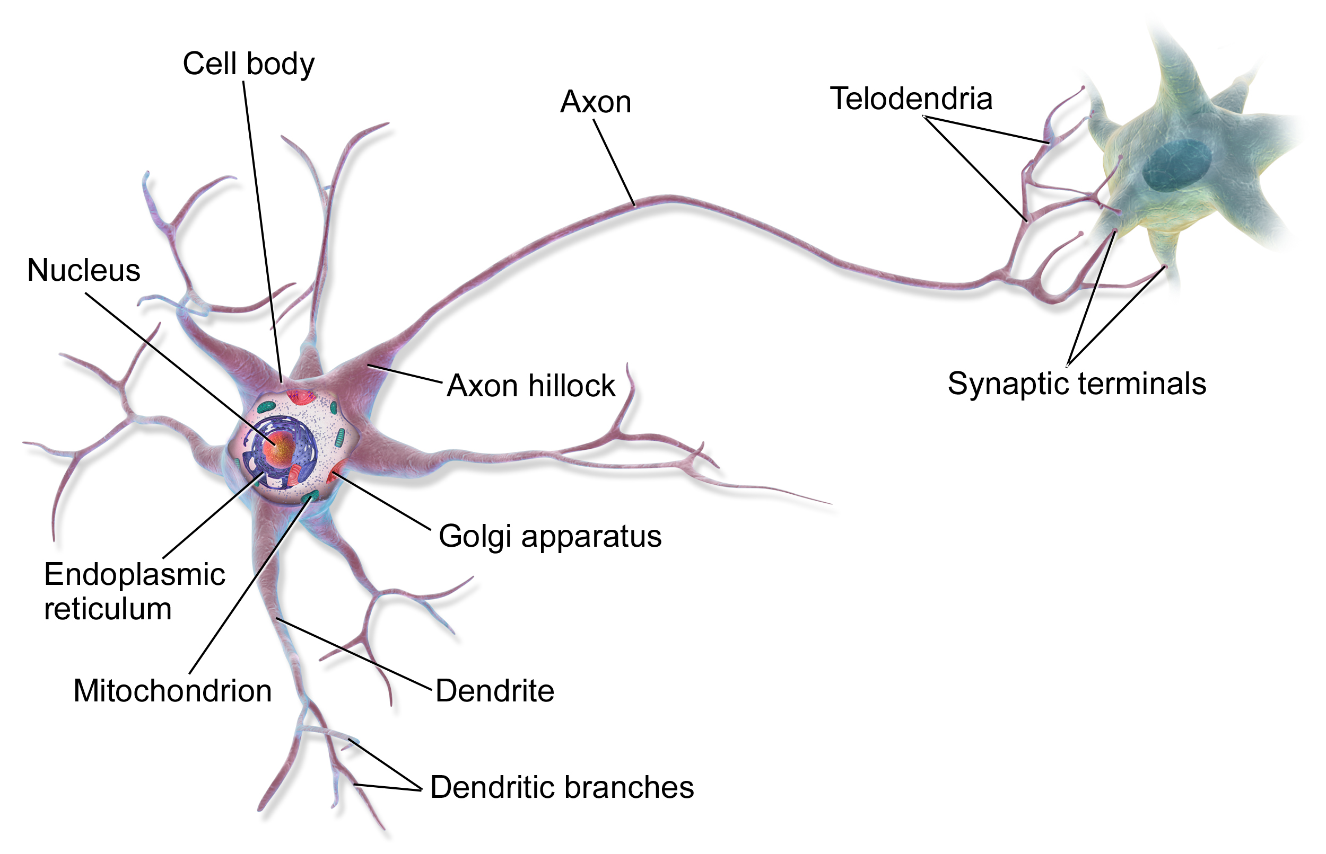
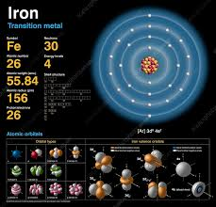
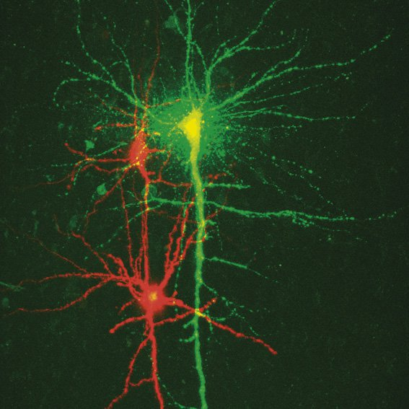
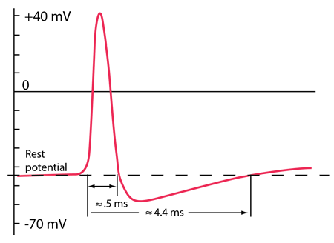
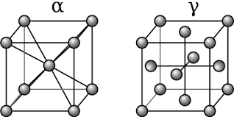
Degrees of freedom?
Interactions?
Networks?
magnetic spin
lattices

Slide 4
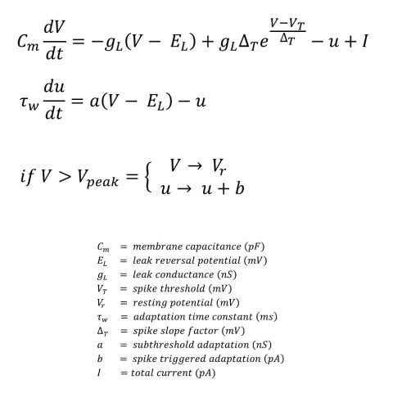
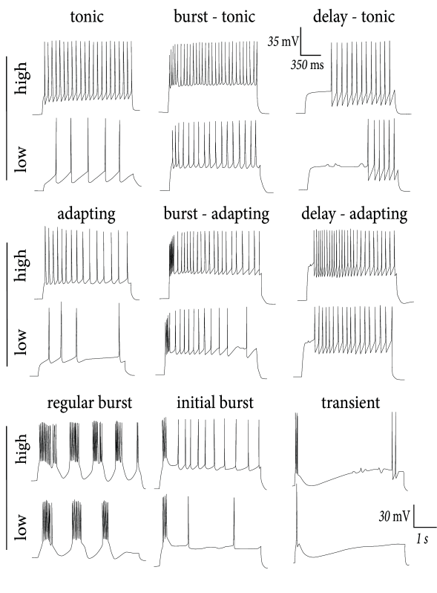
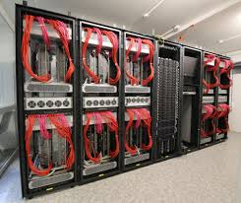
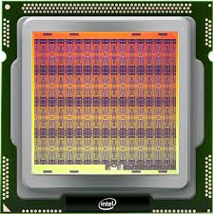
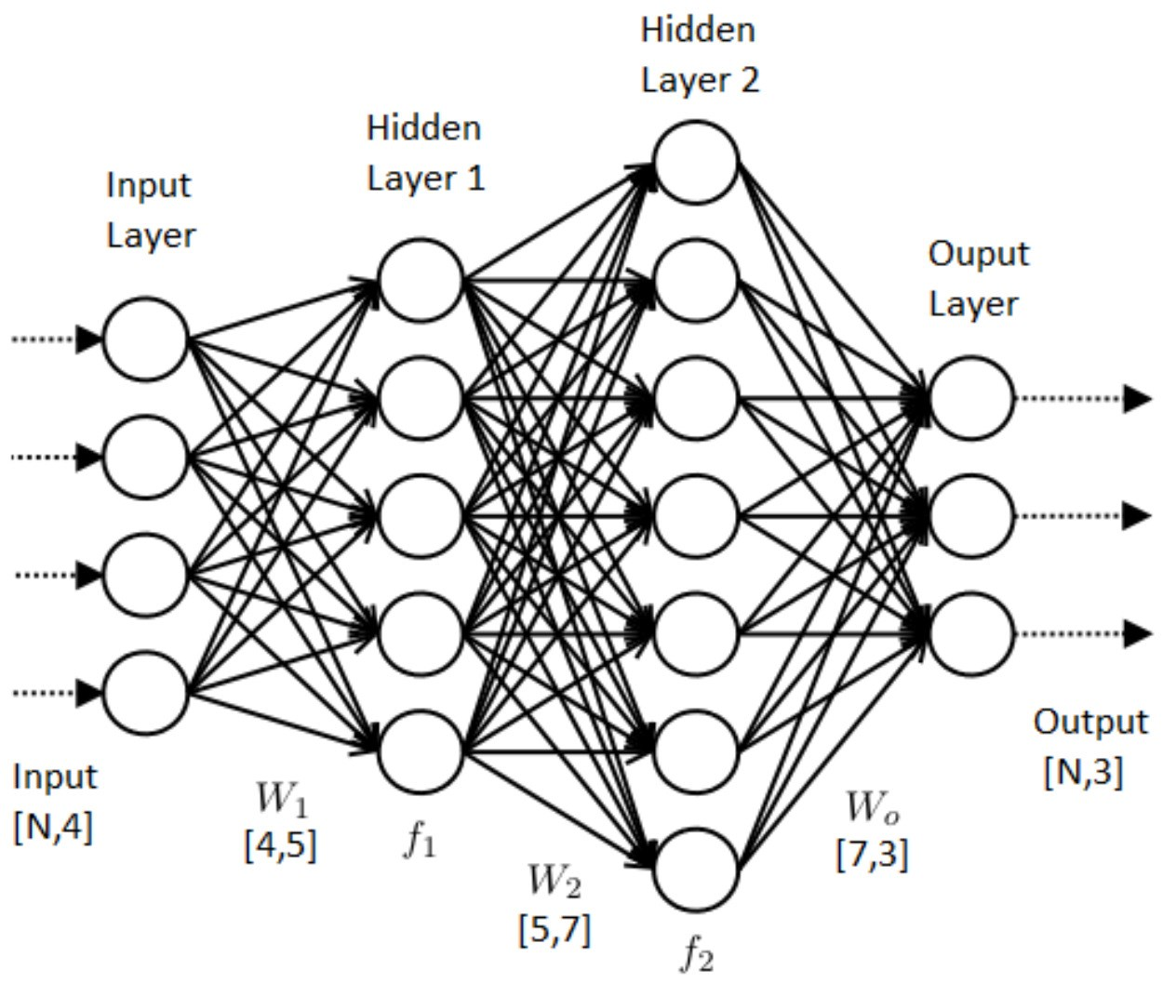
Neural networks
Neuromorphic chips
IBM TrueNorth, Intel Loihi, FPGAs
Conventional computers optimized to
run the mathematical models
Mathematical models
Differential equations that are discretized
AI driven
Long-time simulations
Mathematical artifacts?
Is there an alternative route?
Make neurons directly in hardware!
New neuromorphic functionalities

Slide 5
Neuromorphic materials resistive switching & memristors memory + resistors sudden change in resistance under applied electric field (voltage) hysteresis in the I-V
Electric breakdown in Mott insulators:
volatile effect
a new (and unexpected) neuromorphic functionality

Slide 6
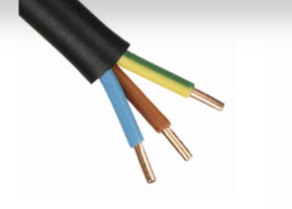
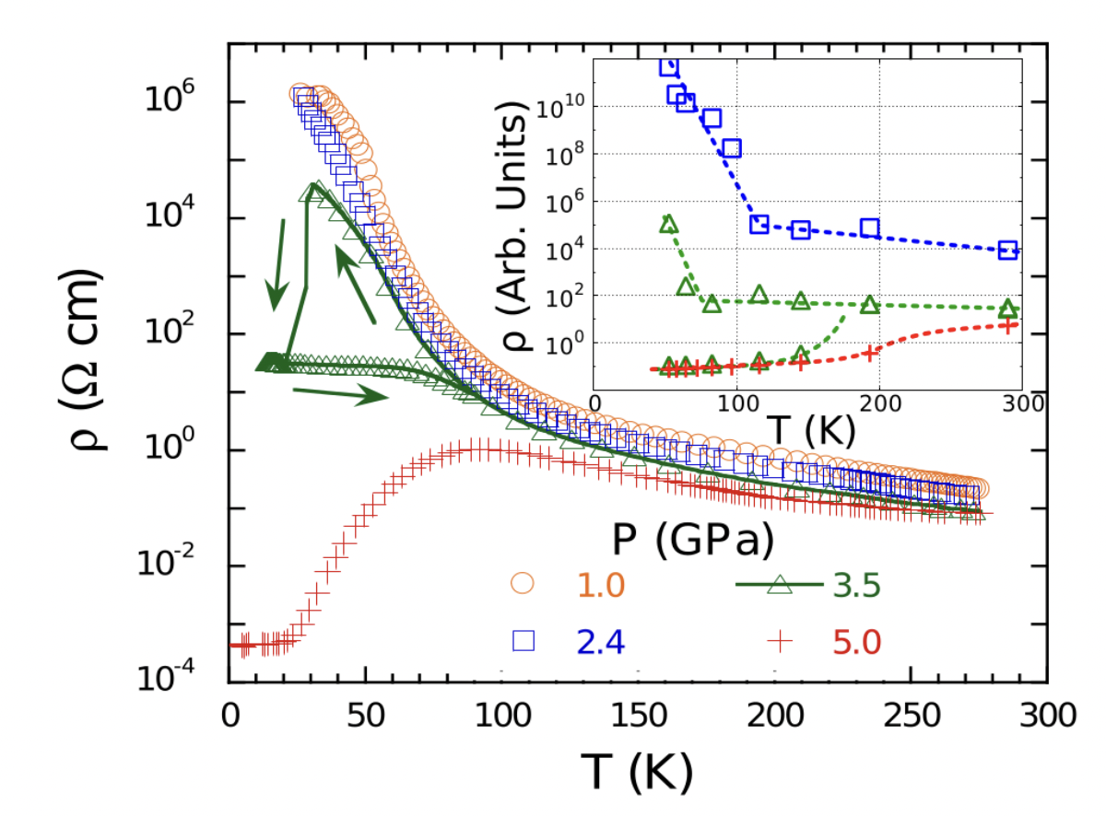
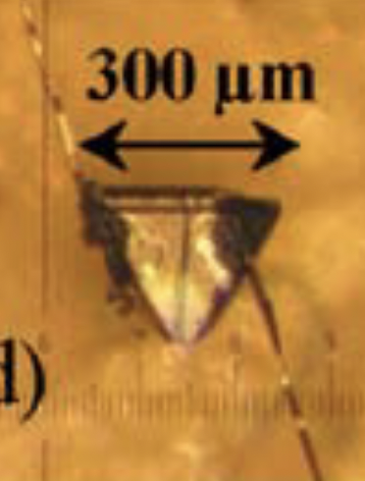
Ordinary matter:
cable made of metal (copper) and insulator (plastic)
Mott Materials (quantum matter)
Should be metals…. But are insulators
insulator to metal (1st order) transition
10 orders of magnitude!!
Strongly Correlated Material
Famous High Tc Superconductors
Acha, Camjayi @ UBA
Phys Rev Lett (2014)

Slide 7
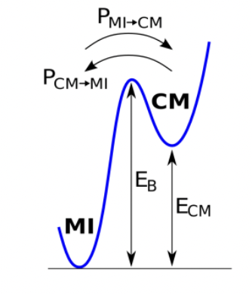
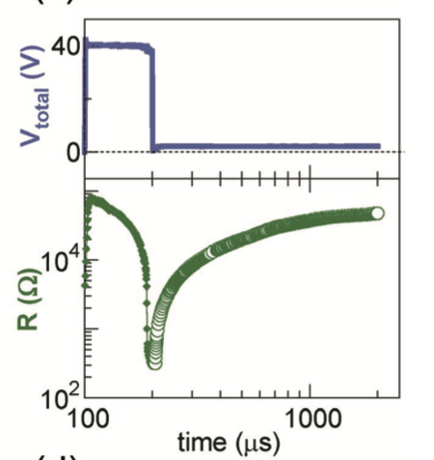
Metastability of the
1st order MIT (DMFT)
Surprise: Electrically driven Mott transition
Volatile
Resistive
transition
2013
How about a non trivial validation?

Slide 8
Metastability of the
1st order MIT (DMFT)
τ
Model
prediction
Experiment
Electric pulses provoke a collapse of resistance, then a surge of current!
1st Aha! Moment !!!!

Slide 9
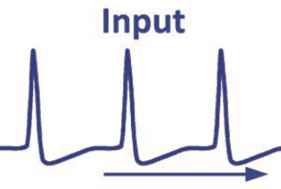
it is like what neurons do !!!
next neuron
A neuron is a cell
Generates and communicates
through electric signals

Slide 10
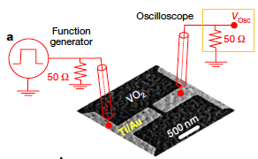
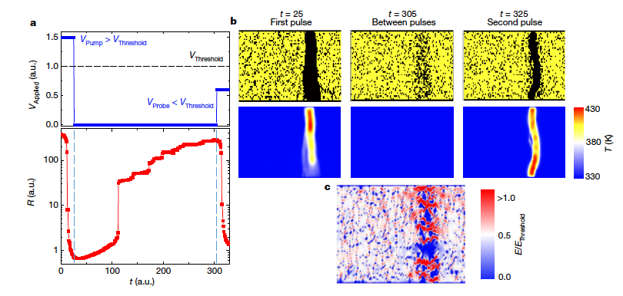
Towards physical artificial neurons
Mott materials (VO₂) are promising
But also difficult to make and control, and we are beginning to understand (filamentary conduction)
Silicon neurons are a reality
Everything can be done with conventional electronics
But silicon neurons are not that simple
Indiveri, Stefanini, Chicca IEEE (2010)
Indiveri et al Front Neurosci 2011 (review)
Del Valle et al, Nature 2019
Del Valle, Ramirez, MR, Schuller JAP 2018 (review)
Kalcheim et al Nat Comm 2020
Del Valle et al, Science 2021
R.Rocco et al PRApp (2022)
Editor’s Suggestion

Slide 11
Can’t we have the “best of both worlds”?
Simplicity of Mott memristors
Reliability of conventional silicon electronics

Slide 12
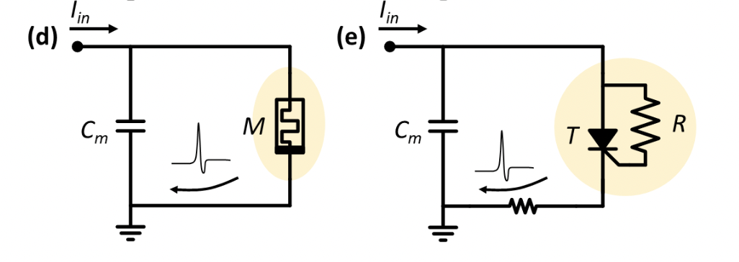
Best of both worlds: Memristive Silicon Spiking Neuron aka Ultra-Compact Neuron
2nd Aha! Moment !!!
MR, O. Schneegans and P. Stoliar, Sci Rep (2019)
memory-resistive effect ←→ hysteresis
Thyristor
Threshold control diode
Leaky-Integrate and Fire model
integrate
fire
leak

Slide 13
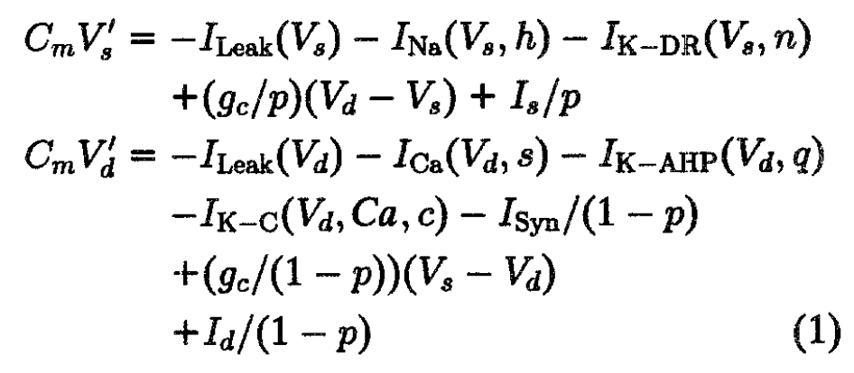
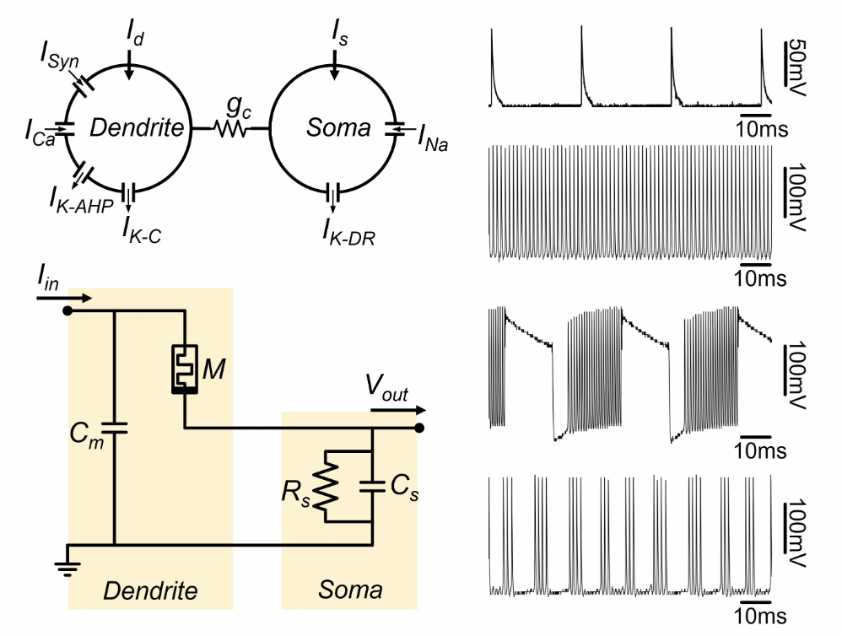
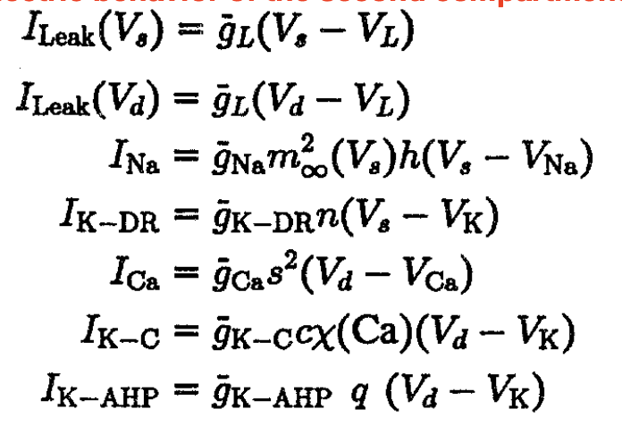
Memristive Bursting neuron
2-compartment Pinsky-Rinzel model
Wu et al (submitted)

Slide 14
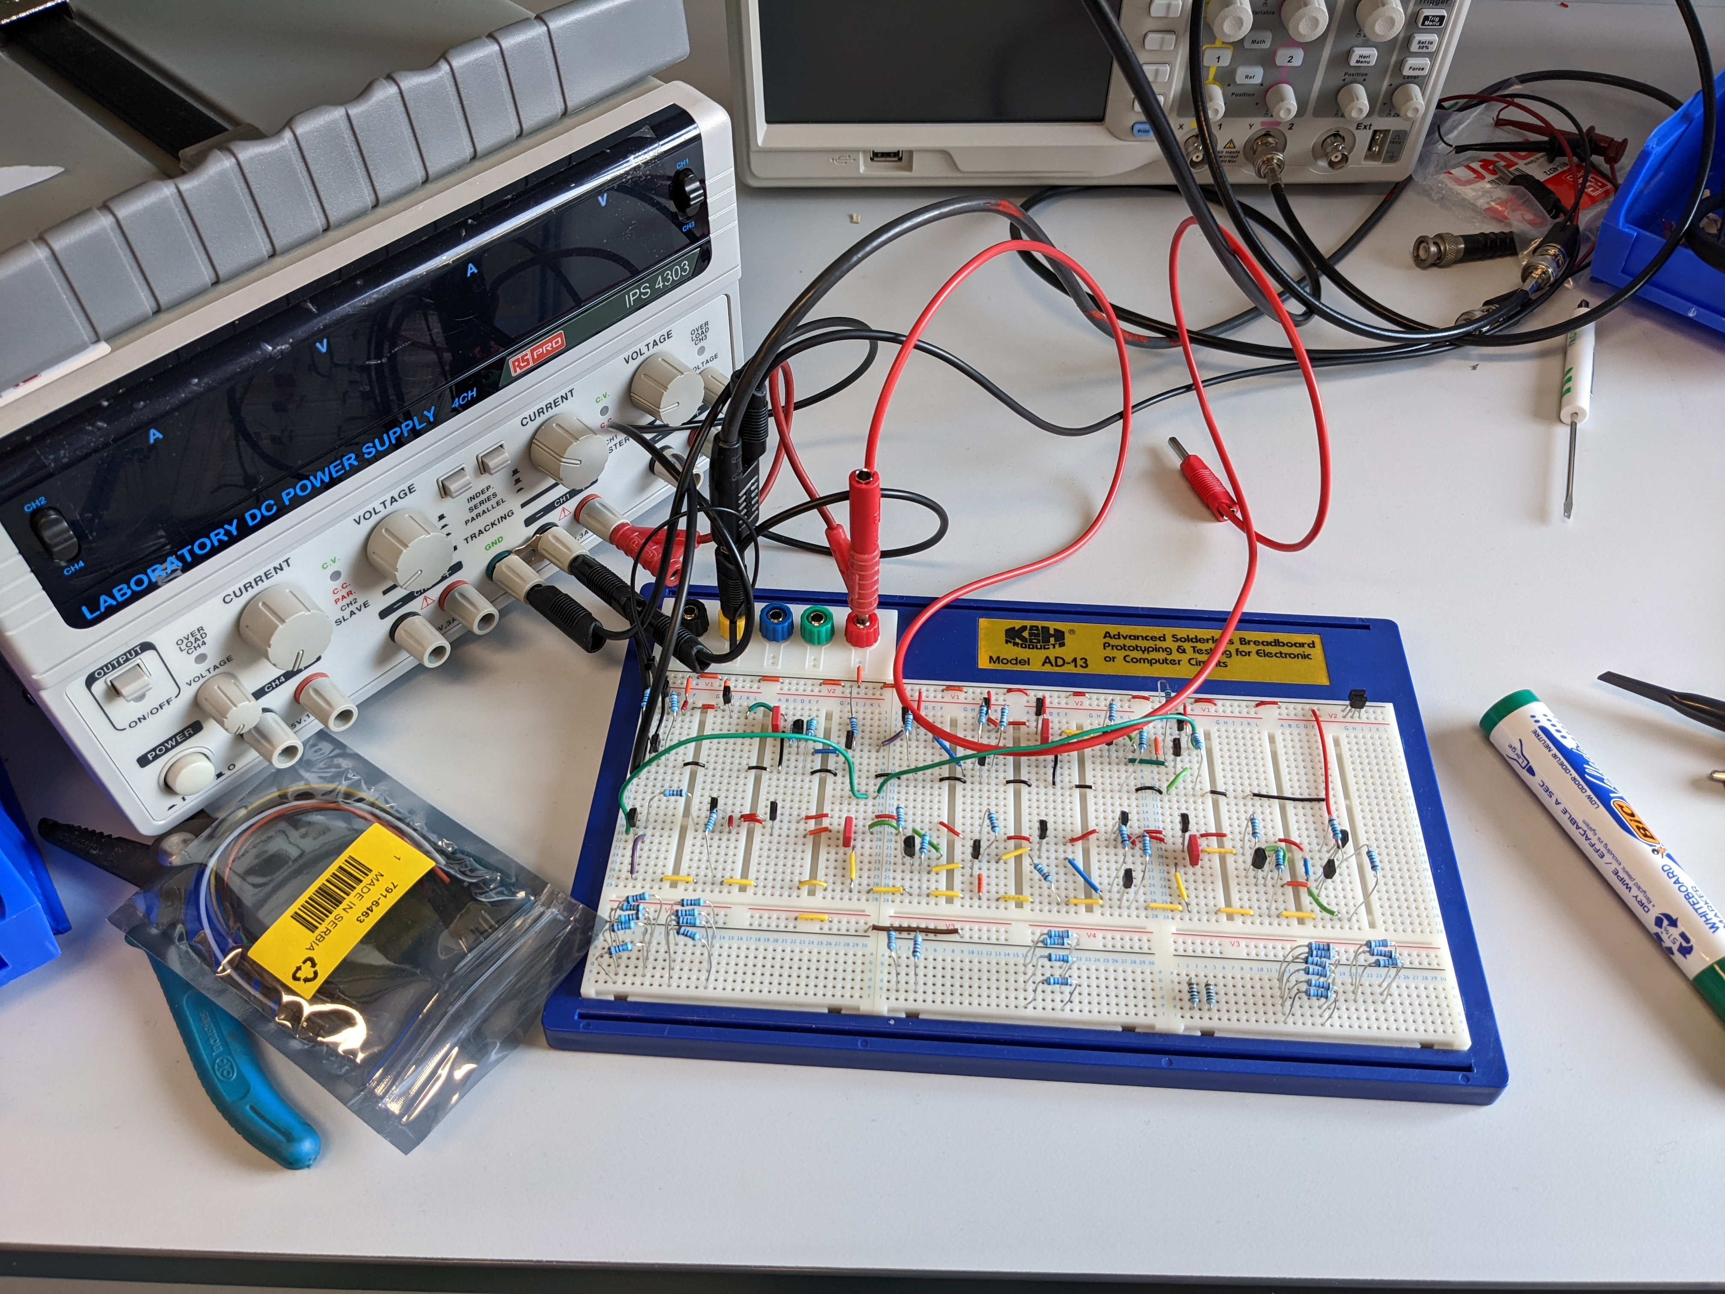
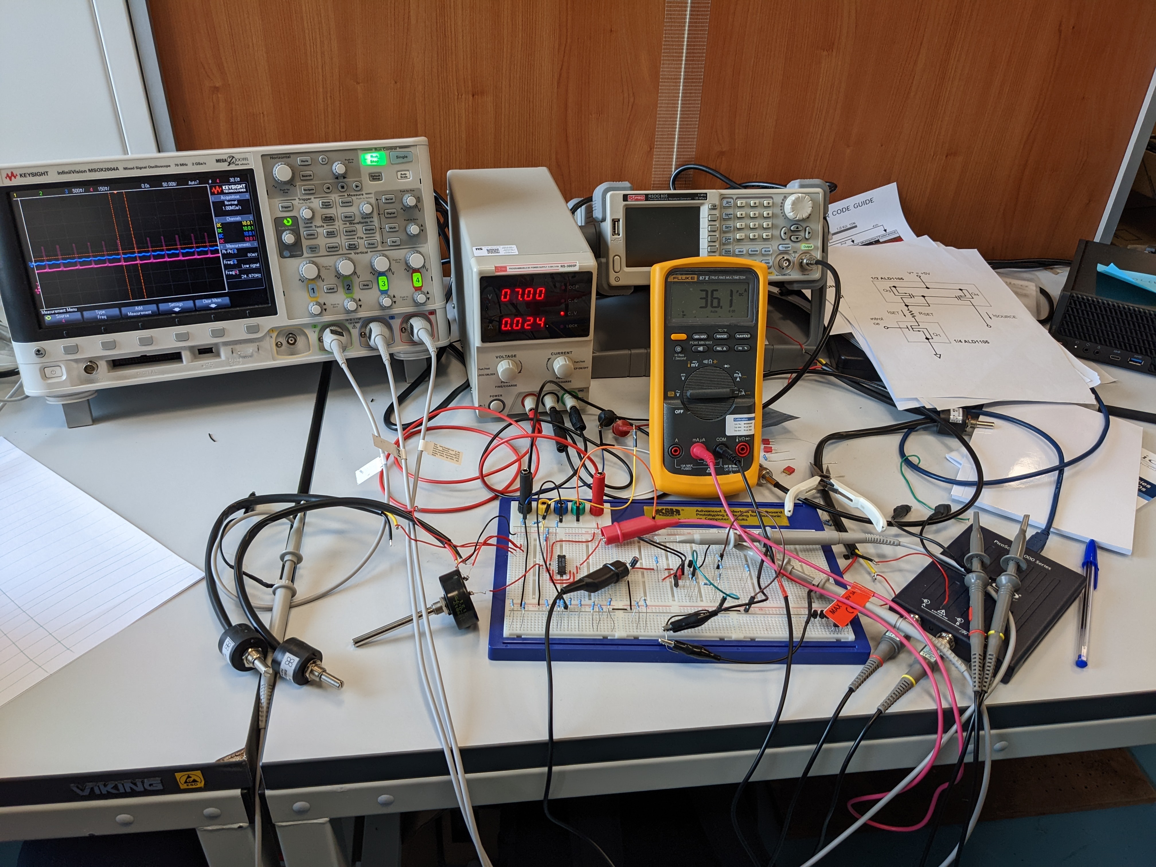
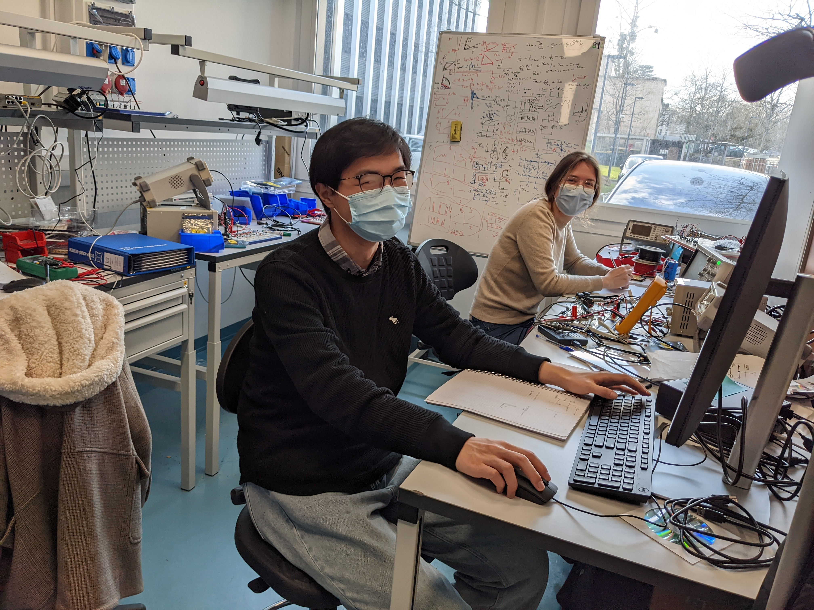
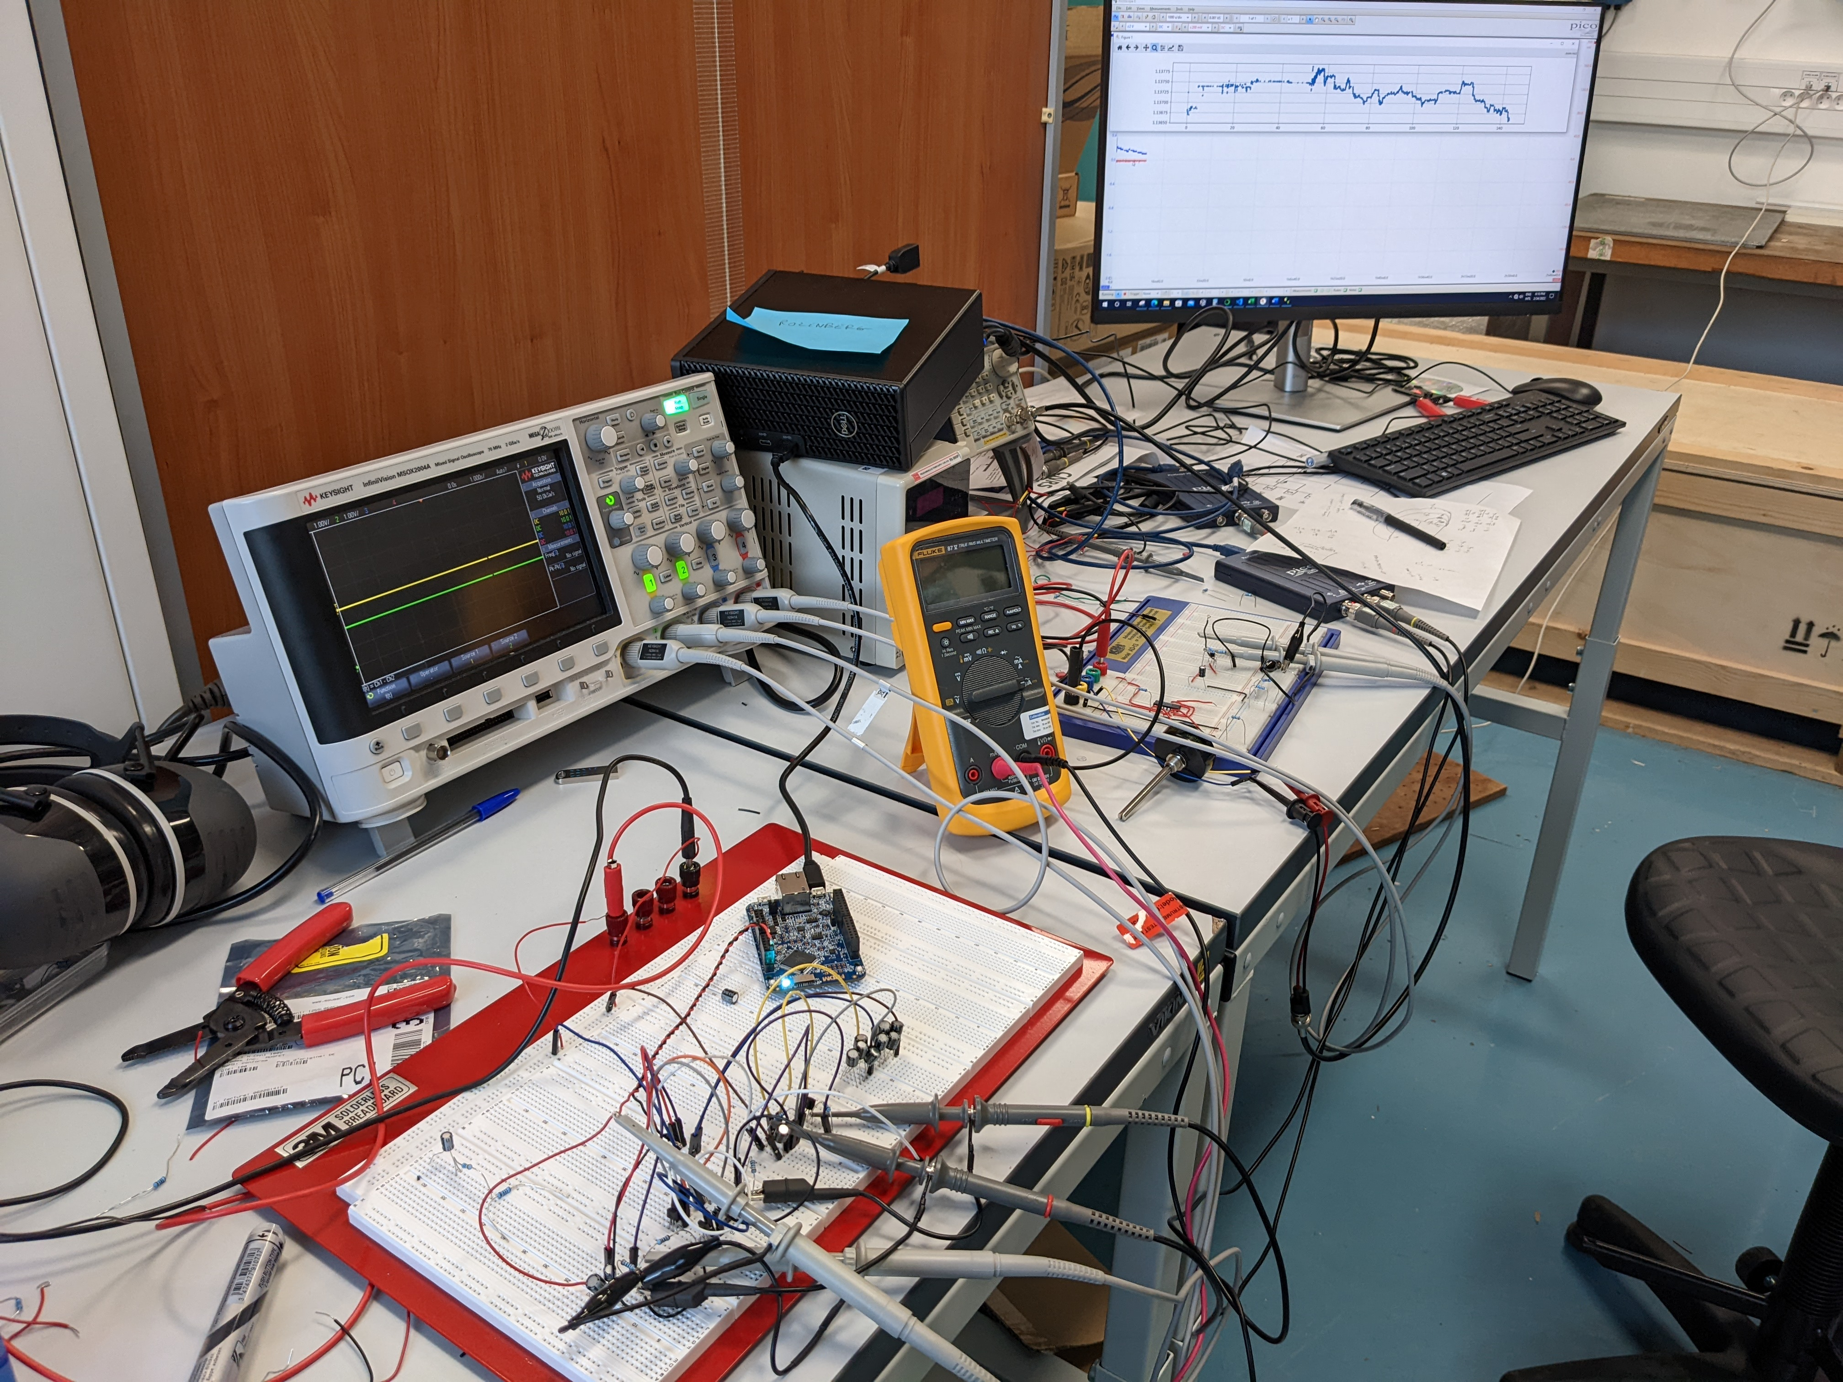
New Experimental Activity at LPS
Solid State Neuroscience Lab
Thanks to LPS for initial support!

Slide 15
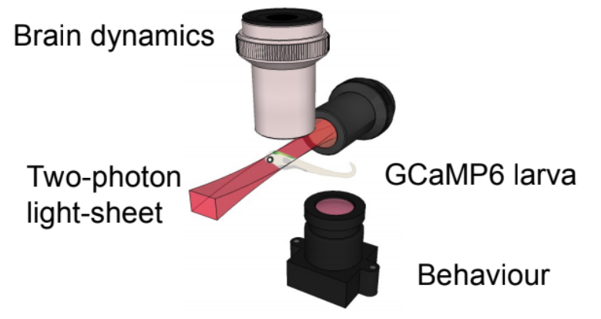
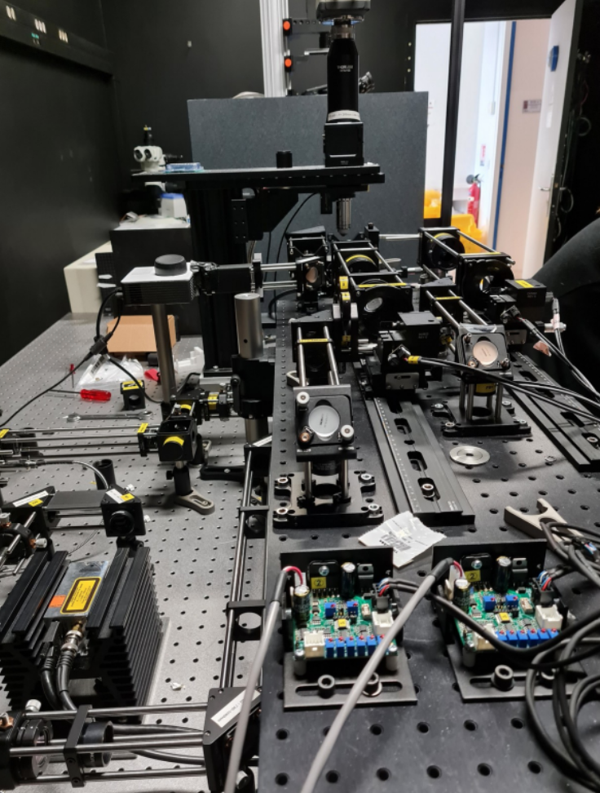
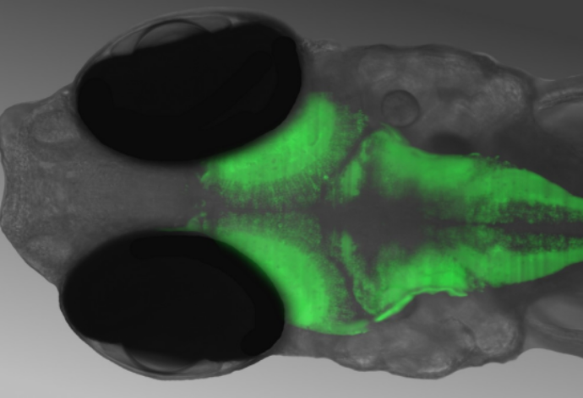
New Project:
- Zebra fish larva optical recording and stimulation
Study fundamental questions of Neuroscience:
- Neural code? Spike timing versus spike rates
- State of matter? Criticality, chaos, phase diagram
- Dynamics? Waves, bumps, spike avalanches, epilepsy?
- Information How different networks communicate?
- Dynamical patterns, working memory
Brain-Machine-Interface:
memristive neural network
zebra fish neural network
w/G. Sumbre @ ENS
Brain of the zebra fish
zebra fish under
the microscope

Slide 16
“What I cannot create, I do not understand” (R. Feynman)

Slide 17
Thank you

