Slide 1
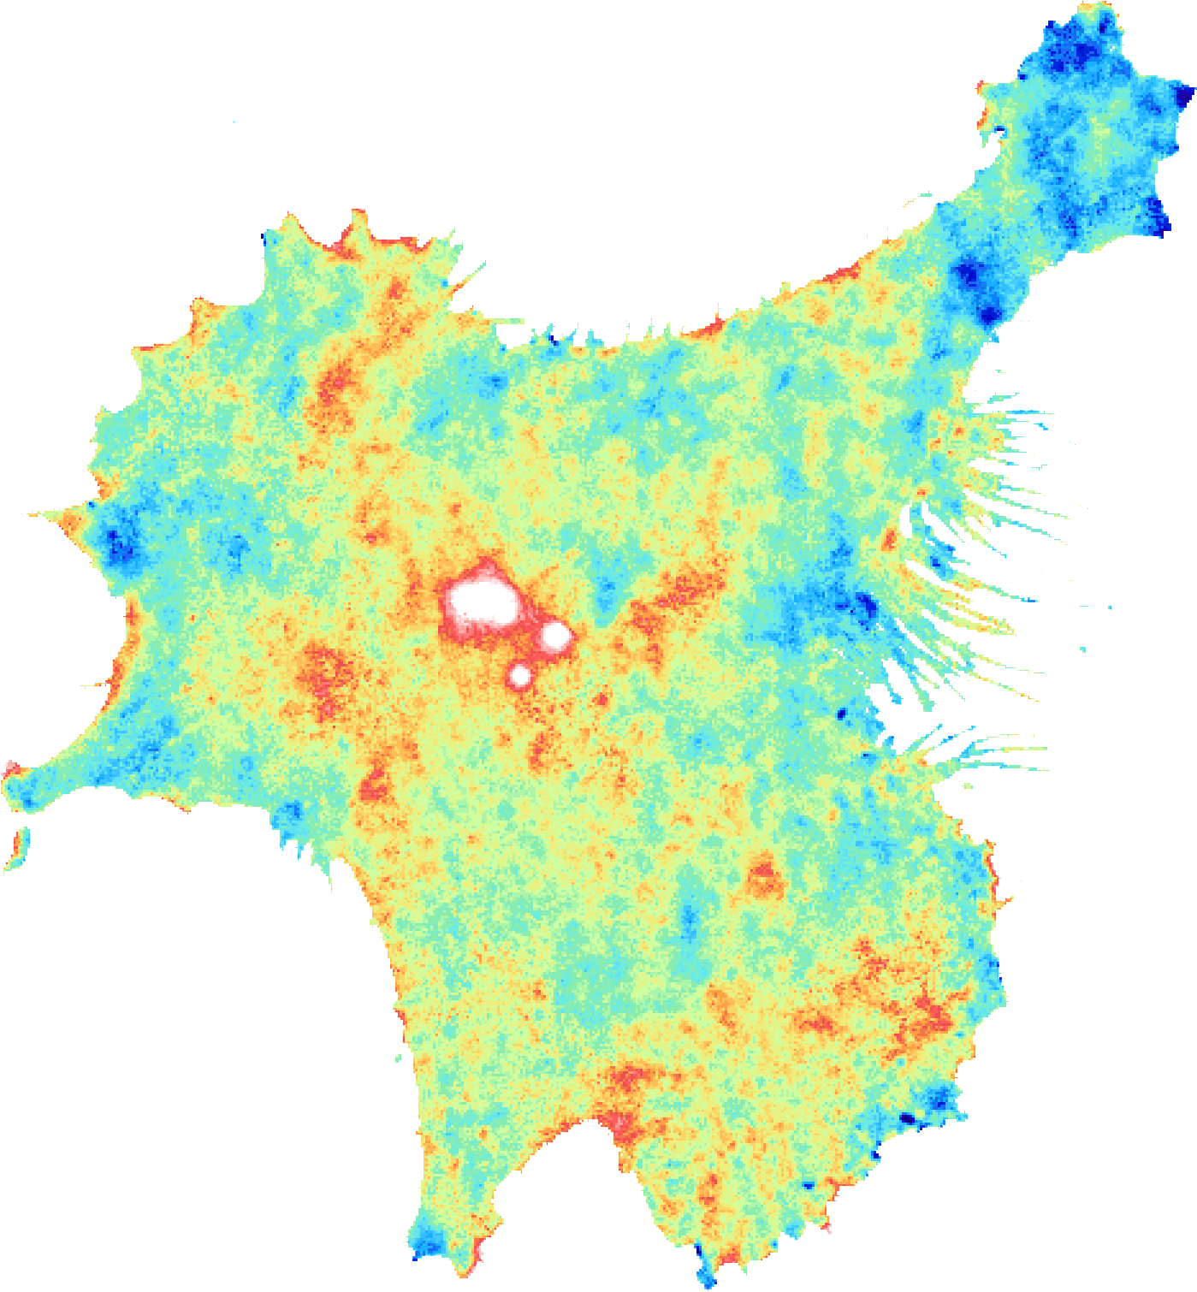
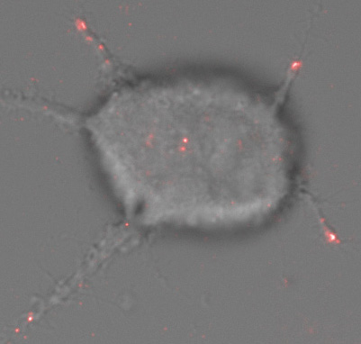
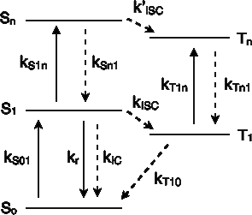
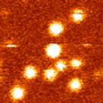
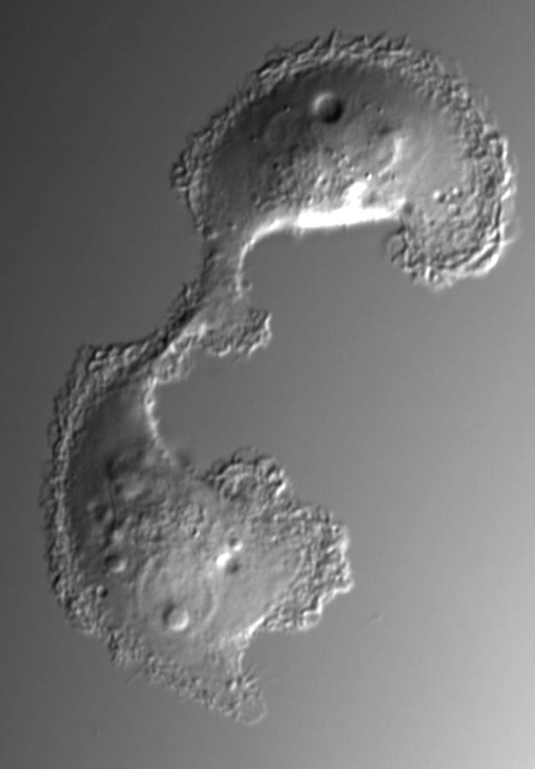
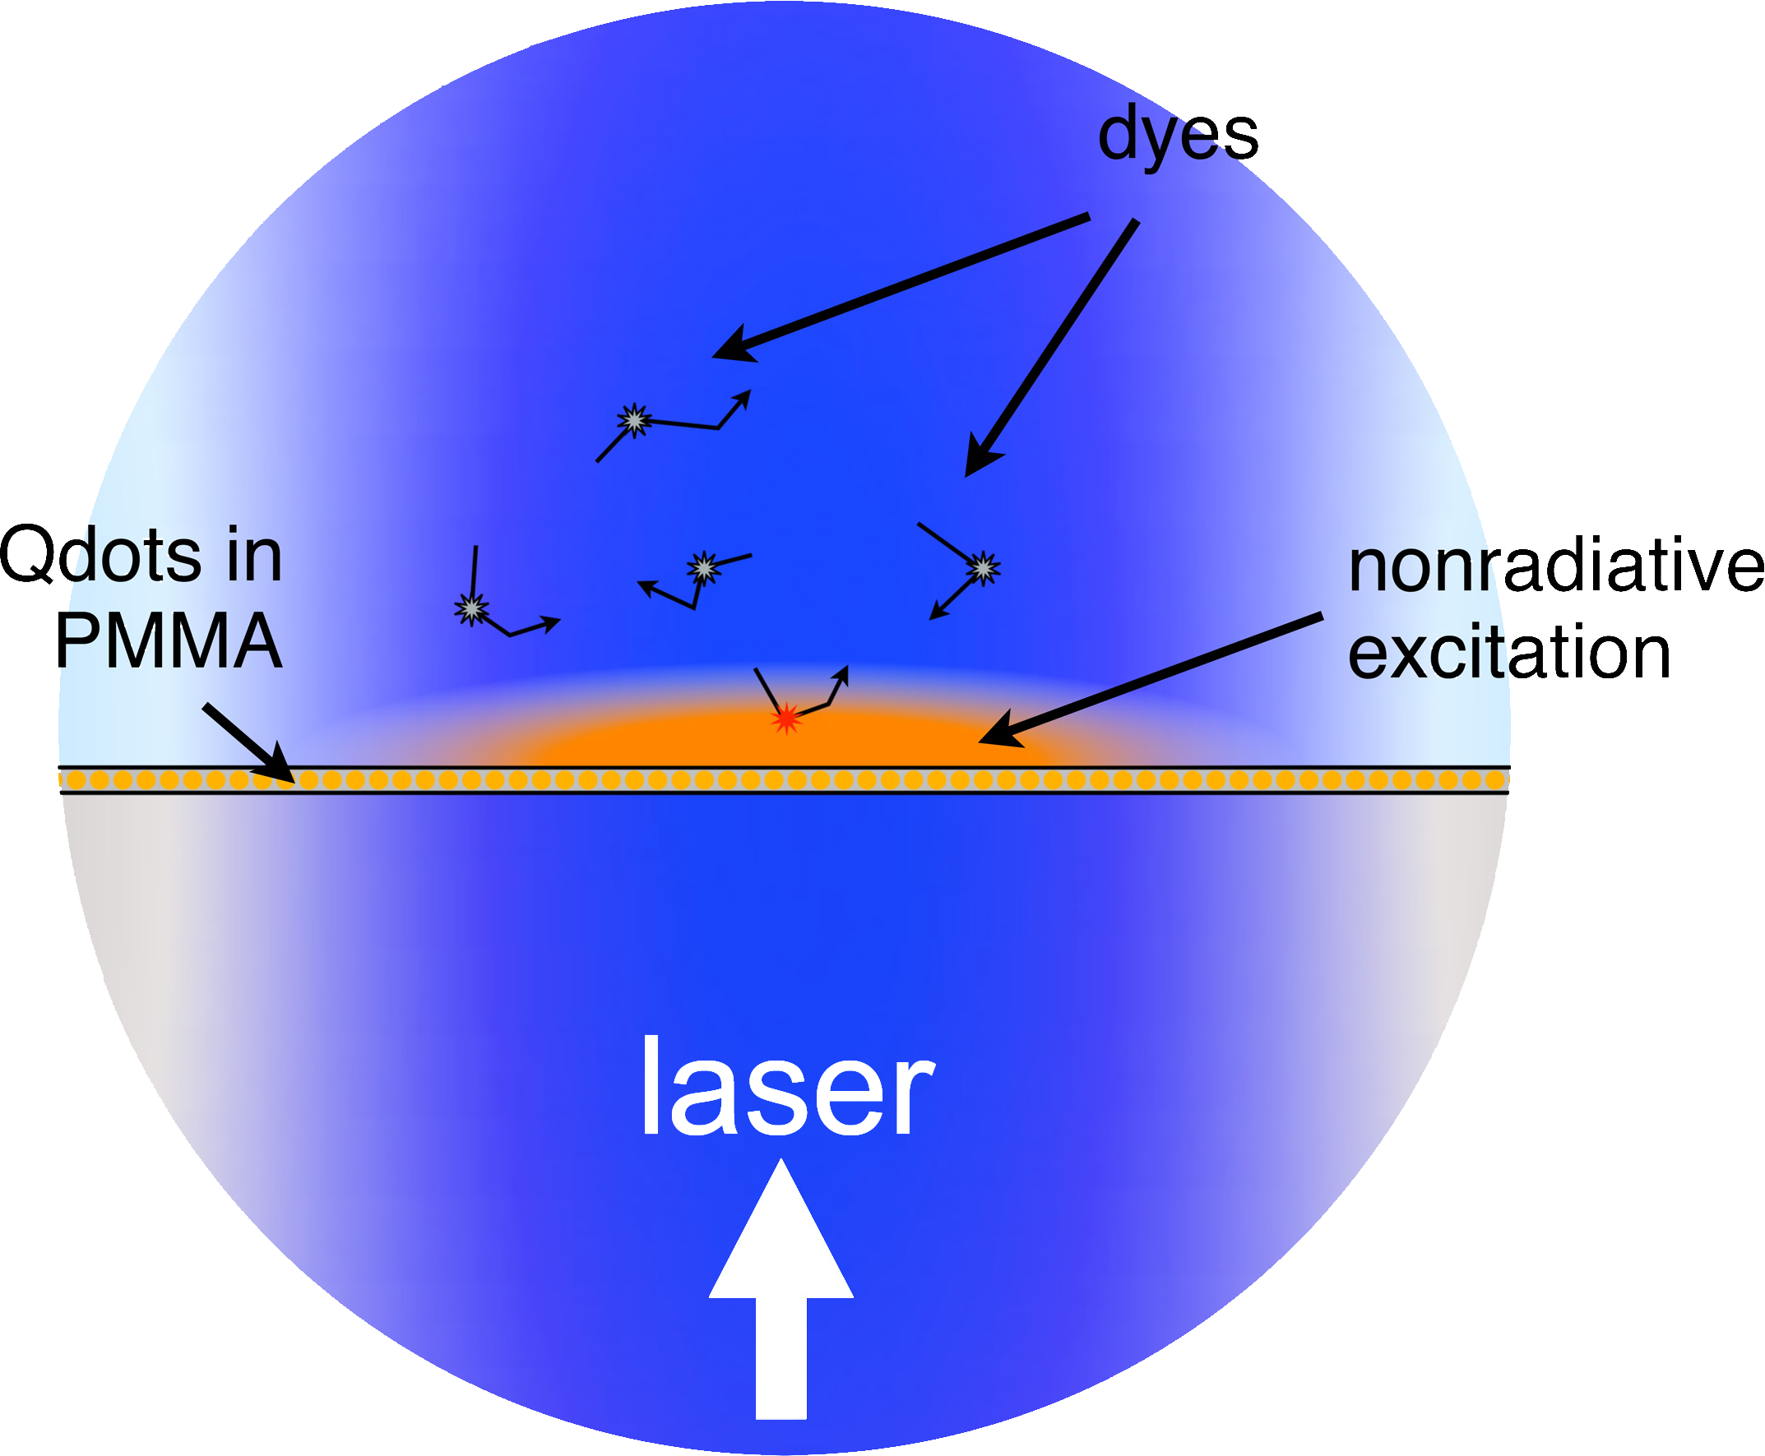
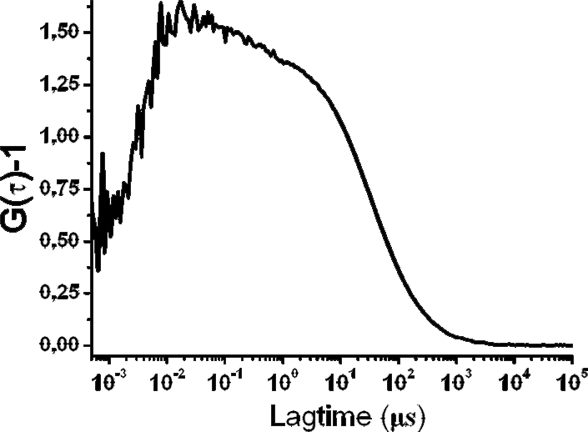
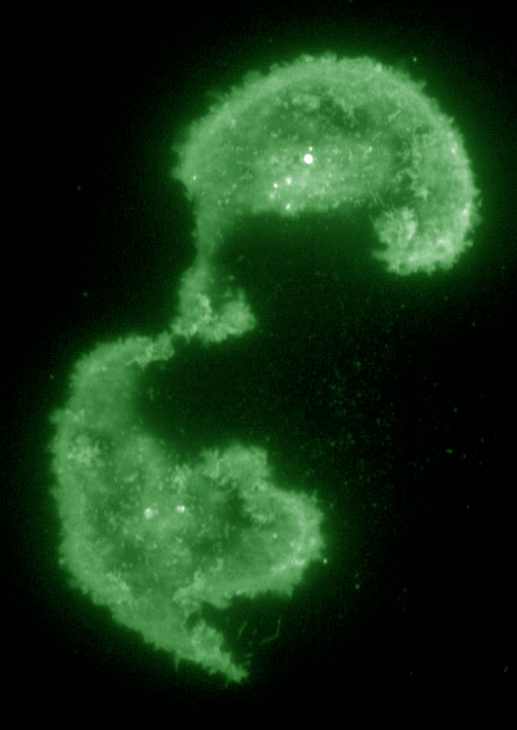
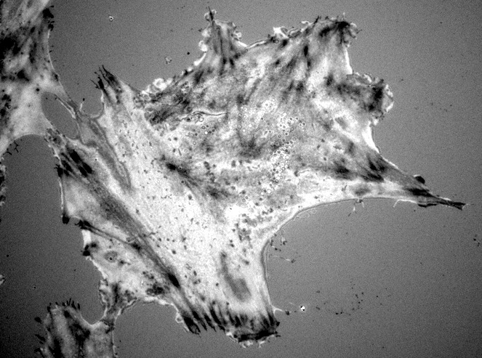
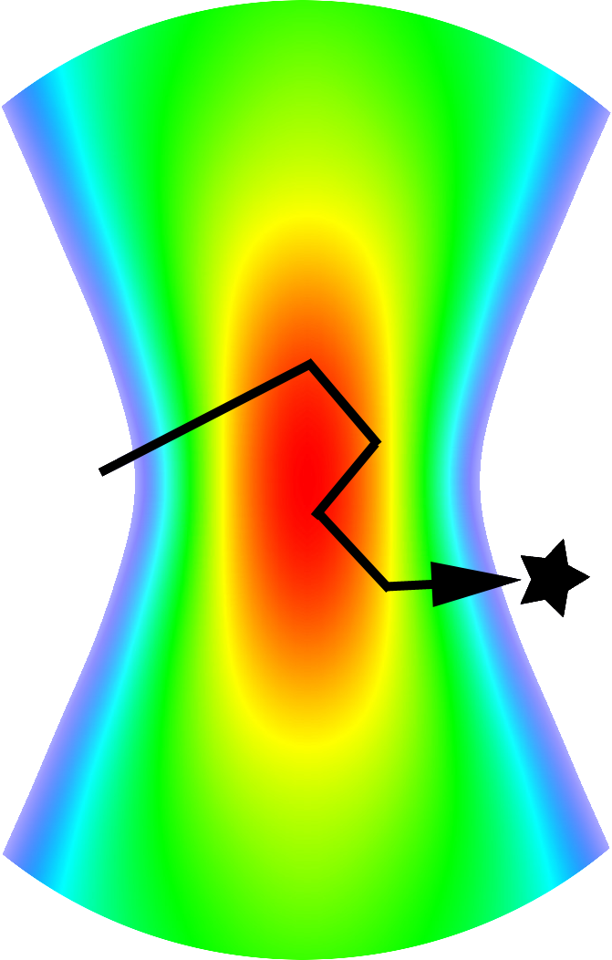
vaTIRF
NEFM
single molecule
FCS
TIRF
RICM
Two-state micropattern: dynamic adhesion assay at the single cell level
Rodolphe JAFFIOL
Cyrille VEZY, Demetrio MACIAS
NanoBioPhotonics and NanoSensors Axis / L2n EMR CNRS 7004
University of Technology of Troyes
France
Notes:
For giving me this time slot to present a quantitative nano-imaging technique called vaTIRF

Slide 2
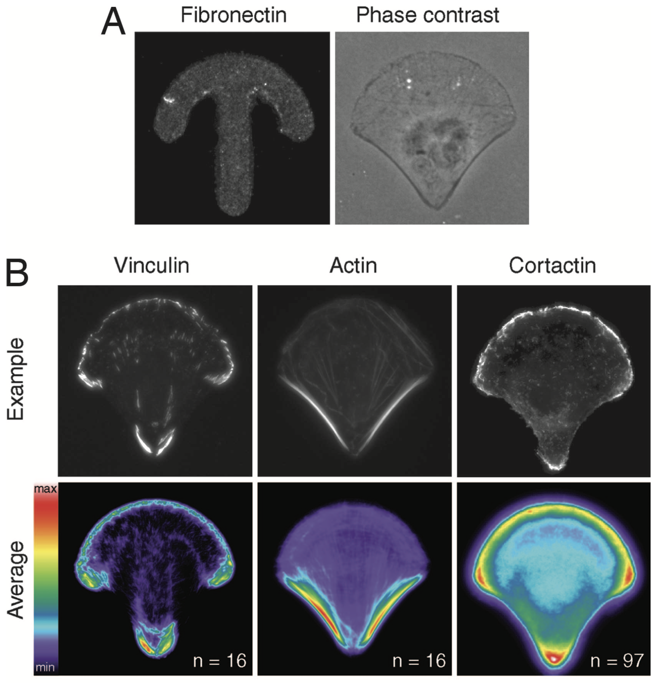
cell patterning
control cell polarity,
contractility…
control of migration
MCF-10A cell
RPE1 cells
K. Kushiro & A. Asthagiri, Langmuir (2012) vol 28, p4357
Cellules NIH3T3
D. Caballero, R. Voituriez, D. Riveline. Biophys. J. (2014) vol 107, p34
M. Théry, M. Piel et al., PNAS (2006) vol 103, p19771
2

Slide 3
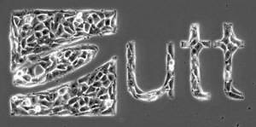
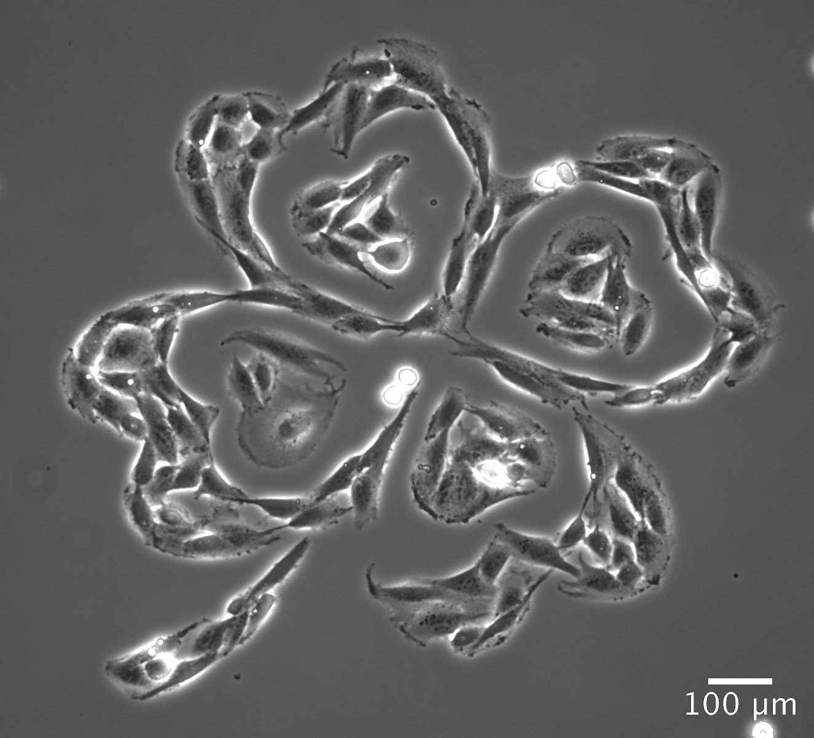
cell patterning
PLPP (photoactivable reagent)
glass cleaning and activation with UV-O3 cleaner
+
Incubation with PLL-g-PEG @ 0.15 mg/mL (SuSoS)
dose
(mJ/mm²)
d1
d2<d1
rinsing
PEG brush
PLL
glass
glass
glass
(1) glass coating with PEG
(2) maskless UV-photolithography @375nm with PRIMO system (Alvéole)
(3) local degradation of PEG chains
depending of the dose of irradiation
add cell
Incubation with fibronectin (FN) @ 10-20 μg/mL
FN
100 μm
PEG brush
PLL
U87MG cells
glass
glass
(4) fibronectin adsorption
(5) cell adhesion
3
RPE1 cells

Slide 4
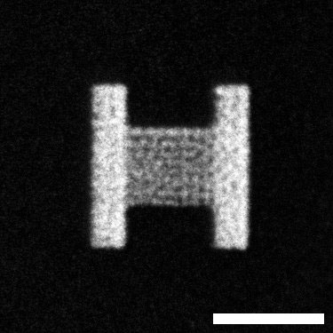
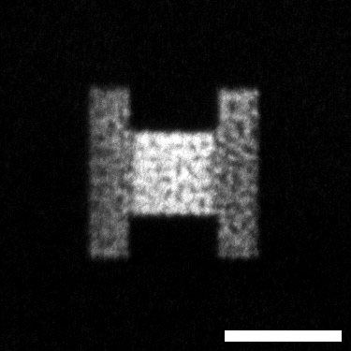
pro-adhesive and pro-contractile motif
M1
M2
2 motifs:
&
d1 = 550 mJ/mm²
fibronectine surface concentration
d2 = 275 mJ/mm²
TIRF imaging @488nm
(HiLyte fibronectin)
M1
20μm
M2
4

Slide 5
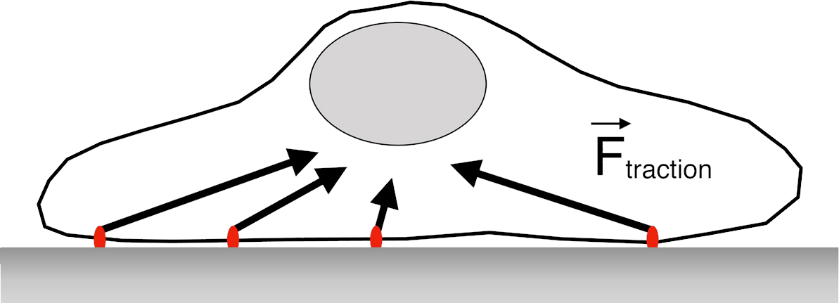
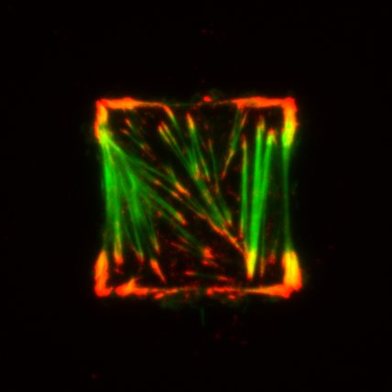
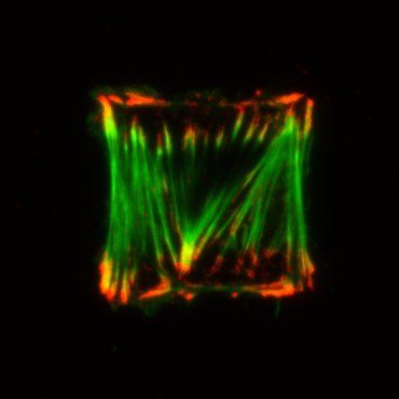
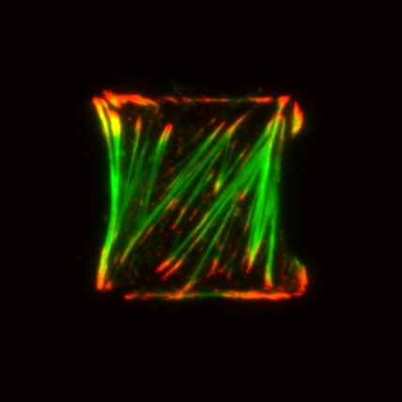
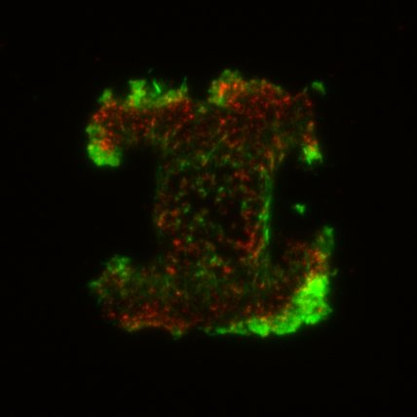
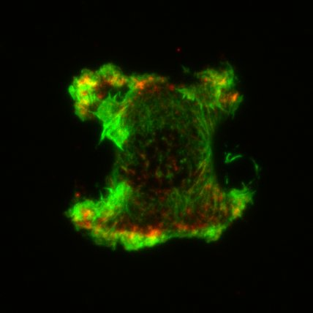
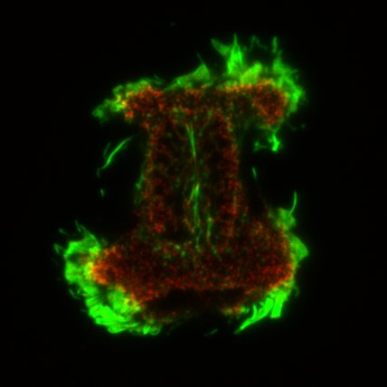
pro-adhesive and pro-contractile motif
M1
M2
2 motifs:
&
d1 = 550 mJ/mm²
fibronectine surface concentration
d2 = 275 mJ/mm²
TIRF imaging @488 & 561nm on fixed REP1 cells
M1
Motif 1
20μm
pro-contractile
AlexaFluor488 phalloidin
paxillin immunolabeling (AlexaFluor568)
and
pro-adhesive
M2
20μm
4

Slide 6
Two-state micropattern system
asymmetric pattern
M 1
M 2
fibronectine surface concentration
Two connected motifs M1 and M2
30 μm
cell
75 μm
data recording (48h)
acquisition rate: every 10mn
10x objective
@ 37°C & 5% CO2
5

Slide 7
RPE1 cell tracking on 2-state micropattern
asymmetric pattern
M 1
M 2
fibronectine surface concentration
Two connected motifs M1 and M2
cell
movie 48h
phase contrast
50 μm
epi-fluorescence @365nm
(nucleus labeling with Hœchst)
50 μm
6

Slide 8
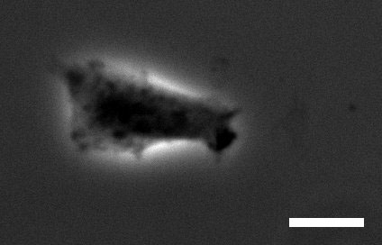
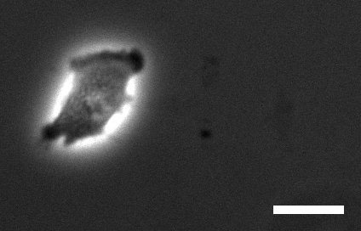
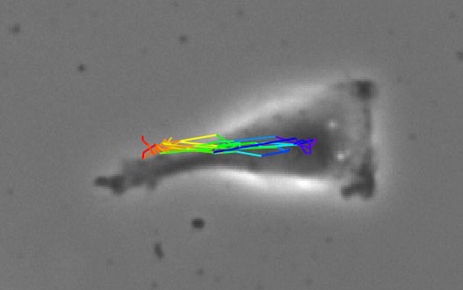
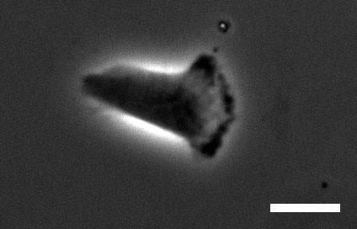
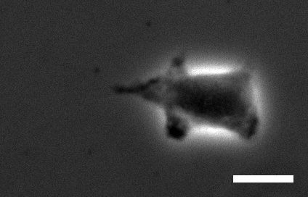
RPE1 cell tracking on 2-state micropattern
asymmetric pattern
M1
M2
cell
cell tracking (phase contrast)
1D cell trajectory
t0
t0+1h
20 μm
t0+1h30
t0+2h45
7

Slide 9
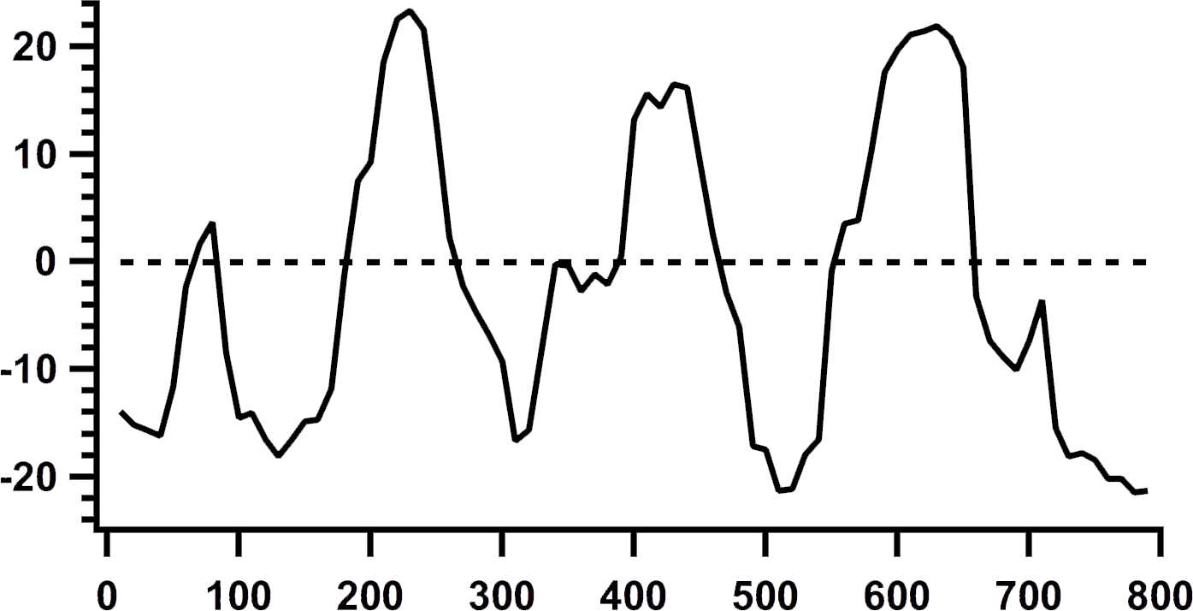
RPE1 cell tracking on 2-state micropattern
asymmetric pattern
xo
x
M1
M2
yo
cell
y
Δx(t) x(t)-xo
=
cell tracking (phase contrast)
relative x-position of the cell
τ2
t0
t0+1h
{
M2
20 μm
τ11
Δx(t) (μm)
t0+1h30
t0+2h45
τ1
{
M1
Δx probability of occupancy
dwell times τi
transition rate τij
7

Slide 10
RPE1 cell tracking on 2-state micropattern
phase contrast
epi-fluorescence @365nm
(nucleus labeling with Hœchst)
M 1
M 2
pattern
No. I
↺
↺
20 μm
20 μm
M 1
M 2
pattern
No. II
20 μm
20 μm
8

Slide 11
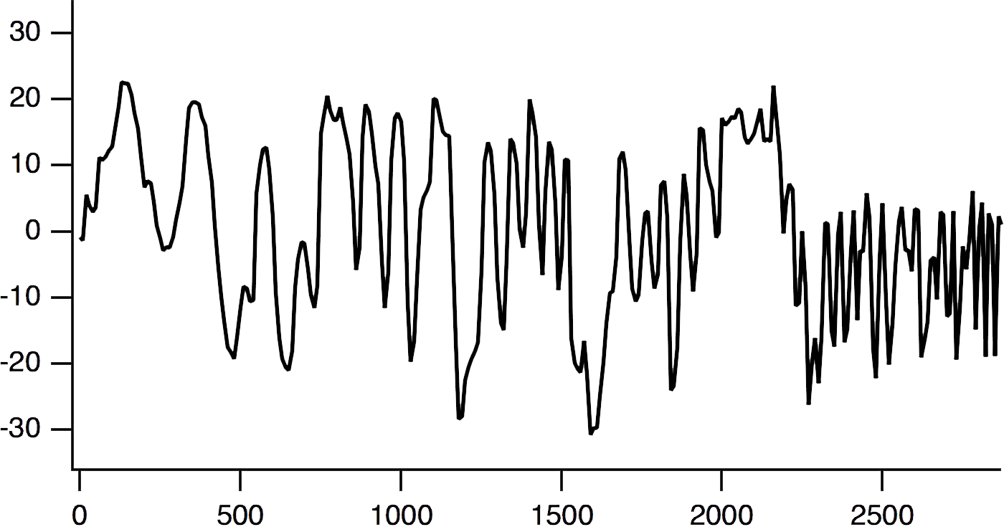
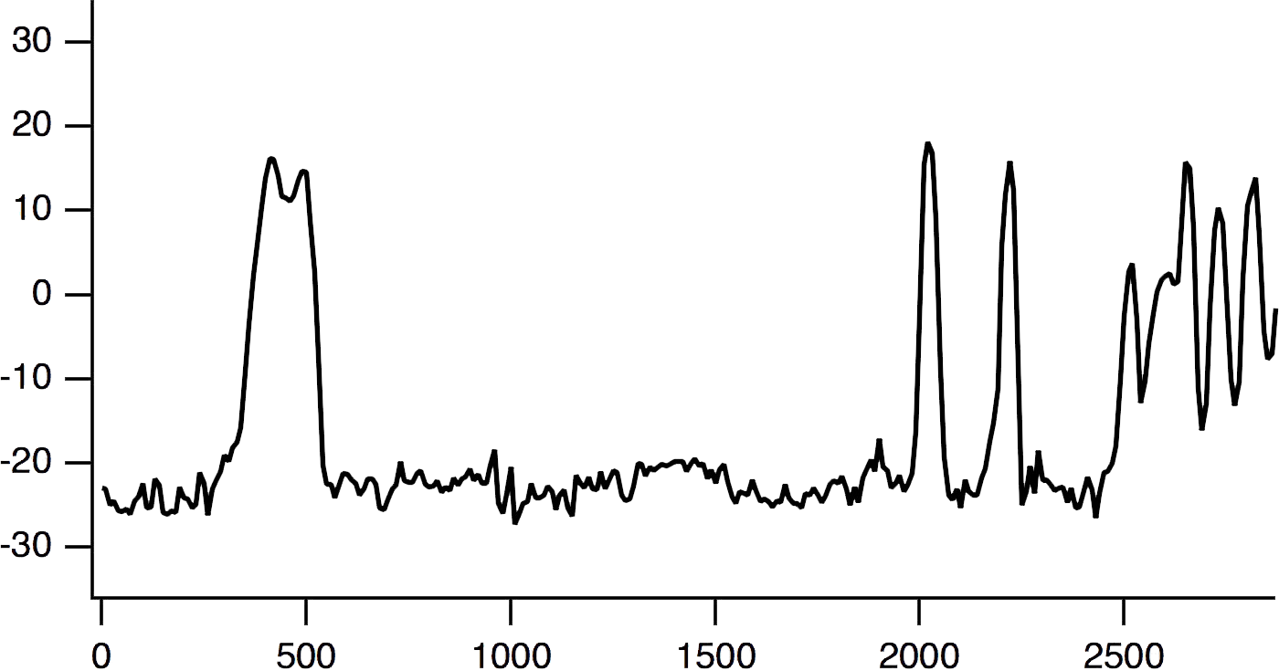
RPE1 cell tracking on 2-state micropattern
single cell x-trajectories
xo
M 1
M 2
x
pattern
No. I
Δx(t) (μm)
Δx(t) x(t)-xo
xo
=
time (min)
M 1
M 2
x
pattern
No. II
Δx(t) (μm)
{
M1
time (min)
9

Slide 12
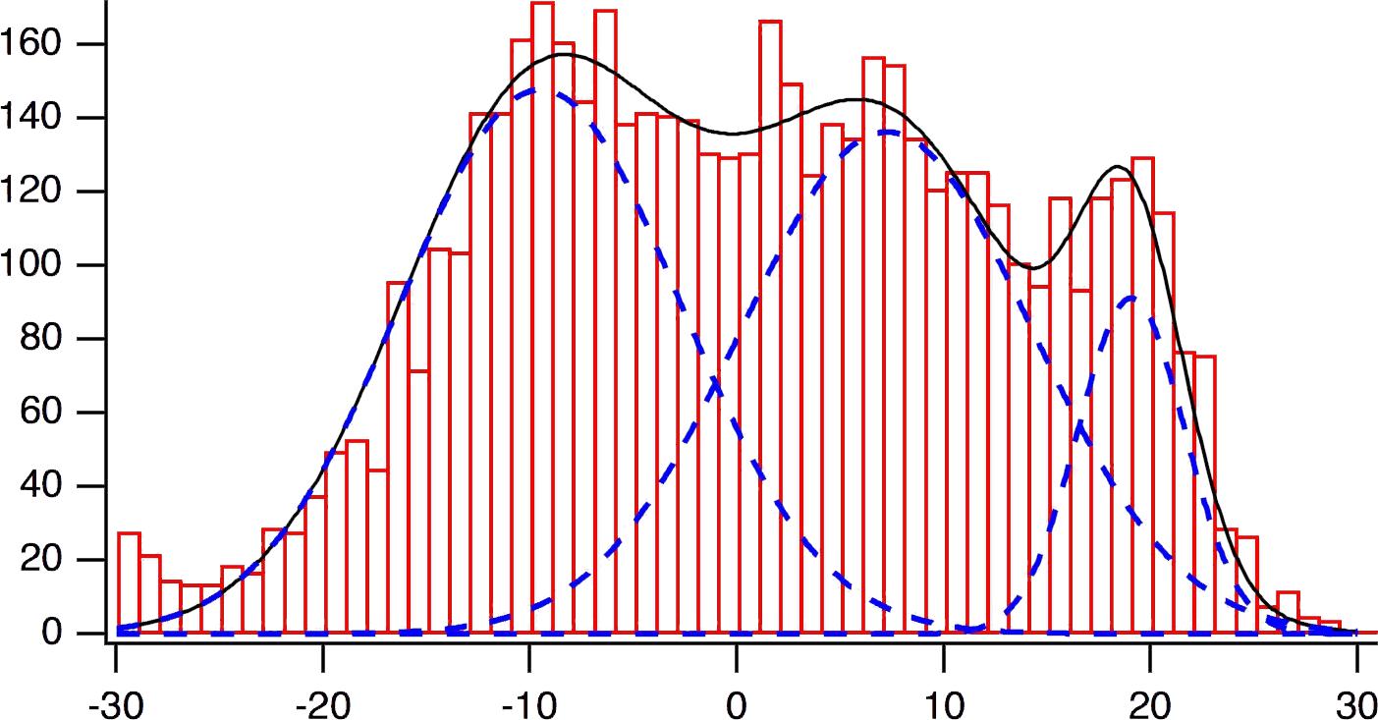
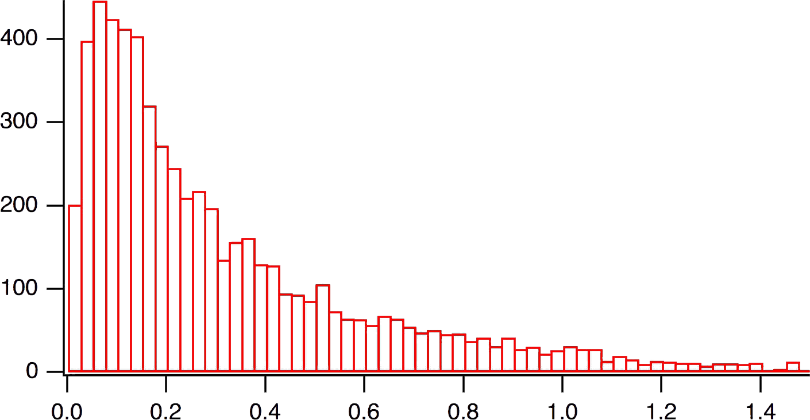
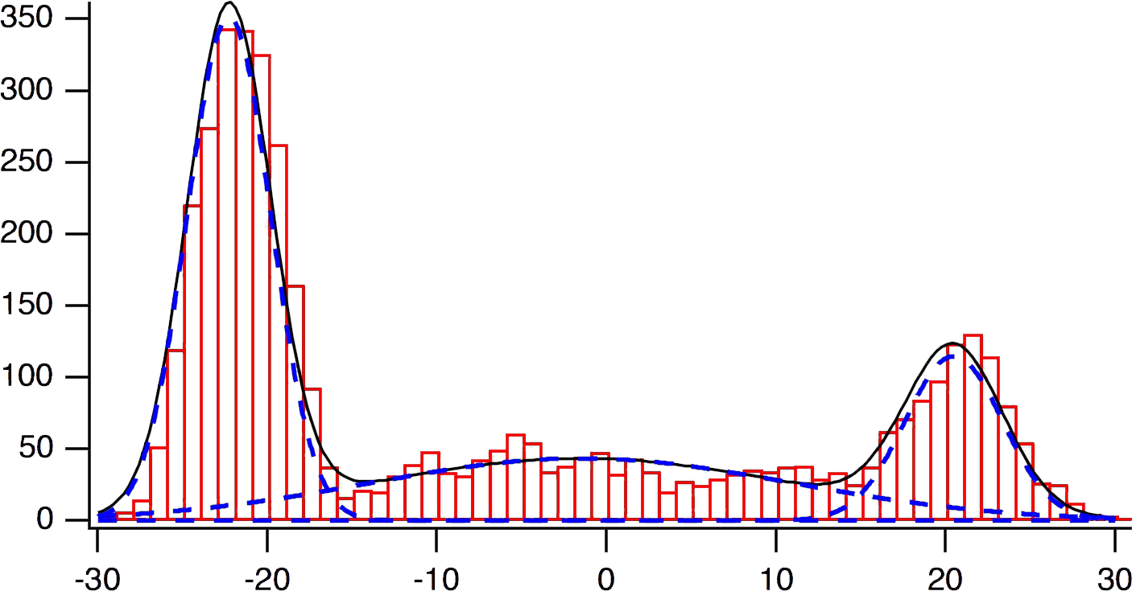
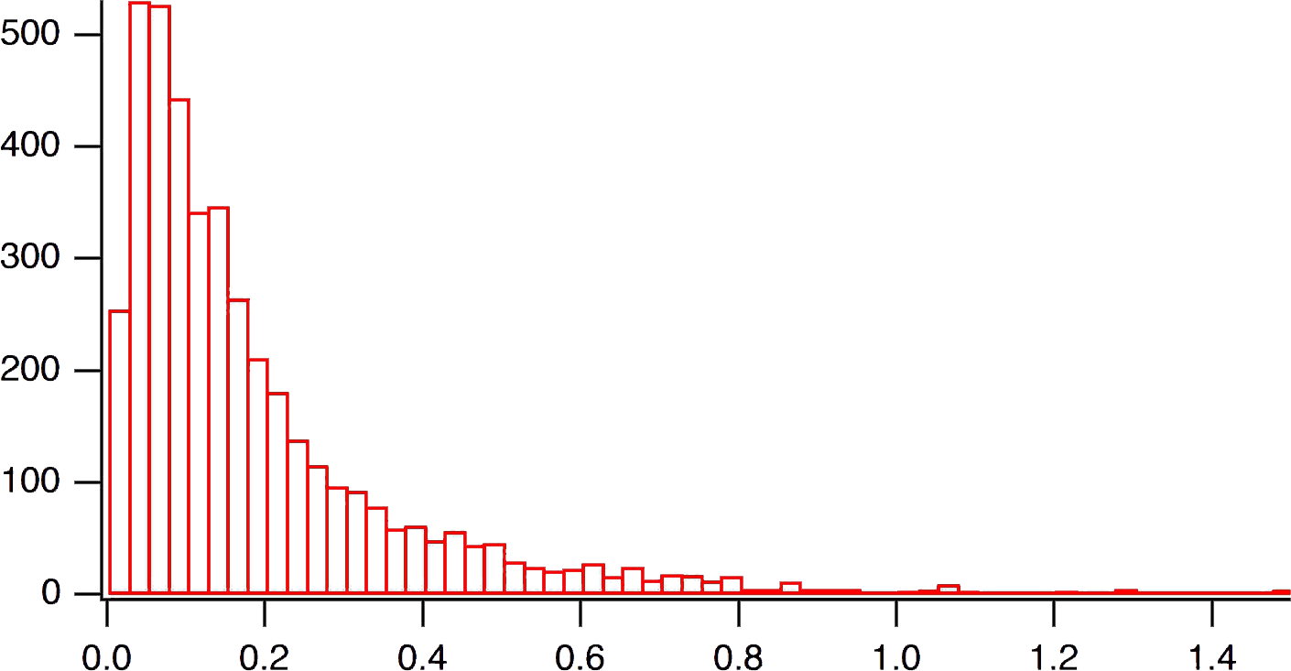
RPE1 cell tracking on 2-state micropattern
probability of occupancy
speed distribution
M 1
M 2
# cell = 28
pattern
No. I
occurence
-30
0
30
0.0
1.0
Δx(t) (μm)
𝑣 (μm/min)
M 1
M 2
# cell = 23
pattern
No. II
occurence
-30
0
30
0.0
1.0
Δx(t) (μm)
𝑣 (μm/min)
cells trap
on
pattern No. II
10

Slide 13
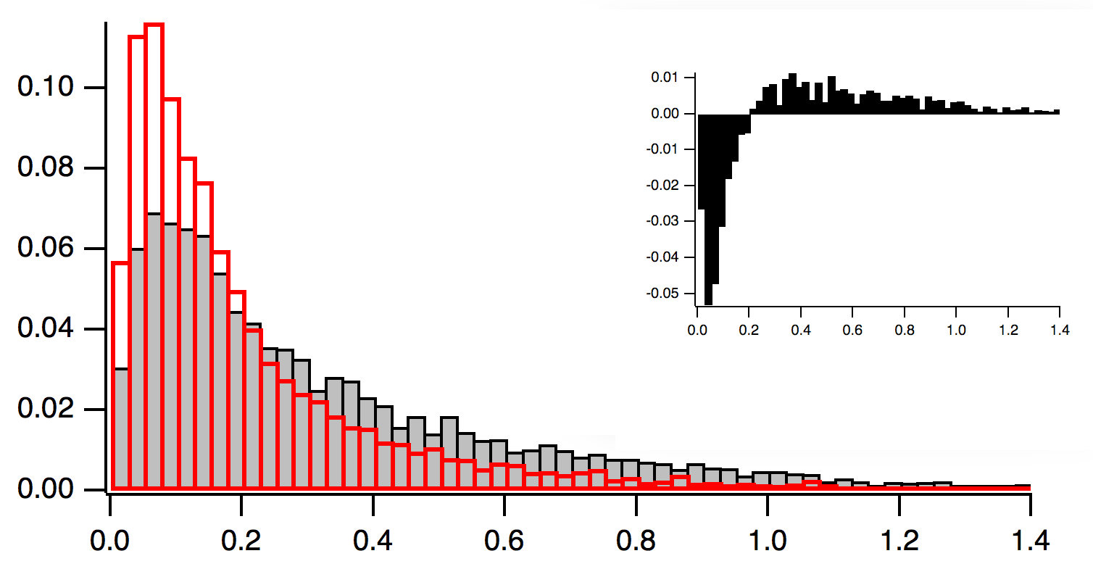
RPE1 cell tracking on 2-state micropattern
probability of occupancy
speed distribution
M 1
M 2
# cell = 28
pattern
No. I
occurence
◼︎ pattern No. I
◼︎ pattern No. II
-30
0
30
Δx(t) (μm)
M 1
M 2
proba density
# cell = 23
pattern
No. II
occurence
0.0
1.0
𝑣 (μm/min)
-30
0
30
Δx(t) (μm)
cells trap
on
pattern No. II
cells more dynamic on pattern No. I
10

Slide 14
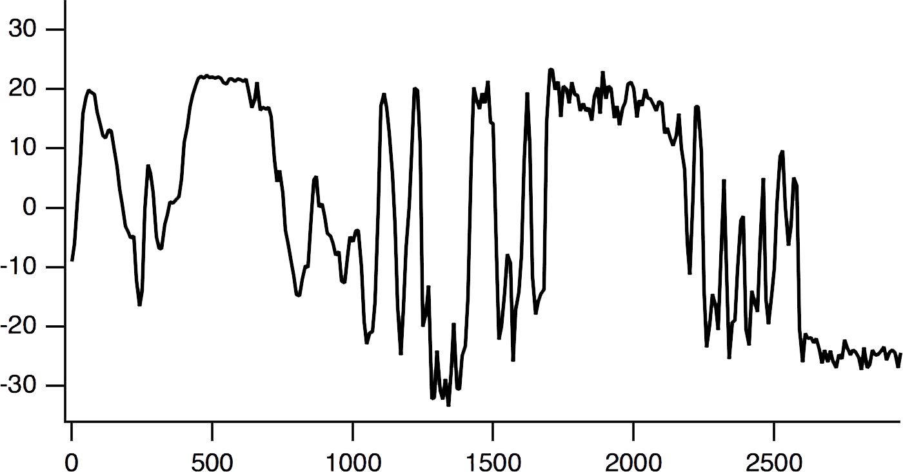
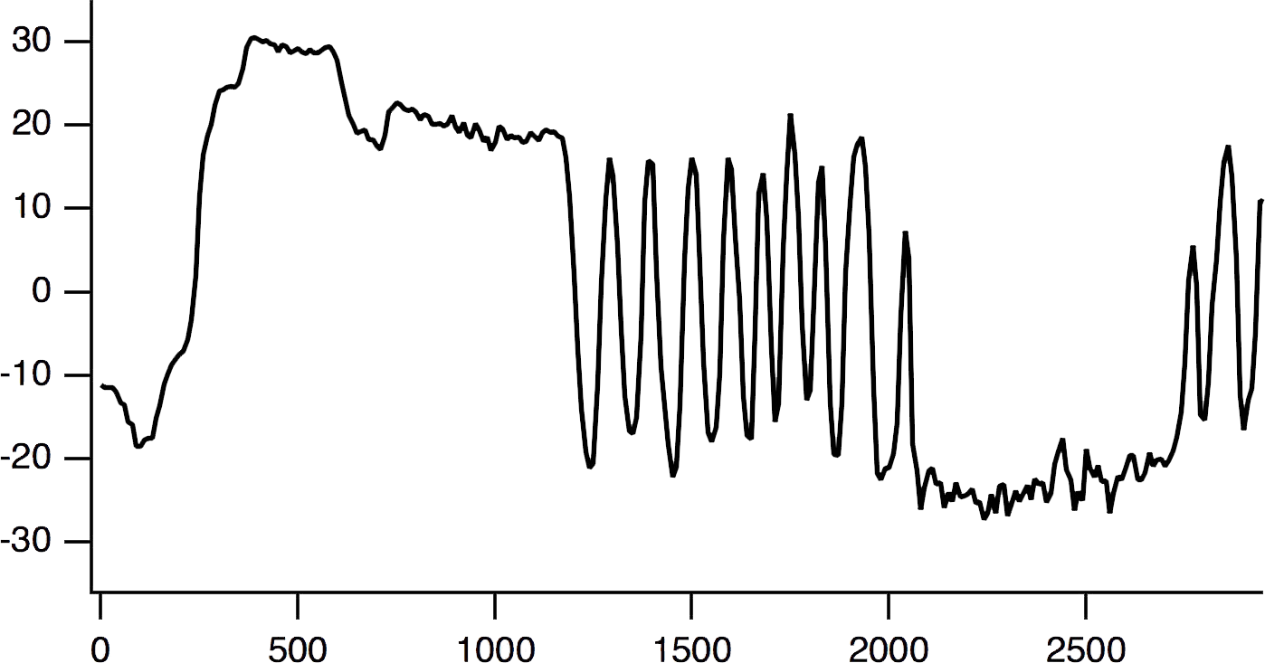
deep learning approach to sort the cell
training with neural network (5k epochs) and ≈ 50 single cell trajectories
input
hidden layers
wi
single cell x-trajectories
No.I
wj
output
wk
Δx(t) (μm)
No.II
…
time (min)
…
…
neurons:
288
144
72
1
random
cells on pattern No.I
with ≈ 10-20% of error
11

Slide 15
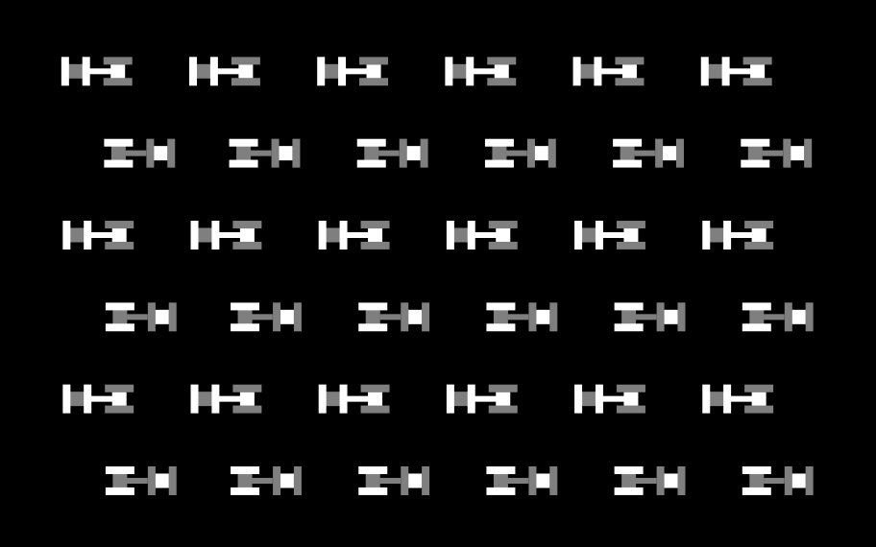
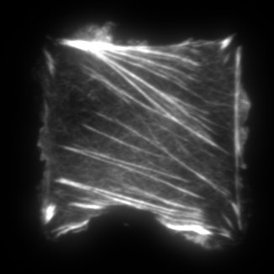
Conclusion
✓ new way to sort cells according to their adhesiveness and contractility
✓ specific patterned substrate
M 1
M 2
pattern
No. I
promote
cell
migration
pattern
No. II
trap
cells
TIRF imaging of actin
contractile
actomyosin
stress fibers
12

Slide 16
vaTIRF
NEFM
single molecule
FCS
TIRF
RICM
Thanks to
financial support:
Fonds Européen de Développement Régional (FEDER) CELLnanoFLUO and Qnanoscopy projects
comité de l’Aube
and you for your attention !

Slide 17
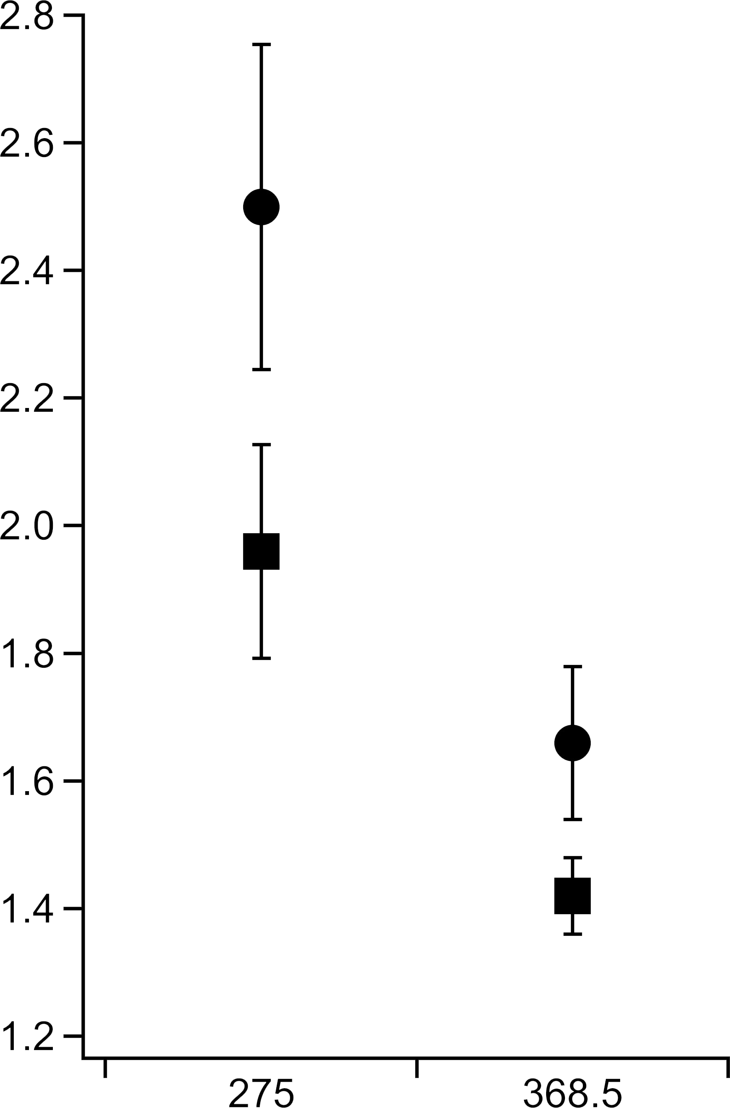
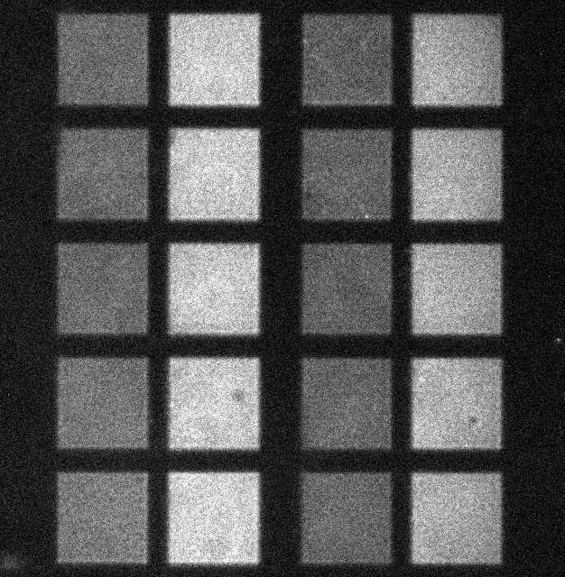
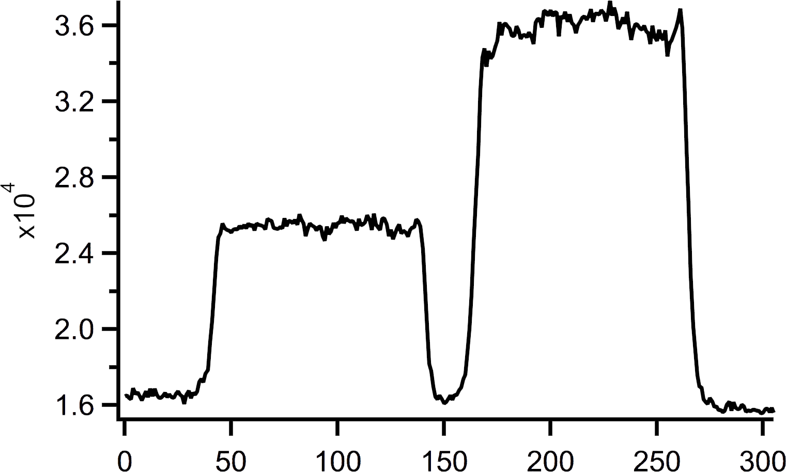
Fibronectin micropatterning
control of the relative surface concentration
Incubation with dye-conjugated fibronectin to evaluate the relative surface concentration within patterns
d2
d1
d2
dose
d1
Fluorescence intensity profile
I
10 μg/mL
20 μg/mL
d1
I
I
profile
d2
d1
d2
d1
I
50 μm
d2
epi-fluorescence image @488 nm with HiLyte FN
pixel
d1 = 550 mJ/mm²
d2 = 275 mJ/mm²
@ d1 = 550 mJ/mm² → maximal concentration
of fibronectine
d2 (mJ/mm²)

Slide 18
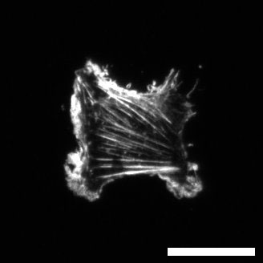
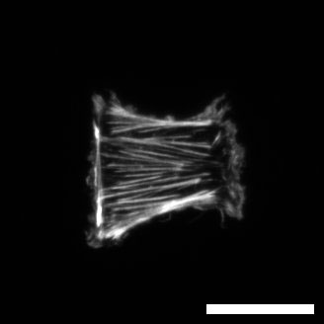
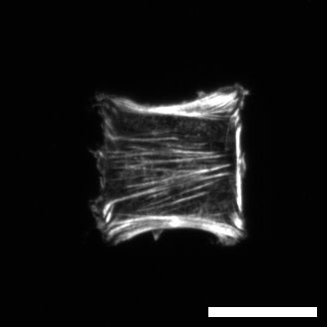
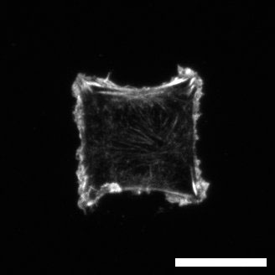
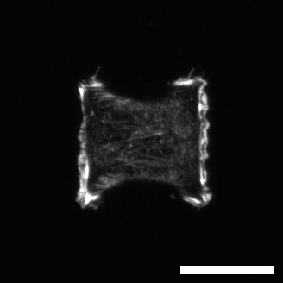
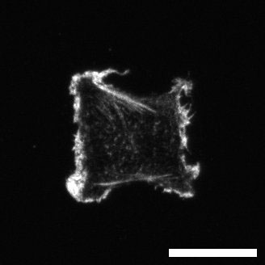
Two-state micropattern system
asymmetric pattern
Control cell adhesion, contractility
and migration
M 1
M 2
Two connected motifs M1 and M2
30 μm
75 μm
Fibronectine surface concentration
TIRF imaging @561nm on fixed REP1 cells (AlexaFluor561 phalloidin)
M1
Motif 1
20μm
pro-contractile
d1 = 550 mJ/mm²
d2 = 275 mJ/mm²
M2
20μm

Slide 19
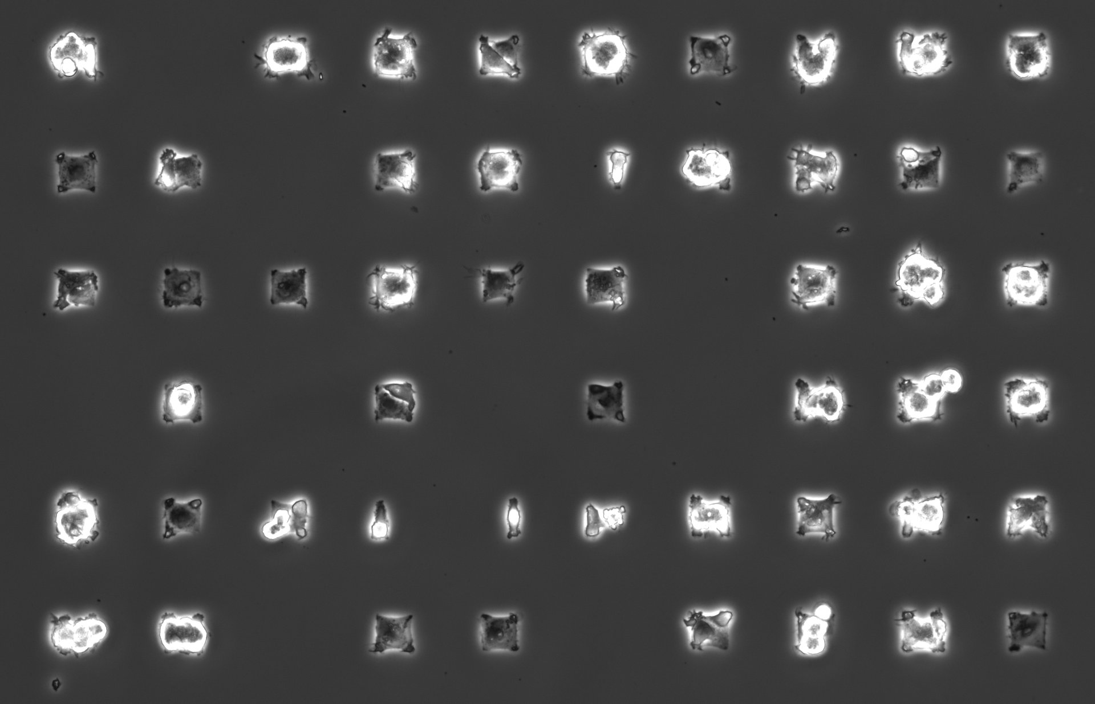
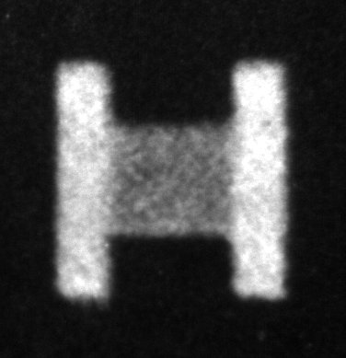
pattern
Cellules U87MG

Slide 20
Two connected patterns
Cellules RPE1 (48h)

Slide 21
Probability of occupancy and speed
typical single cell x-trajectories
# cell = 28
M 1
M 2
pattern
No. I
Δx(t) (μm)
time (min)
# cell = 18
control
Δx(t) (μm)
time (min)

Slide 22
Probability of occupancy and speed
typical single cell x-trajectories
# cell = 23
M 1
M 2
pattern
No. II
Δx(t) (μm)
time (min)
# cell = 28
control
Δx(t) (μm)
time (min)

Slide 23
Probability of occupancy and speed
probability of occupancy
speed distribution
# cell = 28
M 1
M 2
pattern
No. I
occurence
Δx(t) (μm)
𝑣 (μm/min)
# cell = 18
control
occurence
Δx(t) (μm)
𝑣 (μm/min)

Slide 24
Probability of occupancy and speed
probability of occupancy
speed distribution
# cell = 23
M 1
M 2
pattern
No. II
occurence
Δx(t) (μm)
𝑣 (μm/min)
# cell = 28
control
occurence
Δx(t) (μm)
𝑣 (μm/min)

