Slide 1
Physics of bacterial exploration in confined environments
Renaud Baillou, PMMH-ESPCI-PSL
Physics : Marta Pedrosa, Thierry Darnige, Fernando Peruani, Eric Clément
Biology/Medicine : Marta Vazquez, Tiphaine Le Roy, Karine Clément

Slide 2
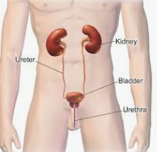
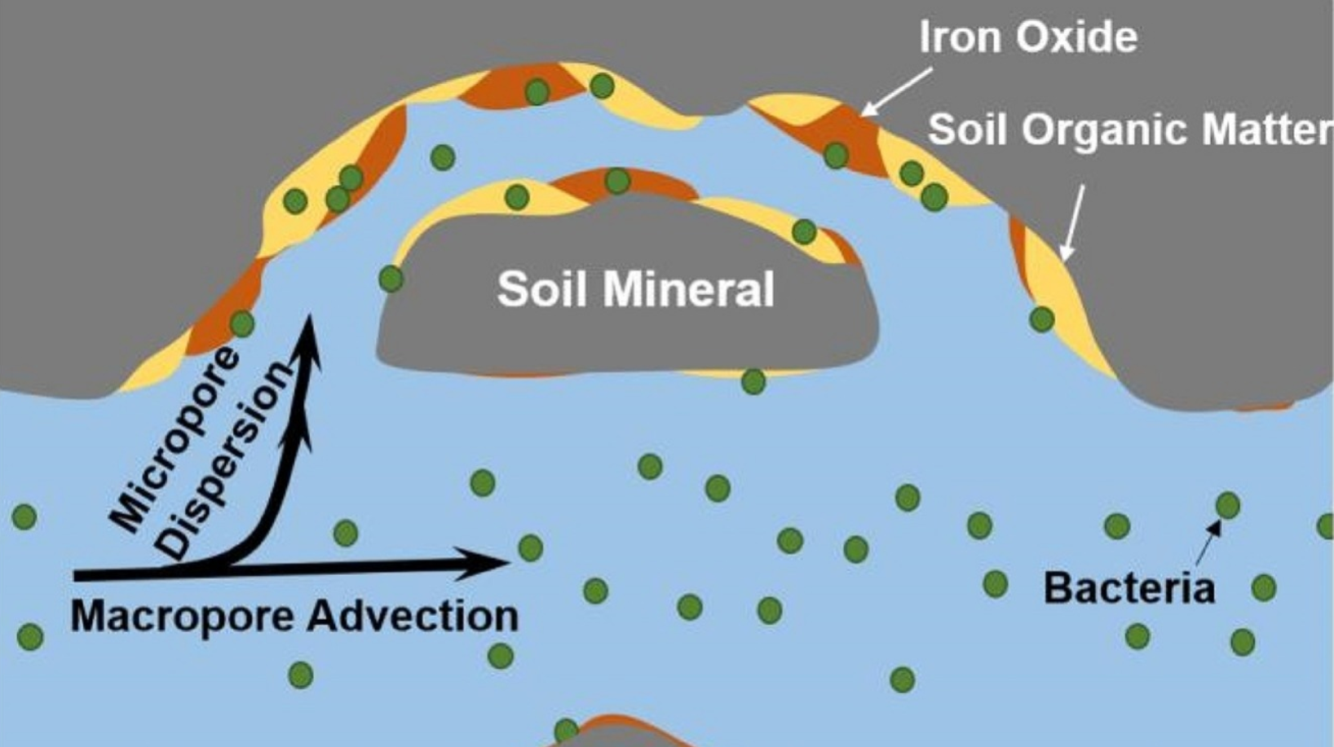
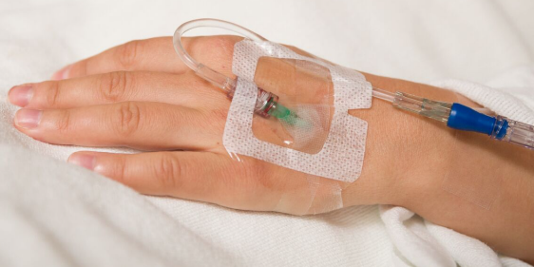
Motivations
In nature
Medical tubing
Physiological ducts
Porous soils
In the lab
What is the impact of confinement on transport properties ?

Slide 3
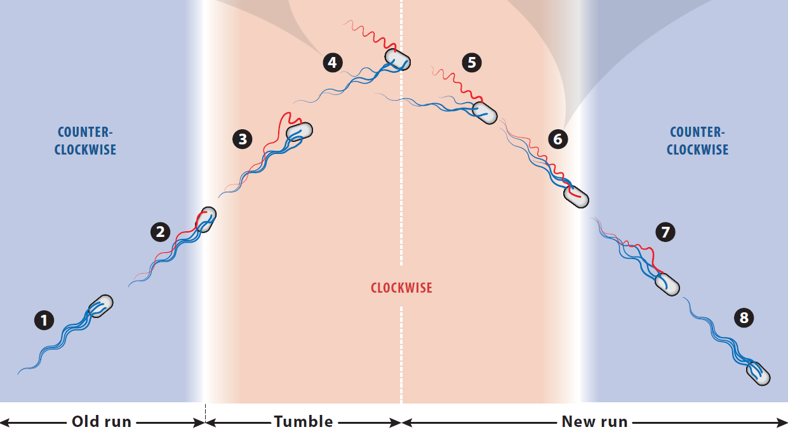
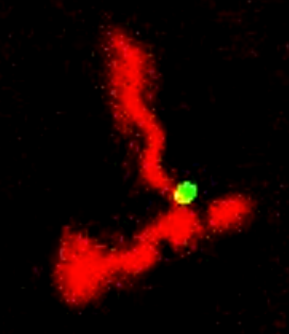
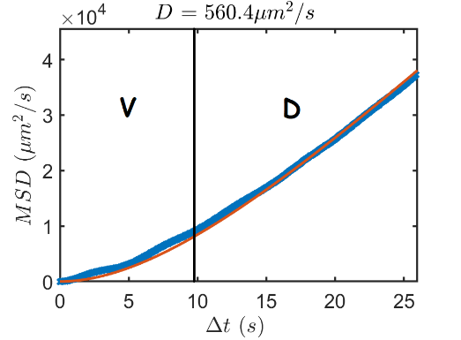
E. Coli : a model bacterium
Wild-type E. Coli in the lab
Run & Tumble
Run
2-3 µm
5-10 µm
Tumble
Lauga, E. Annual Review of Fluid Mechanics 48, 105–130 (2016).
Run & tumble dynamics leads to diffusive process.

Slide 4
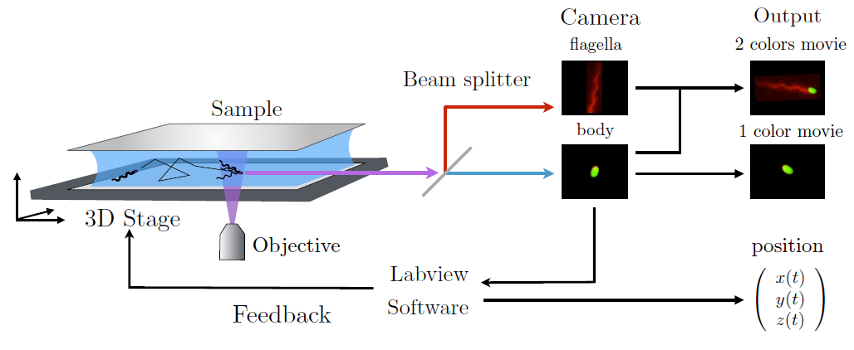
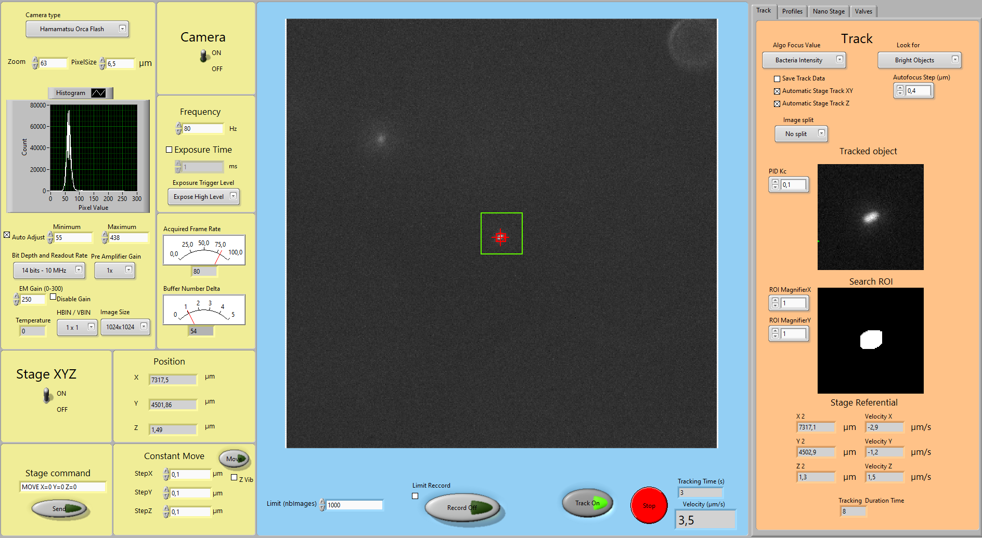
Lagrangian 3D tracking of motile E. coli
Setup
Live-visualization and trajectory
Darnige, et al, E. Review of Scientific Instruments 88, 055106 (2017).
Labview interface
Swimming speed V
Long trajectory (around 10 min).
We can extract the swimming speed V.

Slide 5
Bacterial exploration under confinement
Tracking in the chamber
Experimental set-up
40µm < H < 260µm
Chamber
Archetypal system to study the interplay between bulk and surface in transport properties.
Circular motion at surfaces => « trapping ».

Slide 6
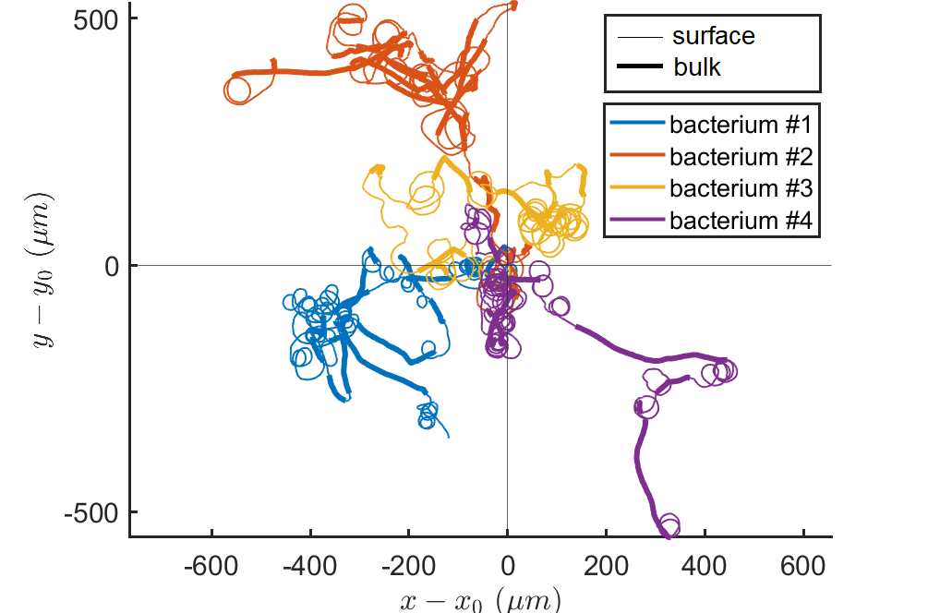
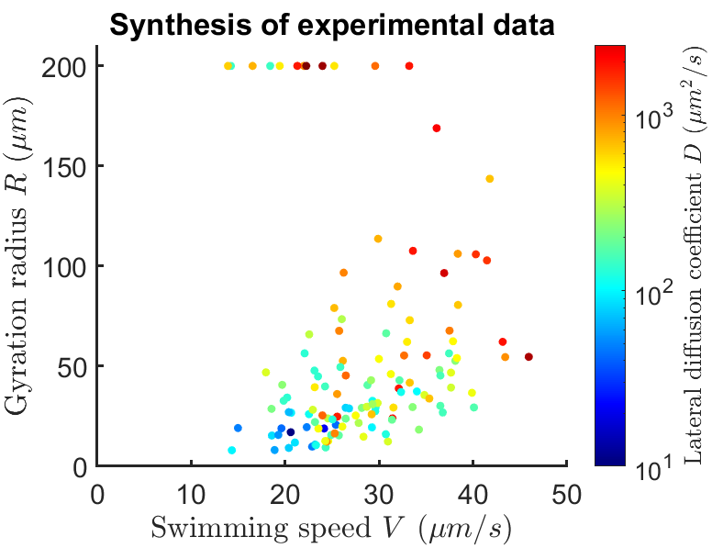
Large variability in E. coli population
Top view of several tracks of
same duration T=250s at a given height H=210µm
117 bacterial tracks
H = [40, 60, 90, 110, 220] µm
>
Variability of the measured
diffusion coefficient D
at constant confinement height H.
Large variability of bacterial track parameters V and R as well as the exploration quantifier D.

Slide 7
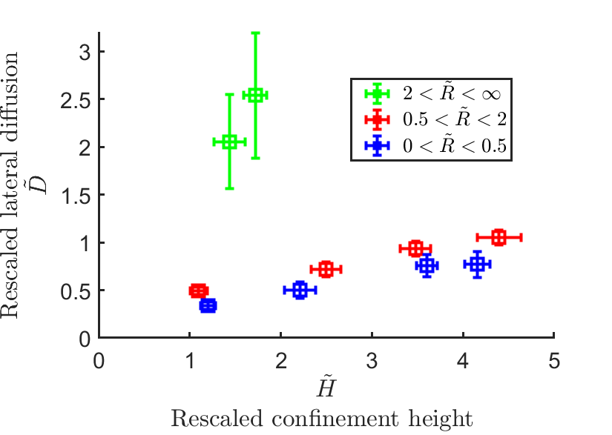
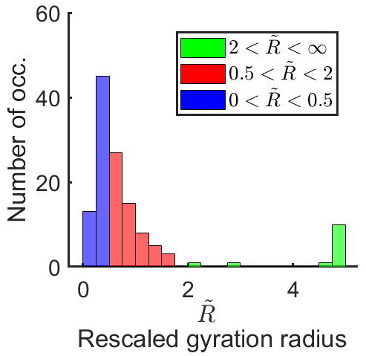
Impact of confinement on transport properties
Dimensionless variables
τ_{r}=2.2s : mean run time
Junot, G. et al. Phys. Rev. Lett. 128, 248101 (2022).
Group of radii
Bacteria explore more as the confinement height increases.
The gyration radius is an important parameter.

Slide 8
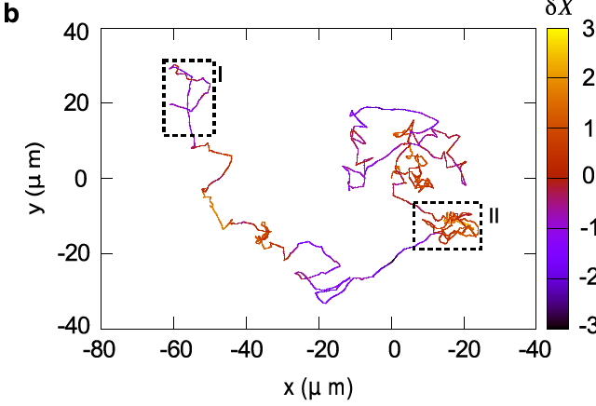
Run & tumble simulations under confinement
(i) Bahvioral variability (BV) model for run times [calibrated in F-M. Phys. Rev. X 10, 021004 (2020)].
Internal variable δX(t) : « Mood »
Trajectory
Exploring
Foraging
Large distribution of run times.
Temporal variations: « mood ».
(ii) Effective rotational diffusion for the tumbles
Circular trajectory of gyration radius R
Take off
after tumbling
if pointing out
Alignment
at landing
(iii) Kinematics
at surface
time t

Slide 9
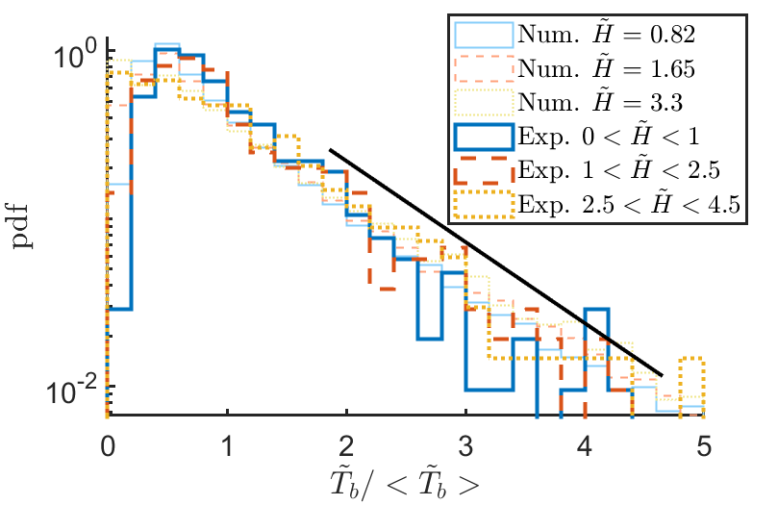
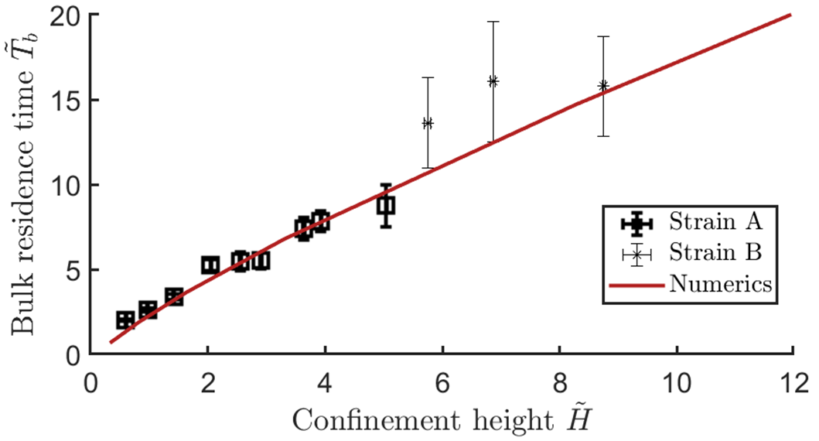
Impact of confinement on residence times
Residence time in the bulk
Exponential cut-off.
Residence time at surface
Log-normal distribution.
Good agreement experiments/model in average values and distributions.

Slide 10
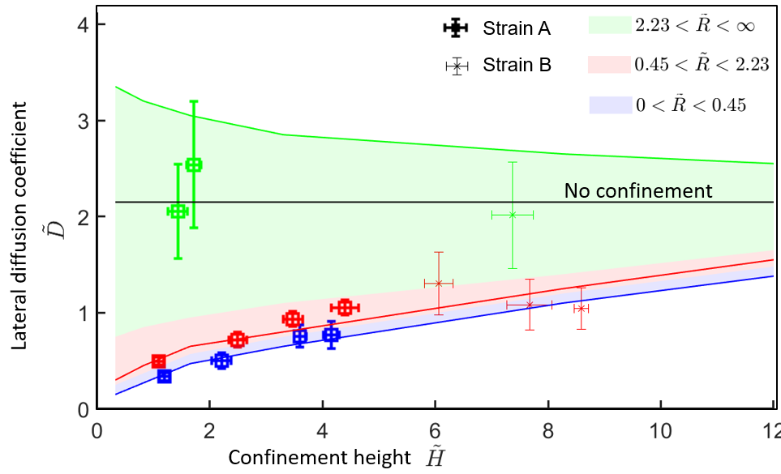
Impact of confinement on transport properties
« Run» l$imit \tilde{R}=∞$
$$\tilde{H}=∞$$
« Stick » l$imit \tilde{R}=0$
500<H<1000µm
The numerical model is in remarkable quantitative agreement with experiments (no fitted parameters).

Slide 11
Conclusions
Study the emerging dispersion process for motile wild-type E. coli bacteria exploring their environment under confinement :
Diffusion coefficients essentially increase with confinement height and surface gyration radii.
The surface residence time is log-normal distributed.
Mean bulk residence times increase quasi linearly with confinement height.
Numerical "behavioral" simulations quantitatively reproduce surface and bulk residence times as well as diffusion phenomenology.
This study is a base to understand bacterial infection and spreading of bacteria in more complex situations :
Geometrical disorder (porous media)
Chemotactic response
Flow

Slide 12
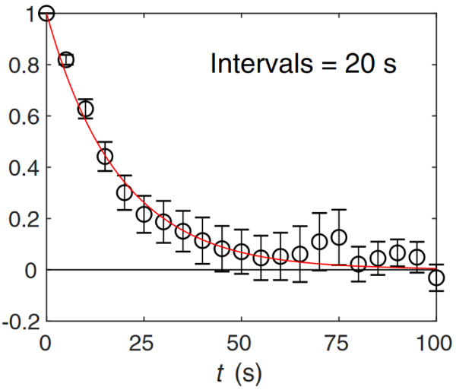
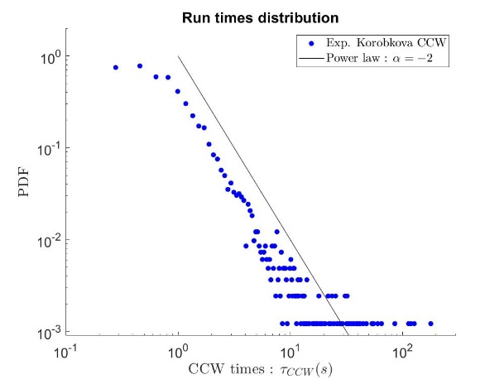
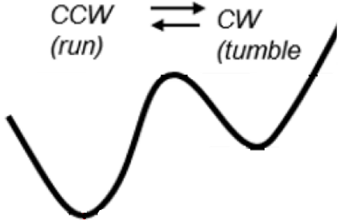
Behavioral variability (BV) model for the dynamics of run times
Figueroa-Morales, N. et al. 3D Spatial Exploration by E. coli Echoes Motor Temporal Variability. Phys. Rev. X 10, 021004 (2020).
Role of CheY-P in the flagellar motor
Memory
Distribution of run times
Persistence times
self-correlation
function Cp
Chang, Y. et al. Molecular mechanism for rotational switching of the bacterial flagellar motor. Nat Struct Mol Biol 27, 1041–1047 (2020).
Figueroa-Morales, N. et al. 3D Spatial Exploration by E. coli Echoes Motor Temporal Variability. Phys. Rev. X 10, 021004 (2020).
Korobkova, et al. From molecular noise to behavioural variability in a single bacterium. Nature 428, 574–578 (2004).
CheY-P fluctuations Y(t)
Activation barrier ΔG₀[Y(t)]
Run time τ_{r} at time t
Model
ΔG₀
Large distribution.
Mood.

Slide 13
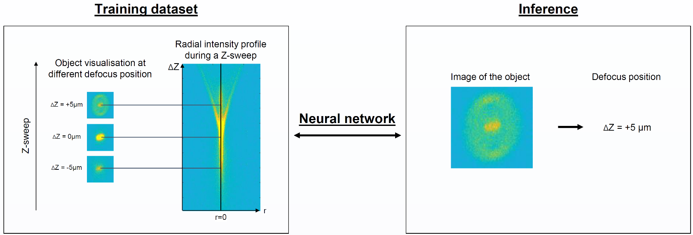
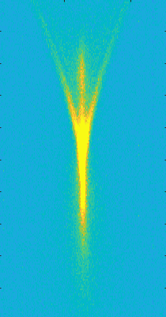
Lagrangian tracking of active objects
How ?
Machine learning
Long track on large length scale
(only limited in z axis)
Visualization of the tracked object and its surrounding environment
Why ?
Lagrangian > Eulerian
Temporal
variability
Large scale transport properties
Interaction with complex fluids
Morphological evolution
Training dataset
Inference
Radial intensity profile during a Z-sweep
Object visualisation at different defocus position
ΔZ
Image of the object
Defocus position
ΔZ = +5µm
Neural network
ΔZ = +5 µm
Z-sweep
ΔZ = 0µm
ΔZ = -5µm
r=0
r

Slide 14
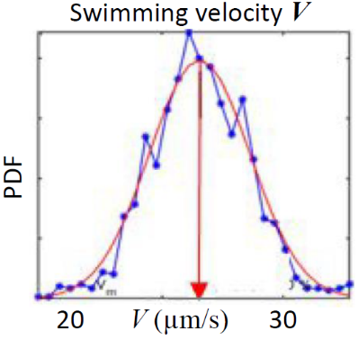
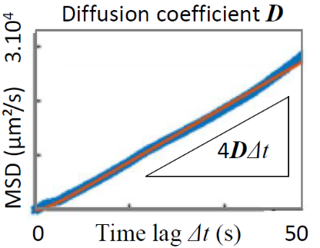
Conclusion

