Slide 1
A biomimetic approach to cell-cell communication
Sapna Ravindran
Cécile Vincent, Alexis Prevost, Léa-Laetitia Pontani, and Elie Wandersman
26ème Congrès Général de la SFP 3–7 Jul 2023
Cité des sciences et de l'Industrie, Paris

Slide 2
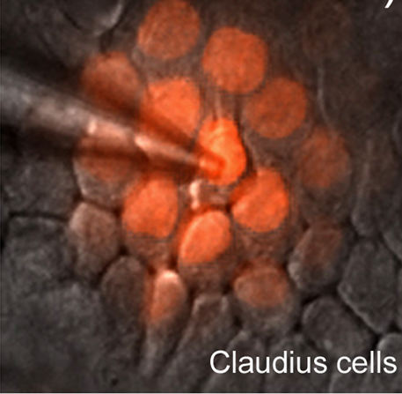
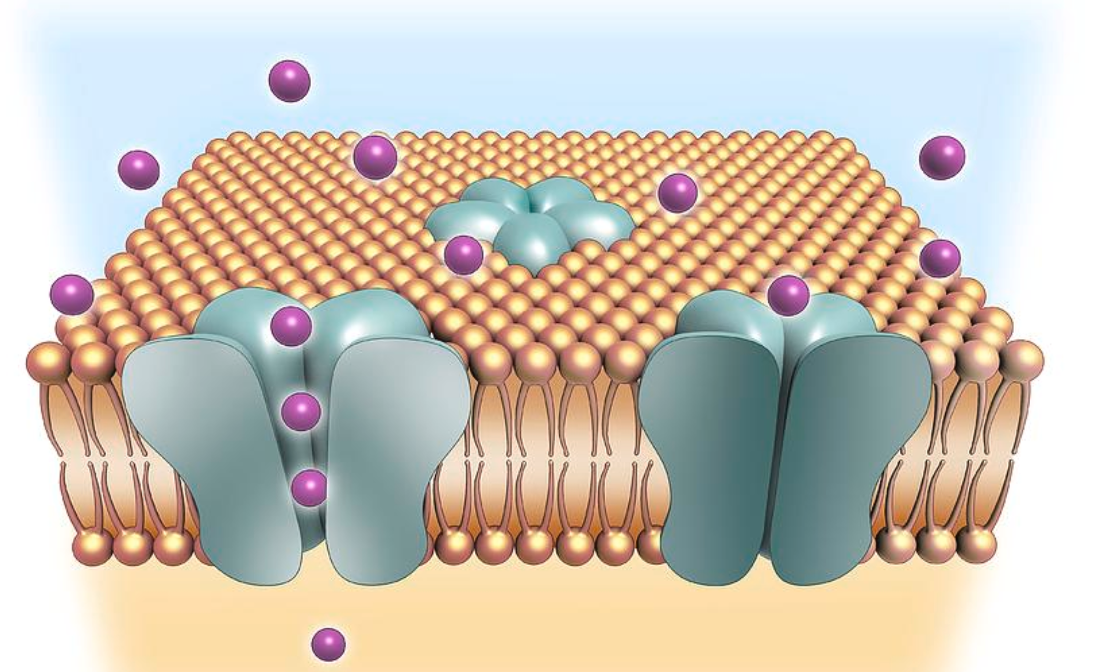
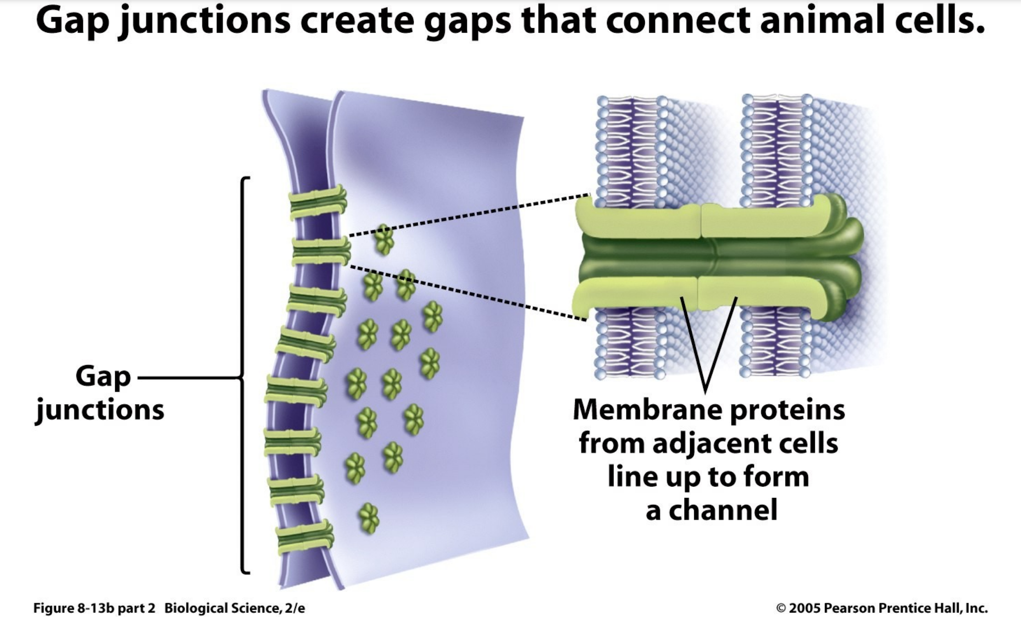
Cell-cell communication in tissues
Cell synchronisation, regulation, patterning… Multiple communication modes
Distant
Contact
eg: Ion channel-transmembrane protein
eg: Gap junctions in tissues
©Science Photo Library (SPL)
Chang et al.
Molecular transport: a simplified biomimetic experimental framework
develop statistical physics-based theoretical models

Slide 3
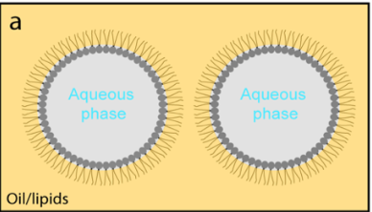
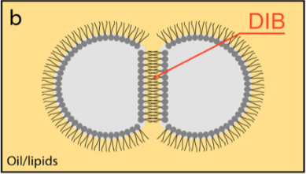
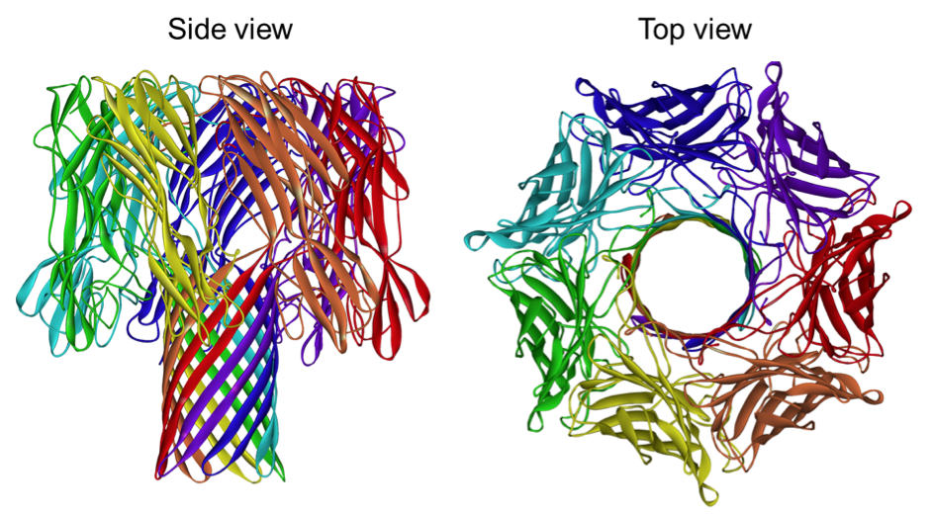
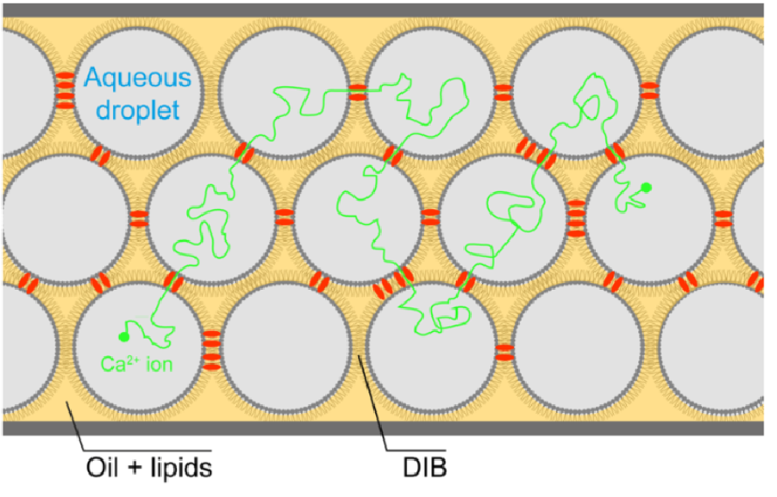
A biomimetic Tissue Model
Model lipid membranes: Droplet Interface Bilayers(DIB)
Aqueous Droplets bathing in oil/lipid mix
Lipid bilayer
is formed at contact
Hagan Bayley Mol. Biosyst. (2017).
Insert Transmembrane nanopores in the membrane
Transmembrane protein: α Hemolysin
Which physical mechanism controls diffusion in tissues?
Diffusion timescale ?
Dependance with pore concentration ?
~1 nm
Song et al., 1996

Slide 4
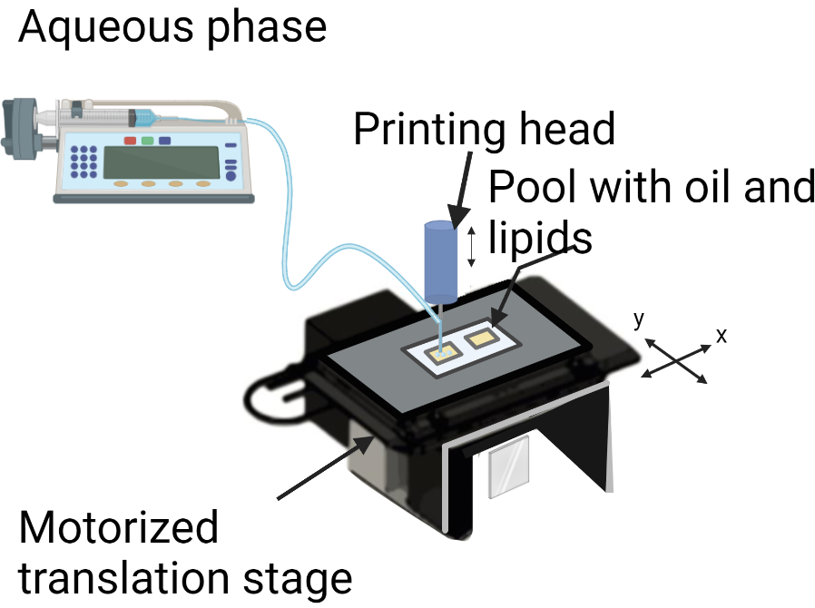
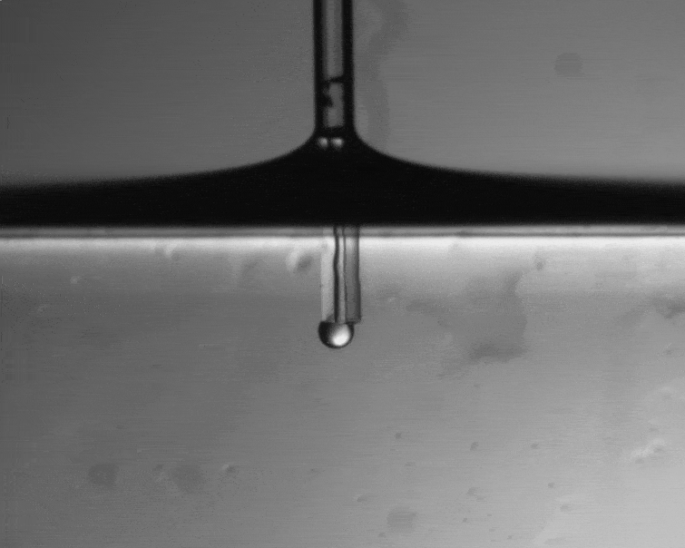
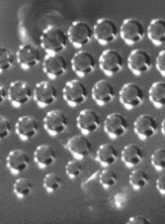
How to make a DIB ? Slow Microfluidics
On Demand microfluidic to produce DIB networks : the « Capillary Trap »
A new capillary instability to produce droplets
γ _{ow} < γ _{aw}
Quasi static
Versatile
Low-cost
d = [40 – 500] µm
Adapted to
DIB network production
1 mm
air
capillary
Aqueous phase
oil+lipids
200 µm
t₀
t₀+12 h
M. Valet et al., Phys Rev Applied 2018

Slide 5
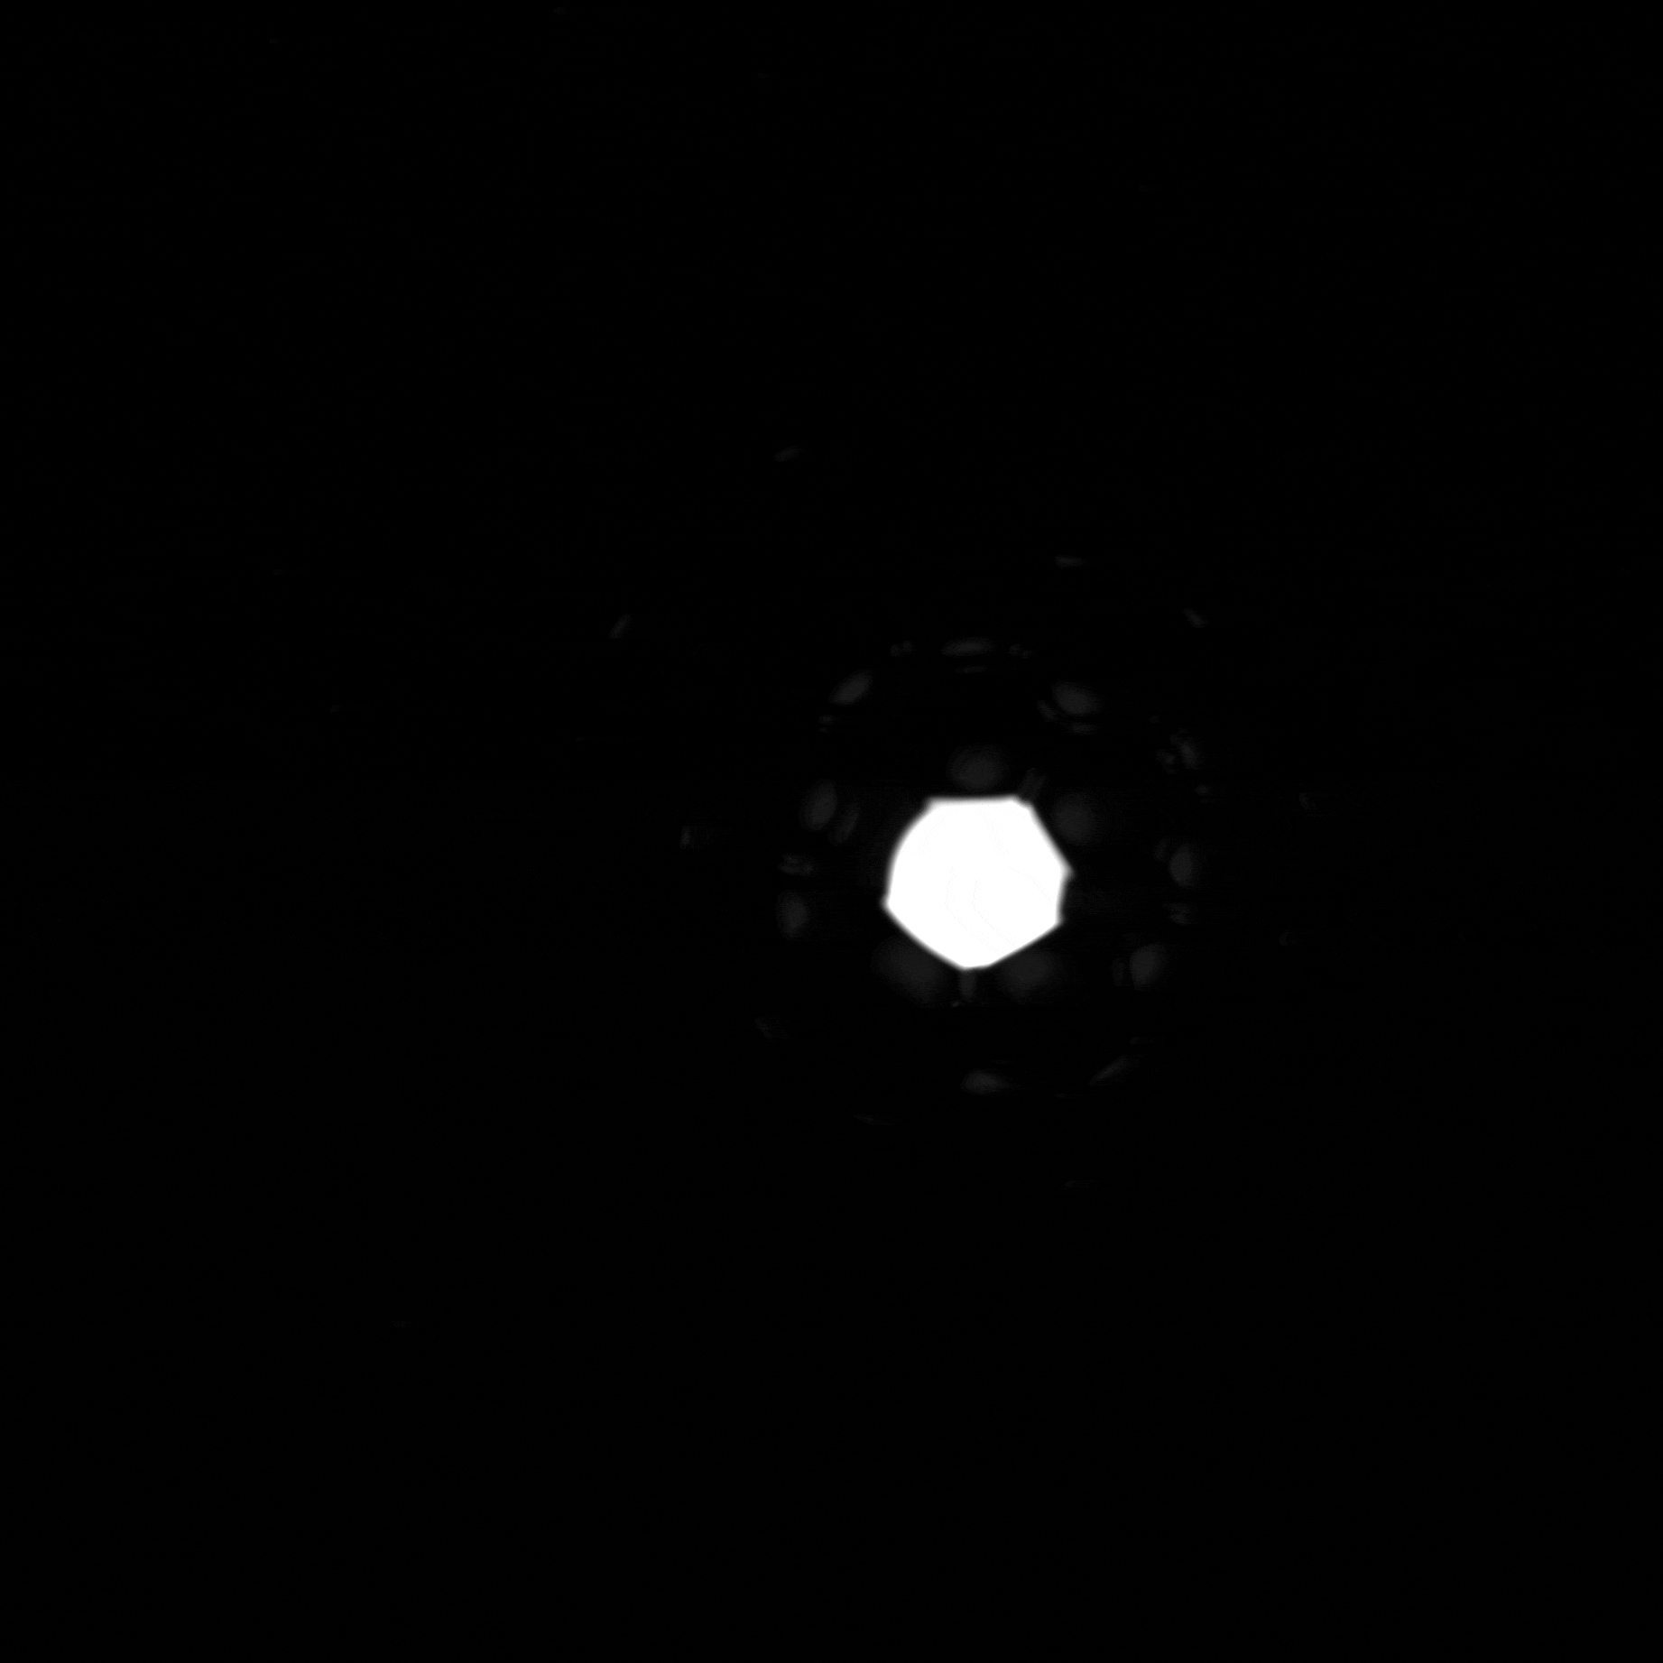
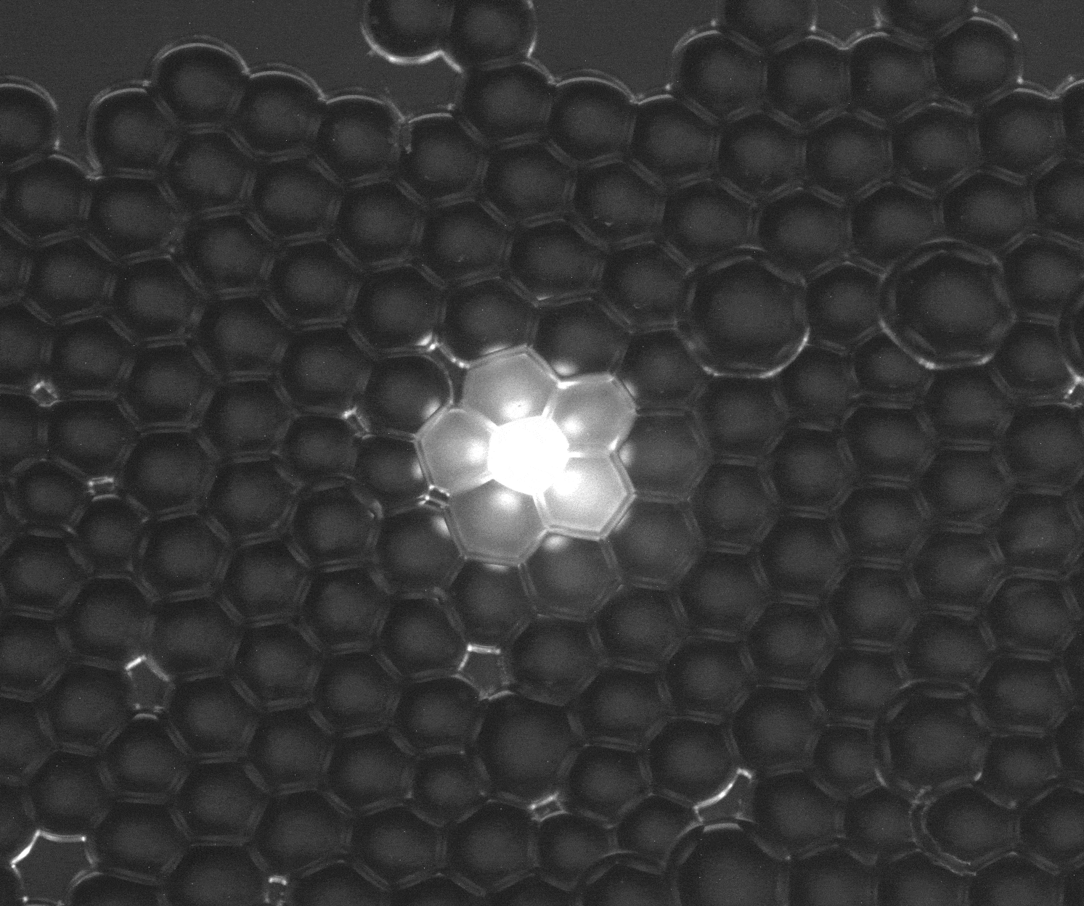
Artificial systems to mimic cellular tissues
Diffusion experiment in DIB network decorated with inert nanopore
200 µm
200 µm
Control without the nanopores
Experiment with 100 µg/ml of 𝛼HL
Duration of the experiment: ~16 hours

Slide 6
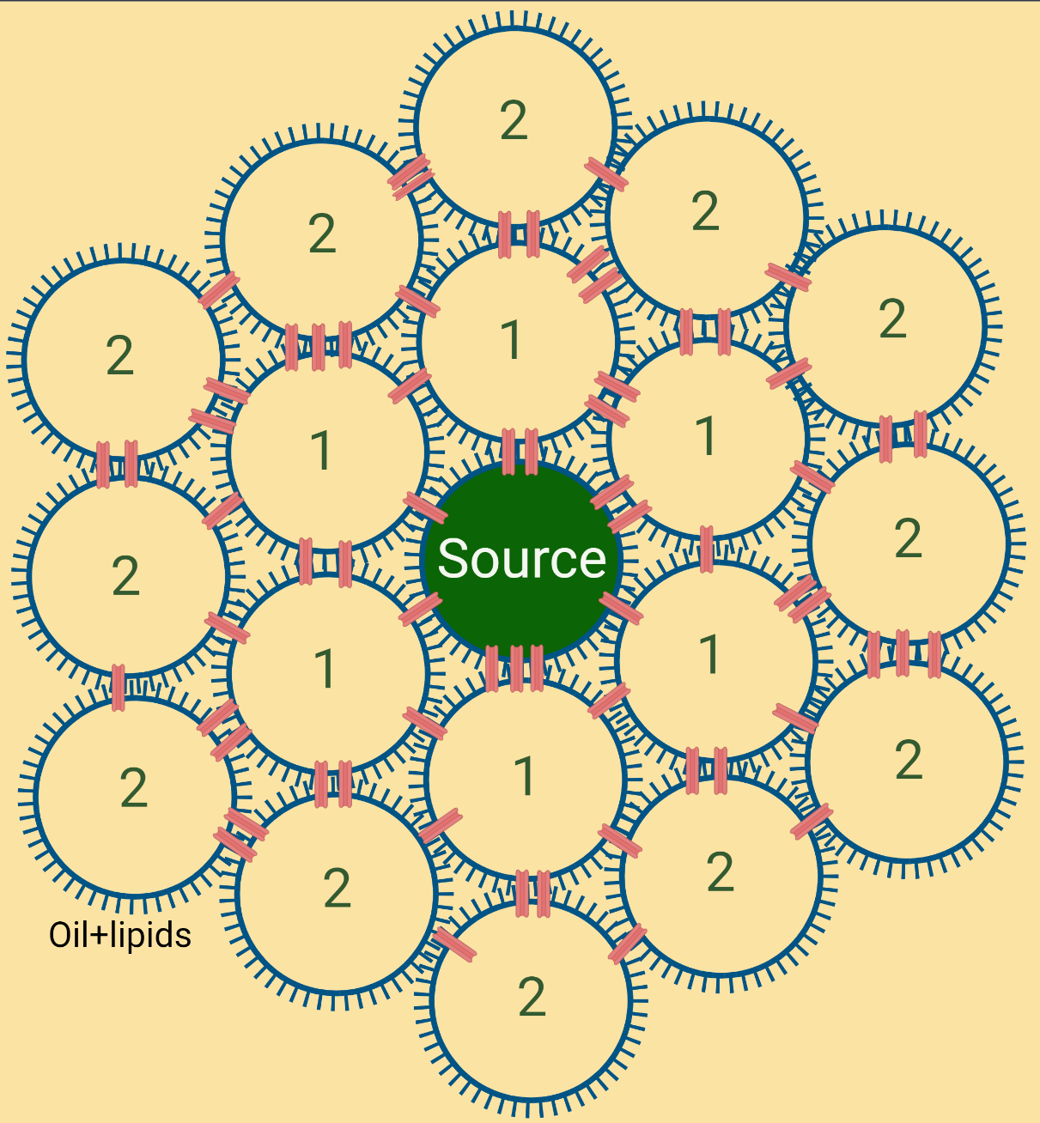
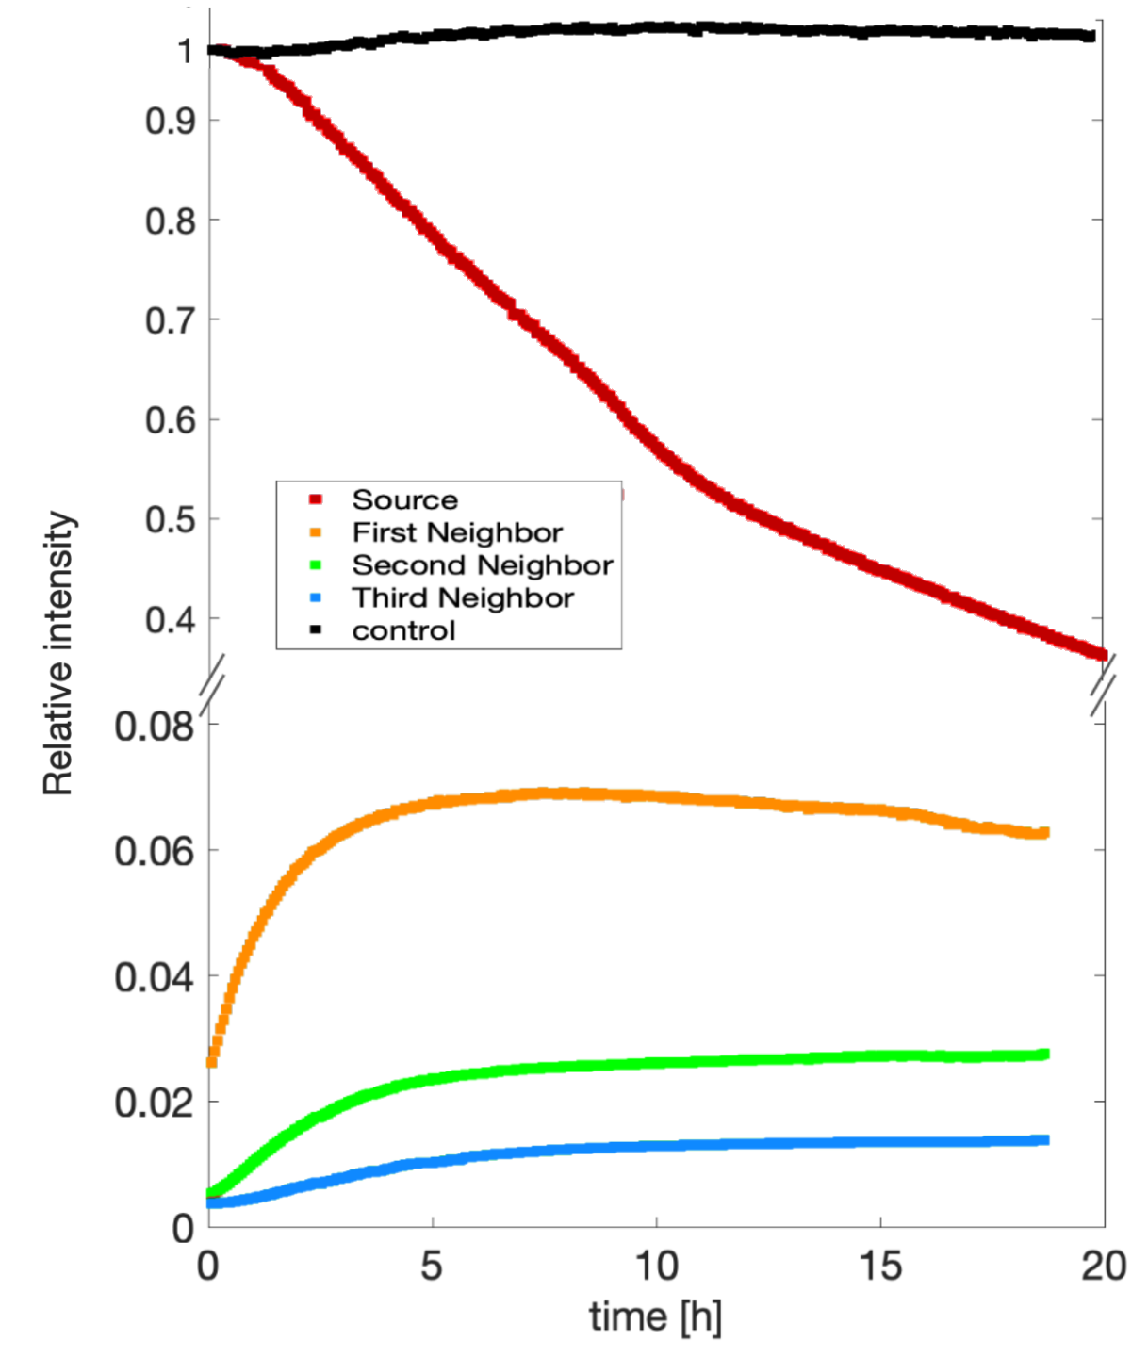
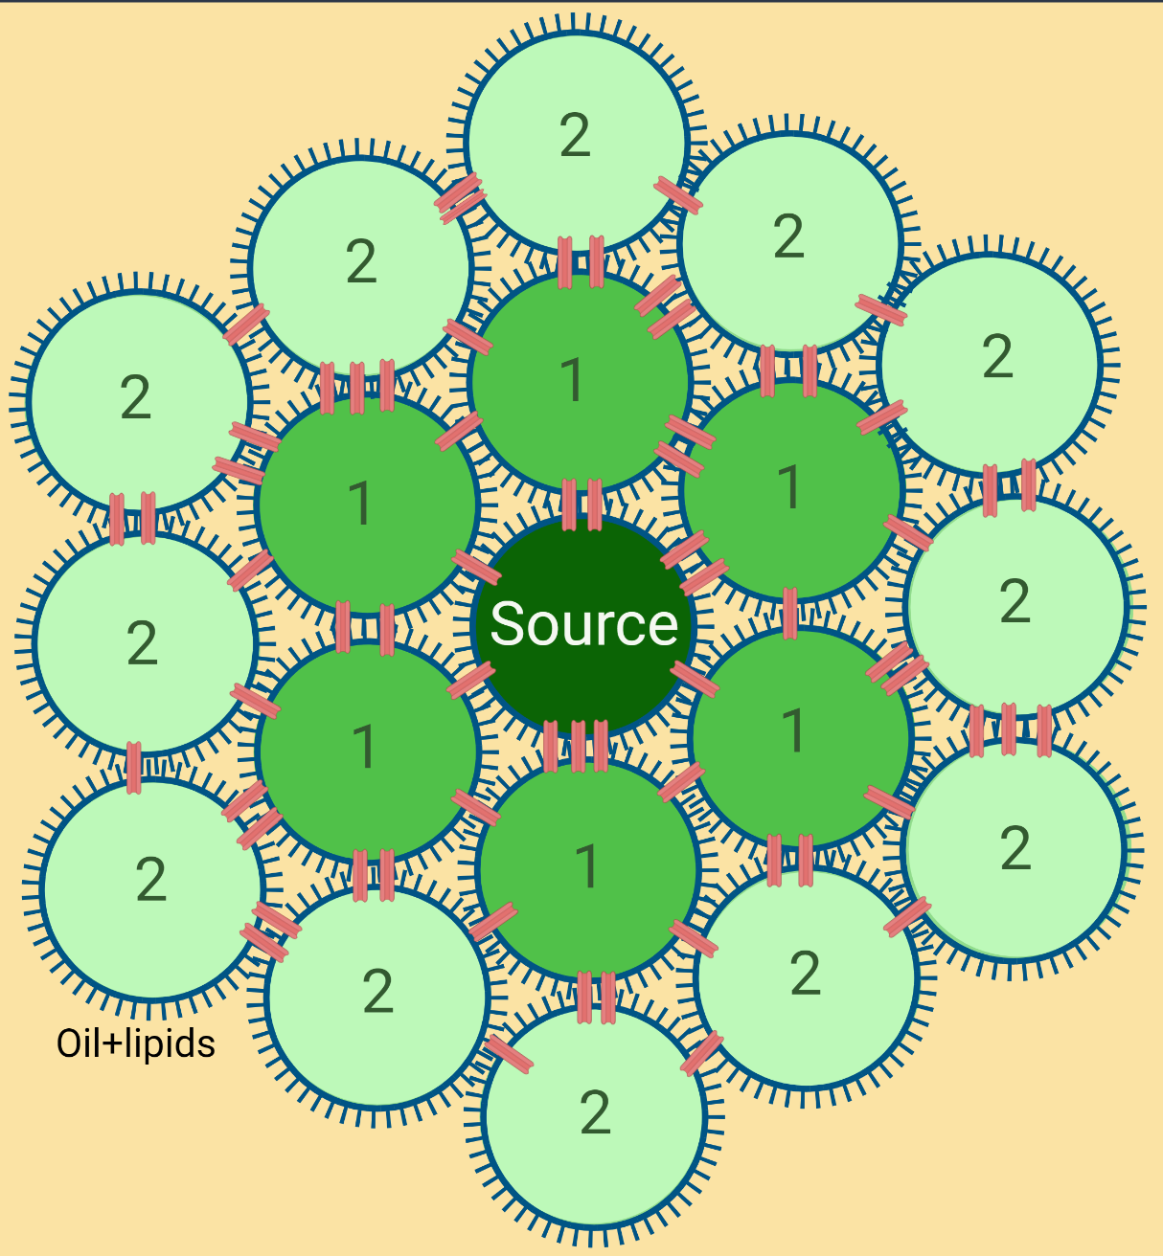
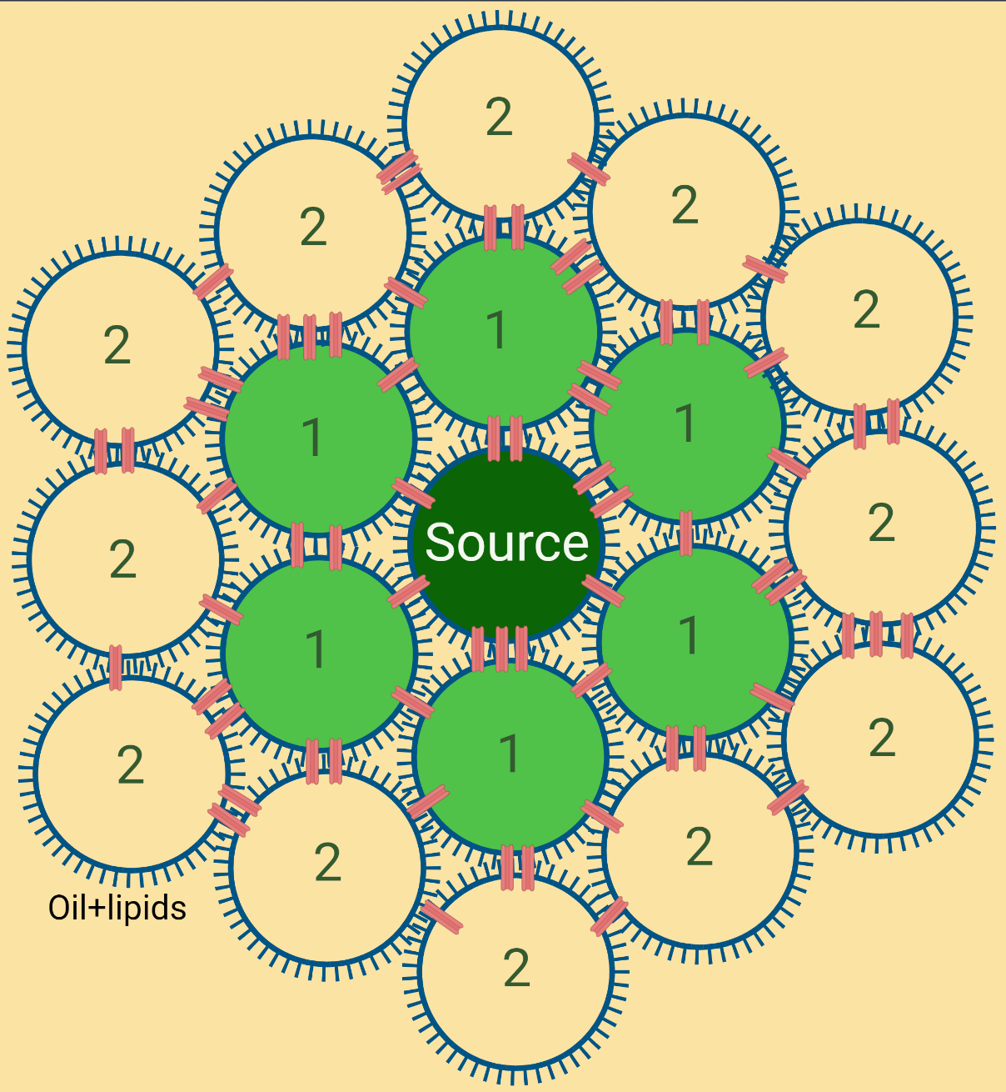
Preliminary results: Diffusion in DIB Networks
Diffusion in 2D 𝛼HL-DIB networks
Epifluorescence Microscopy
Control with no pores
Source
First neighbour
Second neighbour
Third neighbour

Slide 7
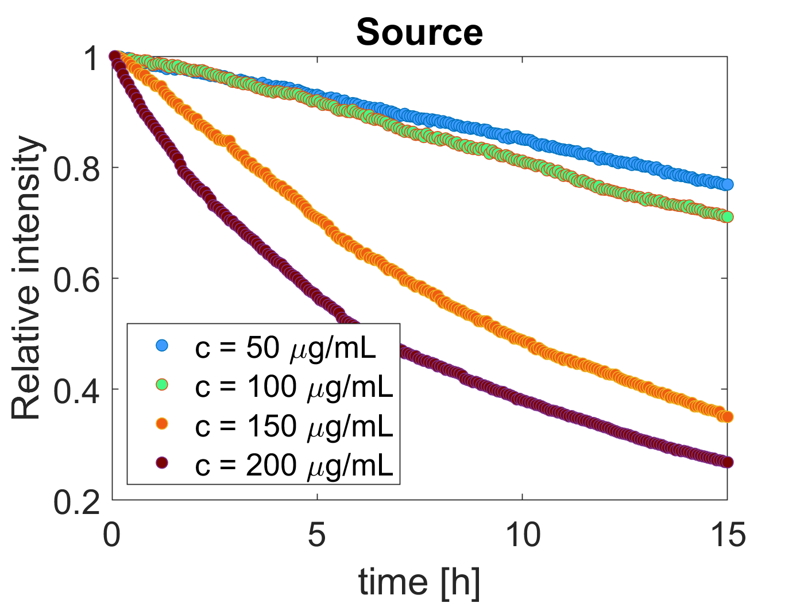
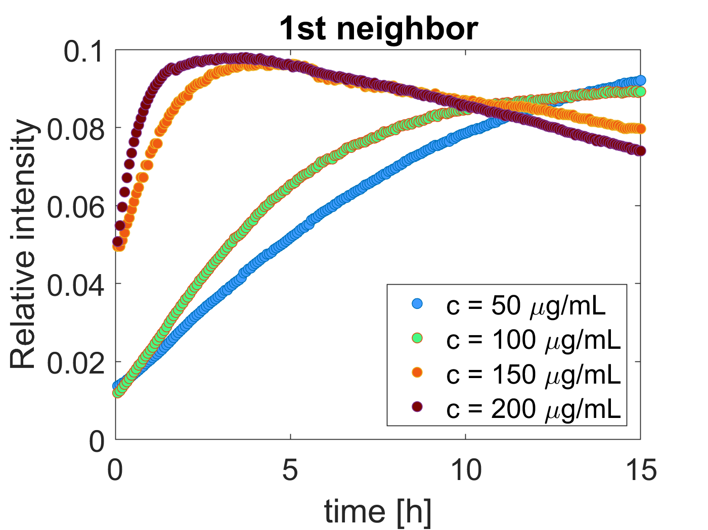
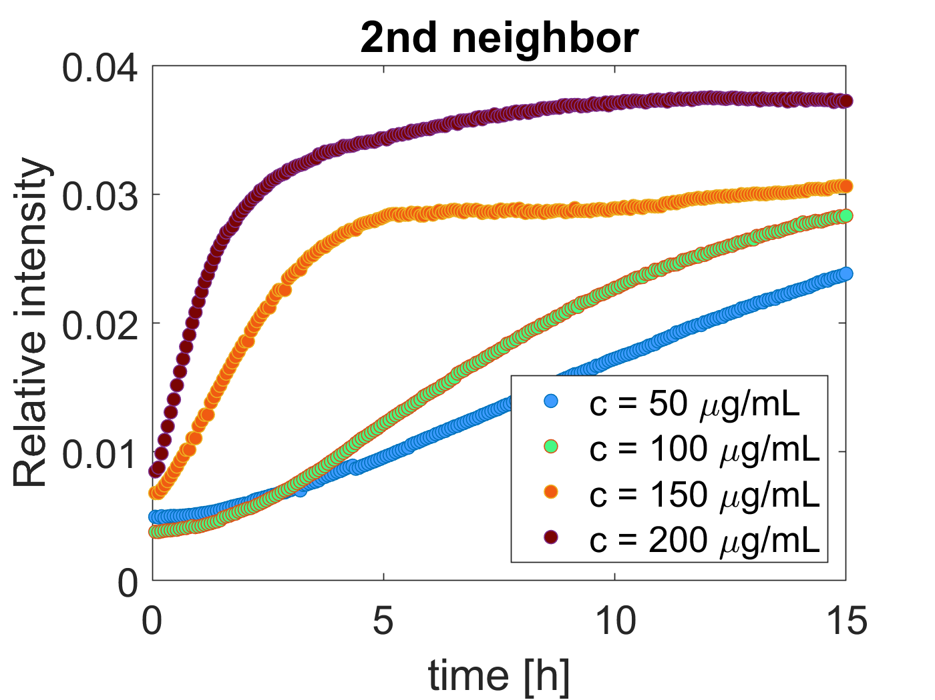
Diffusion with nanopore concentration
[𝝰HL]
[𝝰HL]
Increasing the pore concentration makes the diffusion faster.
[𝝰HL]

Slide 8
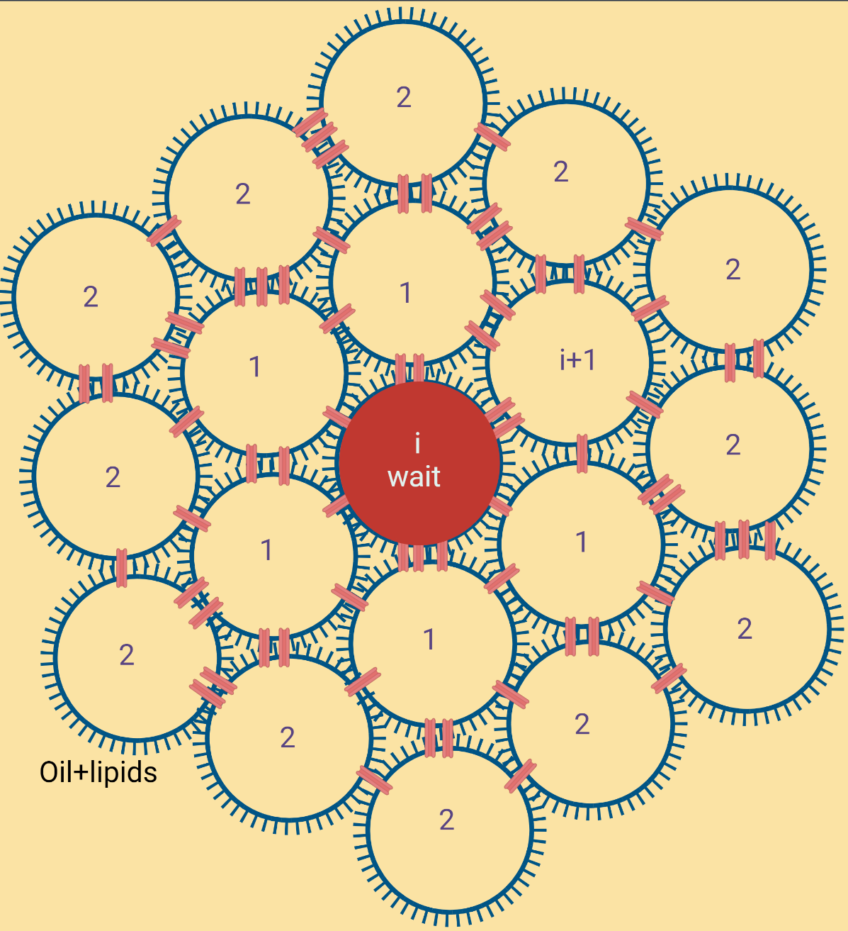
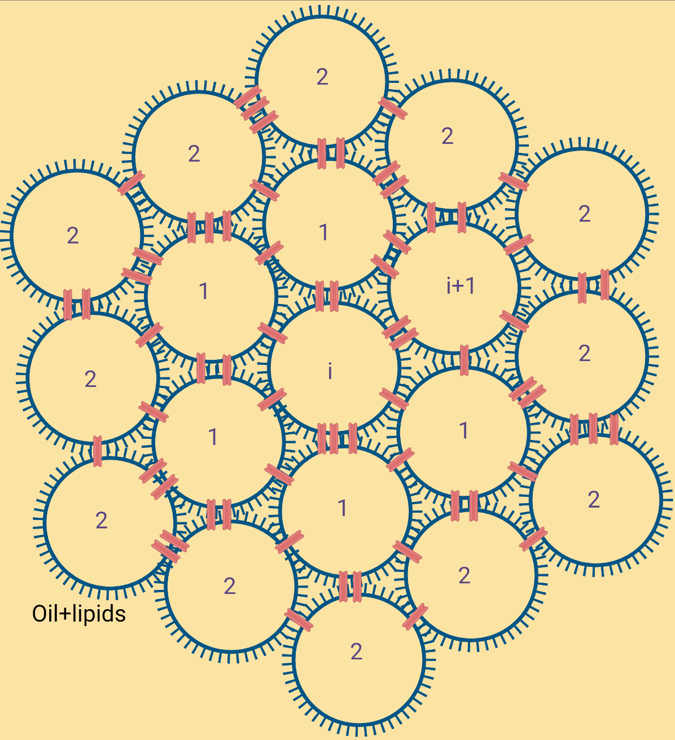
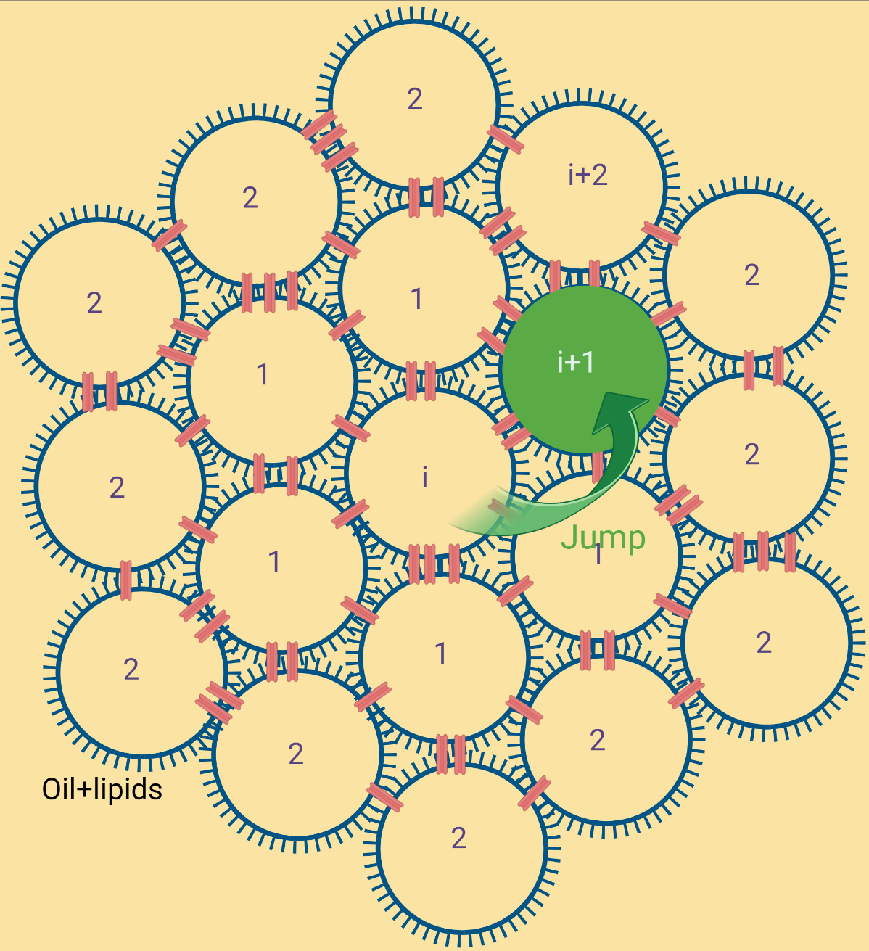
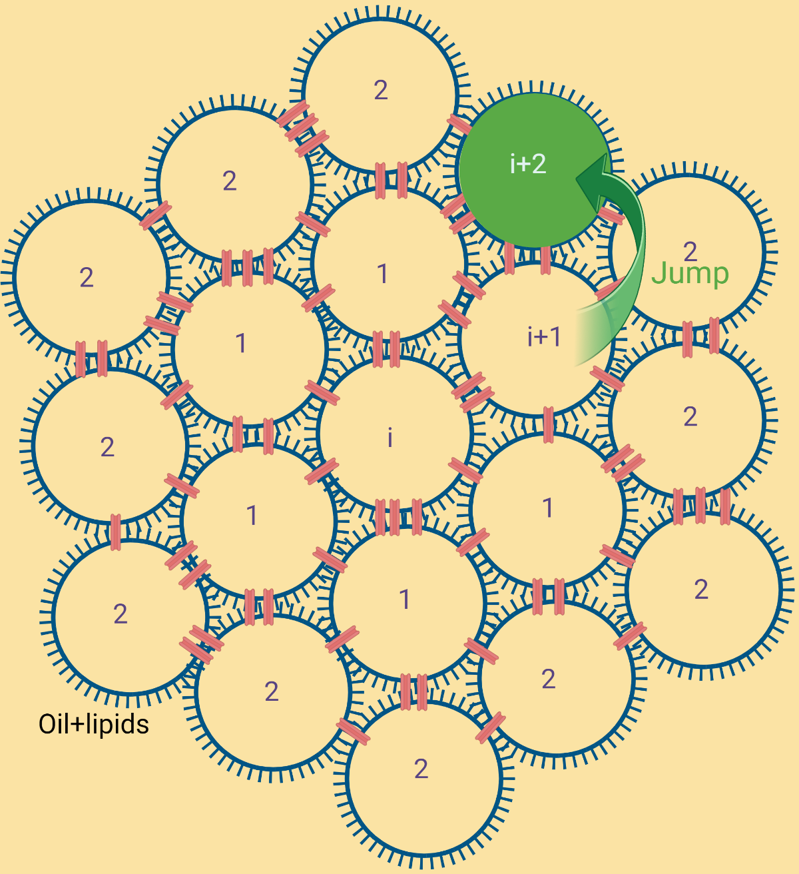
The 2D hexagonal network
Continuous time random walk model with exponential waiting time is used to find the presence probability: In collaboration with O Bénichou, LPTMC, Paris.
Walker at position i, waits for some time.
wait..
jump !
i
Walker at position i, waits for some time. 𝝉= 1/𝛌₀
i+1
i+2 …
Then makes a jump to any of the six accessible points from the site.
The process repeats to i+2 and so on..
The presence probability is obtained by analytically solving continuous time random walk on a hexagonal network.

Slide 9
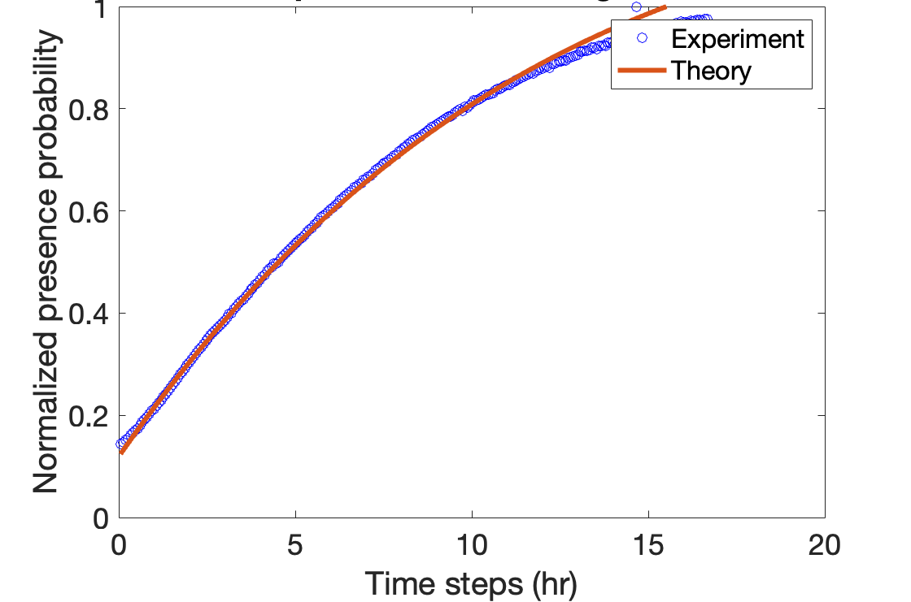
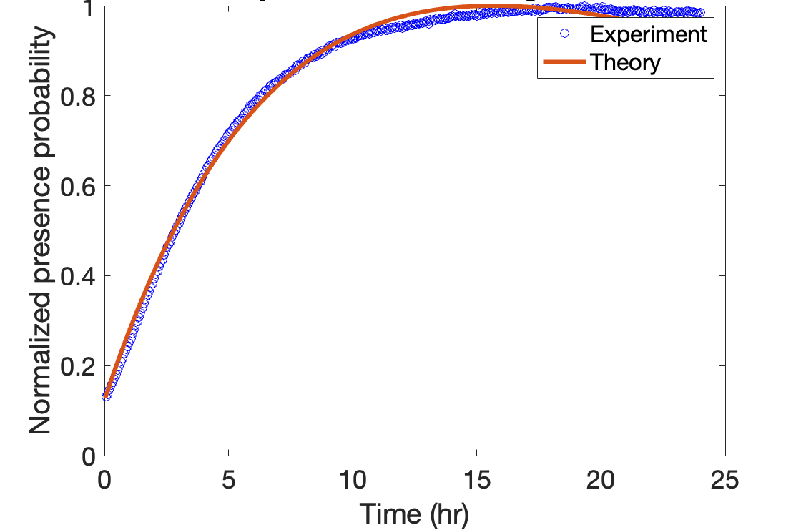
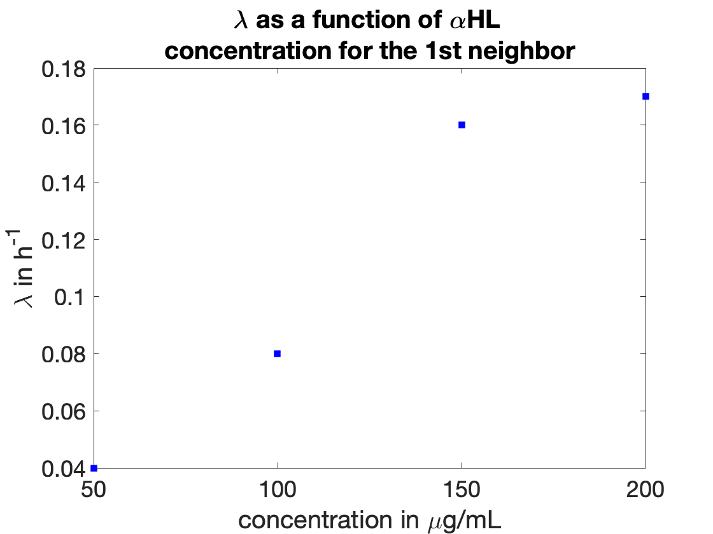
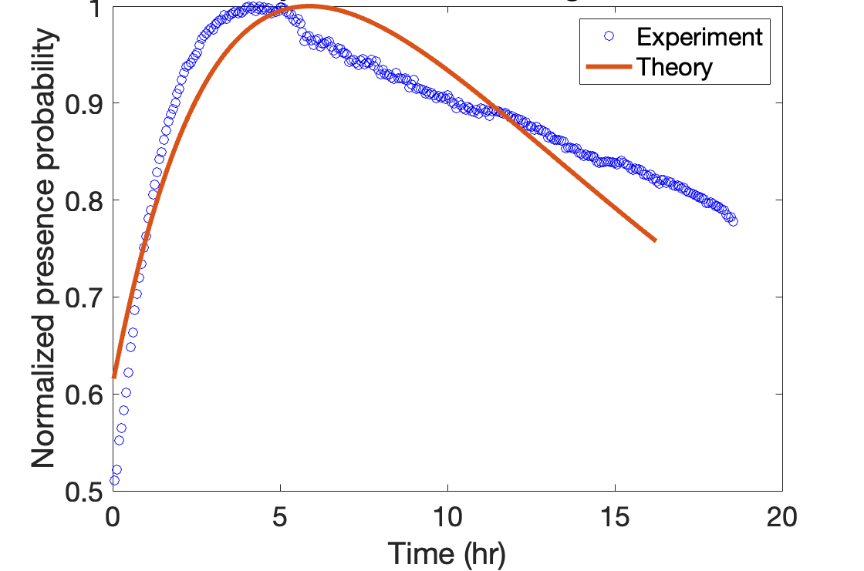
Analytical model and experimental comparison
[𝝰HL]=50 µg/ml
[𝝰HL]=100 µg/ml
[𝝰HL]=150 µg/ml
The preliminary results shows qualitative agreement with the theoretical model.

Slide 10
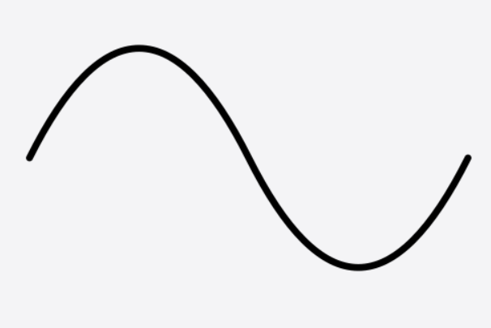
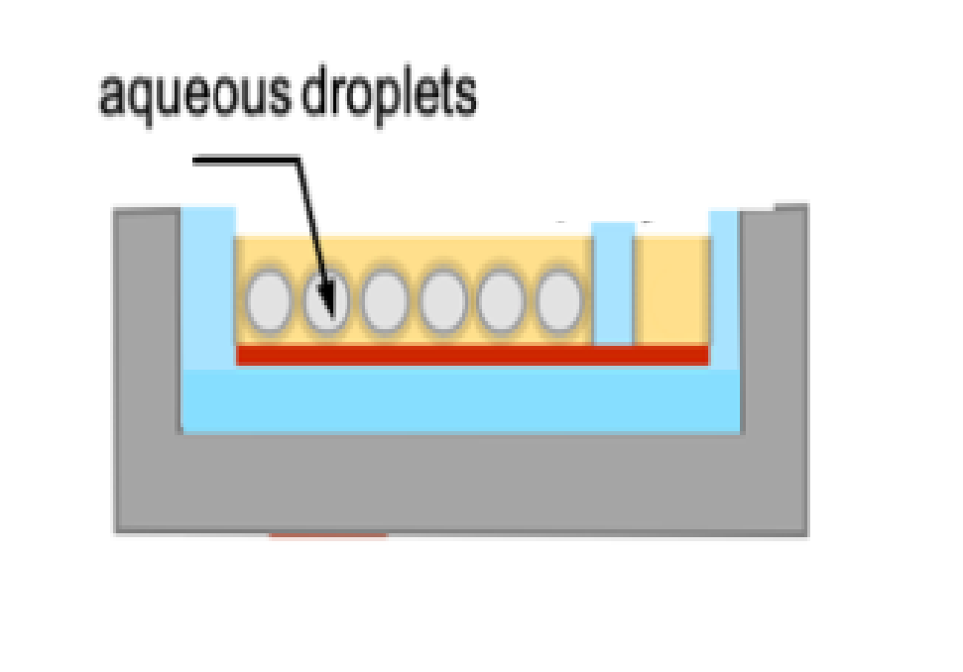
Perspective: Mechanical excitation device for the mechanical deformations of a DIB network.
F
F
Models of the E. coli MscL in the closed, and open states. (Sukharev, Sigurdson et al.,)
Actuated motion
Signal generator
Mechanosensitive Channels ? Diffusion=f(stress)?
Piezoelectric transducer

Slide 11
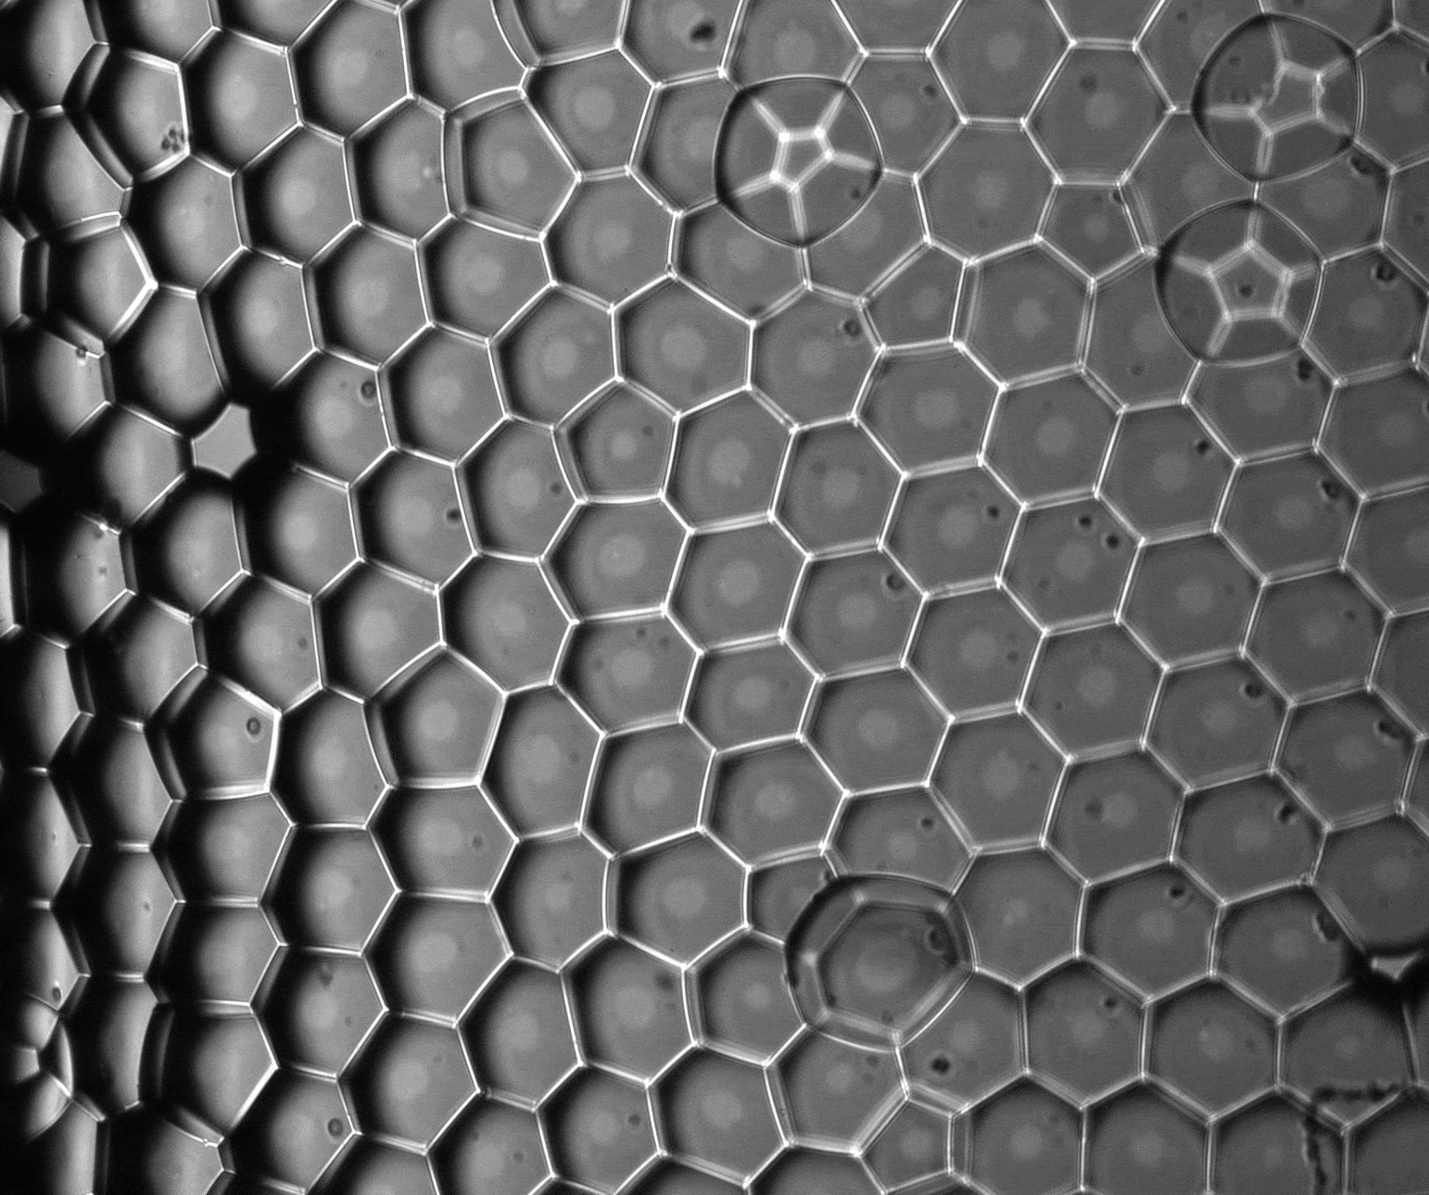
Mechanical excitation device for the mechanical deformations of a DIB network.
Agar Piston
f= 2 Hz
Tune diffusion as f(stress).
200 µm
Setup is operational. Rheological characterisation in progress.

Slide 12
Conclusion
A biomimetic tissue: DIB array decorated with ion channels .
Diffusion is faster with the increase of nanopore concentration.
Analytical model with continuous time random walk fits the diffusion process.
Origin of 𝛌?
Mechanosensitive Channels ? Diffusion=f(stress)?

Slide 13
Thank you…

