Slide 1
Adhesion hierarchy and mechanical stress drive the organization of biomimetic emulsions
Quentin GUIGUE, Lea-Laetitia PONTANI
Mechanics of integrated and artificial biological systems
Laboratoire Jean Perrin
26ème Congrès Général de la SFP

Slide 2
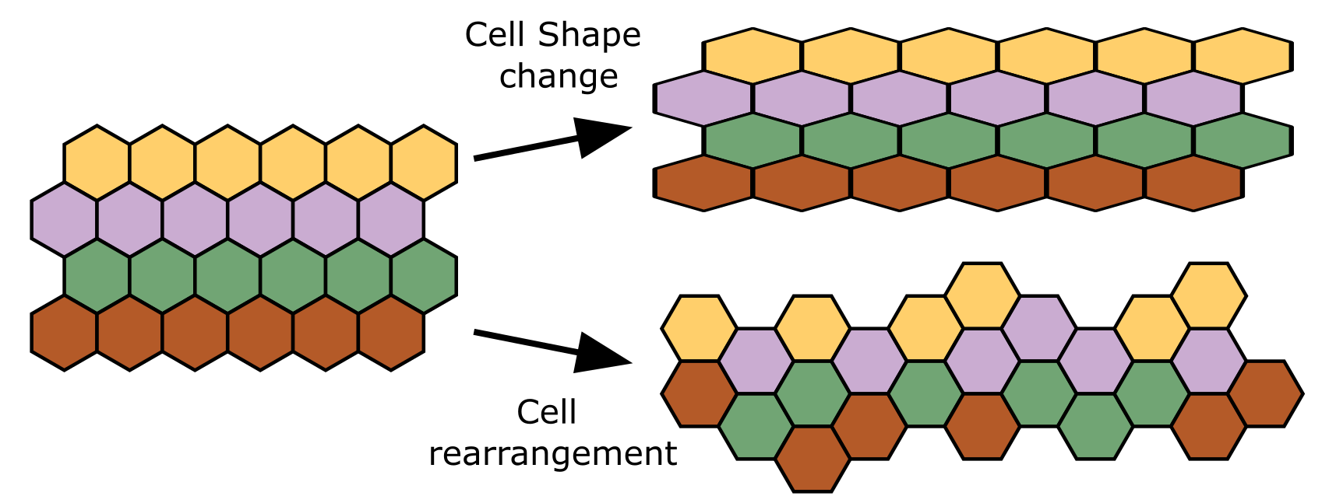
Adhesion in tissues mechanics & morphogenesis
See review [Montel, Guigue & Pontani, Frontiers in Physics, 2022]
Tissue remodeling under external forces :
During germ-band extension the tissues is elongated by extrinsic forces, short time scale (no signaling)
→ The elasto-plastic response of the tissue can be studied in a soft matter framework
2.5h
24h
In vitro, cell types organize according to their intercellular adhesion :
Analogy with fluids: red cells adhere more i.e. they have a higher surface tension → surface minimization at the core.
150µm
[Foty et al., Rev. Dev. Biol., 2021]
Are applied forces and adhesion enough to induce the emergence of organization in tissues?

Slide 3
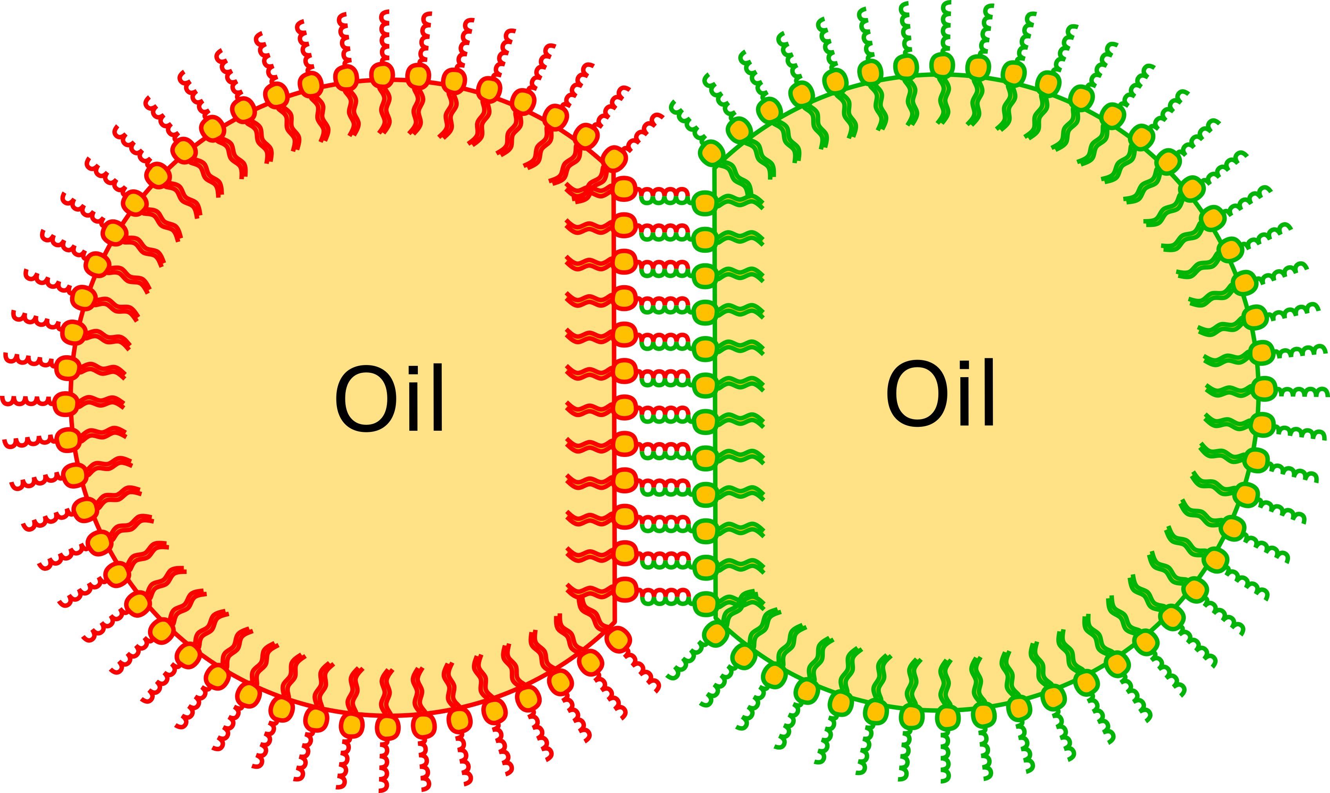
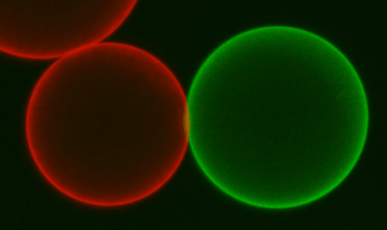
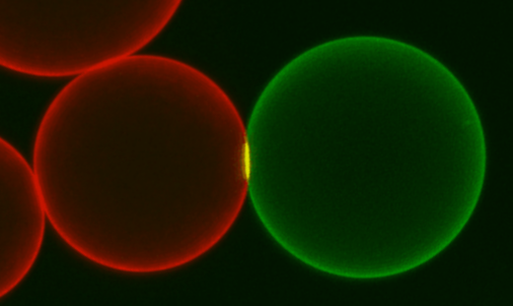
System – Biomimetic adhesive emulsion
Deformable oil droplets (Ø=30µm) stabilized with phospholipids diffusing on the surface and decorated with complementary DNA strands.
~ 60 nm
PALINDROMIC SEQUENCES
COMPLEMENTARY SEQUENCES
STREPTAVIDIN
PEG₂₀₀₀
BACKBONE
BIOTIN
DSPE
15µm
Use of palindromic (self-adhering) DNA sequence in order to introduce a differential of adhesion
Tune :
Adhesion differential (ΔEb)
Global binding energy (ΣEb)
Surface diffusion over few minutes
P0 vs P14 : ΔEb = 14 bp
P0 vs P10 : ΔEb = 10 bp
P6 vs P10 : ΔEb = 4 bp but high ∑Eb
Eb₁ > EB₂
Strong adhesion at the contact zone

Slide 4
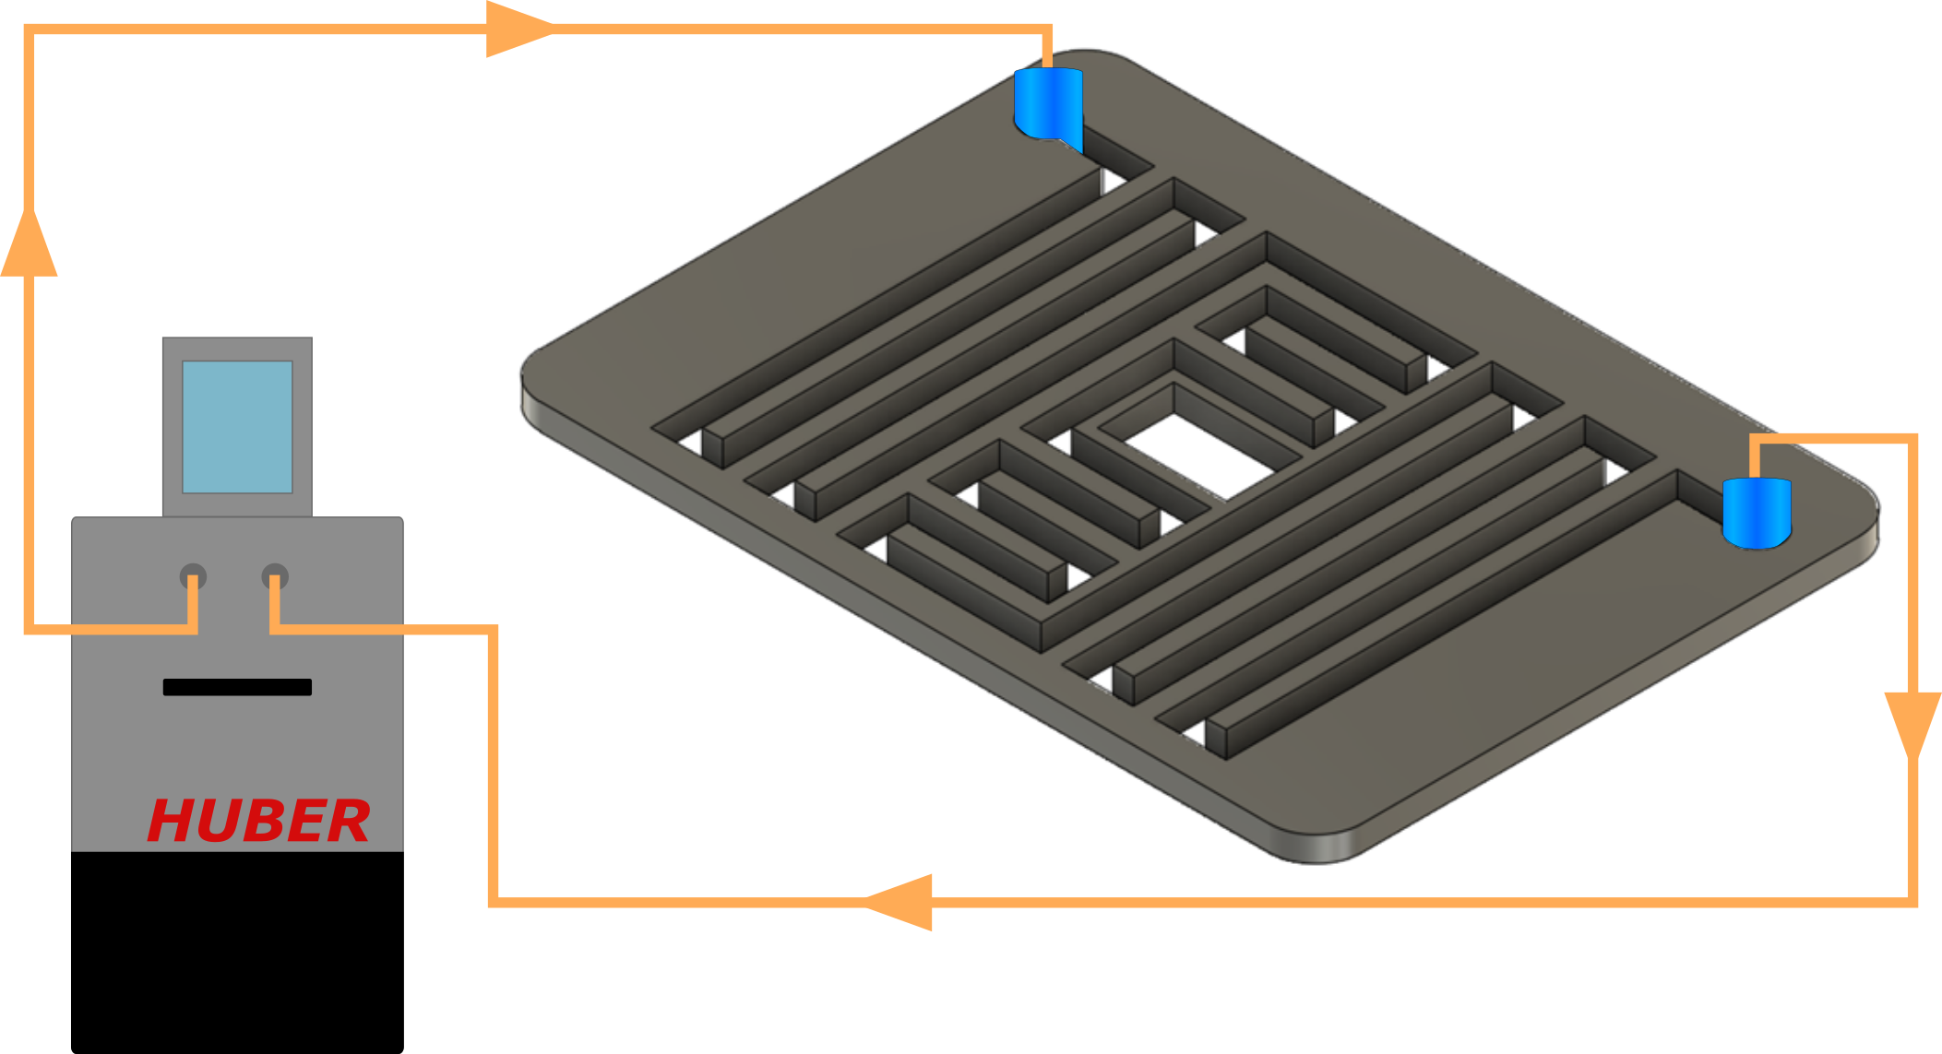
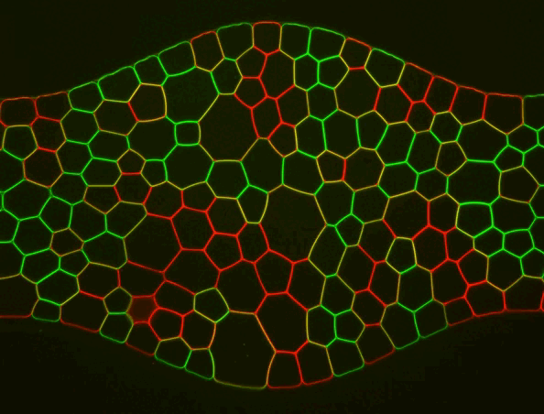
System – Experimental set-up
Micro channel :
-Channel decorated with sinusoïdal oscillations
→ periodical force application on droplets
50µm
-Evacuation channel near the entry and constriction at the exit
→ helps for droplet packing
15µm
IN
OUT
« Entry » (#1)
« Exit » (#20)
Thermalisation system :
keep surrounding temperature around 18-20°C
Transparency by index matching of the oil and water phases
→ Confocal microscopy
100µm

Slide 5
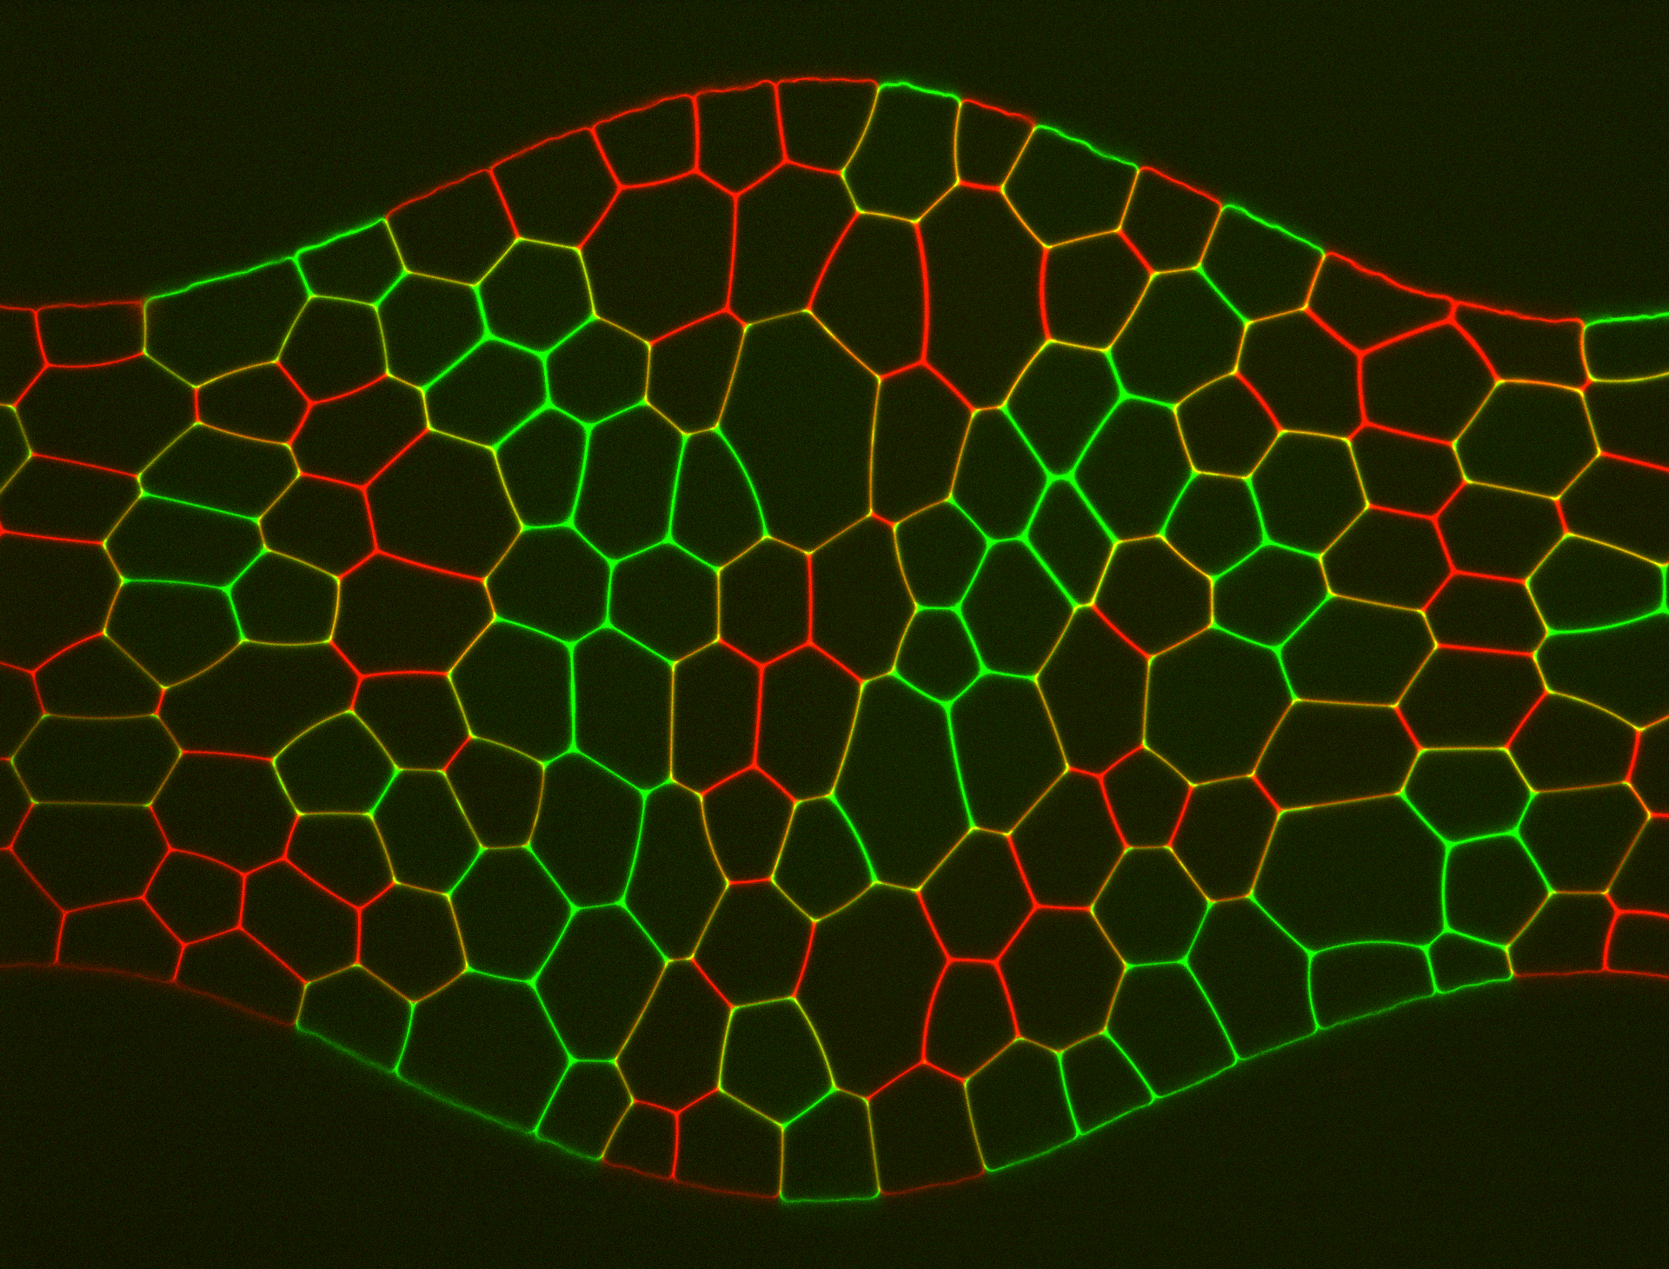
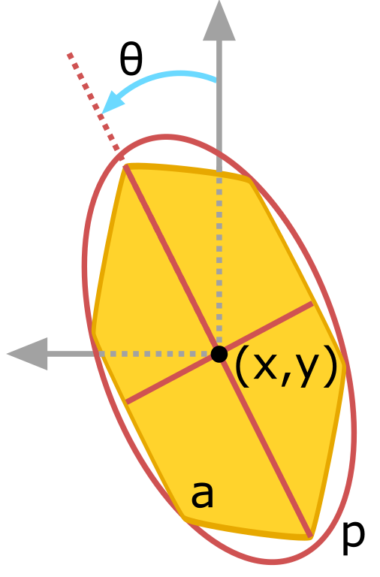
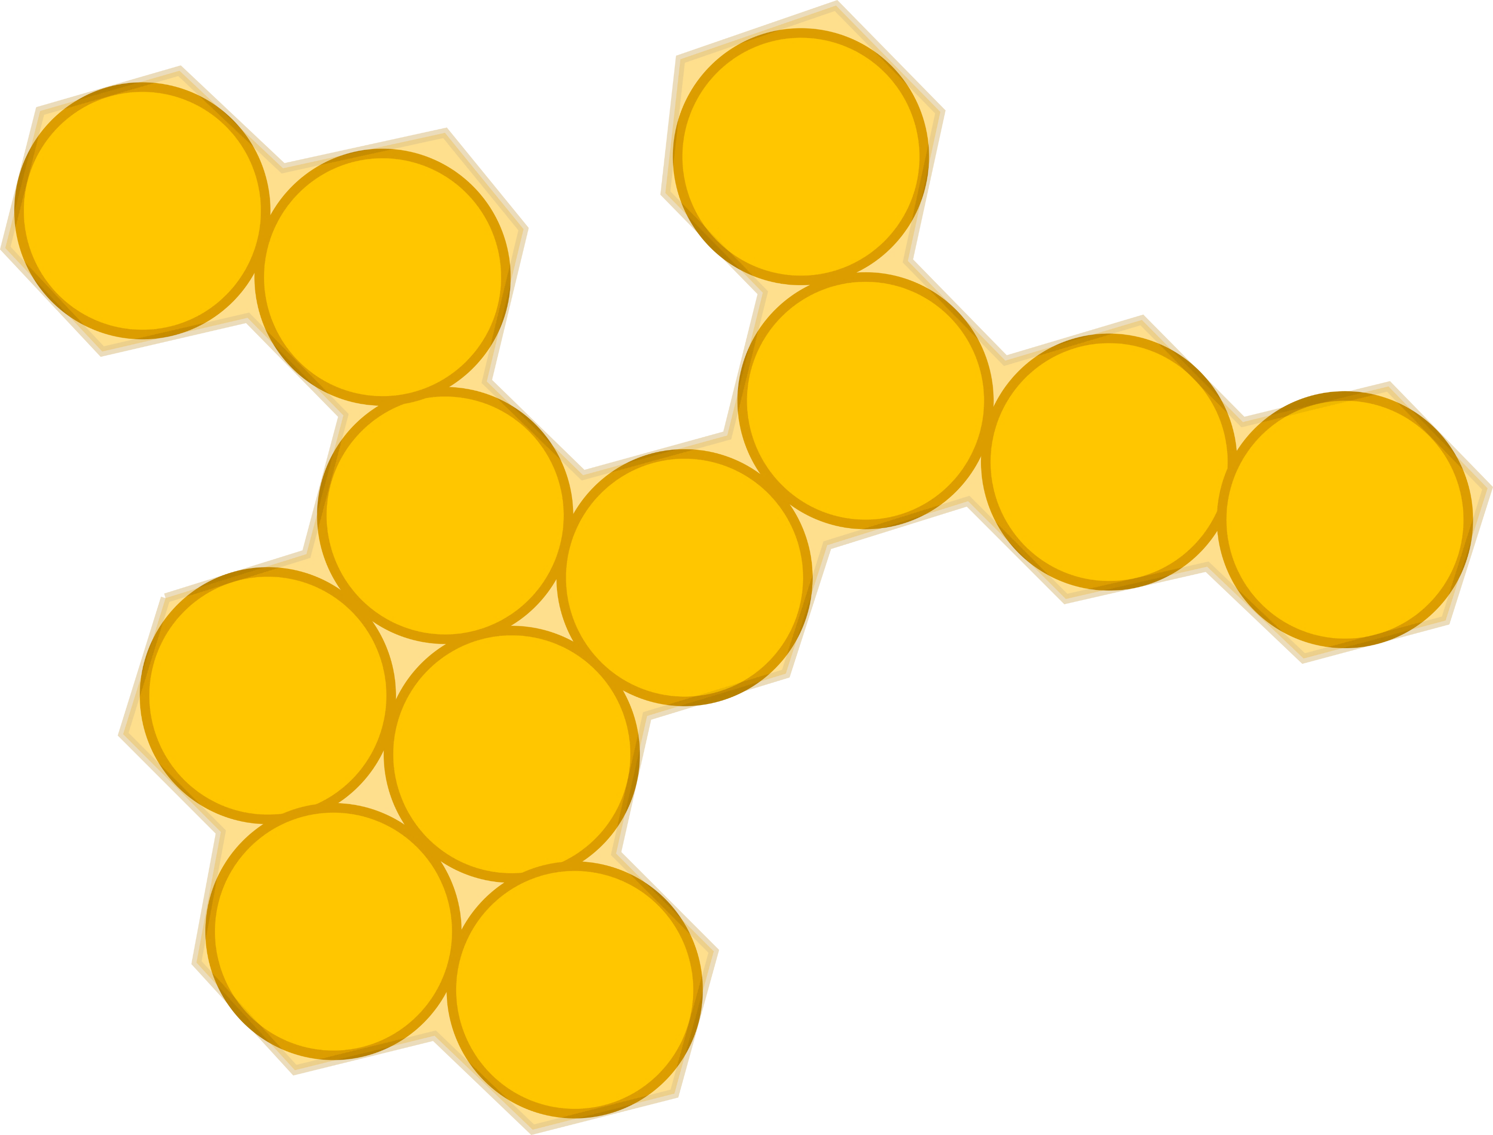
Image analysis
Droplet identification
Segmentation
Droplet Analysis:
-Position
-Orientation
-Local packing fraction
-Shape factor ↴
Voronoi Tessellation
Cluster analysis:
For a continuous group of same color droplets we find each member and their valency inside the cluster
A =$\frac{p^{2}}{4πa}$
A( ) = 1
A( ) > 1

Slide 6
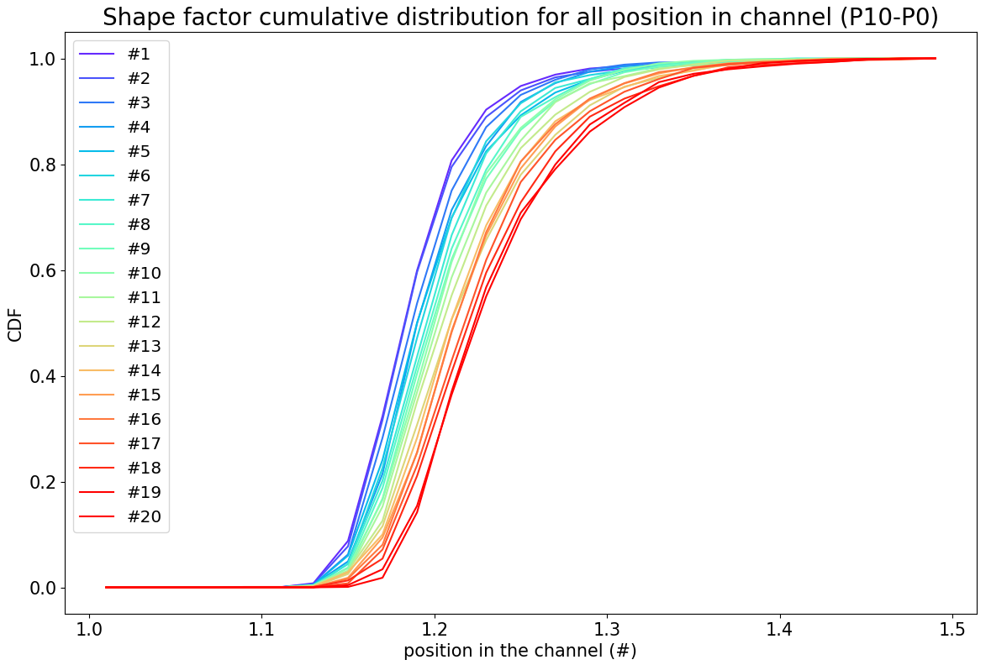
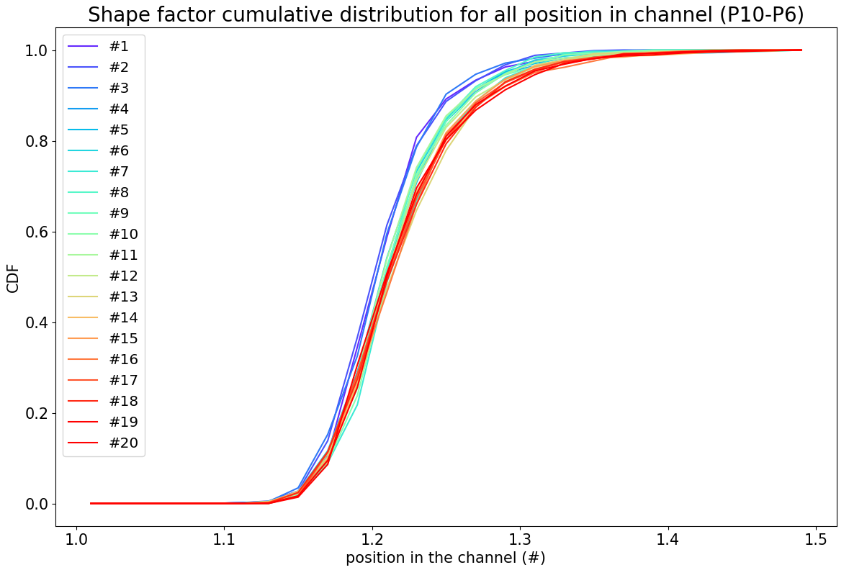
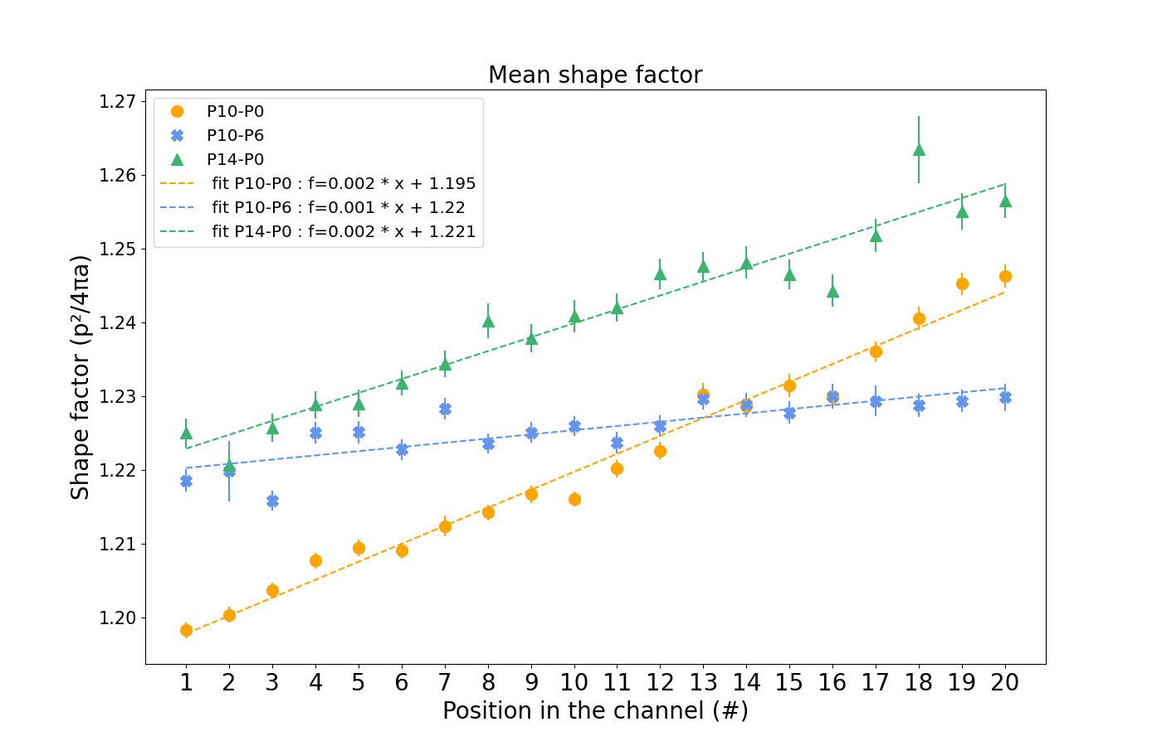
Shape factor
A =$\frac{p^{2}}{4πa}$
#1
#20
#1
#20
ΔEb=10bp
ΔEb=4bp
Higher adhesion contrast increases the accumulation of deformation after mechanical perturbation.
Independent of any compaction effect.
Restricted packing fraction : 0.94 ≤ φ ≤ 0.97
ΔEb=14bp
ΔEb=10bp
ΔEb=4bp

Slide 7
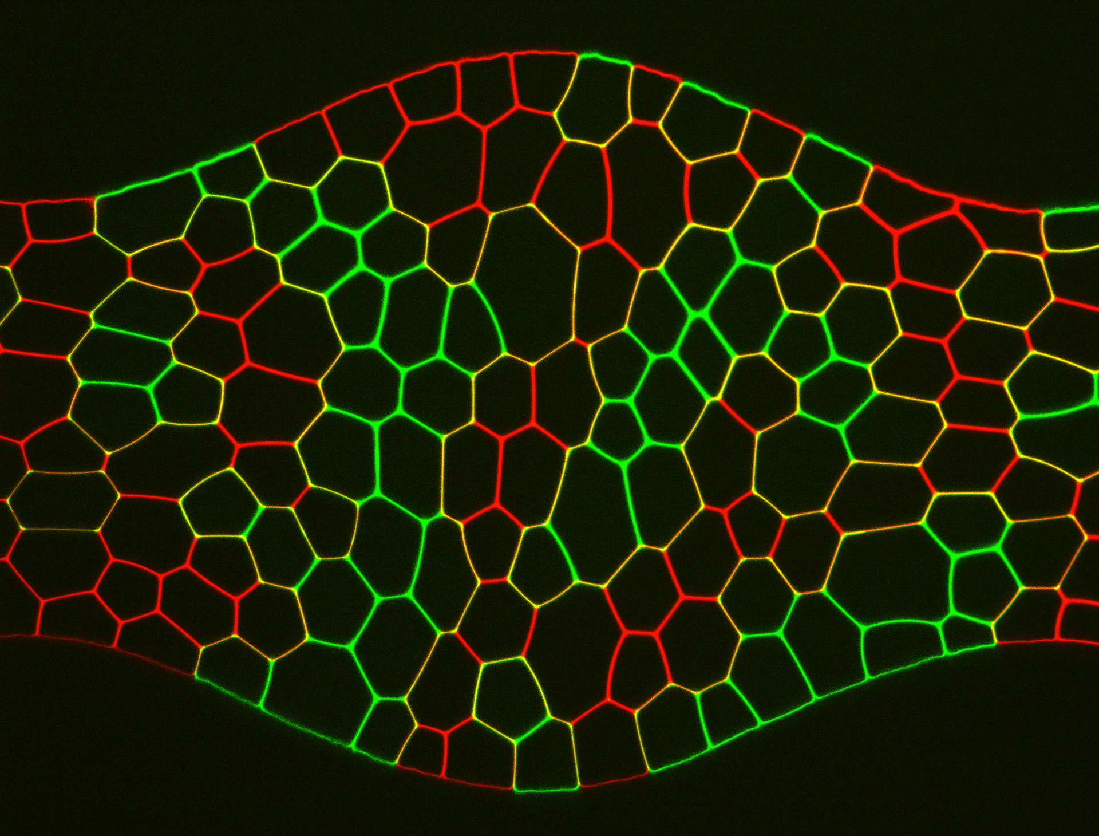
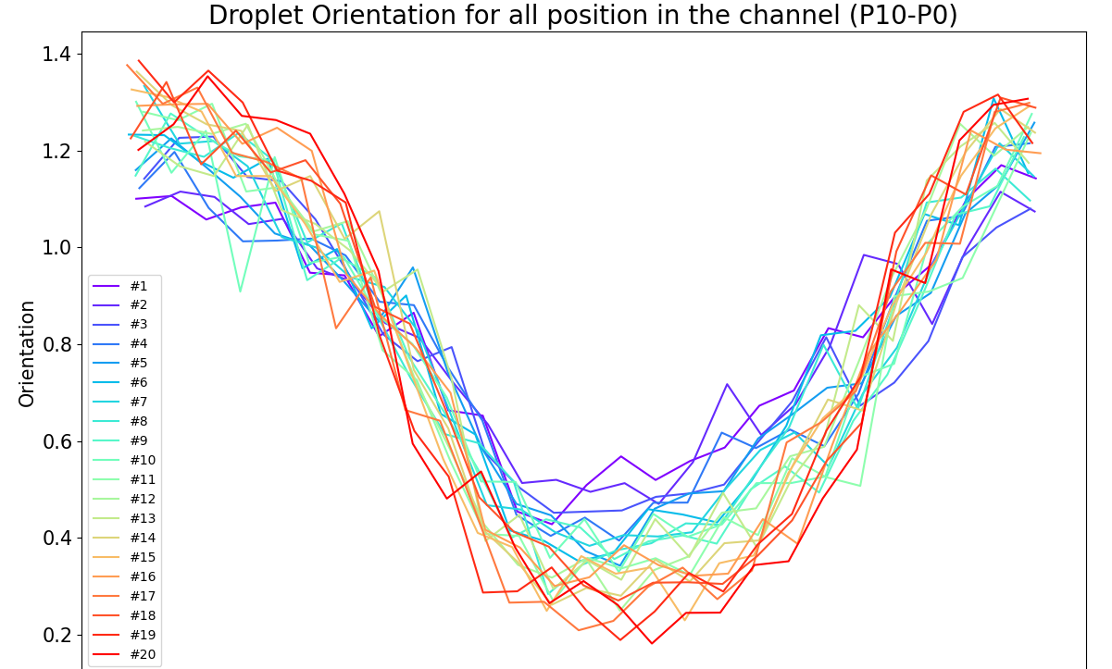
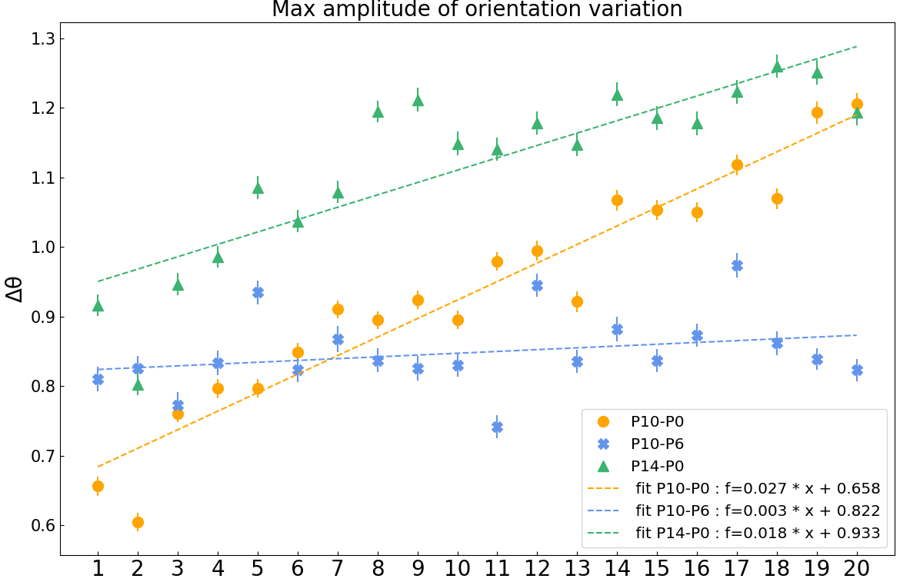
Orientation
θ=0
Droplet orientation depends on the position along one wave
θ=π/2
ΔEb=10bp
#20
#1
Δθ?
#1
X
#20
ΔEb=14bp
ΔEb=10bp
ΔEb=4bp
X
Accumulation of polarization after periodic perturbations depends more on the contrast of adhesion between the two population than on the adhesion itself.
Rules for tissues organization :
Total adhesion energy? (ΣEb)
Adhesion differential? (ΔEb)

Slide 8
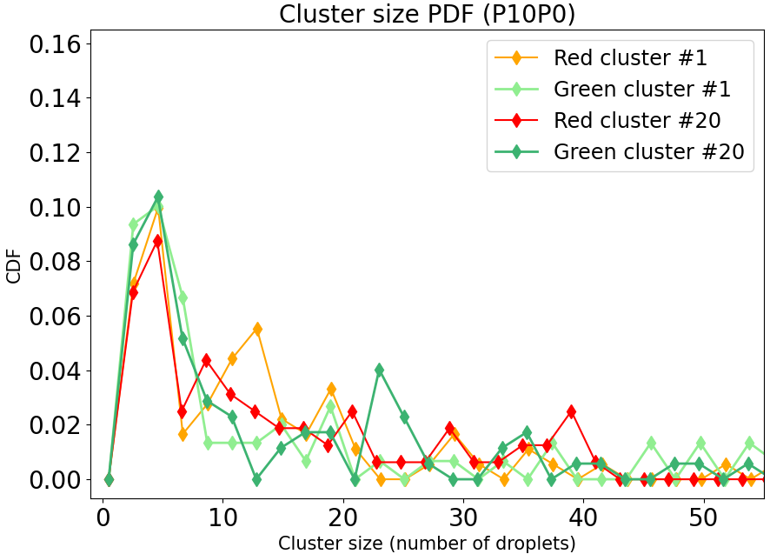
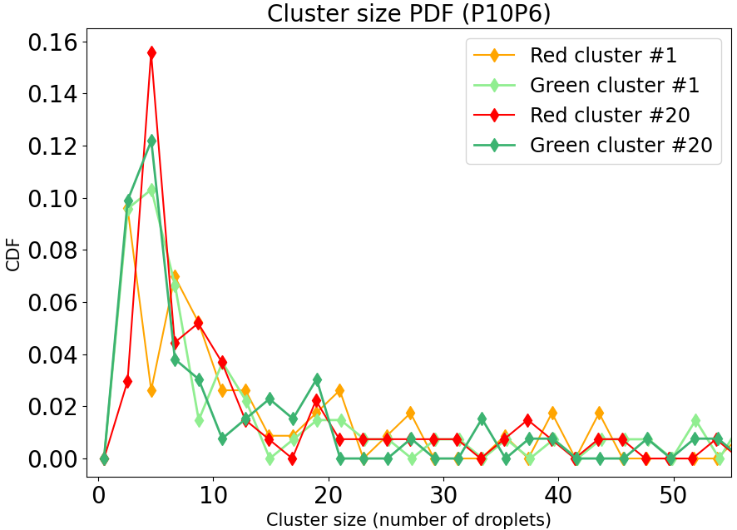
Perspectives
Consolidate preliminary results & try other DNA sequences combinations
Vary the amplitude of the wave perturbation to vary the imposed stress
Try to evidence organization at a more global scale (i.e. cluster scale) ↴
Size of colored cluster quantified as number of constitutive droplets (PDF) :
ΔEb=10bp
ΔEb=4bp

Slide 9
Thank you
MECHANIC OF BIOLOGICAL SYSTEMS INTEGRATED AND ARTIFICIAL
LJP
Clément Nizak
Silvia Grigolon
Jean-Christophe Galas
Thomas Panier
IPGG
- Jacques Fattaccioli
(for membrane emulsification device)
- Bertrand Cinquin & Thao Phuong
(microfluidic platform)
Léa-Lætitia Pontani
Alexis Prevost
Elie Wandersman
Nicolas Escoubet
Pierre Tapie
Cécile Vincent
Sapna Ravindran
Dario Dell'Arciprete
Lorraine Montel (Now ILM, CNRS)
Emergence

