Slide 1


Self-organized cable formation and force transmission in an active vertex model for epithelial tissues
Mingfeng Qiu, Vincent Hakim, Francis Corson
Laboratoire de Physique de l’École Normale Supérieure
Congrès Général des 150 ans de la SFP
2023.7.5, Paris
Notes:
Looking at active force transmission in an epithelial tissue, which could give rise to supracellular actomyosin cables in a self-organized way.

Slide 2
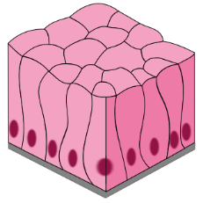
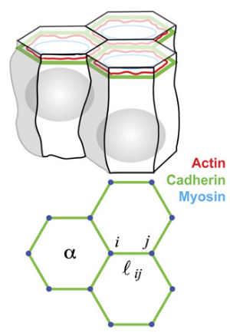
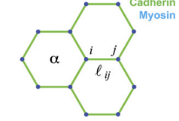
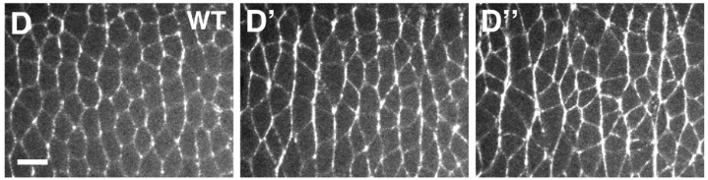
Epithelial tissues
The (epithelial) tissue may be modelled as a network of active edges.
The active edges are mechanosensitive.
epithelial tissue
force-generating machineries
vertex model
Farhadifar et al., Curr Biol, 2007;
Fernandez-Gonzalez et al., Dev Cell, 2009;
Sumi et al., Dev Cell, 2018;
Duda et al., Dev Cell, 2019.
Notes:
Zooming in: the force-generating machinery that we are interested in is the cortical actomyosin cytoskeleton.
The contractile rings are cross-linked by adherens junctions, providing confluency and transmitting forces throughout the tissue.
Unlike purely passive materials such as elastic springs, these edges can sense mechanical signals and actively respond. It has been well known that…

Slide 3
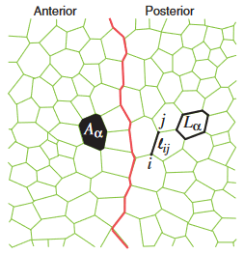
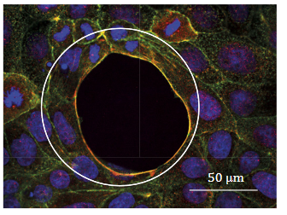
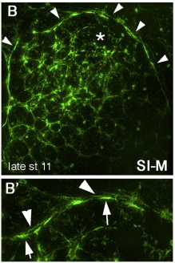
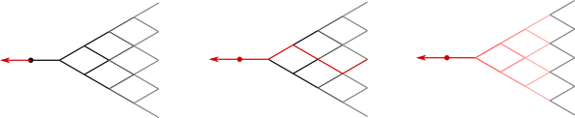
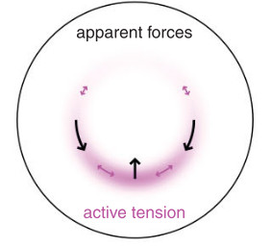
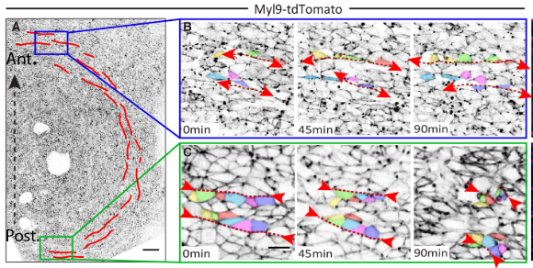
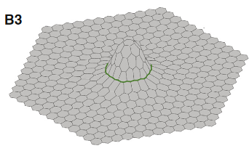
Actomyosin cables
Supracellular actomyosin cables are ubiquitous in development.
Could mechanical feedback lead to the assembly/refinement of cables?
Landsberg et al., Curr Biol, 2009;
Nier et al., Proc Natl Acad Sci USA, 2015;
Röper, Dev Cell, 2012;
Murisic et al., Biophys J, 2015;
Saadaoui et al., Science, 2020
Notes:
Supracellular actomyosin cables are everywhere. They consist of strongly contracting active cell-cell junctions across multiple cells.
Examples: compartmental boundaries, front of a healing wound, ring that can drive buckling of the tissue into a 3rd dimension, tensile ring driving tissue flow to form the primitive streak in avian embryos.
The cables often reside at cell population boundaries and thus there are cues already in the biochemistry. But what role could the active mechanics play in assembling and controlling them? In other words, can cables self organize?

Slide 4
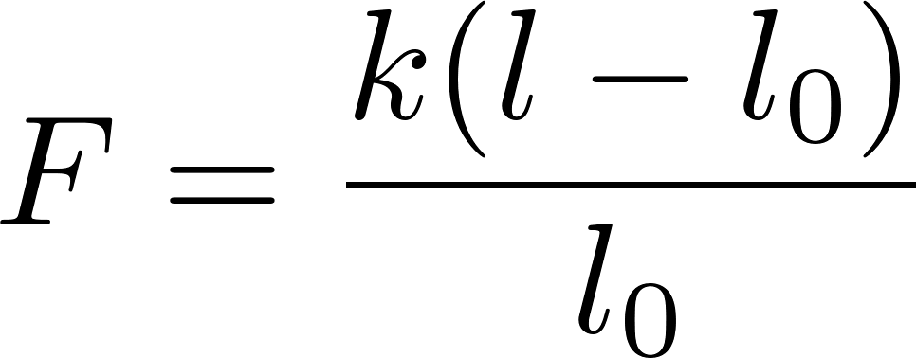
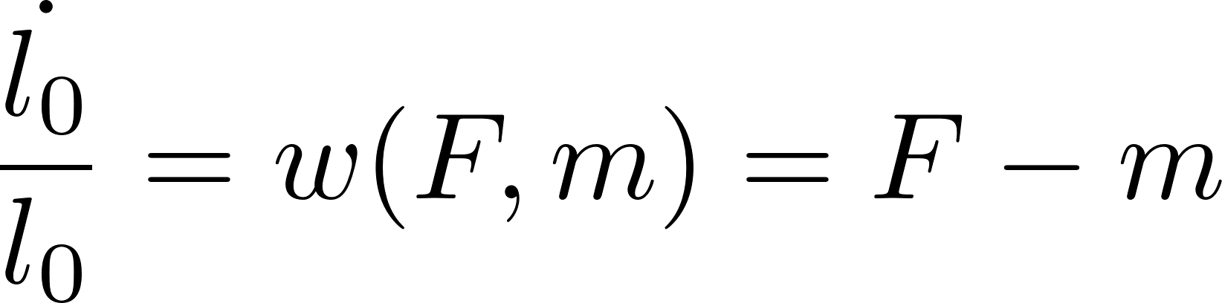
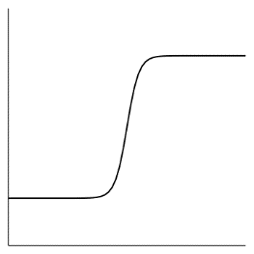
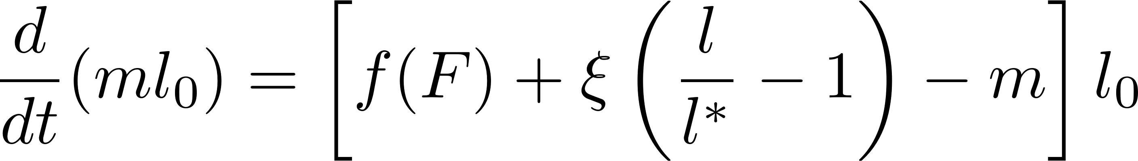
Viscoelastic active edges
Short-time elasticity
Long-time yielding and active contraction
Myosin kinetics
F
F
yielding
active contraction
active state
mechanical feedback
detachment
f(F)
inactive state
preferred length
F
Noll et al., Nat Phys., 2017
Notes:
The xi term is analogous to the perimeter contractility in classical vertex models, e.g. by Farhadifar et al.
This edge elasticity is permanent.

Slide 5

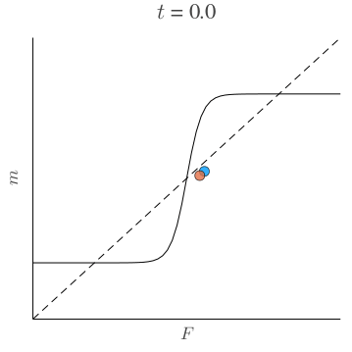
Symmetry breaking leads to tension focusing
The symmetric steady state is unstable if the mechanical feedback is sufficiently nonlinear.
F₁, m₁
T
T
F₂, m₂
l
F
Notes:
Some simplified theoretical analysis to identify the qualitative behaviour of the active edges.
focus on physical intuition of symmetry breaking (and lateral inhibition)

Slide 6
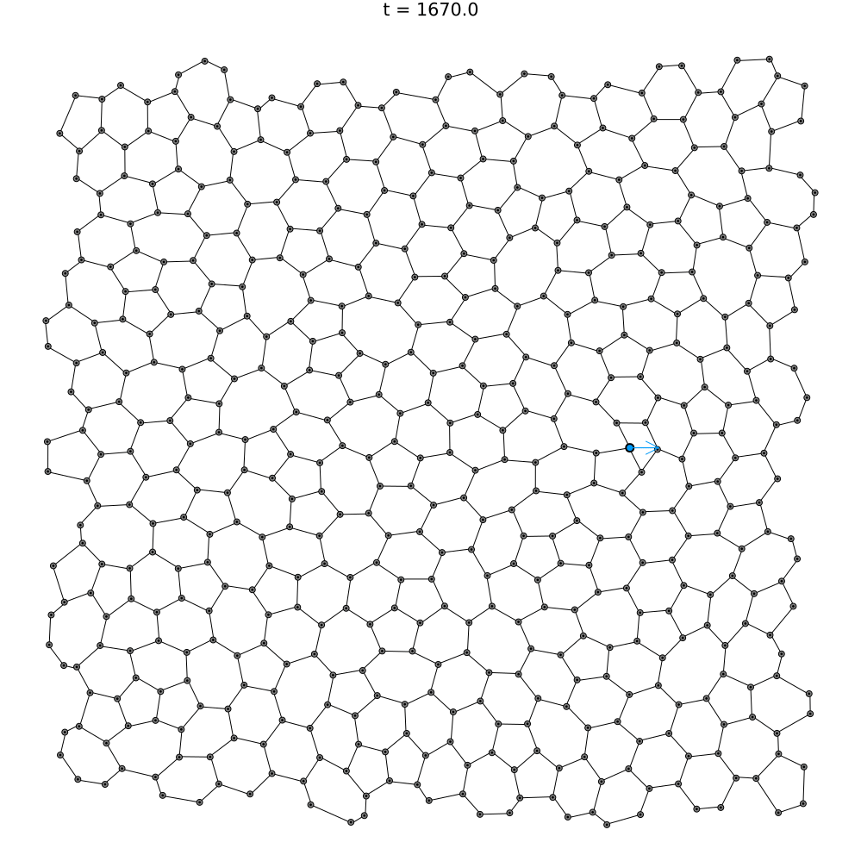

Self-organized cables in a 2D tissue
Notes:
Now we study the force transmission in a 2D tissue equipped with the mechanical feedback.
We implement the active edge behaviour in a vertex model and perform numerical simulations.
We pull a vertex in the lattice slowly and examine the response of the network.
An example case where we pull a vertex and increase the force magnitude slowly.
A cable forms by consecutively recruiting neighbouring edges.
An edge stretches its neighbour, which experiences higher tension thanks to the tendency to restore a fixed length.
This tension decays as the distance to the pulling force becomes larger.
lambda = 0.3, xi = 2.0
a = 0.7, b = 0.7
v347
f_ex = 1

Slide 7
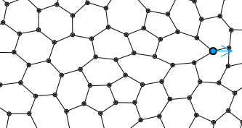
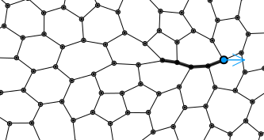
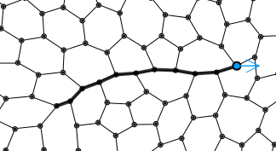
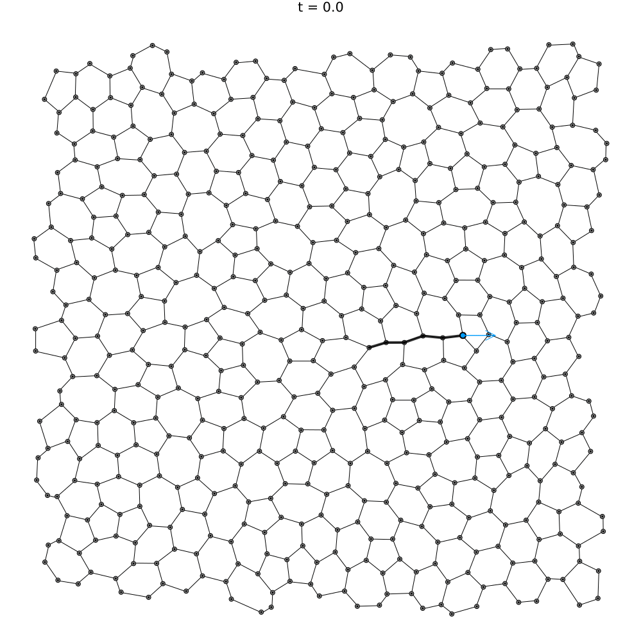
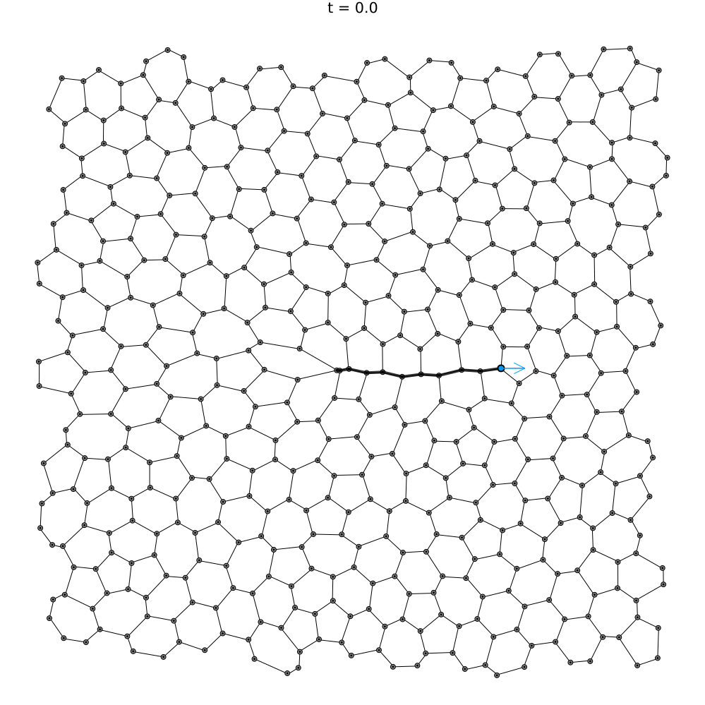
Properties of a finite cable
The cable length can be modulated by the pulling force.
Cables can be reversible
vertex 358, P = 1.0
vertex 358, P = 1.4
vertex 358, P = 1.8
ξ = 2.0, a = 0.7, b = 0.5, P = 1.5
ξ = 0.2, a = 0.52, b = 0.45, P = 1
Notes:
Next we pull at different locations. After the simulations, we compute the average number of active edges in the cable formed.
We can control the length of the cables by modulating the magnitude of the pulling force.
lambda = 0.3, xi = 2.0
a = 0.7, b = 0.7

Slide 8
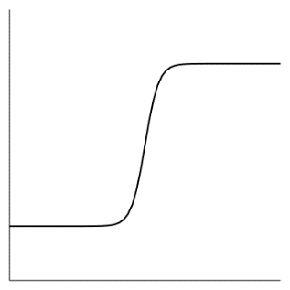
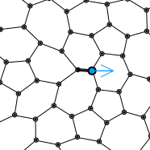
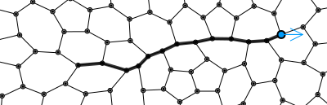
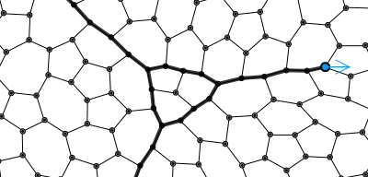
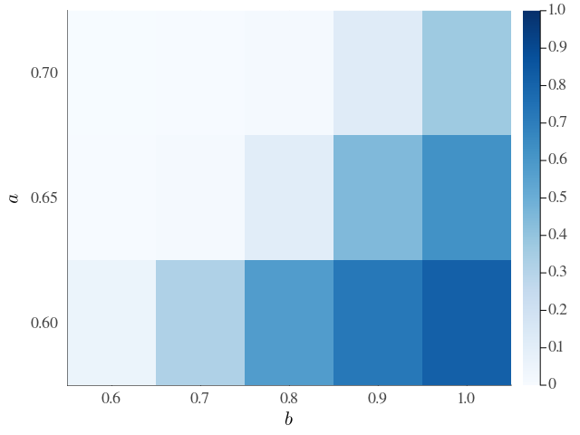
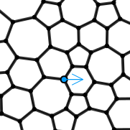
Spontaneous activation propagation
finite growing
self-growing
f(F)
2b
a
myosin activation threshold a
pull-stop simulation: increase the pulling force slowly until at least one edge is activated
myosin activation strength b
full activation
Notes:
Pull-stop simulations
Every square shows the number of activated edges as a proportion of all available edges in the lattice. This is averaged across 22 simulations in which we pull at different locations.
The phase diagram shows three types of qualitative behaviour.
We have focused on the regime where cables grow with a limited length, since this is the regime in which it is the easiest to control cable growth.
lambda = 0.3, xi = 2.0
kf = 0.0005
eta = 0.1
mu = 4
dt = 0.0025

Slide 9
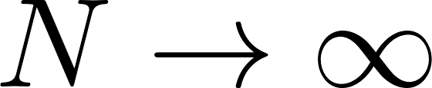
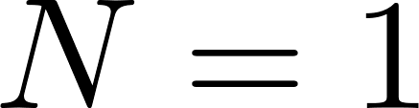
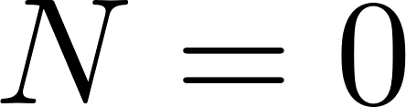
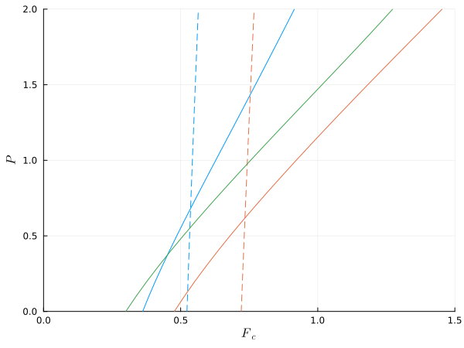
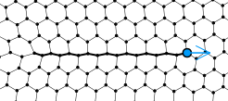
Cable growth and reversibility
prescribing a cable of N edges with a pulling force P
tension at the cable end
inside F₀
A
outside F₋₁
F₋₁
F₀
before activation
B
pulling force P
C
A
finite cable, reversible
B
finite cable, reversible if short
myosin activation threshold a
C
infinite cable

Slide 10
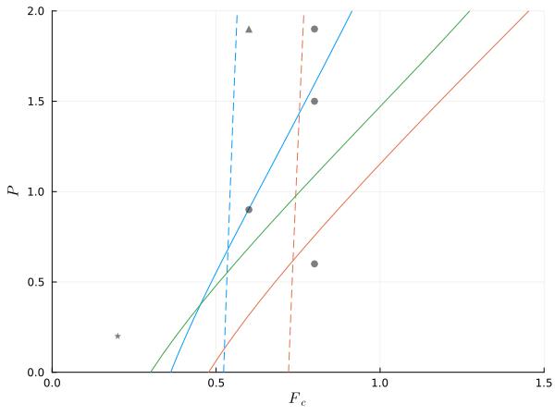
Cable growth and reversibility
C
B
A
comparing with numerical simulations
N = 3, reversible
N = 18, irreversible
N = 2, reversible
F₋₁
F₀
pulling force P
N = 3, reversible
N = 0
A
finite cable, reversible
full activation
B
finite cable, reversible if short
myosin activation threshold a
C
infinite cable

Slide 11
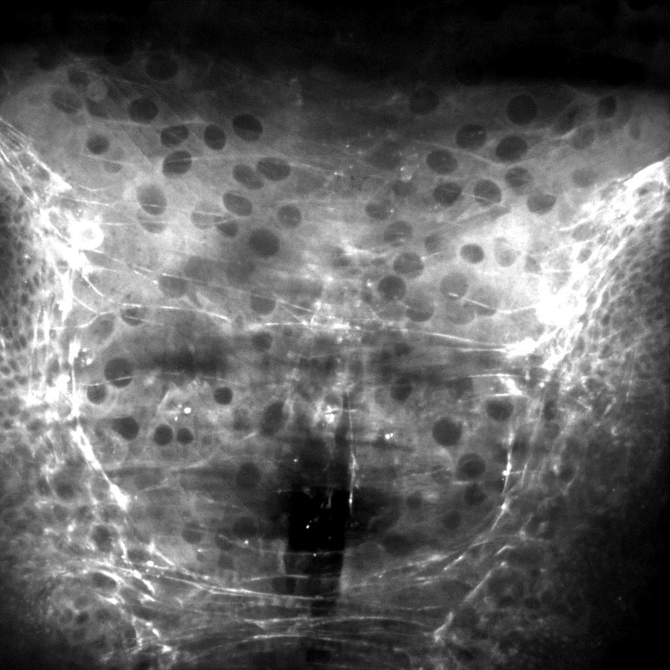


Experimental evidence
Drosophila wing imaginal discs migrating on the larval epidermis
Supracellular cables assemble in the larval epidermis.
myosin
cables
wing disc
larval epidermis
Loïc Le Goff, Huicheng Meng, Angughali Sumi
Institut Fresnel, Aix-Marseille Université

Slide 12
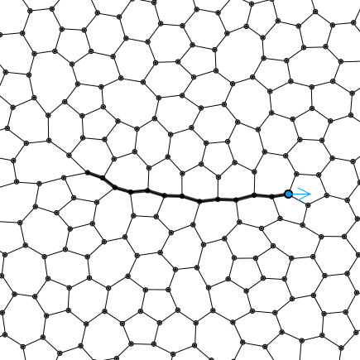
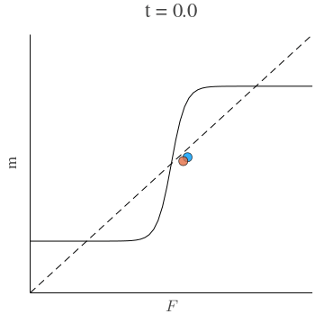
Summary
An active cellular network equipped with nonlinear mechanosensitive feedback
The bistability allows for active/inactive states of edges.
Symmetry breaking due to the mechanical feedback.
Tensile cables: long-range, focused, reversible
Mechanical self-organization
f(F)
F
Notes:
Self-organization using mechanical signals can be fast, and takes advantage of the mechanical state of tissues.
It is particularly advantageous in protecting tissue, for example, from over-stretching.
It can drive development without precise biochemical cues.

Slide 13
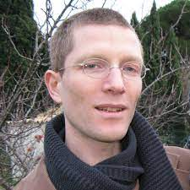
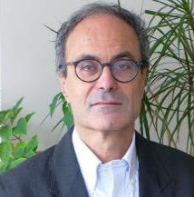
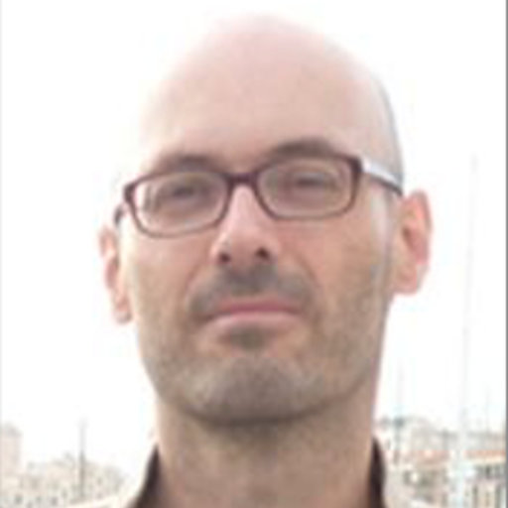
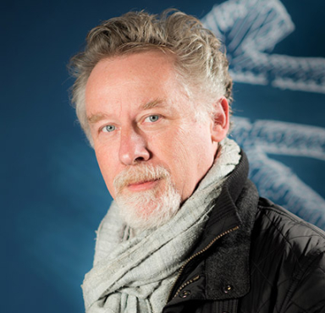



Acknowledgement
Francis Corson
Vincent Hakim
Loïc Le Goff
Huicheng Meng Angughali Sumi
(Marseille)
François Payre
(Toulouse)
mingfeng.qiu@phys.ens.fr
@MingfengQiu

Slide 14
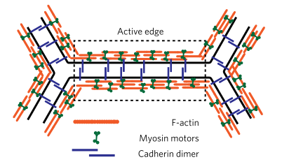
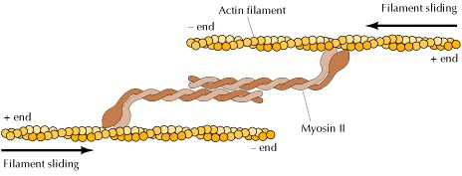
introduction: epithelial tissues
The (epithelial) tissue may be modelled as a network of active edges.
Actomyosin cytoskeleton
Cell-cell junctions
Epithelial tissue
Vertex model
Myosin motor on actin filaments
Sciencetopia
Farhadifar et al., Curr Biol, 2007
Noll et al., Nat Phys., 2017
Cooper, The Cell, 2nd Ed., 2000
Notes:
Cadherin: 1. maintain integrity; 2. transmit force

Slide 15
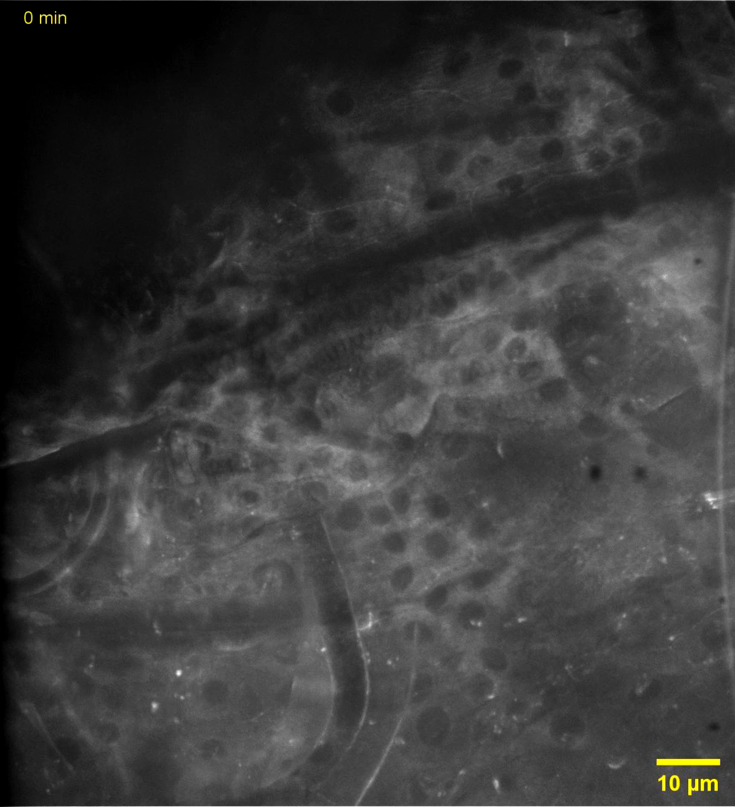
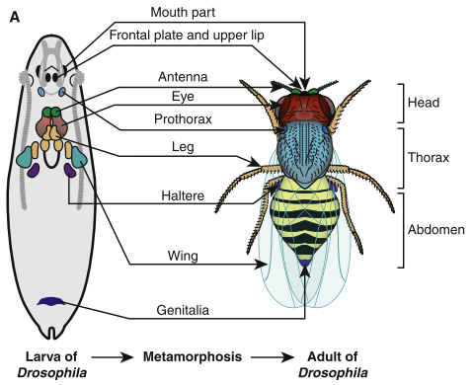
Aldaz and Escudero, Curr Biol, 2010
Notes:
Give context

Slide 16
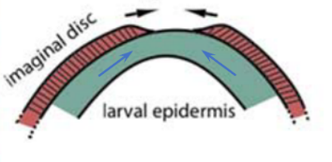
experiments
Migration of imaginal wing discs on the larval epidermis.
Supracellular actomyosin cables assemble.
The actomyosin cable appears to colocalize with cell-cell junctions.
Myosin Cadherin
Sumi and Le Goff, unpublished

Slide 17
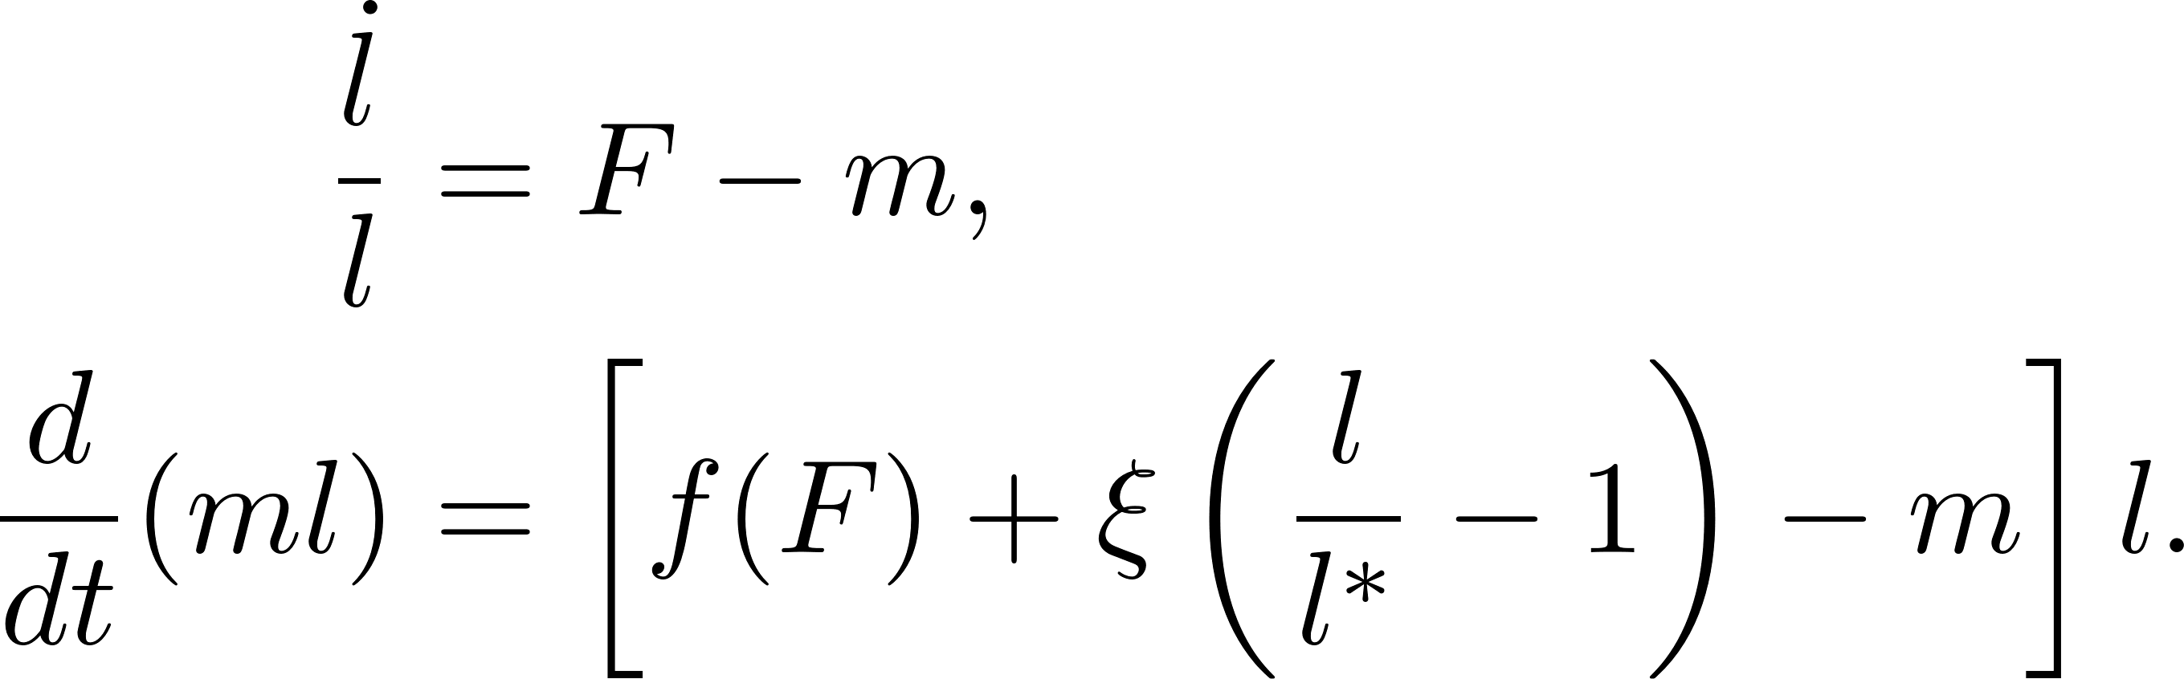
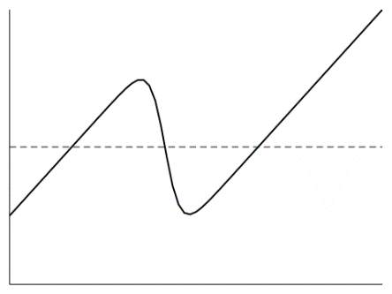
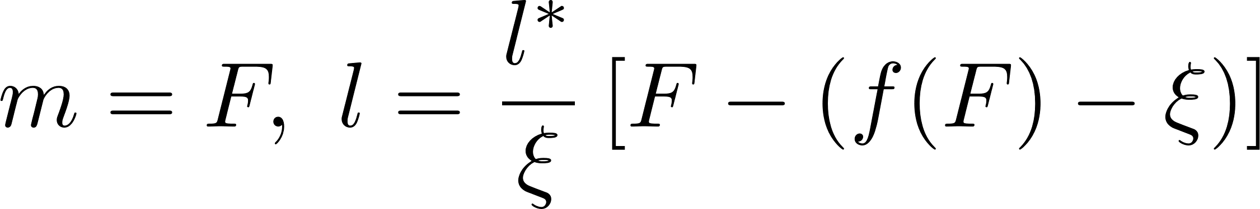
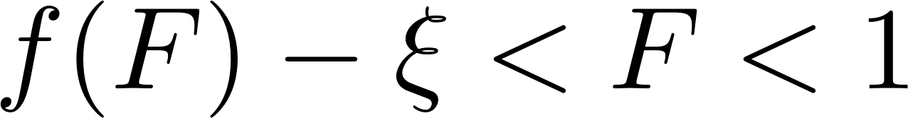
individual edge
F
F
l, m
l
Steady state (non-trivial)
Stability
l*
F
Given a constant loading F, the a non-trivial steady-state is stable if and only if
f(F)
F

Slide 18




individual edge
F
F
l, M
F < 1
F = 1
F > 1
M = ml
l
l
l

Slide 19


assembly of cells
Short-time elasticity
Long-time yielding and active contraction
Myosin kinetics
Equations of motion for the vertices
yielding
active contraction
mechanical feedback
preferred length

Slide 20





Symmetry breaking leads to tension focusing
Long-term behavior ( )
Analogous to lateral inhibition in Delta-Notch signalling
F₁, m₁
T
T
Given T, the homogeneous steady state m₁ = m₂ = F₁ = F₂ = T/2 is unstable to asymmetric perturbations δm₁ = - δm₂ when
F₂, m₂
l
F
Collier et al., J Theor Biol, 1996
Notes:
Some simplified theoretical analysis to identify the qualitative behaviour of the active edges.
focus on physical intuition of symmetry breaking (and lateral inhibition)

Slide 21

assembly of cells
Notes:
State the relationship with conventional “passive” vertex models.
remove old equations
focus on the physics

Slide 22

Cable lengths regulated by pulling forces
vertex 358, P = 1.0
vertex 358, P = 1.4
vertex 358, P = 1.8
Cable length n_{c}
Pulling force P
Notes:
Next we pull at different locations. After the simulations, we compute the average number of active edges in the cable formed.
We can control the length of the cables by modulating the magnitude of the pulling force.
lambda = 0.3, xi = 2.0
a = 0.7, b = 0.7

Slide 23

Force transmission behaviour
N = 8
N = 24
f(F)
N = 16
N = 16
N = 8
N = 24
N = 1
2b
N = 1
a
pulling force P
tension at the cable end
inside
outside
before activation
myosin activation threshold a

Slide 24
Force transmission behaviour
numerical simulation of a cable of N edges with a pulling force P
tension at the cable end
inside F₀
outside F₋₁
F₋₁
F₀
before activation
pulling force P
A
finite cable, reversible
B
finite cable, reversible if short
C
B
A
myosin activation threshold a
C
infinite cable

