Slide 1
Mass and viscoelasticity of single cells
Dr. Marco Portalupi, Nanosurf AG

Slide 2
AFM – how does it work?
Scanner position is readjusted to maintain constant interaction strength
Tip-sample
interaction
Change in interaction is detected
Feedback controller aims at maintaining constant interaction strength
Data visualization and instrument control
Notes:
To understand, how AFM works, let’s look at the different components of an AFM. In general, there are a few core components. The first component is the AFM cantilever, basically a very small and soft leaf spring with a sharp tip at its end. This cantilever replaces the rigid wire that was used in STM and allows sensing the interactions that occur between the surface and the sharp tip at its end. The interactions in the simplest case cause the cantilever to bend depending on the strength of the interaction. This bending can then be detected by typically an optical, laser-based deflection readout system.
Fun fact: The first AFM used an STM system mounted to the back of the cantilever to detect the cantilever bending.
The detected cantilever interaction or changes thereof are transferred to a controller unit that aims to maintain the interaction strength constant and thereto adjusts the scanner z position while rasterscanning the surface at the same time using a xyz translation unit. The controller itself is interfaced with a PC to allow the user to set and adjust feedback and scanning parameters as well as providing visualization of the surface.
As we will see within the course of this course, the interactions between tip and surface can be manifold and do not only provide topographic information.

Slide 3
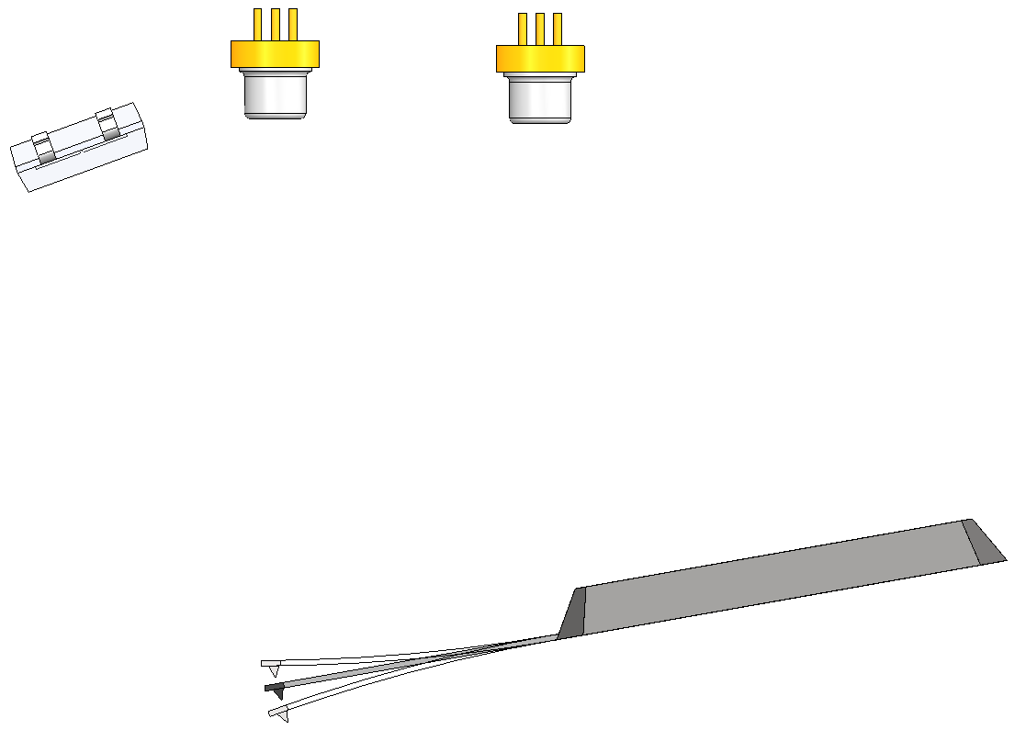
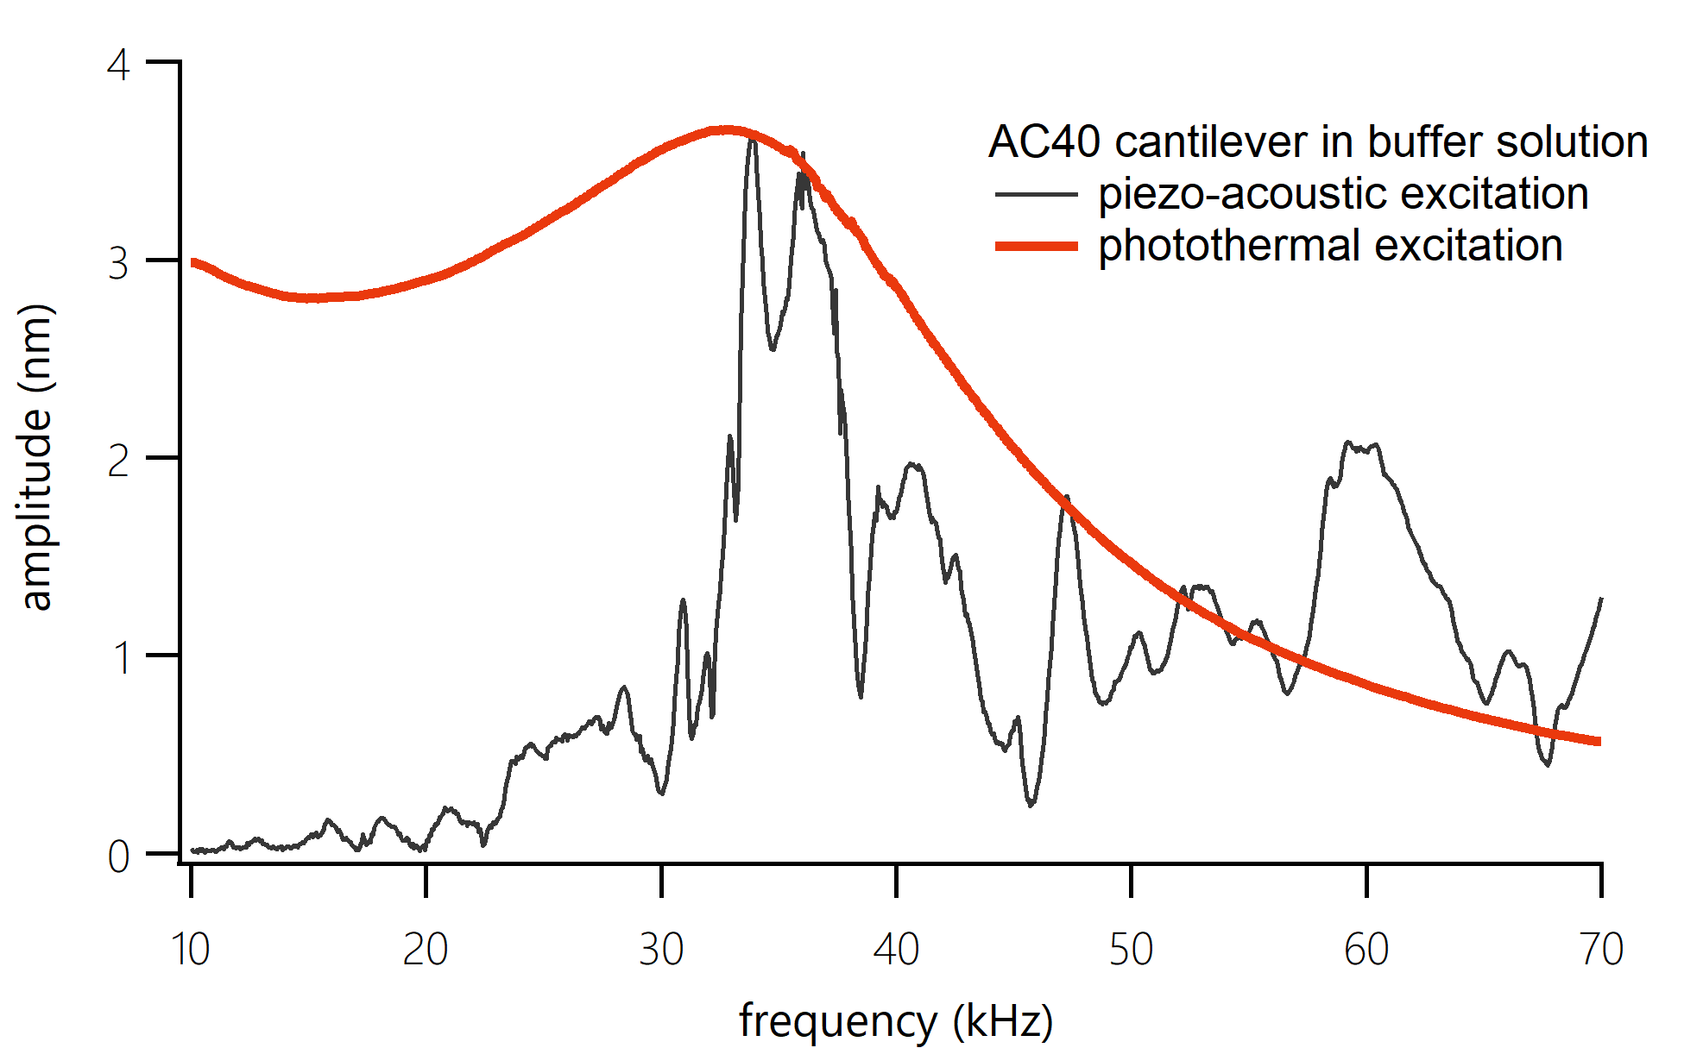
CleanDrive photothermal
excitation
Readout SLD
Modulated excitation laser
Bandpass
filter
CleanDrive
“Textbook
response”
Bio-compatible 785nm NIR laser source
No “forest of peaks” in any environment
Reliable automatic tuning
Ultra stable excitation
Piezo excitation:
“Forest of peaks”
Notes:
Local heating only excites the cantilever
Compatible with optically and thermally sensitive experiments
Works with all cantilever shapes

Slide 4
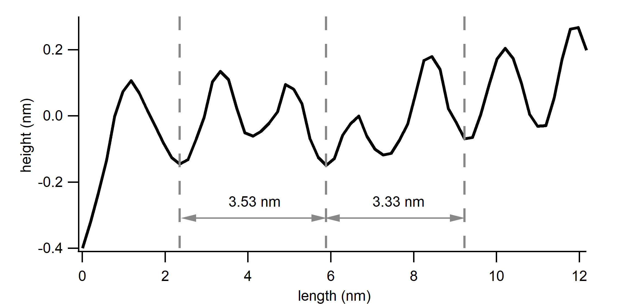
Secondary structure of dsDNA

Slide 5
DriveAFM as a table-top system…
Stage mounted on Isostage 300 active vibration isolation
…or on an inverted optical microscope
A variety of stages for different inverted optical microscope brands is available.
Notes:
It can be used e.g. as a stand-alone system, e.g. for high-resolution applications or when working with opaque samples. But it can also be integrated with an inverted optical microscope to work with cell culture material.

Slide 6
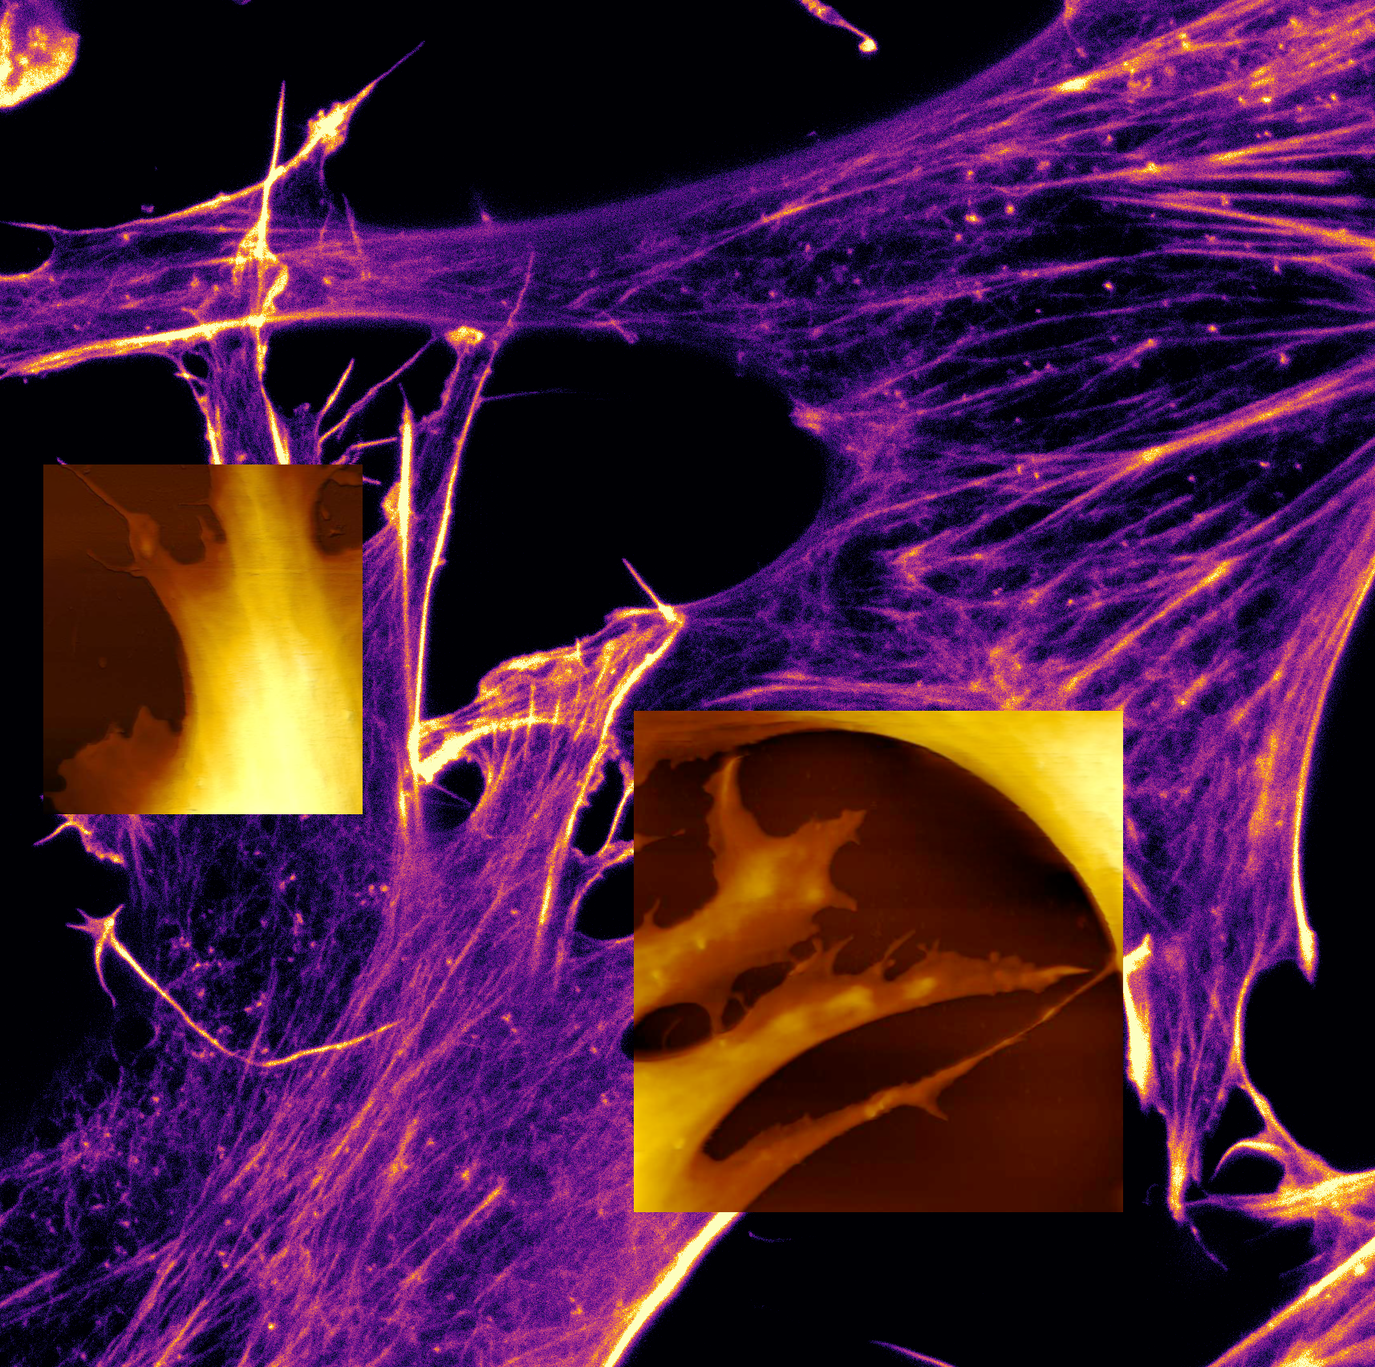
AFM +optical microscopy
Super-resolution techniques challenge AFM in the biosphere
Mechanical interaction→ other insights than just structure

Slide 7
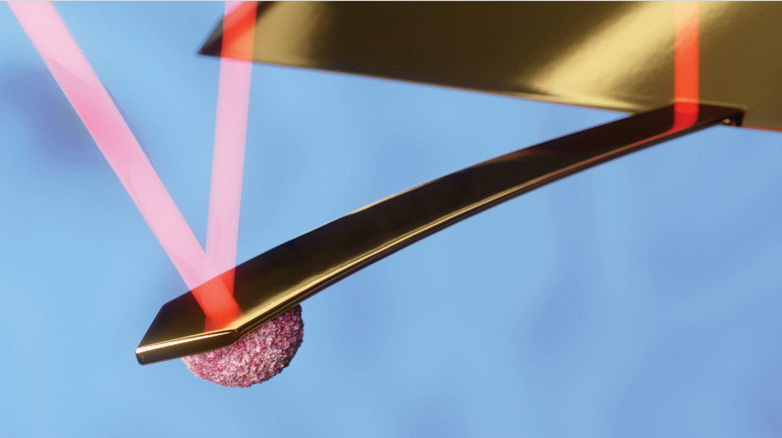
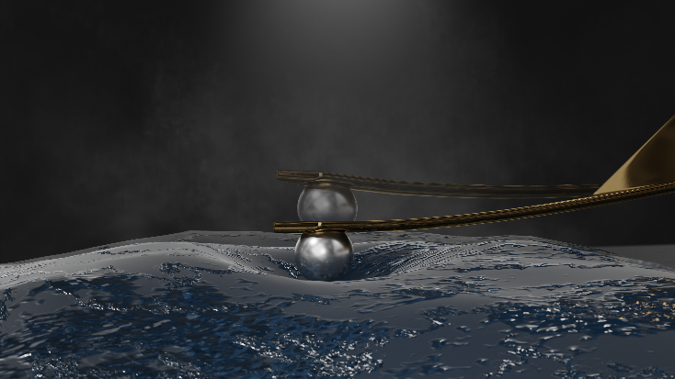
Mass measurements
Viscoelasticity measurements

Slide 8
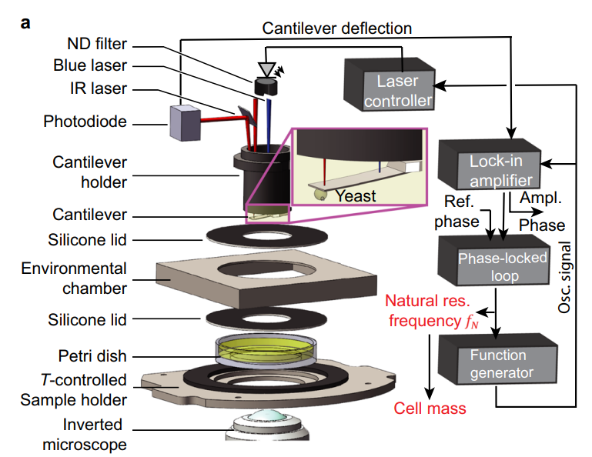
Mass measurements of single yeast cells
Advancing the original technology (Martinez-Martin & Fläschner et. al. Nature 2017)
Increasing mass resolution, improving optical microscopy
Cuny, Sapra, Martinez-Martin, Fläschner et al., Nat. Commun. 2022

Slide 9
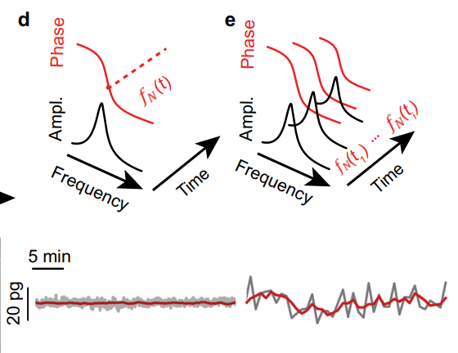
Mass measurements of single yeast cells
Two measurement modes:
Continuous mode
Sweep mode

Slide 10
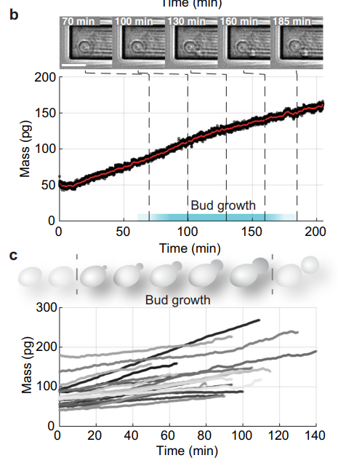
Mass measurements of single yeast cells
Increasing mass resolution
Notes:
Motivation: growth behaviour is giving insights into regulation of growth (what are the mechanisms, how does the cell check whether it is properly sized and ready to have daughters)
S. Cerevisiae is a budding yeast that is about 50 times lighter than mammalian cells
In b) appearance of the daughter cell after 100min (after pickup) – high mass resolution tracking, but not a precise cell cycle measure
c) 25 individual yeast cells measured.

Slide 11
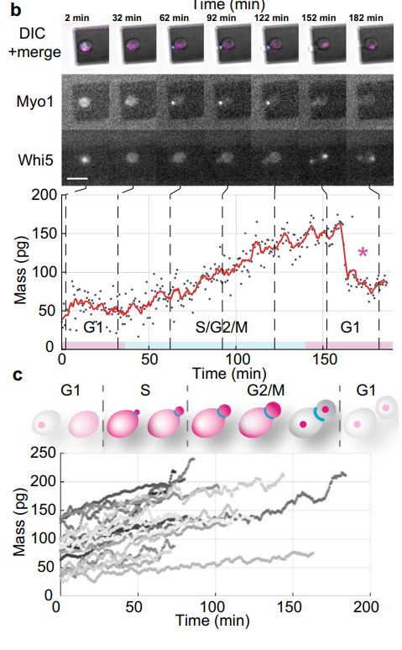
Mass measurements of single yeast cells
Increasing mass resolution, improving optical microscopy
Notes:
Improving the cell cylce determination with fluorescent markers (myo1 and Whi5). With these markers the cell cycle can be better determined.
However, fluorescence is stressing the cells, therefore we switched to the “sweep” mode in which we have a lower mass resolution, but it is less taxing to the cells.
Then again 25 mass traces of yeast cells measured
We see no significant difference between the “more noisy” measurement (with better cell cycle determination) and the “less noisy” measurement (with worse cell cycle determination)
→ This allows us now to analyse both.

Slide 12
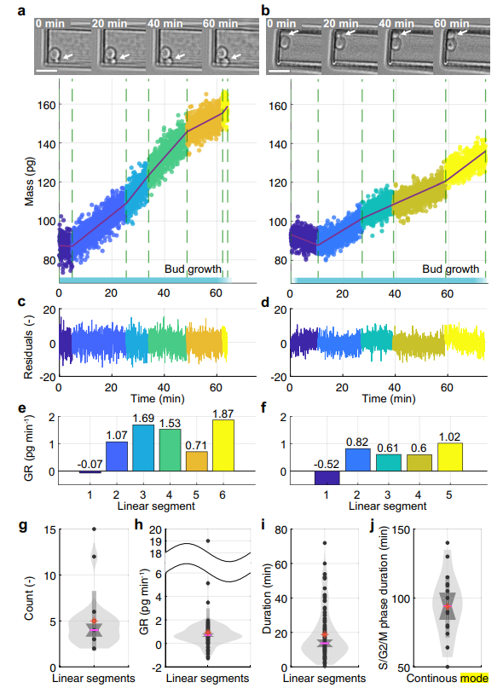
Single budding yeast cells (S/G2/M phase) increase total mass in multiple linear segments sequentially
Cuny, Sapra, Martinez-Martin, Fläschner et al., Nat. Commun. 2022
Notes:
It currently looks like it being neither exponential nor linear, rather a multi-linear one. Needs to be connected to growth models or biological modelling, so far only a phenomenological finding
like 1

Slide 13
Viscoelastic measurements
F_{setpoint}
Materials exhibit only elasticity
Reactive force: F_{elasticity}
All compression energy is stored
From F_{elasticity} and probe geometry: E_{Youngs}
F_{elasticity}

Slide 14
Viscoelastic measurements
Materials exhibit elasticity and internal friction
Some energy is stored, some lost
Two force components: F_{elasticity} and F_{friction}
Analogous to E_{Youngs}: E_{storage and} E_{loss}
F_{setpoint}
F_{friction}
F_{elasticity}

Slide 15
Calibration
Amplitude $A_{free},\text{and} \text{phase} φ_{free}$characterize the cantilever behavior in absence of conservative and dissipative forces of the sample (i.e. stiffness and viscosity of the sample)

Slide 16
Characterization
Go in contact. Stay there. Modulate.
Using the same “driving” of the cantilever, the oscillation of the cantilever changes, characterized by its new amplitude $A_{sample},\text{and} \text{phase} φ_{sample}$

Slide 17
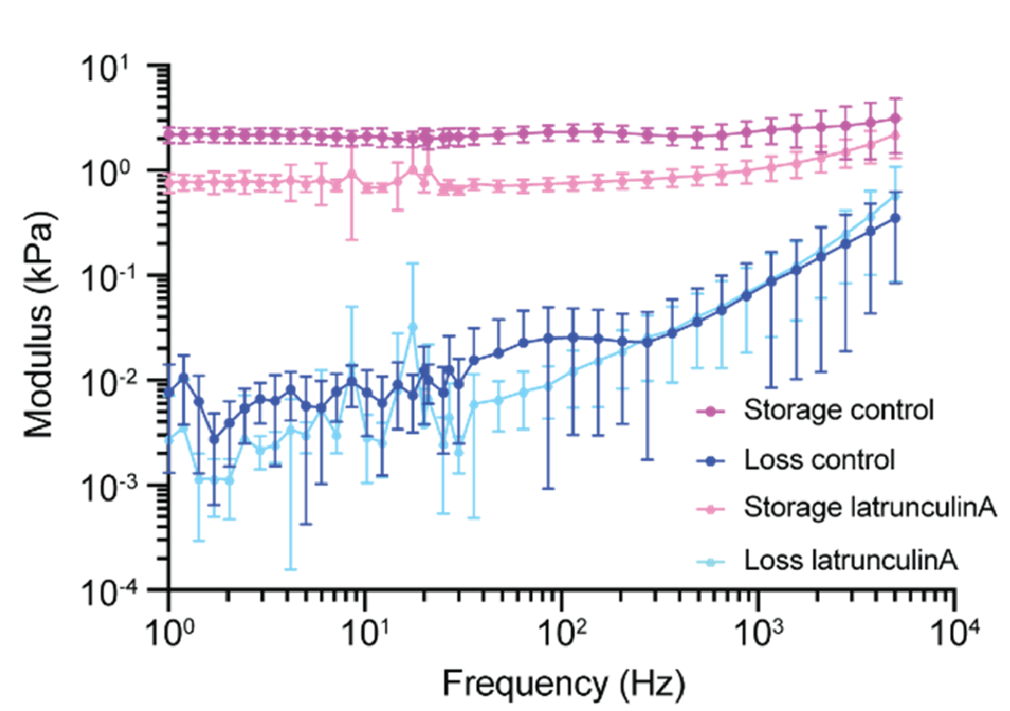
Calculation
$$k_{sample}=k_{cantilever}\left(\frac{A_{free}}{A_{sample}}−1\right)$$
Dynamic sample stiffness:
Loss tangent:
$$tan(δ)=tan(φ_{sample}−φ_{free})$$
*L.M. Rebelo et al. Soft Matter 10 (2014) 2141
Use contact models to extract E_{storage} from $k_{sample}$
With E_{storage} and $tan(δ)$ get E_{loss}
Low and high frequency nano-viscoelasticity

Slide 18
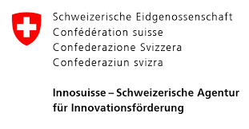
Acknowledgements
Biophysics lab, ETHZ, Basel
Prof. Daniel Müller
Dr. Nico Strohmeyer
Dr. Michele Nava
Dr. Laura Gonzales
Giulia Ammirati
Nanosurf AG, Liestal
Dr. Jonathan Adams
Dr. Gotthold Fläschner
Hans Gunstheimer
Computational biology lab, ETHZ, Basel
Prof. Jörg Stelling
Dr. Andreas Cuny
School of Biomedical Engineering, University of Sydney
Dr. David Martinez-Martin
Low and high frequency nano-viscoelasticity

Slide 19
Thank you for your attention
For more information visit or email us
www.nanosurf.com/DriveAFM
info@nanosurf.com
Follow Nanosurf on
Notes:
Thank you for your attention and we are now open for a short Q&A session.

