Slide 1
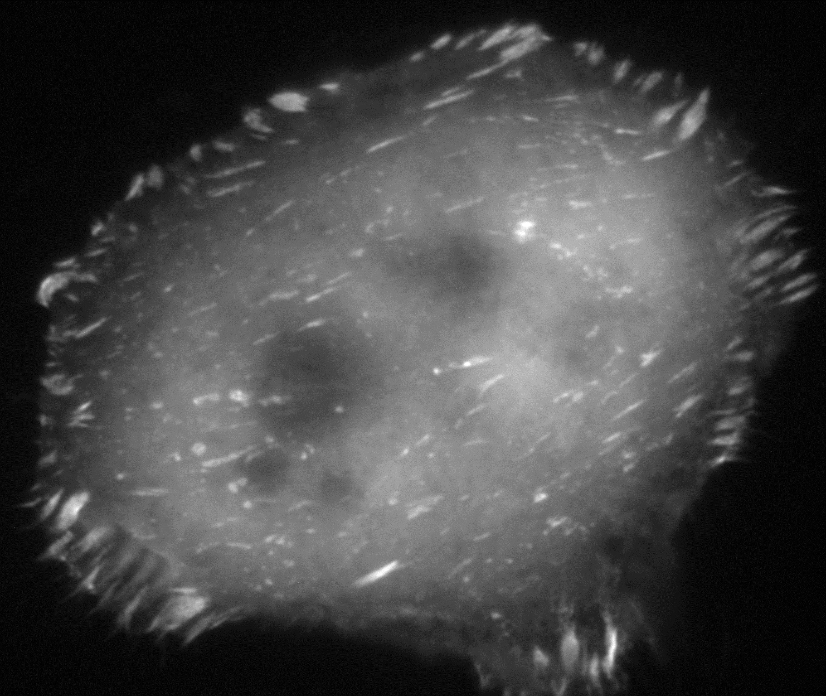
Combination of fluorescence FRET microscopy and optical tweezers for mechanical studies on living cells
Camille Dubois
Biophotonics group, Laboratoire Charles Fabry, Institut d’Optique
Under the supervision of Nathalie Westbrook
Ludivine Houel-Renault
Nada Boustany
SFP
7 juillet 2023
Marie Erard

Slide 2
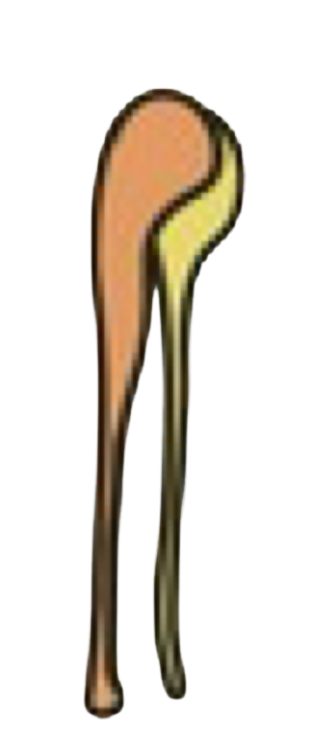
Focal adhesions on adherent cells
Introduction :
Cells experience forces : External forces and cell-generated forces (cell migration, contraction)
Shear
Compression
Mechanotransduction : mechanisms by which cells convert a physical force into a biochemical signal
Traction
Gravity
Cell migration
Involved in :
Senses (hearing, touch,…)
Regulating forces and tension within the body (muscle tension or blood pressure regulation)
Embryonic development
extra-cellular matrix
Focal adhesion
actin
Tension sensor localized on vinculin
Diseases :
vinculin
Cancer
talin
Abnormal mechanotransduction signalling can induce cancer
Cancerous cells have different adhesion
Cell membrane
integrin
extra-cellular matrix

Slide 3
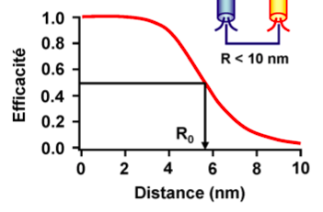
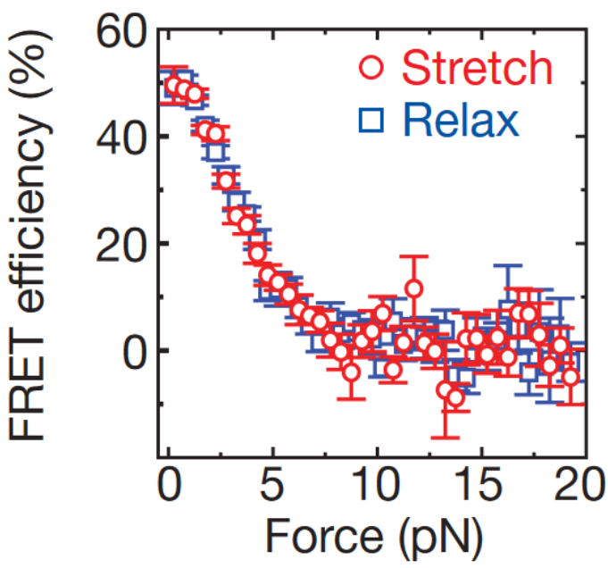
Measuring forces using fluorescence FRET microscopy
Förster Resonance Energy Transfert (FRET) :
Excitation transfer between to two fluorophores in close proximity
$$E=\frac{1}{1+{\left(\frac{R}{R_{0}}\right)}^{6}}$$
Donor
Acceptor
FRET Efficiency :
Donor
Acceptor
Ex
Em
Ex
Em
Intensity
$R_{0}$ Förster distance
Typ around 1 and 10 nm
R
Excitation
Emission
Spectral overlap
$$λ_{em}$$
Efficiency
$$λ_{exc}$$
Wavelength
Force tension sensor :
Single-molecule in-vitro calibration curve
Excitation
Emission
R
High FRET :
F
F
Donor
Acceptor
R
Low FRET :
Donor
Acceptor
3
Grashoff 2010

Slide 4
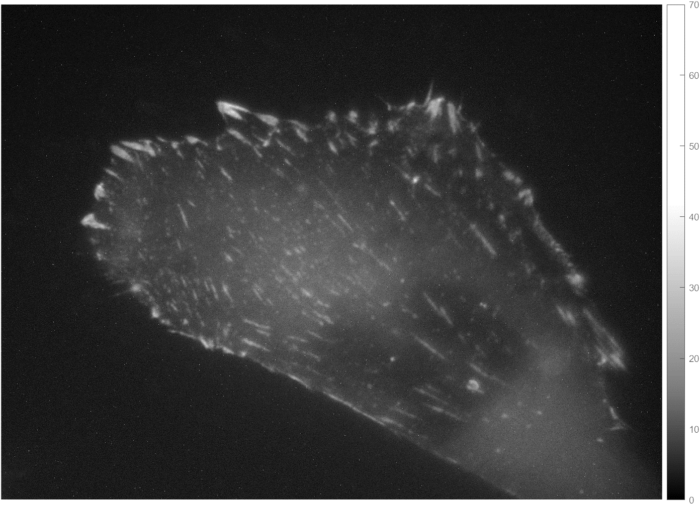
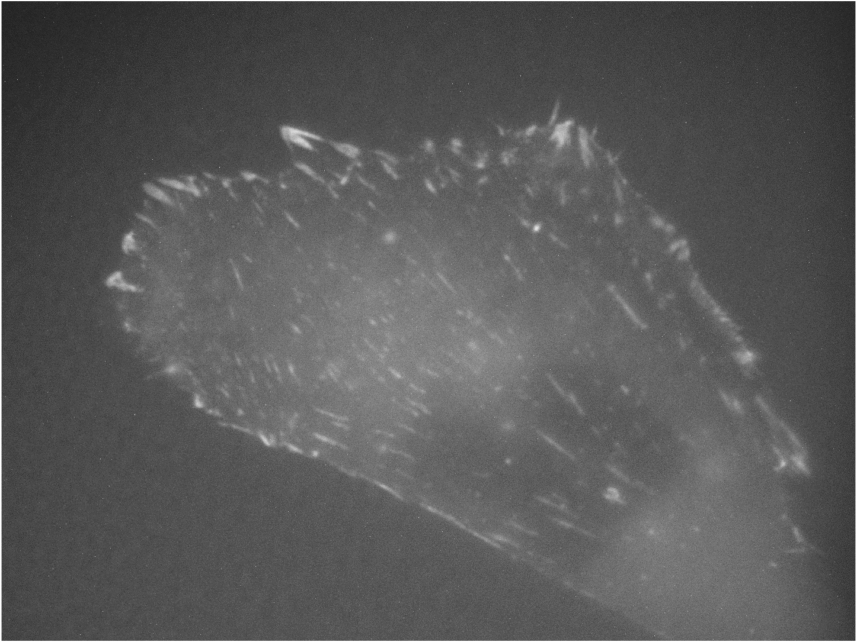
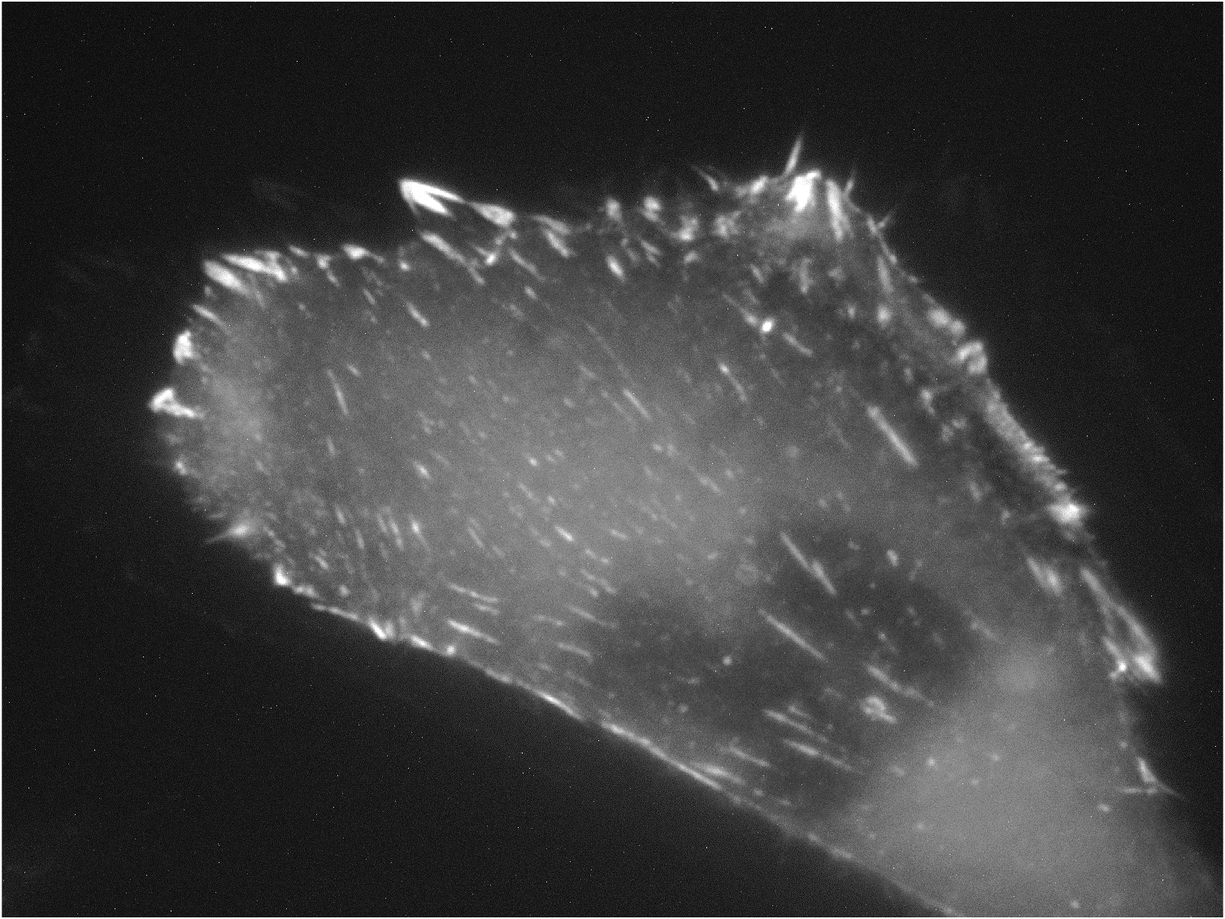
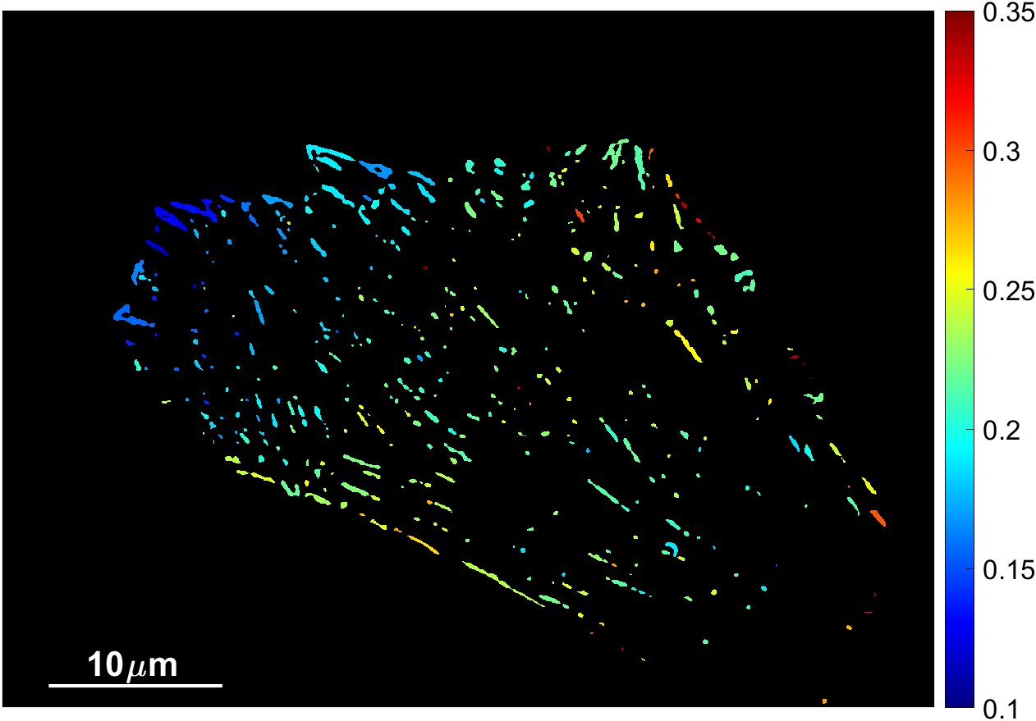
FRET efficiency measurement
Halogen lamp
Extraction of FRET efficiency
 | Camera D | Camera A
LED D 440 nm
LED A 520 nm
Acceptor fluorescence intensity when donor is excited
Cells expressing tension sensor + beads
DD
DA
excitation
detection
Optical Tweezer
Microscope objective
100x NA=1,3
Optical tweezer detection
AA
Donor
Acceptor
Laser 1069 nm
$$E ∝\frac{DA}{AA}$$
LED Donor@440 nm
or
Calibration +
image processing
LED Acceptor@520 nm
Camera : phase contrast imaging
FRET excitation
VinTS
0.35
Emission filter 2
0.3
Camera A :
fluo 535-590
0.25
FRET Efficiency
Emission filter 1
0.2
Camera D : fluo 480-530
FRET detection
0.15
0.1

Slide 5
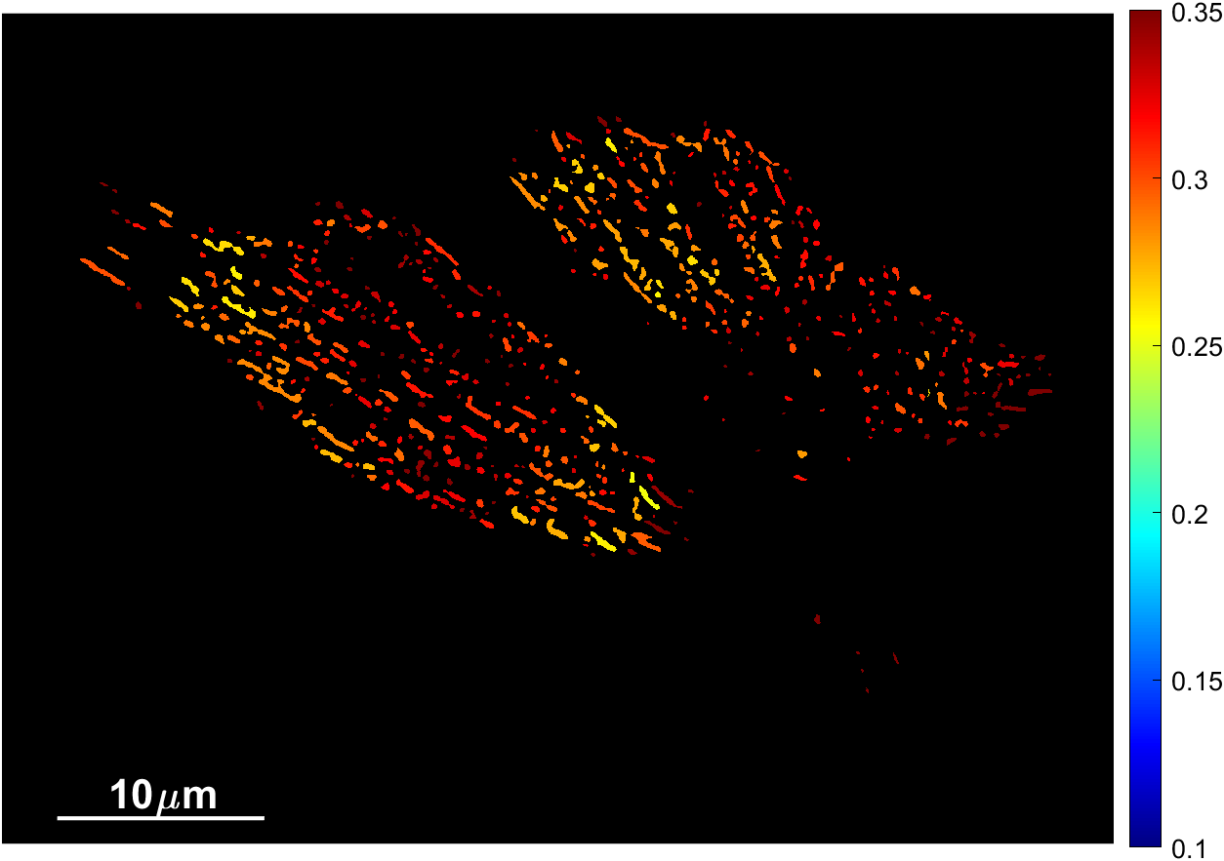
Tension sensors on CHO cells
0.35
***
VinTS
0.3
➜ Lower FRET efficiency with tension sensor compared to control
0.25
0.2
VinTS
Tension sensor
0.15
CHO-K1, 60 cells (VinTL) and 87 cells (VinTS)
0.1
Rutgers : Different coverslip treatments
FRET Efficiency
0.35
Poly-D-lysine (PDL) or Fibronectine (FN)
VinTL
➜ The control is insensitive to coverslip treatment
➜ Tension sensor is sensitive to change in cell adhesion
0.3
***
***
0.25
0.2
VinTL
Control
0.15
VinTL
VinTS
0.1
➜ Coherent with published values
(Li 2019, Gates 2019, Rothenberg 2015, Dumas 2019)

Slide 6
Combination with optical tweezer
Optical tweezer
$$\vec{F_{trap}}=k_{trap} \vec{x}$$
$$x$$
$$\vec{F_{trap}}$$
Functionalized bead
Application of a localized force controlled in direction and in amplitude
Cell expressing force sensor
Vinculin
Objective : Apply a calibrated force using an optical tweezer and measure forces on vinculin via FRET

Slide 7
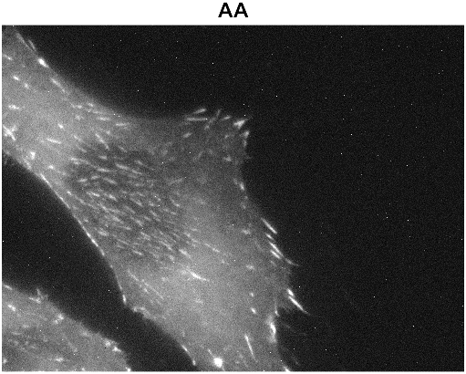
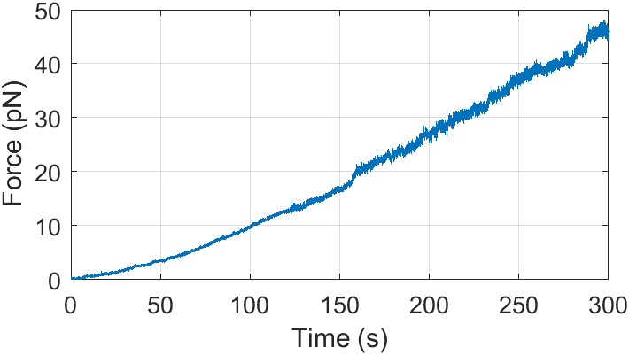
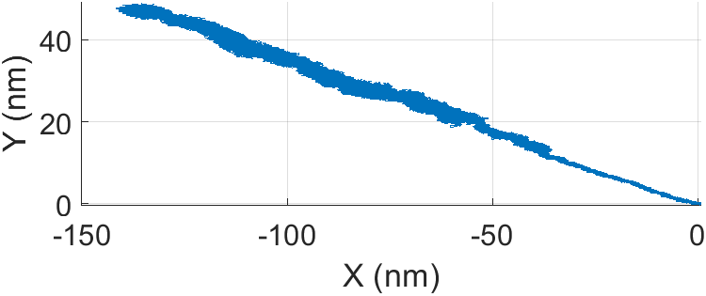
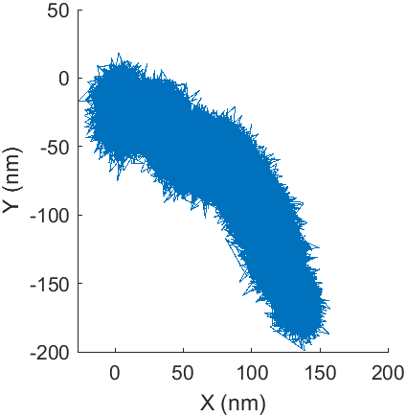
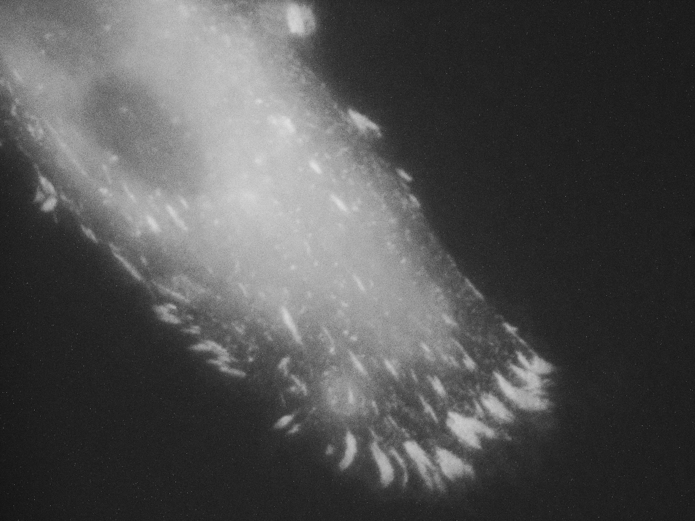
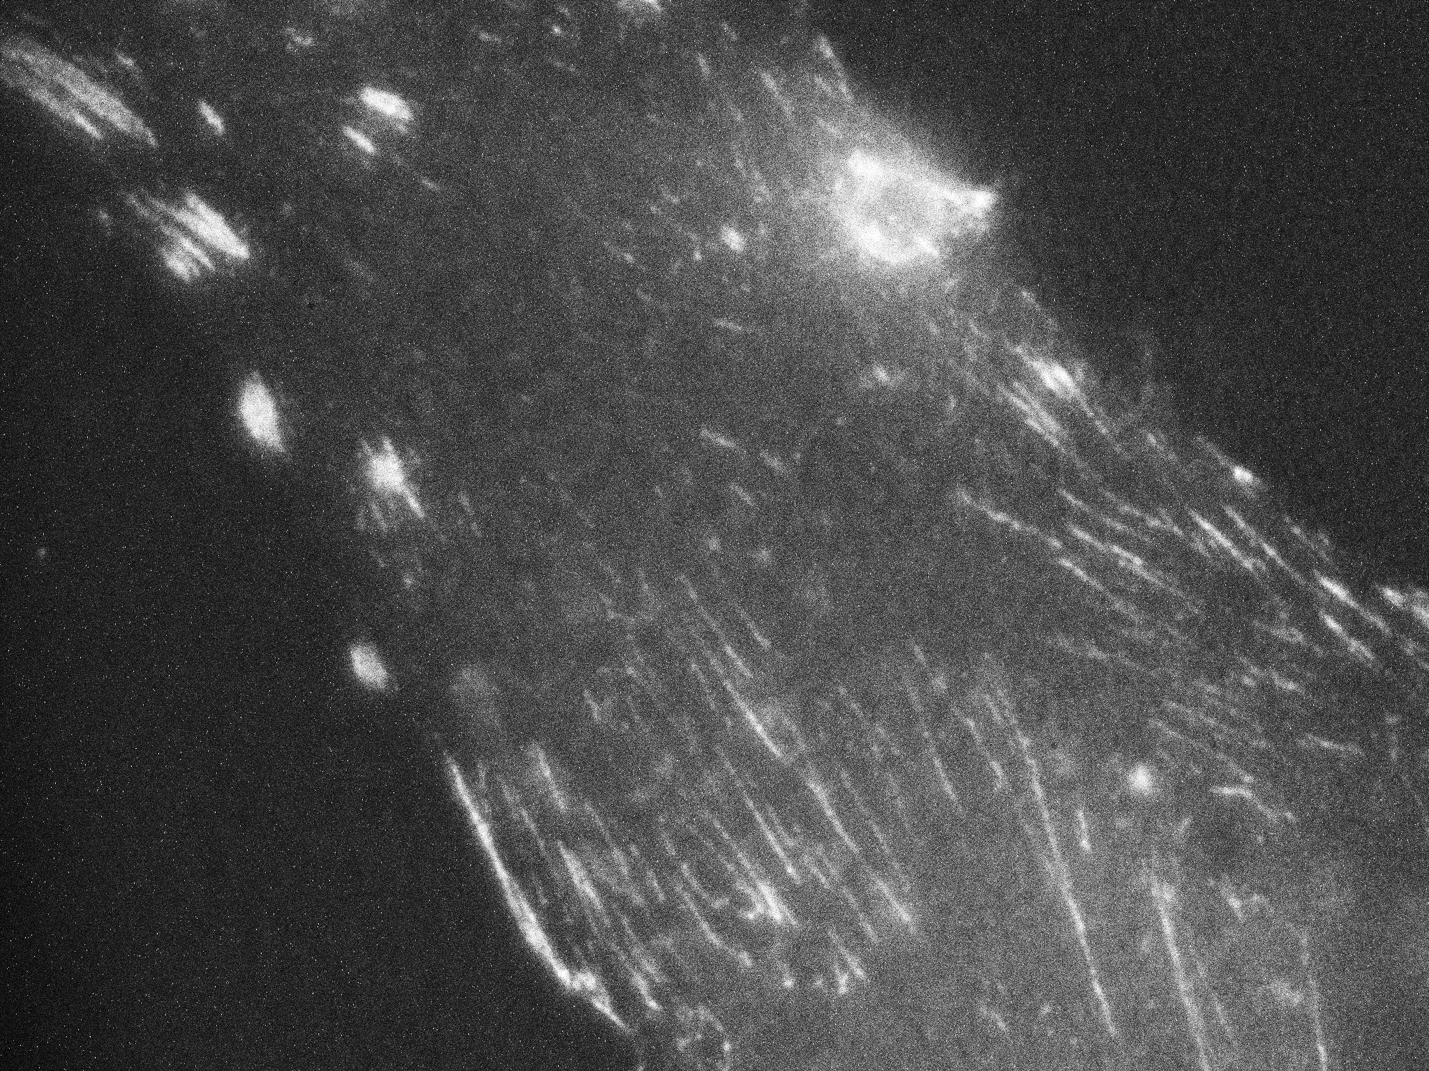
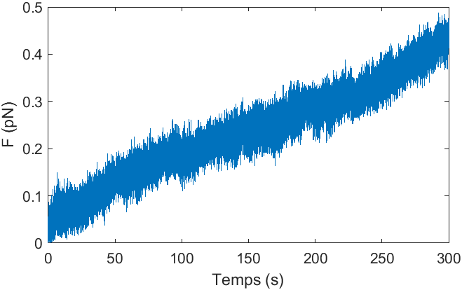
Preliminary results with optical tweezer
Change of cell type
Cells are pulling on beads
10µm
Force exerted by the cell on the bead
HDFn
Bead displacement over 5min
t
Chinese hamster ovary (CHO)
VinTS efficiency
$$\sim 22 \%$$
t
Focal adhesions are formed around beads
Fluorescence image of a cell expressing vinculin tension sensor
1µm
bead
10µm
Vinculin accumulation
Human Primary Dermal Fibroblast (HDFn)
VinTS efficiency
$$\sim 18 \%$$
HDFn

Slide 8
Conclusion and perspectives
FRET measurement gives access to tension on vinculin localized at focal adhesions
Formation of focal adhesions on beads
Measured force exerted by a cell on a bead as a function of time
Perspectives :
Correlate tension on vinculin and force exerted on the bead

Slide 9
Experimental setup
Annex :
Optical Tweezer
Halogen lamp
Donor
mTFP1
Acceptor
Venus
Imaging filter 590
1069 bandpass filter
Cellules exprimant le couple FRET + billes
QPD
D=1
$$2 mm$$
Microscope objective
100x NA=1,3
Camera 4 :
interference pattern
D=1
$$λ/2$$
$$λ/4$$
DBS 3
1069 nm, 150 to 600 mW
Excitation filter 2
DBS 1
LED A
505 nm
DBS 2
Excitation filter 1
D=1,2
Nikon tube lens
L_{T} =$200mm$
DBS 6
Optional filter (stop 1069 nm)
Phase shift ring
Camera 3 : phase contrast imaging
LED D
440 nm
DBS 5
Emission filter 2
FRET excitation
Camera A :
fluo Venus 535-590
Emission filter 1
Camera D : fluo mTFP 480-530
FRET detection

