Slide 1
Microrheology and structural quantification of blood clots as a diagnosis of hypercoagulability
Nathalie Westbrook, Julien Moreau
Biophotonics group, Lab. Charles Fabry
in collaboration with
Jean-Marc Allain, Adrien Seripa, Lab. Mécanique des Solides, Ecole Polytechnique, IPP
Chloé James, Laura Wolff-Trombini, Univ. Bordeaux, INSERM, Biology of cardiovascular diseases & CHU Bordeaux Lab. Hématologie
Hubert Galinat, CHU Brest, Service Hématologie Biologique
L. Wolff-Trombini et al, accepted in Biomedical Optics Express (30 june 2023)
150 ans SFP, 5 july 2023

Slide 2
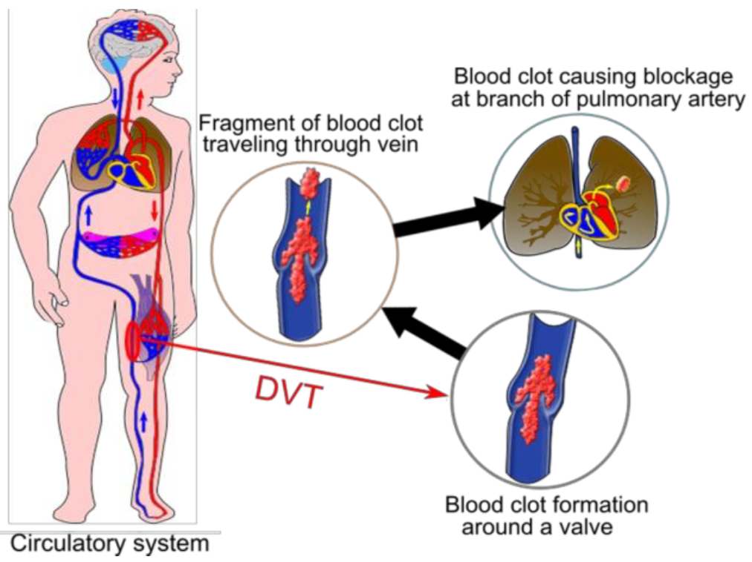
Hypercoagulability and thrombosis
What is thrombosis?
Clot formed in a blood vessel
2 types of thrombosis :
  Arterial (major)
  Venous
Complications : recurrence and pulmonary embolism
In France : 50 000 to 100 000 phlebitis, 40 000 P. Emb / year
Thromboembolic events: 3rd cause of cardiovascular deaths
Problem : 50% of recurrent deep venous thrombosis events remain unexplained
Berthomier, T. and al. Adv. Sci. Technol. Eng. Syst. J. 2, 48–59 (2017).

Slide 3
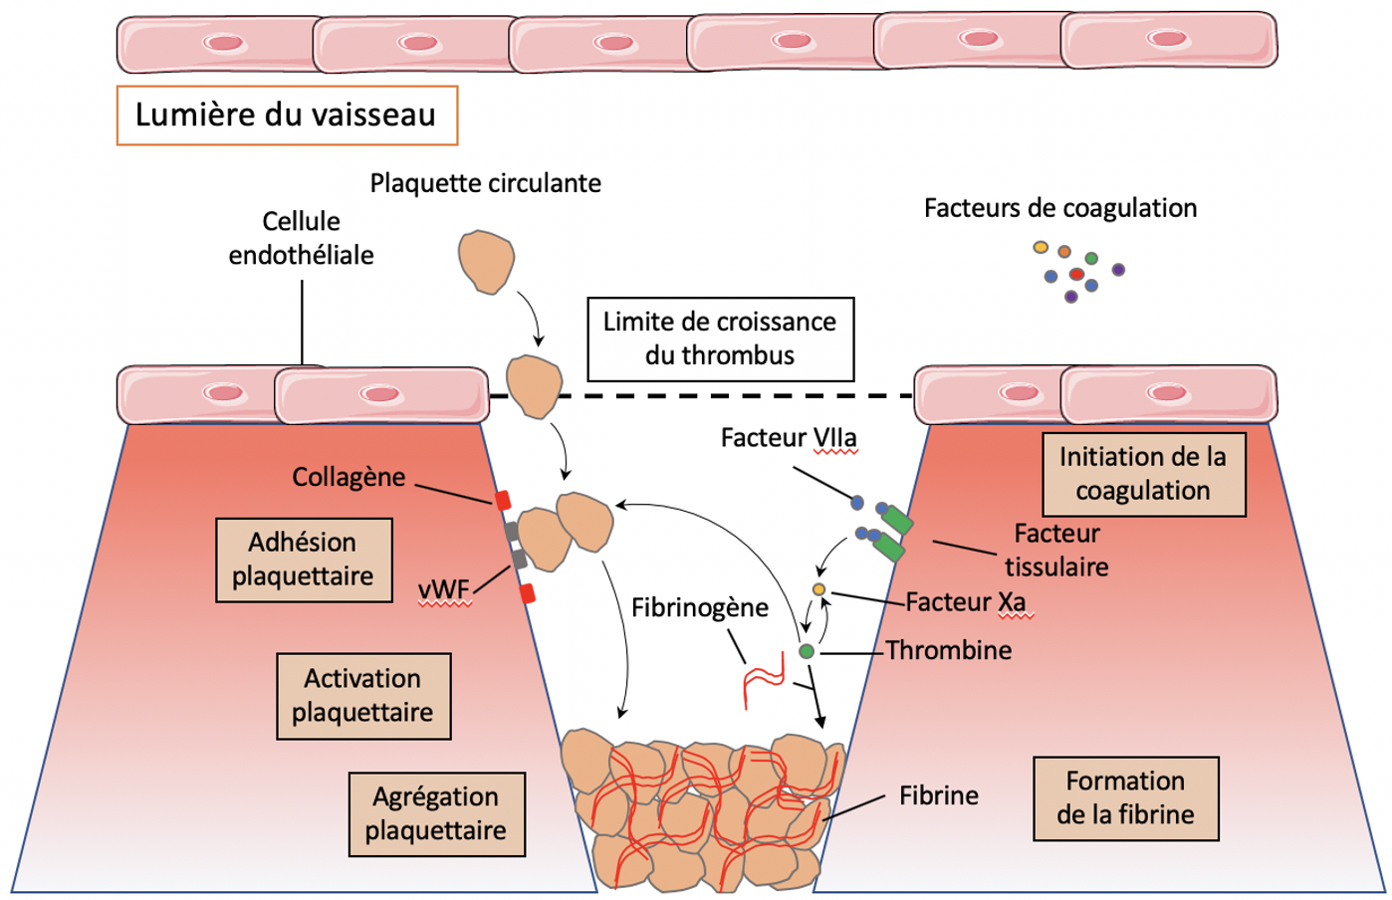
Blood clot and coagulation
Physiological hemostasis and its regulation
→ Maintaining blood flow and healing vascular breaches
Primary hemostasis: agregation of platelets in the breach
Secondary hemostasis: formation of fibrin based on coagulation factors (factors I to XII)
We start from poor platelet plasma (PPP) = no red or white blood cells nor platelets but with coagulation factors (non activated proteins)
We initiate coagulation by adding tissue factor, calcium and phospholipids + microbeads for our optical microrheology

Slide 4
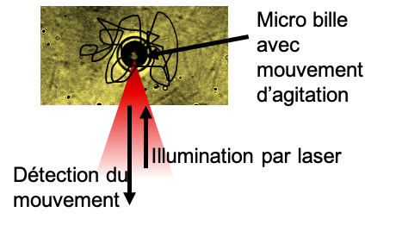
Passive microrheology
Microbeads are incorporated in the blood clot and their brownian motion under thermal fluctuations is measured using an optical tweezer setup when the reflection of a laser beam focused on the bead gives access very precisely to the position of the bead.
Measurement of brownian motion
Blood clot with 6 µm polystyrene beads
Interference pattern used to center the bead on the laser focus
Beads trapped by the clot not by the laser
=> Need to center the bead on the laser focus
Image used to position the bead on the laser focus

Slide 5
Extraction of viscoelastic ppties
Brownian motion recorded with high spatial and temporal resolution (0.1 to 10kHz)
=> Local viscoelastic properties of the blood clot as a function of frequency
Storage modulus at 30 rad/s
Same shape for all the curves => characterization with one measurement = storage modulus at 30 rad/s

Slide 6
Measurement protocol
Choice of microrheology parameters to define a reference measurement on normal clots
Storage modulus @100Hz
Choice of bead diameter: 6 µm
=> less dispersion in the measurement
Choice of bead height
(distance to coverslip): 40 to 60µm
=> less variation with height
@30Hz

Slide 7
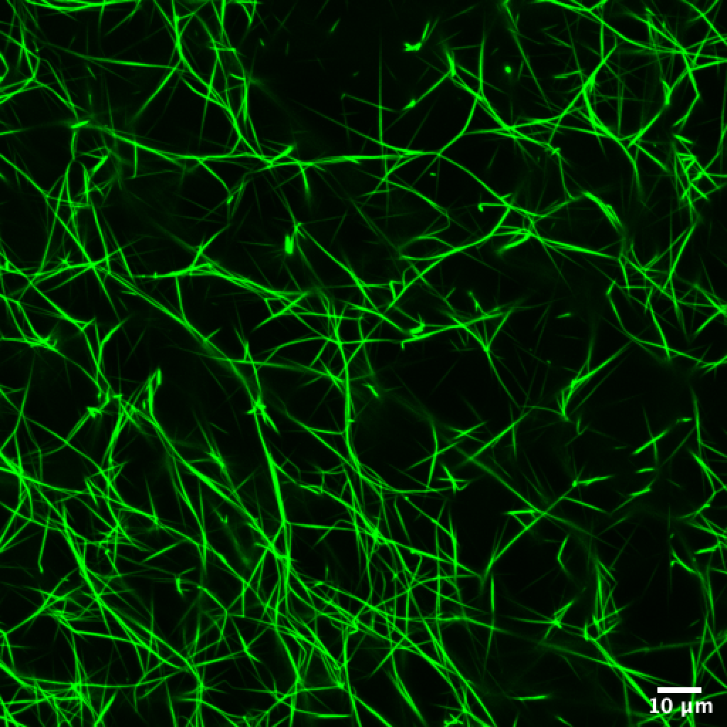
Confocal imaging of fibrin
Correlation of mechanical measurements with confocal images of fibrin network (fibrinogen labeled with Alexa488)
Hemophilic patient
FVIII=1,1%
Example of confocal image of a looser fibrin network
Confocal image of a fibrin network.
Control from a human pool. FVIII=100%
Scale bar 25µm. Zoom on an area with a bead (scale bar 10µm).
Quantification of confocal images:
fiber density and length

Slide 8
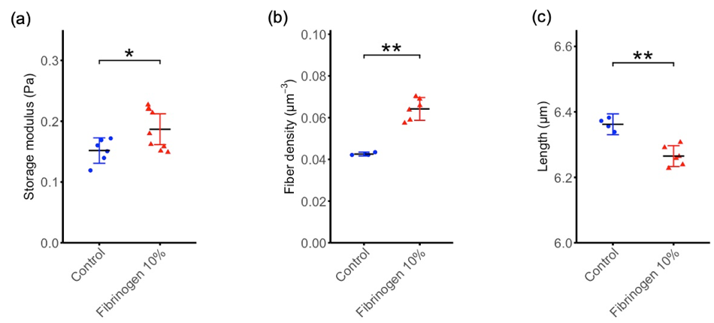
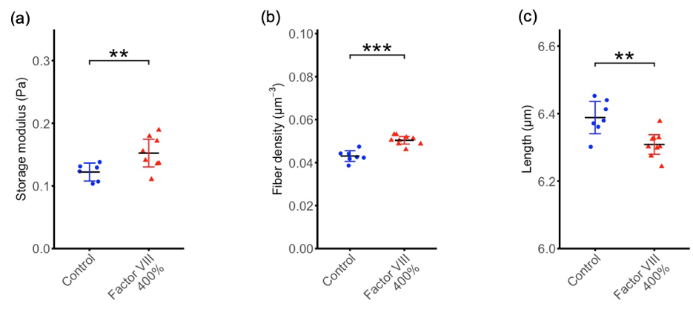
Characterization of induced hypercoagulability
Blood clots with 10% more fibrinogen are more rigid than control clots
structural imaging
Microrheology measurements
Blood clots supplemented at 400% with one specific coagulation factor (Factor VIII) are more rigid than control clots
1 point=1 clot (4 beads)

Slide 9
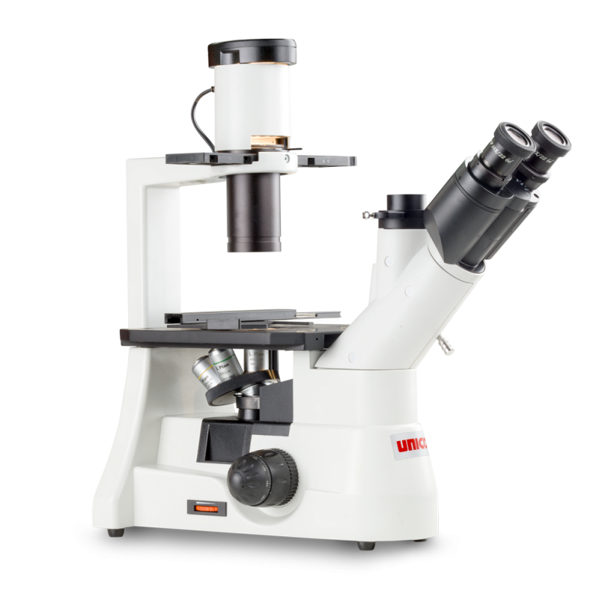


Perspectives
→ Characterize blood clots from patients with coagulation pathology (thrombotic or hemophilic)
Brownian motion detection
Blood clot containing microbeads
DIODE LASER
→ Compact and automatized prototype transportable to the hospital

