Slide 2
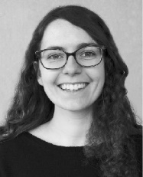
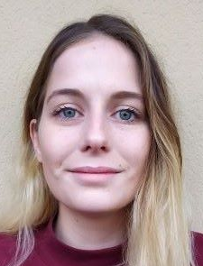

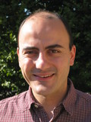
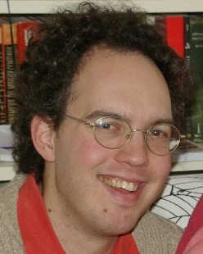





Fingering instability of coalescing thin films
Manon L’Estimé, Maud Dobler, Laurent Duchemin, José Bico, Etienne Reyssat
PMMH, ESPCI, Paris, France

Slide 3
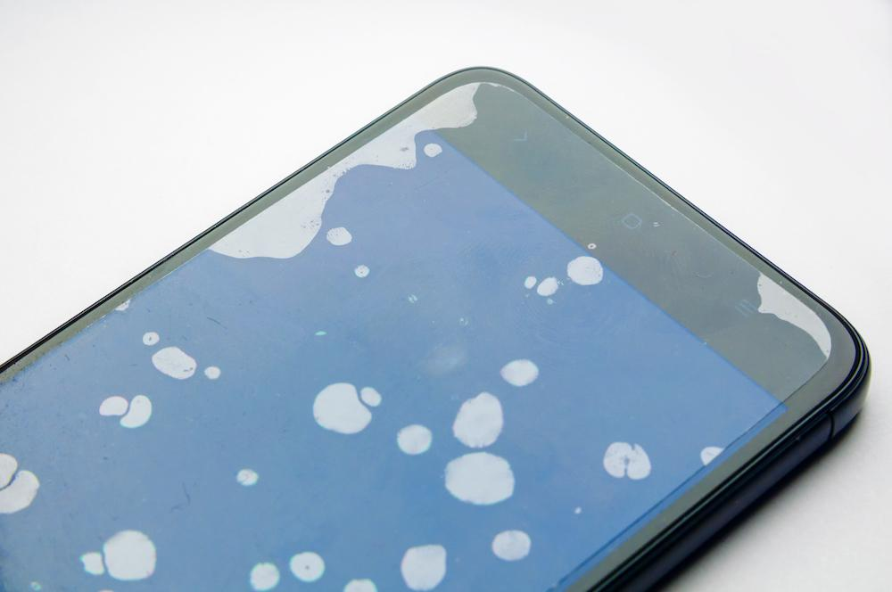

Slide 4


Slide 5


Slide 6
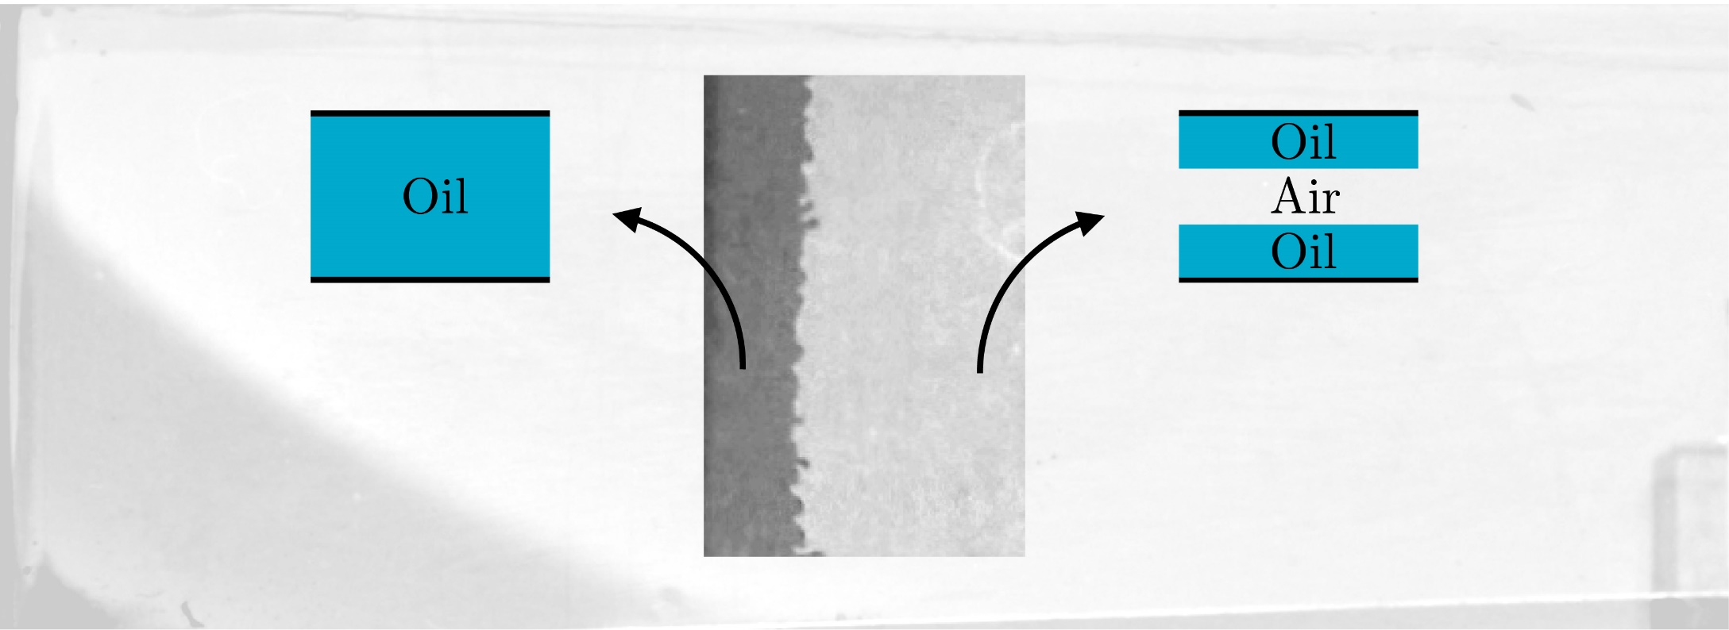



Slide 7
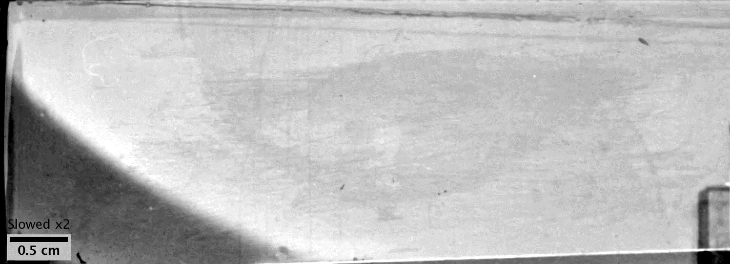

Slide 8


Slide 9
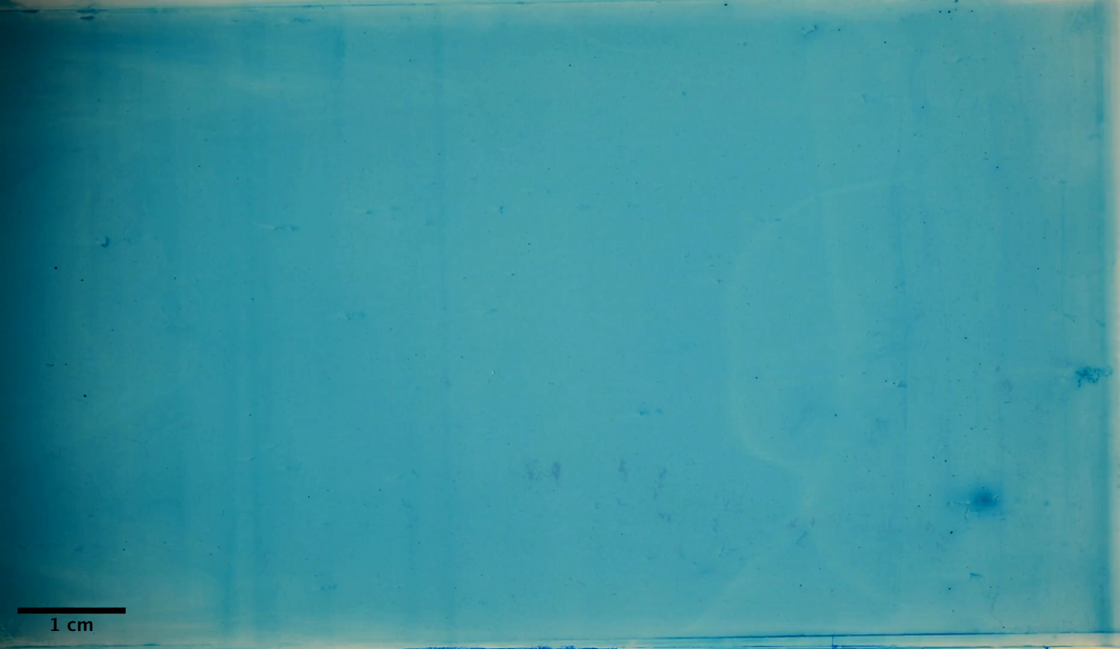
An original fingering phenomenon

Slide 10
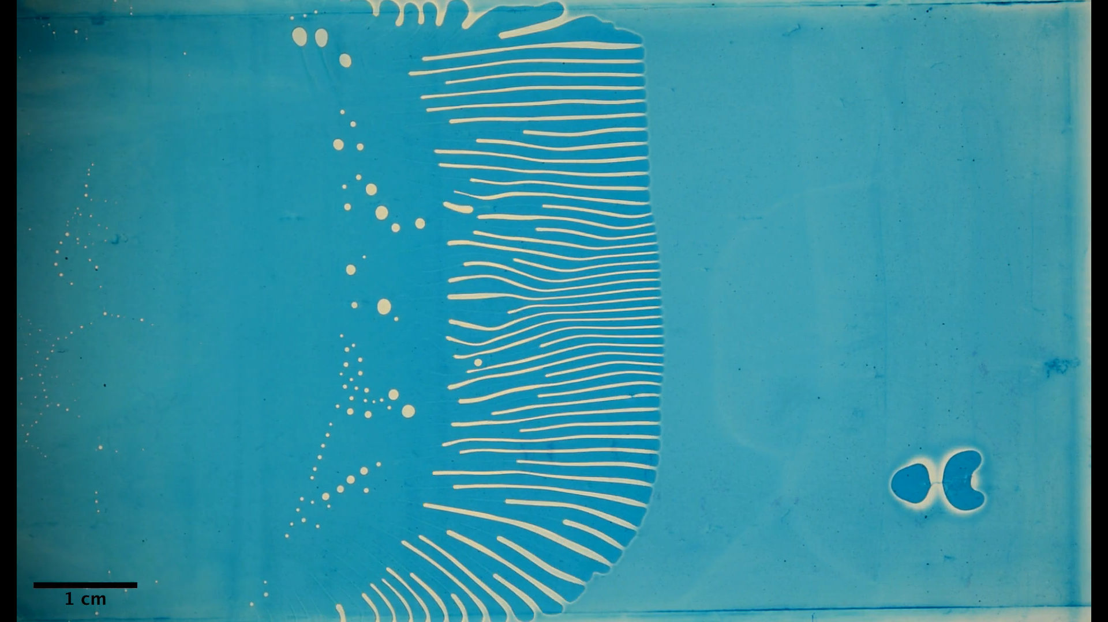





Slide 12
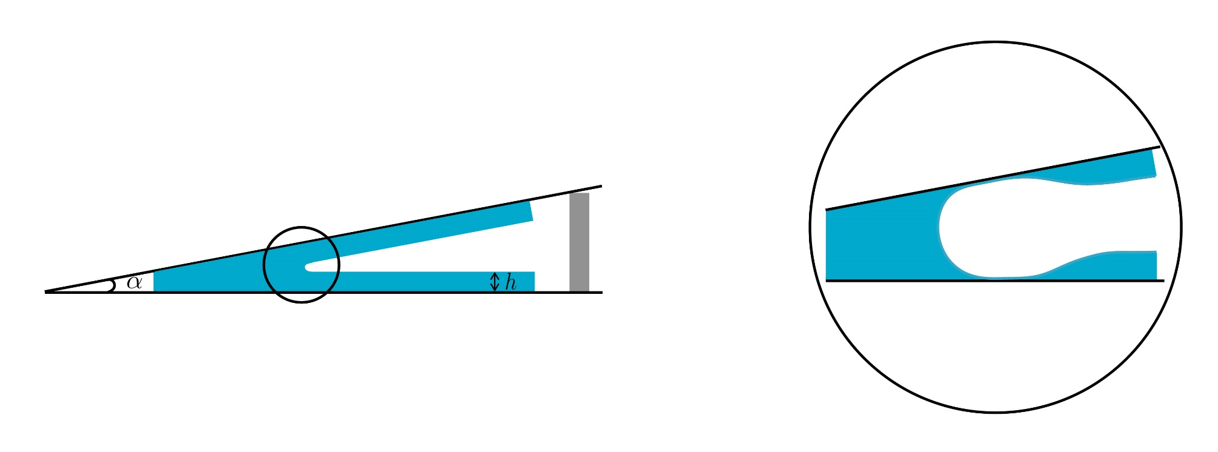

Slide 13



Slide 14
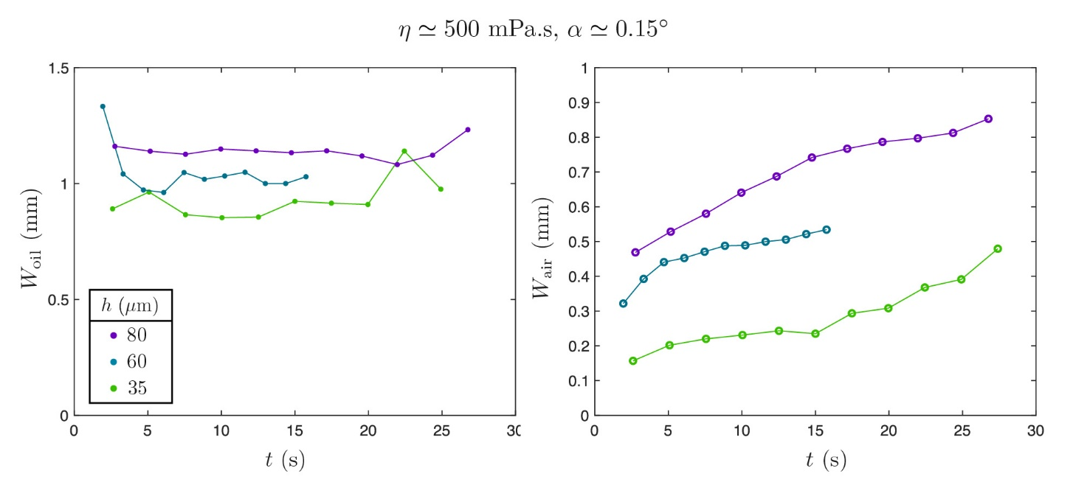
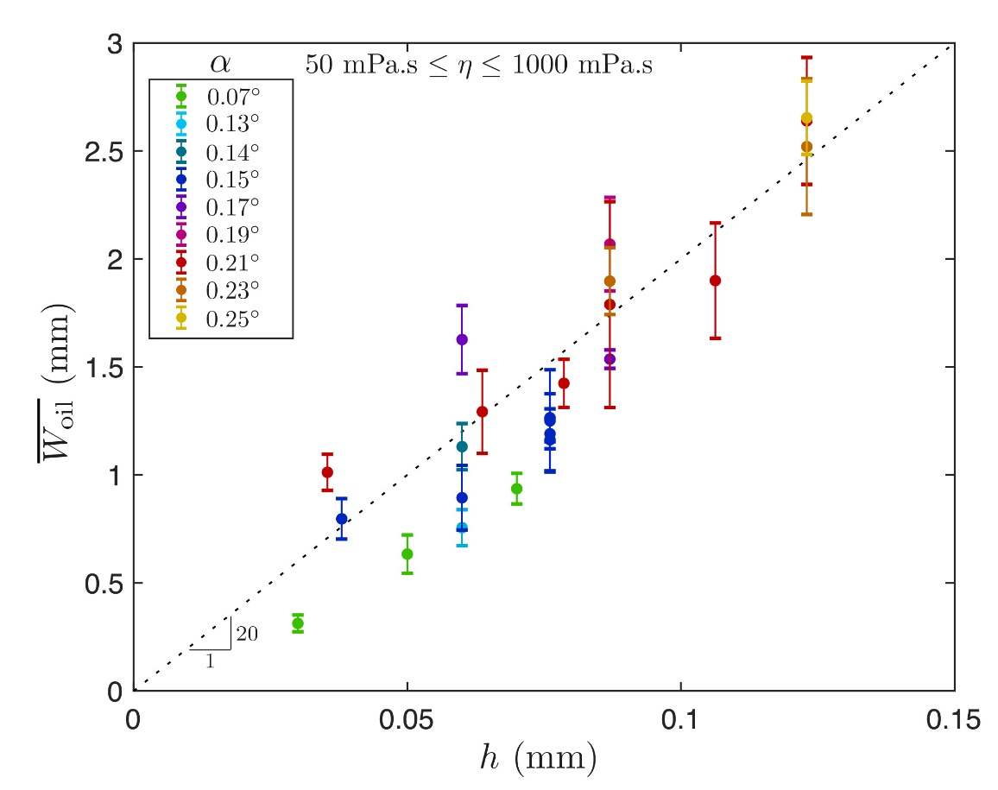
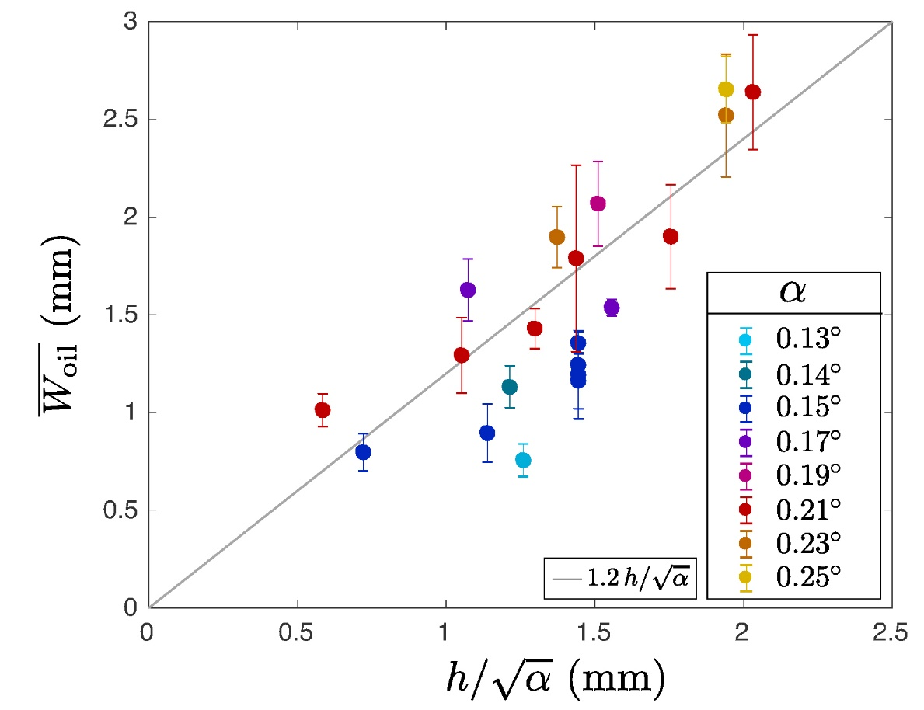
Oil fingers

Slide 15
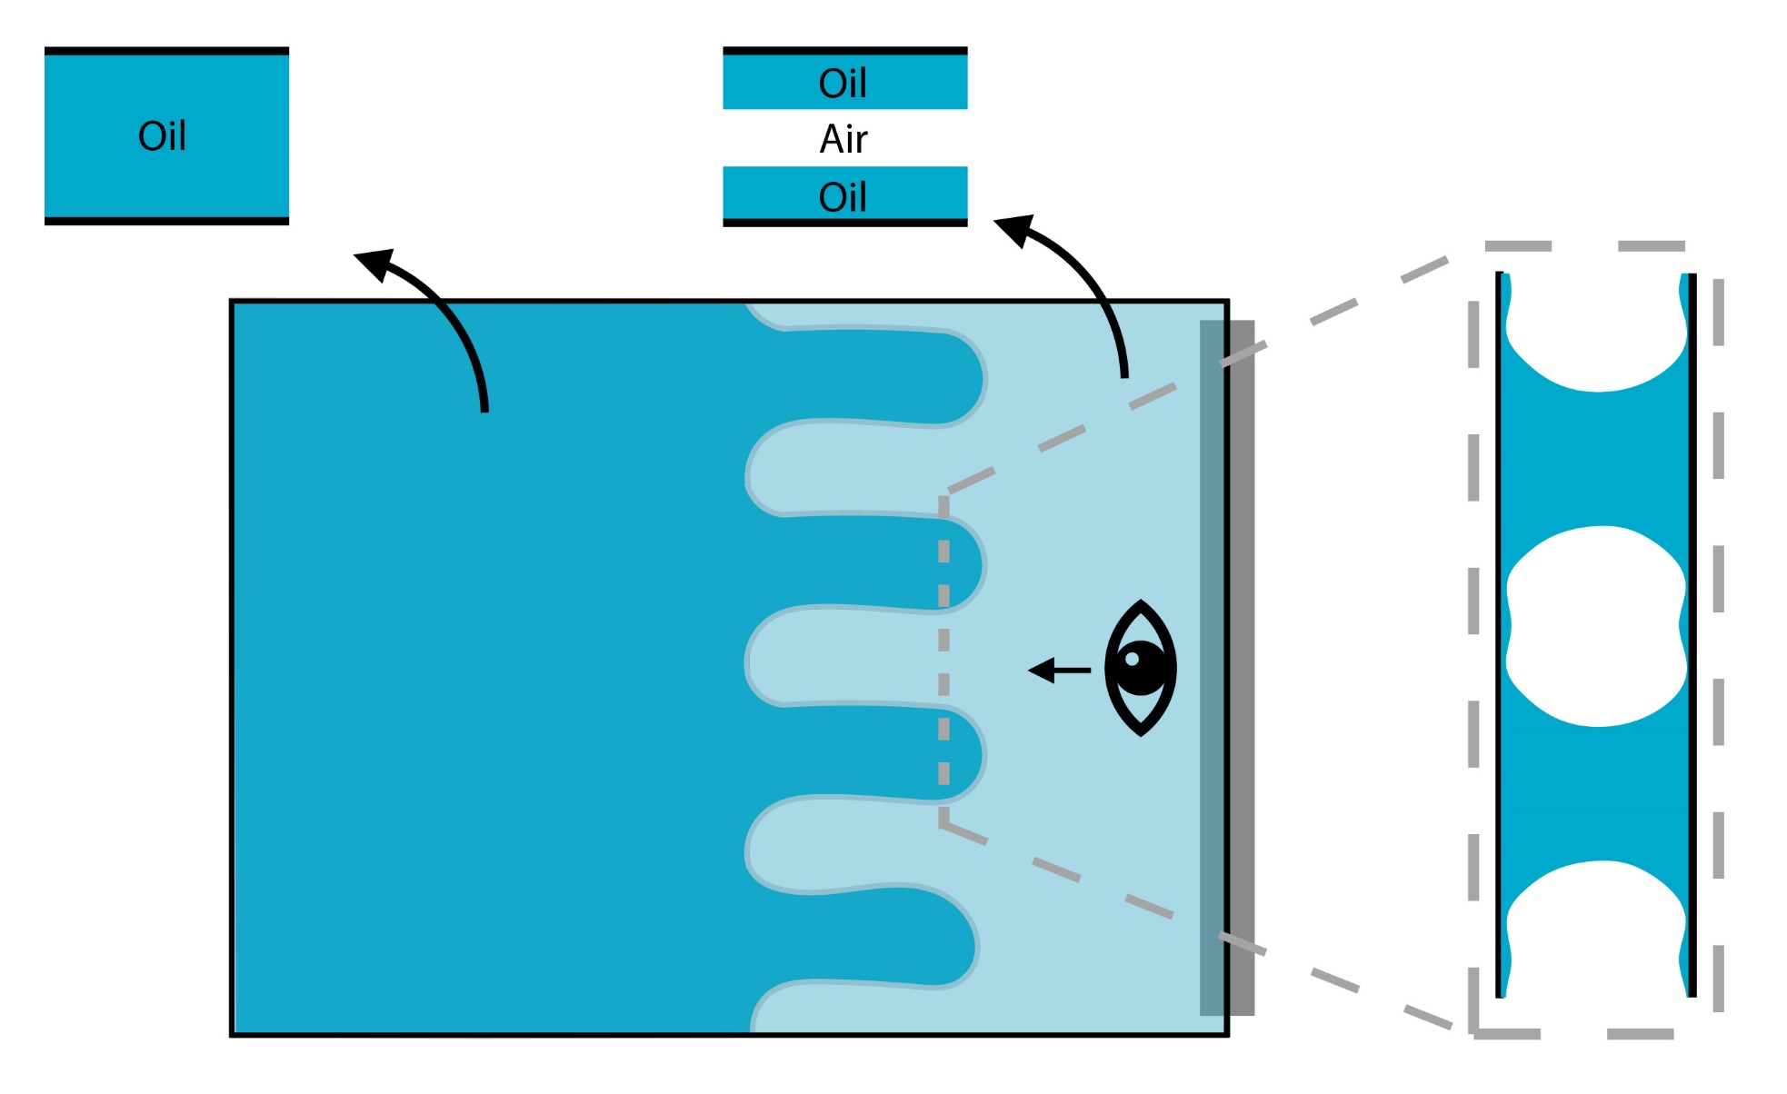
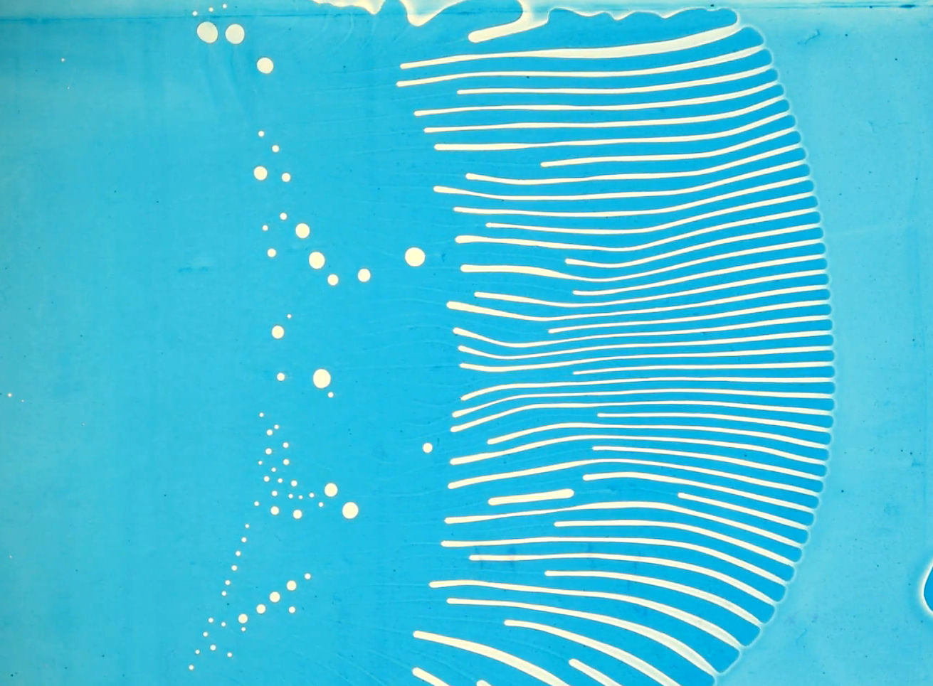
Physical mechanism: fingers feed in the film from the sides

Slide 16
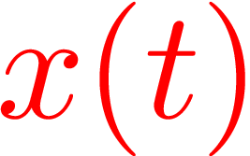
Front dynamics

Slide 17
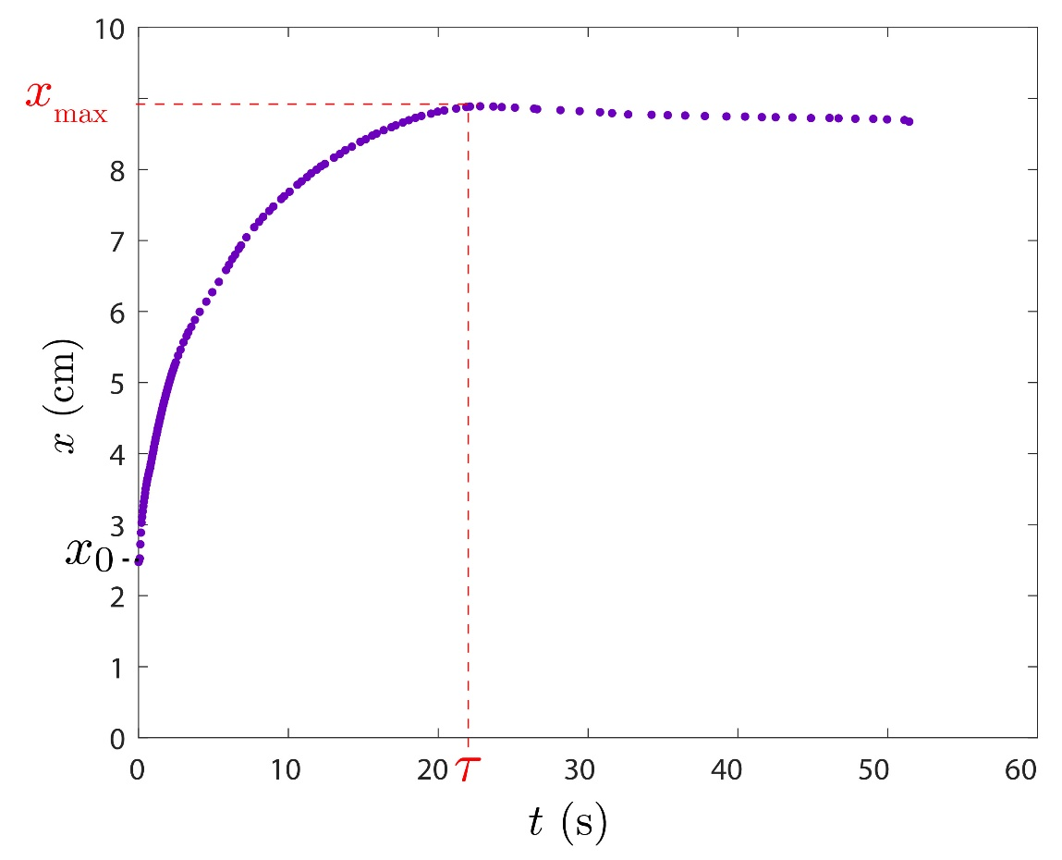
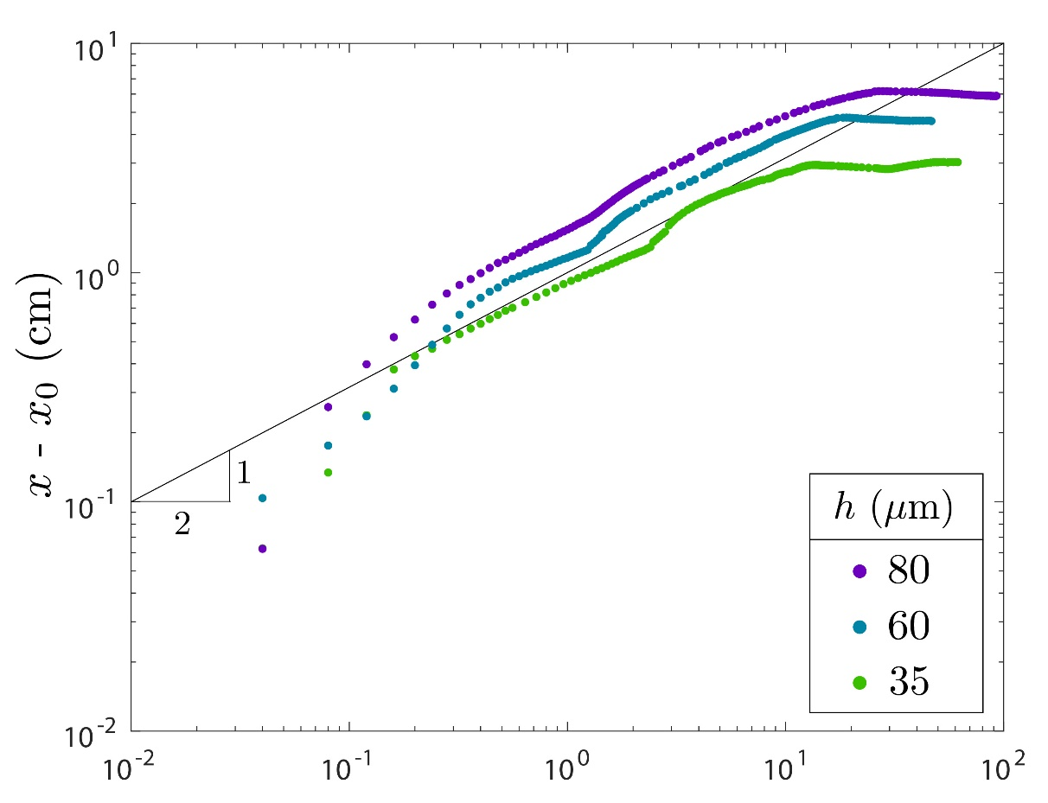
t (s)

Slide 18
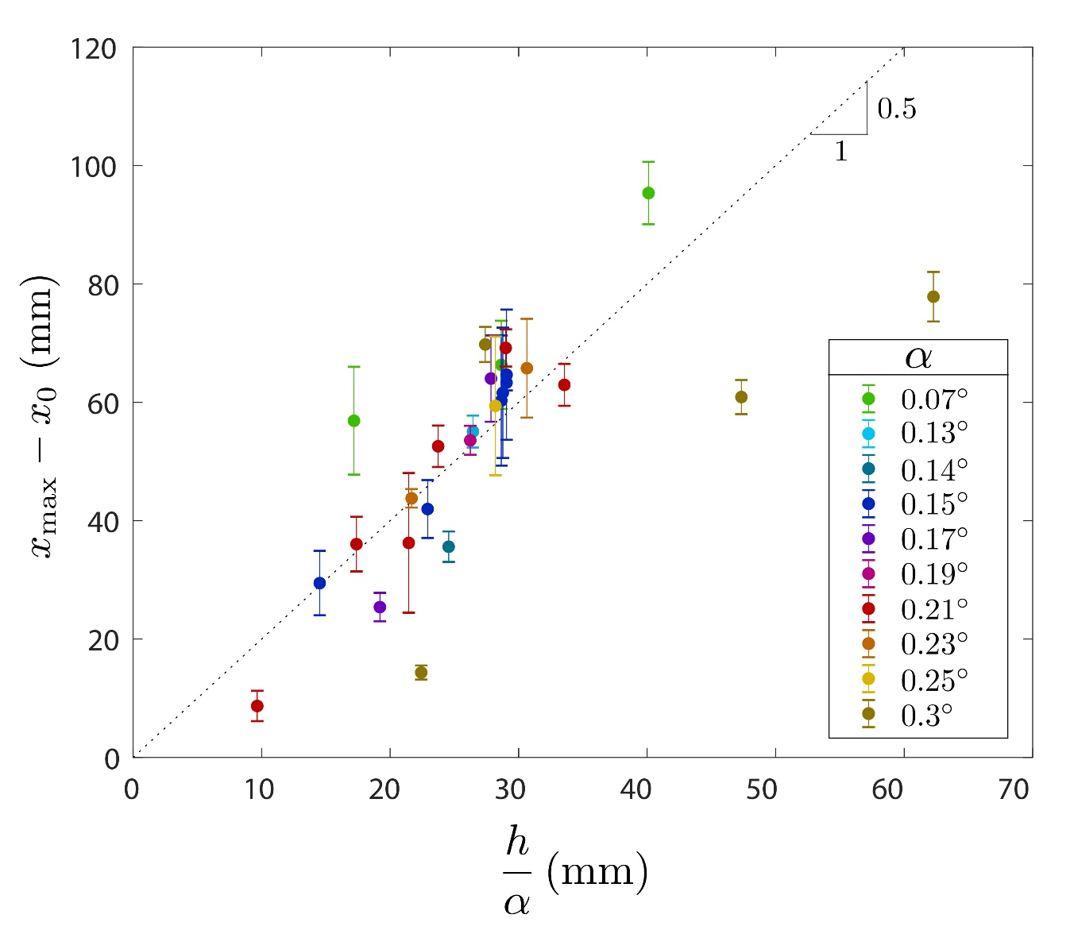




2

Slide 19
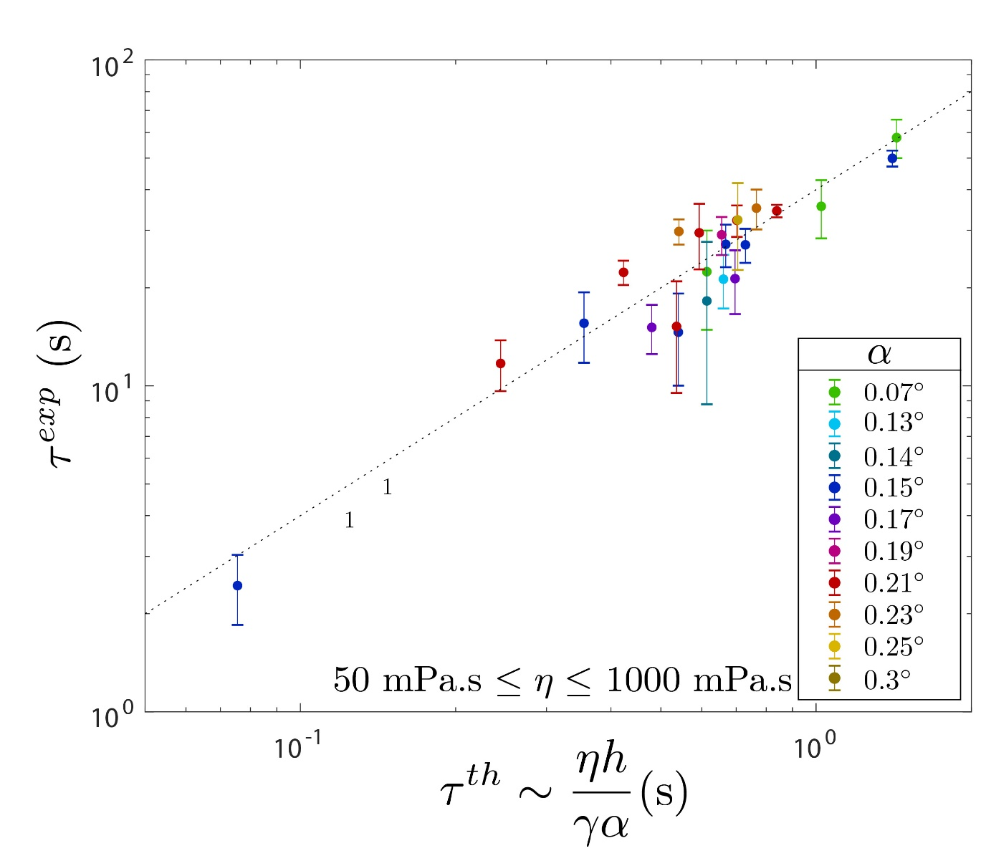
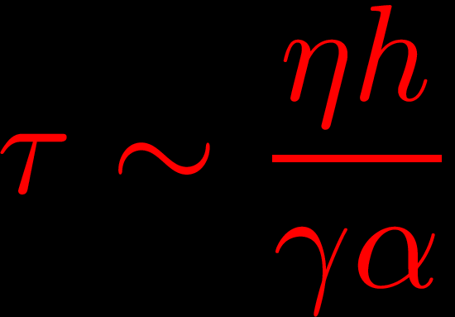

Slide 20
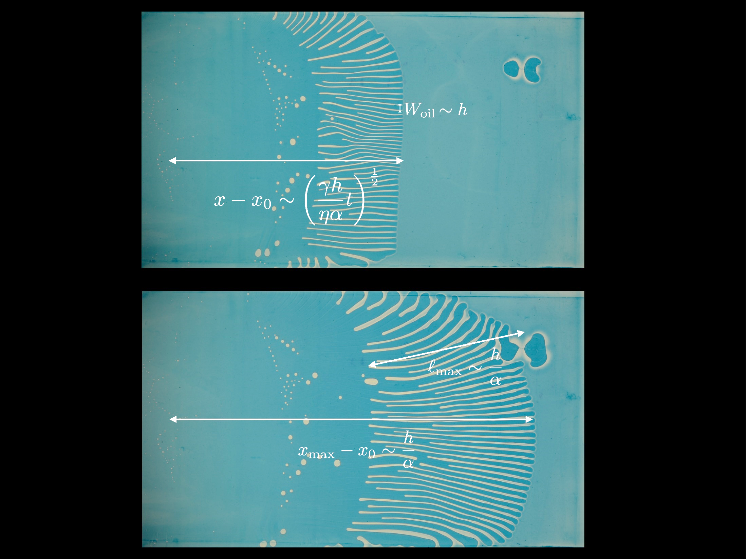


L’Estimé et al.,
J. Fluid Mech. (2022)

Slide 21
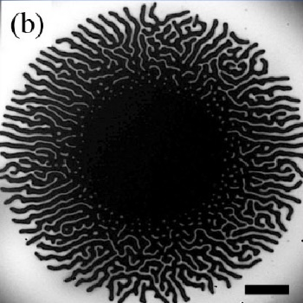
Vilmin, Langmuir, 2010
Chaudhury, EPJE, 2015
Davis-Purcell, EPJE, 2018

Slide 22
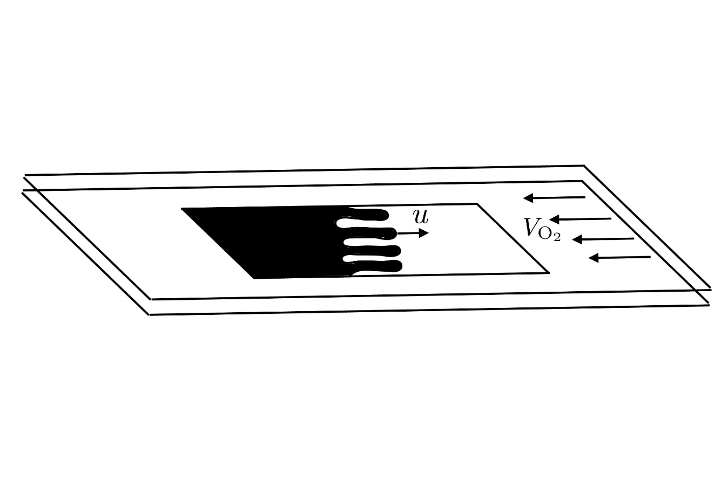
Zik, Phys. Rev. E, 1999

Slide 23
What is next?

Slide 24
What is next?

Slide 25
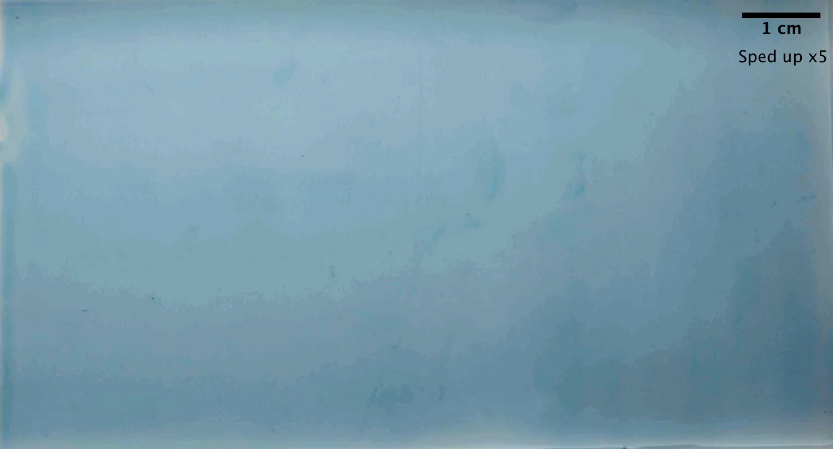
Maud Dobler

Slide 26
What is next?

Slide 27
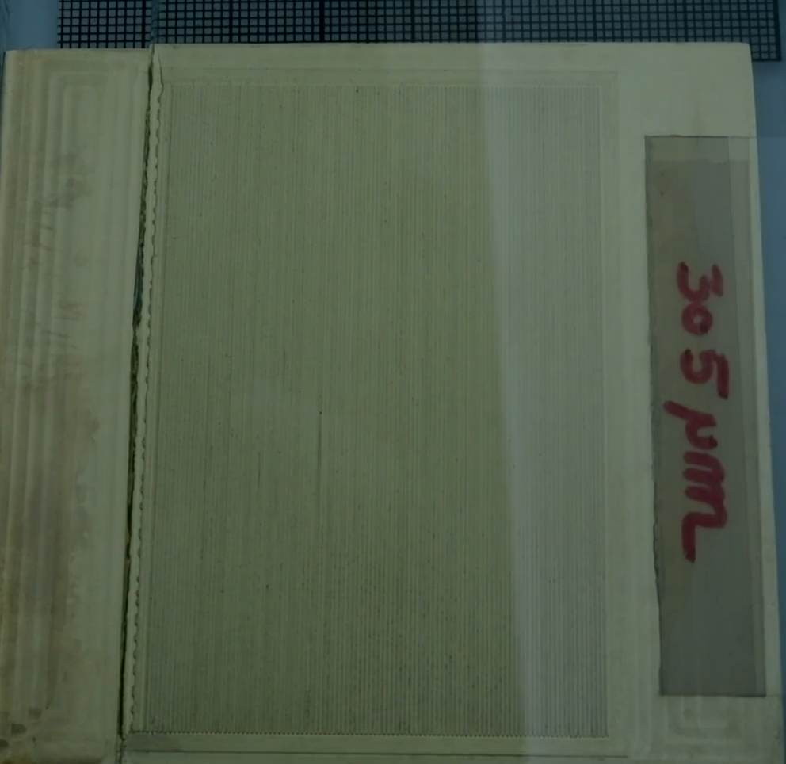
Maud Dobler

Slide 28
Thank you!
[etienne.reyssat@espci.fr]

Slide 33
Oil fingers

Slide 34
