Slide 1
Auto-organization and doping of
ultra-thin films of conducting polymers
Presented by : Hugo Fernandez
Supervised by : Pr. Sophie Cantin, Dr. Alae El Haitami, Dr. Philippe Fontaine

Slide 2
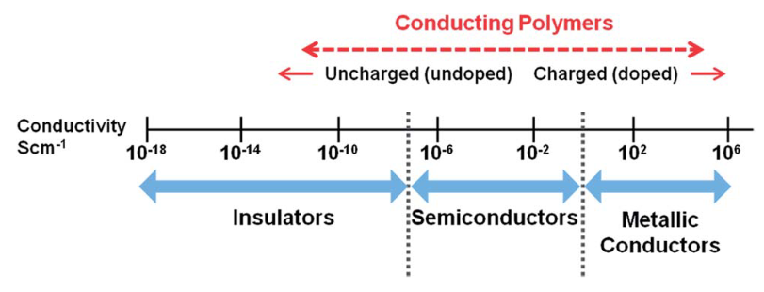
Context
P3HT
Poly(3-hexylthiophene)
Conjugated and conductive polymer :
σ can reach 10³ S/cm after doping¹
Applications :
Field effect transistor²
Photovoltaic cell³
Ref. figure: G. Kaur et al., RSC Adv., 5(47), 37553-37567 (2015)
Properties
Structure
Elaboration technique
Objective :
Elaboration of ultra-thin and organized films
with the Langmuir film technique
ð Link between structure and conductive properties
Ref. :
1. Y. Zhong et al., Adv. Funct. Mater., 32(30), 2202075 (2022)
2. L. Wu et al., ACS Appl. Electron. Mater., 3(3), 1252−1259 (2021)
3. S. Oh et al., ACS Appl. Mater. Interfaces, 9(14), 12865–12871 (2017)

Slide 3
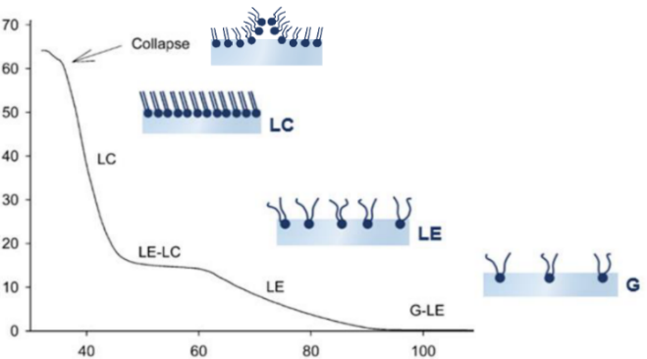
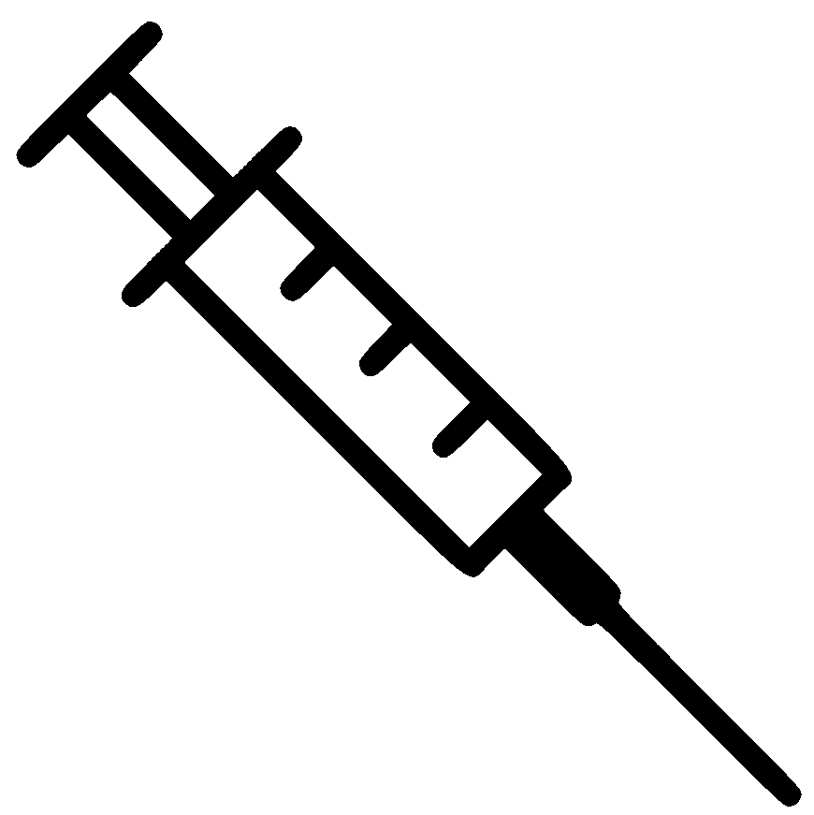
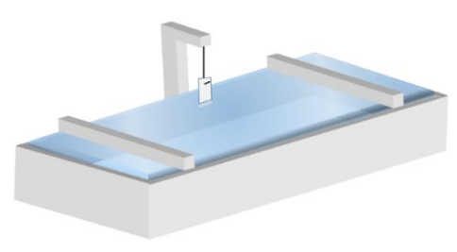
Langmuir film technique principle
Elaboration of film at the air-water interface
π = γ₀ - γ
Compression isotherm
γ₀ = Surface tension of pure water
γ = Surface tension of water with film
Film compression
Force sensor
ð Measurement of surface pressure (π)
Surface pressure (mN/m)
Mean molecular area (Å²)
Thermostat
ð Temperature control
ð Film thermodynamic characterization
ð Detection of phase transitions
Mobile barriers
ð Area control

Slide 4
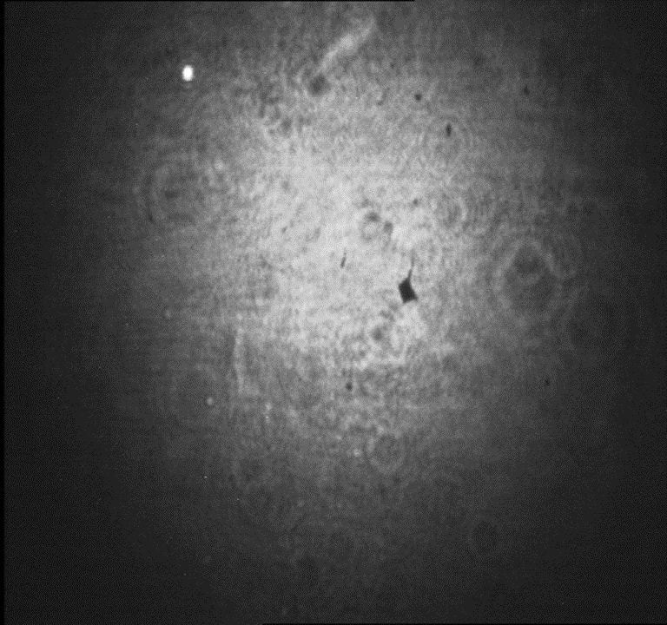
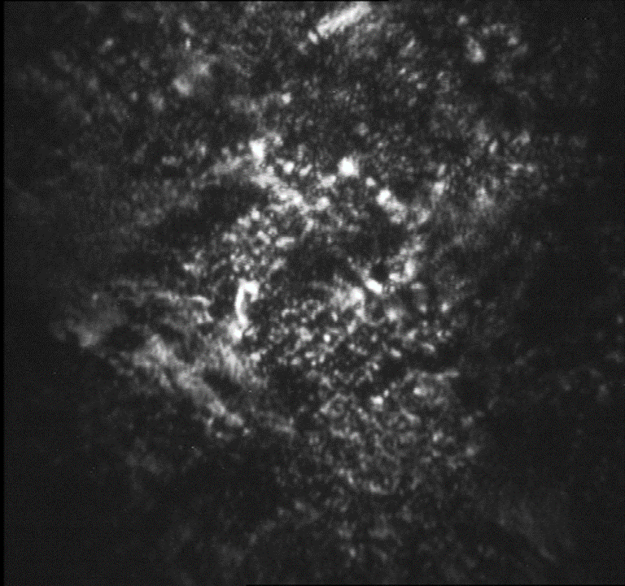
Thermodynamic and morphology of P3HT film at the air-water interface
4 / 15
Compression isotherm at 20°C
Brewster angle microscopy (BAM)
ð Morphology at the air-water interface
ð Image size : 600 x 600 µm²
P3HT
Homogeneous surface
With analyzer :
Optical anisotropy
ð In-plane organization
ð No phase transition detected at non-zero surface pressure.
Notes:
Echelle mésoscopique, je révèle une anisotropie optique qui se traduit par la présence de petits domaines, de petites cristallites montre une organisation dans le plan.

Slide 5
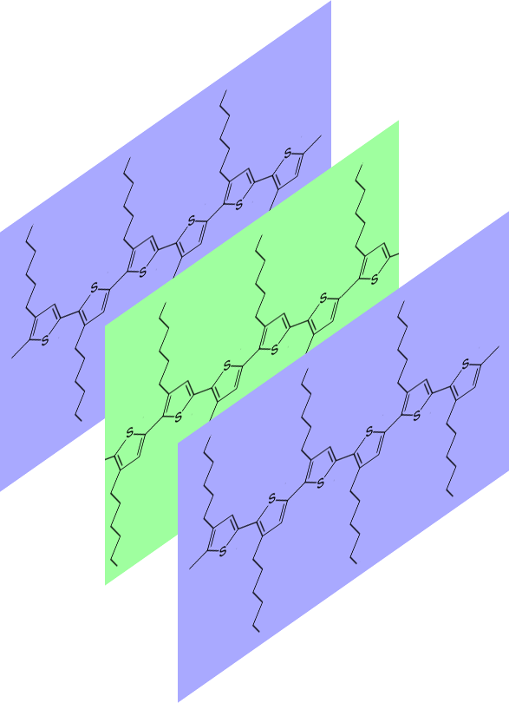
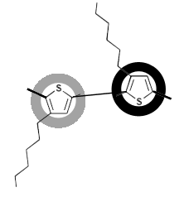
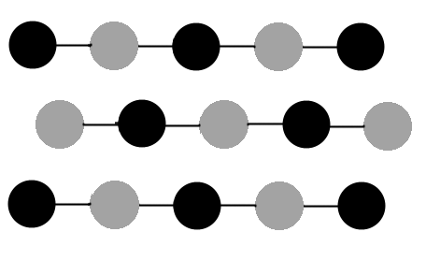
In-plane structure of P3HT film at the air-water interface
5 / 15
Grazing Incidence X-ray Diffraction (GIXD)
P3HT at 5mN/m
Ref. : N. Persson et al., Acc. Chem. Res., 50(4), 932-942 (2017)
Characteristic length between thiophenes planes (π-π interactions inter-chains)^{ref.}
(0 2)
(2 0)
$$\frac{2π}{q_{xy}}=3.84 Å$$
(1 1)
(1 2)
(2 1)
3.84Å
$$\frac{a}{2}$$
(1 3)
(3 1)
$$\frac{b}{2}$$
b = 7.68Å
Thin peaks (FWHM = 0.05Å⁻¹) and good signal-to-noise ratio
ð Long range positional order
Diffraction rods ð 2D Structure
(Rings ð 3D Structure)
a = 7.78Å
Existence of (1 2) – (2 1) peak ð Non-centered lattice
Notes:
Selon la littérature, il s’agit de la distance caractéristiques entre les plans thiophènes successifs. Elle est associée aux interactions π-π inter-chaines.

Slide 6
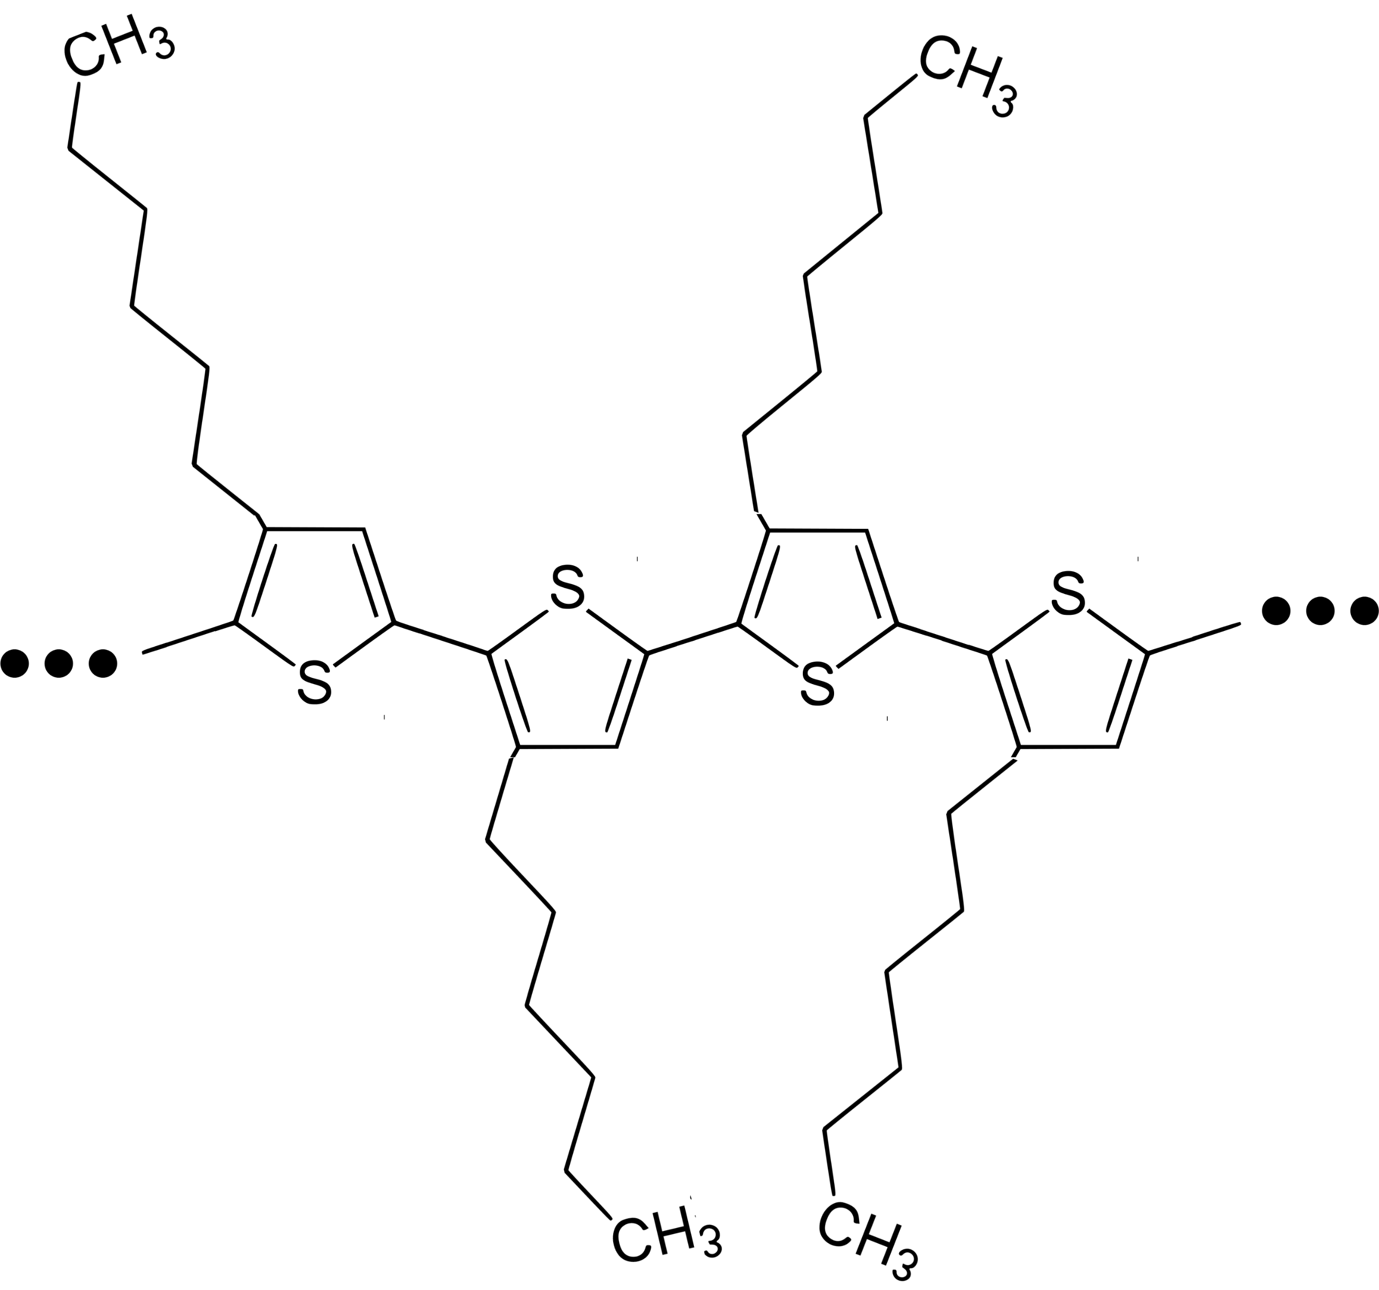
Vertical structure of P3HT film at the air-water interface
6 / 15
Air
σ = 7.0Å
X-ray reflectivity (XRR)
Fitting software : REFLEX, https://reflex.irdl.fr/Reflex/
7.6Å
PETRA III, P08
σ = 2.4Å
P3HT at 5mN/m
4.7Å
σ = 2.1Å
11.8Å
σ = 2.2Å
4.7Å
σ = 2.6Å
6.8Å
ð Bilayer with edge-on orientation
σ = 1.0Å
Total thickness = 36Å
Water
Notes:
A partir de la courbe de réflectivité, on tire le profil de densité électronique en fonction de la profondeur. Celle-ci est associée au modèle suivant.

Slide 7
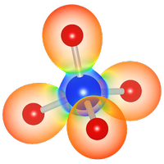
More thorough structure determination
7 / 15
Avogadro https://avogadro.cc/
ð Drawing of the repetition unit
VESTA JP-minerals http://www.jp-minerals.org/vesta/en/
Originally designed to simulate 3D powder diffraction pattern from known lattice
Using a very high c parameter (= 500 Å) ð Simulation of « 2D powder » diffraction
$$qz=\frac{2πl}{c}$$
Vertical section of map ð Diffraction rods (Intensity vs q_{z} with q_{xy} fixed)
(0 2)
(2 0)
(0 2)
(2 0)
(1 1)
(1 1)

Slide 8
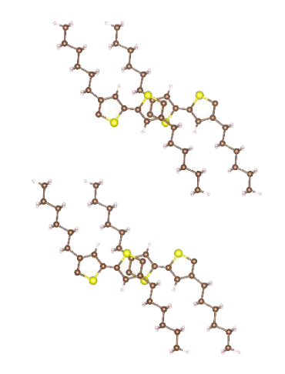
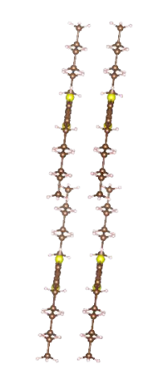
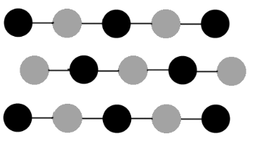
More thorough structure determination at the air-water interface
8 / 15
θ
b = 7.68Å
a = 7.78Å
d
d
Δa
b’
$$\frac{b}{2}$$
a’
$$\frac{a}{2}$$
$$\frac{a}{2}$$
- d = 15Å : vertical distance between thiophene
- θ =13° : tilt along the direction b (rotation axis a)
- a’ = 2Å et b’ = 1Å : translation of the top layer relative to the bottom layer
- Δa = 1Å: translation of conjugated chain along the a direction

Slide 9
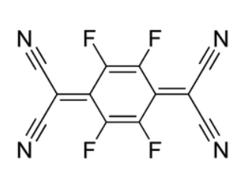
In situ film doping
9 / 15
F₄TCNQ
2,3,5,6-tetrafluoro-7,7,8,8-tetracyanoquinodimethane
Doping
Neutral P3HT
Doped P3HT
P3HT
F₄TCNQ
P3HT + F₄TCNQ
Preparation of mixtures with different proportions
P3HT + F₄TCNQ
Structure determination at the air-water interface

Slide 10
In-plane structure of P3HT+F₄TCNQ films at the air-water interface
10 / 15
Grazing Incidence X-ray Diffraction (GIXD)
P3HT+F₄TCNQ at 5mN/m
b = 7.68Å
(0 2)
(2 0)
(1 1)
a = 7.78Å
(1 2)
(2 1)
Slight lattice contraction
ð F₄TCNQ does not intercalate into the plane
Peak intensity diminution
Also observed in thicker film of 200nm thickness (spin-coating)
Ref. : D. T. Scholes et al., Adv. Funct. Mater., 27(44), 1702654 (2017)

Slide 11
Vertical structure of P3HT+F₄TCNQ films at the air-water interface
11 / 15
X-ray reflectivity (XRR)
Fitting software : REFLEX, https://reflex.irdl.fr/Reflex/
PETRA III, P08
Air
P3HT+F₄TCNQ at 5mN/m
Slight shift of 1st minimum towards smaller q_{z}
ð Film slightly thicker (+2Å)
Water
ð Insertion of F₄TCNQ between the two layers
Also observed in spin-coated films. Ref. : D. T. Scholes et al., Adv. Funct. Mater., 27(44), 1702654 (2017)
Notes:
Cet épaississement pourrait indiquer l’intercalation du F4TCNQ au milieu de la bicouche.

Slide 12
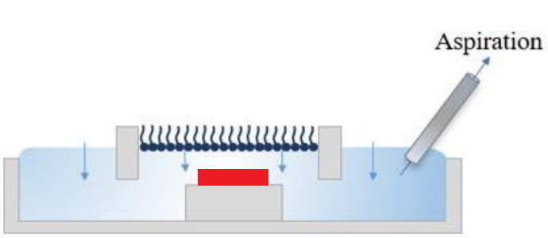
Electronic conductivity determination
12 / 15
● In situ doping, directly at the air-water interface
● Ex situ doping, after the film transfer
P3HT + F₄TCNQ
P3HT
Inverted Langmuir-Schaeffer technique
at 5 mN/m
Inverted Langmuir-Schaeffer technique
at 5 mN/m
Ex situ doping
Dipping 15min in F₄TCNQ solution
0,1g/L or 0,36mM
(solvent : acetonitrile)
R_{o} measurement and electronic conductivity determination

Slide 13
Electronic conductivity determination
13 / 15
P3HT+F₄TCNQ at 5mN/m
Effect of F₄TCNQ amount
In situ doping
in situ vs ex situ doping
Optimum F₄TCNQ amount ð F₄TCNQ34%_{mol}
ð Tunable electronic conductivity
ð Electronic conductivity of the same order of magnitude

Slide 14
Conclusions
14 / 15
● P3HT film organized at the air-water interface
ð Bilayer with edge-on orientation, rectangular non-centered lattice
● In situ doping with F₄TCNQ
ð Slight lattice contraction contraction
ð Film slightly thicker
ð Insertion of F₄TCNQ between the two layers
● Control of F₄TCNQ amount in P3HT film
ð Tunable electronic conductivity
ð Electronic conductivity of the same order of magnitude between in situ and ex situ doping
● Perspectives : Study the P3HT film structure after ex situ doping with F₄TCNQ

Slide 15
Thanks for your attention
Presented by : Hugo Fernandez
Supervised by : Pr. Sophie Cantin, Dr. Alae El Haitami, Dr. Philippe Fontaine

Slide 16
Protocol : electronic conductivity determination
bonus / 15
o : 5 x 5 mm²
ð Application of voltage U, measurement of I
ð Ohm’s law : calculation of R_{o}
Calculation of electronic conductivity (S/cm)
$$= \frac{U}{I}$$
$$\frac{1}{\text{film} \text{thickness}\text{ . }\text{R}\text{o}}$$
Copper electrodes

