Slide 1
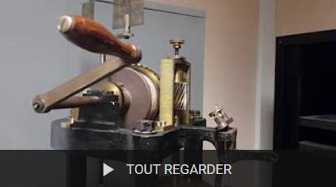
Travaux pratiques d’augmentation d’instruments anciens de physique
Alfonso SAN MIGUEL
Institut Lumière Matière, Université Claude Bernard Lyon 1 & CNRS
Françoise KHANTINE-LANGLOIS
Laboratoire S2HEP, Université Claude Bernard Lyon 1

Slide 2
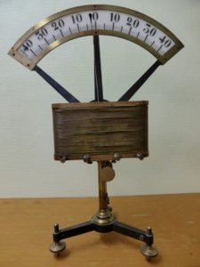
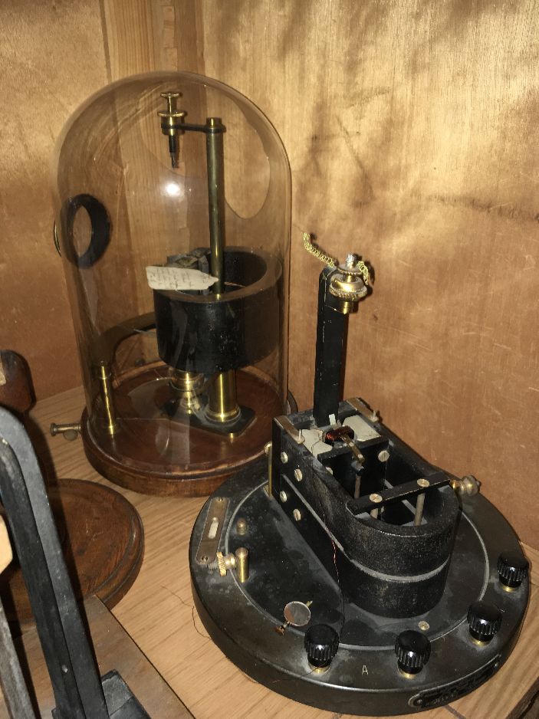
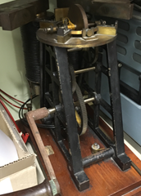
Context
Students from the 1st year of the Master of Physics
Volunteer practical work integrated on a Experimental Unit Course.
Student work on binomials
Maximum of 10 students each year
Working since 2019

Slide 3
Material
Collection of ancient physics instruments from the Claude Bernard Lyon 1 University heritage collection
A portable recording studio for video production
Several portable toolboxes
Lots of goodwill: colleagues, technicians, engineers, etc.
Additional support and resources provided by the Société Française de Physique (SFP), the Association for the preservation and study of scientific and technical instruments for teaching (ASEISTE) and the Society of Friends of André-Marie Ampère (SAAMA) which runs the Ampère Museum.

Slide 4
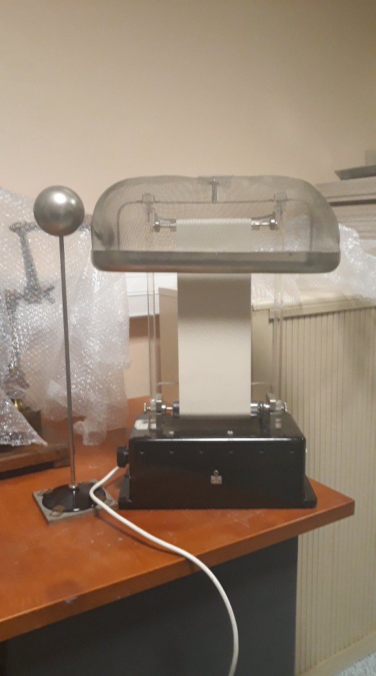
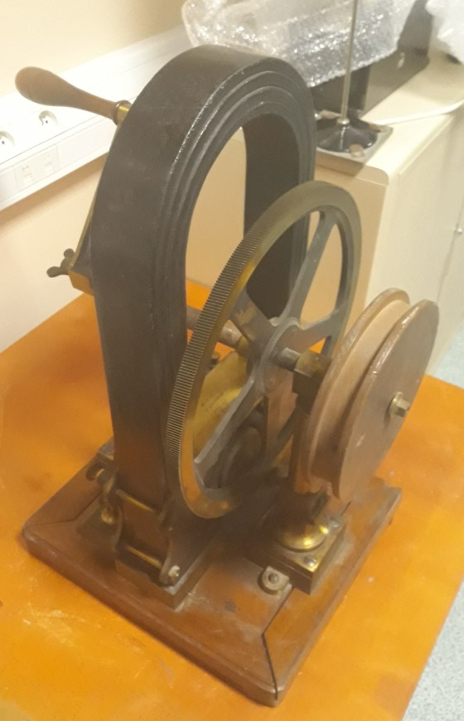
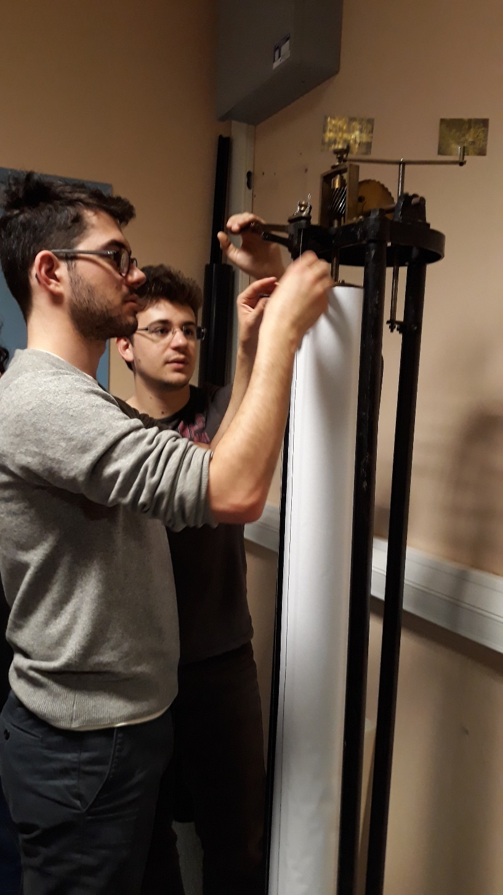

Slide 5
The project – Students point of view
Carry out any necessary restoration with the help of volunteer technicians and guidance from professors who are University Collection Curators.
Get the instruments working and measure their characteristics.
Research the history of the instrument and its underlying physical principles of operation.
Create resources associated to the videos (filming, editing), quizzes, slideshows.
Produce resources for the Instrument Collection: technical sheets (for the Artwork file), descriptions (for the Inventory), etc.
Present the resources through exhibitions, new showcases in the Department of Physics, in collaboration with French Physical Society, etc.

Slide 6
The project – Pedagogical approach
Immersive experience allowing to position oneself in a research-type project.
Show interest in the history of science and technology.
Learn to consult new types of resources: archives, old books, direct contact with historical actors such as builders, families, and other relevant individuals from the past, ...
Development of skills in scientific communication.
Work in networks: associations, museums, laboratory staff, ..

Slide 8
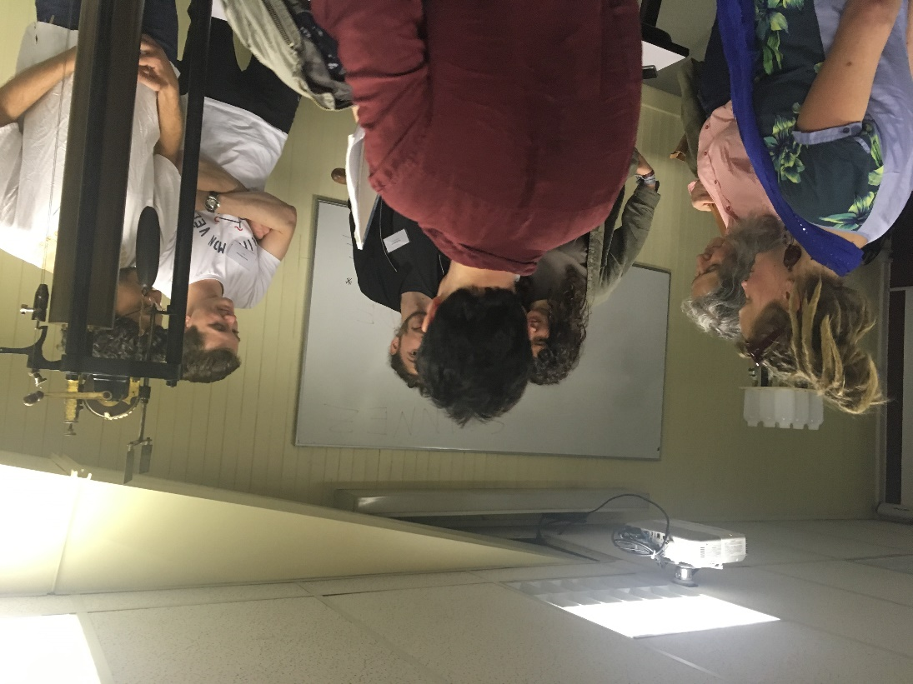
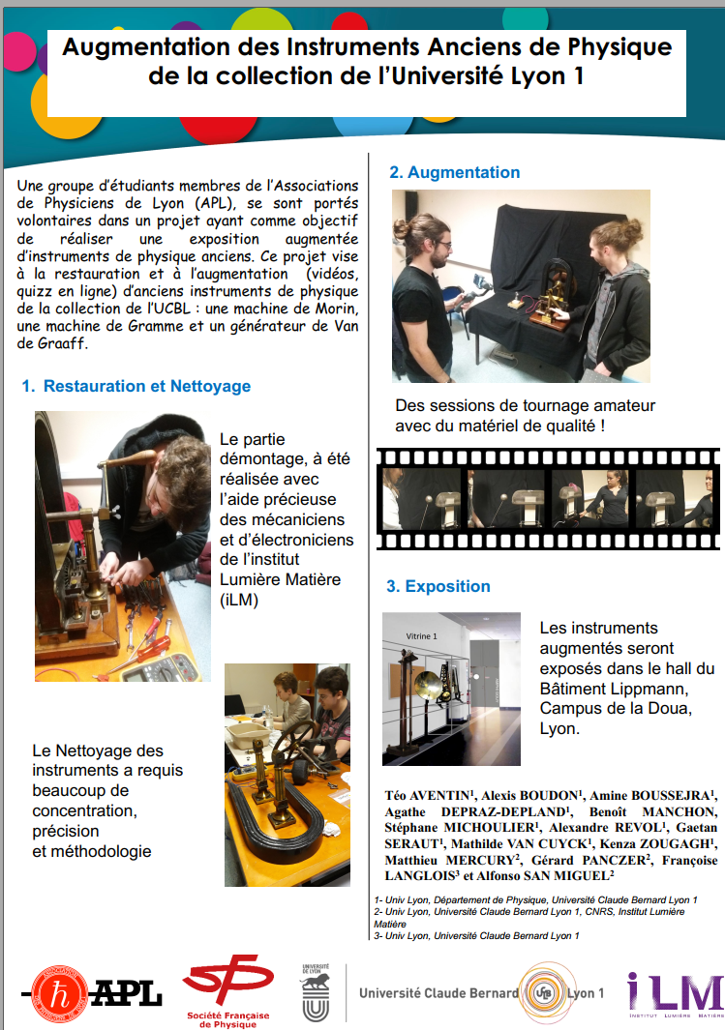
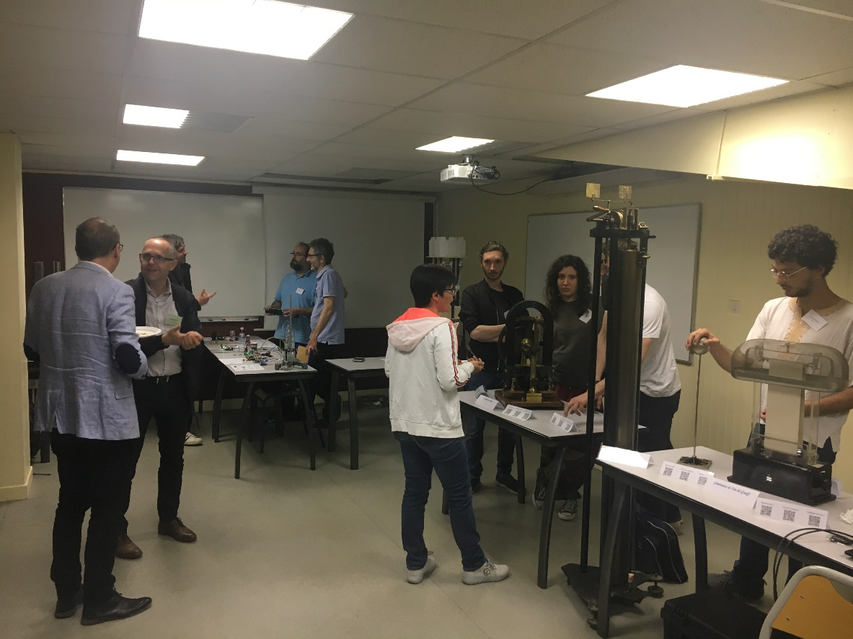
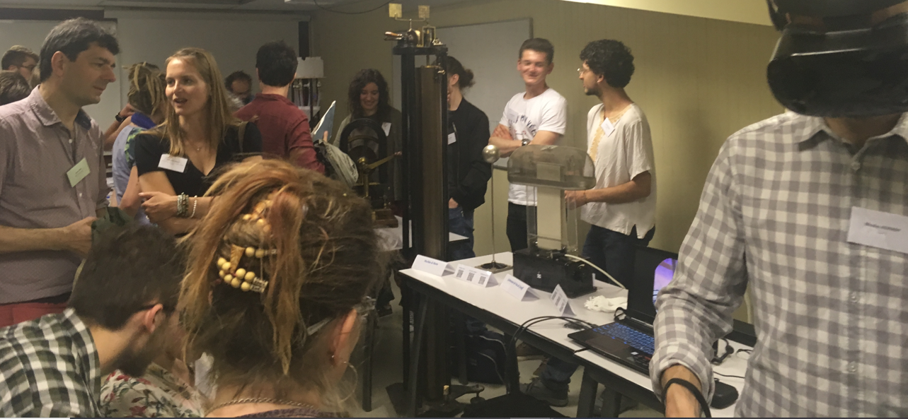
Presentation of a booth and a poster at the "Pedagogical Evolutions Symposium 2019.

Slide 9
Exemples d’appareils augmentés par les étudiants
Refractomètre de Fery
Galvanomètre de Bourbouze
Machine de Morin

Slide 10
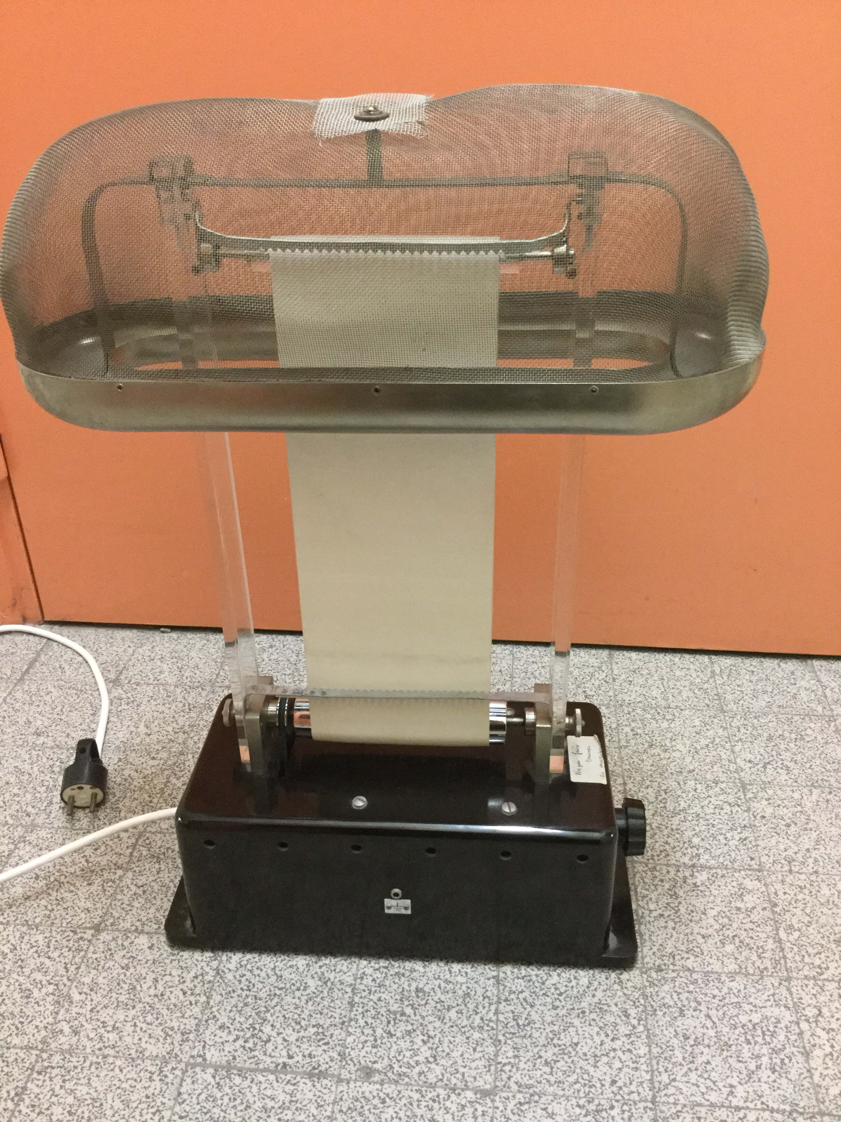
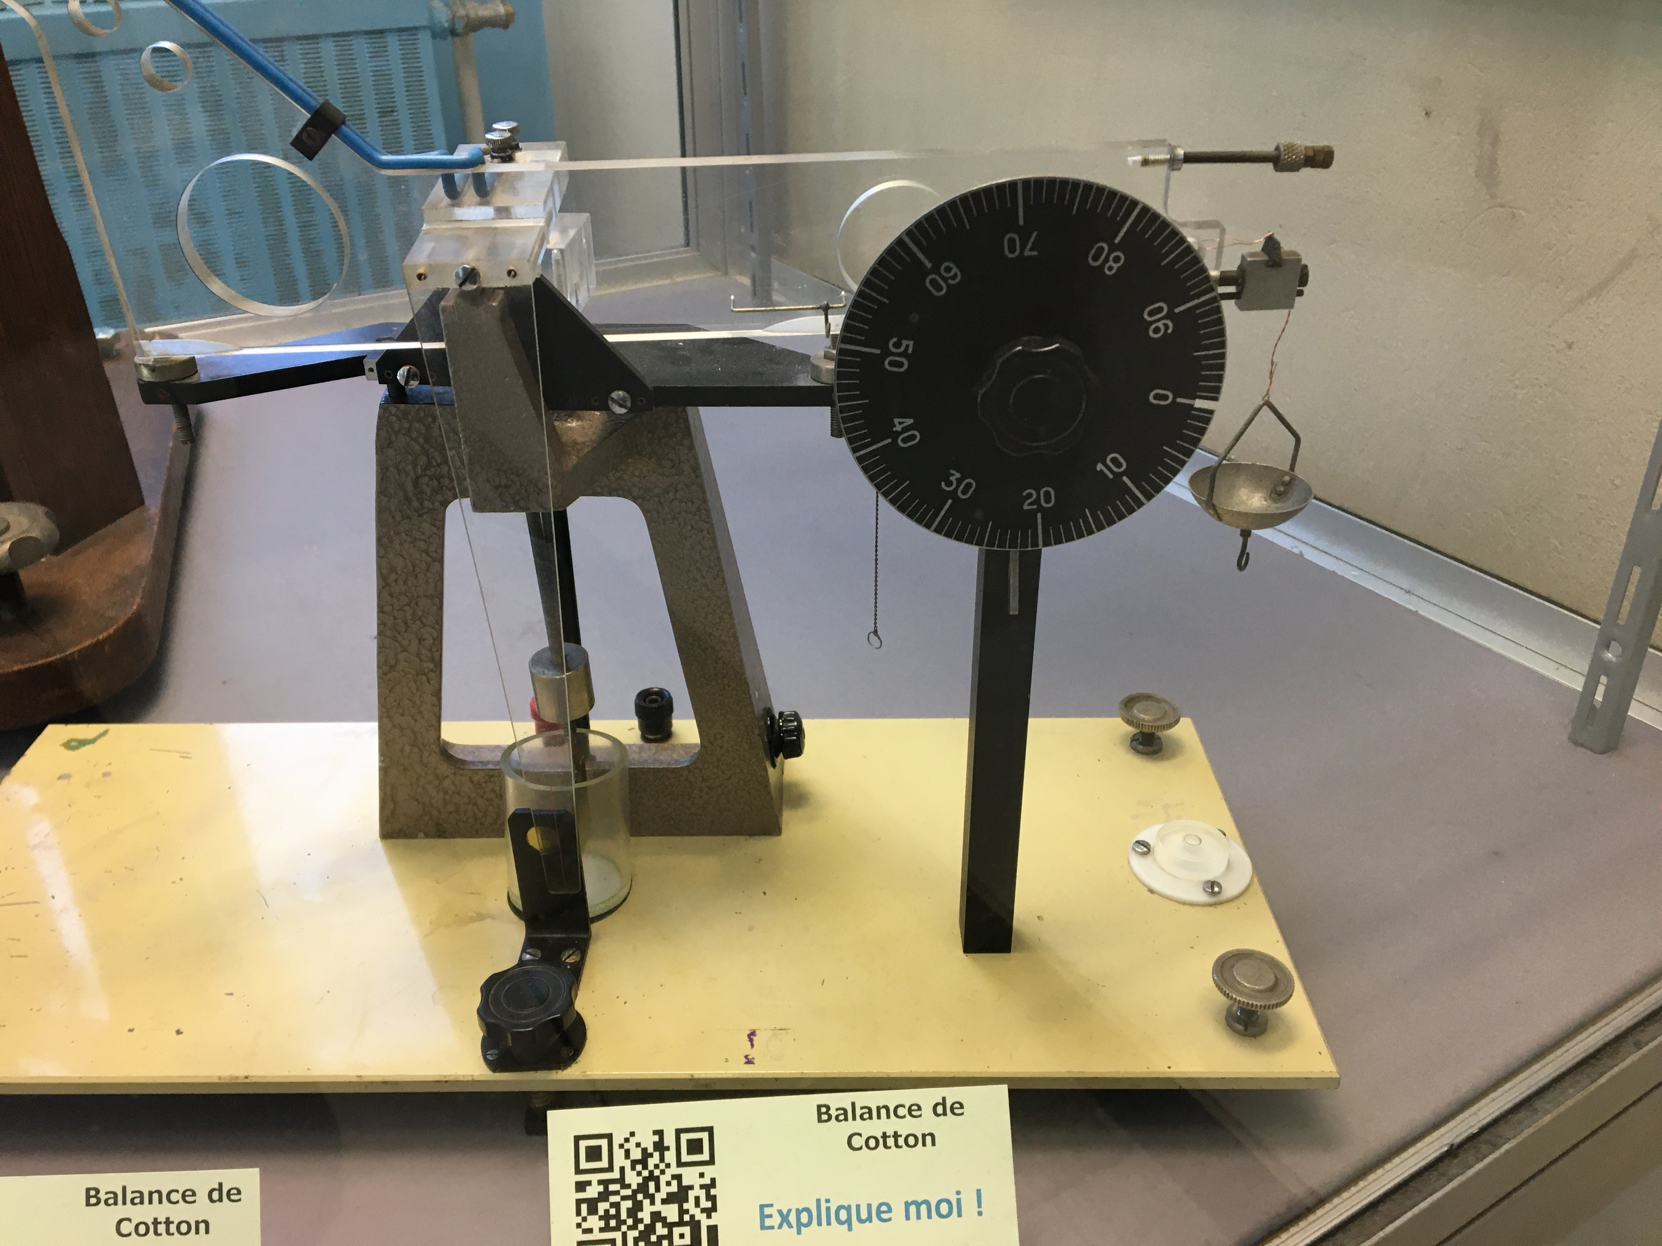
Exemples d’appareils augmentés par les étudiants
Diapasons pour figures de Lissajous
Générateur de Van de Graaff
Balance de Cotton

Slide 11
Some examples of produced videos

Slide 12
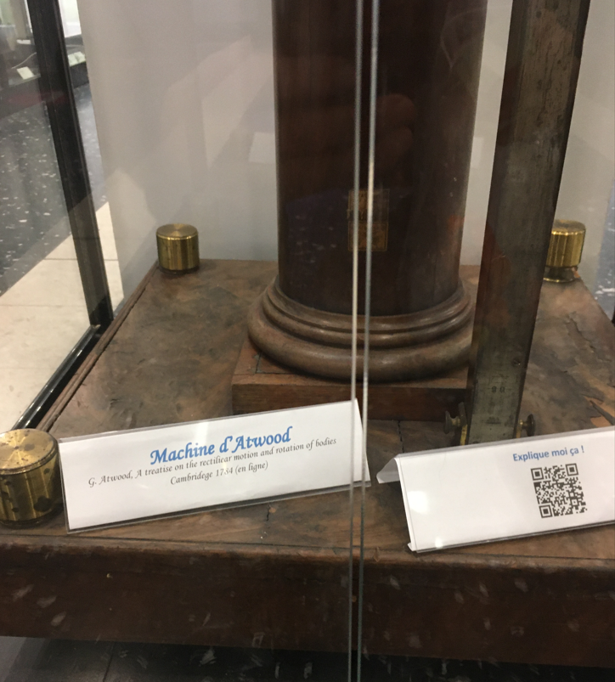
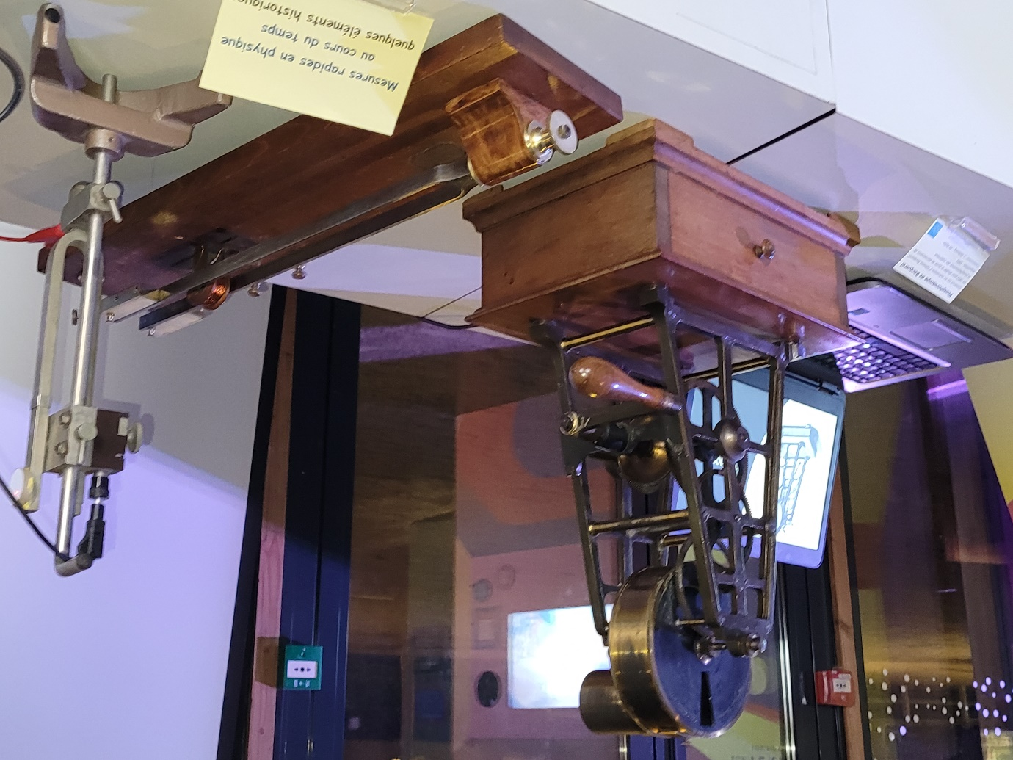
Other outputs
Videos are also available through QR codes in the permanent exhibition of ancient instrument of physics at the University (Lippmann building)
Some videos or experiments are proposed at the Ampère Museum (QR codes, interactive experiments)
Some students discover a new passion !
Promotion of science in different contexts
Augmented physical instruments at the « Nuit de Temps »
at the Planetarium de Lyon in 2022. Event organized by the SFP.

Slide 13
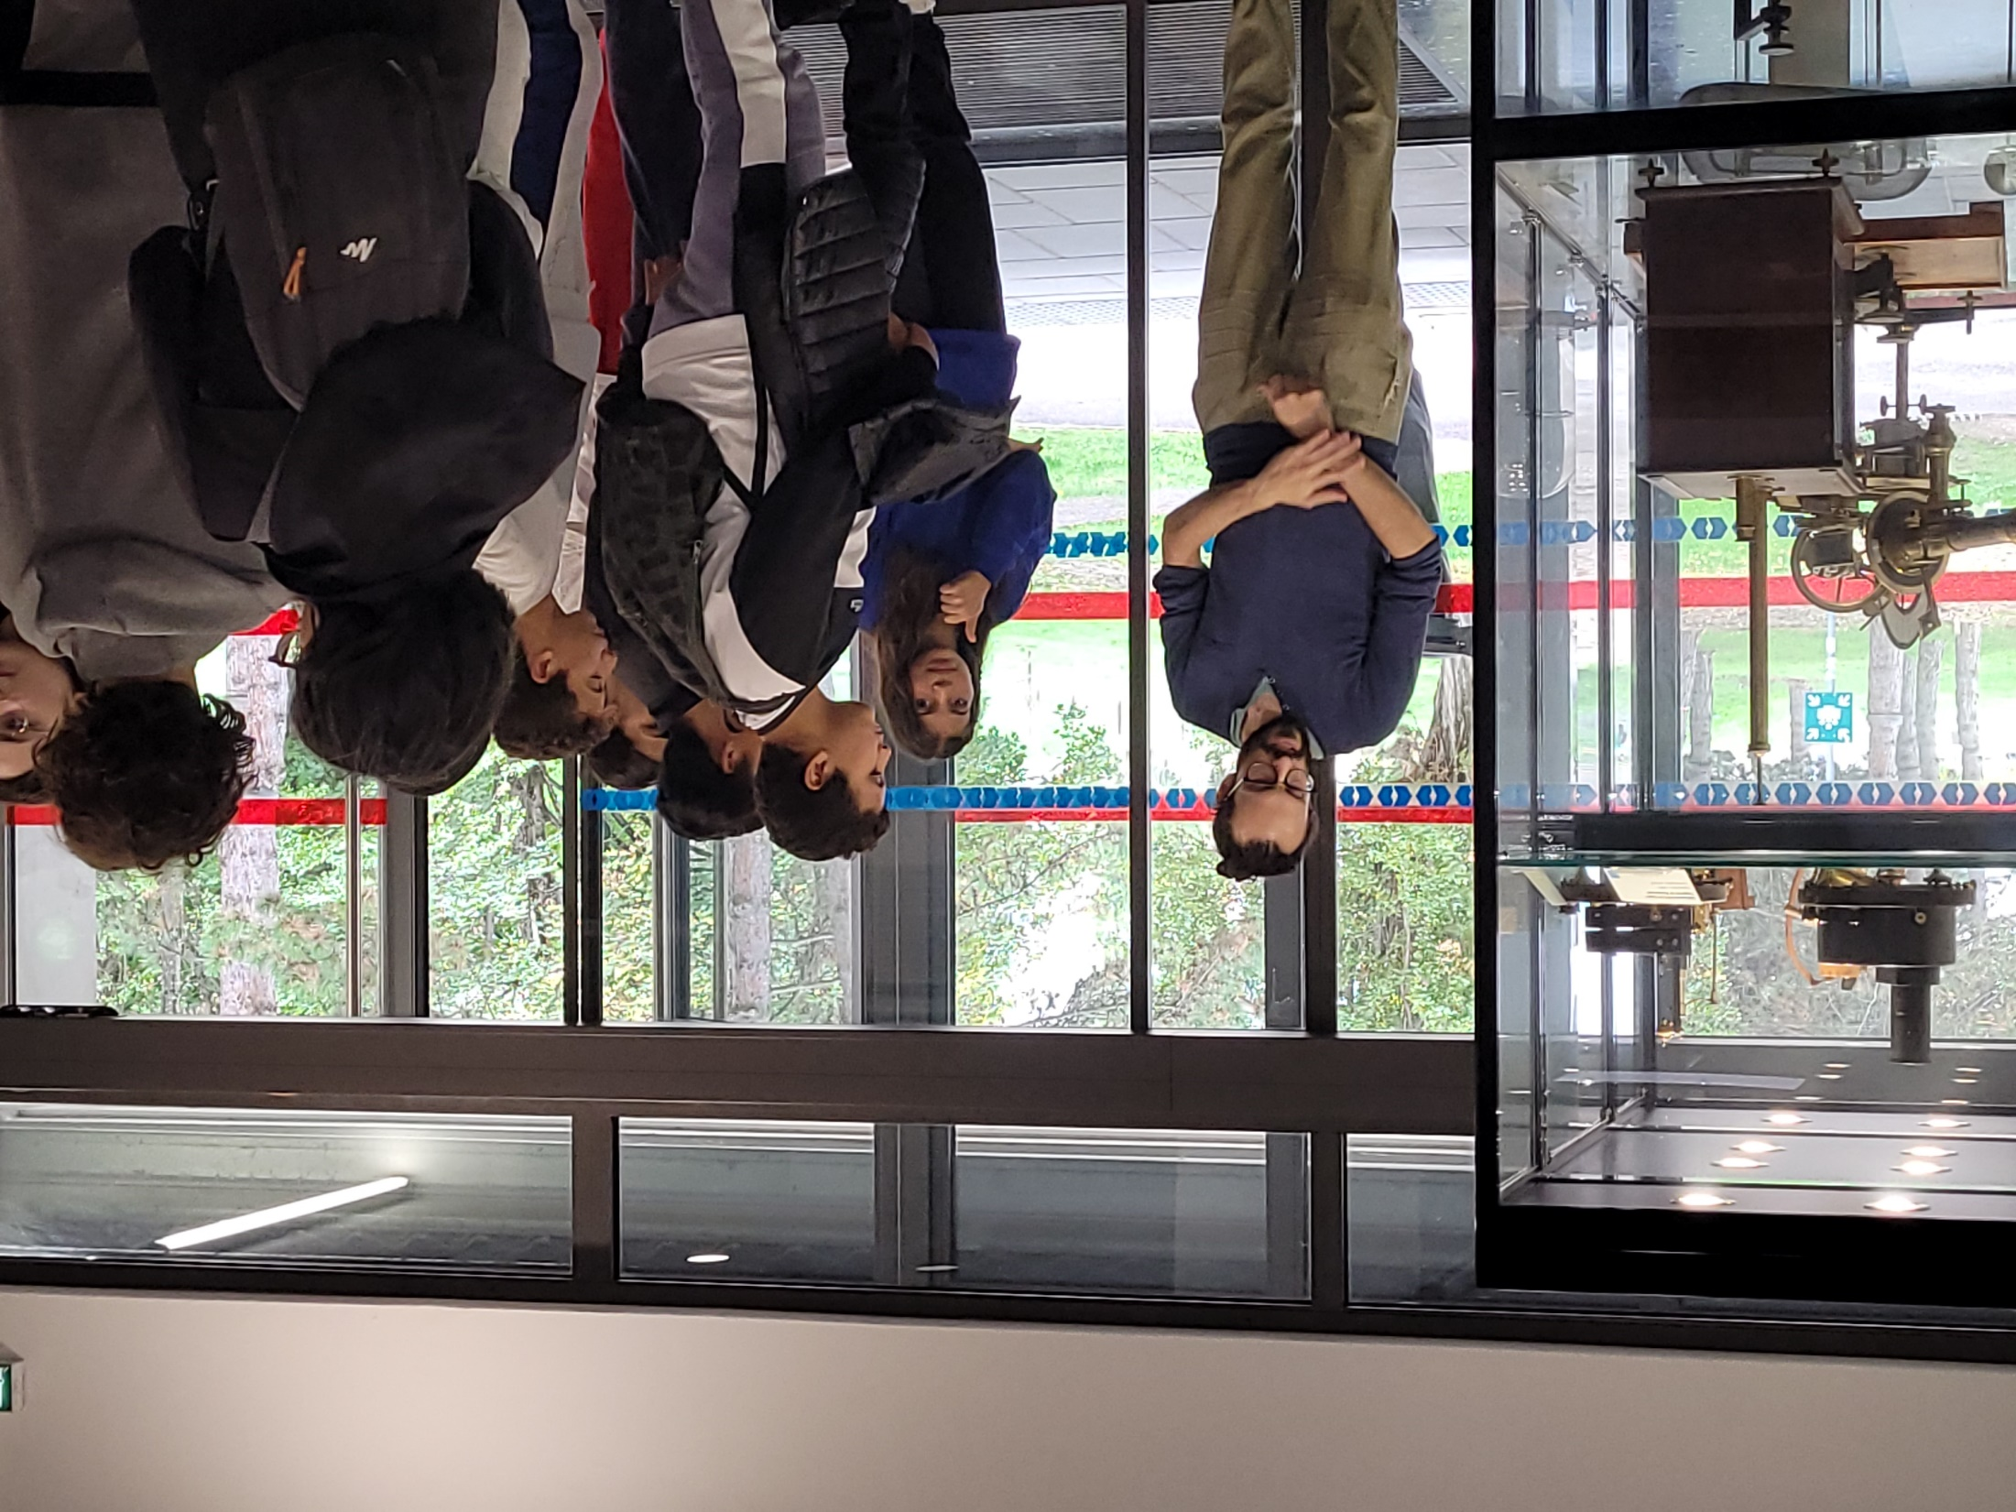
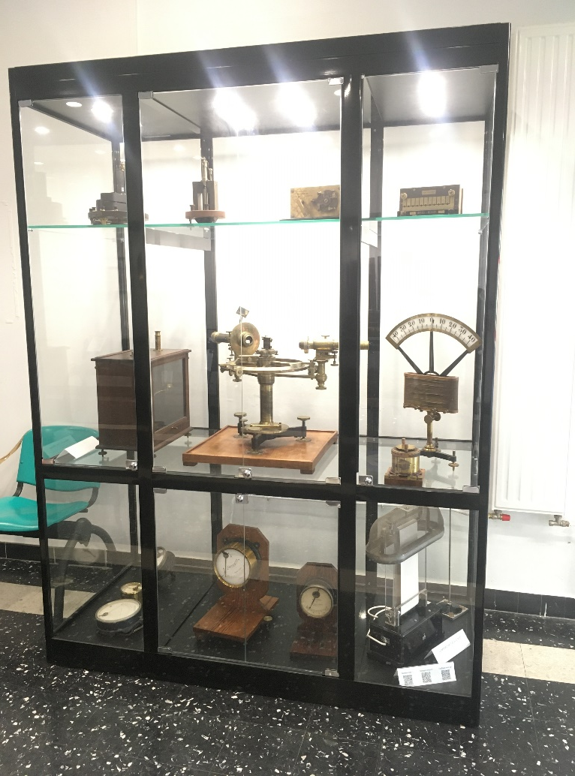
Permanent exhibition of ancient instrument of physics
at the University Lyon 1 - Lippmann building

Slide 14
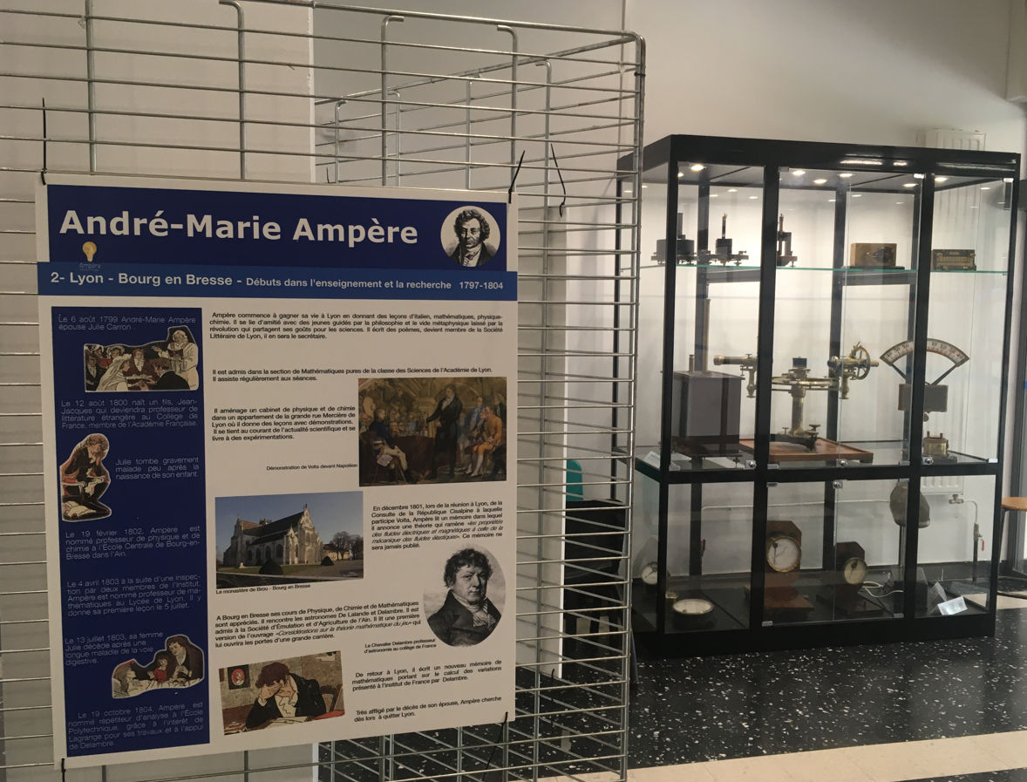
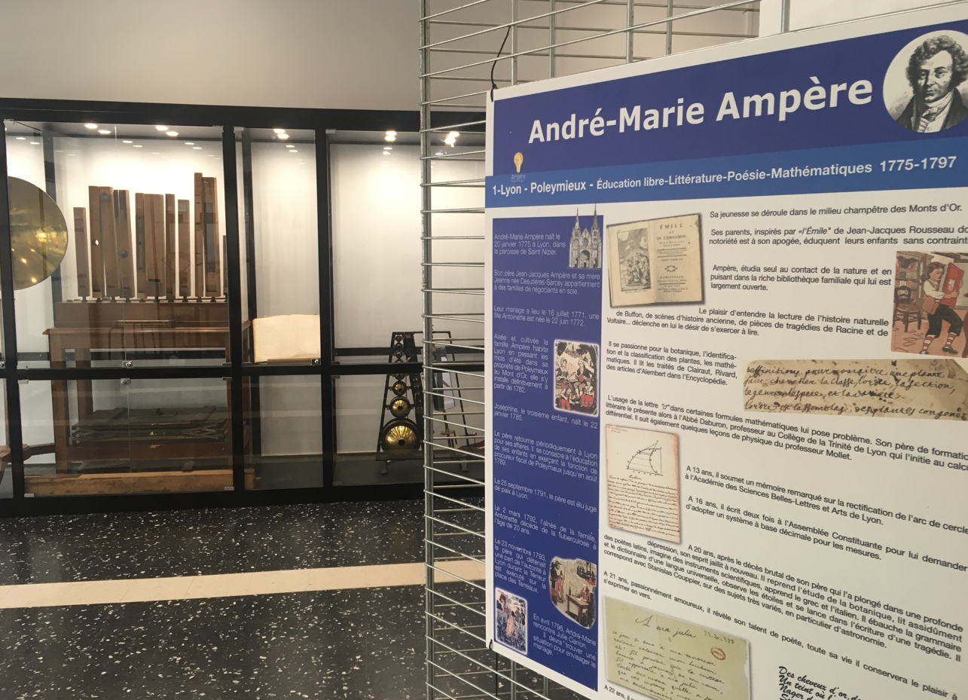
During the “Ampère 200 years” exhibition in… 2020

Slide 15
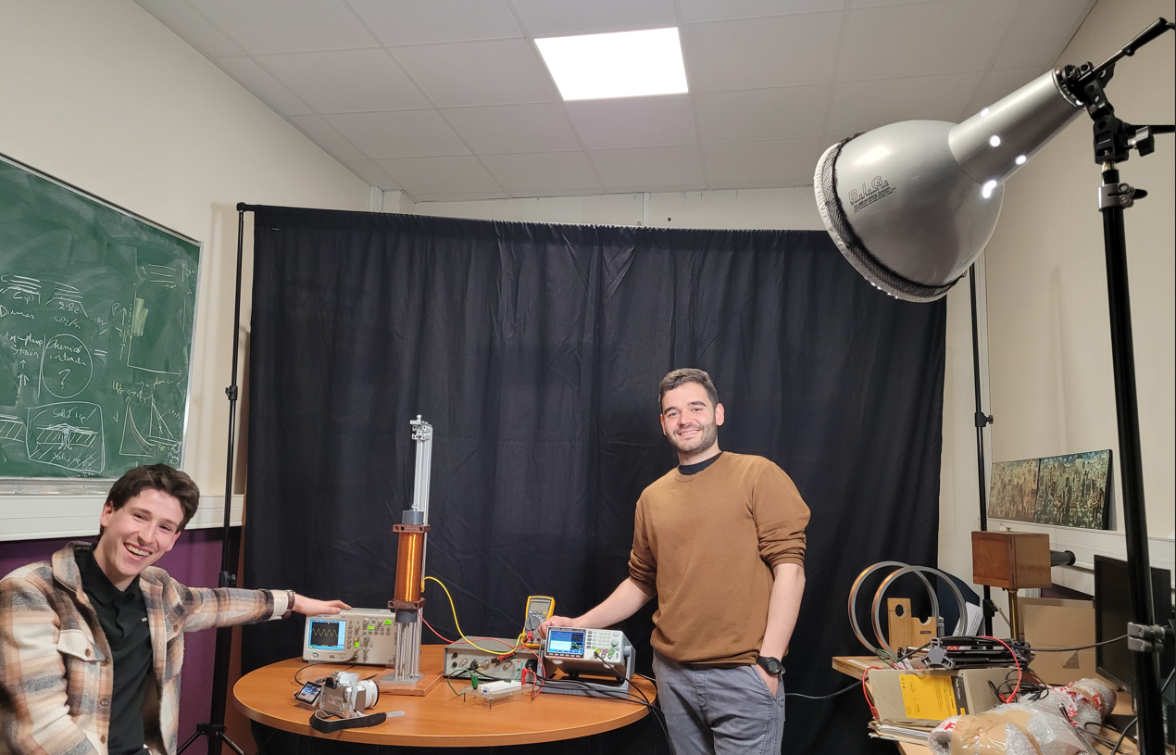
Feedback from students: you can read it on their faces !

Slide 16
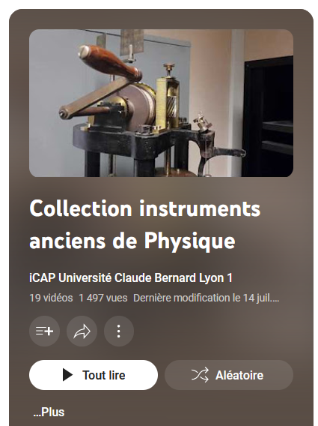
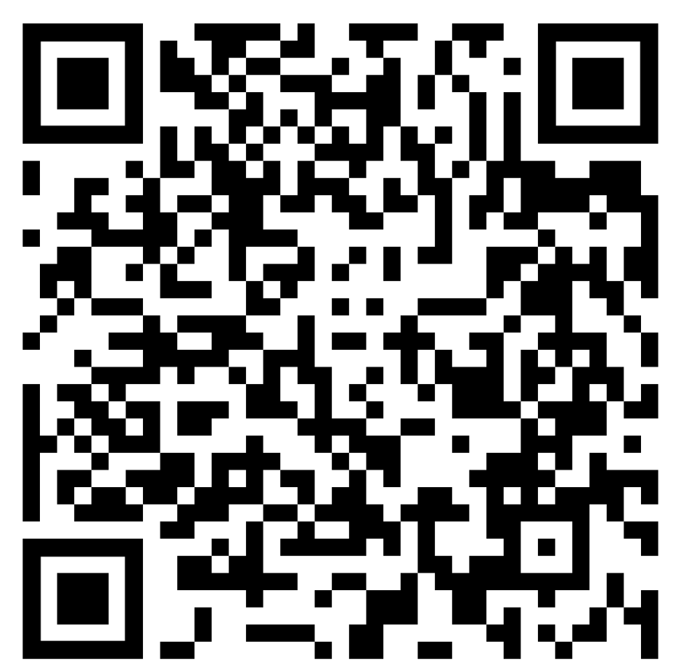
Merci de votre attention !

