Slide 1
The French Physical Society’s online questionnaire: identifying Students’ difficulties at their entrance at University
Estelle Blanquet, LACES, University of Bordeaux, France
estelle.blanquet@u-bordeaux.fr
& Daniel Hennequin, PhLAM, CNRS & University of Lille, France

Slide 2
The French Context: too easy an access to university?
access to university traditionaly determined by a national examination taken by all students in their final year at high school, the Baccalauréat (K12, 18 years old)
- yet, its present success rate (over 90%) no longer guarantees a satisfactory level
- French universities are legally obliged to accept all passed students
- enrolment is mostly free

Slide 3
French Context: selective vs. Non-selective cursus
University: Bachelor degree in Physics
non-selective access
Engineering school, integrated course
after the baccalaureate, selective
OR
OR
BTS and DUT: 2-year post-baccalaureate courses, aimed at rapid integration into professional life, selective
Classes Préparatoires: preparatory courses for engineering schools, selective
OR

Slide 4
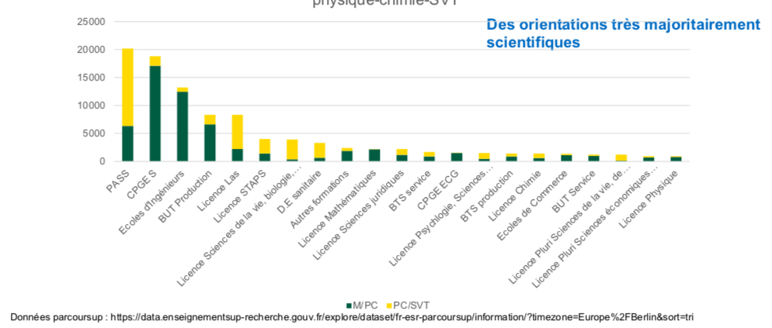
Choosing university: a very minority choice among students taking physics in high school

Slide 5
=> scientific university tracks deal with students who are often already in difficulty. They thus have to adapt their courses to help them succeed. => there is no national indicator to monitor the evolution of students' levels and to provide an overview

Slide 6
a first observation: a lack of national data
A first issue:
what are the impacts of the reforms?
A second issue:
What are the actual difficulties of the students entering higher education?

Slide 7
A nation-wide and anonymous multiple choice questionnaire
- Four parts linked to the French high school curriculum: mathematics, waves, mechanics, general knowledge
questions based on Science Education research testing the understanding of concepts (almost no calculations)
or on basic content
about a hundred questions (« I don’t know » always an option)
- lasting about an hour
- online test, accessible on students' mobile phones
- easy to implement (less than two minutes for a teacher)

Slide 10
Basic mathematics
n objects cost x euros, how much do 6 objects cost?
nx/6 ; 6x/n ; 6n/x €
1 cubic centimetre corresponds to: 1dL / 1cL / 1 mL
100 mL of soup contains 80 kJ. A 25 cL plate contains: 20 / 320 / 200 kJ
- We have the relation U=RI. U remains constant. When R increases : I increases / decreases / stays constant
- in a cube of 10 cm side, how many cubes of 1 cm side do you put? 100 / 1000 / 10 000

Slide 11
Waves
the louder a sound is, the faster it travels through the air: True / False
A sound wave of frequency 100 Hz travels at 300 m.s-1. Its wavelength is: 3m / 3.10⁴m / 30 000 m
as the period of a wave increases, its frequency increases: True / False
- sound waves are electromagnetic waves corresponding to wavelengths outside the visible range: True / False
when a sound becomes higher the frequency:
increases/decreases

Slide 12
Mechanics
A child is on a merry-go-round. His mother, sitting on a bench, sees it spinning at a constant speed. In relation to the child, it is not the merry-go-round but his mother who is spinning: True / False
A train moves at a constant speed in a straight line horizontally. A passenger drops his wallet. It falls:
far behind him/far in front of him/at his feet
- For an observer sitting in a meadow watching the train go by and for a passenger on the train sitting watching the event, the forces on the wallet are the same: True / False
- In a Galilean frame of reference, two bodies of different masses are subjected to an identical force. The one subject to the greater acceleration is: the most massive / the less massive

Slide 13
Mechanics
A soccer-player kicks a ball. The action of the air is neglected. As the ball rises, there are two forces acting on it: its weight and a force tangential to the movement: True / False
The pull of the Sun on the Earth is much greater than the pull of the Earth on the Sun: True / False
- On a flat road, a person pushes his broken-down car. The force he exerts on the car is greater than the force the car exerts on him: True / False
- A juggler is in a tram that moves at a constant speed in a straight horizontal line. To catch the balls he throws, he has to throw them: a little in front of him / vertically as if he were on solid ground
- A juggler (wearing a spacesuit) is on the moon. He moves in a straight line at a constant speed. To catch his balls, he has to throw them: a little in front of him / vertically as if he were standing still

Slide 14
General knowledge
As altitude increases, atmospheric pressure increases: T/ F
The boiling temperature of water increases with altitude: T/ F
- Helium can be cooled to -290°C: T/ F
- A stone and a feather are dropped on the Moon from the same height. They arrive on the ground at the same time: T/ F
- It is warmer in summer than in winter because the Earth is closer to the Sun: T/F
An ice cube / vodka is taken from the freezer (-18°C) and its temperature is measured immediately. What do we find?
-18°C / -10°C / 0°C

Slide 15
Uni | 2013 | 2014 | 2015 | 2016 | 2020 | 2021 | 2022
Scores (%)
inf= 49 | 28,8 % | 33,3 % | 32,4 % | 27,8% |  |  | 34,0 %
inf= 59 | 33,2 % | 31,3 % | 36,4 % | 29,3% |  |  | 38,4 %
inf= 70 | 24,1 % | 24,7 % | 21,3 % | 26,3% |  |  | 22,5 %
sup 70 | 13,9 % | 10,7 % | 9,8 % | 16,5% |  |  | 5,2 %
effectif | 713 | 336 | 225 | 133 |  |  | 365
Prépa | 2013 | 2014 | 2015 |  | 2020 | 2021 | 2022
Scores (%)
inf= 49 | 6,9 % | 4,8 % |  |  | 12,3 % | 26,5 % | 17,8 %
inf= 59 | 25,1 % | 34,9 % |  |  | 26,4 % | 25,3 % | 32,0 %
inf= 70 | 32,7 % | 33,3 % |  |  | 29,5 % | 25,1 % | 28,5 %
sup 70 | 35,3 % | 27,0 % |  |  | 31,8 % | 23,1 % | 21,7 %
effectif | 637 | 63 |  |  | 1839 | 921 | 659

Slide 16
Basic mathematics
n objects cost x euros, how much do 6 objects cost?
nx/6 ; 6x/n ; 6n/x €
2022 Prépa 70% / University 63%
2013 Prépa 79% / University 68 %
in a cube of 10 cm side, how many cubes of 1 cm side do you put? 100 / 1000 / 10 000
2022 Prépa 67% / University 58%
2013 Prépa 72% / University 52%

Slide 17
Waves
A sound wave of frequency 100 Hz travels at 300 m.s-1. Its wavelength is: 3m / 3.10⁴m / 30 000 m
2022 Prépa 59% / University 50%
2013 Prépa 74% / University 53%
sound waves are electromagnetic waves corresponding to wavelengths outside the visible range: True / False
2022 Prépa 52% / University 36%
2013 Prépa 74% / University 49%

Slide 18
Mechanics
A train moves at a constant speed in a straight line horizontally. A passenger drops his wallet. For an observer sitting in a meadow watching the train go by and for a passenger on the train sitting watching the event, the forces on the wallet are the same: True / False
2022 Prépa 43% / University 40%
2013 Prépa 41% / University 39%
In a Galilean frame of reference, two bodies of different masses are subjected to an identical force. The one subject to the greater acceleration is: the most massive / the less massive
2022 Prépa 51% / University 45%
2013 Prépa 51% / University 46%

Slide 19
Mechanics
A soccer-player kicks a ball. The action of the air is neglected. As the ball rises, there are two forces acting on it: its weight and a force tangential to the movement: True / False
2022 Prépa 33% / University 17%
2013 Prépa 43% / University 28%
The pull of the Sun on the Earth is much greater than the pull of the Earth on the Sun: True / False
2022 Prépa 47% / University 33%
2013 Prépa 64% / University 48%
A juggler (wearing a spacesuit) is on the moon. He moves in a straight line at a constant speed. To catch his balls, he has to throw them: a little in front of him / vertically as if he were standing still
2022 Prépa 29% / University 28%
2013 Prépa 26% / University 30%

Slide 20
General knowledge
Helium can be cooled to -290°C: T/ F
2022 Prépa 36% / University 29%
2013 Prépa 40% / University 36%
It is warmer in summer than in winter because the Earth is closer to the Sun: T/F
2022 Prépa 53% / University 51%
2013 Prépa 51% / University 48%
An ice cube / vodka is taken from the freezer (-18°C) and its temperature is measured immediately. What do we find?
-18°C / -10°C / 0°C
2022 Prépa 52% / University 42%
2013 Prépa 58% / University 48%

Slide 21
Findings
Classes préparatoires’ students have better scores than university’s students
There is a decrease of understanding of concepts by both categories of students between 2013 and 2022
- The questionnaire allows to identify math-related difficulties which may become obstacles to learning physics
- The questionnaire reveals the persistence of classic misconceptions
=> A useful tool for teachers and students

Slide 22
Thank you !
qcm.sfpnet.fr
Contact : estelle.blanquet@u-bordeaux.fr

