Slide 1






Low cost high performances electrochemical analysis
Project ELABORE (MITI CNRS 2021-2022)
Partners :
Université de Poitiers : Teko Napporn, Dodzi Zigah
IRD : Agnès Aubouy, Alexis Chaigneau, Valérie Grefeuille
LSTE : Martin Aina
Université Abomey-Calavi : Latifou Lagnika
Associations : Physique sans frontières (François Piuzzi), Chimistes sans Frontières (Manuel Cervera-Marzal), Puya Raimondi (Raymond Campagnolo)
emmanuel.maisonhaute@sorbonne-universite.fr

Slide 2
Outline
Electrochemical analysis and instrumentation
PassStat 1 : fast and simple
PassStat 2 : low cost and easy to adapt
A few applications in Africa
Some reflexions and perspectives
Résultats sur le terrain

Slide 3
What is electrochemistry?
Dictionnary :
Science and technique of reciprocal transformation of chemical energy and electrical energy.
Chemical step
Electron transfer
Physical transport
(diffusion, migration, convection)
+ possible chemical steps
Adsorption?
Ox_{S}
e⁻
Ox_{el}
Ox_{el}
Red_{S}

Slide 4
Many applications
Energy
Corrosion
Depollution/Envirronnement
Métallurgy
(Bio)sensors
Electronics
Electrochemistry
Biology
Photovoltaic
Fuel cells
Batteries
Electrosynthesis
Nuclear
Important to train students and implement research in developping countries

Slide 5
Two usual electrochemical techniques
Cyclic voltammetry
Exemple:
Initially on Red in solution
Potential E (V)
k
Products
Ox
E⁰
Red Ox + e⁻
Red
Time (s)
Characteristic timescale:
τ = RT/(Fv)
v : scan rate = slope (en V/s)

Slide 6
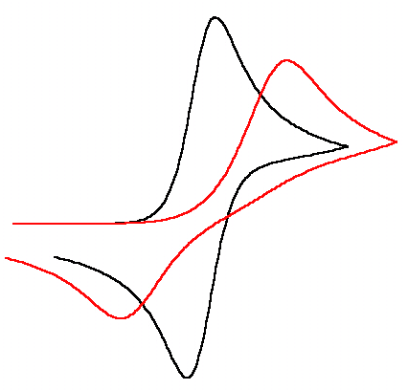
Two usual electrochemical techniques
Cyclic voltammetry
No chemical reaction
I
E⁰
Fast system (Nernstian)
Slow electron transfer kinetics
E
i α D^{1/2}v^{1/2}
τ = RT/(Fv)
Saveant, JM, Elements of Molecular and Biomolecular Electrochemistry

Slide 7
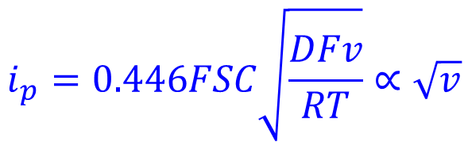
Two usual electrochemical techniques
CV : reversible behaviour
$$i_{p}=0.446FSC\sqrt{\frac{DFv}{RT}}∝\sqrt{v}$$
Peak for the maximum gradient:
Peak to peak difference ΔE_{p}: 59 mV (à 25°C)
From Amatore, in Organic Electrochemistry, an introduction and a guide

Slide 8
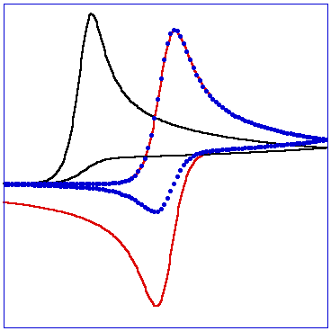
Two usual electrochemical techniques
Influence of a chemical reaction
Red Ox + e⁻
Products
Slow scan rates
Peak shift
No backward current
Fast scan rates
E⁰ and k
Analysis of current peaks provides information on mechanism
No chemical reaction
Fast reaction
Moderately fast reaction

Slide 9
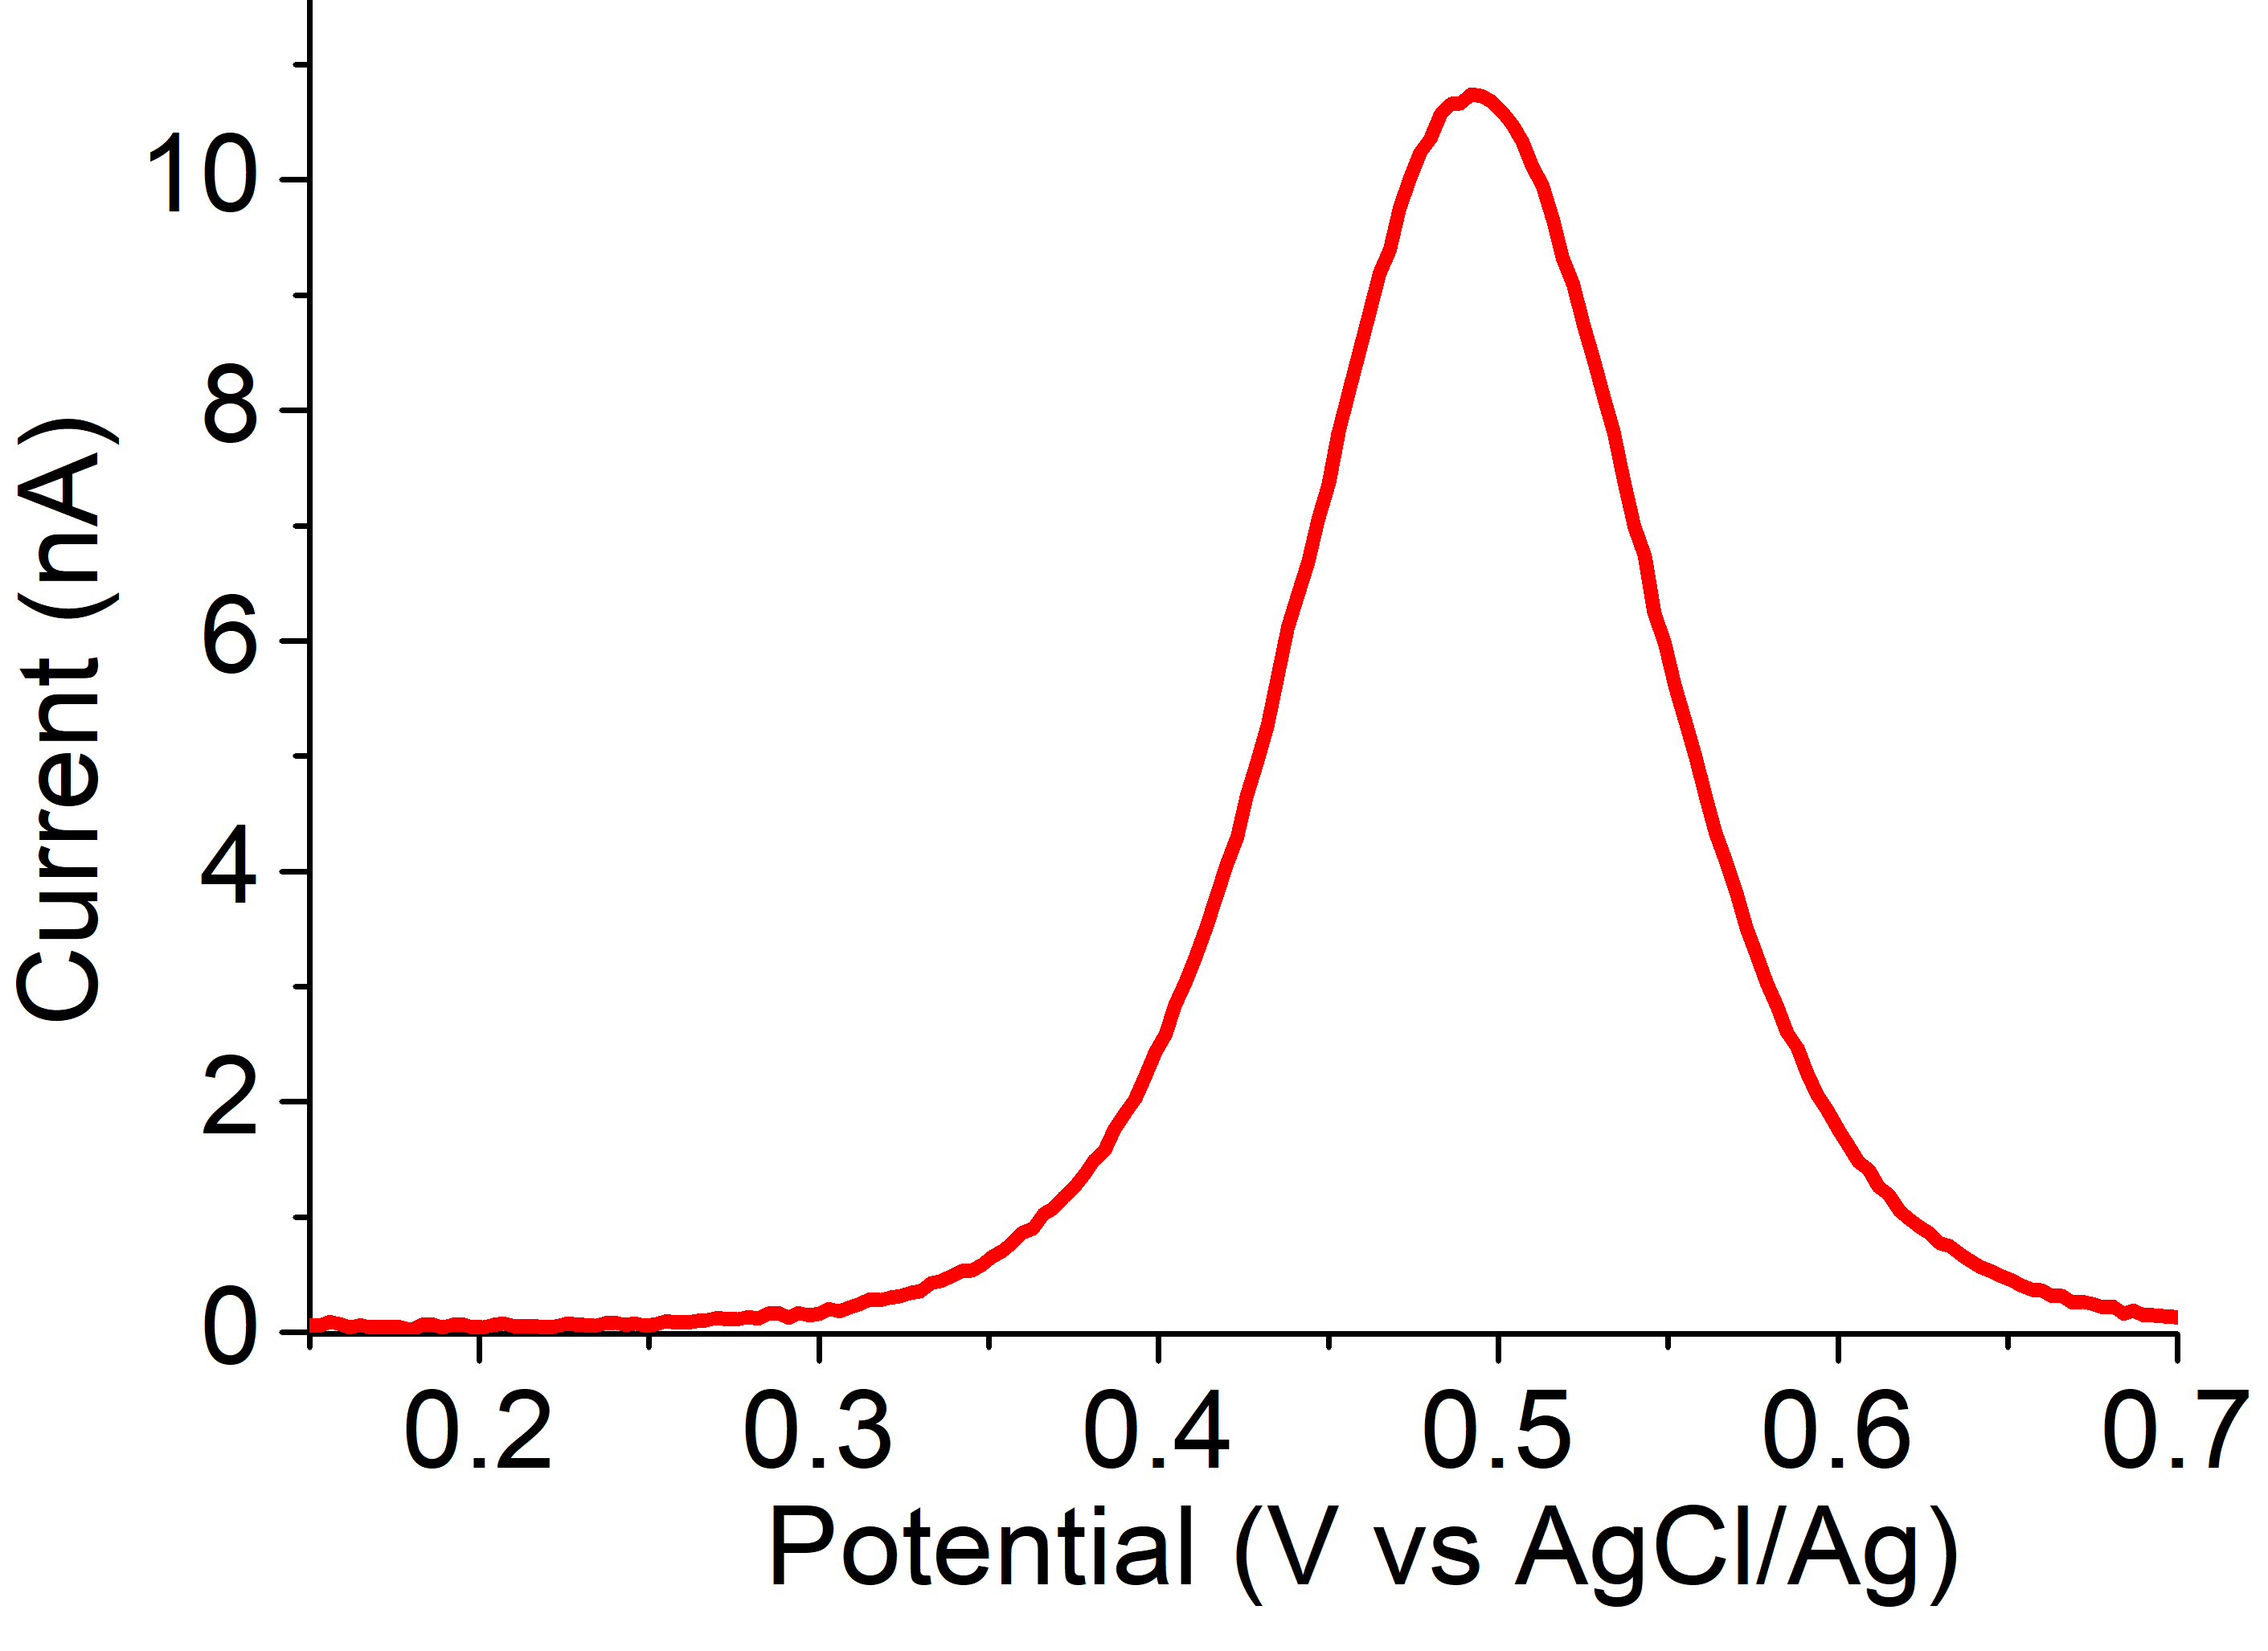
Two usual electrochemical techniques
Square wave voltammetry
More sensitive !

Slide 10
How to properly perform electrochemical experiments: 3 electrode systems
Concept: add a reference electrode for which I_{ref} = 0.
Générator 1
0
If I_{ref} = 0, E_{ref} = C^{te} (Nersnt…)
Générator 2
-5 V
+5 V
A
Control of E = V_{W} – V_{ref} with a voltmeter
Simply adjust U to get the E you want
Potentiometer
U
Then V_{CE} – V_{ref} is no more important
V
Ref
Possible to do I-E curves!
W
CE
I
Solution

Slide 11
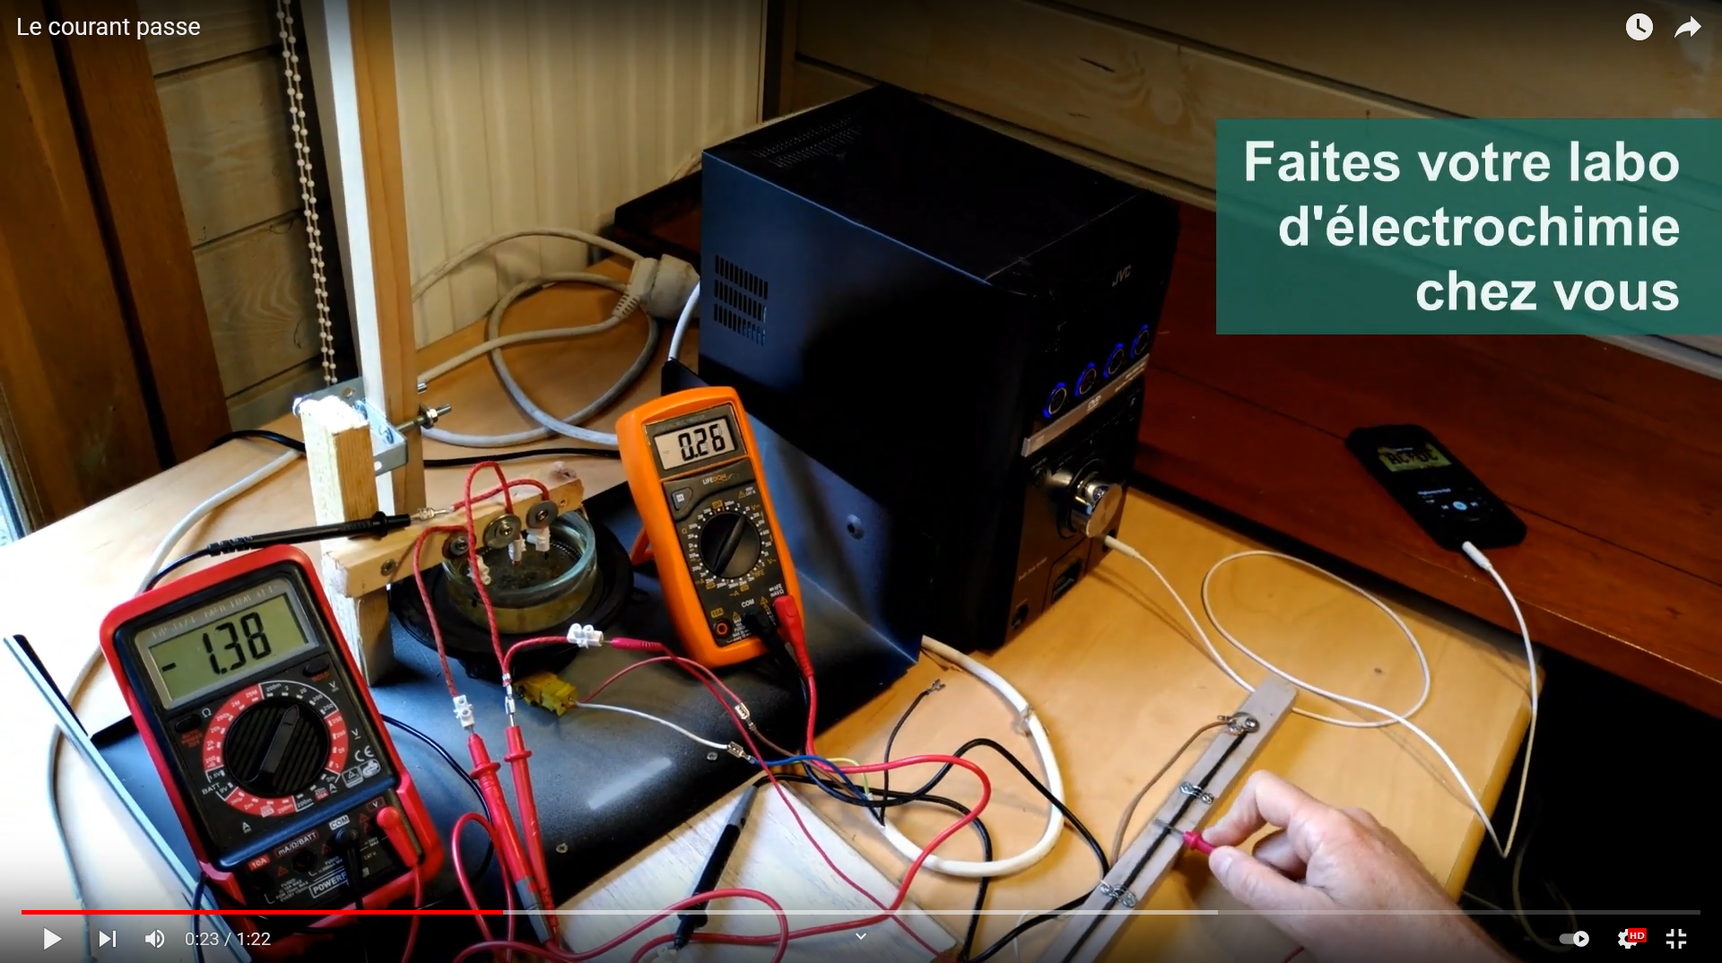
From funny unconventional teaching…
Le courant passe: electrochemistry@home
An electrochemical series:
To distract students, colleagues and friends
To suggest students to make experiments at home (in safe conditions)
To do a maximum with a minimum
https://www.youtube.com/playlist?list=PL4-5RJd2oIUwrvTe3DuxuikS14xa0iJpy
… to something almost serious.
Raymond Campagnolo (Puya Raymondi)
Why not making a real low cost potentiostat?
As simple as possible!

Slide 12
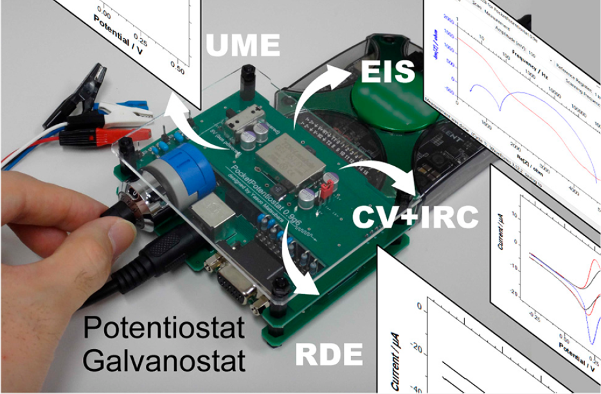
A few low cost potentiostats…
Whitesides
Bibliographie
[2] A. Nemiroski, D.C. Christodouleas, J.W. Hennek, A.A. Kumar, E.J. Maxwell, M.T. Fernández-Abedul, G.M. Whitesides, Universal mobile electrochemical detector designed for use in resource-limited applications, PNAS 111 (33) (2014) 11984–11989,
[3] A. Ainla, M.P.S. Mousavi, M.-N. Tsaloglou, J. Redston, J.G. Bell, M.T. Fernández-Abedul, G.M. Whitesides, Open-source potentiostat for wireless electrochemical detection with smartphones, Anal. Chem. 90 (10) (2018) 6240–6246
[4] Y.C. Li, E.L. Melenbrink, G.J. Cordonier, C. Boggs, A. Khan, M.K. Isaac, L.K. Nkhonjera, D. Bahati, S.J. Billinge, S.M. Haile, R.A. Kreuter, R.M. Crable, T.E. Mallouk, An easily fabricated low-cost potentiostat coupled with user-friendly software for introducing students to electrochemical reactions and electroanalytical techniques, J. Chem. Educ. 95 (9) (2018) 1658–1661,
[5] A.A. Rowe, A.J. Bonham, R.J. White, M.P. Zimmer, R.J. Yadgar, T.M. Hobza, J.W. Honea, I. Ben-Yaacov, K.W. Plaxco, M. Wanunu, CheapStat: An opensource, ‘‘do-it-yourself” potentiostat for analytical and educational applications, PLoS ONE 6 (9) (2011) e23783, [6] P. Irving, R. Cecil, M.Z. Yates, MYSTAT: a compact potentiostat/galvanostat for general electrochemistry measurements, HardwareX. 9 (2021) e00163,
[7] C. Mercer, R. Bennett, P. Conghaile, J. Rusling, D. Leech, Glucose biosensor based on open-source wireless microfluidic potentiostat, Sensors Actuators B Chemical.290 (2019) 616–624
[8] G.N. Meloni, Building a microcontroller based potentiostat: a inexpensive and versatile platform for teaching electrochemistry and instrumentation, J. Chem. Educ. 93 (7) (2016) 1320–1322
[9] S.T. Rajendran, E. Scarano, M.H. Bergkamp, A.M. Capria, C.-H. Cheng, K. Sanger, G. Ferrari, L.H. Nielsen, E.-T. Hwu, K. Zór, A. Boisen, Modular, lightweight, wireless potentiostat-on-a-disc for electrochemical detection in centrifugal microfluidics, Anal. Chem. 91 (18) (2019) 11620–11628
[10] M.D.M. Dryden, A.R. Wheeler, D.T. Eddington, DStat: a versatile, open-source potentiostat for electroanalysis and integration, PLoS ONE 10 (10) (2015) e0140349
[11] Y. Matsubara, A small yet complete framework for a potentiostat, galvanostat, and electrochemical impedance spectrometer, J. Chem. Educ. 98 (10) (2021) 3362–3370
[13] https://iorodeo.com/collections/cheapstat-open-source-potentiostat, (n.d.). https://iorodeo.com/collections/cheapstat-open-source-potentiostat.
[14] M.W. Glasscott, M.D. Verber, J.R. Hall, A.D. Pendergast, C.J. McKinney, J.E. Dick, SweepStat: a build-it-yourself, two-electrode potentiostat for
macroelectrode and ultramicroelectrode studies, J. Chem. Educ. 97 (1) (2020) 265–270, https://doi.org/10.1021/acs.jchemed.9b00893.
Matsubara
Few descriptions of the limits
Hard to repare
Design complicated

Slide 13
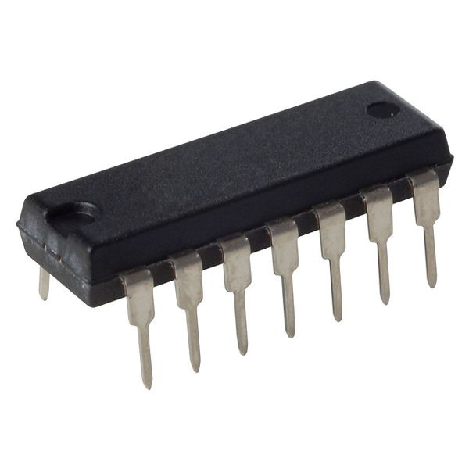
Reminder: basic potentiostat scheme
3 électrodes scheme, only 3 amplifiers
LMC 6484
Electrochemical cell
Potential input
E
E⁻
Current/Voltage converter
R₃
-
CE
W
I
-V_{S} = RI
R₆
R₃ = R₅
E⁺
+
I
Ref
0
E-
V_{S}
R₅
E+
Current output
-E
E⁻
-
Masse E+ = 0
-E
+
I = 0
Suiveur
Simple electronic components

Slide 14
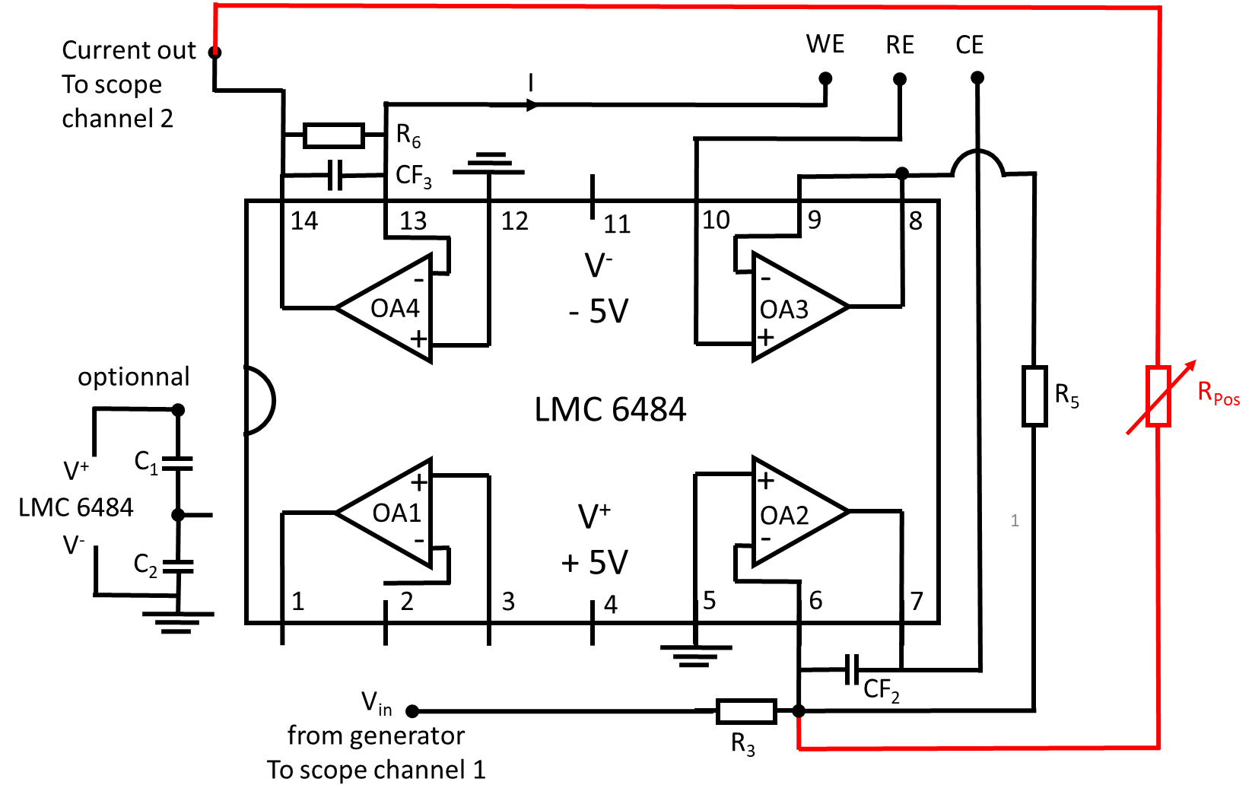
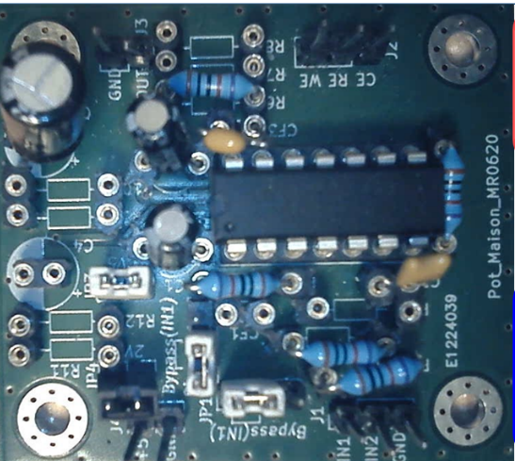
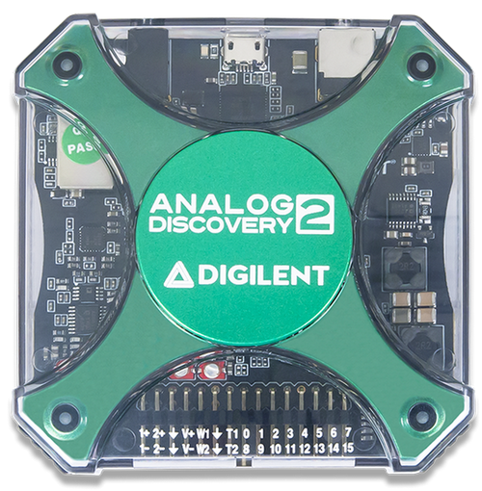
PassStat 1 : fast and simple
PassStat 1.0
+
The most simple !
Necessitates power supplies, generator and oscilloscope
Analog Discovery 2 : 304 €
No dedicated soft for electrochemistry (see however Matsubara)

Slide 15
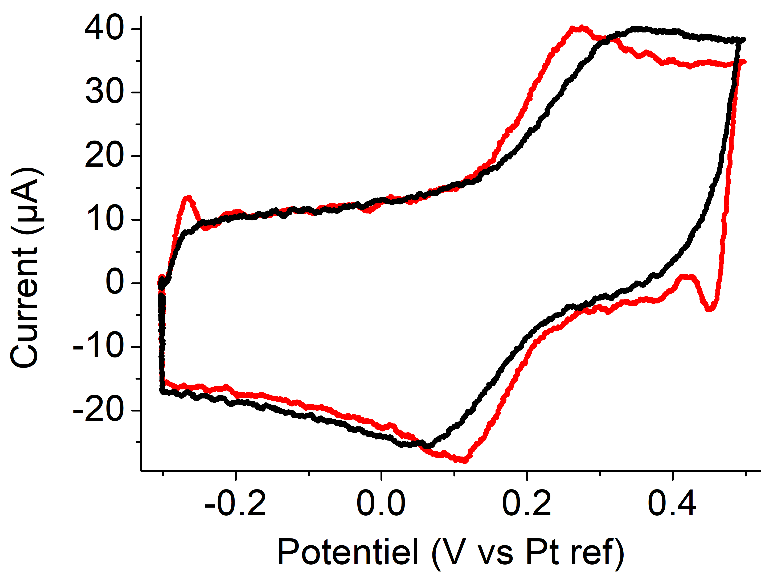
PassStat 1: fast and simple
Performances: PassStat 1.0
1 mM Ferrocene
In CH₃CN + 0.1 M TBAPF₆
Micrometric electrode
8000 Vs⁻¹
Gabriel Boitel-Aullen
Talk on Thursday !
Rather fast !
Rather for confirmed electrochemists

Slide 16
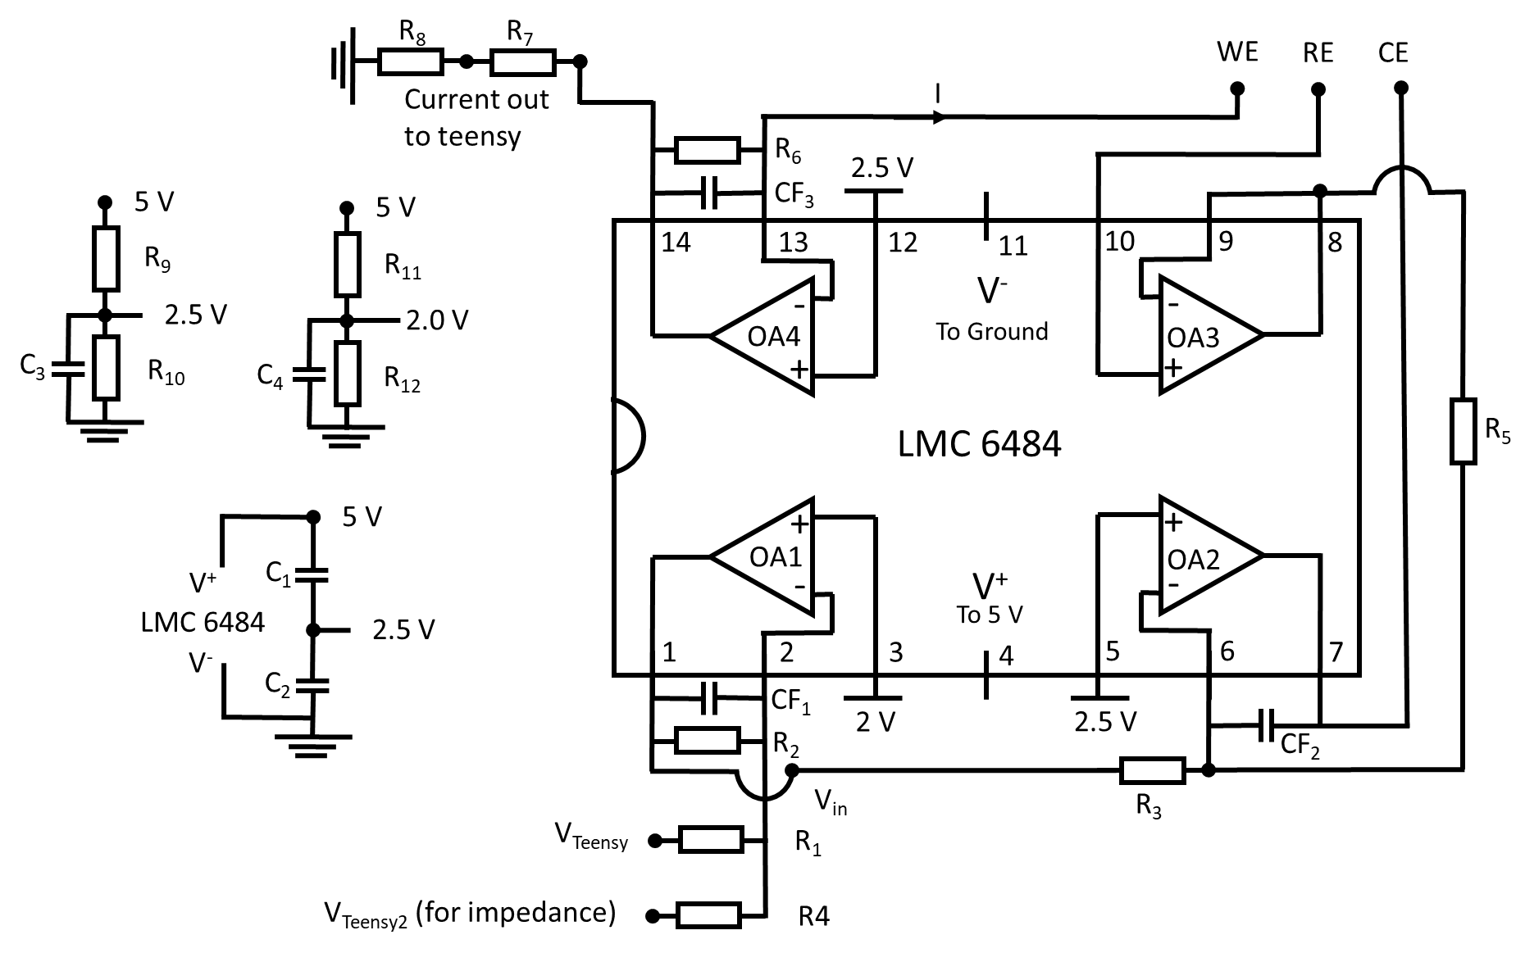
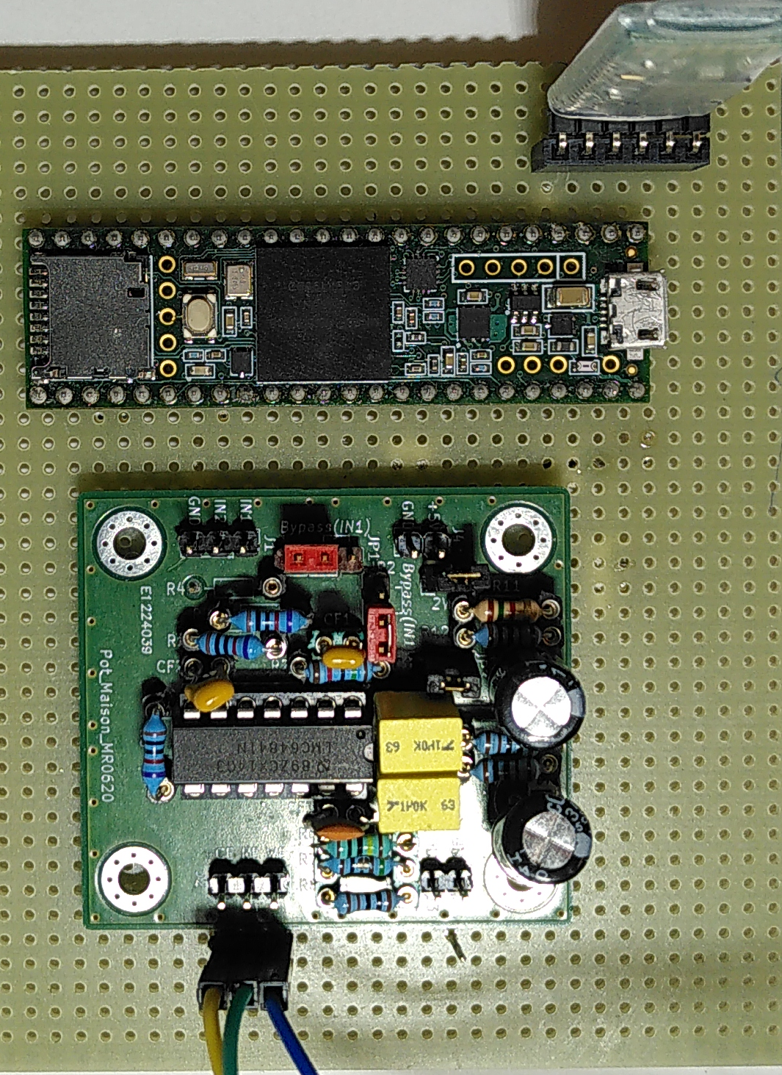
PassStat 2: low cost and easy to adapt
PassStat 2.0, 2.1 et 2.2
Bluetooth HC05
RX
V⁺
TX
TX
GND
RX
Teensy 3.6 card
A22
A0
V⁺
GND
V⁺
Potentiostat
Works on computer or through Bluetooth
Price: between 50 and 80 €
Limited scan rate (100 Vs⁻¹)
Limited compliance (± 2.4 V)
Take care of calibration!
Electrodes

Slide 17
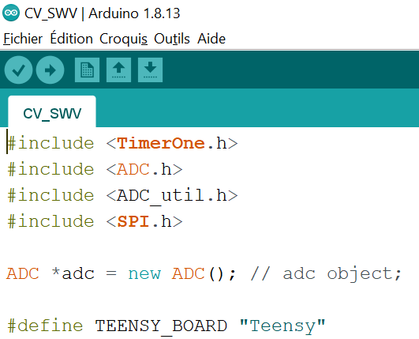
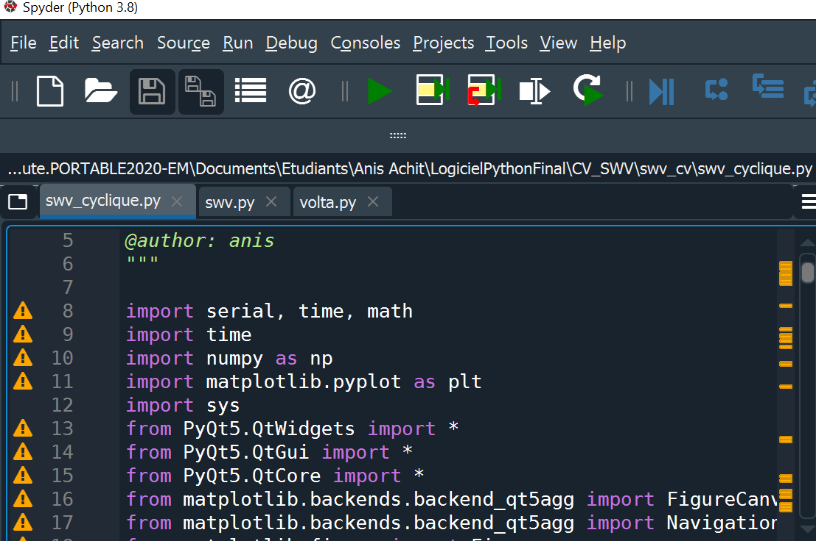

PassStat 2: low cost and easy to adapt
Open source considerations
Arduino core
Python interface
+

Slide 18
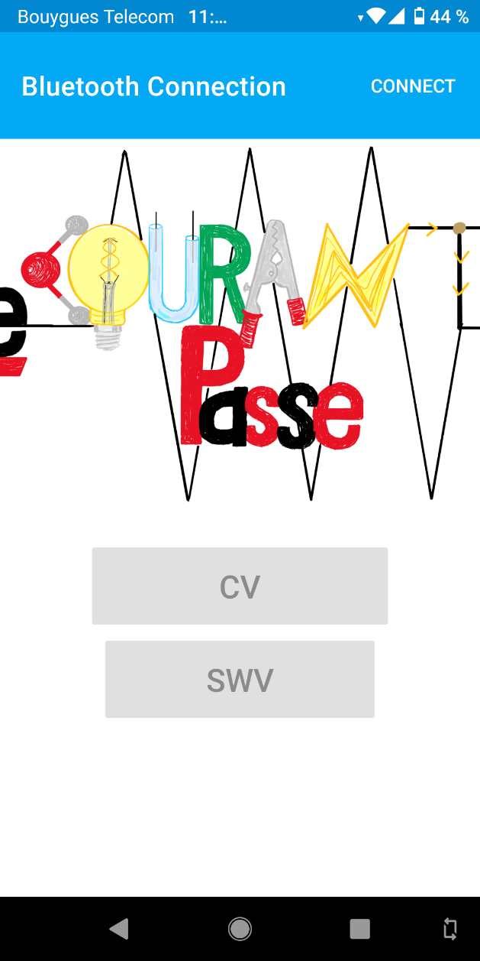
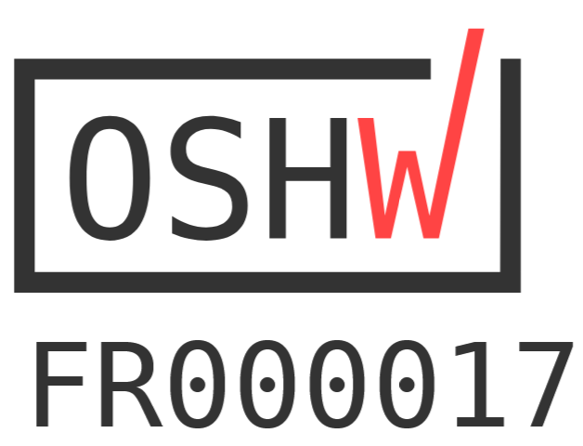
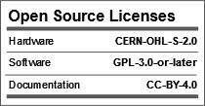

PassStat 2: low cost and easy to adapt
Open source considerations
Application Android conçue avec Android Studio
Stage Anis Achit, 3 mois, étudiant M1 ingénierie
Paper in Hardware X (Caux et al., 2022)
Dépôt sur Zenono
Wiki sur https://ohwr.org/project/passstat/wikis/home
Projet GitHub
Certifié par l’Open Source Hardware Association
A diffuser sans restrictions !

Slide 19
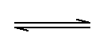
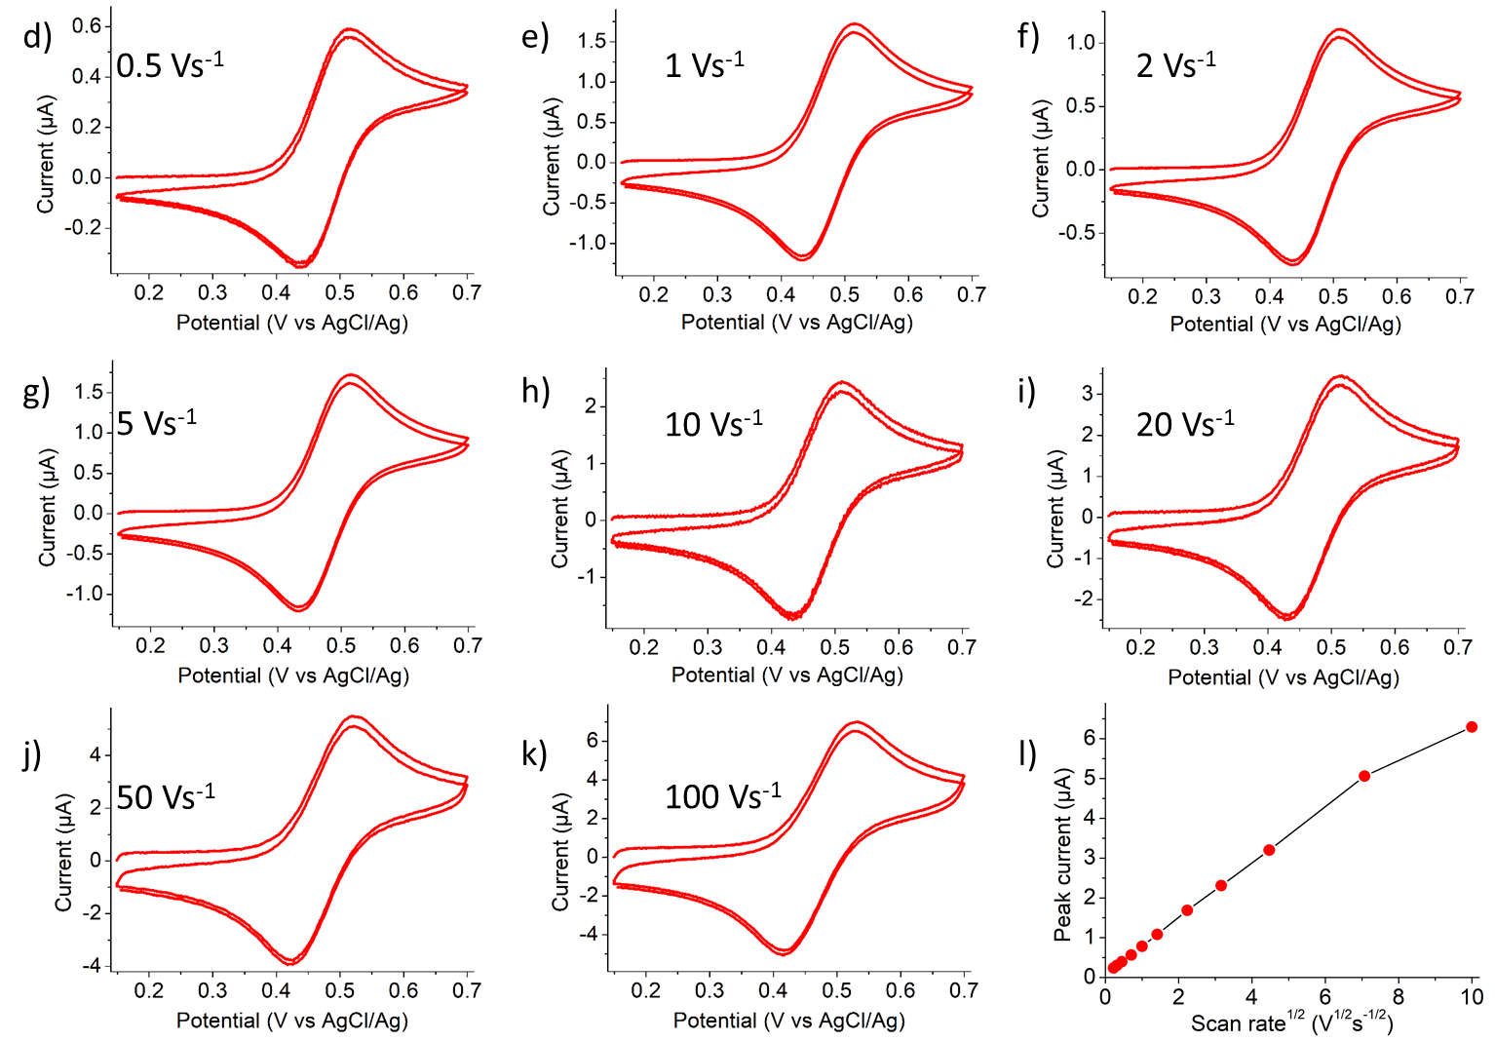
PassStat 2: low cost and easy to adapt
Validation
Fc
Fc⁺ + 1e⁻
Standard conditions:
1 mM Ferrocene
inCH₃CN + 0.1 M TBAPF₆
Pt ∅ 0.5 mm
OK!!!

Slide 20
PassStat 2: low cost and esy to adapt
Validation: Square Wave Voltammetry
Standard conditions:
1 mM Ferrocene
inCH₃CN + 0.1 M TBAPF₆
Pt ∅ 0.5 mm
From Compton, understanding electrochemistry
OK!!!

Slide 21
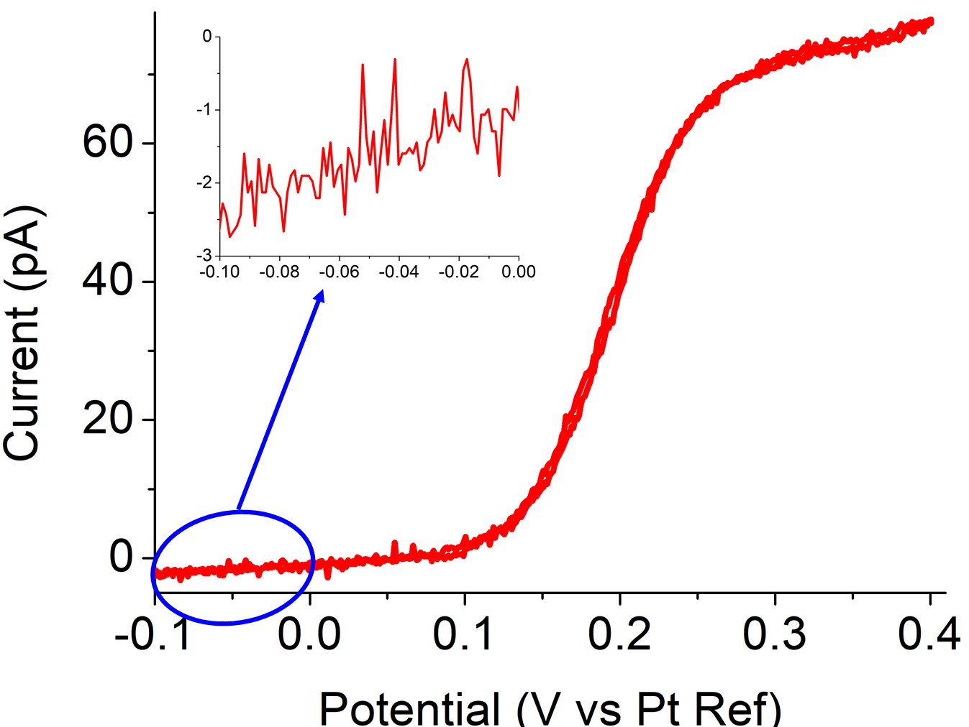
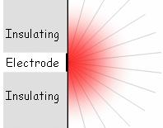
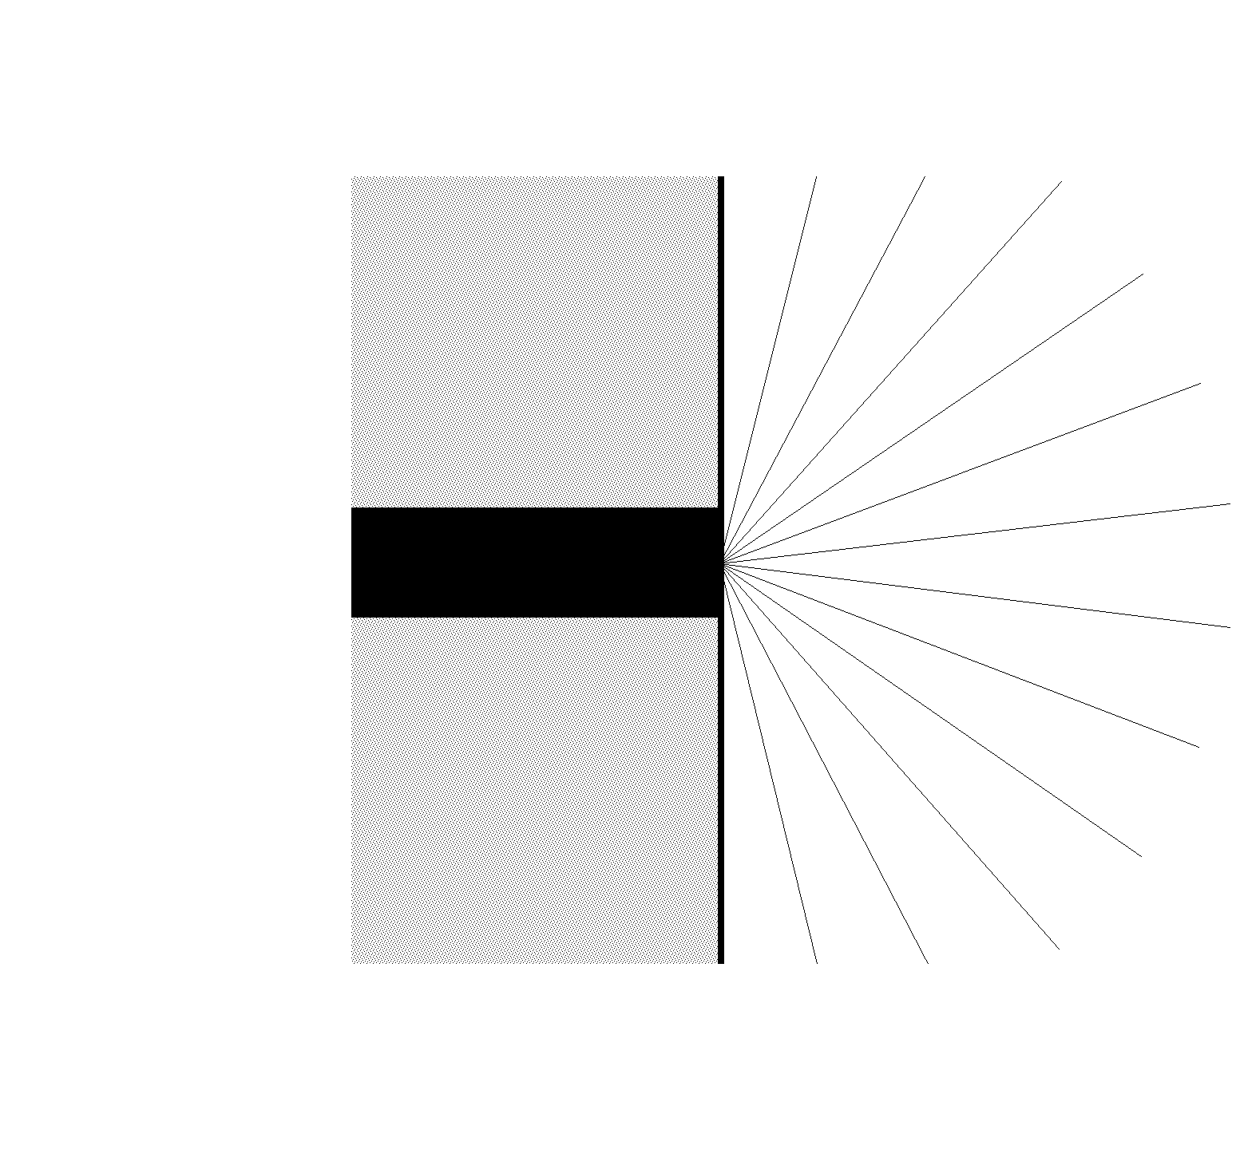
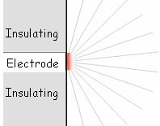
PassStat 2: low cost and easy to adapt
Validation: low currents
Extreme conditions :
Ferrocene 25 µM
in CH₃CN + 1 mM TBAPF₆
UME Pt ∅ 4 µm
Scan rate 20 mVs⁻¹
Spherical diffusion
Planar diffusion: θ << r₀²/D
Insulating
Electrode
Insulating
Very good S/N!
No stray capacitance
Spherical diffusion: θ >> r₀²/D
Insulating
Electrode
Insulating

Slide 22

A few examples

Slide 23
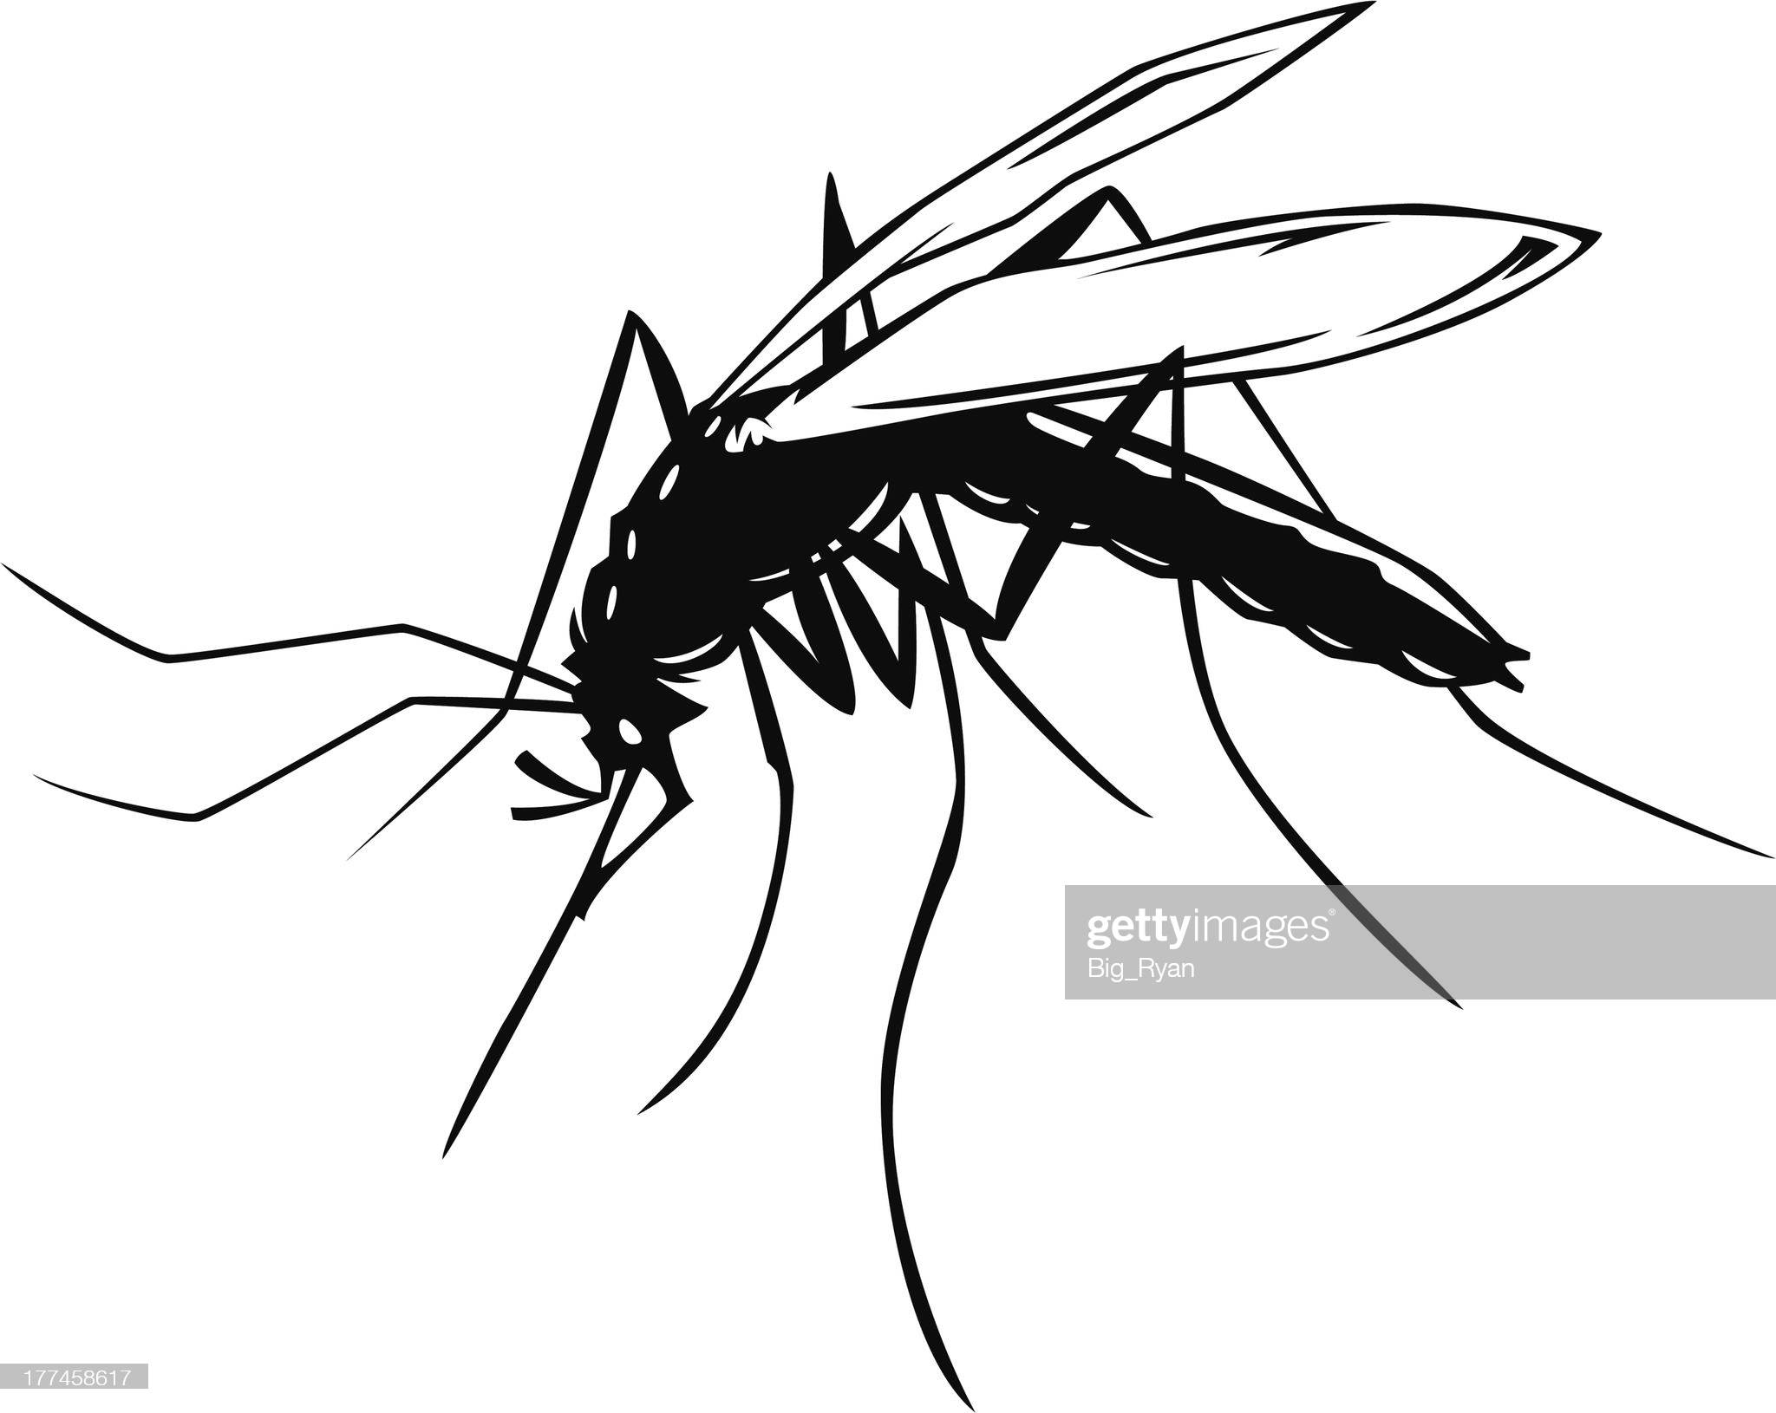
A few examples
Paludism
Counterfeit drugs
Essential oils
Dietary deficiencies
Pollutants
Cu, Cd, Pb, As, Hg

Slide 24
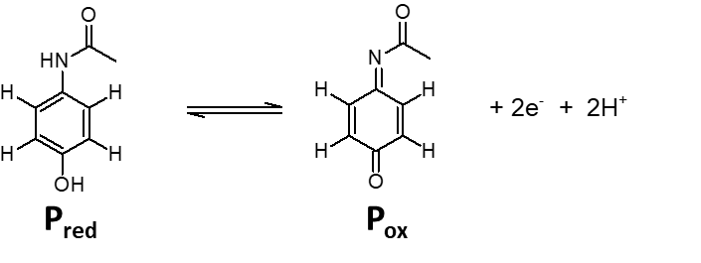
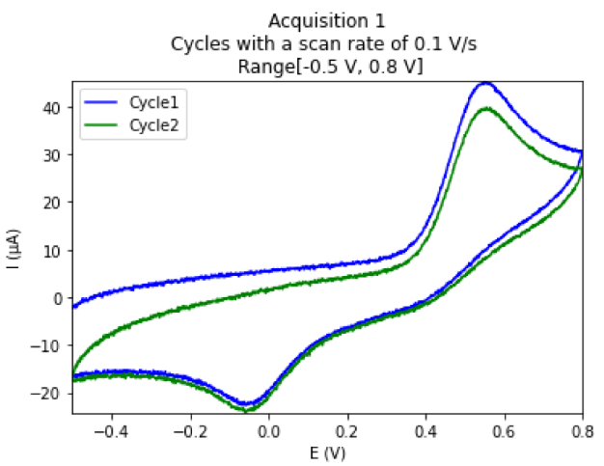
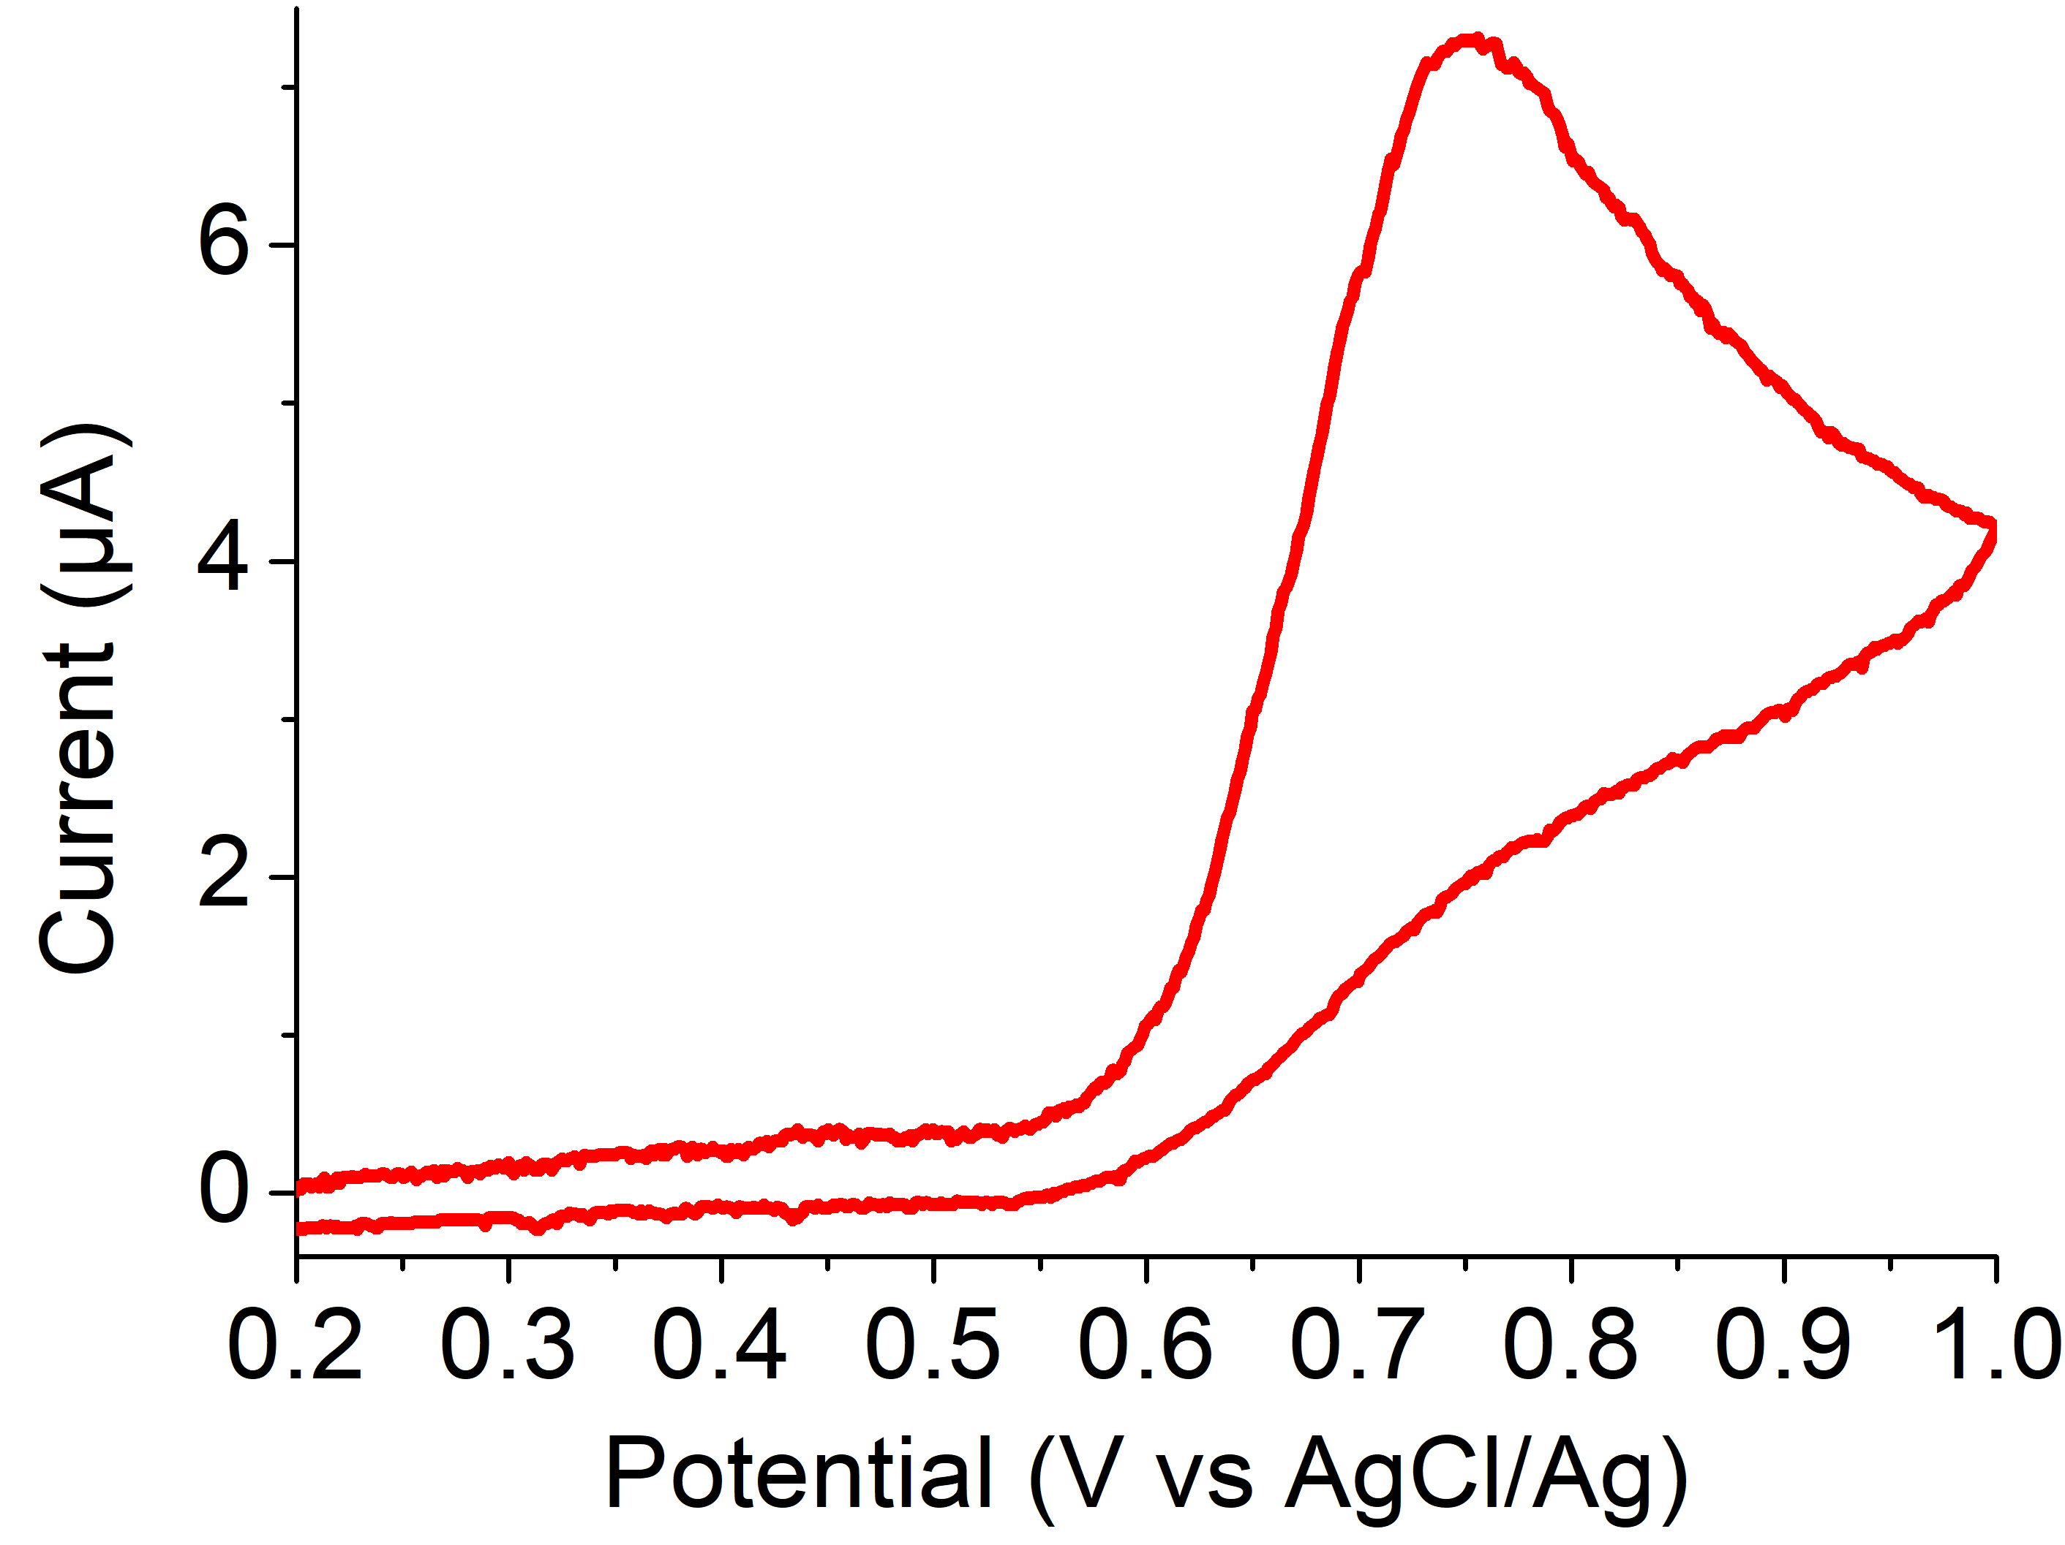
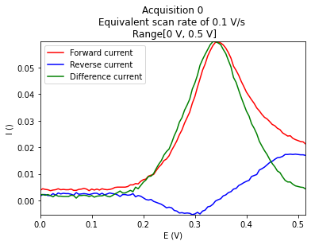
A few examples: paracetamol
Drugs: paracetamol
Produits
PBS
Citric acid
PBS
Mélicia Caux, L3, 2021
Bluetooth OK !

Slide 25
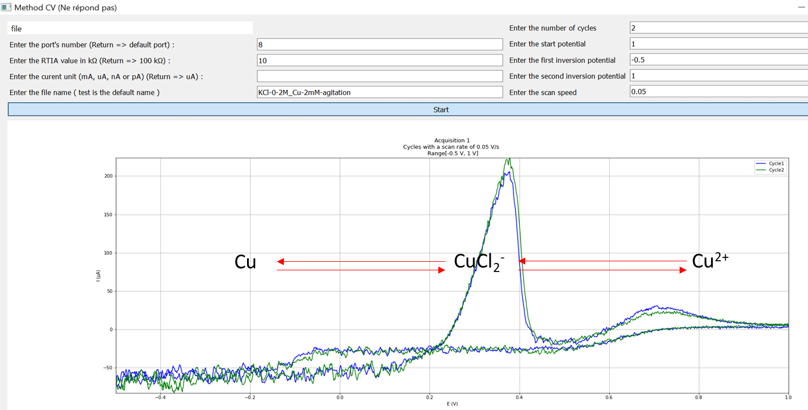
A few examples: copper analysis
Anodic stripping of Cu
Cu²⁺ 1 mM + NaCl 0.100 M
Results Université d’Abomey-Calavi, october 2021
Internship M1 Florença Wassolua, 2022
Titration in tap or sea water

Slide 26
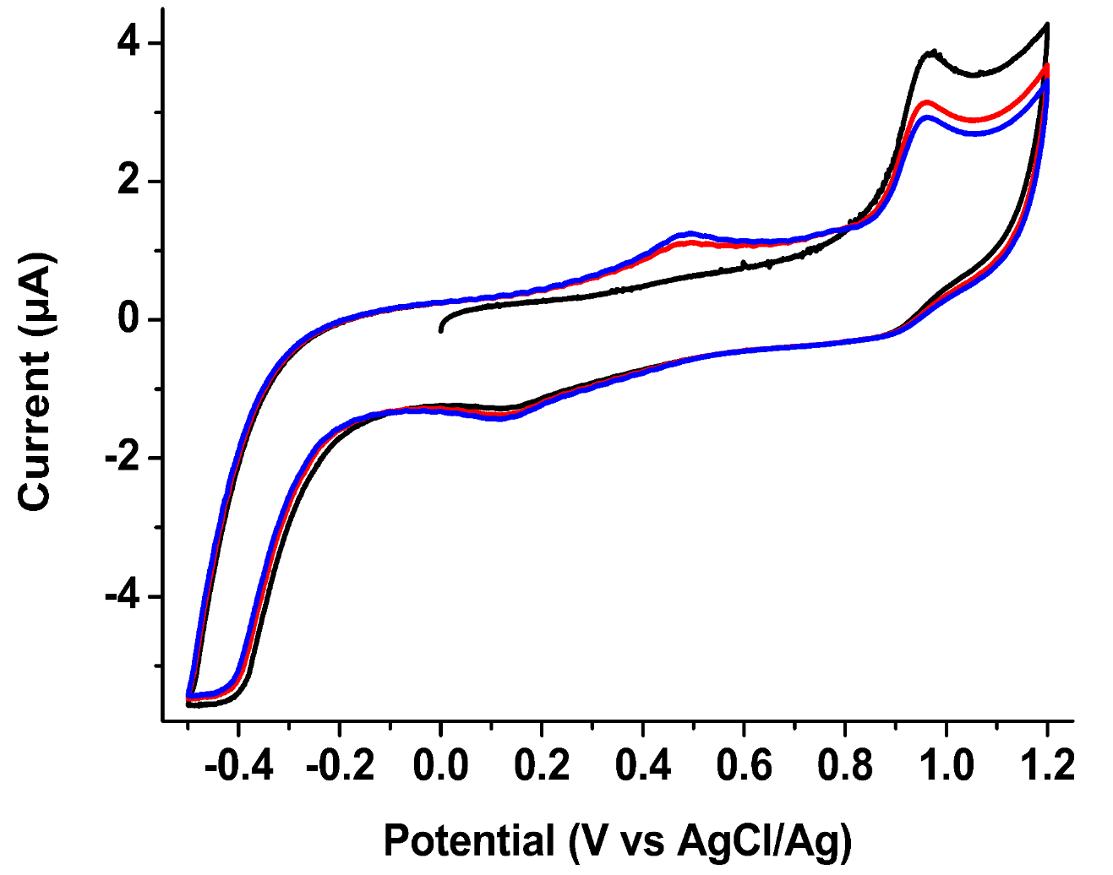
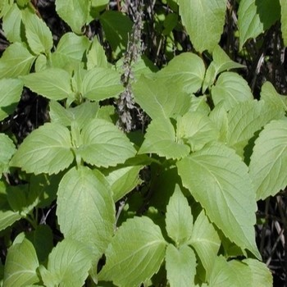
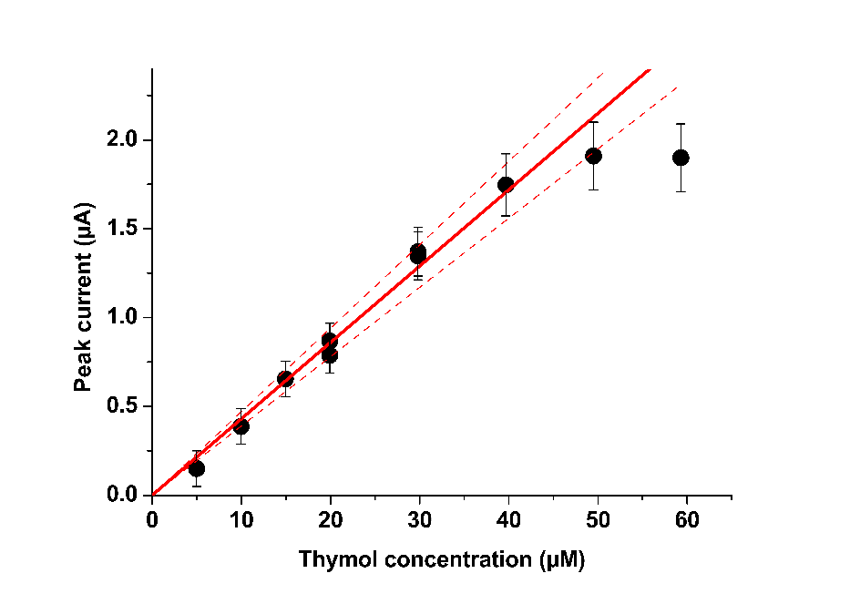
A few examples: plant extract
Essential oil: Occimum gratissimum (faux basilic, Bénin)
Collaboration Pr. Latifou Lagnika, UAC and Agnès Aubouy, IRD
Calibration with pure thymol
A priori contains thymol
Quantification of a complex electrochemical system in a complex matrix

Slide 27
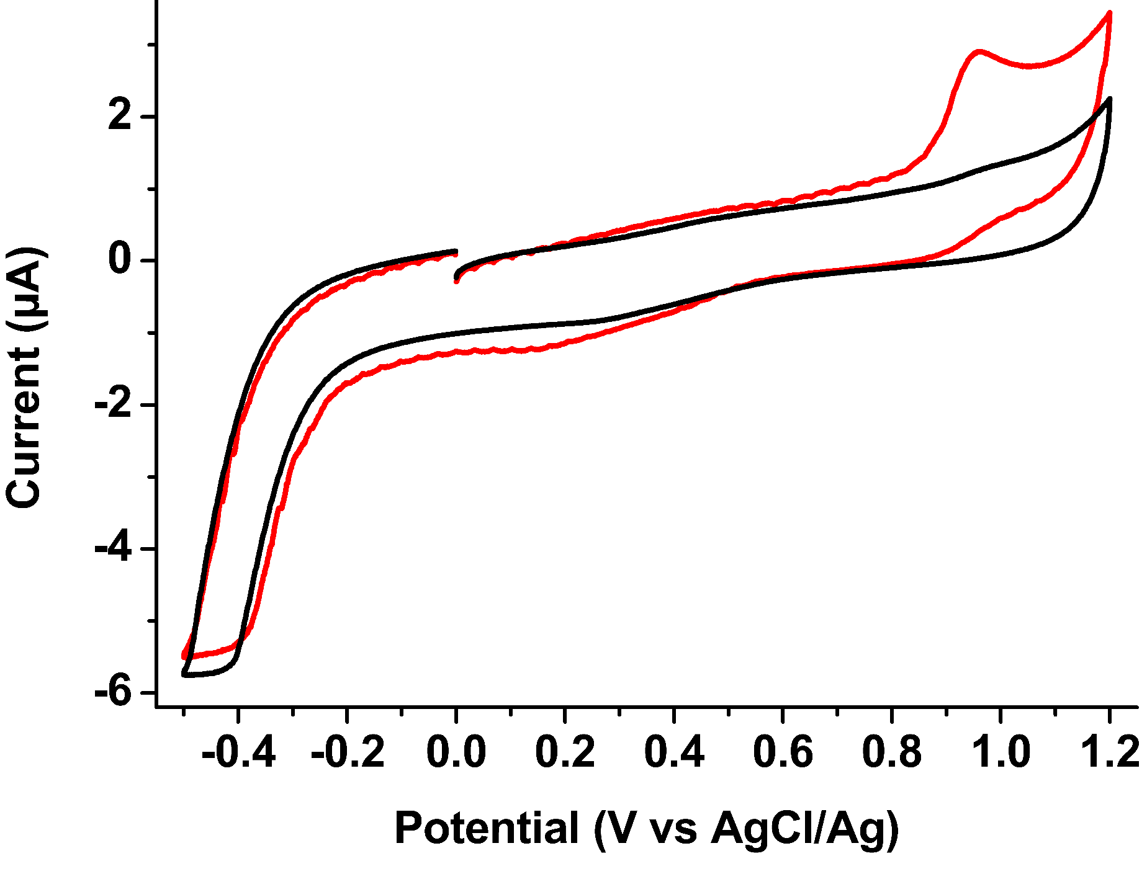
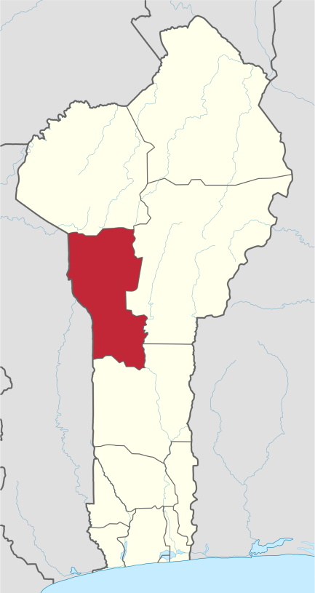
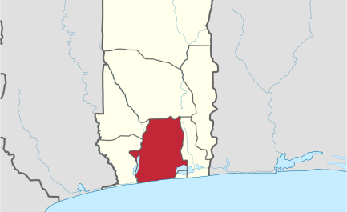
A few examples: plant extract, essential oil
Different thymol composition depending on the area of collection
Djougou
Calavi
Very different compositions

Slide 28
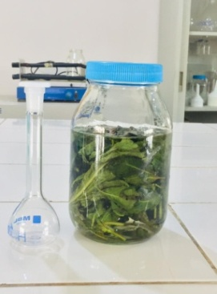
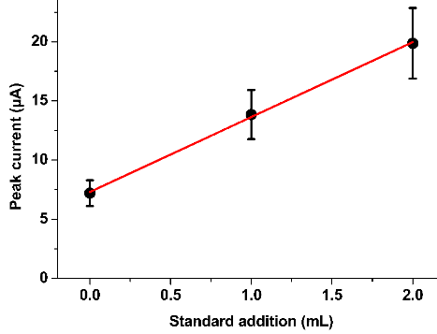
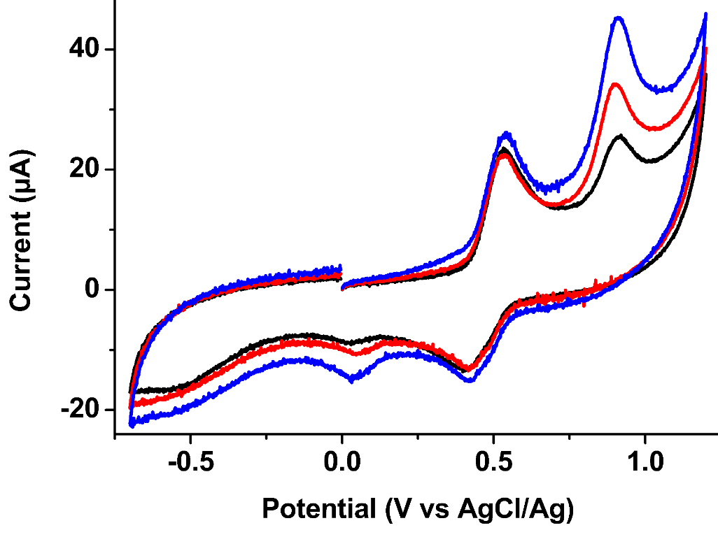
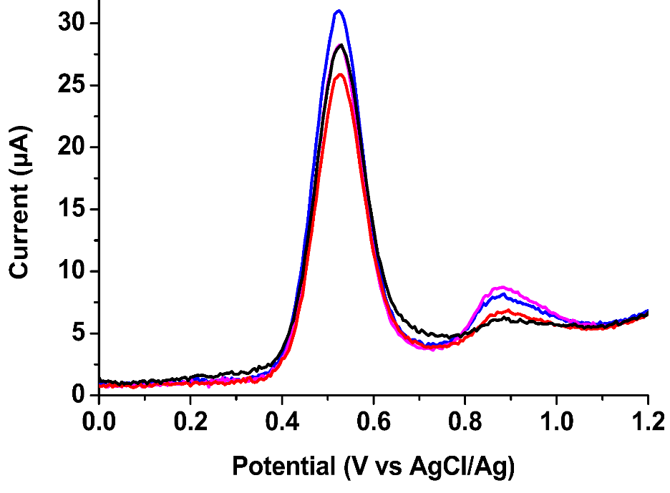
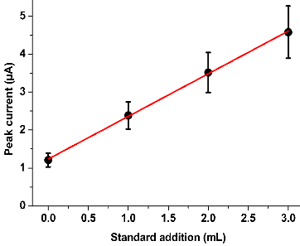

A few examples: plant extract, infusion
Glassy carbon
Pencil lead

Slide 29
Some reflexions…
Commercial systems
PassStat and other open hardwares
Plug and play
Wide range of techniques
Soft
Excellent resolution
Modulables (filters)
Black boxes
Sometimes bulky
Expensive
Not possible to repair yourself
To mount yourself (1h)
Limited functions and soft (to be improved…)
Correct resolution
Low compliance (can be solved)
Easily adaptable at low cost (T, pH, conductivity…)
Totally open source and easy to repair
Light, works on battery (low noise)
Cost-effective for development
and participative science
Perfect to learn instrumentation !

Slide 30
Some perspectives
Electrode material
Commercial electrodes
Screen printed electrodes
Pencil lead
(Activation ?)
UMEs
Carbon paste
Modified electrodes
Systems
Plants ???
Essential oils
Infusions
Metals
Hard and soft improvements
Autonomous underwater measurements
Integration within other techniques (e.g. spectroscopy)
Spread the approach to other users

Slide 31
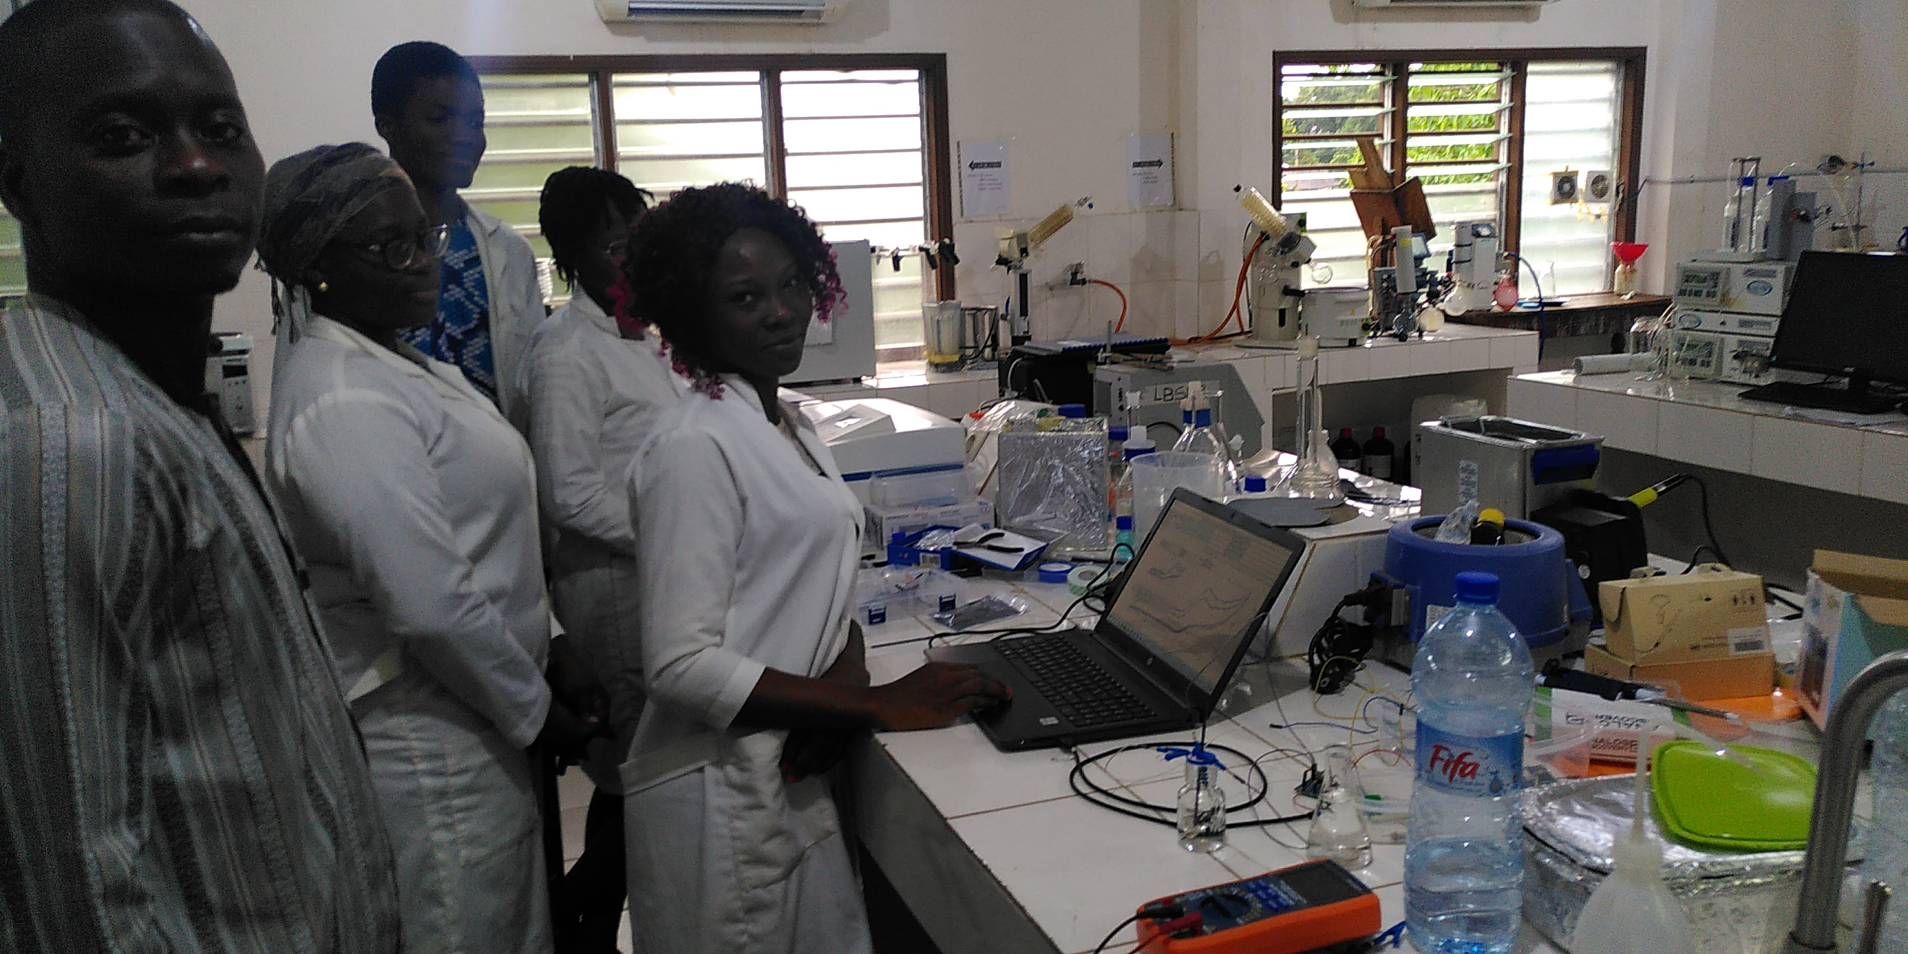

Acknowledgements
Etudiants UAC : Solange Imelda AVOSSE, Faridath BOURAIMA, Sonia Jeliba EDA, Aurellle OGOUTEIBO, Candide SINDEDJI, Satar AKADIRI, Jean Haffiz, Cynthia ATTINDEHOU, Mounirou TCHATCHEDRE
Etudiants SU : Mélicia Caux, Anis Achit, Kethsovann Var, Florença Wassolua, Guillaume Nicole, Gabriel Boitel-Aullen
Université de Poitiers : Teko Napporn, Dodzi Zigah
IRD : Agnès Aubouy, Alexis Chaigneau, Valérie Grefeuille
LSTE : Martin Aina
Université Abomey-Calavi : Latifou Lagnika
Associations : Physique sans frontières, Chimistes sans Frontières, Puya Raimondi (Raymond Campagnolo)

