Slide 1
Journée du Réseau Instrumentation Faisceau 2022
PERLE:
A Powerful Energy Recovery Linac for Experiments
Walid Kaabi
07 Avril 2022

Slide 2
Introduction- ERLs: The Best of Two Worlds
LINEAR ACCELERATOR
ID
X-Rays
STORAGE
Source
ID
RING
IP
IP
X-Rays
Beam parameters defined by the source
High flexibility – single pass
Limited average beam power (<< mA)
Possible short bunches (sub psec)
Low number of user stations
Beam parameters defined by equilibrium
Limited flexibility – multi-pass
High average beam power (A, multi GeV)
Typically long bunches (20 ps – 200 ps)
Many user stations
            Linac-like beam quality
            Easy to upgrade (add linac section or recirculation passes)
            Tolerate more “damage” to the beam from collisions with another beam (the beam is dumped soon after)
ENERGY RECOVERY LINAC
  High beam current possible (RF power limit removed)
  Reduced power bill (RF power recovered)
  Reduced cost of RF amplifiers (smaller RF power amplifiers)
  Reduced beam power and energy in beam dump (less shielding / activation issues)
IP
ID
X-Rays
Main Linac
Source
High average beam power in compact machine, excellent beam parameters with high flexibility

Slide 3
Introduction- Energy Recovery in RF Fields
λ_{Rf}
E_{Out} = E_{Inj}
E = E_{inj} +ΔE
E = E_{inj} +2 ΔE
E_{Inj}
E = E_{inj} +ΔE
E = E_{inj} +ΔE
(β ~ 1)
L = n · λ + λ / 2
L = n · λ
Energy supply → acceleration
Deceleration = “loss free” energy storage (in the beam) → Energy recovery
W. KAABI
Journées FCC France - LPNHE, 15 novembre 2019
3

Slide 4
Introduction- At the origin of ERL concept
ERL concept was proposed first in 1965 by Maury Tigner ¹
¹ M. Tigner: “A Possible Apparatus for Electron Clashing-Beam Experiments”, Il Nuovo Cimento Series 10, Vol. 37, issue 3, pp 1228-1231,1 Giugno 1965
First test was done at SCA@ Stanford in 1986 (interesting concept for FELs, Compton light sources and high current electron cooler)
Concept become only viable with recent advances in SRF technology.

Slide 5
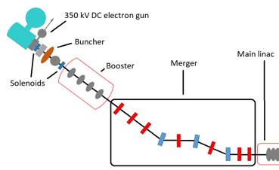
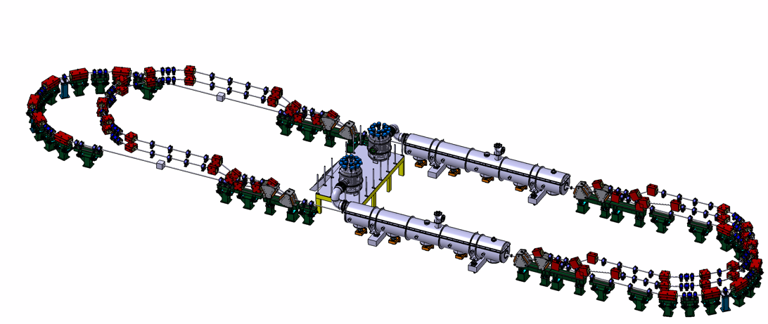
PERLE Configuration and beam parameters
Target Parameter | Unit | Value
Injection energy | MeV | 7
Electron beam energy | MeV | 500
Normalised Emittance γε_{x,y} | mm mrad | 6
Average beam current | mA | 20
Bunch charge | pC | 500
Bunch length | mm | 3
Bunch spacing | ns | 25
RF frequency | MHz | 801.58
Duty factor |  | CW
2 Linacs (Four 5-Cell 801.58 MHz SC cavities)
3 turns (164 MeV/turn)
Max. beam energy 500 MeV
DC = l_{RF}/2
Injector
7 MeV
DE = 82.2 MeV
Arcs 2:4:6
Arcs 1:3:5
Dump
7 MeV
DE = 82.2 MeV
Footprint: 31.5 x 5.5 x 0.9
Courtesy to Rodolphe Marie

Slide 6
A brief history of the effort over the past 4 years
The development of ERLs has been recognized as one of the five main pillars of accelerators R&D in support of the European Strategy for Particle Physics (ESPP).
Following the recommendations of the ESPP, the CERN Council mandated the Laboratory Directors Group (LDG) to define and maintain a priority roadmap for accelerators R&D.
The LDG decided to create Expert Panels for each of the five selected priority areas for accelerators R&D.
The ERL Roadmap Panel, chaired by Max Klein and Andrew Hutton, has done a tremendous job with broad and active participation. The PERLE project was recognized as one of the "essential pillars of the ERL," with milestones to be achieved by the next ESPP in 2026.
The accelerators roadmap was presented and approved by the CERN Council in December 2021, and recently published as the CERN Yellow Report: https://doi.org/10.23731/CYRM-2022-001
The implementation of the roadmap will be followed by LDG (*)
A. Hutton, Report from the ERL Roadmap Panel- July 9, 2021
Funding Limited
Technology Limited
^{(*)} "The Council invites ECFA and LDG to develop, in collaboration with SPC, funding agencies and relevant research organizations in Europe and beyond, detailed implementation plans defining milestones, priorities and funding sources, for consideration by the CERN Council at its spring 2022 session."

Slide 7






PERLE Collaboration & PERLE- France
PERLE international collaboration
A collaboration agreement (CA) signed by all partners. A bilateral ICRADA DOE- JLAB with CNRS is pending signature.
The Collaboration Council chaired by O. Brüning meets regularly (every ~3 months).
New Project Board created
PERLE in France
IN2P3/CNRS National Strategy (end of 2021): Perle@Orsay a priority for accelerators in line with the ESPP
Establishment of PERLE Steering Committee by IJCLab Direction. In addition to the close interaction with IN2P3 within The Master Project PERLE-TDR.
Two laboratories: IJCLab (Orsay) and LPSC (Grenoble) with a significant increase of people involved (see later). Contribution from GANIL and interest from CEA.
Project submitted to the stimulus plan for 2022 (possibility of obtaining financial support for phase 1 of PERLE). Ministry response resubmit in phase3 together with SUpra2030
Infrastructure funding obtained: 2M€ from 2022 for PERLE infrastructures. To be consolidated.

Slide 8
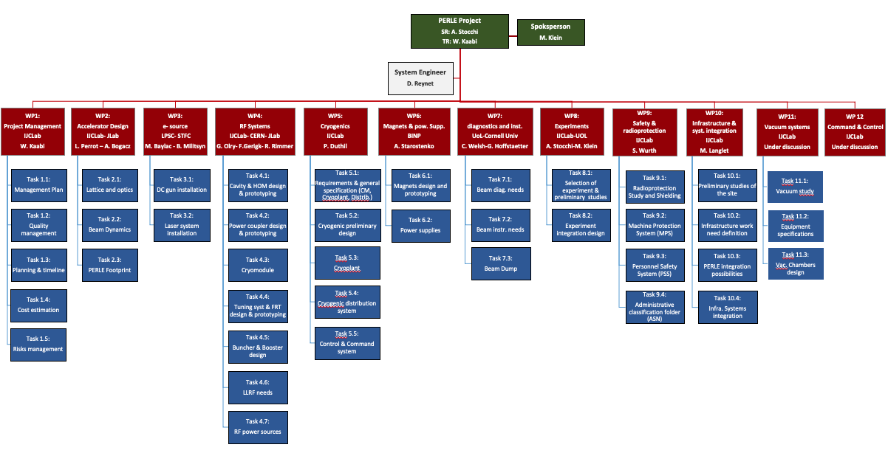
Project Organization:

Slide 9
Why PERLE@Orsay and which Physics with at PERLE@Orsay
ERL machines open a new Frontier for the physics of “the electromagnetic probe”
At low energy e Nuclei (PERLE and Destin@Orsay) 250-500 MeV
(2) At Higher Energy e p (e A) (LHeC and/or FCC-eh) 60 GeV
You need high luminosity → High current (from 10mA up to 100mA)
You need to increase the energy (remaining compact) → Multi turns
The (1) machine (PERLE@Orsay)
  will be the first ERL dedicated to Nuclear Physics for studying the
  It’s a necessary demonstrator for the (2) -HEP machine- (same technological choices & beam parameters)
The key points : high power (current x energy) and complex machine in terms of beam dynamics
+ PERLE@Orsay is also a necessary demonstrator for other future machines and applications

Slide 10
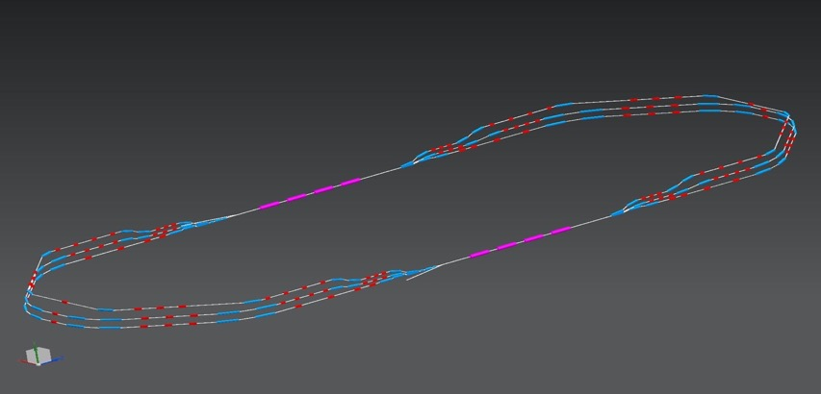
Three passes ‘up’ to reach the maximum energy
1 : 3 : 5
ΔE = 82,2 MeV
injector
7 MeV
ΔE = 82,2 MeV
x
2 : 4 : 6
x
7 MeV
dump
ΔC in arc 6 = λ_{RF}/2
Electron beam at maximum energy could be used for:
Elastic electron-proton scattering with polarised beam (Particle physics)
Exploration of proton densities in exotic nuclei by electron scattering (Nuclear physics)
Gamma ray production between 0.2 and 5 MeV (wide applications in Photo-nuclear physics),

Slide 11
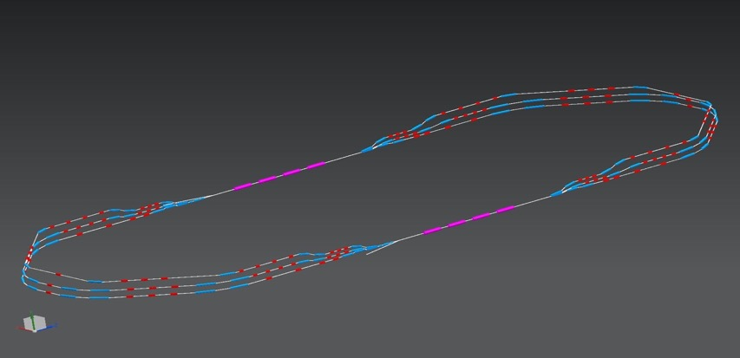
Three passes ‘down’ for energy recovery
1 : 3 : 5
ΔE = 82.2 MeV
injector
7 MeV
x
ΔE = 82.2 MeV
2 : 4 : 6
x
7 MeV
dump
Several benefits from this manipulation:
The required RF power (and its capital cost and required electricity) is significantly reduced to that required to establish the cavity field and make up minor losses.
The beam is constantly renewed: never reach equilibrium state --> provides flexibility to adapt beam properties for specific applications.
The beam power that must be dissipated in the dump is reduced by a large factor.

Slide 12
Bunch recombination pattern
Basic RF structure, without recirculation: Bunches are injected every 25 ns
When recirculation occurs → bunches at different turns in the linacs:
  Ovoid bunches in the same bucket
  Recombination pattern adjusted by tuning returned arcs length of the required integer of λ
  Maximize the distance between the lowest energy bunches ( & ): ovoid reducing the BBU threshold current due to the influence of HOMs kicks
  Achieve a nearly constant bunch spacing: minimize collective effects
1
6

Slide 13
Beam monitoring and instrumentation for ERLs
Specific challenges and requirements imposed by ERL:
Beam in ERLs: combination of the very high average beam power (similar to synchrotrons) and non-equilibrium (non-Gaussian) nature of beams with small transverse and longitudinal emittances (similar to high-brightness linacs) → Need of routine beam profile measurements with a high dynamic range.
ERLs must operate with multiple beams of different beam energies transported in the same beam-lines (6 different beams at 3 different energies in case of PERLE) → Require specific monitoring systems capable to deal with multiple beams needs (BPMs, BAMs…).
Different beam modes have to be well defined for the following operation phases: the machine setup, average-current (power) ramp-up, and high-power operation. For ERLs, the difference in the average beam current between the tune-up mode and the high-power mode is typically of some orders of magnitude → Necessity of high dynamic range measurements.
For ERLs, local beam losses with an average power of about 1 W are an issue that cannot be ignored.
→ Comparing this level of beam loss with the average beam power (10 MW for PERLE) shows again the necessity of high dynamic range beam measurements (Typically of 10⁶).

Slide 14
Beam monitoring and instrumentation for ERLs
Intercepting and Non-intercepting Measurements
Transverse beam profile (YAG:Ce (?) viewers)
Twiss parameters (YAG:Ce (?) viewers)
Transverse Emittance (YAG:Ce (?) viewers)
Projected energy spread (YAG:Ce (?) viewers)
Beam Halo (Wire-scanner or YAG:Ce)
Longitudinal phase space (TCAV and YAG:Ce viewer)
M₅₅ (based on BAM) non-intercepting but very invasive
Beam current / Bunch charge (feedback)
Bunch length measurements On-line (feedback)
BMP system (orbit, energy measurements / feedback)
Beam arrival time measurements
Beam Energy Measurements (BPM based)
Transverse beam profile (Synchrotron Radiation Monitors)
Projected energy spread (Synchrotron Radiation Monitors)
Beam Loss Monitor system (separate story)
- Critical parameters,
- High accuracy,
- Require intercepting techniques,
(cannot be done by non-intercepting methods without major developments)
- Required for feedbacks
- Non-intercepting
- Full power mode and
diagnostic mode
- Monitor critical parameters
during ramp up and operation
- Can be used for feedbacks
- Non-intercepting

Slide 15
Beam monitoring and instrumentation for ERLs
Need on “standard” Diagnostics:
Emittance measurement:
  X,Y slit with YAG crystal at injector (emittance: 4-6 mm-mrad, resolution: <0.5 mm-mrad)
  Quad scan method at the end of Linac (resolution: <0.5 mm-mrad) with wire scanner or YAG screen. Preferably with transverse deflection cavity to measure slice emittance.
Beam profile:
  YAG – plunging transverse profiles.
  SLM – Try to put on most dipoles
    Put streak camera on at least one dipole.
Charge measurement:
  DCCT, to measure 20 mA at injector and in the recirculating part of the ERL.
  FCT measures bunch pattern and differential current for MPS
  ICT measure up to 500 pC bunch charge
  Faraday Cups to dump beam and measure charge: at injector, diagnostic line, dump de-acc beam and at re-injection point.

Slide 16
Beam monitoring and instrumentation for ERLs
Developpment of “specific ” Diagnostics:
Transverse beam profile measurement:
  Advanced wire-scanner system for routine transverse beam profile measurements with a dynamic range of 10⁶.
  → W-S measurement usually less accurate than viewers image, but provide much easier access to the large dynamic range data.
  → Possibility to set up the system to measure beam profiles of multiple passes simultaneously (use of detector with bandwidth much larger than the beam repetition rate).
  An optical system that mitigates diffraction effects to allow imaging with a dynamic range of∼10⁶.
BPM and BAM systems for multi-turn/multi beam ERL:
→ Large Bandwidth System to monitor accelerated and decelerated beams
→ Position on the machine and specification should be discussed later with machine design team.
Non-invasive beam size monitor:
→ For beams at low (injector-like) energies in the range of 5 to 10 MeV, where SR cannot be used.
Beam Loss Monitors
  PMT/Scintillators (fiber optic cables) & Pin Diodes (resolution: ~1uA)
  Beam pipe temperature to see wake or CSR losses.

Slide 17
Thank you for your attention!
MESA ERL simulation©

Slide 18
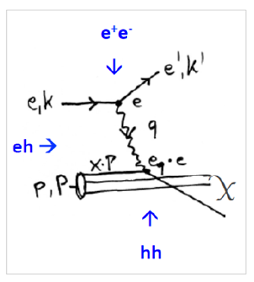
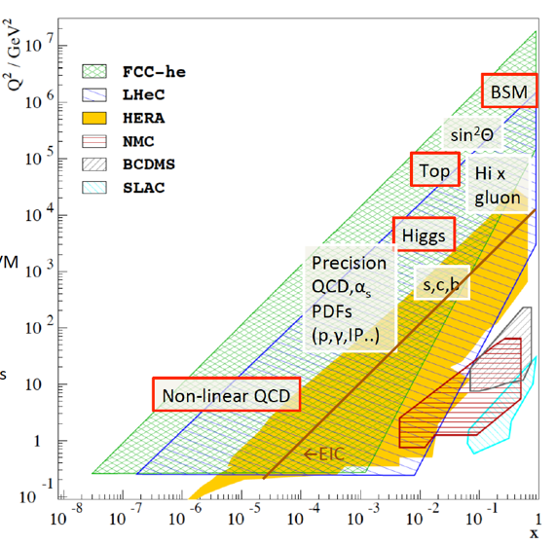
DIS (Deep Inelastic Scattering) ep Physics at High Energy in the next decades
Energy frontier DIS at HEP is necessary to explore SM and beyond
d
d
LHeC and FCC-eh are partners of LHC and FCC.
I(e) = 20mA
Cleanest High Resolution Microscope: QCD Discovery
Empowering the LHC/FCC Search Programme
Transformation of LHC/FCChh into high precision Higgs facility
Discovery (top, H, heavy ν’s..) Beyond the Standard Model
A Unique Nuclear Physics Facility
Published in 2020
Same parameters as the ones for PERLE@Orsay
Collection : from Max Klein
arXiv:2007:14491 (400 pages, 300 authors)

Slide 19
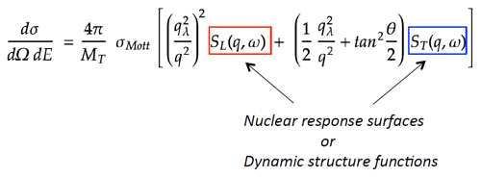

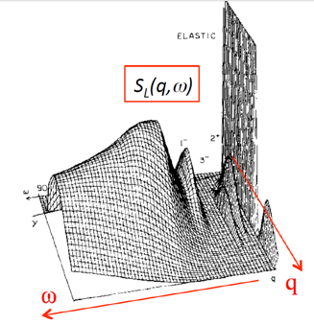
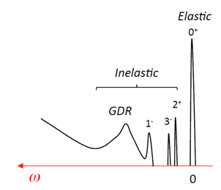
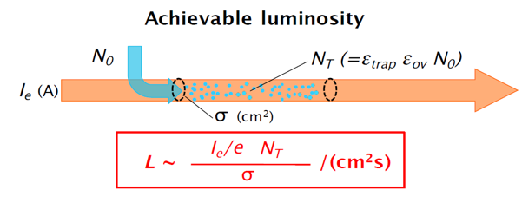
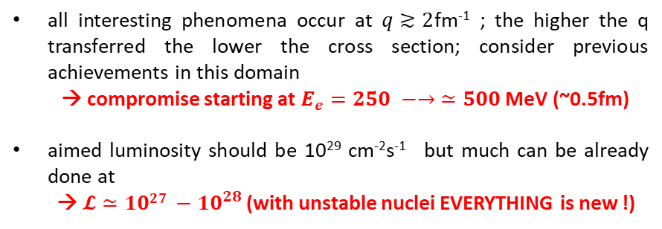
The New Frontier : e-RIB (Radioactive Nuclei Beam)scattering !
A completely new horizon, explore the interior of exotic nuclei :
charge radius, shape… New properties are emerging (halo, pairing..) !
all interesting phenomena occur at $q≳2$fm⁻¹ ; the higher the q transferred the lower the cross section; consider previous achievements in this domain
→ compromise starting at $E_{e}=250 −→ ≃500$ MeV (~0.5fm)
aimed luminosity should be 10²⁹ cm⁻²s⁻¹ but much can be already done at
→ $𝓛≃{1027 −10}^{28 }$(with unstable nuclei EVERYTHING is new !)
Simple imaging
Full tomography
A long road ahead before reaching the full tomography of an exotic nucleus
The starting point is :
DESTIN [DEep STructure Investigation of (exotic) Nuclei]
Very chanellenging
The beam will confine RIB in longitudinal plane e- with positive ions), and traps have to confined RIB in transversal plane ( à la SCRIT at RIKEN)
Collection : from David Verney

Slide 20
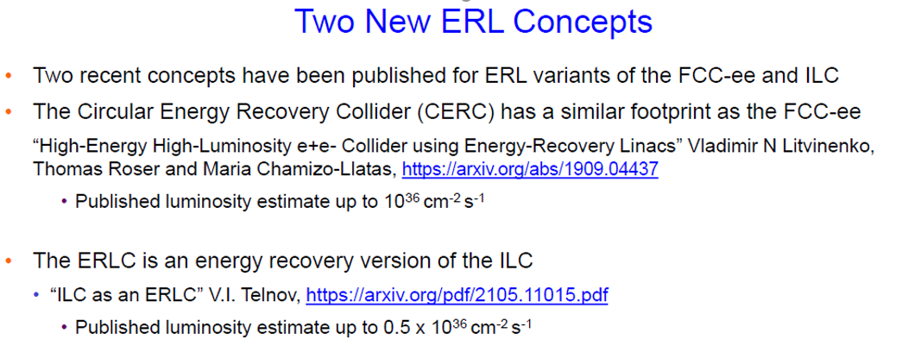
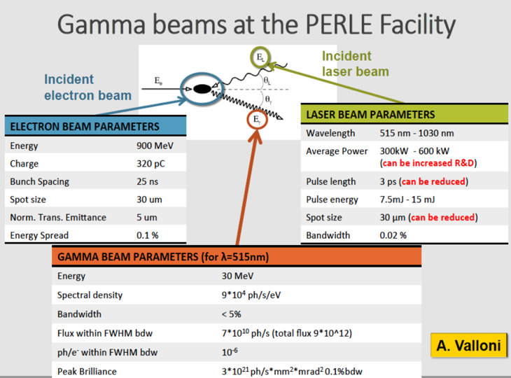
But also…
Evaluation is going :
250 & 500 MeV beam
ep physics at 250MeV.
Interesting measurement of nucleon form factor…
→ Need and experiment at 50°
Investigations of applications uning the electron and photon beam (industrial, health, energy..)
Physics Workshop organised @ Orsay 9th Mai 2022

