Slide 1
PERLE Collaboration Board Meeting
Agenda:
Approval of last meeting minutes
ERL roadmap implementation
Status of the collaboration (ICRADA, Novosibirsk case, Najah University)
Update on project progress (organisation, activities, new comers, user workshop organisation)
Round table
AoB
Walid Kaabi, Denis Reynet, Achille Stocchi
April 28th 2022

Slide 2
A brief history of the effort over the past 4 years
The development of ERLs has been recognized as one of the five main pillars of accelerators R&D in support of the European Strategy for Particle Physics (ESPP).
Following the recommendations of the ESPP, the CERN Council mandated the Laboratory Directors Group (LDG) to define and maintain a priority roadmap for accelerators R&D.
The LDG decided to create Expert Panels for each of the five selected priority areas for accelerators R&D.
The ERL Roadmap Panel, chaired by Max Klein and Andrew Hutton, has done a tremendous job with broad and active participation. The PERLE project was recognized as one of the "essential pillars of the ERL," with milestones to be achieved by the next ESPP in 2026.
The accelerators roadmap was presented and approved by the CERN Council in December 2021, and recently published as the CERN Yellow Report: https://doi.org/10.23731/CYRM-2022-001
The implementation of the roadmap will be followed by LDG (*)
Next to come :
The proposal to follow the implementation of ERL Roadmap by a new panel, including the previous chairs. On going
A. Hutton, Report from the ERL Roadmap Panel- July 9, 2021
Funding Limited
Technology Limited
^{(*)} "The Council invites ECFA and LDG to develop, in collaboration with SPC, funding agencies and relevant research organizations in Europe and beyond, detailed implementation plans defining milestones, priorities and funding sources, for consideration by the CERN Council at its spring 2022 session."

Slide 3






PERLE Collaboration & PERLE- France
PERLE international collaboration
A collaboration agreement (CA) signed by all partners.
The bilateral ICRADA DOE- JLab with CNRS is still pending in DOE for signature.
Position of Budker Institute of Nuclear Physics. Participation suspended ?
New request of An-Najah – Palestine to joint the collaboration. If agreed we have to start their formal inclusion.
PERLE in France. Important News.
  IN2P3/CNRS National Strategy (end of 2021): Perle@Orsay a priority for accelerators in line with the ESPP
  Project submitted to the recovery plan for 2022 (possibility of obtaining financial support for phase 1 of PERLE). Ministry response is asking us to resubmit in next phase in June together with another project (SUpra2030)
  Infrastructure funding obtained: 2M€ available from 2022 for PERLE infrastructures.
  New Organization in France and significant increase of people involved →

Slide 4
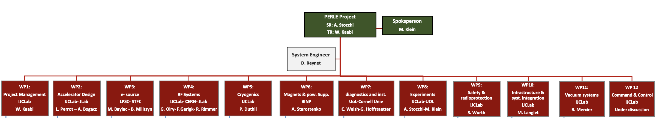
PERLE Collaboration & PERLE- France : Organisation
Lot of effort the last months
We have finalised an internal organisation in France led by two laboratories: IJCLab/LPSC.
WBS already defined aiming a « local person » for each WP system
PHD student (ending now) injection lines : Ben Hounsell (100% PERLE)
PHD student (2nd year) on RF/HOM/cavities : Carmelo Barbagallo (100% PERLE)
PHD student (1st year) on Beam Dynamics : Coline Guyot (50% in PERLE)
Postdoc (beam dynamics) Alex Fomin
5 months interns (Magnets/beam dynamics)→PHD thesis 2022:Rasha Abukeshek
From Jul 2022
  Postdoc (Injection line) Joshua Yoskowitz
From Oct. 2022
  Permanent CRNS position (beam dynamics) Julien Michaud
  PHD thesis Liverpool/AsTec/IJCLab (injections) Connor Monaghan
Denis Reynet System Engineers (IJCLab)
Luc Perrot Beam Dynamics (IJCLab)
Maud Baylac Gun Installation and Operation (LPSC)
Guillaume Olry RF System (IJCLab)
Patxi Duthil Cryogenic (IJCLab)
Hadil Aboualrob Magnets (An-Najah / IJCLab)
Sébastien Wurth Security Issues (IJCLab)
Marc Langlet Infrastructures (IJCLab)
Bruno Mercier Vacuum System (IJCLab)
ALL in ALL many new join PERLE

Slide 5
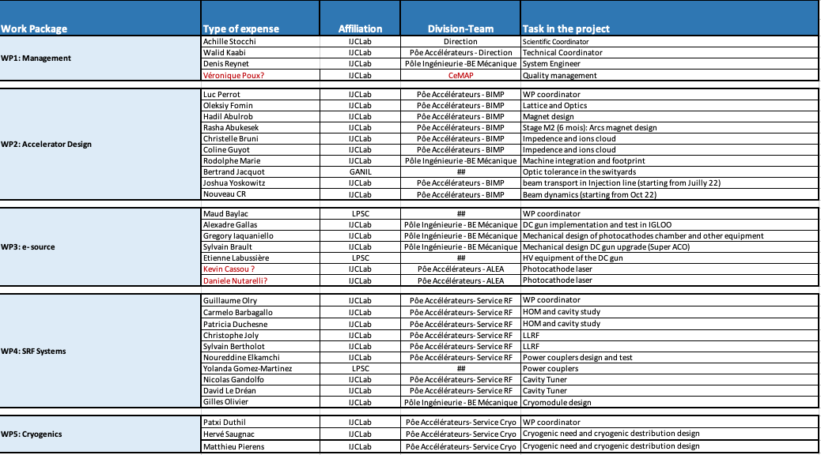
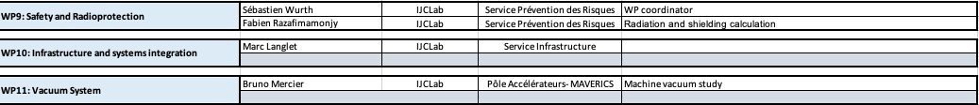
PERLE Collaboration & PERLE- France : New members !
~40 people in
with about 10 FTE !

Slide 6
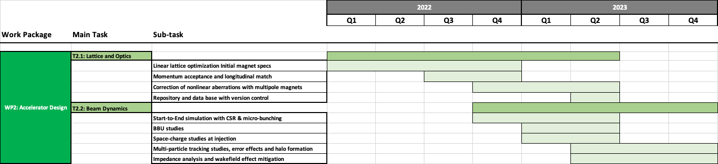
Project Progress: WP2
WP2: Accelerator Design
A first meeting was held last February with A. Bogacz to introduce A. Fomin and discuss the work plan.
New commers are expected in this WP stating from this summer to re-enforce the team @ IJCLab.
S. Saitiniyazi, R. Apsimon (Lancaster) & P. Williams are studying the optimisation of the bunch filling pattern of PERLE.
Scope for the TDR Phase: Consolidate the PERLE Lattice, studies of the collective effects, propose a lattice for 250 MeV version of PERLE.

Slide 7
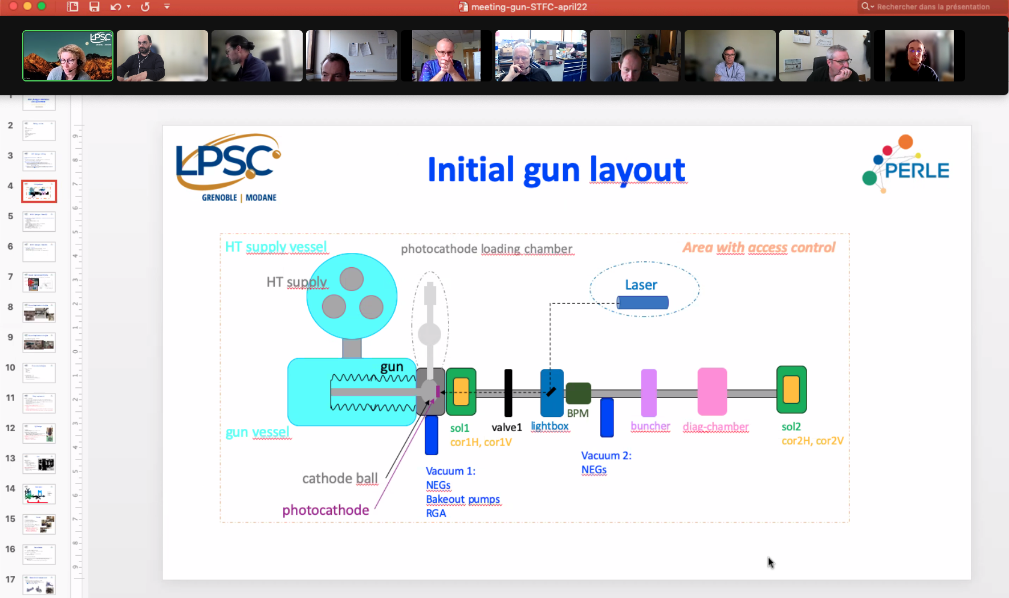
Project Progress: WP3
Participants/contact persons from STFC
Rachael Buckley : radiation protection, site management
Ryan Cash : mechanics engineer, design of upgraded ALICE gun, prep chamber
Andy Goulden : operation manager, SF6 infrastructures, radiation safety
Lee Jones : photocathodes, drive laser, HV conditioning and commissioning
Keith Middleman : vacuum expert, excused for the meeting
Boris Militsyn : gun coordinator, primary contact
Rob Smith : HV engineer, operation of HV supply
Contact person from CNRS/IN2P3
IJCLab-Orsay
  A. Gallas : mechanical engineer
  W. Kaabi : PERLE project leader
  D. Reynet : PERLE system engineer
  S. Wurth : IJCLab safety engineer
LPSC-Grenoble
  M. Baylac : gun assembly coordinator
  E. Labussière : HV power supply

Slide 8
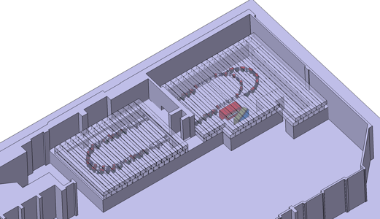
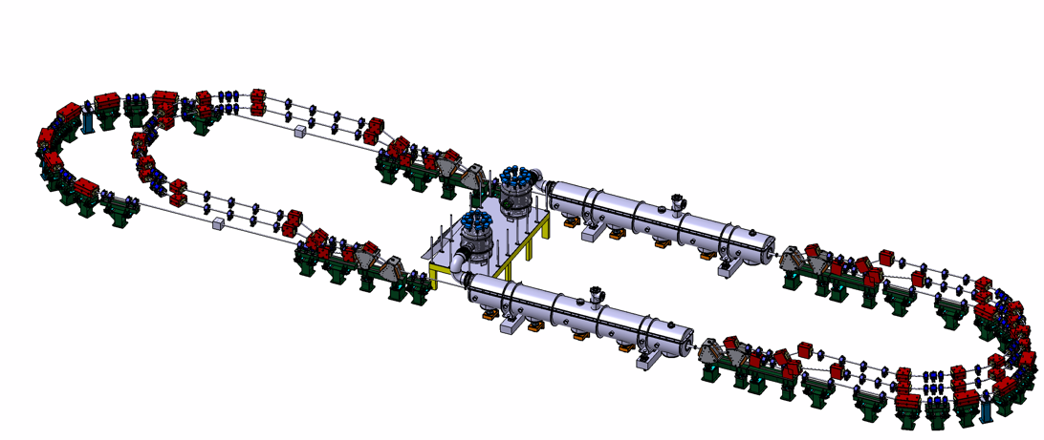

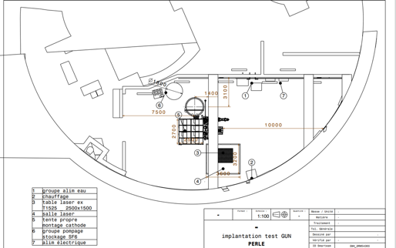
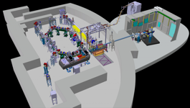
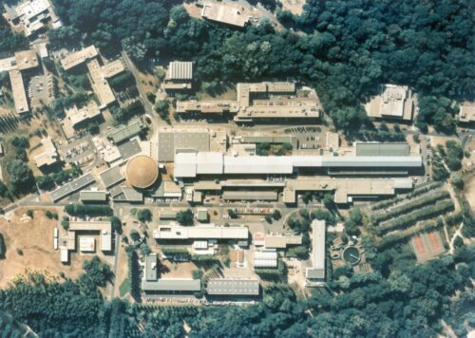
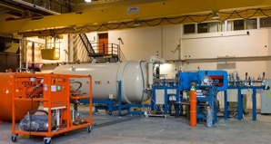
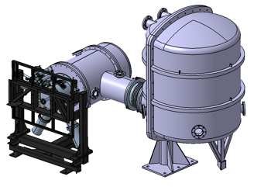

Proposed implantation @ IJCLab-Orsay and initial studies of the footprint
DC = l_{RF}/2
Injector
Footprinting recently produced
7 MeV
DE = 82.2 MeV
Arcs 2:4:6
Arcs 1:3:5
Dump
7 MeV
DE = 82.2 MeV
Footprint: 31.5 x 5.5 x 0.9

Slide 9
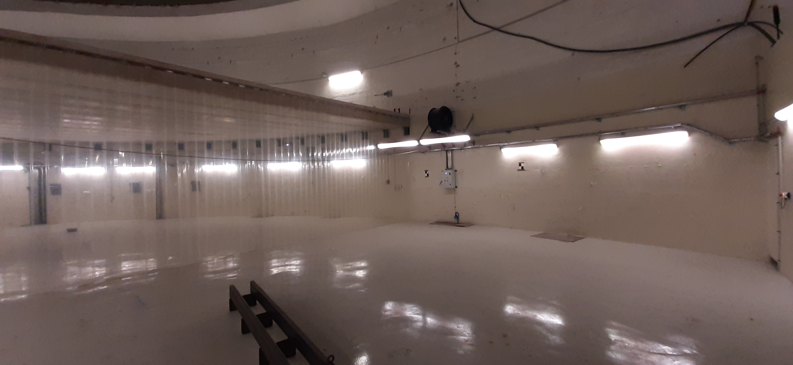
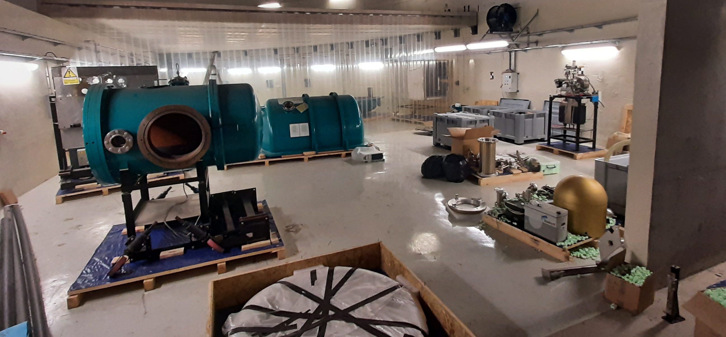
Daresbury DC-Gun for PERLE in the IGLOO Area
DC GUN in the IGLOO AREA – March 2022

Slide 10
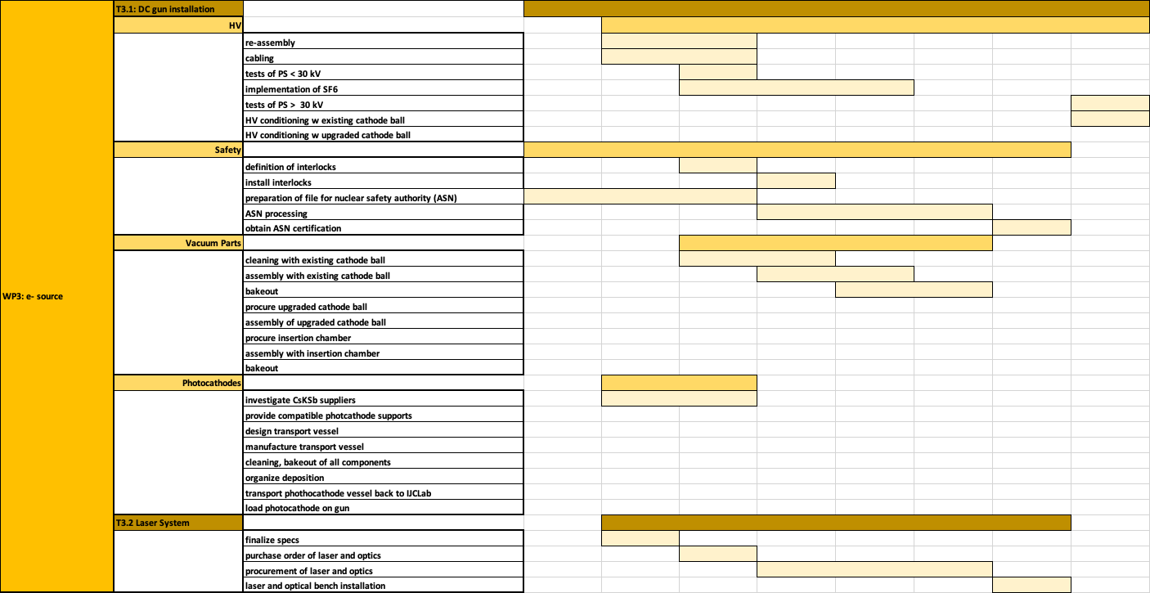
Project Progress: WP3
Scope for the TDR phase: re-install and operate the DC-gun with the Alice parameters and first studies of the DC gun upgrade

Slide 11
Project Progress: WP4
WP4 (RF Systems): Monthly meeting between Frank Gerigk (CERN)- Bob Rimmer (JLab) and Guillame Olry (IJCLab). People identified to contribute by task:
Task 4.1 (Cavity and HOM design):
CERN: R. Calaga, J. Mitchell, E. Montesinos.
Jlab: H. Wang, G. Park, R. Rimmer
IJCLab: C. Barbagallo, P. Duschene and G. Olry.
Task 4.2 (Power Coupler):
CERN: E. Montesinos, J. Mitchell
JLab: J. Guo, H. Wang
lJCLab + LPSC : Y. Gomez-Martinez, W. Kaabi, Ch. Joly
Task 4.3 (SPL CM adaptation):
CERN: L. Dassa, V. Parma
Jlab: J. Henry, R. Rimmer
IJCLab: G. Olivier, H. Sognac
Task 4.4 (Tuning system & FRT):
CERN: A. Macpherson, N. Shipman, L. Dassa
JLab: T. Powers, C. Hovater, T. Plawski
IJCLab: N. Gandolfo, D. Le Dréan
Task 4.5 (LLRF):
IJCLab: C. Joly, S. Berthelot
JLab: C. Hovater, T. Plawski
Task 4.6 (RF power source):
IJCLab: C. Joly, S. Berthelot, F. Fournier
JLab: C. Hovater
Task 4.7 (Booster design):
JLab: H. Wang, R. Rimmer
IJCLab: TBD
Task 4.8 (Buncher design):
IJCLab+ LPSC: Y. Gomez-Martinez + F. Bouly + …
Timeline in progress

Slide 12
Project Progress: WP5
WP5: Cryogenics
Scope for the TDR Phase: Define the Cryogenic requirements and propose the adequate design of the cryoplant and the cryogenic distribution.

Slide 13
ERL- Physics Applications
ERL- Physics Applications
Workshop the 9th May at 15:00
DESTIN (DEep STructure Investigation of exotic Nuclei) PERLE@Orsay
  Starts to be structured in Orsay and involving national and international communities. Coupled to the future of GANIL reflexions. A priority for Nuclear Physics Perspectives at national level.
Photonics with Inverse Compton Scattering (ICS)
  Important community working in Orsay with large experience in past (Japan, USA) and present ICS experiments (ThomX) and in innovative R&D.
ep Physics.
  Important international community with large interest in proton radius, electroweak measurements, dark photons…
Applications
Accelerator R&D
a) the scientific motivation for this to be interesting and competitive in 5-10 years, and
b) the instrumental consequences on PERLE footprint, including apparatus sketches in interaction region and nearby. The operation demands (Required beam parameters, the duration of an experiment, other particular experimental requirements…).

Slide 14
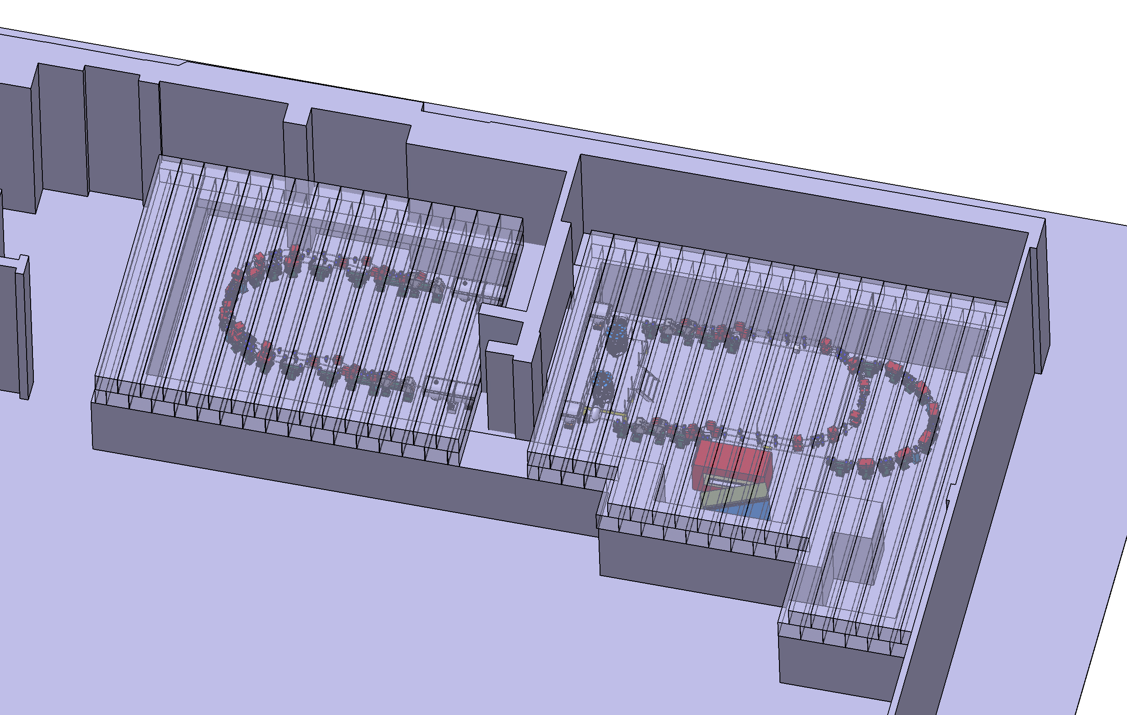
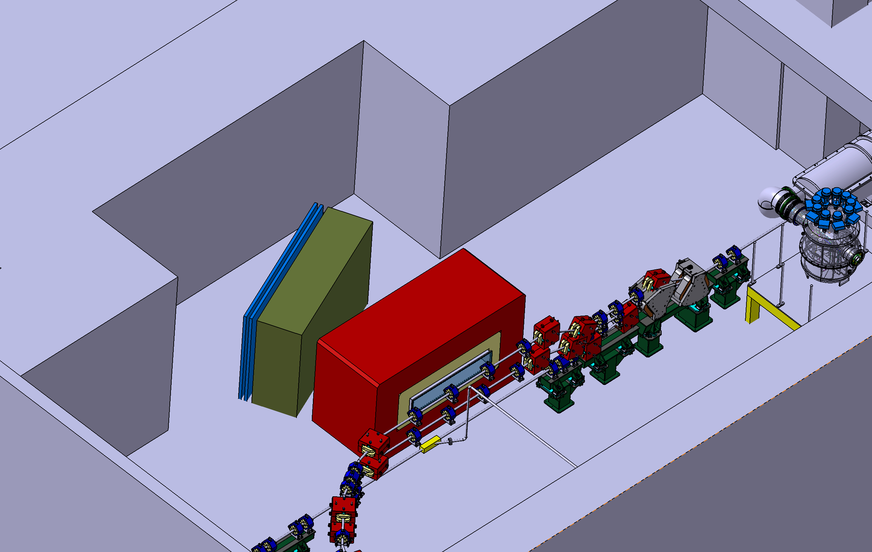
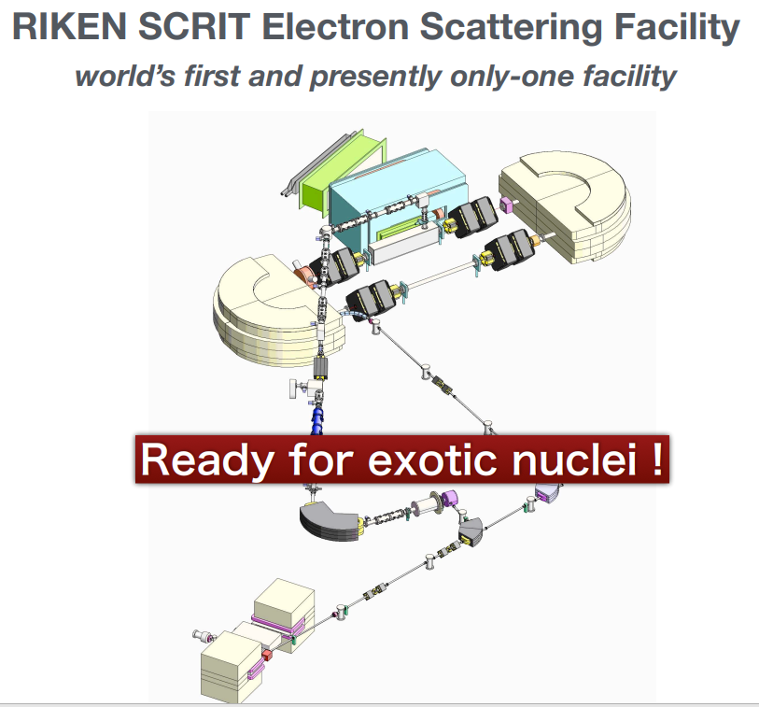
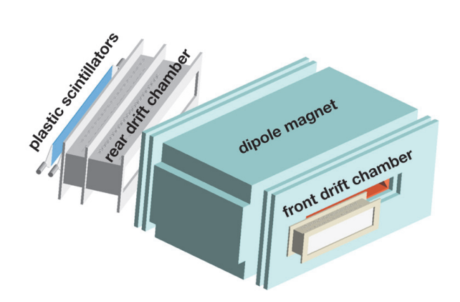
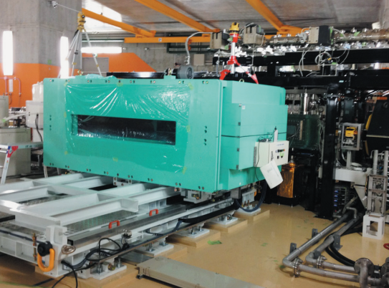
Some example : « Une vue d’esprit »
Work on going for the Physics Workshop
The implementation of nuclear physics requirements is implying a new design of the interaction region and in particular the extension of the last arc + many other “constraints” which we will discuss at the workshop.

Slide 15
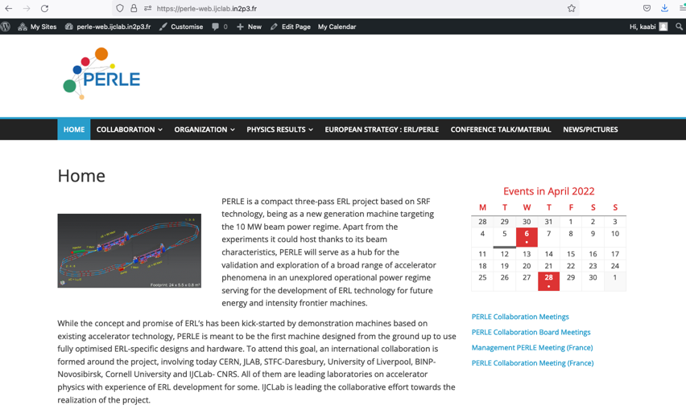
Web page in preparation
Page web PERLE : https://perle-web.ijclab.in2p3.fr/

Slide 16
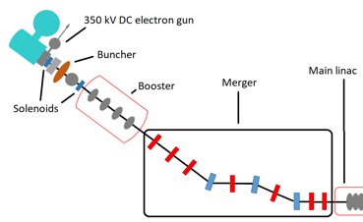
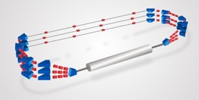
PERLE Timeline
TDR by 2022, this date as you have seen is probably shifted but it does not necessarily imply the global schedule of the other phases. Discussions on what TDR should include and the possible effects on the interaction with funding agencies
Phase 0 2025,
Phase 1 2028
Phase 2 2030.
2025
End Phase 0: Injection line
2030
End Phase 2: PERLE @ 500MeV
2023
2028
End Phase 1: PERLE @ 250MeV
2022
PERLE TDR
06/04/2022

Slide 17
PERLE next meetings and conferences
Next Meetings:
Workshop « Physics with PERLE » 09 Mai 2022.
Several meetings at local and national level :
  IJClab revue for 2022 and 2023 founding and RH requests (9 Mai)
  Project PERLE (IN2P3) for 2022 and 2023 founding and RH requests ( 24 Mai)
  Scientific Council IJCLab (fall 2022).
Conferences and workshops
Thesis defense of Benjamin Hounsell « Conceptual design of the PERLE injector » Mai 2022.
DIS – Santiago de Compostela « PERLE@Orsay » 3-4 Mai 2022 (A. Stocchi for M. Klein)
ARIEL Kick off – Vancouver 26 may 2022 (A. Stocchi)
Participation à LINAC’22: HOM studies (C. Barbagallo) + PERLE Injector design (Ben Hounsell)
Participation au workshop International ERL (Cornell)-
  Invited talk “Status PERLE” (W. Kaabi)
  Invited talk HOM studies (Carmelo B.)
  Invited talk Collective effect on PERLE (K. André)
  Invited talk Longitudinal matching on PERLE (G. Perez Segurana)

Slide 18
Additional Materials

Slide 19
PERLE Configuration and parameters
Target Parameter | Unit | Value
Injection energy | MeV | 7
Electron beam energy | MeV | 500
Normalised Emittance γε_{x,y} | mm mrad | 6
Average beam current | mA | 20
Bunch charge | pC | 500
Bunch length | mm | 3
Bunch spacing | ns | 25
RF frequency | MHz | 801.58
Duty factor |  | CW
2 Linacs (Four 5-Cell 801.58 MHz SC cavities)
3 turns (164 MeV/turn)
Max. beam energy 500 MeV
DC = l_{RF}/2
Injector
7 MeV
DE = 82.2 MeV
Arcs 2:4:6
Arcs 1:3:5
Dump
7 MeV
DE = 82.2 MeV
Footprint: 31.5 x 5.5 x 0.9
Courtesy to Rodolphe Marie

Slide 20
A brief history of the effort over the past 4 years
The development of ERLs has been recognized as one of the five main pillars of accelerators R&D in support of the European Strategy for Particle Physics (ESPP).
Following the recommendations of the ESPP, the CERN Council mandated the Laboratory Directors Group (LDG) to define and maintain a priority roadmap for accelerators R&D.
The LDG decided to create Expert Panels for each of the five selected priority areas for accelerators R&D.
The ERL Roadmap Panel, chaired by Max Klein and Andrew Hutton, has done a tremendous job with broad and active participation. The PERLE project was recognized as one of the "essential pillars of the ERL," with milestones to be achieved by the next ESPP in 2026.
The accelerators roadmap was presented and approved by the CERN Council in December 2021, and recently published as the CERN Yellow Report: https://doi.org/10.23731/CYRM-2022-001
The implementation of the roadmap will be followed by LDG (*)
A. Hutton, Report from the ERL Roadmap Panel- July 9, 2021
Funding Limited
Technology Limited
^{(*)} "The Council invites ECFA and LDG to develop, in collaboration with SPC, funding agencies and relevant research organizations in Europe and beyond, detailed implementation plans defining milestones, priorities and funding sources, for consideration by the CERN Council at its spring 2022 session."

Slide 21
Why PERLE@Orsay and which Physics with at PERLE@Orsay
ERL machines open a new Frontier for the physics of “the electromagnetic probe”
At low energy e Nuclei (PERLE and Destin@Orsay) 250-500 MeV
(2) At Higher Energy e p (e A) (LHeC and/or FCC-eh) 60 GeV
You need high luminosity → High current (from 10mA up to 100mA)
You need to increase the energy (remaining compact) → Multi turns
The (1) machine (PERLE@Orsay)
  will be the first ERL dedicated to Nuclear Physics for studying the
  It’s a necessary demonstrator for the (2) -HEP machine- (same technological choices & beam parameters)
The key points : high power (current x energy) and complex machine in terms of beam dynamics
+ PERLE@Orsay is also a necessary demonstrator for other future machines and applications

Slide 22
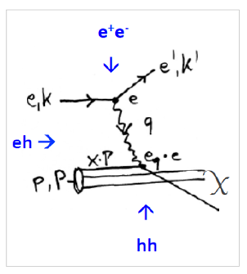
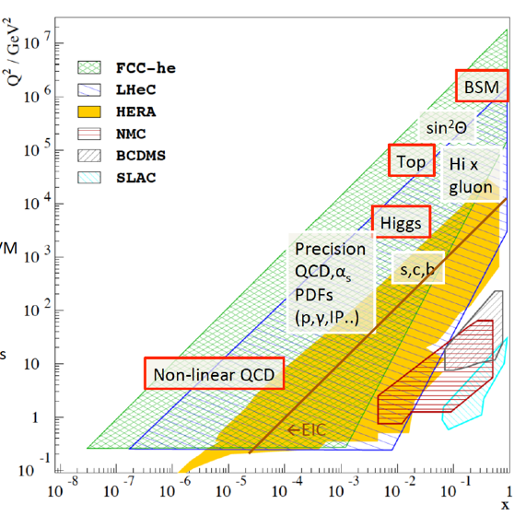
DIS (Deep Inelastic Scattering) ep Physics at High Energy in the next decades
Energy frontier DIS at HEP is necessary to explore SM and beyond
d
d
LHeC and FCC-eh are partners of LHC and FCC.
I(e) = 20mA
Cleanest High Resolution Microscope: QCD Discovery
Empowering the LHC/FCC Search Programme
Transformation of LHC/FCChh into high precision Higgs facility
Discovery (top, H, heavy ν’s..) Beyond the Standard Model
A Unique Nuclear Physics Facility
Published in 2020
Same parameters as the ones for PERLE@Orsay
Collection : from Max Klein
arXiv:2007:14491 (400 pages, 300 authors)

Slide 23
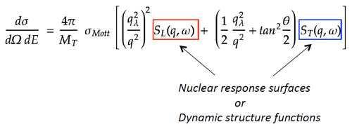

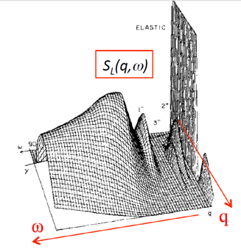
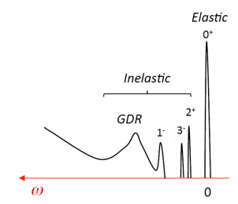
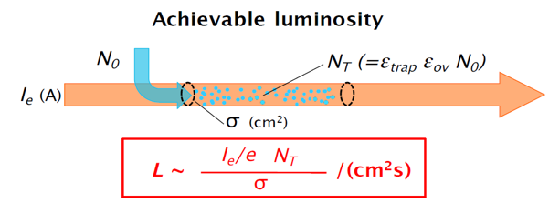
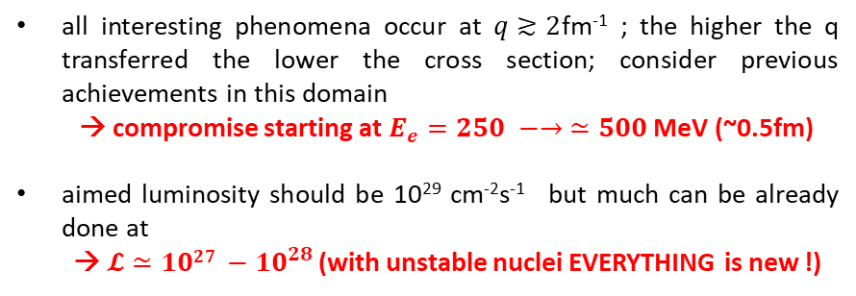
The New Frontier : e-RIB (Radioactive Nuclei Beam)scattering !
A completely new horizon, explore the interior of exotic nuclei :
charge radius, shape… New properties are emerging (halo, pairing..) !
all interesting phenomena occur at $q≳2$fm⁻¹ ; the higher the q transferred the lower the cross section; consider previous achievements in this domain
→ compromise starting at $E_{e}=250 −→ ≃500$ MeV (~0.5fm)
aimed luminosity should be 10²⁹ cm⁻²s⁻¹ but much can be already done at
→ $𝓛≃{1027 −10}^{28 }$(with unstable nuclei EVERYTHING is new !)
Simple imaging
Full tomography
A long road ahead before reaching the full tomography of an exotic nucleus
The starting point is :
DESTIN [DEep STructure Investigation of (exotic) Nuclei]
Very chanellenging
The beam will confine RIB in longitudinal plane e- with positive ions), and traps have to confined RIB in transversal plane ( à la SCRIT at RIKEN)
Collection : from David Verney

Slide 24
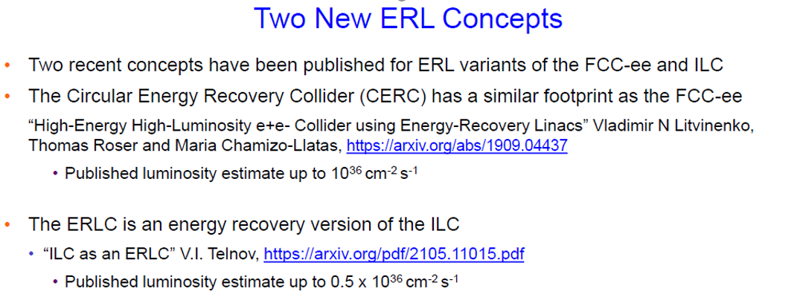
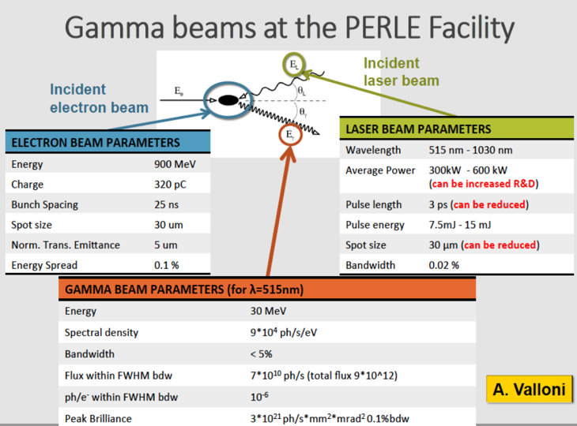
But also…
Evaluation is going :
250 & 500 MeV beam
ep physics at 250MeV.
Interesting measurement of nucleon form factor…
→ Need and experiment at 50°
Investigations of applications uning the electron and photon beam (industrial, health, energy..)
Physics Workshop organised @ Orsay 9th Mai 2022

